Slide 1
US Economy and
Russia/Ukraine Economics
N. Marin Breakfast Club
March 4, 2022
Jon Haveman, Ph.D.
National Economic Education Delegation

Slide 2
National Economic Education Delegation
Vision
One day, the public discussion of policy issues will be grounded in an accurate perception of the underlying economic principles and data.
Mission
NEED unites the skills and knowledge of a vast network of professional economists to promote understanding of the economics of policy issues in the United States.
NEED Presentations
Are nonpartisan and intended to reflect the consensus of the economics profession.

Slide 3
Credits and Disclaimer
This slide deck was authored by:
Jon D. Haveman, NEED
Scott Baier, Clemson University
Geoffrey Woglom, Amherst College (Emeritus)
Brian Dombeck, Lewis & Clark College
Doris Geide-Stevenson, Weber State
Disclaimer
NEED presentations are designed to be nonpartisan.
It is, however, inevitable that the presenter will be asked for and will provide their own views.
Such views are those of the presenter and not necessarily those of the National Economic Education Delegation (NEED).

Slide 4
Outline
State of the pandemic
The U.S. Economy
Hot Topics
The Great Resignation
Russia/Ukraine
Oil
Wheat
Inflation

Slide 5
Making Real Progress!
Nationally
Source: NYTimes

Slide 6
Oklahoma Cases Are Falling Nicely
California
Source: NYTimes

Slide 7
The U.S. Economy

Slide 8
GDP Trajectory: Pandemic Plunge!
GDP is:
$0.3 Trillion below 2019 forecast.
$0.7 Trillion ABOVE 2019-Q4 level.

Slide 9
Monthly Changes in Nonfarm Employment
Notes:
PAYEMS.png

Slide 10
Monthly Changes in Nonfarm Employment
Delta
Recovery
Omicron
Notes:
PAYEMS.png

Slide 11
Employment Gap
1.9 Million below February, 2020.
8.0 Million below where we should be.
Notes:
payroll_recent.png

Slide 12
Trends in Labor Force Participation
0.9 Million below February, 2020.
1.8 Million below where we should be.
Notes:
CLF16OV.png

Slide 13
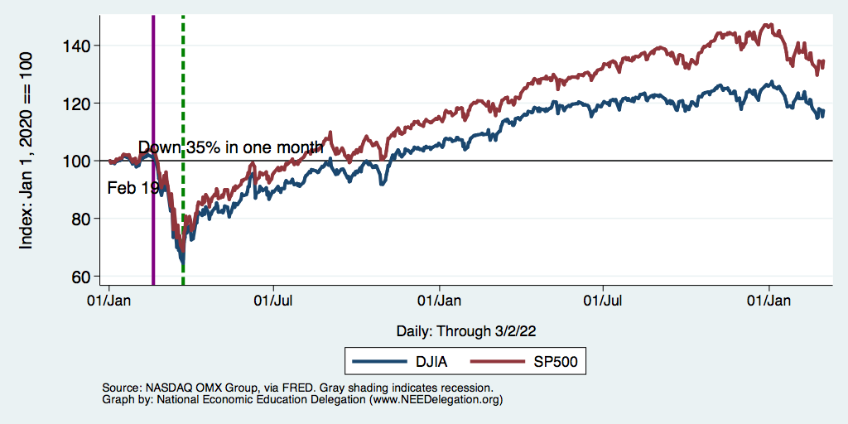
Stocks: Jittery

Slide 14
Hot Topics
The Great Resignation
Russia/Ukraine
Oil
Wheat
Inflation

Slide 15
The Great Resignation

Slide 16
Quits Are High! The Great Resignation

Slide 17
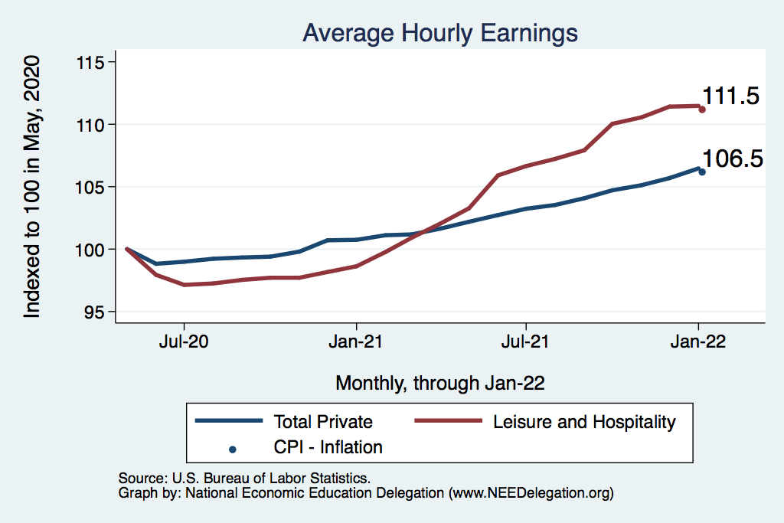
This is Happening Despite Rising Wages
Leisure & Hospitality
L&H wages rising
Not much faster
Than inflation
Total Nonfarm

Slide 18
Russia/Ukraine(/Belarus)

Slide 19
Sanctions
Restrict financial transactions
Severing from SWIFT (partially)
Central bank assets – reserves have been abroad, but can’t access.
Cannot support Ruble
Cut off the Nord Stream 2
Technology export restrictions
Russian aviation – can not use western air space
Most aircraft are leased.
DOJ - KleptoCapture
Private sector sanctions
Apple – no more Apple Pay or iPhones
BP and other oil producers moving out
And many more!

Slide 20
Consequences for the Russian Economy
Massive inflation
Devaluation of the Ruble
High interest rates
Shortages
Not to mention the Oligarchs
Sanctions on 100 specific individuals.

Slide 21
Consequences for the Global Economy
Primarily:
Oil
Wheat
Why?
Major suppliers of each
29% of world wheat production
20-40% of Europe’s oil and gas
Russia part of OPEC+
Russian and Ukranian combined economies are small.
Don’t forget Belarus.

Slide 22
Oil

Slide 23
Wheat

Slide 24
Inflation

Slide 25
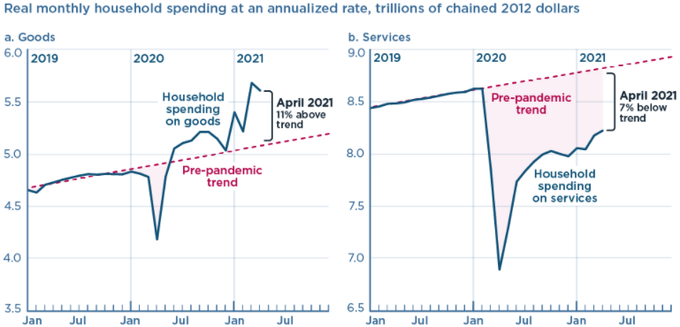
We’re Buying Mostly … Stuff
Demand-Pull
Source: Jason Furman, PIIE

Slide 26
Inflation: Concentrated
Cost-Push

Slide 27
Corporate Profits…Adding to Inflation?

Slide 28
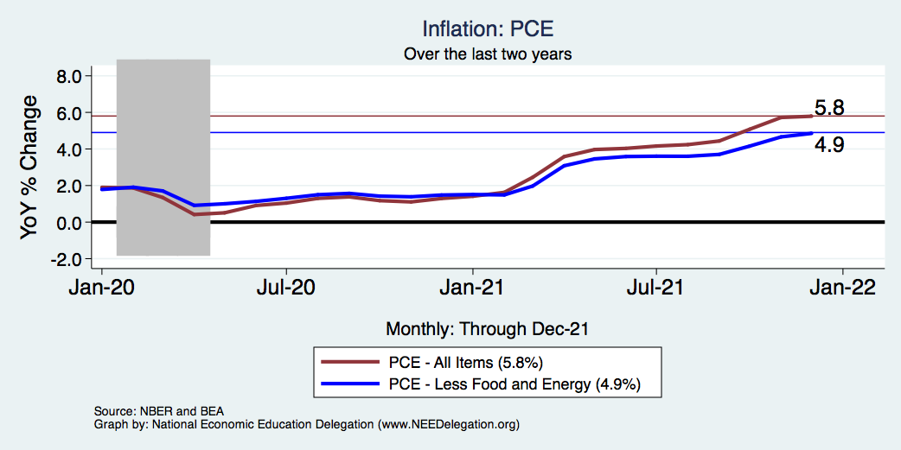
Inflation – The Fed’s Metric! Should we worry?
Notes:
Cpi_recent.png

Slide 29
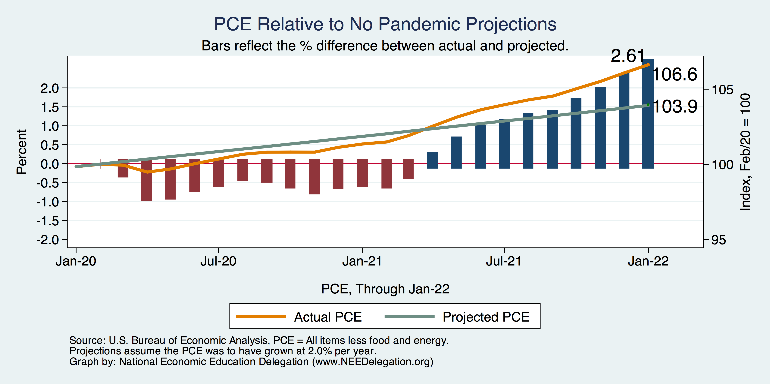
Inflation – PCE and Fed Suggest: I don’t know.
Notes:
Cpi_recent.png

Slide 30
So Far Inflationary Expectations Look Stable
Professional forecasters, financial markets and the Fed itself think that inflation in 2022 will be in the 2.5-3%, range
 | Median Fed Forecasts from 12/15/21 FOMC Meeting
 | 2022 | 2023 | 2024 | Longer run
Unemployment rate | 3.5 | 3.5 | 3.5 | 4.0
Inflation | 2.6 | 2.3 | 2.1 | 2.0
Interest rate | 0.9 | 1.6 | 2.1 | 2.5
Russia/Ukraine conflict may well raise these forecasts.

Slide 31
Conclusion
Recovery is well underway, but may be slowing.
GDP expanded by 5.7% percent in 2021, 3-4% in 2022.
2021 was an odd year.
Workers attained the upper hand.
Supply chains broke.
Inflation surged.
The economy rebuilt itself.
Biggest problems:
Supply chain bottlenecks.
Labor force participation.
Russian war in Ukraine

Slide 32
Where Are We Headed?
Economic fallout of the Russia/Ukraine conflict will be modest.
At best, back to where we were before the pandemic.
Economic growth of ~2%/year.
Low interest rates.
Inflation back in the 2% range.
How long is it going to take to get there and what will we endure?
Entirely speculation.
Could be 5 years before we are back to equilibrium. NOT back to normal.
Next year: elevated inflation and interest rates.
2023: GDP growth relatively slow, but perhaps greater than recent averages.

Slide 33
Thank you!
Any Questions?
www.NEEDelegation.org
Jon D. Haveman
Jon@NEEDelegation.org
Contact NEED: info@NEEDelegation.org
Submit a testimonial: www.NEEDelegation.org/testimonials.php
Become a Friend of NEED: www.NEEDelegation.org/friend.php

