Slide 1
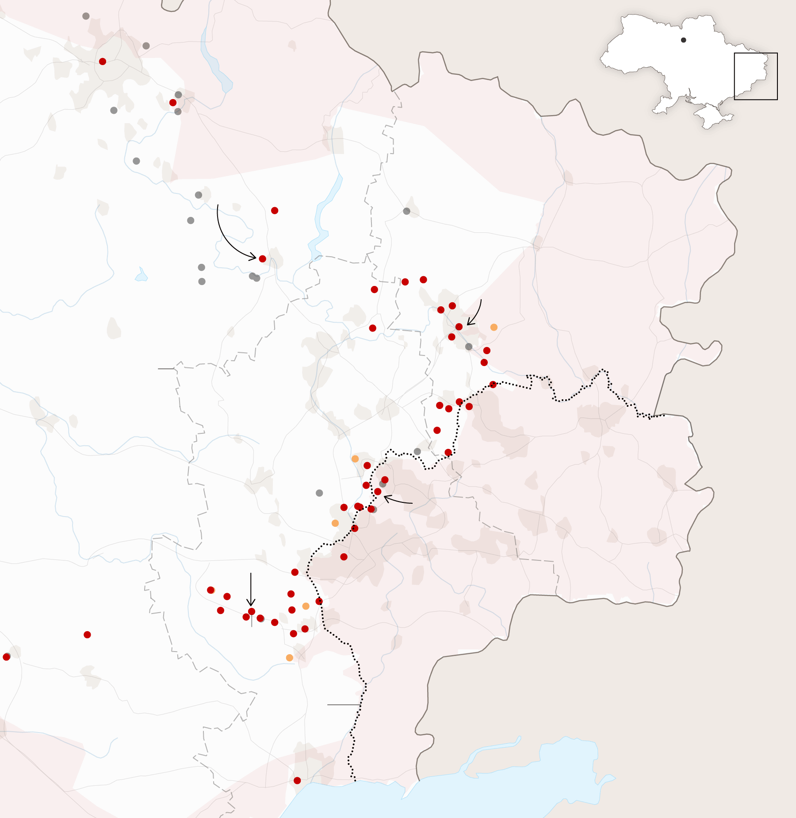
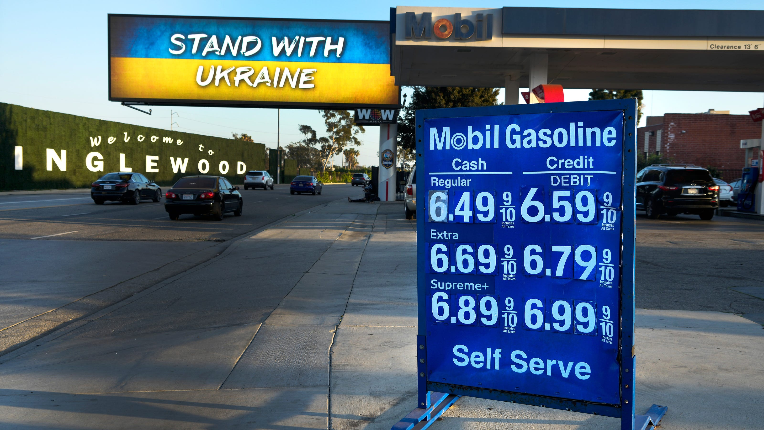
US Economic Update
Annual MRA Educational Conference & Trade Show
Jon Haveman, Ph.D.
NEED
October 20, 2022

Slide 2
Credits and Disclaimer
This slide deck was authored by:
Jon D. Haveman, NEED
Scott Baier, Clemson University
Geoffrey Woglom, Amherst College (Emeritus)
Brian Dombeck, Lewis & Clark College
Doris Geide-Stevenson, Weber State
Disclaimer
NEED presentations are designed to be nonpartisan.
It is, however, inevitable that the presenter will be asked for and will provide their own views.
Such views are those of the presenter and not necessarily those of the National Economic Education Delegation (NEED).

Slide 3
Outline
The State of the US Economy
Recession?
Global Comparisons
Inflation
Summary

Slide 4
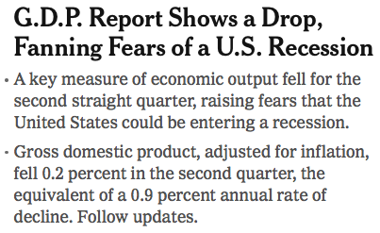
Headline:

Slide 5
GDP: Quarterly Growth
Notes:
Graph: gdp_pot_grow.png
The Point: From 1990 – 2007, average annual US GDP growth pre-crisis is 2.94%. However, post-crisis US GDP growth is 2.19% (0.75 percentage points lower). Why is has the recovery been sluggish?
Note: At the recession’s height, the gap between quarterly GDP growth and potential growth was 2.5 percentage points.

Slide 6
GDP Trajectory: Pandemic Plunge!
GDP is:
$0.4 Trillion below 2019 forecast.
$0.8 Trillion ABOVE 2019-Q4 level.

Slide 7
Recession? Two Quarters….
Depends on what is driving the drop. Drivers are:
Inventories
Housing
Government spending
Consumer spending is still ok.
Employment growth is solid.
Other indicators are still ok.

Slide 8
Contribution to GDP Growth: Consumption
Notes:
Average GDP growth from 1990-2007 is 2.99% and from 2010+ is 2.19%
Average Consumption contribution from 1990-2007 is 2.16 percentage points and from 2010+ is 1.67 percentage points

Slide 9
Retail Sales Are Elevated

Slide 10
Contribution to GDP Growth: Inventories
Notes:
Average GDP growth from 1990-2007 is 2.99% and from 2010+ is 2.19%
Average Consumption contribution from 1990-2007 is 2.16 percentage points and from 2010+ is 1.67 percentage points

Slide 11
Industrial Production (Manuf, Util, Mining)

Slide 12
Monthly Changes in Nonfarm Employment
Notes:
PAYEMS.png

Slide 13
Monthly Changes in Nonfarm Employment
August: 315,000
September: 263,000
Notes:
PAYEMS.png

Slide 14
Employment Gap
0.5 Million ABOVE February, 2020.
6.3 Million below where we should be.
Notes:
payroll_recent.png

Slide 15
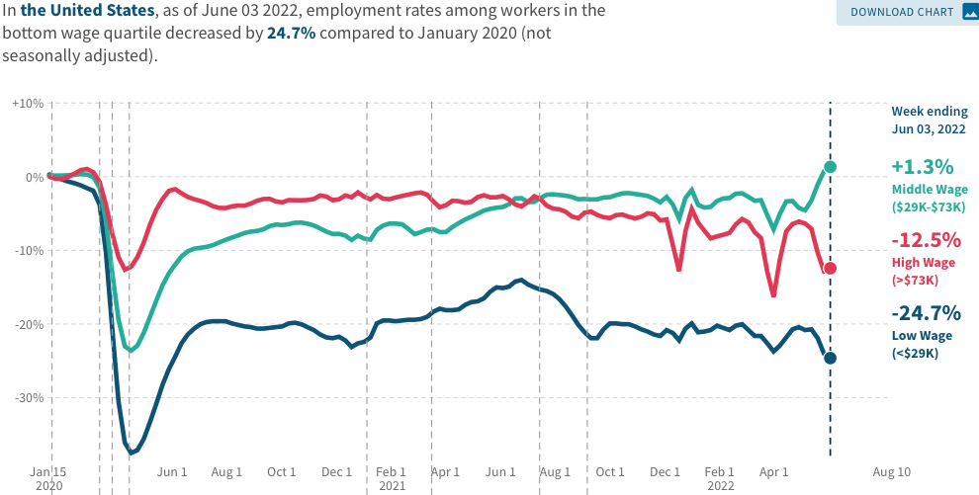
Low Wage Employment is Lagging
Source: https://tracktherecovery.org

Slide 16
Stimulus Payments Saved Low Wage Workers

Slide 17
Where Have All the Workers Gone?
3.9 million below where we should be

Slide 18
Some Explanations
500 Thousand: Long COVID Exits

Slide 19
Inflation

Slide 20
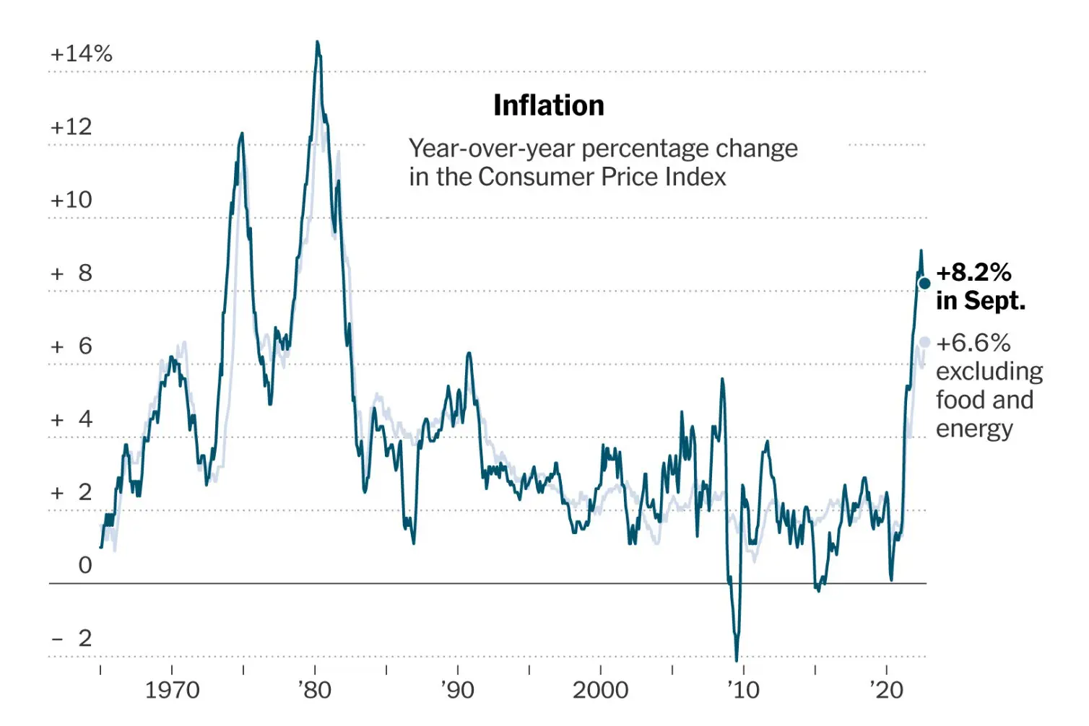
Inflation: Latest Figures
Source: NYTimes.com

Slide 21
Which Prices?
Food
Aug-Sep: +0.4
July-Aug: 0
June-July: 0

Slide 22
Global Evidence

Slide 23
Inflation: Not just a US Problem
United States: 8.5
Netherlands: 12.0
Spain: 10.4
United Kingdom: 10.1
Denmark: 8.9
Sweden: 8.5
Germany: 7.9
Norway: 6.5
France: 5.8
Source: TradingEconomics.com, 9/12/22

Slide 24
GDP: U.S. Stands Out, But Not Alone
United States: -0.6
Netherlands: 2.6
Spain: 1.1
United Kingdom: -0.1
Denmark: 0.9
Sweden: 0.9
Germany: 0.1
Norway: 0.7
France: 0.5
Source: TradingEconomics.com, 9/12/22

Slide 25
Global Summary
Developed economies are uniformly down.
Not entirely a surprise. Went through the same pandemic gyrations:
Supply chain issues.
Import prices are way up.
Somewhat surprising because the economic responses varied across countries.
All used stimulus, but US used MUCH more.
Inflation – tale of two sources:
United States – much more one of elevated demand.
Europe – much more one of food and energy prices (war).

Slide 26
Inflation: A Closer Look

Slide 27
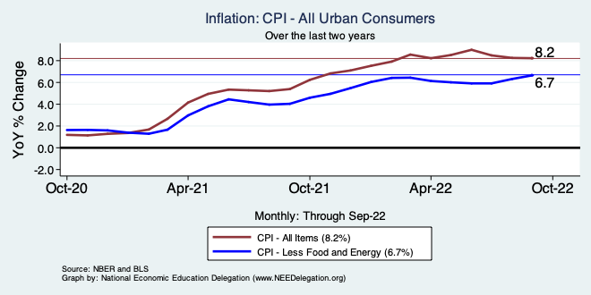
Inflation – Climbing! Or Turning Around?
Notes:
Cpi_recent.png

Slide 28
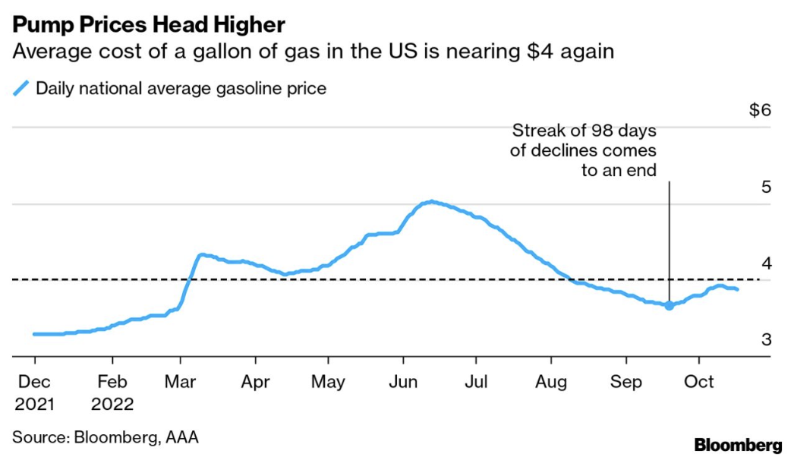
Gas Prices: National Average at the Pump

Slide 29
Food Costs Continue to Rise

Slide 30
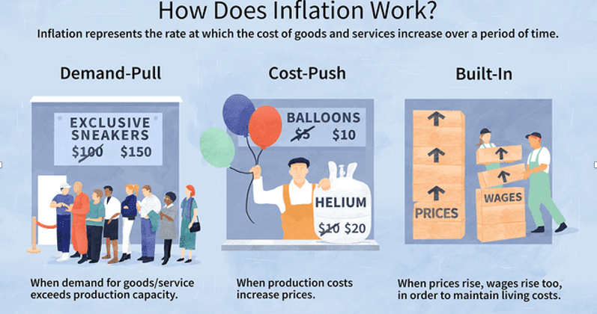
Source: Investopedia

Slide 31
Spending Patterns Changed - More Goods!
Demand-Pull
Goods spending up 14.4%
- And coming down.
Services spending up 2.4%
- And going up.

Slide 32
Inflation: Concentrated
Cost-Push

Slide 33
Supply Chains
Cost-Push

Slide 34
Corporations Have Pricing Power!
Corporate Profits

Slide 35
My Diagnosis for the Uptick in Inflation
Spending patterns have changed dramatically.
Yes, there were supply chain issues that affected some areas in particular (e.g., computer chips).
But there was also too much total spending.
Fiscal stimulus led households to increase saving over 2021 by more than $2 trillion. Strong retail sales numbers suggest they are prepared to spend it.
Whose to Blame: ARP probably too big, but the Fed could have acted sooner.

Slide 36
What’s the Fed Doing About It?

Slide 37
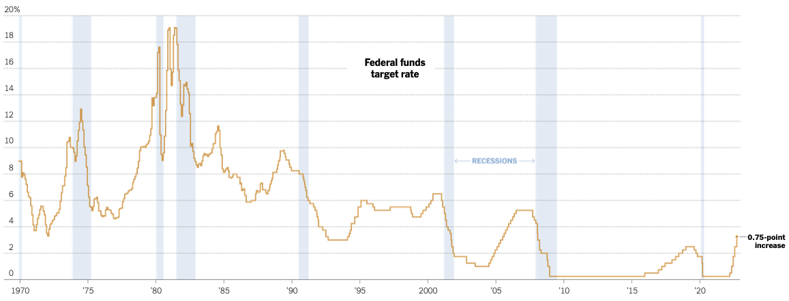
Federal Funds Rate
Just raised to: 3%
- Going higher
Source: NYTimes.com
Notes:
The fed funds rate is the interest rate on overnight loans between banks. Think of it as the baseline interest rate on which banks base all other interest rates (e.g. mortgage rates)
FOMC lowers the fed funds rate during recessions and raises the fed funds rate during expansions
Fed funds rate peaked in the 1980s as then Chairman Paul Volcker sought to reign in “run away” inflation of the 1970s; doing so resulted in a recession in the early 1980s.
Since the 2008-09 recession, the fed funds rate has been kept near zero.
During the 2008-09 recession, Federal Reserve turned to unconventional tools to influence longer term interest rates to further stimulate the economy - QE
FedFunds.png

Slide 38
Implications for Demand
Investment borrowing
Home loans – tied to 10-year Treasury
Car loans
Credit cards
Savings accounts – positive
And more….

Slide 39
Treasuries
Notes:
treas_recent.png

Slide 40
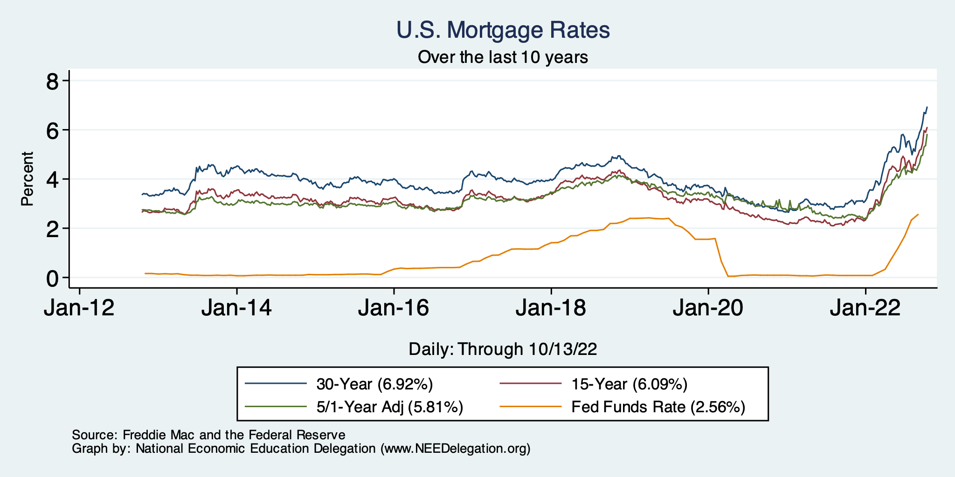
Mortgage Rates

Slide 41
Takeaways
Is a recession on the horizon?
Larry Summers, Jamie Dimon, and Elon Musk are worried about a recession.
While the chances of slipping into a recession have increased, I think on many dimensions the economy is doing quite well.
Consumer’s have been driving the recovery, and consumer’s account for two-thirds of GDP.
Job creation remains robust – 263k in September.
What about GDP?
2022:Q1 was -1.6%, 2022:Q2 was -0.6.
Much of this lower growth was driven by lower inventory.
Inventories led GDP growth in 2021:Q4, didn’t sell, so production in Q1&Q2 fell.
Housing markets – very tightly linked to interest rates – softened … A LOT.
Government spending is falling.
Stay tuned – next week Q3 release

Slide 42
Thank you!
Any Questions?
www.NEEDelegation.org
Jon D. Haveman
Jon@NEEDelegation.org
Contact NEED: info@NEEDelegation.org
Submit a testimonial: www.NEEDelegation.org/testimonials.php
Become a Friend of NEED: www.NEEDelegation.org/friend.php

Slide 43
www.NEEDelegation.org/LocalGraphs
For every state and county in the United States.
Detailed graphs on employment, housing, moves, and other statistics.

Slide 44
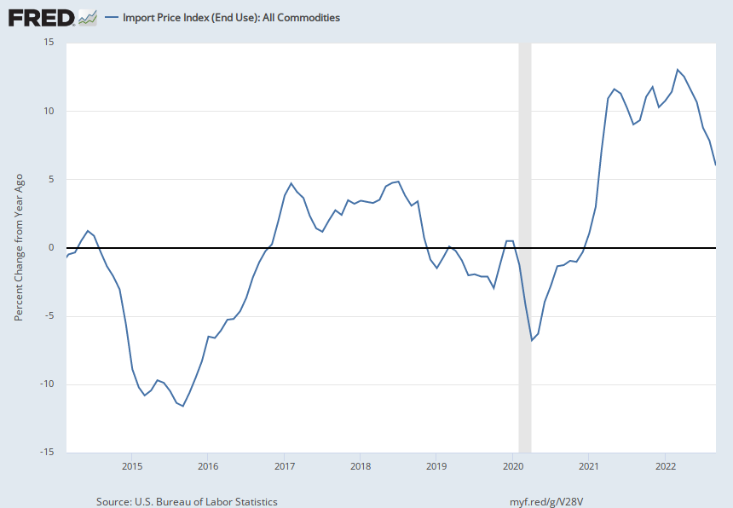
Import Prices Are Elevated
Inflation – Imported Products: 9-10%

Slide 45
Fuel Costs Are Still Elevated

Slide 46
Food Costs Continue to Rise
Food at home: 13.0
Food away from home: 8.5

Slide 47
Measure of Inflation Expectations
Breakeven Inflation Rate = Difference between
nominal and real 5-year and 10-year Treasury
constant maturity securities.
Market participants expect around 2.4%
inflation annually over the next 10 years and
2.6% over the next 5 years.
Inflation expectations are calming down.

