Slide 1
U.S. Economic Update
Global Coworking Unconference Community
January 17, 2023
Jon Haveman, Ph.D.
Executive Director, NEED

Slide 2
National Economic Education Delegation
Vision
One day, the public discussion of policy issues will be grounded in an accurate perception of the underlying economic principles and data.
Mission
NEED unites the skills and knowledge of a vast network of professional economists to promote understanding of the economics of policy issues in the United States.
NEED Presentations
Are nonpartisan and intended to reflect the consensus of the economics profession.

Slide 3
Who Are We?
Honorary Board: 54 members
2 Fed Chairs: Janet Yellen, Ben Bernanke
6 Chairs Council of Economic Advisers
Furman (D), Rosen (R), Bernanke (R), Yellen (D), Tyson (D), Goolsbee (D)
3 Nobel Prize Winners
Akerlof, Smith, Maskin
Delegates: 652+ members
At all levels of academia and some in government service
All have a Ph.D. in economics
Crowdsource slide decks
Give presentations
Global Partners: 49 Ph.D. Economists
Aid in slide deck development

Slide 4
Available NEED Topics Include:
Healthcare Economics
US Economy
Climate Change
Economic Inequality
Economic Mobility
Trade and Globalization
Minimum Wages
Immigration Economics
Housing Policy
Federal Budgets
Federal Debt
Black-White Wealth Gap
Autonomous Vehicles
Healthcare Economics

Slide 5
Credits and Disclaimer
This slide deck was authored by:
Jon D. Haveman, NEED
Scott Baier, Clemson University
Geoffrey Woglom, Amherst College (Emeritus)
Brian Dombeck, Lewis & Clark College
Doris Geide-Stevenson, Weber State
Disclaimer
NEED presentations are designed to be nonpartisan.
It is, however, inevitable that the presenter will be asked for and will provide their own views.
Such views are those of the presenter and not necessarily those of the National Economic Education Delegation (NEED).

Slide 6
Outline
Economic Data
Inflation
Debt Ceiling

Slide 7
What’s in the Data

Slide 8
GDP: Quarterly Growth
Notes:
Graph: gdp_pot_grow.png
The Point: From 1990 – 2007, average annual US GDP growth pre-crisis is 2.94%. However, post-crisis US GDP growth is 2.19% (0.75 percentage points lower). Why is has the recovery been sluggish?
Note: At the recession’s height, the gap between quarterly GDP growth and potential growth was 2.5 percentage points.

Slide 9
GDP Trajectory: Recovering, After A Hiccup
GDP is:
$0.3 Trillion below 2019 forecast.
$1.0 Trillion ABOVE 2019-Q4 level.

Slide 10
Contribution to GDP Growth: Consumption
Notes:
Average GDP growth from 1990-2007 is 2.99% and from 2010+ is 2.19%
Average Consumption contribution from 1990-2007 is 2.16 percentage points and from 2010+ is 1.67 percentage points

Slide 11
Other Indicators Are OK
Employment, Industrial Production

Slide 12
Industrial Production (Manuf, Util, Mining)

Slide 13
Monthly Changes in Nonfarm Employment
Dec: 223,000
Notes:
PAYEMS.png

Slide 14
Employment Gap
1.2 Million ABOVE February, 2020.
6.2 Million below where we should be.
Notes:
payroll_recent.png

Slide 15
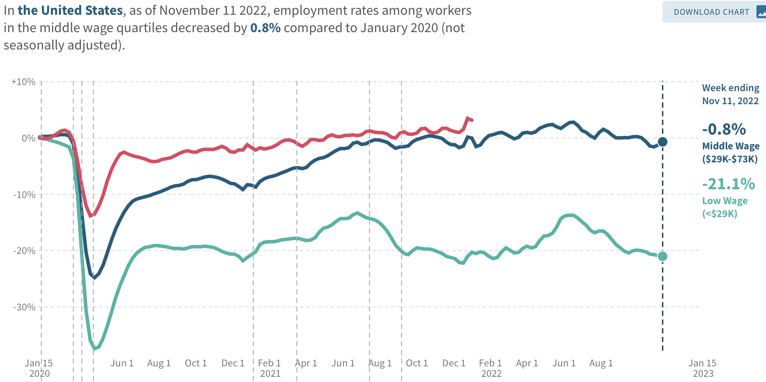
Low Wage Employment is Lagging
Source: https://tracktherecovery.org

Slide 16
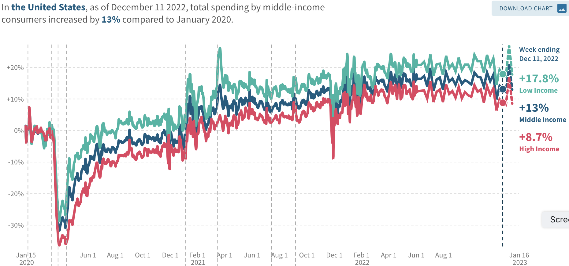
Low Wage Spending is NOT!
Source: https://tracktherecovery.org

Slide 17
Nor is Borrowing on Credit
Notes:
Data/National/FederalReserve/Credit/Programs/rev.png

Slide 18
Data Indicate…
Economy is still growing out of the pandemic downturn.
Employment growth is robust, but slowing.
Low-wage employment is lagging.
Consumption is growing at a good pace.
Many consumers are running out of stimulus funds, so borrowing is up.

Slide 19
Inflation

Slide 20
Inflation: Latest Figures

Slide 21
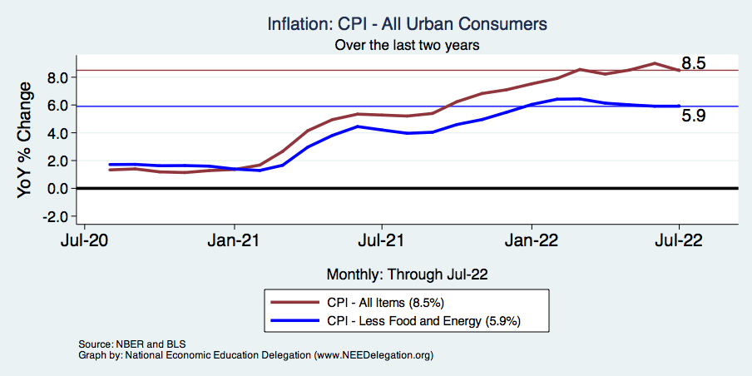
Inflation – Falling! Job done? Maybe.
Notes:
Cpi_recent.png

Slide 22
Inflation in the Last 3 Months – On Target!
Source: https://www.nytimes.com/2023/01/13/opinion/cpi-inflation-fed.html

Slide 23
Which Prices?
Food
Oct-Nov: +0.10
Nov-Dec: -0.08
Food
Gas

Slide 24
Gas Prices: National Average at the Pump

Slide 25
Food Costs Continue to Rise
Food at home: 11.8
Food away from home: 8.3

Slide 26
Supply Chains

Slide 27
My Thoughts on the Sources of Inflation
Supply Chain issues were significant – less so now.
Composition of spending changed significantly.
Is now bouncing back, as are prices.
But there was too much total spending.
Fiscal stimulus led households to increase saving over 2021 by more than $2 trillion. Strong retail sales numbers suggest they are prepared to spend it.
Whose to Blame: ARP probably too big, but the Fed could have acted sooner.
Bottom line: Recovery from a dramatic economic disruption is seldom painless.

Slide 28
What About the Fed?

Slide 29
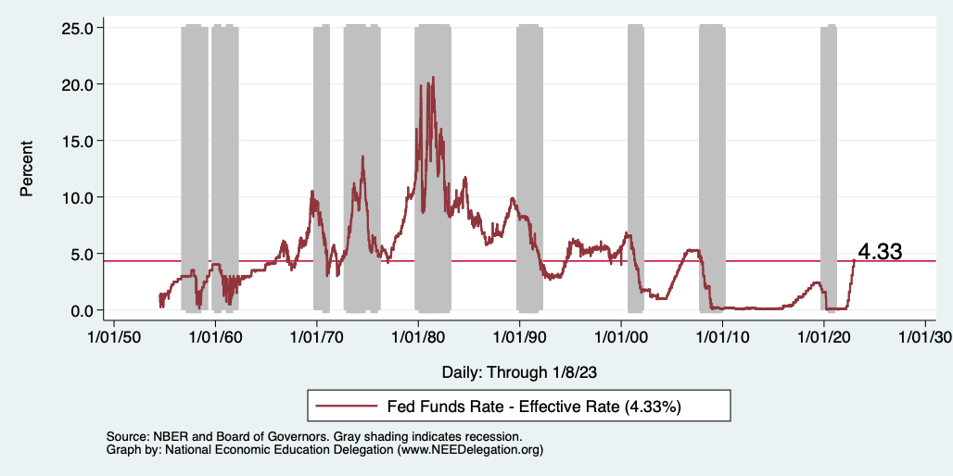
Federal Funds Rate
Notes:
The fed funds rate is the interest rate on overnight loans between banks. Think of it as the baseline interest rate on which banks base all other interest rates (e.g. mortgage rates)
FOMC lowers the fed funds rate during recessions and raises the fed funds rate during expansions
Fed funds rate peaked in the 1980s as then Chairman Paul Volcker sought to reign in “run away” inflation of the 1970s; doing so resulted in a recession in the early 1980s.
Since the 2008-09 recession, the fed funds rate has been kept near zero.
During the 2008-09 recession, Federal Reserve turned to unconventional tools to influence longer term interest rates to further stimulate the economy - QE
FedFunds.png

Slide 30
Implications for Demand
Investment borrowing
Home loans – tied to 10-year Treasury
Car loans
Credit cards
Savings accounts – positive
And more….
All of which slows the economy.

Slide 31
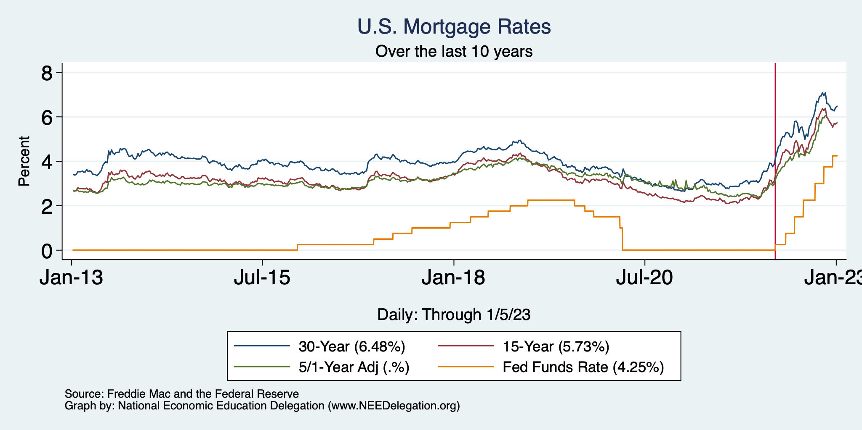
Mortgage Rates

Slide 32
Contributions to GDP: Residential Investment
Notes:
Contribution of residential investment to GDP growth has risen post-2009

Slide 33
Implications for RE Markets?

Slide 34
Existential Threat: Coming This Thursday!

Slide 35
Will the Economy Be Held Hostage?

Slide 36
Lessons from 2011
Government shutdown was very costly:
Employment growth stuttered.
Stock markets plunged.
Treasuries – downgraded credit ratings
Borrowing costs rose
The Debt Ceiling may be a very effective bargaining tool, but…
It is costly.
It is unnecessary.

Slide 37
Takeaways
Is a recession on the horizon?
Perhaps, but no reason to think that it will be anything more than shallow.
Many indicators are still in the black.
Look for 2022-Q4 GDP release in 10 days.
Threats to continued growth:
If inflation stays high, which seems unlikely.
Debt ceiling negotiations
Significant cuts to government budgets may well result.

Slide 38
Thank you!
Any Questions?
www.NEEDelegation.org
Jon D. Haveman
Jon@NEEDelegation.org
Contact NEED: info@NEEDelegation.org
Submit a testimonial: www.NEEDelegation.org/testimonials.php
Become a Friend of NEED: www.NEEDelegation.org/friend.php

Slide 39
www.NEEDelegation.org/LocalGraphs
For every state and county in the United States.
Detailed graphs on employment, housing, moves, and other statistics.

