Slide 1
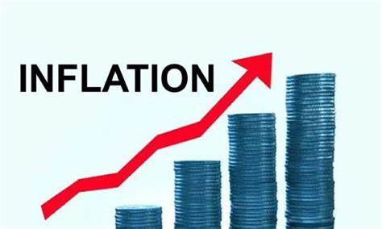
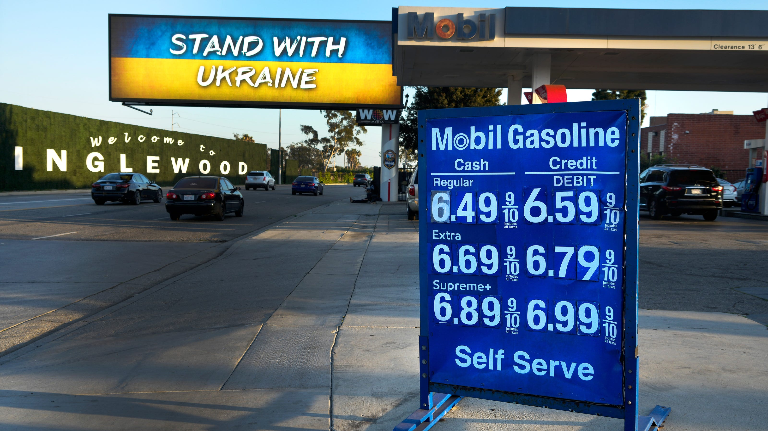
The U.S. Economy - Overview
Archie Williams High School
Jon Haveman, Ph.D.
NEED
February 6, 2022

Slide 2
Outline
The U.S. Economy
Gross Domestic Product (GDP)
Employment and Unemployment
Inflation
The Federal Reserve

Slide 3
Some Basic Statistics, February 2024
Statistic: | Value
Population | 336.1 Million
Labor Force | 167.3 Million
Employment | 157.7 Million
Gross Domestic Product (GDP) | $27.9 Trillion
Income per Capita | $69,329
Ave. Hourly Earnings | $34.55
Statistic: | Value
Population | 336.1 Million
Labor Force | 167.3 Million
Employment | 157.7 Million
Gross Domestic Product (GDP) | $27.9 Trillion
Income per Capita | $69,329
Ave. Hourly Earnings | $34.55
Source: fred.stlouisfed.org

Slide 4
How Do We Measure the Economy?
Gross Domestic Product (GDP)
GDP is the market value of all final goods and services produced within a country in a given period.
(Value added)

Slide 5
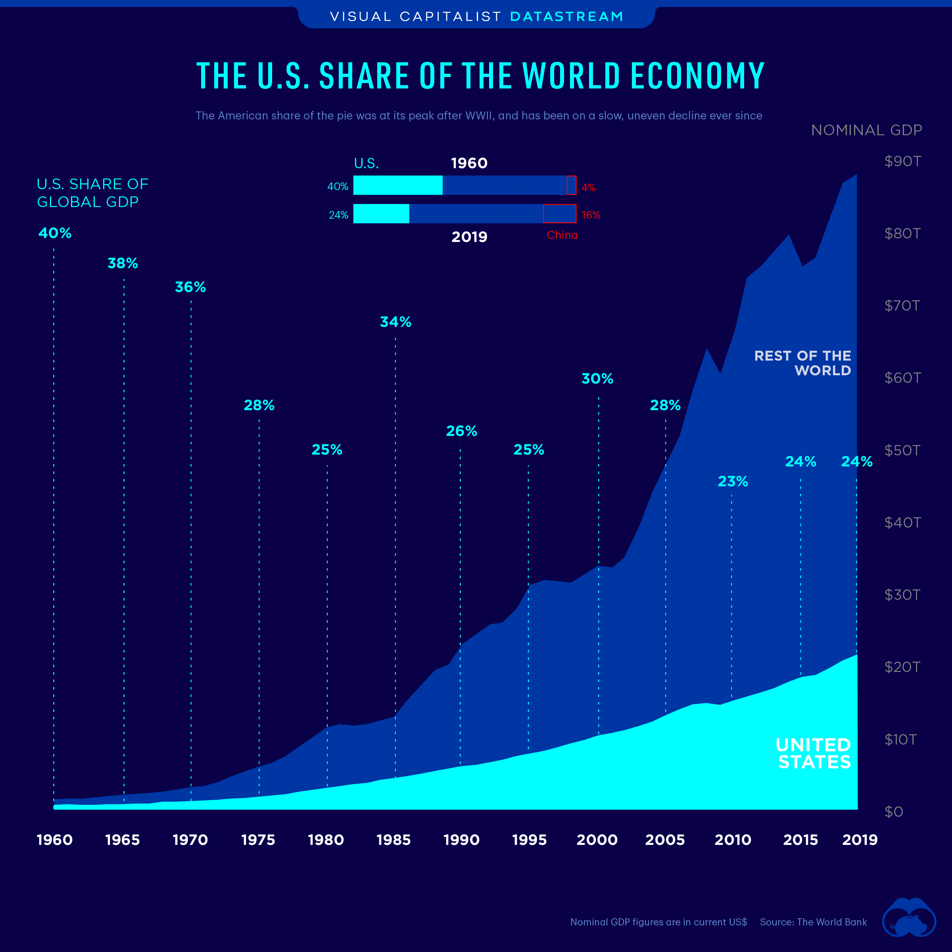
U.S. Economy in Global Perspective
U.S. Nominal GDP:
$21.901 trillion in 2019-Q4
$19.913 trillion in 2020-Q2
$27.939 trillion in 2024-Q1
Notes:
https://www.investopedia.com/insights/worlds-top-economies/#countries-by-gdp

Slide 6
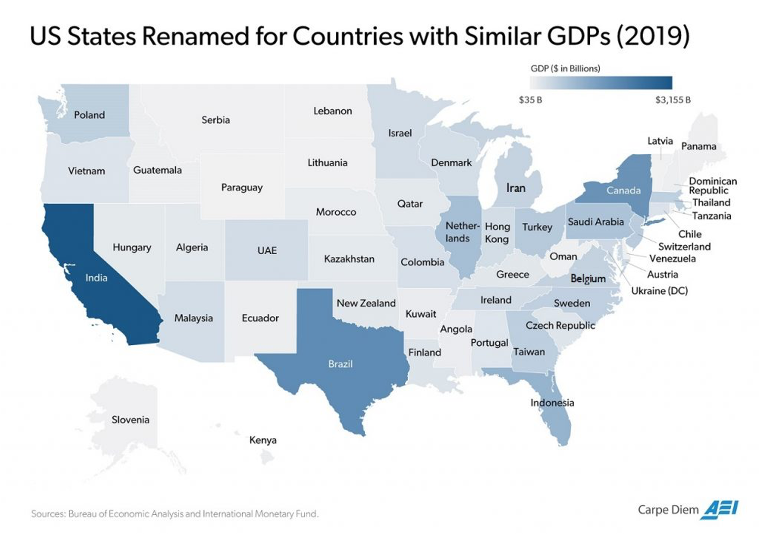

Slide 7
Composition of the U.S. Economy: GDP

Slide 8
Composition of the U.S. Economy: Employment
Manufacturing
GDP Share = 10.7%
Health GDP Share = 7.4%
Note: Does not add to 100% because of omitted sectors.

Slide 9
GDP Trajectory: Pandemic Plunge!
GDP is:
$0.1 Trillion below 2019 forecast.
$2.9 Trillion ABOVE 2019-Q4 level.

Slide 10
GDP: Quarterly Growth
Notes:
Graph: gdp_pot_grow.png
The Point: From 1990 – 2007, average annual US GDP growth pre-crisis is 2.94%. However, post-crisis US GDP growth is 2.19% (0.75 percentage points lower). Why is has the recovery been sluggish?
Note: At the recession’s height, the gap between quarterly GDP growth and potential growth was 2.5 percentage points.

Slide 11
What Determines GDP?
Demand
Supply
Consumption
Investment
Government
International Trade
Labor
Capital
Natural Resources
Entrepreneurship

Slide 12
Monthly Changes in Nonfarm Employment
January: 353,000
Notes:
PAYEMS.png

Slide 13
Employment Gap
5.2 Million ABOVE February, 2020.
5.0 Million below where we should be.
Notes:
payroll_recent.png

Slide 14
Where Have All the Workers Gone?
3.3 million below where we should be

Slide 15
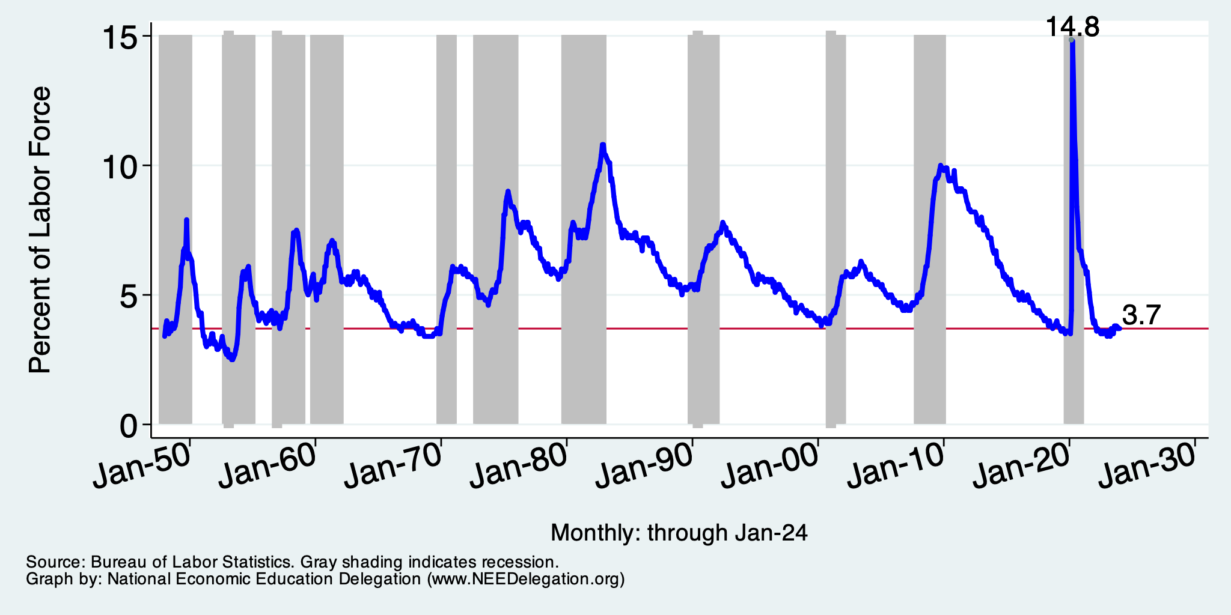
Unemployment Rate
Notes:
Unemployment rises during recessions and falls during economic expansions.
Unemployment peaked at the end of the 2009 recession.
The Fed worked to reduce the effects of the recession. Near the end of 2008, the FOMC reduced the federal funds rate to nearly zero and worked to reduce longer-term interest rates via large-scale asset purchase programs (late 2008 – 10/2014).
Unemployment is currently below the natural rate of unemployment. This is traditionally accompanied by economic growth and rising price levels. It’s also a major reason for FOMC’s decision to increase the federal funds rate.

Slide 16
How is the Unemployment Rate Calculated?
It is not a simple thing:
Why is that not simple?
Because it can go up or down for a variety of reasons:
If the labor force shrinks – UR goes down
If employment grows – UR goes down
Not all employment is created equally
Not a good indicator of the overall well being of the US economy.
# Unemployed
UR = ----------------------- * 100
Labor Force

Slide 17
Inflation

Slide 18
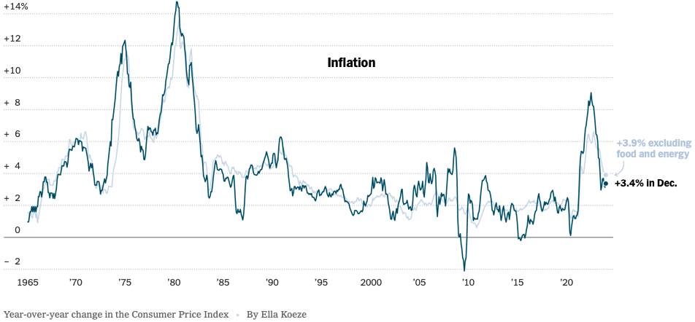
Inflation: Latest Figures
Source: NYTimes.com

Slide 19
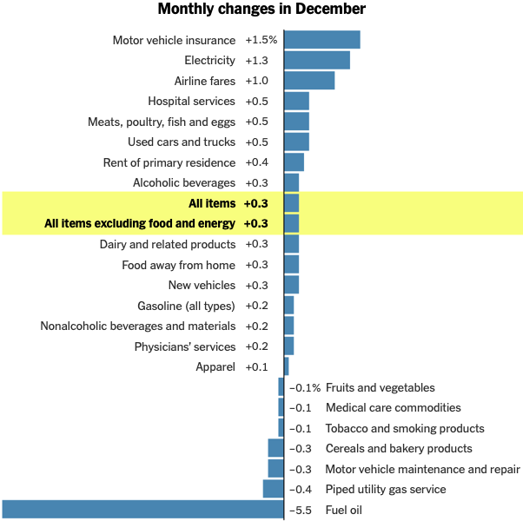
Which Prices?

Slide 20
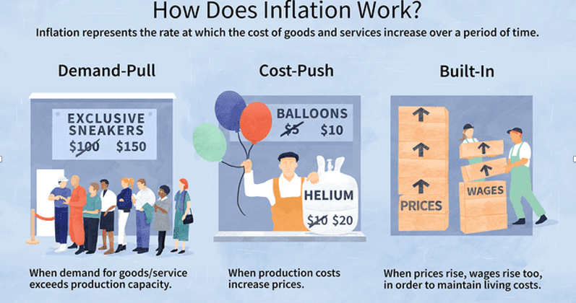
Source: Investopedia

Slide 21
Spending Patterns Changed - More Goods!
Goods spending up 20.3%
Demand-Pull
Services spending up 6.1

Slide 22
Supply Chains
Cost-Push

Slide 23
Why Did we get the Surge in Inflation?
Spending patterns have changed dramatically. (Demand pull)
Yes, there were supply chain issues that affected some areas in particular (e.g., computer chips). (Cost push)
Computer chips was also demand pull – Bitcoin!
But there was also too much total spending.
The government spent $5 TRILLion protecting us from the pandemic’s effects.

Slide 24
What’s the Fed Doing About It?
Fed = Federal Reserve

Slide 25
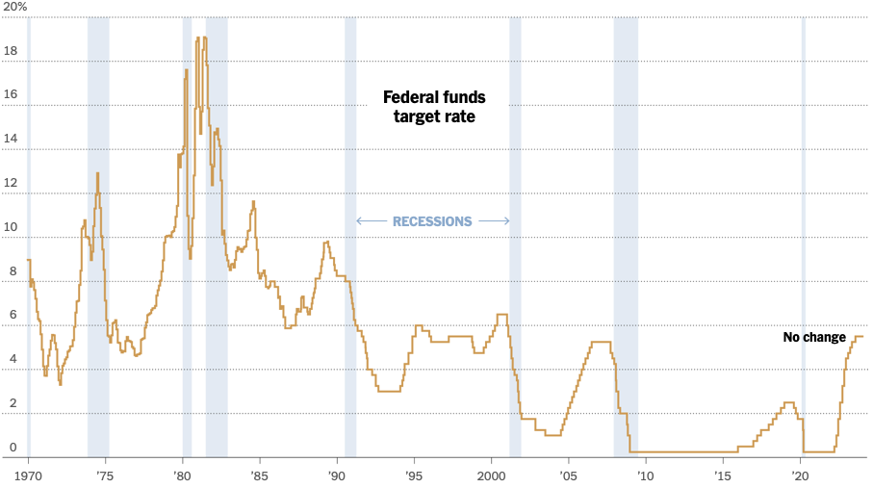
Federal Funds Rate
Holding at 5.5%
Notes:
The fed funds rate is the interest rate on overnight loans between banks. Think of it as the baseline interest rate on which banks base all other interest rates (e.g. mortgage rates)
FOMC lowers the fed funds rate during recessions and raises the fed funds rate during expansions
Fed funds rate peaked in the 1980s as then Chairman Paul Volcker sought to reign in “run away” inflation of the 1970s; doing so resulted in a recession in the early 1980s.
Since the 2008-09 recession, the fed funds rate has been kept near zero.
During the 2008-09 recession, Federal Reserve turned to unconventional tools to influence longer term interest rates to further stimulate the economy - QE
FedFunds.png

Slide 26
Implications for Demand: Reduced
Investment borrowing
Home loans – tied to 10-year Treasury
Car loans
Credit cards
And more….

Slide 27
Takeaways
The U.S. economy is in good shape!
GDP growth is strong.
Employment growth is strong.
Inflation is coming down – almost to the Fed’s target (2%).
Our biggest problems?
Labor force is not growing.
That slows the economy and creates cost-push inflation.
War?

