Slide 1
Osher Lifelong Learning Institute, Winter 2022
Contemporary Economic Policy
Clemson University
February-March, 2022
National Economic Education Delegation

Slide 2
National Economic Education Delegation
Vision
One day, the public discussion of policy issues will be grounded in an accurate perception of the underlying economic principles and data.
Mission
NEED unites the skills and knowledge of a vast network of professional economists to promote understanding of the economics of policy issues in the United States.
NEED Presentations
Are nonpartisan and are intended to reflect the consensus of the economics profession.

Slide 3
Who Are We?
Honorary Board: 54 members
2 Fed Chairs: Janet Yellen, Ben Bernanke
6 Chairs Council of Economic Advisers
Furman (D), Rosen (R), Bernanke (R), Yellen (D), Tyson (D), Goolsbee (D)
3 Nobel Prize Winners
Akerlof, Smith, Maskin
Delegates: 600+ members
At all levels of academia and some in government service
All have a Ph.D. in economics
Crowdsource slide decks
Give presentations
Global Partners: 45 Ph.D. Economists
Aid in slide deck development

Slide 4
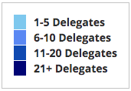
Where Are We?

Slide 5
Available NEED Topics Include:
Coronavirus Economics
US Economy
Climate Change
Economic Inequality
Economic Mobility
Trade and Globalization
Minimum Wages
Immigration Economics
Housing Policy
Federal Budgets
Federal Debt
Black-White Wealth Gap
Autonomous Vehicles
US Social Policy

Slide 6
Course Outline
Contemporary Economic Policy
Week 1 (2/28): US Economy & Coronavirus Economics
Week 2 (3/7): Economic Inequality (Brian Peterson, Central College)
Week 3 (3/14): Cryptocurrencies (Geoffrey Woglom, Amherst College)
Week 2 (3/21): Autonomous Vehicles (Jon Haveman, NEED)

Slide 7
Submitting Questions
Please submit questions in the chat.
I will try to handle them as they come up, but may take them in a bunch as time permits.
We will do a verbal Q&A once the material has been presented.
And the questions in the chat have been addressed.
OLLI allowing, we can stay beyond the end of class to have further discussion.

Slide 8
US Economy and Coronavirus Economics
Simone Wegge, Ph.D.
City University of New York
National Economic Education Delegation

Slide 9
Credits and Disclaimer
This slide deck was authored by:
Simone Wegge, CUNY – Staten Island
Jon D. Haveman, NEED
Scott Baier, Clemson University
Geoffrey Woglom, Amherst College (Emeritus)
Brian Dombeck, Lewis & Clark College
Doris Geide-Stevenson, Weber State
Disclaimer
NEED presentations are designed to be nonpartisan.
It is, however, inevitable that the presenter will be asked for and will provide their own views.
Such views are those of the presenter and not necessarily those of the National Economic Education Delegation (NEED).

Slide 10
Outline – U.S. Economic Outlook
Behavior of GDP
Labor Market
Monetary Policy/Interest Rates
Other Indicators
Summary

Slide 11
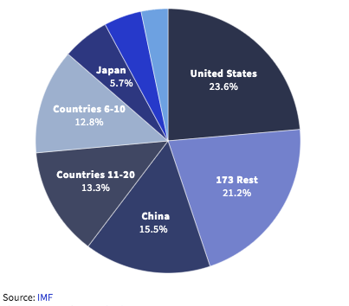
U.S. Economy in Global Perspective
U.S. Nominal GDP:
$21.747 trillion in 2019-Q4
$19.487 trillion in 2020-Q2
$23.202 trillion in 2021-Q3
Notes:
https://www.investopedia.com/insights/worlds-top-economies/#countries-by-gdp

Slide 12
Behavior of GDP

Slide 13
GDP During the Recovery
Real GDP is a standard measure of production used by economists to assess the size, health, and well-being of an economy.
Potential GDP is the level of production in an economy operating at full employment.
We use potential GDP to get a sense of what production should be in an economy.
Notes:
It may be necessary to note :
The difference between nominal vs real GDP
When real GDP > potential GDP → economy is “heating up” (inflation); employment exceed full employment (unsustainable, typically higher underemployment)

Slide 14
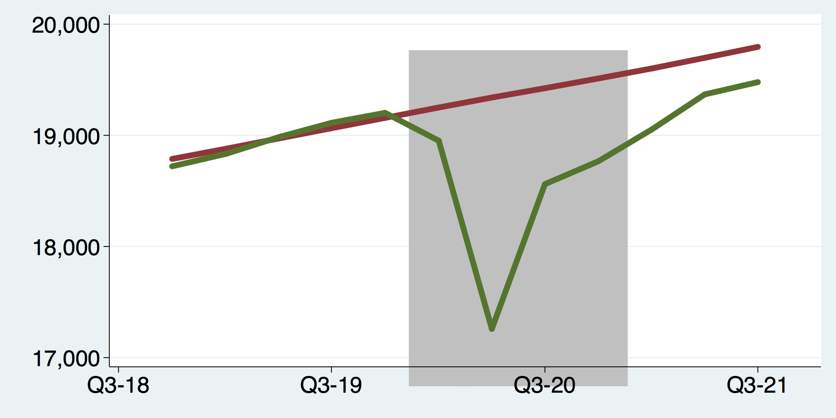
GDP Trajectory: Recovery to Pandemic
Notes:
Graph: gdp_potential.png
Looking at U.S. Real GDP over time:
U.S. GDP has returned to potential GDP
At the height of the recession, GDP fell short of potential by $936 billion (chained 2009)
Currently, GDP exceeds potential by $114 billion (chained 2009)

Slide 15
GDP Growth by Decade

Slide 16
GDP Growth Recovery to Pandemic
Notes:
Graph: gdp_pot_grow.png
The Point: From 1990 – 2007, average annual US GDP growth pre-crisis is 2.94%. However, post-crisis US GDP growth is 2.19% (0.75 percentage points lower). Why is has the recovery been sluggish?
Note: At the recession’s height, the gap between quarterly GDP growth and potential growth was 2.5 percentage points.

Slide 17
GDP Relative to Long-Term Trends

Slide 18
GDP Relative to Long-Term Trends

Slide 19
GDP During the Pandemic: Index

Slide 20
GDP During the Pandemic: Levels

Slide 21
GDP During the Pandemic: Annual Growth

Slide 22
What Is “Accounting” for the Slow Recovery?
Expenditures drive GDP growth.
GDP is the sum of four categories of spending:
Consumption
Investment
Government spending
Net Exports: Exports – Imports
Production also matters.
Employment
Productivity
Notes:
Recall: GDP is measures production of an economy; we often measure GDP as the sum of spending on final goods/services produced within an economy. The first three categories (C,I,G) contain spending on both domestically and foreign produced goods. To accurately measure domestic production, we subtract domestic consumption of foreign goods (imports).
The Point: Analysis of components of GDP as well as the production side of the economy should provide a comprehensive picture of the US economic landscape

Slide 23
A Note on Imports and GDP
GDP = Consumption + Investment + Government + Net Exports
Net Exports = Exports – Imports
Give the impression that IMPORTS are bad for GDP
They are not.
They are merely subtracted from the equation because the measurement of consumption, investment, and government all include imports.
Calculating Gross DOMESTIC Production must exclude IMPORTS
It is merely an accounting identity.

Slide 24
Composition of GDP
Notes:
Components sum to GDP
Average % of GDP for each component from 1960-Present: C = 64%, I=15%, G=24%, NX = 2% (X = 7%, M=9%)
Net Exports as a % of GDP has increased over the sample period, but it’s contribution to GDP is relatively small

Slide 25
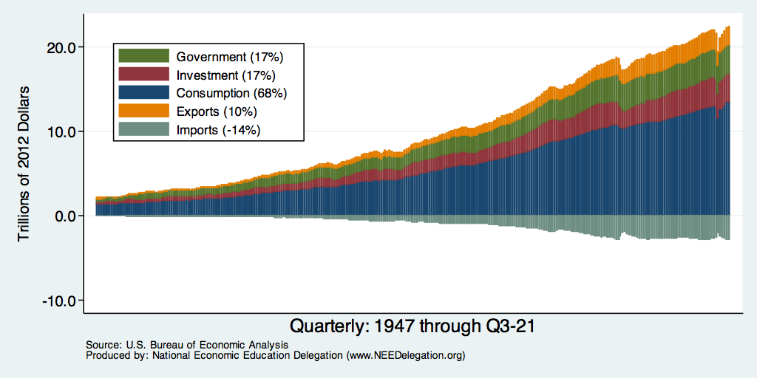
Composition of GDP – Inflation Adjusted
Notes:
Components sum to GDP
Average % of GDP for each component from 1960-Present: C = 64%, I=15%, G=24%, NX = 2% (X = 7%, M=9%)
Net Exports as a % of GDP has increased over the sample period, but it’s contribution to GDP is relatively small

Slide 26
Composition of GDP
Slow growth in any of these categories will slow overall GDP growth.
How does each component contribute to GDP growth pre- vs. post-recession?
What explains current trends in each component?

Slide 27
Understanding Contributions to GDP Growth
GDP Growth is a combination of the growth in its components:
Consumption, Investment, Government, and Net Exports
It’s a weighted average of these components
For example: Consumption
If consumption accounts for 2/3 of the economy,
If consumption grew by 3%,
It would cause GDP growth to be 2 percentage points higher than it would otherwise be
2% = 2/3 * 3%

Slide 28
Contributions to GDP Growth
Notes:
Bars stack to quarterly GDP growth (expressed as an annual rate)
Average quarterly real GDP growth from 1990-2007 is 2.99% and from 2010+ is 2.19% (at annual rates)

Slide 29
Contribution to GDP Growth: Consumption
Notes:
Average GDP growth from 1990-2007 is 2.99% and from 2010+ is 2.19%
Average Consumption contribution from 1990-2007 is 2.16 percentage points and from 2010+ is 1.67 percentage points

Slide 30
Real Disposable Personal Income
Notes:
Pi_disp_recession.png
Pi_disp.do

Slide 31
Real Disposable Personal Income - Growth
Notes:
../Charts/pi_dispYoY_recession.png

Slide 32
Real Disposable Personal Income - Growth
Notes:
../Charts/pi_dispYoY_recession.png

Slide 33
Personal Consumption Expenditures
$1.6 Trillion
Below Trend
Notes:
Chart: ../Charts/personalconsumption_recession.png
Real consumption remains significantly lower than trend consumption since 2008 (actual is 89% of trend).
Since the recession, consumption growth has fallen. From 1990-2007, average annual consumption growth is 3.34%; Post-recession average annual consumption growth is 2.38%.

Slide 34
Personal Consumption Expenditures
$1.6 Trillion
Below Trend
Notes:
Chart: ../Charts/personalconsumption_recession.png
Real consumption remains significantly lower than trend consumption since 2008 (actual is 89% of trend).
Since the recession, consumption growth has fallen. From 1990-2007, average annual consumption growth is 3.34%; Post-recession average annual consumption growth is 2.38%.

Slide 35
Personal Consumption Expenditures
Notes:
Chart: ../Charts/personalconsumption_recession.png
Real consumption remains significantly lower than trend consumption since 2008 (actual is 89% of trend).
Since the recession, consumption growth has fallen. From 1990-2007, average annual consumption growth is 3.34%; Post-recession average annual consumption growth is 2.38%.

Slide 36
Personal Consumption Expenditures
Notes:
Chart: ../Charts/personalconsumption_recession.png
Real consumption remains significantly lower than trend consumption since 2008 (actual is 89% of trend).
Since the recession, consumption growth has fallen. From 1990-2007, average annual consumption growth is 3.34%; Post-recession average annual consumption growth is 2.38%.

Slide 37
Personal Consumption Expenditures
Consumption has been slow to recover.
Pre-crisis average contribution of consumption expenditures is 2.15 percentage points.
Post-crisis contribution is 1.7 percentage points.
In other words, its contribution to GDP growth is down 21%.

Slide 38
Explaining Consumption Expenditures
Retail sales, household debt, and personal savings help explain changes in consumption expenditures.
Lower levels of retail sales and household debt and higher savings should be correlated with lower levels of consumption expenditure.

Slide 39
Retail Sales
Notes:
Graph: RSAFT.png (slides_20.do)
Retail sales fells dramatically during the recession
Sales appear to be returning to forecasted trend; 7 billion 2018 USD gap
Conclusion: Retail sales do not appear to contribute to sluggish consumption growth.
Chart: RSAFS.png

Slide 40
Household Debt as a Share of GDP
Notes:
US household debt relative to GDP rose until the latest recession.
Households have reduced debt relative to GDP 11% since it’s peak in 2008 (at 99%).
Conclusion: Falling household debt likely contributes to slower consumption growth since the recession.
Chart: HHPERCT.png

Slide 41
Household Debt: Mortgages

Slide 42
Household Debt: Other Sources

Slide 43
Household Debt: Other Sources - Pandemic

Slide 44
Household Debt: Change During the Pandemic

Slide 45
Personal Savings
Notes:
Personal savings relative to disposable income immediately rose following the 2008-09 recession, but has since fallen
The post-recession trend is likely closely related to strong retail sales and debt reduction. That is, retail sales remain high but less expenditures are being funded by debt which means households are saving less to fund spending
Conclusion: Falling personal savings has enabled households to reduce household debt while maintaining general consumption patterns
Graph: savings.png

Slide 46
Personal Savings & Disposable Income
Notes:
Personal savings relative to disposable income immediately rose following the 2008-09 recession, but has since fallen
The post-recession trend is likely closely related to strong retail sales and debt reduction. That is, retail sales remain high but less expenditures are being funded by debt which means households are saving less to fund spending
Conclusion: Falling personal savings has enabled households to reduce household debt while maintaining general consumption patterns
Graph: savings.png

Slide 47
Investment Expenditures
Investment expenditures are composed of residential and non-residential spending.
Residential spending refers to purchases of new homes.
Non-residential spending refers to capital purchases and new inventory accumulation.
Tools, machinery, new factories, commercial real estate.

Slide 48
Contributions to GDP: Private Investment
Notes:
The average contribution of private investment to GDP growth has risen since the recession.
This is the result of higher average investment spending post-recession. Average Investment contribution from 1990-2007 is 0.74 percentage points; average Investment contribution from 2010+ is 0.86 percentage points. This change is driven by expanding investment by firms (see points 3 and 4)
On average in 1990-2007, residential investment composes approximately 84% of the Investment contribution to GDP growth. Non-residential composes approximately 8% and Inventories compose approximately 6%
On average in 2010+, residential investment composes approximately 71% of the Investment contribution to GDP growth. Non-residential composes approximately 18% and Inventories compose approximately 10%

Slide 49
Contributions to GDP: Change in Inventories

Slide 50
Contributions to GDP: Residential Investment
Notes:
Contribution of residential investment to GDP growth has risen post-2009

Slide 51
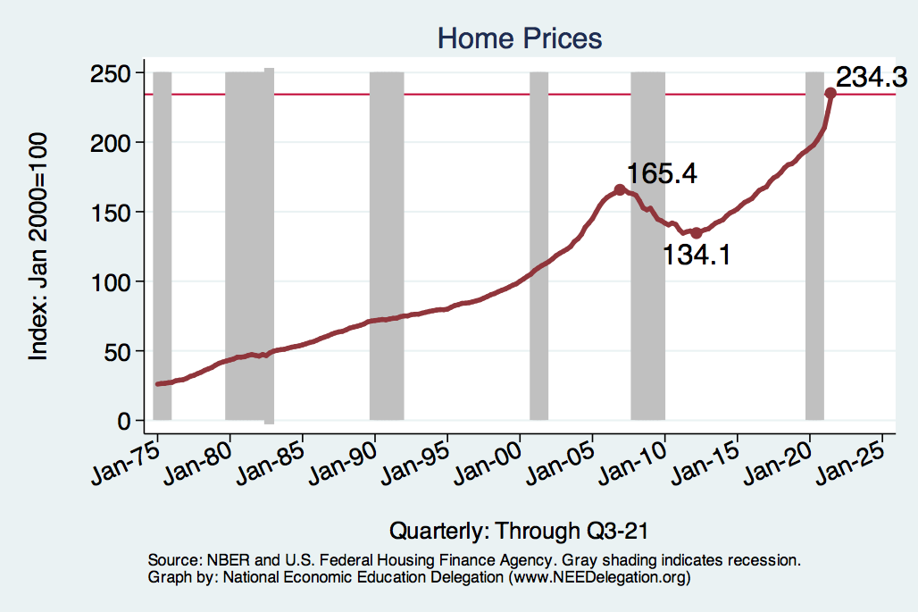
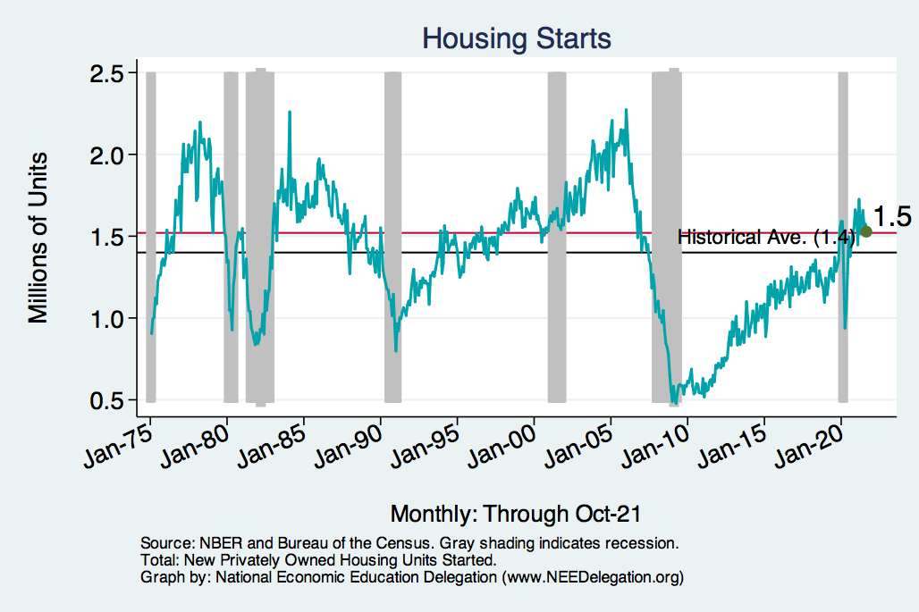
Home Prices and Housing Starts
Notes:
Charts:
homeprices_recession.png
housing.png

Slide 52
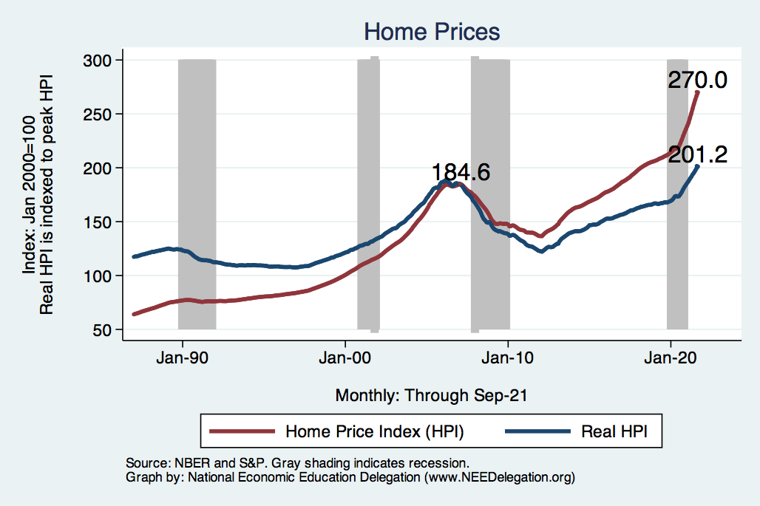
Home Prices: Inflation Adjusted

Slide 53
Housing Growth is Rebounding

Slide 54
Contributions to GDP: Government
Notes:
Since 2010, average government spending growth is shrinking, resulting in a negative average contribution to GDP growth post-recession of -0.8 percentage points
Note that average quarterly government spending growth is 0.42% from 1990-2007 and -0.17% in 2010+ (annualized, 1990-2007 = 1.68%; 2010+ = -0.70%).

Slide 55
Contributions to GDP: Net Exports
Notes:
(1) Average net exports contribution is negative: 1990-2007 avg = -0.23 percentage points; 2010+ avg = -0.19 percentage points

Slide 56
Trade’s Contribution to GDP: Exports
Notes:
Avg Export contribution: 1990-2007 = 0.44 percentage points; 2010+ = 0.33 percentage points

Slide 57
Trade’s Contribution to GDP: Imports
Notes:
(1) Avg Import contribution: 1990-2007 = -0.73 percentage points; 2010+ = -0.57 percentage points

Slide 58
Expenditure Summary
Post-recession consumption is down:
Retail sales are returning to trend;
Household debt down, but climbing;
Personal savings is up.
Investment expenditures are contributing more to GDP growth.
Post-recession government spending was down:
But substantial during the Covid Recession.
Net exports are relatively unchanged.

Slide 59
Expenditure Summary

Slide 60
Expenditure Summary

Slide 61
Labor Market

Slide 62
GDP Growth and Employment Changes

Slide 63
Production and Employment
In addition to the previously discussed components of GDP, the labor market is an important indicator of the health of the U.S. economy.
We’ll focus on employment and productivity.
Trends in employment and labor force participation.
Trend in labor productivity.

Slide 64
Labor Market Conditions
Unemployment rate is low, 4.0%, but rising rapidly.
Natural rate of unemployment is estimated to be 4.5% - 5.5%.
Monthly employment gains have averaged 7,000 jobs over the last six months.
This measure has been growing through the second half of 2019. Will drop precipitously as we go into Q2-2020.
Recent Labor Market Concerns:
Low employment-to-population ratio
Falling labor force participation
Slow wage growth
Notes:
69

Slide 65
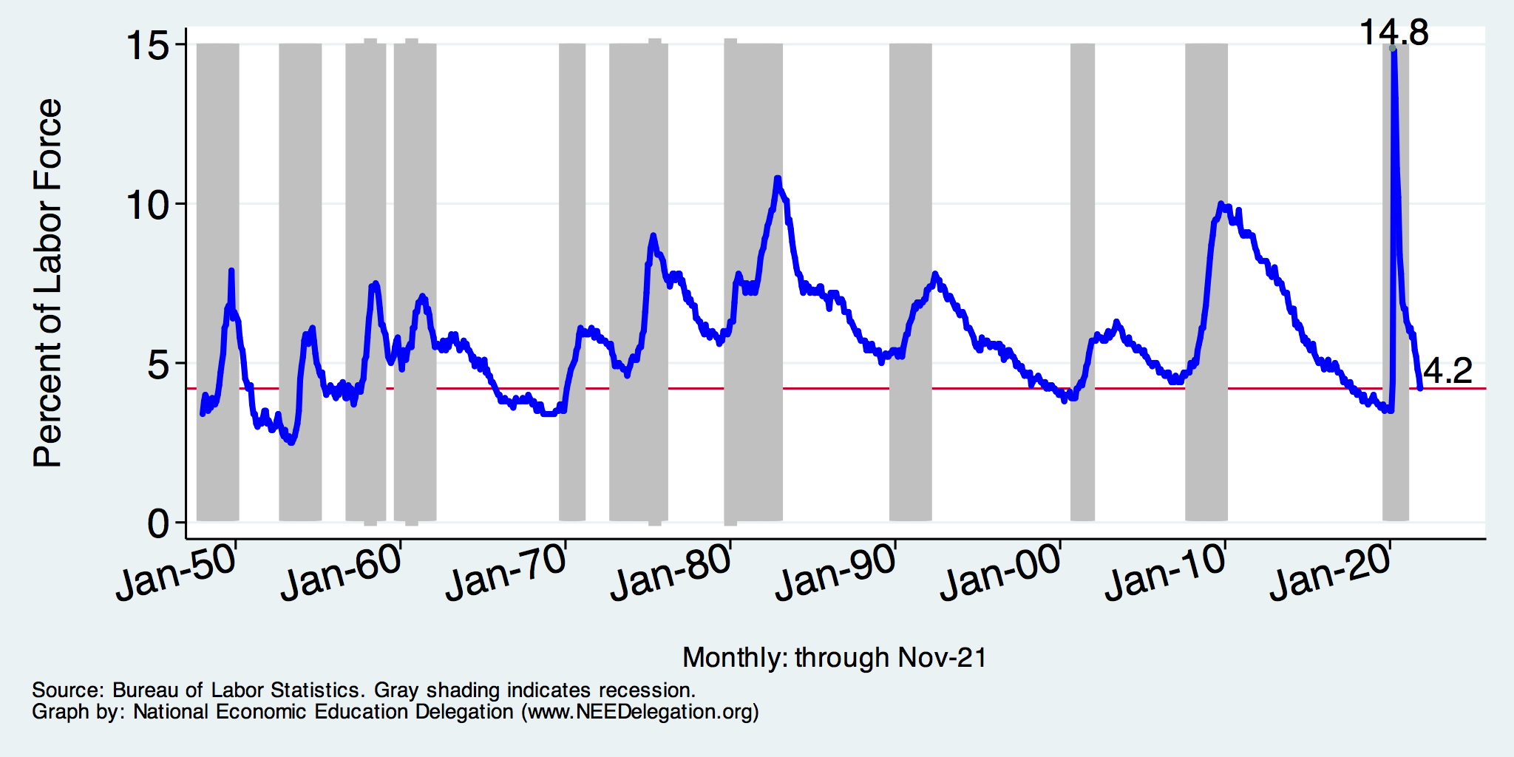
Unemployment Rate
Notes:
Unemployment rises during recessions and falls during economic expansions.
Unemployment peaked at the end of the 2009 recession.
The Fed worked to reduce the effects of the recession. Near the end of 2008, the FOMC reduced the federal funds rate to nearly zero and worked to reduce longer-term interest rates via large-scale asset purchase programs (late 2008 – 10/2014).
Unemployment is currently below the natural rate of unemployment. This is traditionally accompanied by economic growth and rising price levels. It’s also a major reason for FOMC’s decision to increase the federal funds rate.

Slide 66
How is the Unemployment Rate Calculated?
It is not a simple thing:
Why is that not simple?
Because it can go up or down for a variety of reasons:
If the labor force shrinks – UR goes down
If employment grows – UR goes down
Not all employment is created equally
Not a good indicator of the overall well being of the US economy.
# Unemployed
UR = ----------------------- * 100
Labor Force

Slide 67
Underemployment
Notes:
Unemployment rises during recessions and falls during economic expansions.
Unemployment peaked at the end of the 2009 recession.
The Fed worked to reduce the effects of the recession. Near the end of 2008, the FOMC reduced the federal funds rate to nearly zero and worked to reduce longer-term interest rates via large-scale asset purchase programs (late 2008 – 10/2014).
Unemployment is currently below the natural rate of unemployment. This is traditionally accompanied by economic growth and rising price levels. It’s also a major reason for FOMC’s decision to increase the federal funds rate.

Slide 68
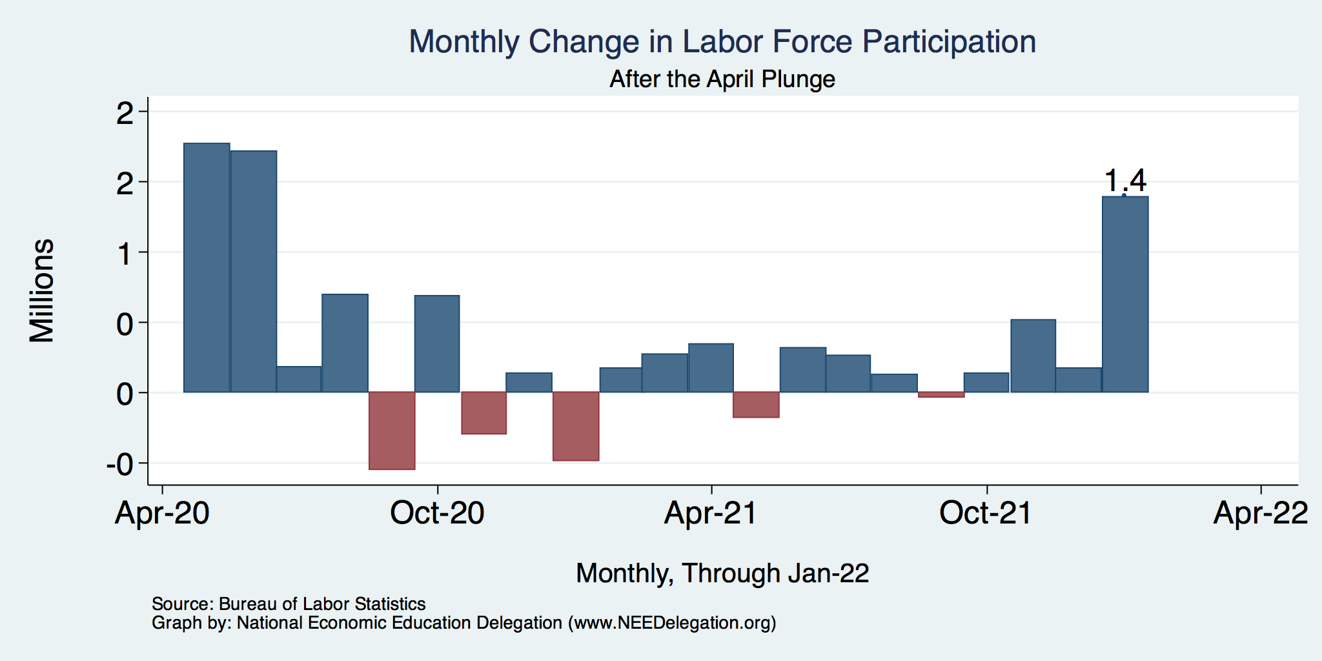
UR Driven by Labor Force Participation?

Slide 69
New Unemployment Insurance Claims

Slide 70
New Unemployment Insurance Claims

Slide 71
New Unemployment Insurance Claims

Slide 72
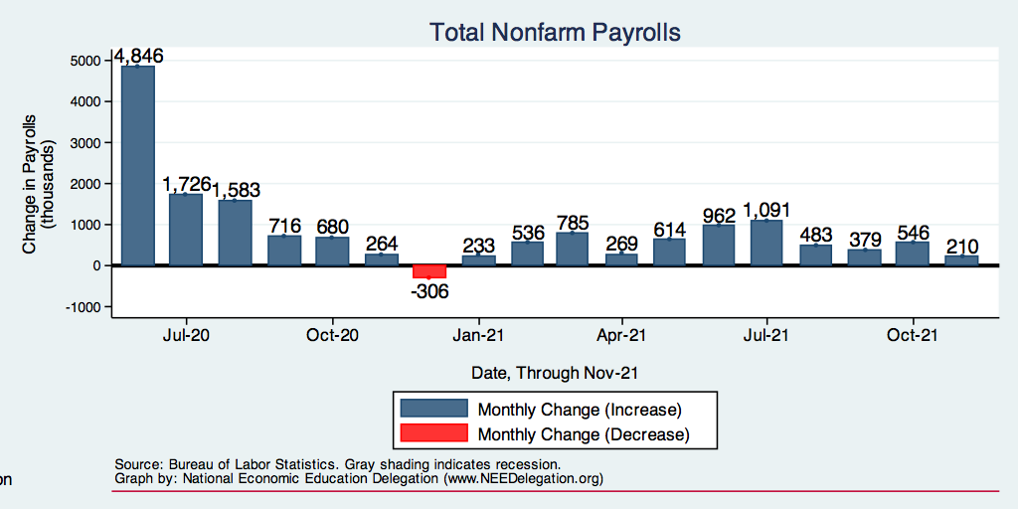
Monthly Changes in Nonfarm Employment
Notes:
PAYEMS_recent.png

Slide 73
Monthly Changes in Nonfarm Employment
Notes:
PAYEMS.png

Slide 74
Part-Time Nonfarm Employment

Slide 75
Monthly Changes in Nonfarm Employment
Notes:
PAYES_historical.png

Slide 76
Employment Growth by Year

Slide 77
Separations: Quits and Layoffs
Notes:
(1) As expected during periods of low unemployment (booms) – workers seek higher paying or better fitting positions (higher quit rate) while firms require more workers for higher production (lower layoff rate).

Slide 78
Job Separations

Slide 79
Job Hires and Separations

Slide 80
Job Openings: Share of Total Employment
Notes:
During expansions, job openings rise.
Reinforces previous slide demonstrating higher separation and hiring rates during expansions

Slide 81
Employment-to-Population Ratios
Notes:
During the 2008-09 recession, the U.S. experienced a sharp fall in employment to population ratio and labor force participation rates. This large drop is mainly caused by rising unemployment and overall, the ratio is expected to return to near 60%.
However, the participation rate peaked in the early 2000s and has been steadily declining since. This trend decline is largely attributed to the lower participation of baby-boomers and to a smaller extent cyclical factors. Note that baby booms are currently in the “55 and over” age group from the participation rate which is lower than the “24 to 55” or “prime” age group participation rate. (See Hipple, Steven. “Labor Force Participation: What has Happened Since the Peak?”, Monthly Review, U.S. BLS, Sep 2016. https://doi.org/10.21916/mlr.2016.43.)
Also see: Bullard, James. “The Rise and Fall of Labor Force Participation in the United States”, Federal Reserve Bank of St. Louis Review, First Quarter 2014, 96(1), pp. 1–12, http://research.stlouisfed.org/publications/review/2014/q1/bullard.pdf
Underlying dynamics:
The labor force participation rate for white males has gradually fallen over time and is expected to continue to fall.
At the same time, the labor force participation rate for women has risen.
Full-time employment is predicted to return to trend.
Future concerns?

Slide 82
Employment to Population Ratios – Recent
Notes:
(1) While male labor force participation has continued its downward trend

Slide 83
Employment to Population Ratios – COVID
Notes:
(1) While male labor force participation has continued its downward trend

Slide 84
Slow Employment Recovery
Notes:
UNRATE_EMRATIO_recent.png

Slide 85
Labor Force Dropouts

Slide 86
Trends in Labor Force Participation
Notes:
CLF16OV.png

Slide 87
There is a Persistent Labor Force Gap

Slide 88
Labor Force Growth Has Been Uneven

Slide 89
Baby Boomers Are Retiring!

Slide 90
Employment Growth
Notes:
Payroll_recession.png
Employment growth has returned to trend growth, but labor market is far below the forecast trend - 20.8 million jobs shy of forecast trend
Possible explanations…
payroll_recession.png

Slide 91
Employment Gap: Up Close
Notes:
payroll_recent.png

Slide 92
Employment Gap: Pandemic
Notes:
payroll_recent.png

Slide 93
Wage Growth

Slide 94
Wage Growth
Notes:
Is this necessary given the previous slide?

Slide 95
Wage Growth
Notes:
Is this necessary given the previous slide?

Slide 96
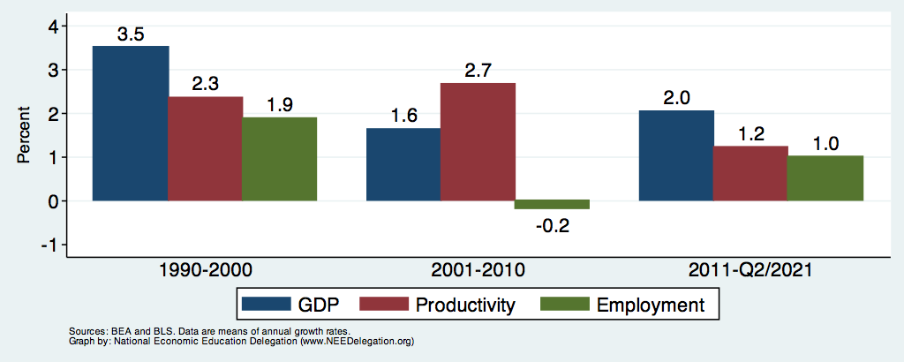
GDP Growth, Productivity, and Employment

Slide 97
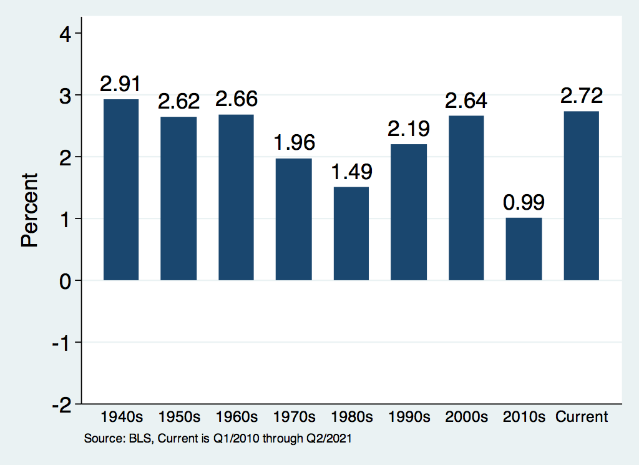
History of Productivity Growth

Slide 98
Summary
GDP growth is primarily fueled by increases in demand for output.
This growth is supported by growth in employment and productivity of the labor force.
Recent years have seen relatively tepid increases in demand for output.
In particular, consumption and government spending have been slow relative to other periods.
This tepid growth has lead to slow increases in employment.
Although labor markets have tightened, wages have not experienced rapid growth.
Productivity growth has played little role in growing GDP.
Why this is so is not immediately clear.

Slide 99
Monetary Policy

Slide 100
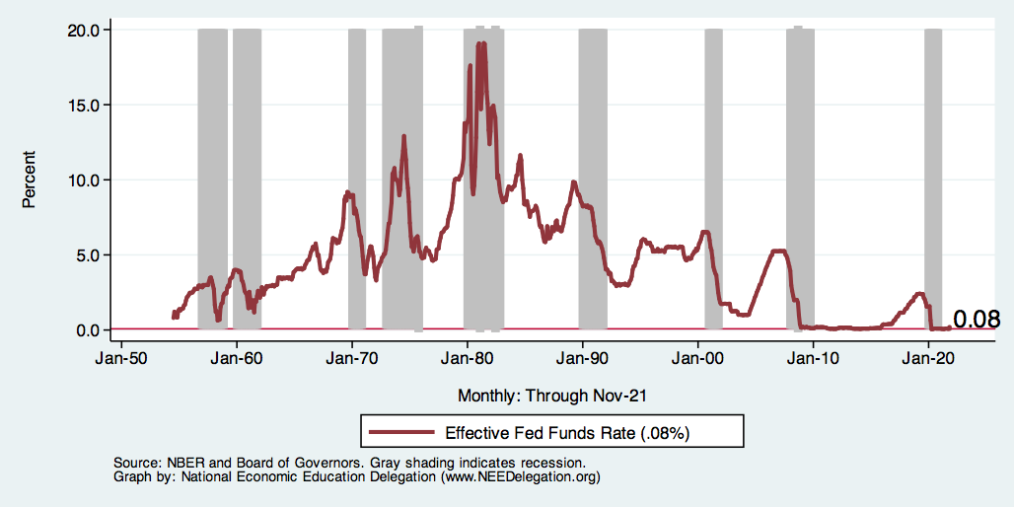
Federal Funds Rate
Notes:
The fed funds rate is the interest rate on overnight loans between banks. Think of it as the baseline interest rate on which banks base all other interest rates (e.g. mortgage rates)
FOMC lowers the fed funds rate during recessions and raises the fed funds rate during expansions
Fed funds rate peaked in the 1980s as then Chairman Paul Volcker sought to reign in “run away” inflation of the 1970s; doing so resulted in a recession in the early 1980s.
Since the 2008-09 recession, the fed funds rate has been kept near zero.
During the 2008-09 recession, Federal Reserve turned to unconventional tools to influence longer term interest rates to further stimulate the economy - QE
FedFunds.png

Slide 101
Federal Funds Rate – Last 5 Years
Notes:
The FOMC waited for labor market conditions to improve before raising the fed funds rate in late 2015.
FOMC currently working to normalize monetary policy by raising interest rates and reducing assets on its balance sheet
FedFunds_recent.png

Slide 102
Treasuries
Notes:
treas_recent.png

Slide 103
Alarming Compression of Interest Rates
Notes:
Yield_curve.png

Slide 104
Alarming Compression of Interest Rates

Slide 105
Inflation
Notes:
Cpi.png

Slide 106
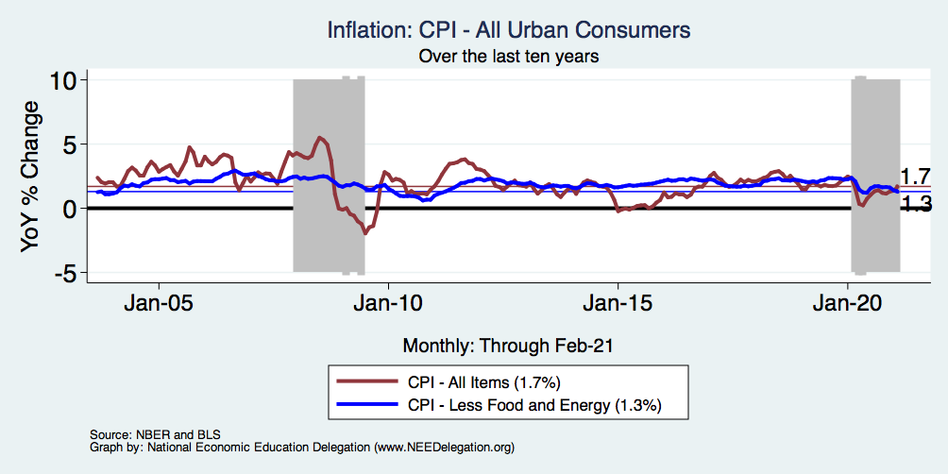
Inflation – Recent Stability
Notes:
Cpi_recent.png

Slide 107
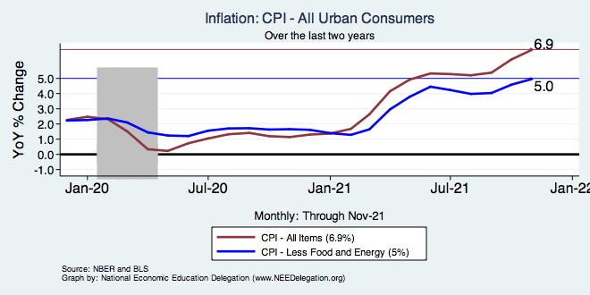
Inflation – Recent Stability
Notes:
Cpi_recent.png

Slide 108
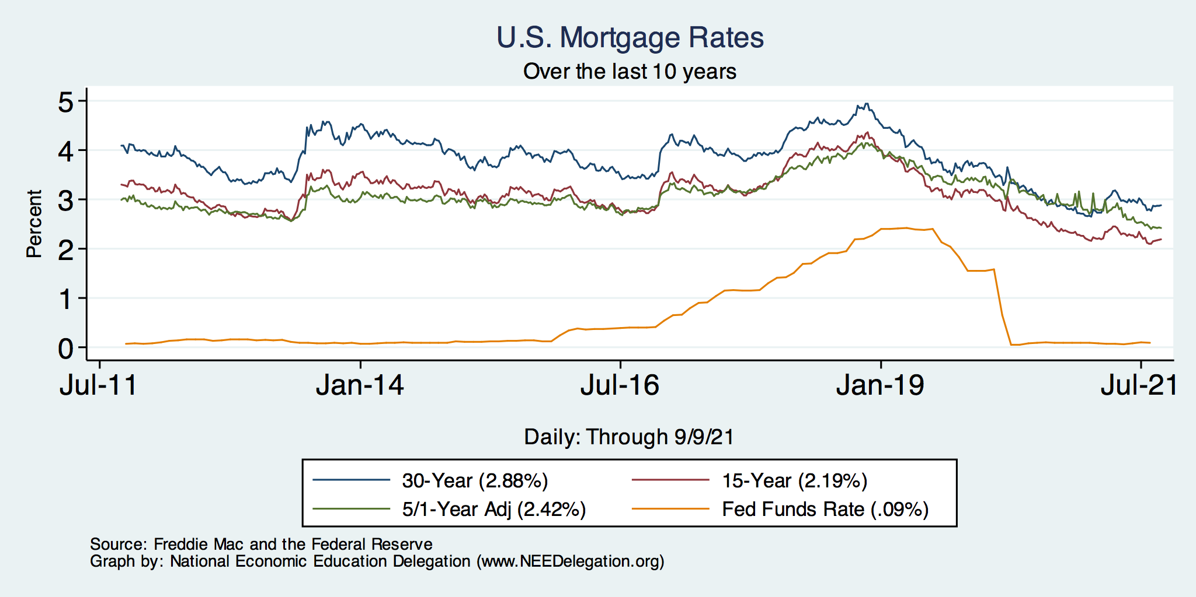
Mortgage Rates

Slide 109
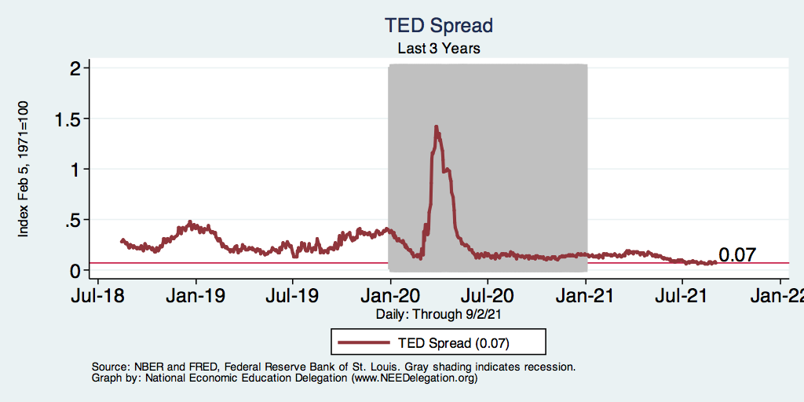
TED Spread
Notes:
TEDRATE_recent.png

Slide 110
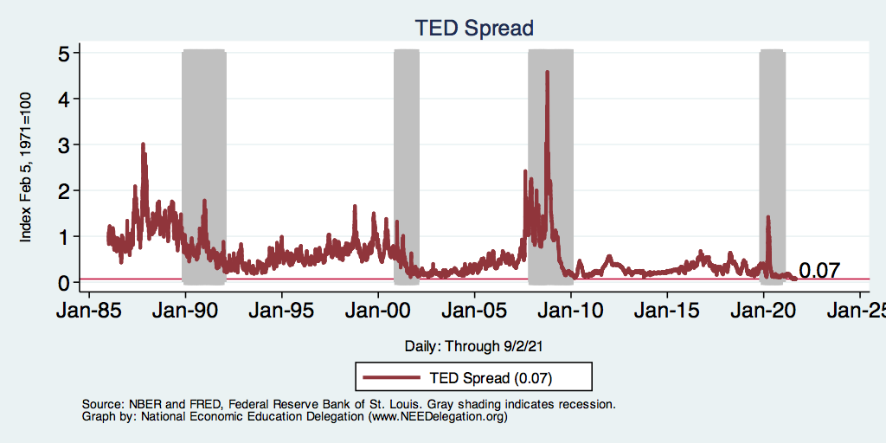
TED Spread
Notes:
Last 10 years?
TEDRATE_recession.png

Slide 111
Other Indicators

Slide 112
Consumer Confidence: Waning?
Notes:
Consumer_confidence.png

Slide 113
Producer Confidence: Gaining Steam?

Slide 114
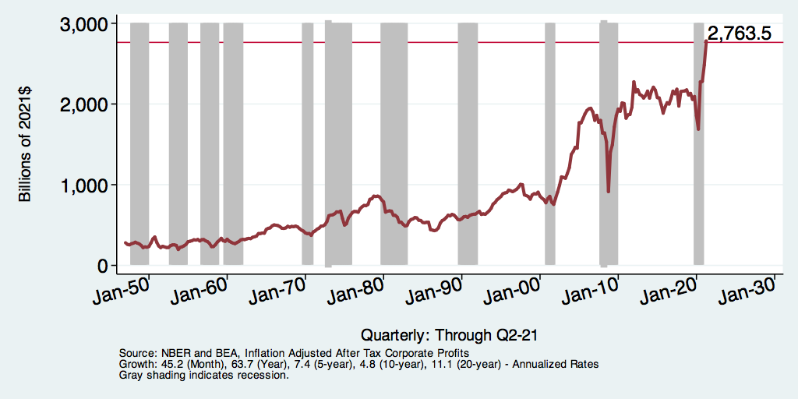
Corporate Profits – Inflation Adjusted
Notes:
corporateprofits_recession.png

Slide 115
Capacity Utilization

Slide 116
E-Commerce Inroads

Slide 117
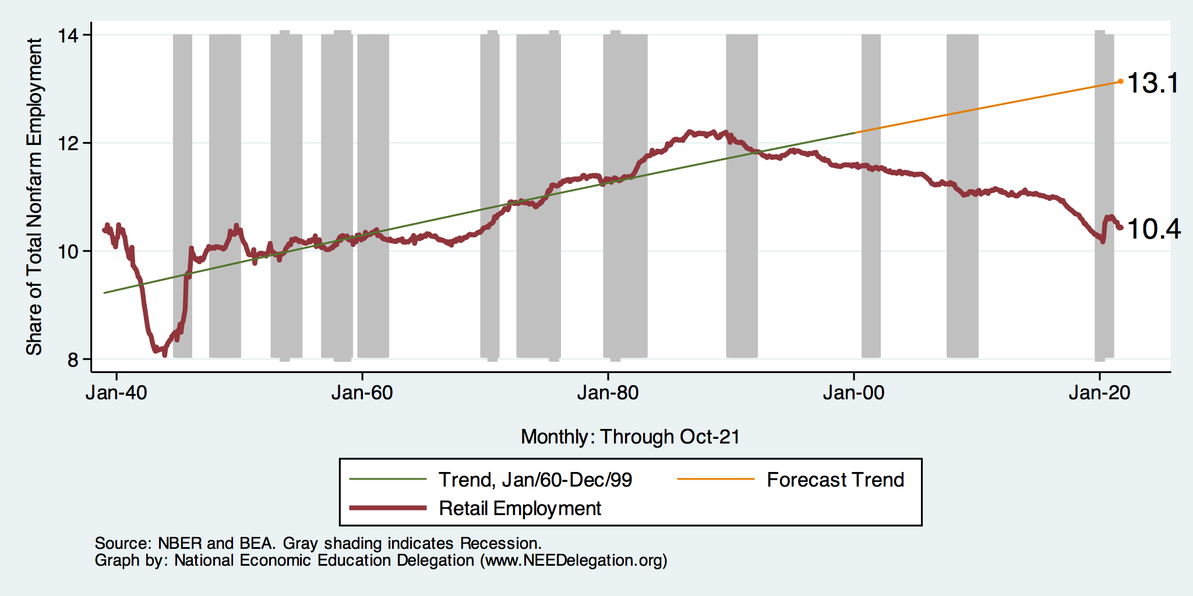
Employment in Retail Trade
Notes:
Retailemp.do

Slide 118
Automobile and Light Truck Sales

Slide 119
Stock Markets

Slide 120
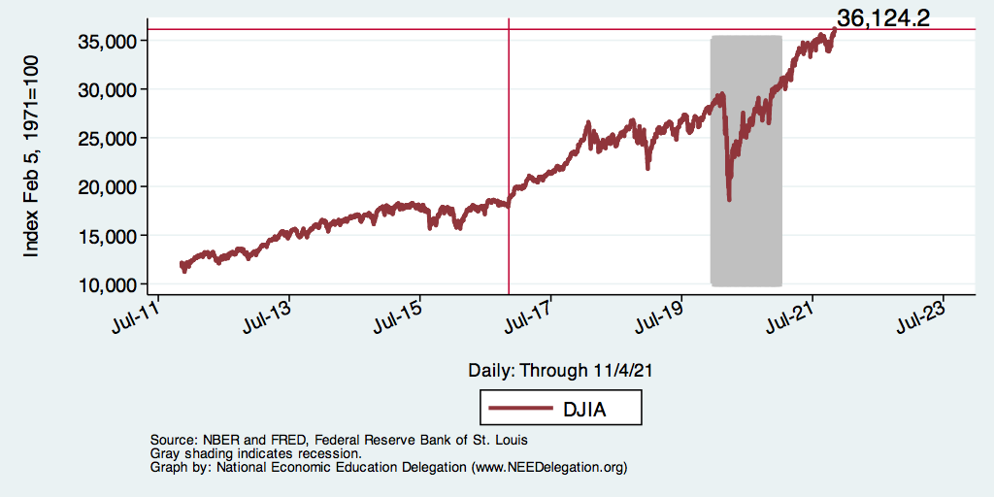
Dow Jones

Slide 121
Dow Jones - Volatility

Slide 122
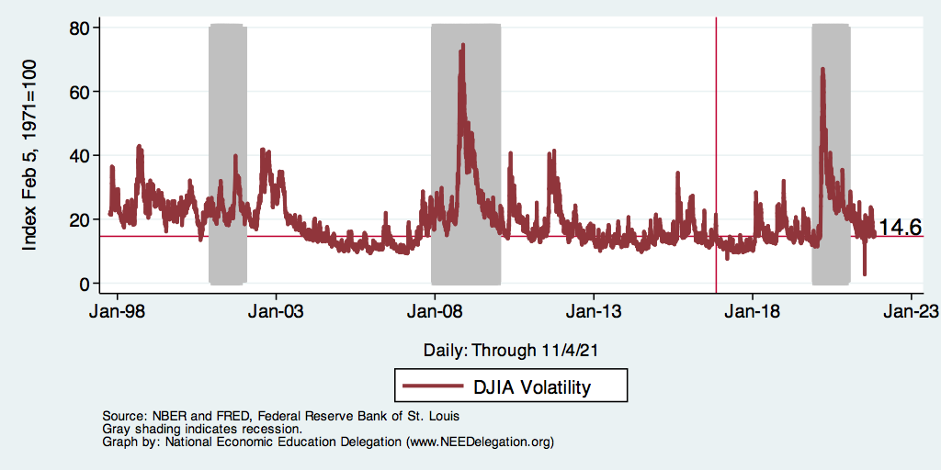
Dow Jones - Volatility

Slide 123
NASDAQ

Slide 124
Summary of GDP, Employment and Monetary Policy
Behavior of GDP
Behavior of expenditure components matter.
On average, post-recession consumption, government, and export. expenditures are contributing less to GDP therefore slowing the recovery.
In contrast, investment expenditures are contributing more.
Labor Market
Unemployment is low, labor force participation is stagnant
Real wages may be starting to grow.
Monetary Policy
Interest rates are rising.
Policy normalization is underway.

Slide 125
Things to Be Worried About
Yield Curve
Government Debt
Growth Abroad
Income and Wealth Inequality
Infrastructure
Savings
Policy Uncertainty
Trade and immigration policy, especially

Slide 126
Alarming Compression of Interest Rates
Inverted Yield Curves (negative values) Have Projected Recent Recessions

Slide 127
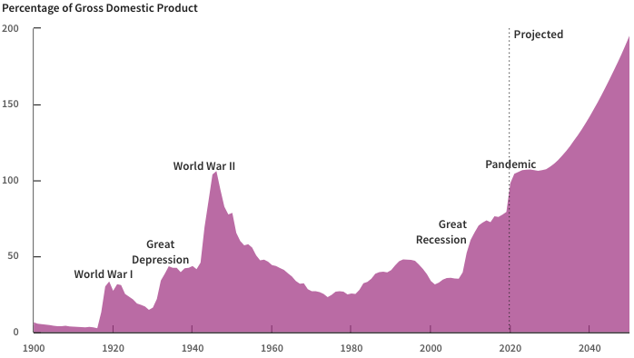
Record Levels of Debt are Forecast
Source: Congressional Budget Office, The Budget and Economic Outlook: 2020 to 2030

Slide 128
Cautious Outlook
Job growth remains robust
Labor force is in decline
Wage growth, but not too much
Business investment is robust, but will uncertainty bite?
Inflation and interest rates remain favorable
Potential source of concern:
Auto and light truck sales are slowing
Home building is slowing

Slide 129
Overall Summary
Tailwinds and headwinds both exist
Economic forecasts for near term are favorable
Later 2019 and 2020 forecasts are less sanguine
There remains room for the economy to grow
Labor force growth is available
Consumption has room to grow, but there is evidence of slowing
Business investment may be slowing
Return to productivity growth? But how? What’s the next big idea?
Long term concerns unaddressed
Demographics, climate change
Federal government debt
International trade policy

Slide 130
Course Outline
Contemporary Economic Policy
Week 1 (2/28): US Economy & Coronavirus Economics
Week 2 (3/7): Economic Inequality (Brian Peterson, Central College)
Week 3 (3/14): Cryptocurrencies (Geoffrey Woglom, Amherst College)
Week 2 (3/21): Autonomous Vehicles (Jon Haveman, NEED)

Slide 131
National Income Inequality: Share of Top 10%
Stock Market Crash
WWII
Housing Bubble
Dot-com Bubble

Slide 132
Bitcoins: What is the Excitement About?
Almost 500% increase in 6 months
Blue Line Price of Bitcoin
Red Line: Price of Gold
On, 12/9, 1PM 1 bitcoin = $48k
Notes:
Bitcoin today was trading at $56,850

Slide 133
Autonomous Vehicles

Slide 134
Thank you!
Any Questions?
www.NEEDelegation.org
<presenter name>
<presenter email>
Contact NEED: info@needelegation.org
Submit a testimonial: www.NEEDelegation.org/testimonials.php
Become a Friend of NEED: www.NEEDelegation.org/friend.php

Slide 135
www.NEEDelegation.org/LocalGraphs
For every state and county in the United States.
Detailed graphs on employment, housing, moves, and other statistics.

Slide 136
Available NEED Topics Include:
US Economy
Economic Inequality
Climate Change
US Social Policy
Trade and Globalization
Economic Mobility
Trade Wars
Housing Policy
Federal Budgets
Federal Debt
2017 Tax Law
Autonomous Vehicles

Slide 137
The Local Economy
These graphs area available for your local area at www.NEEDelegation.org/LocalGraphs
They are not up to date in this deck, but the graphs online are kept constantly up to date. If they are not, please let me know.

Slide 138
Employment Situation: California

Slide 139
Employment Situation: Marin County

Slide 140
Employment Growth: California

Slide 141
Employment Growth: Marin County

Slide 142
Unemployment: California

Slide 143
Unemployment: Marin County

Slide 144
Labor Force: California

Slide 145
Labor Force: Marin County

Slide 146
Gross Regional Product: California

Slide 147
Gross Regional Product: Marin County

Slide 148
Gross Regional Product Detail: California

Slide 149
Employment Growth Detail

Slide 150
Employment Growth Detail: California

Slide 151
Employment Growth Detail: Marin County

Slide 152
Employment Shares

Slide 153
Employment Shares: California

Slide 154
Employment Shares: Marin County

Slide 155
Per Capita Income: California

Slide 156
Per Capita Income: Marin County

Slide 157
Per Capita Income: Marin County

Slide 158
Per Capita Income: Marin County

Slide 159
Income Inequality: Nationwide

Slide 160
Income Inequality: California

Slide 161
Income Inequality: Marin County

Slide 162
Income Inequality: Marin County (5-yr ACS)

Slide 163
Poverty: California

Slide 164
Child Poverty: California

Slide 165
Poverty: Marin County (1-yr ACS)

Slide 166
Poverty: Marin County (5-yr ACS)

Slide 167
Child Poverty: Marin County (1-yr ACS)

Slide 168
Child Poverty: Marin County (5-yr ACS)

Slide 169
Home Prices: California

Slide 170
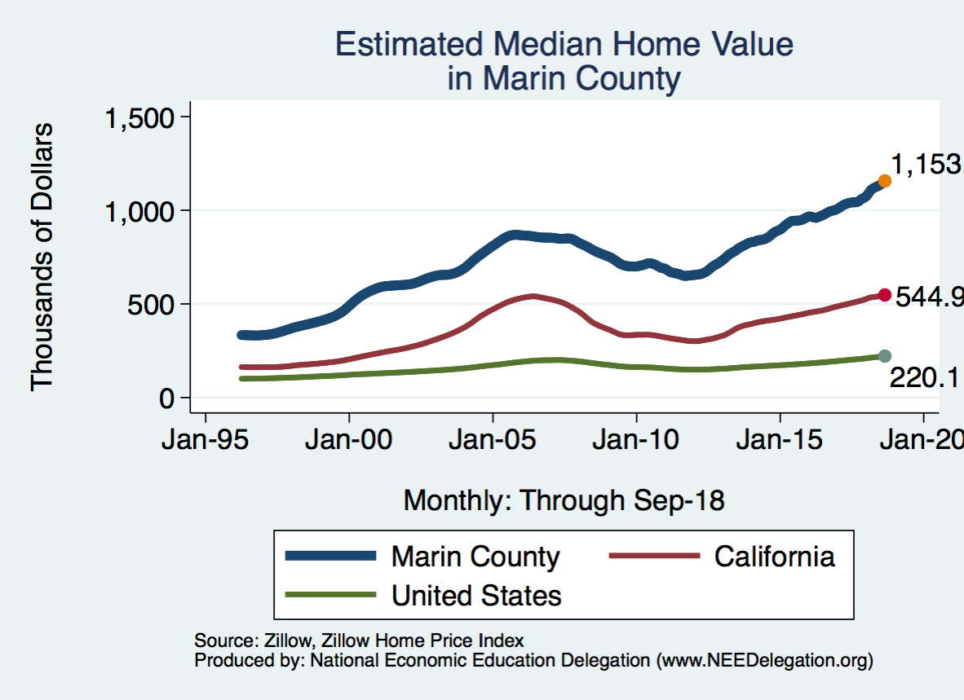
Home Prices: Marin County

Slide 171
Rents: California

Slide 172
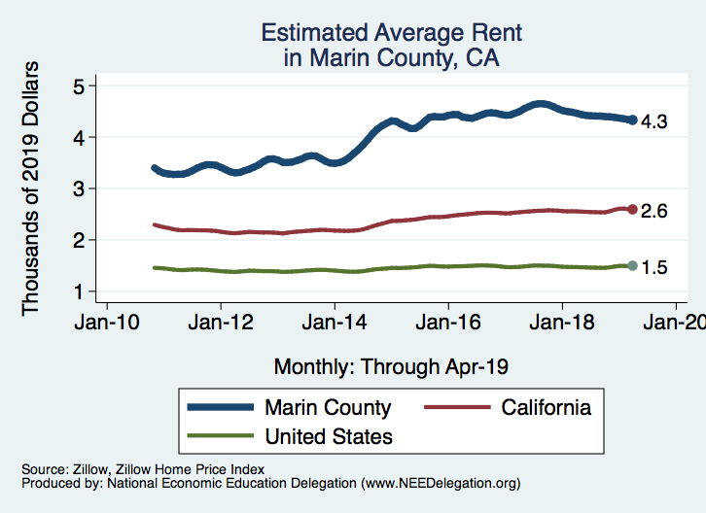
Rents: Marin County

Slide 173
Home Permitting: Nationwide

Slide 174
Home Permitting: California

Slide 175
Home Permitting: Marin County

Slide 176
Population Growth: California

Slide 177
Population Growth: Marin County (1yr ACS)

Slide 178
Population Growth: Marin County (5yr ACS)

Slide 179
Jobs-Housing Ratio

