Slide 1
US Economy and
Russia/Ukraine Economics
CSMFO – San Gabriel Chapter
March 9, 2022
Jon Haveman, Ph.D.
National Economic Education Delegation

Slide 2
National Economic Education Delegation
Vision
One day, the public discussion of policy issues will be grounded in an accurate perception of the underlying economic principles and data.
Mission
NEED unites the skills and knowledge of a vast network of professional economists to promote understanding of the economics of policy issues in the United States.
NEED Presentations
Are nonpartisan and intended to reflect the consensus of the economics profession.

Slide 3
Available NEED Topics Include:
Coronavirus Economics
US Economy
Climate Change
Economic Inequality
Economic Mobility
Trade and Globalization
Minimum Wages
Immigration Economics
Housing Policy
Federal Budgets
Federal Debt
Black-White Wealth Gap
Autonomous Vehicles
US Social Policy

Slide 4
Credits and Disclaimer
This slide deck was authored by:
Jon D. Haveman, NEED
Scott Baier, Clemson University
Geoffrey Woglom, Amherst College (Emeritus)
Brian Dombeck, Lewis & Clark College
Doris Geide-Stevenson, Weber State
Disclaimer
NEED presentations are designed to be nonpartisan.
It is, however, inevitable that the presenter will be asked for and will provide their own views.
Such views are those of the presenter and not necessarily those of the National Economic Education Delegation (NEED).

Slide 5
Outline
State of the pandemic
The U.S. Economy
Hot Topics
The Great Resignation
Russia/Ukraine
Oil
Wheat
Inflation

Slide 6
Making Real Progress!
Nationally
Source: NYTimes

Slide 7
Oklahoma Cases Are Falling Nicely
California
Source: NYTimes

Slide 8
The U.S. Economy

Slide 9
Question 1:
1) Has the economy fully recovered from the pandemic?
That is, is GDP higher or lower than it might have been without the pandemic?

Slide 10
GDP Trajectory: Pandemic Plunge!
GDP is:
$0.3 Trillion below 2019 forecast.
$0.7 Trillion ABOVE 2019-Q4 level.

Slide 11
Monthly Changes in Nonfarm Employment
Notes:
PAYEMS.png

Slide 12
Monthly Changes in Nonfarm Employment
Recovery?
Recovery
Delta
Omicron
Notes:
PAYEMS.png

Slide 13
Employment Gap
1.1 Million below February, 2020.
7.4 Million below where we should be.
Notes:
payroll_recent.png

Slide 14
Trends in Labor Force Participation
0.6 Million below February, 2020.
3.7 Million below where we should be.
Notes:
CLF16OV.png

Slide 15
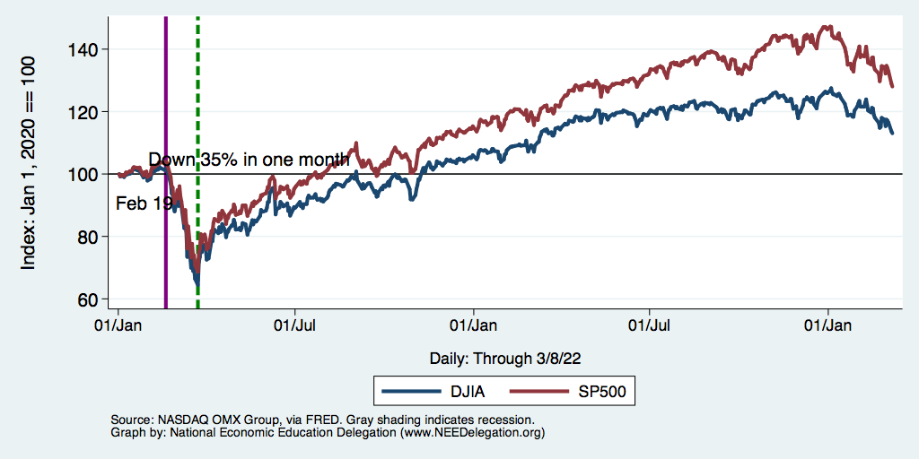
Stocks: Jittery

Slide 16
Hot Topics
The Great Resignation
Russia/Ukraine
Oil
Wheat
Inflation

Slide 17
The Great Resignation

Slide 18
Question 2:
2) What is the great resignation?

Slide 19
Quits Are High! The Great Resignation

Slide 20
Quits – Rising, but More in Some Industries
Accom. & Food Services
Leisure & Hospitality
Retail

Slide 21
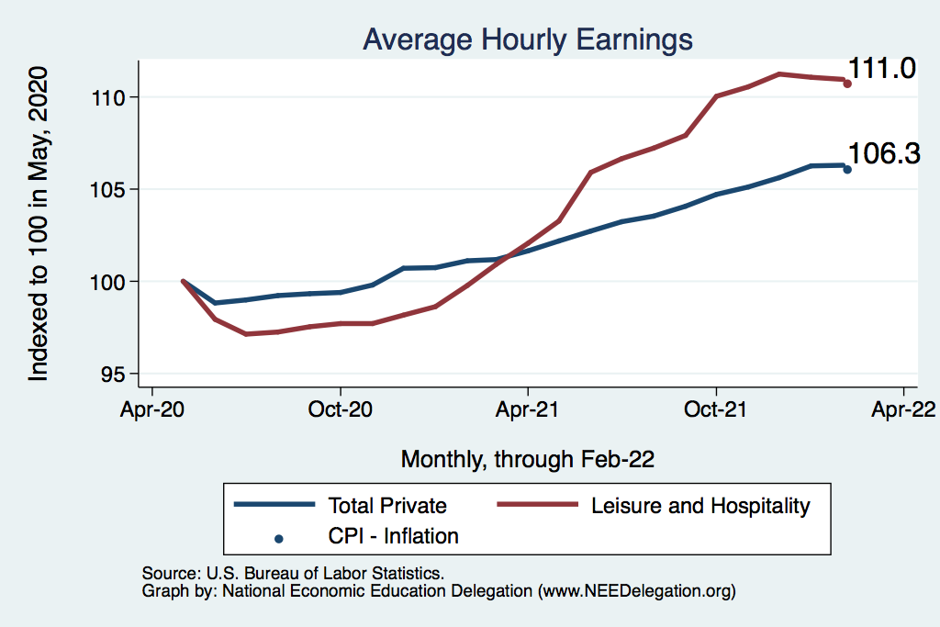
This is Happening Despite Rising Wages
Leisure & Hospitality
109.7
L&H wages rising
Not much faster
Than inflation
Total Nonfarm

Slide 22
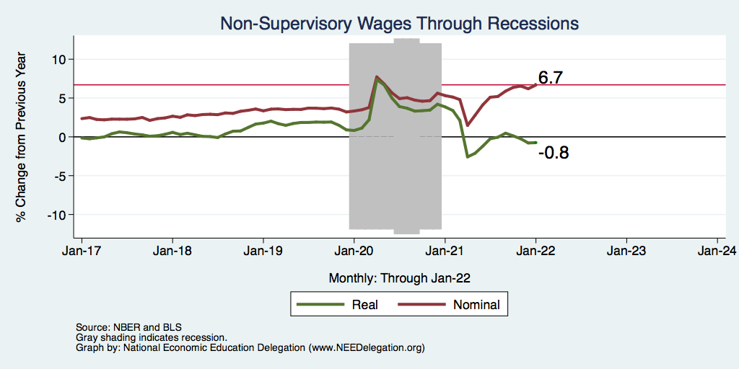
Inflation Adjusted Wages Are Falling

Slide 23
Russia/Ukraine(/Belarus)

Slide 24
Sanctions
Restrict financial transactions
Severing from SWIFT (partially)
Central bank assets – reserves have been abroad, but can’t access.
Cannot support Ruble
Cut off the Nord Stream 2
Technology export restrictions
Russian aviation – can not use western air space
Most aircraft are leased.
DOJ - KleptoCapture
Private sector sanctions
Apple – no more Apple Pay or iPhones
BP and other oil producers moving out
And many more!

Slide 25
Consequences for the Russian Economy
Massive inflation
Devaluation of the Ruble
High interest rates
Shortages
Not to mention the Oligarchs
Sanctions on 100 specific individuals.
Fear of renewed “Iron Curtain”

Slide 26
Consequences for the Global Economy
Primarily:
Oil
Wheat
Why?
Major suppliers of each
29% of world wheat production
20-40% of Europe’s oil and gas
Russia part of OPEC+
Russian and Ukranian combined economies are small.
Don’t forget Belarus.

Slide 27
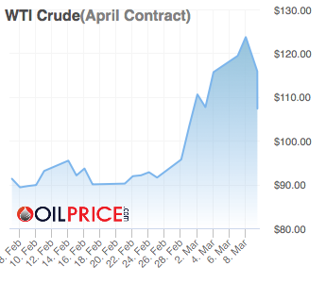
Oil
Russia Invades
Notes:
https://oilprice.com/oil-price-charts/#WTI-Crude

Slide 28
Oil Prices in Historical Context

Slide 29
Oil Prices in Historical Context – Inflation Adj.

Slide 30
Wheat
Notes:
https://news.yahoo.com/surge-wheat-prices-expected-seed-133755571.html?fr=yhssrp_catchall

Slide 31
Inflation

Slide 32
Question 3:
3) How much higher are prices than they might have been if we didn’t have a pandemic?

Slide 33
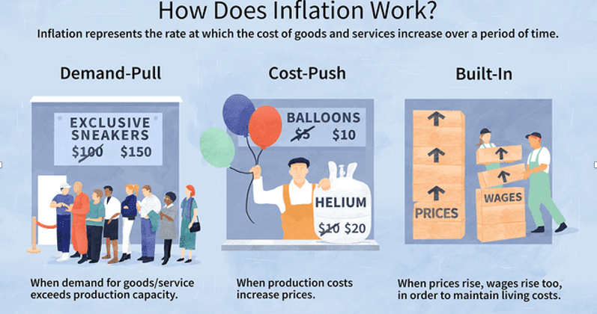
Source: Investopedia

Slide 34
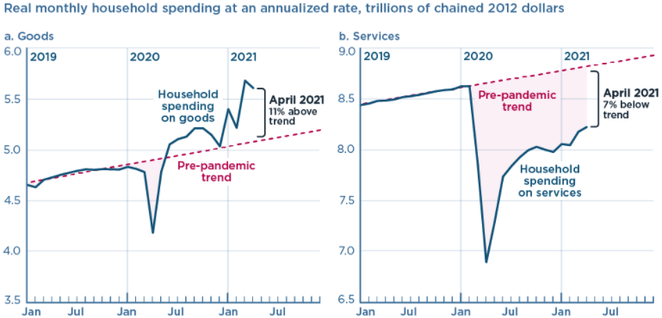
We’re Buying Mostly … Stuff
Demand-Pull
Source: Jason Furman, PIIE

Slide 35
Inflation: Concentrated
Cost-Push

Slide 36
Corporate Profits…Adding to Inflation?

Slide 37
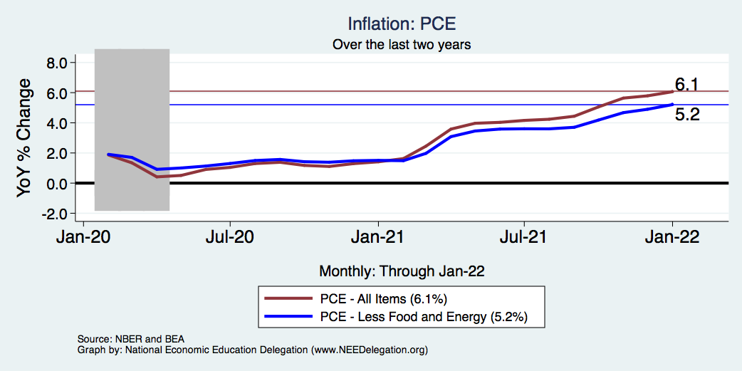
Inflation – The Fed’s Metric! Should we worry?
Notes:
Cpi_recent.png

Slide 38
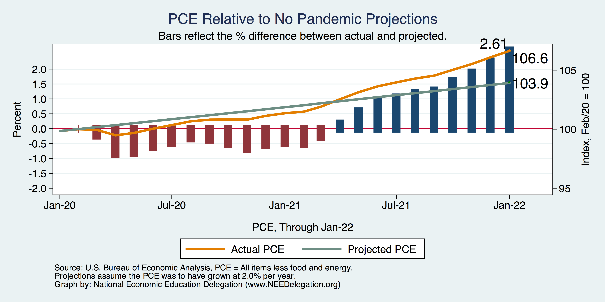
Inflation – PCE and Fed Suggest: I don’t know.
Notes:
Cpi_recent.png

Slide 39
So Far Inflationary Expectations Look Stable
Professional forecasters, financial markets and the Fed itself think that inflation in 2022 will be in the 2.5-3%, range
 | Median Fed Forecasts from 12/15/21 FOMC Meeting
 | 2022 | 2023 | 2024 | Longer run
Unemployment rate | 3.5 | 3.5 | 3.5 | 4.0
Inflation | 2.6 | 2.3 | 2.1 | 2.0
Interest rate | 0.9 | 1.6 | 2.1 | 2.5
Russia/Ukraine conflict may well raise these forecasts.

Slide 40
Conclusion
Recovery is well underway, but may be slowing.
GDP expanded by 5.7% percent in 2021, 3-4% in 2022.
2021 was an odd year.
Workers attained the upper hand.
Supply chains broke.
Inflation surged.
The economy rebuilt itself.
Biggest problems:
Supply chain bottlenecks.
Labor force participation.
Russian war in Ukraine

Slide 41
Where Are We Headed?
Economic fallout of the Russia/Ukraine conflict will be modest.
At best, back to where we were before the pandemic.
Economic growth of ~2%/year.
Low interest rates.
Inflation back in the 2% range.
How long is it going to take to get there and what will we endure?
Entirely speculation.
Could be 5 years before we are back to equilibrium. NOT back to normal.
Next year: elevated inflation and interest rates.
2023: GDP growth relatively slow, but perhaps greater than recent averages.

Slide 42
Thank you!
Any Questions?
www.NEEDelegation.org
Jon D. Haveman
Jon@NEEDelegation.org
Contact NEED: info@NEEDelegation.org
Submit a testimonial: www.NEEDelegation.org/testimonials.php
Become a Friend of NEED: www.NEEDelegation.org/friend.php

Slide 43
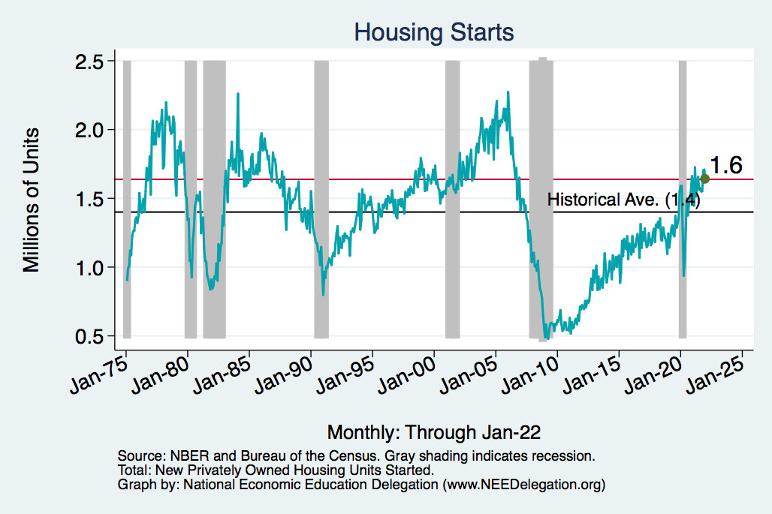
Home Prices and Housing Starts
Notes:
Charts:
homeprices_recession.png
housing.png

Slide 44
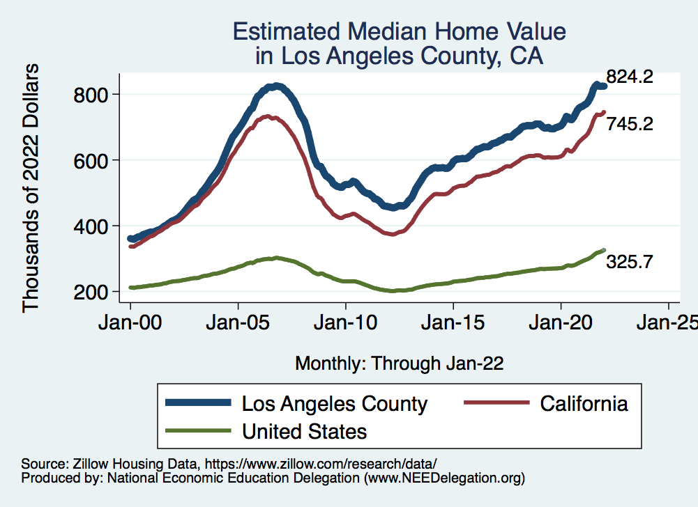
RE Experiences Differ!

Slide 45
www.NEEDelegation.org/LocalGraphs
For every state and county in the United States.
Detailed graphs on employment, housing, moves, and other statistics.

