Slide 1
US Economy and Coronavirus Economics
COO Forum
Jon Haveman, Ph.D.
National Economic Education Delegation

Slide 2
National Economic Education Delegation
Vision
One day, the public discussion of policy issues will be grounded in an accurate perception of the underlying economic principles and data.
Mission
NEED unites the skills and knowledge of a vast network of professional economists to promote understanding of the economics of policy issues in the United States.
NEED Presentations
Are nonpartisan and intended to reflect the consensus of the economics profession.

Slide 3
Credits and Disclaimer
This slide deck was authored by:
Jon D. Haveman, NEED
Scott Baier, Clemson University
Geoffrey Woglom, Amherst College (Emeritus)
Brian Dombeck, Lewis & Clark College
Doris Geide-Stevenson, Weber State
Disclaimer
NEED presentations are designed to be nonpartisan.
It is, however, inevitable that the presenter will be asked for and will provide their own views.
Such views are those of the presenter and not necessarily those of the National Economic Education Delegation (NEED).

Slide 4
Outline
State of the pandemic
The U.S. Economy
Hot Topics
Government policy
Inflation
Great resignation

Slide 5
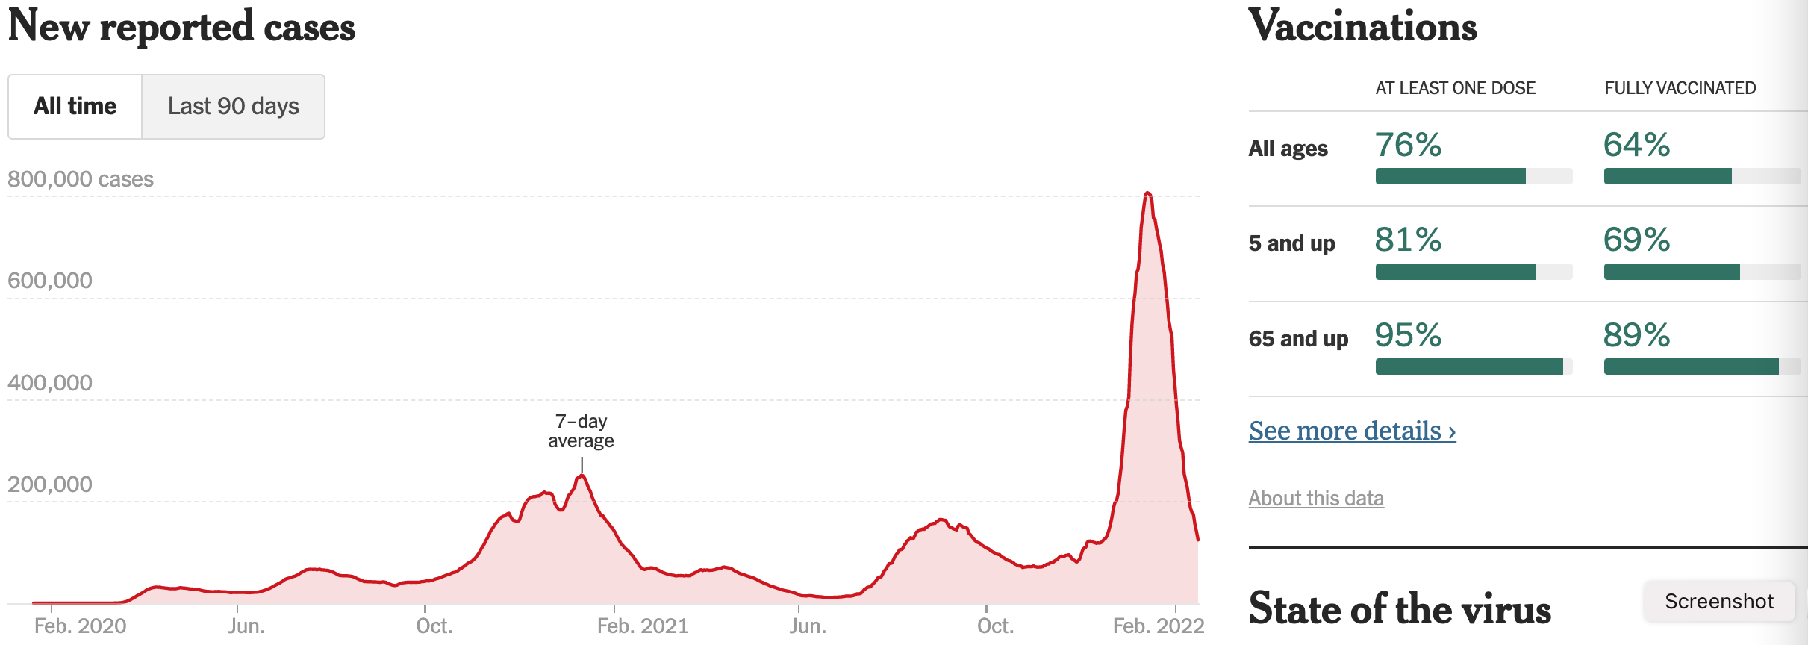
Making Real Progress!
Nationally
Source: NYTimes

Slide 6
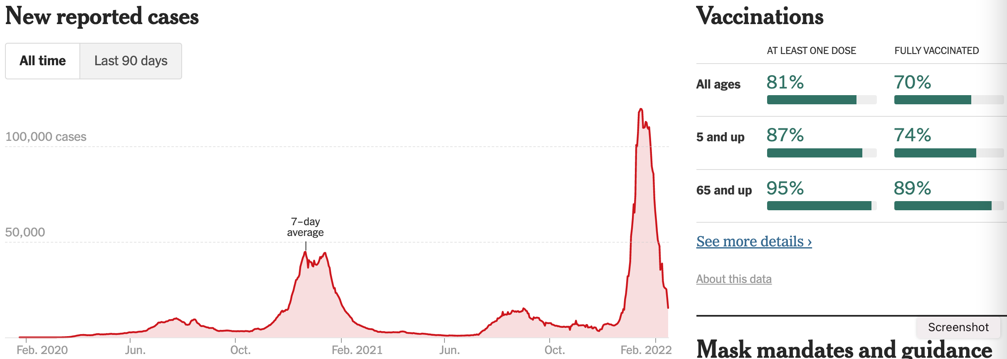
Oklahoma Cases Are Falling Nicely
California
Source: NYTimes

Slide 7
The U.S. Economy

Slide 8
GDP Trajectory: Pandemic Plunge!
Q3 - Flat
GDP is:
$0.3 Trillion below 2019 forecast.
$0.7 Trillion ABOVE 2019-Q4 level.

Slide 9
Monthly Changes in Nonfarm Employment
Notes:
PAYEMS.png

Slide 10
Monthly Changes in Nonfarm Employment
Delta
Recovery
Omicron
Notes:
PAYEMS.png

Slide 11
Employment Gap
1.9 Million below February, 2020.
8.0 Million below where we should be.
Notes:
payroll_recent.png

Slide 12
Trends in Labor Force Participation
0.9 Million below February, 2020.
1.8 Million below where we should be.
Notes:
CLF16OV.png

Slide 13
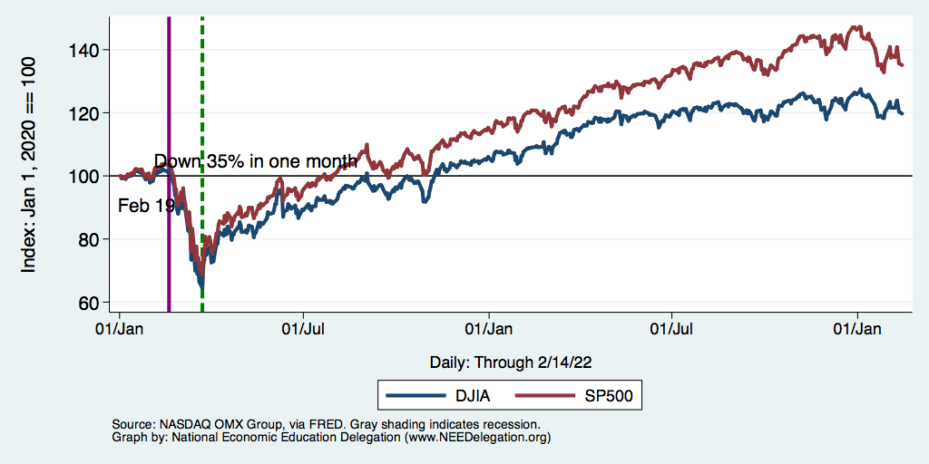
Stocks: Bounced Back Quicker This Time

Slide 14
Hot Topics
Government policy
Inflation
Great resignation

Slide 15
What Have Been Policy Effects?
MONETARY POLICY (Fed) acted quickly and effectively to prevent a financial market meltdown and to keep credit flowing. But the Fed lends and does not spend.
FISCAL POLICY (Congress) acted quickly, but inevitably made some mistakes.
Stimulus Checks, A ($268b)
Expanded Unemployment, B ($268b)
Paycheck Protection Program, C- ($525b)

Slide 16
NASDAQ: Then (Great Recession) and Now

Slide 17
Recovery Due to Immense Fiscal Stimulus and Control of COVID

Slide 18
Stimulus allowed Spending to Recover
But Note that Saving also went way up
Saving
Abnormally high Saving is over $2.8 trillion

Slide 19
Monetary Policy: Federal Reserve
Primary goal is to keep interest rates low, to facilitate continued borrowing.
Federal Funds Rate – rate at which banks lend to each other, usually overnight.
Purchases of U.S. Treasury securities – keep money flowing to the government at low rates of interest.

Slide 20
Federal Funds Rate – Last 5 Years
Notes:
The FOMC waited for labor market conditions to improve before raising the fed funds rate in late 2015.
FOMC currently working to normalize monetary policy by raising interest rates and reducing assets on its balance sheet
FedFunds_recent.png

Slide 21
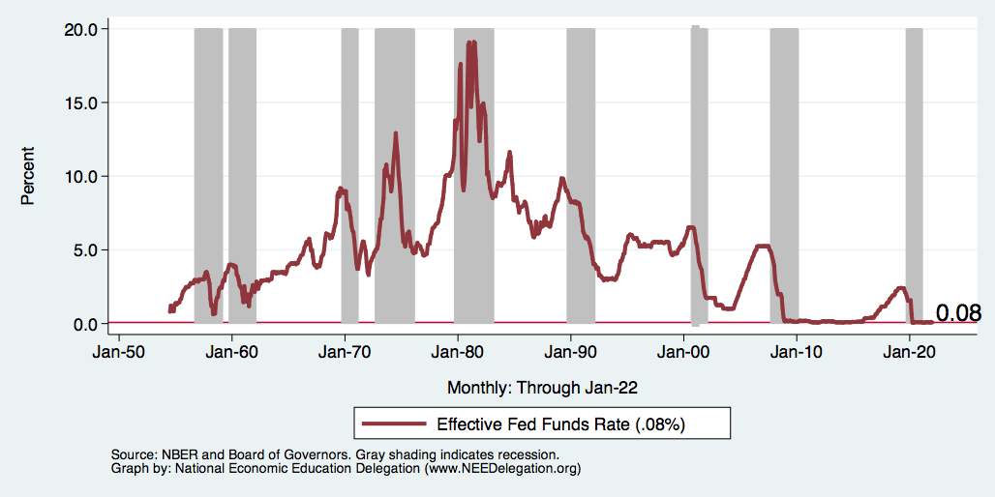
Federal Funds Rate
Notes:
The fed funds rate is the interest rate on overnight loans between banks. Think of it as the baseline interest rate on which banks base all other interest rates (e.g. mortgage rates)
FOMC lowers the fed funds rate during recessions and raises the fed funds rate during expansions
Fed funds rate peaked in the 1980s as then Chairman Paul Volcker sought to reign in “run away” inflation of the 1970s; doing so resulted in a recession in the early 1980s.
Since the 2008-09 recession, the fed funds rate has been kept near zero.
During the 2008-09 recession, Federal Reserve turned to unconventional tools to influence longer term interest rates to further stimulate the economy - QE
FedFunds.png

Slide 22
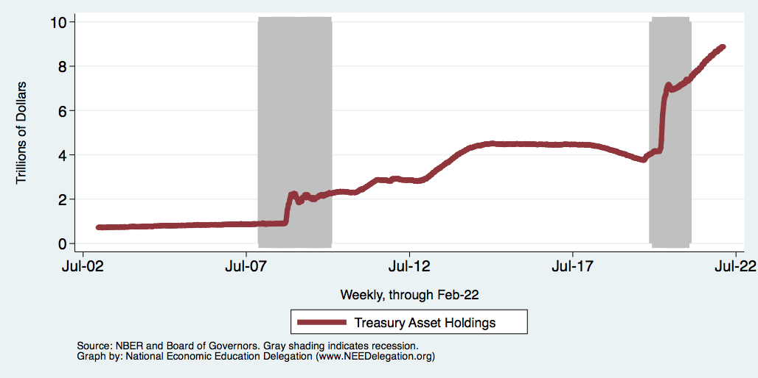
Federal Reserve Assets
8.8
Largely Treasury Securities
Pandemic
Financial Crisis
3.8
1.0
Notes:
The fed funds rate is the interest rate on overnight loans between banks. Think of it as the baseline interest rate on which banks base all other interest rates (e.g. mortgage rates)
FOMC lowers the fed funds rate during recessions and raises the fed funds rate during expansions
Fed funds rate peaked in the 1980s as then Chairman Paul Volcker sought to reign in “run away” inflation of the 1970s; doing so resulted in a recession in the early 1980s.
Since the 2008-09 recession, the fed funds rate has been kept near zero.
During the 2008-09 recession, Federal Reserve turned to unconventional tools to influence longer term interest rates to further stimulate the economy - QE
FedFunds.png

Slide 23
Inflation

Slide 24
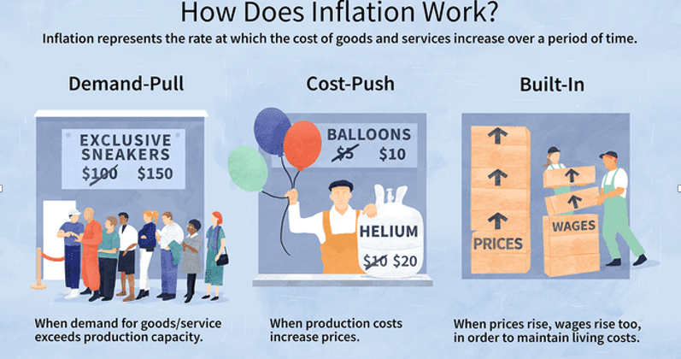
Source: Investopedia

Slide 25
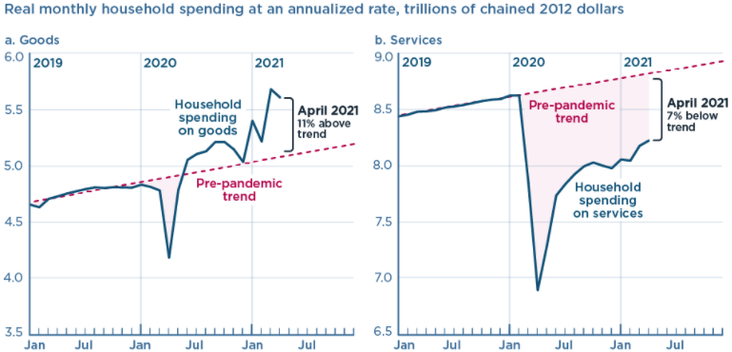
We’re Buying Mostly … Stuff
Demand-Pull
Source: Jason Furman, PIIE

Slide 26
Inflation: Concentrated
Cost-Push

Slide 27
Corporate Profits…Adding to Inflation?

Slide 28
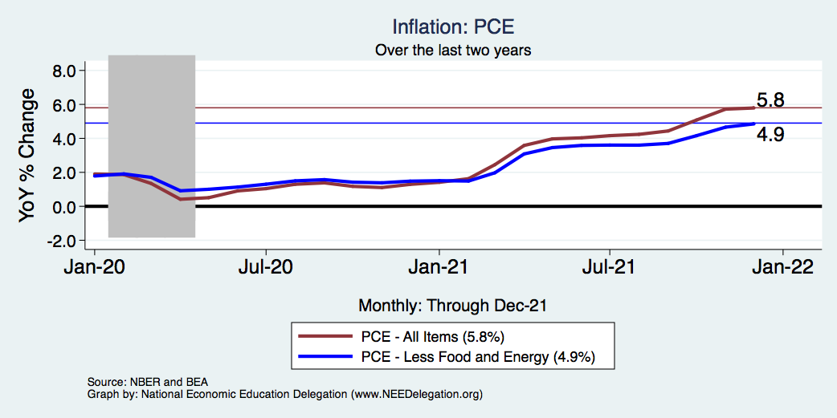
Inflation – The Fed’s Metric! Should we worry?
Notes:
Cpi_recent.png

Slide 29
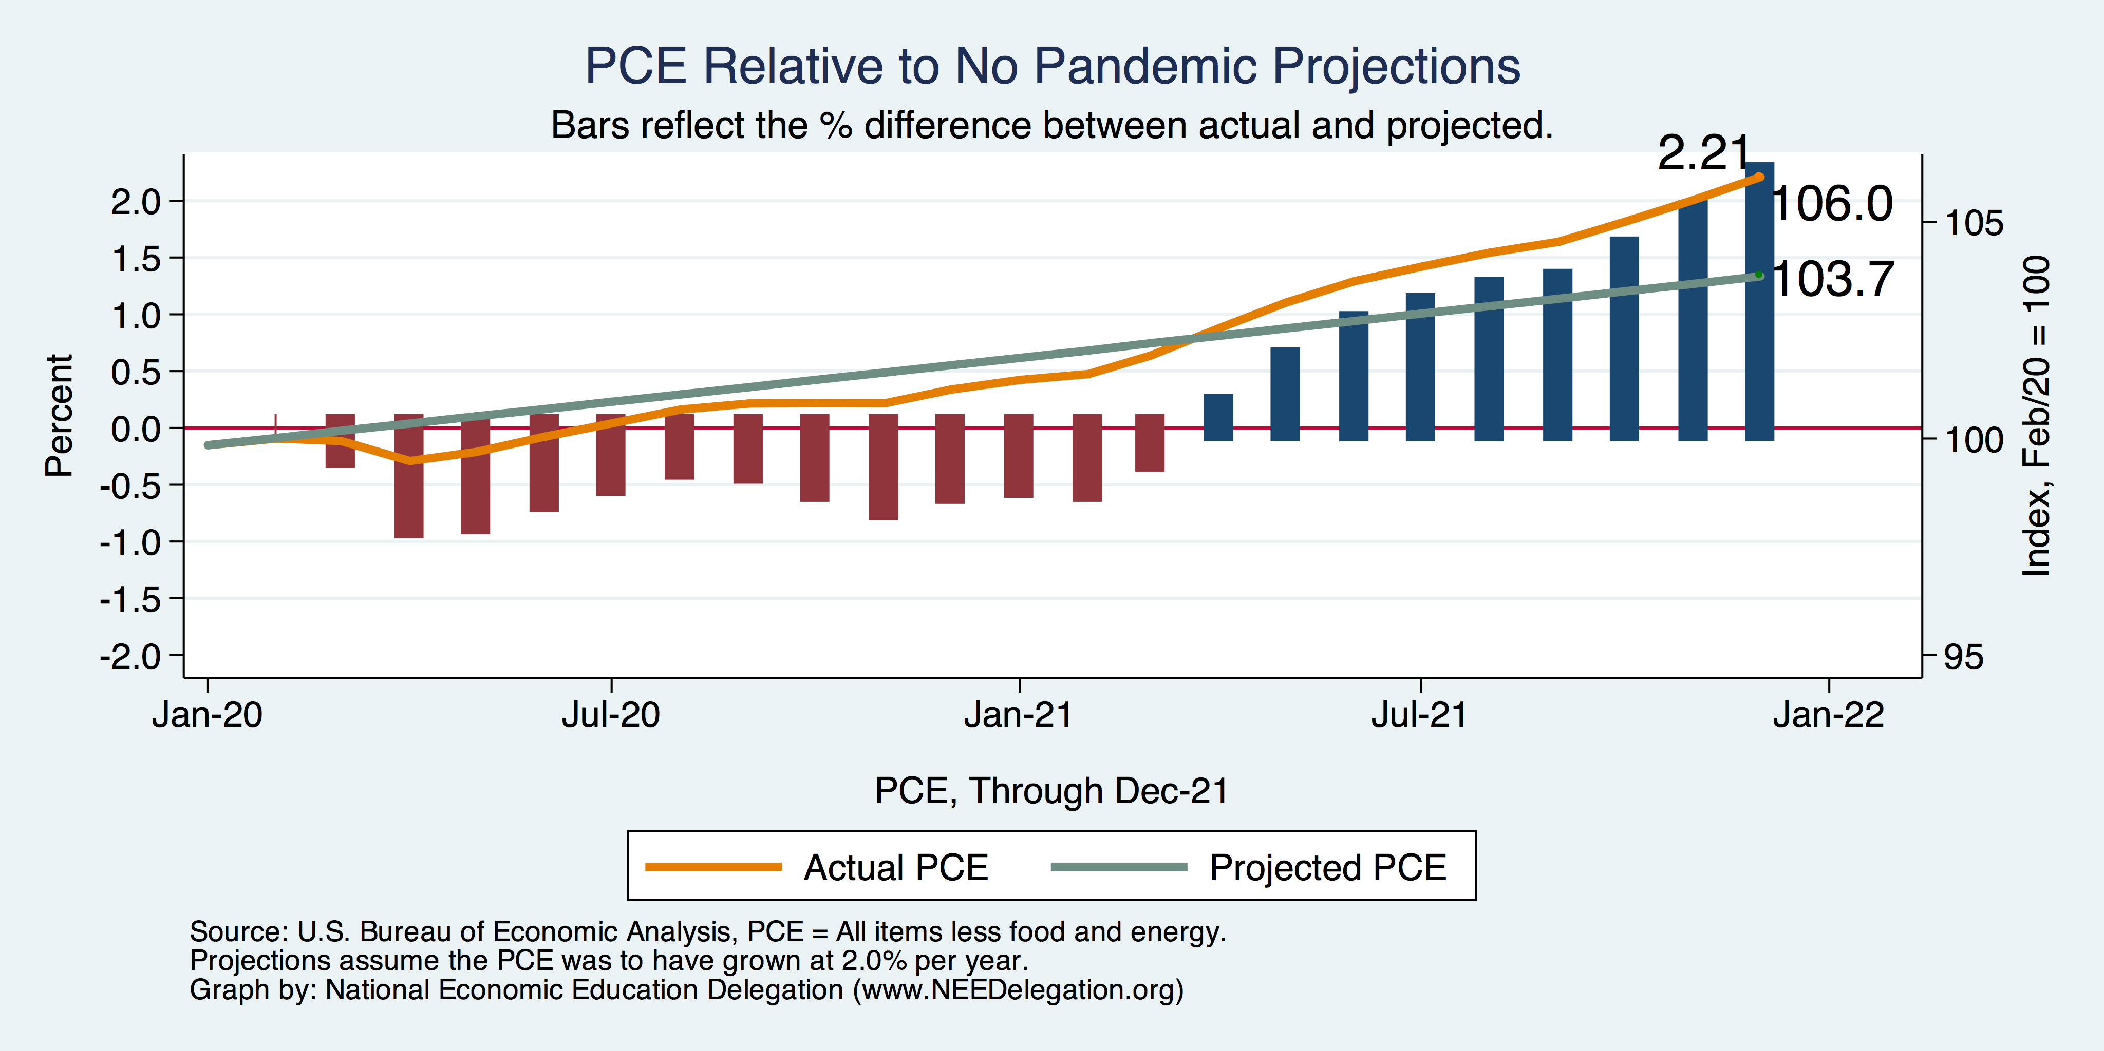
Inflation – PCE and Fed Suggest: I don’t know.
Notes:
Cpi_recent.png

Slide 30
The Great Resignation

Slide 31
Quits Are High! The Great Resignation

Slide 32
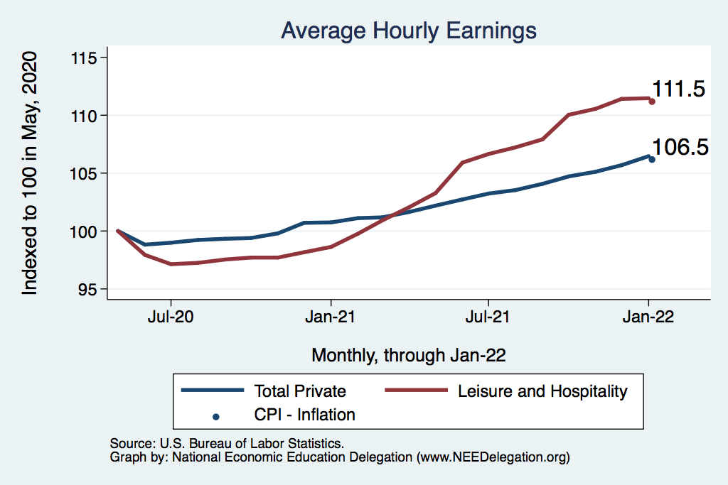
This is Happening Despite Rising Wages
Leisure & Hospitality
L&H wages rising
Not much faster
Than inflation
Total Nonfarm

Slide 33
Primary Topics Covered
GDP
Recovered the decline, but not where it should be.
Won’t recover previous forecast until late 2022.
Employment
Still down 8.0 million jobs relative to forecast. (1.9 million relative to Feb/20).
Labor force is 0.9 million smaller than at the beginning of the pandemic.
Rising wages may be enticing low-wage workers back to work.
Inflation
Going to be high for a while, but transitory – maybe?

Slide 34
Conclusion
Recovery is well underway, but may be slowing.
GDP expanded by 5.7% percent in 2021, 3-4% in 2022.
2021 was an odd year.
Workers attained the upper hand.
Supply chains broke.
Inflation surged.
The economy rebuilt itself.
Biggest problems:
Supply chain bottlenecks.
Labor force participation.

Slide 35
Where Are We Headed?
At best, back to where we were before the pandemic.
Economic growth of ~2%/year.
Low interest rates.
Inflation back in the 2% range.
How long is it going to take to get there and what will we endure?
Entirely speculation.
Could be 5 years before we are back to equilibrium. NOT back to normal.
Next year: elevated inflation and interest rates.
2023: GDP growth relatively slow, but perhaps greater than recent averages.

Slide 36
Available NEED Topics Include:
Coronavirus Economics
US Economy
Climate Change
Economic Inequality
Economic Mobility
Trade and Globalization
Minimum Wages
Immigration Economics
Housing Policy
Federal Budgets
Federal Debt
Black-White Wealth Gap
Autonomous Vehicles
US Social Policy

Slide 37
Thank you!
Any Questions?
www.NEEDelegation.org
Jon D. Haveman
Jon@NEEDelegation.org
Contact NEED: info@NEEDelegation.org
Submit a testimonial: www.NEEDelegation.org/testimonials.php
Become a Friend of NEED: www.NEEDelegation.org/friend.php

