Slide 1
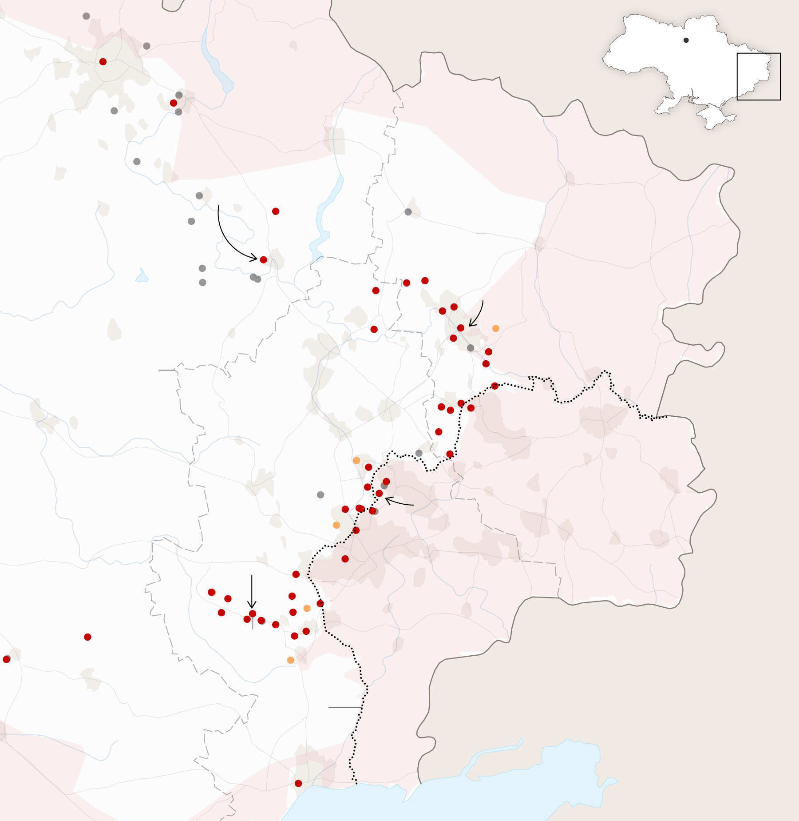
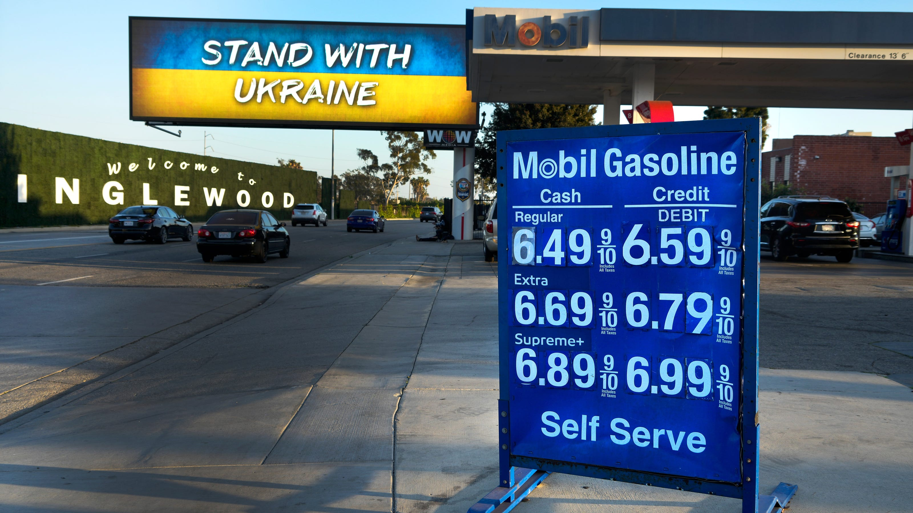
US Economy and
Russia/Ukraine Conflict
California Community Colleges Real Estate Education Center
Jon Haveman, Ph.D.
National Economic Education Delegation
April 22, 2022

Slide 2
National Economic Education Delegation
Vision
  One day, the public discussion of policy issues will be grounded in an accurate perception of the underlying economic principles and data.
Mission
  NEED unites the skills and knowledge of a vast network of professional economists to promote understanding of the economics of policy issues in the United States.
NEED Presentations
  Are nonpartisan and intended to reflect the consensus of the economics profession.

Slide 3
Who Are We?
Honorary Board: 54 members
  2 Fed Chairs: Janet Yellen, Ben Bernanke
  6 Chairs Council of Economic Advisers
    Furman (D), Rosen (R), Bernanke (R), Yellen (D), Tyson (D), Goolsbee (D)
  3 Nobel Prize Winners
    Akerlof, Smith, Maskin
Delegates: 651+ members
  At all levels of academia and some in government service
  All have a Ph.D. in economics
  Crowdsource slide decks
  Give presentations
Global Partners: 49 Ph.D. Economists
  Aid in slide deck development

Slide 4


Where Are We?

Slide 5
Available NEED Topics Include:
Coronavirus Economics
US Economy
Climate Change
Economic Inequality
Economic Mobility
Trade and Globalization
Minimum Wages
Immigration Economics
Housing Policy
Federal Budgets
Federal Debt
Black-White Wealth Gap
Autonomous Vehicles
US Social Policy

Slide 6
Outline
State of the pandemic
The U.S. Economy
Inflation
Russia/Ukraine
Housing Markets

Slide 7
State of the Pandemic

Slide 8
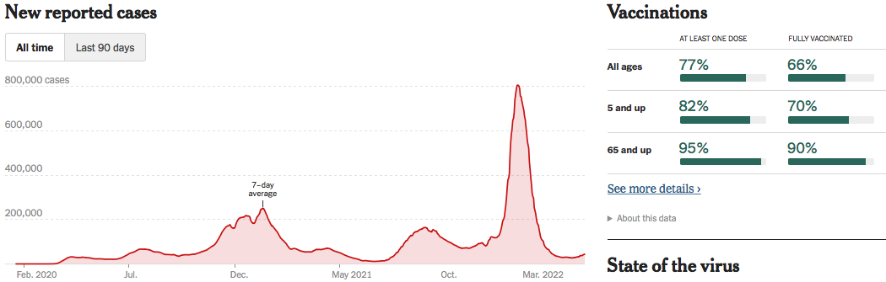
Making Real Progress!
Nationally
Source: NYTimes

Slide 9
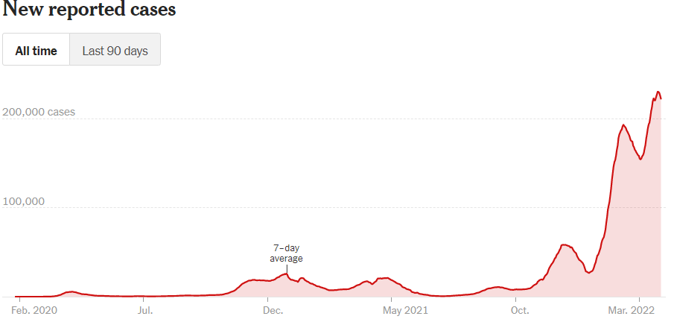
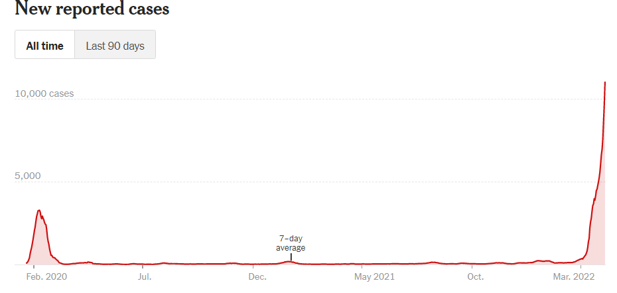
Omicron BA.2 ? Germany and China
Germany
China
Source: New York Times, April 3, 2022

Slide 10
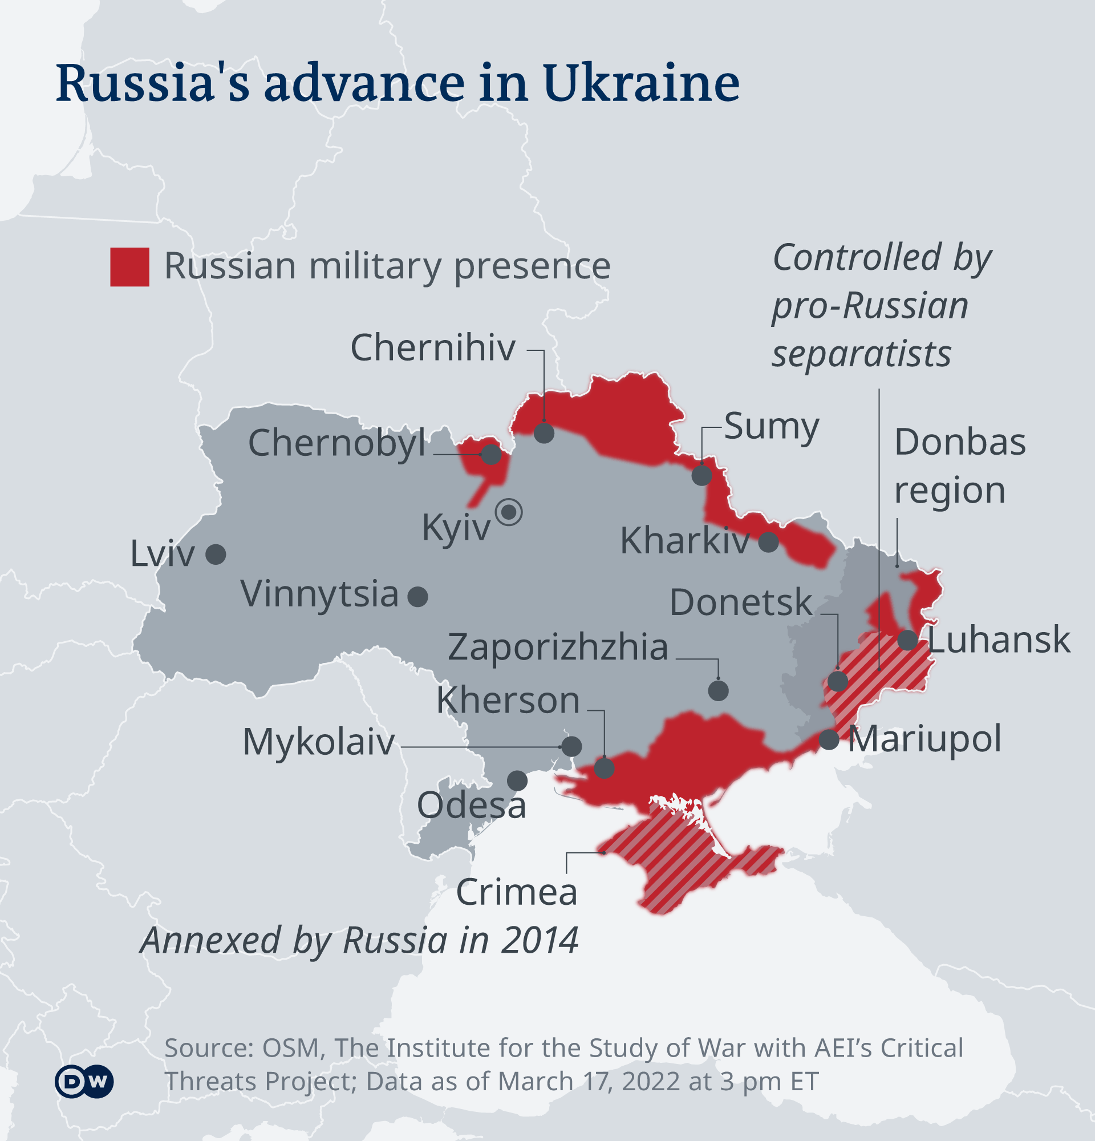
and then – the Russian invasion of Ukraine

Slide 11
The U.S. Economy
The Role of the Pandemic versus Policy Adjustments? And what now?

Slide 12
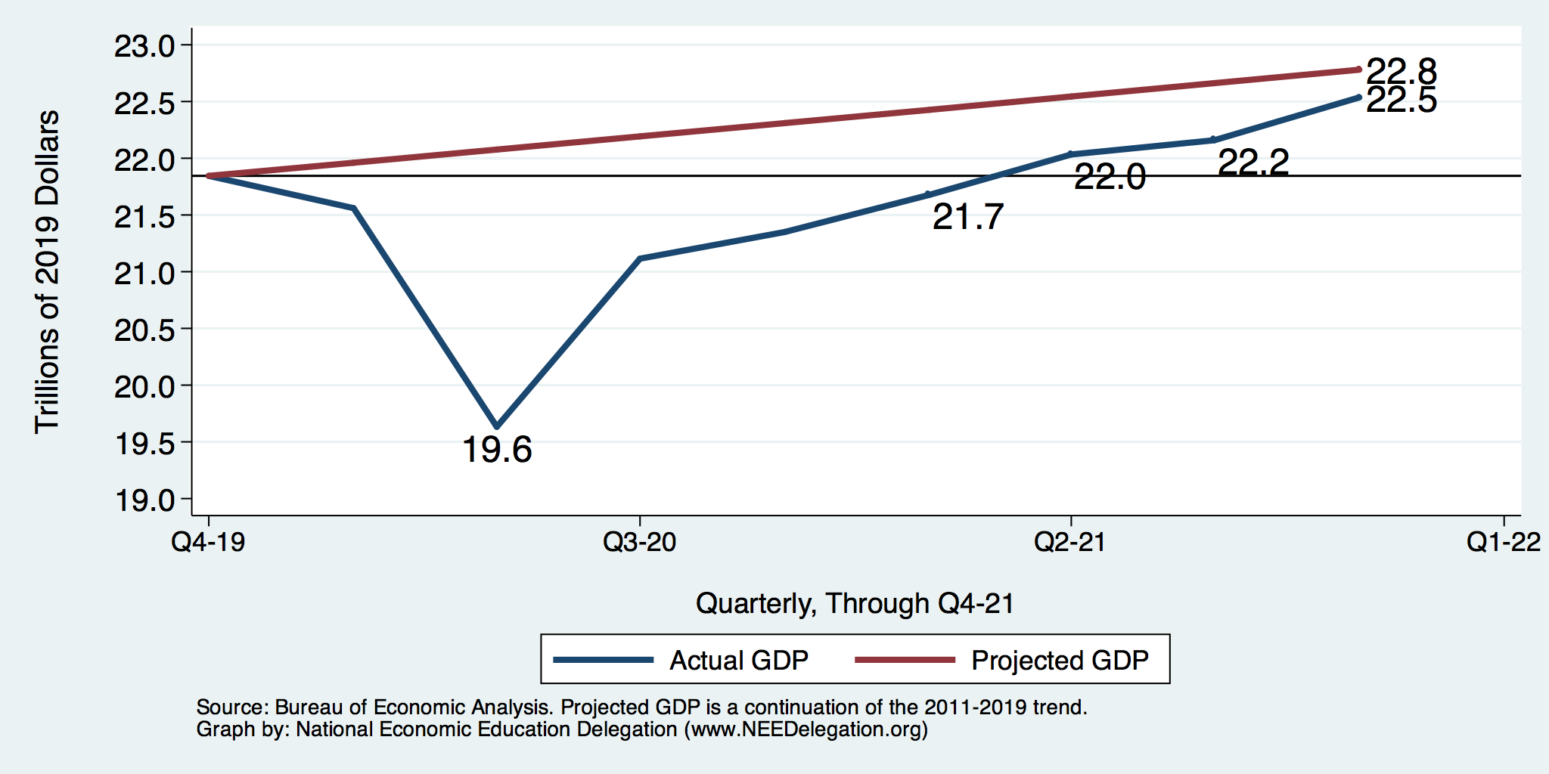
GDP Trajectory: Pandemic Plunge!
GDP is:
$0.3 Trillion below 2019 forecast.
$0.7 Trillion ABOVE 2019-Q4 level.

Slide 13
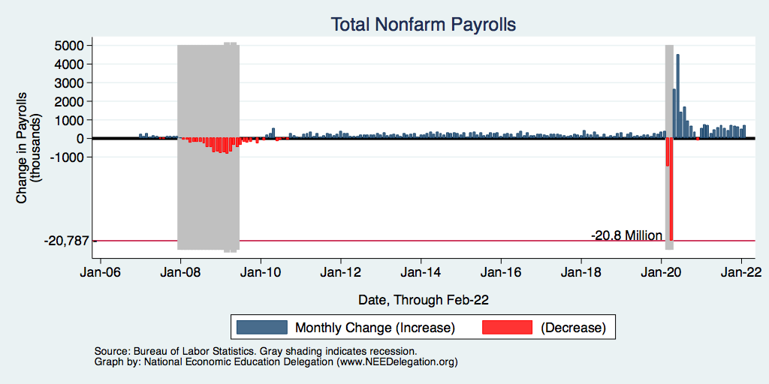
Monthly Changes in Nonfarm Employment
Notes:
PAYEMS.png

Slide 14
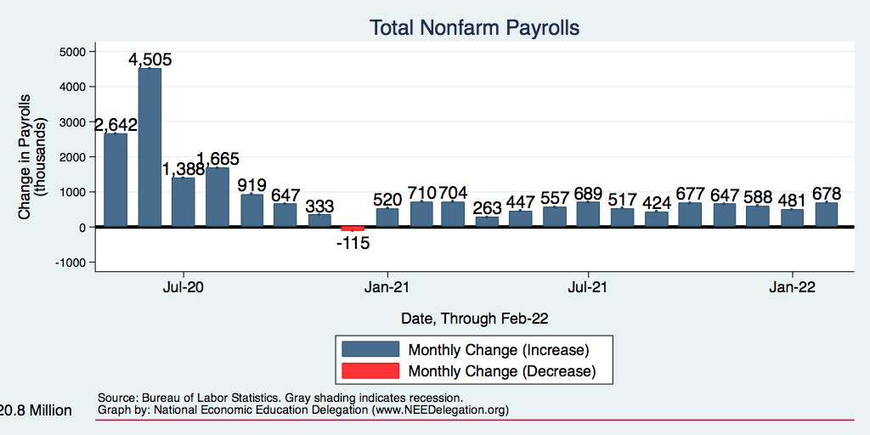
Monthly Changes in Nonfarm Employment
Recovery?
Recovery
Delta
Omicron
Notes:
PAYEMS.png

Slide 15
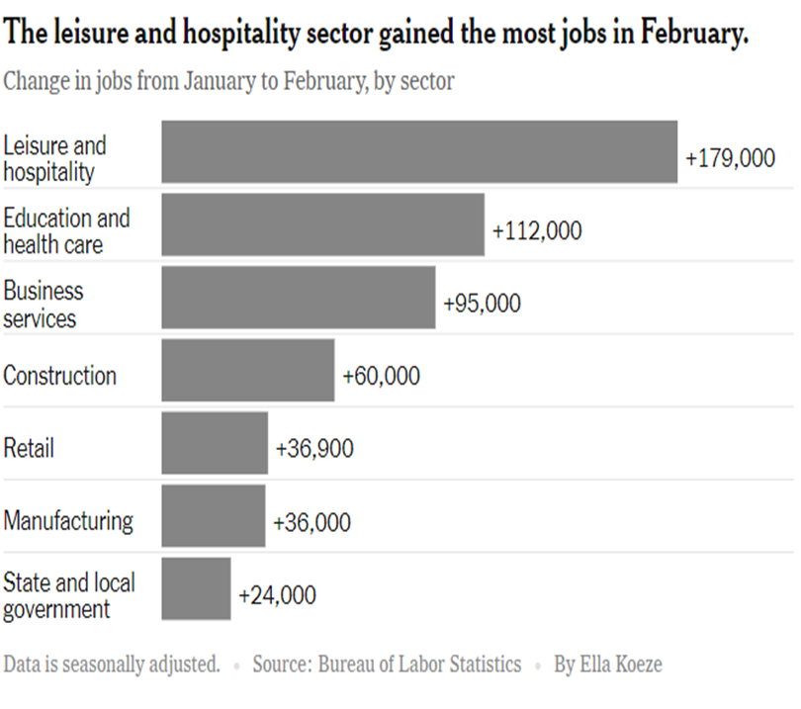
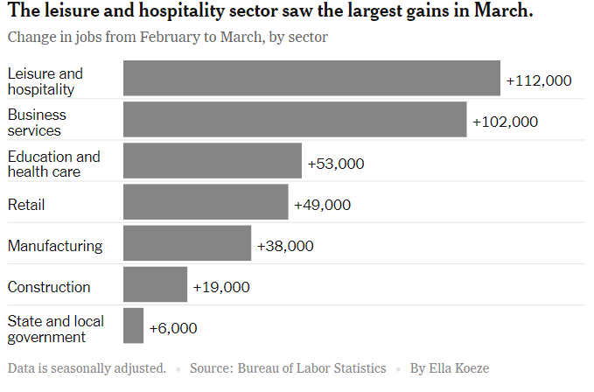
Employment Changes - US
Source: New York Times

Slide 16
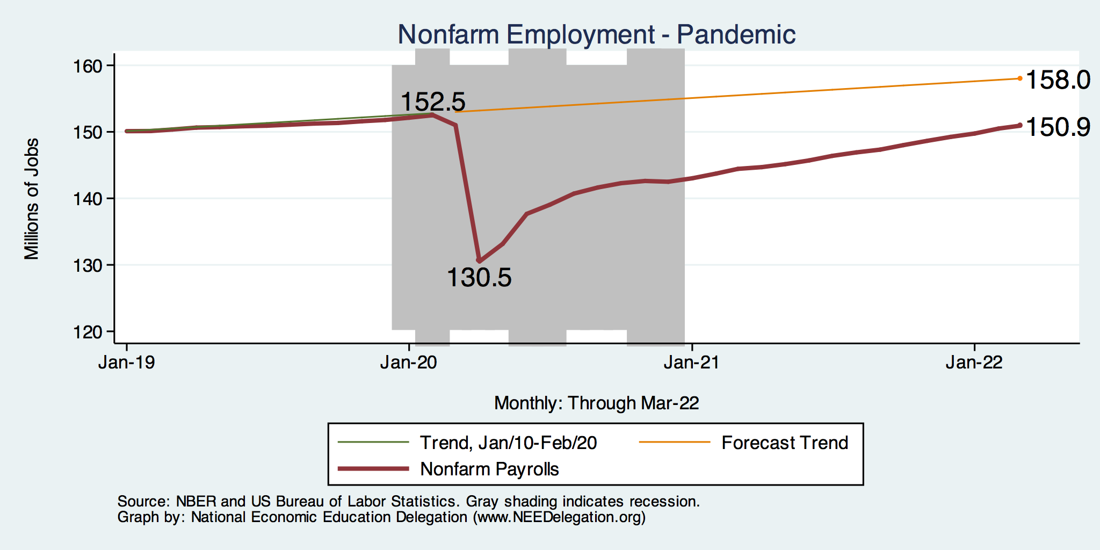
Employment Gap
1.6 Million below February, 2020.
7.1 Million below where we should be.
Notes:
payroll_recent.png

Slide 17
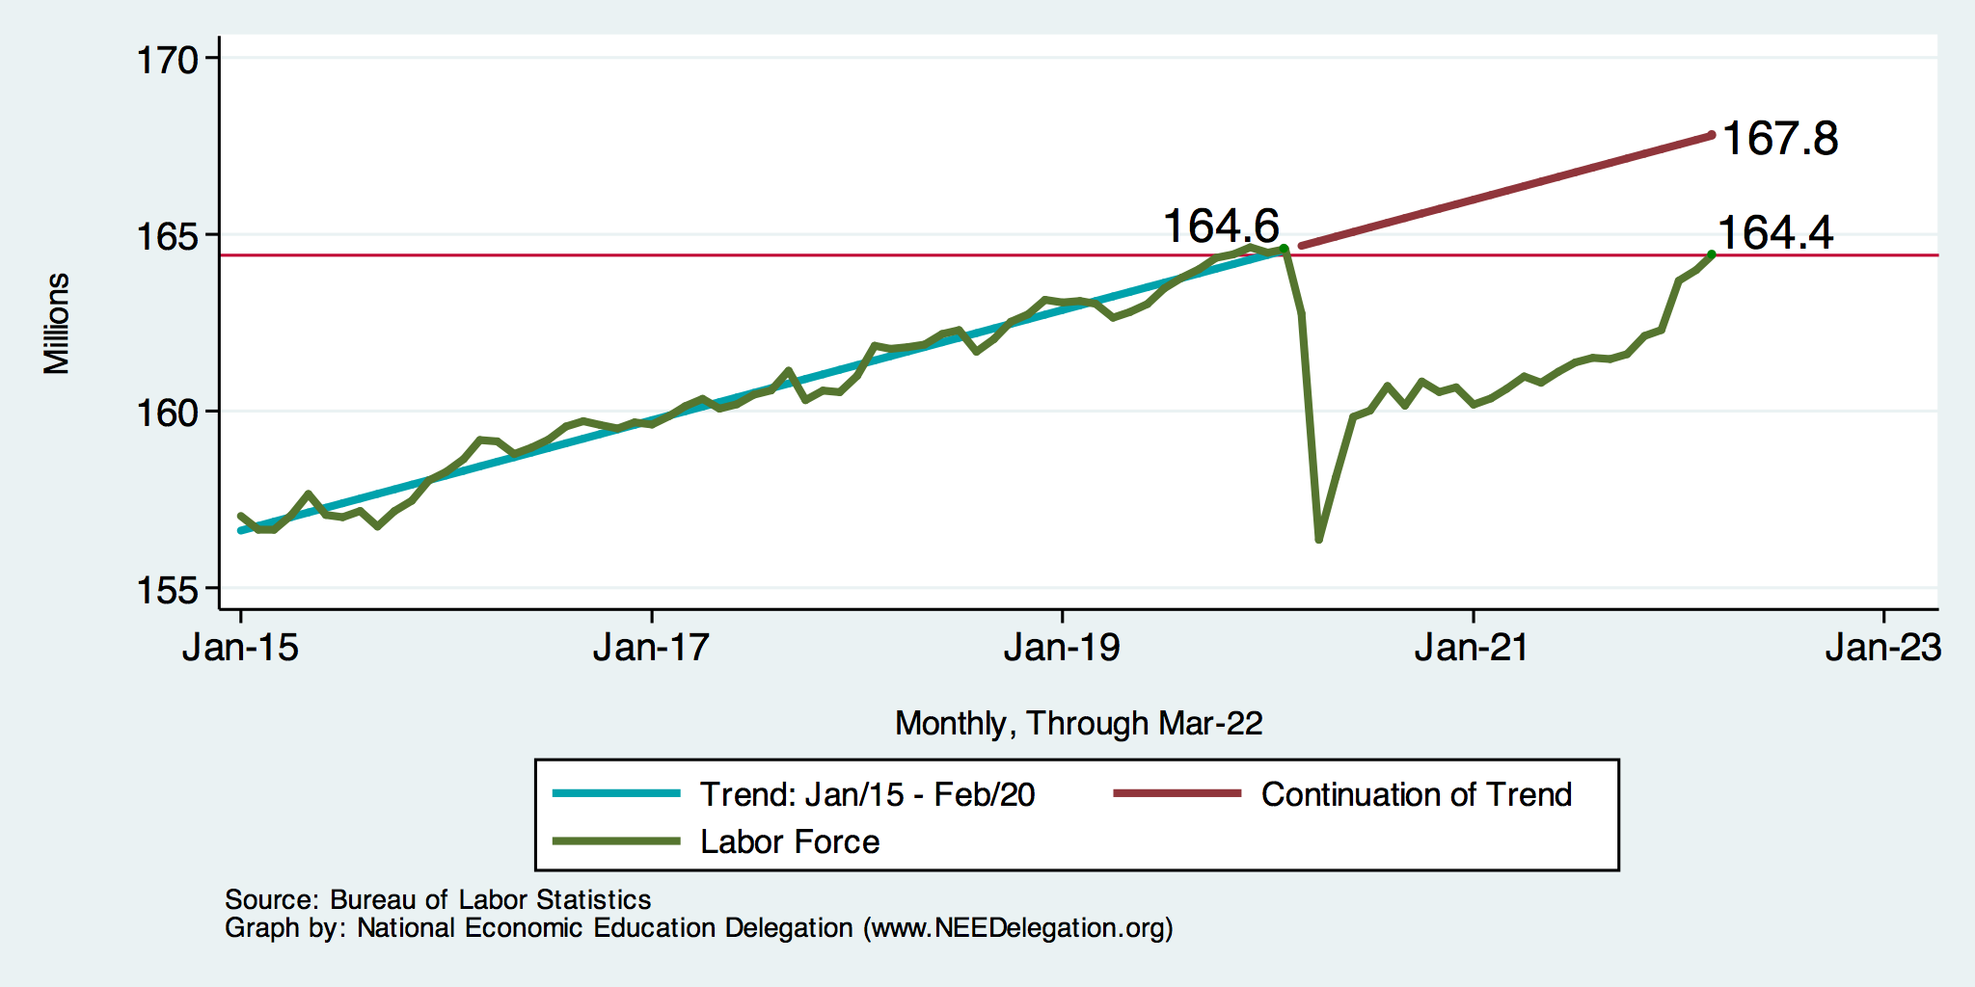
Trends in Labor Force Participation
0.2 Million below February, 2020.
3.4 Million below where we should be.
Notes:
CLF16OV.png

Slide 18
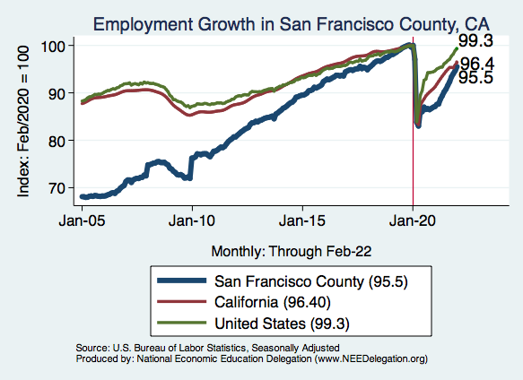
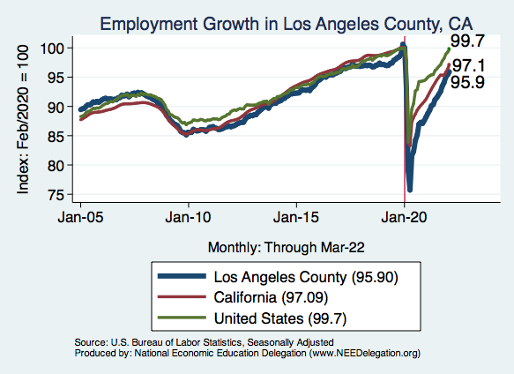
Labor Market Experiences: Employment

Slide 19
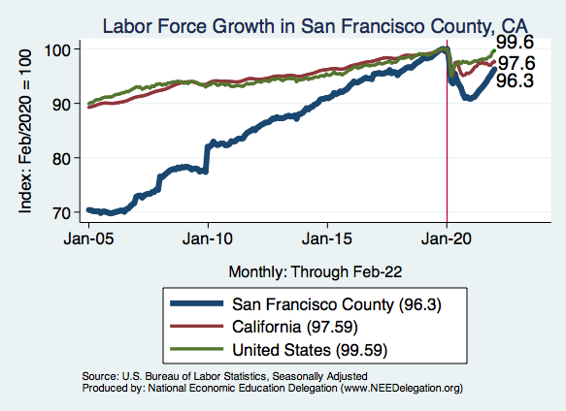
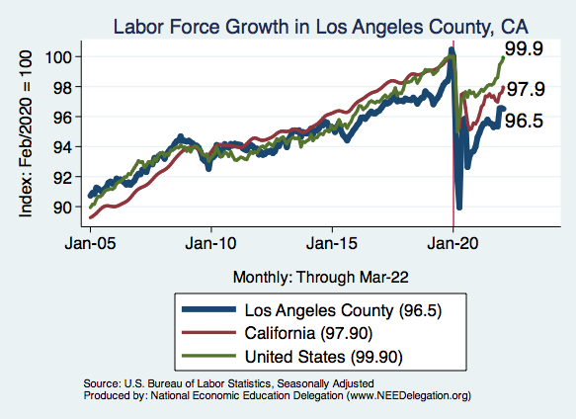
Labor Market Experiences: Labor Force

Slide 20
www.NEEDelegation.org/LocalGraphs
For every state and county in the United States.
Detailed graphs on employment, housing, moves, and other statistics.

Slide 21
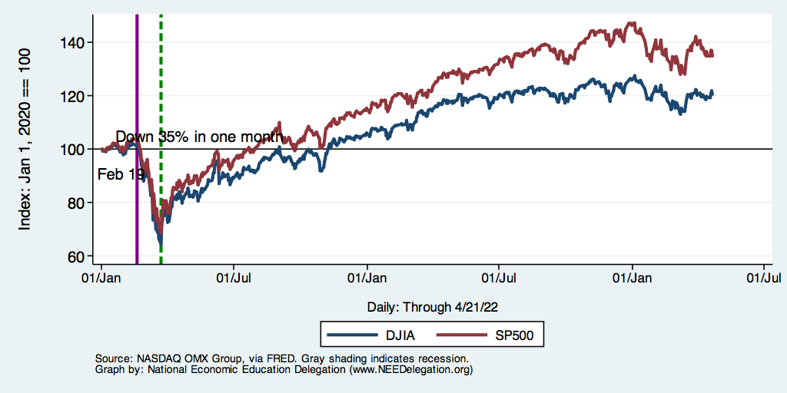
Stocks: Jittery
Interest rates, inflation, Ukraine….oh my!

Slide 22
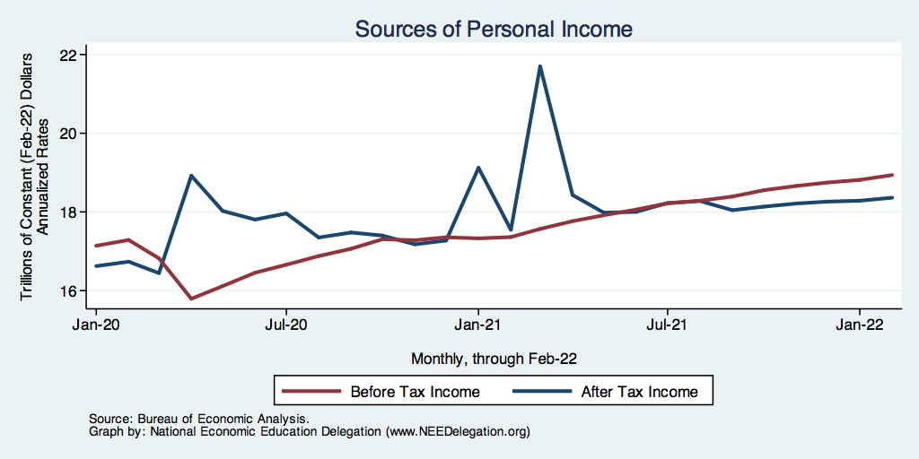
Fiscally Driven Recovery

Slide 23
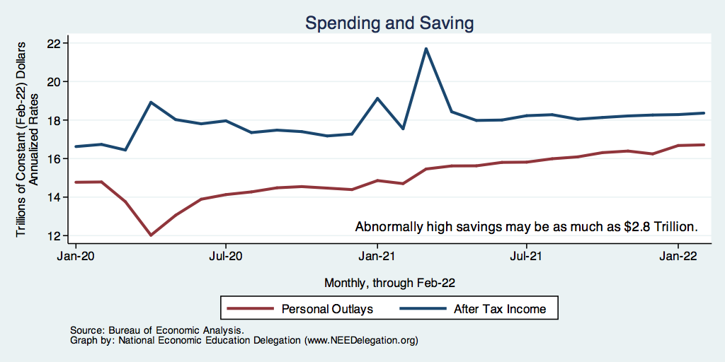
Households Lead the Way
Saving

Slide 24
Overall Households Are Doing Well

Slide 25
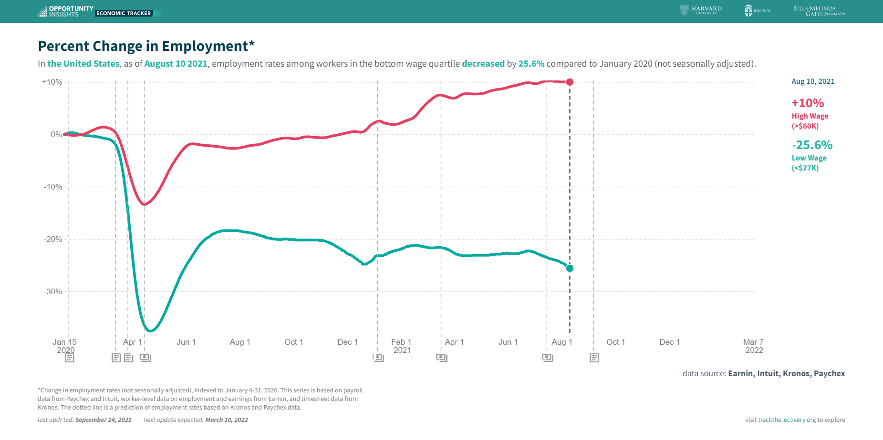
K-Shaped Recovery

Slide 26
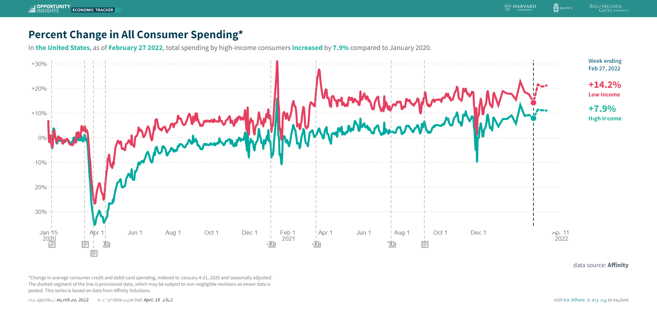
Stimulus Payments Saved Low Income Families

Slide 27
Inflation

Slide 28
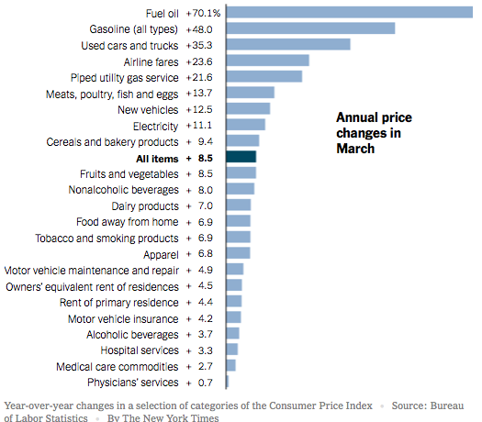
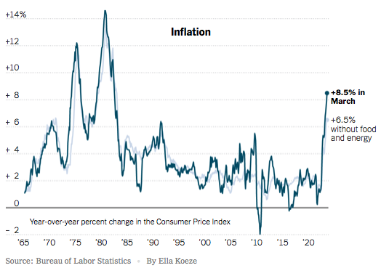
Inflation News
January 2022
Source: New York Times, Wall Street Journal
Notes:
Why CPI overestimates or underestimates inflation – COVID CPI should reflect a change in purchases. Covid CPI 6.54%

Slide 29
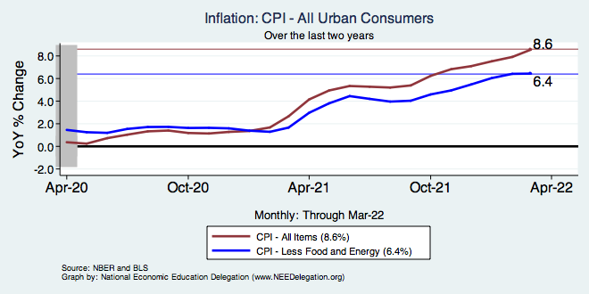
Food and Fuel are A Big Part of the Story

Slide 30
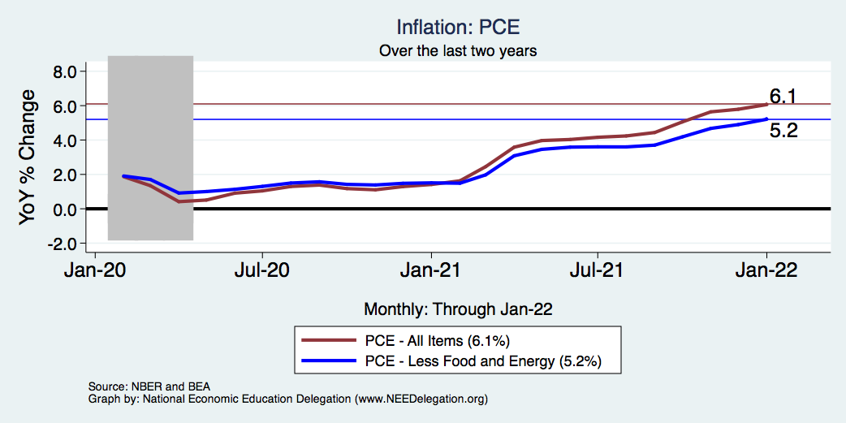
Inflation – The Fed’s Metric! Not Sooo High.
Notes:
Cpi_recent.png

Slide 31
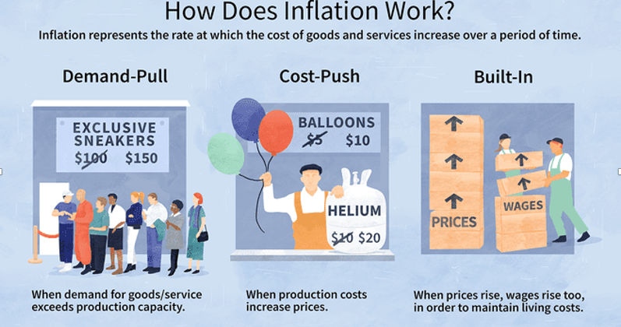
Source: Investopedia

Slide 32
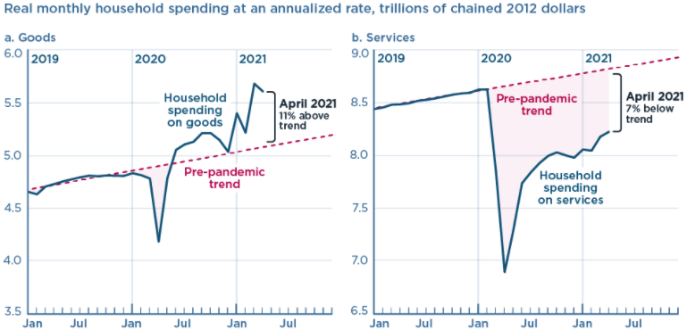
We’re Buying Mostly … Stuff
Demand-Pull
Source: Jason Furman, PIIE

Slide 33
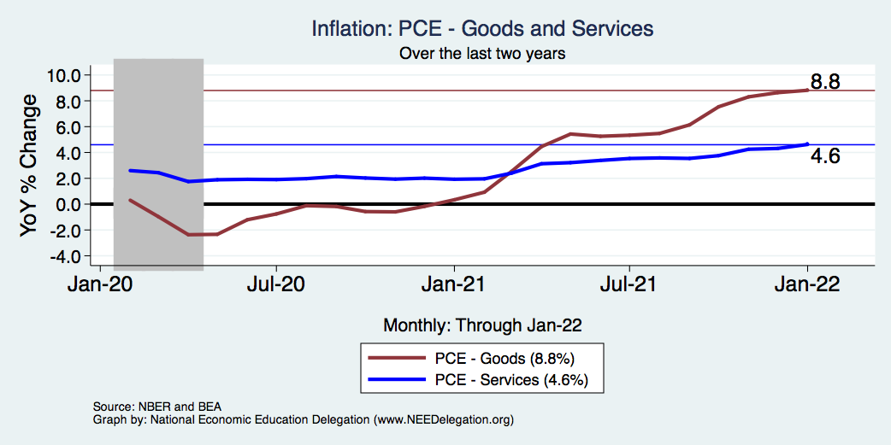
Goods are Driving Inflation

Slide 34
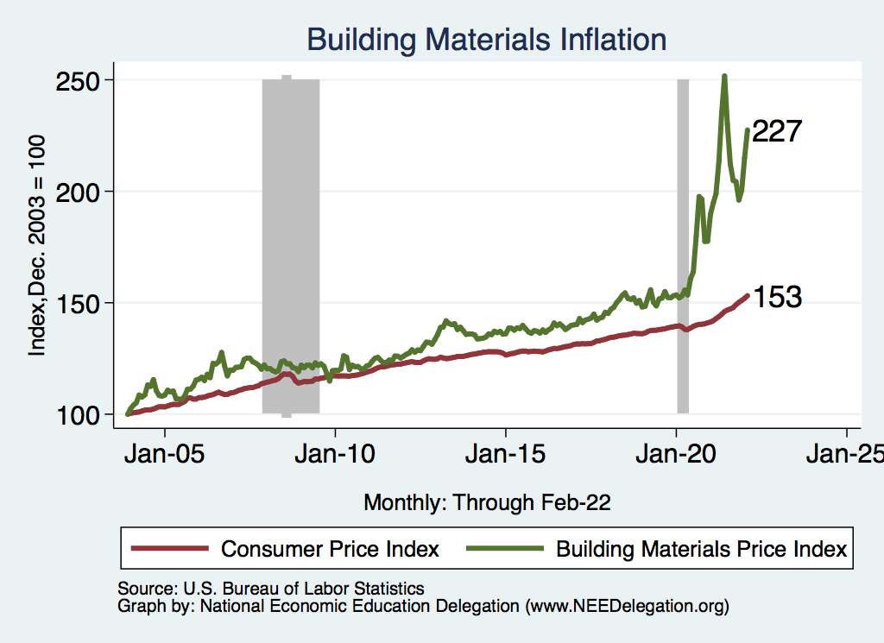
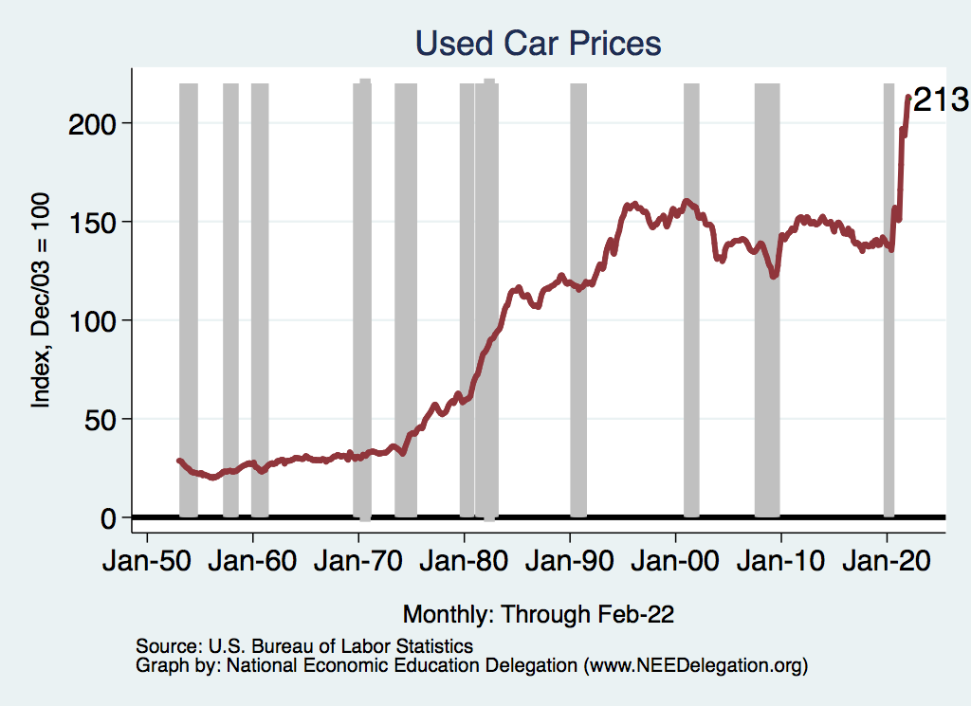
Inflation: Concentrated
Cost-Push

Slide 35
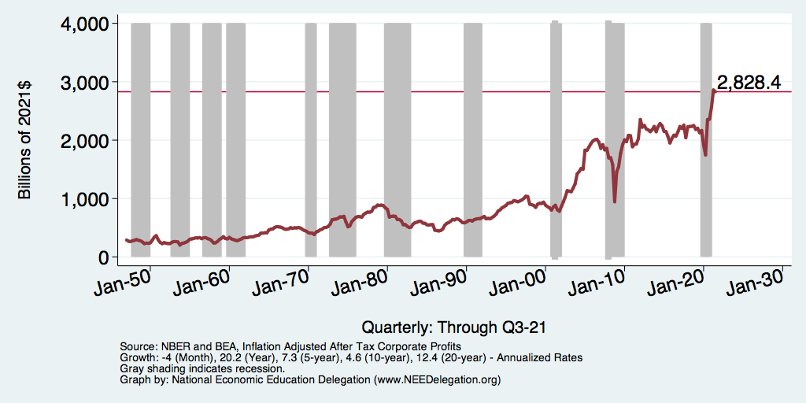
Corporate Profits…Adding to Inflation?

Slide 36
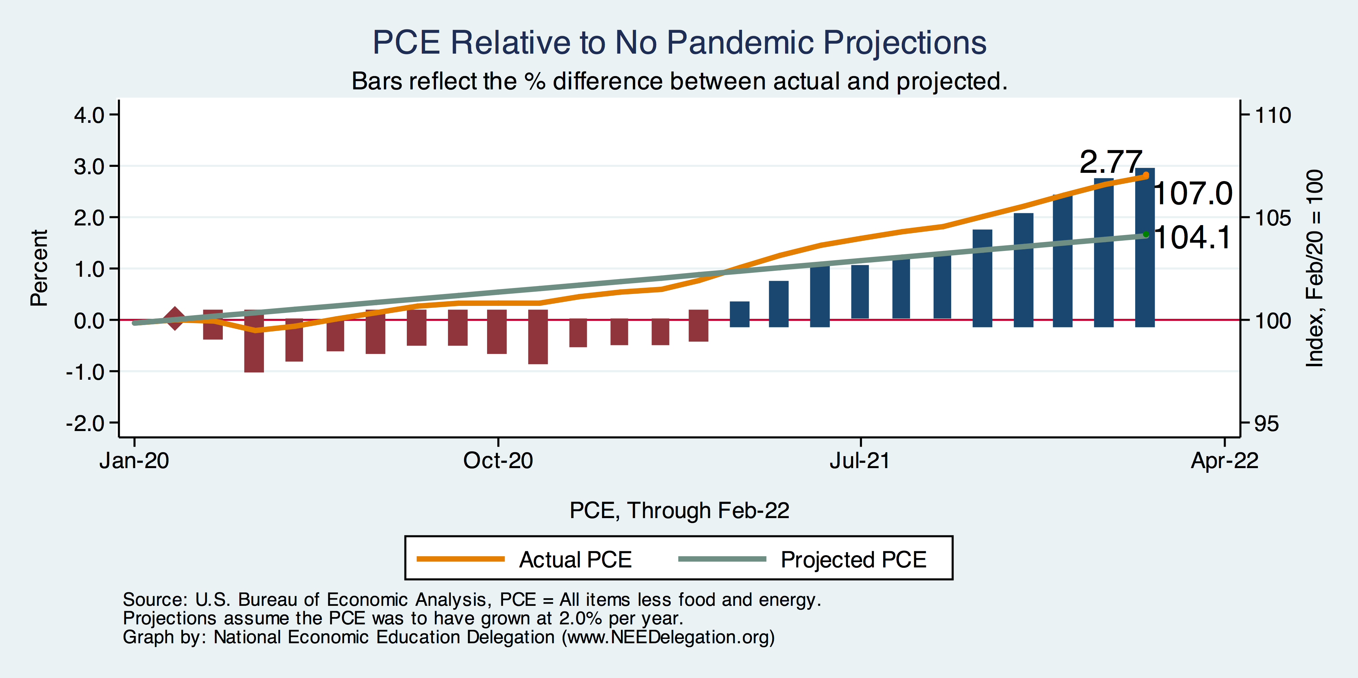
Inflation – PCE and Fed Suggest: I don’t know.
Notes:
Cpi_recent.png

Slide 37
This Inflation is Different!
12-month, percentage price increase, selected items in the CPI
Category: | Weight in CPI, 2022 | December 1981 | March 2022
All Items | 100% | 8.9 | 8.5
Services | 60.6 | 13.0 | 5.4
Commodities | 39.3 | 6.0 | 15.0
Housing | 42.2 | 10.2 | 6.8
Transportation | 18.3 | 11.0 | 23.2
Food | 14.3 | 4.3 | 8.5
Medical Care | 8.4 | 12.5 | 2.9
Energy | 7.5 | 11.9 | 33.3
Used Cars | 4.2 | 20.3 | 31.4
Sources: BLS and Fred data from the St Louis Federal Reserve Bank

Slide 38
My Diagnosis for the Uptick in Inflation
Yes, there were supply chain issues that affected some areas in particular (e.g., computer chips).
But there is too much total spending and in the absence of bold Fed actions is likely to continue.
Fiscal stimulus led households to increase saving over 2021 by more than $2 trillion and Monday’s strong retail sales numbers suggest they are prepared to spend it.
Whose to Blame: ARP probably too big, but the Fed could have acted sooner.

Slide 39
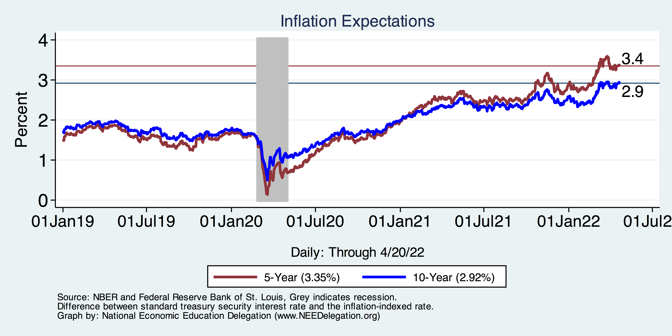
Measure of Inflation Expectations
Breakeven Inflation Rate = Difference between
nominal and real 5-year and 10-year Treasury
constant maturity securities.
Market participants expect around 2.9%
of inflation annually over the next 10 years and
3.4% over the next 5 years.
Inflation expectations are calming down.

Slide 40
So Far Inflationary Expectations Look Stable
Professional forecasters, financial markets and the Fed itself think that inflation in 2023 will be in the 2.5-3.3%, range
Good Luck with these Forecasts!

Slide 41
Russia/Ukraine(/Belarus)

Slide 42
Consequences for the Global Economy
Primarily:
  Oil
  Wheat
Why?
  Major suppliers of each
    29% of world wheat production
    20-40% of Europe’s oil and gas
    Russia part of OPEC+
  Russian and Ukranian combined economies are small.
    Don’t forget Belarus.

Slide 43
The Conflict in Ukraine and the US Economy
Short run
  Uncertainty
  Recession?
  Increase in cost of food and fuel
Long run
  Decrease in globalization

Slide 44
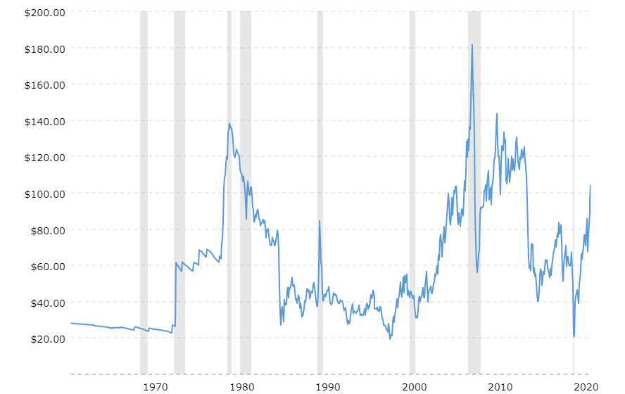
Supply Shocks: Then and Now
Historical Oil Price adjusted for Inflation
Source: macrotrends.net

Slide 45
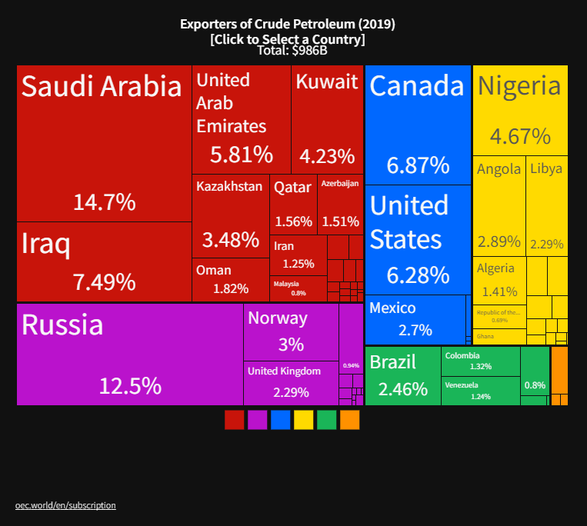
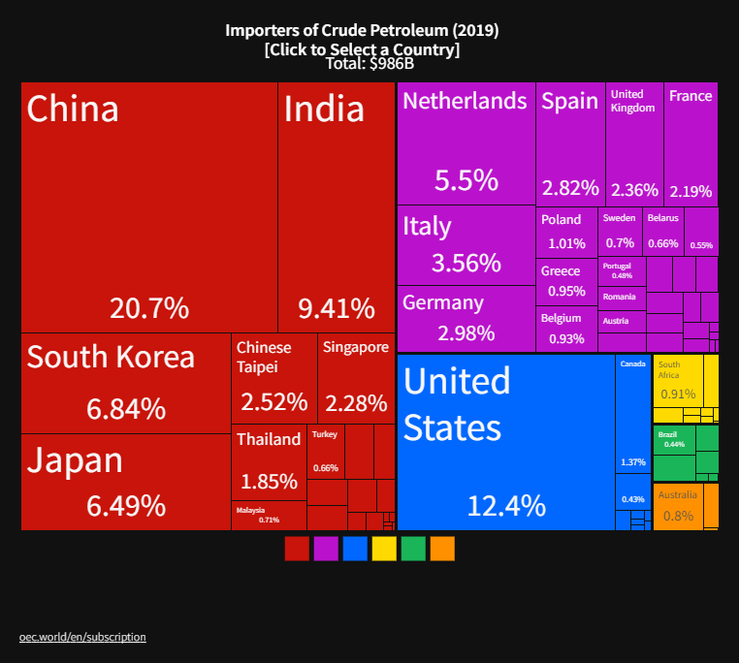
The Price of Oil is Likely to Rise (further)
Winners
Losers
Notes:
Since 2019 US has become a net exporter of oil

Slide 46
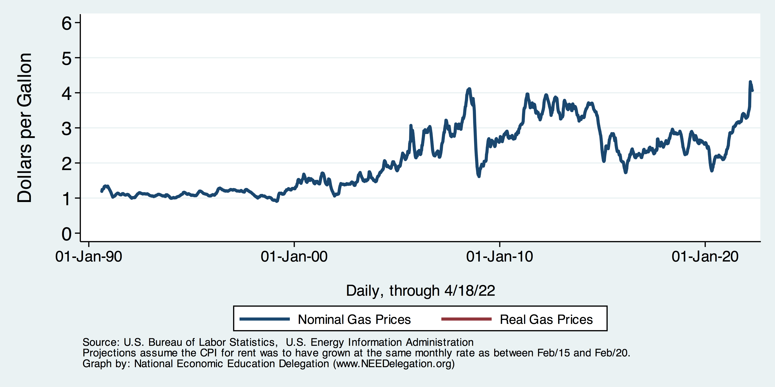
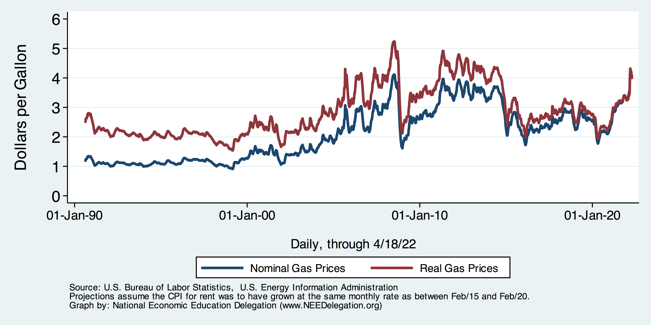
Gas Prices at the Pump

Slide 47
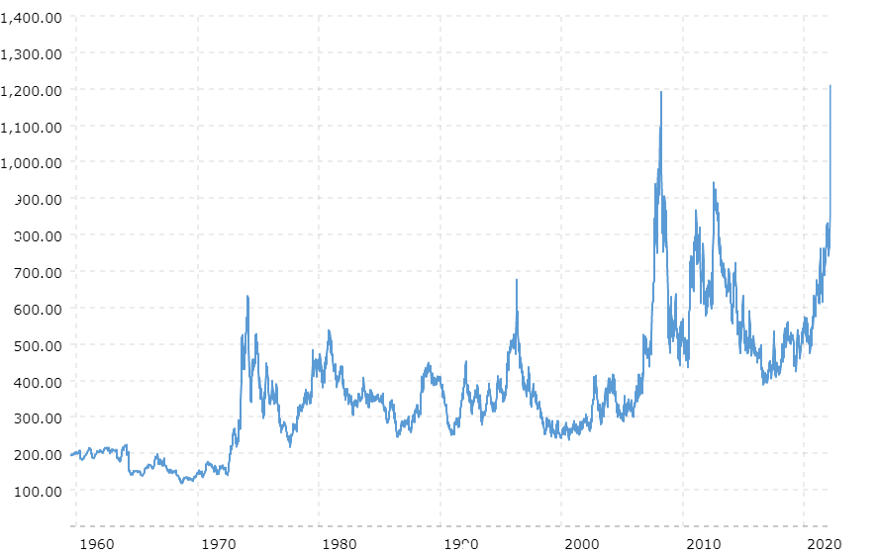
Wheat Prices Also Look Scary
Wheat Futures Prices
NOT Adjusted for inflation
Source: Macrotrends.net

Slide 48
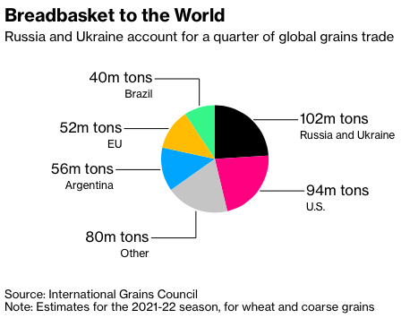
Grains
Notes:
https://www.bloomberg.com/news/articles/2022-03-02/wheat-soars-above-10-as-russia-invasion-stifles-black-sea-trade

Slide 49
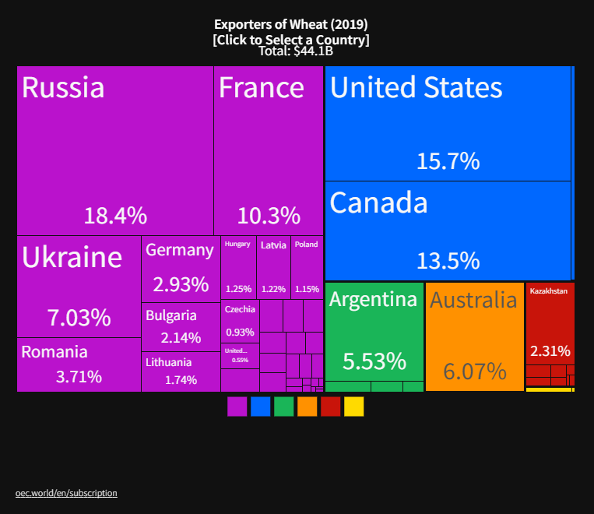
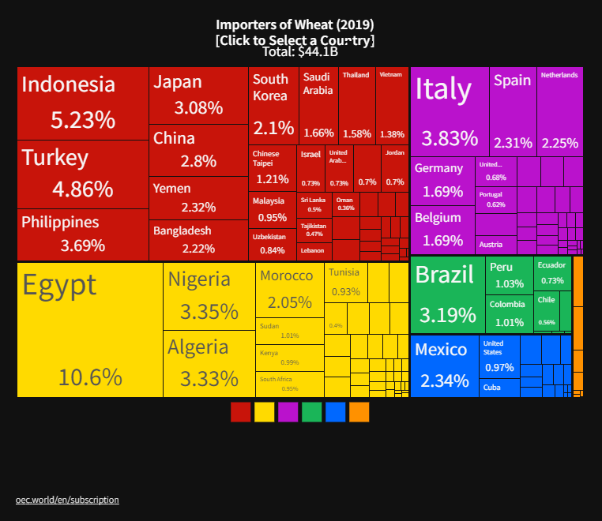
The Price of Wheat: Winners and Losers
Winners
Losers

Slide 50
Oh, and…
40% of the world’s PALLADIUM comes from Russia.
  Used in catalytic convertors.
70% of the world’s NEON comes from Ukraine.
  Used in production of semiconductors.
Fertilizer: Russia is the world’s largest supplier.
  Prices are 3-4x their 2020 levels.
Therefore: more supply chain issues, more inflation, food insecurity.

Slide 51
Real Estate

Slide 52
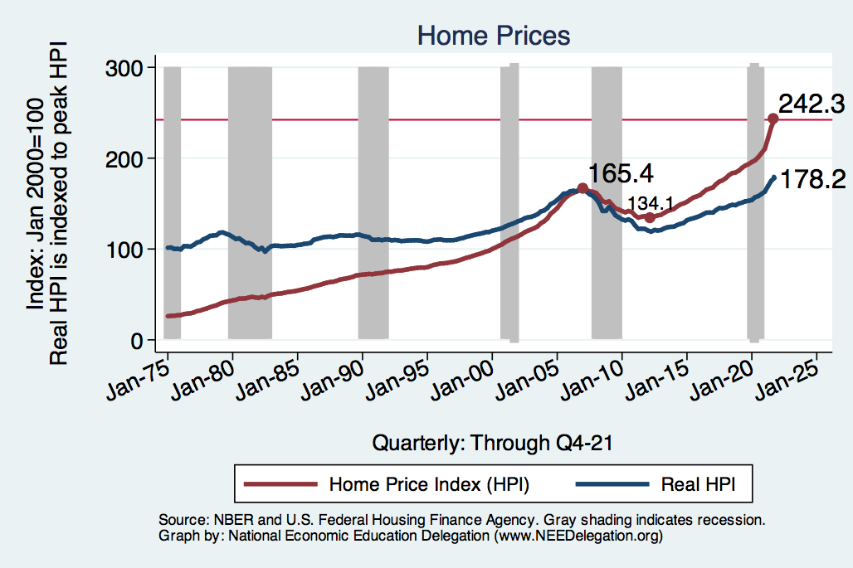
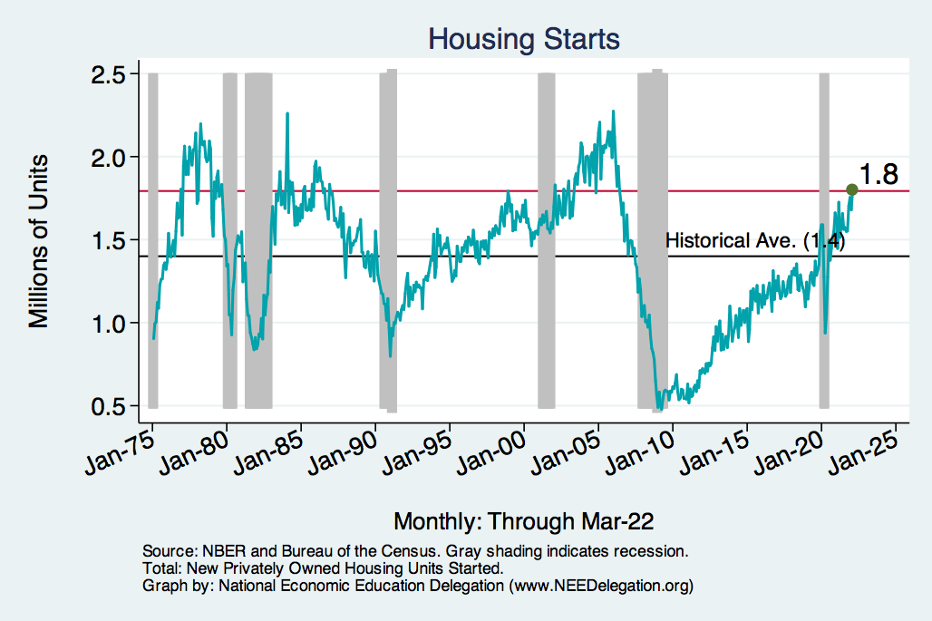
Home Prices and Housing Starts
Notes:
Charts:
homeprices_recession.png
housing.png

Slide 53
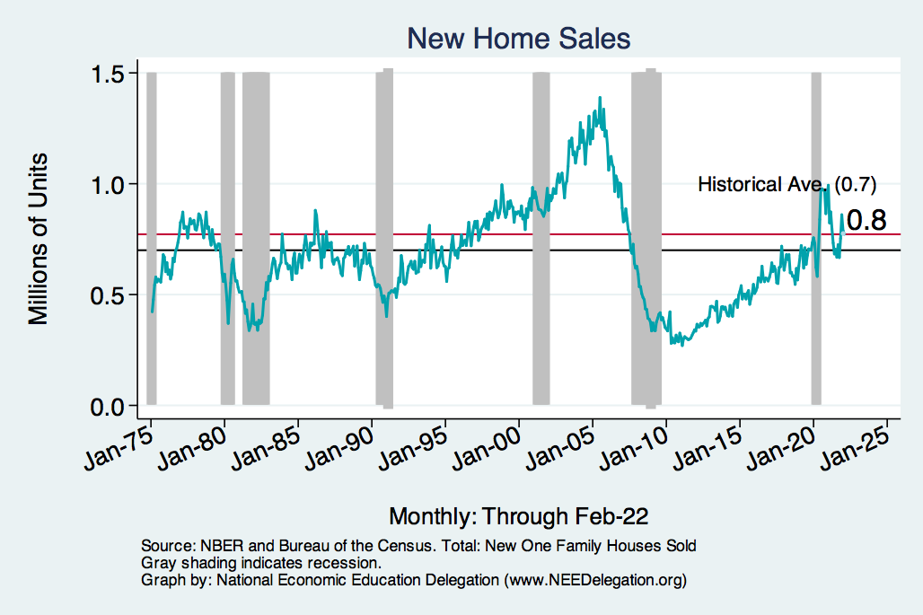
Home Prices and Home Sales
Notes:
Charts:
homeprices_recession.png
housing.png

Slide 54
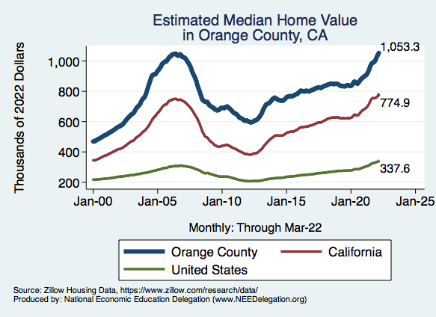
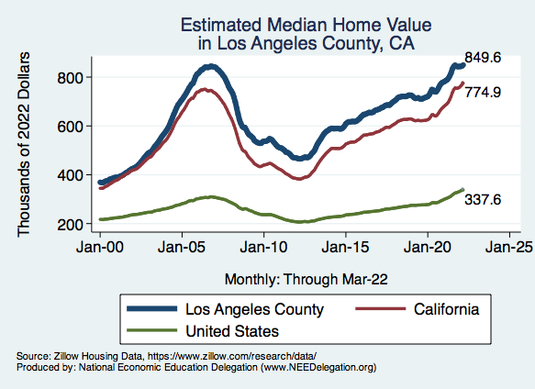
RE Experiences Differ!

Slide 55
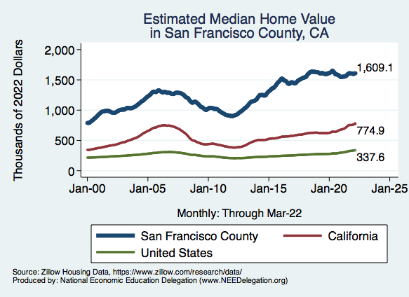
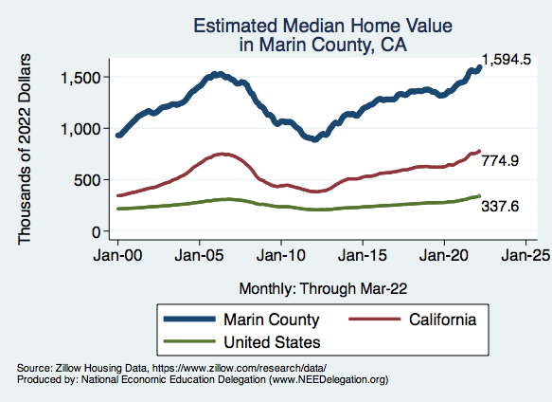
RE Experiences Differ!

Slide 56


RE Experiences Differ!

Slide 57
www.NEEDelegation.org/LocalGraphs
For every state and county in the United States.
Detailed graphs on employment, housing, moves, and other statistics.

Slide 58

Interest Rates are Rising!

Slide 59
Conclusion
GDP will likely expand about 4% in 2022.
  Completing the recovery.
Employment is still lagging.
Real estate markets likely to cool.
Physical health determines economic health for the economy.
  Variants may slow our progress: Omicron BA.2 (see Europe and China)
  Gov’t missteps may also hinder progress.
Biggest problems:
  Supply chain bottlenecks.
  Labor force participation.
  Russian invasion of Ukraine.
There is much uncertainty.

Slide 60
Thank you!
Any Questions?
www.NEEDelegation.org
Jon D. Haveman
Jon@NEEDelegation.org
Contact NEED: info@NEEDelegation.org
Submit a testimonial: www.NEEDelegation.org/testimonials.php
Become a Friend of NEED: www.NEEDelegation.org/friend.php

