Slide 1
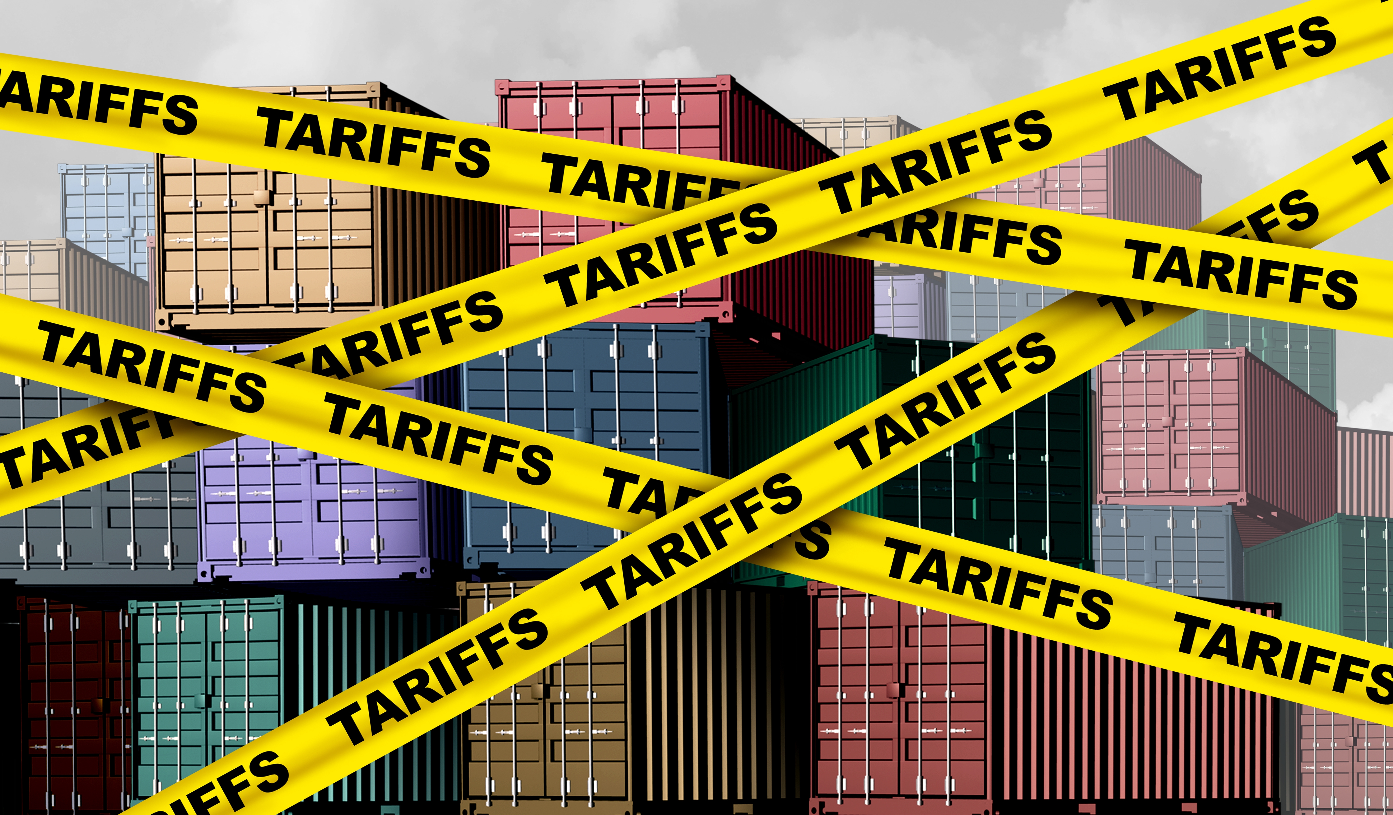

U.S. Economic Update
Belvedere Tiburon Public Library
Jon Haveman, Ph.D.
NEED
April 13, 2026

Slide 2
Outline
U.S. Economy
Economic Indicators
Inflation
Federal Reserve
Big Picture: Uncertainty

Slide 3
U.S. Economy

Slide 4
Some Basic Statistics, April 2026
Statistic: | Value
Population | 342.5 Million
Labor Force | 170.1 Million
Employment | 162.8 Million
Gross Domestic Product (GDP) | $31.4 Trillion
Income per Capita | $77,354
Ave. Hourly Earnings | $37.38
Source: fred.stlouisfed.org

Slide 5
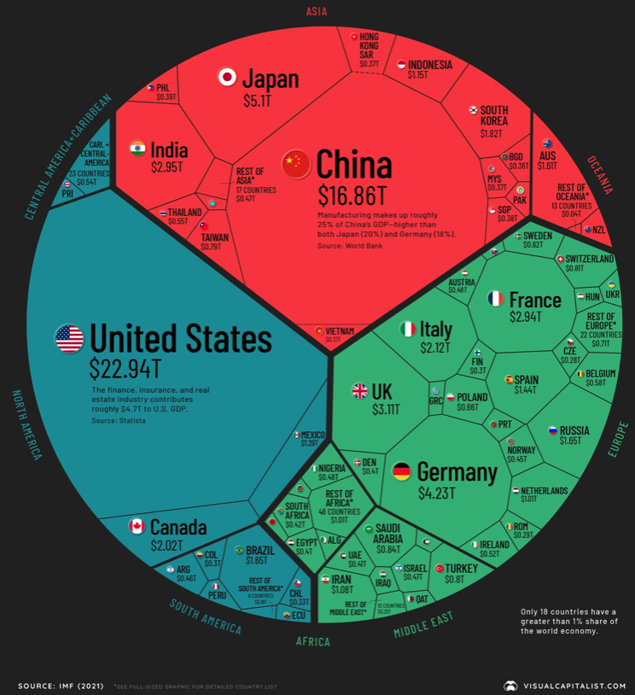
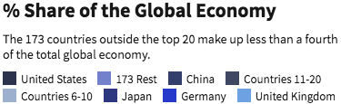
U.S. Economy in Global Perspective
U.S. Nominal GDP:
$21.9 trillion in 2019-Q4
$19.9 trillion in 2020-Q2
$31.4 trillion in 2025-Q4
Notes:
https://www.investopedia.com/insights/worlds-top-economies/#countries-by-gdp

Slide 6
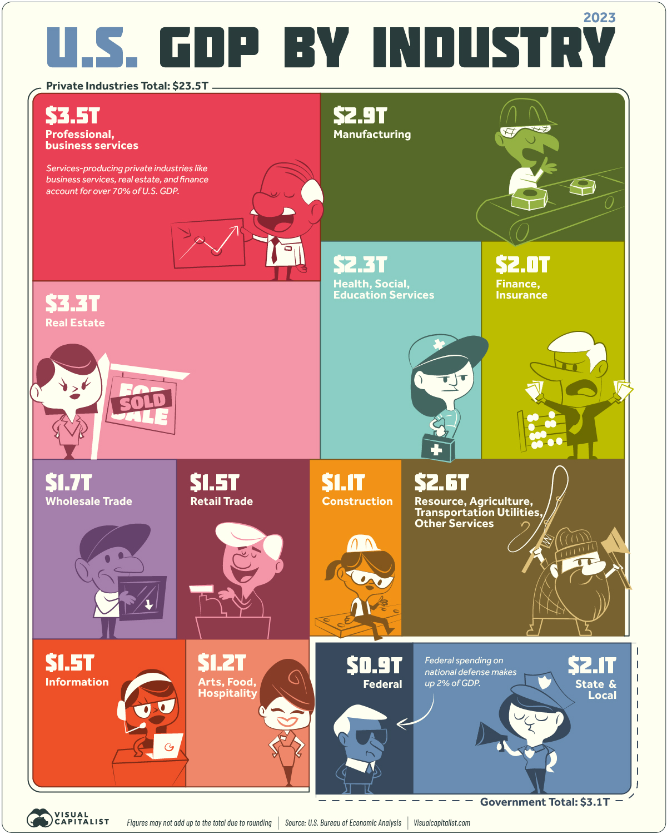
Different Breakdown
Note: State and Local Government comprises 10% of GDP!

Slide 7
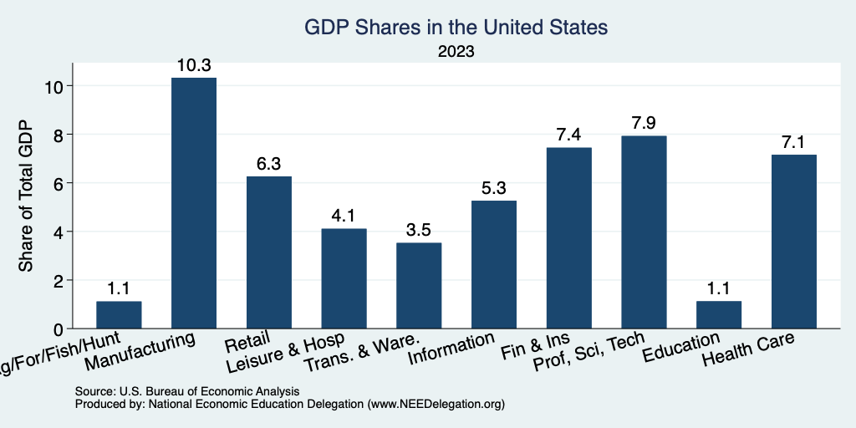
Composition of the U.S. Economy: GDP

Slide 8
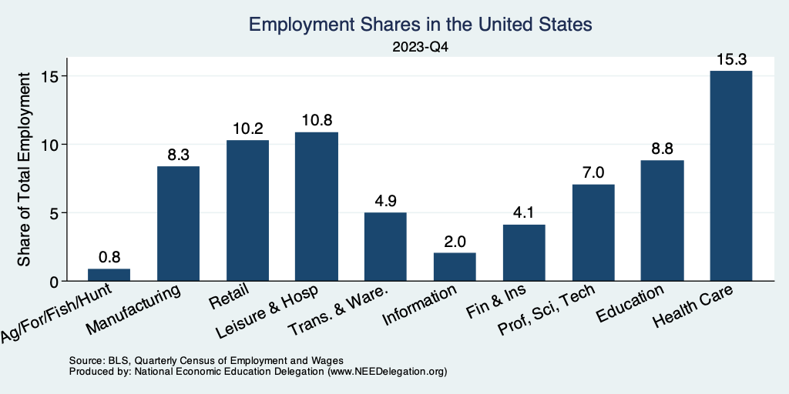
Composition of the U.S. Economy: Employment
Manufacturing
GDP Share = 10.3%
Health GDP Share = 7.1%
Note: Does not add to 100% because of omitted sectors.

Slide 9
Economic Indicators

Slide 10
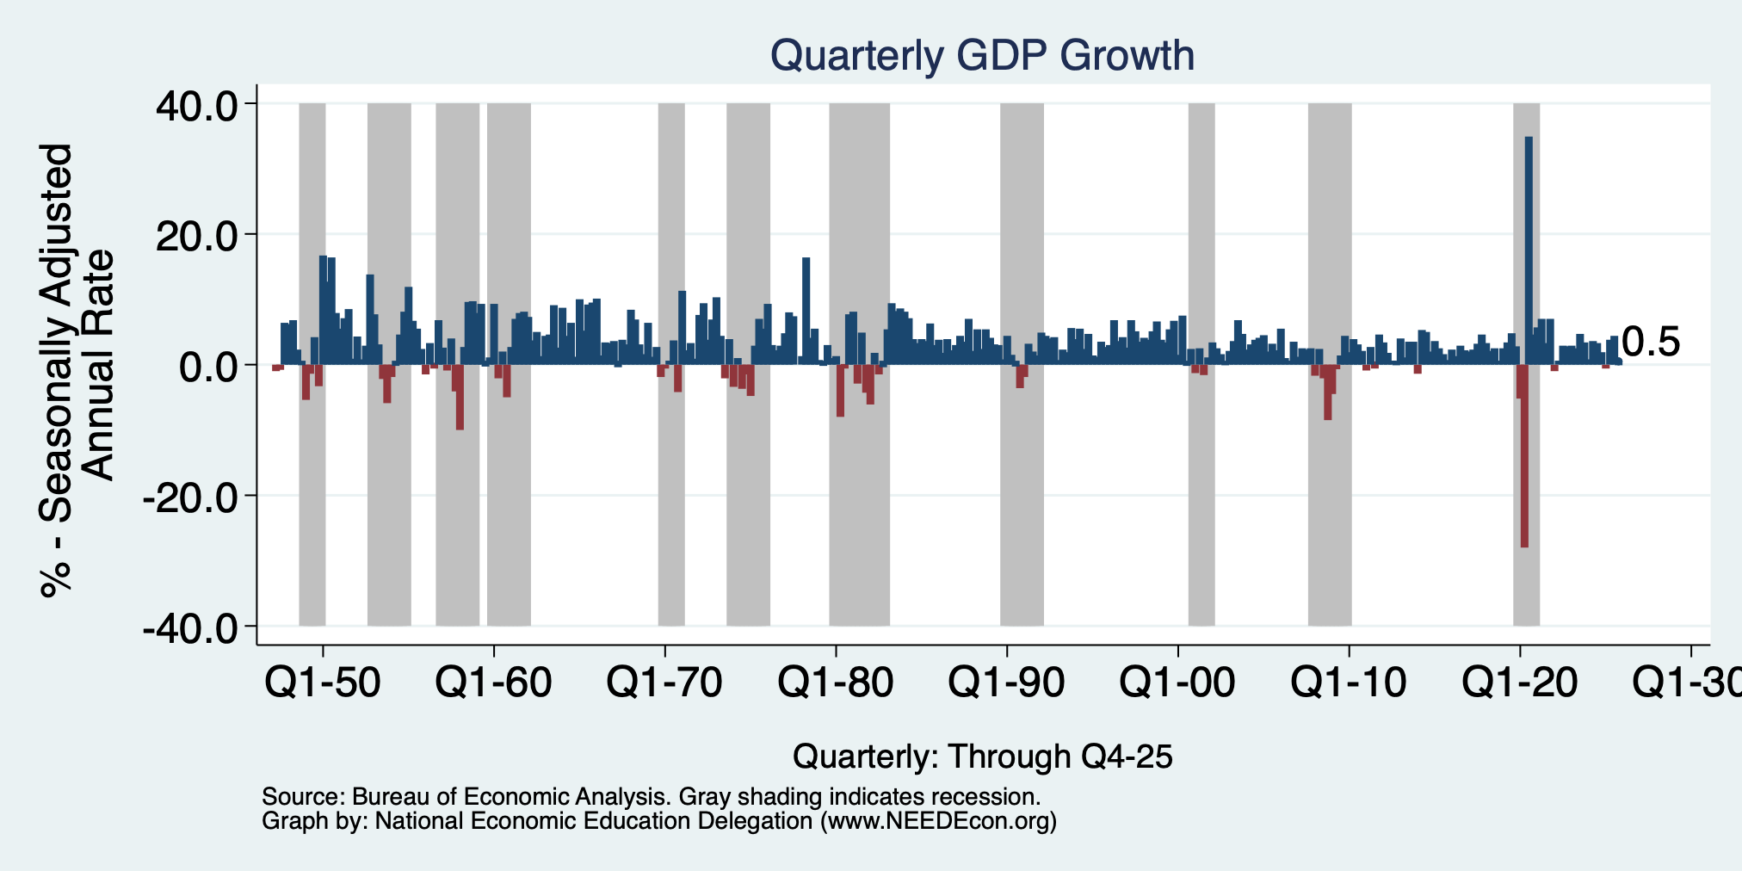
GDP: Quarterly Growth
Q1-2025: -0.6%
Q2-2025: 3.8%
Q3-2025: 4.4%
Q4-2025: 0.5%
Growth in 2025: 2.1%
Notes:
Graph: gdp_pot_grow.png
The Point: From 1990 – 2007, average annual US GDP growth pre-crisis is 2.94%. However, post-crisis US GDP growth is 2.19% (0.75 percentage points lower). Why is has the recovery been sluggish?
Note: At the recession’s height, the gap between quarterly GDP growth and potential growth was 2.5 percentage points.

Slide 11
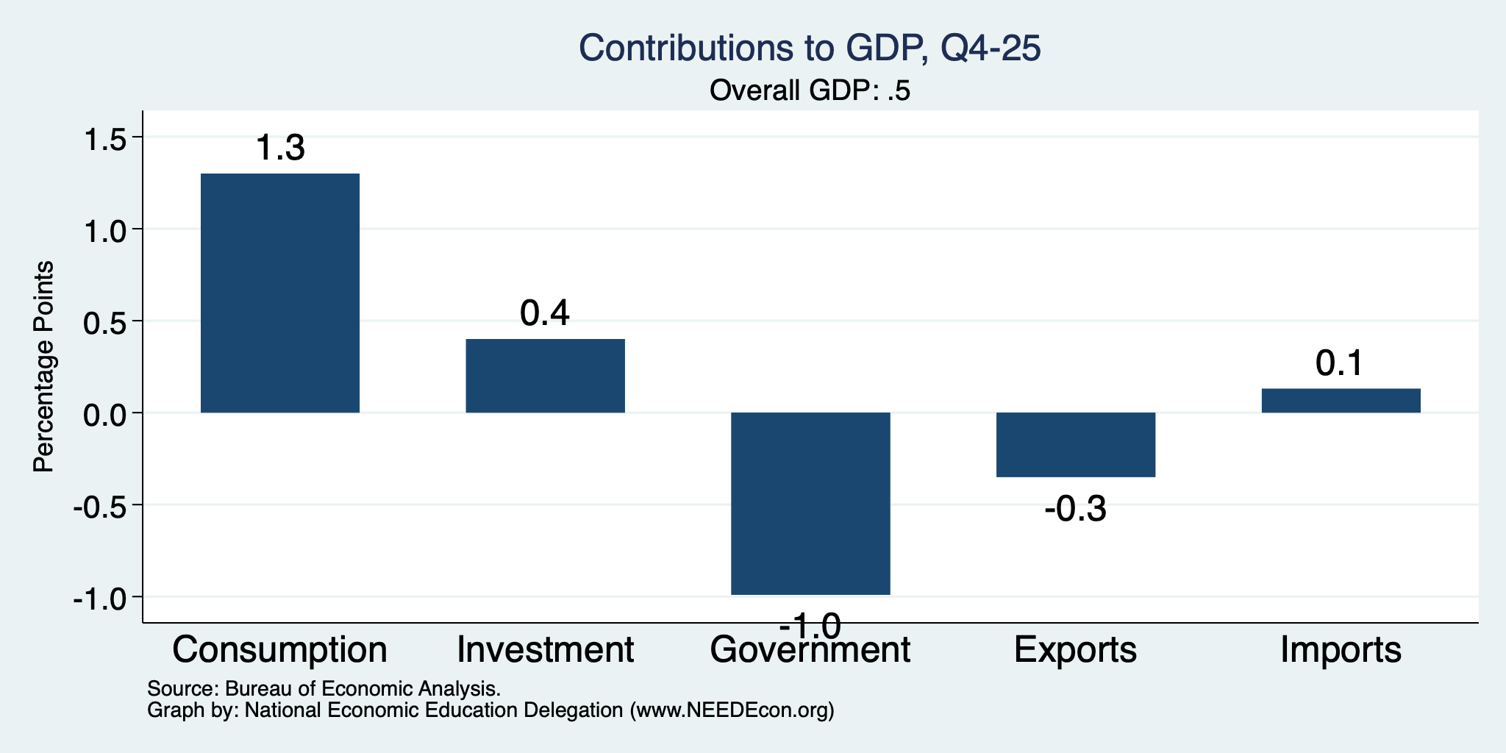
What Drove GDP Growth?
Normally
2.3%

Slide 12
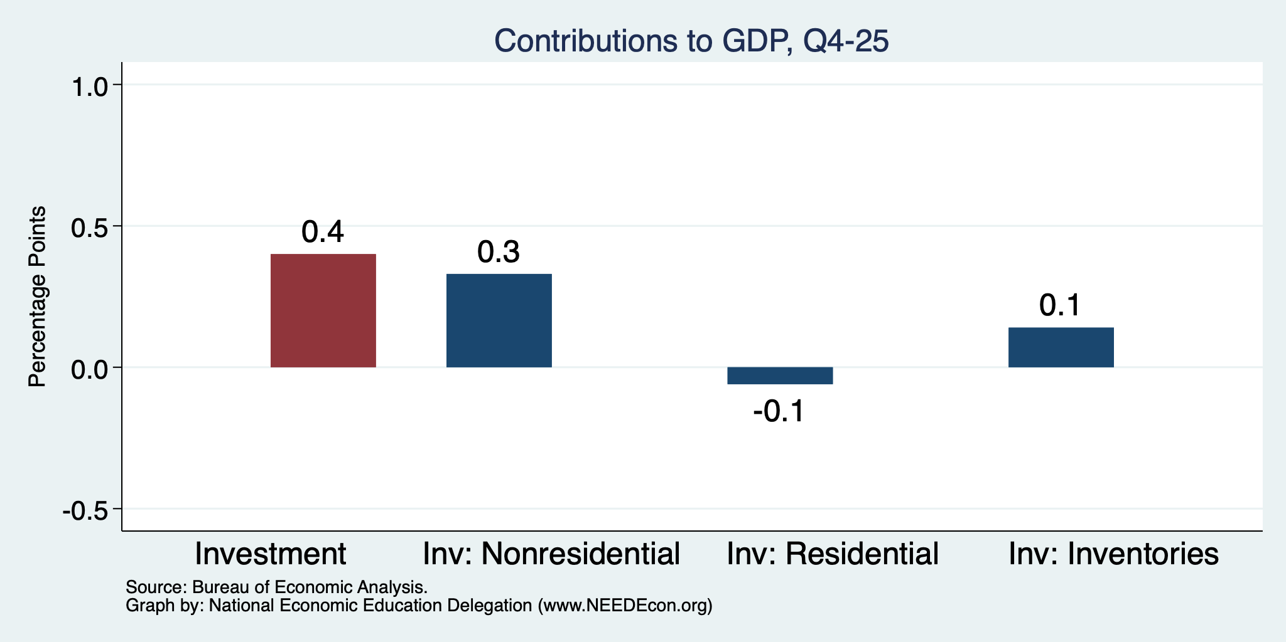
Investment Levels Are Low
Normally
About 0.9
Normally
About 0.8

Slide 13
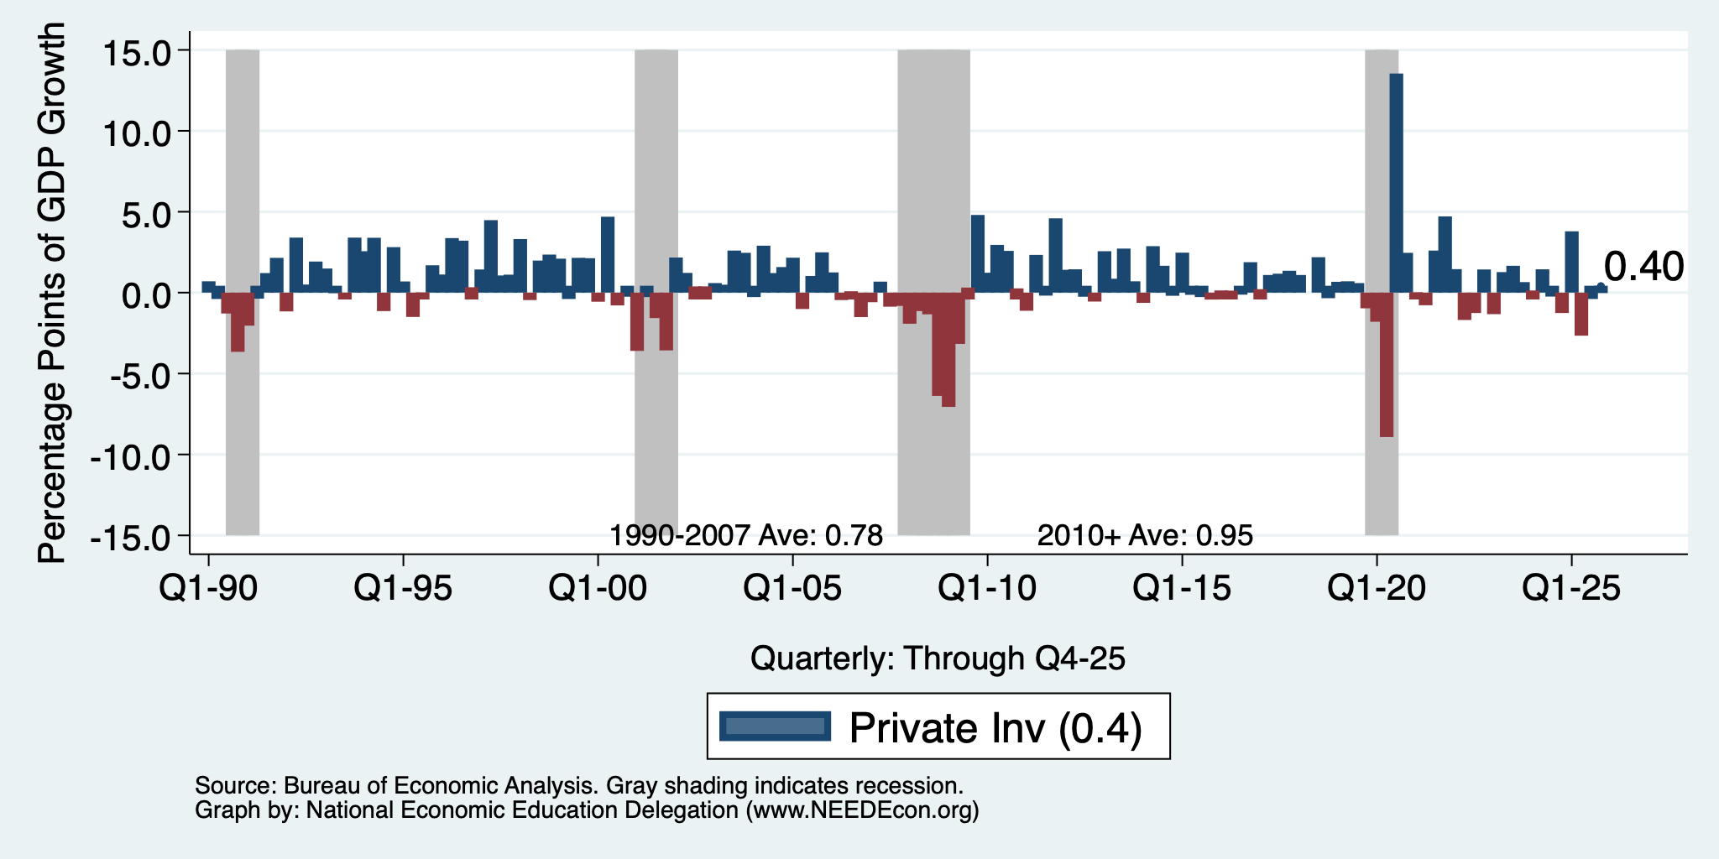
Investment Levels Are Low

Slide 14
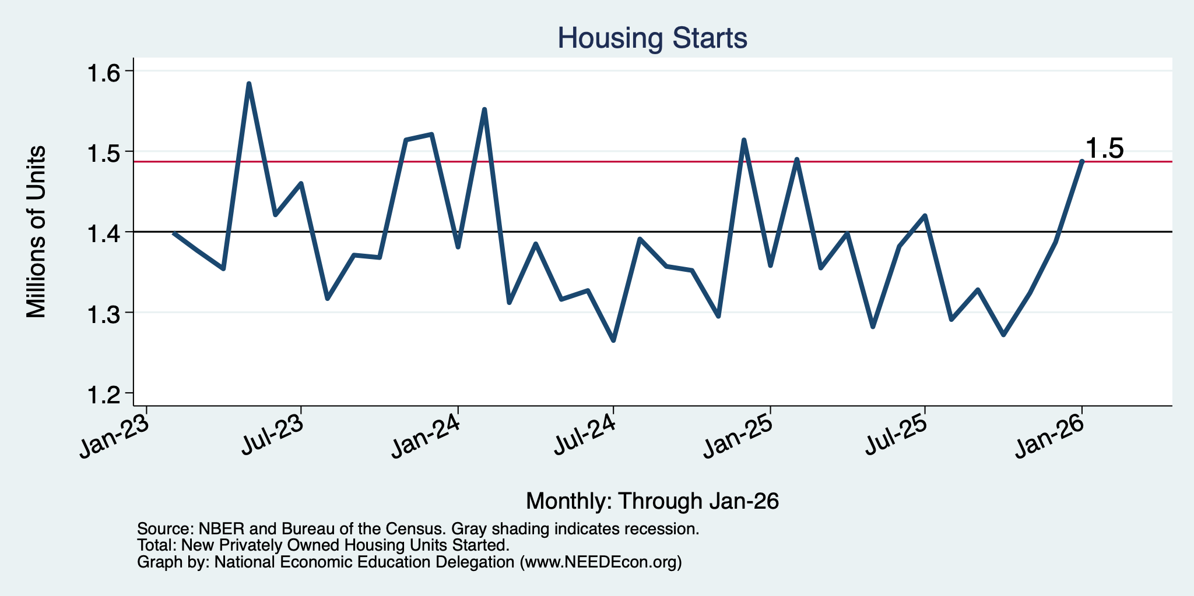
Housing Starts Were Quite Low

Slide 15
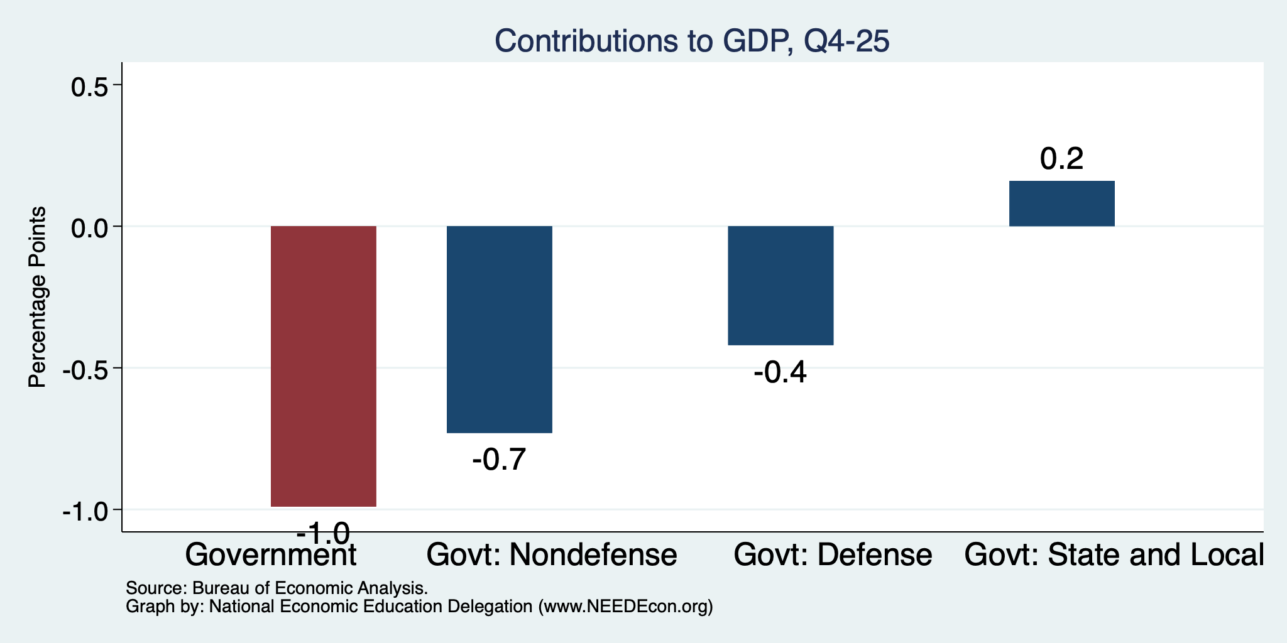
Government Spending Didn’t Help

Slide 16
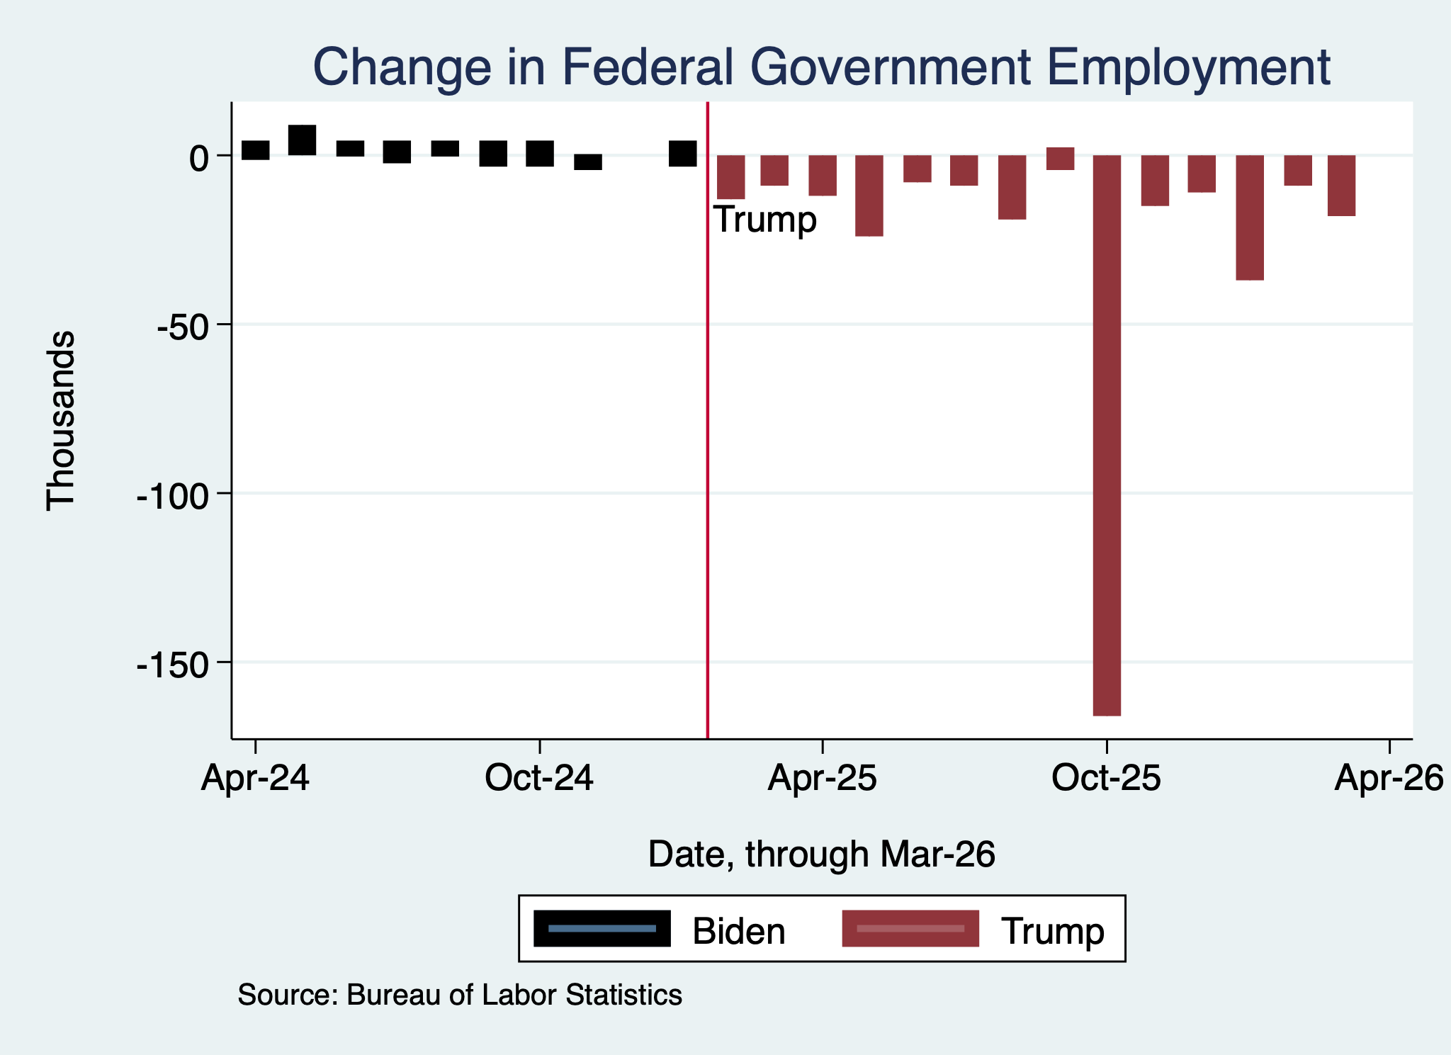
Monthly Changes in Federal Gov’t Employment
Notes:
PAYEMS.png

Slide 17
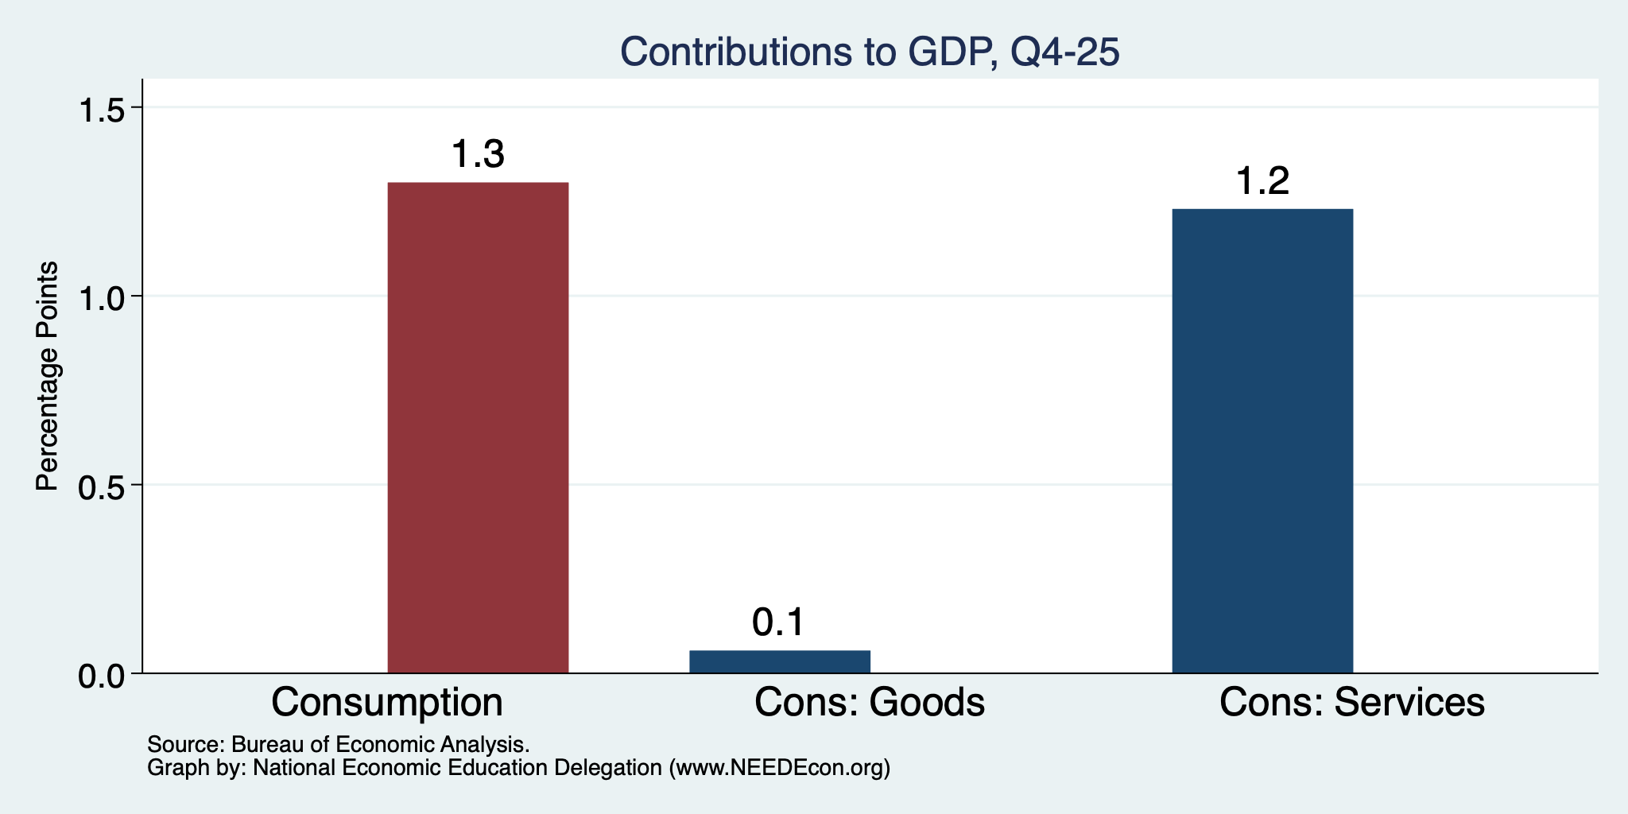
Consumers Also Tightened
Normally
2+%
Normally
0.8%

Slide 18
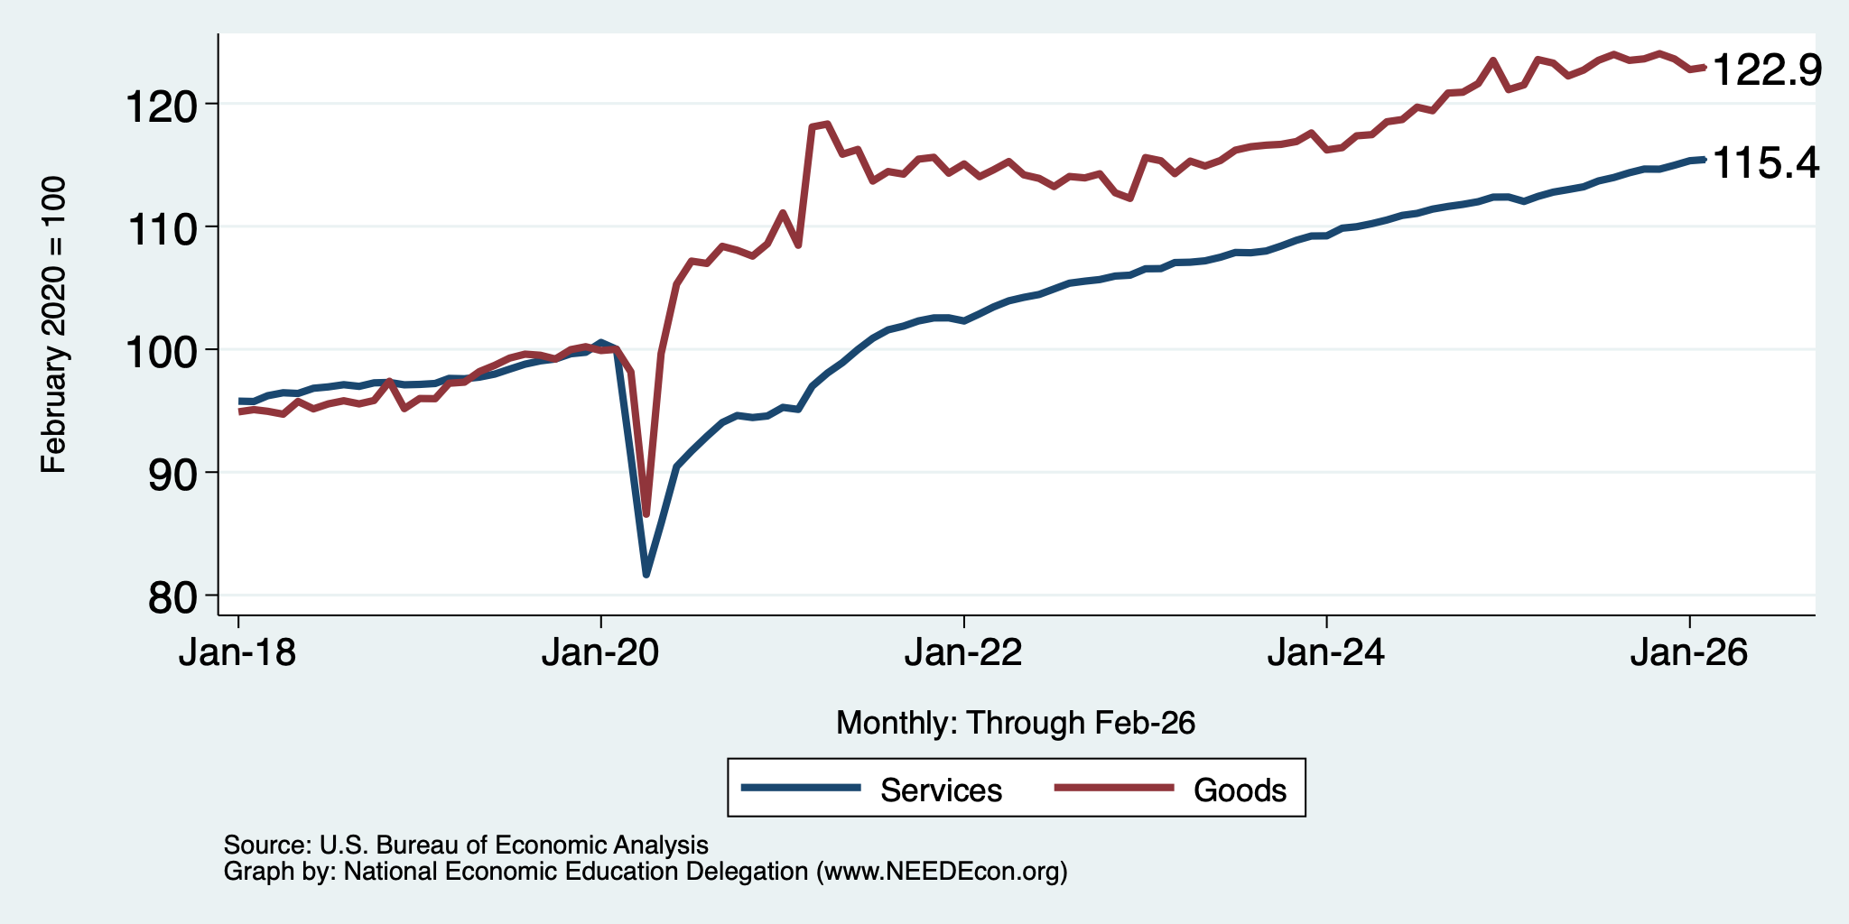
Consumers Spending Less on Goods
Flat

Slide 19
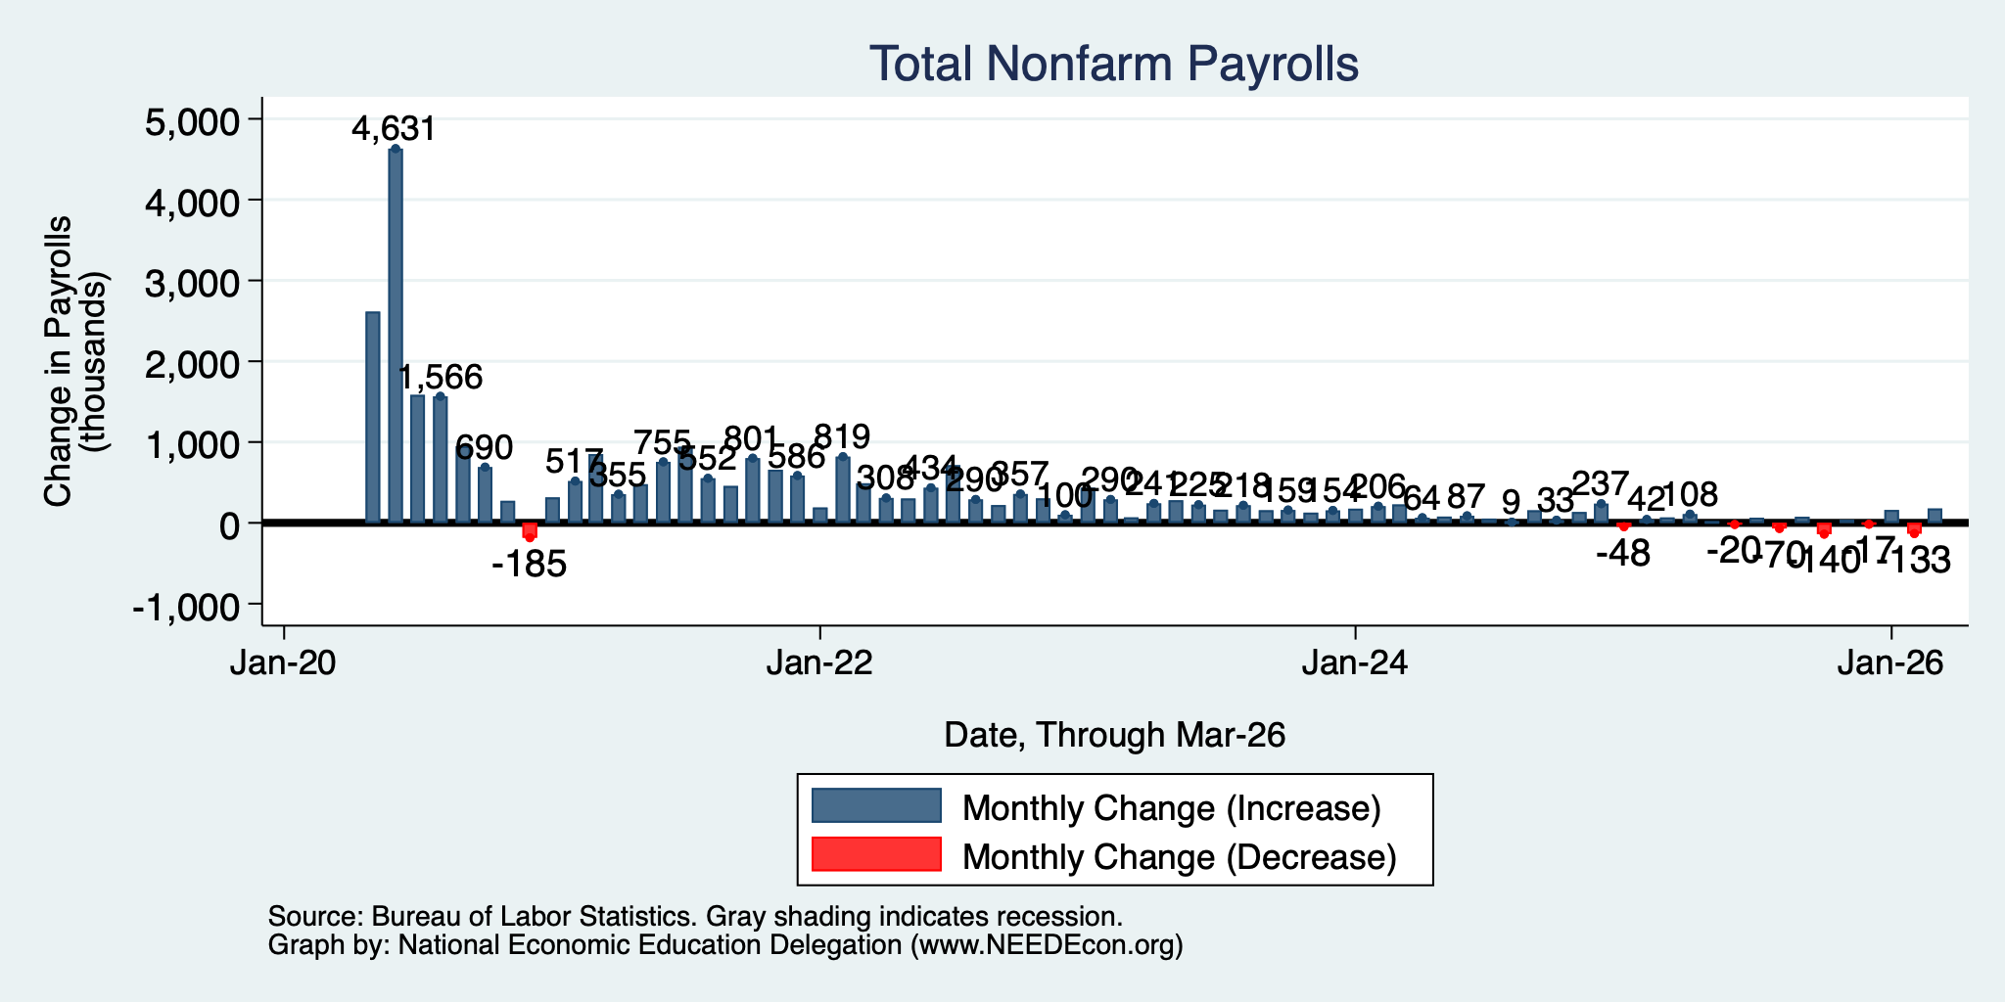
Monthly Changes in Nonfarm Employment
Jan: 160,000
Feb: -133,000
Mar: 178,000
Notes:
PAYEMS.png

Slide 20
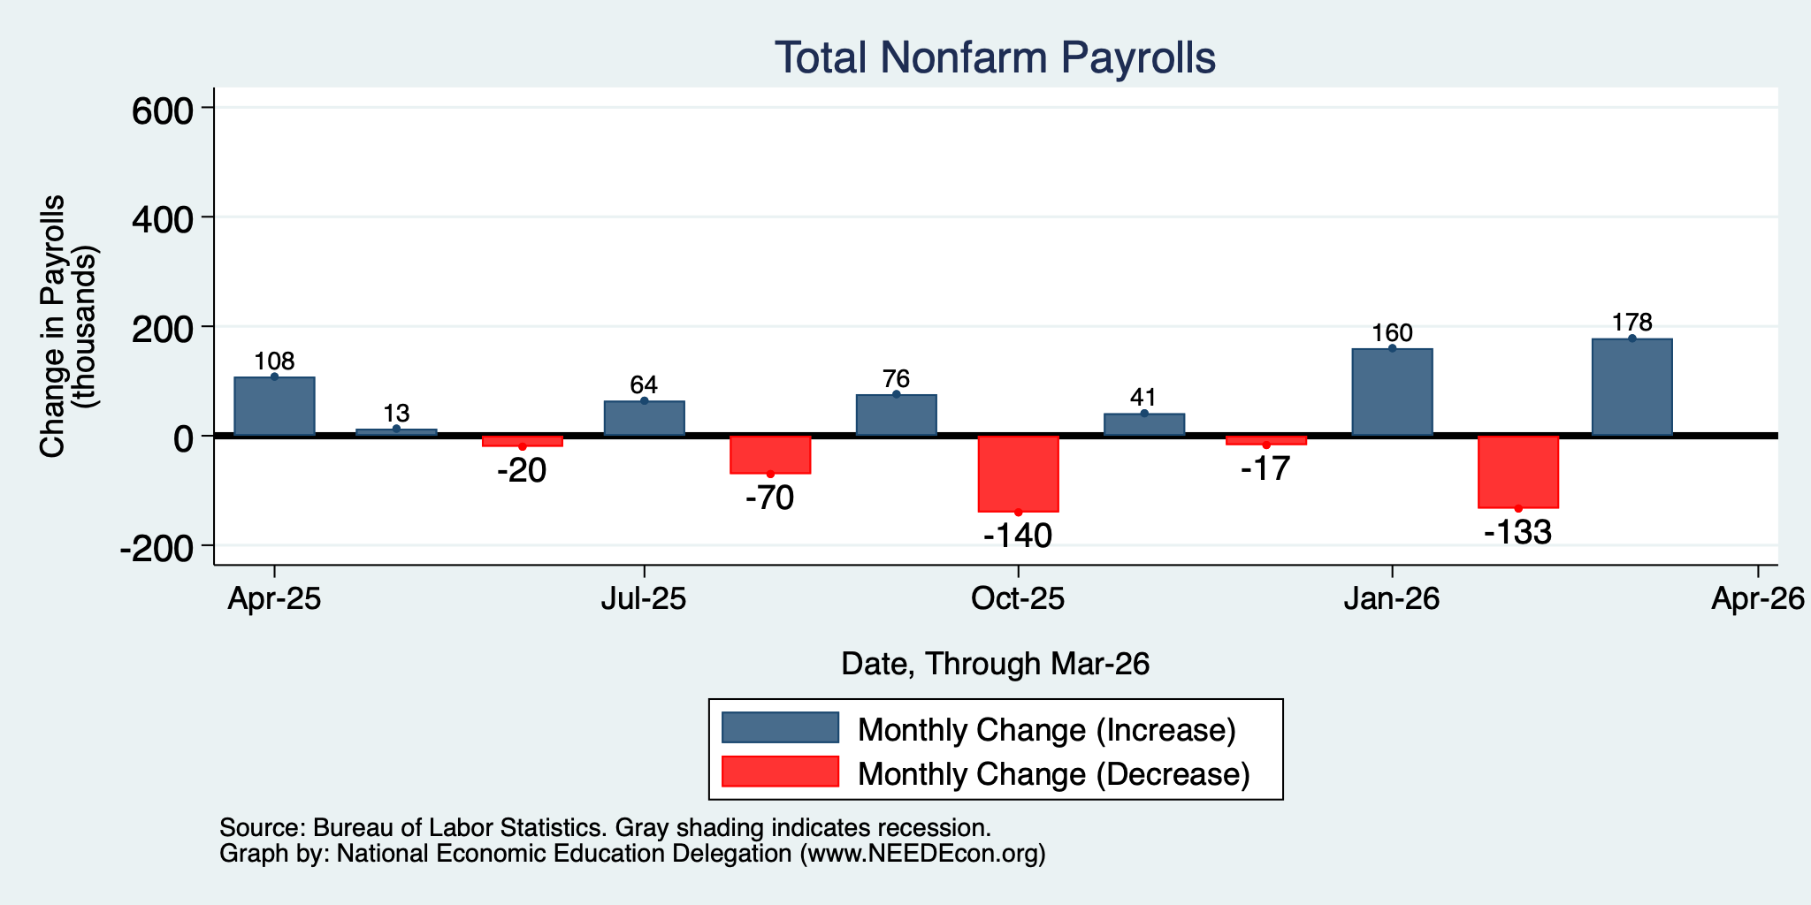
Monthly Changes in Nonfarm Employment
Jan: 160,000
Feb: -133,000
Mar: 178,000
Notes:
PAYEMS.png

Slide 21
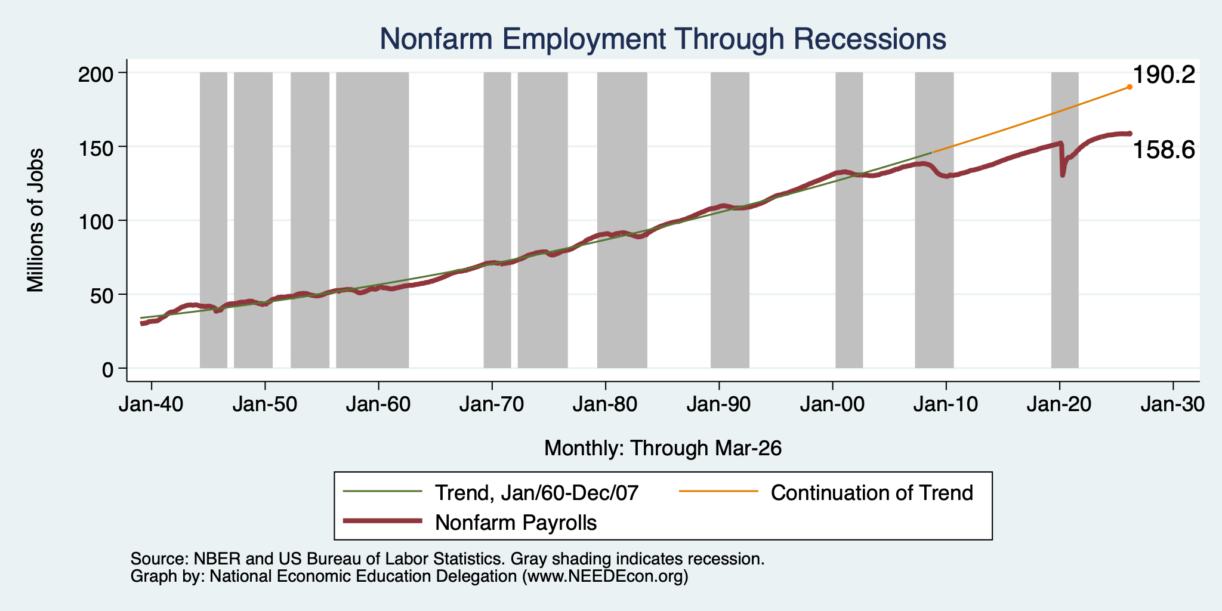
Monthly Changes in Nonfarm Employment
Notes:
PAYEMS.png

Slide 22
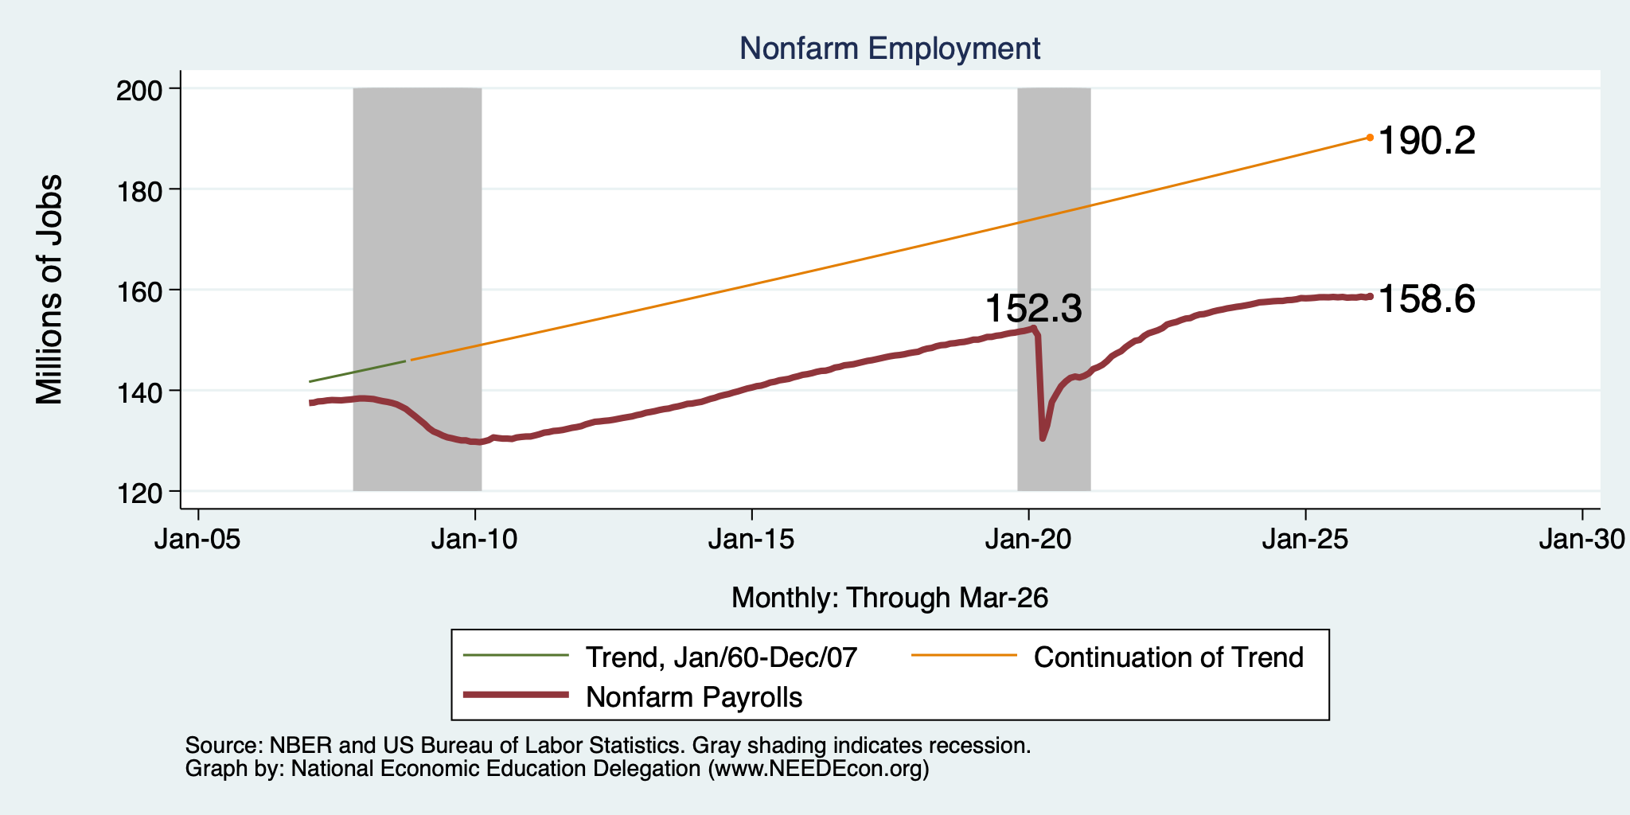
Monthly Changes in Nonfarm Employment
Notes:
PAYEMS.png

Slide 23
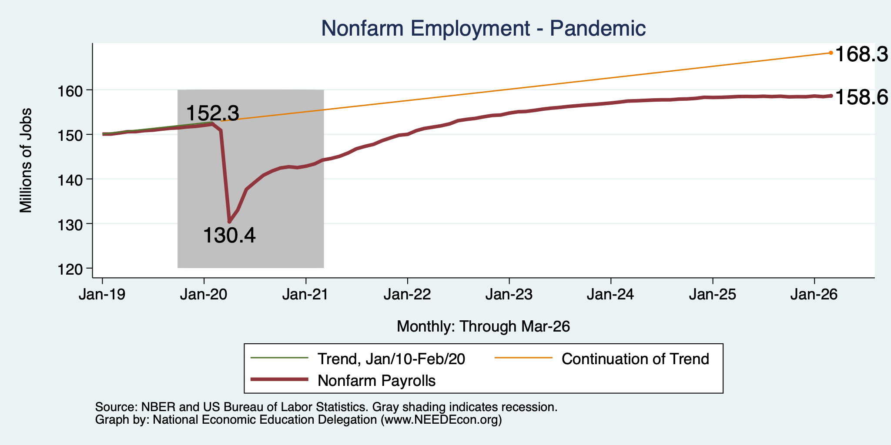
Monthly Changes in Nonfarm Employment
Notes:
PAYEMS.png

Slide 24
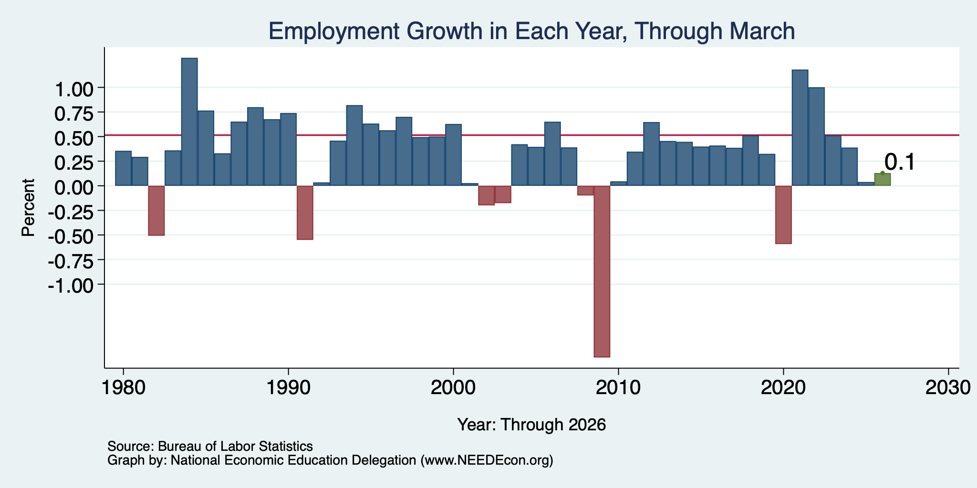
Annual Changes in Nonfarm Employment
Notes:
PAYEMS.png

Slide 25
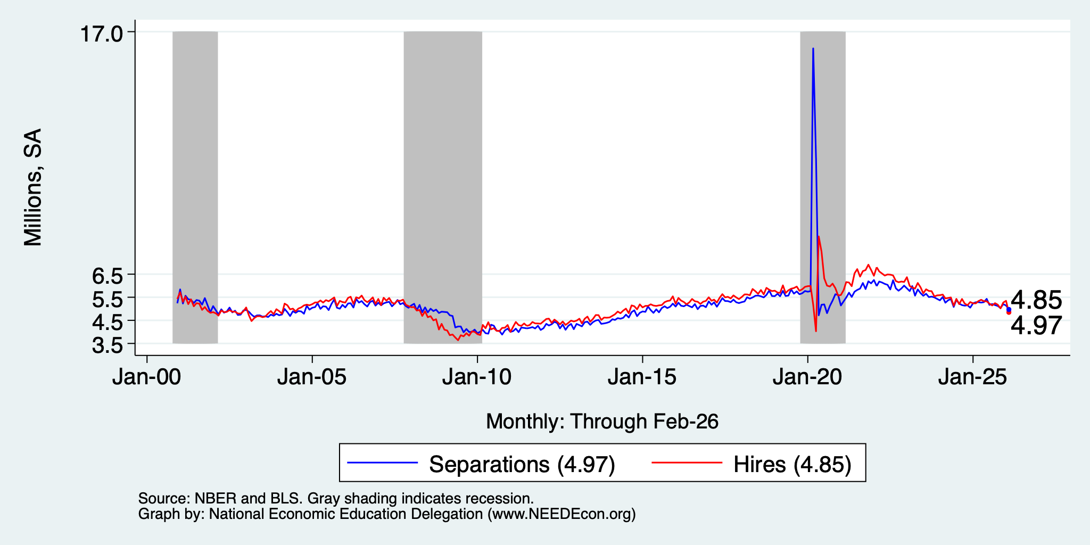
Great Hesitation

Slide 26
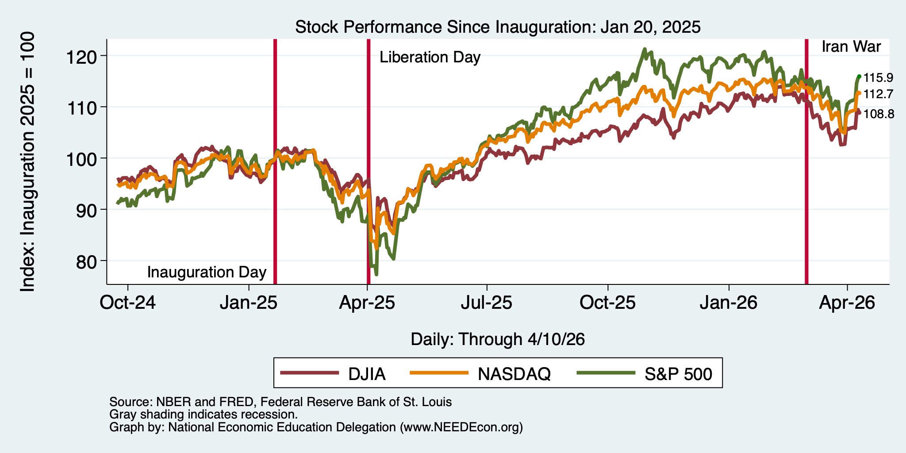
And Stocks?

Slide 27
Inflation

Slide 28
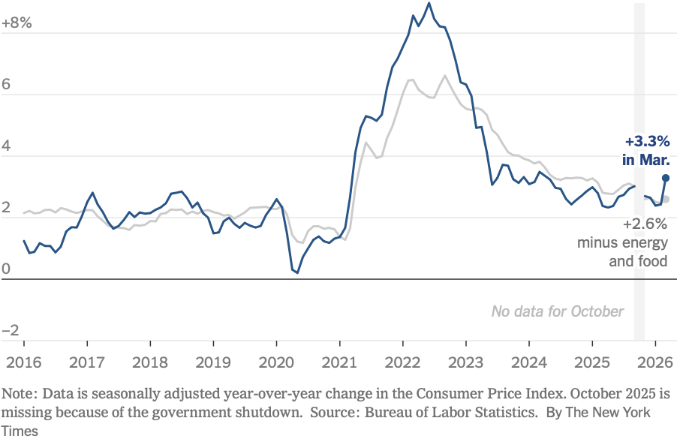
Inflation: Latest Figures
The uptick is entirely because of the war.
Source: NYTimes.com

Slide 29
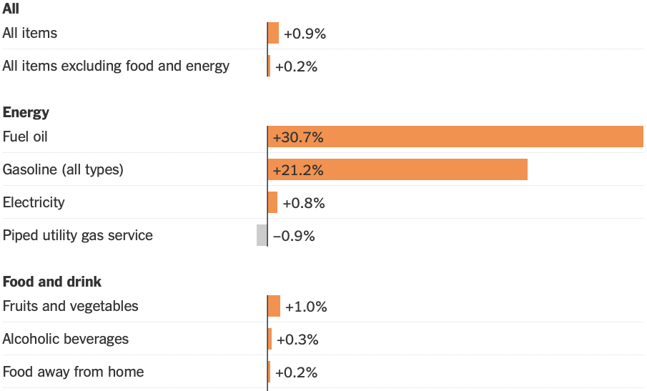
Inflation: Latest Monthly Figures
Source: NYTimes.com

Slide 30
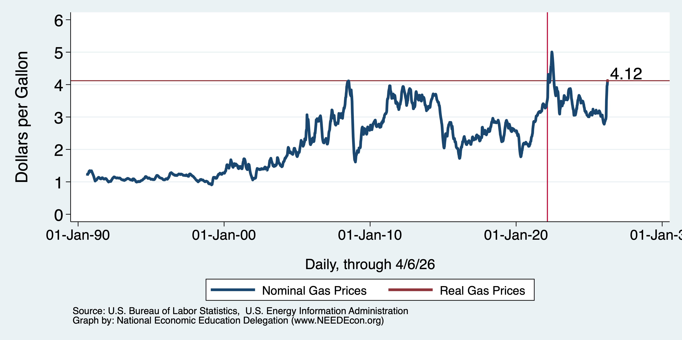
Inflation: Gas Prices

Slide 31
The Fed: Going to Sit Tight

Slide 32
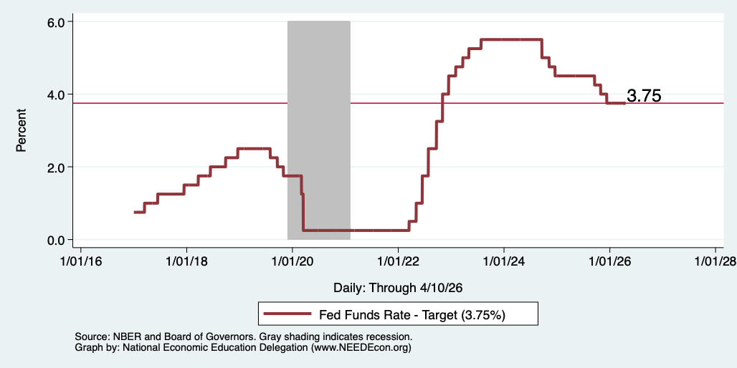
Federal Funds Rate
Notes:
The fed funds rate is the interest rate on overnight loans between banks. Think of it as the baseline interest rate on which banks base all other interest rates (e.g. mortgage rates)
FOMC lowers the fed funds rate during recessions and raises the fed funds rate during expansions
Fed funds rate peaked in the 1980s as then Chairman Paul Volcker sought to reign in “run away” inflation of the 1970s; doing so resulted in a recession in the early 1980s.
Since the 2008-09 recession, the fed funds rate has been kept near zero.
During the 2008-09 recession, Federal Reserve turned to unconventional tools to influence longer term interest rates to further stimulate the economy - QE
FedFunds.png

Slide 33
Takeaways
Is a recession on the horizon?
  I wouldn’t be surprised, but not betting on it.
    Jobs growth is slow.
    GDP growth is slow – but that was artificial.
    Inflation has ticked up.
Stagflation likely on the horizon.
The problem?
  Uncertainties abound!

Slide 34
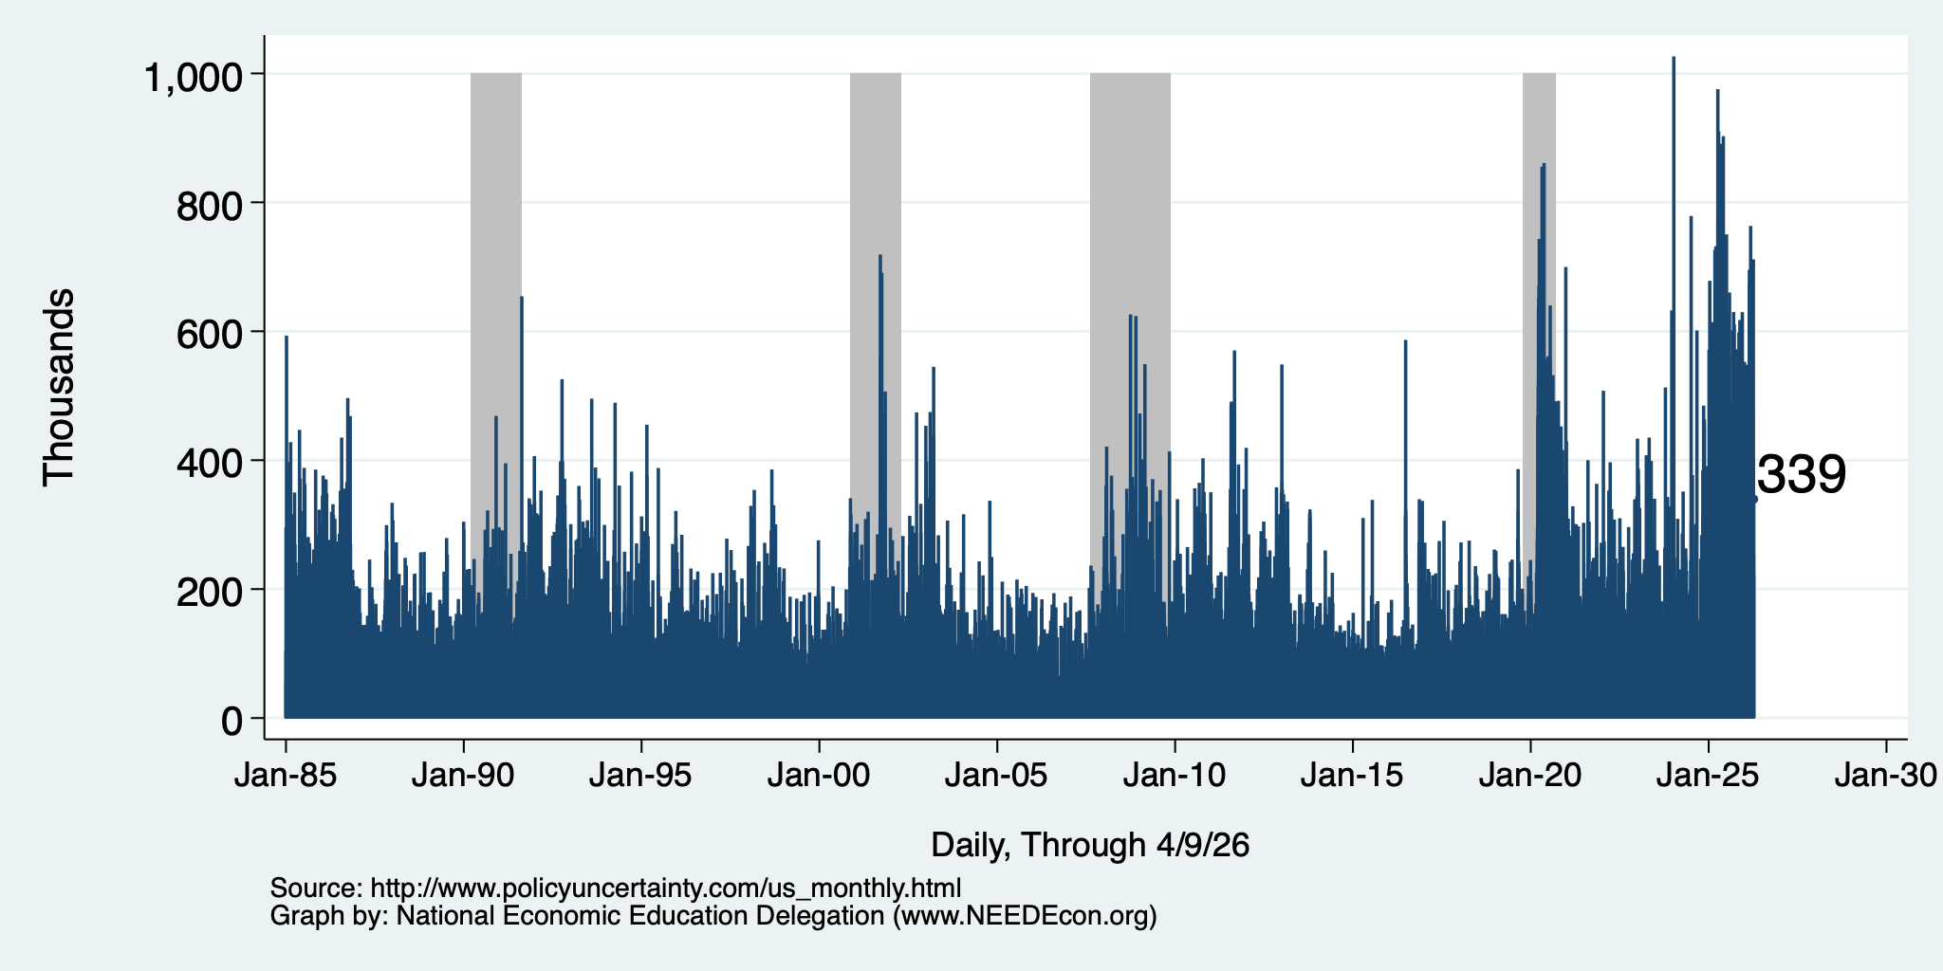
Policy Uncertainty Index
Notes:
The fed funds rate is the interest rate on overnight loans between banks. Think of it as the baseline interest rate on which banks base all other interest rates (e.g. mortgage rates)
FOMC lowers the fed funds rate during recessions and raises the fed funds rate during expansions
Fed funds rate peaked in the 1980s as then Chairman Paul Volcker sought to reign in “run away” inflation of the 1970s; doing so resulted in a recession in the early 1980s.
Since the 2008-09 recession, the fed funds rate has been kept near zero.
During the 2008-09 recession, Federal Reserve turned to unconventional tools to influence longer term interest rates to further stimulate the economy - QE
FedFunds.png

Slide 35
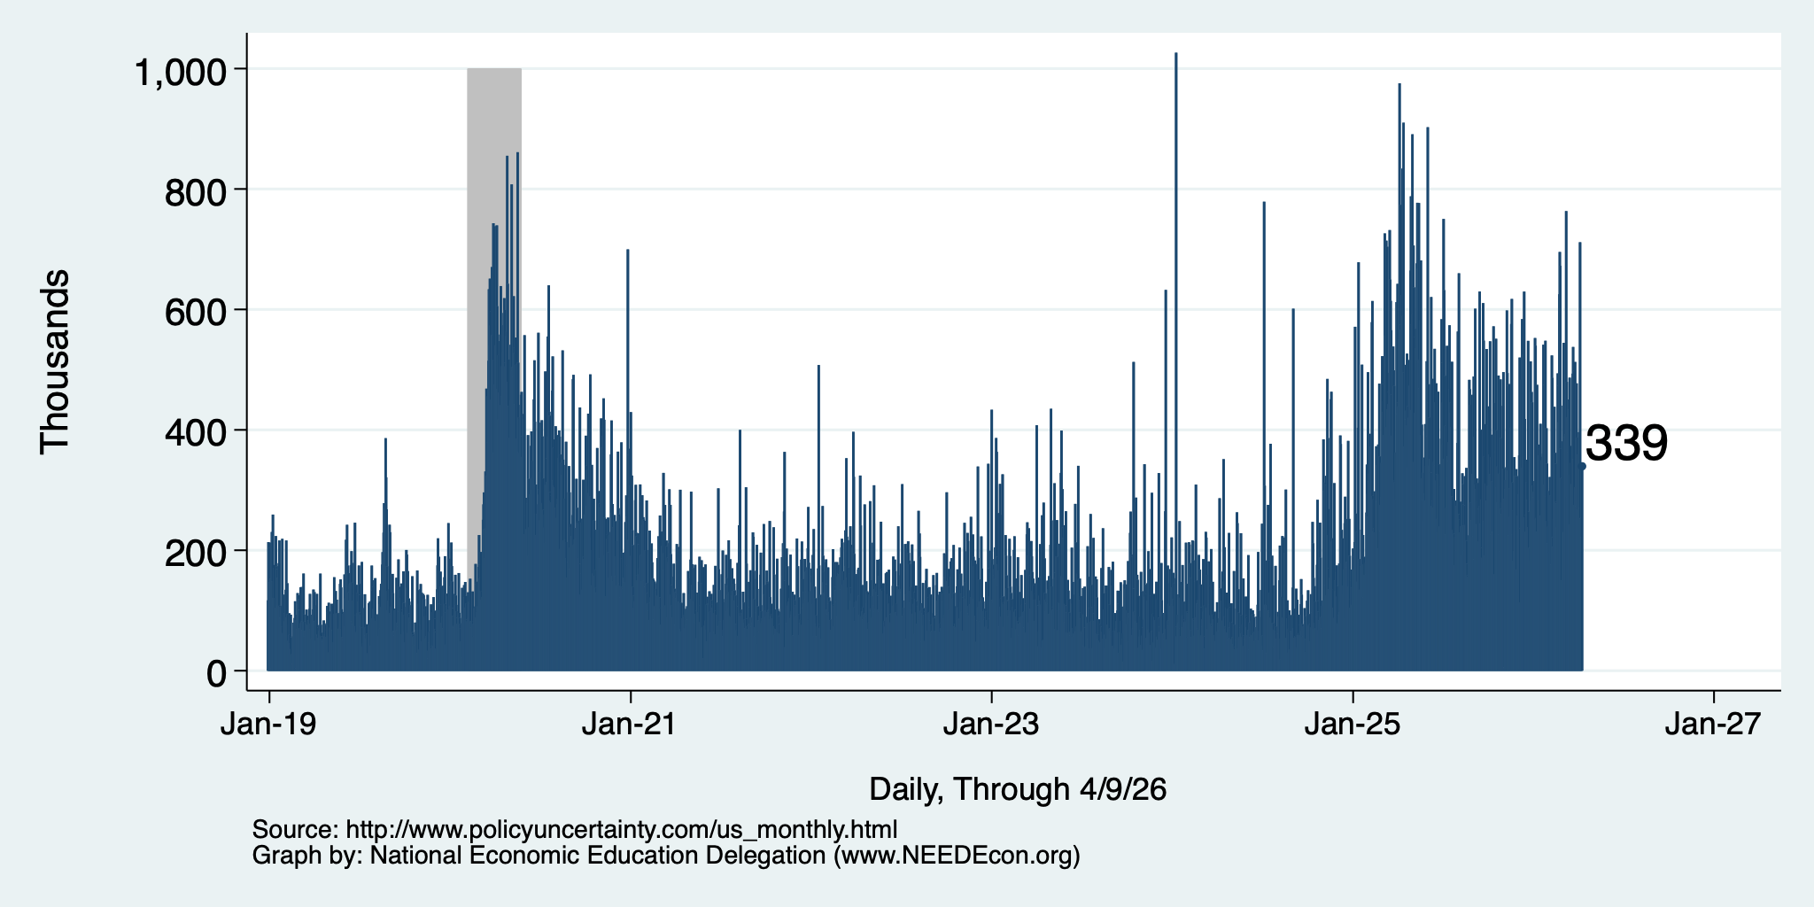
Policy Uncertainty Index – Last 10 Years
Notes:
The fed funds rate is the interest rate on overnight loans between banks. Think of it as the baseline interest rate on which banks base all other interest rates (e.g. mortgage rates)
FOMC lowers the fed funds rate during recessions and raises the fed funds rate during expansions
Fed funds rate peaked in the 1980s as then Chairman Paul Volcker sought to reign in “run away” inflation of the 1970s; doing so resulted in a recession in the early 1980s.
Since the 2008-09 recession, the fed funds rate has been kept near zero.
During the 2008-09 recession, Federal Reserve turned to unconventional tools to influence longer term interest rates to further stimulate the economy - QE
FedFunds.png

Slide 36
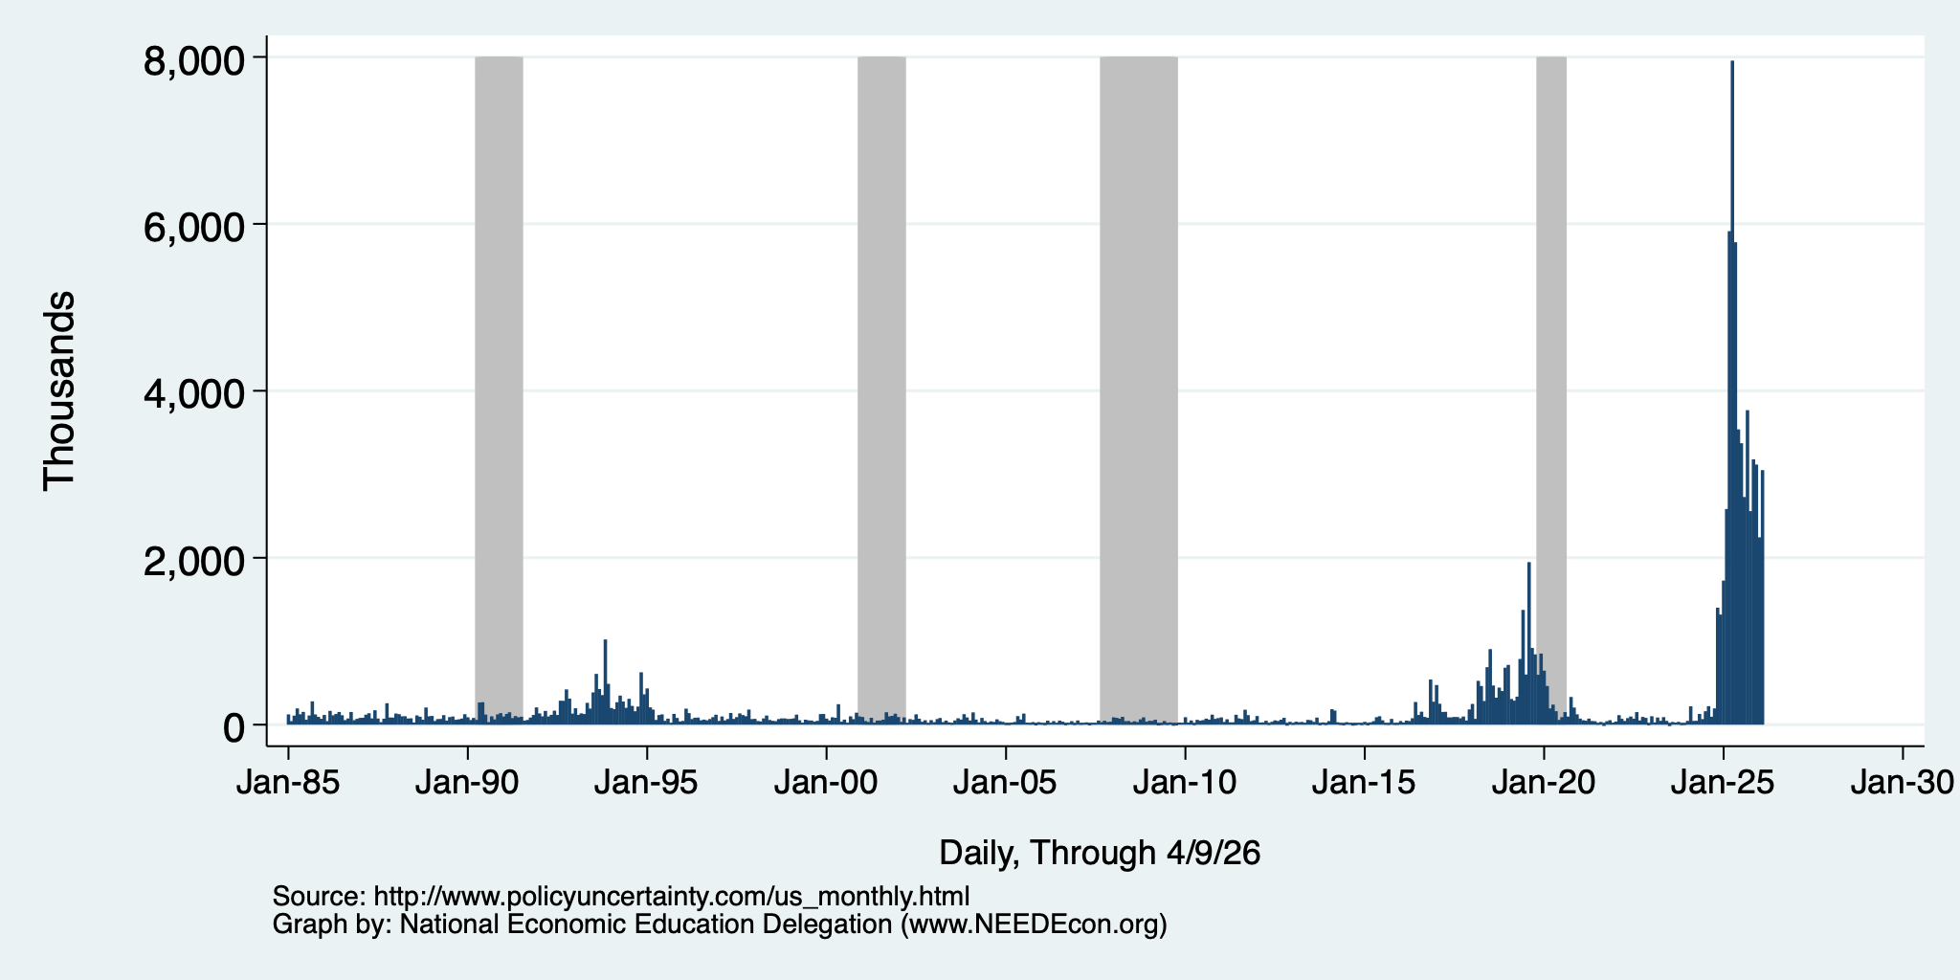
Policy Uncertainty Index – Trade
Notes:
The fed funds rate is the interest rate on overnight loans between banks. Think of it as the baseline interest rate on which banks base all other interest rates (e.g. mortgage rates)
FOMC lowers the fed funds rate during recessions and raises the fed funds rate during expansions
Fed funds rate peaked in the 1980s as then Chairman Paul Volcker sought to reign in “run away” inflation of the 1970s; doing so resulted in a recession in the early 1980s.
Since the 2008-09 recession, the fed funds rate has been kept near zero.
During the 2008-09 recession, Federal Reserve turned to unconventional tools to influence longer term interest rates to further stimulate the economy - QE
FedFunds.png

Slide 37
Uncertainties
What effect will continued deportations have?
Will AI continue to drive growth?
Will tariffs continue to drive inflation?
  Fed says that ALL of the inflation above 2% is from tariffs, until…
Will the war drive inflation beyond fuel prices?
  It is clear in fuel prices, but every other sector of the economy depends on fuel. Higher fuel prices drive prices in the rest of the economy up.
Will consumers continue to hold up?
  Evidence that spending is in decline.
What happens to Fed policy once Jerome Powell is gone?

Slide 38
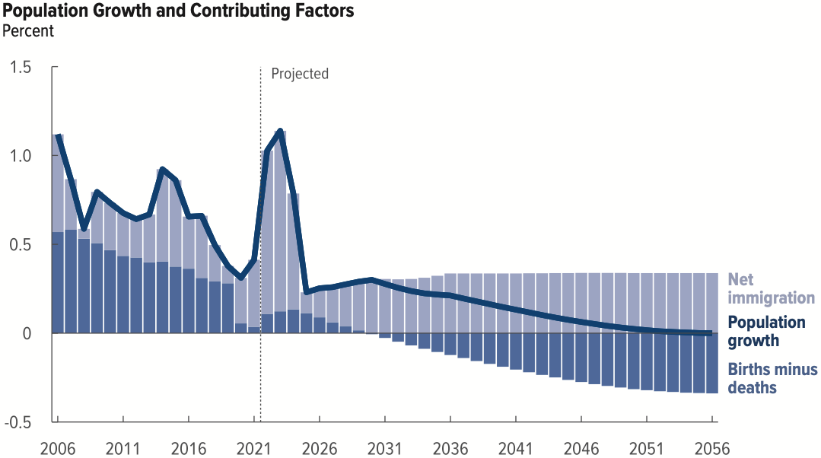
Is Immigration Saving the Day?
Native-born population growth turns
negative by the end of THIS decade.
Source: CBO – The Demographic Outlook, 2026-2056

Slide 39
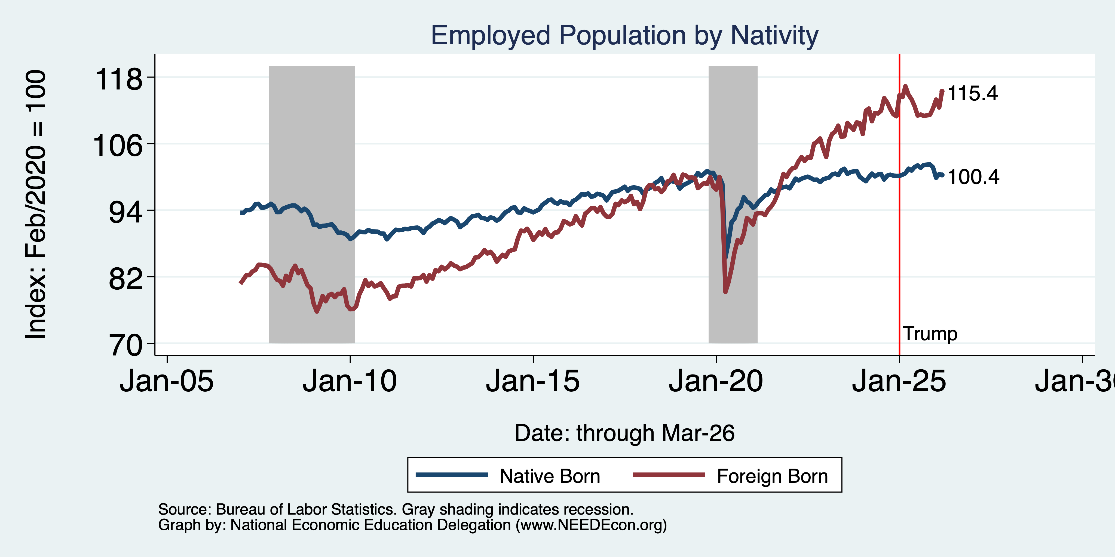
Immigrants to the Rescue?

Slide 40
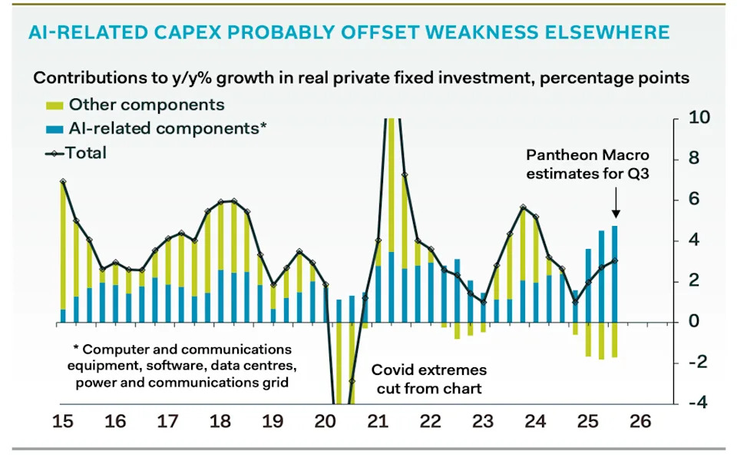
AI and Investment
AI Investment & GDP Growth
Period | GDP Growth | AI Contribution | Difference
25Q1 | 2.0 percent | 1.3 percent | 0.7 percent
25Q2 | 2.1 | 1.2 | 0.9
25Q3 | 2.3 | 0.5 | 1.8
Source: BEA & https://www.stlouisfed.org/on-the-economy/2026/jan/tracking-ai-contribution-gdp-growth
Source Parthenon: Macroeconomics

Slide 41
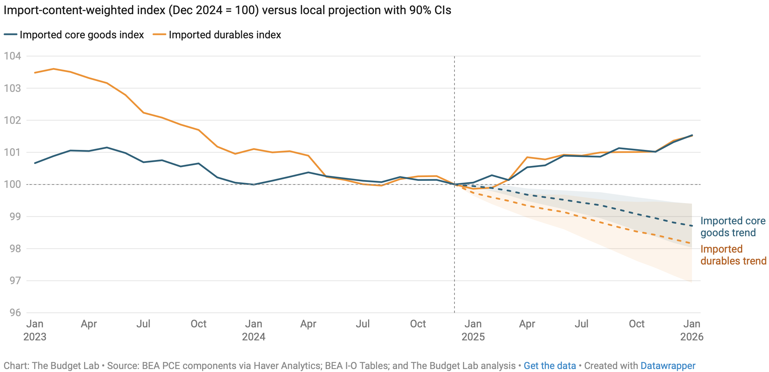
Tariffs and Price Effects

Slide 42
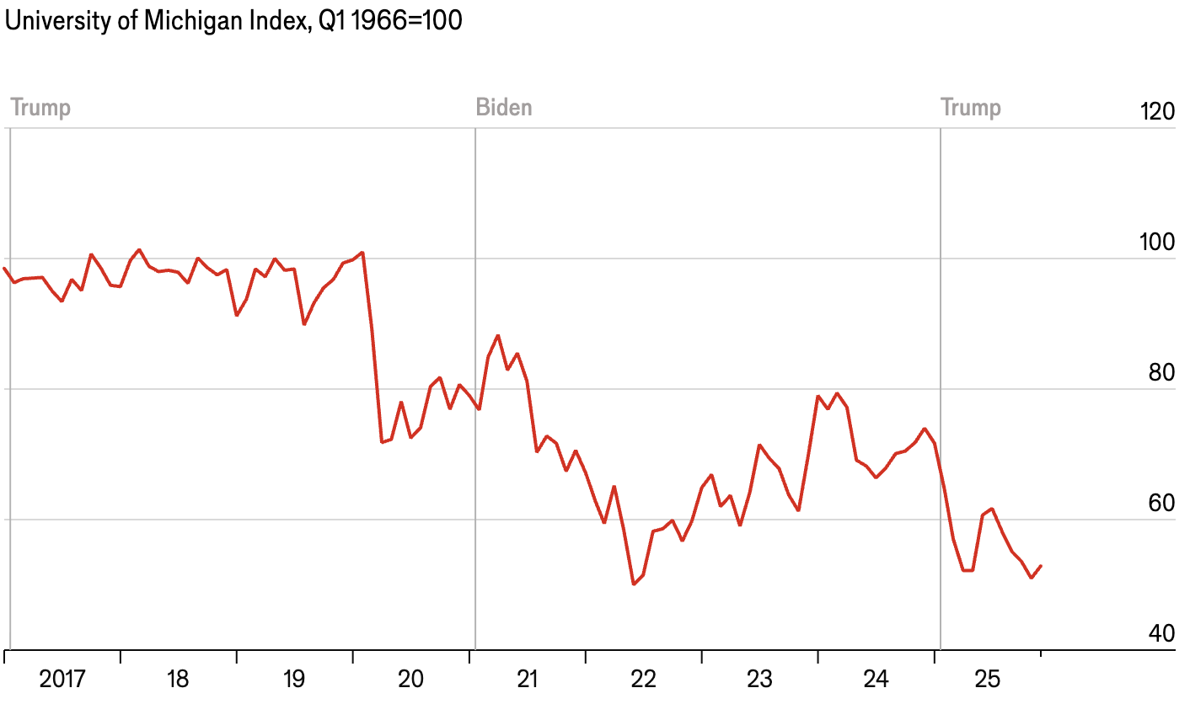
Consumer Confidence is Waning

Slide 43
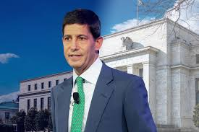
Monetary Policy after Jerome Powell?
Kevin Warsh: Trump Nominee to replace Jerome Powell as the Chair of the Fed in May

Slide 44
Bigger Picture

Slide 45
Summary
Inflation: was getting close to Fed’s 2% target.
  But is now going in the wrong direction
Current immigration and trade policies will exacerbate inflation.
Immigration: deportations tax the economy and are expensive.
  Many, MANY ag workers are unauthorized immigrants. (50% of Central Valley)
Tariffs: are a tax.
  Taxes raise prices. Period. Full Stop.
  Taxes often cost jobs. Tariffs likely will.
The war is going to drive up prices and uncertainty.
  Nobody invests into uncertainty.
What if the AI bubble bursts?

Slide 46
Are We Headed for A Recession?
Uncertain.
Forecasts are all over the place.
  IMF forecasting 2.4% in 2026.
  30-50% chance of a recession by some models.
A slowdown in economic growth seems inevitable.
A bout of stagflation unlikely, but possible.

Slide 47
Thank you!
Any Questions?
www.NEEDEcon.org
Jon D. Haveman
Jon@NEEDEcon.org
Contact NEED: info@NEEDEcon.org
Submit a testimonial: www.NEEDEcon.org/testimonials.php
Become a Friend of NEED: www.NEEDEcon.org/friend.php

