Slide 1
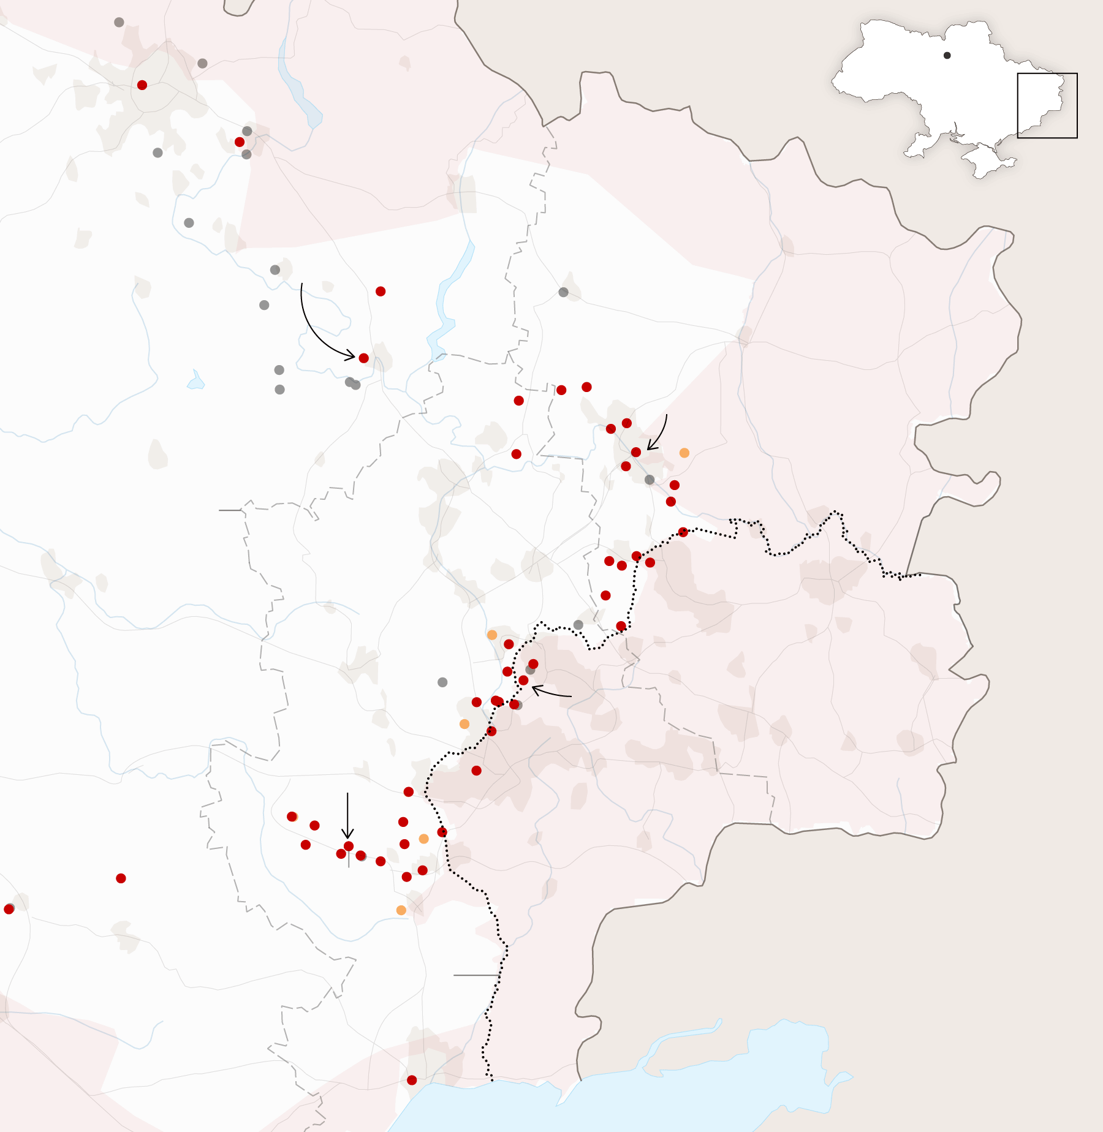
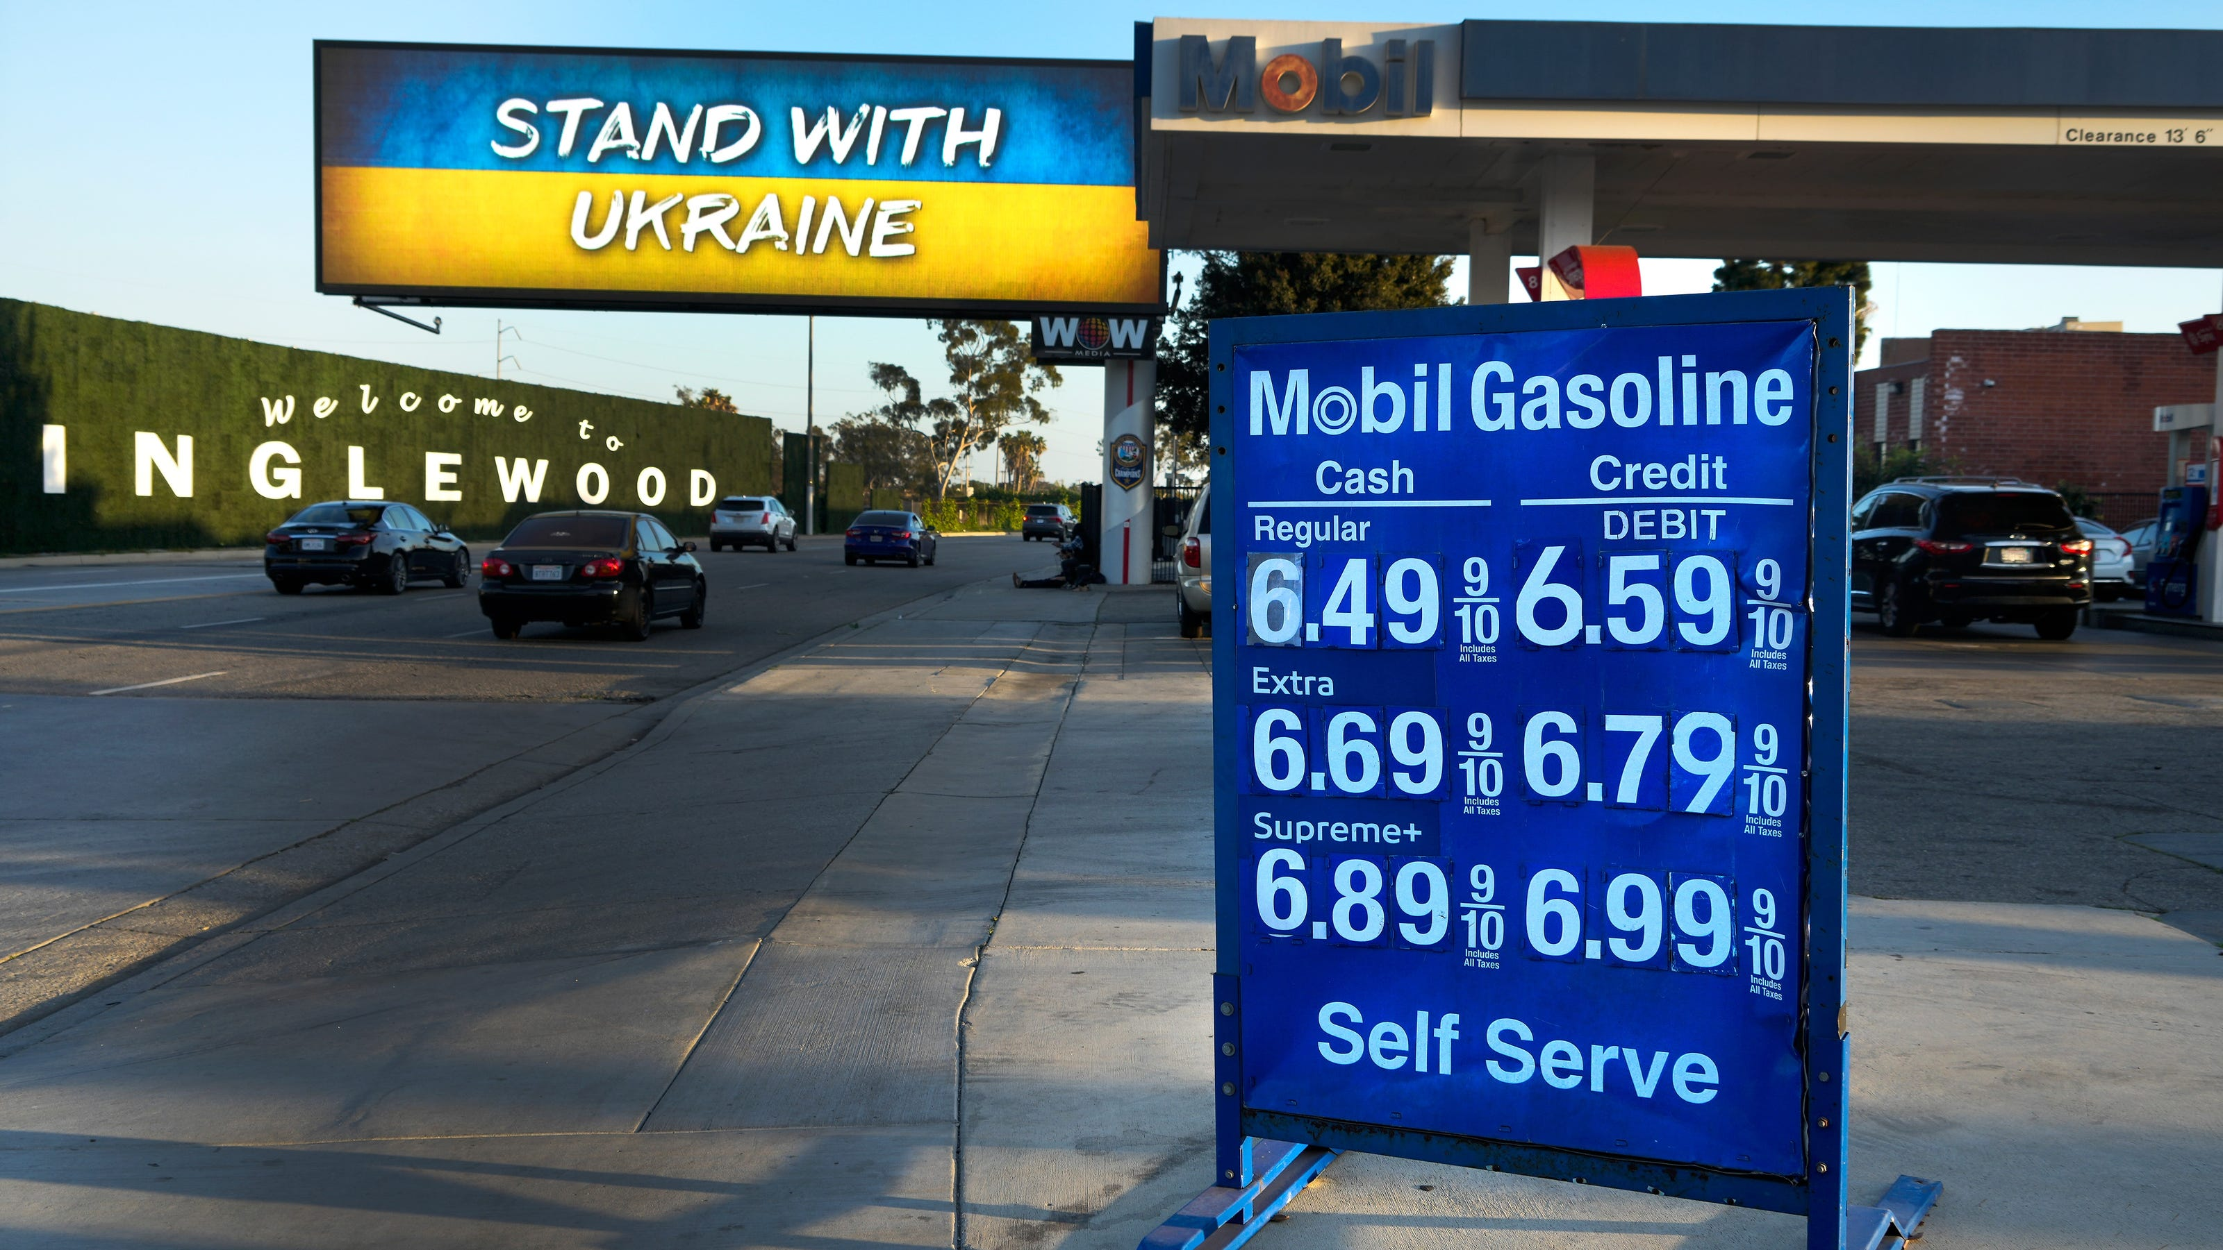
US Economy: Update
Geoffrey Woglom,
Professor of Economics
Amherst College, emeritus
January 13, 2023

Slide 2
National Economic Education Delegation
Vision
One day, the public discussion of policy issues will be grounded in an accurate perception of the underlying economic principles and data.
Mission
NEED unites the skills and knowledge of a vast network of professional economists to promote understanding of the economics of policy issues in the United States.
NEED Presentations
Are nonpartisan and intended to reflect the consensus of the economics profession.

Slide 3
Who Are We?
Honorary Board: 54 members
2 Fed Chairs: Janet Yellen, Ben Bernanke
6 Chairs Council of Economic Advisers
Furman (D), Rosen (R), Bernanke (R), Yellen (D), Tyson (D), Goolsbee (D)
3 Nobel Prize Winners
Akerlof, Smith, Maskin
Delegates: 652+ members
At all levels of academia and some in government service
All have a Ph.D. in economics
Crowdsource slide decks
Give presentations
Global Partners: 49 Ph.D. Economists
Aid in slide deck development

Slide 4
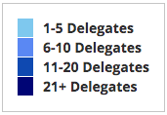
Where Are We?

Slide 5
Available NEED Topics Include:
US Economy
Healthcare Economics
Climate Change
Economic Inequality
Economic Mobility
Trade and Globalization
Minimum Wages
Immigration Economics
Housing Policy
Federal Budgets
Federal Debt
Black-White Wealth Gap
Autonomous Vehicles
Healthcare Economics

Slide 6
Credits and Disclaimer
This slide deck was authored by:
Jon D. Haveman, NEED
Scott Baier, Clemson University
Geoffrey Woglom, Amherst College (Emeritus)
Brian Dombeck, Lewis & Clark College
Doris Geide-Stevenson, Weber State
Disclaimer
NEED presentations are designed to be nonpartisan.
It is, however, inevitable that the presenter will be asked for and will provide their own views.
Such views are those of the presenter and not necessarily those of the National Economic Education Delegation (NEED).

Slide 7
Outline for the Talk
Quick summary of the state of the economy.
Into the weeds on inflation data.
What will the Fed do?
Questions welcome as we go along

Slide 8
Real GDP and ‘Potential’ during the Recovery
The “output gap” is about $150b
Source: Fred, St Louis Fed
Notes:
GDP is about $27 trillion. GDPNOw 3.9 1/5 Blue Chip 1.2

Slide 9
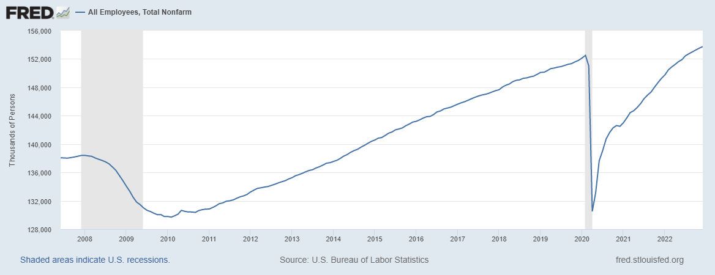
Labor Market: Fully Recovered?
Notes:
One big difference with GDP graph. Total jobs have barely recovered

Slide 10
Where Have All the Workers Gone?
Notes:
Overstates because of the slowdown in population growth. Drop in participation rate from 63.3 to 62.3 accounts for about 1.6 million lost jobs

Slide 11
Overall Good News on the Real Side
GDP is very close to its potential.
The labor market as measured by the unemployment rate is fully recovered.
Fly in the ointment: labor force has lost over 1.5 million workers.
But there is also a nominal side: interest rates, assets prices, inflation and wages.
News isn’t so good!

Slide 12
Interest Rates: Era of Falling Rates Over?
Notes:
Fed policy rate 4.5 to 4.25. Concerns with inflation

Slide 13
What about Housing?

Slide 14
Stock Prices: Rates and Recession?

Slide 15
Inflation during the Recovery
Notes:
August CPI yoy 8.3% down from 8.5 and Core 6.3 up from 6.3 in JUly

Slide 16
Inflation a Closer Look: Good News

Slide 17
Rents Paid and Rents Asked For

Slide 18
Inflation a Closer Look: Troubling News

Slide 19
What is Happening to Wages?

Slide 20
Where we Stand
The ARP was probably too big, but helped many poor families, and the Fed was aware of the size of the stimulus.
Monetary policy was too easy for too long, but since March of last years has been much more restrictive.
Yes, there were supply chain issues that temporarily raised inflation, but there was too much total spending.
So, where are we headed?

Slide 21
What about the “R” Word?
Latest Observation, 10/2022: 63%
Source Wall Street Journal

Slide 22
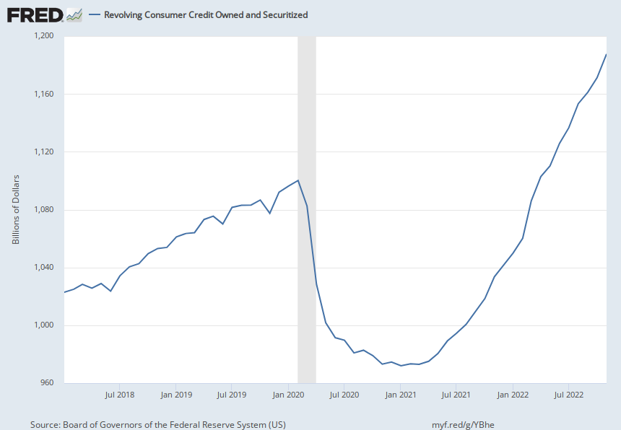
Prospects for Consumer Spending?
Credit Card Debt
Deutsche Bank Research
Notes:
Last year consumption increased by 7 %

Slide 23
Prospects for Inflation: Some Other Good News

Slide 24
Troubling Signs: Inflation Expectations
Source: Federal Reserve of Philadelphia

Slide 25
Things have changed at the Fed
Jerome Powell, Fed Chair
February 10, 2021: we will not tighten monetary policy solely in response to a strong labor market. .. [F]ollowing periods when inflation has been running persistently below 2 percent, appropriate monetary policy will likely aim to achieve inflation moderately above 2 percent for some time
December 14, 2022: Price stability is the bedrock of a healthy economy and provides the public with immeasurable benefits over time... But restoring price stability when inflation is high can require measures that are not popular in the short term as we raise interest rates to slow the economy.

Slide 26
What Will the Fed Do?
Here is what markets think:
Probability of 0.5 pcts point rise: 10%

Slide 27
Good News is Bad New for the Stock Market

Slide 28
Summary of Where We are Headed
The growth in total spending is at least slowing.
Labor Market is still strong, but lagging indicator.
Hard or Soft Landing: the Jury is out.
Inflation is coming down, but how fast?
Known Unknowns: New Covid Variant, Ukraine War, Budget Fights.
Unknown, Unknowns!

Slide 29
Olivier Blanchard 12/30 Twitter Post
Inflation is fundamentally the outcome of the distributional conflict, between firms, workers, and taxpayers… The source of the conflict may be too hot an economy. But in the end, forcing the players to accept the outcome, and thus stabilizing inflation, is typically left to the central bank… It is a highly inefficient way to deal with distributional conflicts…

Slide 30
Stay Tuned
January 26, BEA first estimate of fourth quarter GDP.
January 27, BEA releases PCE inflation for December.
January 31, next Federal Reserve meeting

Slide 31
Let’s Hear from You!
Geoffrey Woglom
grwoglom@amherst.edu
Contact NEED: Info@NEEDelegation.org
Submit a testimonial: www.NEEDelegation.org/testimonials.php
Support NEED: www.NEEDelegation.org/donate.php

Slide 32
www.NEEDelegation.org/LocalGraphs
For every state and county in the United States.
Detailed graphs on employment, housing, moves, and other statistics.

