Slide 1
US Economy and Coronavirus Economics
American Individual Investors Association, Maine Chapter
April 6, 2022
Doris Geide-Stevenson, Ph.D.
Weber State University, Ogden, UT

Slide 2
National Economic Education Delegation
Vision
  One day, the public discussion of policy issues will be grounded in an accurate perception of the underlying economic principles and data.
Mission
  NEED unites the skills and knowledge of a vast network of professional economists to promote understanding of the economics of policy issues in the United States.
NEED Presentations
  Are nonpartisan and intended to reflect the consensus of the economics profession.

Slide 3
Who Are We?
Honorary Board: 54 members
  2 Fed Chairs: Janet Yellen, Ben Bernanke
  6 Chairs Council of Economic Advisers
    Furman (D), Rosen (R), Bernanke (R), Yellen (D), Tyson (D), Goolsbee (D)
  3 Nobel Prize Winners
    Akerlof, Smith, Maskin
Delegates: 640+ members
  At all levels of academia and some in government service
  All have a Ph.D. in economics
  Crowdsource slide decks
  Give presentations
Global Partners: 48 Ph.D. Economists
  Aid in slide deck development

Slide 4
Credits and Disclaimer
This slide deck was authored by:
  Jon D. Haveman, NEED
  Scott Baier, Clemson University
  Geoffrey Woglom, Amherst College (Emeritus)
  Brian Dombeck, Lewis & Clark College
  Doris Geide-Stevenson, Weber State
Disclaimer
  NEED presentations are designed to be nonpartisan.
  It is, however, inevitable that the presenter will be asked for and will provide their own views.
  Such views are those of the presenter and not necessarily those of the National Economic Education Delegation (NEED).

Slide 5
Outline
State of the pandemic
The U.S. Economy
  Total Output - GDP
  Policy Support
  Labor Market
  Inflation
  Equity Markets
  Housing Markets
  Federal Debt

Slide 6
State of the Pandemic

Slide 7
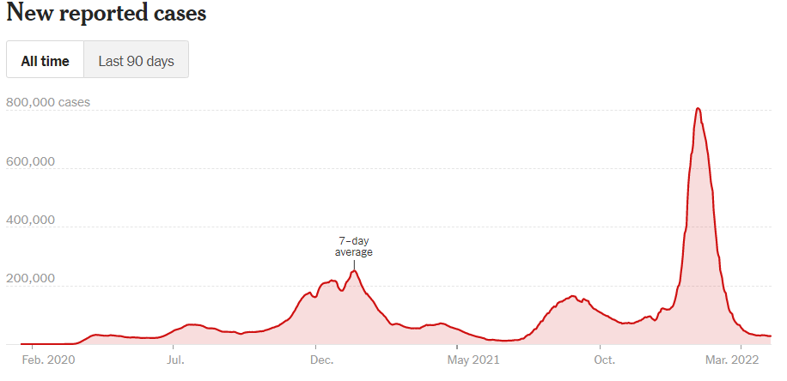
U.S Covid Cases
Source: NY Times, April 3, 2022

Slide 8
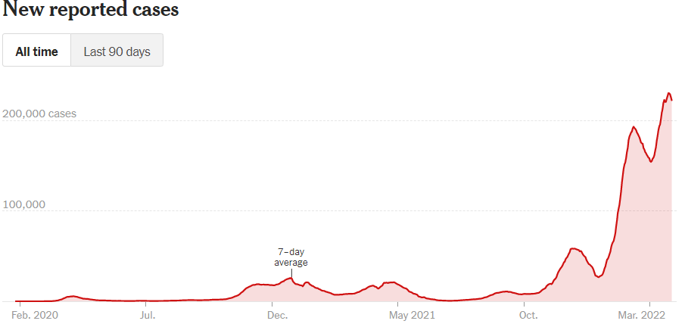
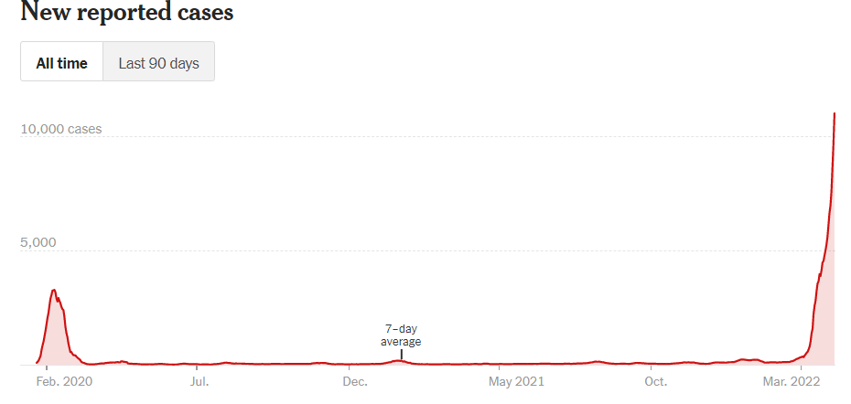
Omicron BA.2 ? Germany and China
Germany
China
Source: New York Times, April 3, 2022

Slide 9
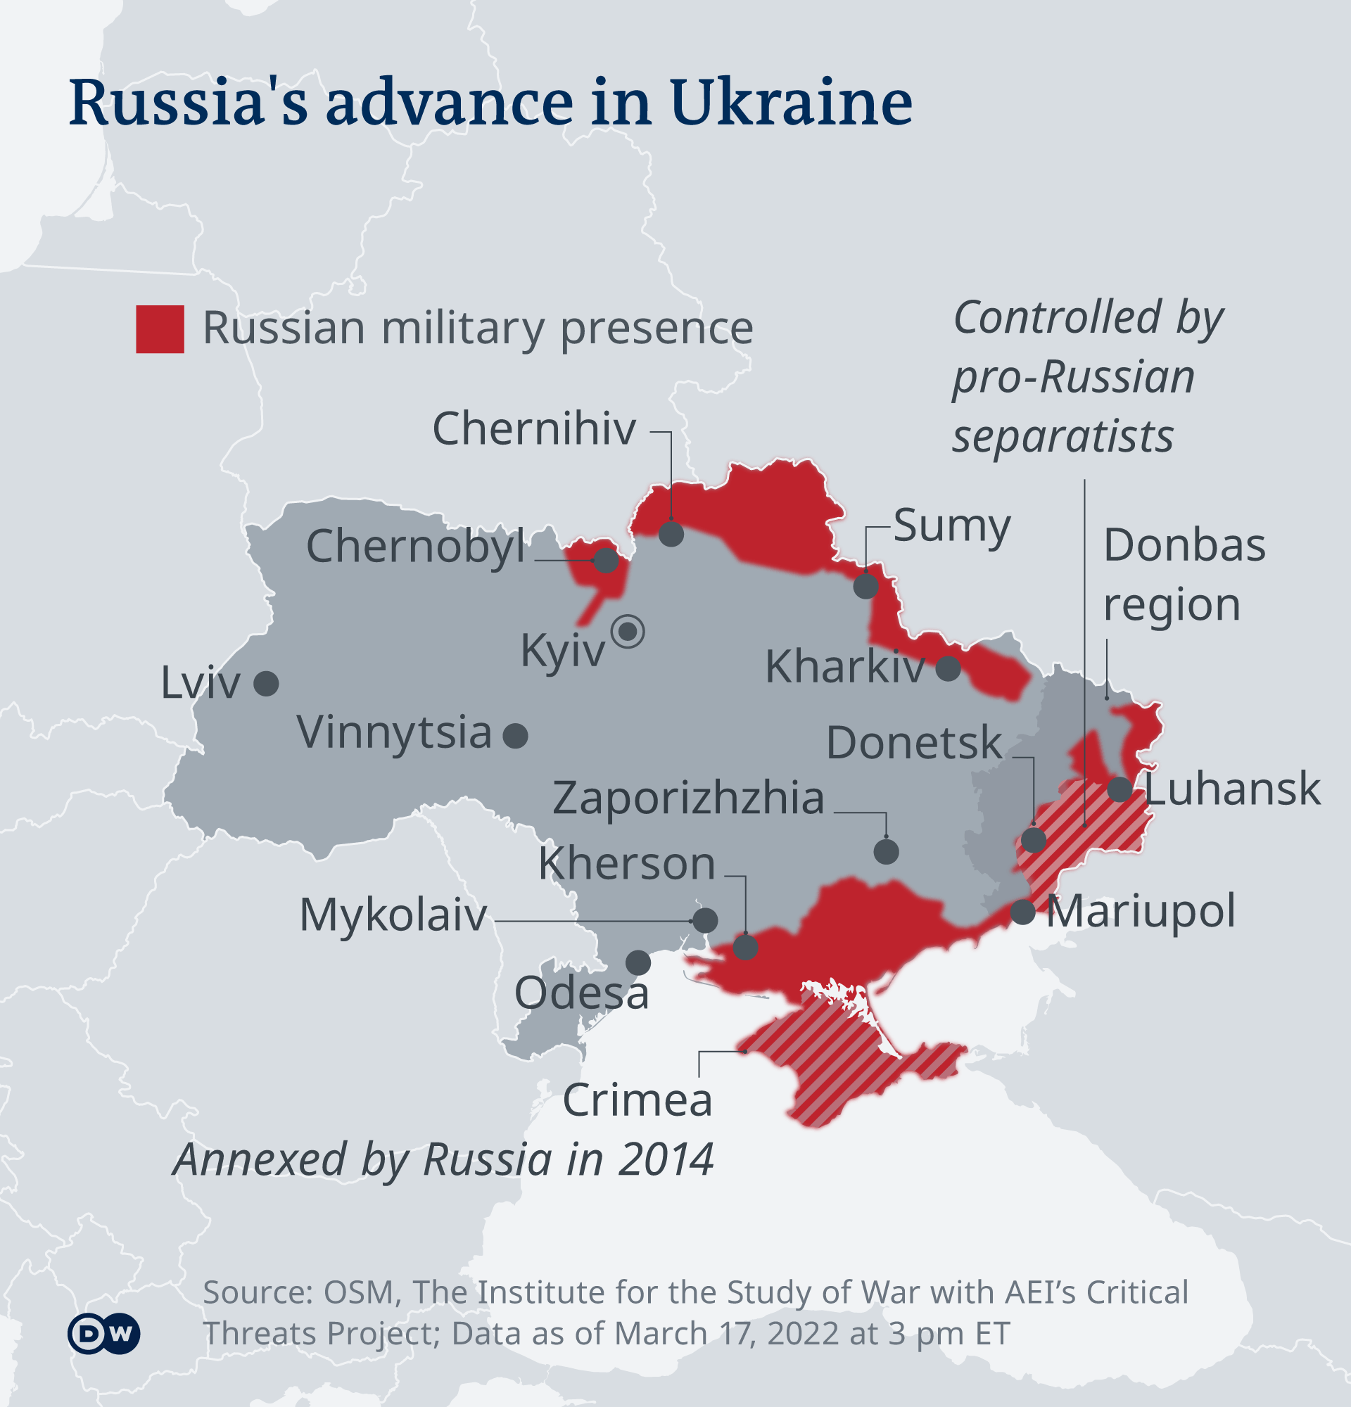
and now – the Russian invasion of Ukraine

Slide 10
The U.S. Economy
The Role of the Pandemic versus Policy Adjustments? And what now?

Slide 11
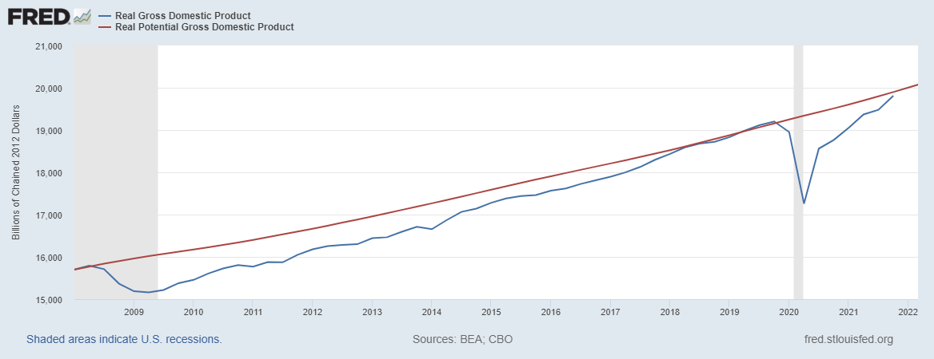
GDP Trajectory: Pandemic Plunge and Recovery
GDP is:
$0.5 Trillion below 2019 forecast.
$0.2 Trillion ABOVE 2019-Q4 level.
Real GDP = Total value of production = Consumption + Investment + Government Purchases + Net Exports
Almost no Output Gap compared to the start of the pandemic, and a quick recovery.
Notes:
Above pre-pandemic levels, but not back to potential output.

Slide 12
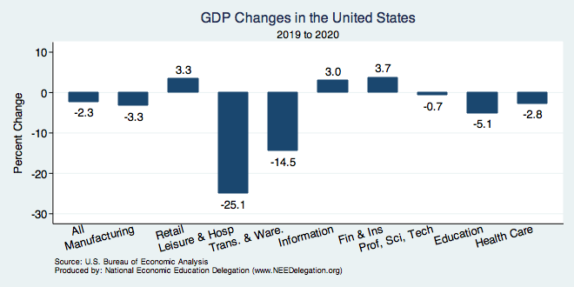
But Not All Industries Were Equally Harmed

Slide 13
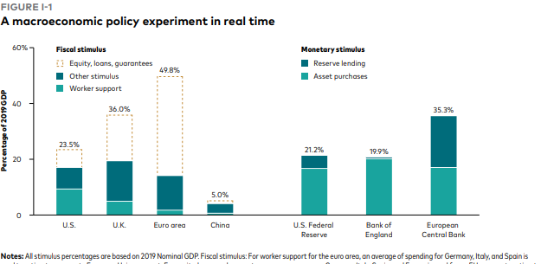
Unprecedented Policy Support
Source: Vanguard Economic and Market Outlook for 2022:Striking a better balance

Slide 14
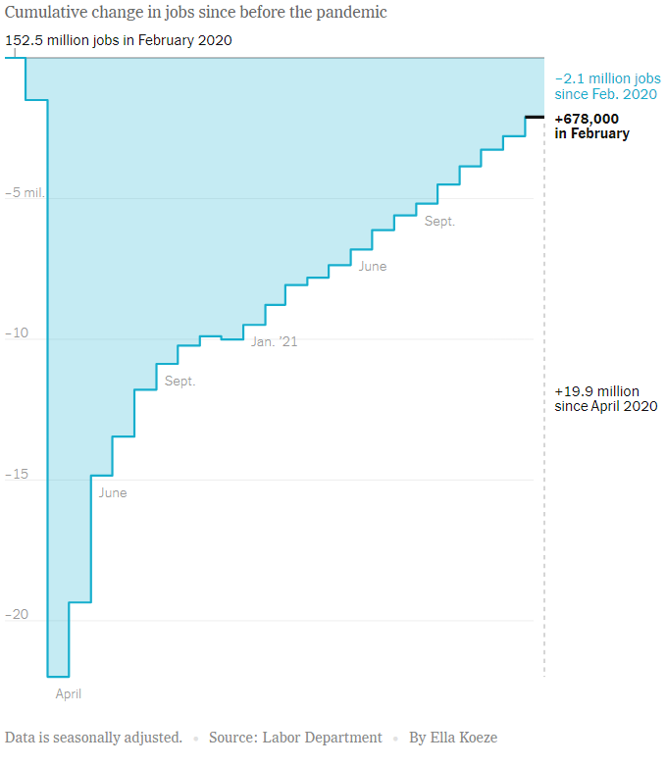
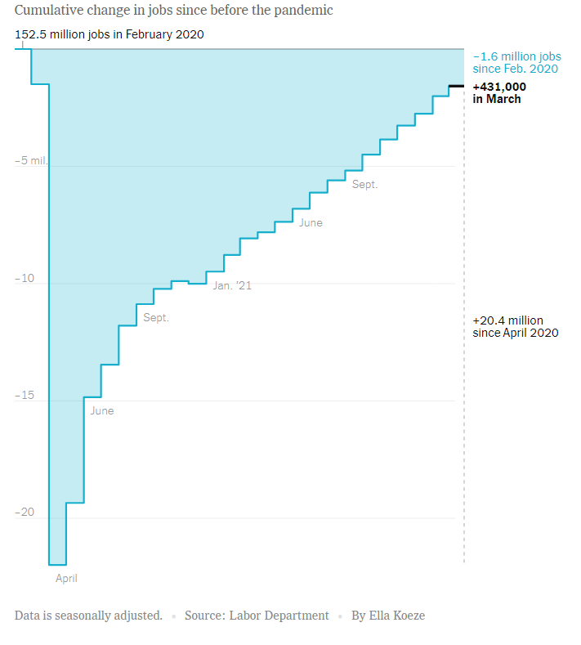
Employment Changes - US
Source: New York Times

Slide 15
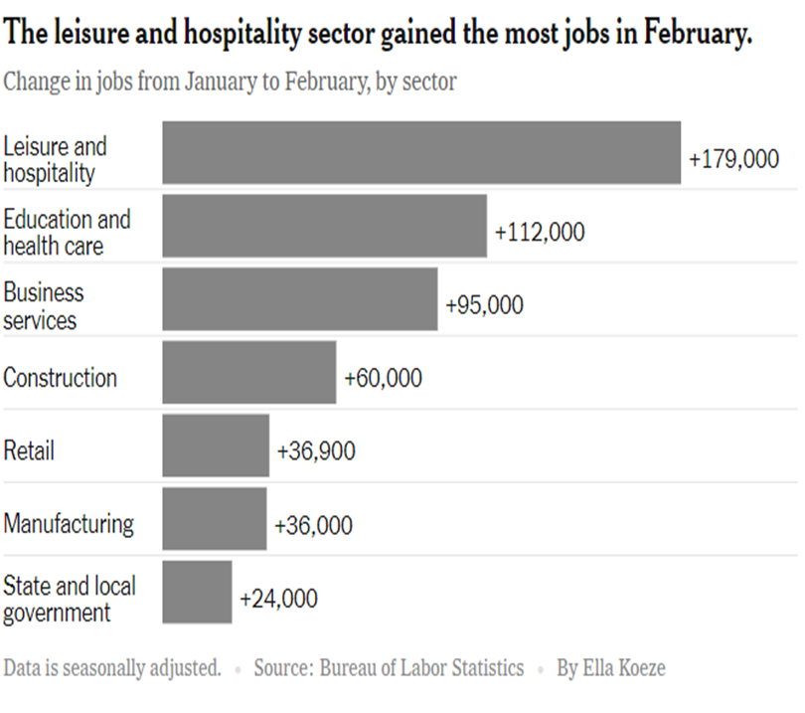
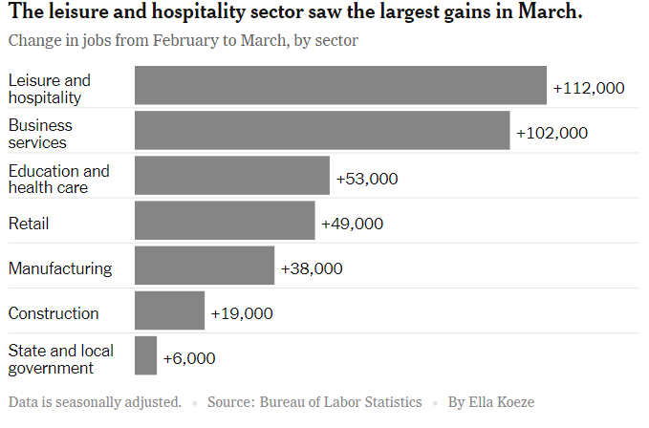
Employment Changes - US
Source: New York Times

Slide 16
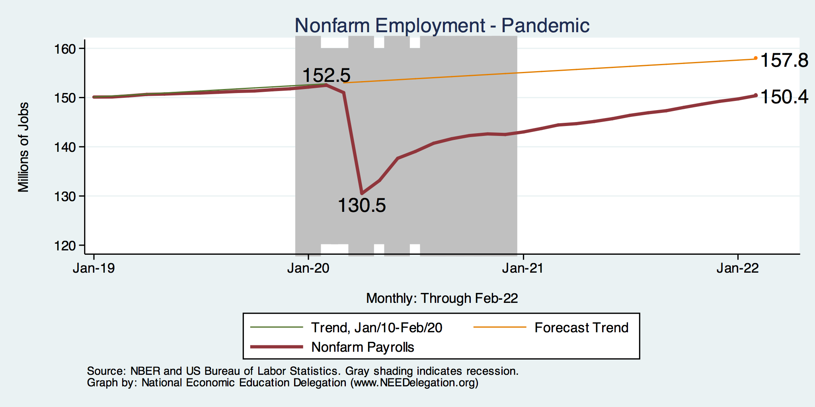
Employment Gap: Pandemic
Notes:
payroll_recent.png

Slide 17
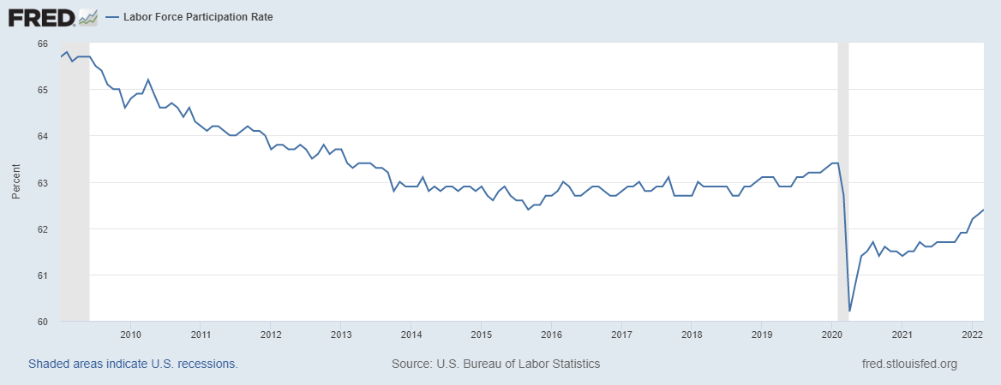
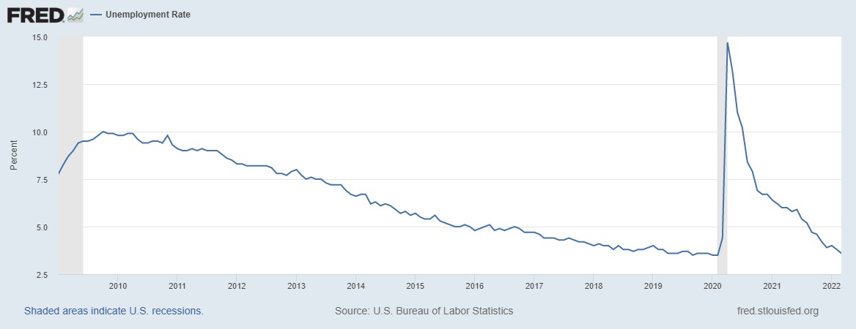
Labor Force Participation and Unemployment
Notes:
Labor force participation rate: 62.4%, unemployment at 3.6%

Slide 18
Inflation and Asset Markets
Inflation, Equity Markets, Housing Markets

Slide 19
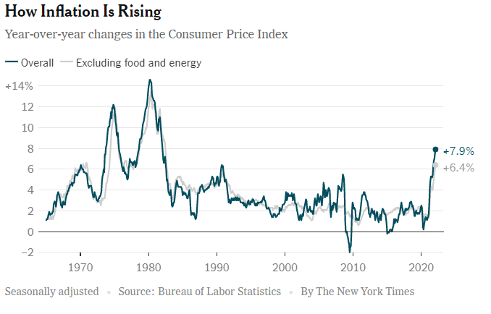
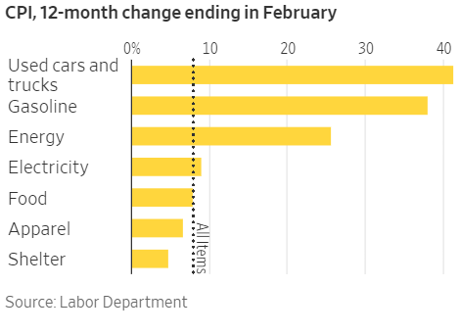
Inflation News
January 2022
All items: 7.9% - new four decade high
Source: New York Times, Wall Street Journal
Notes:
Why CPI overestimates or underestimates inflation – COVID CPI should reflect a change in purchases. Covid CPI 6.54%

Slide 20
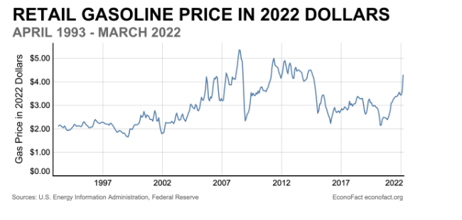
Gas Prices in Perspective -

Slide 21
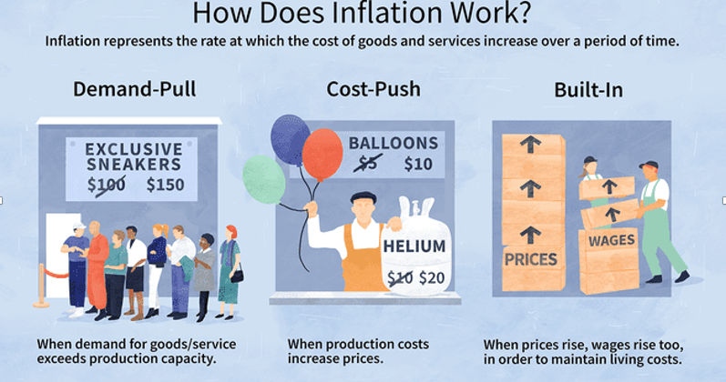
Source: Investopedia

Slide 22
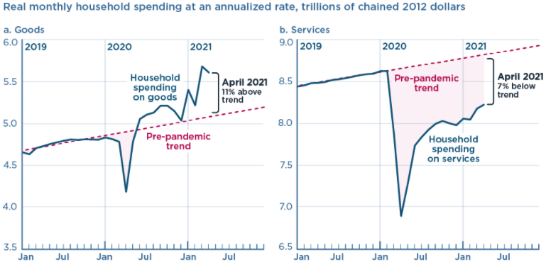
We’re Buying Mostly … Stuff
Demand-Pull
Source: Jason Furman, PIIE

Slide 23
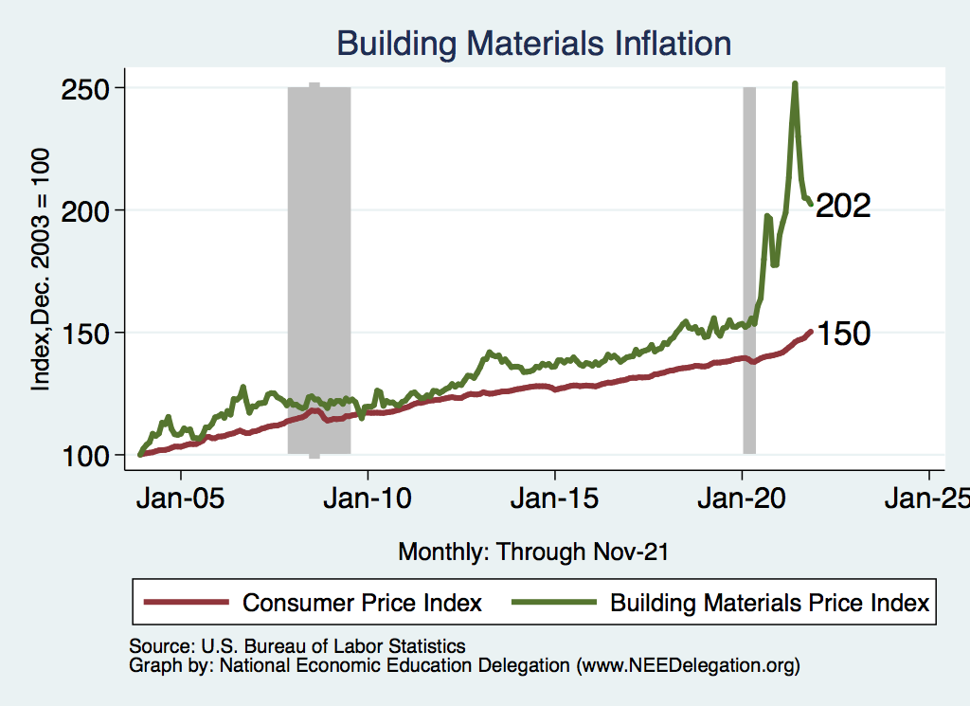
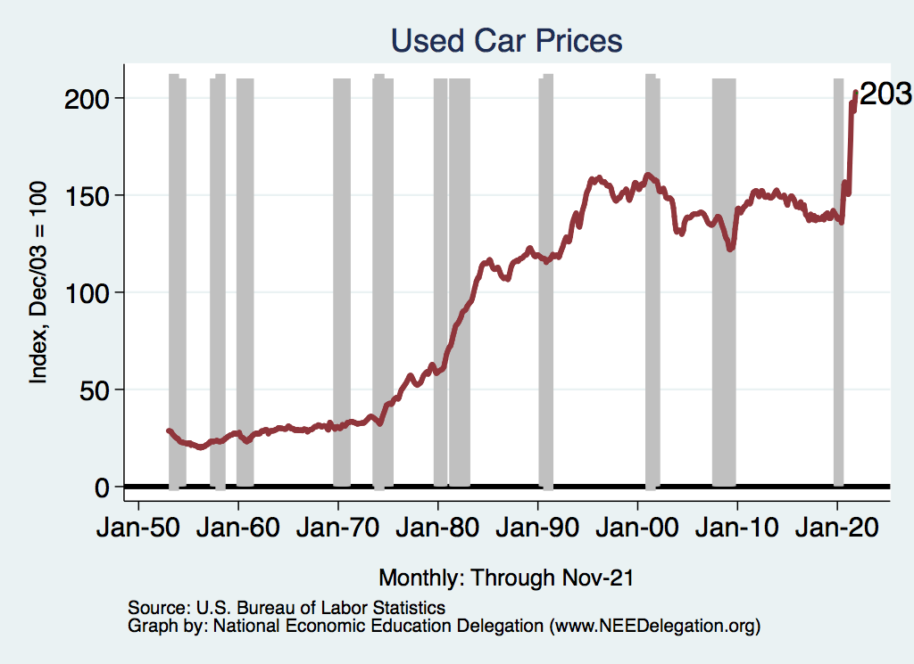
Inflation: Concentrated
Cost-Push
Notes:
Cost push will continue through 22: China Covid measures, staffing issues US

Slide 24
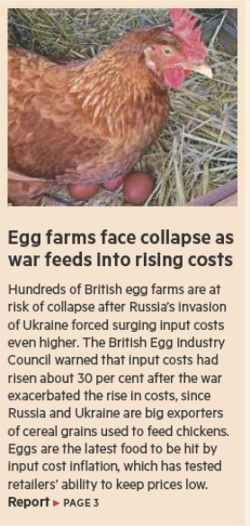
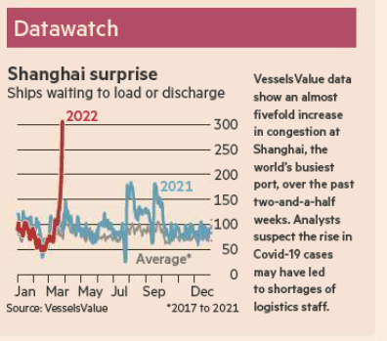
Inflation: Cost-Push will continue
Source: Financial Times, April 1, 2022
Notes:
Cost push will continue through 22: China Covid measures, staffing issues US

Slide 25
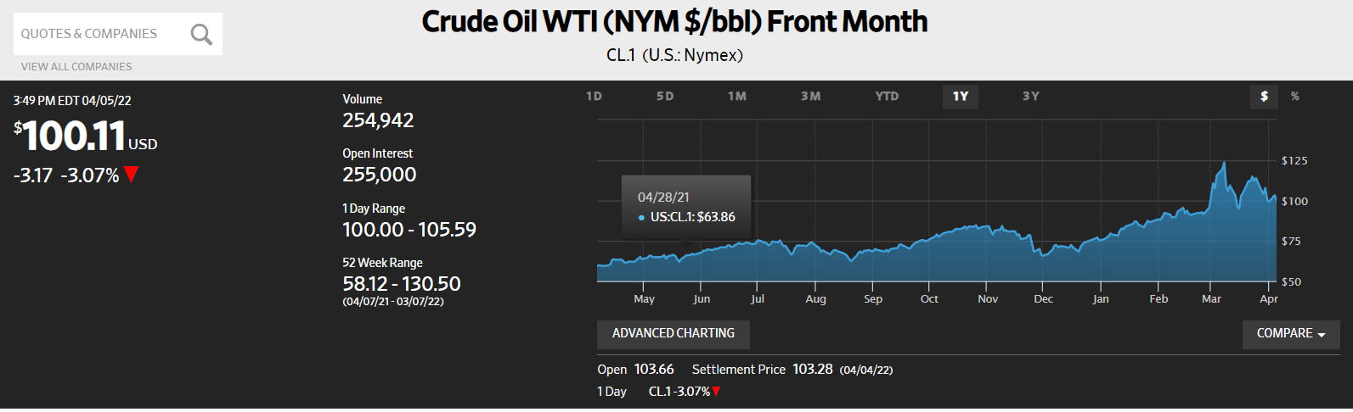
More Cost-push, but with a twist
Effects of sanctions on Russia are somewhat countered by Covid-related lockdowns in China and Hongkong, and
announcements to release strategic reserves in the U.S.
Source: Wall Street Journal, March 17, 22

Slide 26
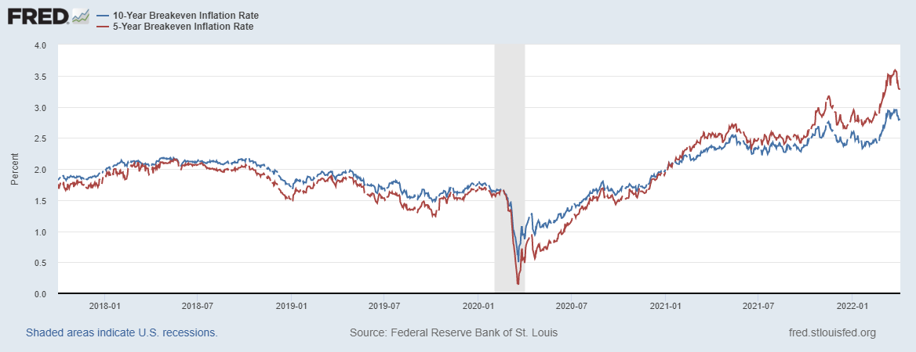
Measure of Inflation Expectations
Breakeven Inflation Rate = Difference between
nominal and real 5-year and 10-year Treasury
constant maturity securities.
Market participants expect around 2.8%
of inflation annually over the next 10 years and
3.3% over the next 5 years.
Inflation expectations were increasing – especially
after the Russian invasion, but most recently have
decreased.

Slide 27
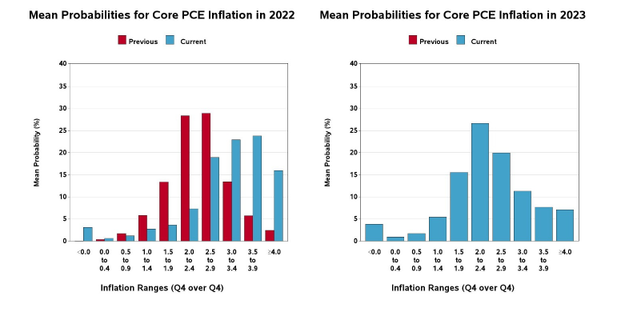
Alternative Measure of Inflation Expectations
Survey of Professional Forecasters, Feb. 11, 2022

Slide 28
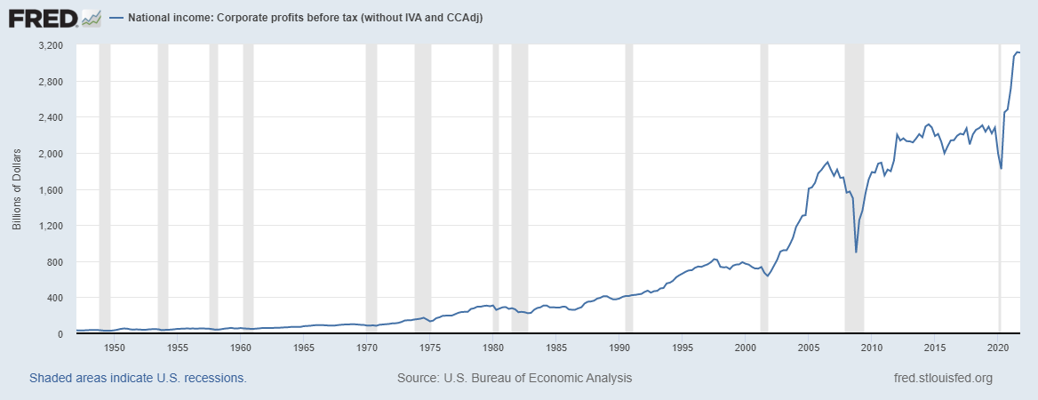
Corporate Profits…Adding to Inflation?

Slide 29
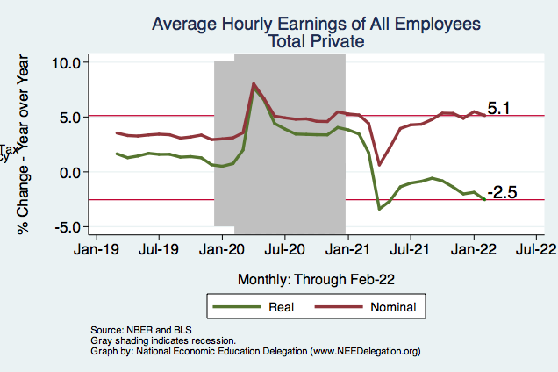
Wage Growth
Notes:
Is this necessary given the previous slide?

Slide 30
Will Inflation continue to be elevated?
Yes, at least through 2022 and 2023.
Continued supply chain issues (China Covid strategy, US staff shortages, Russia-Ukraine conflict)
Mitigated by a slower increase in demand (policy support decreased), but if consumers go back to substituting toward in-home consumption more bottlenecks will develop
Will this lead to a recession, i.e. stagflation?

Slide 31
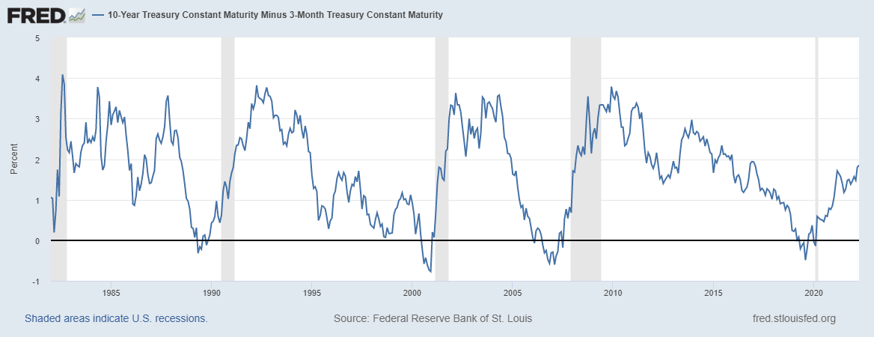
What Does the Yield Curve say?

Slide 32
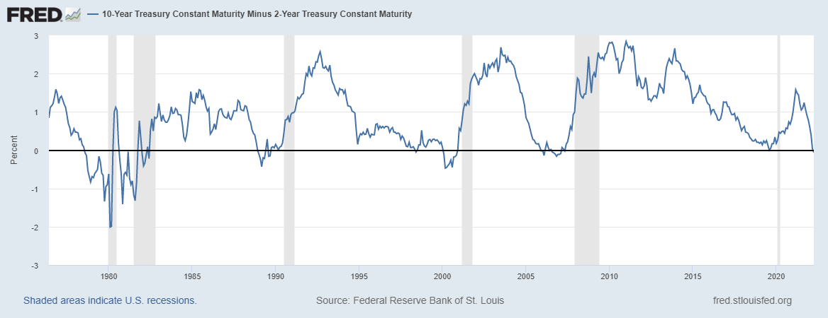
What Does the Yield Curve say?

Slide 33
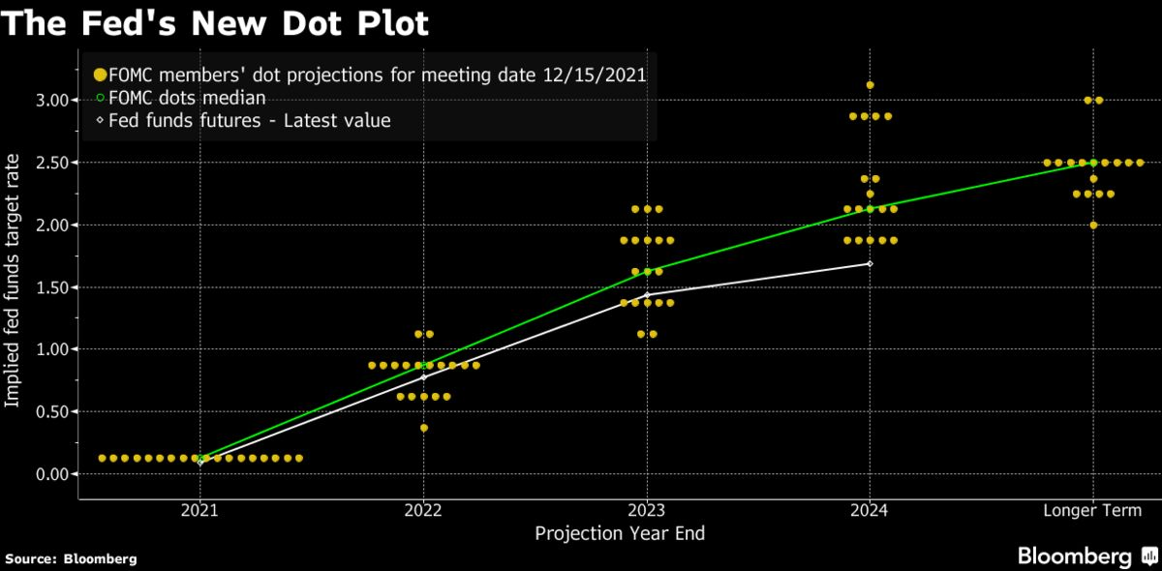
Projected Policy Changes - Fed
Notes:
From Dec. 15, 2021

Slide 34
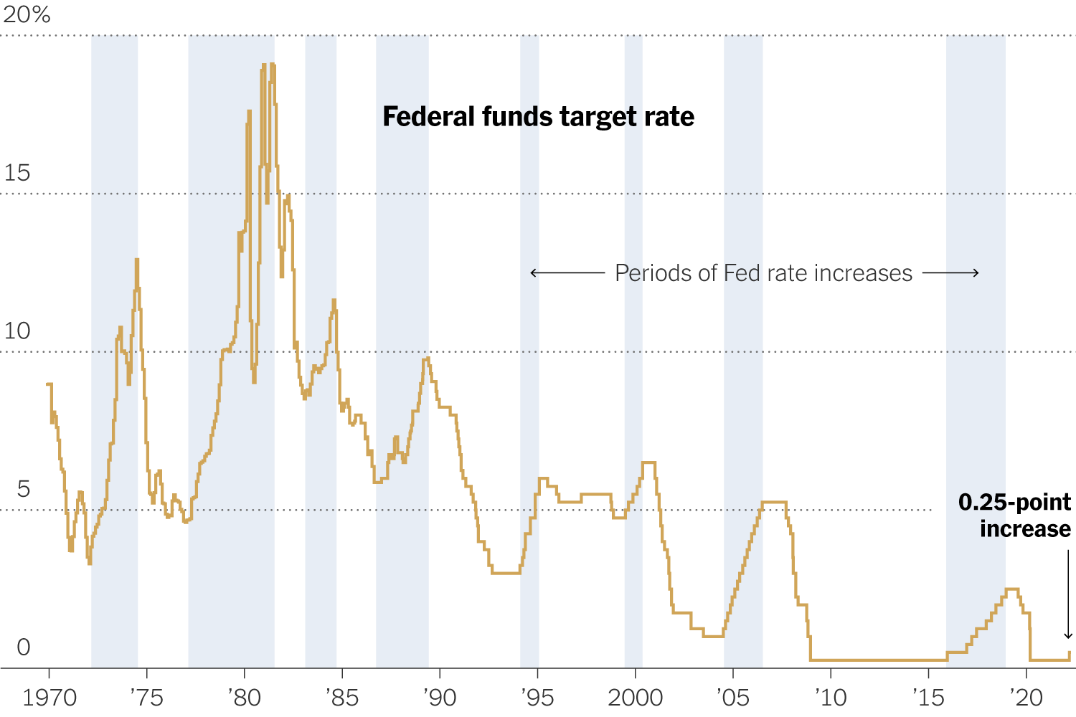
Fed Reaction – Wed. March 17, 2022
Fed is likely to raise interest rates faster than expected. Fed projects inflation at 4.3% for 2022.
Monetary policy adjustment is necessary, but trying to avoid a 1980’s scenario of causing a recession.
Current situation likely more comparable to post-WWII than to the late 1970’s.

Slide 35
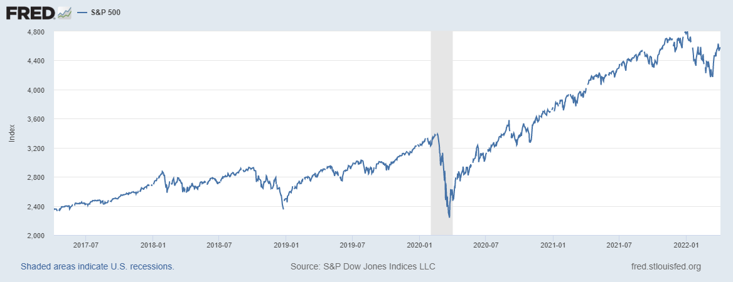
Equity Markets – Is there still Overvaluation?
Maybe yes – based on negative real earnings yields (inflation adjusted earnings per share) which indicates
that profits are not keeping up with share price increases (even though corporate profits are increasing)
at the peak of the market.

Slide 36
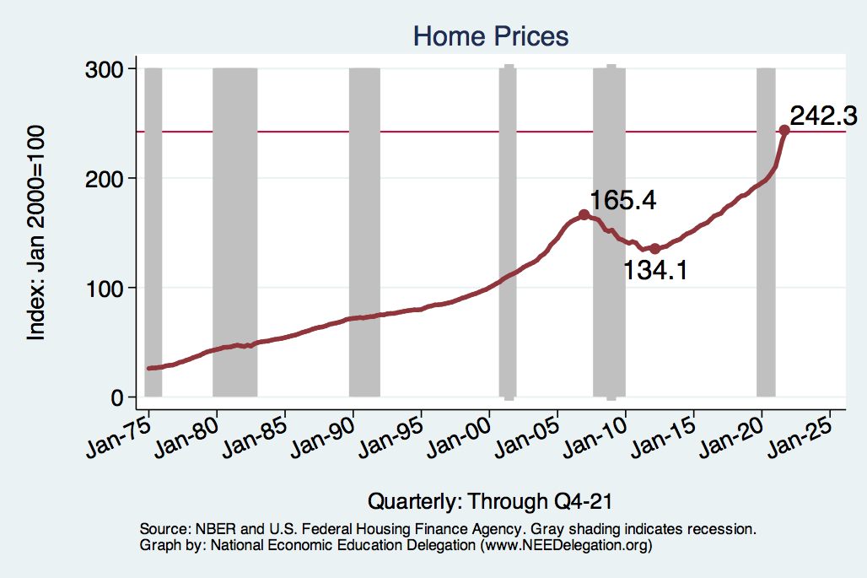
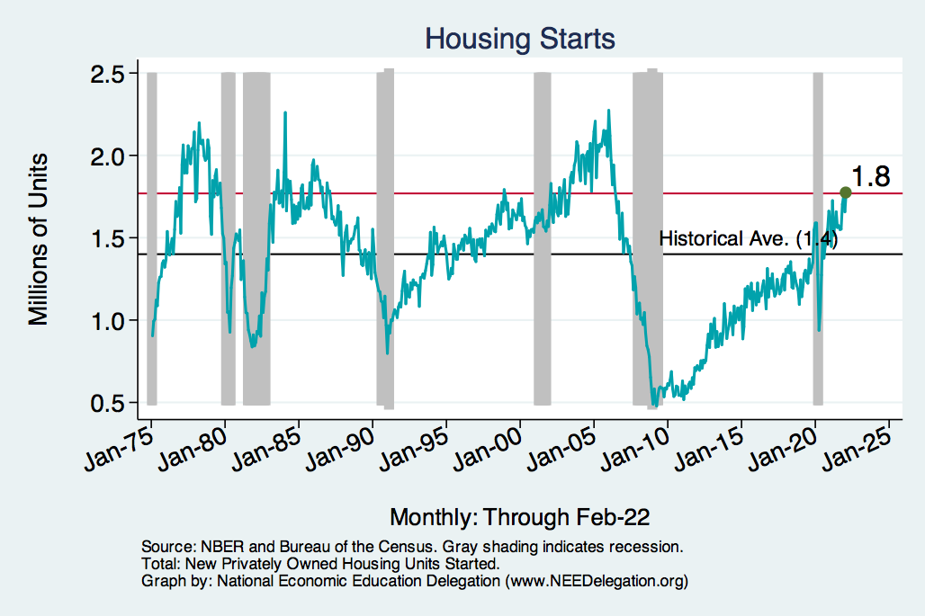
Home Prices and Housing Starts
Notes:
Charts:
homeprices_recession.png
housing.png

Slide 37
Federal Debt

Slide 38
The Federal Budget in FY2021
Mandatory, 71%
Discret. 22%
Net Interest, 7%
IIT, 50.5%
SST, 32,5%
CT, 9.0%
Programmatic Outlays = Mandatory + Discretionary
Source: Monthly Treasury Report, 9/2021

Slide 39
Past and Future of Deficits
Useful Deficit Decompositions:
Total Deficit= (Programmatic Outlays +
Interest Expense)-Revenue
=(Programmatic Outlays – Revenue)+Interest Expense
=Primary Deficit + Net Interest
Source: CBO, Updated Budget and Econo9mic Projections, 7/15/2021
Notes:
Christina Romer: 3 packages war production of 1943

Slide 40
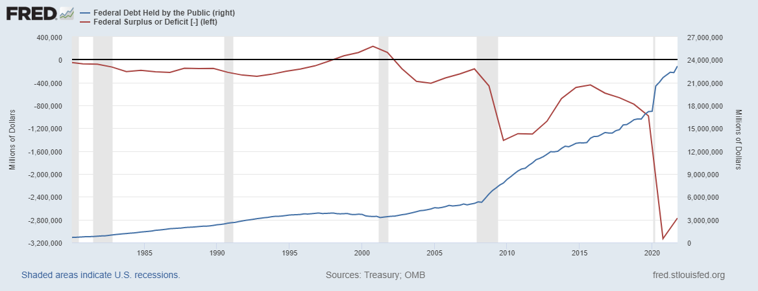
Debt vs. Deficit
The Sum of All Past Deficits Less Surpluses Equals the Debt
Blue Line Debt; Red Line Deficit
Shaded areas are recessions
Notes:
Yestere

Slide 41
Key Points About the U.S. Relative Debt
1946-1974
Relative debt peaked during WWII (106%) - followed by a steady decline until the 1980s.
Prior to 1983, relative debt rose purposefully (wars, recessions, public investment) and then fell.
What can we learn from the 46-74 period, where the relative debt fell continuously?

Slide 42
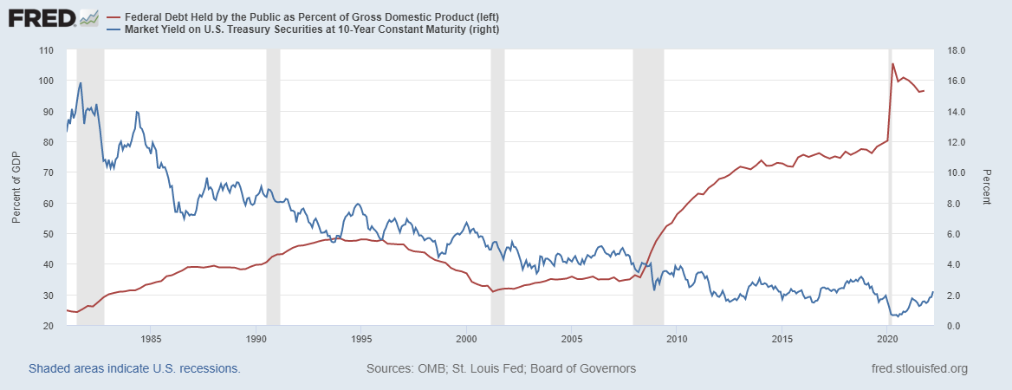
The Dog that Didn’t Bark; Rising Interest Rates?
Blue Line Rate on 10-Yr Treasury Bonds; Red Line Relative Debt
12 PM: 10-yr 2.24%

Slide 43
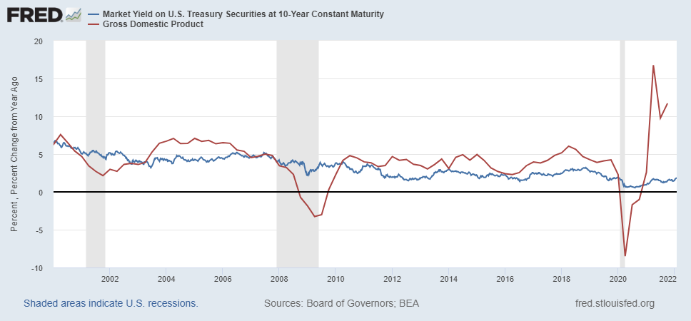
Blanchard’s Evidence
Blue Line Rate on 10-Yr Treasury Bonds; Red Line GDP growth
Notes:
Except for recessions.

Slide 44
Bottom Line: We Need to Worry about the Debt
Interest rates may not stay this low forever. In fact, economist don’t really know why they have fallen to such low levels over the past 20 years
A fiscal crisis should be avoided at all costs.
The good news is we may be able to stabilize the relative debt without running a surplus.

Slide 45
Conclusion
Recovery was V-shaped!
GDP will likely expand about 4% in 2022.
Physical health determines economic health for the economy.
  Variants may well slow our progress: Omicron (see Europe and China)
  Gov’t missteps may also hinder progress.
Biggest problems:
  Supply chain bottlenecks.
  Labor force participation.
  Russian invasion of Ukraine.
  Falling real wages

Slide 46
Best Measures of Progress – Conclusion
Inflation – getting it under control.
Real wages – need to see progress.
No further waves of Covid – State and federal plans to address future outbreaks

Slide 47
Thank you!
Any Questions?
www.NEEDelegation.org
Jon D. Haveman
Jon@NEEDelegation.org
Contact NEED: info@NEEDelegation.org
Submit a testimonial: www.NEEDelegation.org/testimonials.php
Become a Friend of NEED: www.NEEDelegation.org/friend.php

Slide 48
www.NEEDelegation.org/LocalGraphs
For every state and county in the United States.
Detailed graphs on employment, housing, moves, and other statistics.

Slide 49
Available NEED Topics Include:
Coronavirus Economics
US Economy
Climate Change
Economic Inequality
Economic Mobility
Trade and Globalization
Minimum Wages
Immigration Economics
Housing Policy
Federal Budgets
Federal Debt
Black-White Wealth Gap
Autonomous Vehicles
US Social Policy

