Slide 1
The State of the Recovery and the Challenges Ahead
Nov. 1, 2021
Kiwanis Club of San Jose
Geoffrey Woglom
Professor of Economics (emeritus)
Amherst College

Slide 2
National Economic Education Delegation
Vision
One day, the public discussion of policy issues will be grounded in an accurate perception of the underlying economic principles and data.
Mission
NEED unites the skills and knowledge of a vast network of professional economists to promote understanding of the economics of policy issues in the United States.
NEED Presentations
Are nonpartisan and intended to reflect the consensus of the economics profession.

Slide 3
Who Are We?
Honorary Board: 54 members
2 Fed Chairs: Janet Yellen, Ben Bernanke
6 Chairs Council of Economic Advisers
Furman (D), Rosen (R), Bernanke (R), Yellen (D), Tyson (D), Goolsbee (D)
3 Nobel Prize Winners
Akerlof, Smith, Maskin
Delegates: 600+ members
At all levels of academia and some in government service
All have a Ph.D. in economics
Crowdsource slide decks
Give presentations
Global Partners: 44 Ph.D. Economists
Aid in slide deck development

Slide 4
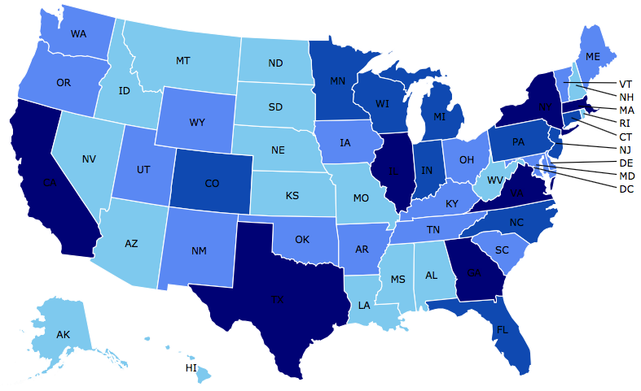
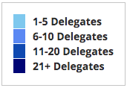
Where Are We?

Slide 5
Available NEED Topics Include:
Coronavirus Economics
US Economy
Climate Change
Economic Inequality
Economic Mobility
Trade and Globalization
Minimum Wages
Immigration Economics
Housing Policy
Federal Budgets
Federal Debt
Black-White Wealth Gap
Autonomous Vehicles
US Monetary Policy

Slide 6
Credits and Disclaimer
This slide deck was authored by:
Geoffrey Woglom, Amherst College, emeritus
This slide deck was reviewed by:
Jon Haveman
Disclaimer
NEED presentations are designed to be nonpartisan.
It is, however, inevitable that the presenter will be asked for and will provide their own views.
Such views are those of the presenter and not necessarily those of the National Economic Education Delegation (NEED).

Slide 7
Outline
Quick Review of where the recovery stands.
3 Related economic puzzles all related to the persistence of inflation and the future of the recovery.
Why are all eyes on the Fed next Wednesday.

Slide 8
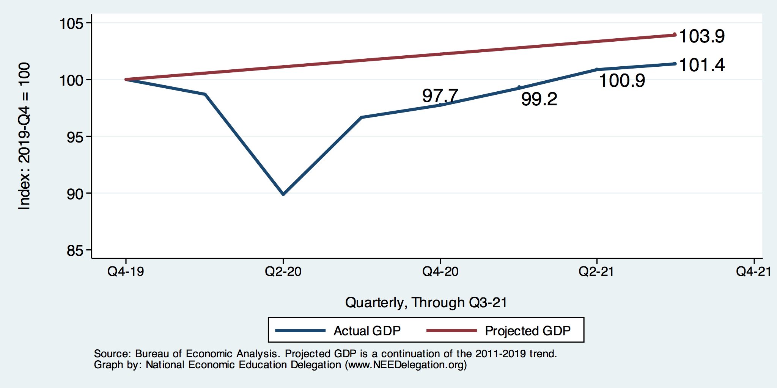
Real GDP and Potential during the Recovery
-2.5%
The “output gap” is about $500b
Source: Bureau of Economic Activity https://www.bea.gov/ & CBO
Notes:
Point Out that the recover is slowing

Slide 9
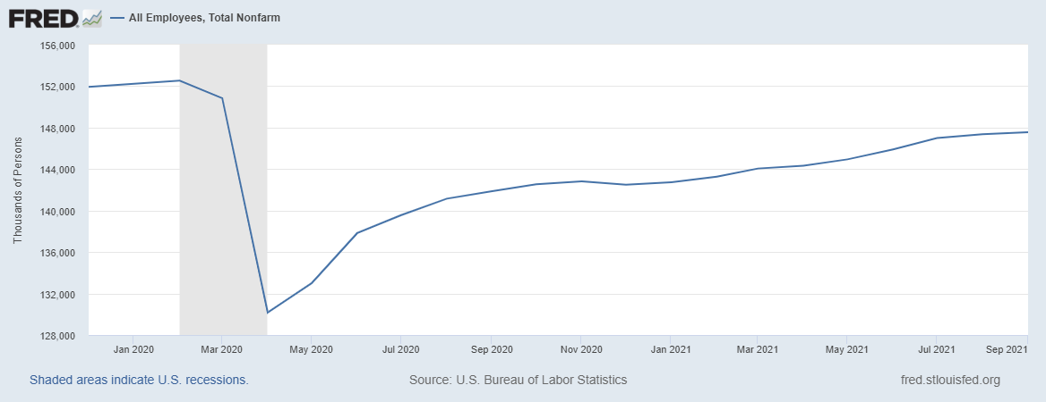
How about the Labor Market?
-5m
Source: BLS
Notes:
Recovery is incomplete and slowing recently

Slide 10
Recovery Due to Immense Fiscal Stimulus and Control of COVID
Source: BEA
Notes:
Different Fiscal Stimulua pckgs. 7 million people lose emergency unemployment benefits.

Slide 11
Stimulus allowed Spending to Recover
But Note that Saving also went way up
Saving
Abnormally high Saving is over $2trillion

Slide 12
Inflation during the Recovery
Source: BEA
Notes:
Fed targets realized inflation. Inflation most revenlty is slowing

Slide 13
Three Related Puzzles
How long will Supply Chain Bottlenecks persist?
Is there a Labor Shortage?
Will the increase In Inflation persist?

Slide 14
1. Supply Chain Bottlenecks
Transportation Issues:
Shortage of port workers.
Minnesota Trucking Association estimates 60,000 person shortage of truck drivers (The Atlantic, 10/7/21).
But, also an increase in demand for goods relative to services.

Slide 15
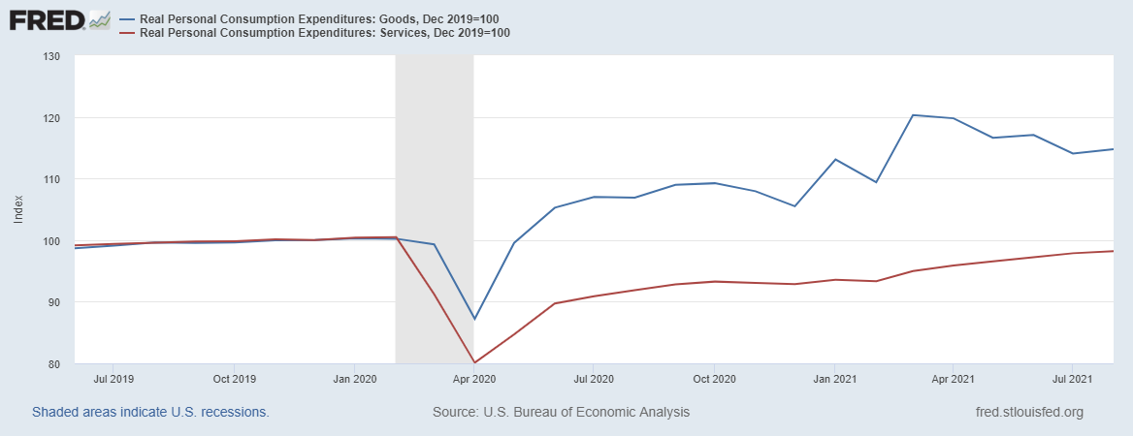
Bottlenecks Are Not Just Supply Issues

Slide 16
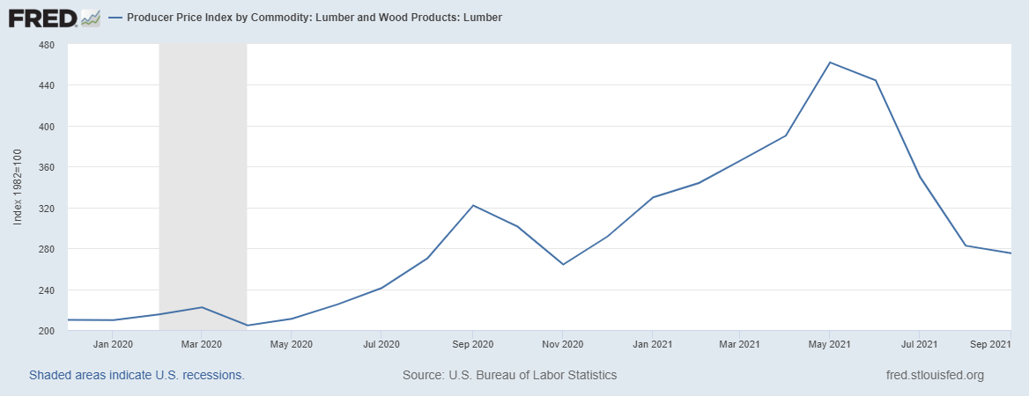
Econ 101: Market Response to a Temporary Shortage

Slide 17
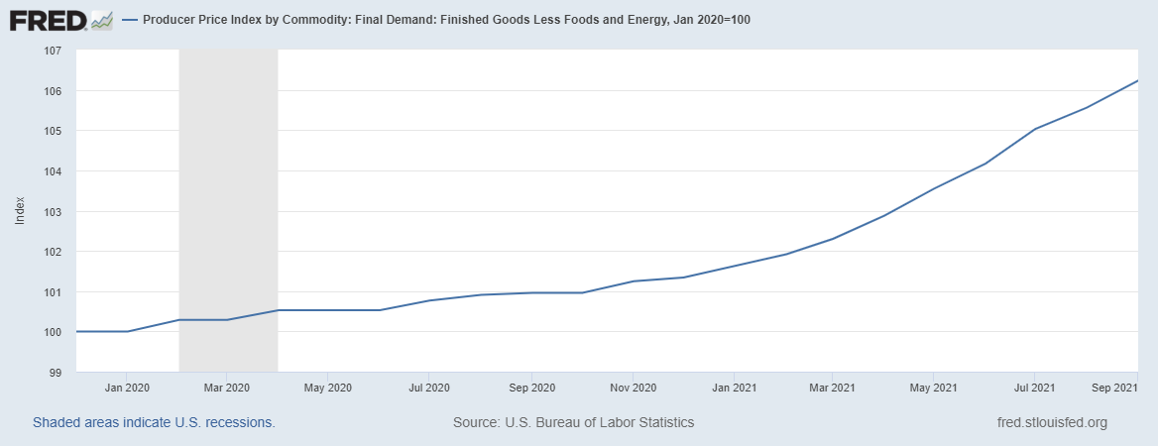
Overall, Producer Prices are Still Rising

Slide 18
2. Crazy Labor Market

Slide 19
Explanations of Labor Shortage
Too generous unemployment benefits.
Covid Fears and Family responsibilities.
Mismatch of available workers and jobs.
This Friday we get a reading on employment and unemployment from the BLS

Slide 20
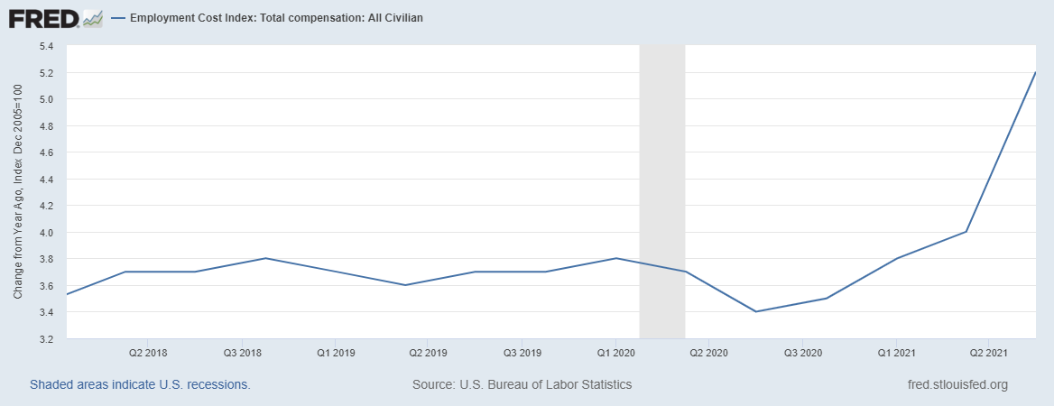
Whatever the Reason: Labor Costs Are Rising
Notes:
Rising labor costs persistent supply and labor shortages suggest inflation is will stay high for a least a while, but key question is what is it doing to expectations
Also, significant that most of the industrialized economies are seeing rising inflation.

Slide 21
3. Democratic Economists Disagree
Former Treasury Secretary Larry Summers, 10/13/2021:
“We’re in more danger than we’ve been during my career of losing control of inflation in the U.S.,” the 66-year-old Summers,…, said.
Current Treasury Secretary Janet Yellen, 10/24/2021:
“I don’t think we’re about to lose control of inflation,” Yellen said, “Americans haven’t seen inflation like we have experienced recently in a long time. But as we get back to normal, expect that to end.”
Yellen in the Spring, 3/14
“We have had very well anchored inflationary expectations, and a Federal Reserve that’s learned how to manage inflation.”
Source: Bloomberg

Slide 22
Have We Lost Our Anchor?
Notes:
Last week’s readings the highest ever since the series began in 2003. Why expectations are important.

Slide 23
So, What’s the Problem?
If the Fed sees persistent inflation, can’t they just raise interest rates?
Economic Problems
Total Spending has tremendous inertia, it could take months for a rise in interest rates to slow spending;
Significant danger of “overshooting.” What would a substantial rise in interest rates do to stock prices, financial stability, Federal deficit?
Political Economic Problem
Would the Fed raise rates with the 2022 elections pending?
A substantial rise in rates would make our deficit and debt problems much, much worse.
Notes:
That is why FOMC meeting and polisy statement to be releaed Wednesday at 2 will be widely studiesd.

Slide 24
Thank you!
What Do You Think?
www.NEEDelegation.org
Geof Woglom
grwoglom@amherst.edu
Contact NEED: info@needelegation.org
Submit a testimonial: www.NEEDelegation.org/testimonials.php
Become a Friend of NEED: www.NEEDelegation.org/friend.php

