Slide 1
US Economic Update
SIRs 146, Walnut Creek
August 11, 2022
Jon Haveman, Ph.D.
National Economic Education Delegation

Slide 2
Available NEED Topics Include:
Healthcare Economics
US Economy
Climate Change
Economic Inequality
Economic Mobility
Trade and Globalization
Minimum Wages
Immigration Economics
Housing Policy
Federal Budgets
Federal Debt
Black-White Wealth Gap
Autonomous Vehicles
Healthcare Economics

Slide 3
Credits and Disclaimer
This slide deck was authored by:
Jon D. Haveman, NEED
Scott Baier, Clemson University
Geoffrey Woglom, Amherst College (Emeritus)
Brian Dombeck, Lewis & Clark College
Doris Geide-Stevenson, Weber State
Disclaimer
NEED presentations are designed to be nonpartisan.
It is, however, inevitable that the presenter will be asked for and will provide their own views.
Such views are those of the presenter and not necessarily those of the National Economic Education Delegation (NEED).

Slide 4
Outline
Recession – is we is?
Inflation
Federal Reserve

Slide 5
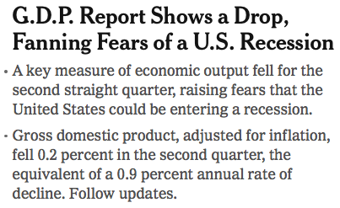
Headline:

Slide 6
GDP: Quarterly Growth
Notes:
Graph: gdp_pot_grow.png
The Point: From 1990 – 2007, average annual US GDP growth pre-crisis is 2.94%. However, post-crisis US GDP growth is 2.19% (0.75 percentage points lower). Why is has the recovery been sluggish?
Note: At the recession’s height, the gap between quarterly GDP growth and potential growth was 2.5 percentage points.

Slide 7
GDP Trajectory: Pandemic Plunge!
GDP is:
$0.6 Trillion below 2019 forecast.
$0.6 Trillion ABOVE 2019-Q4 level.

Slide 8
What Is “Accounting” for the Decline?
Expenditures drive GDP growth.
GDP is the sum of four categories of spending:
Consumption
Investment – housing/business/inventories
Government spending
Net Exports: Exports – Imports
Notes:
Recall: GDP is measures production of an economy; we often measure GDP as the sum of spending on final goods/services produced within an economy. The first three categories (C,I,G) contain spending on both domestically and foreign produced goods. To accurately measure domestic production, we subtract domestic consumption of foreign goods (imports).
The Point: Analysis of components of GDP as well as the production side of the economy should provide a comprehensive picture of the US economic landscape

Slide 9
Recession? Two Quarters….
Depends on what is driving the drop.
Inventories
Housing
Government spending
Consumer spending is still ok.
Employment growth is solid.
Other indicators are still ok.

Slide 10
Contribution to GDP Growth: Consumption
Notes:
Average GDP growth from 1990-2007 is 2.99% and from 2010+ is 2.19%
Average Consumption contribution from 1990-2007 is 2.16 percentage points and from 2010+ is 1.67 percentage points

Slide 11
Contribution to GDP Growth: Inventories
Notes:
Average GDP growth from 1990-2007 is 2.99% and from 2010+ is 2.19%
Average Consumption contribution from 1990-2007 is 2.16 percentage points and from 2010+ is 1.67 percentage points

Slide 12
Industrial Production (Manuf, Util, Mining)

Slide 13
Monthly Changes in Nonfarm Employment
Notes:
PAYEMS.png

Slide 14
Monthly Changes in Nonfarm Employment
June: 372,000
Notes:
PAYEMS.png

Slide 15
Employment Gap
40 thousand ABOVE February, 2020.
6.3 Million below where we should be.
Notes:
payroll_recent.png

Slide 16
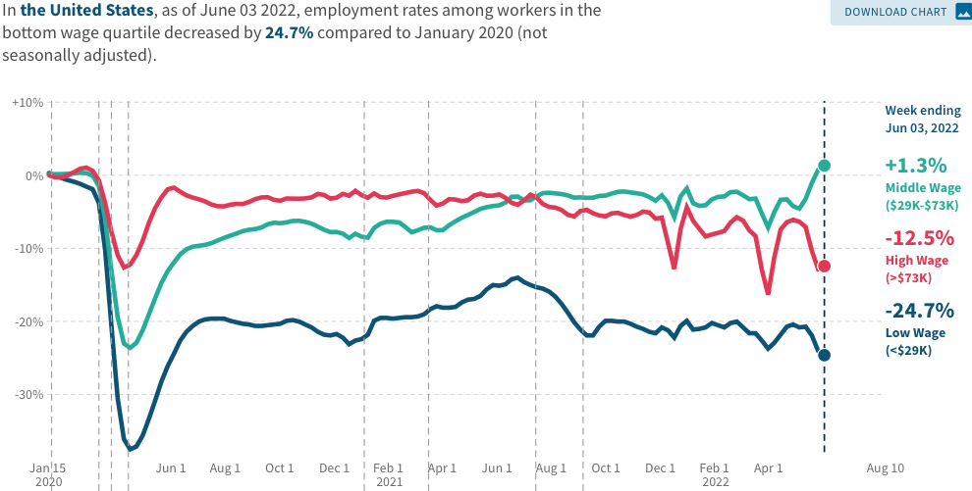
Low Wage Employment is Lagging

Slide 17
Inflation

Slide 18
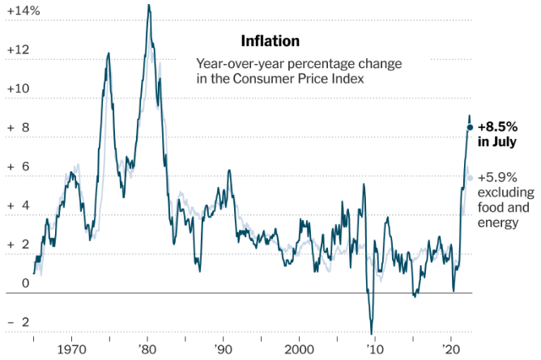
Inflation: Latest Figures

Slide 19
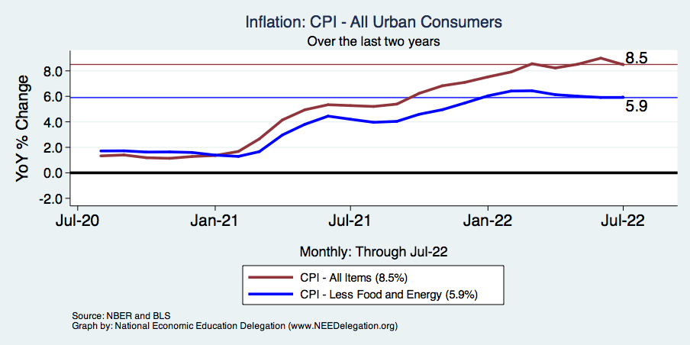
Inflation – Climbing! Should we worry?
Notes:
Cpi_recent.png

Slide 20
Inflation: ZERO from June to July

Slide 21
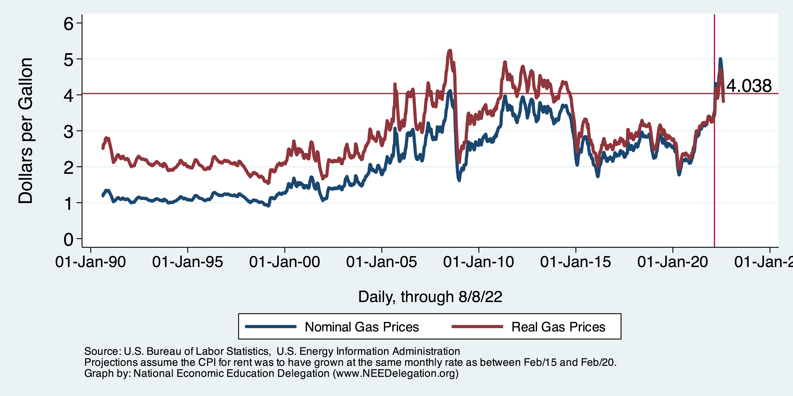
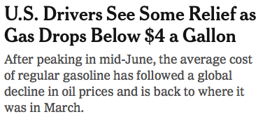
Gas Prices: National Average at the Pump

Slide 22
Fuel Costs Continue Are Still Elevated

Slide 23
Food Costs Continue to Rise
Food at home: 13.1
Food away from home: 7.6

Slide 24
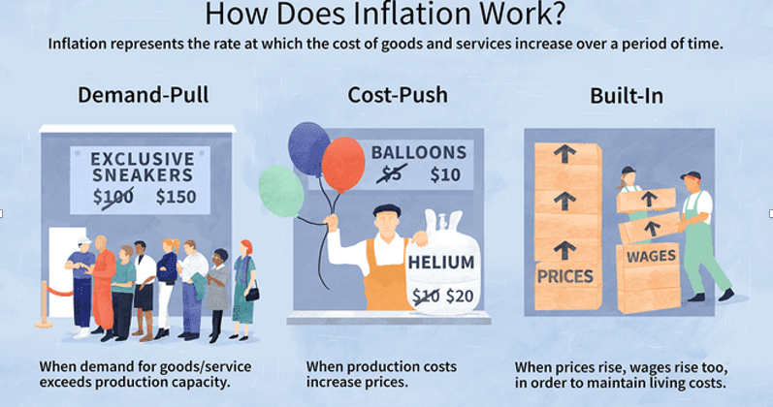
Source: Investopedia

Slide 25
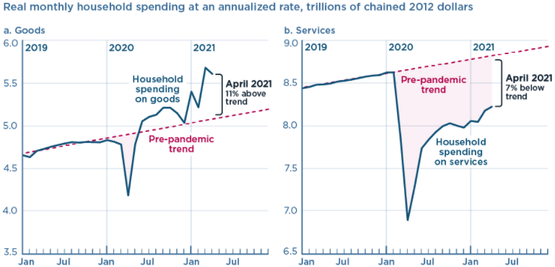
We Have Been Buying Mostly … Stuff
Demand-Pull
Source: Jason Furman, PIIE

Slide 26
Inflation: Concentrated
Cost-Push

Slide 27
Supply Chains
Cost-Push

Slide 28
Inflation in Historical Perspective

Slide 29
Fed’s Preferred Measure of Inflation

Slide 30
My Diagnosis for the Uptick in Inflation
Yes, there were supply chain issues that affected some areas in particular (e.g., computer chips).
But there was too much total spending.
Fiscal stimulus led households to increase saving over 2021 by more than $2 trillion. Strong retail sales numbers suggest they are prepared to spend it.
Whose to Blame: ARP probably too big, but the Fed could have acted sooner.

Slide 31
Measure of Inflation Expectations
Breakeven Inflation Rate = Difference between
nominal and real 5-year and 10-year Treasury
constant maturity securities.
Market participants expect around 2.4%
of inflation annually over the next 10 years and
2.6% over the next 5 years.
Inflation expectations are calming down.

Slide 32
What About the Fed?

Slide 33
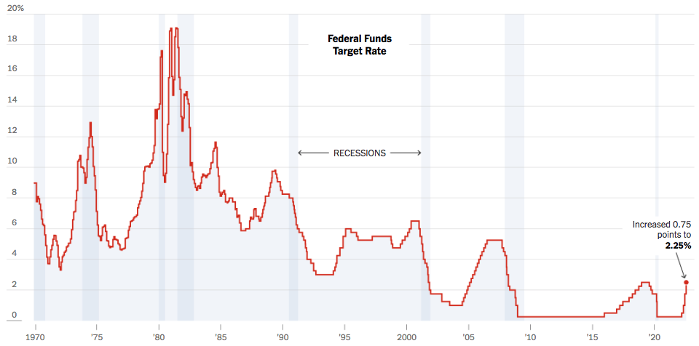
Federal Funds Rate
Notes:
The fed funds rate is the interest rate on overnight loans between banks. Think of it as the baseline interest rate on which banks base all other interest rates (e.g. mortgage rates)
FOMC lowers the fed funds rate during recessions and raises the fed funds rate during expansions
Fed funds rate peaked in the 1980s as then Chairman Paul Volcker sought to reign in “run away” inflation of the 1970s; doing so resulted in a recession in the early 1980s.
Since the 2008-09 recession, the fed funds rate has been kept near zero.
During the 2008-09 recession, Federal Reserve turned to unconventional tools to influence longer term interest rates to further stimulate the economy - QE
FedFunds.png

Slide 34
Implications for Demand
Investment borrowing
Home loans – tied to 10-year Treasury
Car loans
Credit cards
Savings accounts – positive
And more….

Slide 35
Treasuries
Notes:
treas_recent.png

Slide 36
Alarming Compression of Interest Rates
Notes:
Yield_curve.png

Slide 37
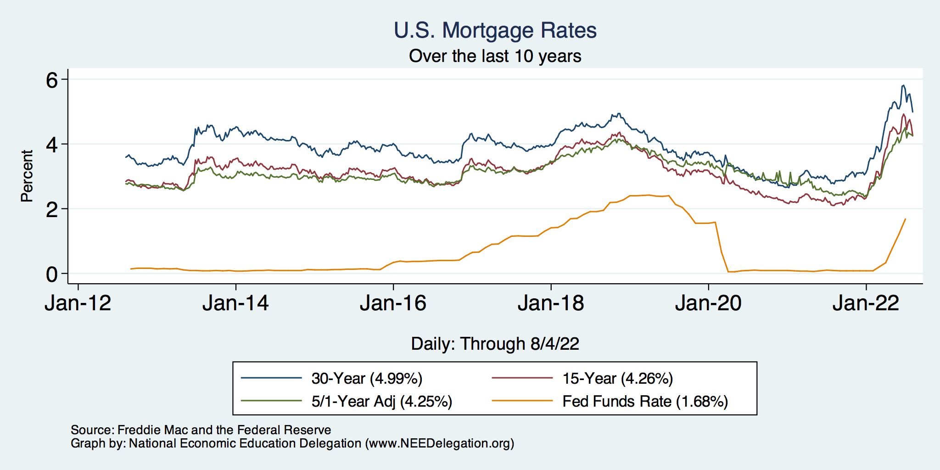
Mortgage Rates

Slide 38
Takeaways
Is a recession on the horizon?
Larry Summers, Jamie Dimon, and Elon Musk are worried about a recession.
While the chances of slipping into a recession have increased, I think on many dimensions the economy is doing quite well.
Consumer’s have been driving the recovery, and consumer’s account for two-thirds of GDP.
Job creation remains robust – 528k in July.
What about GDP?
2022:Q1 was -1.6%, 2022:Q2 was -0.9.
Much of this lower growth was driven by lower inventory.
Inventories led GDP growth in 2021:Q4, didn’t sell, so production in Q1&Q2 fell.
Housing markets – very tightly linked to interest rates – softened … A LOT.
Government spending is falling.

Slide 39
Thank you!
Any Questions?
www.NEEDelegation.org
Jon D. Haveman
Jon@NEEDelegation.org
Contact NEED: info@NEEDelegation.org
Submit a testimonial: www.NEEDelegation.org/testimonials.php
Become a Friend of NEED: www.NEEDelegation.org/friend.php

Slide 40
www.NEEDelegation.org/LocalGraphs
For every state and county in the United States.
Detailed graphs on employment, housing, moves, and other statistics.

