Slide 1
U.S. and Alameda Economic Update
Alameda Chamber of Commerce
Economic Forecast
October 1, 2021
Jon Haveman, Ph.D.
National Economic Education Delegation

Slide 2
Credits and Disclaimer
This slide deck was authored by:
Jon D. Haveman, NEED
Scott Baier, Clemson University
Geoffrey Woglom, Amherst College (Emeritus)
Brian Dombeck, Lewis & Clark College
Doris Geide-Stevenson, Weber State
Disclaimer
NEED presentations are designed to be nonpartisan.
It is, however, inevitable that the presenter will be asked for and will provide their own views.
Such views are those of the presenter and not necessarily those of the National Economic Education Delegation (NEED).

Slide 3
Outline
State of the Pandemic
US Economic Growth
Inflation
Alameda

Slide 4
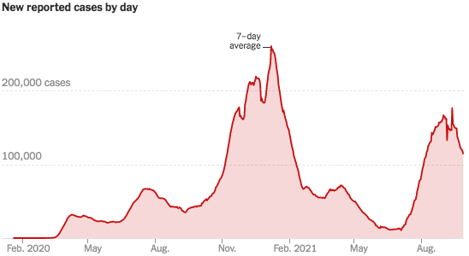
COVID Cases: Trend is Reversing Nationwide
Source: NYTimes

Slide 5
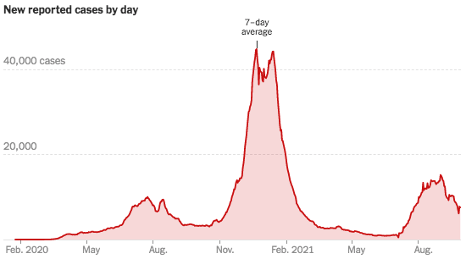
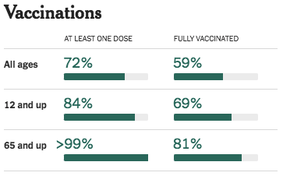
California Cases Were Falling Nicely
Source: NYTimes

Slide 6
US Economic Growth

Slide 7
GDP Trajectory: Pandemic Plunge!
GDP is:
$0.5 Trillion below 2019 forecast.
$0.2 Trillion ABOVE 2019-Q4 level.

Slide 8
Spending Patterns Since First US Case
Source: https://tracktherecovery.org/

Slide 9
Employment Gap
5.3 Million below February, 2020.
9.4 Million below where we should be.
Notes:
payroll_recent.png

Slide 10
Employment Gap
Slow Aug.
5.3 Million below February, 2020.
9.4 Million below where we should be.
Notes:
payroll_recent.png

Slide 11
Employment in California

Slide 12
Not All Jobs Are Recovering

Slide 13
Why Slow Employment Growth?
It might be:
Continued fear of the virus.
Microchip shortages.
Geographic mismatch and an unwillingness to relocate…yet.
Childcare – lack of availability.
People wanting to do better.
Facilitated by additional UI payments.
People dropping out of the labor force.
It probably isn’t the generous UI checks.
Low wage employment is growing faster in states WITH supplement than in states w/o.

Slide 14
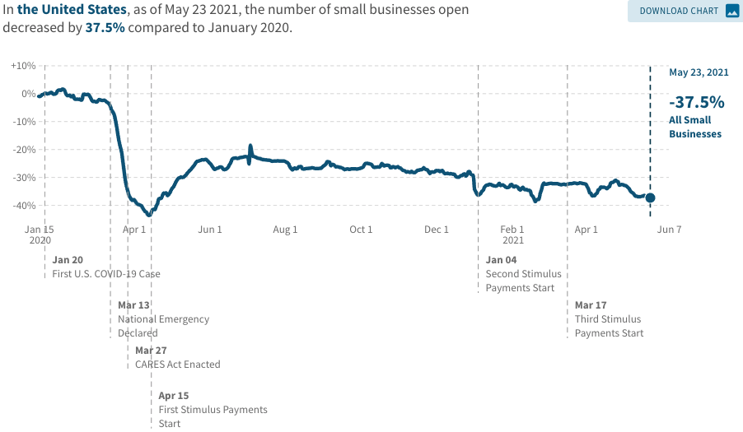
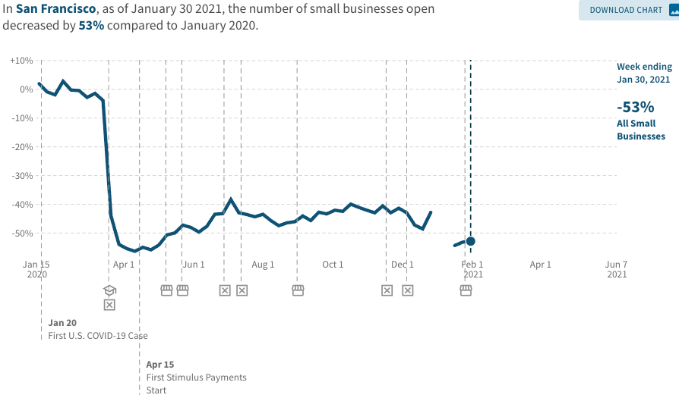
Another Hard-Hit Sector: Small Business
Small Biz Closures in the United States
Small Biz Closures in San Francisco

Slide 15
Small Businesses: They Didn’t Get Enough PPP

Slide 16
Inflation

Slide 17
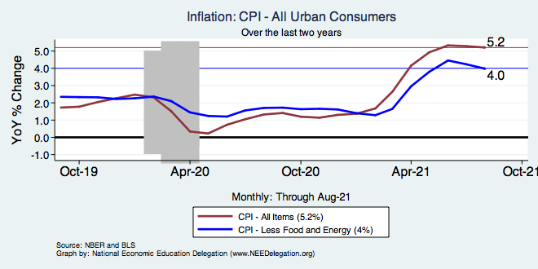
Inflation – Climbing! Should we worry?
Notes:
Cpi_recent.png

Slide 18
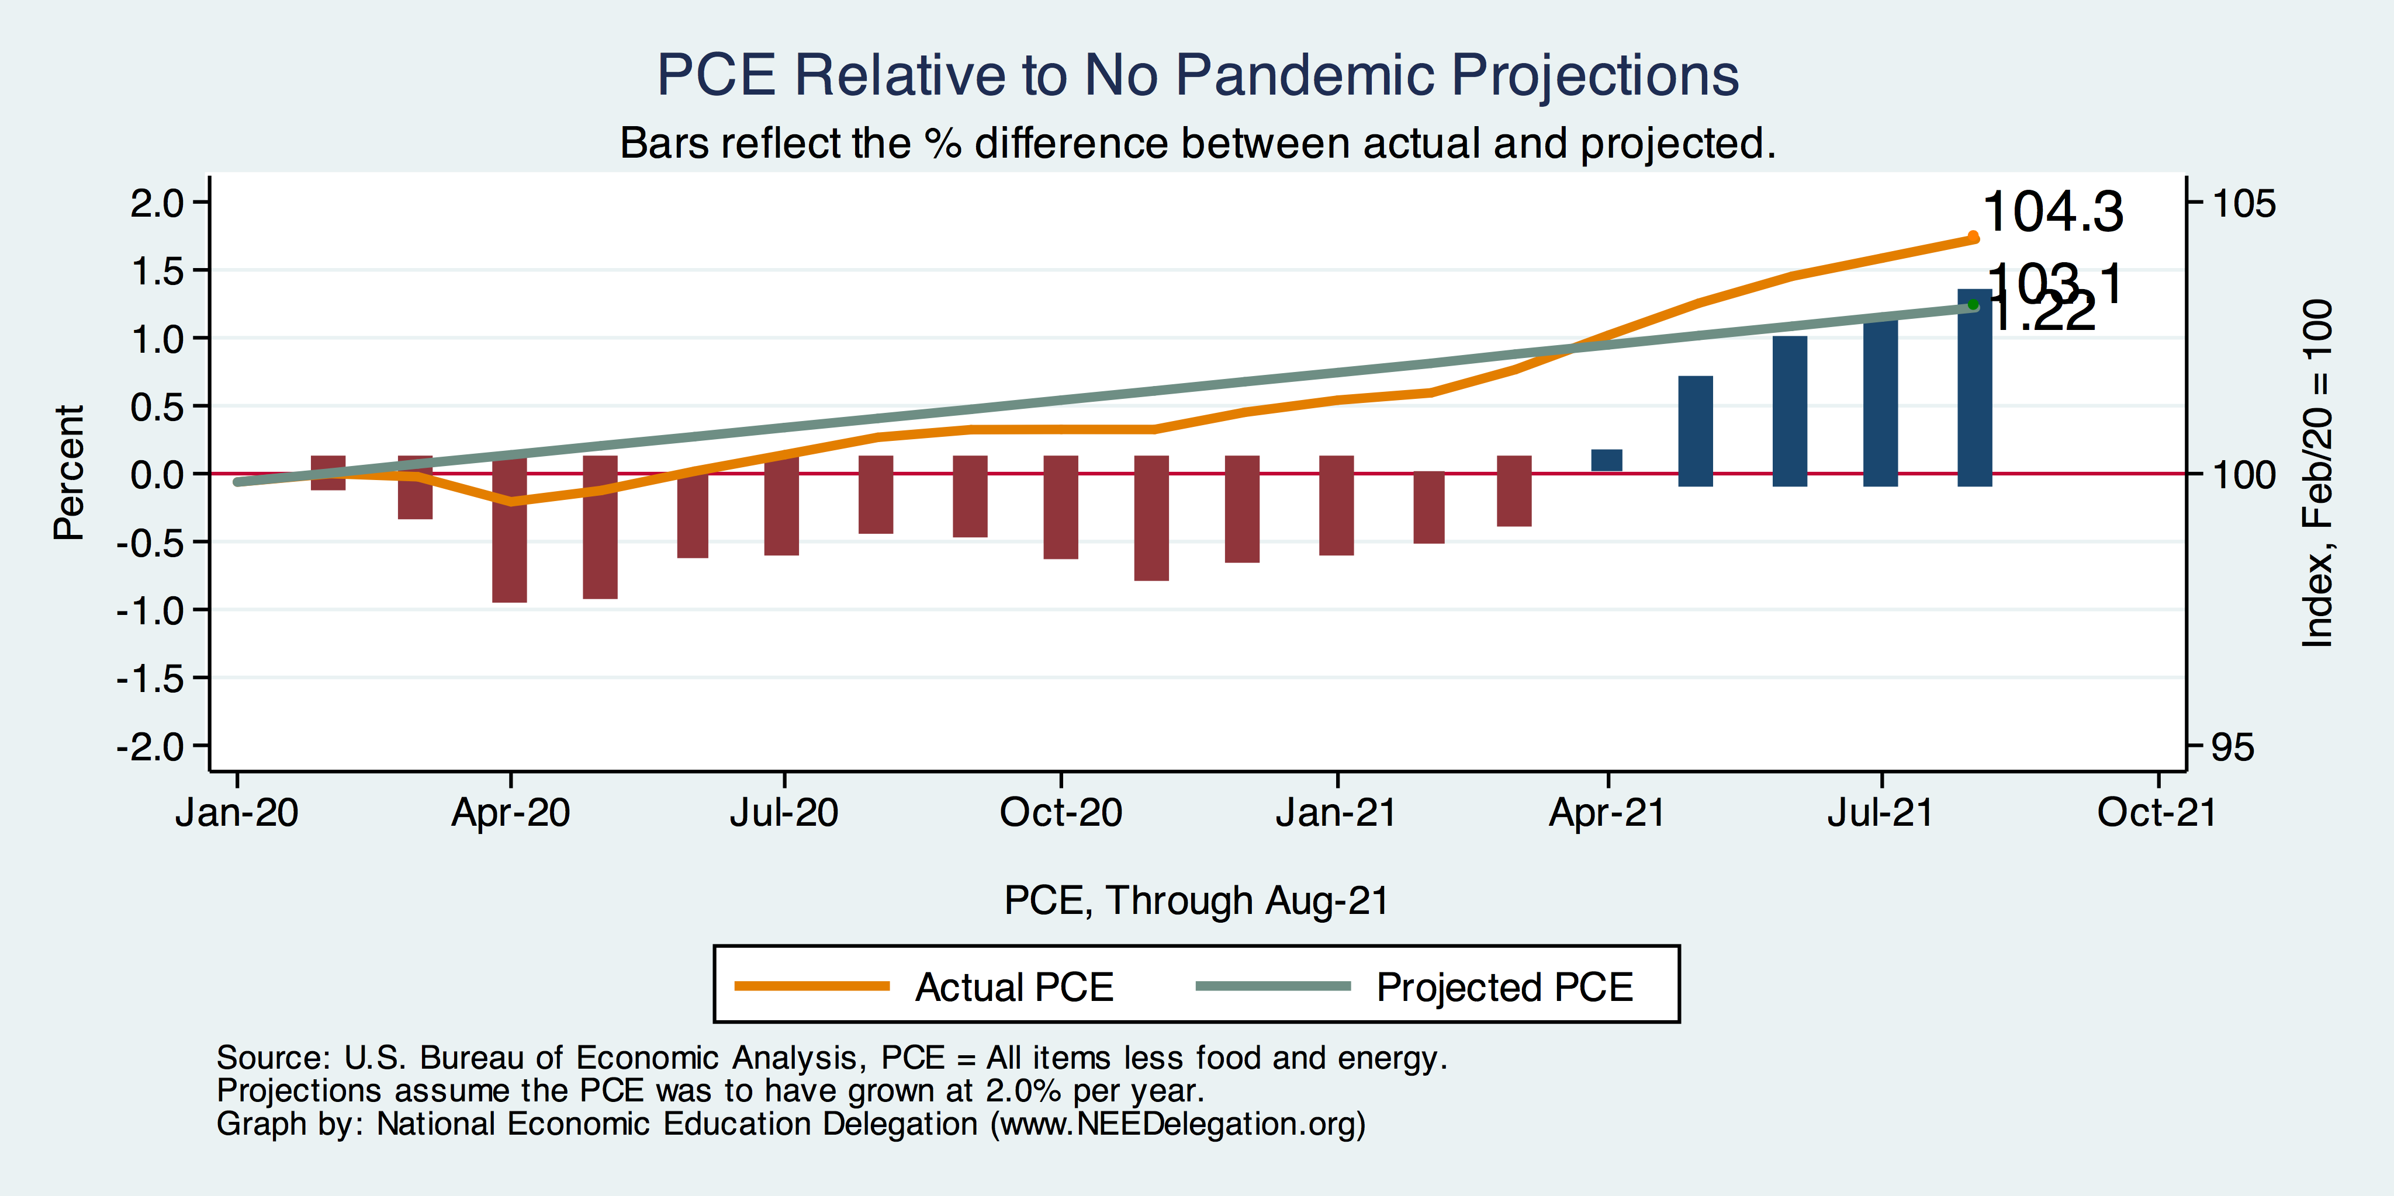
Inflation – PCE and Fed Suggest: No!
1.22
Notes:
Cpi_recent.png

Slide 19
Inflation: Concentrated

Slide 20
Alameda Indicators

Slide 21
Employment in Alameda County

Slide 22
Employment in Alameda City
Employment: -8.4%

Slide 23
Employment in Alameda City

Slide 24
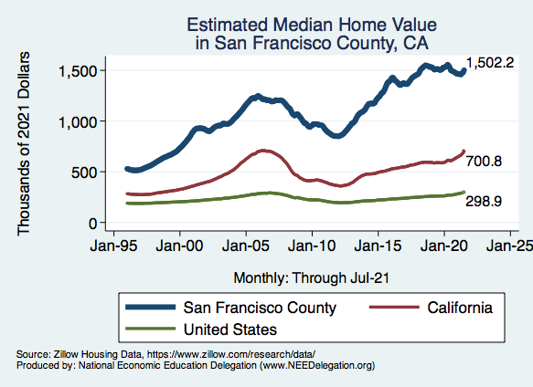
RE Experiences Differ!

Slide 25
Alameda City Real Estate
San Francisco

Slide 26
Conclusion: Where do we go from here?
U.S. Economy:
Solid road to recovery. Followed by slow growth.
Structural changes will present challenges.
Stock markets are jittery. China may be in trouble. U.S. politicians….
OECD Forecast for U.S.: 6% in 2021, 3.9% in 2022.
Alameda City – will shine in the wake of the pandemic.
Telecommuting
Lots of green shoots that Lois will talk to you about.

Slide 27
Thank you!
Any Questions?
www.NEEDelegation.org
Jon D. Haveman
Jon@NEEDelegation.org
Contact NEED: info@NEEDelegation.org
Submit a testimonial: www.NEEDelegation.org/testimonials.php
Become a Friend of NEED: www.NEEDelegation.org/friend.php

Slide 28
Labor Force is Shrinking

Slide 29
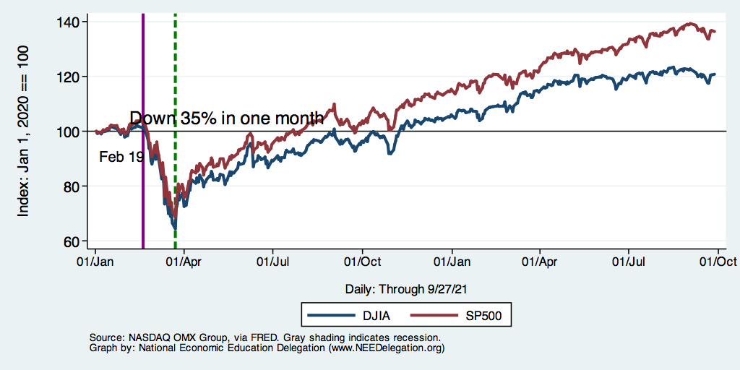
DJIA and S&P 500

Slide 30
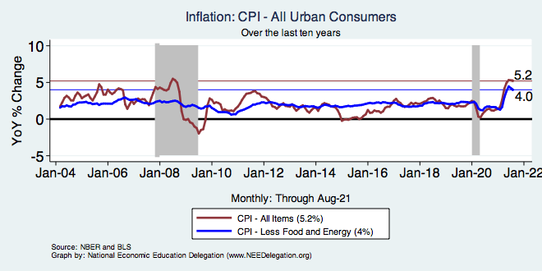
Inflation – Prepandemic Stability
Notes:
Cpi_recent.png

Slide 31
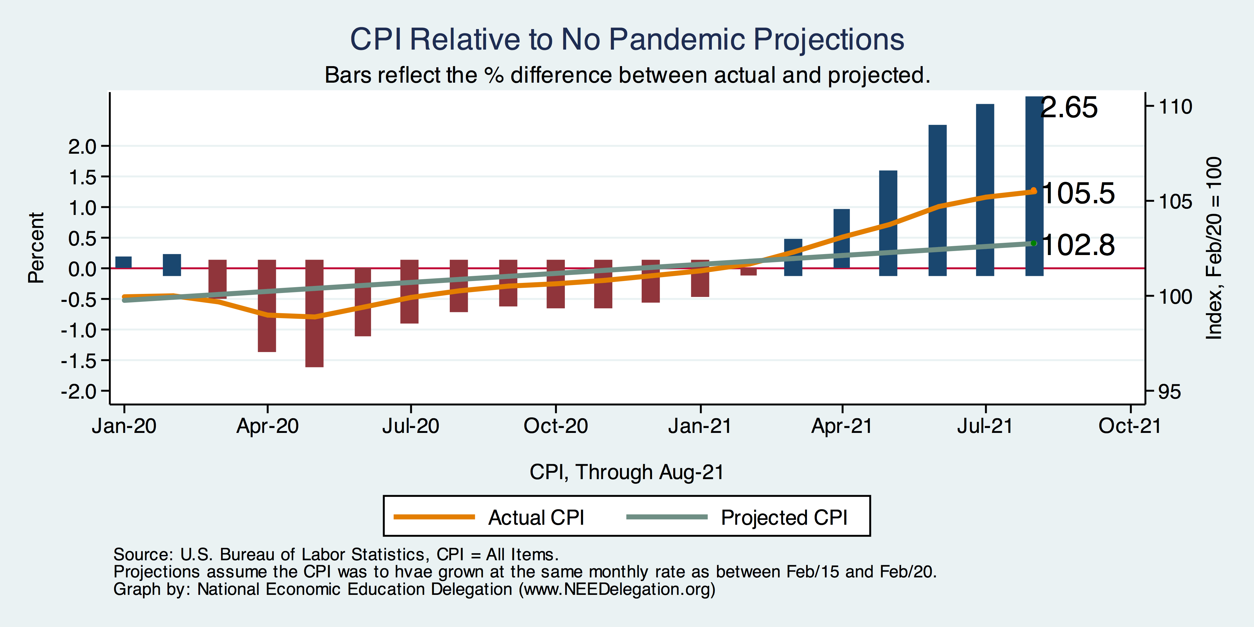
Inflation – CPI Suggests: Yes!
Notes:
Cpi_recent.png

Slide 32
Inflation: Concentrated

Slide 33
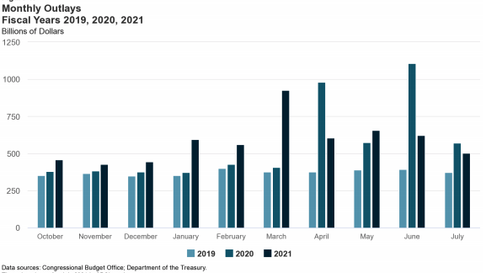
Trillions in Pandemic Spending

Slide 34
Why so Excited About Telecommunting?
Productivity at home appears to be really high during pandemic.
Nothing else to do.
Short term – corporate culture and new hires – visibility to the boss – camaraderie.
CEOs are salivating over reduced Comm RE costs.

Slide 35
Telecommuting – Will it Stick?
Working from home is ALWAYS less productive than working in the office.
But the gap has shrunk because of technology.
In the interest of workplace productivity, employers are likely to allow more working from home.
Increased in-office moral and hence productivity.
But not 100% or even 50%. How much?
Has important implications for real estate.

Slide 36
Population Change: San Francisco & CCC

Slide 37
www.NEEDelegation.org/LocalGraphs
For every state and county in the United States.
Detailed graphs on employment, housing, moves, and other statistics.

