Slide 1
Osher Lifelong Learning Institute, Summer 2022
Contemporary Economic Policy
Emory University
June-July, 2022
Jon Haveman, Ph.D.
National Economic Education Delegation

Slide 2
Available NEED Topics Include:
Coronavirus Economics
US Economy
Climate Change
Economic Inequality
Economic Mobility
Trade and Globalization
Minimum Wages
Immigration Economics
Housing Policy
Federal Budgets
Federal Debt
Black-White Wealth Gap
Autonomous Vehicles
US Social Policy

Slide 3
Course Outline
Contemporary Economic Policy
  Week 1 (6/30): US Economic Update
  Week 2 (7/7): The U.S. Federal Debt (Geoffrey Woglom, Amherst College)
  Week 3 (7/14): Climate Change
  Week 4 (7/21): Economic Inequality
  Week 5 (8/4): The Black-White Wealth Gap
  Week 6 (8/11): Discriminatory Policies
  Week 7 (8/18): Cryptocurrencies

Slide 4


The US Federal Debt
Geoffrey Woglom
Amherst College
Professor of Economics (emeritus)

Slide 5
Credits and Disclaimer
This slide deck was created by:
  Jon Haveman, Executive Director, NEED
  Geoffrey Woglom, Amherst College, Emeritus
This slide deck was reviewed by:
  Olivier Blanchard, Peterson Institute for International Economics
  John H. Cochrne, Stanford University
Disclaimer
  NEED presentations are designed to be nonpartisan.
  It is, however, inevitable that presenters will be asked for and offer their own views.
  Such views are those of the presenters and not necessarily those of the National Economic Education Delegation (NEED).

Slide 6
Submitting Questions
Please submit questions of clarification in the chat.
  I will try to handle them as they come up.
We will do a verbal Q&A once the material has been presented.
OLLI allowing, we can stay beyond the end of class to have further discussion.
Slides will be available from the NEED website tomorrow (https://needelegation.org/delivered_presentations.php)

Slide 7
Outline
Definitions and Basic Data and Historical Data.
What needs to be done to “stabilize” the debt?
Traditional Economic Analysis of the Costs of the Debt
New Ideas about the Costs of the Debt and the importance of foreign holders of the debt.
“Debt? What me Worry?” Modern Monetary Theory.
Recent Congressional Budget Office (CBO) analysis of the Cost of the Debt.
Budget Reconciliation and CBO projections.

Slide 8
Basic Definitions
Fiscal year Deficit = Total Outlays Less Revenues between Oct to September.
The deficit paid for by government borrowing: (net) issue of new government bonds.
The accumulated value of past borrowing is the total government debt.

Slide 9
The Federal Budget in FY2022: Oct. thru May
Mandatory, 64%
Discret. 29%
Net Interest, 7%
IIT, 54%
SST, 30%
CT, 8.0%
Programmatic Outlays = Mandatory + Discretionary
Source: Monthly Treasury Report, 5/2022

Slide 10
Past and Future of Deficits
Useful Deficit Decompositions:
Total Deficit= (Programmatic Outlays +
Interest Expense)-Revenue
=(Programmatic Outlays – Revenue)+Interest Expense
=Primary Deficit + Net Interest
E.g, 2007: 1.1 = (17.4+1.7) - 18.0 = 19.1-18.0 = 1.1
1.1 = (17.4-18.0) + 1.7 = -0.6 + 1.7 = 1.1
Source: CBO, “The Budget and Economic Outlook: 2022:2032,” 5/2022
Notes:
Christina Romer: 3 packages war production of 1943.

Slide 11
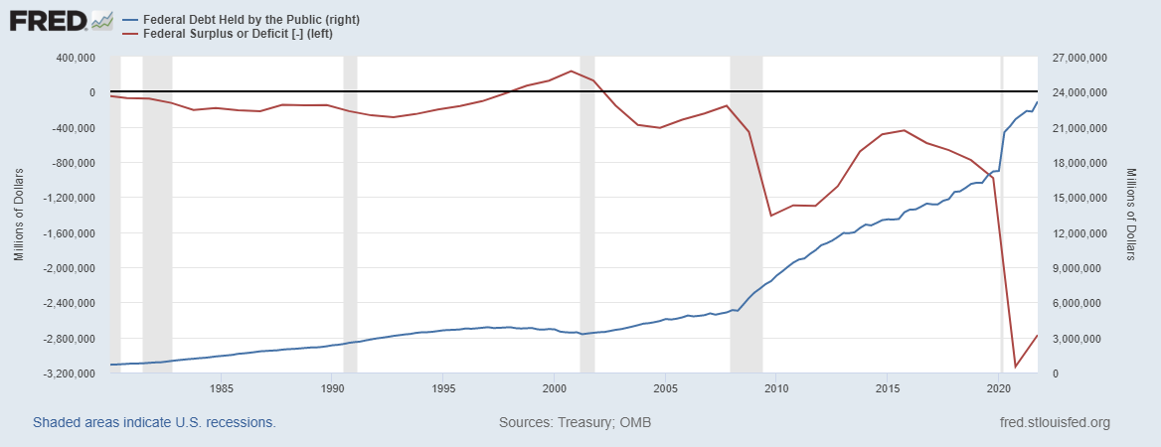
Debt vs. Deficit
The Sum of All Past Deficits Less Surpluses Equals the Debt
Blue Line Debt; Red Line Deficit
Shaded areas are recessions
Notes:
Yestere

Slide 12
A Breakdown of the Total Federal Debt
Japan, $1.2 tr
China, $1.0 tr
Sources: US Treasury, Federal Reserve Board
Notes:
3/17 phd 23.8 and total 30.3 Last the total public debt exceeded $30 trillion. Federal reserve increased holding by over $1t last fiscal year, 40% of the deficit was financed by the Fed.

Slide 13
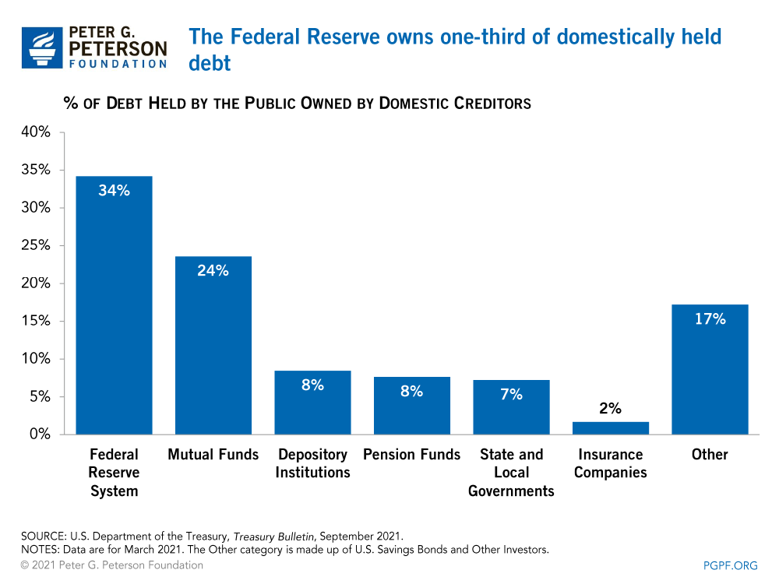
Notes:
Domestic debt held by the Fed is now 37%

Slide 14
Not All Debt Is Created Equal
Intra-governmental debt is important bookkeeping.
  This debt DOES NOT require funding on credit markets
Debt held by the public
  This debt is funded by borrowing on credit markets and competes with private funding.
Most analyses focus on the publicly held debt relative to GDP because:
  To the extent that debt and deficits have burdens these burdens depend on the size of the debt relative to the size of the economy.

Slide 15
CBO: Budget Analysts in Chief
The Congressional Budget Office was founded in 1974 to provide Congress with information about the budgetary implications of legislation.
Two kinds of Reports
  Cost Estimates or “Scoring”
    H.R. 486 Ukraine Religious Freedom Support Act
    Build Back Better Scoring.
  Projections of Debt and Deficits – The Budget and Economic Outlook: 2022 to 2032
Notes:
Lindsey Graham an alternate scoring

Slide 16
Key Points About the U.S. Relative Debt
1946-1974
Relative debt peaked during WWII (106%) - followed by a steady decline until the 1980s.
Prior to 1983, relative debt rose purposefully (wars, recessions, public investment) and then fell.
What can we learn from the 46-74 period, where the relative debt fell continuously?

Slide 17
Debt Dynamics
The relative debt fell in spite of deficits in 21 of the 29 years, with the debt increasing by 42%. How?
1946-1974, deficits caused the debt to grow, but not as fast as the economy was growing.
While the debt grew by 42%, GDP (nominal) grew by 550%
You don’t need a surplus to reduce the relative debt:
You just need GDP to grow faster than the debt

Slide 18
Relative Debt Dynamics
Two Parts to the growth rate the debt:
  The interest rate on the debt.
  A portion that reflects a primary deficit (+) or primary surplus (-)
Numerical Example: GDP grows at 4%, interest rate is 5%
  If there is either a primary deficit or a primary balance of zero, relative debt grows: Growth in debt is greater than or equal to 5%, greater than GDP growth of 4%.
  To stabilize the debt, there must be a primary surplus
  Primary surplus has to be bigger, the higher the relative debt.
Notes:
Interest on the debt is about 2 % . If the primary budget had been in surplus the debt still would have grown by 2% Because there was still a very large primarty deficit.he debt actually grew by 6,5%

Slide 19
Traditional Views of the Cost of the Debt
First a non-issue: There is no analogy between household and government debt.
  The government does not have to pay back the debt.
  Maturing government bonds are paid by issuing new bonds (“rolling over” the debt).
Economist View of the Debt circa 1980, very little cost because relative debt was falling. That changes in 1983.

Slide 20
Traditional View: Debt and Deficits Raise Interest Rates
Crowding Out via higher interest rates:
  Private: less investment and over time to a smaller capital stock and reduced future output.
  Government: primary surplus needed to stabilize the debt is larger; i.e., less programmatic outlays or higher taxes
Foreign Borrowing: Higher interest rates lead to foreign capital inflows or foreign borrowing. With foreign borrowing, some of our GDP is paid to foreigners as interest.

Slide 21
Quiz!
If the statement is true, raise the hand icon on your computer:
The largest source of Federal revenues are taxes on labor income.
If the primary deficit is zero (programmatic outlays equal revenues.), the overall budget is in surplus
Between 2020Q2 and 2021Q3, the relative debt fell from 105% of GDP to 96%.
The most important reason for the fall in the relative debt was the decrease in the deficit.

Slide 22
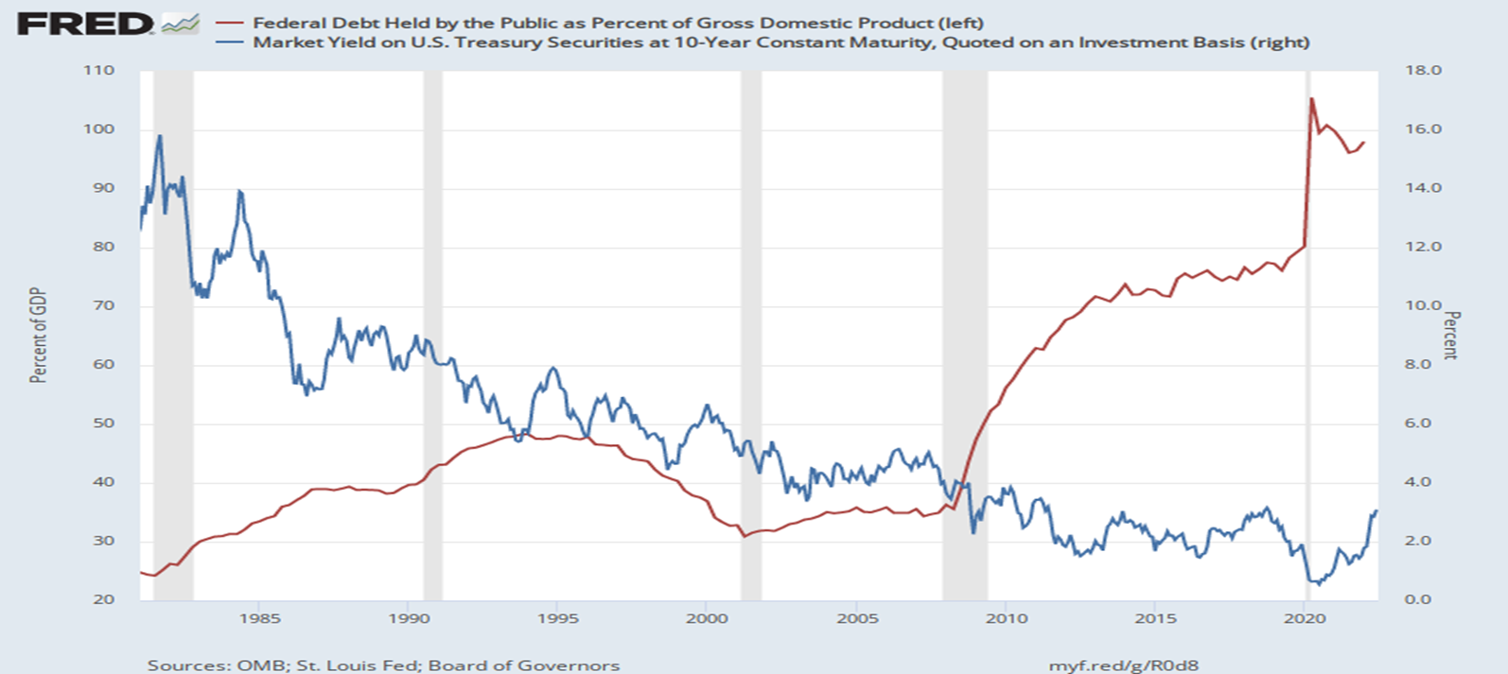
The Dog that Didn’t Bark; Rising Interest Rates?
Blue Line Rate on 10-Yr Treasury Bonds; Red Line Relative Debt

Slide 23
Olivier Blanchard’s Presidential Address to the AEA 1/2019
“If the future is like the past [with low interest rates],…the issuance of debt without a later increase in taxes may well be feasible. Put bluntly, public debt may have no fiscal cost.”
But,
“My purpose…is not to argue for more public debt, especially in the current political environment. It is to have a richer discussion of the costs of debt…than is currently the case.”

Slide 24
What the Traditional View Got Wrong
Assumed that the interest rate was greater than the growth in GDP
  In order to stabilize the debt, government must run a primary surplus.
  The bigger the debt, the larger the required primary surplus.
More debt today means a higher primary surplus is needed in the future, i.e., higher taxes and/or less programmatic outlays.
Notes:
Numerical example: interest rate a 4%; GDP growth at 3%. there must be a primary surplus to offset the interest rate

Slide 25
New View: Almost a Free Lunch
If the interest rate is less than the growth rate of GDP, then Debt to GDP can be stabilized with a (small) primary deficit: programmatic outlays can be less than revenues!
Remember our example with GDP growth of 4%. Now assume the interest rate is 3%. Relative debt will fall with a primary balance of zero!
Blanchard does believe that the relative debt must be stabilized
  At some point current deficits must be reduced.
  But it may not be crucial at what level of debt we stabilize.
Notes:
Olivier Blanchard

Slide 26
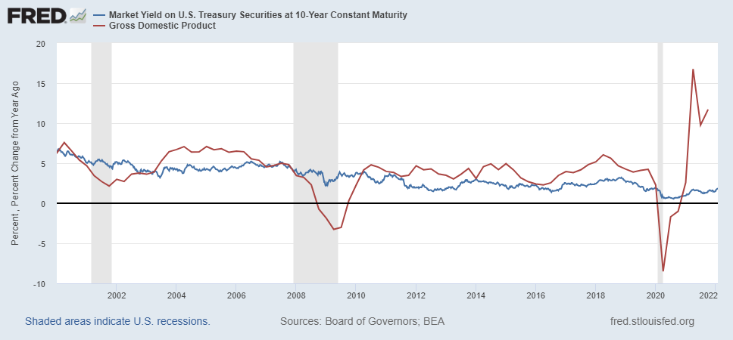
Blanchard’s Evidence
Blue Line Rate on 10-Yr Treasury Bonds; Red Line GDP growth
Notes:
Except for recessions. Blanchard does not explain why interest rates have been so low!

Slide 27
But Why Must the Relative Debt Be Stabilized?
Stephanie Kelton provided a prominent and recent exposition of Modern Monetary Theory in her June 6th 2020, NYTimes op-ed, “Learn to Love Trillion-Dollar Deficits.”
  US Treasury borrows in dollars and therefore cannot default (as opposed to Greece).
  Example: How did we “find the money” in FY 2020 to increase in the deficit by about $1.9 trillion?
  Answer: Fed open market purchases of $1.7 trillion provided 89% of the financing.
  More generally, she argues that we can always find the money to increase federal spending

Slide 28
MMT’s Free Lunch
The only limit on deficit spending is if it leads to too much spending thereby increasing current inflation.
Recognizing this fact, “…could free policymakers not only to act boldly amid crises but also to invest boldly in times of more stability.”
Too bad the second part isn’t true. And, the recent rise in inflation suggests even Dr Kelton should now be worried about the debt
We rely on foreigners to hold a substantial portion of our debt and they can loose if the exchange value of the dollar falls

Slide 29
Why do Foreigners Buy US Treasuries?
Market for Treasuries is the deepest, most liquid and safest capital market in the world.
US economy has a history of political and economic stability.
We enjoy “An exorbitant privilege” (Valery Giscard d’Estaing): The dollar is the largest international reserve currency.
  Most trade transactions are quoted in dollars, e.g., oil.
  With some exceptions, foreigners borrow in dollars. E.g., Yankee bonds

Slide 30
Demand for Dollars by Central Banks
Source IMF Currency Composition of Official Exchange Reserves
Notes:
Talk about the fall of the Euro Brexit etc.

Slide 31
CBO on the Costs of “High and Rising Debt”
The interest expense portion of the deficit will rise, including payments to foreigners.
Crowding out of private investment.
“The likelihood of a fiscal crisis in the United States would increase.”
Slow erosion of confidence in the U.S. dollar as an international reserve currency leading to higher interest rates.
Policymaker constraint in using deficit-financed fiscal policy to respond to unforeseen events.
CBO, “Budget and Economic Outlook: 2022-2032,” May 2022, pp15-16.
Notes:
1 & 2 are part of my traditional costs. 3-5 are new and related

Slide 32
What would a Fiscal Crisis Look Like?
Foreigners lose confidence in the dollar and sell Treasuries in exchange for assets denominated in their own currency,
  Sale of Treasuries raises interest rates, worsening our fiscal outlook.
  Trading of Foreign for US assets lowers US exchange rate.
    Raising the price of imports thereby increasing inflation.
    Lowering the foreign currency returns on all US assets, exacerbating 1.
Could the Fed Bail us Out?
  It could buy Treasuries and prevent the rise in interest rates.
  Insufficient foreign assets to prevent the fall in the exchange rate,

Slide 33
Bottom Line: We Need to Worry about the Debt
Interest rates may not stay this low forever. In fact, economist don’t really know why they have fallen to such low levels over the past 20 years
A fiscal crisis should be avoided at all costs.
The good news is we may be able to stabilize the relative debt without a running a surplus.

Slide 34
But is this Problem Impossible?
CBO, “Budget and Economic Outlook: 2022-2032,” May 2022

Slide 35
CBO Baseline Projection
CBO, “Budget and Economic Outlook: 2022-2032,” May 2022
Notes:
10 yr Treasury rate rising slowly from 2.4 to 3.7 and then stabilizing

Slide 36
The Blueprint for a Crisis?
But, these are “projections,” not forecasts!
CBO, “Budget and Economic Outlook: 2022-2032,” May 2022

Slide 37
Citizen’s Guide to “Budget Reconciliation.”
Procedure successfully used 22 times since 1974 to avoid a Senate filibuster.
Reconciliation can be used for changing taxes and spending (not Social Security) subject to the Byrd Rule.
Byrd rule:
  No extraneous provisions.
  No increase in the deficit after 10 year window.
Reconciliation games played by both parties:
  BBB.
  Trump Tax Cut

Slide 38
Reconciliation and CBO Projections
For the CBO to be effective it must be perceived to be (and must be) nonpartisan.
Therefore, CBO “baseline” projections and legislative scoring must not try to predict changes in legislation.
Instead, CBO must analyze the data based on the current law as written.

Slide 39
Example: Trump Tax Cut
Why do Income Taxes go up in 2025?

Slide 40
Outlays based on Current Law

Slide 41
Unfortunately, The Required Changes are Big!
CBO is allowed to publish, alternative projections.
To Stabilize the relative debt at the current level of 100% of GDP:
  Deficit in 2025 needs to go from projected 4.7 % of GDP to 2.9% and be maintained at the 2.9% level.
  This amounts to over $500 billion per year.
CBO, “2020 Long-Term Budget Outlook, “ Sep 2022

Slide 42
Any of these Options Sound Good?
Pick 10!

Slide 43
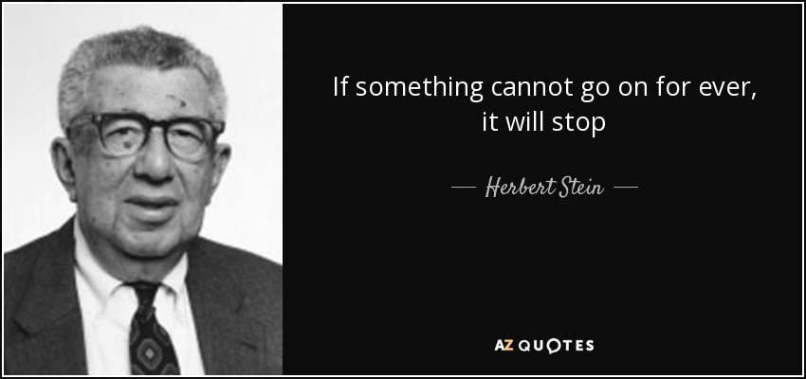
The Wit and Wisdom of Herb Stein
Notes:
Ben Stein’s father and Chair Council under Nixon

Slide 44
Federal Debt Glossary
Total Federal Debt is the value of all outstanding government bonds (or “Treasuries”) that have been issued to finance past federal government deficits.
Deficit is the difference between total federal spending and revenues.
Federal Debt in the Held by the Public is the debt held by the private domestic investors, foreign investors and the Federal Reserve. The concept of the debt excludes intragovernmental debt, such as the debt held by the Social Security and Medicare Trust Funds.
The Relative Debt is the Federal Debt Held by the Public as a fraction of the size of the economy, or GDP.
Congressional Budget Office (CBO) is a congressional think tank that analyzes the effect of legislation on the budget (“scoring”) and issues periodic projections on the future of debt and deficits
Primary Deficit is the difference between federal spending on programs and total revenues. The primary deficit excludes interest on the debt.
Rolling Over the Debt the process of paying off maturing government bonds with newly issued bonds

Slide 45
Federal Debt Glossary (Cont.)
Crowding Out is the phenomena where government financing of deficits raises interest rates and lowers firms’ investment.
International Reserve Currency is foreign holdings of US debt (and other countries debt) to facilitate international trade; e.g., oil is traded in dollars.
Default is when an entity that issues a bond fails to make an interest payment or the repayment of the face amount on time.
Foreign Exchange Value of the Dollar is the purchasing power of the dollar in terms of a foreign currency. When the US exchange rate falls, the dollar has les purchasing power over foreign goods.
Budget Reconciliation is a Senate process for by-passing the filibuster, so that legislation can be enacted with a 51-vote majority. The process can only be used for changing spending or taxes and the legislation cannot increase the deficit after 10 years.

Slide 46
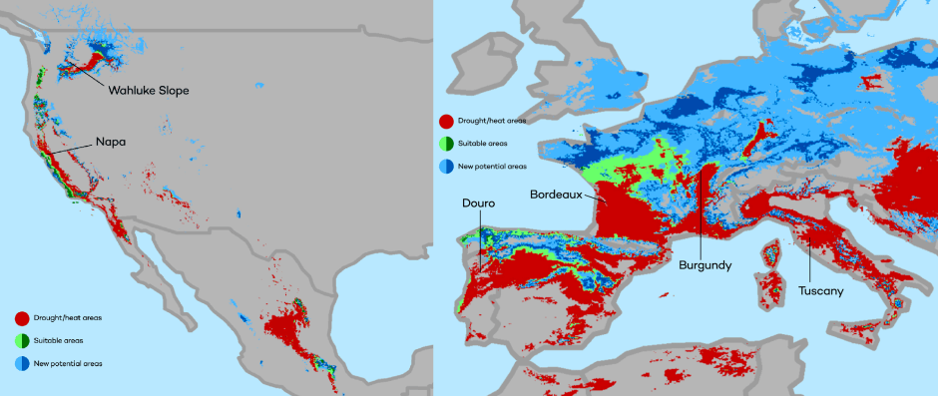
Climate Change: Jon Haveman
The changing map of the world’s wine-growing regions.

Slide 47
Questions?
www.NEEDelegation.org
Geoffrey Woglom
grwoglom@amherst.edu
Contact NEED: Info@NEEDelegation.org
Submit a testimonial: www.NEEDelegation.org/testimonials.php
Support NEED: www.NEEDelegation.org/donate.php

