Slide 1
Osher Lifelong Learning Institute, Fall 2022
Contemporary Economic Policy Issues
California State University, Dominguez Hills
Fall, 2022
Ryan Herzog, Ph.D.
National Economic Education Delegation

Slide 2
Course Outline
Contemporary Economic Policy
  Week 1 (9/19): Economic Update (Jon Haveman, NEED)
  Week 2 (9/26): Trade and Globalization (Alan Deardorff, University of Michigan)
  Week 3 (10/3): Cryptocurrencies (Geoffrey Woglom, Amherst College)
  Week 4 (10/10): The Federal Debt (Ryan Herzog, Gonzaga University)
  Week 5 (10/17): Economic Inequality (Ryan Herzog, Gonzaga University)
  Week 6 (10/24): Trade Deficit and Exchange Rates (Alan Deardorff, Univ. of Michigan)

Slide 3
US Government Debt

Slide 4
A Fun Website
Brookings Institute
  The Fiscal Ship - https://fiscalship.org

Slide 5
The Federal Budget in FY2022: Oct. thru Aug.
Mandatory, 64%
Discret. 29%
Net Interest, 7%
IIT, 55%
SST, 31%
CT, 7.2%
Programmatic Outlays = Mandatory + Discretionary
Source: Monthly Treasury Report, 8/2022 & CBO, May 2022
Notes:
Over 2/3rds of total income reported to the IRS for 2019 returns was earned income.

Slide 6
Past and Future of Deficits
Useful Deficit Decompositions:
Total Deficit= (Programmatic Outlays +
Interest Expense)-Revenue
=(Programmatic Outlays – Revenue)+Interest Expense
=Primary Deficit + Net Interest
Source: CBO, “The Long-Term Budget Outlook,” 7/2022
Notes:
Christina Romer: 3 packages war production of 1943.

Slide 7
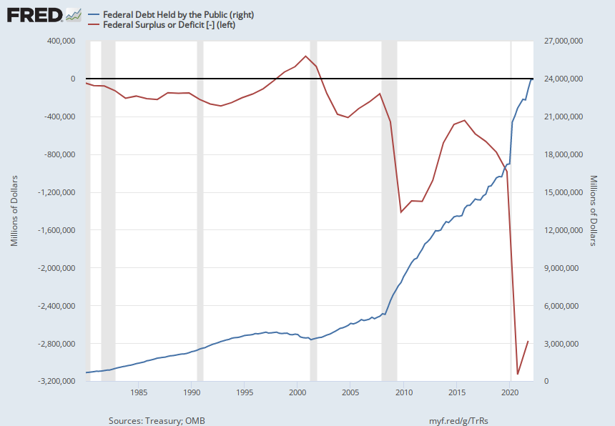
Debt vs. Deficit
The Sum of All Past Deficits Less Surpluses Equals the Debt
Blue Line Debt; Red Line Deficit
Shaded areas are recessions
Notes:
Yestere

Slide 8
How Does the US Government Borrow?
It issues debt.
  Treasury marketable securities:
    Treasury bills, notes, and bonds
    TIPS: Treasury inflation-protected securities
    Savings bonds
Who buys the debt?
  Other federal agencies
  Individuals and businesses
  State and local governments
  Foreign government and individuals
  Federal Reserve

Slide 9
A Breakdown of the Total Federal Debt
Japan, $1.2 tr
China, $1.0 tr
Sources: US Treasury, Federal Reserve Board
Notes:
China holding od US Treasuries peaked aat 1.3tr in 2013. and more recently has been falling. Japan notr so much.

Slide 10
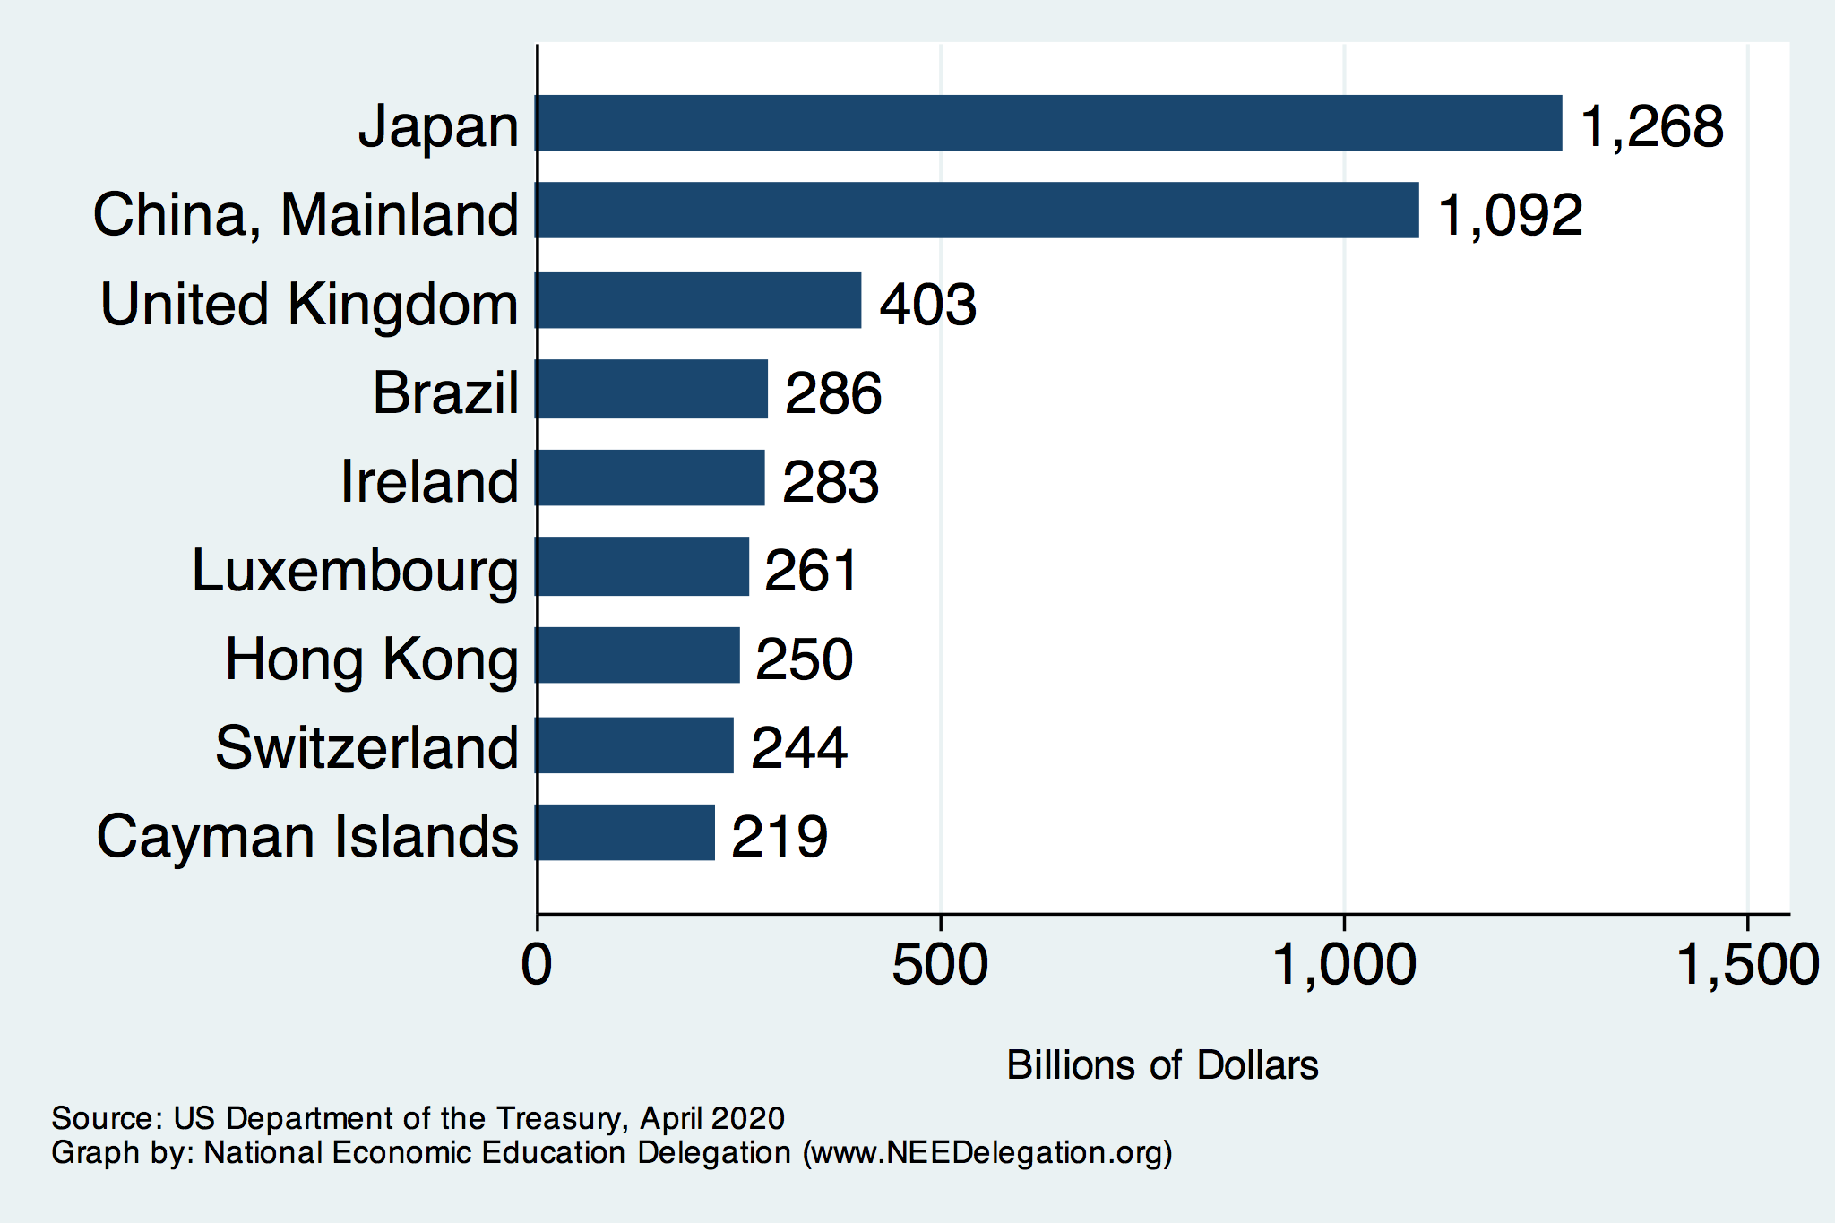
Who Holds Debt to Foreigners
https://ticdata.treasury.gov/Publish/mfh.txt

Slide 11
Why do Foreigners Buy US Treasuries?
Market for Treasuries is the deepest, most liquid and safest capital market in the world.
US economy has a history of political and economic stability.
We enjoy “An exorbitant privilege”. The dollar is the largest international reserve currency.
  Most trade transactions are quoted in dollars, e.g., oil.
  With some exceptions, foreigners borrow in dollars. E.g., Yankee bonds

Slide 12
Demand for Dollars by Central Banks
Source IMF Currency Composition of Official Exchange Reserves
Notes:
Talk about the fall of the Euro Brexit etc. What will the war in Ukraine do to these numbers.

Slide 13
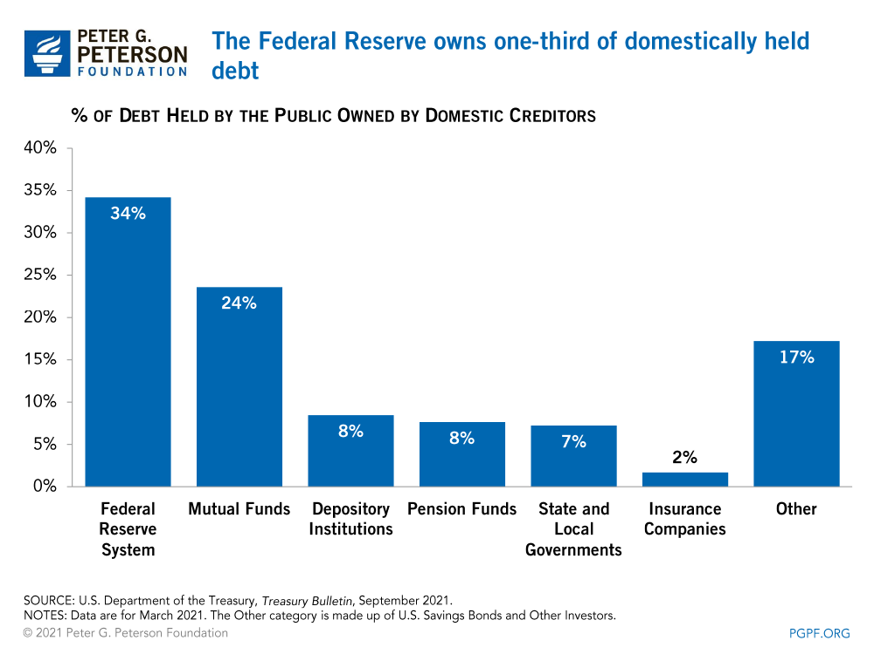
Notes:
Domestic debt held by the Fed is now 37%

Slide 14
Changes since the Pandemic
December 2019: Total, 17.2 tr;
  Foreign, 6.8 (40%) ; Fed 2.3 (13%)
Change to 6/2022: Total, 6.6;
  Foreign, 0.7 (11%); Fed, 3.5 (53%)
Country Changes:
  China, -100; Japan, (81b)
Russia:
  $9b to $2b

Slide 15
Not All Debt Is Created Equal
Intra-governmental debt is important bookkeeping.
  This debt DOES NOT require funding on credit markets
Debt held by the public
  This debt is funded by borrowing on credit markets and competes with private funding.
Most analyses focus on the publicly held debt relative to GDP because:
  To the extent that debt and deficits have burdens these burdens depend on the size of the debt relative to the size of the economy.

Slide 16
CBO: Budget Analysts in Chief
The Congressional Budget Office was founded in 1974 to provide Congress with information about the budgetary implications of legislation.
Two kinds of Reports
  Cost Estimates or “Scoring”
    H.R. 486 Ukraine Religious Freedom Support Act
    Build Back Better Scoring.
  Projections of Debt and Deficits – The Budget and Economic Outlook: 2022 to 2032
Notes:
Lindsey Graham an alternate scoring

Slide 17
Key Points About the U.S. Relative Debt
1946-1974
Relative debt peaked during WWII (106%) - followed by a steady decline until the 1980s.
Prior to 1983, relative debt rose purposefully (wars, recessions, public investment) and then fell.
What can we learn from the 46-74 period, where the relative debt fell continuously?

Slide 18
Debt Dynamics
The relative debt fell in spite of deficits in 21 of the 29 years, with the debt increasing by 42%. How?
1946-1974, deficits caused the debt to grow, but not as fast as the economy was growing.
While the debt grew by 42%, GDP (nominal) grew by 550%
You don’t need a surplus to reduce the relative debt:
You just need GDP to grow faster than the debt

Slide 19
Relative Debt Dynamics
Two Parts to the growth rate of the debt:
  The interest rate on the debt.
  A portion that reflects a primary deficit (+) or primary surplus (-)
Numerical Example: GDP grows at 4%, interest rate is 5%
  Interest expense will cause the debt to grow at 5%. Unless there is a primary surplus: Growth in debt is greater than or equal to 5%, greater than GDP growth of 4%, and the relative debt rises.
  To stabilize the debt, there must be a primary surplus
  Primary surplus has to be bigger, the higher the relative debt.
Notes:
Interest on the debt is about 2 % . If the primary budget had been in surplus the debt still would have grown by 2% Because there was still a very large primarty deficit.he debt actually grew by 6,5%

Slide 20
Traditional Views of the Cost of the Debt
First a non-issue: There is no analogy between household and government debt.
  The government does not have to pay back the debt.
  Maturing government bonds are paid by issuing new bonds.
Economist View of the Debt circa 1980, very little cost because relative debt was falling. That changes in 1983.

Slide 21
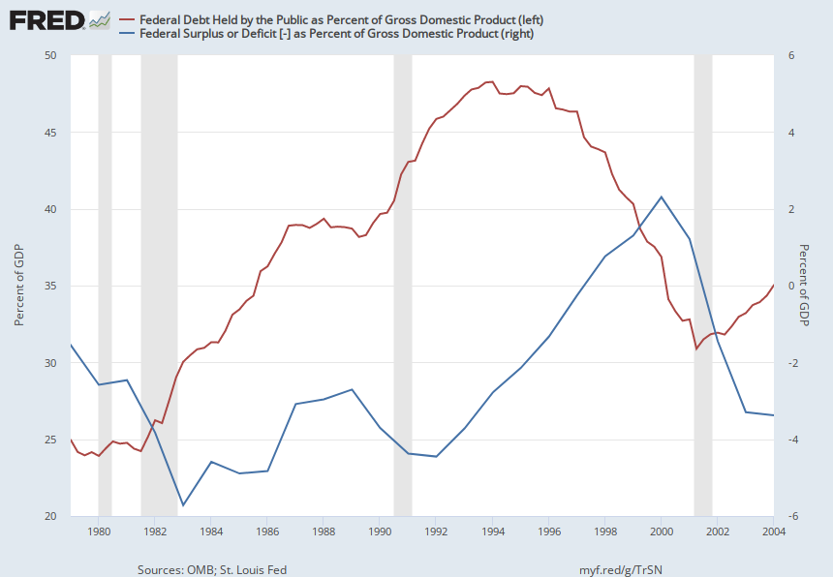
Tax Cuts Don’t “Pay for Themselves”
Notes:
Why 1983?

Slide 22
Traditional View: Debt and Deficits Raise Interest Rates
Crowding Out via higher interest rates:
  Private: less investment and over time to a smaller capital stock and reduced future output.
  Government: primary surplus needed to stabilize the debt is larger; i.e., less programmatic outlays or higher taxes
Foreign Borrowing: Higher interest rates lead to foreign capital inflows or foreign borrowing. With foreign borrowing, some of our GDP is paid to foreigners as interest.

Slide 23
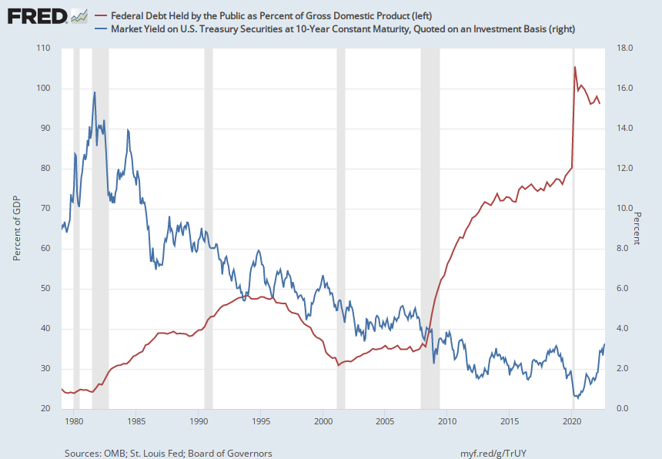
The Dog that Didn’t Bark; Rising Interest Rates?
Blue Line Rate on 10-Yr Treasury Bonds; Red Line Relative Debt

Slide 24
Not All Debt Is Created Equal
Some debt can reduce the availability of investment funds to other borrowers.
  Often referred to as “crowding out” private investment
Intragovernment debt is (important) bookkeeping.
  This debt DOES NOT crowd out private investment.
Debt held by the public
  This debt MIGHT crowd out private investment.
Most analyses of debt focus on federal debt held by the public.

Slide 25
Questions
Let’s take a short break for questions

Slide 26
Olivier Blanchard’s Presidential Address to the AEA 1/2019
“If the future is like the past [with low interest rates],…the issuance of debt without a later increase in taxes may well be feasible. Put bluntly, public debt may have no fiscal cost.”
But,
“My purpose…is not to argue for more public debt, especially in the current political environment. It is to have a richer discussion of the costs of debt…than is currently the case.”

Slide 27
What the Traditional View Got Wrong
Assumed that the interest rate was greater than the growth in GDP
  In order to stabilize the debt, government must run a primary surplus.
  The bigger the debt, the larger the required primary surplus.
More debt today means a higher primary surplus is needed in the future, i.e., higher taxes and/or less programmatic outlays.
Notes:
Numerical example: interest rate a 4%; GDP growth at 3%. there must be a primary surplus to offset the interest rate

Slide 28
New View: Almost a Free Lunch
If the interest rate is less than the growth rate of GDP, then Debt to GDP can be stabilized with a (small) primary deficit: programmatic outlays can be less than revenues!
Remember our example with GDP growth of 4%. Now assume the interest rate is 3%. Relative debt will fall with a primary balance of zero!
Blanchard does believe that the relative debt must be stabilized
  At some point current deficits must be reduced.
  But it may not be crucial at what level of debt we stabilize.
Notes:
Olivier Blanchard

Slide 29
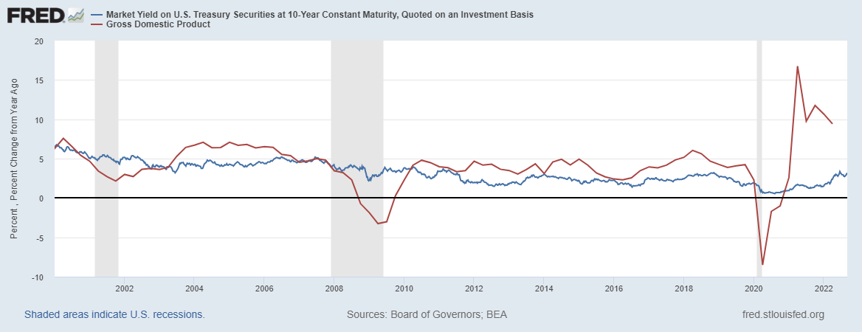
Blanchard’s Evidence
Blue Line Rate on 10-Yr Treasury Bonds; Red Line GDP growth
Notes:
Except for recessions. Blanchard does not explain why interest rates have been so low!

Slide 30
But Why Must the Relative Debt Be Stabilized?
Stephanie Kelton provided a prominent and recent exposition of Modern Monetary Theory in her June 6th 2020, NYTimes op-ed, “Learn to Love Trillion-Dollar Deficits.”
  US Treasury borrows in dollars and therefore cannot default (as opposed to Greece).
  Example: How did we “find the money” in FY 2020 to increase in the deficit by about $1.9 trillion?
  Answer: Fed open market purchases of $1.7 trillion provided 89% of the financing.
  More generally, she argues that we can always find the money to increase federal spending

Slide 31
MMT’s Free Lunch
The only limit on deficit spending is if it leads to too much spending thereby increasing current inflation.
Recognizing this fact, “…could free policymakers not only to act boldly amid crises but also to invest boldly in times of more stability.”
Too bad the second part isn’t true. And, the recent rise in inflation suggests even Dr Kelton should now be worried about the debt
We rely on foreigners to hold a substantial portion of our debt and they can loose if the exchange value of the dollar falls

Slide 32
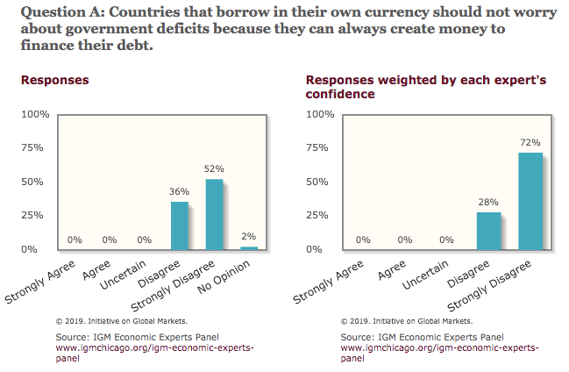
Don’t Just Take My Word for It
Notes:
Recent Increase in inflation does not discredit MMT

Slide 33
CBO on the Costs of “High and Rising Debt”
The interest expense portion of the deficit will rise, including payments to foreigners.
Crowding out of private investment.
“The likelihood of a fiscal crisis in the United States would increase.”
Slow erosion of confidence in the U.S. dollar as an international reserve currency leading to higher interest rates.
Policymaker constraint in using deficit-financed fiscal policy to respond to unforeseen events.
CBO, “Budget and Economic Outlook: 2022-2032,” May 2022, pp15-16.
Notes:
1 & 2 are part of my traditional costs. 3-5 are new and related

Slide 34
What would a Fiscal Crisis Look Like?
Foreigners lose confidence in the dollar and sell Treasuries in exchange for assets denominated in their own currency,
  Sale of Treasuries raises interest rates, worsening our fiscal outlook.
  Trading of Foreign for US assets lowers US exchange rate.
    Raising the price of imports thereby increasing inflation.
    Lowering the foreign currency returns on all US assets, exacerbating 1.
Could the Fed Bail us Out?
  It could buy Treasuries and prevent the rise in interest rates.
  Insufficient foreign assets to prevent the fall in the exchange rate,

Slide 35
Bottom Line: We Need to Worry about the Debt
Interest rates have started to increase. In fact, economist don’t really know why they have fallen to such low levels over the past 20 years
A fiscal crisis should be avoided at all costs.
The good news is we may be able to stabilize the relative debt without a running a surplus.
Inflation isn’t all bad, debt is nominal.

Slide 36
But is this Problem Impossible?
CBO, “Budget and Economic Outlook: 2022-2032,” May 2022

Slide 37
CBO Baseline Projection
CBO, “Budget and Economic Outlook: 2022-2032,” May 2022
Notes:
10 yr Treasury rate rising slowly from 2.4 to 3.7 and then stabilizing

Slide 38
Unfortunately, The Required Changes are Big!
To Stabilize the relative debt at the current level of 100% of GDP:
  Deficit in 2025 needs to go from projected 4.7 % of GDP to 2.9% and be maintained at the 2.9% level.
  This amounts to reducing the deficit by over $500 billion per year.
CBO, “2020 Long-Term Budget Outlook, “ Sep 2022

Slide 39
Any of these Options Sound Good?
Pick 10!

Slide 40
Major Takeaways: Talking Points
The current trajectory of federal debt is unsustainable.
Given the historically low interest rates, we can afford to wait until after the crisis to act.
After the crisis, we must enact plans to reduce the future (primary) deficits.
  These are driven by Medicare and Social Security spending.
The longer we postpone action, the greater the probability of a “fiscal crisis.”

Slide 41
Bottom Line: We Need to Worry about the Debt
Interest rates will not stay this low forever.
A fiscal crisis should be avoided at all costs.
Stabilizing relative debt would substantially reduce the possibility of a crisis.
The good news is we might be able to stabilize relative debt without a primary surplus.
But (after the pandemic is over) we must substantially reduce primary deficits.

Slide 42
Thank you!
Any Questions?
www.NEEDelegation.org
Ryan Herzog, Ph.D.
herzogr@gonzaga.edu
Contact NEED: info@NEEDelegation.org
Submit a testimonial: www.NEEDelegation.org/testimonials.php
Become a Friend of NEED: www.NEEDelegation.org/friend.php

