Slide 1
Osher Lifelong Learning Institute, Winter 2022
Contemporary Economic Policy
University of Alaska, Anchorage
September-October, 2022
National Economic Education Delegation

Slide 2
Available NEED Topics Include:
Coronavirus Economics
US Economy
Climate Change
Economic Inequality
Economic Mobility
Trade and Globalization
Minimum Wages
Immigration Economics
Housing Policy
Federal Budgets
Federal Debt
Black-White Wealth Gap
Autonomous Vehicles
US Social Policy

Slide 3
Course Outline
Contemporary Economic Policy
  Week 1 (9/15): US Economy (Geoffrey Woglom, Amherst College)
  Week 2 (9/22): Economic Inequality (Christopher Herrington, VCU)
  Week 3 (9/29): The Black-White Wealth Gap (Jon Haveman, NEED)
  Week 4 (10/6): Federal Debt (Joseph Carolan, Oakland University)

Slide 4
Submitting Questions
Please submit questions of clarification in the chat.
  I will leave them until the end to answer as it is a tight time frame for the amount of material to cover.
We will do a verbal Q&A once the material has been presented.
Slides will be available from the NEED website (https://needelegation.org/delivered_presentations.php)

Slide 5


The US Federal Debt
OLLI – University of Alaska, Fairbanks
October 6, 2022
Joseph Carolan, Ph.D.
Oakland University

Slide 6
Debt: Feelings….
Feelings about debt – often personal
How you feel….depends

Slide 7
Debt: What do we use it for / why need it?
NOTE: Debt = negative savings
Don’t make enough to cover expenses
Buy things you want now, don’t have the money → implies you will have it later
Big purchases (house, car, etc.)
Use it for investment (not speculating, economic investment which creates value greater than the cost of capital – ROI>WACC)
  Education
  Think: businesses – using it to grow!
Unexpected emergencies – we need $ now!
Others?

Slide 8
Debt: From whom / how do we get it?
Family & friends (incl. crowd sourcing)
Banking system
Credit cards
Venture capitalists
Government (think student loans)
Loan sharks
Others?
Q: Does is matter from whom? Why?

Slide 9
Debt: When does it become problem?
Can’t pay it back
Gets too big (relative to what?)
Interest rates too high
  Requires higher ROI
  Interest payments eat up too much of income
Creditors demand repayment
Damages credit rating severely
  Hurts ability to borrow again
  Increases cost of borrowing
Things don’t go as planned….
Others?

Slide 10
Debt: What does US gov’t use it for?
Don’t make enough to cover expenses
Buy things you want now, don’t have the money → implies you will have it later
Big purchases
Use it for investment (not speculating, economic investment which creates value greater than the cost of capital – ROI>WACC)
  Education
  Think: businesses – using it to grow!
Unexpected emergencies – we need $ now!
Others?

Slide 11
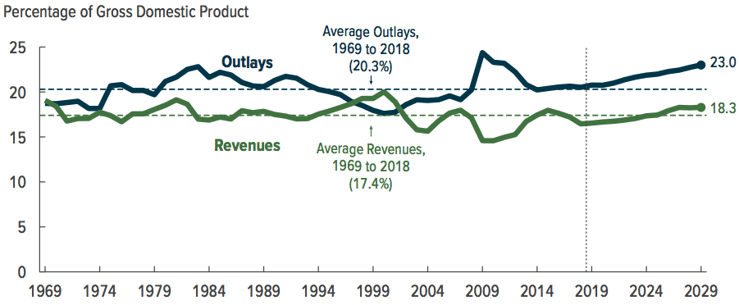
Why Has the Federal Debt Risen So Much?

Slide 12
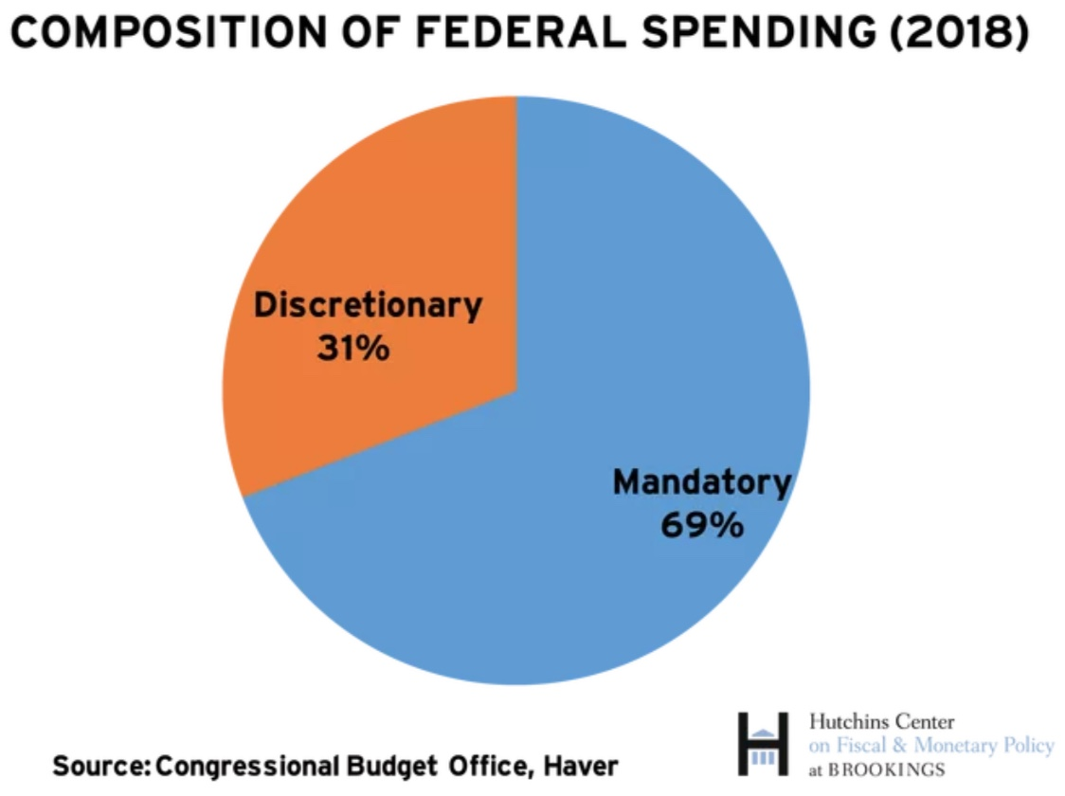
On What is the Money Spent? Complicated

Slide 13
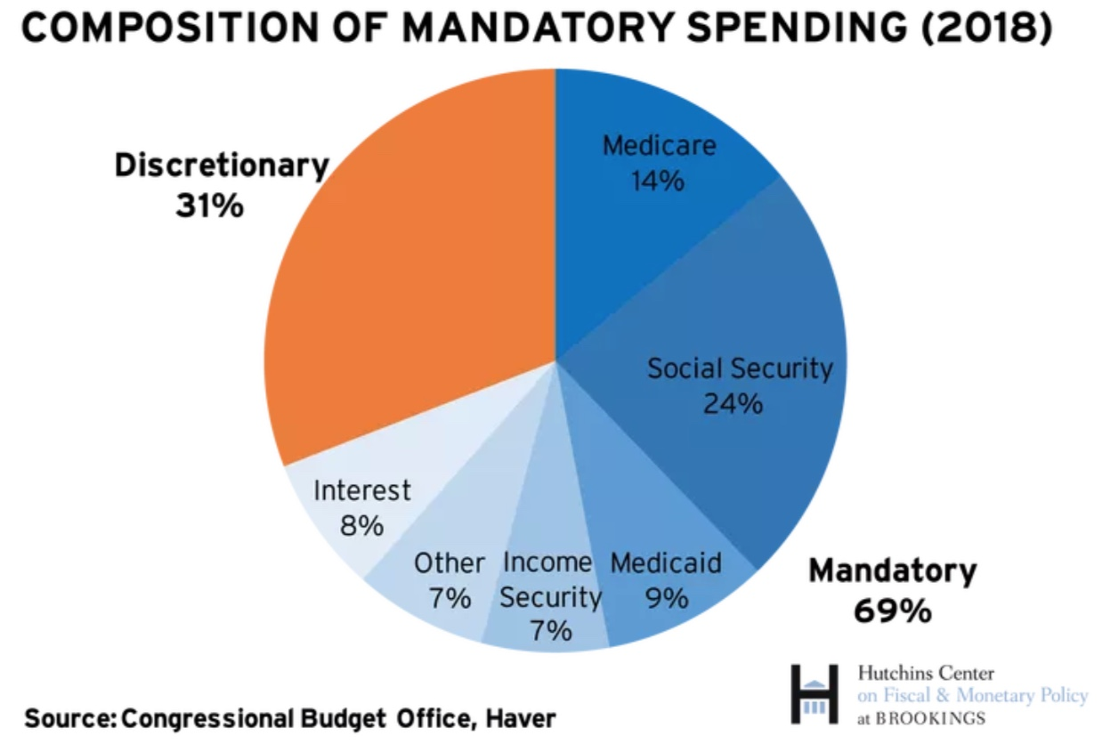
What is Mandatory Spending?

Slide 14
The Federal Budget in FY2022: Oct. thru May
Mandatory, 64%
Discret. 29%
Net Interest, 7%
IIT, 54%
SST, 30%
CT, 8.0%
Programmatic Outlays = Mandatory + Discretionary
Source: Monthly Treasury Report, 5/2022

Slide 15
Mandatory Spending: Total Mandatory
Source: Congressional Budget Office (2017)

Slide 16
Mandatory Spending: Social Security Spending
Outlays 2018: $ 982 billion
Outlays 2029: $1,900 billion
6% annual growth rate
Source: Congressional Budget Office (2017)

Slide 17
Mandatory Spending: Medicare Spending
Outlays 2018: $1,100 billion
Outlays 2029: $2,100 billion
Growth 6.8%
66% of the growth from rising
health care costs and 33% from
increased enrollments.
Source: Congressional Budget Office (2017)

Slide 18
Mandatory Spending: Medicaid Spending
Source: Congressional Budget Office (2017)

Slide 19
Debt: What does US gov’t use it for?
Big purchases – National Defense,
Others?

Slide 20
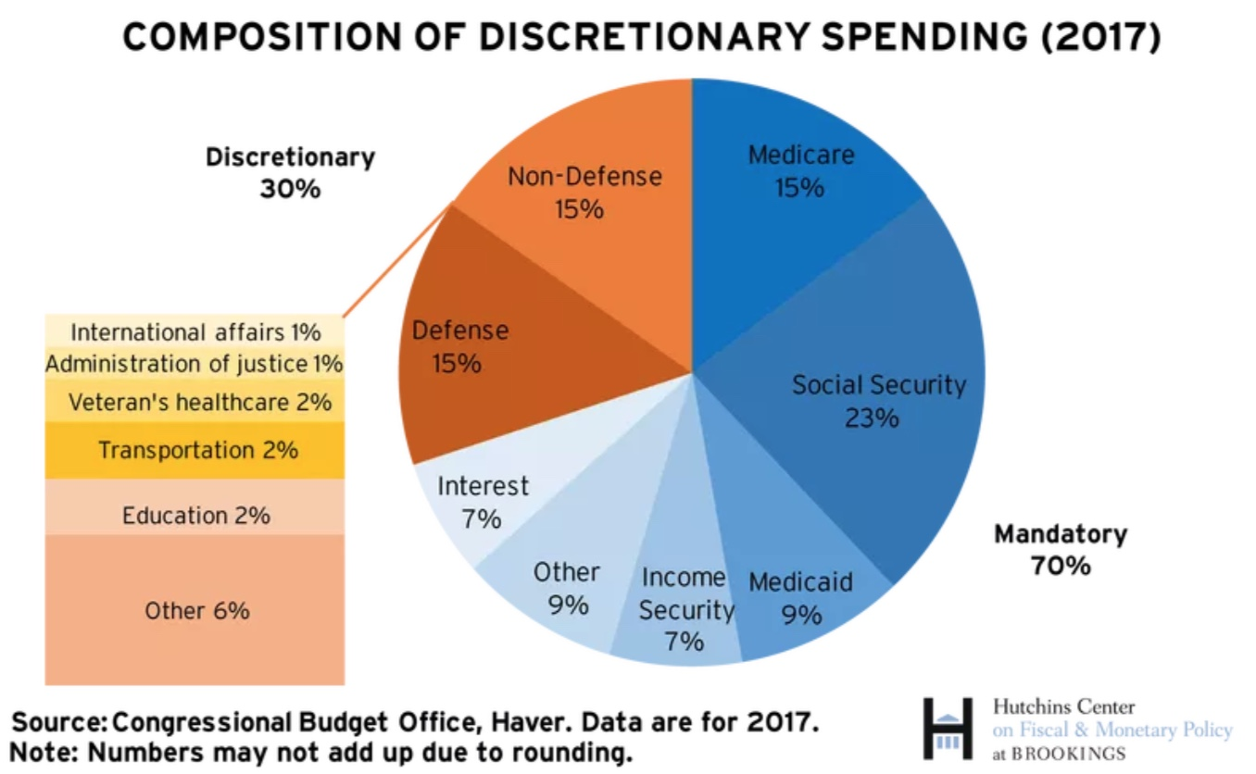
What is Discretionary Spending?
Int’l Affairs 1%

Slide 21
Discretionary Spending: Total
Source: Congressional Budget Office (2017)

Slide 22
Discretionary Spending: Defense Spending
Source: Congressional Budget Office (2017)

Slide 23
Debt: What does US gov’t use it for?
Don’t make enough to cover expenses
Buy things you want now, don’t have the money → implies you will have it later
Big purchases
Use it for investment (not speculating, economic investment which creates value greater than the cost of capital – ROI>WACC)
  Education
  Think: businesses – using it to grow!
Unexpected emergencies – we need $ now!
Others?

Slide 24
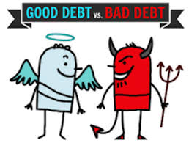
Common belief :Not All Borrowing Is Bad!
Two good reasons to borrow:
  During a temporary crisis
    Recession
    War
    Pandemic
  Productive public investment
    Infrastructure
    Education
These deficits do not permanently increase relative debt.
  Great Depression, WWII → Great Recession? COVID?
  Public investment expands GDP and tax revenue → ROI > WACC
Government spends more than earns. Use it on good debt? Or bad debt?

Slide 25
What Does the US Govt. Budget Look Like?
2019 Budget Summary (in billions)
Revenue |  |  | Outlays
Income Taxes | $1,718 |  | Mandatory | $2,735
Payroll Taxes | $1,243 |  | Discretionary | $1,336
Corporate Taxes | $230 |  | Interest | $376
Other | $271
Total | $3,462 |  | Total | $4,447
Budget Deficit: $984 Billion
Source: Congressional Budget Office, The Budget and Economic Outlook: 2020 to 2030
Notes:
https://www.cbo.gov/publication/53627
https://www.cbo.gov/publication/53624

Slide 26
What Does the U.S. Gov’t Budget Look Like?
Fiscal 2020 Budget Summary
Revenue | Billions |  | Outlays | Billions
Income Taxes | $1,609 |  | Mandatory | $2,315
Payroll Taxes | $1,310 |  | Discretionary | $3,850
Corporate Taxes | $212 |  | Interest | $387
Other | $289
Total | $3,420 |  | Total | $6,552
Budget Deficit: $3,132
Source: Congressional Budget Office, Monthly Budget Review, Nov 2020
Notes:
https://www.cbo.gov/publication/53627
https://www.cbo.gov/publication/53624

Slide 27
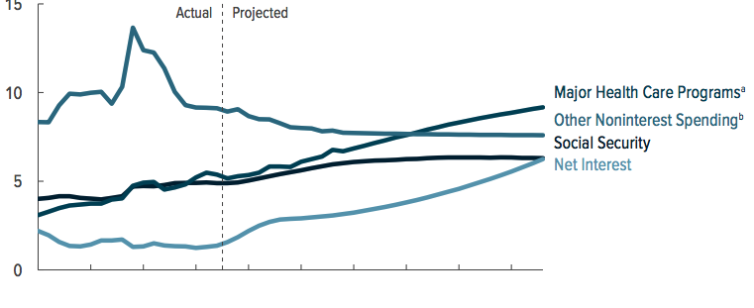
What Are the Primary Drivers Going Forward?

Slide 28
Federal Debt: definitions
‘Deficit’ vs ‘Debt’
  Fiscal year Deficit = Total Outlays Less Revenues (what we’ve been looking at).
  Accumulated value of past borrowing is total government debt.

Slide 29
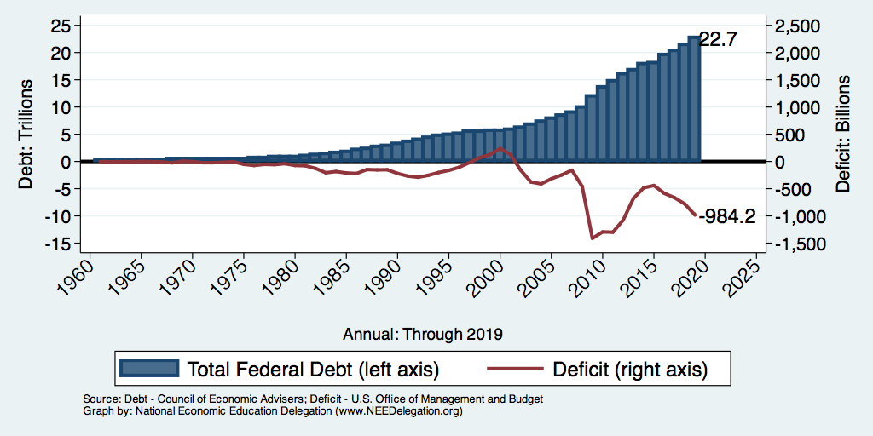
Debt vs. Deficit
Debt = The Sum of All Past Deficits Less Surpluses
Notes:
Debt2deficit.png

Slide 30
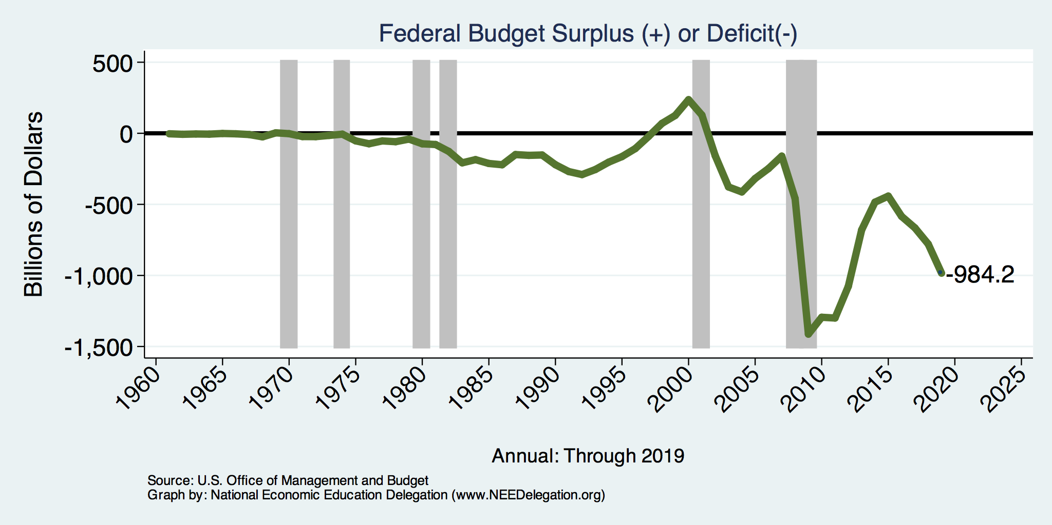
A History of Persistent Deficits
Notes:
Debt2deficit.png

Slide 31
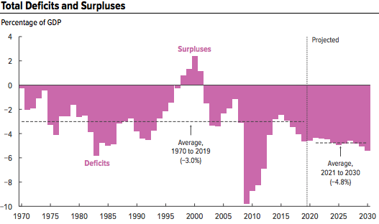
A Future of Deficits
Source: Congressional Budget Office, The Budget and Economic Outlook: 2020 to 2030

Slide 32
Two Measures of the Deficit
(1) Primary deficit = current programmatic outlays – revenues
(2) Total deficit = primary deficit + interest
Interest on the debt is
  The part of the total deficit that is due to past deficits.
This distinction becomes important for understanding:
  The future course of relative debt.
  The costs borne by future generations because of the debt.

Slide 33
Issue: deficit spending….
Continued deficit spending increases debt. Is this a problem?
Think: personal debt – answer depends on various moving parts, including
  Where do you get debt from?
  How much does it cost you?
  Can you pay it back?

Slide 34
How Does the US Government Borrow?
It issues debt.
  Treasury marketable securities:
    Treasury bills, notes, and bonds
    TIPS: Treasury inflation-protected securities
    Savings bonds
Who buys the debt?
  Other federal agencies
  Individuals and businesses
  State and local governments
  Foreign government and individuals
  Federal Reserve

Slide 35
Traditional View
Repayment a non-issue: unlike private sector debt
  Government doesn’t “pay back” debt.
  Maturing government bonds are paid by issuing new bonds (“rolling over” the debt)
  Interest on the debt is essentially paid by the young to their parents.
      When the young are old, their young will do the same for them.
  ? What’s cost of “rolling over”? When is it good?

Slide 36
Not All Debt Is Created Equal
Some debt can reduce the availability of investment funds to other borrowers.
  Often referred to as “crowding out” private investment
Intra-government debt is (important) bookkeeping.
  This debt DOES NOT crowd out private investment.
  This debt DOES NOT require funding on credit markets
Debt held by the public
  This debt MIGHT crowd out private investment.
  This debt is funded by borrowing on credit markets and competes with private funding.

Slide 37
A Breakdown of the Total Federal Debt
Japan, $1.3 tr
China, $1.1 tr
Sources: US Treasury, Federal Reserve Board
Notes:
3/17 phd 23.8 and total 30.3 Last the total public debt exceeded $30 trillion. Federal reserve increased holding by over $1t last fiscal year, 40% of the deficit was financed by the Fed.

Slide 38
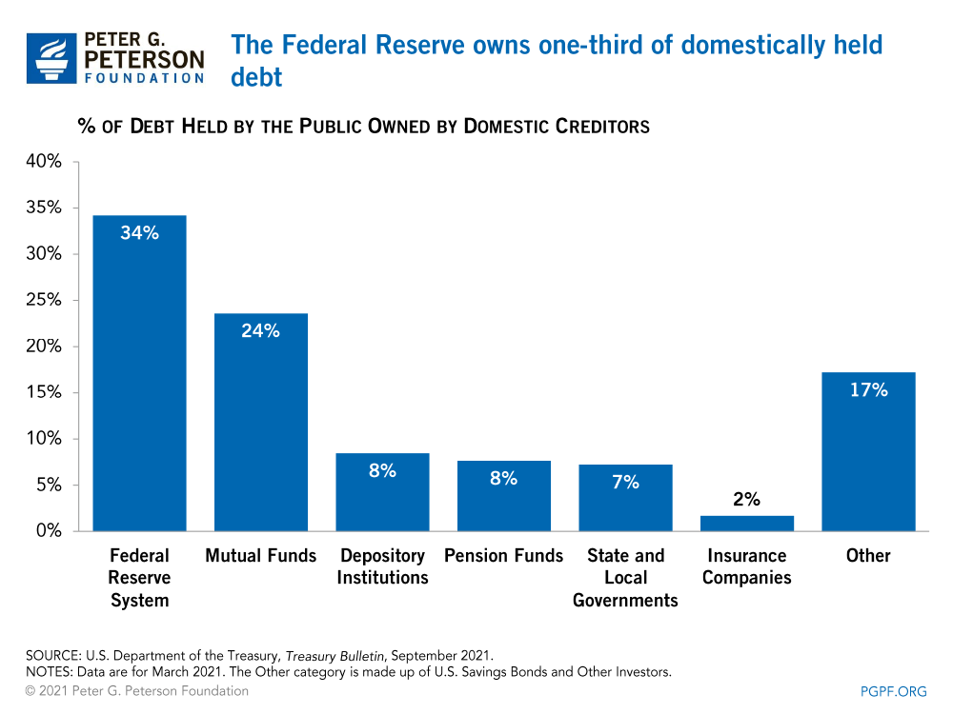
Notes:
Domestic debt held by the Fed is now 37%

Slide 39
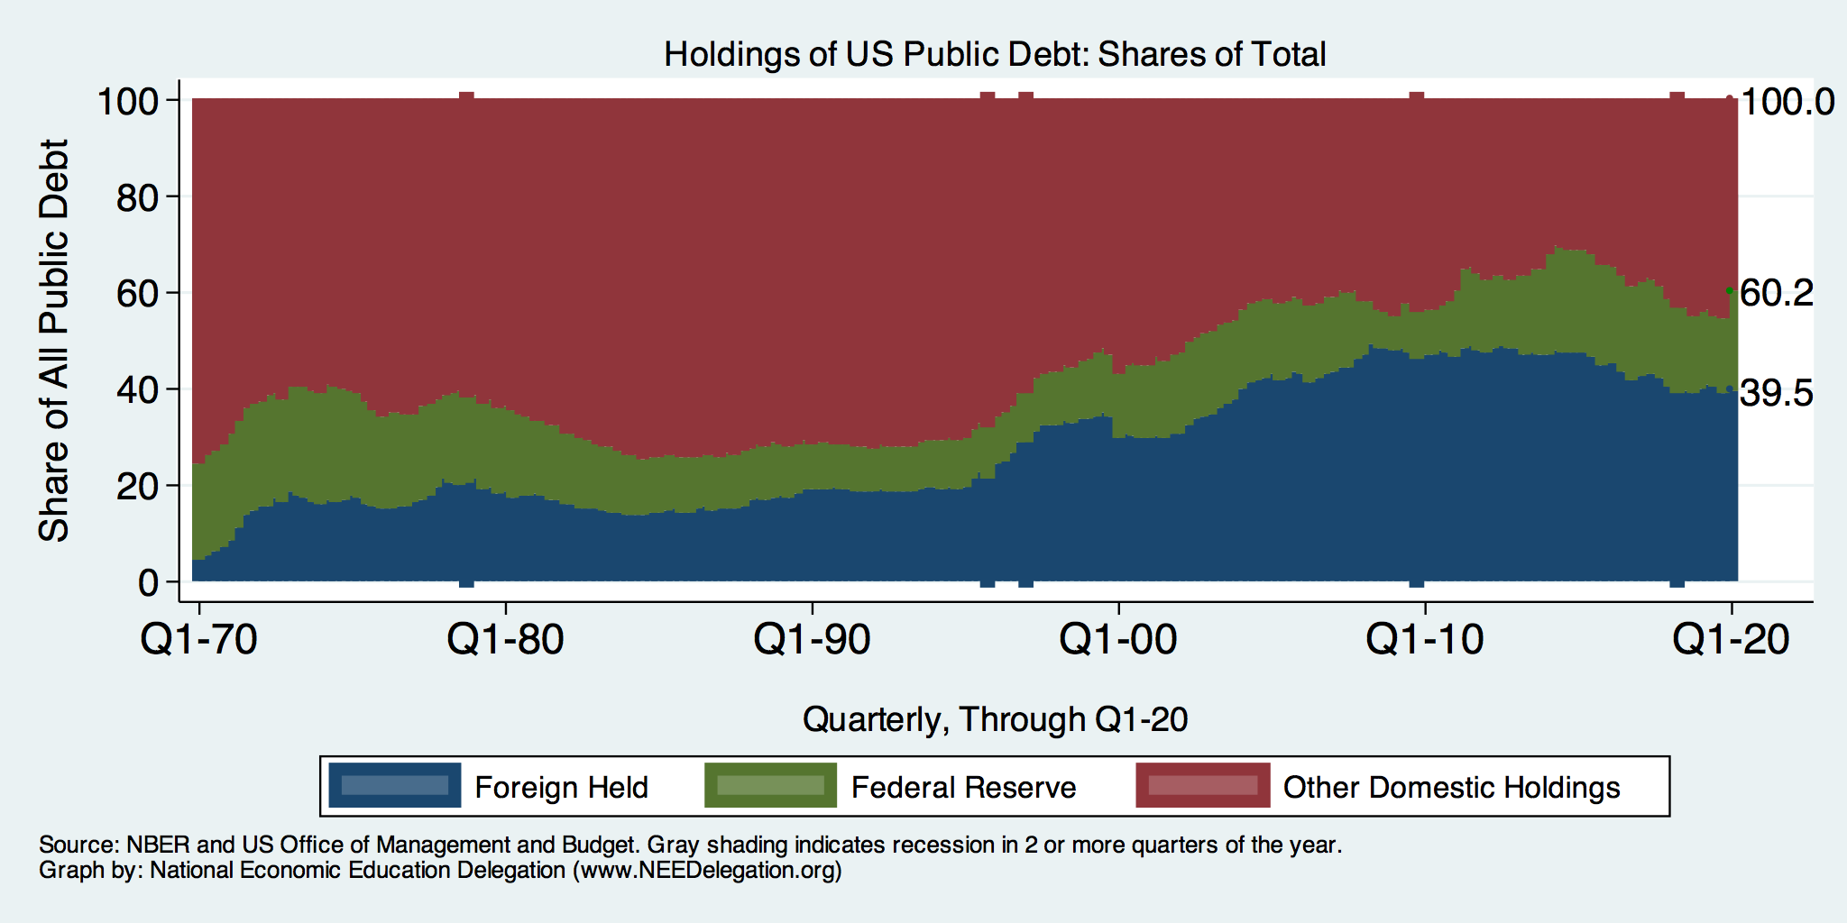
Trends in US Debt Over Time
2020, Q1: Other Domestic: 39.8%
Federal Reserve: 20.7%
Foreign: 39.5%

Slide 40
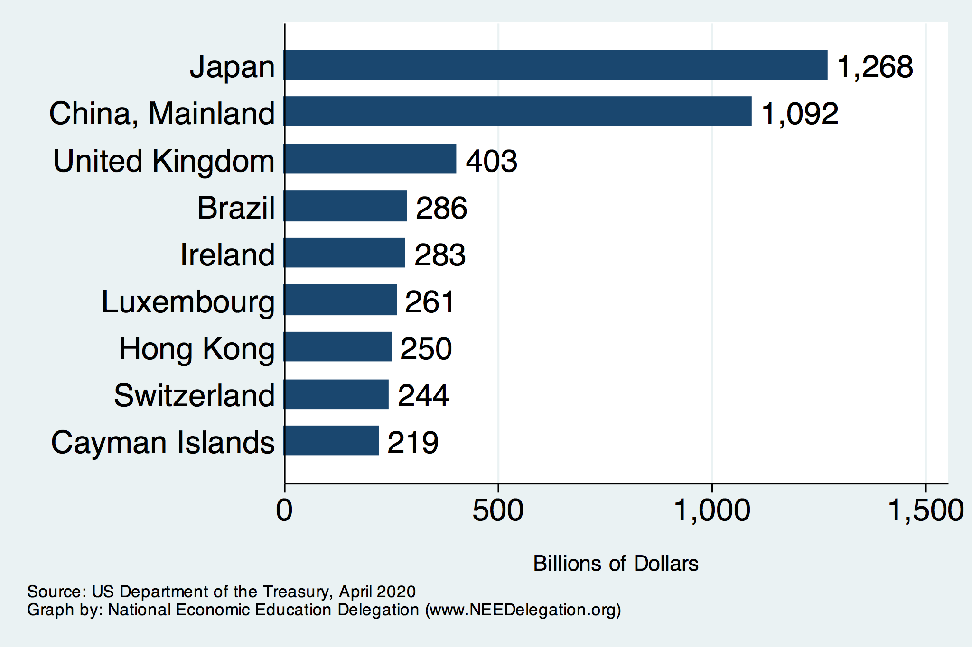
Who Holds Debt: Foreign holders

Slide 41
Should Foreigner ownership be concerning?
Why not?
  Currency used for international trade
  Investors that are looking for stable ROI
  Imports & foreign borrowing go hand in hand (The “Best buy” effect)
  Fed holds foreign debt (the “poker game” idea)
Why?
  Interest payments go to foreigners
  Possibility of a “fiscal crisis” (later)

Slide 42
Why do Foreigners Buy US Treasuries?
Market for Treasuries is the deepest, most liquid and safest capital market in the world.
US economy has a history of political and economic stability.
We enjoy “An exorbitant privilege” (Valery Giscard d’Estaing): The dollar is the largest international reserve currency.
  Most trade transactions are quoted in dollars, e.g., oil.
  With some exceptions, foreigners borrow in dollars. E.g., Yankee bonds

Slide 43
Trade and Investment Flows Balance Out
This is the “Best Buy” effect

Slide 44
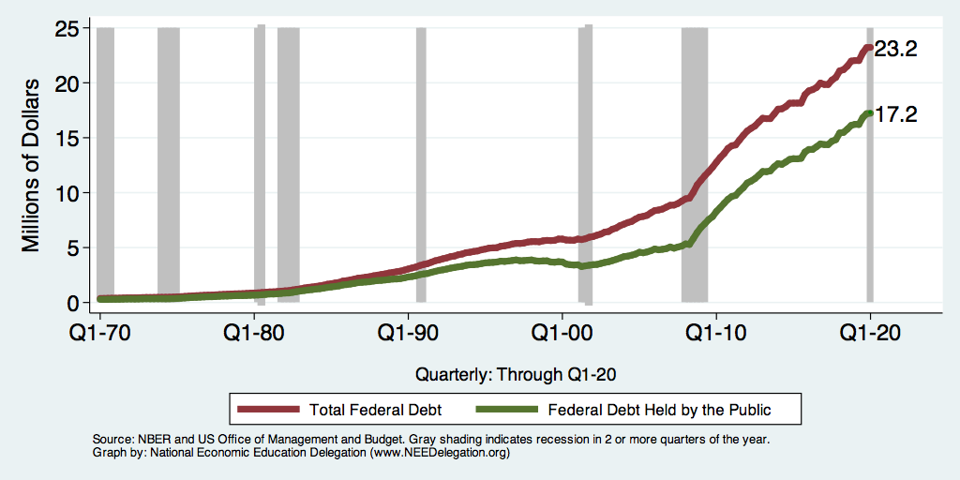
Two Measures of the Debt

Slide 45
Key Idea: Relative Debt
Most analyses of debt focus on federal debt held by the public.
  To the extent that debt and deficits have burdens these burdens depend on the size of the debt relative to the size of the economy (i.e. GDP)
Relative debt is a fraction: Debt/GDP; fractions fall if:
  The numerator falls (budget surplus)
  The denominator rises (nominal GDP growth)
  The denominator grows faster than the numerator
Why just public debt? Because it has to be “repaid” via “rolling over” and is subject to interest rate fluctuation

Slide 46
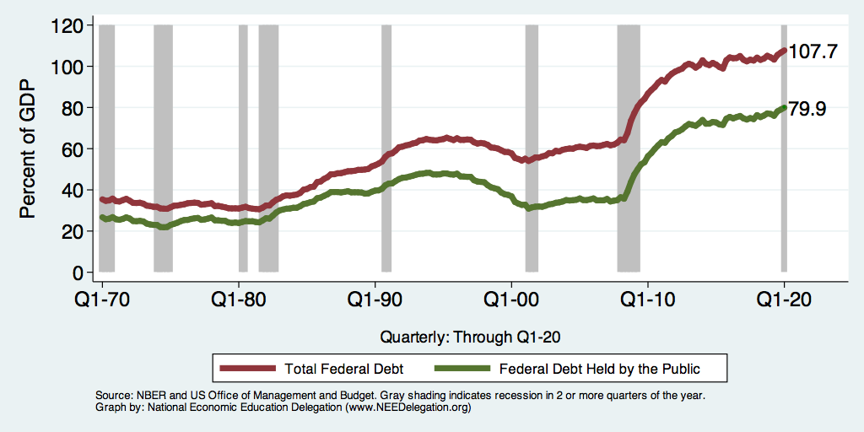
Two Measures of RELATIVE Debt

Slide 47
Key Points About the U.S. Relative Debt
1946-1974
Relative debt peaked during WWII (106%) - followed by a steady decline until the 1980s.
Prior to 1983, relative debt rose purposefully (wars, recessions, public investment) and then fell.
What can we learn from the 46-74 period, where the relative debt fell continuously?

Slide 48
Reminder: Two Measures of the Deficit
(1) Primary deficit = current programmatic outlays – revenues
  Continues to grow!
(2) Total deficit = primary deficit + interest

Slide 49
Debt Dynamics
The relative debt fell in spite of deficits in 21 of the 29 years, with the debt increasing by 42%. How?
1946-1974, deficits caused the debt to grow, but not as fast as the economy was growing.
While the debt grew by 42%, GDP (nominal) grew by 550%
You don’t need a surplus to reduce the relative debt:
You just need GDP to grow faster than the debt
GDP growth needs to exceed Int Rate + Growth Rate of deficit
Two Parts to the growth rate of US debt:
  The interest rate on the debt.
  A portion that reflects a primary deficit (+) or primary surplus (-)

Slide 50
Traditional View: Yes
Debt and Deficits Raise Interest Rates
Government spending ‘Crowds Out’ Private Investment via higher interest rates & fewer loanable funds:
  Private sector: less investment over time means smaller capital stock and reduced future output.
  Government: primary surplus needed to stabilize the debt is larger; i.e., less programmatic outlays or higher taxes
Increases Foreign Borrowing & investment domestically:
  Higher interest rates lead to foreign capital inflows or foreign borrowing.
  With foreign borrowing, some of our GDP is paid to foreigners as interest.

Slide 51
Issue: rising interest payments
More debt means more interest to pay as debt matures
Rising interest rates → cost more to “roll over” debt
Are days of very low interest rates gone?
IF foreign owners panic, rates up! (see later)
Foreign borrowing demands higher rates (later)
Interest costs in 2018: $325 Billion
  1.6% of GDP, or 8% of the Federal Budget
Forecast to increase to $928 Billion in 2029
  3.0% of GDP, or 22% of the Federal budget

Slide 52
What the Traditional View Got Wrong
Assumed that the interest rate was greater than the growth in GDP
  In order to stabilize the debt, government must run a primary surplus.
  The bigger the debt, the larger the required primary surplus.
More debt today means a higher primary surplus is needed in the future, i.e., higher taxes and/or less programmatic outlays.
BUT….interest rates didn’t behave that way
Notes:
Numerical example: interest rate a 4%; GDP growth at 3%. there must be a primary surplus to offset the interest rate

Slide 53
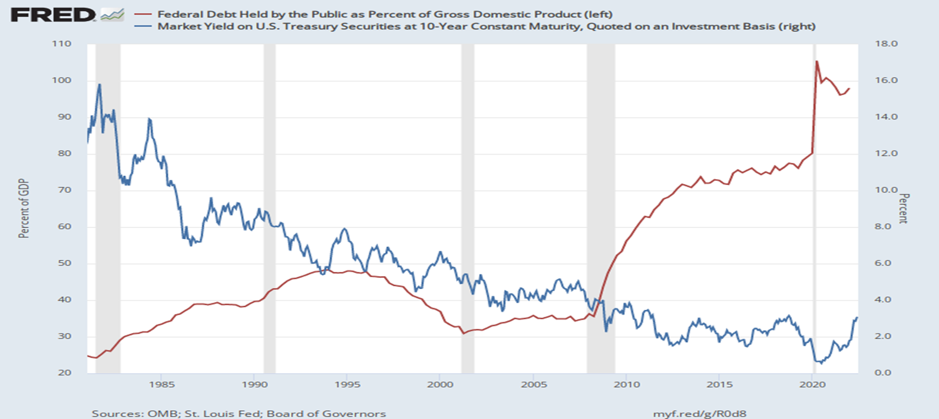
The Dog that Didn’t Bark; Rising Interest Rates?
Blue Line Rate on 10-Yr Treasury Bonds; Red Line Relative Debt

Slide 54
MMT’s ‘Free Lunch’
The only limit on deficit spending is if it leads to too much spending thereby increasing current inflation.
Recognizing this fact, “…could free policymakers not only to act boldly amid crises but also to invest boldly in times of more stability.”
Dr. Kelton again
  Example: How did we “find the money” in FY 2020 to increase in the deficit by about $1.9 trillion?
  Answer: Fed open market purchases of $1.7 trillion provided 89% of the financing.
  More generally, she argues that we can always find the money to increase federal spending

Slide 55
MMT’s Free Lunch – maybe not so free…
Recent rise in inflation suggests free and easy application of MMT theories – acting boldly in times of emergency, finding money via Fed, etc – might lead to problems.
Deficit spending need to be reigned in….?
AND, foreigners hold a substantial portion of our debt and they can lose if the exchange value of the dollar falls (later)

Slide 56
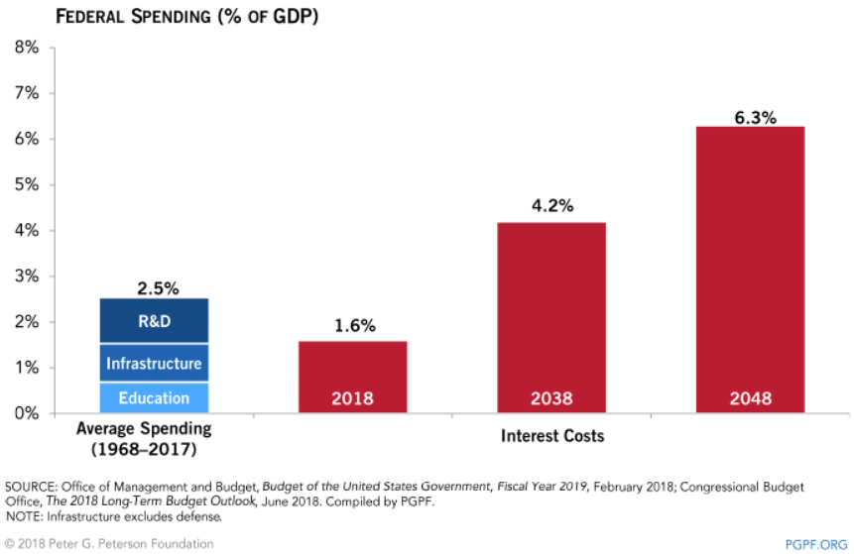
Interest Payments to Grow Significantly

Slide 57
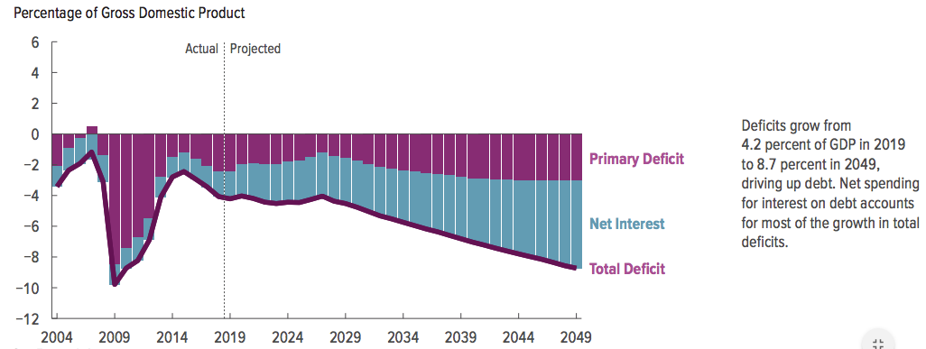
Interest Will Grow as a Share of the Deficit

Slide 58
Spending to Grow Much Faster Than Revenue
Interest, too!

Slide 59
Fed Debt: Problem yet? Soon?

Slide 60
Issue: how big is too big?
Debt is growing b/c
  Primary deficits continue to grow
  Interest payments continue to grow
When should we start to worry that it’s getting too big?

Slide 61
Is The Debt a Problem Today? (Pre-COVID 19)
Currently borrow about $100 billion each month with little difficulty.
Very little evidence of ”crowding out.”
Interest rates are very low, less than 1% on 10-year notes (changing?).

Slide 62
What about default?
Private sector can default / declare bankruptcy
Stephanie Kelton (Modern Monetary Theorist)
6-6-2020, NYTimes op-ed, “Learn to Love Trillion-Dollar Deficits.”
  US Treasury borrows in dollars and therefore cannot default (as opposed to Greece).

Slide 63
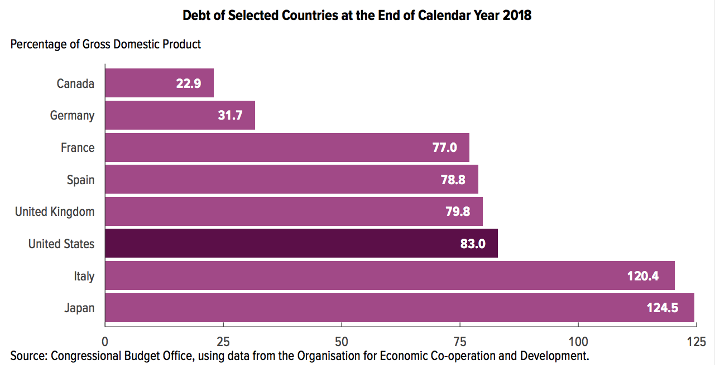
Other Countries Have Higher Debt Levels

Slide 64
Relative Debt Cannot Grow Forever, But
IF Relative does grow, then we encounter issues with lenders
  Interest payments will grow with it.
  Investors might start questioning the creditworthiness of the US government
  Interest rates might increase
  It becomes more difficult to borrow in times of crisis.
  Could start to crowd out investment by consumers and businesses.
  Could be inflationary.
May not present a problem if GDP > Interest rates (Blanchard)
Don’t forget that 40% to foreigners (yep…later…almost..)

Slide 65
New View: Almost a Free Lunch
If the interest rate is less than the growth rate of GDP, then Debt to GDP can be stabilized with a (small) primary deficit: programmatic outlays can be less than revenues!
Olivier Blanchard (economist @ MIT, Head of IMF..):
Blanchard does believe that the relative debt must be stabilized
  At some point current deficits must be reduced.
  But it may not be crucial at what level of debt we stabilize.
“If the future is like the past [with low interest rates],…the issuance of debt without a later increase in taxes may well be feasible. Put bluntly, public debt may have no fiscal cost.”
But,
“My purpose…is not to argue for more public debt, especially in the current political environment. It is to have a richer discussion of the costs of debt…than is currently the case.”
Notes:
Olivier Blanchard

Slide 66
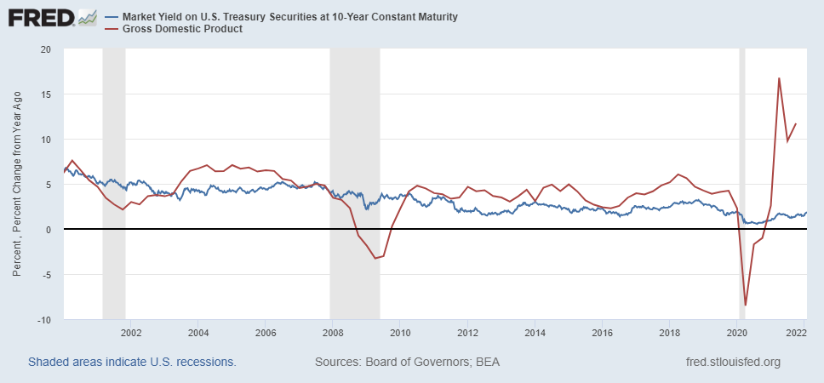
Blanchard’s Evidence
Blue Line Rate on 10-Yr Treasury Bonds; Red Line GDP growth
IF interest rates low AND GDP growth high enough…
Notes:
Except for recessions. Blanchard does not explain why interest rates have been so low!

Slide 67
Issue: The International Dimension (finally)
Interest on foreign-held debt reduces US residents’ welfare.
  Interest payments go to other countries.
When the Fed raises interest rates, the exchange rate of the dollar rises, causing:
  Increases in the trade deficit
  Foreign borrowing.
Sharp increases in interest rates and the cost of imports raises the possibility of a fiscal crisis or a “run on the dollar.”

Slide 68
What would a Fiscal Crisis Look Like?
Foreigners lose confidence in the dollar and sell Treasuries in exchange for assets denominated in their own currency,
  Sale of Treasuries raises interest rates, worsening our fiscal outlook.
  Trading of Foreign for US assets lowers US exchange rate.
    Raising the price of imports thereby increasing inflation.
    Lowering the foreign currency returns on all US assets, exacerbating 1.
Could the Fed Bail us Out? – the “poker game”
  Yes - It could buy Treasuries and prevent the rise in interest rates.
  But - Insufficient foreign assets to prevent the fall in the exchange rate,

Slide 69
Any of these Options Sound Good?

Slide 70
Takeaways / talking points
Can’t technically default, nor technically have to “repay”
  “Rolling over” debt may cost more in future
The current trajectory for the federal debt seems unsustainable
Persistence of deficit spending will increase need to borrow
  What should we cut?
Debt service will increase due to
  Deficit spending
  Possible increased interest rates
Good borrowing may become more difficult if relative debt grows
  Economic investment may lack
  Emergency borrowing ability may be constrained
Increased debt service may “crowd out” private investment
Debt held by foreigners increases – may lead to ‘fiscal crisis
Relative debt stabilization may be handled by combination of GDP growth and low interest rates

Slide 71
Thank you!
Any Questions?
www.NEEDelegation.org
Joseph Carolan, Ph.D.
carolan@oakland.edu
Contact NEED: info@NEEDelegation.org
Submit a testimonial: www.NEEDelegation.org/testimonials.php
Become a Friend of NEED: www.NEEDelegation.org/friend.php

Slide 72
Federal Debt Glossary
Total Federal Debt is the value of all outstanding government bonds (or “Treasuries”) that have been issued to finance past federal government deficits.
Deficit is the difference between total federal spending and revenues.
Federal Debt in the Held by the Public is the debt held by the private domestic investors, foreign investors and the Federal Reserve. The concept of the debt excludes intragovernmental debt, such as the debt held by the Social Security and Medicare Trust Funds.
The Relative Debt is the Federal Debt Held by the Public as a fraction of the size of the economy, or GDP.
Congressional Budget Office (CBO) is a congressional think tank that analyzes the effect of legislation on the budget (“scoring”) and issues periodic projections on the future of debt and deficits
Primary Deficit is the difference between federal spending on programs and total revenues. The primary deficit excludes interest on the debt.
Rolling Over the Debt the process of paying off maturing government bonds with newly issued bonds

Slide 73
Federal Debt Glossary (Cont.)
Crowding Out is the phenomena where government financing of deficits raises interest rates and lowers firms’ investment.
International Reserve Currency is foreign holdings of US debt (and other countries debt) to facilitate international trade; e.g., oil is traded in dollars.
Default is when an entity that issues a bond fails to make an interest payment or the repayment of the face amount on time.
Foreign Exchange Value of the Dollar is the purchasing power of the dollar in terms of a foreign currency. When the US exchange rate falls, the dollar has les purchasing power over foreign goods.
Budget Reconciliation is a Senate process for by-passing the filibuster, so that legislation can be enacted with a 51-vote majority. The process can only be used for changing spending or taxes and the legislation cannot increase the deficit after 10 years.

