Slide 1
Osher Lifelong Learning Institute, Fall 2022
Contemporary Economic Policy
Arizona State University
September, 2022
Jon Haveman, Ph.D.
National Economic Education Delegation

Slide 2
National Economic Education Delegation
Vision
  One day, the public discussion of policy issues will be grounded in an accurate perception of the underlying economic principles and data.
Mission
  NEED unites the skills and knowledge of a vast network of professional economists to promote understanding of the economics of policy issues in the United States.
NEED Presentations
  Are nonpartisan and intended to reflect the consensus of the economics profession.

Slide 3
Who Are We?
Honorary Board: 54 members
  2 Fed Chairs: Janet Yellen, Ben Bernanke
  6 Chairs Council of Economic Advisers
    Furman (D), Rosen (R), Bernanke (R), Yellen (D), Tyson (D), Goolsbee (D)
  3 Nobel Prize Winners
    Akerlof, Smith, Maskin
Delegates: 652+ members
  At all levels of academia and some in government service
  All have a Ph.D. in economics
  Crowdsource slide decks
  Give presentations
Global Partners: 48 Ph.D. Economists
  Aid in slide deck development

Slide 4


Where Are We?

Slide 5
Available NEED Topics Include:
Healthcare Economics
US Economy
Climate Change
Economic Inequality
Economic Mobility
Trade and Globalization
Minimum Wages
Immigration Economics
Housing Policy
Federal Budgets
Federal Debt
Black-White Wealth Gap
Autonomous Vehicles
US Social Policy

Slide 6
Course Outline
Contemporary Economic Policy
  Week 1 (9/12): The U.S. Federal Debt (Jon Haveman, NEED)
  Week 2 (9/19): Minimum Wages (Jon Haveman, NEED)

Slide 7


The US Federal Debt
Jon Haveman, Ph.D.
National Economic Education Delegation

Slide 8
Credits and Disclaimer
This slide deck was created by:
  Jon Haveman, Executive Director, NEED
  Geoffrey Woglom, Amherst College, Emeritus
This slide deck was reviewed by:
  Olivier Blanchard, Peterson Institute for International Economics
  John H. Cochren, Stanford University
Disclaimer
  NEED presentations are designed to be nonpartisan.
  It is, however, inevitable that presenters will be asked for and offer their own views.
  Such views are those of the presenters and not necessarily those of the National Economic Education Delegation (NEED).

Slide 9
Submitting Questions
Please submit questions of clarification in the chat.
  I will try to handle them as they come up.
We will do a verbal Q&A once the material has been presented.
OLLI allowing, we can stay beyond the end of class to have further discussion.
Slides will be available from the NEED website tomorrow (https://needelegation.org/delivered_presentations.php)

Slide 10
Outline
Definitions and Basic Data.
How do we “stabilize” the debt?
Traditional Approach
New Ideas about the Costs of the Debt
“Debt? What me Worry?” Modern Monetary Theory.
Recent Congressional Budget Office (CBO) analysis of the Cost of the Debt.
CBO projections

Slide 11
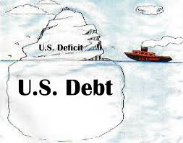
Of Debt, Deficits, and Surpluses
FLOW
  Deficit: The excess of outlays over revenues in a year.
  Surplus: The excess of revenues over outlays in a year.
STOCK
  Debt: The accumulation of debt over time.
      The sum of all past deficits and surpluses.

Slide 12
Basic Definitions
Fiscal year Deficit: Total Outlays less Revenues between October and September.
The deficit is paid for by government borrowing: (net) issue of new government bonds.
Total government debt: the accumulated value of past borrowing.

Slide 13
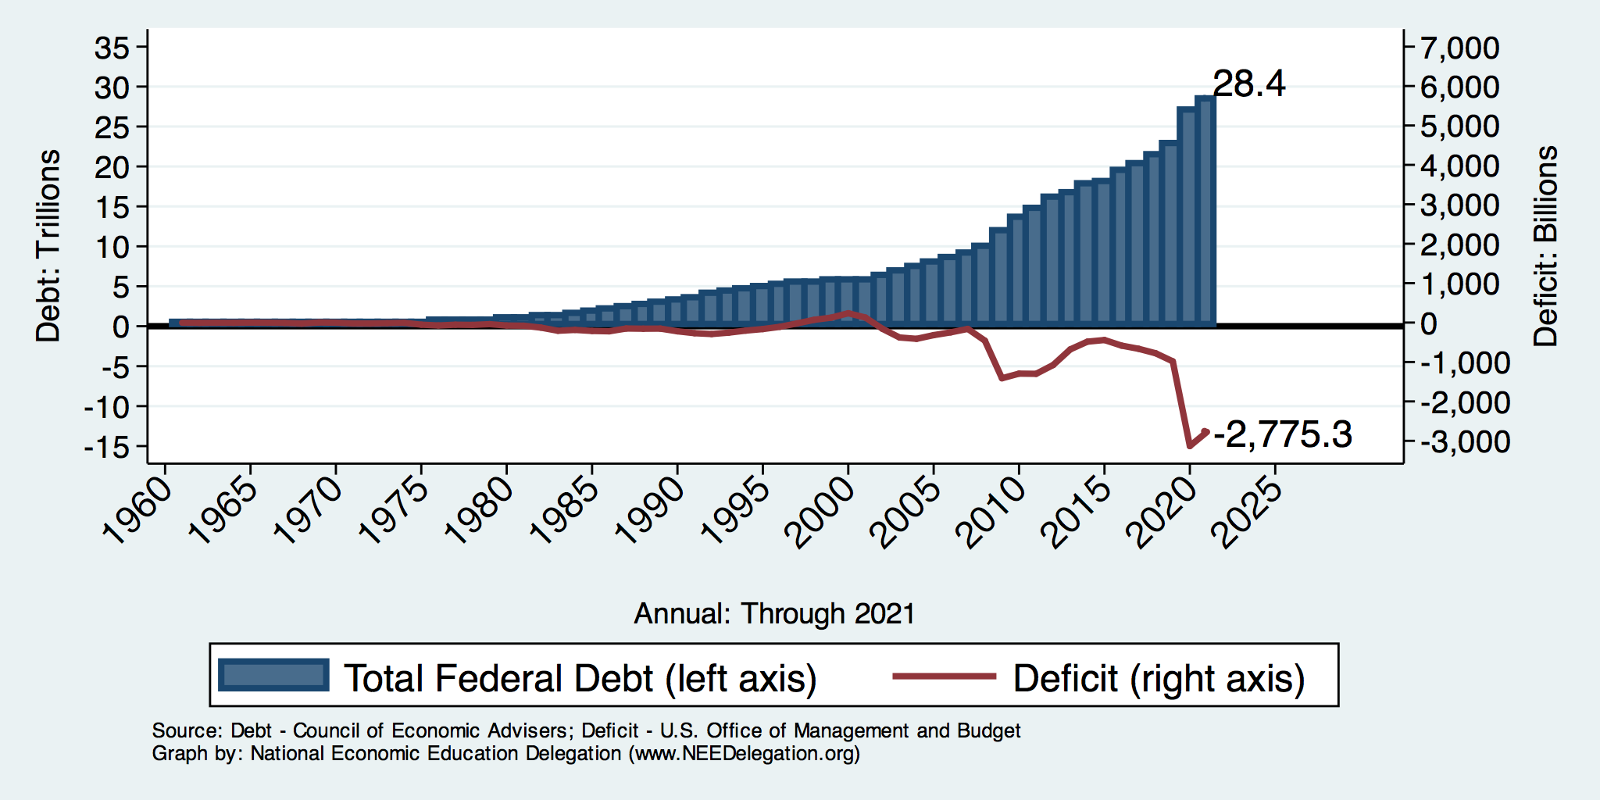
The Debt and Deficit

Slide 14
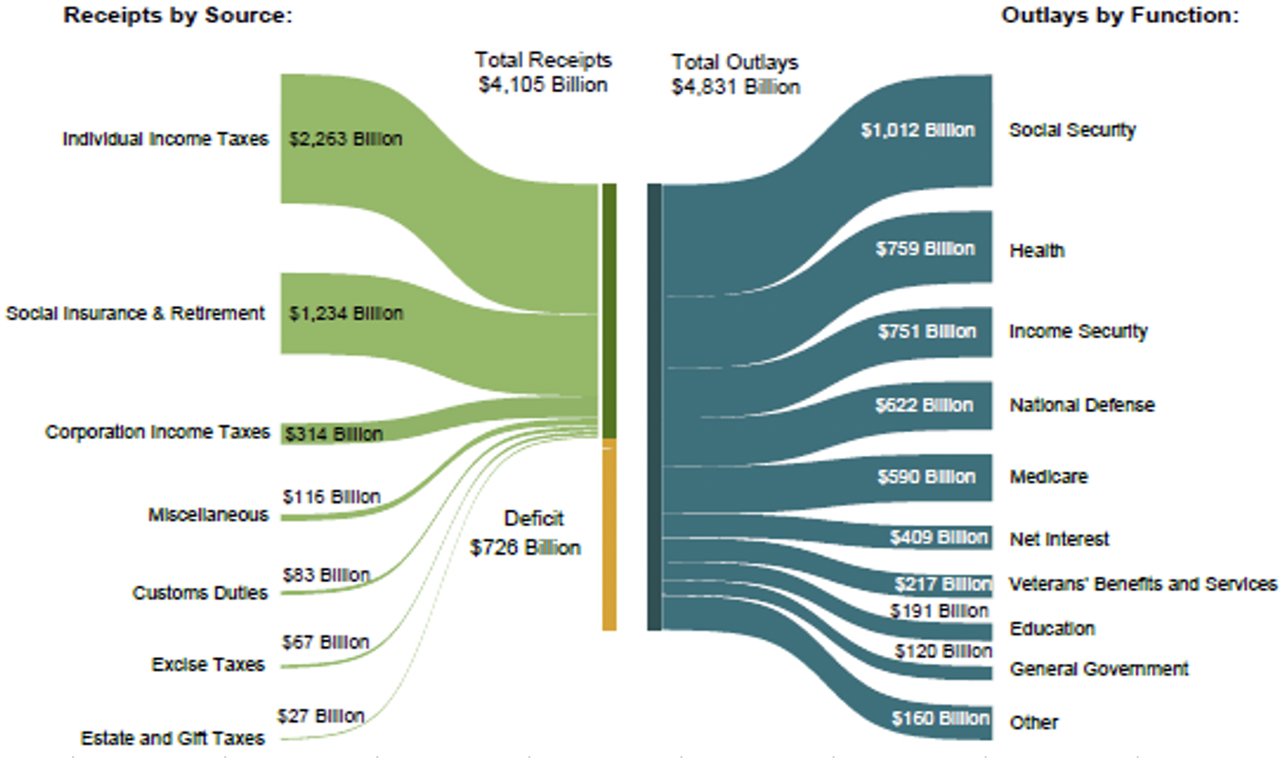
The Federal Budget in FY2022: Oct. thru July
Mandatory, 64%
Discret. 29%
Net Interest, 7%
IIT, 54%
SST, 30%
CIT, 8.0%
Programmatic Outlays = Mandatory + Discretionary
Source: Monthly Treasury Report, 7/2022

Slide 15
Past and Future of Deficits
Useful Deficit Decomposition:
Deficit = (Outlays + Interest) - Revenue
=(Outlays – Revenue) + Interest
=Primary Deficit + Interest
Source: CBO, “The Budget and Economic Outlook: 2022:2032,” 5/2022
Notes:
Christina Romer: 3 packages war production of 1943.

Slide 16
A Breakdown of the Total Federal Debt
Japan, $1.2 tr
China, $1.0 tr
Sources: US Treasury, Federal Reserve Board
Notes:
3/17 phd 23.8 and total 30.3 Last the total public debt exceeded $30 trillion. Federal reserve increased holding by over $1t last fiscal year, 40% of the deficit was financed by the Fed.

Slide 17
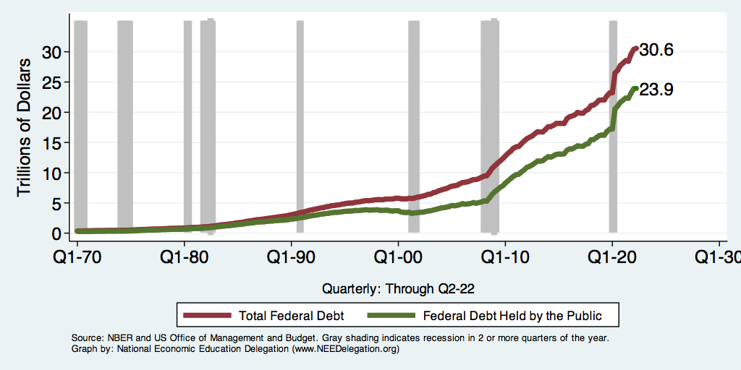
Two Measures of the Debt
SSN & Medicare Trust Funds

Slide 18
Not All Debt Is Created Equal
Intra-governmental debt is important bookkeeping.
  This debt DOES NOT require funding on credit markets.
Debt held by the public
  This debt is funded by borrowing on credit markets and competes with private funding.
Most analyses focus on the publicly held debt relative to GDP because:
  To the extent that debt and deficits have burdens these burdens depend on the size of the debt relative to the size of the economy.

Slide 19
The All-Important Relative Debt
CBO analyzes the debt relative to GDP because:
  To the extent that debt and deficits have burdens, these burdens depend on the size of the debt relative to the size of the economy.
 | Total Public Debt | Relative Debt Debt/GDP
United States | $30.6 Trillion | 96%
Greece | $0.4 Trillion | 176%

Slide 20
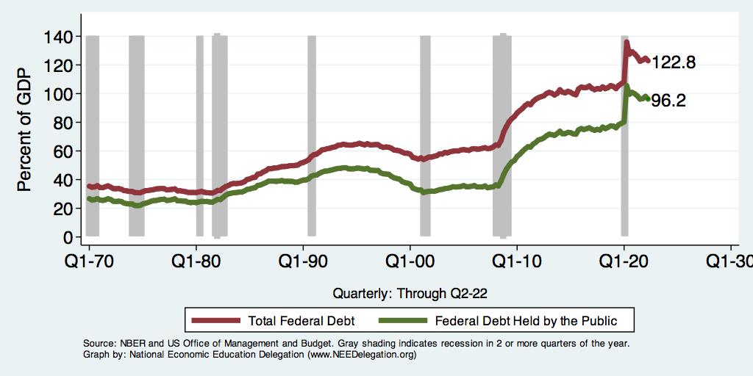
Two Measures of RELATIVE Debt
Recall $ Value of Debt

Slide 21
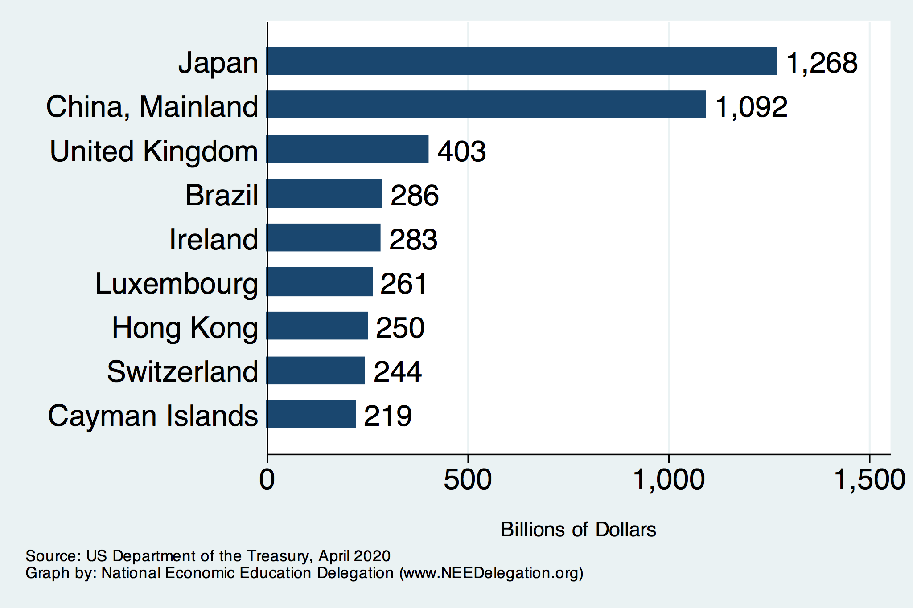
Who Holds Debt to Foreigners

Slide 22
Why do Foreigners Buy US Treasuries?
Market for Treasuries is the deepest, most liquid and safest capital market in the world.
US economy has a history of political and economic stability.
We enjoy “An exorbitant privilege” (Valery Giscard d’Estaing): The dollar is the largest international reserve currency.
  Most trade transactions are quoted in dollars, e.g., oil.
  With some exceptions, foreigners borrow in dollars. E.g., Yankee bonds

Slide 23
Demand for Dollars by Central Banks
Source IMF Currency Composition of Official Exchange Reserves
Notes:
Talk about the fall of the Euro Brexit etc.

Slide 24
How Does the US Government Borrow?
It issues debt.
  Treasury marketable securities:
    Treasury bills, notes, and bonds
    TIPS: Treasury inflation-protected securities
    Savings bonds
Who buys the debt?
  Other federal agencies
  Individuals and businesses
  State and local governments
  Foreign government and individuals
  Federal Reserve

Slide 25
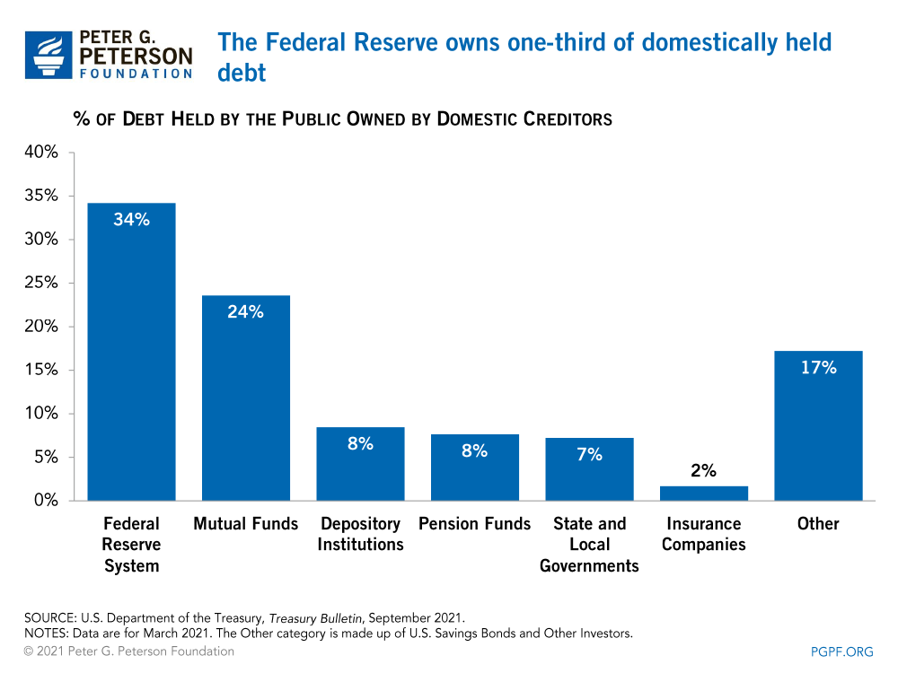
Notes:
Domestic debt held by the Fed is now 37%

Slide 26
CBO: Budget Analysts in Chief
The Congressional Budget Office was founded in 1974 to provide Congress with information about the budgetary implications of legislation.
Two kinds of Reports
  Cost Estimates or “Scoring”
    H.R. 486 Ukraine Religious Freedom Support Act
    Build Back Better Scoring.
  Projections of Debt and Deficits – The Budget and Economic Outlook: 2022 to 2032
Notes:
Lindsey Graham an alternate scoring

Slide 27
Key Points About the U.S. Relative Debt
1946-1974
Relative debt peaked during WWII (106%) - followed by a steady decline until the 1980s.
Prior to 1983, relative debt rose purposefully (wars, recessions, public investment) and then fell.
What can we learn from the 46-74 period, where the relative debt fell continuously?

Slide 28
Debt Dynamics
The relative debt fell in spite of deficits in 21 of the 29 years, with the debt increasing by 42%. How?
1946-1974, deficits caused the debt to grow, but not as fast as the economy was growing.
While the debt grew by 42%, GDP (nominal) grew by 550%
You don’t need a surplus to reduce the relative debt:
You just need GDP to grow faster than the debt.

Slide 29
Debt Dynamics
Surprising (?) Facts
  From 1945 to 1979, relative debt fell from 100% of GDP to 25% of GDP.
  During this period, the federal budget was in surplus only once, in 1969.
Relative debt is a fraction: Debt/GDP; fractions fall if:
  The numerator falls (budget tends toward surplus)
  The denominator rises (nominal GDP growth)
  The denominator grows faster than the numerator
  You don’t need a surplus to reduce the relative debt:
  You just need GDP to grow faster than the debt.

Slide 30
Relative Debt Dynamics
Two Parts to the growth rate the debt:
  The interest rate on the debt.
  A portion that reflects a primary deficit (+) or primary surplus (-).
Numerical Example: GDP grows at 4%, interest rate is 5%
  If there is either a primary deficit or a primary balance of zero, relative debt grows:
    Growth in debt is greater than or equal to 5%, greater than GDP growth of 4%.
  To stabilize the debt, there must be a primary surplus.
  Primary surplus has to be bigger, the higher the relative debt.
Notes:
Interest on the debt is about 2 % . If the primary budget had been in surplus the debt still would have grown by 2% Because there was still a very large primarty deficit.he debt actually grew by 6,5%

Slide 31
How to Think About the Debt

Slide 32
Perspectives on Increased Debt
Government borrowing crowds out private capital and investments.
  Weakened by the ability to borrow from other countries.
Does debt impose a burden on future generations?
  Does it inevitably have to be paid off?
In time, debt service might crowd out other government spending.
  Diminishing policy priorities in the budget.
Is it reasonable to borrow at low interest rates for investment?
  For example, for infrastructure.

Slide 33
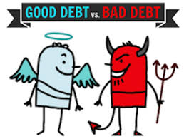
Not All Borrowing Is Bad!
Two good reasons to borrow:
  During a temporary crisis
    Recession
    War
    Pandemic
  Productive public investment
    Infrastructure
    Education
These deficits do not permanently increase relative debt.
  Great Depression, WWII
  Public investment expands GDP and tax revenue
  Pandemic

Slide 34
Traditional View of the Debt

Slide 35
Traditional Views of the Cost of the Debt
First a non-issue: There is no analogy between household and government debt.
  The government does not have to pay back the debt.
  Maturing government bonds are paid by issuing new bonds (“rolling over” the debt).
Economist View of the Debt circa 1980, very little cost because relative debt was falling. That changes in 1983.

Slide 36
Traditional View post-1983: Debt and Deficits Raise Interest Rates
Crowding Out via higher interest rates:
  Private: less investment and over time to a smaller capital stock and reduced future output.
  Government: primary surplus needed to stabilize the debt; i.e., less programmatic outlays or higher taxes.
Foreign Borrowing: Higher interest rates lead to foreign capital inflows or foreign borrowing.
  With foreign borrowing, some of our GDP is paid to foreigners as interest.

Slide 37
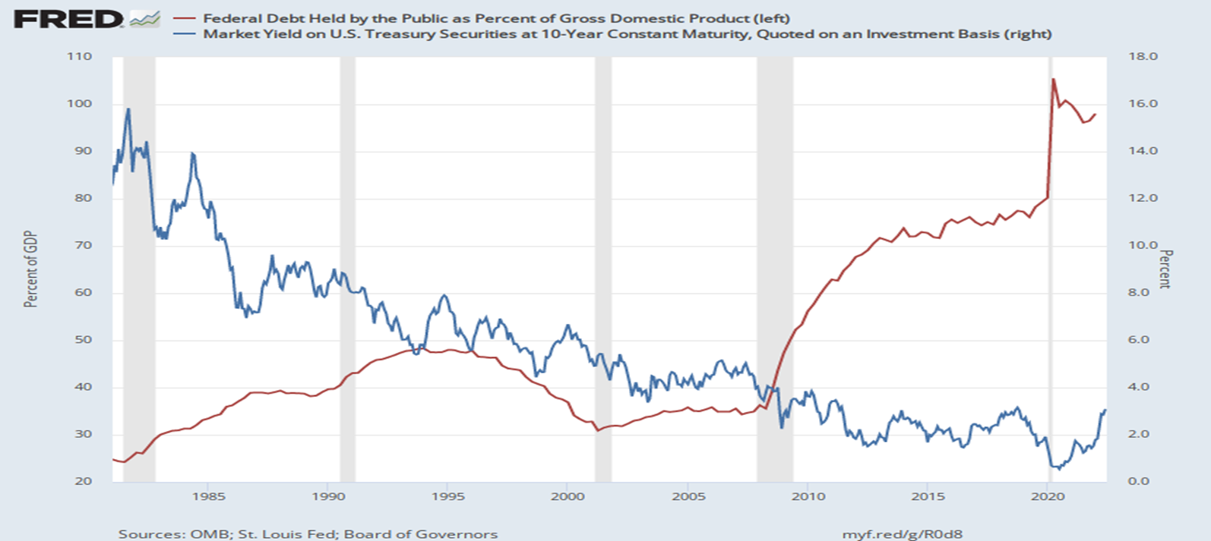
The Dog that Didn’t Bark; Rising Interest Rates?
Blue Line Rate on 10-Yr Treasury Bonds; Red Line Relative Debt

Slide 38
Now: A Change in Thinking

Slide 39
Olivier Blanchard’s Presidential Address to the AEA 1/2019
“If the future is like the past [with low interest rates],…the issuance of debt without a later increase in taxes may well be feasible. Put bluntly, public debt may have no fiscal cost.”
But,
“My purpose…is not to argue for more public debt, especially in the current political environment. It is to have a richer discussion of the costs of debt…than is currently the case.”

Slide 40
What the Traditional View Got Wrong
Assumed that the interest rate was greater than the growth in GDP
  In order to stabilize the debt, government must run a primary surplus.
  The bigger the debt, the larger the required primary surplus.
More debt today means a higher primary surplus is needed in the future, i.e., higher taxes and/or less programmatic outlays.
Notes:
Numerical example: interest rate a 4%; GDP growth at 3%. there must be a primary surplus to offset the interest rate

Slide 41
New View: Almost a Free Lunch
If the interest rate is less than the growth rate of GDP, then Debt to GDP can be stabilized with a (small) primary deficit: programmatic outlays can be more than revenues!
Remember our example with GDP growth of 4%. Now assume the interest rate is 3%. Relative debt will fall with a primary balance of zero!
Blanchard does believe that the relative debt must be stabilized.
  At some point current deficits must be reduced.
  But it may not be crucial at what level of debt we stabilize.
Notes:
Olivier Blanchard

Slide 42
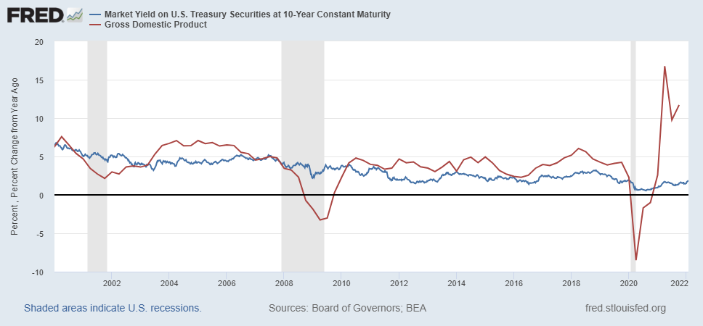
Blanchard’s Evidence
Blue Line Rate on 10-Yr Treasury Bonds; Red Line GDP growth
Notes:
Except for recessions. Blanchard does not explain why interest rates have been so low!

Slide 43
But Why Must the Relative Debt Be Stabilized?
Stephanie Kelton provided a prominent and recent exposition of Modern Monetary Theory in her June 6th 2020, NYTimes op-ed, “Learn to Love Trillion-Dollar Deficits.”
  US Treasury borrows in dollars and therefore cannot default (as opposed to Greece).
  Example: How did we “find the money” in FY 2020 to increase in the deficit by about $1.9 trillion?
  Answer: Fed open market purchases of $1.7 trillion provided 89% of the financing.
  More generally, she argues that we can always find the money to increase federal spending.

Slide 44
MMT’s Free Lunch
The only limit on deficit spending is if it leads to too much spending thereby increasing current inflation.
Recognizing this fact, “…could free policymakers not only to act boldly amid crises but also to invest boldly in times of more stability.”
Too bad the second part isn’t true. And, the recent rise in inflation suggests even Dr Kelton should now be worried about the debt
We rely on foreigners to hold a substantial portion of our debt and they can lose if the exchange value of the dollar falls.

Slide 45
CBO on the Costs of “High and Rising Debt”
The interest expense portion of the deficit will rise, including payments to foreigners.
Crowding out of private investment.
“The likelihood of a fiscal crisis in the United States would increase.”
Slow erosion of confidence in the U.S. dollar as an international reserve currency leading to higher interest rates.
Policymaker constraint in using deficit-financed fiscal policy to respond to unforeseen events.
CBO, “Budget and Economic Outlook: 2022-2032,” May 2022, pp15-16.
Notes:
1 & 2 are part of my traditional costs. 3-5 are new and related

Slide 46
What would a Fiscal Crisis Look Like?
Foreigners lose confidence in the dollar and sell Treasuries in exchange for assets denominated in their own currency,
  Sale of Treasuries raises interest rates, worsening our fiscal outlook.
  Trading of US assets for Foreign lowers US exchange rate.
    Raising the price of imports thereby increasing inflation.
    Lowering the foreign currency returns on all US assets, exacerbating 1.
Could the Fed Bail us Out?
  It could buy Treasuries and prevent the rise in interest rates.
  Insufficient foreign assets to prevent the fall in the exchange rate,

Slide 47
Bottom Line: We Need to Worry about the Debt
Interest rates may not stay this low forever. In fact, economist don’t really know why they have fallen to such low levels over the past 20 years
A fiscal crisis should be avoided at all costs.
The good news is we may be able to stabilize the relative debt without a running a surplus.

Slide 48
But is this Problem Impossible?
CBO, “Budget and Economic Outlook: 2022-2032,” May 2022

Slide 49
CBO Baseline Projection
CBO, “Budget and Economic Outlook: 2022-2032,” May 2022
Notes:
10 yr Treasury rate rising slowly from 2.4 to 3.7 and then stabilizing

Slide 50
The Blueprint for a Crisis?
But, these are “projections,” not forecasts!
CBO, “Budget and Economic Outlook: 2022-2032,” May 2022

Slide 51
Outlays based on Current Law

Slide 52
Unfortunately, The Required Changes are Big!
CBO is allowed to publish, alternative projections.
To Stabilize the relative debt at the current level of 100% of GDP:
  Deficit in 2025 needs to go from projected 4.7 % of GDP to 2.9% and be maintained at the 2.9% level.
  This amounts to over $500 billion per year.
CBO, “2020 Long-Term Budget Outlook, “ Sep 2022

Slide 53
Any of these Options Sound Good?
Pick 10!

Slide 54
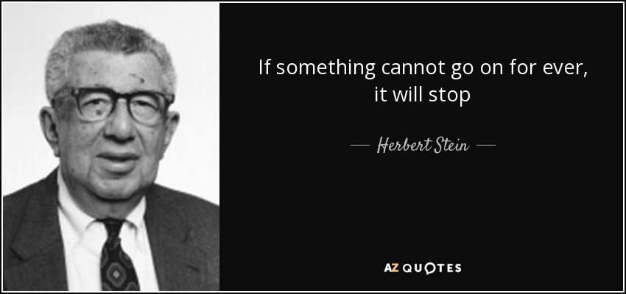
The Wit and Wisdom of Herb Stein
Notes:
Ben Stein’s father and Chair Council under Nixon

Slide 55
Summary
Government debt is not like household debt.
  It never truly comes due.
That doesn’t mean that we should be profligate debtors.
  Increased debt comes with costs:
    Crowding out of other spending priorities (via interest payments).
    Payments to foreigners.
    Potential for fiscal crisis.
MMT and its prescriptions trouble majority of economists.
The United States is in a unique position.
  There is room for more borrowing, but we don’t know exactly how much more.
The current debt picture is one of instability.
  Important and difficult policy decisions are needed to stabilize the debt.

Slide 56
Bottom-Line Takeaways
Relative debt must be stabilized, so it is imperative to reduce primary deficits after the virus has been defeated.
Given the fiscal challenges of an aging population and climate change, it is better to do this sooner rather than later.
But high debt levels should not deter:
  Productive infrastructure investment.
  Fiscal responses to crises:
    “When the house is on fire, you don’t worry about being in a drought; you just put it out.”

Slide 57
Major Takeaways: Talking Points
The current trajectory for the federal debt is unsustainable.
After the crisis, we must enact plans to reduce the future (primary) deficits.
  These are driven by Medicare and Social Security spending.
The longer we postpone action, the greater the probability of a “fiscal crisis.”
Government debt is NOTHING LIKE household debt!

Slide 58
Federal Debt Glossary
Total Federal Debt is the value of all outstanding government bonds (or “Treasuries”) that have been issued to finance past federal government deficits.
Deficit is the difference between total federal spending and revenues.
Federal Debt in the Held by the Public is the debt held by the private domestic investors, foreign investors and the Federal Reserve. The concept of the debt excludes intragovernmental debt, such as the debt held by the Social Security and Medicare Trust Funds.
The Relative Debt is the Federal Debt Held by the Public as a fraction of the size of the economy, or GDP.
Congressional Budget Office (CBO) is a congressional think tank that analyzes the effect of legislation on the budget (“scoring”) and issues periodic projections on the future of debt and deficits
Primary Deficit is the difference between federal spending on programs and total revenues. The primary deficit excludes interest on the debt.
Rolling Over the Debt the process of paying off maturing government bonds with newly issued bonds

Slide 59
Federal Debt Glossary (Cont.)
Crowding Out is the phenomena where government financing of deficits raises interest rates and lowers firms’ investment.
International Reserve Currency is foreign holdings of US debt (and other countries debt) to facilitate international trade; e.g., oil is traded in dollars.
Default is when an entity that issues a bond fails to make an interest payment or the repayment of the face amount on time.
Foreign Exchange Value of the Dollar is the purchasing power of the dollar in terms of a foreign currency. When the US exchange rate falls, the dollar has les purchasing power over foreign goods.
Budget Reconciliation is a Senate process for by-passing the filibuster, so that legislation can be enacted with a 51-vote majority. The process can only be used for changing spending or taxes and the legislation cannot increase the deficit after 10 years.

Slide 60
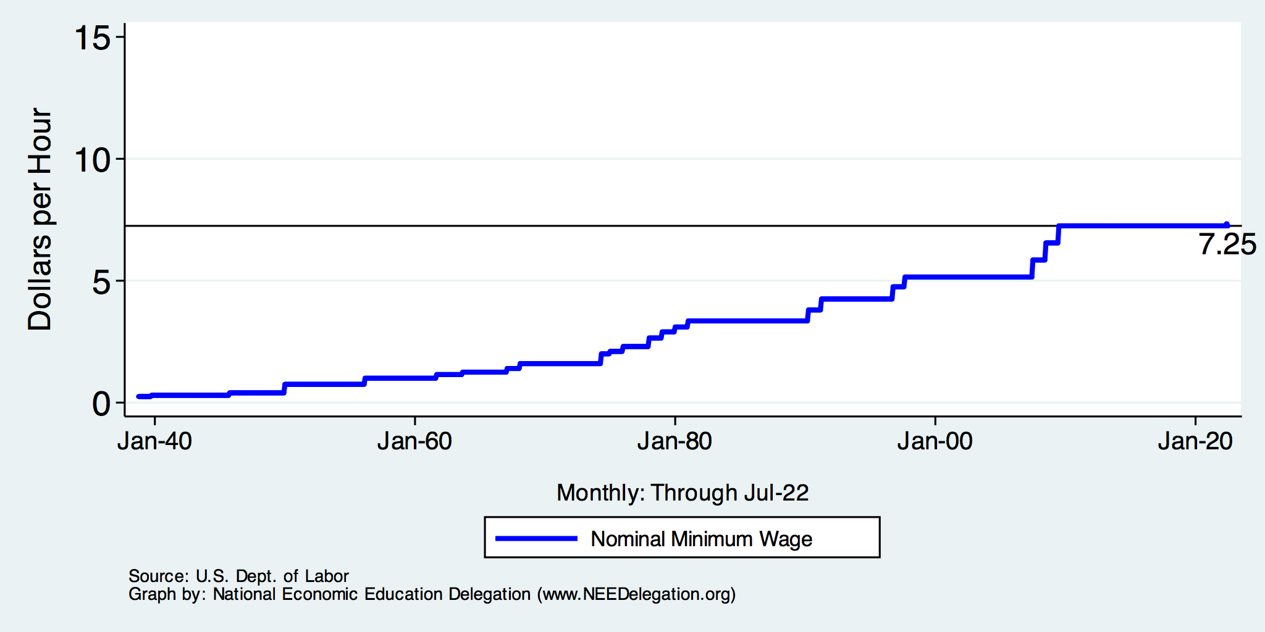
The Federal Minimum Wage

Slide 61
Thank you!
Any Questions?
www.NEEDelegation.org
Jon Haveman, Ph.D.
Jon@NEEDelegation.org
Contact NEED: info@NEEDelegation.org
Submit a testimonial: www.NEEDelegation.org/testimonials.php
Become a Friend of NEED: www.NEEDelegation.org/friend.php

