Slide 1


The US Federal Debt
Money Talks
05/16/2022
Scott Baier, Ph.D.

Slide 2
National Economic Education Delegation
Vision
  Someday, the public discussion of policy issues will be grounded in an accurate perception of the underlying economic principles and data.
Mission
  NEED unites the skills and knowledge of a vast network of professional economists to promote understanding of the economics of policy issues in the United States.
NEED Presentations
  Are nonpartisan and intended to reflect the consensus of the economics profession.

Slide 3
Credits and Disclaimer
This slide deck was created by:
  Jon Haveman, Executive Director, NEED
  Geoffrey Woglom, Amherst College, Emeritus
  Scott Baier, Clemson University
Disclaimer
  NEED presentations are designed to be nonpartisan.
  It is, however, inevitable that presenters will be asked for and offer their own views.
  Such views are those of the presenters and not necessarily those of the National Economic Education Delegation (NEED).

Slide 4
US Government Debt

Slide 5
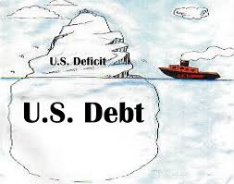
Of Debt, Deficits, and Surpluses
FLOW
  Deficit: The excess of outlays over revenues in a year.
  Surplus: The excess of revenues over outlays in a year.
STOCK
  Debt: The accumulation of debt over time.
      The sum of all past deficits and surpluses.

Slide 6
What Does the U.S. Gov’t Budget Look Like?
Fiscal 2020 Budget Summary
Revenue | Billions |  | Outlays | Billions
Income Taxes | $1,609 |  | Mandatory | $2,315
Payroll Taxes | $1,310 |  | Discretionary | $3,850
Corporate Taxes | $212 |  | Interest | $387
Other | $289
Total | $3,420 |  | Total | $6,552
Budget Deficit:
Source: Congressional Budget Office, Monthly Budget Review, Nov 2020
Notes:
https://www.cbo.gov/publication/53627
https://www.cbo.gov/publication/53624

Slide 7
What Does the U.S. Gov’t Budget Look Like?
Fiscal 2020 Budget Summary
Revenue | Billions |  | Outlays | Billions
Income Taxes | $1,609 |  | Mandatory | $2,315
Payroll Taxes | $1,310 |  | Discretionary | $3,850
Corporate Taxes | $212 |  | Interest | $387
Other | $289
Total | $3,420 |  | Total | $6,552
Budget Deficit: $3,132
Source: Congressional Budget Office, Monthly Budget Review, Nov 2020
Notes:
https://www.cbo.gov/publication/53627
https://www.cbo.gov/publication/53624

Slide 8
What Does the US Govt. Budget Look Like?
2019 Budget Summary (in billions)
Revenue |  |  | Outlays
Income Taxes | $1,718 |  | Mandatory | $2,735
Payroll Taxes | $1,243 |  | Discretionary | $1,336
Corporate Taxes | $230 |  | Interest | $376
Other | $271
Total | $3,462 |  | Total | $4,447
Budget Deficit: $984 Billion
Source: Congressional Budget Office, The Budget and Economic Outlook: 2020 to 2030
Notes:
https://www.cbo.gov/publication/53627
https://www.cbo.gov/publication/53624

Slide 9
US Government Deficits Over Time

Slide 10
Figure 1: Federal Expenditures
Appropriate to measure the ”size” of the Federal Government relative to the size of the economy

Slide 11
Figure 2: Federal Revenue

Slide 12
Figure 3: Debt-to-GDP
Source: usgovernmentrevenue.com

Slide 13
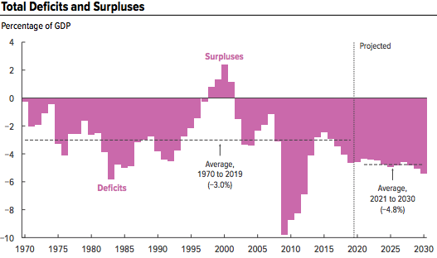
A Future of Deficits
Source: Congressional Budget Office, The Budget and Economic Outlook: 2020 to 2030

Slide 14
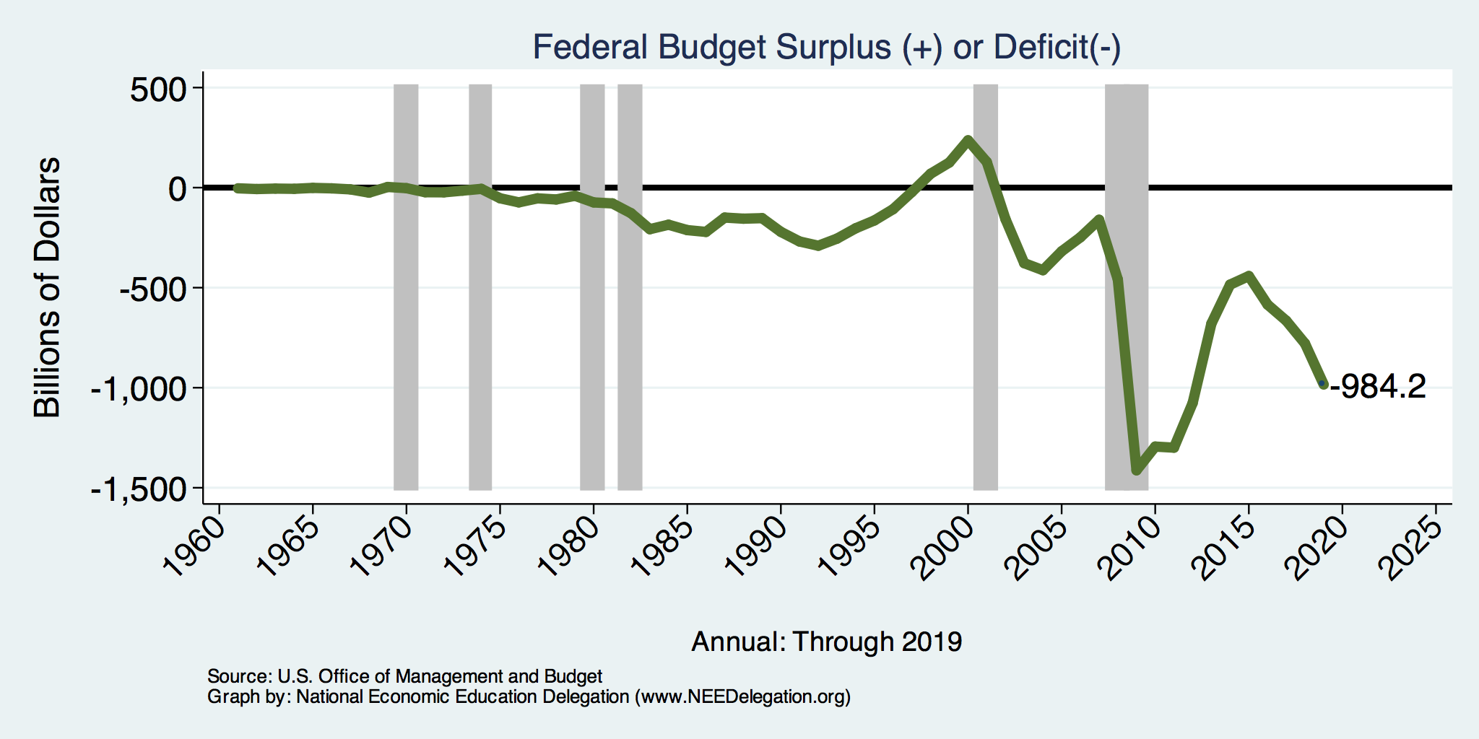
A History of Persistent Deficits
Notes:
Debt2deficit.png

Slide 15
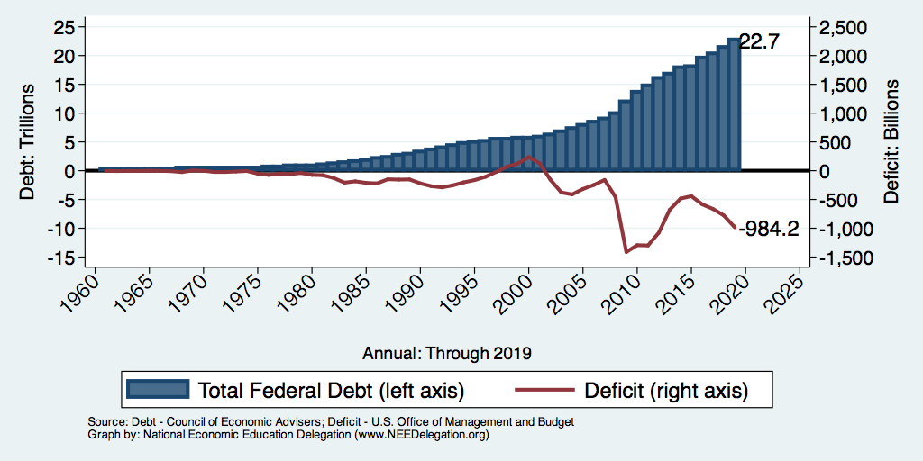
Debt vs. Deficit
Debt = The Sum of All Past Deficits Less Surpluses
Notes:
Debt2deficit.png

Slide 16
How Does the US Government Borrow?
It issues debt.
  Treasury marketable securities:
    Treasury bills, notes, and bonds
    TIPS: Treasury inflation-protected securities
    Savings bonds
Who buys the debt?
  Other federal agencies
  Individuals and businesses
  State and local governments
  Foreign government and individuals
  Federal Reserve

Slide 17
Not All Debt Is Created Equal
Some debt can reduce the availability of investment funds to other borrowers.
  Often referred to as “crowding out” private investment
Intragovernment debt is (important) bookkeeping.
  This debt DOES NOT crowd out private investment.
Debt held by the public
  This debt MIGHT crowd out private investment.
Most analyses of debt focus on federal debt held by the public.

Slide 18
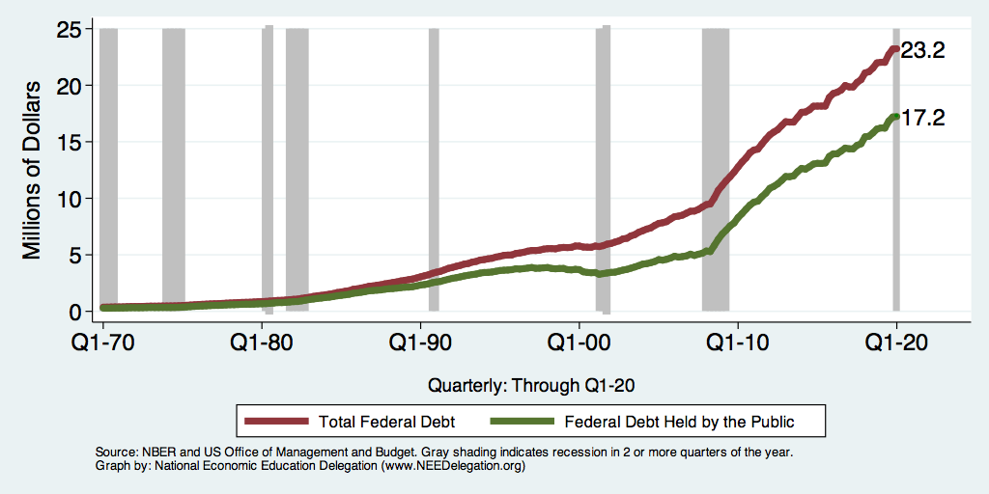
Two Measures of the Debt

Slide 19
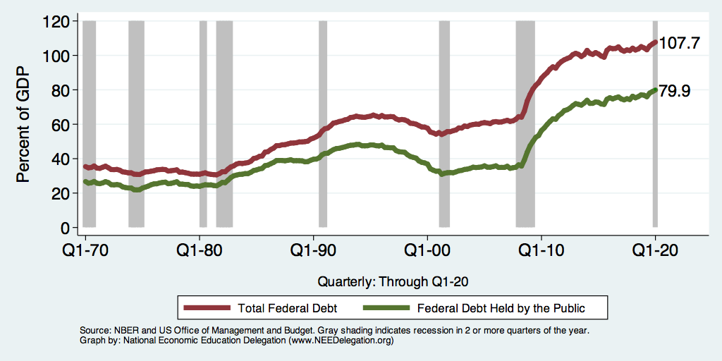
Two Measures of RELATIVE Debt

Slide 20
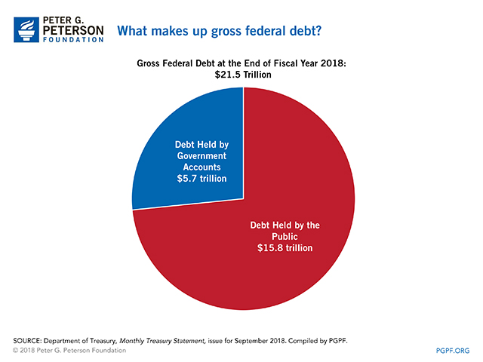

Slide 21
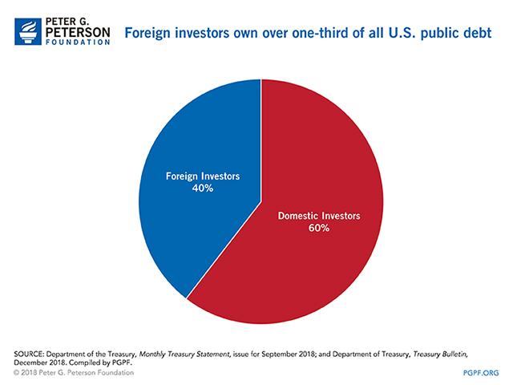

Slide 22
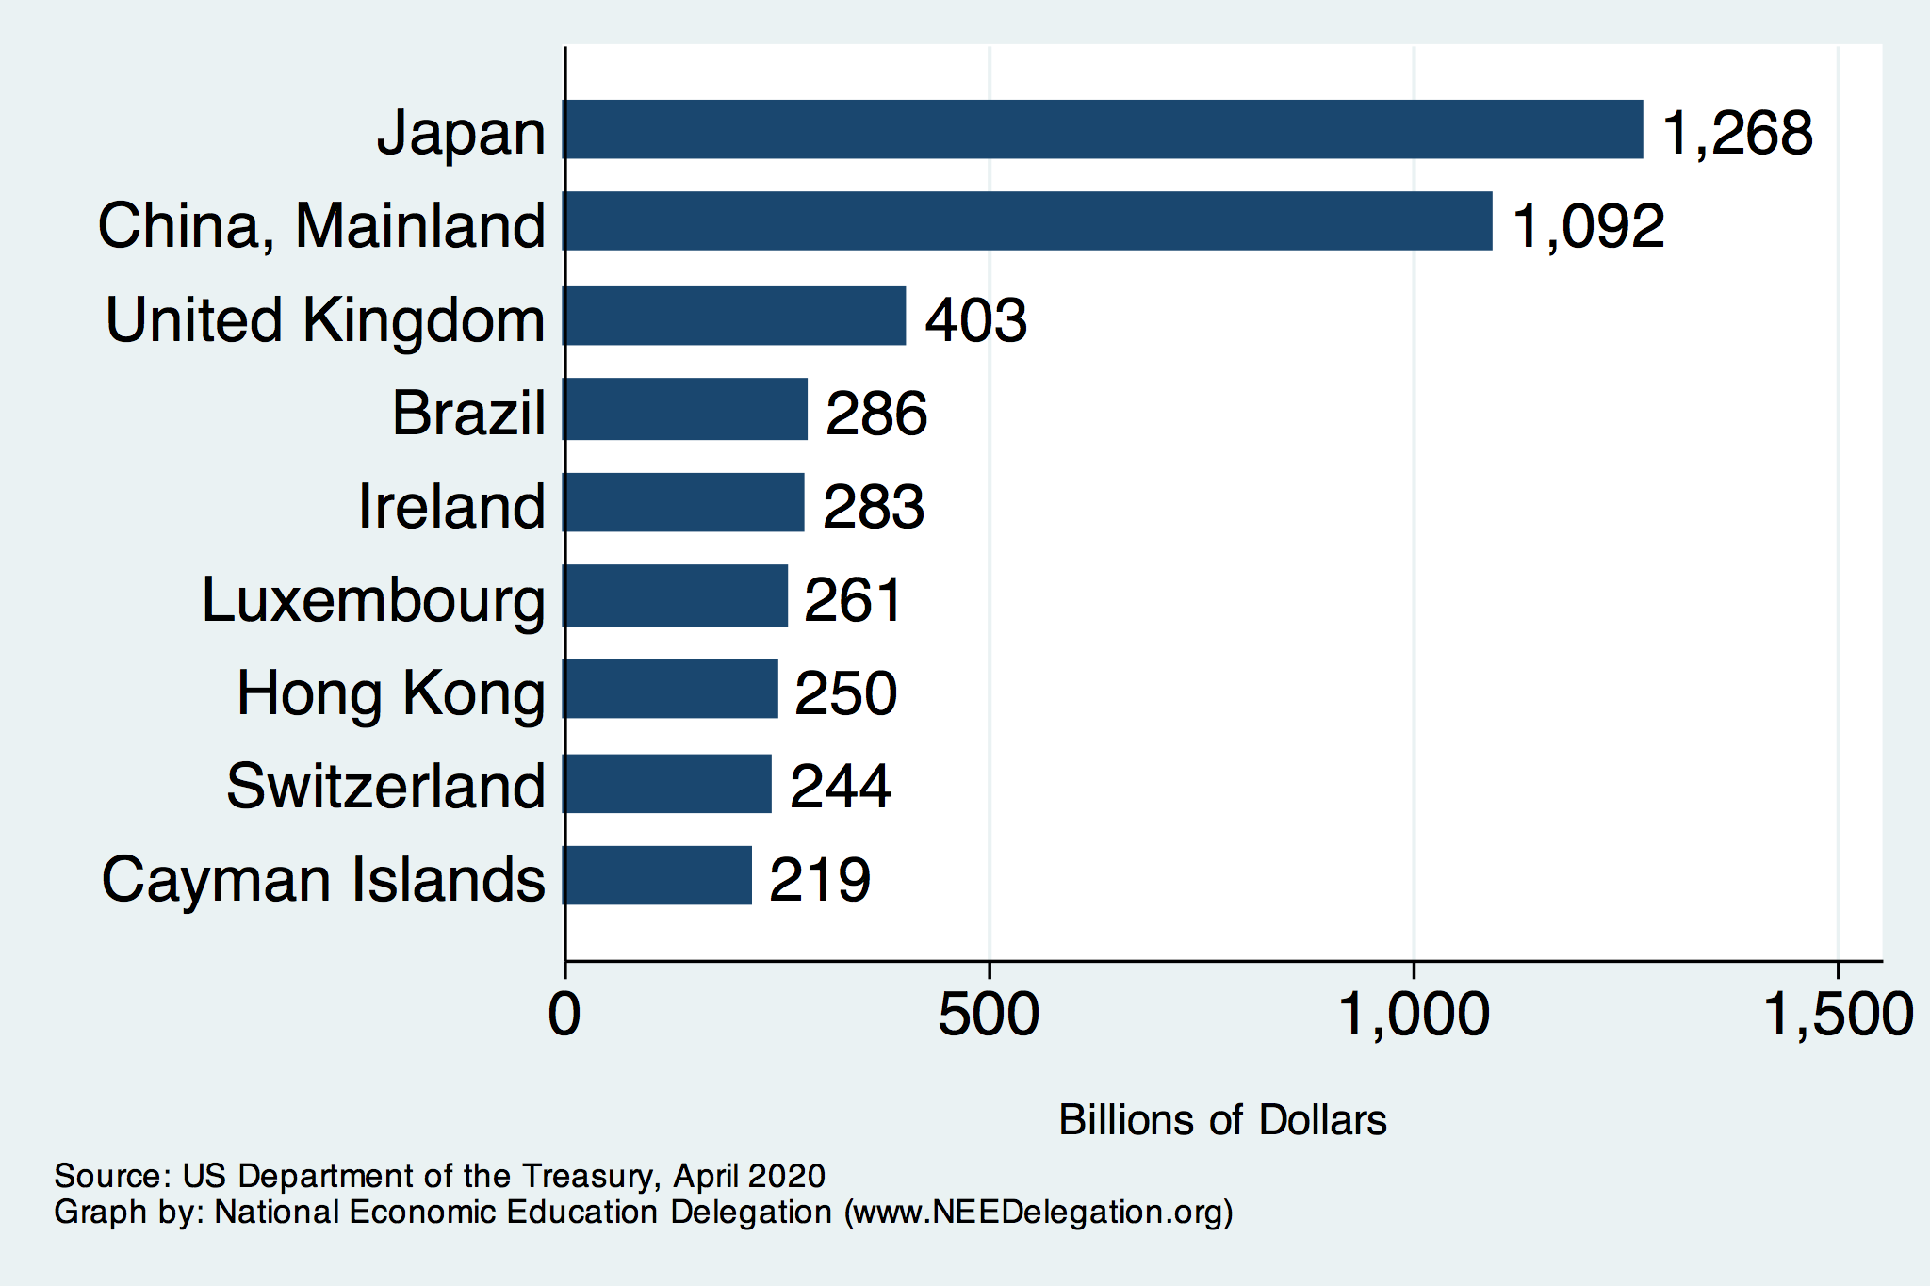
Who Holds Debt to Foreigners

Slide 23
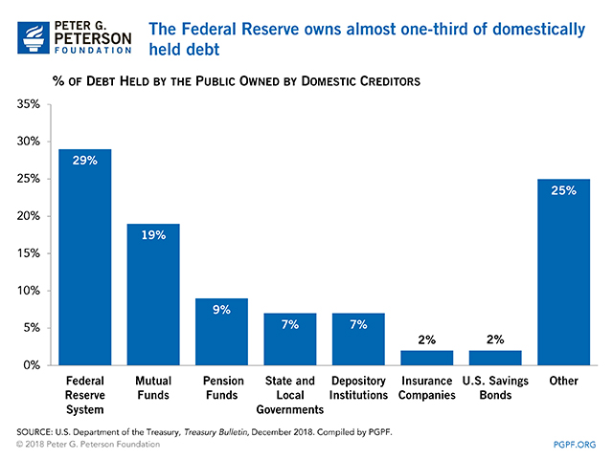

Slide 24
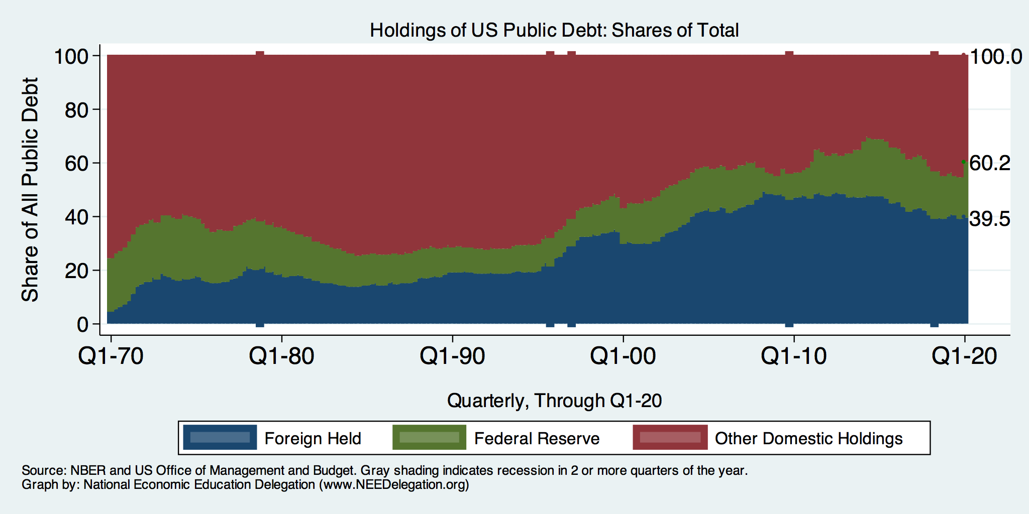
Trends in US Debt Over Time
2020, Q1: Other Domestic: 39.8%
Federal Reserve: 20.7%
Foreign: 39.5%

Slide 25
Key Points About US Relative Debt
Prior to 1983, relative debt rose purposefully (wars and recessions) and then fell.
Relative debt peaked during World War II, followed by a long decline.
Relative debt has been and is expected to rise for the next 30 years w/o a strategic purpose.

Slide 26
Debt Dynamics
Surprising (?) Facts
  From 1945 to 1979, relative debt fell from 100% of GDP to 25% of GDP.
  During this period, the federal budget was in surplus only once, in 1969.
Relative debt is a fraction: Debt/GDP; fractions fall if:
  The numerator falls (budget surplus)
  The denominator rises (nominal GDP growth)
  The denominator grows faster than the numerator

Slide 27
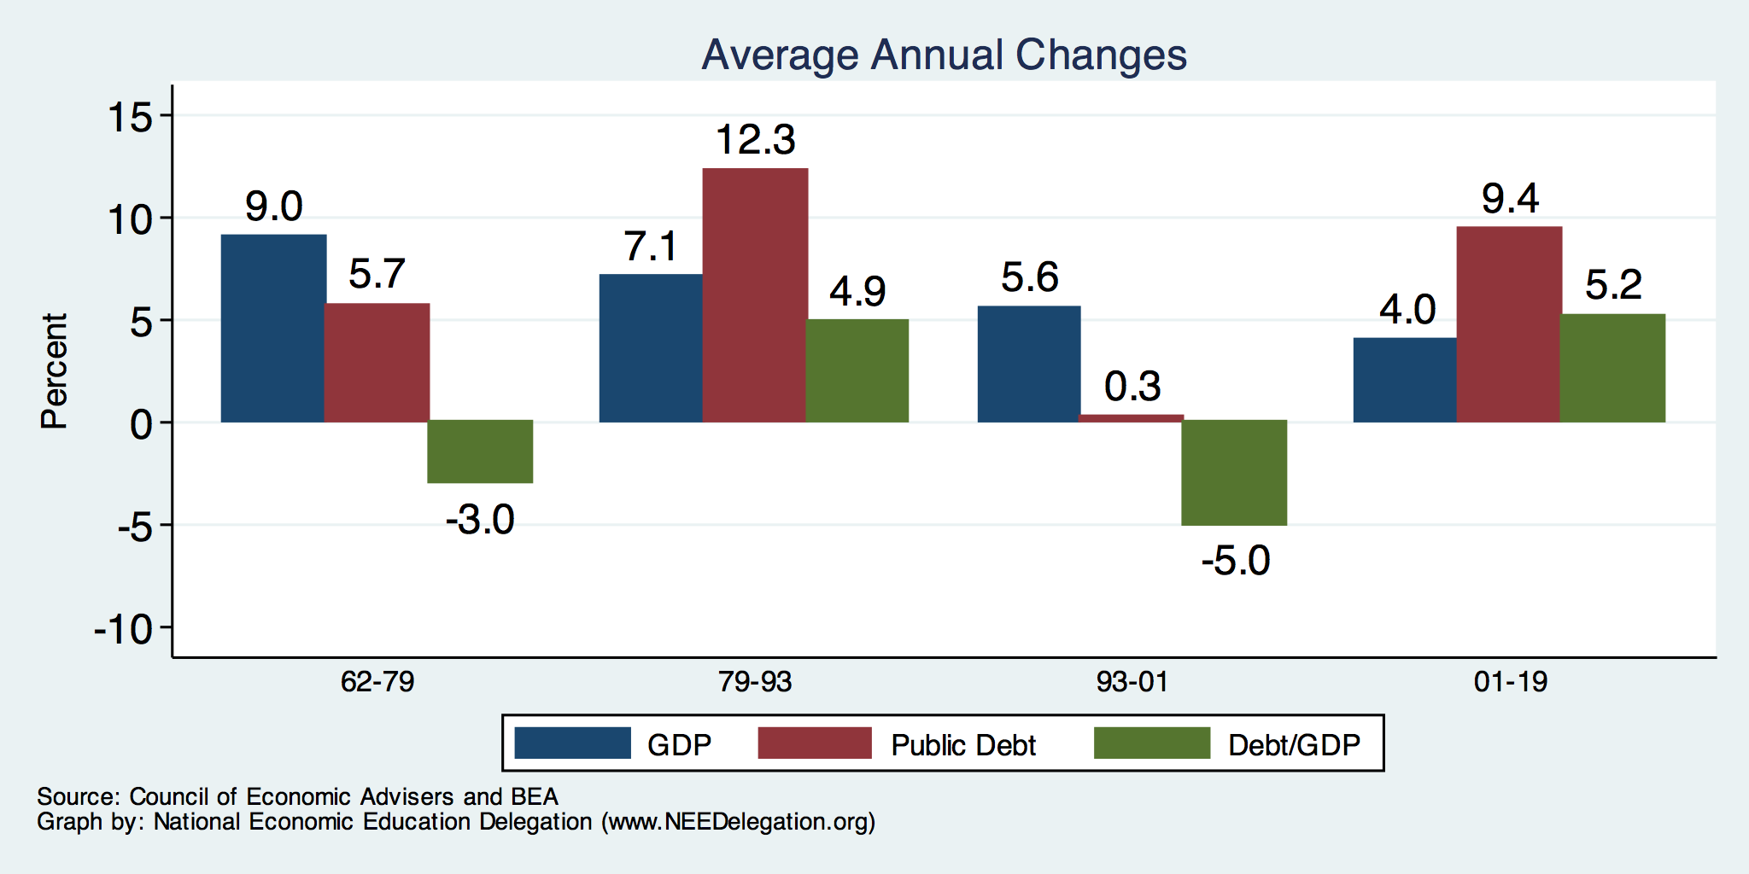
The Arithmetic of Changes in Relative Debt

Slide 28
Why has the Federal Debt Risen so Much?
Expenditures:
  Social Security
  Healthcare costs
  Economic stimulus
    In particular, during the Great Recession.
  Foreign entanglements
Revenues
  Declining income tax revenues
    Stagnant wages
    Tax cuts
  Social security
    Declining revenues
  Corporate income taxes

Slide 29
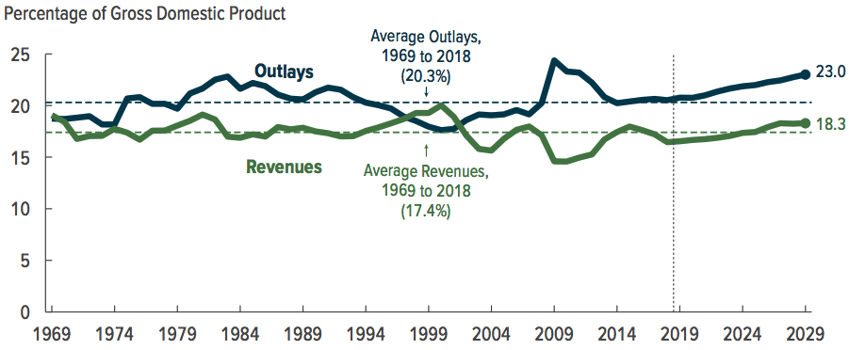
Why Has the Federal Debt Risen So Much?

Slide 30
Why Has the Federal Debt Risen So Much?

Slide 31
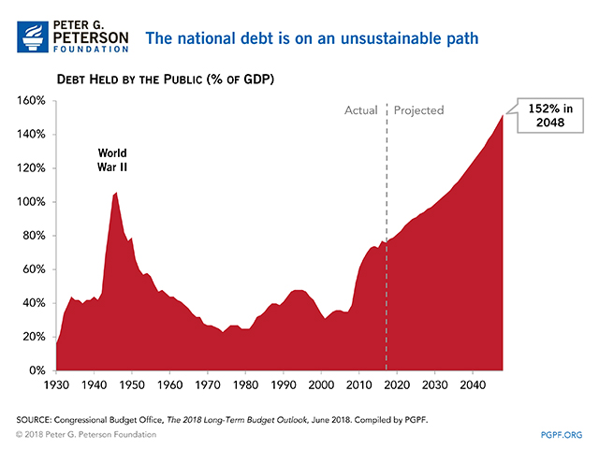

Slide 32
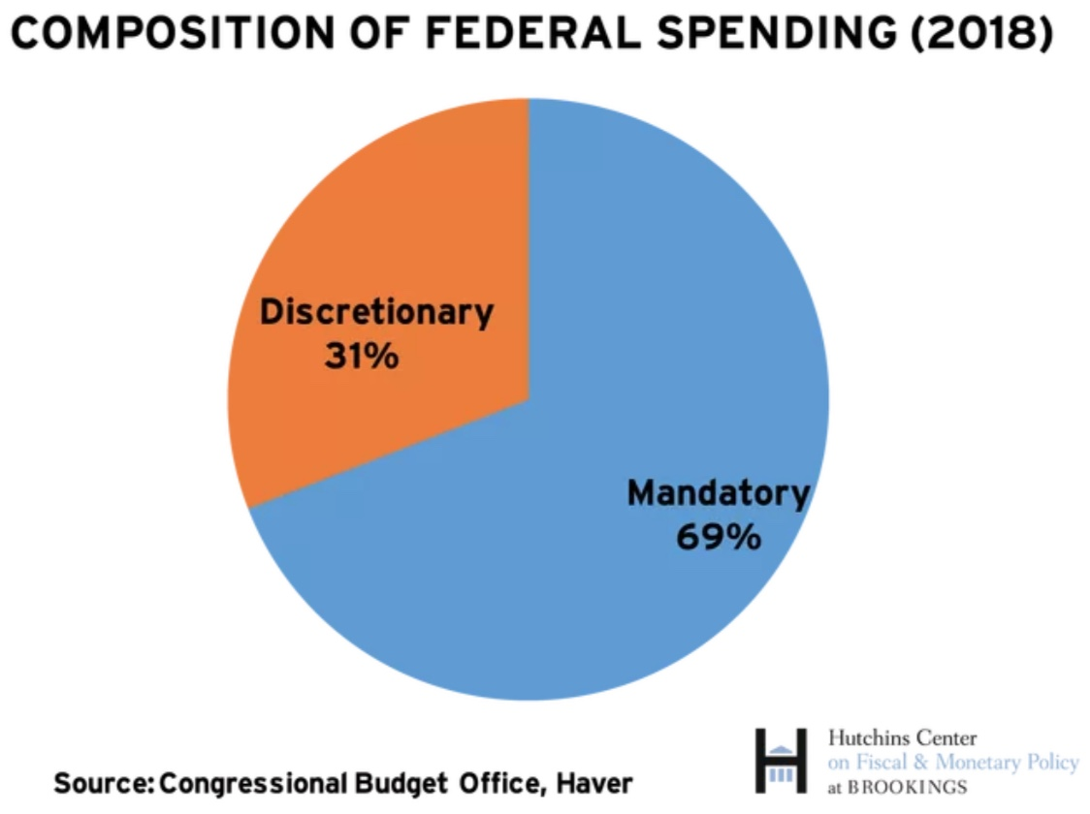
On What is the Money Spent? Complicated

Slide 33
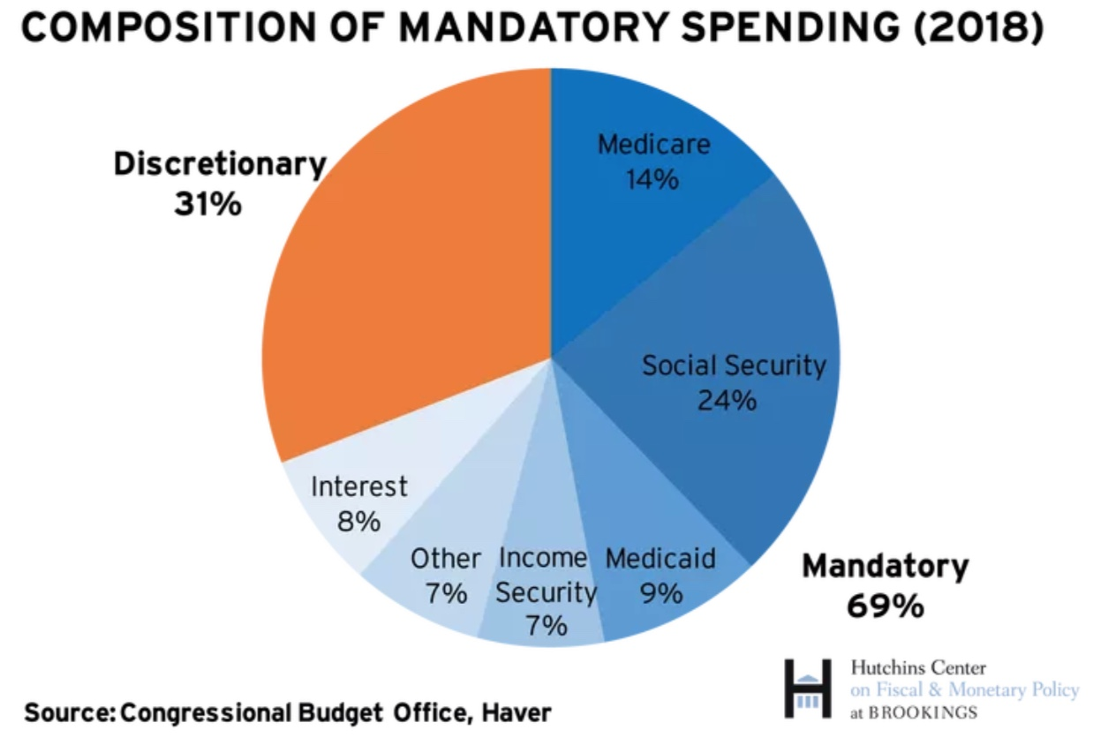
What is Mandatory Spending?

Slide 34
Mandatory Spending: Total Mandatory
Source: Congressional Budget Office (2017)

Slide 35
Mandatory Spending: Social Security Spending
Outlays 2018: $ 982 billion
Outlays 2029: $1,900 billion
6% annual growth rate
Source: Congressional Budget Office (2017)

Slide 36
Mandatory Spending: Medicare (14%)
Part A: Hospital Insurance
Part B: Physician, outpatient, home health, and other services.
Part D: Subsidized access to pharmaceuticals.
Part C: Medicare Advantage Plans – offered by private companies approved by Medicare.
  Medicare Advantage Plans may offer extra coverage, such as vision, hearing, dental, and/or health and wellness programs.

Slide 37
Mandatory Spending: Medicare Spending
Outlays 2018: $1,100 billion
Outlays 2029: $2,100 billion
Growth 6.8%
66% of the growth from rising
health care costs and 33% from
increased enrollments.
Source: Congressional Budget Office (2017)

Slide 38
Medicare Finances in 2018
Part A:
  Income in 2018: $299 billion
  Expenses in 2018: $297 billion
  Surplus: $2.8 billion
Part B and Part D:
  Income in 2018: $406 billion
  Expenses in 2018: $414 billion
  Surplus: $-7.9 billion
Long term sustainability:
  Deficits began in 2016
  For as far as the eye can see
  Insolvent in 2026 with current parameters.

Slide 39
Mandatory Spending: Medicaid Spending
Source: Congressional Budget Office (2017)

Slide 40
Mandatory Spending: Medicaid (9%)
Medicaid provides medical insurance for those whose income and resources are insufficient to pay for health care.
It is a program with costs shared with the states.
Amount spent in 2017: $576.6 Billion
  Federal: 61.5% or $354.6 Billion
  States: 38.5% $222.0 Billion
People served in 2017: 72 million (22% of Americans)

Slide 41
Mandatory Spending: Other
Source: Congressional Budget Office (2017)

Slide 42
Mandatory Spending: Interest (8%)
Interest costs in 2018: $325 Billion
  1.6% of GDP, or 8% of the Federal Budget
Forecast to increase to $928 Billion in 2029
  3.0% of GDP, or 22% of the Federal budget
Source: CBO, January 2019 Budget Projections

Slide 43
Spending to Grow Much Faster Than Revenue
Interest, too!

Slide 44
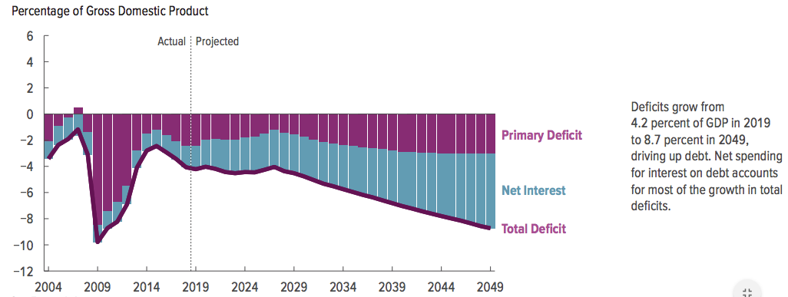
Interest Will Grow as a Share of the Deficit

Slide 45
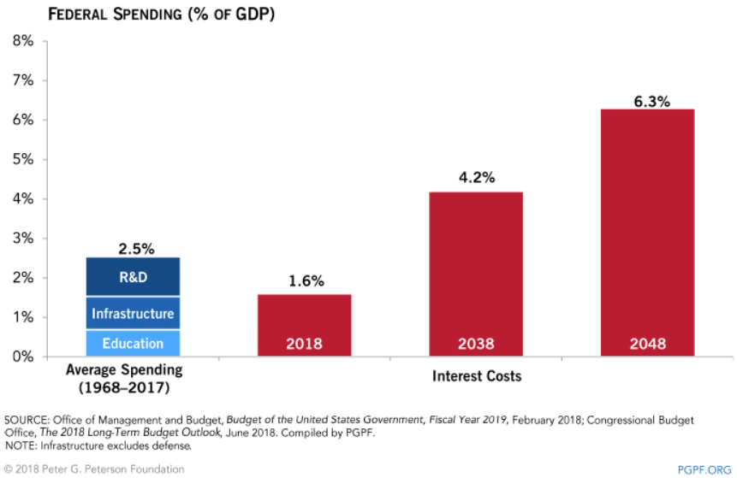
Interest Payments to Grow Significantly

Slide 46
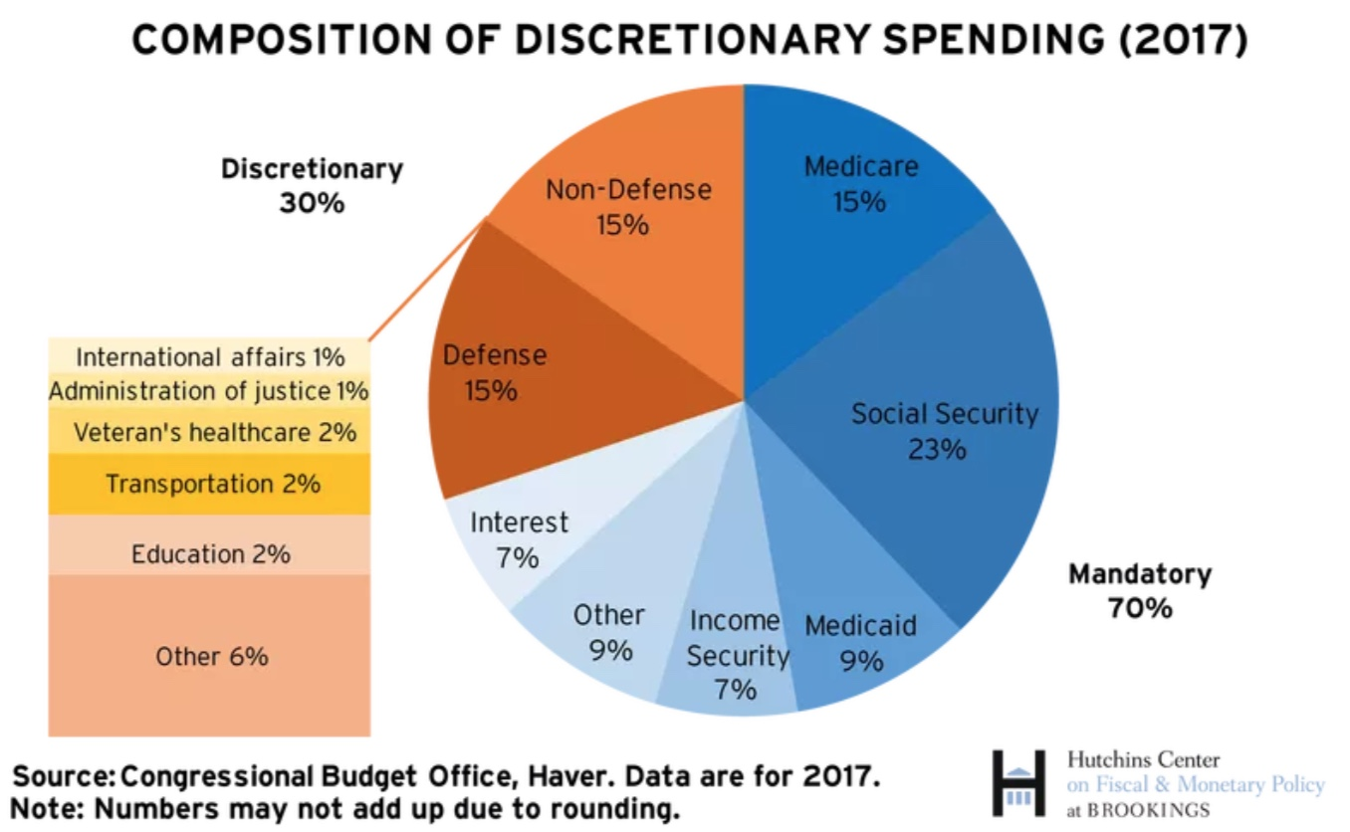
What is Discretionary Spending?
Int’l Affairs 1%

Slide 47
Discretionary Spending: Total
Source: Congressional Budget Office (2017)

Slide 48
Discretionary Spending: Defense Spending
Source: Congressional Budget Office (2017)

Slide 49
Discretionary Spending: Other
Source: Congressional Budget Office (2017)

Slide 50
Debt and Deficit and the Pandemic
The long run drivers of the debt and deficit are social security, Medicare and Medicaid spending.
Discretionary spending has been declining as a share of GDP.
Most likely, the American Rescue Plan will not have a long run impact on the debt….unless

Slide 51
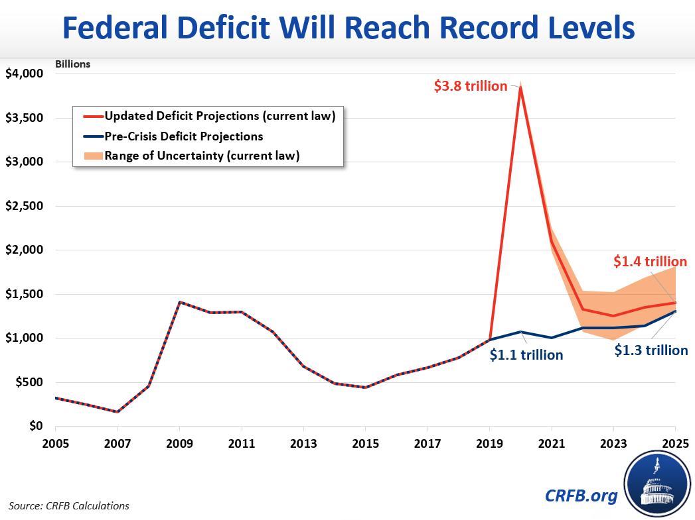
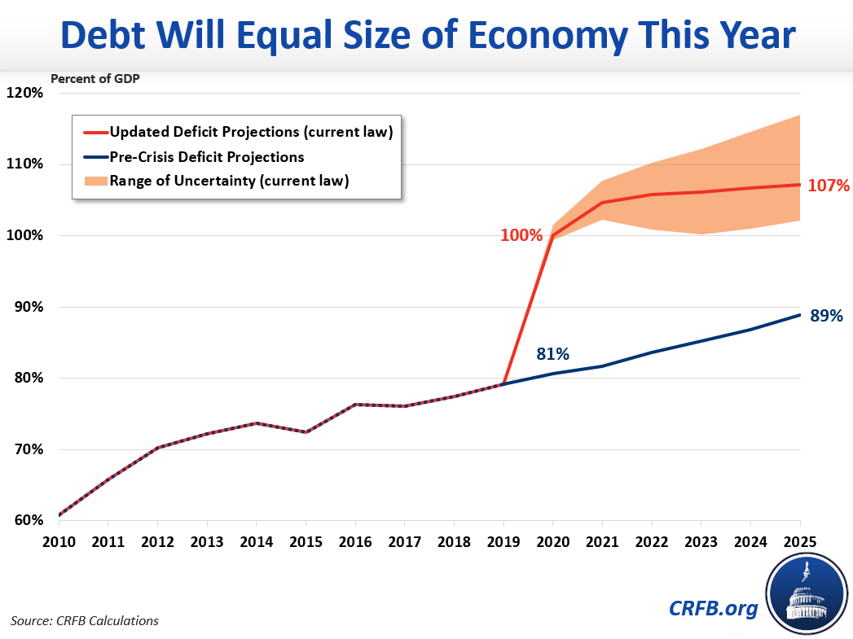
Very Large Deficit!
https://www.crfb.org/blogs/budget-projections-debt-will-exceed-size-economy-year

Slide 53
How to Think About the Debt

Slide 54
Perspectives on Increased Debt
Government borrowing crowds out private capital and investments.
  Weakened by the ability to borrow from other countries.
Does debt impose a burden on future generations?
  Does it inevitably have to be paid off?
In time, debt service might crowd out other government spending.
  Diminishing policy priorities in the budget.
Is it reasonable to borrow at low interest rates for investment?
  For example, for infrastructure.

Slide 55
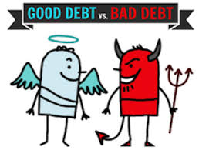
Not All Borrowing Is Bad!
Two good reasons to borrow:
  During a temporary crisis
    Recession
    War
    Pandemic
  Productive public investment
    Infrastructure
    Education
These deficits do not permanently increase relative debt.
  Great Depression, WWII
  Public investment expands GDP and tax revenue

Slide 56
Is The Debt a Problem Today? (Pre-COVID 19)
Currently borrow about $100 billion each month with little difficulty.
Very little evidence of ”crowding out.”
Interest rates are very low, less than 1% on 10-year notes.

Slide 57
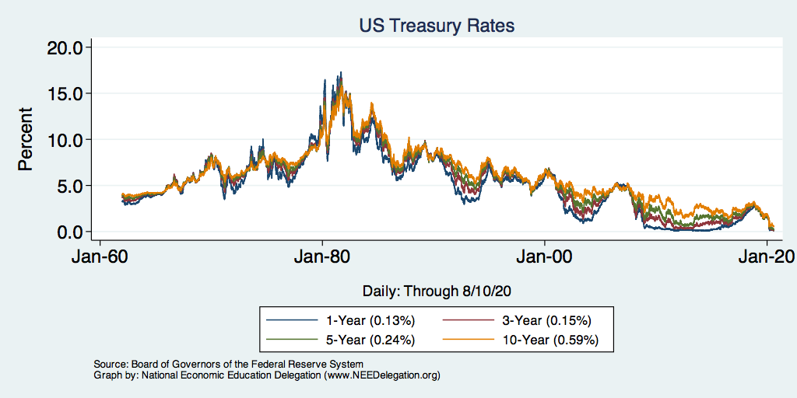
Interest Rates Are Historically Low

Slide 58
So, Why Worry About it?
If debt become too high:
  Investors might start questioning the creditworthiness of the US government.
    Problem: Nobody knows how high is too high.
  It becomes more difficult to borrow in times of crisis.
    War, severe recession
    “Fiscal space”
      Impossible to measure how much we have.
      Clearly, we have less now than in 2007.
  Could start to crowd out investment by consumers and businesses.
    Not currently a problem.
  Could be inflationary.

Slide 59
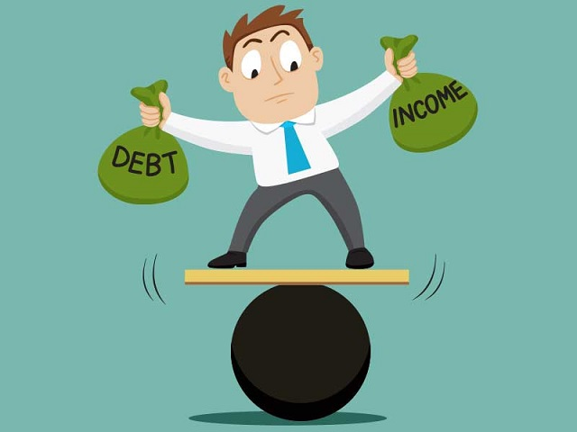
So, Why Worry About It?
If debt continues to grow:
  Interest payments will grow with it.
    8% of spending in 2018.
    22% of spending in 2048.
    Less room for using the budget for policy priorities.
    40% of payments go to other countries.
  The longer we wait to address it, the harder and more disruptive addressing it will be.
  Interest rates might increase.

Slide 60
Inflation
If inflation does not come down, the interest
rates on government bonds will likely rise.
Source: BLS

Slide 61
Economists’ Views on the Debt Evolve

Slide 62
Traditional View: Four True Costs
Crowding out:
  The Treasury’s borrowing needs compete with private borrowers, so debt and deficits raise interest rates.
Higher interest rates lead to foreign capital inflows or foreign borrowing.
  With foreign borrowing, some of the interest on the debt goes to foreign countries.
Larger primary surpluses are needed to stabilize the relative debt.
  The larger the relative debt, the bigger the needed primary surplus.
  Thus, higher taxes or programmatic outlays must be reduced.
Government bias toward higher inflation
  GDP grows if either prices rise or real output rises.
Source: CBO, Federal Debt: A Primer, March 2020 pp.24-5

Slide 63
Maybe Debt Isn’t a Problem After All: MMT
Stephanie Kelton provided a prominent and recent exposition of modern monetary theory in a NY Times op-ed on June 6, 2020:
  “Learn to Love Trillion-Dollar Deficits.”
Modern monetary theory
  US Treasury borrows in its own currency and therefore cannot default.
    As opposed to countries, such as Greece, which borrow in euros.
  Example: How did we ”find the money” for the recent increase in the deficit of about $1.9 trillion?
    Answer: The Fed purchased $1.7 trillion = 89% of financing
  More generally, MMT argues that we can always find the money to increase federal spending.

Slide 64
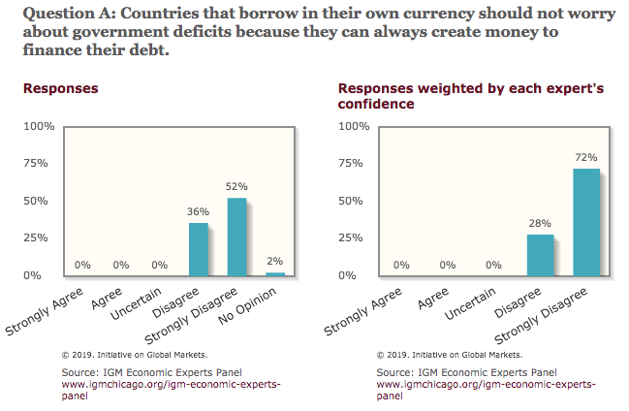
General Sense on Modern Monetary Theory

Slide 65
The Key: Stabilization of Relative Debt
Stabilization of relative debt might forestall the consequences of chronic deficits.
Problem: The US federal debt is in no way stable.
W/O stability, interest rates might rise, causing crowding out of:
  policy priorities
  domestic investment
Budget surpluses are not necessary, but budget control is.

Slide 66
What Is a Fiscal Crisis?
Increased perception of risk in government debt.
Potential manifestations:
  Sudden major increase in interest rates
  Plunging exchange rates
Why?
  Increased expectation of default
Potential results:
  Dramatic budget reforms may be quickly necessary to stave off actual default.
  Recession from declines in:
    investment (interest rates)
    consumption (interest rates)
    Government spending
  Higher interest bill on existing debt

Slide 67
Bottom Line: We Need to Worry about the Debt
Interest rates will not stay this low forever.
A fiscal crisis should be avoided at all costs.
Stabilizing relative debt would substantially reduce the possibility of a crisis.
The good news is we might be able to stabilize relative debt without a primary surplus.
But (after the pandemic is over) we must substantially reduce primary deficits.

Slide 68
Major Takeaways: Talking Points
The current trajectory of federal debt is unsustainable.
Given the historically low interest rates, we can afford to wait until after the crisis to act.
  How long will interest rates stay low?
After the crisis, we must enact plans to reduce the future (primary) deficits.
  These are driven by Medicare and Social Security spending.
The longer we postpone action, the greater the probability of a “fiscal crisis.”

Slide 69
Takeways
After the pandemic, some combination of spending cuts and tax increases must be enacted.
The particular combination of spending cuts and revenue increases is a political question.
But high debt levels should not deter:
  Productive infrastructure investment.
  Fiscal responses to crises.
Given the fiscal challenges of an aging population and climate change, it is better to do this sooner rather than later.

Slide 70
Fiscal Crisis, or a Run on the Dollar
With an exploding relative debt, what happens if foreigners lose confidence in the stability of the dollar?
CBO (Federal Debt: A Primer, March 2020):
  because the United States currently benefits from the dollar’s position as the world’s reserve currency and because the federal government borrows in dollars, a financial crisis—similar to those that befell Argentina, Greece, or Ireland—is less likely in the United States.
Although no one can predict whether or when a fiscal crisis might occur or how it would unfold, the risk is almost certainly increased by high and rising federal debt.
Crises of confidence, in addition to being unpredictable, happen very quickly.

Slide 71
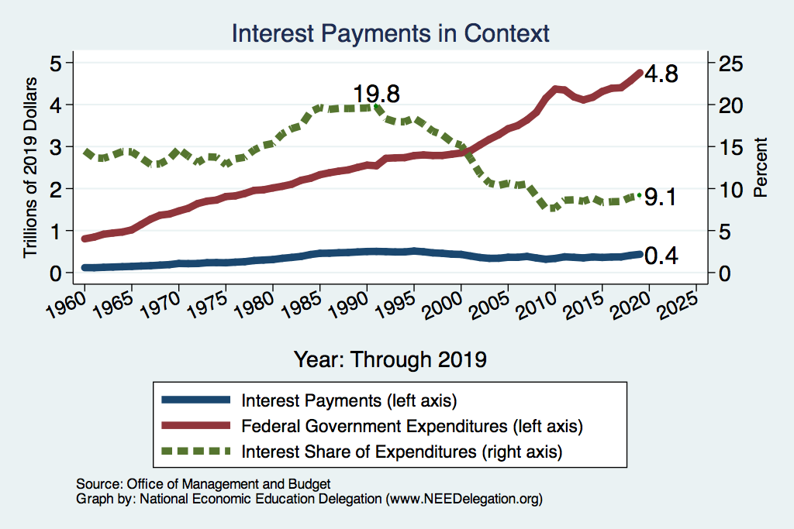
History: A Cautionary Tale of Interest Rates?
What happened
here?

Slide 72
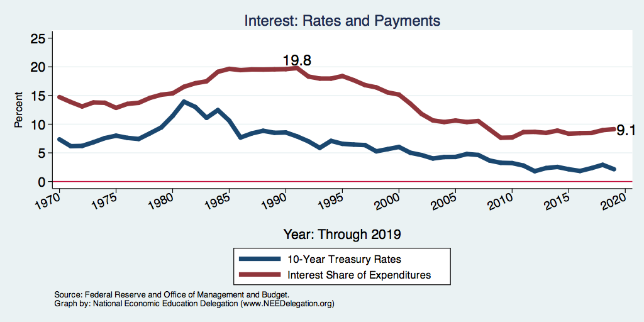
Interest Payments and Interest Rates

Slide 73
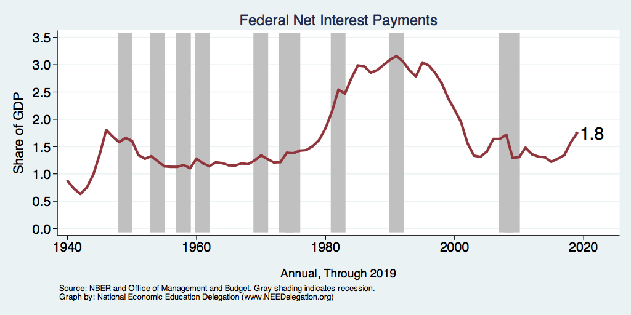
Rising Interest Expenses?

Slide 74
Covid-19 Update
CBO projections (as of 4/24) :
  The 2020 federal deficit will rise from $1 trillion to $3.7 trillion.
  Relative debt: will rise from 80 percent to 101 percent of GDP.
FY 2019–2020 ends September 30.

Slide 75
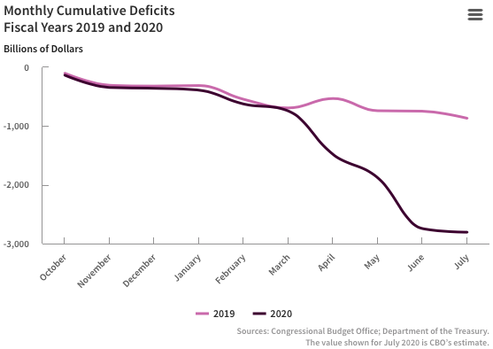
COVID-19’s Impact on the Deficit – to July
Source: https://www.cbo.gov/publication/56497

Slide 76
Very Large Deficit!
https://www.crfb.org/blogs/budget-projections-debt-will-exceed-size-economy-year

Slide 77
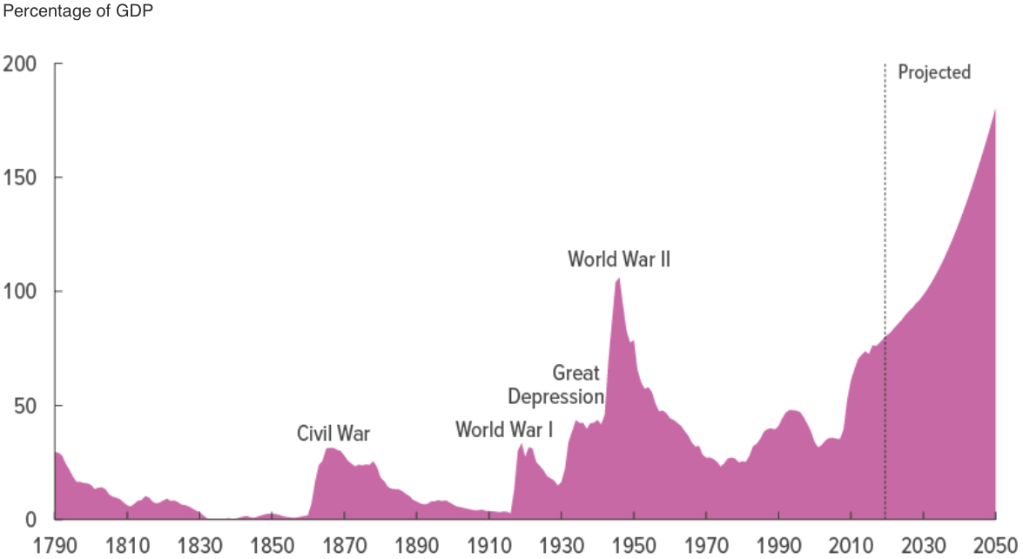
How Do We Pay for This?
Good News: Treasury interest rates are nearly 0.
Bad News: The long-term budget outlook was already a mess.
Don’t worry about the drought when the house is on fire!
CBO, “The Budget and Economic Outlet: 2020-2030,” 1/2020

Slide 78
Why Has the Federal Debt Risen So Much?
Expenditures:
  Social Security
  Health-care costs
  Economic stimulus
    In particular, during the Great Recession.
  Military engagements overseas
Revenues
  Declining income tax revenues
    Stagnant wages
    Tax cuts
  Social security
    Declining revenues
  Corporate income taxes

Slide 79
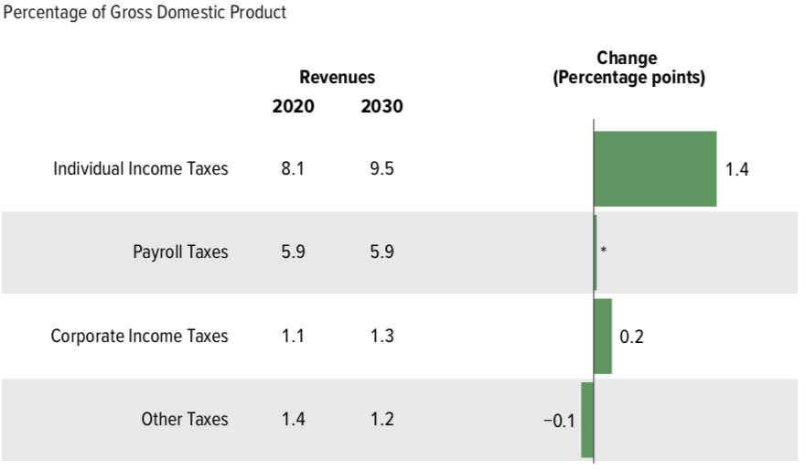
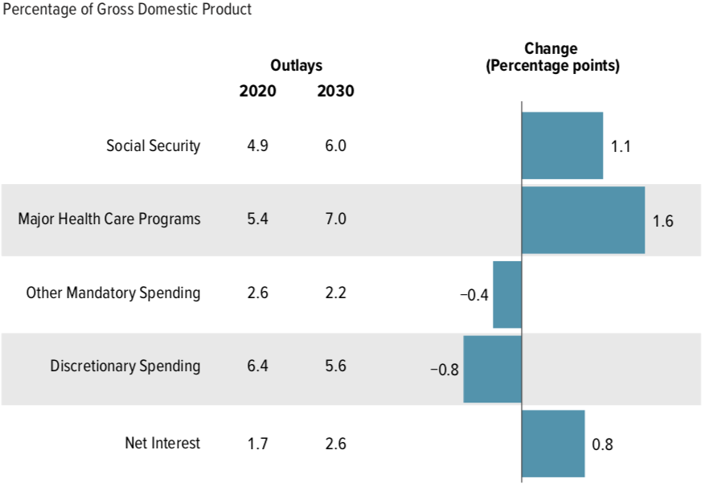
Growth in Outlays Exceeds Revenue

Slide 80
Budget Consequences of an Aging Population
Contributions to the Federal Deficit: % of GDP
 | 2020 | 2031–2040 | Change
Social Security | -0.4 | -1.7 | -1.3
Medicare | -1.7 | -3.4 | -1.7
Other | -2.5 | -1.9 | +0.6
Deficit | -4.6 | -7.0 | -2.4

Slide 81
Bottom-Line Takeaways
Herb Stein, an expert on fiscal policy and the chairman of the Council of Economic Advisors under Richard Nixon, is famous for observing: “If something cannot go on forever, it will stop.” A rising and accelerating ratio of debt to GDP cannot go on forever.
We have a choice largely between:
  Fiscal crisis.
  Reductions in the primary deficit.

Slide 82
OK: Relative Debt Cannot Grow Forever, But
Does it matter at what level we stabilize relative debt?
Relative debt stops growing:
  when the growth of debt is less the growth in GDP (on average).
Arithmetic: growth rate of the debt equals the interest rate plus the effect of the primary surplus or deficit.
The bigger the relative debt, the smaller the effect of the primary surplus or deficit.

Slide 83
CBO on the Possibility of a Fiscal Crisis
Moreover,
  because the United States currently benefits from the dollar’s position as the world’s reserve currency and
  because the federal government borrows in dollars,
  a financial crisis—similar to those that befell Argentina, Greece, or Ireland—is less likely in the United States.
Although no one can predict whether or when a fiscal crisis might occur or how it would unfold, the risk is almost certainly increased by high and rising debt.
Source: CBO – Federal Debt: A Primer, March 2020

Slide 84
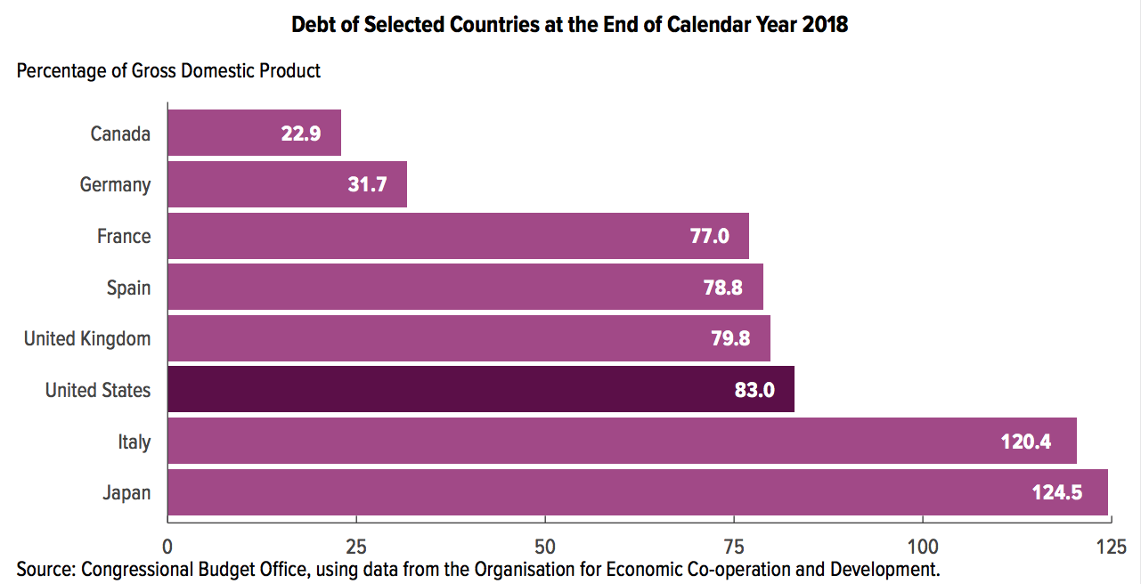
Other Countries Have Higher Debt Levels

Slide 85
Takeways (Continued)
After the virus is defeated, some combination of spending cuts and tax increases must be enacted.
The particular combination of spending cuts and revenue increases is a political question.
But high debt levels should not deter:
  Productive infrastructure investment.
  Fiscal responses to crises.
Given the fiscal challenges of an aging population and climate change, it is better to do this sooner rather than later.

Slide 86
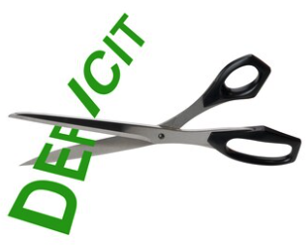
Bottom Line
Question is not WHETHER the US will have to act…
but WHEN.
Some combination of the following WILL be necessary:
  Raising taxes
  Cutting spending
  Reining in health-care costs

Slide 87
Are There Reasons to Wait?
Very little evidence of:
  Crowding out
  Inflationary impact
Uncertainty about the future
  Economic growth might render action today unnecessary.
There are a great many investments to be made by the govt.
  Infrastructure
  Education
  Much, much more …

Slide 88
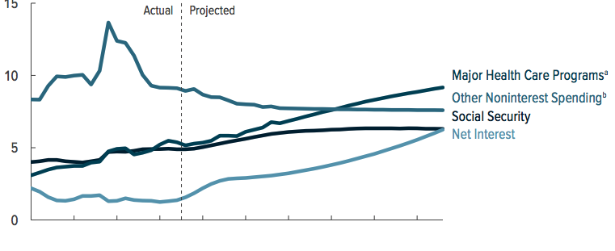
What Are the Primary Drivers Going Forward?

Slide 89
Proposals Do Exist
Simpson-Bowles
Domenici-Rivlin Task Force
Solutions Initiative – Peter G. Peterson Foundation
  American Action Forum
  American Enterprise Institute
  Bipartisan Policy Center
  Center for American Progress
  Economic Policy Institute

Slide 90
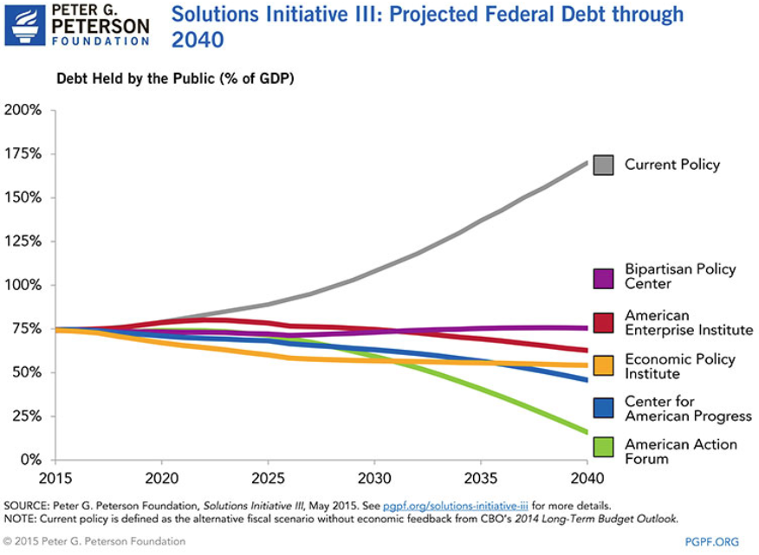

Slide 91
There Are Other (Bad/Costly) Solutions
Financial repression
  Using regulation to force down interest rates.
Paying the interest by printing money.
  Risks inflation, hyper or otherwise.
Or defaulting on the debt.
  This will forever raise the cost of government borrowing.

Slide 92
Summary: The Debt
The jury is (sort of) out on the debt.
Conventional wisdom is being challenged:
  Previously: inflationary and crowd out private investment
  New assertion: these things don’t matter for a country that can borrow in its own currency.
Upshot?
  This is a policy choice.
  The cautious approach is to rein in the debt.
  The cautious approach may lead to slower economic growth.

Slide 93
Summary
Debt: $22.9 Trillion
  Relative debt: 107% of GDP
  Publicly held debt: 79% of GDP
Deficits drive growth in the debt.
  Likely greater than $1 trillion per year.
Publicly held debt matters most.
  Will grow from 78% of GDP today to 180% in 2049 – pre-COVID-19 estimates.
  Could exceed 100% of GDP by the end of 2020 and 200% by 2050.
Multiple ways to offset this growth.
Growing interest payments can constrain budgets.

Slide 94
Summary: Address the Debt?
Reasons to wait:
  Interest rates are very low
  Lots of important investments to make
  Economic growth may take care of it
Risks:
  Inflation
  Slower economic growth
    Higher interest rates
    Crowding out
  Default

Slide 95
Bottom-Line Takeaways
Relative debt must be stabilized, so it is imperative to reduce primary deficits after the virus has been defeated.
Given the fiscal challenges of an aging population and climate change, it is better to do this sooner rather than later.
But high debt levels should not deter:
  Productive infrastructure investment.
  Fiscal responses to crises:
    “When the house is on fire, you don’t worry about being in a drought; you just put it out.”

Slide 96
Major Takeaways: Talking Points
The current trajectory for the federal debt is unsustainable.
Given historically low interest rates, we can afford to wait until after the crisis to act.
After the crisis, we must enact plans to reduce the future (primary) deficits.
  These are driven by Medicare and Social Security spending.
The longer we postpone action, the greater the probability of a “fiscal crisis.”

Slide 97
Who Are We?
Honorary Board: 48 members
  2 Fed chairs: Janet Yellen, Ben Bernanke
  6 chairs of the Council of Economic Advisers
    Furman (D), Rosen (R), Bernanke (R), Yellen (D), Tyson (D), Goolsbee (D)
  3 Nobel Prize-winners
    Akerlof, Smith, Maskin
Delegates: 500+ members
  At all levels of academia and some in government service
  All have a PhD in economics
  Crowdsource slide decks
  Give presentations
Global Partners: 45 PhD Economists
  Aid in slide deck development

Slide 98
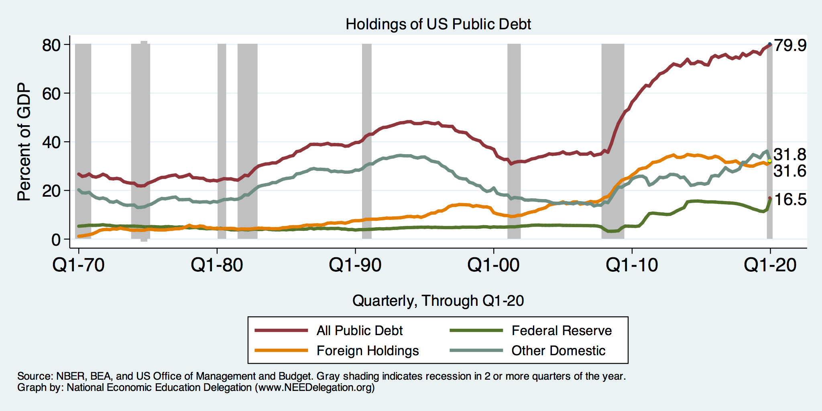
Summary: Who Holds US Public Debt?

Slide 99
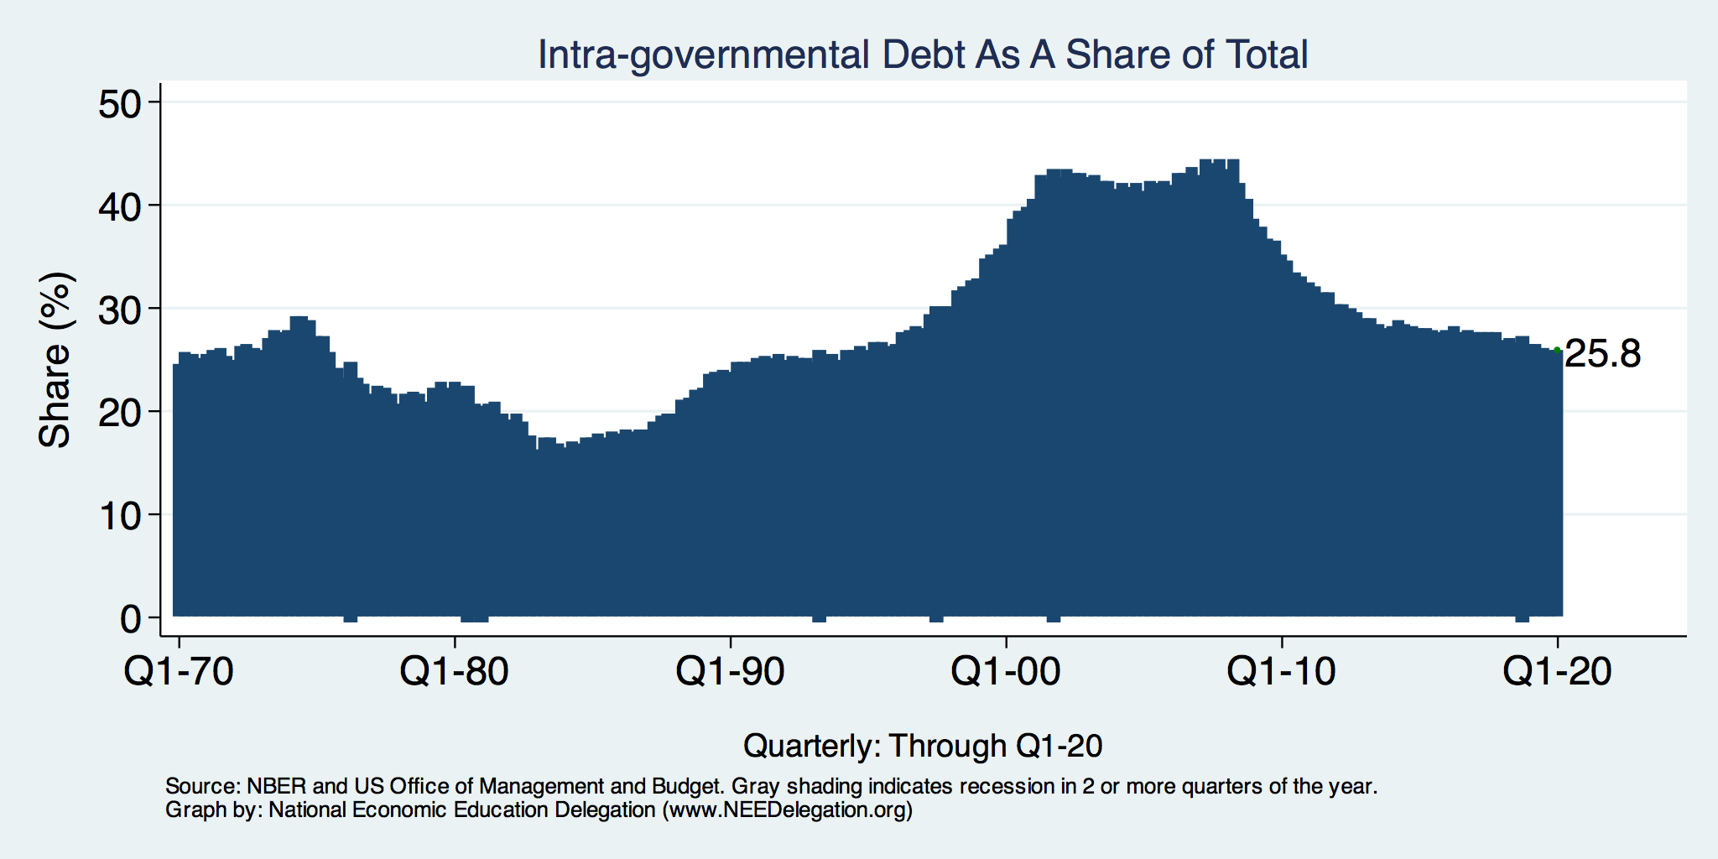
Trends in Intragovernment Debt

Slide 100
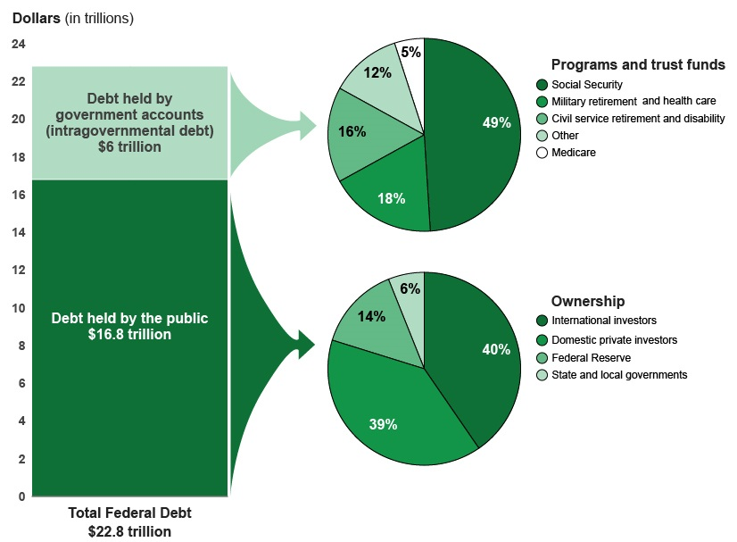
A Breakdown of Total Federal Debt
Share of US Public Debt
Foreign ownership is relatively recent – in 1990 foreign ownership was less than 20%
https://www.gao.gov/americas_fiscal_future?t=federal_debt

Slide 101
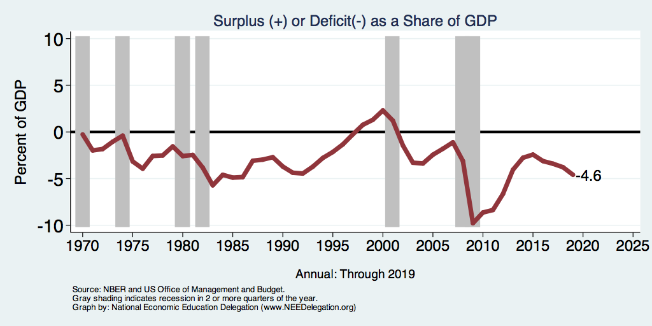
Deficits and Recessions
Notes:
Debt2deficit.png

Slide 102
Reagan’s Experiment in Supply-Side Economics
Tax cuts were supposed to be “investments.”
  Lower marginal tax rates, and people will work more/harder and save.
  Higher GDP will raise tax revenue to pay for the deficit.
Sadly, in 1981-89, debt rises from 25% to 40%.
  For the first time, relative debt rises during a non-recessionary peacetime.
  Reignites concern about debt and deficits.
Failed experiment?

Slide 103
Traditional View: Cost 1
Rising debt reduces investment.
  Deficits and debt raise aggregate demand.
    Direct government spending.
    Lower taxes lead households to spend more.
  To offset this increase in demand, the Fed has to raise interest rates, reducing investment and future GDP.
  By causing interest rates to rise:
    debt and deficits “crowd out” investment.

Slide 104
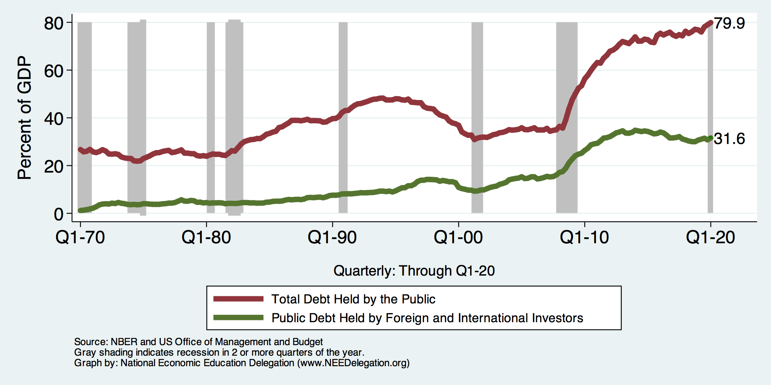
The International Appetite for US Treasuries

Slide 105
The International Appetite for US Treasuries

Slide 106
2005: The International Dimension to Debt
Interest on foreign-held debt reduces US residents’ welfare.
  Interest payments go to other countries.
When the Fed raises interest rates, the exchange rate of the dollar rises, causing:
  Increases in the trade deficit
  Foreign borrowing.
Sharp increases in interest rates and the cost of imports raises the possibility of a fiscal crisis or a “run on the dollar.”

Slide 107
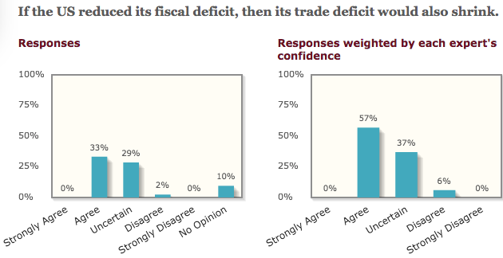
General Agreement Among Economists

Slide 108
Trade and Investment Flows Balance Out

Slide 109
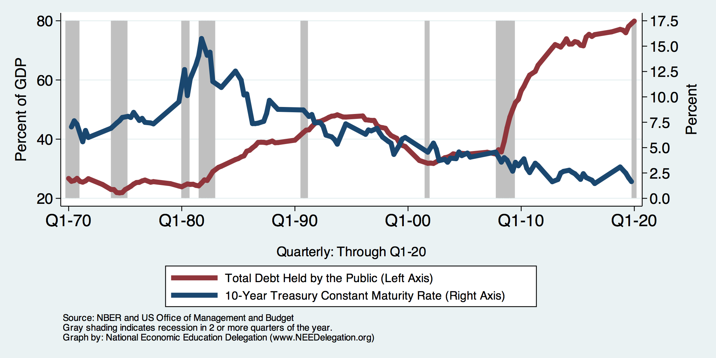
Costs 1–2: The Dog That Didn’t Bark

Slide 110
Traditional View: Cost 3
Rising debt reduces budgetary options.
  More debt means higher interest costs.
  Therefore, greater relative debt:
    requires a bigger primary surplus to stabilize the relative debt.
  Larger primary surplus means either higher tax rates or less government spending:
    “crowding out” of outlays and/or tax cuts.

Slide 111
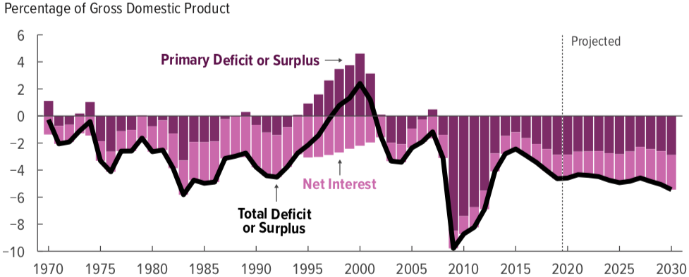
Cost 3: No Primary Surplus Since 2007!
This graph was done before Covid-19
Source: Congressional Budget Office, The Budget and Economic Outlook: 2020 to 2030

Slide 112
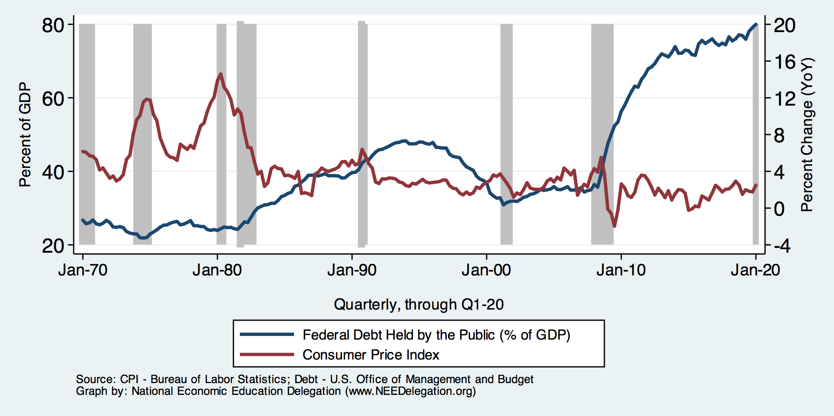
Cost 4: Anybody See Any Inflation?

Slide 113
MMT’s Free Lunch
The only limit on deficit spending is when it leads to too much spending, thereby increasing current inflation.
Recognizing this fact, “could free policymakers not only to act boldly amid crises but also to invest boldly in times of more stability.”
  First part, acting boldly, is important and likely true.
  Second part, invest boldly, is suspect.

Slide 114
A More Reasonable, But Still Optimistic View
Olivier Blanchard:
Emeritus Professor at MIT
Chief Economist at the IMF, 2008–2015
President of the American Economic Association, 2018

Slide 115
AEA Presidential Address, January 2019
“If the future is like the past [with low interest rates], … the issuance of debt without a later increase in taxes may well be feasible. Put bluntly, public debt may have no fiscal cost.”
But,
“My purpose … is not to argue for more public debt, especially in the current political environment. It is to have a richer discussion of the costs of debt … than is currently the case.”

Slide 116
An Almost Free Lunch
If the interest rate is less than the growth rate of GDP, then the contribution from the primary budget can be positive, or
Debt to GDP can be stabilized with a (small) primary deficit.
Blanchard is not MMT (when the crisis is over)
  Relative debt must be stabilized.
  Primary deficit must be reduced.
  But the level of debt at which we stabilize may not be crucial.

Slide 117
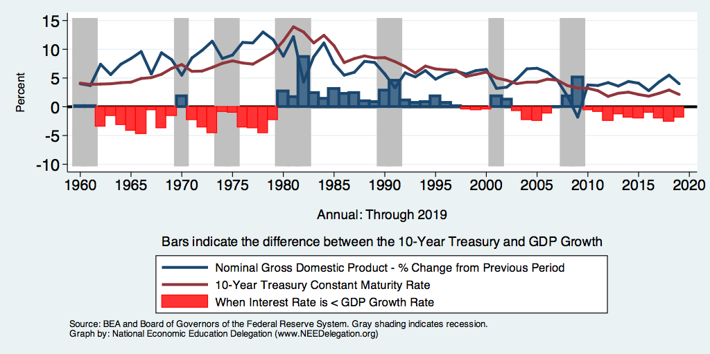
Evidence?

Slide 118
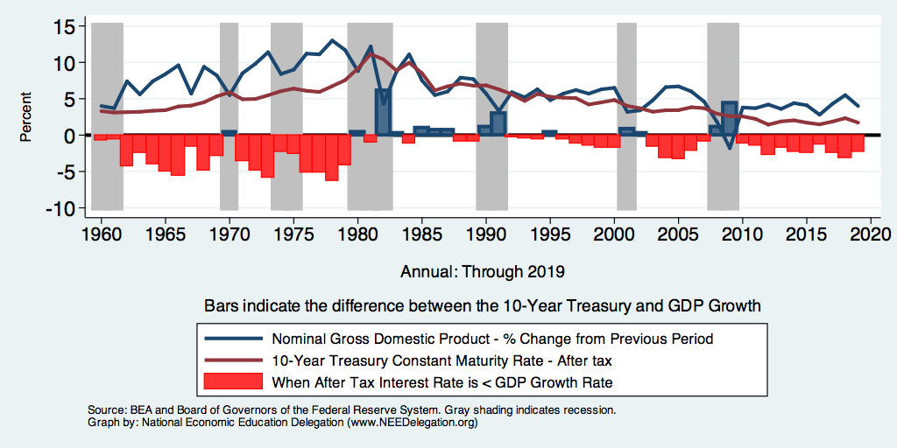
But Interest on the Debt Is Taxable

Slide 119
Thank you!
Any Questions?
www.NEEDelegation.org
<presenter name>
<presenter email>
Contact NEED: Info@NEEDelegation.org
Submit a testimonial: www.NEEDelegation.org/testimonials.php
Support NEED: www.NEEDelegation.org/donate.php

Slide 120
CBO: Budget Analysts in Chief
The Congressional Budget Office was founded in 1974 to provide Congress with information about the budgetary implications of legislation.
Two kinds of reports
  Cost Estimates: HR 6036 VA Family Leave Act of 2020
  Projections of Debt and Deficits: The Budget and Economic Outlook, 2020 to 2030

