Slide 1


Economy Update & The US Federal Debt
Golden Gate Computer Society
August 23, 2021
Geoffrey Woglom
Amherst College
Professor of Economics (emeritus)

Slide 2
National Economic Education Delegation
Vision
  One day, the public discussion of policy issues will be grounded in an accurate perception of the underlying economic principles and data.
Mission
  NEED unites the skills and knowledge of a vast network of professional economists to promote understanding of the economics of policy issues in the United States.
NEED Presentations
  Are nonpartisan and intended to reflect the consensus of the economics profession.

Slide 3
Who Are We?
Honorary Board: 54 members
  2 Fed Chairs: Janet Yellen, Ben Bernanke
  1 Secretary of the Treasury: Yellen (D)
  6 Chairs Council of Economic Advisers
    Furman (D), Rosen (R), Bernanke (R), Yellen (D), Tyson (D), Goolsbee (D)
  3 Nobel Prize Winners
    Akerlof, Smith, Maskin
Delegates: 590+ members
  At all levels of academia and some in government service
  All have a Ph.D. in economics
  Crowdsource slide decks
  Give presentations
Global Partners: 45 Ph.D. Economists
  Aid in slide deck development

Slide 4
Available NEED Topics Include:
US Economy
Climate Change
Economic Inequality
Economic Mobility
US Social Policy
Trade and Globalization
Trade Wars
Immigration Economics
Housing Policy
Federal Budgets
Federal Debt
2017 Tax Law
Autonomous Vehicles

Slide 5
Credits and Disclaimer
This slide deck was authored by:
  Jon Haveman, Executive Director, NEED
  Geoffrey Woglom, Amherst College, Emeritus
Disclaimer
  NEED presentations are designed to be nonpartisan.
  It is, however, inevitable that the presenter will be asked for and will provide their own views.
  Such views are those of the presenter and not necessarily those of the National Economic Education Delegation (NEED).

Slide 6
Real GDP and Potential during the Recovery
The “output gap” is about $340b
-1.7%
-10.8%
Source: Bureau of Economic Activity https://www.bea.gov/ & CBO

Slide 7
Recovery Due to Immense Fiscal Stimulus and Control of COVID

Slide 8
Stimulus allowed Spending to Recover
But Note that Saving also went way up
Saving
Abnormally high Saving is over $2trillion

Slide 9
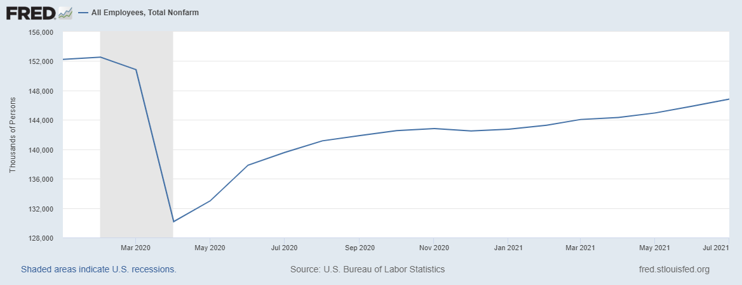
How about the Labor Market?
-5.7m

Slide 10
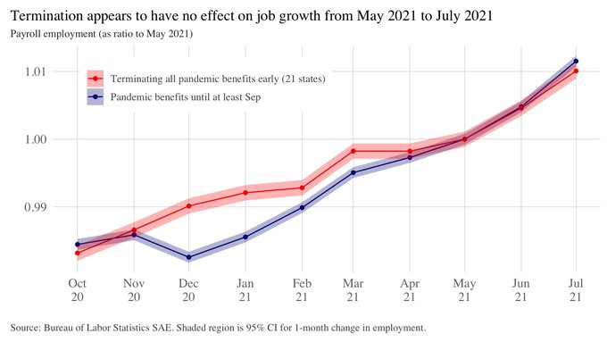

Puzzle: Is There a Labor Shortage?
1. As of the end of June, 10.1 million job openings, record high.
As of July 31, 11.7 million receiving unemployment benefits.
Are pandemic unemployment benefits the problem?

Slide 11
But What about Inflation?
Jun to Jul, 4.0%
Jul 20 to Jul, 4.3%

Slide 12
Puzzle: Is Inflation Permanently Higher?
Fed: No. Price increases are
  1) rebound from low prices last year;
  2) temporary due to supply chain disruptions; e.g., used cars, car rentals.
Me: I am not so sure. We are close to full employment and monetary and fiscal policies are very easy.

Slide 13
Where We Stood Before the Delta Upsurge
Fiscal Stimulus is Not Done, but is slowing.
  Will the excess saving of $2 trillion be spent?
  Emergency Unemployment will end on September 6th for 7.5 million.
  Expanded Child Tax Credit Payments started last month and continue to the end of the year.
  Infrastructure on the Horizon?
Monetary Policy is committed to maintaining near zero interest rates:
  With inflation having run persistently below this longer-run goal, the Committee will aim to achieve inflation moderately above 2 percent for some time so that inflation averages 2 percent over time and longer‑term inflation expectations remain well anchored at 2 percent. The Committee expects to maintain an accommodative stance of monetary policy until these outcomes are achieved (Policy Statement 7/28)
In my view the outlook is entirely dependent on the virus

Slide 14
Federal Debt and Deficits
Definitions and Basic Data.
The History of the Debt.
Traditional View on the Costs of the Debt.
New Ideas about the Costs of the Debt: Reassuring in the short term; scary in the longer term.

Slide 15
The Federal Budget in FY 2020
Programmatic Outlays
less
Equals
Deficit
$3.2 Trillion
14.9% of GDP
Source: CBO, 4/30/2021

Slide 16
Past and Future of Deficits
Useful Deficit Decompositions:
Total Deficit= (Spending on Programs +
Interest Expense)-Revenue
=(Programmatic Outlays – Revenue)+Interest Expense
=Primary Deficit + Net Interest
Source: CBO, Updated Budget and Econo9mic Projections, 7/15/2021

Slide 17
Current Deficits in Perspective:
The budgetary cost of the 3 major fiscal packages during the pandemic was over $5 trillion. As a share of the economy this is almost the size of war production in 1943 (Romer, Brookings Papers on Economic Activity, 3/25/2021).
Since March of 2021, Fed net holdings of US Treasury bonds have increased by $2.7 trillion.

Slide 18
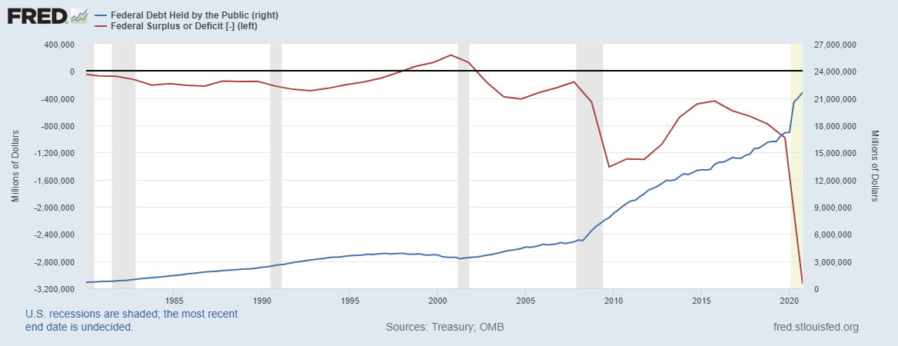
Debt vs. Deficit
The Sum of All Past Deficits Less Surpluses Equals the Debt
Shaded areas are recessions
Notes:
Debt2deficit.png

Slide 19
A Breakdown of the Total Federal Debt
Sources: US Treasury, Federal Reserve Board

Slide 20
Not All Debt Is Created Equal
Intra-governmental debt is important bookkeeping.
  This debt DOES NOT require funding on credit markets
Debt held by the public
  This debt is funded by borrowing on credit markets and competes with private funding.
Most analyses focus on the publicly debt relative to GDP because:
  To the extent that debt and deficits have burdens these burdens depend on the size of the debt relative to the size of the economy.

Slide 21
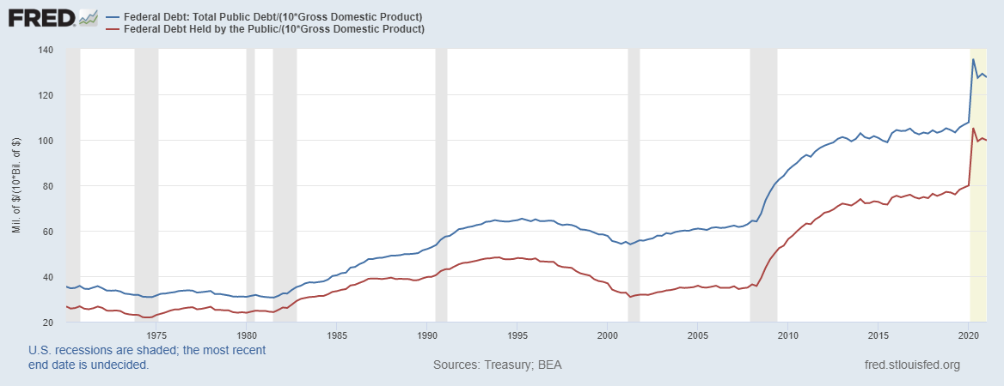
Two Measures of the Relative Debt
SSN & Medicare Trust Funds

Slide 22
CBO: Budget Analysts in Chief
The Congressional Budget Office was founded in 1974 to provide Congress with information about the budgetary implications of legislation.
Two kinds of Reports
  Cost Estimates – H.R. 486 Ukraine Religious Freedom Support Act
  Projections of Debt and Deficits – The Budget and Economic Outlook: 2021 to 2031

Slide 23
Key Points About the U.S. Relative Debt
1946-1974
Relative debt peaked during WWII (106%) - followed by a steady decline until the 1980s.
Prior to 1983, relative debt rose purposefully (wars, recessions, public investment) and then fell.
What can we learn from the 46-74 period, where the relative debt fell continuously?

Slide 24
Debt Dynamics
The relative debt fell in spite of deficits in 21 of the 29 years, with the debt increasing by 42%. How?
1946-1974, deficits caused the debt to grow, but not as fast as the economy was growing.
While the debt grew by 42%, GDP (nominal) grew by 550%
You don’t need a surplus to reduce the relative debt: you need the economy to grow faster than the debt.

Slide 25
Traditional Views of the Cost of the Debt
First a non-issue: There is no analogy between household and government debt.
  The government does not have to pay back the debt.
  Retirees cash in maturing bonds which are financed with new bond issues sold to younger people.
  Interest on the debt is essentially paid by the young to their parents
Economist View of the Debt circa 1980, very little cost because relative debt was falling. That changes in 1983.

Slide 26
Traditional View: Debt and Deficits Raise Interest Rates
Crowding Out: Higher interest rates lead to less investment and over time to a smaller capital stock and reduced future output.
Foreign Borrowing: Higher interest rates lead to foreign capital inflows or foreign borrowing. With foreign borrowing, some of our GDP is paid to foreigners as interest.

Slide 27
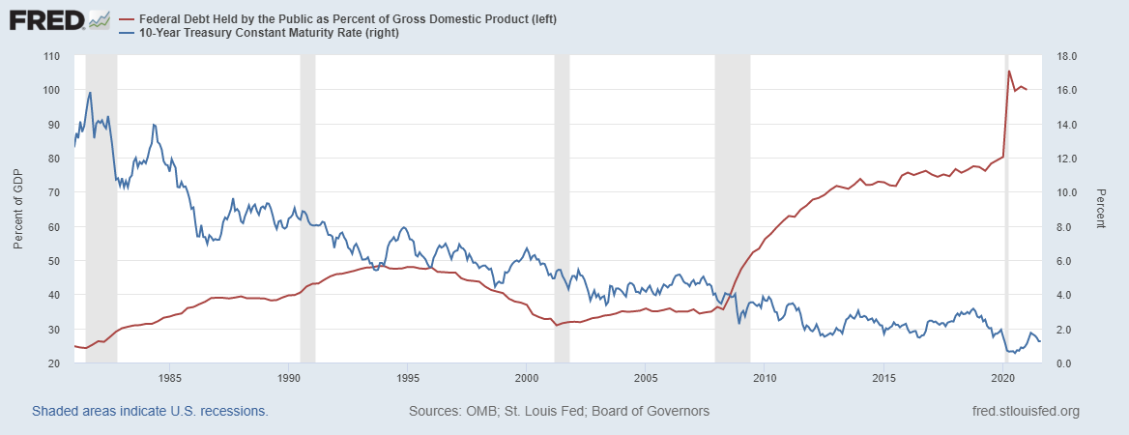
The Dog that Didn’t Bark; Rising Interest Rates?
Relative Debt
10 yr. Treasury Rate

Slide 28
Olivier Blanchard’s Presidential Address to the AEA 1/2019
“If the future is like the past [with low interest rates],…the issuance of debt without a later increase in taxes may well be feasible. Put bluntly, public debt may have no fiscal cost.”
But,
“My purpose…is not to argue for more public debt, especially in the current political environment. It is to have a richer discussion of the costs of debt…than is currently the case.”

Slide 29
What the Traditional View Got Wrong
The growth rate in debt :
  One part of the debt grows at the interest rate.
  Total debt grows by more than the interest rate when there is a primary deficit.
The traditional view assumes that the interest rate on debt is greater than the growth rate of GDP
  So, there must be a primary surplus to offset the interest rate
  i.e., programmatic outlays must be less than revenues to stabilize the debt.

Slide 30
An Almost Free Lunch
If the interest rate is less than the growth rate of GDP, then Debt to GDP can be stabilized with a (small) primary deficit: programmatic outlays can be less than revenues!
Blanchard does believe that the relative debt must be stabilized
  At some point deficits must be reduced.
  But it may not be crucial at what level of debt we stabilize.

Slide 31
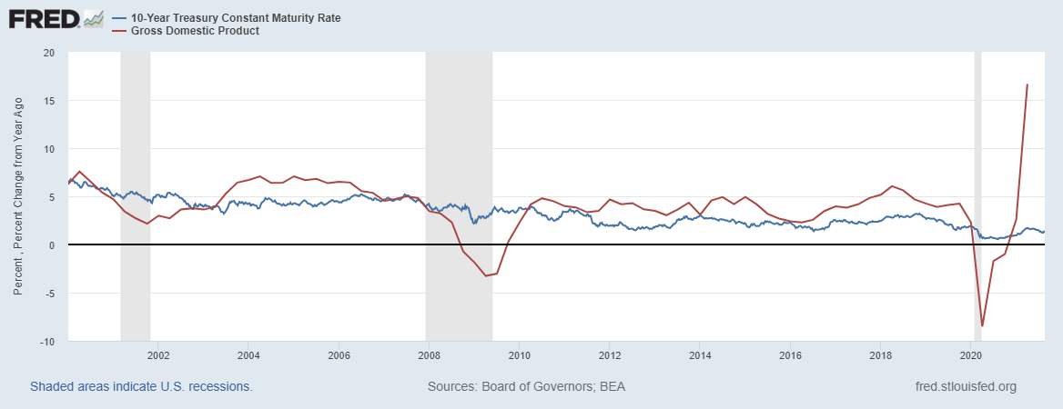
Blanchard’s Evidence
Except for recessions, interest rates have been less than GDP growth
GDP growth rate
10 yr. Treasury Rate
But, why have interest rates fallen and how long will low rates continue?
Sadly, we don’t know the answer to either question

Slide 32
But why must the relative debt be stabilized
For practical purposes, the US cannot default on its debt, but…
International investors, however, can still lose if the exchange value of the dollar falls.
Remember, foreign holdings of the public debt amount to almost one-third of the total.

Slide 33
Why do Foreigners Buy US Treasuries?
Market for Treasuries is the deepest, the most liquid and safest capital market in the world.
What would happen if foreigners lost confidence in the stability of the dollar?
CBO, The 2020 Long-Term Budget Outlook, 9/2020
The risk of a fiscal crisis appears to be low in the short run despite the higher deficits and debt stemming from the pandemic…. Nonetheless, the much higher debt over time would raise the risk of a fiscal crisis in the years ahead.

Slide 34
What would a Fiscal Crisis Look Like?
Foreigners lose confidence in the dollar and sell Treasuries in exchange for assets denominated in their own currency,
  Sale of Treasuries raises interest rates, worsening our fiscal outlook.
  Trading of Foreign for US assets lowers US exchange rate.
    Raising the price of imports thereby increasing inflation.
    Lowering the foreign currency returns on all US assets, exacerbating 1.
Could the Fed Bail us Out?
  It could buy Treasuries and prevent the rise in interest rates.
  Insufficient foreign assets to prevent the fall in the exchange rate,

Slide 35
Bottom Line: We Need to Worry about the Debt
Interest rates may not stay this low forever.
A fiscal crisis should be avoided at all costs.
The good news is we may be able to stabilize the relative debt without a running a surplus.

Slide 36
But is this Problem Impossible?

Slide 37
CBO to the Rescue (The 2020 Long-Term Budget Outlook, 9/2020):
First a note on CBO projections:
  The “baseline projections” (such as on the previous slide) are based on the law as currently written; they are not forecasts of what will happen.
  E.g., The 2017 tax cuts that reduced personal and estate taxes will be phased out in 2025.
But, CBO is allowed to project alternate scenarios:
  CBO (9/2020) suggests deficits in 2025 be reduced from 5 to 2.5 percent of GDP, but it won’t be easy

Slide 38
We Have Some Time: CBO’s Crystal Ball
But, it won’t be easy

Slide 39
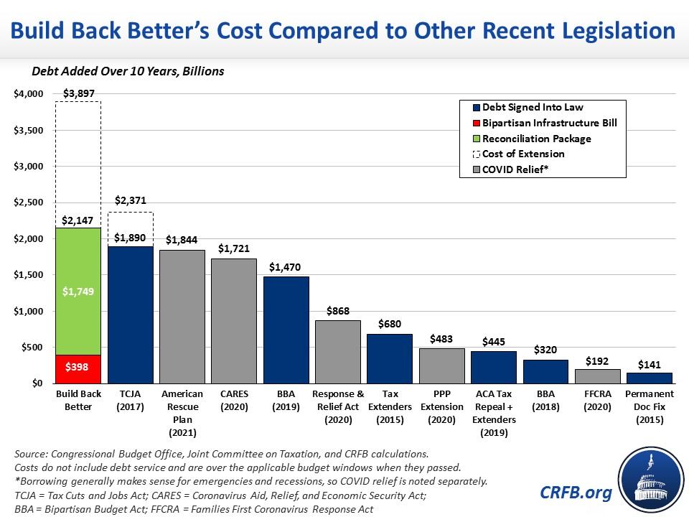
But What About Infrastructure?

Slide 40
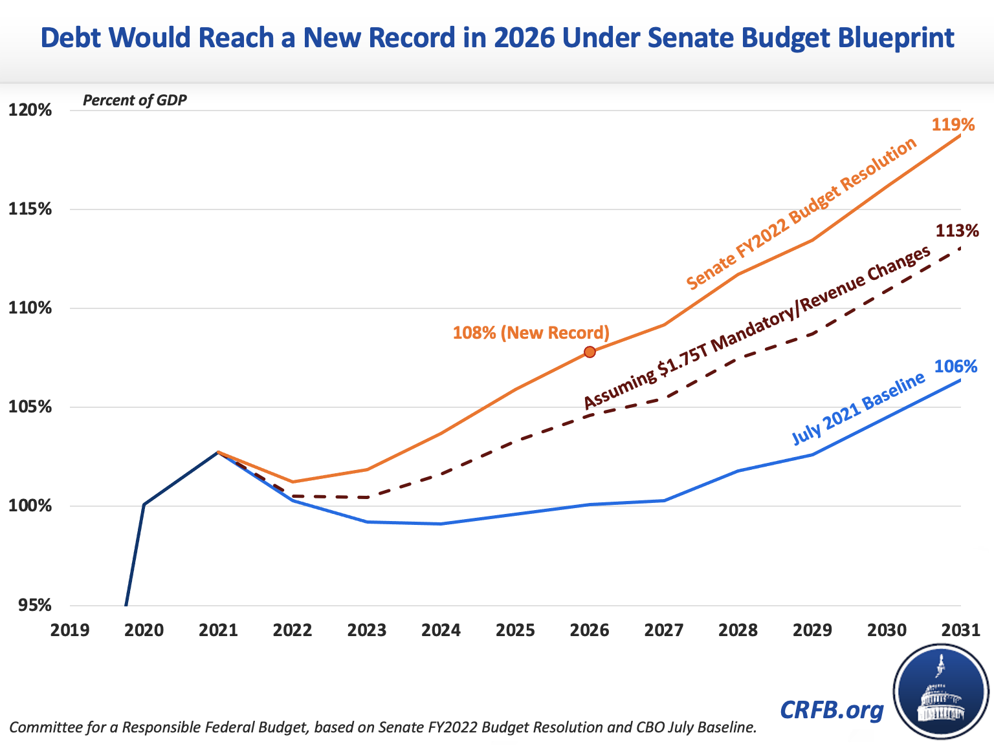
Infrastructure and the Relative Debt

Slide 41
Thank you!
Any Questions?
www.NEEDelegation.org
<Geoffrey Woglom>
<grwoglom@amherst.edu>
Contact NEED: Info@NEEDelegation.org
Submit a testimonial: www.NEEDelegation.org/testimonials.php
Support NEED: www.NEEDelegation.org/donate.php

