Slide 1
Osher Lifelong Learning Institute, Winter 2022
Contemporary Economic Policy
Berkshire Community College
January-March, 2022
Jon Haveman, Ph.D.
National Economic Education Delegation

Slide 2
National Economic Education Delegation
Vision
One day, the public discussion of policy issues will be grounded in an accurate perception of the underlying economic principles and data.
Mission
NEED unites the skills and knowledge of a vast network of professional economists to promote understanding of the economics of policy issues in the United States.
NEED Presentations
Are nonpartisan and intended to reflect the consensus of the economics profession.

Slide 3
Course Outline
Contemporary Economic Policy
Week 1 (1/24): US Economy & Coronavirus Economics
Week 2 (1/31): Climate Change Economics (Sarah Jacobson, Williams College)
Week 3 (2/7): Monetary Policy (Geoffrey Woglom, Amherst College)
Week 4 (2/14): Cryptocurrencies (Geoffrey Woglom, Amherst College)
Week 5 (2/28): Federal Debt (Geoffrey Woglom, Amherst College)
Week 6 (3/7): Health Economics (Veronika Dolar, SUNY, Old Westbury)

Slide 4
Submitting Questions
Please submit questions of clarification in the chat.
I will try to handle them as they come up.
We will do a verbal Q&A once the material has been presented.
OLLI allowing, we can stay beyond the end of class to have further discussion.

Slide 5
Outline
Basic Data, Definitions and History.
Arithmetic of Changes in the Debt.
Traditional Views of the Economic Costs of the Debt.
New Views on the Cost of the Debt.
The Challenges Ahead.
Budget Reconciliation Games.

Slide 6
The Federal Budget in FY2021
Mandatory, 71%
Discret. 22%
Net Interest, 7%
IIT, 50.5%
SST, 32,5%
CT, 9.0%
Programmatic Outlays = Mandatory + Discretionary
Source: Monthly Treasury Report, 9/2021

Slide 7
Past and Future of Deficits
Useful Deficit Decompositions:
Total Deficit= (Programmatic Outlays + Interest Expense)-Revenue
=(Programmatic Outlays – Revenue)+Interest Expense
=Primary Deficit + Net Interest
Source: CBO, Updated Budget and Econo9mic Projections, 7/15/2021
Notes:
Christina Romer: 3 packages war production of 1943

Slide 8
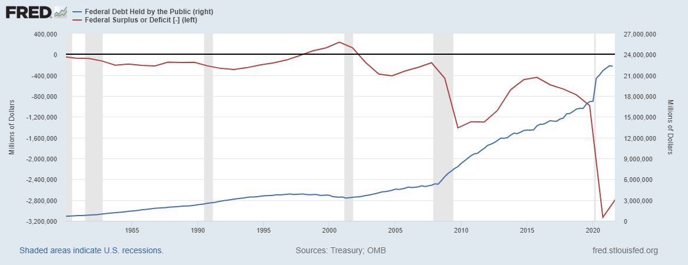
Debt vs. Deficit
The Sum of All Past Deficits Less Surpluses Equals the Debt
Blue Line Debt; Red Line Deficit
Shaded areas are recessions
Notes:
Yestere

Slide 9
A Breakdown of the Total Federal Debt
Japan, $1.3 tr
China, $1.1 tr
Sources: US Treasury, Federal Reserve Board
Notes:
Last the total public debt exceeded $30 trillion. Federal reserve increased holding by over $1t last fiscal year, 40% of the deficit was financed by the Fed.

Slide 10
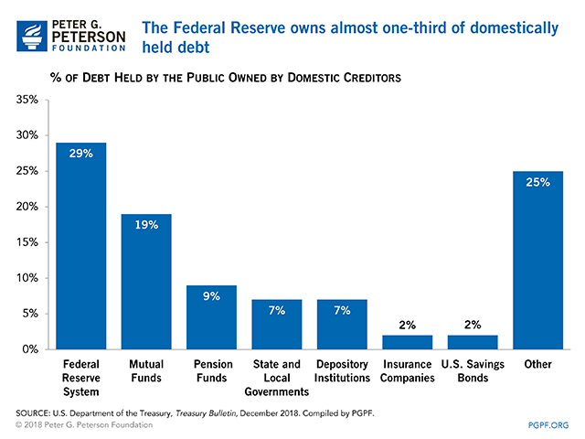
Notes:
Domestic debt held by the Fed is now 37%

Slide 11
Not All Debt Is Created Equal
Intra-governmental debt is important bookkeeping.
This debt DOES NOT require funding on credit markets
Debt held by the public
This debt is funded by borrowing on credit markets and competes with private funding.
Most analyses focus on the publicly debt relative to GDP because:
To the extent that debt and deficits have burdens these burdens depend on the size of the debt relative to the size of the economy.

Slide 12
CBO: Budget Analysts in Chief
The Congressional Budget Office was founded in 1974 to provide Congress with information about the budgetary implications of legislation.
Two kinds of Reports
Cost Estimates or “Scoring”
H.R. 486 Ukraine Religious Freedom Support Act
Build Back Better Scoring.
Projections of Debt and Deficits – The Budget and Economic Outlook: 2021 to 2031
Notes:
Lindsey Graham an alternate scoring

Slide 13
Key Points About the U.S. Relative Debt
1946-1974
Relative debt peaked during WWII (106%) - followed by a steady decline until the 1980s.
Prior to 1983, relative debt rose purposefully (wars, recessions, public investment) and then fell.
What can we learn from the 46-74 period, where the relative debt fell continuously?

Slide 14
Debt Dynamics
The relative debt fell in spite of deficits in 21 of the 29 years, with the debt increasing by 42%. How?
1946-1974, deficits caused the debt to grow, but not as fast as the economy was growing.
While the debt grew by 42%, GDP (nominal) grew by 550%
You don’t need a surplus to reduce the relative debt: You just need GDP to grow faster than the debt

Slide 15
Relative Debt Dynamics
Two Parts to the growth in the debt:
The interest rate on the debt.
A portion that reflects a primary deficit (+) or primary surplus (-)
Notes:
Interest on the debt is about 2 % . If the primary budget had been in surplus the debt still would have grown by 2% Because there was still a very large primarty deficit.he debt actually grew by 6,5%

Slide 16
Traditional Views of the Cost of the Debt
First a non-issue: There is no analogy between household and government debt.
The government does not have to pay back the debt.
Maturing government bonds are paid by issuing new bonds.
Economist View of the Debt circa 1980, very little cost because relative debt was falling. That changes in 1983.

Slide 17
Traditional View: Debt and Deficits Raise Interest Rates
Crowding Out: Higher interest rates lead to less investment and over time to a smaller capital stock and reduced future output.
Foreign Borrowing: Higher interest rates lead to foreign capital inflows or foreign borrowing. With foreign borrowing, some of our GDP is paid to foreigners as interest.

Slide 18
Quiz!
If the statement is true, raise the hand icon on your computer:
The largest source of Federal revenues are taxes on labor income.
If the primary deficit is zero (programmatic outlays equal revenues.), the overall budget is in surplus
Between 2020Q2 and 2021Q3, the relative debt went from 105% of GDP to 96%.
The most important reason for the fall in the relative debt was the decrease in the deficit.

Slide 19
Answer to #3 in More Detail
Facts:
2020Q2: GDP, 19.5 trillion; Debt, 20.5 trillion
2021Q3: GDP, 23.2 trillion; Debt, 22.3 trillion
Analysis:
Growth in GDP = (23.2-19.5)/19.5 = 3.7/19.5=0.19, or 19 percent
Growth in Debt = (22.3-20.5)/20.5 =1.8/20.5=0.09, or 9 percent
Growth in GDP exceeded the Growth in the Debt.
Lesson: You don’t need a Budget Surplus to Lower the Relative Debt.

Slide 20
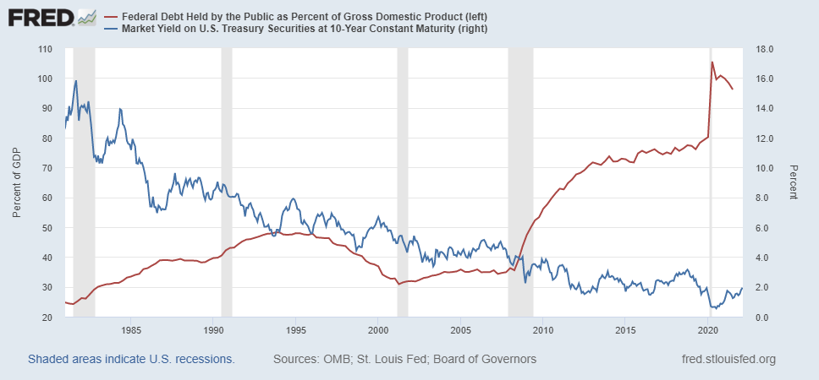
The Dog that Didn’t Bark; Rising Interest Rates?
Blue Line Rate on 10-Yr Treasury Bonds; Red Line Relative Debt
3 PM: 10-yr 1.84%

Slide 21
Olivier Blanchard’s Presidential Address to the AEA 1/2019
“If the future is like the past [with low interest rates],…the issuance of debt without a later increase in taxes may well be feasible. Put bluntly, public debt may have no fiscal cost.”
But,
“My purpose…is not to argue for more public debt, especially in the current political environment. It is to have a richer discussion of the costs of debt…than is currently the case.”

Slide 22
What the Traditional View Got Wrong
Assumed that the interest rate was greater than the growth in GDP
In order to stabilize the debt, government must run a primary surplus.
The bigger the debt, the larger the required primary surplus.
More debt today means a higher primary surplus in the future, i.e., higher taxes and/or less programmatic outlays.
Notes:
Numerical example: interest rate a 4%; GDP growth at 3%. there must be a primary surplus to offset the interest rate

Slide 23
New View: Almost a Free Lunch
If the interest rate is less than the growth rate of GDP, then Debt to GDP can be stabilized with a (small) primary deficit: programmatic outlays can be less than revenues!
Blanchard does believe that the relative debt must be stabilized
At some point deficits must be reduced.
But it may not be crucial at what level of debt we stabilize.
Notes:
Olivier Blanchard

Slide 24
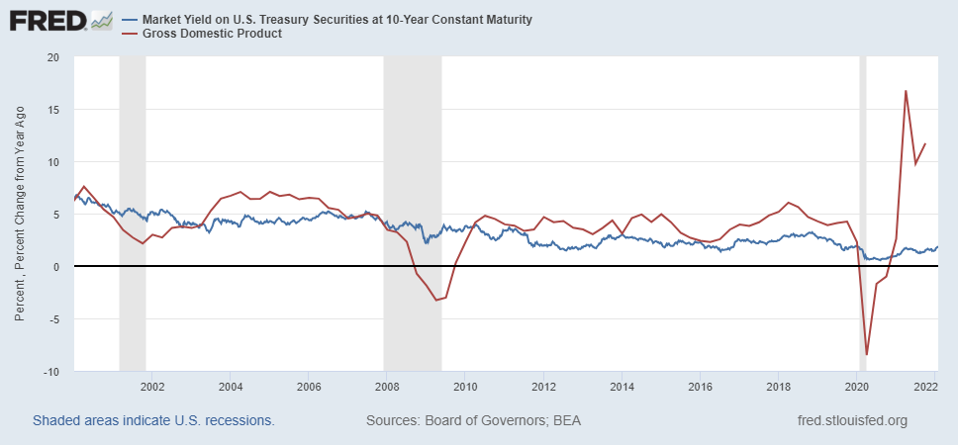
Blanchard’s Evidence
Blue Line Rate on 10-Yr Treasury Bonds; Red Line GDP growth
Notes:
Except for recessions.

Slide 25
But Why Must the Relative Debt Be Stabilized?
Stephanie Kelton provided a prominent and recent exposition of Modern Monetary Theory in her June 6th 2020, NYTimes op-ed, “Learn to Love Trillion-Dollar Deficits.”
US Treasury borrows in dollars and therefore cannot default (as opposed to Greece).
Example: How did we “find the money” in FY 2020 to increase in the deficit by about $1.9 trillion?
Answer: Fed open market purchases of $1.7 trillion provided 89% of the financing.
More generally, she argues that we can always find the money to increase federal spending

Slide 26
MMT’s Free Lunch
The only limit on deficit spending is if it leads to too much spending thereby increasing current inflation.
Recognizing this fact, “…could free policymakers not only to act boldly amid crises but also to invest boldly in times of more stability.”
Too bad the second part isn’t true. Ans, the recent rise in inflation suggests even Dr Kelton should be worried about the debt
We rely on foreigners to hold a substantial portion of our debt and they can loose if the exchange value of the dollar falls

Slide 27
Why do Foreigners Buy US Treasuries?
Market for Treasuries is the deepest, most liquid and safest capital market in the world.
US economy has a history of political and economic stability.
We enjoy “An exorbitant privilege” (Valery Giscard d’Estaing): The dollar is the largest international reserve currency.
Most trade transactions are quoted in dollars, e.g., oil.
With some exceptions, foreigners borrow in dollars. E.g., Yankee bonds

Slide 28
10-Yr Treasury Yield Over the Last Month
Notes:
FOMC meeting ends on the 26th; Feb 10th CPI for Jan 7.5%

Slide 29
Demand for Dollars by Central Banks
Source IMF Currency Composition of Official Exchange Reserves
Notes:
Talk about the fall of the Euro Brexit etc.

Slide 30
What If Foreigners Lost Confidence in the $
CBO, The 2020 Long-Term Budget Outlook, 9/2020
The risk of a fiscal crisis appears to be low in the short run despite the higher deficits and debt stemming from the pandemic…. Nonetheless, the much higher debt over time would raise the risk of a fiscal crisis in the years ahead.

Slide 31
What would a Fiscal Crisis Look Like?
Foreigners lose confidence in the dollar and sell Treasuries in exchange for assets denominated in their own currency,
Sale of Treasuries raises interest rates, worsening our fiscal outlook.
Trading of Foreign for US assets lowers US exchange rate.
Raising the price of imports thereby increasing inflation.
Lowering the foreign currency returns on all US assets, exacerbating 1.
Could the Fed Bail us Out?
It could buy Treasuries and prevent the rise in interest rates.
Insufficient foreign assets to prevent the fall in the exchange rate,

Slide 32
Bottom Line: We Need to Worry about the Debt
Interest rates may not stay this low forever. In fact, economist don’t really know why they have fallen to such low levels over the past 20 years
A fiscal crisis should be avoided at all costs.
The good news is we may be able to stabilize the relative debt without a running a surplus.

Slide 33
But is this Problem Impossible?

Slide 34
CBO to the Rescue (The 2020 Long-Term Budget Outlook, 9/2020):
First a note on CBO projections:
The “baseline projections” (such as on the previous slide) are based on the law as currently written; they are not forecasts of what will happen.
E.g., The 2017 tax cuts that reduced personal and estate taxes will be phased out in 2025.
But, CBO is allowed to project alternate scenarios:
CBO (9/2020) suggests deficits in 2025 be reduced from 5 to 2.1 percent of GDP, but it won’t be easy: about $700b or 2.9% of GDP

Slide 35
We Have a Little Time: CBO’s Crystal Ball
But, it won’t be easy

Slide 36
What about Infrastructure and BBB?
Infrastructure $1.2t - terrible reporting
Net New Spending $415b over 10 years.
But infrastructure can be good borrowing
Build Back Better: CBO Scoring
$160b over ten years.
Robert Byrd and Reconciliation Games.
Effect on Deficit in the first 5 years: +$750b ; Last 5 years -$590!
Notes:
Define Reconciliation. Robert Byrd of WVA!

Slide 37
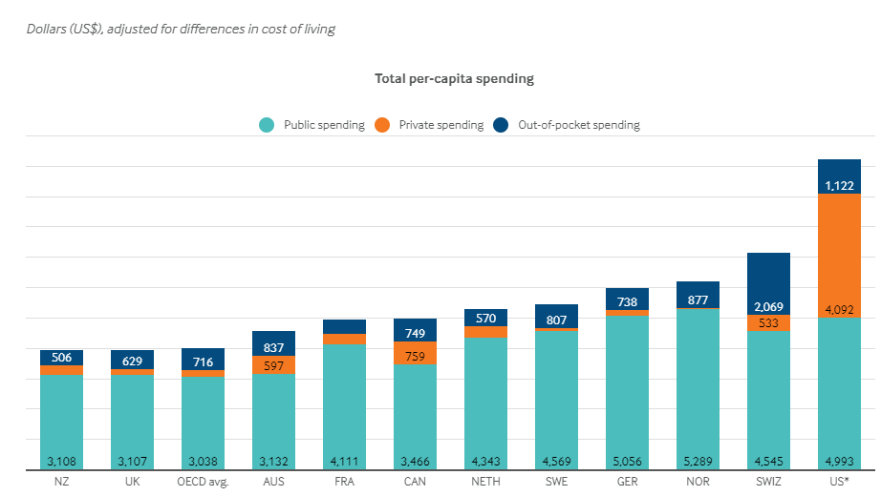
Healthcare Economics: Veronika Dolar
Notes:
Some good resources:
https://www.commonwealthfund.org/publications/issue-briefs/2020/jan/us-health-care-global-perspective-2019
A bit older report: https://www.commonwealthfund.org/publications/issue-briefs/2015/oct/us-health-care-global-perspective
https://www.healthsystemtracker.org/chart-collection/quality-u-s-healthcare-system-compare-countries/#item-overall-age-specific-potential-years-of-life-lost-per-100000-population-1990-2017
https://axenehp.com/international-healthcare-systems-us-versus-world/

Slide 38
Questions?
www.NEEDelegation.org
Geoffrey Woglom
grwoglom@amherst.edu
Contact NEED: Info@NEEDelegation.org
Submit a testimonial: www.NEEDelegation.org/testimonials.php
Support NEED: www.NEEDelegation.org/donate.php

