Slide 1
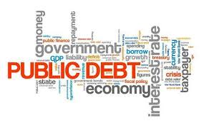
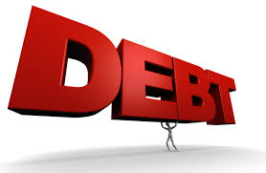
The US Federal Debt
680 Exchange
November 17, 2021
Geoffrey Woglom
Amherst College
Professor of Economics (emeritus)

Slide 2
National Economic Education Delegation
Vision
One day, the public discussion of policy issues will be grounded in an accurate perception of the underlying economic principles and data.
Mission
NEED unites the skills and knowledge of a vast network of professional economists to promote understanding of the economics of policy issues in the United States.
NEED Presentations
Are nonpartisan and intended to reflect the consensus of the economics profession.

Slide 3
Who Are We?
Honorary Board: 54 members
2 Fed Chairs: Janet Yellen, Ben Bernanke
1 Secretary of the Treasury: Yellen (D)
6 Chairs Council of Economic Advisers
Furman (D), Rosen (R), Bernanke (R), Yellen (D), Tyson (D), Goolsbee (D)
3 Nobel Prize Winners
Akerlof, Smith, Maskin
Delegates: 590+ members
At all levels of academia and some in government service
All have a Ph.D. in economics
Crowdsource slide decks
Give presentations
Global Partners: 45 Ph.D. Economists
Aid in slide deck development

Slide 4
Available NEED Topics Include:
US Economy
Climate Change
Economic Inequality
Economic Mobility
US Social Policy
Trade and Globalization
Trade Wars
Immigration Economics
Housing Policy
Federal Budgets
Federal Debt
2017 Tax Law
Autonomous Vehicles

Slide 5
Credits and Disclaimer
This slide deck was authored by:
Jon Haveman, Executive Director, NEED
Geoffrey Woglom, Amherst College, Emeritus
Disclaimer
NEED presentations are designed to be nonpartisan.
It is, however, inevitable that the presenter will be asked for and will provide their own views.
Such views are those of the presenter and not necessarily those of the National Economic Education Delegation (NEED).

Slide 6
National Economic Education Delegation
Vision
One day, the public discussion of policy issues will be grounded in an accurate perception of the underlying economic principles and data.
Mission
NEED unites the skills and knowledge of a vast network of professional economists to promote understanding of the economics of policy issues in the United States.
NEED Presentations
Are nonpartisan and intended to reflect the consensus of the economics profession.

Slide 7
Who Are We?
Honorary Board: 54 members
2 Fed Chairs: Janet Yellen, Ben Bernanke
6 Chairs Council of Economic Advisers
Furman (D), Rosen (R), Bernanke (R), Yellen (D), Tyson (D), Goolsbee (D)
3 Nobel Prize Winners
Akerlof, Smith, Maskin
Delegates: 600+ members
At all levels of academia and some in government service
All have a Ph.D. in economics
Crowdsource slide decks
Give presentations
Global Partners: 44 Ph.D. Economists
Aid in slide deck development

Slide 8
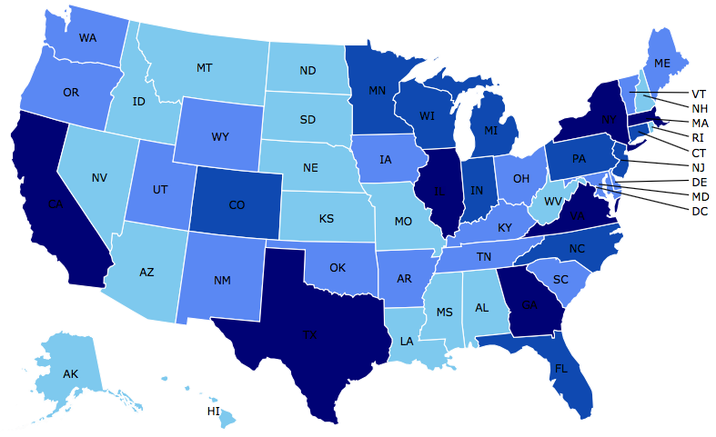
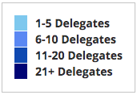
Where Are We?

Slide 9
Available NEED Topics Include:
Coronavirus Economics
US Economy
Climate Change
Economic Inequality
Economic Mobility
Trade and Globalization
Minimum Wages
Immigration Economics
Housing Policy
Federal Budgets
Federal Debt
Black-White Wealth Gap
Autonomous Vehicles
US Monetary Policy

Slide 10
Credits and Disclaimer
This slide deck was authored by:
Geoffrey Woglom, Amherst College, emeritus
This slide deck was reviewed by:
Jon Haveman
Disclaimer
NEED presentations are designed to be nonpartisan.
It is, however, inevitable that the presenter will be asked for and will provide their own views.
Such views are those of the presenter and not necessarily those of the National Economic Education Delegation (NEED).

Slide 11
The Federal Budget in 2020
Programmatic Outlays
less
Equals
Deficit
$3.2 Trillion
15% of GDP
Source: CBO, 4/30/2021

Slide 12
Fiscal 2021 (no fancy graphics yet)
Deficit, 2.8t (12.4% of GDP) =Outlays, 6.8t – Receipts, 4.0t
$250b more outlays; $600b more in taxes.

Slide 13
Past and Future of Deficits
Useful Deficit Decompositions:
Total Deficit= (Spending on Programs + Interest Expense)-Revenue
=(Programmatic Outlays – Revenue)+Interest Expense
=Primary Deficit + Net Interest
Source: CBO, Updated Budget and Econo9mic Projections, 7/15/2021

Slide 14
Current Deficits in Perspective:
The budgetary cost of the 3 major fiscal packages during the pandemic was over $5 trillion. As a share of the economy this is almost the size of war production in 1943 (Romer, Brookings Papers on Economic Activity, 3/25/2021).
Since March of 2021, Fed net holdings of US Treasury bonds have increased by $2.7 trillion.

Slide 15
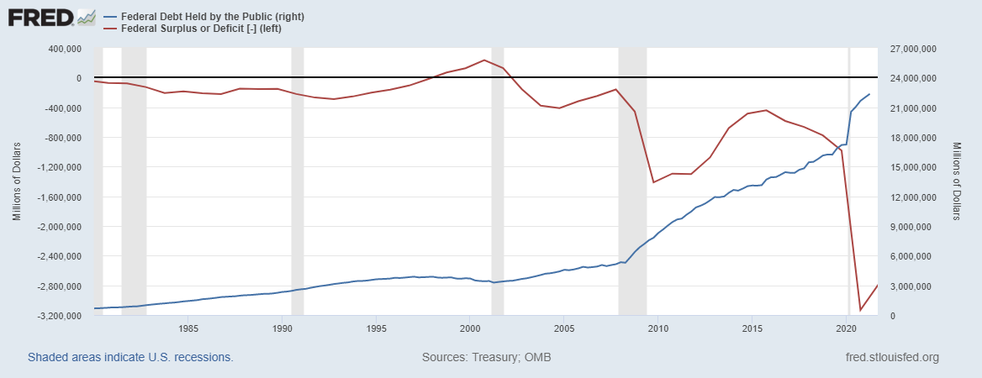
Debt vs. Deficit
The Sum of All Past Deficits Less Surpluses Equals the Debt
Blue Line Debt; Red Line Deficit
Shaded areas are recessions
Notes:
Debt2deficit.png

Slide 16
A Breakdown of the Total Federal Debt
Sources: US Treasury, Federal Reserve Board

Slide 17
Not All Debt Is Created Equal
Intra-governmental debt is important bookkeeping.
This debt DOES NOT require funding on credit markets
Debt held by the public
This debt is funded by borrowing on credit markets and competes with private funding.
Most analyses focus on the publicly debt relative to GDP because:
To the extent that debt and deficits have burdens these burdens depend on the size of the debt relative to the size of the economy.

Slide 18
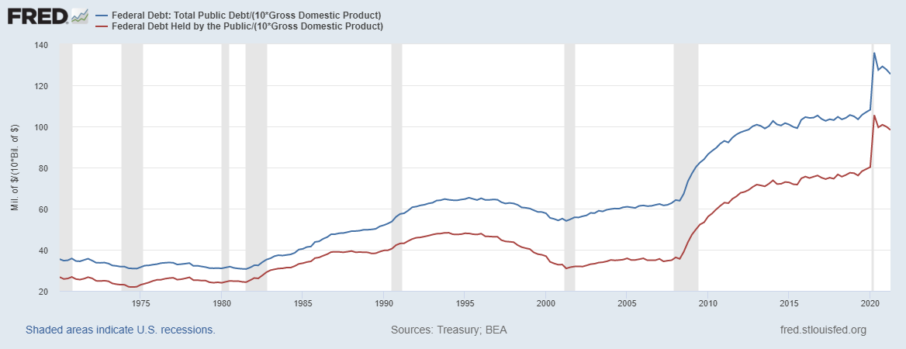
Two Measures of the Relative Debt
Blue Line Total Debt; Red Line Deficit
SSN & Medicare Trust Funds

Slide 19
CBO: Budget Analysts in Chief
The Congressional Budget Office was founded in 1974 to provide Congress with information about the budgetary implications of legislation.
Two kinds of Reports
Cost Estimates – H.R. 486 Ukraine Religious Freedom Support Act
Build Back Better Scoring this Friday!
Projections of Debt and Deficits – The Budget and Economic Outlook: 2020 to 2030

Slide 20
Key Points About the U.S. Relative Debt
1946-1974
Relative debt peaked during WWII (106%) - followed by a steady decline until the 1980s.
Prior to 1983, relative debt rose purposefully (wars, recessions, public investment) and then fell.
What can we learn from the 46-74 period, where the relative debt fell continuously?

Slide 21
Debt Dynamics
The relative debt fell in spite of deficits in 21 of the 29 years, with the debt increasing by 42%. How?
1946-1974, deficits caused the debt to grow, but not as fast as the economy was growing.
While the debt grew by 42%, GDP (nominal) grew by 550%
You don’t need a surplus to reduce the relative debt

Slide 22
Traditional Views of the Cost of the Debt
First a non-issue: There is no analogy between household and government debt.
The government does not have to pay back the debt.
Retirees cash in maturing bonds which are financed with new bond issues sold to younger people.
Interest on the debt is essentially paid by the young to their parents
Economist View of the Debt circa 1980, very little cost because relative debt was falling. That changes in 1983.

Slide 23
Traditional View: Debt and Deficits Raise Interest Rates
Crowding Out: Higher interest rates lead to less investment and over time to a smaller capital stock and reduced future output.
Foreign Borrowing: Higher interest rates lead to foreign capital inflows or foreign borrowing. With foreign borrowing, some of our GDP is paid to foreigners as interest.

Slide 24
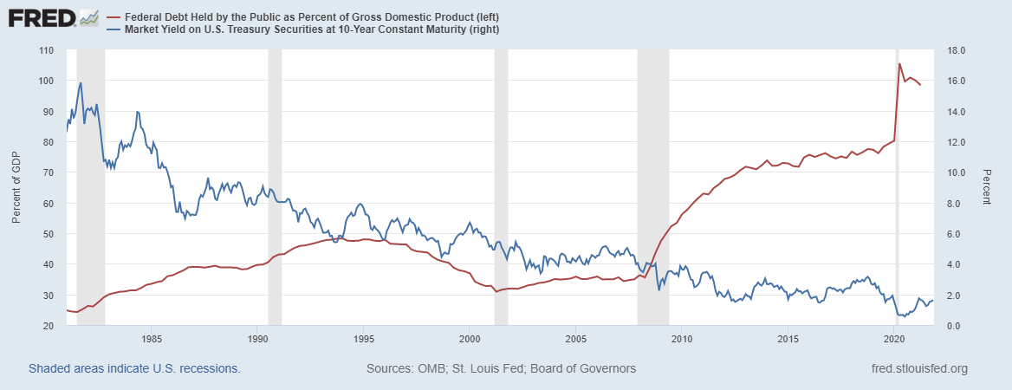
The Dog that Didn’t Bark; Rising Interest Rates?
Blue Line Debt; Red Line Rate on 10-Yr Treasury
yesterday, 10-yr: 1.63%

Slide 25
Olivier Blanchard’s Presidential Address to the AEA 1/2019
“If the future is like the past [with low interest rates],…the issuance of debt without a later increase in taxes may well be feasible. Put bluntly, public debt may have no fiscal cost.”
But,
“My purpose…is not to argue for more public debt, especially in the current political environment. It is to have a richer discussion of the costs of debt…than is currently the case.”

Slide 26
What the Traditional View Got Wrong
The growth rate in debt :
One part of the debt grows at the interest rate.
Total debt grows by more than the interest rate when there is a primary deficit.
The traditional view assumes that the interest rate on debt is greater than the growth rate of GDP
So, there must be a primary surplus to offset the interest rate
i.e., programmatic outlays must be less than revenues to stabilize the debt.

Slide 27
An Almost Free Lunch
If the interest rate is less than the growth rate of GDP, then Debt to GDP can be stabilized with a (small) primary deficit: programmatic outlays can be less than revenues!
Blanchard does believe that the relative debt must be stabilized
At some point deficits must be reduced.
But it may not be crucial at what level of debt we stabilize.

Slide 28
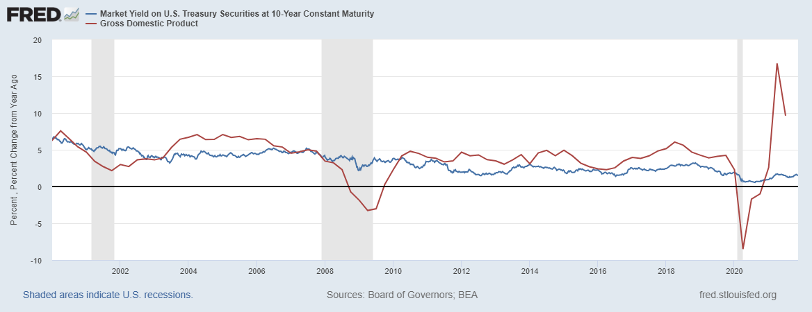
Blanchard’s Evidence
Blue: Rate on 10-Yr Treasury; Red: GDP Growth
Except for recessions, interest rates have been less than GDP growth
But, why have interest rates fallen and how long will low rates continue?
Sadly, we don’t know the answer to either question

Slide 29
But why must the relative debt be stabilized
For practical purposes, the US cannot default on its debt, but…
International investors, however, can still lose if the exchange value of the dollar falls.
Remember, foreign holdings of the public debt amount to almost one-third of the total.

Slide 30
Why do Foreigners Buy US Treasuries?
Market for Treasuries is the deepest, the most liquid and safest capital market in the world.
What would happen if foreigners lost confidence in the stability of the dollar?
CBO, The 2020 Long-Term Budget Outlook, 9/2020
The risk of a fiscal crisis appears to be low in the short run despite the higher deficits and debt stemming from the pandemic…. Nonetheless, the much higher debt over time would raise the risk of a fiscal crisis in the years ahead.

Slide 31
What would a Fiscal Crisis Look Like?
Foreigners lose confidence in the dollar and sell Treasuries in exchange for assets denominated in their own currency,
Sale of Treasuries raises interest rates, worsening our fiscal outlook.
Trading of Foreign for US assets lowers US exchange rate.
Raising the price of imports thereby increasing inflation.
Lowering the foreign currency returns on all US assets, exacerbating 1.
Could the Fed Bail us Out?
It could buy Treasuries and prevent the rise in interest rates.
Insufficient foreign assets to prevent the fall in the exchange rate,

Slide 32
Bottom Line: We Need to Worry about the Debt
Interest rates may not stay this low forever.
A fiscal crisis should be avoided at all costs.
The good news is we may be able to stabilize the relative debt without a running a surplus.

Slide 33
But is this Problem Impossible?

Slide 34
CBO to the Rescue (The 2020 Long-Term Budget Outlook, 9/2020):
First a note on CBO projections:
The “baseline projections” (such as on the previous slide) are based on the law as currently written; they are not forecasts of what will happen.
E.g., The 2017 tax cuts that reduced personal and estate taxes will be phased out in 2025.
But, CBO is allowed to project alternate scenarios:
CBO (9/2020) suggests deficits in 2025 be reduced from 5 to 2.1 percent of GDP, but it won’t be easy: about $700b or 2.9% of GDP

Slide 35
We Have a Little Time: CBO’s Crystal Ball
But, it won’t be easy

Slide 36
What about Infrastructure and BBB?
Infrastructure $1.2t - terrible reporting
Net New Spending $415b over 10 years.
Build Back Better: CBO this Friday
Joint Committee on Taxation (11/4/21) estimates that the $1.7 trillion is spending is paid for on 10 years
Problem: spending is equally spread; tax increases occur in the last 5 years.

Slide 37
Thank you!
Any Questions?
www.NEEDelegation.org
<Geoffrey Woglom>
<grwoglom@amherst.edu>
Contact NEED: Info@NEEDelegation.org
Submit a testimonial: www.NEEDelegation.org/testimonials.php
Support NEED: www.NEEDelegation.org/donate.php

