Slide 1
Osher Lifelong Learning Institute, Fall 2026
Contemporary Economic Policy
University of Massachusetts, Boston
Host: Geoffrey Woglom, Director
National Economic Education Delegation

Slide 2
Course Schedule
Contemporary Economic Policy
  Week 1 (9/16): Economic Update & Changes at the Fed, Geoffrey Woglom, Amherst College
  Week 2 (9/23): Economic Inequality, Joseph Carolan, Oakland University
  Week 3 (9/30): Saving Social Security, Geoffrey Woglom, Amherst College
  Week 4 (10/07): Federal Debt, Dmitriy Stolyarov, University of Michigan
  Week 5 (10/14): Trade and Globalization, Andreas Waldkirch, Colby College
  Week 6 (10/21): Climate Change Economics, Sarah Jacobson, Williams College

Slide 3
Submitting Questions
I encourage questions. Please put questions in the chat and I will answer them periodically during the talk,
We will do a verbal Q&A once the material has been presented.
Slides are available from the NEED website https://needecon.org/delivered_presentations.php.

Slide 4
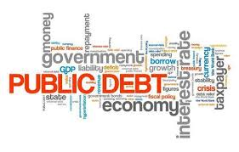

The US Federal Debt
October 7, 2026
Dmitriy Stolyarov
University of Michigan

Slide 5
Outline
Budget and Deficits
Government Borrowing
Important Points About the Debt
How to Think About the Debt
Summary
Notes:
We will first learn the basics about the US federal budget, the concept of deficit and the relation between deficit and debt; I will fill in some details about how the US government does its borrowing. To understand the drivers of US debt amount, it will be informative to look at what happened to federal budget deficits over time. As we will learn, the debt reflects the past borrowing behavior that manifested in deficits. To understand debt, it will be useful to spend some time discussing the trends in deficit and its components and the reasons behind deficits.

Slide 6
First: A Budget Review

Slide 7
Glossary
Revenue: taxes received from individuals and businesses and other government income
Outlays: expenditures on government programs and interest payments
  59% Mandatory expenditures are required by existing law (e.g. Social Security, Medicare, Medicaid)
  27% Discretionary expenditures require an annual appropriations act (e.g. defense, education, federal agencies)
  14% Net interest payments on the debt
Surplus or Deficit: difference between revenues and outlays
  If revenues exceed outlays, we have a surplus; if outlays exceed revenues, we have a deficit
Primary Deficit: difference between non-interest outlays and revenues
  Total deficit = primary deficit + interest on the debt
Notes:
Shares are FY2025 actual outlays: mandatory $4,168 bn (59%), discretionary $1,872 bn (27%), net interest $970 bn (14%) of $7,010 bn total. Source: CBO, The Budget and Economic Outlook: 2026 to 2036 (February 2026), www.cbo.gov/publication/61882.
Other government income includes customs duties (now a sizable item: $195 bn in FY2025), excise taxes, Federal Reserve remittances, estate and gift taxes, fees and fines, income from leasing federal land, radio spectrum, etc.

Slide 8
What Does the US Govt. Budget Look Like?
FY2025 Budget Summary (in billions of dollars)
Revenue |  |  | Outlays
Income taxes | $2,656 |  | Mandatory | $4,168
Payroll taxes | $1,748 |  | Discretionary | $1,872
Corporate taxes | $452 |  | Net interest | $970
Customs duties | $195
Other | $183
Total | $5,235 |  | Total | $7,010
Total Deficit: $1,775 Billion
Source: CBO, Budget and Economic Outlook, Feb. 2026 (FY2025 actual)
Notes:
Fiscal year 2025 (Oct. 2024 - Sept. 2025) actual figures. Primary deficit (excluding net interest) was $805 bn. Source: CBO, The Budget and Economic Outlook: 2026 to 2036 (February 2026), www.cbo.gov/publication/61882.
Mandatory outlays are mostly Social Security ($1,575 bn), Medicare ($988 bn net of premiums), and Medicaid/CHIP/marketplace subsidies ($832 bn). Roughly half of discretionary spending is defense ($893 bn).
Customs duties jumped from about $80 bn in FY2024 to $195 bn in FY2025 because of the 2025 tariff increases.

Slide 9
What Does the US Govt. Budget Look Like?
FY2025 Budget Summary (as % of GDP)
Revenue |  |  | Outlays
Income taxes | 8.7 |  | Mandatory | 13.7
Payroll taxes | 5.8 |  | Discretionary | 6.2
Corporate taxes | 1.5 |  | Net interest | 3.2
Customs duties | 0.6
Other | 0.6
Total | 17.2 |  | Total | 23.1
Total Deficit: 5.8
Source: CBO, Budget and Economic Outlook, Feb. 2026 (FY2025 actual)
Notes:
50-year (1976-2025) averages for comparison: revenues 17.3% of GDP, outlays 21.2%, deficit 3.8%, net interest 2.1%, mandatory 11.2%, discretionary 7.8%. Source: CBO, The Budget and Economic Outlook: 2026 to 2036 (February 2026), www.cbo.gov/publication/61882.

Slide 10
Debt accumulation

Slide 11
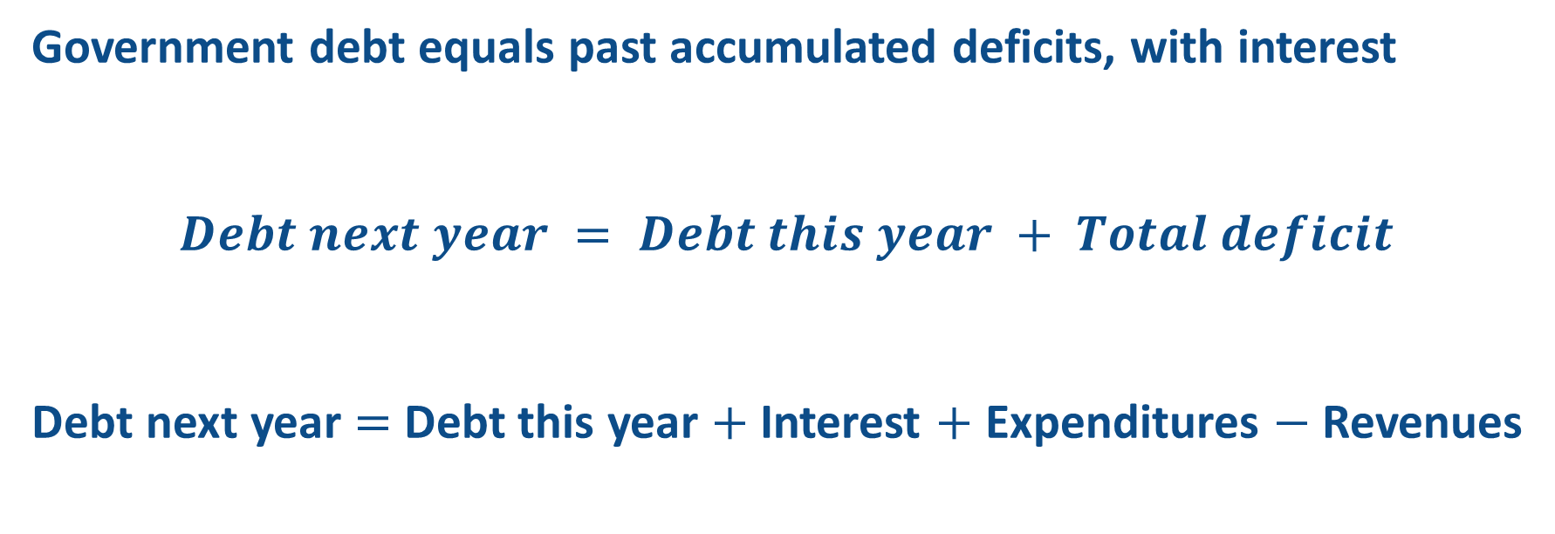
Debt accumulation
Government debt equals past accumulated deficits, with interest
$$Debt next year = Debt this year + Total deficit$$
Debt next year $=$ Debt this year $+$ Interest $+$ Expenditures $−$ Revenues
Primary deficit
Notes:
Accumulation of government debt parallels accumulation of credit card debt. Government expenditures play the same role as charges to the credit card and tax revenues play the same role as monthly payments on the account.
Law of motion: added debt = interest on current debt + primary deficit. Because the primary deficit has been positive in most years since 1970, and interest is always positive, the debt keeps growing: deficits are chronic.

Slide 12
Deficits have been chronic
Total deficit, net interest, and primary deficit, percent of GDP, 1976-2036
Dashed lines are CBO projections (Feb. 2026 baseline). Positive values are deficits; negative values are surpluses. Sources: OMB historical tables via FRED; CBO.
Notes:
The government ran a primary surplus in 1995-2001 (and a total surplus in 1998-2001). The largest deficits coincide with the 2007-09 financial crisis and COVID. CBO projects no reduction in the total deficit over the next decade: it stays at 5.6-6.7% of GDP, far above the 50-year average of 3.8%.
Net interest was high in the 1980s-90s (high interest rates on a growing debt), very low in the 2010s (near-zero rates), and is now the fastest-growing item: 3.2% of GDP in 2025, projected 4.6% in 2036, i.e. interest will be the majority of the deficit.
FY2025 FRED values use calendar-year GDP so they differ slightly from CBO's fiscal-year ratios; the chart switches to CBO numbers from 2025.

Slide 13
Outlays have outrun revenues
Total outlays and revenues, percent of GDP, 1976-2036
Dashed lines are CBO projections (Feb. 2026 baseline); dotted lines are 50-year averages. Sources: OMB historical tables via FRED; CBO.
Notes:
Revenues are remarkably stable as a share of GDP: 17.2% in 2025 and 17.5-17.8% projected through 2036, right around the 50-year average of 17.3%. Outlays are 23.1-24.4% of GDP, well above their 21.2% average, and rising after 2028 because of Social Security, Medicare and net interest. The gap between the two lines is the deficit. Source: CBO, The Budget and Economic Outlook: 2026 to 2036 (February 2026), www.cbo.gov/publication/61882.

Slide 14
And Now: The Debt

Slide 15
US federal debt as of Oct 5, 2026
$40,249,104,431,078
Total debt over 40 trillion dollars
Or about $300,000 per US household
Notes:
Total public debt outstanding (debt held by the public plus intragovernmental holdings), Treasury 'Debt to the Penny', record date Oct. 5, 2026. The debt passed $40 trillion on Aug. 18, 2026 and has grown about $2.4 trillion over the past 12 months.
Per full-time worker: $40.25 tn / 134.5 million full-time workers (BLS CPS, 2026) = about $299,000. Per household: $40.25 tn / about 134 million households (Census) = about $300,000.

Slide 16
Not All Debt Is Created Equal
As of Oct. 2026, 19% is within-government debt, a form of bookkeeping
  This debt DOES NOT affect private asset markets
  Example: the Social Security trust fund lends its past surpluses to the Treasury
81% is debt held by the public
Most analyses of debt focus on federal debt held by the public
7.8 trn
32.4 trn
Notes:
Treasury Debt to the Penny, Oct. 2, 2026: debt held by the public $32.43 tn (80.6%), intragovernmental holdings $7.81 tn (19.4%).
Some government programs such as Social Security, Medicare and military pensions do not have a perfect match between revenues and outlays. They are like households with a savings account: they earn interest on what they do not spend by letting the Treasury borrow their funds. The Social Security trust fund is the largest example. Intragovernmental debt is money the government owes itself, so it does not compete with private borrowers for funds.

Slide 17
Is $40 trillion a lot? Compared to what?
Alex and Bob each owe $10,000. Who is more deeply in debt?
Alex
Owes $10,000
Earns $20,000 a year
Debt-to-income: 50%
Bob
Owes $10,000
Earns $100,000 a year
Debt-to-income: 10%
Same debt, very different burden. The dollar amount by itself is not informative; what matters is debt relative to the income that can service it.
For a country, the equivalent of income is GDP, the economy's annual output. That is why the standard measure of indebtedness is the debt-to-GDP ratio.
Notes:
Alex has to give up half a year's income to repay the debt; Bob only five weeks' worth. Lenders look at the same thing: can the borrower's income carry the debt? For the federal government, 'income' is the tax base, which grows with GDP. Hence debt/GDP.

Slide 18
US debt held by the public, relative to GDP
Federal debt held by the public, percent of GDP, 1940-2056
Dashed line is CBO's projection: 101% of GDP in 2026, 120% in 2036, 144% in 2046 and 175% in 2056 (path between decade-end values interpolated). Sources: OMB via FRED; CBO Feb. 2026 Outlook and Long-Term Budget Outlook Data 2026-2056.
Notes:
Debt held by the public was 99% of GDP at the end of FY2025 and about 101% at the end of FY2026. CBO projects it will pass the 1946 record of 106% around 2030 and reach 120% in 2036 and 175% in 2056.
To repay today's debt at once, every worker, retiree and business would have to hand over a full year's income. The WWII debt (106% of GDP in 1946) was worked down to 25% by the mid-1970s because the economy grew fast, the government ran primary surpluses, inflation eroded the real value of the debt, and interest rates were held low (see the 'four levers' later).
Only 2026-2036 and the decade-end values 2046 and 2056 are CBO numbers; the years in between are interpolated for the chart.

Slide 19
Source: IMF World Economic Outlook, April 2026 (general government gross debt; US figure includes state and local government debt).
Notes:
IMF general government gross debt, % of GDP, 2025 (WEO April 2026 vintage). The IMF measure for the US (124%) is broader than CBO's 'debt held by the public' (99%): it is gross debt and includes state and local governments. Japan's figure was revised down by the IMF's switch to a consolidated face-value definition; on the old definition it was above 230%. Japan: aging, decades of fiscal stimulus, a domestic investor base and a central bank holding about half of the bonds.
https://www.imf.org/external/datamapper/GGXWDG_NGDP@WEO

Slide 20
The debt-GDP ratio: when does it rise or fall?
The ratio (top-bottom) compares two things that both grow every year
  The debt (top) grows by interest on existing debt + the primary deficit
  The economy (bottom) grows by inflation + real economic growth
If the debt grows faster than the economy, the ratio rises
If the economy grows faster than the debt, the ratio falls, even though the debt in dollars keeps rising
Today the debt is growing about 6% a year and the economy about 4-5%, so the ratio rises
  CBO: 99% of GDP in 2025, 101% in 2026, 120% in 2036, 175% in 2056
Notes:
FY2025 to FY2026 (CBO): debt held by the public rises from $30.2 tn to $32.1 tn (+6.4%); nominal GDP rises from $30.4 tn to $31.9 tn (+5.1%). Debt growth = interest ($1.04 tn, 3.4% of the debt) + primary deficit ($0.81 tn, 2.7% of the debt) + other means of financing. Economy growth = inflation (about 2.7%) + real growth (about 2.2%).
This is the verbal version of the condition in D_Y.pdf: the ratio falls when added debt / added GDP is less than the current ratio.

Slide 21
Mechanics of government borrowing
US Department of the Treasury issues bonds (i.e. debt contracts)
  T-bills: maturity up to 1 year
  T-notes: maturity 2-10 years
  T-bonds: maturity 20-30 years
Sells bonds via auction, at market interest rates
  A T-bill that pays $1,000 one year from now sells for about $960 when the market rate is 4%, and for about $940 when the rate is 6%
  Bond prices and interest rates move in opposite directions
Proceeds are deposited in the Treasury's account at the Federal Reserve (the Treasury General Account)
Notes:
The interest rate on Treasury securities is set in the market at auction: investors bid prices, and the price determines the yield. If investors demand a higher return (because of inflation risk, more supply, or doubts about fiscal policy), they pay less for the same promised payment: $1,000/1.04 = $962, $1,000/1.06 = $943. Lower price = higher interest rate.
If bonds are sold to investors, money passes from investors to the government and bonds pass to investors. This transaction does not create new money.

Slide 22
Follow the money: where borrowing goes
Treasury sells $1,000 of bonds to an investor. Follow the money on the Fed's books:
Investor
Pays $1,000 from a bank account
Receives a $1,000 Treasury bond
Investor's bank
Its reserve account at the Fed falls by $1,000
Treasury General Account at the Fed
Rises by $1,000; later spent on programs, which puts the reserves back
$
$
bond goes to the investor
Borrowing moves money that already exists: within the Fed's books, from commercial banks' reserve accounts to the Treasury's account. No new money is created.
The bonds end up in the private sector (households, funds, banks, foreign investors), where they compete with every other use of savings. That competition is what sets the interest rate.
Notes:
The TGA (Treasury General Account) is the government's checking account at the Fed. Payments to the government drain bank reserves into the TGA; government spending drains the TGA back into bank reserves. Contrast this with the Treasury selling bonds directly to the Fed (section 5): that would create new reserves out of nothing.

Slide 23
More Detail on borrowing by US Government
A multitude of debt contracts
  Treasury bills, notes, and bonds; TIPS (inflation-protected securities); savings bonds
Who holds the $30 trillion of debt held by the public? (Sept. 2025)
  Domestic holders, 69%: Federal Reserve 16%, mutual funds 15%, banks and insurers 6%, pension funds, state and local governments, individuals
  Foreign holders, 31%: Japan 4%, United Kingdom 3%, mainland China 2%, then Canada, Belgium, the Cayman Islands, Luxembourg
The Federal Reserve buys existing debt in the market, never new debt from the Treasury
Notes:
CBO, Budget and Economic Outlook Feb. 2026, Figure 1-6: of the $30.2 tn held by the public at the end of FY2025, $20.9 tn (69%) was held domestically and $9.2 tn (31%) abroad. The Fed held $4.2 tn (16%); CBO projects the Fed's share to rise to 17% by 2036.

Slide 24
The world wants US debt. Why?
Safe asset: the deepest, most liquid market in the world; no default in 235 years
Collateral: Treasuries back trillions of dollars of short-term lending (repo) and derivatives every day
Reserve asset for central banks: the dollar is 57% of global foreign-exchange reserves (IMF, mid-2026), mostly held as Treasuries
Benchmark: the 'risk-free' rate off which mortgages, corporate bonds and foreign governments' dollar debt are priced
Monetary policy tool: the Fed and other central banks buy and sell Treasuries to steer interest rates
So zero US debt is not desirable. In 2001, when surpluses were projected to retire the debt, the Fed worried about losing the asset the financial system is built on
Notes:
The combination of safety and liquidity is what makes Treasuries special. The dollar's share of allocated foreign-exchange reserves was 56.7% in 2026Q2 (IMF COFER, Sept. 30, 2026), down from about 71% in 1999 but still three times the euro's 20.6%. Most trade transactions (e.g. oil) are quoted in dollars and foreign governments and firms borrow heavily in dollars.
In January 2001, with CBO projecting surpluses large enough to pay off all redeemable debt within a decade, Fed Chairman Greenspan testified that the Fed would need to find other assets to conduct open-market operations and that paying down the debt too fast raised its own problems. Zero debt would remove the global safe asset, the collateral base and the benchmark yield curve.
https://www.brookings.edu/articles/the-dollars-international-role-an-exorbitant-privilege-2/

Slide 25
Borrowing discipline: where does it come from?

Slide 26
Borrowing discipline: four aspects
1. Appropriations process
  Discretionary spending requires annual approval by Congress (mandatory spending does not)
2. Debt ceiling
  Legal limit on total federal debt, currently $41.1 trillion (set July 2025); CBO expects it to bind in 2027. Congress must vote to raise or suspend it
3. Market discipline
  The interest rate on US debt is set in the market; it is a gauge of investor confidence in US fiscal policy
4. Federal Reserve independence
  The Treasury cannot have the Fed print money to cover deficits; it must borrow from investors at market rates
Notes:
Market discipline is especially harsh if the country is integrated in international capital markets: foreign investors can pull out of the US and domestic investors can switch to foreign assets if US debt is not perceived as safe.
Debt limit: the 2025 reconciliation act (P.L. 119-21) raised the statutory limit to $41.1 trillion. Debt subject to limit was $37.5 tn at the end of FY2025 and is projected at $39.6 tn at the end of FY2026, so under CBO's baseline the limit is reached sometime in 2027.

Slide 27
Interest rates as feedback: market discipline
Investors are free to say no, or to demand a higher interest rate
  They want compensation for the risks they see: future inflation, a weaker dollar, or in the extreme, not being repaid
A higher rate is the market's verdict on fiscal policy, and it bites immediately
  Every dollar of new borrowing, and every maturing bond that is rolled over, is refinanced at the new rate
The feedback loop: higher rates, bigger interest bill, bigger deficit, more borrowing, higher rates
  Net interest was $970 billion in FY2025 (3.2% of GDP), already more than defense; CBO projects 4.6% of GDP by 2036
Discipline is harshest for a country plugged into global capital markets
  Foreign investors hold 31% of US debt and can leave; domestic investors can switch to foreign assets
Notes:
Interest rates on Treasuries are a continuous referendum on fiscal policy. CBO's rule of thumb: if interest rates were 0.1 percentage point higher than projected every year, deficits over 2026-2036 would be about $350 billion larger (How Changes in Economic Conditions Might Affect the Federal Budget, April 2026). The Liz Truss episode (section 8) shows how fast the verdict can arrive. Source: CBO, The Budget and Economic Outlook: 2026 to 2036 (February 2026), www.cbo.gov/publication/61882.

Slide 28
Federal Reserve independence
Why doesn't the Treasury just sell bonds directly to the Fed?
  Selling bonds to the Fed creates money in the government's account without removing money from anywhere else
  Spending that money adds to demand with no offsetting reduction elsewhere: this causes inflation
In the US, government borrowing is distinct from 'printing money'
  Principle of separation of monetary and fiscal policy
  The Fed independently decides how much existing US debt it holds, buying and selling bonds to steer interest rates and the amount of money in the banking system
Federal Reserve independence underpins financial stability and investor confidence
  Investors lend to a government that cannot inflate its debt away at will; that keeps interest rates lower
Notes:
The US financial system is based on the principle of separation of monetary and fiscal policy. The Federal Reserve Act prohibits the Fed from buying Treasury securities directly from the Treasury (with narrow exceptions); it buys them in the secondary market, from investors who already own them. The 1951 Treasury-Fed Accord ended the WWII-era practice of the Fed pegging Treasury yields.

Slide 29
Fed independence lost: the 1970s
US consumer price inflation, percent per year, 1965-1985
1971-72: President Nixon pressed Fed chairman Arthur Burns to keep money easy ahead of the 1972 election; the Nixon tapes record the pressure, and the Fed let money growth surge
Result: inflation went from 3.2% in 1972 to 11% in 1974 and 13.5% in 1980, with two recessions along the way
The cure: Paul Volcker's Fed (1979-82) raised rates to 19%; unemployment hit 10.8% before inflation fell
Lesson: a central bank that accommodates the government's wishes buys a short boom at the price of years of inflation and a painful cure
Arthur Burns was Fed chairman from Feb. 1970 to Jan. 1978. Source: BLS, CPI-U annual averages.
Notes:
Burton Abrams, 'How Richard Nixon Pressured Arthur Burns: Evidence from the Nixon Tapes', Journal of Economic Perspectives 20(4), 2006. Nixon repeatedly pressed Burns (his former economic adviser) for easy money and even leaked damaging stories about him; Burns delivered rapid money growth in 1972 and Nixon won re-election in an election-year boom. The oil shock of 1973 added to inflation, but inflation was already rising and the Fed did not tighten decisively until Volcker. Volcker's disinflation produced the 1981-82 recession (unemployment 10.8% in late 1982).
This is the domestic version of the inflationary channel: fiscal pressure on the central bank. Hyperinflations (Weimar, Zimbabwe, Venezuela) are the extreme cases of a central bank financing the government directly.

Slide 30
Why are deficits projected to keep growing?

Slide 31
Outlays: where the growth comes from
Federal outlays by category, percent of GDP (CBO projections)
Total outlays: 23.1% of GDP in 2025, 24.4% in 2036, 27.9% in 2056
Three items do all the growing: Social Security (+0.8 pts), Medicare (+2.2 pts) and net interest (+3.7 pts)
Everything else shrinks relative to GDP: discretionary spending (defense, education, agencies) falls from 6.2% to 4.6%
Revenues rise only from 17.2% to 18.8% of GDP
Notes:
Sources: CBO, Budget and Economic Outlook Feb. 2026 (2025 actual and 2036) and Long-Term Budget Outlook Data 2026-2056 (2056). Medicare is net of premiums and other offsetting receipts. For 2056, Medicaid/CHIP/marketplace, other mandatory and discretionary are the 2047-2056 period averages from CBO's Table 1-4 (2.7, 2.3 and 4.6% of GDP); Social Security (6.0), Medicare (5.5) and net interest (6.9) are the 2056 values. Deficit: 5.8% of GDP in 2025, 6.7% in 2036, 9.1% in 2056. Net interest overtakes Medicare in 2028 and Social Security in 2047, becoming the largest single item in the budget.

Slide 32
Social Security vs. Medicare
Both are mandatory programs driven by aging
The 65+ population is nearly three times what it was 50 years ago and grows another 15% by 2036 as baby boomers retire and live longer
Social Security: one driver
Outlays grow only because there are more beneficiaries; the benefit per person tracks wages, i.e. grows with GDP. Result: +0.8 pts of GDP by 2056
Medicare: two drivers
More beneficiaries AND the cost of medical care per person grows faster than prices in general and faster than GDP per capita ('excess cost growth'). Result: +2.2 pts of GDP by 2056, net of premiums
Source: CBO Long-Term Budget Outlook Data 2026-2056 (Feb. 2026); Medicare net of premiums and offsetting receipts.
Notes:
CBO: Social Security outlays rise from 5.2% of GDP in 2025 to 5.9% in 2036 and 6.0% in 2056; Medicare (net) from 3.3% to 4.2% and 5.5%. Gross Medicare outlays (before premiums) reach 6.6% of GDP on average in 2047-2056. The Social Security and Medicare Trustees (2026 reports) show a similar picture: Social Security cost 5.2% of GDP (2025) to 6.2% (2056), Medicare 3.9% to 6.7%.
CBO's long-standing decomposition: over 25-30 years roughly half of the growth in federal health spending as a share of GDP comes from aging and half from excess cost growth; over longer horizons excess cost growth dominates. For Social Security, essentially all of the growth comes from the number of beneficiaries, because initial benefits are indexed to wages.
US health care facts from the earlier version of these slides: the US spends about 18 cents of every dollar on health care, 40% more than Canada and 70% more than Japan relative to GDP, and yet life expectancy at 65 is 2.5 years longer in Canada. Fragmented delivery, financial incentives for specialized rather than preventive care, defensive medicine (a survey of 2,106 physicians found 20.6% of care unnecessary, PMC5587107).

Slide 33
Why Has the Federal Debt Risen So Much?
Revenues DOWN:
  Declining income tax revenues
    Weaker wage growth
    Tax cuts
  Social security
    Weaker wage growth
Expenditures UP:
  Social Security, aging
  Health-care costs, aging
  Economic stimulus
    In particular, during the Great Recession & COVID.
  Military engagements overseas
Notes:
Summary of the drivers of the rise in debt since 2001, when debt held by the public was 31% of GDP: two rounds of tax cuts (2001-03 and 2017, now extended permanently in 2025), the 2007-09 recession and the COVID response, wars in Iraq and Afghanistan, and the steady rise of Social Security and health care spending with an aging population. Weaker wage growth lowers both income tax and payroll tax receipts relative to what was expected.

Slide 34
Did tax cuts add to the deficit?
Mechanically, yes: cut tax rates and, if economic activity does not change, revenue falls
  CBO (2018): the 2017 tax act added about $1.9 trillion to deficits over 2018-2028 even after its boost to growth; the 2025 act adds about $4.7 trillion over 2026-2035
Yet revenue as a share of GDP is remarkably stable: 17.2% in 2025 vs. a 50-year average of 17.3%
  So did the tax cuts really cost anything? The stable share is not proof either way
How to tell: compare actual revenue with the projection made right after the cut
  Revenue fell from about 18% of GDP in 2015 to 16.3% in 2018-19; actual revenue in those years was 99.8% and 99.2% of what CBO projected after the cut. The loss was real and about as predicted
Why the share recovered: offsetting forces, not free tax cuts
  Inflation and bracket creep after 2021, booming capital gains, tariffs (0.6% to 1.3% of GDP), and earlier cuts partly expiring
Notes:
CBO, Budget and Economic Outlook 2018-2028 (April 2018), Appendix B: the 2017 tax act was estimated to increase deficits by $1.9 trillion over 2018-2028 including macroeconomic feedback (about $2.3 trillion before feedback). CBO, Feb. 2026 Outlook, Box 5-1: the 2025 reconciliation act increases deficits by $4.7 trillion over 2026-2035 including economic effects and debt service, while higher tariffs reduce them by $3.0 trillion.
Swagel, 'CBO's Estimates of the 2017 Tax Act: Growth and Revenues', NBER Tax Policy and the Economy conference (Sept. 2025): actual revenues in FY2018 and FY2019 were 99.8% and 99.2% of CBO's April 2018 projection, i.e. the projected revenue loss from the tax act showed up as predicted. Revenues were 18.0% of GDP in FY2015, 16.3% in FY2018 and 16.3% in FY2019. The later surge in revenues (19.3% of GDP in 2022) came mostly from the inflation burst and capital gains, not from the tax cuts.
The honest counterfactual question is 'what would revenue have been without the cut?', not 'is revenue lower than before?'.

Slide 35
Stabilizing the debt-GDP ratio

Slide 36
Stable debt relative to GDP: good enough?
Stable means the debt rises in step with the size of the economy
  The debt in dollars keeps growing; what stops growing is the burden relative to income
Yes, it is probably good enough
  It reflects the economy's ability to support the debt
  Stability avoids bond-market scares: investors care about the trajectory, not the level
Stable relative debt is not a burden on future generations
  We expect them to be more numerous, better off, or both; a constant ratio asks them to carry what we carry today
CBO's baseline is the opposite of stable: 99% of GDP today, 120% in 2036, 175% in 2056
Notes:
Content carried over from the previous version of the deck ('Is stable debt relative to GDP good enough?'). A constant debt-GDP ratio means debt service claims a constant share of national income, as long as interest rates do not rise.

Slide 37
Four levers to bring the ratio down
Each lever works on one term of the rule: primary deficit < (growth − interest rate) × debt ratio
Austerity shrinks the primary deficit
Raise taxes and/or cut spending. The direct route, and the only one fully under Congress's control, but politically the hardest; done abruptly it slows the economy.
Economic growth raises the growth rate
Faster real growth makes the denominator grow. Everyone's favorite lever, but policy can only nudge productivity, investment and the labor force; it cannot command 1 extra point of growth.
Inflation raises nominal growth
Prices rise, so GDP in dollars outgrows a debt fixed in dollars. Works only on existing debt and only while it surprises lenders; once they expect it, they demand a higher interest rate. A tax on savers and fixed incomes.
Financial repression holds the interest rate down
Keep the rate on the debt below the growth rate: central-bank bond buying, rules forcing banks, pensions and insurers to hold Treasuries, caps on deposit rates. A hidden tax on savers; conflicts with Fed independence.
After WWII the US pulled all four levers; debt fell from 106% of GDP in 1946 to 25% by 1975.
Notes:
The four levers from the handout (D_Y.pdf): financial repression makes i small; austerity makes the deficit share small; inflation makes pi large; growing out of debt happens when g is large.
Historical note: between 1946 and 1975 the debt-GDP ratio fell from 106% to 25%. Nominal GDP grew about 7% a year (half inflation, half real growth), the government ran small primary surpluses in most years, and interest rates on the debt averaged well below nominal growth, partly because the Fed pegged yields until the 1951 Accord and Regulation Q capped deposit rates. Reinhart and Sbrancia, 'The Liquidation of Government Debt' (2011), estimate that financial repression liquidated 3-4% of GDP of debt per year in the US in the late 1940s and 1950s.
Inflation lever caveat: about a quarter of the debt matures within a year, so the Treasury is constantly refinancing at current rates; a surprise inflation erodes the long bonds but raises the cost of the rest quickly.

Slide 38
Pulling each lever: a back-of-the-envelope
Change in the debt-GDP ratio, using 2026 numbers (debt ratio = 1.0): primary deficit + (interest rate − growth) X 1.0
Scenario | Primary deficit | Nominal growth | Interest rate | Ratio change per year
CBO baseline, 2026 | 2.6 | 5.1 | 3.4 | +0.9 (rising)
Austerity: cut the primary deficit to 1.0% of GDP (about $500 bn a year) | 1.0 | 5.1 | 3.4 | −0.7 (falling)
Growth: 1 extra point of real growth every year | 2.6 | 6.1 | 3.4 | −0.1 (stable)
Inflation: 2 extra points, lenders fooled (interest rate unchanged) | 2.6 | 7.1 | 3.4 | −1.1 (falling)
Inflation: 2 extra points, lenders catch on (interest rate up 2) | 2.6 | 7.1 | 5.4 | +0.9 (no gain)
Financial repression: hold the interest rate 1 point lower | 2.6 | 5.1 | 2.4 | −0.1 (stable)
Takeaway: no single lever is enough on its own at today's numbers; stabilizing the ratio takes a primary deficit of roughly 1-1.5% of GDP (a $300-500 billion a year adjustment) while growth still exceeds the interest rate. Waiting makes the required adjustment larger.
Notes:
Each row changes one term of the one-line rule with 2026 values (primary deficit 2.6% of GDP, nominal growth 5.1%, average interest rate on debt 3.4%, debt ratio about 1). Change in ratio = primary deficit + (interest rate - growth) x debt ratio. $500 bn is about 1.6% of 2026 GDP ($31.9 tn). The last row uses CBO's 2036 values, where the interest rate exceeds nominal growth, so the whole primary deficit (and a bit more) adds to the ratio every year.
CBO (The Economic Effects of Waiting to Stabilize Federal Debt, 2022): the longer the adjustment is delayed, the larger it has to be, because interest on the accumulated debt compounds.

Slide 39
Consequences of doing nothing

Slide 40
Consequences of a rising ratio: CBO's list
Borrowing costs rise throughout the economy, crowding out private investment and slowing growth
The budget becomes more vulnerable to interest-rate increases: the bigger the debt, the more each extra point of rates costs
Investors lose confidence, interest rates jump abruptly
Expectations of higher inflation could erode confidence in the dollar as the dominant reserve currency
Lawmakers lose room to respond to emergencies: recessions, pandemics, wars
No one knows when 'too much' is reached. Crises of confidence are unpredictable and unfold very fast
Notes:
The first six points paraphrase the list of consequences of large and growing debt in CBO's Feb. 2026 Budget and Economic Outlook (Chapter 1, 'Debt'). Source: CBO, The Budget and Economic Outlook: 2026 to 2036 (February 2026), www.cbo.gov/publication/61882.

Slide 41
Anatomy of a fiscal crisis
1. Trigger event: investors lose trust in US debt
2. Interest rates spike
3. Investors expect inflation: the only way to deal with ballooning deficits quickly
4. Expected inflation weakens the dollar; foreign capital departs
5. Interest rates spike further; borrowing costs rise for everyone
6. Economy enters recession
7. Tax receipts fall; the deficit rises even further
8. Back to the start, with less trust
It needs a trigger, and no one knows what or when: a failed auction, a downgrade, a policy announcement, a foreign shock. The feedback loop is what turns a scare into a crisis: higher rates raise the deficit, and the higher deficit justifies the higher rates.
Notes:
The chain from the outline: investors lose trust in US debt, interest rates spike, investors expect inflation because that is the only way to deal with ballooning deficits immediately, expected inflation weakens the dollar, foreign capital departs, interest rates spike further, borrowing costs rise, the economy enters recession, tax receipts fall, and the deficit rises even further. Dramatic budget reforms may become necessary overnight (as in Greece 2010, Italy 2011, the UK 2022). Recession works through declines in investment and consumption (higher rates) and in government spending (forced austerity), plus a higher interest bill on the existing debt.

Slide 42
Case study: Liz Truss “mini-budget” Sep 2022
Trigger: a tax cut bypassing usual budget scrutiny
Market reaction due to confidence collapse
The pound plunged to $1.03, its lowest level in history
Long-term bond rates spiked from 3.5 to 5.1 percent (highest since 2008)
Pension funds that used bonds as collateral for borrowing risked insolvency
Policy response: BoE emergency intervention
BoE had to buy about 3 percent of total government debt to prevent a systemic collapse of pension funds and broader financial system.
Aftermath: The "Idiot Premium"
Government borrowing costs rose by 50-100 basis points
Debt service costs rose from 4.4 to 4.9 percent of GDP
Mortgage rates rose from 4.75 to 6.65 percent
Notes:
The tax cut proposed was actually modest, 45 bn pounds compared to 715 bn total tax revenues (a 6 percent reduction in tax revenues). No independent cost analysis from the Office for Budget Responsibility (OBR) was provided, branded a 'fiscal event' to bypass scrutiny.
Key flaw: unfunded tax cuts with no plan to pay for them; markets saw the plan as fiscally irresponsible, fearing unsustainable borrowing.
Simon French (Panmure Gordon) estimated the crisis added 50-100 basis points to UK borrowing rates, dubbed the 'idiot premium', costing the Treasury 7-14 billion pounds annually in extra debt servicing. This is the market-discipline mechanism from section 5 in action: the verdict arrived within days.

Slide 43
Is The Debt a Problem Today?
The federal government still borrows with little difficulty
  Auctions clear; the 10-year Treasury yield averaged about 4.3% in 2025 and CBO projects 4.1-4.4% over the next decade. Most recently, 10-year Treasury yield rose to over 5% with no change in inflation expectations.
So, not (yet) a crisis. But the warning signs are there
  Net interest ($970 bn in 2025) now exceeds defense spending and overtakes Medicare in 2028
  Long-term rates are higher than before the pandemic and CBO expects them to stay there, partly because of the debt itself (crowding out) and a rising term premium
  10-year US rates are above those in Canada, Germany and Japan; the dollar's reserve share is slowly eroding (71% in 1999, 57% today)
Maintaining confidence requires transparent, credible fiscal policy: the UK's 2022 episode shows how quickly it can be lost
Notes:
It is important to maintain investor confidence by enhancing the transparency and credibility of fiscal policy: independent fiscal oversight (CBO, in the UK the OBR) and credible medium-term plans, possibly binding debt/GDP rules with escape clauses for genuine emergencies. CBO economic projections (Table 2-1): 10-year Treasury rate 4.3% in 2025, 4.1% in 2026, 4.3-4.4% in 2027-2036; CBO attributes the higher long-run level to crowding out by federal debt and a higher term premium.

Slide 44
Raising taxes?

Slide 45
Taxing the rich: least-damaging way?
A popular proposal, two very different ways to do it
A new annual wealth tax
Tax net worth above a threshold every year, e.g. 2-3% on fortunes over $50 million
Incentive problem: a founder whose wealth is a growing but unsold company must sell shares or borrow every year to pay the tax; it taxes success before it is realized and pushes capital and founders abroad
Track record: 12 OECD countries had wealth taxes in 1990, 3 by 2020; revenues were small, valuation disputes and avoidance large
Constitutionality in the US is contested
Fix the wealth tax we already have
The estate and gift tax: a 40% statutory rate on wealth transferred at death, above a $15 million exemption ($30 million per couple)
But it raises under $30 billion a year, less than 1% of revenue, and the average rate on taxable estates is 19%
Why so little: stepped-up basis (unrealized gains never taxed), dynasty trusts, grantor-retained annuity trusts, valuation discounts, and the high exemption
Fixing these rules taxes the same wealth once, at death, without forcing founders to sell while they build
Sources: Tax Foundation; CRS, The Estate and Gift Tax: An Overview (2025); OECD, The Role and Design of Net Wealth Taxes (2018).
Notes:
Estate and gift tax: exemption $13.99 million in 2025, $15 million per person in 2026 ($30 million per married couple), indexed thereafter (2025 reconciliation act). Taxable amounts above the exemption face rates up to 40%. Receipts were just under $30 billion in FY2025, under 1% of federal revenue (about 0.1% of GDP); the CRS reports an average rate of 19% on taxable estates including the gift tax. The main leak is stepped-up basis: capital gains on assets held until death are never taxed at all, so the 40% rate applies to a narrow, heavily planned base.
Wealth tax proposals (e.g. Senator Warren's 2% above $50 million, 3% above $1 billion) raise the valuation problem (private companies, art), the liquidity problem for founders, and the migration problem; the OECD counted 12 member countries with net wealth taxes in 1990 and 3 (Norway, Spain, Switzerland) in 2020. The outline's point: compare the incentive effects on startup founders of a tax on wealth while it is being built with the effects of closing loopholes in a tax that falls on wealth when it is transferred.

Slide 46
Tax work? You get less of what you tax
Another popular proposal: raise or remove the cap on earnings subject to the Social Security payroll tax ($184,500 in 2026, taxed at 12.4%)
It raises the marginal tax rate on work by 12.4 points for high-earning employees and for self-employed business owners (who pay both halves): on top of the 37% federal rate, 2.35% Medicare tax and state taxes, the top marginal rate on labor income passes 50%
It does nothing for rentiers: payroll tax falls on wages only; dividends, interest, capital gains, rents and inherited wealth are untouched, so it taxes the working rich, not the rich
It changes what Social Security is: the program was designed as a government-sponsored, mandatory-participation pension: benefits are tied to contributions, which is why the cap exists at all. Taxing earnings above the cap without paying benefits on them turns the pension into another redistributive income-support program
You get less of the activity you tax: expect less reported labor income at the top, more income re-labeled as capital (S-corp distributions, carried interest), and earlier retirement
Context: Social Security outlays exceed its dedicated revenues by 0.8% of GDP in 2026, rising to 1.5% by 2047-2056 (CBO Table 1-4).
Notes:
The Social Security taxable maximum is $184,500 in 2026 (indexed to average wages). Employees and employers each pay 6.2%; the self-employed pay the full 12.4%. Medicare's 2.9% (plus the 0.9% additional tax above $200,000) already applies to all earnings. Removing the cap while keeping the benefit formula intact would raise the top federal marginal rate on wages from about 39.35% (37% + 2.35%) to about 51.75%, plus state income tax.
Social Security's original design (1935): a contributory social insurance program in which benefits are an earned right proportional (with a progressive formula) to contributions; the cap limits both contributions and benefits. CBO's Table 1-4: Social Security revenues 4.4% of GDP vs. outlays 5.2% (2026), 5.8% (2032-2036), 5.9% (2047-2056). The trust fund is projected to be exhausted in the early 2030s, at which point benefits would be cut about 20% under current law.

Slide 47
Bottom-line takeaways
The ratio of debt to GDP is on an unsustainable path: 99% today, 120% in 2036, 175% in 2056
Deficits have been chronic for 50 years and revenues have not kept pace with aging-driven spending
Market interest rates and Fed independence are the borrowing discipline; both can be lost quickly, as the 1970s and the UK in 2022 show
Four levers: austerity, growth, inflation and financial repression. At today's numbers the primary deficit must fall to about 1% of GDP
The primary drivers going forward are Medicare (aging plus medical cost growth), Social Security (aging) and interest on the debt itself
The longer action is postponed, the larger the adjustment and the greater the probability of a fiscal crisis
High debt should still not deter productive public investment or fiscal responses to genuine crises: 'when the house is on fire, you don't worry about the drought'

Slide 48
Thank you!
Any Questions?
www.NEEDEcon.org
Dmitriy Stolyarov <stolyar@umich.edu>
Contact NEED: info@NEEDEcon.org
Submit a testimonial: www.NEEDEcon.org/testimonials.php
Become a Friend of NEED: www.NEEDEcon.org/friend.php

Slide 49
Appendix

Slide 50
The debt-GDP ratio arithmetic
The debt-GDP ratio falls only if
Primary deficit (% of GDP) < (Nominal growth rate − Interest rate on the debt) × Debt-GDP ratio
With debt at about 100% of GDP, the last term is 1, so the rule is simply: the primary deficit must be smaller than the gap between the economy's growth rate and the interest rate.
Nominal growth = inflation + real growth. Everything on the right-hand side is a percent per year.
 | 2026 (CBO) | 2036 (CBO)
Primary deficit, % of GDP | 2.6 | 2.1
Nominal GDP growth, % per year | 5.1 | 3.8
Average interest rate on the debt, % | 3.4 | 3.9
Room = (growth − interest) × debt ratio | (5.1 − 3.4) × 1.0 = 1.7 | (3.8 − 3.9) × 1.2 = −0.1
Change in debt-GDP ratio, points per year | 2.6 − 1.7 ≈ +1 (CBO: +1.2) | 2.1 + 0.1 ≈ +2.2 (CBO: +2.2)
Source: CBO Feb. 2026 baseline (Tables 1-1, 1-3, 2-1). The rule is the condition derived in the handout (D_Y.pdf) rearranged; the small gap vs. CBO comes from other means of financing.
Notes:
Derivation (from D_Y.pdf): added debt = iD + dY, added GDP = (pi + g)Y. The ratio falls when added debt / added GDP < D/Y, i.e. iD + dY < (pi+g) D, i.e. d < (pi + g - i)(D/Y). With D/Y near 1: primary deficit must be smaller than nominal growth minus the interest rate.
Check with CBO's numbers for 2026: debt grows by interest (3.4% of debt) + primary deficit (2.6% of GDP, about 2.6% of debt) = 6.0%; GDP grows 5.1%; so the ratio rises by about 1 point (99.4 to 100.6, with other means of financing adding a little). In 2036 the gap between growth and the interest rate has closed, so the full primary deficit (2.1) plus a bit shows up as ratio growth: 118.0 to 120.2.
Key intuition: in the 2010s, interest rates were far below growth, so the ratio could be stable even with sizable primary deficits. That gift is gone: CBO projects the interest rate on the debt (3.9%) to equal or exceed nominal growth (3.8%) by the 2030s.

Slide 51
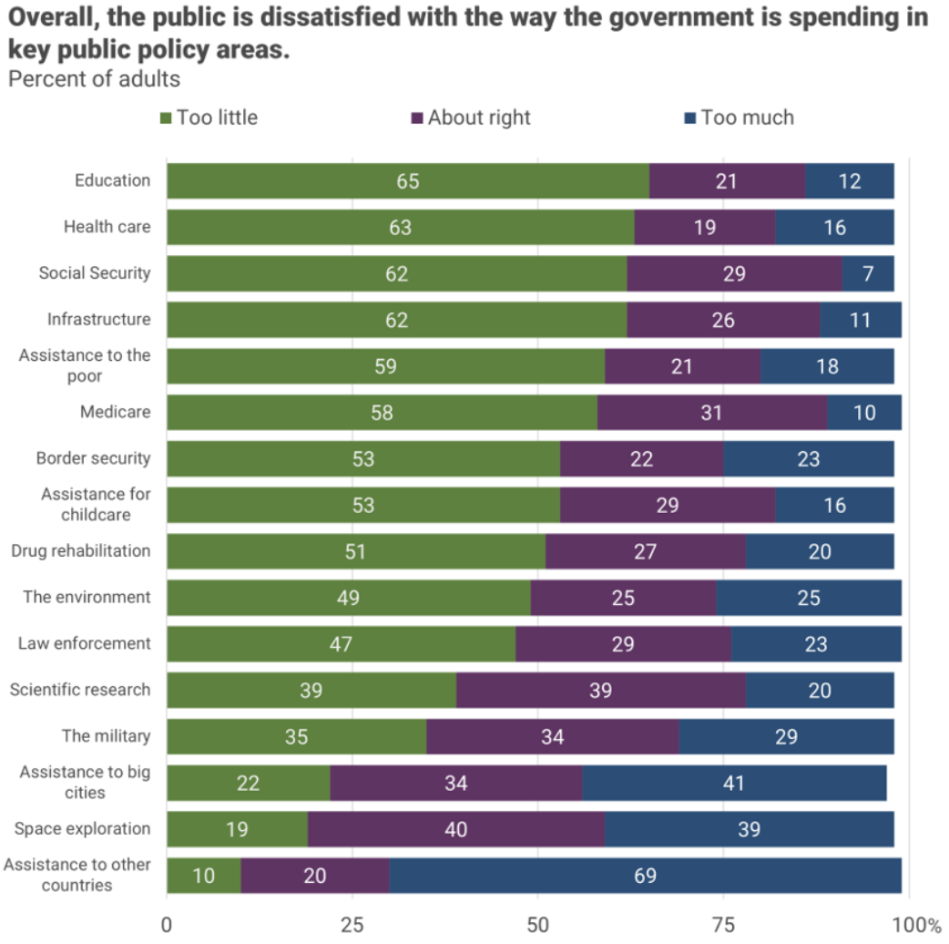
There is very little
enthusiasm for
cutting anything.
Source, NYTimes, Paul Krugman, “Why We Should, but Won’t, Reduce the Budget Deficit”

Slide 52
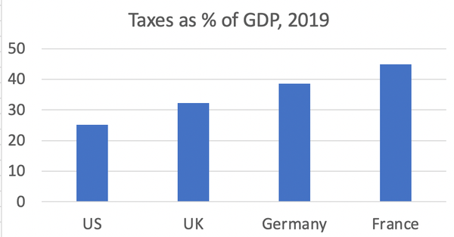
Source, NYTimes, Paul Krugman, “Why We Should, but Won’t, Reduce the Budget Deficit”

Slide 53
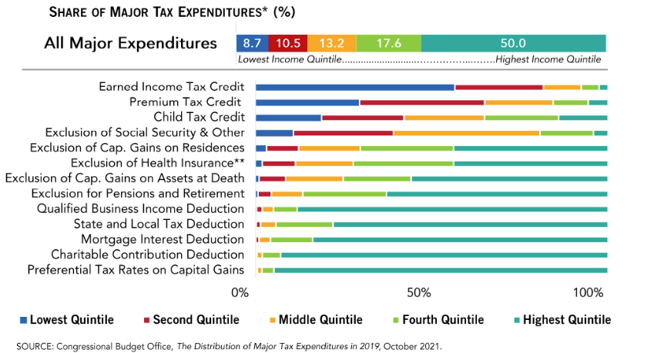
What Are Tax Expenditures?
Total: About 8% of GDP in 2023
Source: https://www.pgpf.org/Chart-Archive/0199_distribution_tax_expenditures

Slide 54
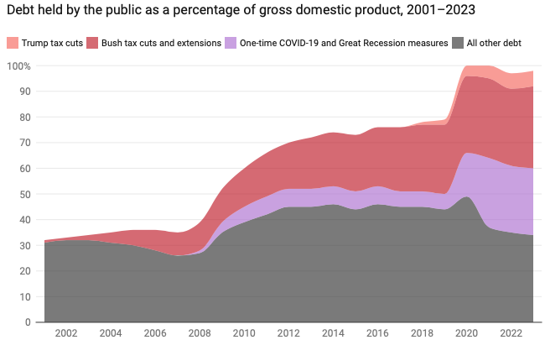
Recent contributors to Debt Increases
Trump Tax Cuts: 6% of GDP
Bush Tax Cuts: 32% of GDP
Great Recession & COVID: 26% of GDP
The rest: 34% of GDP
Up from 31% in 2001
Notes:
Bush tax cuts lowered individual income tax rates, reduced the top marginal tax rate from 39.6% to 35%, tax rates on long-term capital gains and qualified dividends to a maximum of 15%

