Slide 1
Osher Lifelong Learning Institute, Summer 2025
The Economics of Public Policy Issues
Northwestern University
Host: Geoffrey Woglom
Director, National Economic Education Delegation

Slide 2
Available NEED Topics Include:
US Economy
Healthcare Economics
Climate Change
Economic Inequality
Economic Mobility
Trade and Globalization
Minimum Wages
Immigration Economics
Housing Policy
Federal Budgets
Federal Debt
Black-White Wealth Gap
Autonomous Vehicles
US Social Policy

Slide 3
Course Outline
The Economics of Public Policy Issues
  Week 1 (7/8): Economic Update (including tariffs) (Geoffrey Woglom, Amherst College)
  Week 2 (7/15): Climate Change Economics (Sarah Jacobson, Williams College)
  Week 3 (7/22) The Economics of the Minimum Wage (Veronika Dolar Pace University)
  Week 4 (7/29): Cryptocurrencies (Joan Nix Queens College (CUNY))
  Week 5 (8/5): Saving Social Security (Jon Haveman, Exec Director, NEED)
  Week 6 (8/12): Federal Debt and Deficits (Geoffrey Woglom, Amherst College)

Slide 4
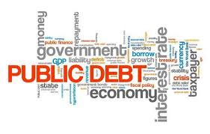
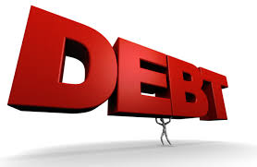
The US Federal Debt
Geoffrey Woglom,
Professor of Economics
Amherst College, emeritus
August 12, 2025

Slide 5
Outline
Definitions, Basic Data and Historical Data.
Traditional Economic Analysis of the Costs of the Debt
Recent Congressional Budget Office (CBO) analysis of the Cost of the Debt.
Debt, Trade Deficits and “Our Exorbitant Privilege”
Citizen’s Guide to Budget Reconciliation.

Slide 6
Basic Definitions
Fiscal year Deficit = Total Outlays Less Revenues between Oct to September.
The deficit is paid for by government borrowing: (net) issue of new government bonds.
  In 2024, the government issued $28.5 trillion in new Treasuries (https://treasurydirect.gov/auctions/) to finance a $2 trillion deficit.
The accumulated value of past borrowing is the total government debt.

Slide 7
The Federal Budget in FY2024 (ended 9/30)
Mandatory: $4.1tr, 61% Discretion.: $1.8tr, 27%
Net Interest, $0.9tr, 13%
Inc Tax, 49%
SS Tax, 35%
Corp Tax, 11%
Deficit: 1.8 tr, 25%
6.4% of GDP
Programmatic Outlays = Mandatory + Discretionary
Source: Monthly Treasury Report, 9/2024
Notes:
Over 2/3rds of total income reported to the IRS for 2019 returns was earned income.

Slide 8
Where Do the Federal Dollars Come from?
Inc Tax, 49%
SS+Medicare Tax, 35%
Corp Tax, 10%

Slide 9
Where Do Federal Dollars Go?
Programmatic Outlays = Mandatory + Discretionary
Paul Krugman, “The Federal government is basically an insurance company with an Army.”
1.8+1.5+0.4+0.2+0.9= 4.8; 4.8/5.9=0.81=81%

Slide 10
Past and Future of Deficits
Useful Deficit Decompositions:
Total Deficit=
Primary Deficit + Net Interest,
Primary Deficit =
Programmatic Outlays less Taxes
2007
E.g., 2007: 1.1 = (17.4+1.7) -18.0 =1.1
1.1 = (17.4-18.0)+1.7 =1.1
Policies aimed at reducing Debt and Deficit must focus on the primary deficit
CBO, “The Budget and Economic Outlook,” Jan 2025
Notes:
Christina Romer: 3 packages war production of 1943.

Slide 11
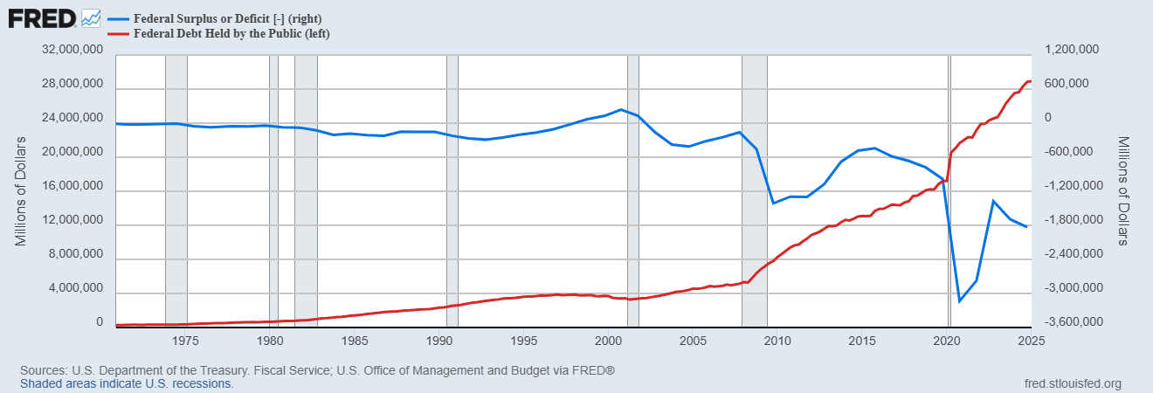
Debt vs. Deficit
The Sum of All Past Deficits Less Surpluses Equals the Debt
Blue Line Debt; Red Line Deficit
Shaded areas are recessions
Notes:
Yestere

Slide 12
A Breakdown of the Total Federal Debt

Slide 13
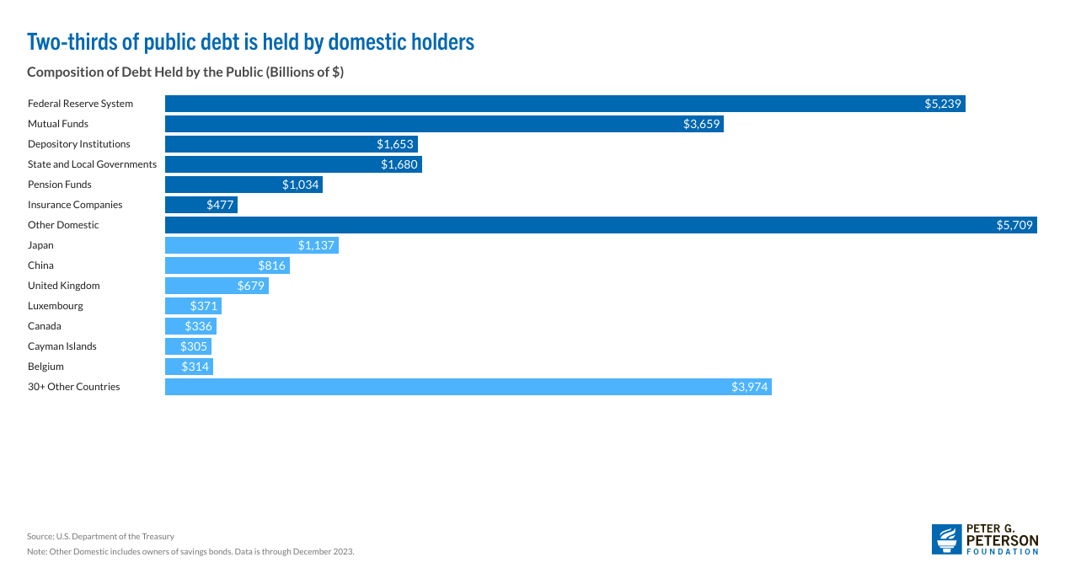
Ownership of $27 trillion Publicly Held Debt
(12/23)
US Savings Bonds, $120 billion

Slide 14
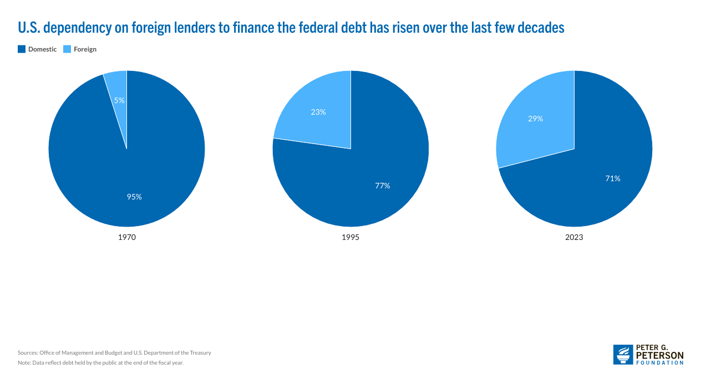
The Growing Importance of Foreign Held Debt

Slide 15
Not All Debt Is Created Equal
Intra-governmental debt is important bookkeeping.
  This debt DOES NOT require funding on credit markets
Debt held by the public
  This debt is funded by borrowing on credit markets and competes with private funding.
Most analyses focus on the publicly held debt relative to GDP because:
  To the extent that debt and deficits have burdens these burdens depend on the size of the debt relative to the size of the economy.

Slide 16
CBO: Budget Analysts in Chief
The Congressional Budget Office was founded in 1974 to provide Congress with information about the budgetary implications of legislation.
Two kinds of Reports
  Cost Estimates or “Scoring”
    H.R. 5409, Safeguarding American Farms from Foreign Influence Act
    Build Back Better Scoring.
Projections of Debt and Deficits – The Budget and Economic Outlook: 2025 to 2035,
  https://www.cbo.gov/publication/60870
Notes:
Lindsey Graham an alternate scoring

Slide 17
Key Points About the U.S. Relative Debt
1946-1974
Relative debt peaked during WWII (106%) - followed by a steady decline until the 1980s.
Prior to 1983, relative debt rose purposefully (wars, recessions, public investment) and then fell.
What can we learn from the 46-74 period, where the relative debt fell continuously?

Slide 18
Debt Dynamics
The relative debt fell in spite of deficits in 21 of the 29 years, with the debt increasing by 42%. How?
1946-1974, deficits caused the debt to grow, but not as fast as the economy was growing.
While the debt grew by 42%, GDP (nominal) grew by 550%
You don’t need a surplus to reduce the relative debt:
You just need GDP to grow faster than the debt

Slide 19
Traditional View: Debt and Deficits Raise Interest Rates
Crowding Out via higher interest rates:
  Private: less investment and over time leads to a smaller capital stock and reduced future output.
  Government: primary surplus needed to stabilize the debt is larger; i.e., less programmatic outlays or higher taxes
Foreign Borrowing: Higher interest rates lead to foreign capital inflows or foreign borrowing (Larger trade Deficit!). With foreign borrowing, some of our GDP is paid to foreigners as interest.

Slide 20
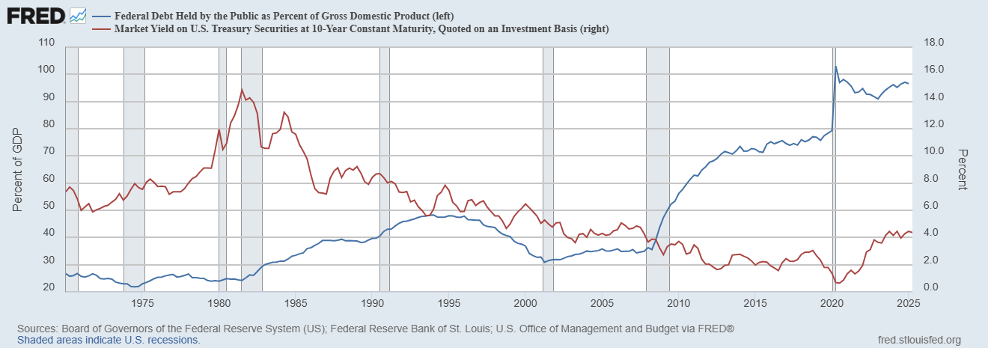
The Dog that Didn’t Bark; Rising Interest Rates?
Red Line Rate on 10-Yr Treasury Bonds; Blue Line Relative Debt

Slide 21
Why do Foreigners Buy US Treasuries?
Market for Treasuries is the deepest, most liquid and safest capital market in the world.
US economy has a history of political and economic stability.
We enjoy “An exorbitant privilege” (Valery Giscard d’Estaing): The dollar is the largest international reserve currency.
  Most trade transactions are quoted in dollars, e.g., oil.
  With some exceptions, foreigners borrow in dollars. E.g., Yankee bonds
World has(d?) an insatiable demand for safe US assets.

Slide 22
Demand for Dollars by Central Banks
https://www.imf.org/en/Blogs/Articles/2024/06/11/dollar-dominance-in-the-international-reserve-system-an-update
Notes:
Talk about the fall of the Euro Brexit etc. What will the war in Ukraine do to these numbers.

Slide 23
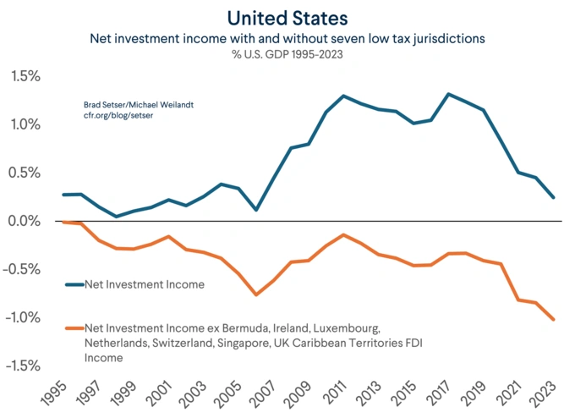
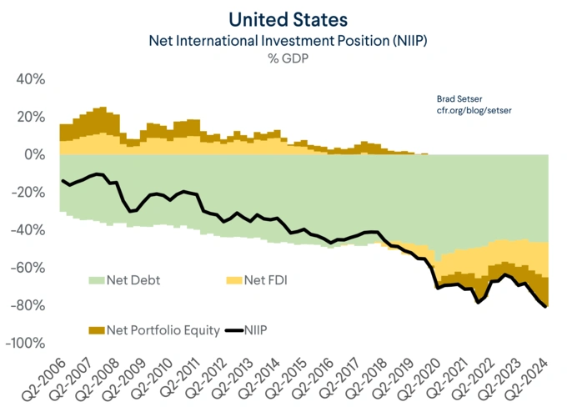
Reflections of “Privilege”
Includes over $1 trillion in US currency, 45% of total currency
2024:$36- $62= -$26 trillion
https://www.cfr.org/blog/us-income-balance-puzzle

Slide 24
CBO on the Costs of “High and Rising Debt”
The interest expense portion of the deficit will rise, including payments to foreigners.
Crowding out of private investment.
“The likelihood of a fiscal crisis in the United States would increase.” (emphasis added)
Slow erosion of confidence in the U.S. dollar as an international reserve currency leading to higher interest rates.
Policymaker constraint in using deficit-financed fiscal policy to respond to unforeseen events.
CBO, “Budget and Economic Outlook: 2022-2032,” May 2022, pp15-16.
Notes:
1 & 2 are part of my traditional costs. 3-5 are new and related

Slide 25
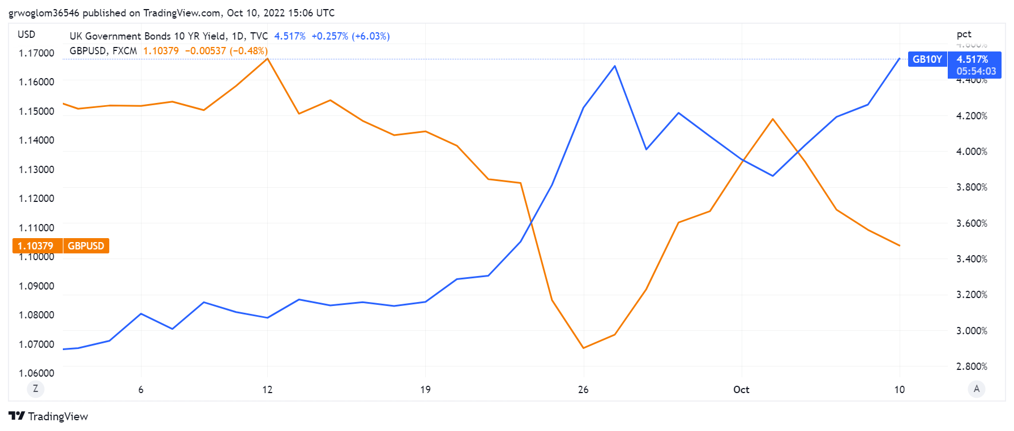
Fiscal Crisis Preview: Liz Truss & Head of Lettuce

Slide 26
What would a Fiscal Crisis Look Like?
Foreigners lose confidence in the dollar and sell Treasuries in exchange for assets denominated in their own currency,
  Sale of Treasuries raises interest rates, worsening our fiscal outlook.
  Trading of Foreign for US assets lowers US exchange rate.
    Raising the price of imports thereby increasing inflation.
    Lowering the foreign currency returns on all US assets, exacerbating 1.
Could the Fed Bail us Out?
  It could buy Treasuries and prevent the rise in interest rates.
  Insufficient foreign assets to prevent the fall in the exchange rate,

Slide 27
Bottom Line: We Need to Worry about the Debt
Economist don’t really know why they fell to such low levels over the past 20 years. What will they be in the next 20?
A fiscal crisis should be avoided at all costs.
The good news is we may be able to stabilize the relative debt without a running a surplus.

Slide 28
But is this Problem Impossible?
By 2054, CBO publicly-held debt will rise to 166% of GDP
CBO, “The Budget and Economic Outlook,” Jan 2025

Slide 29
The Blueprint for a Crisis?
But, these are “projections,” not forecasts!
CBO, “The Budget and Economic Outlook,” Jan 2025

Slide 30
CBO Spending Options
We need $700 billion per year to stabilize relative debt.

Slide 31
How about Revenue “Enhancement?”

Slide 32
And, It Gets Worse
CBO Projections have to be based on forecasted future interest rates.
Remember, nobody really understands why interest rates fell from 2000-2020.
What if interest rates rise (and they have been)?

Slide 33
Pretty Bad
And 2034 is when SS Trust Fund runs Out!

Slide 34
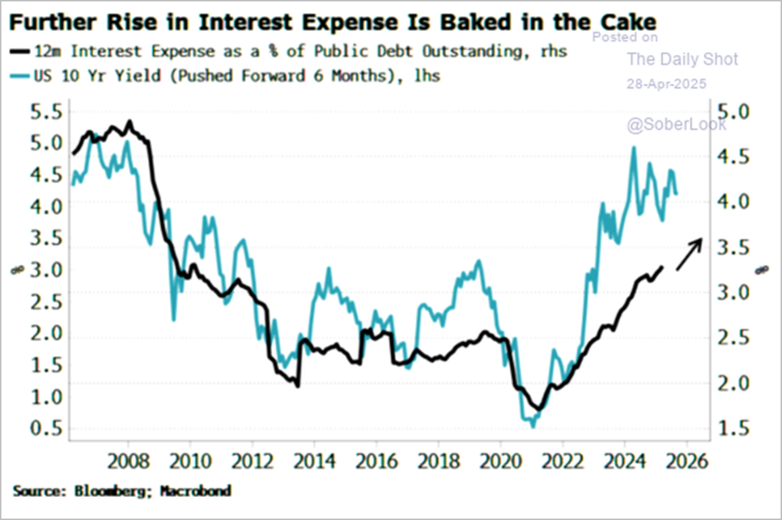
The Future of Interest on the Debt?

Slide 35
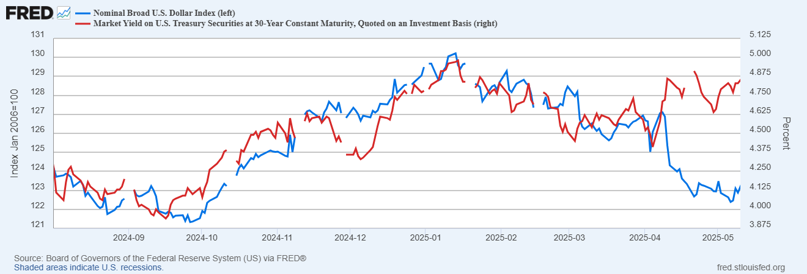
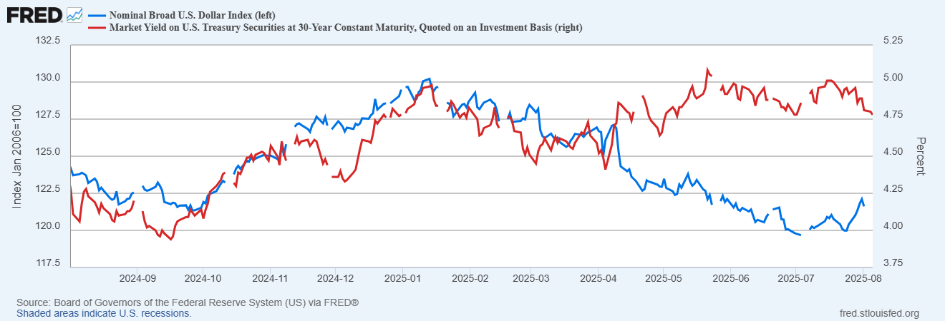
What About Those Gloomy Signals?
Life Got More Complicated
Look Familiar?

Slide 36
Brookings on a Fiscal Crisis (2/12/2025)
In most … scenarios, it is likely within policymakers’ power to avoid a crisis altogether, even given the projected increase in federal borrowing. In other words, a fiscal crisis is more likely to result from political missteps (Liz Truss?). These missteps include threats to default or efforts to undermine credibility of the Federal Reserve as well as enactment of policies that sharply increase deficits and thus raise the specter of strategic default.
https://www.brookings.edu/articles/what-are-the-risks-of-a-rising-federal-debt/

Slide 37
How Did We Get in This Mess?
Partly, because of the “exorbitant” privilege combined with industrializing Asia.
Japan, South Korea and China followed a similar playbook.
Develop the industrial sector through subsidies, tariffs and an “undervalued” currency.
Sort of an “Infant Industry” argument.

Slide 38
How to Undervalue Your Currency
Restrict domestic consumption to generate an increase in National saving and a trade surplus.
Normally a trade surplus would lead to an increase in the supply of dollars on foreign exchange markets and a fall in the value of the dollar (or rise in the value of US currency).
Offset the rise in the value of the your currency by buying US financial assets, e.g., US Treasury bonds. (which also helps to restrict domestic consumption).

Slide 39
The Chinese Example
Bigger Trade Surplus
Rise in the Value of the Yuan
Bigger Trade Surplus
Fall in the Value of the Yuan
Chinese Consumption: 2003, 46.0% of GDP; 2007, 39.9%
Holding of US Treasury Bonds: 2003, $147b; 2007, $471b

Slide 40
Why Didn’t the US Respond?
Cheap Chinese goods kept US inflation low and benefited US consumers.
Low US interest rates made the job of financing the deficit easier.
Diplomatic reasons: “The US wants a prosperous China.”
Instead, the Fed cut interest rate to raise domestic spending enough to accommodate growing imports, while maintaining domestic production.
But manufacturing takes a big hit.

Slide 41
The Rise of a Heterodox Critic
Michael Pettis (based in a Chinese University!), The Great Rebalancing, 2013.
In the WSJ, April 30, 2025
Letting other countries take the lead in manufacturing harms the American economy. The U.S. accommodates other countries’ successful industrial policies by absorbing their negative consequences—namely, by absorbing global savings imbalances, running trade deficits and offshoring manufacturing.
U.S. leaders must adopt a strategic approach to industrial policy…and, more important, by reversing the U.S. role in absorbing global trade and capital imbalances.

Slide 42
But, How Would We Do This?
The “Mara Lago Accords”:
  Tariffs
  Discourage Capital inflows by
    Forcing Foreigner governments to own 100-year Zero Coupon bonds.
    Charging foreigners a fee for owning US Treasuries.
Sound Anything Like a Brookings Misstep?
How about “discouraging capital inflows” by cutting the deficit to decrease the need to borrow from foreigners!

Slide 43
Was that on the Congressional Agenda?
Sadly no.
Liberation Day Tariffs
One Big Beautiful Bill
What will be the effect of these policies be on National Saving and the Trade Deficit?

Slide 44
What about Entitlements?
Scott Bessent:
"These entitlements are massive. I think the next four years isn't the time to deal with them, that we've got to deal with the discretionary portion of the budget…then the next step is for a future administration to have the confidence to be able to deal with entitlements”
Total Discretionary Spending last fiscal year was $1.8 trillion.
(There was a “reform” of Medicaid and Food Stamps; about $600 billion in Federal spending last year.)
But there is no way this could get through the Senate Democrats, right?
https://www.foxbusiness.com/politics/treasury-secretary-nominee-scott-bessents-3-3-3-plan-what-know

Slide 45
Citizen’s Guide to “Budget Reconciliation.”
Procedure successfully used 22 times since 1974 to avoid a Senate filibuster.
Reconciliation can be used for changing taxes and spending (not Social Security) subject to the Byrd Rule.
Byrd rule:
  No extraneous provisions.
  No increase in the deficit after 10-year window.
Reconciliation games played by both parties:
  BBB.
  2017 Trump Tax Cut

Slide 46
Reconciliation and CBO Projections
For the CBO to be effective it must be perceived to be (and must be) nonpartisan.
Therefore, CBO “baseline” projections and legislative scoring must not try to predict changes in legislation.
Instead, CBO must analyze the data without making assumptions about changes in law (2017 tax cut phased out in 2025)
CBO is allowed to provide analyses of policy options.
(“Options for Reducing the Deficit: 2025 to 2034,” https://www.cbo.gov/publication/60557”
Notes:
One exception: assumes SS will be paid

Slide 47
The Reconciliation Game in Action

Slide 48
A New Wrinkle to the Reconciliation Gamew
When is a Tax Cut, Not a Tax Cut: Change the Baseline
  Current Law
  Current Policy
2034:
Current Policy, 3.4% of GDP
Current Law, 2.7% of GDP
0.7% of 2034 GDP =$300billion

Slide 49
Consequences: Taxes, Spending & Tariffs
2025-2034 Net Effects on the Deficit
One Big Beautiful Bill |  | Tariffs | Added Interest |  | Total
 | Primary Deficit | Primary Deficit
As Written | 3062 | -2125 | 182 |  | 1119
Permanent | 3787 | -2125 | 322 |  | 1984
Authors Calculation from: https://budgetlab.yale.edu/research/state-us-tariffs-august-7-2025 & https://budgetlab.yale.edu/research/financial-cost-senate-passed-budget-bill

Slide 50
Consequences: Taxes, Spending and Tariffs
Distribution of Benefits
Authors Calculation from: https://budgetlab.yale.edu/research/state-us-tariffs-august-7-2025 & https://budgetlab.yale.edu/research/distribution-tax-cuts-new-tax-law

Slide 51
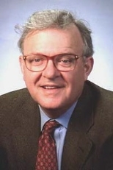
Famous Economist Quotes”
Dornbusch’s Law:
The crisis takes a much longer time coming than you think, and then it happens much faster than you would have thought.
A Cheerful Rudi Dornbusch

Slide 52
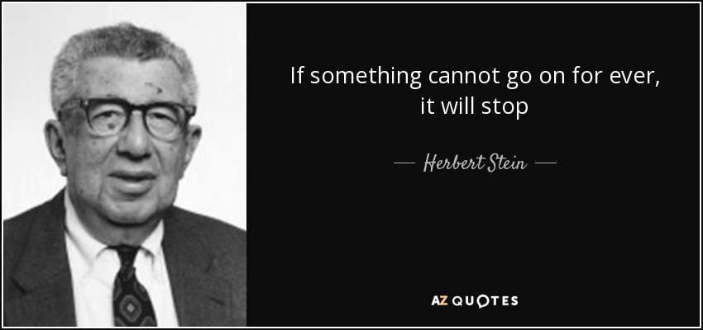
The Wit and Wisdom of Herb Stein
And, what will be the damage when it stops!
Notes:
Ben Stein’s father and Chair Council under Nixon

Slide 53
Your Turn
https://needecon.org/
grwoglom@amherst.edu
My Website:
https://sites.google.com/view/macro-current-issues/debt

