Slide 1
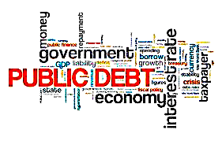
The US Deficit and Debt
Scott L Baier
Department Chair, John E. Walker Department of Economics
National Education Education Delegation (NEED)

Slide 2
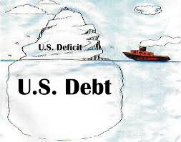
Of Debt, Deficits, and Surpluses
FLOW
  Deficit: When government expenses exceed revenues in a single year.
  Surplus: The excess of revenues over expenses in a single year.
STOCK
  Debt: The accumulation of debt over time.
      The sum of all past deficits and surpluses.

Slide 3
What Does the U.S. Gov’t Budget Look Like?
Fiscal 2020 Budget Summary
Revenue | Billions |  | Outlays | Billions
Income Taxes | $1,609 |  | Mandatory | $2,315
Payroll Taxes | $1,310 |  | Discretionary | $3,850
Corporate Taxes | $212 |  | Interest | $387
Other | $289
Total |  |  | Total | $6,552
Budget Deficit:
Source: Congressional Budget Office, Monthly Budget Review, Nov 2020
Notes:
https://www.cbo.gov/publication/53627
https://www.cbo.gov/publication/53624

Slide 4
What Does the U.S. Gov’t Budget Look Like?
Fiscal 2020 Budget Summary
Revenue | Billions |  | Outlays | Billions
Income Taxes | $1,609 |  | Mandatory | $2,315
Payroll Taxes | $1,310 |  | Discretionary | $3,850
Corporate Taxes | $212 |  | Interest | $387
Other | $289
Total | $3,420 |  | Total | $6,552
Budget Deficit: $3,132
Source: Congressional Budget Office, Monthly Budget Review, Nov 2020
Notes:
https://www.cbo.gov/publication/53627
https://www.cbo.gov/publication/53624

Slide 5
What Does the U.S. Gov’t Budget Look Like?
2018 Budget Summary
Revenue | Billions |  | Expenditures | Billions
Income Taxes | $1,684 |  | Mandatory | $2,520
Payroll Taxes | $1,171 |  | Discretionary | $1,263
Corporate Taxes | $205 |  | Interest | $325
Other | $270
Total | $3,329 |  | Total | $4,108
Note the large difference in Discretionary Spending: $3,850 in 2020 and $1,263 in 2018
Budget Deficit: $779 Billion
Source: https://www.cbo.gov/publication/53624
Notes:
https://www.cbo.gov/publication/53627
https://www.cbo.gov/publication/53624

Slide 6
US Government Deficits Over Time

Slide 7
Figure 1: Federal Expenditures
Appropriate to measure the ”size” of the Federal Government relative to the size of the economy

Slide 8
Figure 2: Federal Revenue

Slide 9
Figure 3: Debt-to-GDP
Source: usgovernmentrevenue.com

Slide 10
Recent Past and Forecasted Future of Deficits
CBO projection does not include the American rescue plan
Source: Congressional Budget Office, Additional Information About the Budget Outlook: 2021 to 2031

Slide 11
Recent Past and Forecasted Future of Deficits
Measured as a share of the economy, the deficit will total 15.6 percent of GDP this year and average 4.7 percent over the coming decade.
As a share of GDP, the 2021 deficit will be the fourth highest in history, eclipsed only by three years of borrowing to fight World War II.
Source: Committee for a Responsible Federal Budget Deficit

Slide 12
Debt vs. Deficit
The sum of all past deficits
and surpluses equal the debt
Notes:
Debt2deficit.png

Slide 13
Debt vs. Deficit: Share of GDP
The sum of all past deficits
and surpluses equal the debt
Notes:
Debt2deficit.png

Slide 14
Not All Debt Is Created Equal
Some debt can reduce the availability of investment funds to other borrowers.
  Often referred to as “crowding out” private investment
Intra-governmental debt is important bookkeeping.
  This debt DOES NOT crowd out private investment.
Debt held by the public
  This debt MAY crowd out private investment.
Most analyses of debt focus on the federal debt held by the public.

Slide 15
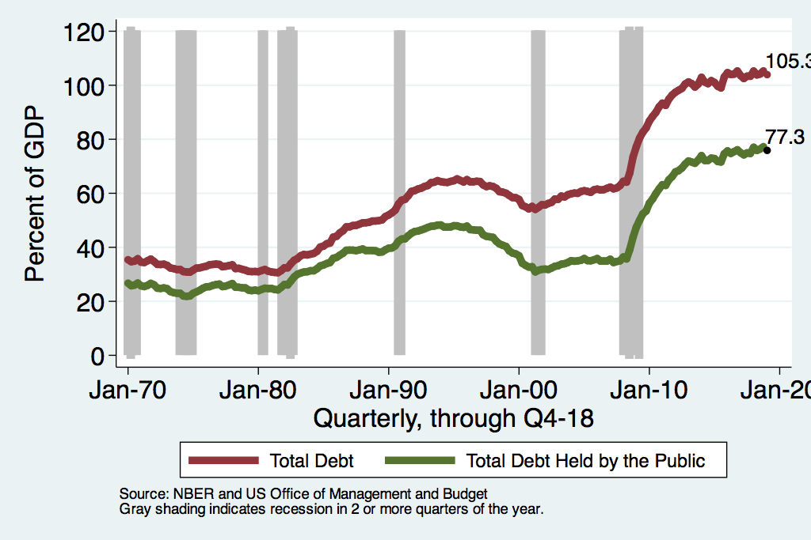
Two Measures of the Debt

Slide 16
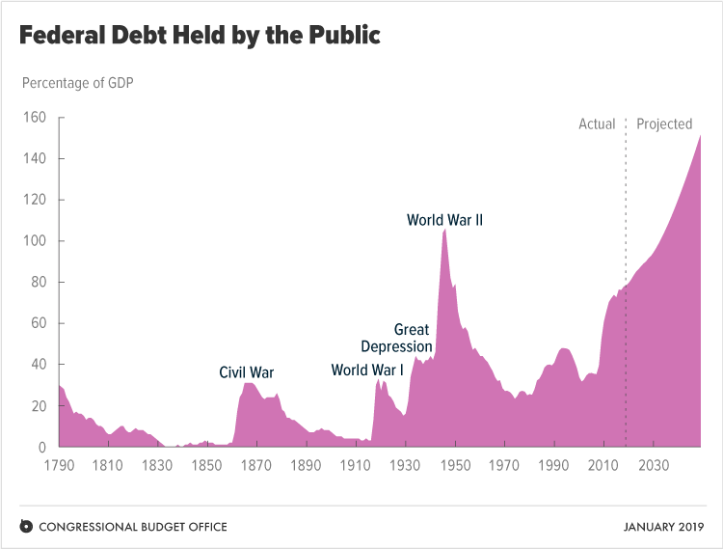
Deficits add up: Debt
Source: Congressional Budget Office, The Budget and Economic Outlook: 2019 to 2029

Slide 17
Deficits add up: Debt
Source: Congressional Budget Office, The Budget and Economic Outlook: 2019 to 2029

Slide 18
Why has the Federal Debt Risen so Much?
Notes:
Why has the debt risen so much? Deficits have increased. Why have deficits increased 1) an in crease in obligations to retired individuals (social security) increase in the quantity of costs of government subsidized health care (Medicare and Medicaid) – part o of the plan of the Affordable Care Act (Obama Care) was to ”bend the cost curve down” that is slow the growth of rising prices in health care. In addition to these longer term trends, the 2017 tax act reduced revenues while at the same time the Federal Government has increased spending.

Slide 19
Why has the Federal Debt Risen so Much?
Expenditures:
  Social Security
  Healthcare costs
  Economic stimulus
    In particular, during the Great Recession.
  Foreign entanglements
Revenues
  Declining income tax revenues
    Stagnant wages
    Tax cuts
  Social security
    Declining revenues
  Corporate income taxes

Slide 21
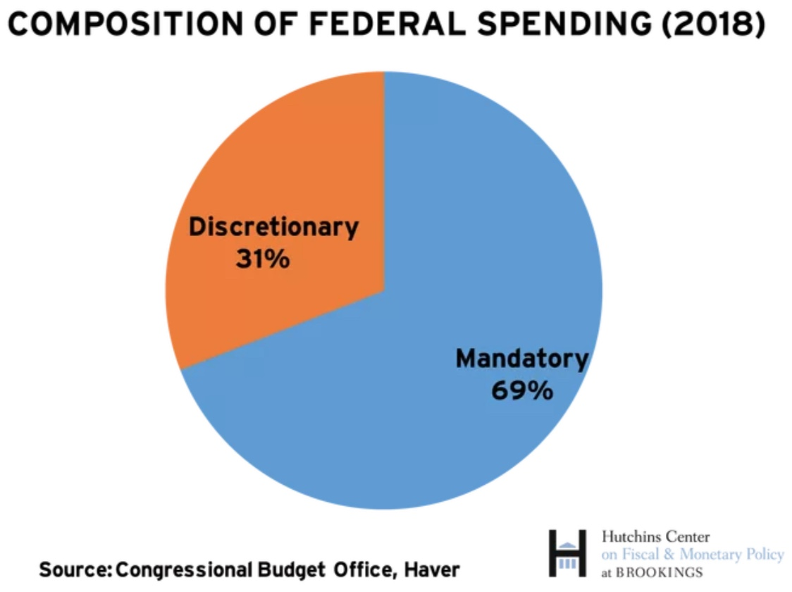
On What is the Money Spent? Complicated

Slide 22
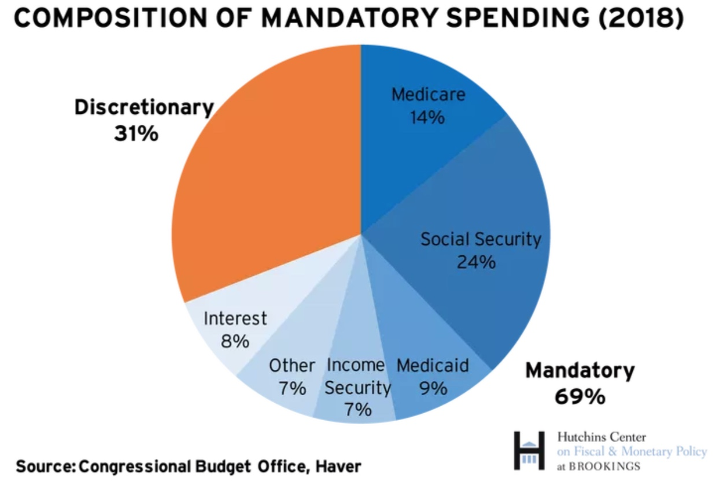
What is Mandatory Spending?

Slide 23
Mandatory Spending: Total Mandatory
Source: Congressional Budget Office (2017)

Slide 24
Mandatory Spending: Total Mandatory
In 2018 outlays were $2.5 trillion
Outlays 2031: $5 trillion
5% annual growth rate
Source: Congressional Budget Office (2017)

Slide 25
Mandatory Spending: Social Security Spending
Outlays 2018: $ 982 billion
Outlays 2029: $1,900 billion
6% annual growth rate
Source: Congressional Budget Office (2017)

Slide 26
Mandatory Spending: Medicare Spending
Outlays 2020: $ 0.916 trillion
Outlays 2029: $1.78 trillion
Growth 6%
66% of the growth from rising
health care costs and 33% from
increased enrollments.*
Source: Congressional Budget Office (2017)

Slide 27
Mandatory Spending: Medicaid Spending
Source: Congressional Budget Office (2017)

Slide 28
Mandatory Spending: Other
Source: Congressional Budget Office (2017)

Slide 29
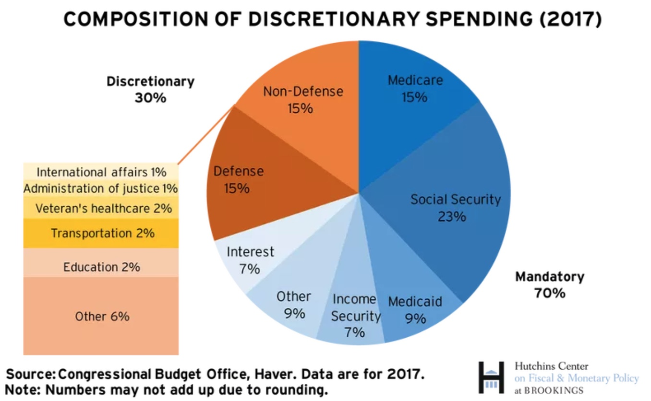
What is Discretionary Spending?
Int’l Affairs 1%

Slide 30
Discretionary Spending: Total
Source: Congressional Budget Office (2017)

Slide 31
Discretionary Spending: Defense Spending
Source: Congressional Budget Office (2017)

Slide 32
Discretionary Spending: Other
Source: Congressional Budget Office (2017)

Slide 33
Mandatory Spending Dominates Forecasts
Source: Congressional Budget Office, Additional Budget Outlook: 2021 to 2031

Slide 34
Debt and Deficit and the Pandemic
The long run drivers of the debt and deficit are social security, Medicare and Medicaid spending.
Discretionary spending has been declining as a share of GDP.
Most likely, the American Rescue Plan will not have a long run impact on the debt….unless

Slide 36
Key Points About the U.S. Relative Debt
Relative debt peaked during WWII (106%) - followed by a steady decline until the 1980s.
Prior to 1983, relative debt rose purposefully (wars and recessions) and then fell.
Recently, relative debt has been and is expected to continue to rise for the next 30 years w/o strategic purpose.

Slide 37
Traditional View: Debt and Deficits Raise Interest Rates
Crowding Out: Higher interest rates lead to less investment and over time to a smaller capital stock and reduced future output.
Foreign Borrowing: Higher interest rates lead to foreign capital inflows or foreign borrowing. With foreign borrowing, some of our GDP is paid to foreigners as interest.

Slide 38
Olivier Blanchard’s Presidential Address to the AEA 1/2019
“If the future is like the past [with low interest rates],…the issuance of debt without a later increase in taxes may well be feasible. Put bluntly, public debt may have no fiscal cost.”
But,
“My purpose…is not to argue for more public debt, especially in the current political environment. It is to have a richer discussion of the costs of debt…than is currently the case.”

Slide 39
What s the story here? How is it (almost) free
Suppose that the government increases the debt by another $5 trillion and this increases the debt to 125 percent of GDP.
With an interest rate of one percent then the debt grows by one percent.
However, if GDP grows by two percent the debt to GDP ratio falls by one percent.
If this happens over time, it is like we did not spend it at all and we return to the same level.
In order for this to work, interest rates have to stay low and GDP growth needs to be higher than interest.

Slide 40
But why must the relative debt be stabilized
For practical purposes, the US cannot default on its debt, but…
International investors, however, can still lose if the exchange value of the dollar falls.
Remember, foreign holdings of the public debt amount to 40 percent of the total

Slide 41
In CBO’s assessment, the debt-to-GDP ratio has no set tipping point at which a crisis becomes likely or imminent; nor is there an identifiable set point at which interest costs as a percentage of GDP become unsustainable.
The risk of a fiscal crisis in the near term is not currently apparent in financial markets, even though the pandemic and the government’s response to it have increased the federal deficit; there is still great uncertainty about the speed and scope of a recovery.

Slide 42
What would a Fiscal Crisis Look Like?
Foreigners lose confidence in the dollar and sell Treasuries in exchange for assets denominated in their own currency,
  Sale of Treasuries raises interest rates, worsening or fiscal outlook.
  Trading of Foreign for US assets lowers US exchange rate.
    Raising the price of imports thereby increasing inflation.
    Lowering the foreign currency returns on all US assets, exacerbating 1.
Could the Fed Bail us Out?
  It could buy Treasuries and prevent the rise in interest rates.
  Insufficient foreign assets to prevent the fall in the exchange rate,

Slide 43
Bottom Line: We Need to Worry about the Debt
Interest rates may not stay this low forever.
A fiscal crisis should be avoided at all costs.
The good news is we may be able to stabilize the relative debt without a running a surplus.
But, we must substantially reduce deficits after the pandemic: CBO (9/2020) suggests deficits in 2025 be reduced from 5 to 2.5 percent of GDP, but it won’t be easy

Slide 44
Thank you!
Any Questions?
www.NEEDelegation.org
<presenter name>
<presenter email>
Contact NEED: NEEDelegation@gmail.com

Slide 45
How Does the U.S. Government Borrow?
It issues debt
  Treasury marketable securities:
    Treasury bills, notes, and bonds
    TIPS: Treasury inflation-protected securities
Who buys the debt?
  Other federal government agencies
  Individuals and businesses
  State and local governments
  People, businesses, and governments from other countries.

Slide 46
Forecast Spending
Interest
What trends
do you see?
Other
Health
Social Security

Slide 47
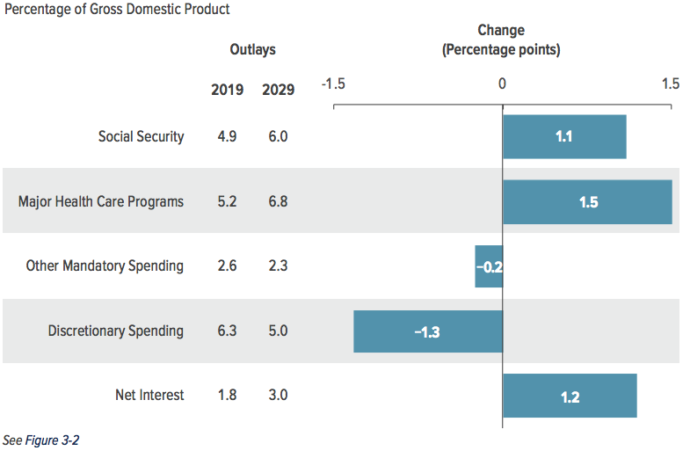
Aging and Health Care Costs
Source: Congressional Budget Office, The Budget and Economic Outlook: 2019 to 2029

Slide 48
Deficit to Grow Much Faster than Revenues
Interest, too!

Slide 49
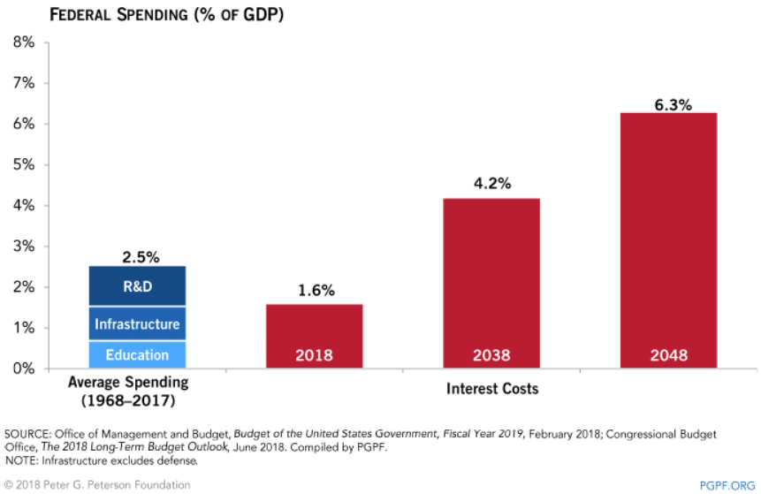
Interest Payments to Grow Significantly

Slide 50
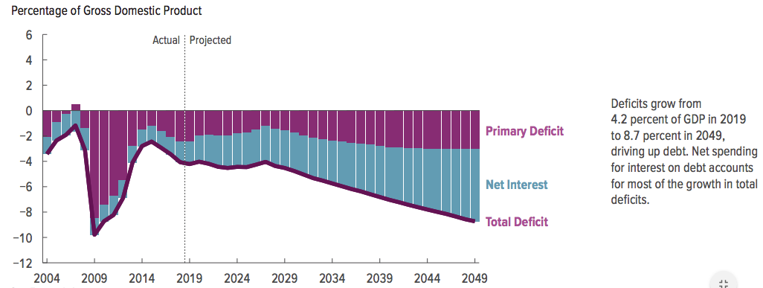
Interest Will Start to Drive Growth in Deficit

Slide 51
Perspectives on Increased Debt
Government borrowing crowds out private capital and investments.
  Weakened by ability to borrow from abroad.
Does debt impose a burden on future generations?
  Does it inevitably have to be paid off?
In time, it may start to crowd out other government spending.
  Diminishing policy priorities in the budget.
Is it reasonable to borrow at low interest rates for investments?
  For example, infrastructure.

Slide 52
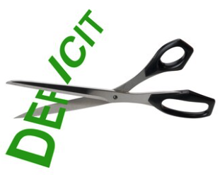
Bottom Line
Question is not WHETHER the U.S. will have to act…
…but WHEN.
Some combination of the following WILL be necessary:
  Raising taxes
  Cutting spending
  Reining in health care costs

Slide 53
Proposals Do Exist
Simpson-Bowles
Domenici-Rivlin Task Force
Solutions Initiative – Peter G. Peterson Foundation
  American Action Forum
  American Enterprise Institute
  Bipartisan Policy Center
  Center for American Progress
  Economic Policy Institute

Slide 54
Another Category of Spending: Tax Expenditures
Description
  Social policies that are implemented and paid for through the tax code.
List of the largest tax breaks:
  Mortgage interest deduction - Low tax rates for Capital Gains
  Retirement contributions - Child related tax credits
  State and local taxes - Charitable gifts
  Health insurance` - Lifetime Learning
Evidence of who they benefit
  Regressive

Slide 55
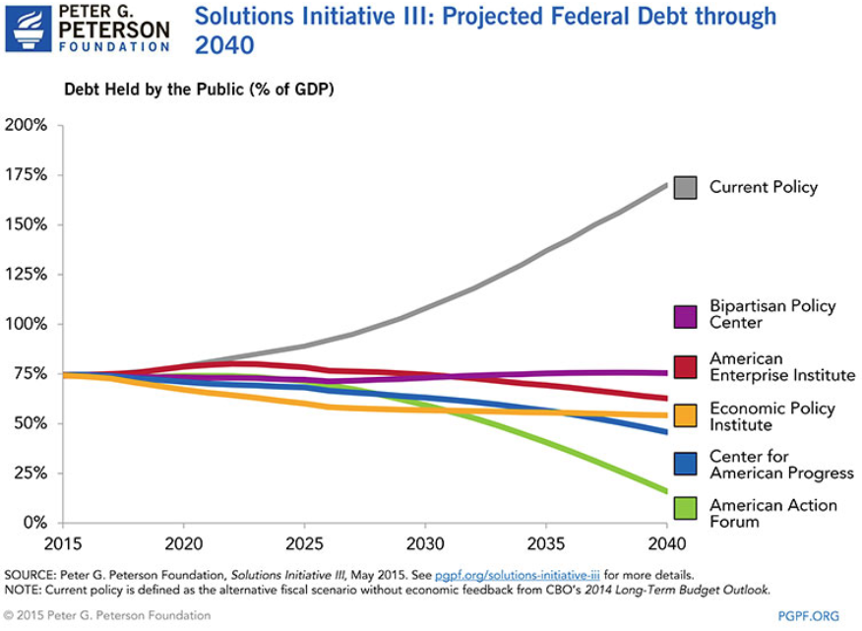

Slide 56
Are There Reasons to Wait?
Very little evidence of:
  Crowding out
  Inflationary impact
Uncertainty about the future
  Economic growth may render action today unnecessary.
There are a great many investments to be made by the gov’t.
  Infrastructure
  Education
  Much, much more…

Slide 57
The first 2/3 letters should be changed to white
There are two options for each layout:
  Title and content for titles that need one line and Title and content for titles that need two lines of text
  Two content for titles that need one line and Title and content for titles that need two lines of text
The first 2 or 3 letters starting the title should manually be changed to white, can’t be done automatically.
Vertical alignment of text boxes is set to middle.
Recent colors section features the two colors used in this template: dark blue and blue-gray.

Slide 58
Inequality and Poverty
Instruction on how to use the template

Slide 59
National Economic Education Delegation
Vision
  One day, the public discussion of policy issues will be grounded in an accurate perception of the underlying economic principles and data.
Mission
  NEED unites the skills and knowledge of a
  vast network of professional economists to promote understanding of the economics of policy issues in the United States
NEED Presentations
  Are nonpartisan and intended to reflect the consensus of the economics profession

Slide 60
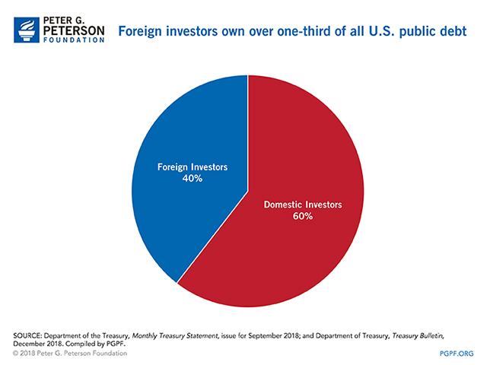
Notes:
Foreign investors own about $8 trillion of the 25.7 million in US debt. Japan and China each hold a little more than $1 trillion. The UK and Brazil hold about 350 billion and 300 billion respectively. Many countries hold US debt because it is a (relatively) safe asset.

Slide 61
Who Holds Debt to Foreigners
Billions of $ in August, 2019
Source: Wikipedia

Slide 62
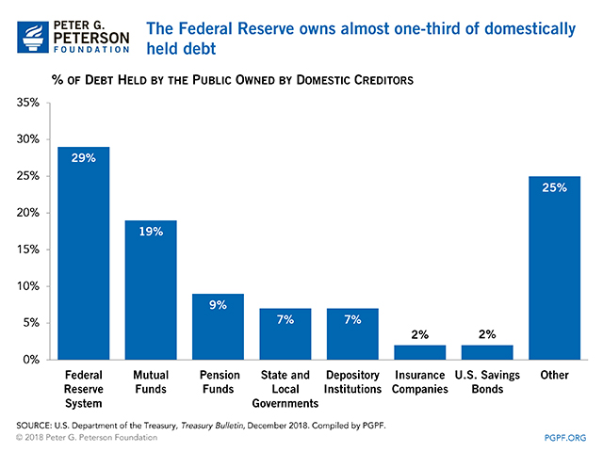

Slide 63
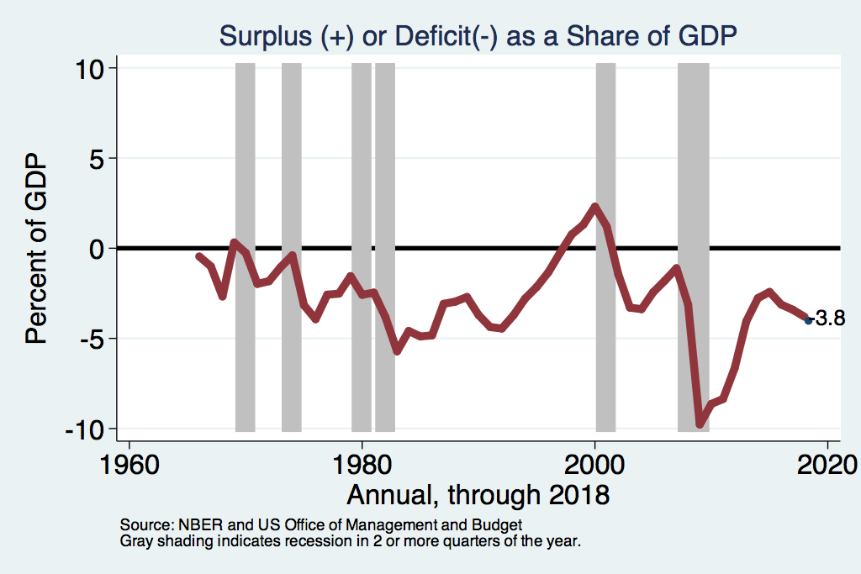
Deficits and Recessions
Notes:
Deficits become larger, in absolute value, during recessions. Reasons: Tax revenues decline (income and corporate taxes fall) Expenditures rise: unemployment insurance and transfer payments tend to increase. In addition, policy related increases in government spending referred to as ”stimulus packages” can be introduced to stimulate GDP growth – stimulus packages can be tax cuts or increased spending by the government.

Slide 64
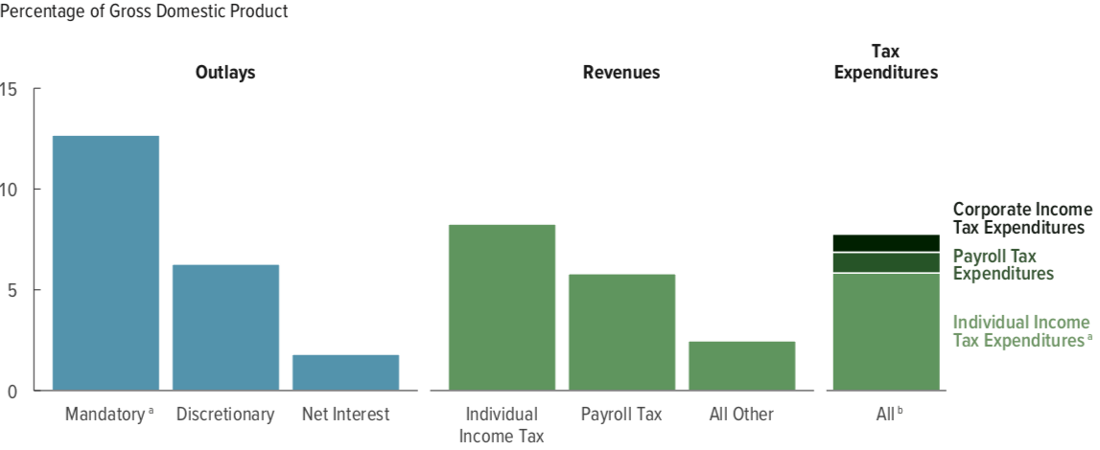
Tax Expenditures are Significant
$1.6 Trillion 200 different categories
7.8% of GDP and more than Discretionary Spending

Slide 65
Tax Expenditures Tend to be Regressive
Income Group | Benefits
Bottom 20% | 7.0%
Top 20% | 12.8%

