Slide 1

Cryptocurrencies
Sausalito Rotary Club
Jon Haveman
February 2, 2023

Slide 2
Outline of the Talk
Fun Facts about Bitcoin
A little bit on the underlying technology of bitcoin.
Economist evaluation of 2 Key Questions
  Is Bitcoin serving a legitimate economic role?
  Is there potential for beneficial, financial innovations using the underlying technology?
In order to tap that potential, we need:
  Legislation to provide “good” regulation of crypto markets.
  The Federal Reserve needs to follow other central banks in creating a safe and secure, digital means of payment: Central Bank Digital Currency (CBDC)

Slide 3
But First, What is Bitcoin?
Bitcoin is the first cryptocurrency and was invented in 2008.
Cryptocurrencies are a form of DIGITAL MONEY (viz. data on a computer) where account ownership is confidential and where record keeping is decentralized over a multitude of computers.
  In the category of Decentralized Finance (DeFi).
More importantly,…

Slide 4
Bitcoin Has Started a Revolution in Finance
The way we buy and sell things, our “payments system;” the way we save, borrow and invest; the role of banks and other financial firms is rapidly changing.
In my view, Bitcoin will NOT be an important player in these developments, but the technologies underlying Bitcoin may be.

Slide 5
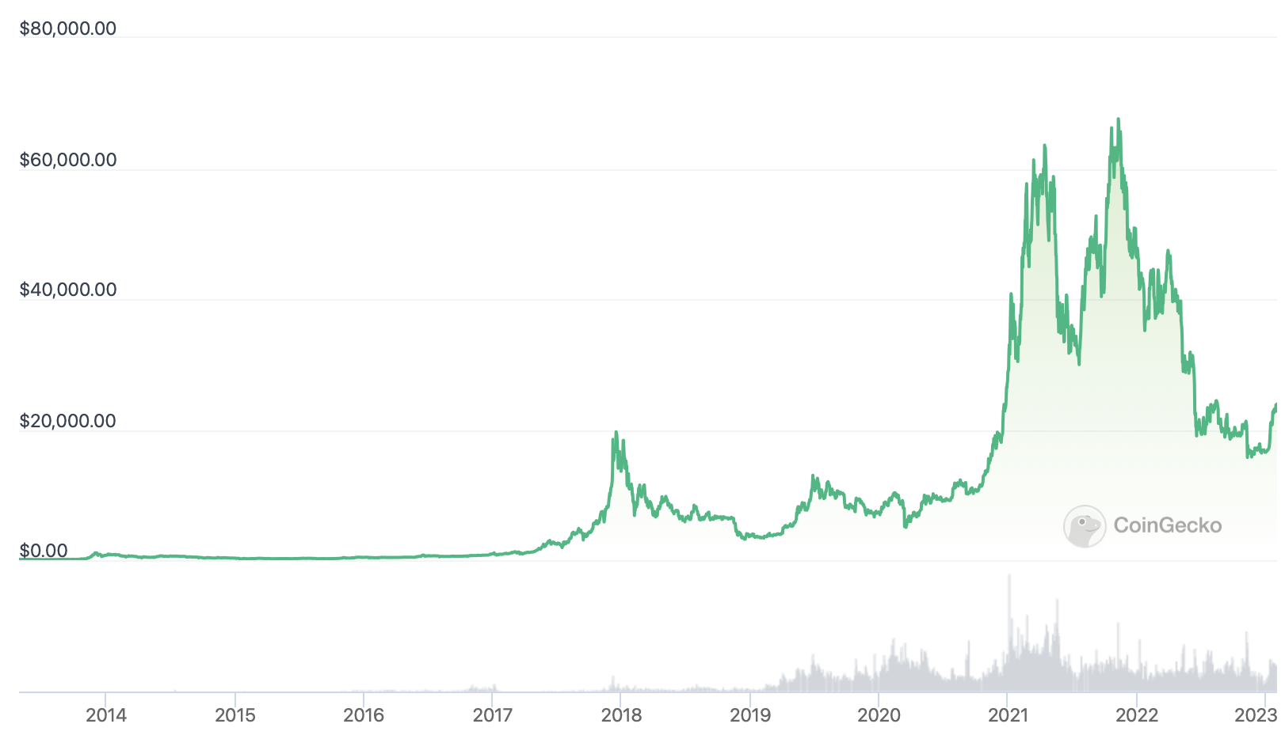
Bitcoins: What Is All the Excitement About?
$69,045 on Nov 10, 2021
$23,922 at 8pm last night

Slide 6
One of the Over 60,000 Bitcoin ATMs
Notes:
1489 Lake Drive SE

Slide 7
An Origin Story Worthy of a Pulp Novel!
The Mysterious Satoshi Nakamoto:
  Lehman Brothers Bankruptcy, 9/2008
  Halloween 2008: a white paper is published on the Internet laying out the idea and design for Bitcoin.
    The author (or authors) used Satoshi Nakamoto as a pseudonym.
  January 2009: Satoshi releases the first version of the Bitcoin software.
  2009-2010: Satoshi releases new versions of the software and is actively involved in Internet Chatter about Bitcoin.
  April 2011: Satoshi ceases all known and/or verified communications.
To this date the identity or identities of Satoshi are unknown.
Notes:
Rick Santelli 2/19/2009 Teaparty Rant

Slide 8
The Possible Economic Role for Bitcoin
Satoshi’s Vision: “A purely peer-to-peer version of electronic cash [that] would allow online payments to be sent directly from one party to another without going through a financial institution.”
More, prosaically
Facilitate payments at lower costs with SPEED and SECURITY.
  E.g., Credit Card Fees (3 percent).
  Merchant doesn’t get paid for at least 2 days.
  More importantly, cross-border transactions costs were $1.9 trillion in 2018.
  2019: Capital One hackers access personal information of 106 m users
Meet the needs of previously unbanked.
  Particularly a problem in the Developing World, but
  Fed estimates that 50 million US adults have little or no banking relationships.
Notes:
Satoshi, Bitcoin is “A purely peer-to-peer version of electronic cash [that] would allow online payments to be sent directly from one party to another without going through a financial institution.”
So, Natoshi’s goal was to improve money, in a way that did not depend banks or governments!

Slide 9
Facts about Cryptocurrencies (as of 2/1, 8pm)
Bitcoin was the first and is the largest in terms of market cap (total value of all bitcoins) of about $460 billion.
Ethereum is in second place with a market cap of about $201 billion.
Presently, 13,000 different varieties with a total market cap of about $1.3 trillion (https://www.coingecko.com/en)
Market cap of domestically listed US companies is about $40 trillion.

Slide 10
Underlying Technology of Bitcoin
Digital Token (exists only as data on a computer) whose ownership is cryptographically protected.
Distributed Ledger, Block Chain Technology.
Software protocol provides a “consensus” mechanism on the validity of new transactions.
Payments based on trust, without a “trusted third party.” (i.e., a bank or the Fed).
Notes:
Define distributed Ledger

Slide 11
So, how does it work?
Jack buys a bitcoin at an ATM.
  He is given a public number or key and a private encrypted key.
Jack can give his bitcoin to Jill by using Jill’s public key and verifying the transaction with his private key.
The new transaction is then posted on a number of different computers and can be read by anyone.
The clearing of the transaction is done with a public database or distributed ledger called a BLOCKCHAIN through a process know as BITCOIN MINING.
First, Bitcoin Miners gather about 3000 new transactions into a “block.”
The next step is to provide a decentralized mechanism to add the new block to the block chain and agree that the transactions are valid.

Slide 12
Proof of Work: Bitcoin “Mining”
The miners’ competition involves generating long, random numbers (“hashing”) until one of the numbers fits a precise set of attributes.
Presently, miners produce on the order of 200 million trillion random numbers per second.
The winning miner adds the new block to the previous block in the blockchain. The total process takes about 10 minutes.
The incentive for miners is that the winner of the competition gets compensated with new bitcoins and transaction fees.
However, the miner will not get the reward unless other miners subsequently add new blocks to the first miner’s block.
In this way transactions are added to the chain via a “consensus” of miners.

Slide 13

Bitcoin Mine

Slide 14
Question #1: Is Bitcoin Serving an Economic Role
Bitcoin is not and cannot be widely used to make transactions.
Scalability?
Price Instability.
Transactions costs
And, the network is costly
  Resources used in mining
  Environmental Costs
    Carbon footprint bigger than Thailand
    Electronic waste
BIS, Annual Report 2018, Chapter V
Notes:
Presently, Bitcoin mining requires 150-200 terawatt-hours per year, more than Thailand with a carbon footprinttof the Czech Republicenergy consumption (although less than is used in gold mining). (Note there are other consensus mechanisms that do not use as much energy.)
In addition, computer hardware quickly becomes obsolete and is dumped.

Slide 15
What Role Does Bitcoin (or Ether) Play?
For some it plays the same role as $100 bills: 32.8% of all bills in circulation (more than the number of $1 bills)
Illegal Activity
Notes:
Trading of banned goods; e.g, Silk Road
Ransomware Payments.
Money Laundering.
Tax Evasion

Slide 16

Illegal Activity and Bitcoin
Billions

Slide 17
But What about as a Financial Investment?
It is hard to argue with the fact that Bitcoin had provided outsized returns for many, albeit very volatile.
Financial Assets are Promises by the Issuer.
The “fundamental value” of a financial assets is the value of those promises based on the time value of money and the risk that the promises will not be kept.
What does Bitcoin promise?
Notes:
Promised future payments such as dividends for stocks or coupon payments for bonds.
For currencies, promise of future use in exchange with stable values.
Bitcoin only promises the possibility of capital gains, but not based on future payments.

Slide 18
Crypto compares favorably to….
The stock market?
A casino?

Slide 19
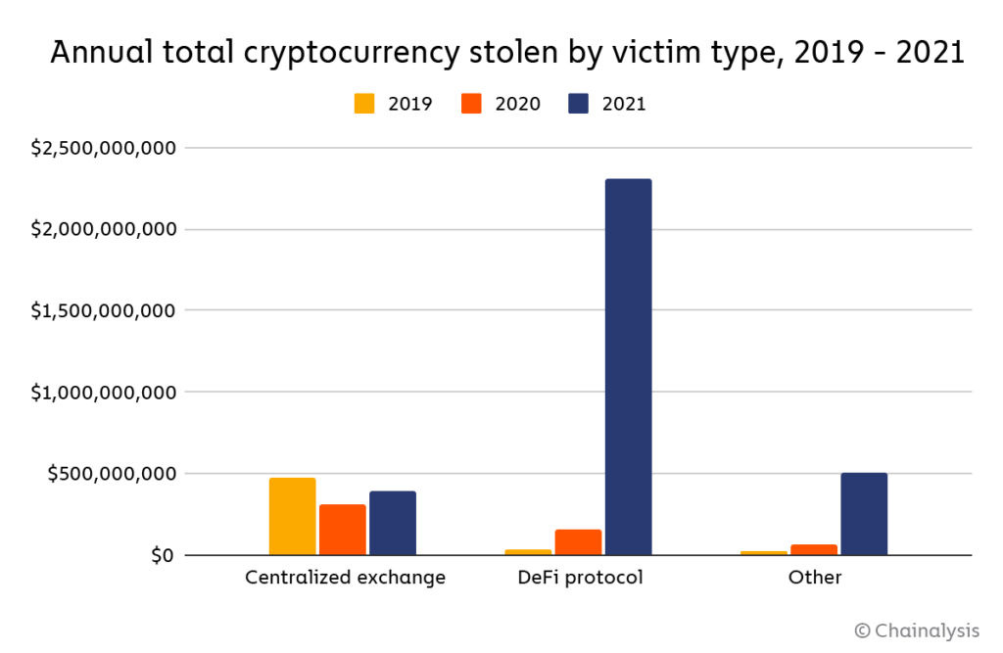
Security? Not Good News for Defi
Record $3.2 Billion
stolen in 2022 in
DeFi markets.

Slide 20
Question #2: The Value of the New Technology?
Don’t Throw the baby out with the bathwater!
The value of cryptographically protected digital-tokens is nuanced:
Blockchain technologies have significant promise some of which is already being realized.
  Private blockchains, Walmart and its produce suppliers
  Public Blockchains, Ethereum and smart contracts
See: Mehta N,. Agashe A., P. Detroja Blockchain Bubble or Revolution, 2021
Notes:
Cryptographic protection is a tougher call and depends on your views of privacy rights, as well as what information is being kept private (e.g., medical records versus financial transactions) Supply Chains (Walmart IBM)
Smart Contracts (Xbox royalties)

Slide 21
It’s The Wild West Out There!

Slide 22
BlockFi and Crypto Lending
Feb, 14, 2022, NYTimes Headline:
BlockFi, a crypto firm, reaches a $100 million settlement for failing to register loan products.
Cannot offer interest-bearing accounts to US residents.
  Unless registered as an investment company.
BlockFi was working work with the SEC to develop an account that meets US security laws.

Slide 23
Sam Bankman-Fried & FTX
In August, Fortune compared the 30-yr old to Warren Buffet.
Helped save BlockFi and other crypto firms in May 2022.
Mid-November, $32B firm declares bankruptcy.
  SBF’s net worth goes from $16billion to 0.
Misused customer funds to prop up his investment firm Alameda Research.
Regulation is needed!

Slide 24
What is Good Regulation?
The Principles Are Easy;
  Security: Eliminate fraud, abuse and manipulation.
  Do not let markets be dominated by a small number of powerful firms.
  Allow startups with new innovations to displace incumbent firms.
  Minimize risk of a financial crisis.
Legislation and Implementation: Not So Easy

Slide 25
Biden Framework for Regulating Crypto (9/16)
Protect Consumers, Investors, and Business.
Promote Access to Safe Financial Services.
Fostering Financial Stability.
Advancing Responsible Innovation.
Reinforcing our Global Financial Leadership.
Fighting Illicit Finance.
Exploring a U.S. Central Bank Digital Currency (CBDC)

Slide 26
Summary
Cryptocurrencies are digital money.
  Part of decentralized finance (DeFi).
There is little economic case for cryptocurrencies.
  There is a case that the underlying technology is useful.
  Government backed electronic currencies may be the path forward.
  Its operation is highly costly.
Crypto is currently an unregulated banking environment.
  Banking is regulated for VERY good reason.

Slide 27
Thank you!
Any Questions?
www.NEEDelegation.org
Jon Haveman, Ph.D.
Jon@NEEDelegation.org
Contact NEED: info@NEEDelegation.org
Submit a testimonial: www.NEEDelegation.org/testimonials.php
Become a Friend of NEED: www.NEEDelegation.org/friend.php

Slide 28
Resources to Learn More
N. Mehta, et.al. Blockchain Bubble or Revolution
E Prasad, The Future of Money (https://youtu.be/o3NuHb7V1IA)
Presidential Working Group on Financial Markets, 11/1/21 (https://home.treasury.gov/system/files/136/StableCoinReport_Nov1_508.pdf)
Federal Reserve White paper
(https://www.federalreserve.gov/publications/files/money-and-payments-20220120.pdf)
Executive Order: https://www.whitehouse.gov/briefing-room/statements-releases/2022/03/09/fact-sheet-president-biden-to-sign-executive-order-on-ensuring-responsible-innovation-in-digital-assets/

