Slide 1
Osher Lifelong Learning Institute, Fall 2026
The Economics of Public Policy Issues
University Of Minnesota
Host: Geoffrey Woglom, Director
National Economic Education Delegation

Slide 2
Course Schedule
The Economics of Public Policy Issues
  Week 1 (10/8): Economic Update & Changes at the Fed, Geoffrey Woglom, Amherst College
  Week 2 (10/15): Climate Change Economics, Galina Hale, UC Santa Cruz
  Week 3 (10/22): The Future of Money, Geoffrey Woglom, Amherst College
  Week 4 (10/29): The Economics of Tariffs, Tibor Besedes, Georgia Institute of Technology
  Week 5 (11/5): Economics of Immigration, Roger White, Whittier College
  Week 6 (11/12): Gender Pay Gap, Tibor Besedes, Georgia Institute of Technology

Slide 3
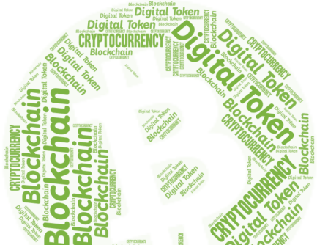
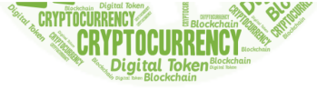

Cryptocurrencies & The Future of Money
Geoffrey Woglom,
Professor of Economics
Amherst College, emeritus
October 22, 2026

Slide 4
Submitting Questions
Submit questions in the chat.
  I will try to handle them as they come up.
We will do a verbal Q&A once the material has been presented.
Slides will be available from the NEED website tomorrow (https://needelegation.org/delivered_presentations.php)

Slide 5
Outline of the Talk
Fun Facts about Bitcoin
A little bit on the underlying technology of cryptocurrencies.
Evaluation of 3 uses of this technology
  Bitcoin as a financial investment.
  Smart Contracts and Defi.
  Crypto Currencies as a “Means of Payment:” Stablecoins.
Central Bank Digital Currencies (CBDC); e.g. a digital-euro

Slide 6
But First, What is Bitcoin?
Bitcoin is the first cryptocurrency and was invented in 2008.
Cryptocurrencies are a form of digital money (viz. data on a computer) where account ownership is confidential and where record keeping is decentralized over a multitude of computers
Little regulation; no reliance on trusted third party; no government!

Slide 7
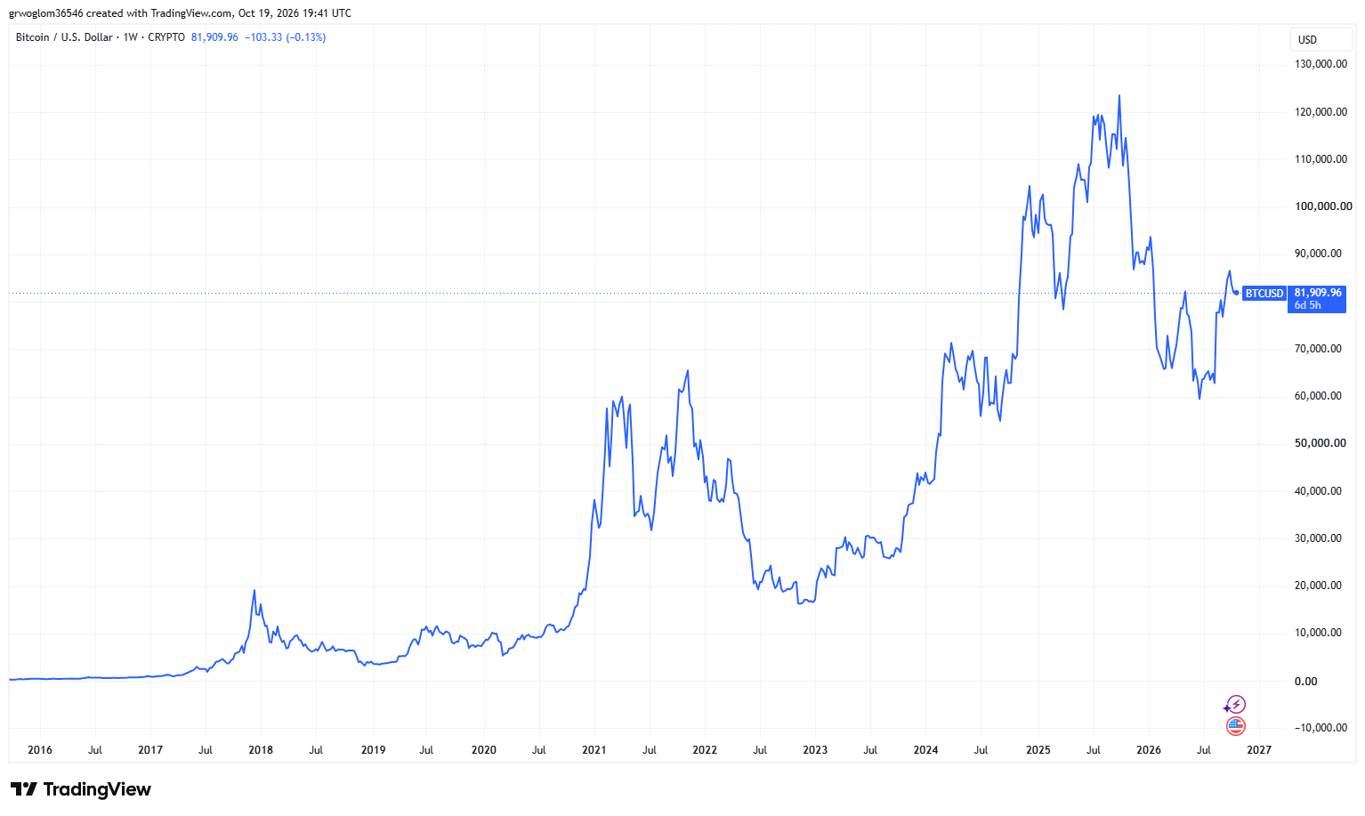
Bitcoins: A Roller Coaster Ride?
50% drop
400% gain

Slide 8
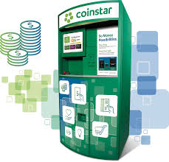
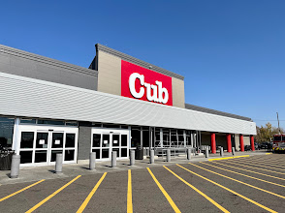
One of the Over 30,000 Bitcoin ATMs
Notes:
2850 26th Ave South Minneapolis

Slide 9
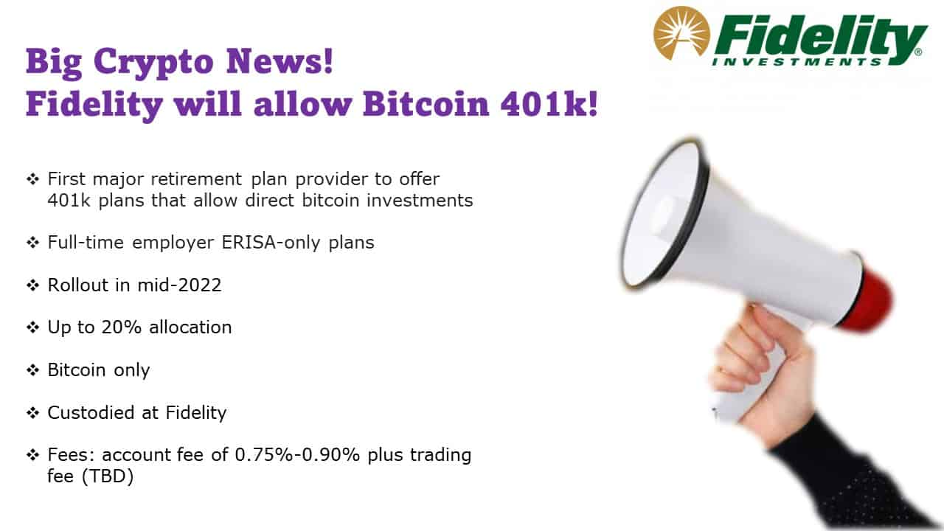
Give Me a Break?
As of 1/10/2024, Fidelity also offers Bitcoin, Ethereum and Solana ETFs

Slide 10
An Origin Story Worthy of a Pulp Novel!
The Mysterious Satoshi Nakamoto:
  Lehman Brothers Bankruptcy, 9/2008
  Halloween 2008: a white paper is published on the Internet laying out the idea and design for Bitcoin. The author (or authors) used Satoshi Nakamoto as a pseudonym.
  January 2009: Satoshi releases the first version of the Bitcoin software.
  2009-2010: Satoshi releases new versions of the software and is actively involved in Internet Chatter about Bitcoin.
  April 2011: Satoshi ceases all known and/or verified communications.
To this date the identity or identities of Satoshi are unknown.
Notes:
Rick Santelli 2/19/2009 Teaparty Rant

Slide 11
The Possible Economic Role for Bitcoin
Satoshi’s Vision: “A purely peer-to-peer version of electronic cash [that] would allow online payments to be sent directly from one party to another without going through a financial institution.”
More, prosaically
Facilitate payments at lower costs with speed and security
  E.g., Credit Card Fees (3 percent).
  Merchant doesn’t get paid for at least 2 days.
  More importantly, cross-border transactions costs were $1.9 trillion in 2018.
  2019 Capital One hackers access personal information of 106 m users
Meet the needs of previously unbanked.
  Particularly a problem in the Developing World, but
  Fed estimates that 50 million US adults have little or no banking relationships.
Notes:
Satoshi, Bitcoin is “A purely peer-to-peer version of electronic cash [that] would allow online payments to be sent directly from one party to another without going through a financial institution.”
So, Natoshi’s goal was to improve money, in a way that did not depend banks or governments!

Slide 12
Facts about Cryptocurrencies (as of 10/19)
Bitcoin was the first and is the largest in terms of market cap (total value of all bitcoins) of about $1.6 trillion.
Ethereum is in second place with a market cap of about $292 billion; tether a “stablecoin” is third at $183 billion.
Presently, 22,000 different varieties with a total market cap of about $2.8 trillion (https://www.coingecko.com/en)
Market cap of domestically listed US companies is about $75 trillion.

Slide 13
Underlying Technology of Bitcoin
Digital Token (exists only as data on a computer) whose ownership is cryptographically protected.
Distributed Ledger, Block Chain Technology.
Software protocol the provides a “consensus” mechanism on the validity of new transactions.
Payments based on trust, without a “trusted third party.” (i.e, a bank or the Fed).
Notes:
Define distributed Ledger

Slide 14
So, how does a blockchain transaction work?
Jack, the owner of a bitcoin is given a public number or key and a private encrypted key.
Jack can trade his bitcoin with Jill by using Jill’s public key and verifying the transaction with his private key.
The new transaction is then posted on a a number of different computers and can be read by anyone.
The clearing of the transaction is done with public database or distributed ledger called a blockchain through a process know as bitcoin mining.
First, Bitcoin Miners gather about 3000 new transactions into a “block.”
The next step is to provide a decentralized mechanism to add the new block to the block chain and agree that the transactions are valid
Notes:
When you buy a bitcoin at the ATM, that is not a blockchain transaction

Slide 15
Proof of Work: Bitcoin “Mining”
The miners’ competition involves generating long, random numbers (“hashing”) until one of the numbers fits a precise set of attributes.
Presently, miners produce on the order of 200 million trillion random numbers per second.
The winning miner then adds the new block to the previous block in the blockchain. The total process takes about 10 minutes
The incentive for miners is that the winner of the competition gets compensated with new bitcoins and transaction fees.
However, the miner will not get the reward unless other miners subsequently add new blocks to the first miner’s block.
In this way transactions are added to the chain via a “consensus” of miners.

Slide 16
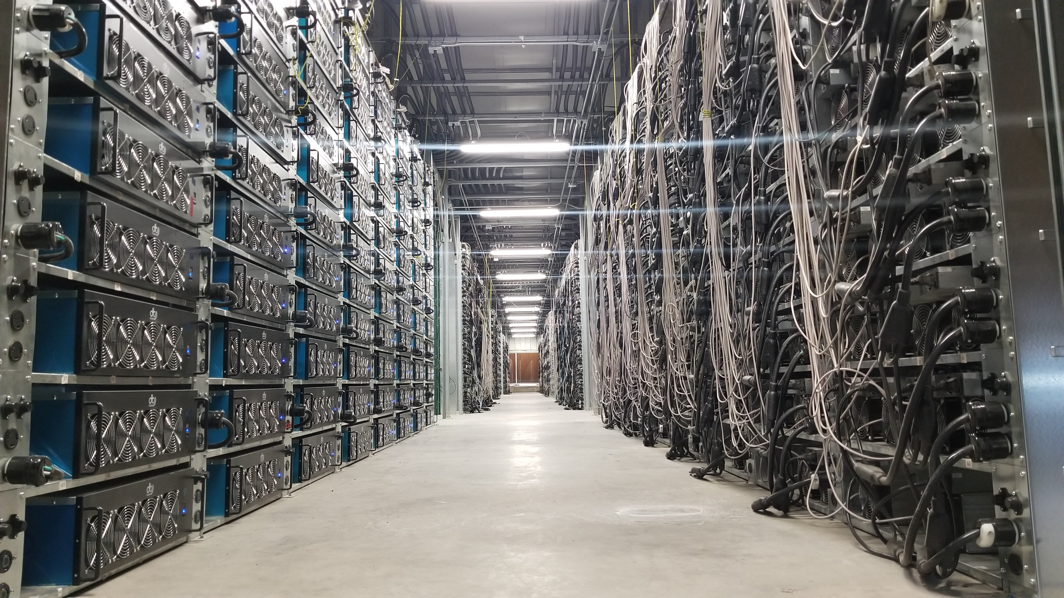
Bitcoin Mine
14 GW of computing capacity
US Data Centers: 50 GW
But 30% of Miners Revenues comes from leasing capacity to AI

Slide 17
“A purely peer-to-peer version of electronic cash…”?
Not really,
By far most trades in bitcoin take place with exchanges such as Binance and formerly FTK (of Sam Bankman Fried fame).
The ratio of exchange trades to blockchain trades is estimated to be in the range of 5 to 10 to one.
Blockchain fees cost about $1, but also require the user to have a bitcoin wallet.
Exchange fees are on the order 0.1 percent.
And, then there are also Bitcoin ETFs
What trades tend to occur on the blockchain and why?

Slide 18
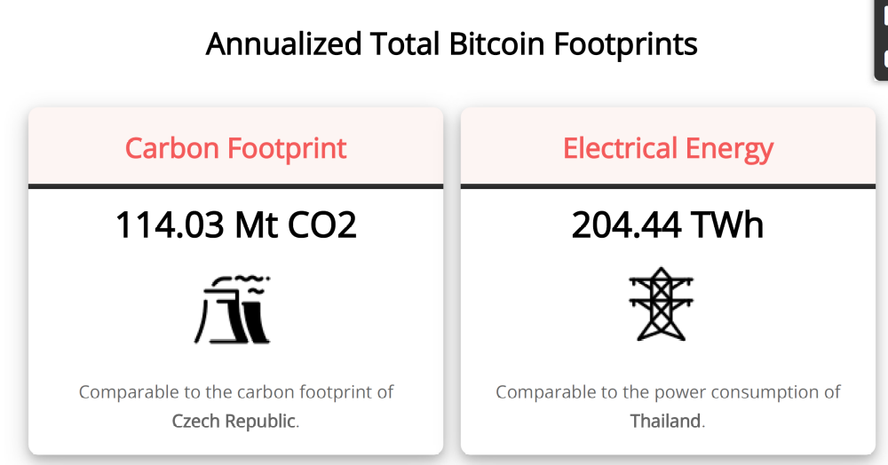
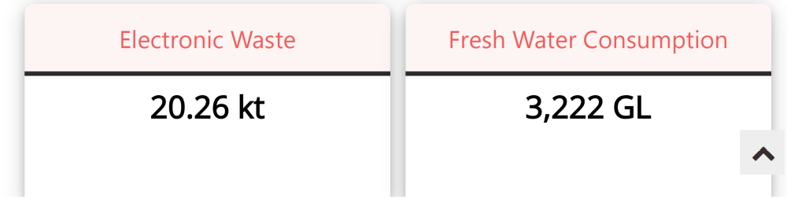
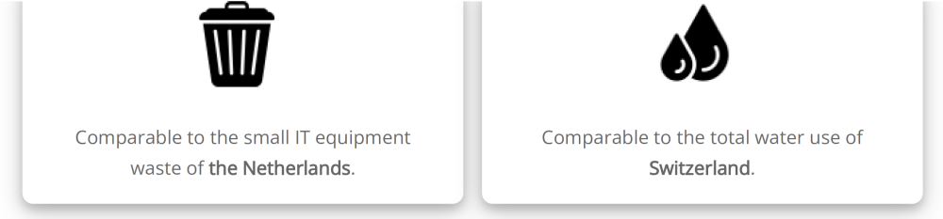
Bitcoin’s Environmental Impact
Bitcoin Mining uses something between 40 and 60 percent of Data Centers useage.
Source: https://digiconomist.net/bitcoin-energy-consumption
Notes:
Data Centers: 240-340 and growing fast; One BTC transaction uses 1.5 megawatts, or household consumption over 52 days.

Slide 19
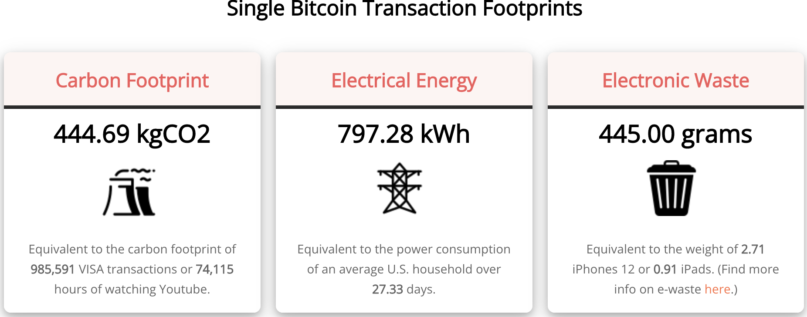
Bitcoin’s Environmental Impact
Source: https://digiconomist.net/bitcoin-energy-consumption

Slide 20
The Merge: Ethereum and Proof of Stake (9/22)
Potential Block Creators place cryptocurrency in specialized wallets that are locked while they are acting as blockchain “validators” (as opposed to “miners”).
Validators are selected randomly, where the odds of being selected are proportional to the value of the currency “staked” in the wallet.
The rest of the process of validation is similar: transaction fees only paid if subsequent blocks are added, but!!
If an invalid block is discovered the staked deposit is forfeited.
Notes:
Merge occurred on September 15th

Slide 21
What Role Does Bitcoin (or Ether) Play?
For some it plays the same role as $100 bills: 32.8% of all bills in circulation (more than the number of $1 bills): Illegal Activity.
Notes:
Trading of banned goods; e.g, Silk Road
Ransomware Payments.
Money Laundering.
Tax Evasion

Slide 22
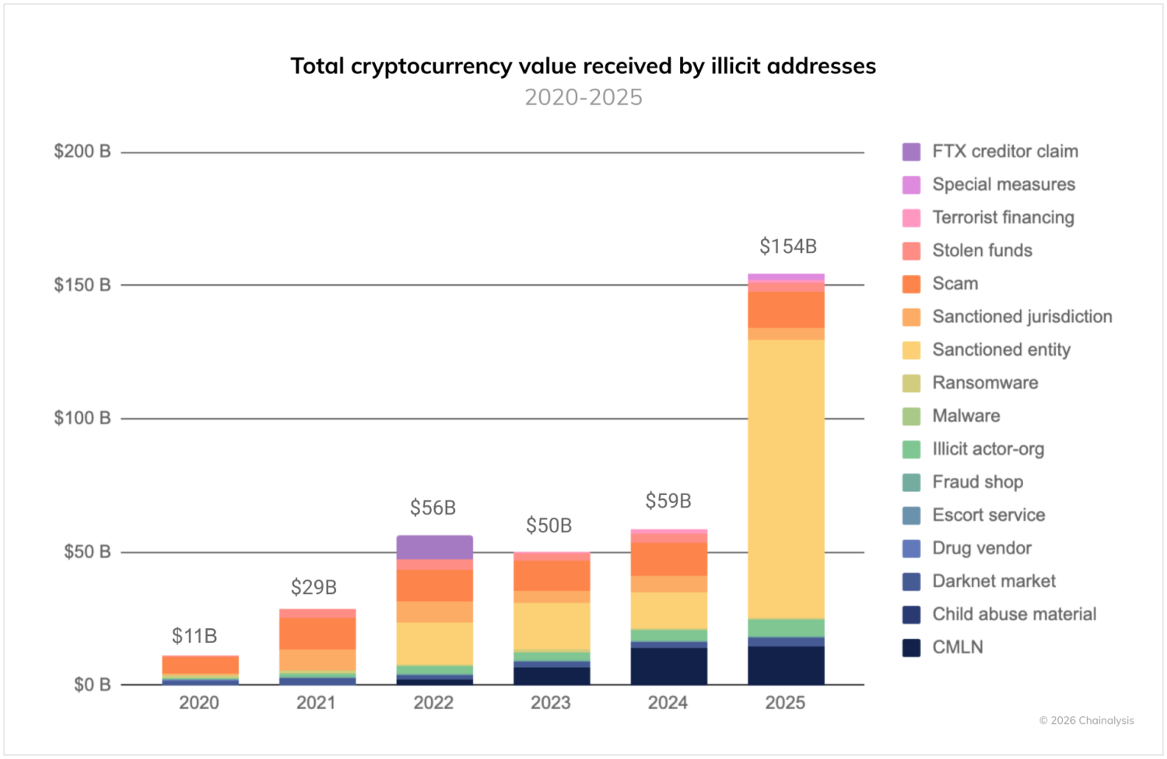
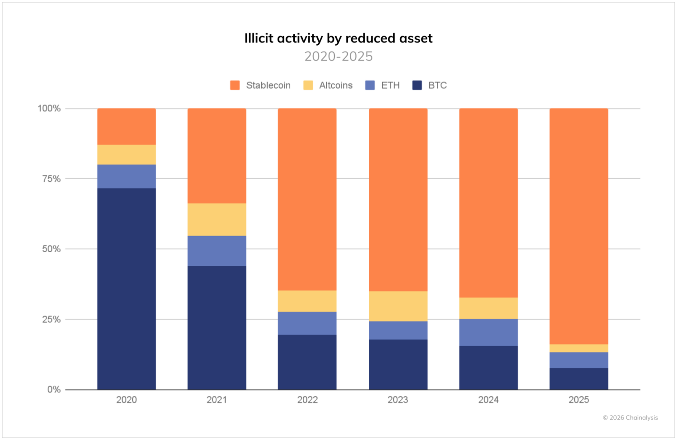
Illegal Activity and Bitcoinhe
https://www.chainalysis.com/blog/2026-crypto-crime-report-introduction/
Notes:
Crypto Advocates: Less than 1% share of the total volume of transactions.

Slide 23
Binance’s Troubled History
Largest Crypto Exchange with a daily volume of $10 billion dollars more than twice as big as second place.
2023 pled deal admitting to money laundering, violating sanctions and transactions from “illicit” actors. Fined $4.3 billion; CEO Changpeng Zhao served 4 months in prison. Trump pardon 10/25
2/23, WSJ, “Binance Fired Staff Who Flagged $1 Billion Moving to Sanctioned Iran Entities”
Notes:
FTX collapsed in 11/2022

Slide 24
But What about as a Financial Investment?
It is hard to argue with the fact that Bitcoin had provided outsized returns for many, albeit very volatile.
Financial Assets are Promises by the Issuer
The “fundamental value” of a financial assets is the value of those promises based on the time value of money and the risk that the promises will not be kept.
What does Bitcoin promise?
Notes:
Promised future payments such as dividends for stocks or coupon payments for bonds.
For currencies, promise of future use in exchange with stable values.
Bitcoin only promises the possibility of capital gains, but not based on future payments.

Slide 25
How Do Economist Think About Investments?
Good Starting Place
“In the short term the stock market behaves like a voting machine, but in the long term it acts like a weighing machine.”
What is being “weighed” is prospective payments from the security, or other intrinsic value, i.e. its fundamental value.
Bitcoin?
Notes:
Warren Buffet paraphrasing Benjamin Graham. Payments mean dividends or coupon payments. Even, gold has some intrinsic value as the ultimate insuarbne

Slide 26
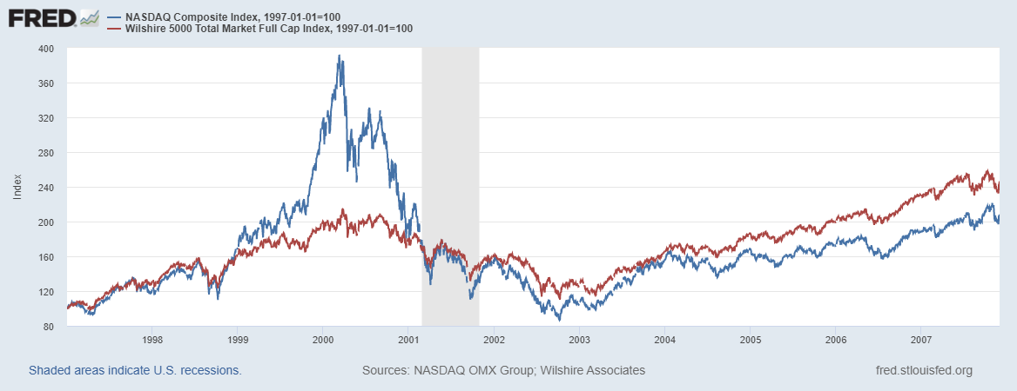

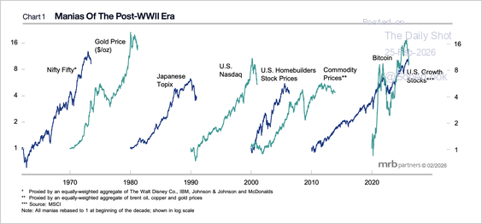
Does Voting Ever Get it “Wrong?”
https://www.mrbpartners.com/

Slide 27
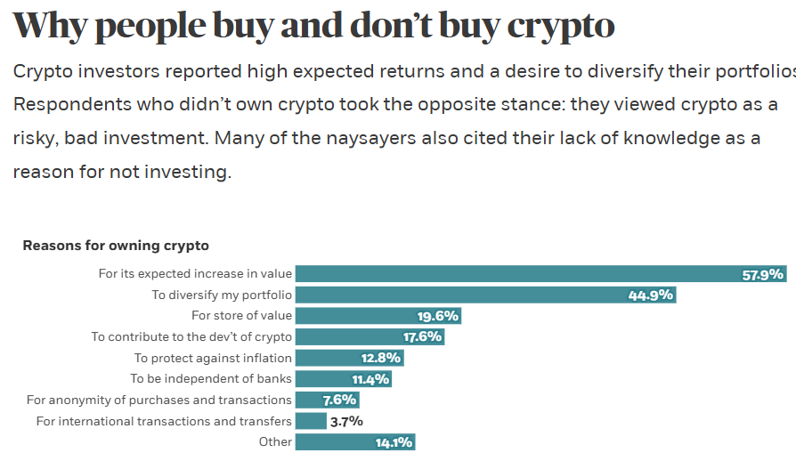
Well, Why Do People Buy Bitcoin?
https://www.chicagobooth.edu/review/stephen-colbert-was-wrong-bitcoin

Slide 28
Smart Contracts on the Blockchain
A Smart Contract is a computer code that resides on the block chain and is executed based on incoming information.
Example, Parametric Hurricane Insurance via the Blockchain:
  Computer program on Ethereum continuously monitors Charleston Executive Airport wind speed for 1 year.
  If the windspeed is greater than 150 miles per hour, immediately transfers 100 ether to the Seabrook Island Property Association.
  If the windspeed is less than 150 miles per hour, but more than 125 miles per hour, immediately transfers 75 ether; etc.
Smart Contracts are Automatic, Immediate, Irreversible and Uncontestable.

Slide 29
Real World Example: Lemonade Insurance
& Kenyan Farmers
“In 2023, 7000 farmers in Kenya who signed up for the insurance were paid out claims due to the occurrence of a drought. No claim adjuster, claims, or processors were needed. Because information like rain data is easily measured for an oracle to transmit, a multitude of use cases exist.”
Sadly, the vast majority of smart contracts are all in the crypto world: e.g. process stable coin transactions, run derivative exchanges for crypto currencies.
https://today.westlaw.com/Document/I0c8dc176826c11efb5eab7c3554138a0/View/FullText.html?

Slide 30
Desirable Attributes of a Means of Payment
Accepted for most, if not all transactions and widely available. (wire transfers?).
Stable value. (Bitcoin?).
Low transactions costs. (3 percent credit card fees?).
Time to clear. (Venmo payments?).
Risk Use (Dollar Bills & counterfeits).
Irreversibility (Bad Checks ?)
Privacy (?) (Bank Checks and the Bank Safety Act)
“Tokenized” for use in smart contracts.

Slide 31
Can The Digital World Do Better?
Yes, and not only with crypto currencies!
Kenya’s M- Pesa (2007!): Cell phone app for storing digital currency.
(https://www.m-pesa.africa/).
India’s UPI (2016): Universally accepted “Apple Pay.”
(https://www.imf.org/en/publications/fandd/issues/2025/09/indias-frictionless-payments-maria-peria).

Slide 32
Stablecoins
Cryptocurrency whose value is pegged to a national currency. We will focus on the dollar stable coins.
  Reserve Backed (?): when coins are issued, assets are purchased to “back” the coins value.
  Algorithmically Backed.
Pioneered by Tether in 2014, it is now the largest, but it has a checkered past.
Prior to the current administration, financial regulators were negative towards stable coins.
E.g., Facebook and Diem in 2019: Proposed blockchain enabled stablecoin, where all Facebook users would have diem wallets.
Regulators lodged lots of objections: Should a potentially ubiquitous private currency be run by one company?
What could go wrong?
Meta (Facebook) dropped out of the Diem project on 1/31/2022.
Notes:
WSJ, Headline, 8/11/2021, “Poly Network Hackers Steal More Than $600 Million in Cryptocurrency” Bloomberg 7/27/2021: “Tether and the Facebook Inc.-backed Diem token were a main focus of a recent meeting of U.S. regulators held on the financial risks posed by stablecoins.
Facebook NOVI wallets for holding Pax dollars ($1.1 billion in market cap)

Slide 33
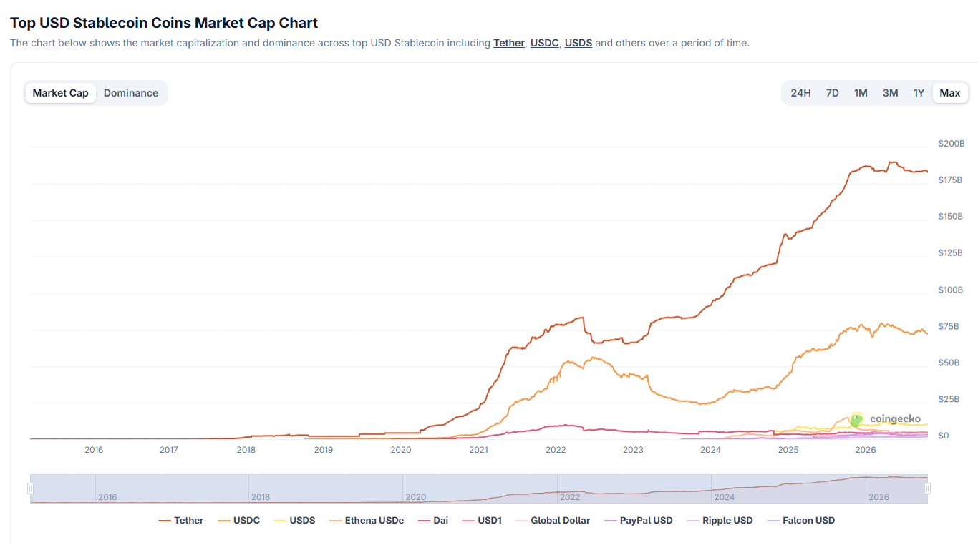
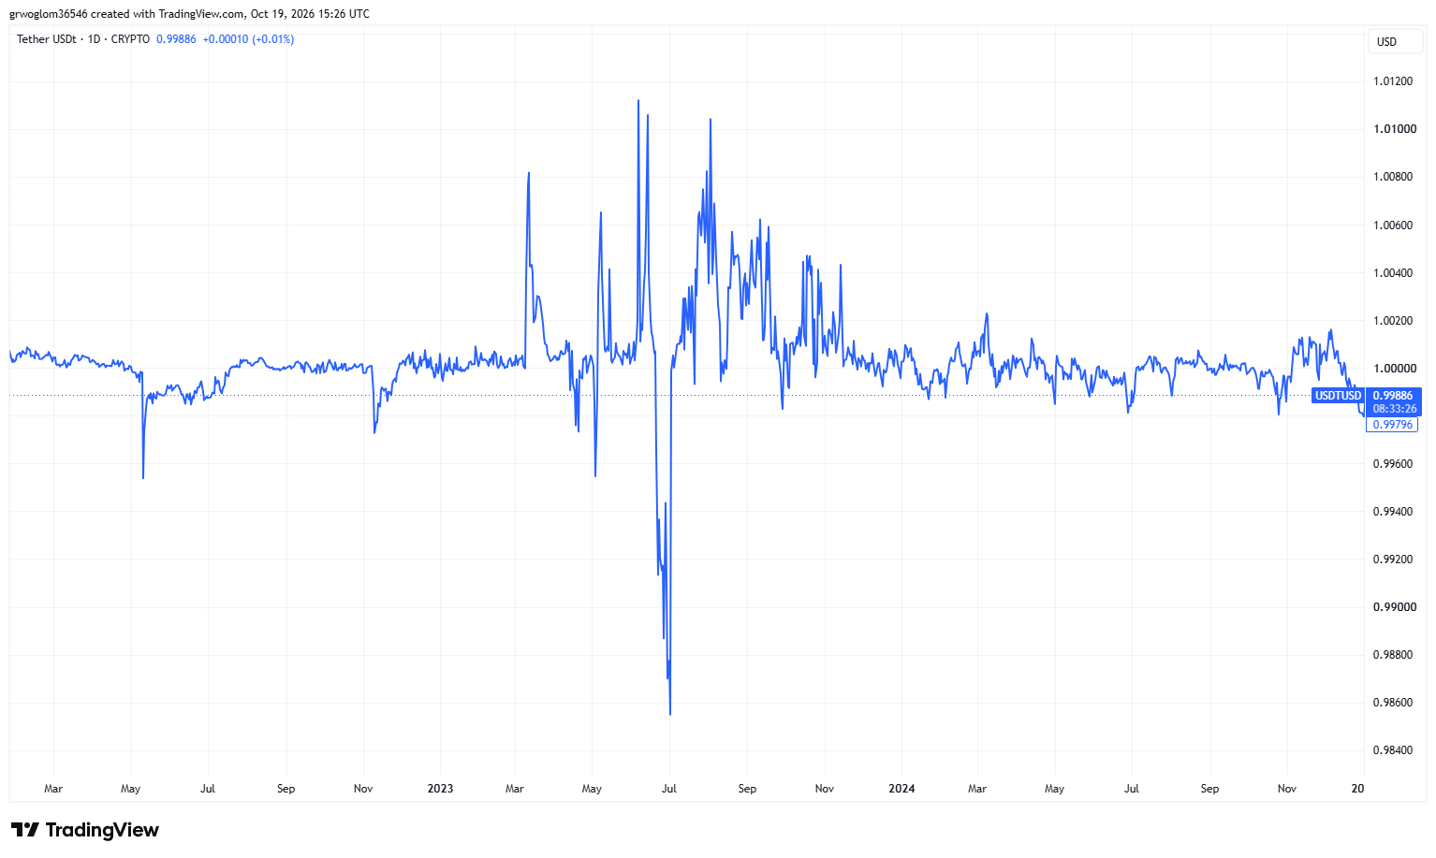
Stablecoins (?)
World Liberty Financial’s, USD1 has a market cap of $4billion
https://www.coingecko.com/en/categories/usd-stablecoin#key-stats
Tether’s price fell to $.95 on May 22 2022 because of collapse of an algorithmic stable coin called terra
Notes:
Total market cap of $295 billion

Slide 34
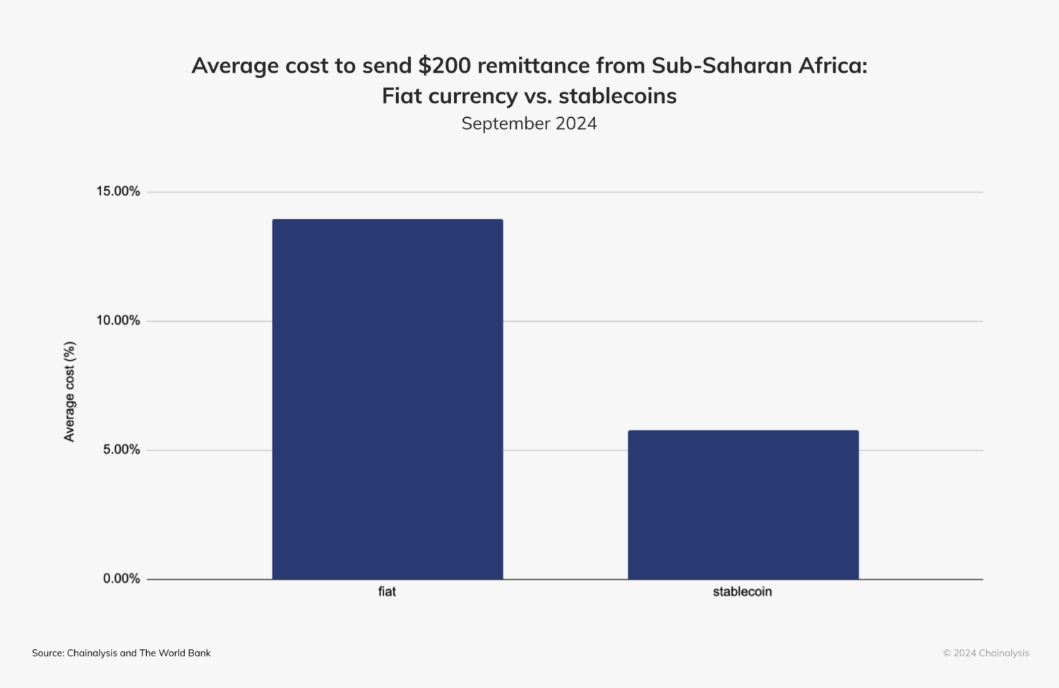
Uses of Stable Coins
Smart Contracts “lock” stablecoins for payments when the contract is executed
Peer-to-Peer Transactions in regions with unreliable banking.
Cross-border Transactions and Remittances.
https://www.chainalysis.com/blog/stablecoins-most-popular-asset/

Slide 35
Uses: Continued
Store of value in the face of instability and inflation.
Illicit Activity: maybe less than 1%, but still major source of illegal activity.
Sanction Evasion, but also
Getting funds to insurgents in countries like Iran.

Slide 36
Recent Congressional Legislation
Genius Act (passed): Stable Coin Issuers
  100% liquid asset backing of stable coins (but includes uninsured bank deposits.
  Regulated by bank regulators, not CFTC nor SEC (which had been tough)
  Cannot pay interest.
  Must use blockchain technology.
  Must Comply with the Bank Secrecy Act.
The Anti-CBDC Surveillance State Act (House passed): prohibits the Fed from issuing or even investigating a Fed digital dollar.
The Clarity Act (House Passed): Regulatory definitions for other crypto coins; awaiting a Senate vote. At the last minute, Crypto-advocates objected, and it recently died (for now)

Slide 37
Should Stablecoins Be Allowed to Pay Interest?
Some stablecoins pay about 3.5% in “rewards.”
If they can, they would be like a “tokenized” money market mutual fund serving as a more attractive means of payment.
Estimates of potential losses in bank deposits range from $500 billion to $6.6 trillion.
So, what is the harm?

Slide 38
Economic Role of Banks
Accept deposits and manage check payments.
Make Commercial Loans and Mortgages
Money Market Mutual Funds (MMMF) do 1, but not 2.
Stablecoins would be a crypto version of MMMF with more convenient payment options.
Unintended Consequences?
The primary source of credit for small business (500 or fewer employees) is from small and regional bank lending.
Small business:
  Number: over 38K
  Employment: over 62 million employees, or over 45% total private sector employment.

Slide 39
Small Banks (less than $300 billion total assets)
Deposits $5.6 trillion out of a total of $18.6 trillion.
Loans and Mortgages $2.8 trillion out of $5.8
Understated because while a $301 billion bank is classified as “large,” its lending is more like a small bank.
“Large Banks” include JPMorgan Chase at $3.8 trillion and Drake Bank $247 billion.
Unintended (?) Consequences of current Crypto enthusiasm?
Shift from loans to small firms towards financing US Treasuries.

Slide 40
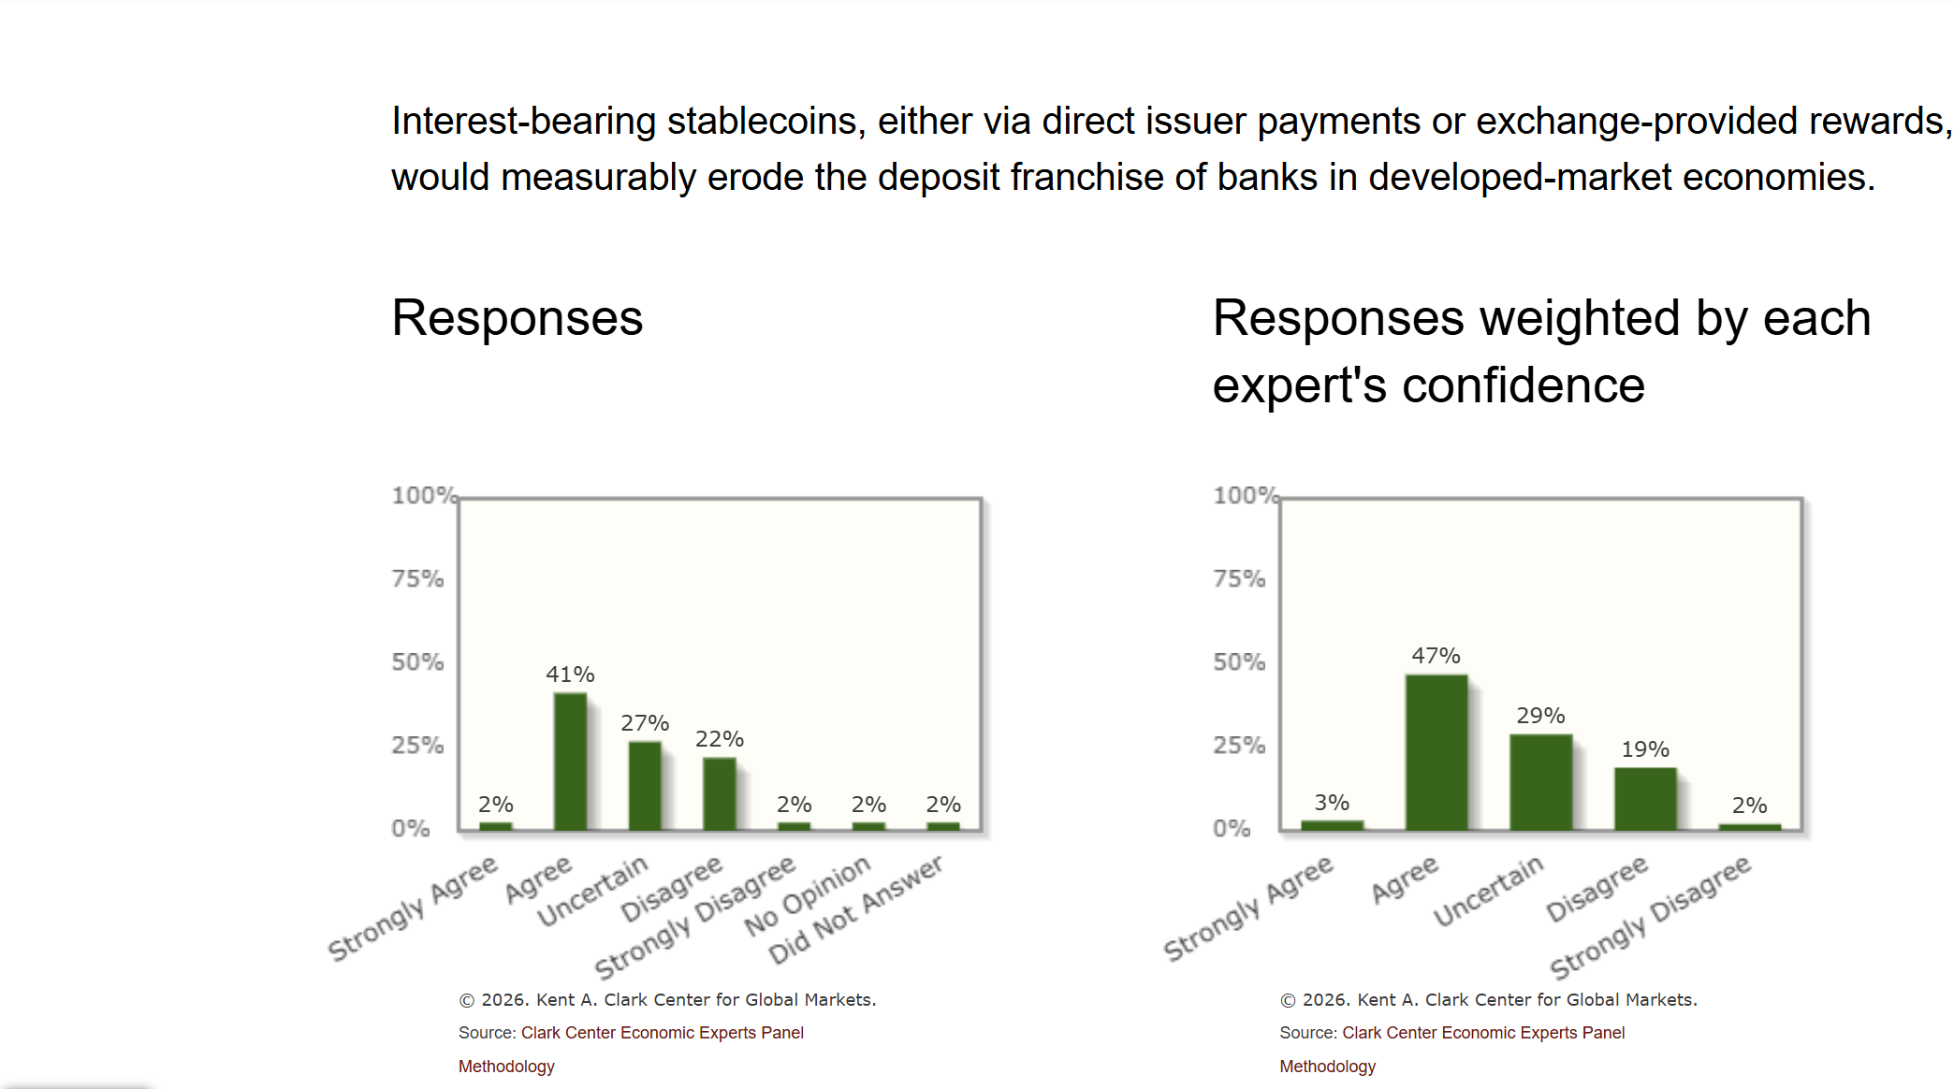
Expert Views on Stable Coins and Banks

Slide 41
Central Banks Get into the Act
Central Bank Digital Currency is a digital form of currency and is a liability of the central banks just like paper currency. Like M-pesa run by the countries central bank. Except many CBDCs can be tokenized and used in smart contracts
Jamaica, the Bahamas and Nigeria are “operational.”
China had a “pilot” program that was started in 2020. In 2025, 3.4 trillion transactions worth about $2.4 trillion.
ECB has started working on a digital euro in 2023 and is planning a pilot project to start in 2027 with a full rollout in 2029.
And, scores of other countries are exploring or running pilot programs

Slide 42
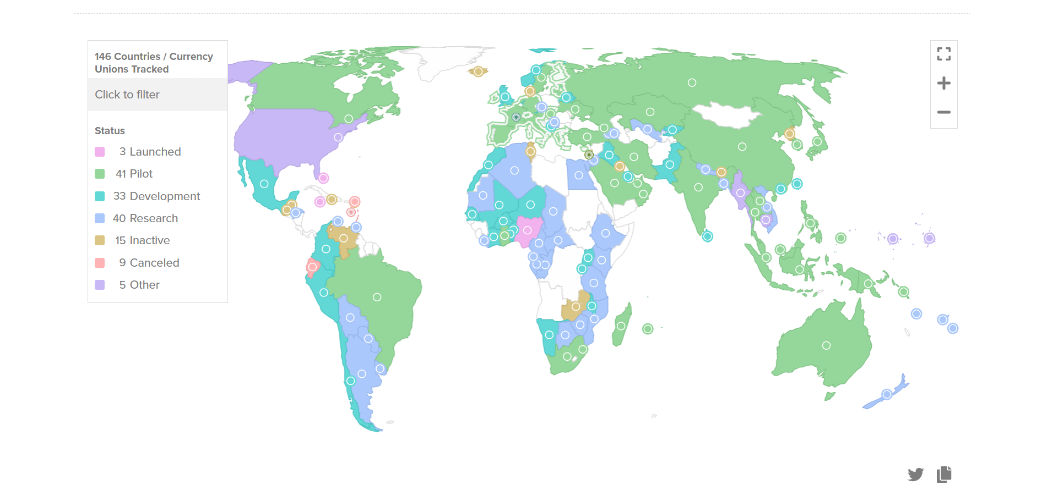
Central Bank Digital Currency Tracker 5/2026
https://www.atlanticcouncil.org/cbdctracker/

Slide 43

The Digital Yuan

Slide 44
Why was China So Eager for a CBDC?
In 2016 committed to the digital yuan.
In 2021 they banned all cryptocurrencies and crypto mining (the exact reverse of US policy choice).
China has ambitions to become a “reserve” currency used for international transactions and more generally cross border payments.
Surveillance probably a motive also.
But, at the end of last year, they made a major change

Slide 45
The New and Improved Digital Yuan
Shifts the liability for deposits to commercial banks and off the books of the Peoples Bank of China.
  Digital Yuan will now pay interest making it more attractive.
  But, the growth of the digital yuan will not come at the expense of bank lending
No longer technically a CBDC.

Slide 46
ECB and the Digital Euro
Electronic cash, a liability of the National Banks, but wallets and accounts will be provided by commercial banks.
Designed for retail payments “intermediated” through banks, but allows for peer-to-peer, confidential transactions.
Won’t pay interest and their will be limits on holdings to protect against draining bank deposits.
Stablecoins will still be permitted.

Slide 47
Questions and Takeaways
Can the dollar maintain its dominant reserve currency position, while relying on private, regulated stablecoins for digital cash?
How will regulated stablecoins affect small banks and small firm financing?
Blockchain technology has potential to revolutionize many areas of finance, but so far there have been few applications outside the crypto world.
Traditional cryptocurrencies like bitcoin are pure speculative assets with little or no fundamental value.
Are these currencies heading for a “crash” and what will be the consequences for the real economy?

Slide 48
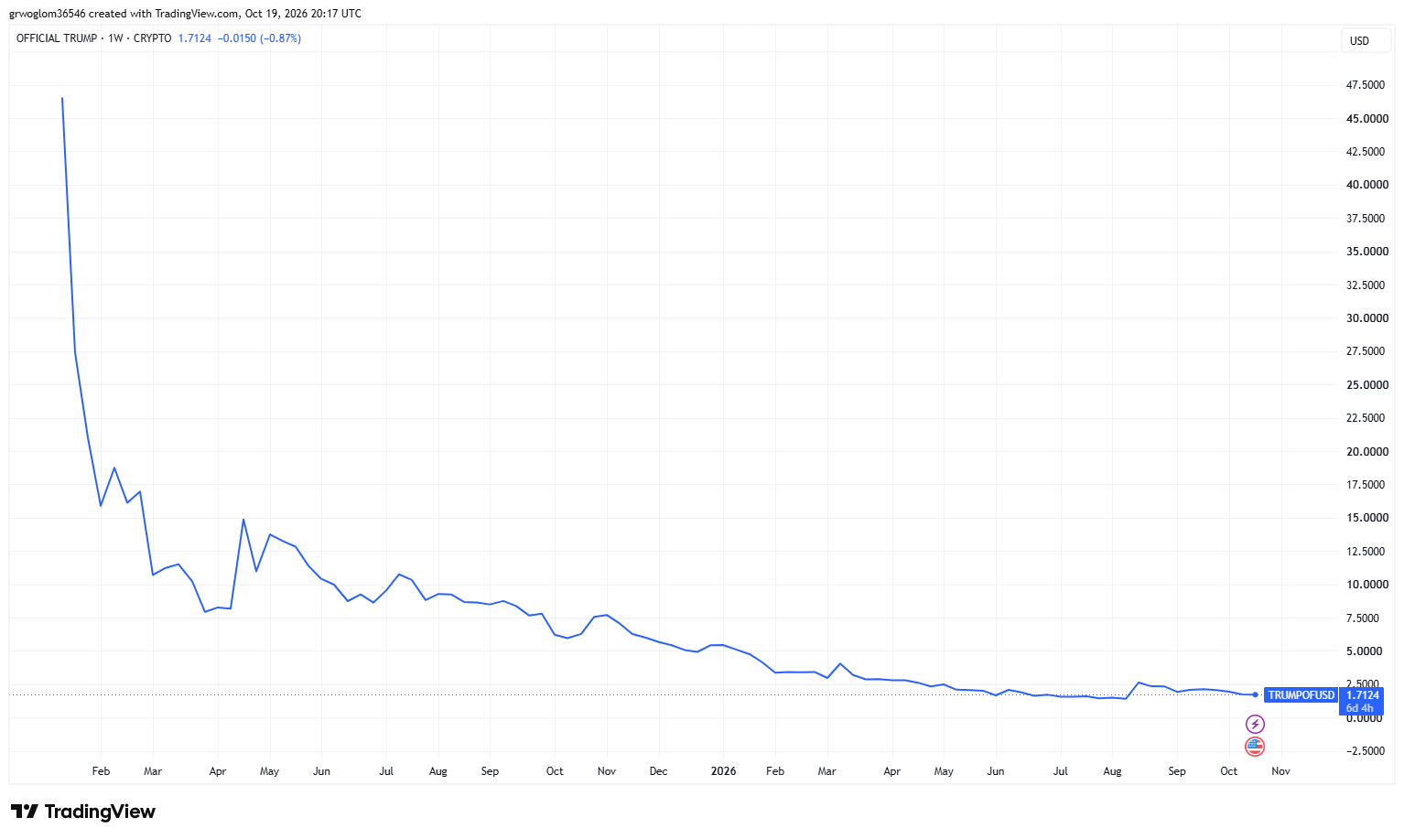
Official Trump Meme Coin
On 1/18/2025, coin has a price of $74 and market cap of 200 billion coins issued to the public of $27 billion
Monday, price was $1.70 and market cap was $480 million.

Slide 49
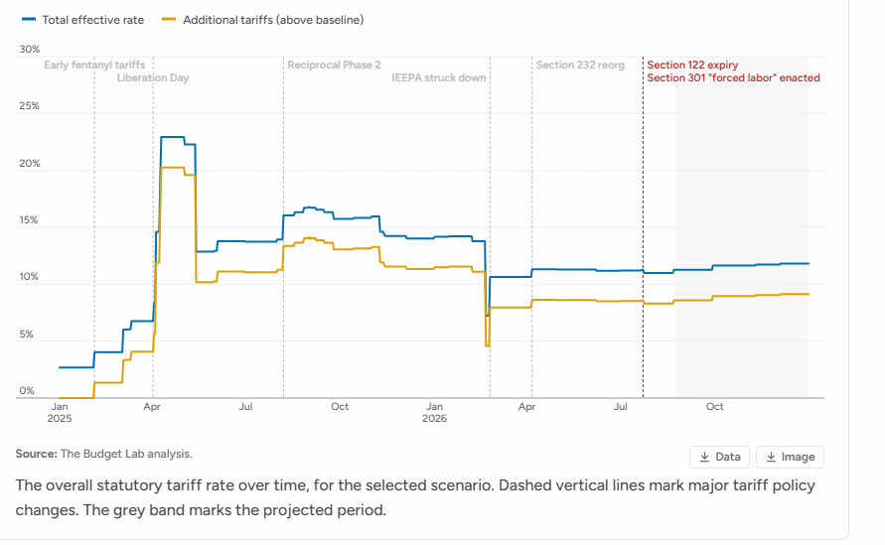
Next Week: Economics of Tariffs
2023
1.2 Million

Slide 50
Let’s Hear from You!
Geoffrey Woglom grwoglom@amherst.edu
Contact NEED: Info@NEEDEcon.org
Support NEED: www.NEEDEcon.org/donate.php

