Slide 1
Osher Lifelong Learning Institute, Winter 2023
Contemporary Economic Policy
Sonoma State University
February-March, 2023
Host: Jon Haveman, Ph.D.
National Economic Education Delegation

Slide 2
Available NEED Topics Include:
US Economy
Healthcare Economics
Climate Change
Economic Inequality
Economic Mobility
Trade and Globalization
Minimum Wages
Immigration Economics
Housing Policy
Federal Budgets
Federal Debt
Black-White Wealth Gap
Autonomous Vehicles
Healthcare Economics

Slide 3
Course Outline
Contemporary Economic Policy
  Week 1 (2/1): Trade and Globalization (Alan Deardorff, Univ. of Michigan)
  Week 2 (2/8): US Economic Update (Jon Haveman, NEED)
  Week 3 (2/15): Trade Deficits and Exchange Rates (Alan Deardorff)
  Week 4 (2/22): Economic Mobility (Joe Carolan, Oakland University)
  Week 5 (3/1): Cryptocurrencies (Jon Haveman)
  Week 5 (3/8): Autonomous Vehicles (Jon Haveman)
  Week 6 (3/15): Cryptocurrencies (Jon Haveman)

Slide 4
Submitting Questions
Please submit questions in the chat.
  I will try to handle them as they come up.
We will do a verbal Q&A once the material has been presented.
  Also during the break.
Slides will be available from the NEED website tomorrow (https://needelegation.org/delivered_presentations.php)

Slide 5

Cryptocurrencies & The Future of Money
Jon Haveman, Ph.D.
NEED
March 15, 2023

Slide 6
Outline of the Talk
Fun Facts about Bitcoin
A little bit on the underlying technology of bitcoin.
Economist evaluation of 2 Key Questions
  Is Bitcoin serving a legitimate economic role?
  Is there potential for beneficial, financial innovations using the underlying technology?
But, in order to tap that potential, we need:
  Legislation to provide “good” regulation of crypto markets.
  The Federal Reserve needs to follow other central banks in creating a safe and secure, digital means of payment: Central Bank Digital Currency (CBDC)

Slide 7
But First: What is Bitcoin?
Bitcoin is the first cryptocurrency and was invented in 2008.
Cryptocurrencies are a form of digital money (viz. data on a computer) where account ownership is confidential and where record keeping is decentralized over a multitude of computers.
More importantly…

Slide 8
Bitcoin Has Started a Revolution in Finance
It is influencing:
The way we buy and sell things, our “payments system”;
The way we save, borrow and invest;
The roles of banks and other financial firms are rapidly changing.
In my view, Bitcoin will NOT be an important player in these developments, but the technologies underlying Bitcoin may be.

Slide 9
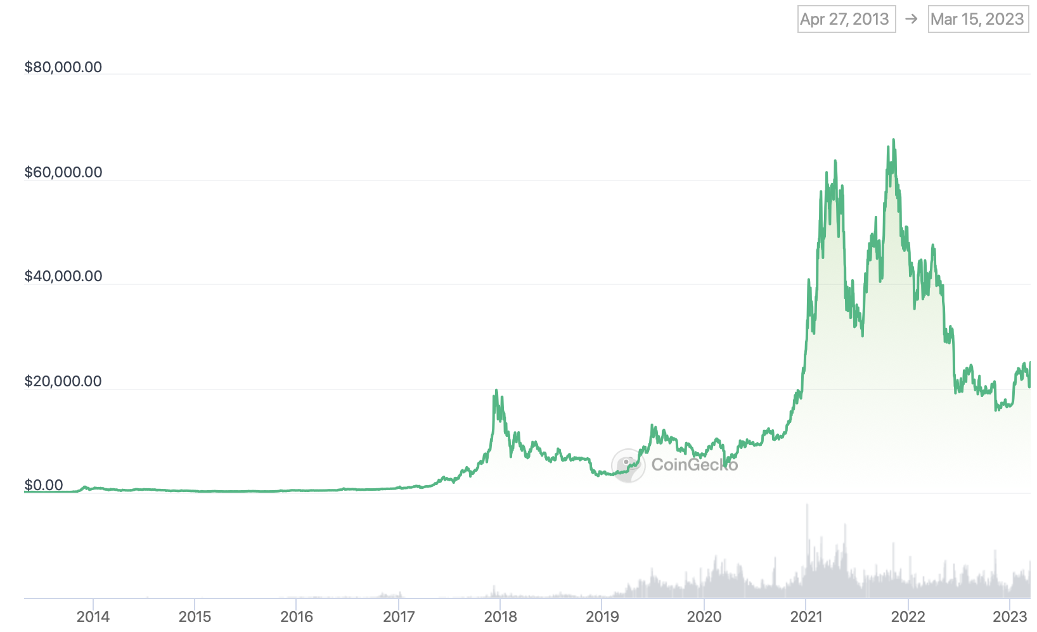
Bitcoins: What Is All the Excitement About?
$69,045 on Nov 10, 2021
$24,933 at 7am today

Slide 10
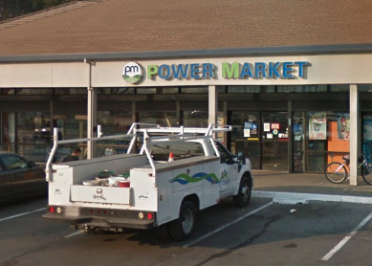
One of the Over 69,000 Bitcoin ATMs
Notes:
1489 Lake Drive SE

Slide 11
An Origin Story Worthy of a Pulp Novel!
The Mysterious Satoshi Nakamoto:
  Lehman Brothers Bankruptcy, 9/2008
  Halloween 2008: a white paper is published on the Internet laying out the idea and design for Bitcoin.
    The author (or authors) used Satoshi Nakamoto as a pseudonym.
  January 2009: Satoshi releases the first version of the Bitcoin software.
  2009-2010: Satoshi releases new versions of the software and is actively involved in internet chatter about Bitcoin.
  April 2011: Satoshi ceases all known and/or verified communications.
To this date the identity or identities of Satoshi are unknown.
Notes:
Rick Santelli 2/19/2009 Teaparty Rant

Slide 12
Primary Impetus or Goals
Satoshi’s Vision: “A purely peer-to-peer version of electronic cash [that] would allow online payments to be sent directly from one party to another without going through a financial institution.”
Fast
Decentralized
  No central organization monitoring transactions (no bank).
Secure
Anonymous

Slide 13
The Possible Economic Role for Bitcoin
More prosaically:
Facilitate payments at lower costs with speed and security.
  E.g., Credit Card Fees (3 percent).
  Merchant doesn’t get paid for at least 2 days.
  More importantly, cross-border transactions costs were $1.9 trillion in 2018.
  2019 Capital One hackers access personal information of 106 m users.
Meet the needs of previously unbanked.
  Particularly a problem in the Developing World, but…
  Fed estimates that 50 million adults in the US have little or no banking relationships.
Notes:
Satoshi, Bitcoin is “A purely peer-to-peer version of electronic cash [that] would allow online payments to be sent directly from one party to another without going through a financial institution.”
So, Natoshi’s goal was to improve money, in a way that did not depend banks or governments!

Slide 14
Facts about Cryptocurrencies (as of 3/15)
Bitcoin was the first and is the largest in terms of market cap of about $483 billion (total value of all bitcoins).
Ethereum is in second place with a market cap of about $203 billion.
Presently, 13,000 different varieties with a total market cap of about $1.13 TRillion (https://www.coingecko.com/en)
Market cap of domestically listed US companies is about $41 trillion (2020).
Source: CoinGecko.com and data.worldbank.org

Slide 15
Underlying Technology of Bitcoin
Digital Token (exists only as data on a computer) whose ownership is cryptographically protected.
Distributed Ledger, Block Chain Technology.
Software protocol that provides a “consensus” mechanism on the validity of new transactions.
Payments based on trust, without a “trusted third party.” (i.e., a bank or the Fed).
Notes:
Define distributed Ledger

Slide 16
So, how does it work?
Jack buys a bitcoin at an ATM.
  He is given a public number or key and a private encrypted key.
Jack can give his bitcoin to Jill by using Jill’s public key and verifying the transaction with his private key.
The new transaction is then posted on a number of different computers and can be read by anyone.
The clearing of the transaction is done with a public database or distributed ledger called a BLOCKCHAIN through a process know as BITCOIN MINING.
First, Bitcoin Miners gather about 3,000 new transactions into a “block.”
The next step is to provide a decentralized mechanism to add the new block to the block chain and agree that the transactions are valid.

Slide 17
Proof of Work: Bitcoin “Mining” (Nakamoto Concensus)
The miners’ competition involves generating long, random numbers (“hashing”) until one of the numbers fits a precise set of attributes.
Presently, miners produce on the order of 200 million trillion random numbers per second.
The winning miner then adds the new block to the previous block in the blockchain. The total process takes about 10 minutes. (Block proposal)
Why do miners mine?
  The winner of the competition gets compensated with new bitcoins and transaction fees.
However, the miner will not get the reward unless other miners subsequently add new blocks to the first miner’s block.
  They won’t do that unless they validate the first miner’s block.
In this way transactions are added to the chain via a “consensus” of miners.

Slide 18

Bitcoin Mine

Slide 19
Question #1: Is Bitcoin Serving an Economic Role?
Bitcoin is not and cannot be widely used to make transactions.
Scalability?
Price Instability.
Transactions costs
And, the network is costly
  Resources used in mining
  Environmental Costs
    Carbon footprint bigger than Sweden
    Electronic waste
BIS, Annual Report 2018, Chapter V
Notes:
Presently, Bitcoin mining requires 150-200 terawatt-hours per year, more than Thailand with a carbon footprinttof the Czech Republicenergy consumption (although less than is used in gold mining). (Note there are other consensus mechanisms that do not use as much energy.)
In addition, computer hardware quickly becomes obsolete and is dumped.

Slide 20
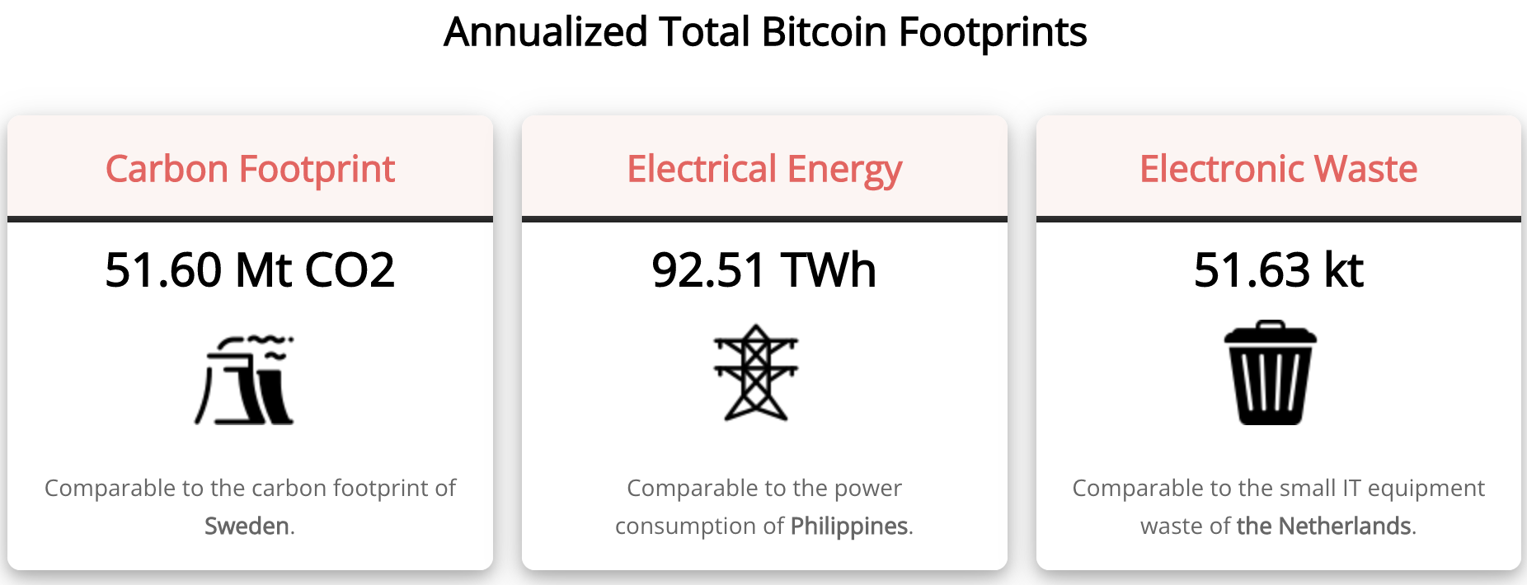
Bitcoin’s Environmental Impact
Source: https://digiconomist.net/bitcoin-energy-consumption

Slide 21
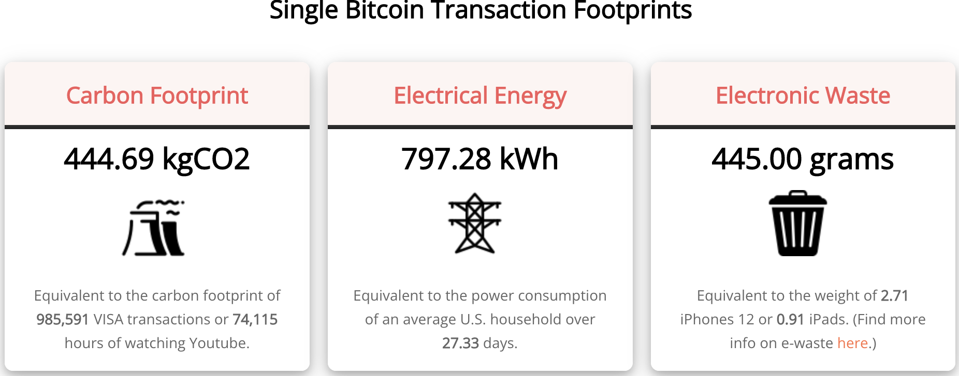
Bitcoin’s Environmental Impact
Source: https://digiconomist.net/bitcoin-energy-consumption

Slide 22
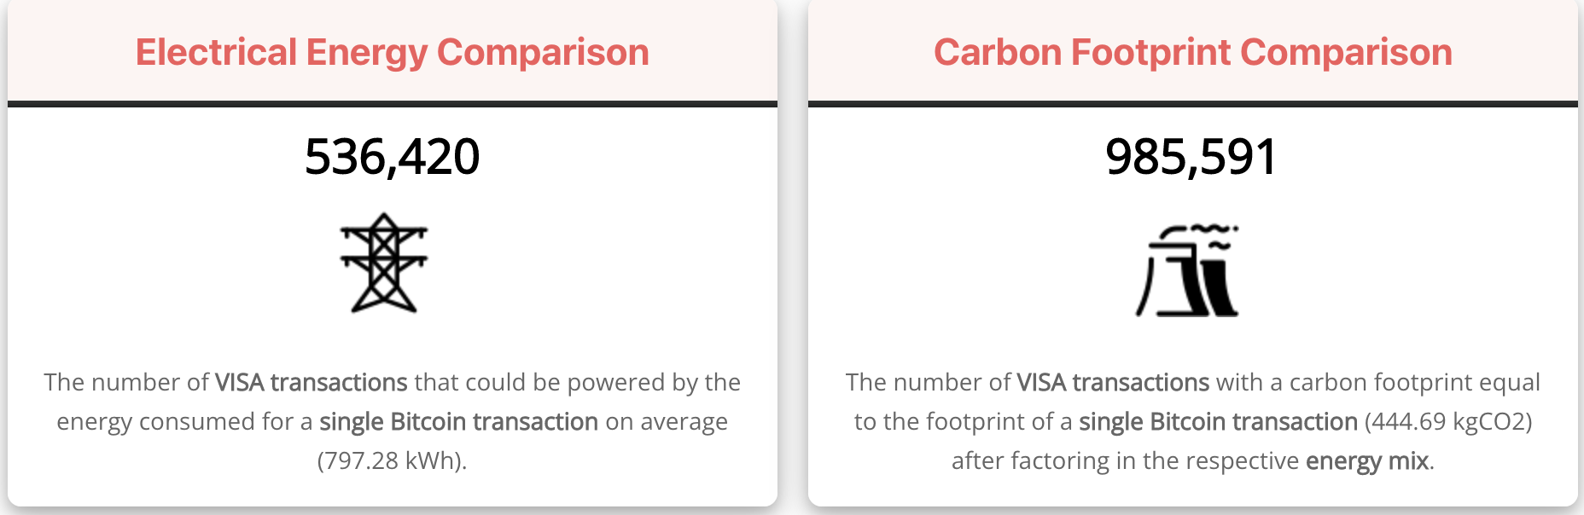
Bitcoin’s Environmental Impact vs Visa
Source: https://digiconomist.net/bitcoin-energy-consumption

Slide 23
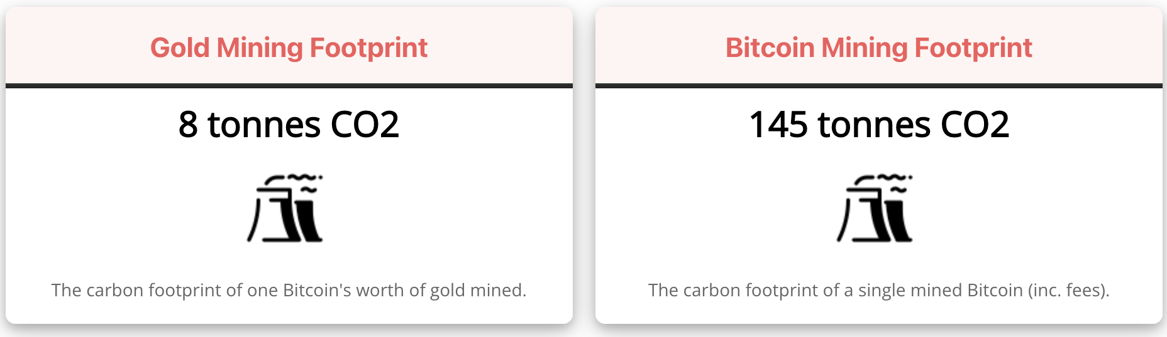
Bitcoin’s Environmental Impact vs Gold
Source: https://digiconomist.net/bitcoin-energy-consumption

Slide 24
Proof of Work: Pros and Cons
Pros:
  High level of security.
  Decentralized method of verifying transactions.
Cons:
  Unfavorable tradeoff between security and computational complexity.
    Energy consumption.
    Limited in terms of throughput.
      Time consuming and expensive.
      Requires expensive equipment.

Slide 25
Enter: Proof of Stake!

Slide 26
The Merge: Ethereum and Proof of Stake
Potential Block Creators place cryptocurrency (currently about 32 ETH) in specialized wallets that are locked while they are acting as blockchain “validators” (as opposed to “miners”).
Validators are selected randomly, where the odds of being selected are proportional to the value of the currency “staked” in the wallet.
The rest of the process of validation is similar: transaction fees only paid if subsequent blocks are added, but!!
If an invalid block is discovered the staked deposit is forfeited.
Notes:
Merge occurred on September 15th

Slide 27
Proof of Stake (POS) vs Proof of Work (POW)
POW competition over computer power and energy usage.
  Energy requirements are a barrier to entry.
POS competition over staked deposits.
  No computer power or energy usage involved.
  Faster transaction speeds.
Security? Many think POW is more secure and tampering more difficult.
Regulation? POS and the Howey Test. More on this later….

Slide 28
What Role Do Cryptocurrencies Play?

Slide 29
What Role Does Bitcoin (or Ether) Play?
For some it plays the same role as $100 bills:
  32.8% of all bills in circulation (more than the number of $1 bills)
  80.2% of the value of all bills.
Illegal Activity
Notes:
Trading of banned goods; e.g, Silk Road
Ransomware Payments.
Money Laundering.
Tax Evasion

Slide 30
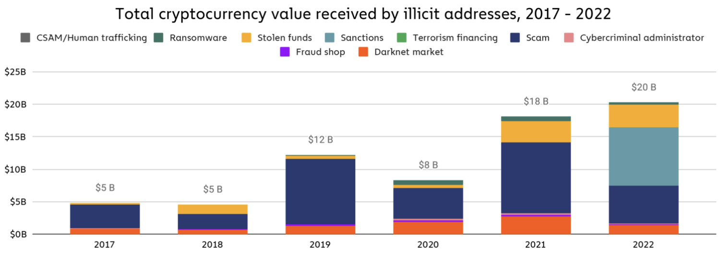
Illegal Activity and Bitcoinhe
Source: Chainalysis: https://blog.chainalysis.com/reports/2023-crypto-crime-report-introduction/

Slide 31
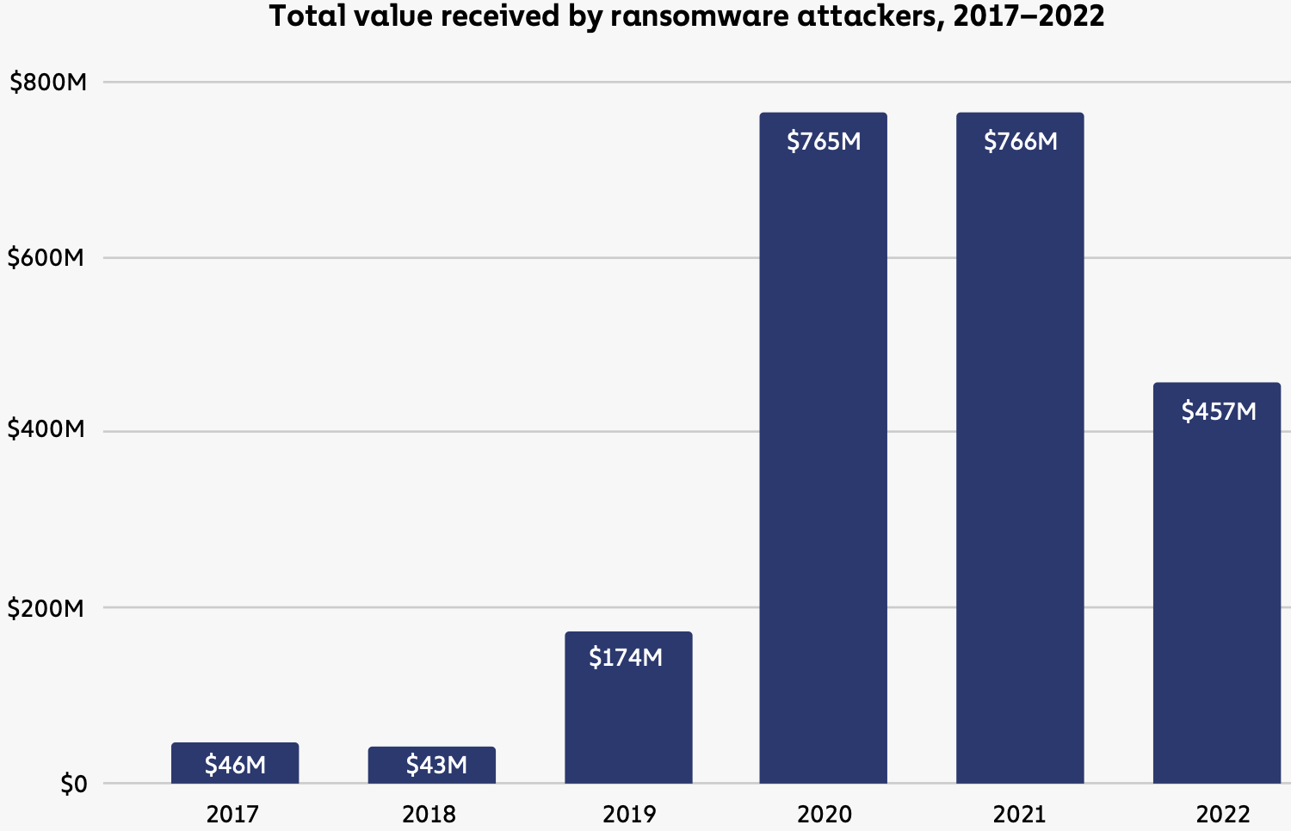
Ransomeware Volumes
True totals are MUCH higher!
Source: Chainalysis: The 2023 Crypto Crime Report, pg 27

Slide 32
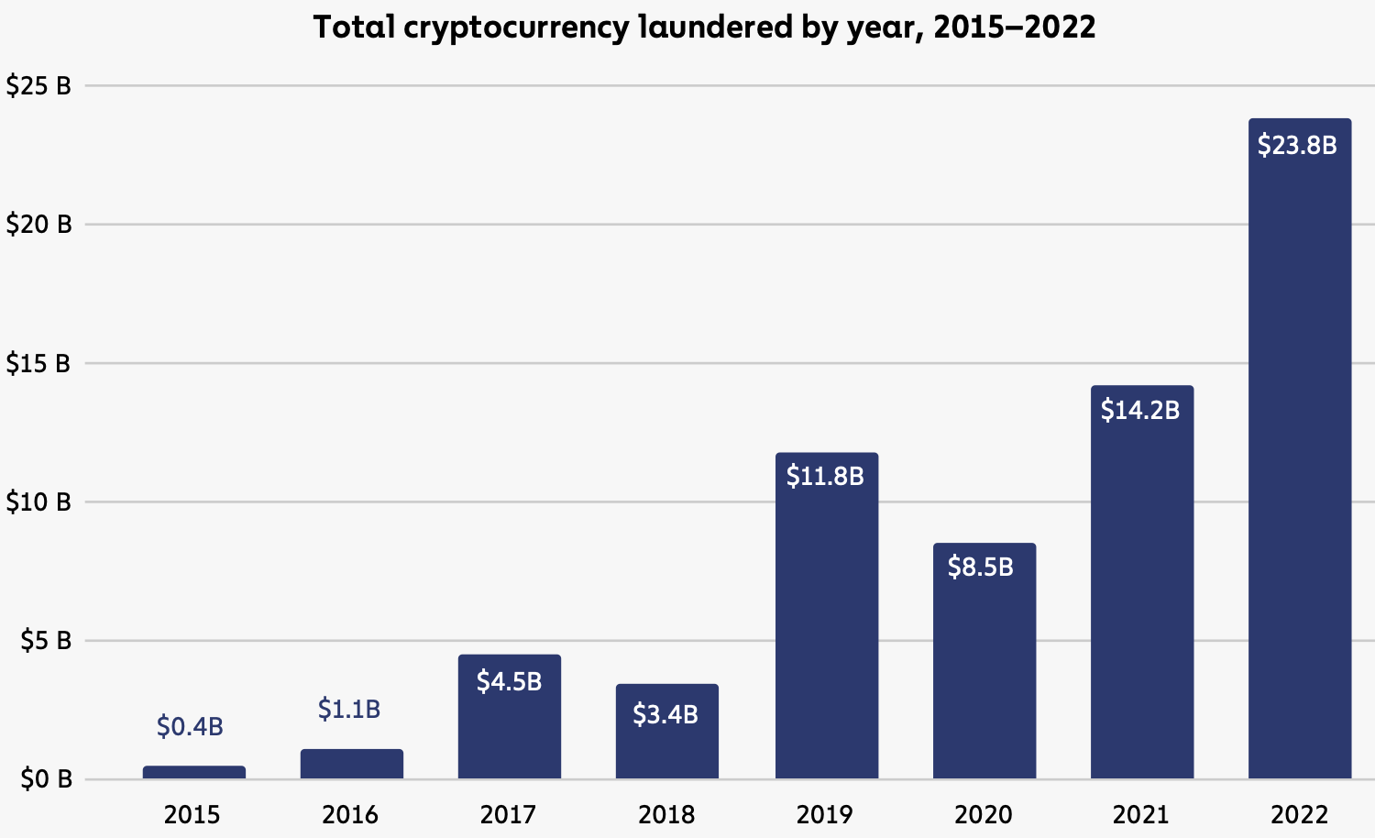
Money Laundering
Source: Chainalysis: The 2023 Crypto Crime Report, pg 43

Slide 33
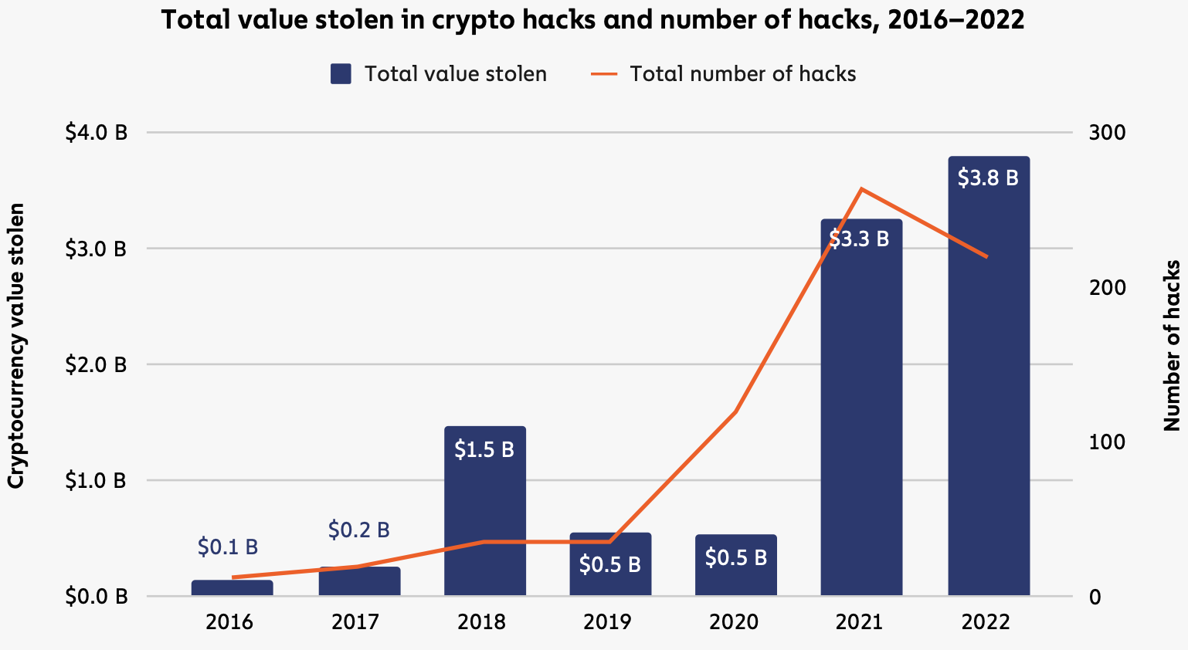
Stolen Funds: Hacking
Source: Chainalysis: The 2023 Crypto Crime Report, pg 56

Slide 34
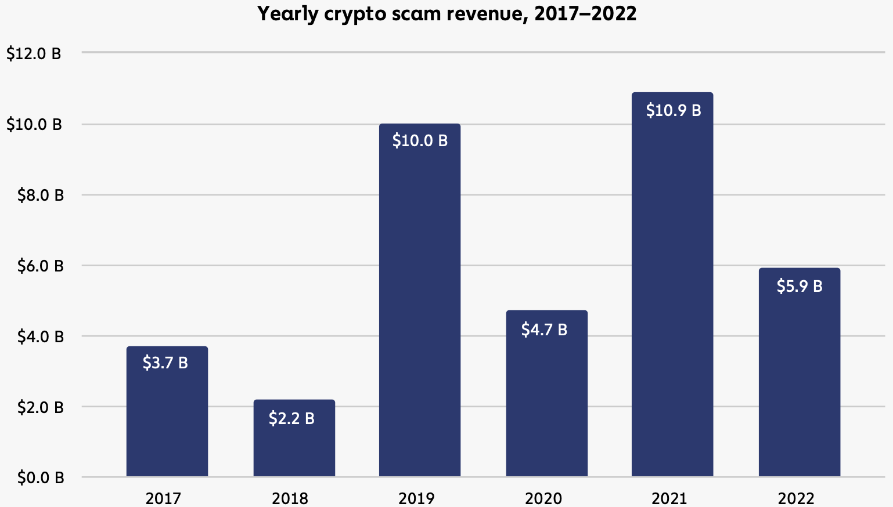
Crypto-based Scams – Overall Volumes
Source: Chainalysis: The 2023 Crypto Crime Report, pg 56

Slide 35
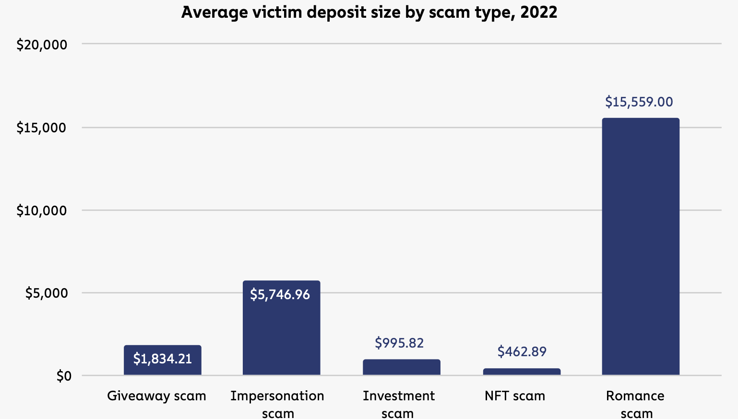
Crypto-based Scams – by Type
Source: Chainalysis: The 2023 Crypto Crime Report, pg 56

Slide 36
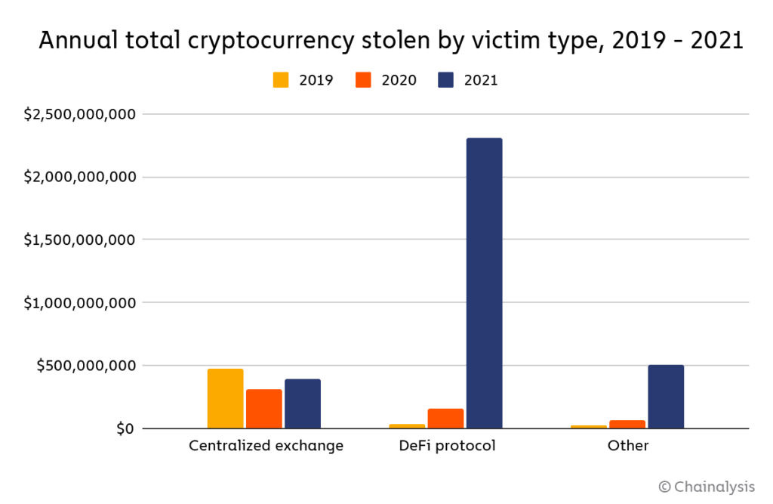
Clearly, Not Good News for DeFi

Slide 37
But What About as a Financial Investment?
It is hard to argue with the fact that Bitcoin had provided outsized returns for many, albeit very volatile.
Financial assets are promises by the issuer.
The “fundamental value” of a financial assets is the value of those promises based on the time value of money and the risk that the promises will not be kept.
What does Bitcoin promise?
Notes:
Promised future payments such as dividends for stocks or coupon payments for bonds.
For currencies, promise of future use in exchange with stable values.
Bitcoin only promises the possibility of capital gains, but not based on future payments.

Slide 38
How Do Economist Think About Investments?
Good starting place:
“In the short term the stock market behaves like a
voting machine, but in the long term it acts like a weighing machine.”
Warren Buttet, paraphrasing Benjamin Graham
What is being weighed?
Prospective payments from the security, or other intrinsic value.
In other words, its fundamental value.
Bitcoin?
Notes:
Warren Buffet paraphrasing Benjamin Graham. Payments mean dividends or coupon payments. Even, gold has some intrinsic value as the ultimate insuarbne

Slide 39
It’s Not Just Me
IGM Forum Question: Private, unbacked crypto assets serve no economic purpose.
Source: https://www.igmchicago.org/surveys/crypto-assets-2/

Slide 40
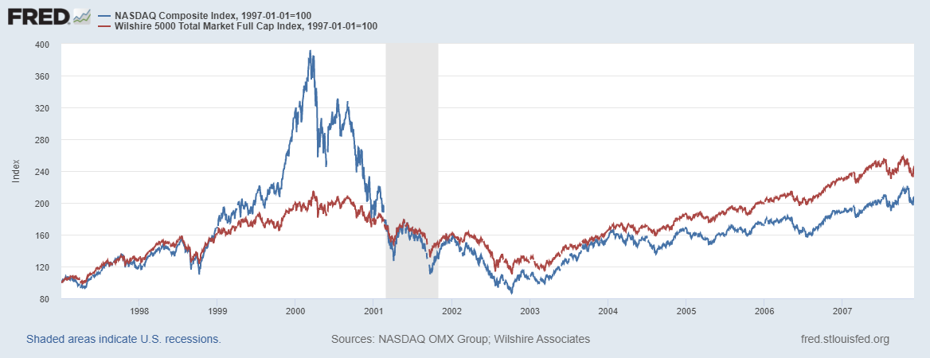
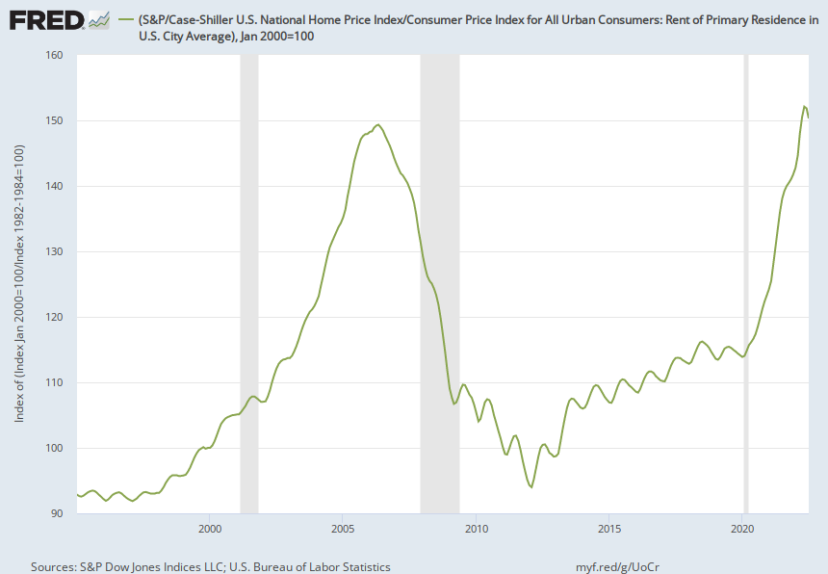

Does Voting Ever Get it “Wrong?”

Slide 41
Crypto compares favorably to….
The stock market?
A casino?

Slide 42
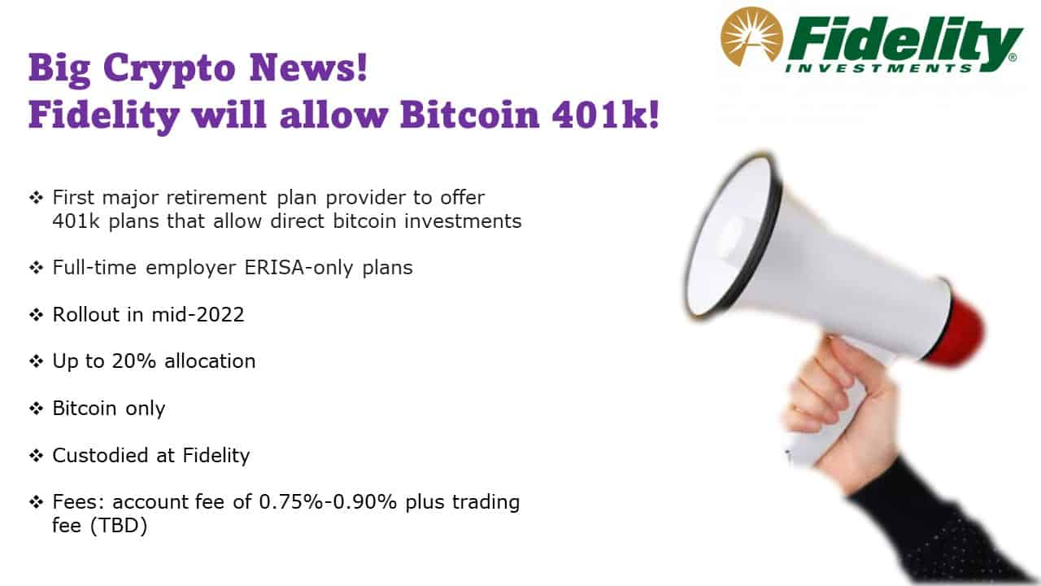
Give Me a Break?

Slide 43
Question 2: Value of the Underlying Technology?

Slide 44
Question #2: The Value of the New Technology?
Don’t Throw the baby out with the bathwater!
The value of cryptographically protected digital-tokens is nuanced.
Blockchain technologies have significant promise. Some of which is already being realized:
  Private blockchains, Walmart and its produce suppliers.
  Public Blockchains, Ethereum and smart contracts.
See: Mehta N,. Agashe A., P. Detroja Blockchain Bubble or Revolution, 2021
Notes:
Cryptographic protection is a tougher call and depends on your views of privacy rights, as well as what information is being kept private (e.g., medical records versus financial transactions) Supply Chains (Walmart IBM)
Smart Contracts (Xbox royalties)

Slide 45
Smart Contracts on the Blockchain
A Smart Contract is a computer code that resides on the block chain and is executed based on incoming information.
Example, Parametric Hurricane Insurance via the Blockchain:
  Computer program on Ethereum continuously monitors Charleston Executive Airport wind speed for 1 year.
  If the windspeed is greater than 150 miles per hour, immediately transfers 100 bitcoin to the Seabrook Island Property Association.
  If the windspeed is less than 150 miles per hour, but more than 125 miles per hour, immediately transfers 75 bitcoin; etc.
Smart Contracts are Automatic, Immediate, Irreversible and Uncontestable.

Slide 46
DeFi and Smart Contracts
Broad Category of Decentralized (De) Financial (Fi) Services
  Crypto exchanges, online lending platforms, crypto derivatives, insurance, startup finance, etc.
  Explosion over time: $1b in 2019; $15b in 2020; $100b as of 12/2021 (DefiPulse.com). [Recently, it has fallen]
Smart Contracts are executed mostly on the Ethereum blockchain. No brokers, financial intermediaries, traders, and little regulation.
I personally have not seen the “killer application” of DeFi.
Note in my insurance example, that bitcoin isn’t a great means of payment because of price volatility.
Notes:
Recently, these numbers have come down

Slide 47
But What about Digital Payments for Consumers?
Who pays for their lattes with cash? We already have digital payments, but what about the needs of the unbanked?
The US and the developed world are far behind Africa: Mobile, as in cellphone money, the M-Pesa.
Grameen Foundation:
Making Cash Digital is the Key to Possibility
When Poor Women Control their own money, it no longer controls them.
Notes:
Started in Kenya in 2007 and now available in 10 countries.
Buy M-Pesa credits from “agents” (local shop) which can be transferred to others with an M-Pesa account via cellphone.
96 percent of Kenyan households have a mobile account.
M-pesa is a digital currency, but not a crypto currency

Slide 48
Retail versus Wholesale Digital Payments
Retail: M-pesa
Wholesale: Cryptocurrency for DEFI transactions.
Bitcoin doesn’t work for either because of transactions costs and price volatility.
But, to tap into the potential benefits of DEFI we need a safe and secure crypto medium of exchange to facilitate DEFI transactions, at least wholesale transactions.

Slide 49
Enter Stablecoins
Stablecoin a cryptocurrency whose value is pegged to a fiat currency like the dollar.
  Reserve-Backed stablecoin, think Money Market Mutual Fund.
  Algorithmic stablecoin, think castles in the air (no foundation).
What are they useful for?
  Safe place to park your digital funds.
  Developers hope that they can be used for every day transactions.
What could go wrong?

Slide 50
Tether Stablecoin: Reserve Backed?
“The Coin That Could Wreck Crypto” (NYTIMES, 6/17/21):
  “In 2021, New York’s attorney general fined Tether $18.5 million and said the company had lied about its reserves, calling it ‘a stablecoin without stability.’”
Market cap of $68 billion; daily volume of $50 billion.
What could go wrong?
Notes:
WSJ, Headline, 8/11/2021, “Poly Network Hackers Steal More Than $600 Million in Cryptocurrency” Bloomberg 7/27/2021: “Tether and the Facebook Inc.-backed Diem token were a main focus of a recent meeting of U.S. regulators held on the financial risks posed by stablecoins.
Facebook NOVI wallets for holding Pax dollars ($1.1 billion in market cap)

Slide 51
Problems with Stablecoins
Not clear whether or not reserves exist.
If they do, are they in riskless assets?
Are there other claimants to the reserves?
What are the rules around redemptions?
How easy is it to transfer proceeds of a redemption into the banking system?
Bottom line: Completely Unregulated!

Slide 52
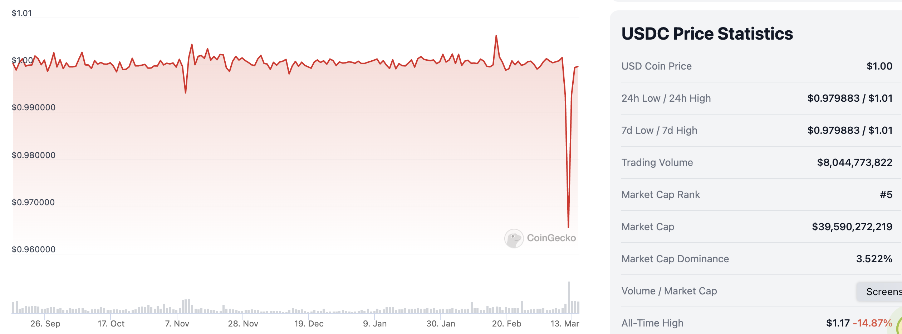
USDC & Silicon Valley Bank
$3.3 Billion in Reserves at SVB
Source: CoinGecko

Slide 53
Mark Zuckerberg & Stablecoins
Enter Facebook and Diem in 2019: Proposed blockchain enabled stablecoin, where all Facebook users would have diem wallets.
Regulators lodged lots of objections: Should a potentially ubiquitous private currency be run by one company?
What could go wrong?
Meta (Facebook) dropped out of the Diem project on 1/31/2022.
Notes:
WSJ, Headline, 8/11/2021, “Poly Network Hackers Steal More Than $600 Million in Cryptocurrency” Bloomberg 7/27/2021: “Tether and the Facebook Inc.-backed Diem token were a main focus of a recent meeting of U.S. regulators held on the financial risks posed by stablecoins.
Facebook NOVI wallets for holding Pax dollars ($1.1 billion in market cap)

Slide 54
Algorithmic Stablecoin
Create a regular cryptocurrency and call it say, Luna. (Governance coin)
Create a stablecoin and call it say, Terra.
Tie it to Luna. Allow exchanges:
  one terra into $1 worth of Luna
  $1 of Luna into one terra
Luna = $1, you can trade 1 Luna for 1 Terra and vice versa
Luna = $10, you can trade 1 Luna for 10 Terra
Terra price drops to $0.80, buy Terra and get $1 of Luna
  Increased demand for Terra increases its price.
Terra price rises to $1.20, sell Terra and buy $1.20 of Luna
  Reduced demand for Terra lowers its price.
What could go wrong?
Notes:
Collapse of Terra/Luna erased $60billion

Slide 55
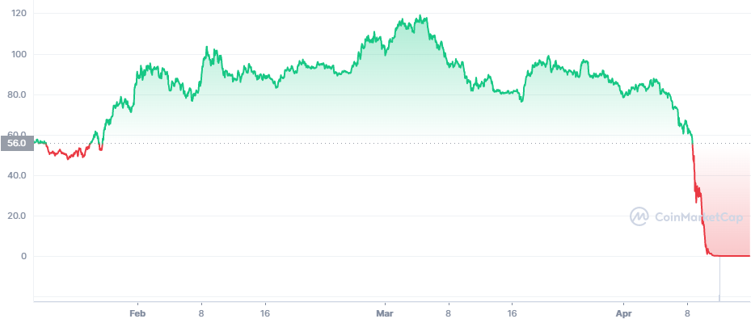
Luna’s Price This Year
It’s a problem when the capitalization
Of the governance coin is less than
The stock of the stablecoin!
Source: https://coinmarketcap.com/
Notes:
Wiped out $60 billion in value

Slide 56
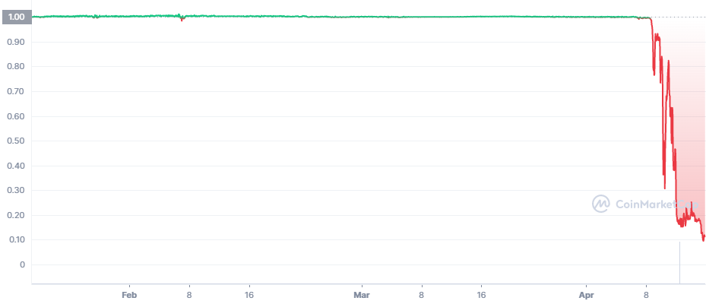
Terra’s Price
Death SpiRal!!!
The value of an algorithmic stablecoin is derived purely from
"the expectation of its future market worth."
Erased $60 billion worth of value.
Notes:
Collapse of Terra/Luna erased $60billion

Slide 57
“Cryptocurrency is the Wild West of our
Financial System” Sen. E. Warren of Mass
Pick Your Own Adventure: (https://web3isgoinggreat.com/)

Slide 58
“Clean Up the Mess on Aisle 3”
Gary Gensler, Chair of the SEC wants to regulate.
Rostin Benham, Chair of the CFTC.
Janet Yellen at Treasury.
They will act, but they would need Congressional legislation, too: Cash markets in cryptocurrencies are viewed as commodities and are unregulated.
Notes:
Paper on CBDC

Slide 59
What is Good Regulation?
The Principles Are Easy;
  Eliminate fraud, abuse, illegal activity and manipulation.
  Do not let markets be dominated by a small number of powerful firms.
  Allow startups with new innovations to displace incumbent firms.
  Minimize risk of a financial crisis.
Legislation and Implementation: Not So Easy

Slide 60
1930s Regulation in the 21st Century
Bank: An institution that accepts deposits and makes loans for a profit.
  Stablecoins?
  Money Market Mutual Funds?
Investment Contract subject to security laws (Howey Test):
  Investment of Money.
  Common Enterprise (pooling of funds).
  Expectation of profit from effort others.
  Profits come from the efforts of a promoter or third party.
  BlockFI and crypto Lending.

Slide 61
BlockFi and Crypto Lending
Feb, 14, 2022, NYTimes Headline
BlockFi, a crypto firm, reaches a $100 million settlement for failing to register loan products.
Cannot offer interest-bearing accounts to US residents.
BlockFi was working work with the SEC to develop an account that meets US security laws.

Slide 62
Sam Bankman-Fried & FTX
In August, Fortune compared the 30-yr old to Warren Buffet.
Helped save BlockFi and other crypto firms in May 2022.
Mid November $32b firm declares bankruptcy; SBF’s net worth goes from $16 billion to 0.
Misused customer funds to prop up his investment firm Alameda Research.
Regulation is needed!

Slide 63
Biden Framework for Regulating Crypto (9/16)
Protect Consumers, Investors, and Business.
Promote Access to Safe Financial Services.
Fostering Financial Stability.
Advancing Responsible Innovation.
Reinforcing our Global Financial Leadership.
Fighting Illicit Finance.
Exploring a U.S. Central Bank Digital Currency (CBDC)

Slide 64
Three Recent US Government Reports
Presidential Working Group on Financial Markets on Stable Coins and CBDC, 11/2021.
Federal Reserve Discussion Paper on CBDCs, 1/2022
Executive Order of the President, 3/09/2022
  (a): fraud; (b) stability; (c illicit activity
  (d): “We must reinforce United States leadership in the global financial system and in technological and economic competitiveness.”
  (e) equitable access; (f) support responsible innovation;
  Explore Central Bank Digital Dollar

Slide 65
Do We Need More Than (Good) Regulation?
The Bank for International Settlement (BIS) and a number of central banks are exploring how the development of Central Bank Digital Currencies (CBDC) can:
“contribute to an open, safe and competitive monetary environment that supports innovation and serves the public interest.”
Source of quotes, BIS Annual Report 2021

Slide 66
CBDCs and Other Central Bank Liabilities
The Fed and most Central Banks presently already have digital money!
CBDCs would permit wider access to the Fed’s digital assets to other financial institutions and possibly to the public.
In addition, CBDCs could be designed for rapid settlement, finality, privacy and security (perhaps using blockchain technology).
Notes:
The Fed and most Central Banks presently have two financial liabilities:
Currency.
Bank Reserves.
Bank Reserves are Balances that Commercial Banks hold at the Fed and that are used in check clearing. They are already di

Slide 67
Uses of CBDCs
Private instant risk-free transfers.
Make basic purchases:
  Private individuals and businesses as well as government.
Collect taxes or make benefit payments.
Program payments to be made at specific times.
Hold money is a secure and safe location.

Slide 68
CBDCs – Benefits not Without Risks
Benefits
Risks
Meet today and tomorrow’s demand for payment services.
Improve cross-border transactions.
Support the dollar’s international role.
Financial inclusion.
Extent public access to safe central bank money.
Change financial market structure.
Safety and stability of the financial system.
Effect on monetary policy implementation.
Privacy and data protection.
Operational resiliance and cybersecurity.

Slide 69
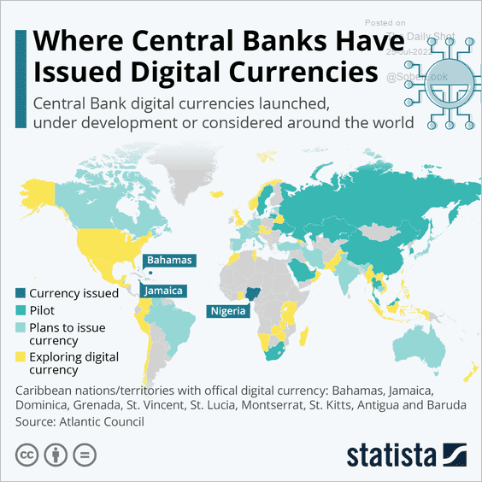
The Devil Is In the Details
Many countries as diverse as Sweden, Ecuador and China have begun experiments with CBDCs.
Source: E. Prasad, The Future of Money
Notes:
MIT Boston Fed experiment. But pretty conservative vision. CBDC offered to consumers through insured institutions, i.e., banks. Electronic cash like checks.

Slide 70
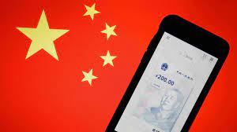
The Devil Is In the Details
Many countries as diverse as Sweden, Ecuador and China have begun experiments with CBDCs.
Where is the Fed?
Source: E. Prasad, The Future of Money
Notes:
MIT Boston Fed experiment. But pretty conservative vision. CBDC offered to consumers through insured institutions, i.e., banks. Electronic cash like checks.

Slide 71




Who should design our payment system?
Vitaly Buterin
Vitaly Buterin
Notes:
Vitalek Buterin, age 27 cofounder of Ethereum at age 20

Slide 72
Summary
Cryptocurrencies are digital money.
  Part of decentralized finance (DeFi).
There is little economic case for cryptocurrencies.
  There is a case that the underlying technology is useful.
  Its operation can be VERY slow and costly.
  Government backed electronic currencies may be the path forward.
Crypto is currently an unregulated banking environment.
  Banking is regulated for VERY good reason.
Crypto has also provided the impetus for significant change in financial markets and technology!

Slide 73
Thank you!
Any Questions?
www.NEEDelegation.org
Jon Haveman, Ph.D.
Jon@NEEDelegation.org
Contact NEED: info@NEEDelegation.org
Submit a testimonial: www.NEEDelegation.org/testimonials.php
Become a Friend of NEED: www.NEEDelegation.org/friend.php

Slide 74
Glossary
Traditional Money is currency plus bank checking accounts.
Currency is paper and coin issued by the government. Currency is legal tender and must be accepted for all debts. Transactions using currency are immediate and final (can’t be undone without the agreement of both parties.)
Digital Payments are used for purchases where no physical money is exchanged. Examples include many online banking payments, credit card payments, PayPal.
Digital Currency or Virtual currency is a form of money that exists solely in digital form, such as a digital token (i.e., as data on a computer). Examples: cryptocurrencies, central bank digital currencies and virtual currencies used in online gaming.
Cryptographic identity protection assigns people two account numbers, or keys, one public and one private. Public record keeping is done using the public key and transactions are authorized using the private key.
Cryptocurrency is a digital currency where the owner’s identity is protected using cryptographic encryption and where record keeping is done with a public blockchain, e.g., Bitcoin.
Stablecoin is a cryptocurrency with a stable value of $1, somewhat like a money market mutual fund.

Slide 75
Glossary (Cont.)
Distributed ledger is a database for recording transactions or other information, where the information or ledger is shared on a network of many computers simultaneously.
Blockchains are distributed ledgers where new transactions (new blocks) are added to the chain sequentially when a consensus of the network agrees that the transactions are valid.
Decentralized Finance (DeFi) is peer-to-peer financial activity conducted through public blockchains and smart contracts.
Smart Contracts are computer programs that execute automatically based on external conditions. Example, travel insurance that pays off automatically when a flight is cancelled.
Central Bank Digital Currency (CBDC) is a digital currency issued by a central bank. Different central banks are experimenting with various forms of CBDCs, including some using blockchain technology, electronic wallets and cryptography.

Slide 76
Resources to Learn More
N. Mehta, et.al. Blockchain Bubble or Revolution
E Prasad, The Future of Money (https://youtu.be/o3NuHb7V1IA)
Presidential Working Group on Financial Markets, 11/1/21 (https://home.treasury.gov/system/files/136/StableCoinReport_Nov1_508.pdf)
Federal Reserve White paper
(https://www.federalreserve.gov/publications/files/money-and-payments-20220120.pdf)
Executive Order: https://www.whitehouse.gov/briefing-room/statements-releases/2022/03/09/fact-sheet-president-biden-to-sign-executive-order-on-ensuring-responsible-innovation-in-digital-assets/

