Slide 1
Osher Lifelong Learning Institute, Winter 2026
The Economics of Public Policy Issues
Johns Hopkins University
Host: Geoffrey Woglom, Director
National Economic Education Delegation

Slide 2
Course Schedule
Contemporary Economic Policy Issues
Week 1 (2/25): Economic Update & Tariffs Geoffrey Woglom, Amherst College
Week 2 (3/04): An Introduction to Cryptocurrencies, Geoffrey Woglom
Week 3 (3/11): Saving Social Security, Geoffrey Woglom
Week 4 (3/18) Economics of Immigration, Robert Gitter, Ohio Wesleyan University
Week 5 (3/25): Climate Change Economics, Sarah Jacobson, Williams College
Week 6 (2/27): Health Care Economics, Robert Rebelein, Vassar College

Slide 3
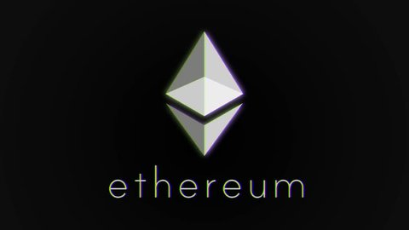
Cryptocurrencies & The Future of Money
Geoffrey Woglom,
Professor of Economics
Amherst College, emeritus
March 29, 2023

Slide 4
Submitting Questions
Raise your digital hand or submit questions in the chat.
I will try to handle them as they come up.
10 Minute Break; after 5 minutes I will answer questions in the chat.
We will do a verbal Q&A once the material has been presented.
Slides will be available from the NEED website tomorrow (https://needelegation.org/delivered_presentations.php)

Slide 5
Outline of the Talk
Fun Facts about Bitcoin
A little bit on the underlying technology of cryptocurrencies.
Evaluation of 3 uses of this technology
Bitcoin as a financial investment.
Smart Contracts and Defi.
Crypto Currencies as a “Means of Payment:” Stablecoins.
Central Bank Digital Currencies (CBDC); e.g. a digital-euro

Slide 6
But First, What is Bitcoin?
Bitcoin is the first cryptocurrency and was invented in 2008.
Cryptocurrencies are a form of digital money (viz. data on a computer) where account ownership is confidential and where record keeping is decentralized over a multitude of computers
Little regulation; no reliance on trusted third party; no government!

Slide 7
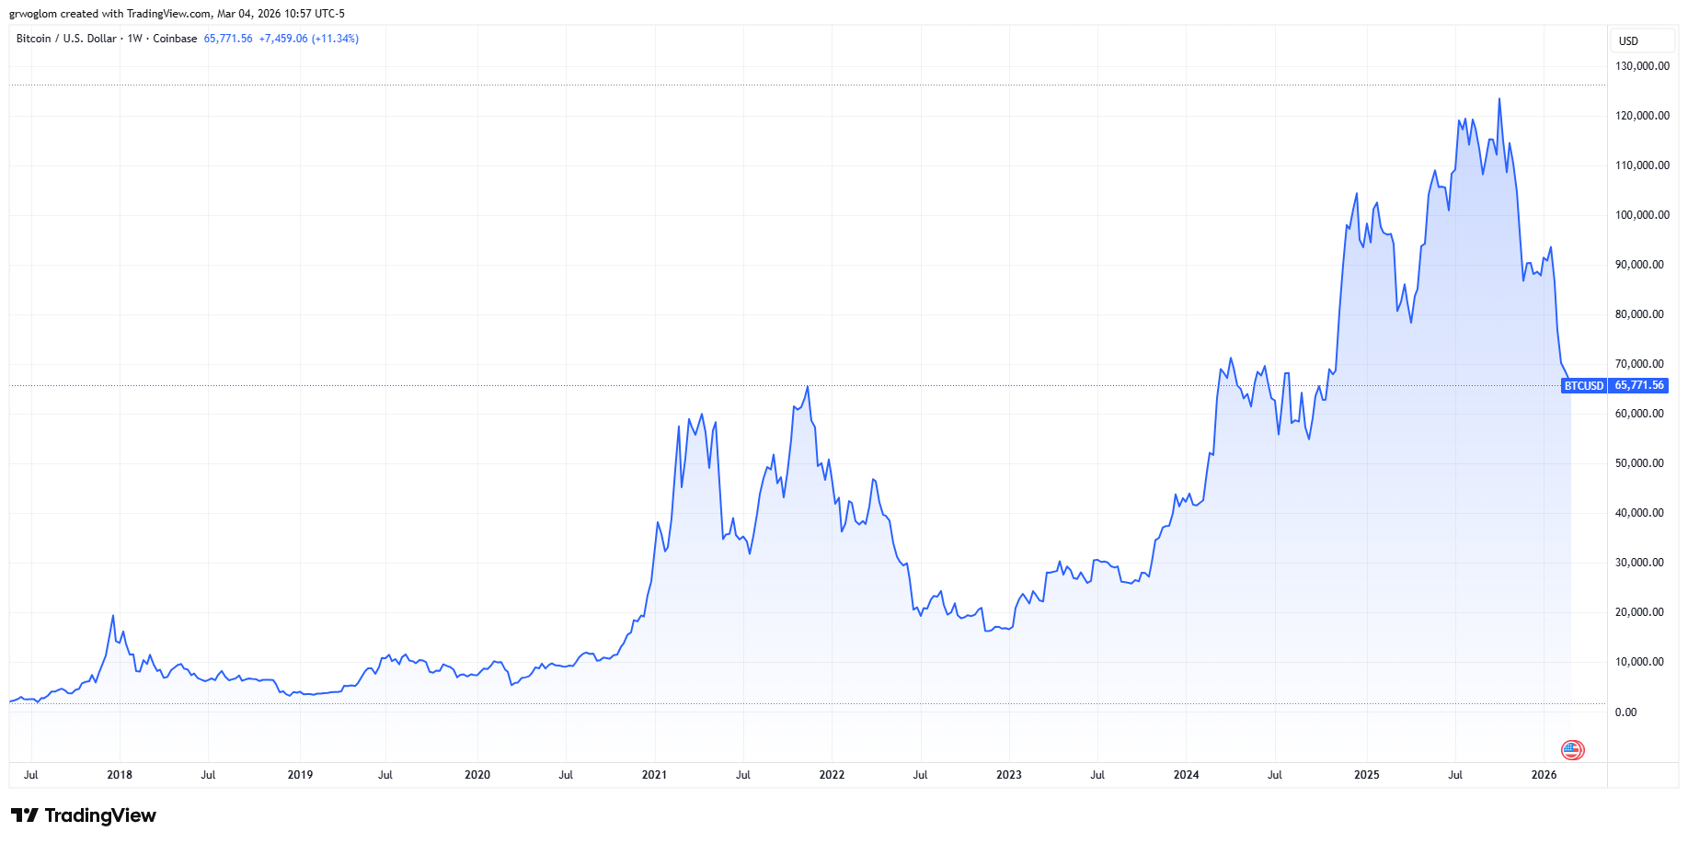
Bitcoins: What Is All the Excitement About?
Was
46% decline

Slide 8
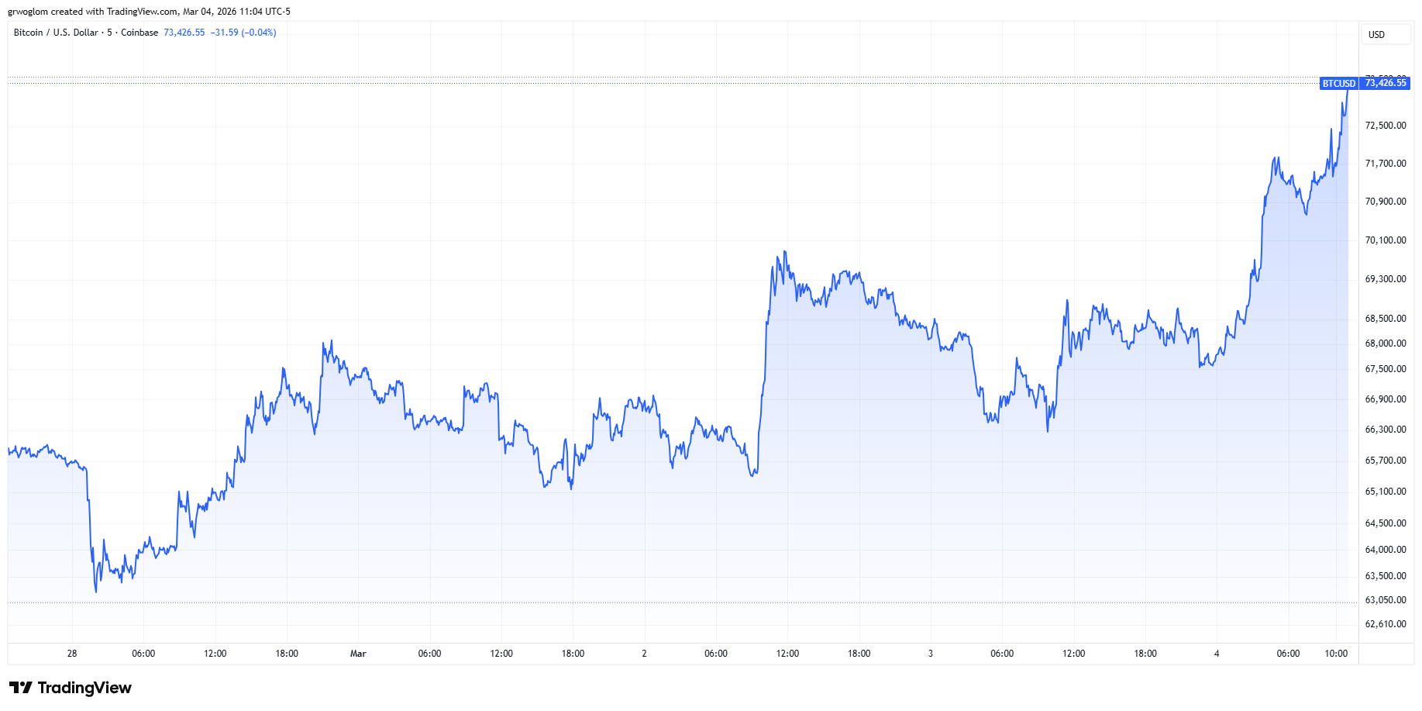
Why I have to Get the data at the last minute
11.5% rise

Slide 9
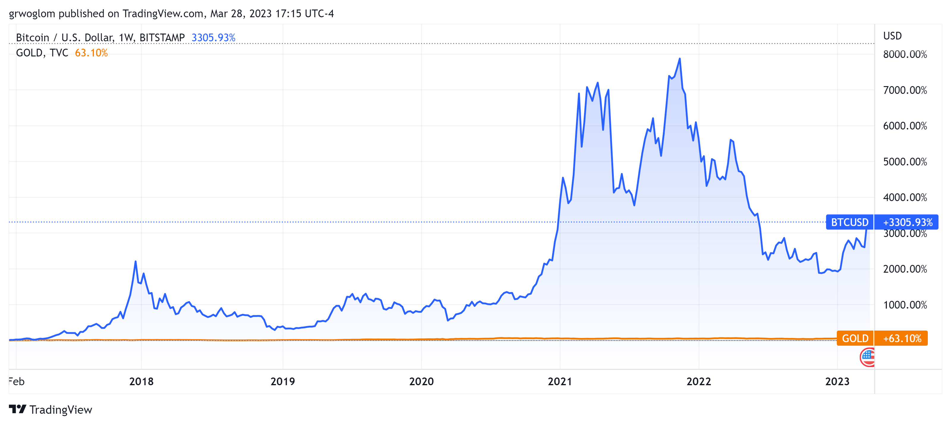
Bitcoins: What Is All the Excitement About?
Was
$27,300, at 5PM

Slide 10
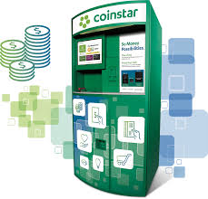
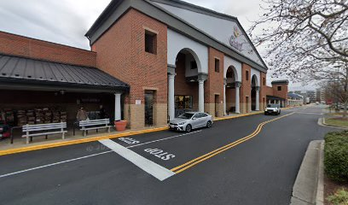
One of the Over 30,000 Bitcoin ATMs

Slide 11
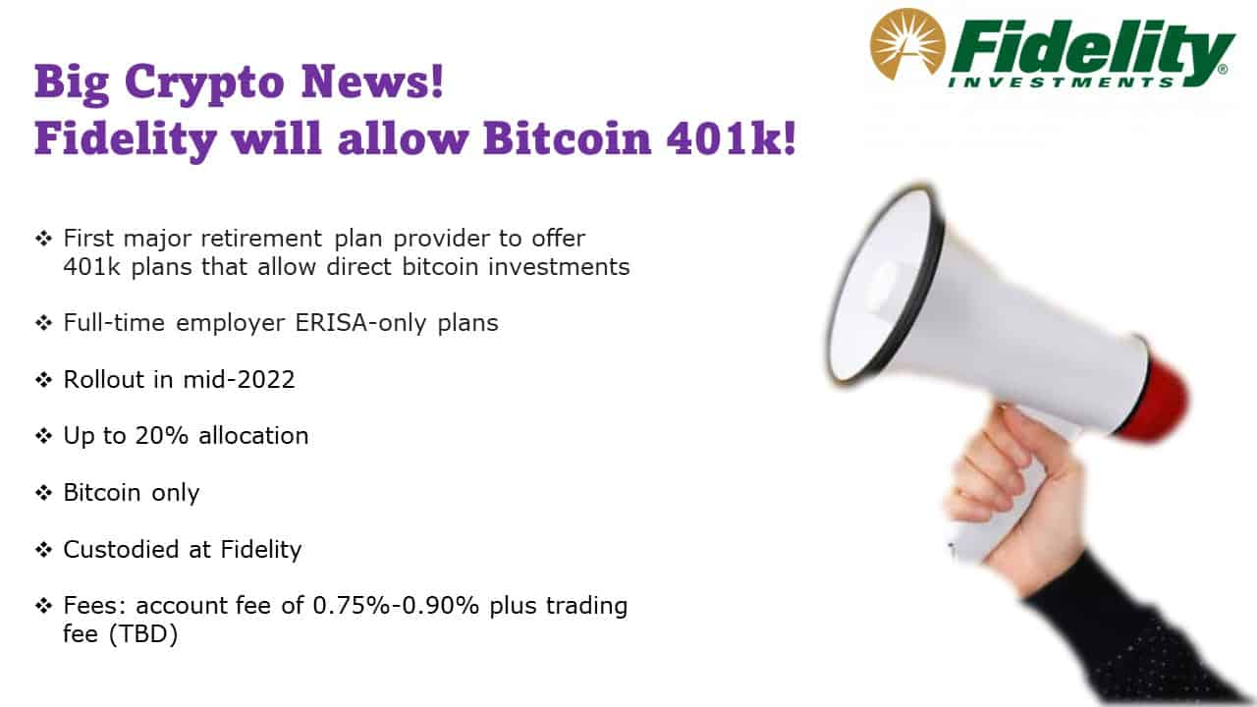
Give Me a Break?
As of 1/10/2024, Fidelity also offers Bitcoin, Ethereum and Solana ETFs

Slide 12
An Origin Story Worthy of a Pulp Novel!
The Mysterious Satoshi Nakamoto:
Lehman Brothers Bankruptcy, 9/2008
Halloween 2008: a white paper is published on the Internet laying out the idea and design for Bitcoin. The author (or authors) used Satoshi Nakamoto as a pseudonym.
January 2009: Satoshi releases the first version of the Bitcoin software.
2009-2010: Satoshi releases new versions of the software and is actively involved in Internet Chatter about Bitcoin.
April 2011: Satoshi ceases all known and/or verified communications.
To this date the identity or identities of Satoshi are unknown.
Notes:
Rick Santelli 2/19/2009 Teaparty Rant

Slide 13
The Possible Economic Role for Bitcoin
Satoshi’s Vision: “A purely peer-to-peer version of electronic cash [that] would allow online payments to be sent directly from one party to another without going through a financial institution.”
More, prosaically
Facilitate payments at lower costs with speed and security
E.g., Credit Card Fees (3 percent).
Merchant doesn’t get paid for at least 2 days.
More importantly, cross-border transactions costs were $1.9 trillion in 2018.
2019 Capital One hackers access personal information of 106 m users
Meet the needs of previously unbanked.
Particularly a problem in the Developing World, but
Fed estimates that 50 million US adults have little or no banking relationships.
Notes:
Satoshi, Bitcoin is “A purely peer-to-peer version of electronic cash [that] would allow online payments to be sent directly from one party to another without going through a financial institution.”
So, Natoshi’s goal was to improve money, in a way that did not depend banks or governments!

Slide 14
Facts about Cryptocurrencies (as of 3/4, 11AM)
Bitcoin was the first and is the largest in terms of market cap (total value of all bitcoins) of about $1.46 trillion.
Ethereum is in second place with a market cap of about $258 billion; tether a “stablecoin” is third at $183 billion.
Presently, 20,000 different varieties with a total market cap of about $2.55 trillion (https://www.coingecko.com/en)
Market cap of domestically listed US companies is about $62 trillion.

Slide 15
Underlying Technology of Bitcoin
Digital Token (exists only as data on a computer) whose ownership is cryptographically protected.
Distributed Ledger, Block Chain Technology.
Software protocol the provides a “consensus” mechanism on the validity of new transactions.
Payments based on trust, without a “trusted third party.” (i.e, a bank or the Fed).
Notes:
Define distributed Ledger

Slide 16
So, how does a blockchain transaction work?
Jack, the owner of a bitcoin is given a public number or key and a private encrypted key.
Jack can trade his bitcoin with Jill by using Jill’s public key and verifying the transaction with his private key.
The new transaction is then posted on a a number of different computers and can be read by anyone.
The clearing of the transaction is done with public database or distributed ledger called a blockchain through a process know as bitcoin mining.
First, Bitcoin Miners gather about 3000 new transactions into a “block.”
The next step is to provide a decentralized mechanism to add the new block to the block chain and agree that the transactions are valid
Notes:
When you buy a bitcoin at the ATM, that is not a blockchain transaction

Slide 17
Proof of Work: Bitcoin “Mining”
The miners’ competition involves generating long, random numbers (“hashing”) until one of the numbers fits a precise set of attributes.
Presently, miners produce on the order of 200 million trillion random numbers per second.
The winning miner then adds the new block to the previous block in the blockchain. The total process takes about 10 minutes
The incentive for miners is that the winner of the competition gets compensated with new bitcoins and transaction fees.
However, the miner will not get the reward unless other miners subsequently add new blocks to the first miner’s block.
In this way transactions are added to the chain via a “consensus” of miners.

Slide 18
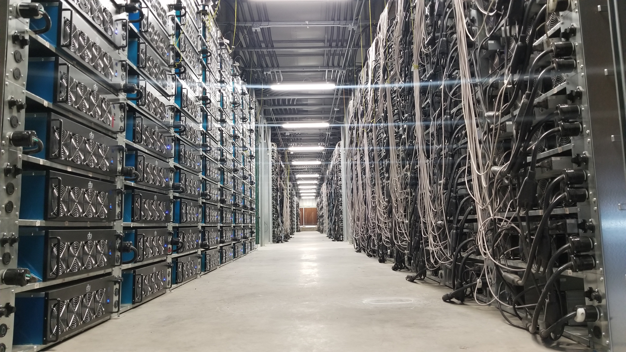
Bitcoin Mine

Slide 19
“A purely peer-to-peer version of electronic cash…”?
Not really,
By far most trades in bitcoin take place with exchanges such as Binance and formerly FTK (of Sam Bankman Fried fame).
The ratio of exchange trades to blockchain trades is estimated to be in the range of 5 to 10 to one.
Blockchain fees cost about $1, but also require the user to have a bitcoin wallet.
Exchange fees are on the order 0.1 percent.
And, then there are also Bitcoin ETFs
What trades tend to occur on the blockchain and why?

Slide 20
Bitcoin’s Environmental Impact
Bitcoin Mining uses something between 40 and 60 percent of Data Centers useage.
Source: https://digiconomist.net/bitcoin-energy-consumption
Notes:
Data Centers: 240-340 and growing fast; One BTC transaction uses 1.5 megawatts, or household consumption over 52 days.

Slide 21
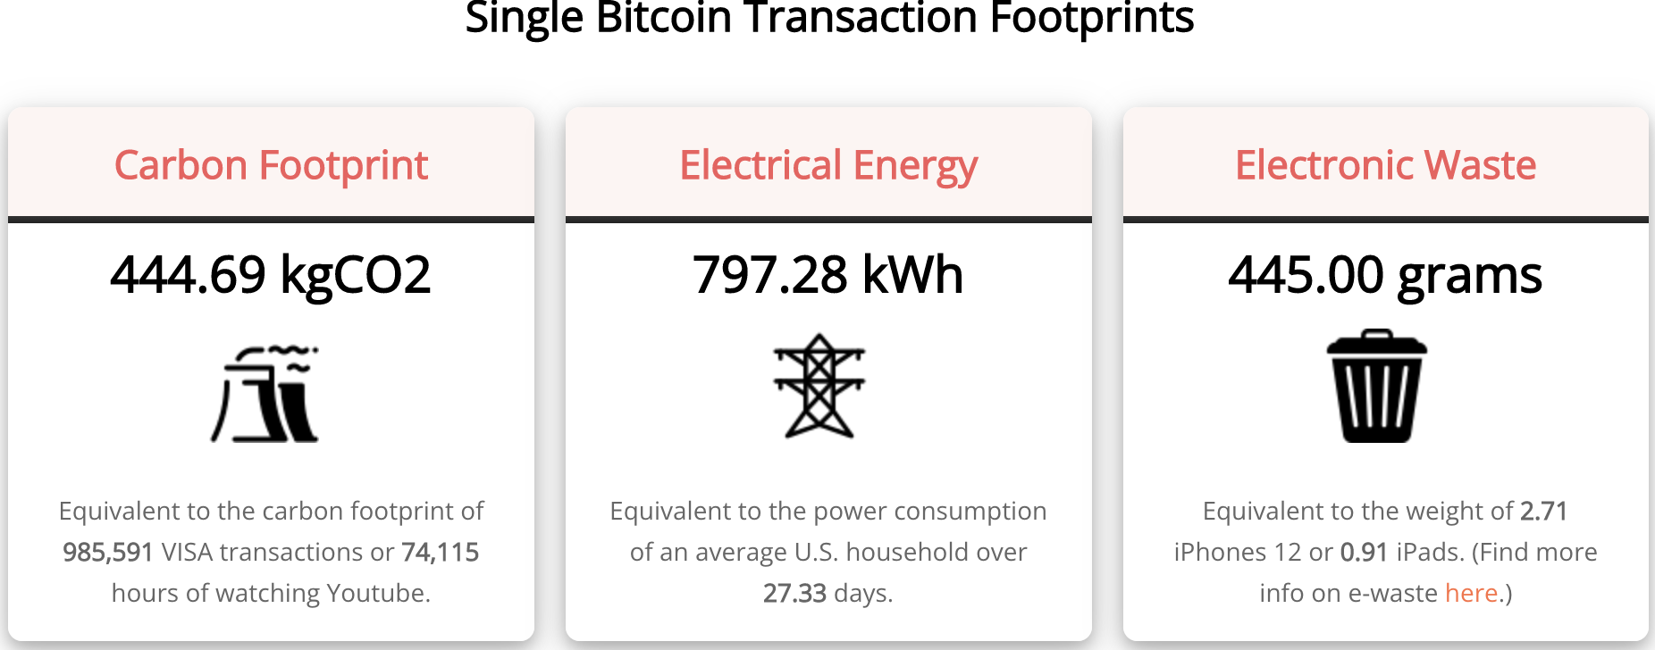
Bitcoin’s Environmental Impact
Source: https://digiconomist.net/bitcoin-energy-consumption

Slide 22
The Merge: Ethereum and Proof of Stake
Potential Block Creators place cryptocurrency in specialized wallets that are locked while they are acting as blockchain “validators” (as opposed to “miners”).
Validators are selected randomly, where the odds of being selected are proportional to the value of the currency “staked” in the wallet.
The rest of the process of validation is similar: transaction fees only paid if subsequent blocks are added, but!!
If an invalid block is discovered the staked deposit is forfeited.
Notes:
Merge occurred on September 15th

Slide 23
What Role Does Bitcoin (or Ether) Play?
For some it plays the same role as $100 bills: 32.8% of all bills in circulation (more than the number of $1 bills): Illegal Activity.
Notes:
Trading of banned goods; e.g, Silk Road
Ransomware Payments.
Money Laundering.
Tax Evasion

Slide 24
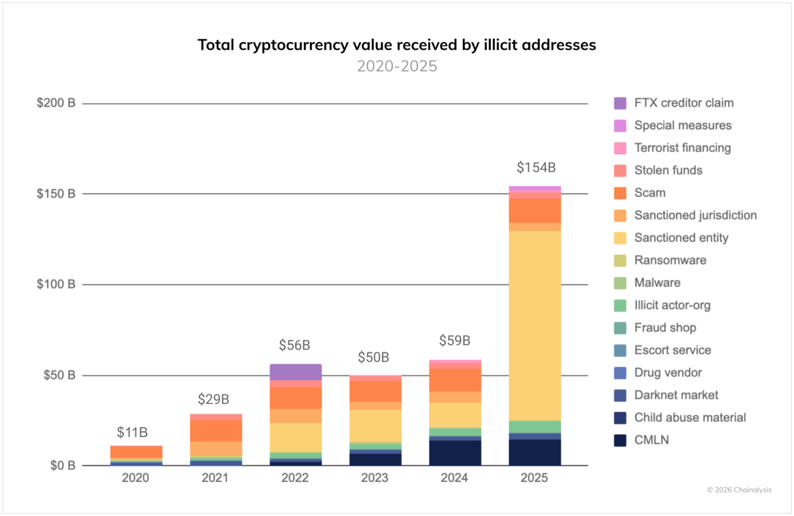
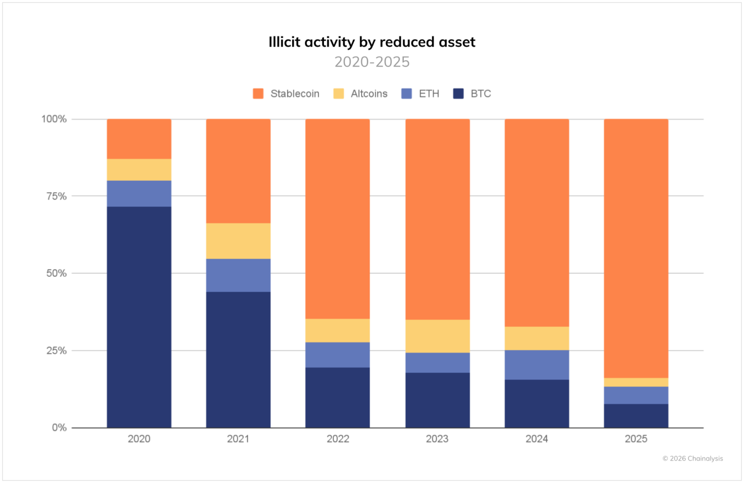
Illegal Activity and Bitcoinhe
https://www.chainalysis.com/blog/2026-crypto-crime-report-introduction/
Notes:
Crypto Advocates: Less than 1% share of the total volume of transactions.

Slide 25
Binance’s Troubled History
Largest Crypto Exchange with a daily volume of $10 billion dollars more than twice as big as second place.
2023 plea deal admitting to money laundering, violating sanctions and transactions from “illicit” actors. Fined $4.3 billion; CEO Changpeng Zhao served 4 months in prison. Trump pardon 10/25
2/23, WSJ, “Binance Fired Staff Who Flagged $1 Billion Moving to Sanctioned Iran Entities”
Notes:
FTX collapsed in 11/2022

Slide 26
But What about as a Financial Investment?
It is hard to argue with the fact that Bitcoin had provided outsized returns for many, albeit very volatile.
Financial Assets are Promises by the Issuer
The “fundamental value” of a financial assets is the value of those promises based on the time value of money and the risk that the promises will not be kept.
What does Bitcoin promise?
Notes:
Promised future payments such as dividends for stocks or coupon payments for bonds.
For currencies, promise of future use in exchange with stable values.
Bitcoin only promises the possibility of capital gains, but not based on future payments.

Slide 27
How Do Economist Think About Investments?
Good Starting Place
“In the short term the stock market behaves like a voting machine, but in the long term it acts like a weighing machine.”
What is being “weighed” is prospective payments from the security, or other intrinsic value, i.e. its fundamental value.
Bitcoin?
Notes:
Warren Buffet paraphrasing Benjamin Graham. Payments mean dividends or coupon payments. Even, gold has some intrinsic value as the ultimate insuarbne

Slide 28
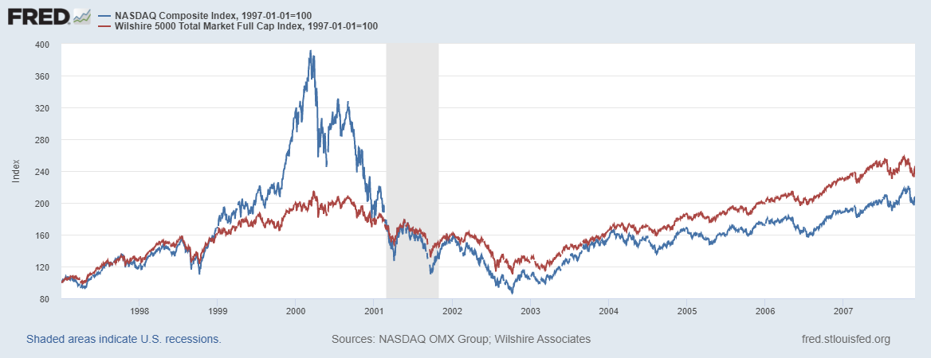

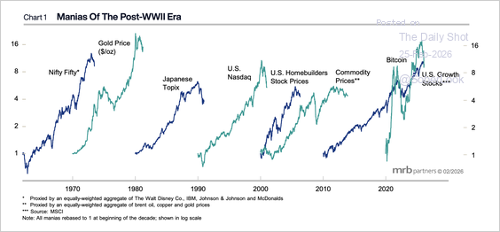
Does Voting Ever Get it “Wrong?”
https://www.mrbpartners.com/

Slide 29
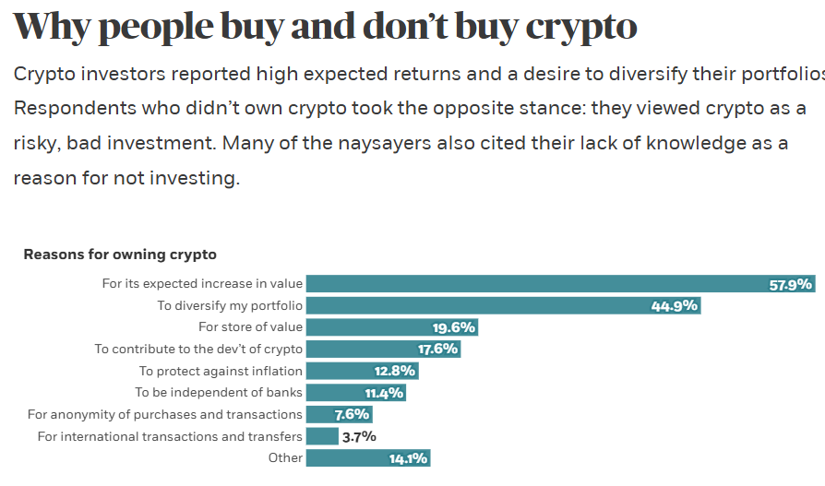
Well, Why Do People Buy Bitcoin?
https://www.chicagobooth.edu/review/stephen-colbert-was-wrong-bitcoin

Slide 30
Smart Contracts on the Blockchain
A Smart Contract is a computer code that resides on the block chain and is executed based on incoming information.
Example, Parametric Hurricane Insurance via the Blockchain:
Computer program on Ethereum continuously monitors Charleston Executive Airport wind speed for 1 year.
If the windspeed is greater than 150 miles per hour, immediately transfers 100 bitcoin to the Seabrook Island Property Association.
If the windspeed is less than 150 miles per hour, but more than 125 miles per hour, immediately transfers 75 bitcoin; etc.
Smart Contracts are Automatic, Immediate, Irreversible and Uncontestable.

Slide 31
Real World Example: Lemonade Insurance & Kenyan Farmers
“In 2023, 7000 farmers in Kenya who signed up for the insurance were paid out claims due to the occurrence of a drought. No claim adjuster, claims, or processors were needed. Because information like rain data is easily measured for an oracle to transmit, a multitude of use cases exist.”
Sadly, the vast majority of smart contracts are all in the crypto world: e.g. process stable coin transactions, run derivative exchanges for crypto currencies.
https://today.westlaw.com/Document/I0c8dc176826c11efb5eab7c3554138a0/View/FullText.html?

Slide 32
Desirable Attributes of a Means of Payment
Accepted for most, if not all transactions and widely available. (wire transfers?).
Stable value. (Bitcoin?).
Low transactions costs. (3 percent credit card fees?).
Time to clear. (Venmo payments?).
Risk Use (Dollar Bills & counterfeits).
Irreversibility (Bad Checks ?)
Privacy (?) (Bank Checks and the Bank Safety Act)
“Tokenized” for use in smart contracts.

Slide 33
Can The Digital World Do Better
Yes!
Kenya’s M- Pesa (2007!): Cell phone app for storing digital currency. (https://www.m-pesa.africa/).
India’s UPI (2016): Universally accepted “Apple Pay.” (https://www.imf.org/en/publications/fandd/issues/2025/09/indias-frictionless-payments-maria-peria).

Slide 34
Stablecoins
Cryptocurrency whose value is pegged to a national currency. We will focus on the dollar stable coins.
Reserve Backed (?): when coins are issued, assets are purchased to “back” the coins value.
Algorithmically Backed.
Pioneered by Tether in 2014, it is now the largest, but it has a checkered past.
Prior to the current administration, financial regulators were negative towards stable coins.
E.g., Facebook and Diem in 2019: Proposed blockchain enabled stablecoin, where all Facebook users would have diem wallets.
Regulators lodged lots of objections: Should a potentially ubiquitous private currency be run by one company?
What could go wrong?
Meta (Facebook) dropped out of the Diem project on 1/31/2022.
Notes:
WSJ, Headline, 8/11/2021, “Poly Network Hackers Steal More Than $600 Million in Cryptocurrency” Bloomberg 7/27/2021: “Tether and the Facebook Inc.-backed Diem token were a main focus of a recent meeting of U.S. regulators held on the financial risks posed by stablecoins.
Facebook NOVI wallets for holding Pax dollars ($1.1 billion in market cap)

Slide 35
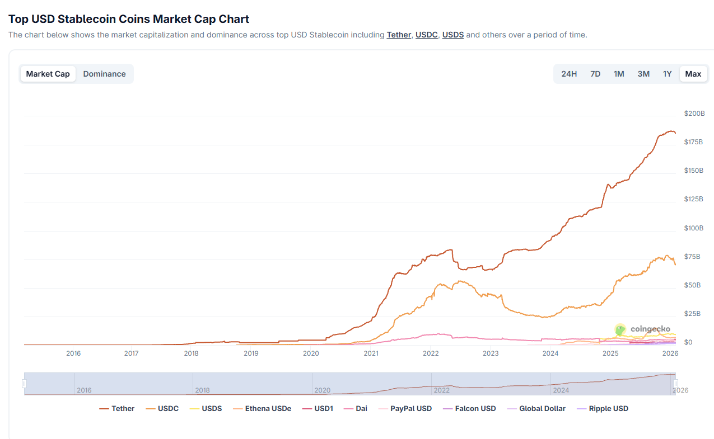
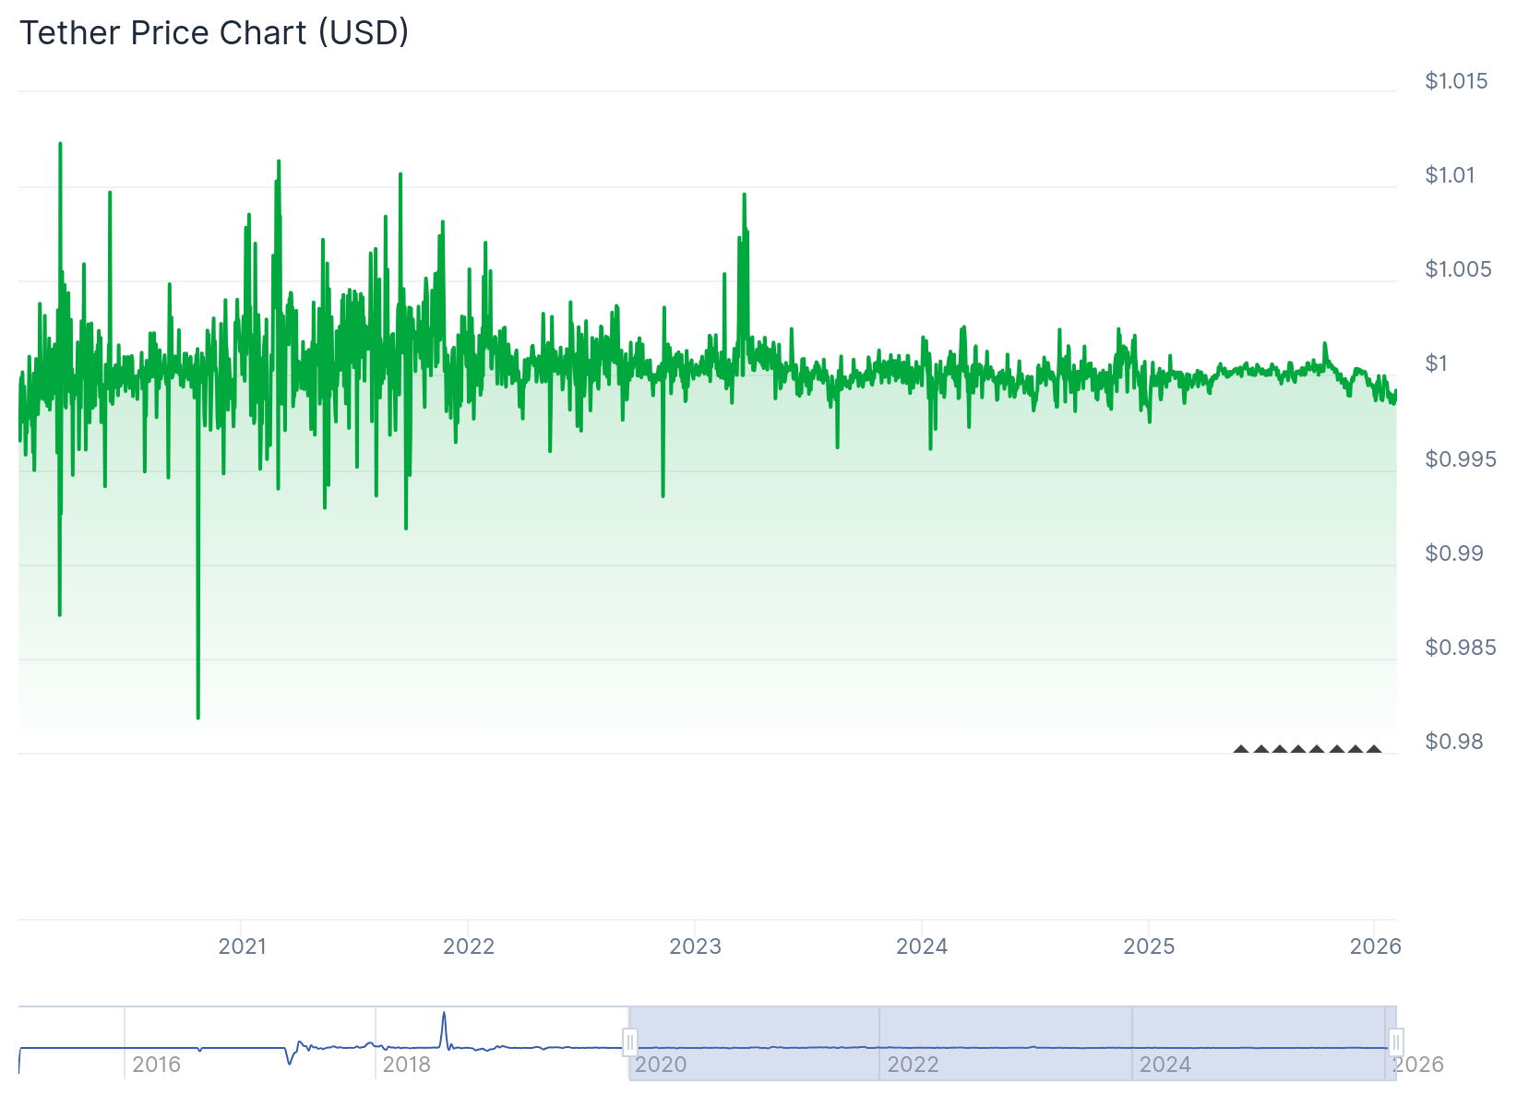
Stablecoins
https://www.coingecko.com/en/categories/usd-stablecoin#key-stats
Tether’s price fell to $.95 on May 22 2022 because of collapse of an algorithmic stable coin called terra

Slide 36
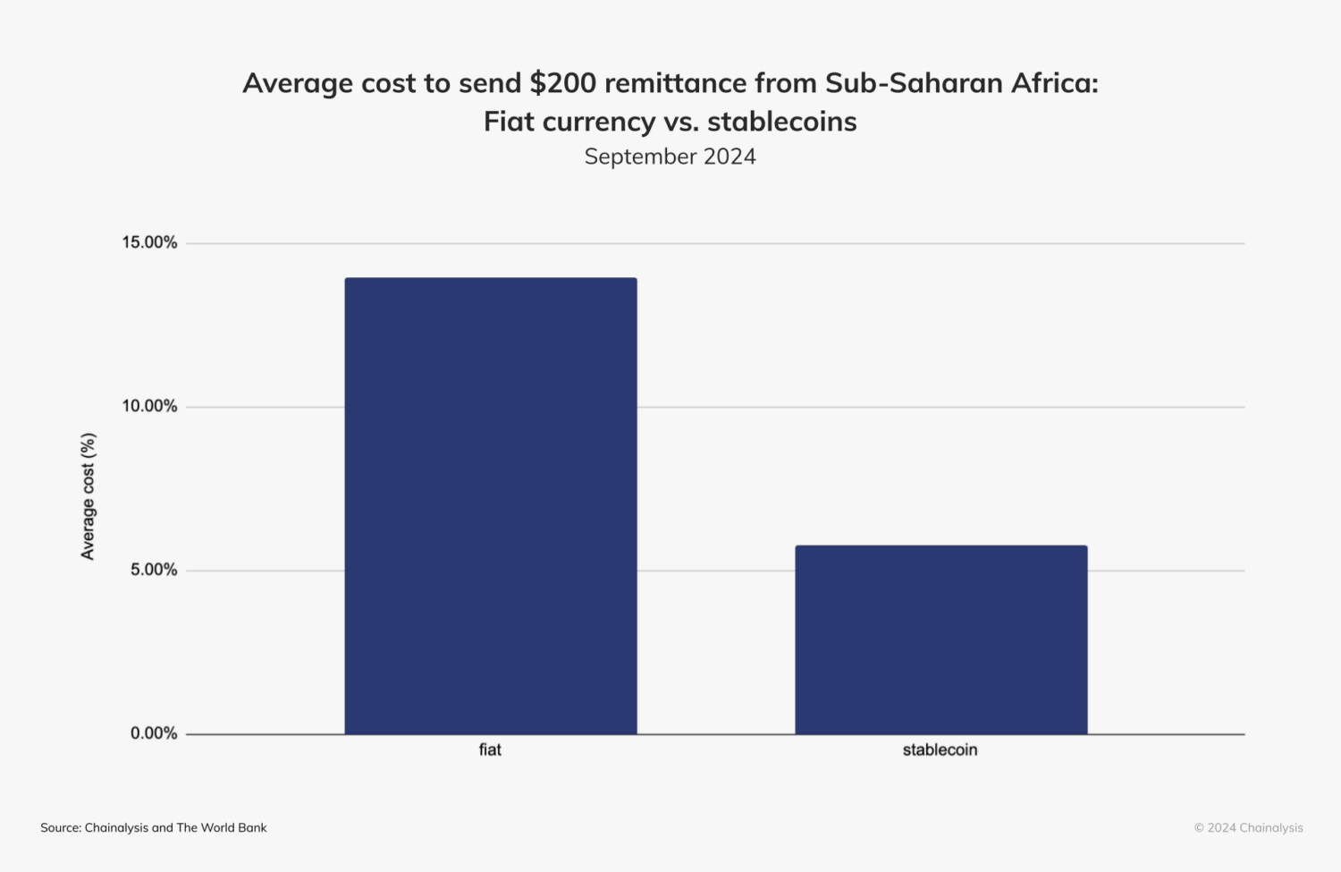
Uses of Stable Coins
Smart Contracts “lock” stablecoins for payments when the contract is executed
Peer-to-Peer Transactions in regions with unreliable banking.
Cross-border Transactions and Remittances.
https://www.chainalysis.com/blog/stablecoins-most-popular-asset/

Slide 37
Uses: Continued
Store of value in the face of instability and inflation.
Illicit Activity: maybe less than 1%, but still major source of illegal activity.
Sanction Evasion, but also
Getting funds to insurgents in countries like Iran.

Slide 38
Recent Congressional Legislation
Genius Act (passed): Stable Coin Issuers
100% liquid asset backing of stable coins (but includes uninsured bank deposits.
Regulated by bank regulators, not CFTC nor SEC (which had been tough)
Cannot pay interest.
Must use blockchain technology.
Must Comply with the Bank Secrecy Act.
The Anti-CBDC Surveillance State Act (House passed): prohibits the Fed from issuing or even investigating a Fed digital dollar.
The Clarity Act (House Passed): Regulatory definitions for other crypto coins; awaiting a Senate vote. At the last minute, Crypto-advocates objected

Slide 39
Should Stablecoins Be Allowed to Pay Interest?
Some stablecoins pay about 3.5% in “rewards.”
If they can, they would be like a “tokenized” money market mutual fund serving as a more attractive means of payment.
Estimates of potential losses in bank deposits range from $500 billion to $6.6 trillion.
So, what is the harm?

Slide 40
Economic Role of Banks
Accept deposits and manage check payments.
Make Commercial Loans and Mortgages
Money Market Mutual Funds (MMMF) do 1, but not 2.
Stablecoins would be a crypto version of MMMF with more convenient payment options.
Unintended Consequences?
The primary source of credit for small business (500 or fewer employees) is from small and regional bank lending.
Small business:
Number: over 38K
Employment: over 62 million employees, or over 45% total private sector employment.

Slide 41
Small Banks (less than $300 billion total assets)
Deposits $5.6 trillion out of a total of $18.6 trillion.
Loans and Mortgages $2.8 trillion out of $5.8
Understated because while a $301 billion bank is classified as “large,” its lending is more like a small bank.
“Large Banks” include JPMorgan Chase at $3.8 trillion and Bank of Glen Burnie at $352 billion.
Unintended Consequences of current Crypto enthusiasm?
Shift from loans to small firms towards financing US Treasuries.

Slide 42
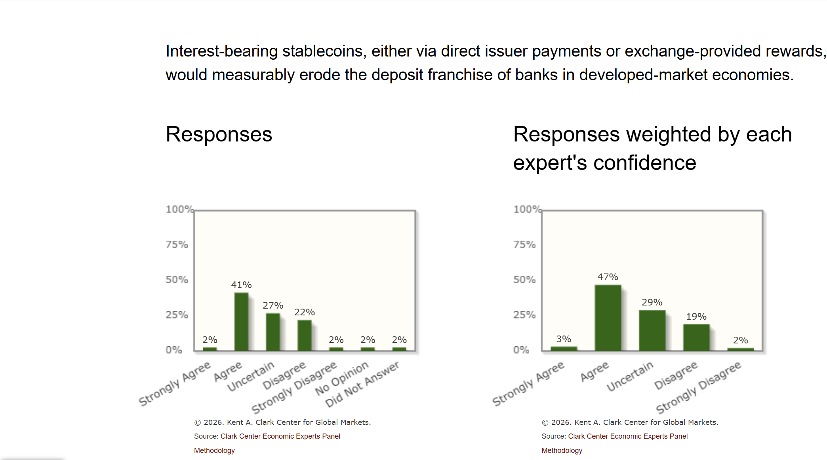
Expert Views on Stable Coins and Banks

Slide 43
Central Banks Get into the Act
Central Bank Digital Currency is a digital form of currency and is a liability of the central banks just like paper currency. Like M-pesa run by the countries central bank. Except many CBDCs can be tokenized and used in smart contracts
Jamaica, the Bahamas and Nigeria are “operational.”
China has a “pilot” program that was started in 2020. In 2025, 3.4 trillion transactions worth about $2.4 trillion.
ECB has started working on a digital euro in 2023 and is planning a pilot project to start in 2027 with a full rollout in 2029.
And, scores of other countries are exploring or running pilot programs

Slide 44
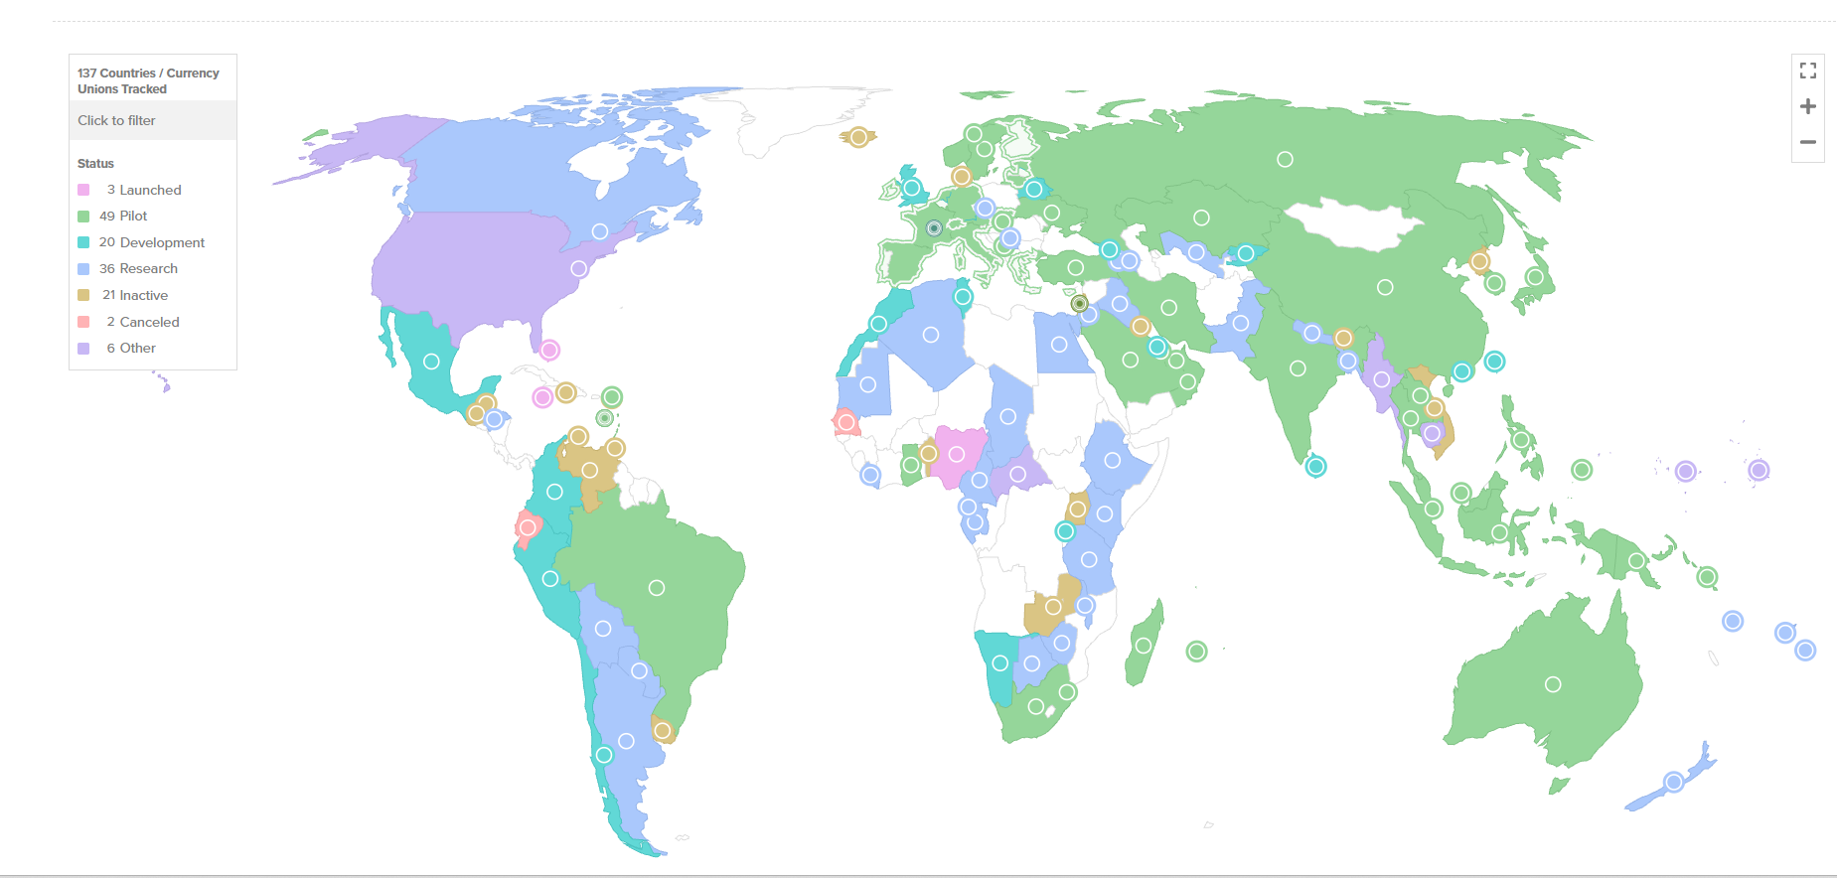
Central Bank Digital Currency Tracker 7/25
https://www.atlanticcouncil.org/cbdctracker/

Slide 45
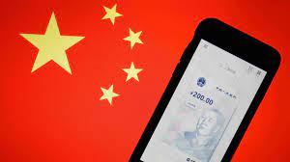
The Digital Yuan

Slide 46
Why was China So Eager for a CBDC?
In 2016 committed to the digital yuan.
In 2021 they banned all cryptocurrencies and crypto mining (the exact reverse of US policy choice).
China has ambitions to become a “reserve” currency used for international transactions and more generally cross border payments.
Surveillance probably a motive also.
But, at the end of last year, they made a major change

Slide 47
The New and Improved Digital Yuan
Shifts the liability for deposits to commercial banks and off the books of the Peoples Bank of China.
Digital Yuan will now pay interest making it more attractive.
But, the growth of the digital yuan will not come at the expense of bank lending
No longer technically a CBDC.

Slide 48
ECB and the Digital Euro
Electronic cash, a liability of the National Banks, but wallets and accounts will be provided by commercial banks.
Designed for retail payments “intermediated” through banks, but allows for peer-to-peer, confidential transactions.
Won’t pay interest and their will be limits on holdings to protect against draining bank deposits.
Stablecoins will still be permitted.

Slide 49
Questions and Takeaways
Can the dollar maintain its dominant reserve currency position, while relying on private, regulated stablecoins for digital cash?
How will regulated stablecoins affect small banks and small firm financing?
Blockchain technology has potential to revolutionize many areas of finance, but so far there have been few applications outside the crypto world.
Traditional cryptocurrencies like bitcoin are pure speculative assets with little or no fundamental value.
Are these currencies heading for a “crash” and what will be the consequences for the real economy?

Slide 50
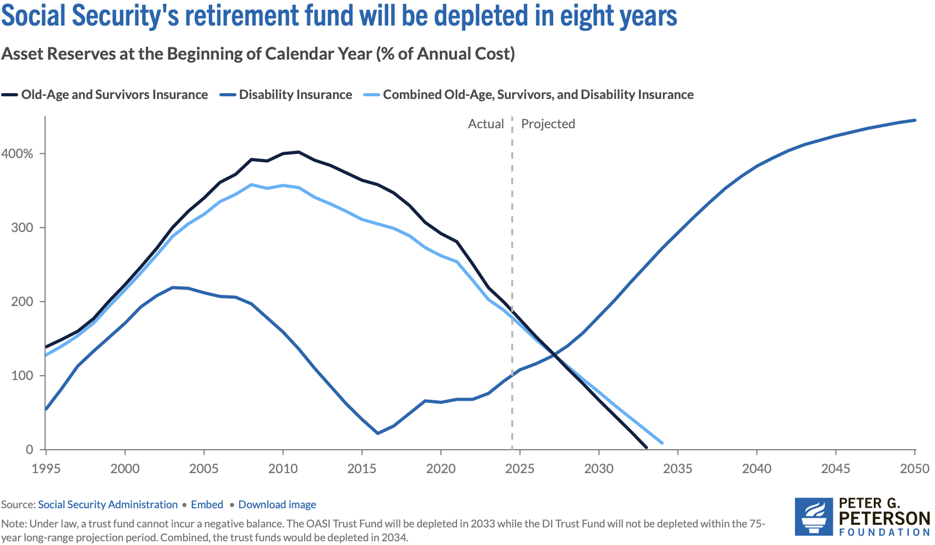
Next Week: Trajectory of Funds

Slide 51
Let’s Hear from You!
Geoffrey Woglom grwoglom@amherst.edu
Contact NEED: Info@NEEDEcon.org
Support NEED: www.NEEDEcon.org/donate.php

