Slide 1
Osher Lifelong Learning Institute, Summer 2022
Contemporary Economic Policy
Emory University
June-August, 2022
Jon Haveman, Ph.D.
National Economic Education Delegation

Slide 2
Available NEED Topics Include:
Healthcare Economics
US Economy
Climate Change
Economic Inequality
Economic Mobility
Trade and Globalization
Minimum Wages
Immigration Economics
Housing Policy
Federal Budgets
Federal Debt
Black-White Wealth Gap
Autonomous Vehicles
US Social Policy

Slide 3
Course Outline
Contemporary Economic Policy
  Week 1 (6/30): US Economic Update
  Week 2 (7/7): The U.S. Federal Debt (Geoffrey Woglom, Amherst College)
  Week 3 (7/14): Climate Change
  Week 4 (7/21): Economic Inequality (Christopher Herrington, VCU)
  Week 5 (7/28): Autonomous Vehicles
  Week 6 (8/4): The Black-White Wealth Gap
  Week 7 (8/11): Discriminatory Policies
  Week 8 (8/18): Cryptocurrencies

Slide 4
Submitting Questions
Please submit questions of clarification in the chat.
  I will try to handle them as they come up.
We will do a verbal Q&A once the material has been presented.
Slides will be available on NEED’s website( www.NEEDelegation.org)

Slide 5

Cryptocurrencies & The Future of Money
OLLI – Emory University
August 18, 2022
Jon Haveman
NEED

Slide 6
Outline of the Talk
Fun Facts about Bitcoin
A little bit on the underlying technology of bitcoin.
Economist evaluation of 2 Key Questions:
  Is Bitcoin serving a legitimate economic role?
  Is there potential for beneficial, financial innovations using the underlying technology?
But, in order to tap that potential, we need:
  Legislation to provide “good” regulation of crypto markets.
  The Federal Reserve needs to follow other central banks in creating a safe and secure, digital means of payment: Central Bank Digital Currency (CBDC)

Slide 7
But First, What is Bitcoin?
Bitcoin is the first cryptocurrency and was invented in 2008.
Cryptocurrencies are a form of digital money:
  I.e., data on a computer,
  Where account ownership is confidential, and
  Record keeping is decentralized over a multitude of computers.
More importantly,…

Slide 8
Bitcoin Has Started a Revolution in Finance
The way we buy and sell things, our “payments system;” the way we save, borrow and invest; the role of banks and other financial firms are rapidly changing.
In my view, Bitcoin will NOT be an important player in these developments, but the technologies underlying Bitcoin may be.

Slide 9
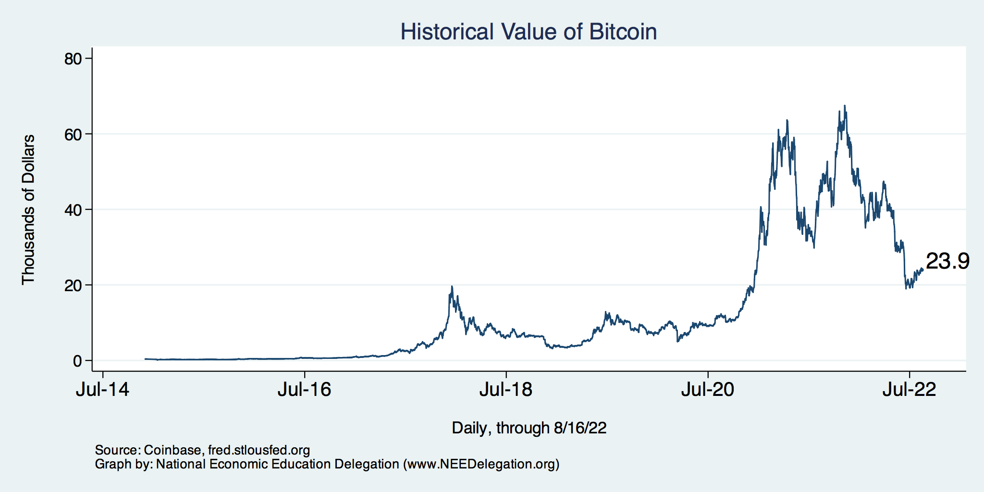
Value of Bitcoin
Peaked: over $60,000

Slide 10
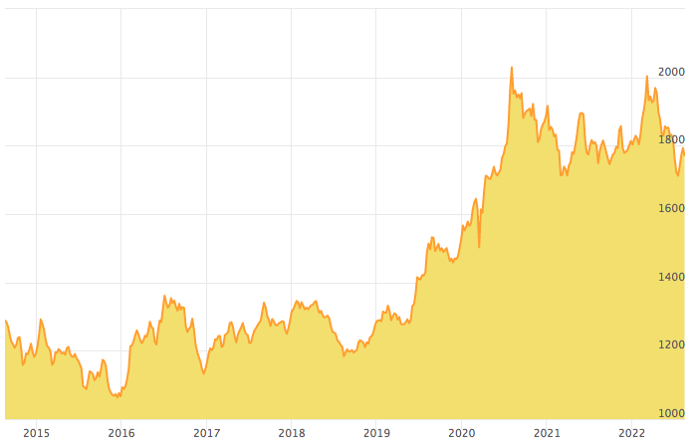
Value of Gold

Slide 11
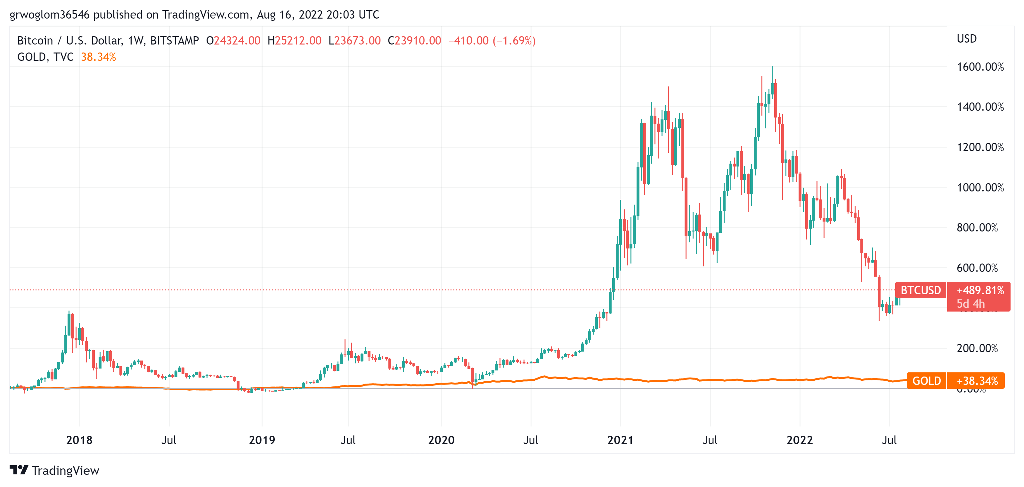
Bitcoins: What Is All the Excitement About?
Was
$23,400, 0n 8/17, 10:30 AM
Notes:
When I last spoke in March Bitcoin was $40k

Slide 12
One of the Over 50,000 Bitcoin ATMs
Big Mouth Ben Convenience Store
Atlanta, GA
Notes:
35 South Commons Way

Slide 13
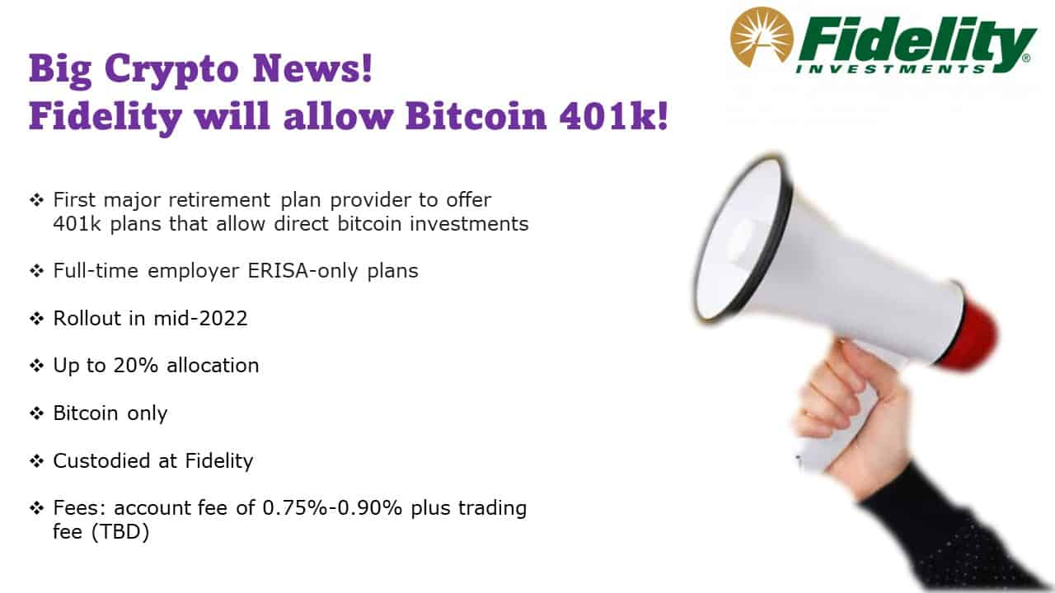
Going too Far?

Slide 14
An Origin Story Worthy of a Pulp Novel!
The Mysterious Satoshi Nakamoto:
  Lehman Brothers Bankruptcy, 9/2008
  Halloween 2008: a white paper is published on the Internet laying out the idea and design for Bitcoin. The author (or authors) used Satoshi Nakamoto as a pseudonym.
  January 2009: Satoshi releases the first version of the Bitcoin software.
  2009-2010: Satoshi releases new versions of the software and is actively involved in Internet Chatter about Bitcoin.
  April 2011: Satoshi ceases all known and/or verified communications.
To this date the identity or identities of Satoshi are unknown.
Notes:
Rick Santelli 2/19/2009 Teaparty Rant

Slide 15
The Possible Economic Role for Bitcoin
Satoshi’s Vision: “A purely peer-to-peer version of electronic cash [that] would allow online payments to be sent directly from one party to another without going through a financial institution.”
More, prosaically
Facilitate payments at lower costs with speed and security.
  E.g., credit card fees (3 percent).
  Merchant doesn’t get paid for at least 2 days.
  2019 Capital One hackers access personal information of 106 m users
Meet the needs of previously unbanked.
  Particularly a problem in the Developing World, but
  Fed estimates that 50 million US adults have little or no banking relationships.
Notes:
Satoshi, Bitcoin is “A purely peer-to-peer version of electronic cash [that] would allow online payments to be sent directly from one party to another without going through a financial institution.”
So, Natoshi’s goal was to improve money, in a way that did not depend banks or governments!

Slide 16
Facts about Cryptocurrencies (as of 8/17)
Bitcoin was the first and is the largest in terms of market cap (total value of all bitcoins) of about $450 billion.
Ether is in second place with a market cap of about $220 billion.
Presently, 11,500 different varieties with a total market cap of about $1.2 trillion (https://www.coingecko.com/en)
Market cap of:
  domestically listed US companies is about $40 trillion.
  the NYSE is about $25 trillion.

Slide 17
Underlying Technology of Bitcoin
Digital Token (exists only as data on a computer) whose ownership is cryptographically protected.
Distributed Ledger, Block Chain Technology.
Software protocol that provides a “consensus” mechanism on the validity of new transactions.
Payments based on trust, without a “trusted third party.” (i.e, a bank or the Fed).
Notes:
Define distributed Ledger

Slide 18
So, how does it work?
Jack, the owner of a bitcoin is given a public number or key and a private encrypted key.
Jack can trade his bitcoin with Jill by using Jill’s public key and verifying the transaction with his private key.
The new transaction is then posted on a number of different computers and can be read by anyone.
The clearing of the transaction is done with public database or distributed ledger called a blockchain through a process know as bitcoin mining.
First, Bitcoin Miners gather about 3,000 new transactions into a “block.”
Bitcoin “miners” then engage in an elaborate computational competition to determine who adds the new transactions to the blockchain.

Slide 19
Mining for Bitcoin
Bitcoin Miners gather about 3,000 new transactions into a “block.”
The miners’ competition involves generating long, random numbers (“hashing”) until finding one with a precise set of attributes.
  1 in 200 million trillion (or 200 quadrillion)
The winning miner then adds the new block to the previous block in the blockchain. The total process takes about 10 minutes.
The incentive for miners is that the winner of the competition gets rewarded new bitcoins and transaction fees.
However, the miner will not get the reward unless other miners subsequently add new blocks to the first miner’s block.
In this way transactions are added to the chain via a “consensus” of miners.

Slide 20

Bitcoin Mine

Slide 21
Question #1: Is Bitcoin serving an economic role?
Bitcoin is not and cannot be widely used to make transactions
Scalability?
Price Instability.
Transactions costs.
Cash ATM vs. Bitcoin ATM.
  Transaction vs asset purchase (?).
  Not necessarily buying bitcoin…
And, the network is costly.
  Resources used in mining.
    - Energy use equivalent to Thailand.
  Environmental Costs.
    - Disposal of obsolete equipment.
BIS, Annual Report 2018, Chapter V
Notes:
Presently, Bitcoin mining requires 150-200 terawatt-hours per year, more than Thailand with a carbon footprinttof the Czech Republicenergy consumption (although less than is used in gold mining). (Note there are other consensus mechanisms that do not use as much energy.)
In addition, computer hardware quickly becomes obsolete and is dumped.

Slide 22
What Role Does Bitcoin Play?
For some it plays the same role as $100 bills:
  32.8% of all bills in circulation (more than the number of $1 bills)
  80.2% of the value of all bills.
Illegal Activity
Notes:
Trading of banned goods; e.g, Silk Road
Ransomware Payments.
Money Laundering.
Tax Evasion

Slide 23

Illegal Activity and Bitcoin (Good News? No)

Slide 24
But What about as a Financial Investment?
It is hard to argue with the fact that Bitcoin had provided outsized returns for many, albeit very volatile.
Financial Assets are Promises by the Issuer
  Bond – payment of coupons and repayment of principal in the future.
  Stock – payment of dividends in the future; voting rights.
  Options or Futures – payments of money conditional on future info.
  Currency – promise that it will be acceptable for payments in the future with stable value.
The “fundamental value” of a financial assets is the value of those promises.
What does Bitcoin promise?
  To me, purely speculative investment.
Notes:
Promised future payments such as dividends for stocks or coupon payments for bonds.
For currencies, promise of future use in exchange with stable values.
Bitcoin only promises the possibility of capital gains, but not based on future payments.

Slide 25
How Do Economist Think About Investments?
Good Starting Place
“In the short term the stock market behaves like a voting machine, but in the long term it acts like a weighing machine.”
What is being weighed is prospective payments from the security, or other intrinsic value, i.e. its fundamental value.
Bitcoin?
- Buying because you hope that somebody will pay more for it than you paid. No intrinsic or fundamental value.
- Warren Buffet, paraphrasing Benjamin Graham
Notes:
Warren Buffet paraphrasing Benjamin Graham. Payments mean dividends or coupon payments. Even, gold has some intrinsic value as the ultimate insuarbne
Graham: Intelligent Investor

Slide 26
It’s Not Just Me
IGM Forum Question: Private, unbacked crypto assets serve no economic purpose.
https://www.igmchicago.org/surveys/crypto-assets-2/

Slide 27
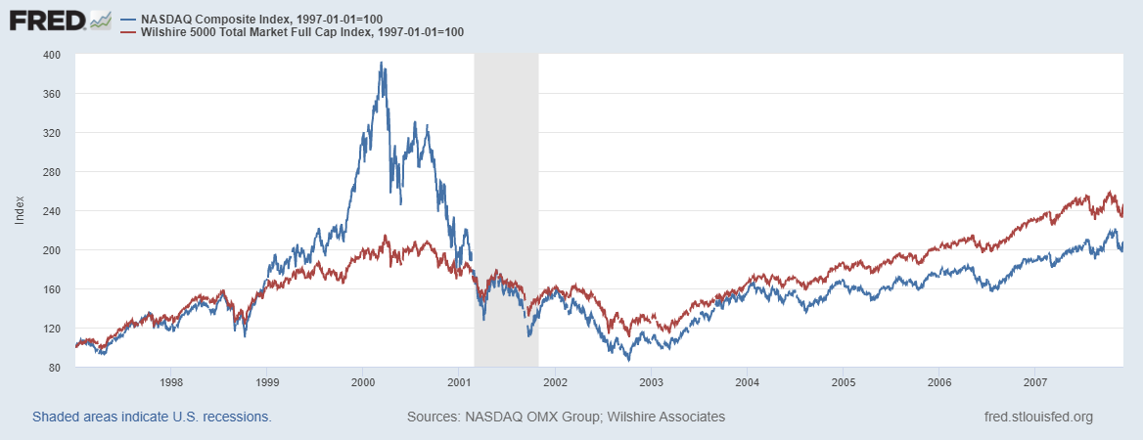
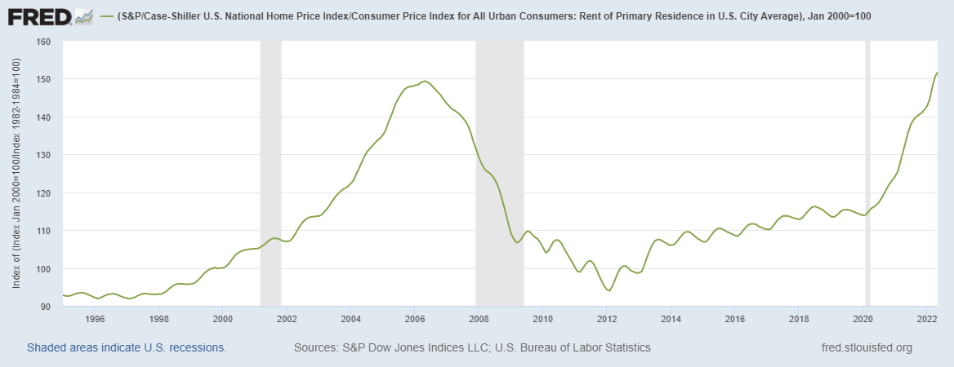

Does Voting Ever Get it “Wrong?”
Notes:
Pets.com sock puppet

Slide 28
Question #2: The Value of the New Technology?
Don’t Throw the baby out with the bathwater!
The value of cryptographically protected digital-tokens is nuanced.
  Tax avoidance? Illegal activity? Not only…..
Blockchain technologies have significant promise some of which is already being realized.
  Private blockchains, Walmart and its produce suppliers.
    Medical records?
  Public Blockchains, Ethereum and smart contracts
See: Mehta N,. Agashe A., P. Detroja Blockchain Bubble or Revolution, 2021
Notes:
Cryptographic protection is a tougher call and depends on your views of privacy rights, as well as what information is being kept private (e.g., medical records versus financial transactions) Supply Chains (Walmart IBM)
Smart Contracts (Xbox royalties)

Slide 29
Smart Contracts on the Blockchain
A Smart Contract is a computer code that resides on the block chain and is executed based on incoming information.
Example, Parametric Hurricane Insurance via the Blockchain:
  Computer program on Ethereum continuously monitors Charleston Executive Airport wind speed for 1 year.
  If the windspeed is greater than 150 miles per hour, immediately transfers 100 bitcoin to the Seabrook Island Property Association.
  If the windspeed is less than 150 miles per hour, but more than 125 miles per hour, immediately transfers 75 bitcoin; etc.
Smart Contracts are Automatic, Immediate, Irreversible and Uncontestable.

Slide 30
DeFi and Smart Contracts
Broad Category of Decentralized Financial Services (DeFi)
  Crypto exchanges, online lending platforms, crypto derivatives, insurance, startup finance, etc.
  Explosion over time: $1b in 2019; $15b in 2020; $100b as of 12/2021 (DefiPulse.com). [Recently, it has fallen]
Smart Contracts are executed mostly on the Ethereum blockchain. No brokers, financial intermediaries, traders, and little regulation.
I personally have not seen the “killer application” of DEFI.
Note on the insurance example, that bitcoin isn’t a great means of payment because of price volatility.
- Trading weather uncertainty for payment uncertainty.
Notes:
Recently, these numbers have come down

Slide 31
But What about Digital Payments for Consumers?
Who pays for their lattes with cash? We already have digital payments, but what about the needs of the unbanked?
The US and the developed world are far behind Africa: Mobile, as in cellphone money, the M-Pesa.
Grameen Foundation:
Making Cash Digital is the Key to Possibility
When Poor Women Control their own money, it no longer controls them.
Notes:
Started in Kenya in 2007 and now available in 10 countries.
Buy M-Pesa credits from “agents” (local shop) which can be transferred to others with an M-Pesa account via cellphone.
96 percent of Kenyan households have a mobile account.
M-pesa is a digital currency, but not a crypto currency

Slide 32
Retail versus Wholesale Digital Payments
Retail: M-pesa
Wholesale: Cryptocurrency for DEFI transactions.
Bitcoin doesn’t work for either because of transactions costs and price volatility.
But, to tap into the potential benefits of DEFI we need a safe and secure crypto medium of exchange to facilitate DEFI transactions, at least wholesale transactions.

Slide 33
Enter Stablecoins
Stablecoin a cryptocurrency whose value is pegged to a fiat currency like the dollar.
  Reserve-Backed stablecoin, think Money Market Mutual Fund.
  Algorithmic stablecoin, think castles in the air.
    - No foundation.

Slide 34
Tether Stablecoin: Reserve Backed?
“The Coin That Could Wreck Crypto” (NYTIMES, 6/17): “In 2021, New York’s attorney general fined Tether $18.5 million and said the company had lied about its reserves, calling it ‘a stablecoin without stability.’”
Market cap of $68 billion; daily volume of $50 billion.
What could go wrong?
Notes:
WSJ, Headline, 8/11/2021, “Poly Network Hackers Steal More Than $600 Million in Cryptocurrency” Bloomberg 7/27/2021: “Tether and the Facebook Inc.-backed Diem token were a main focus of a recent meeting of U.S. regulators held on the financial risks posed by stablecoins.
Facebook NOVI wallets for holding Pax dollars ($1.1 billion in market cap)

Slide 35
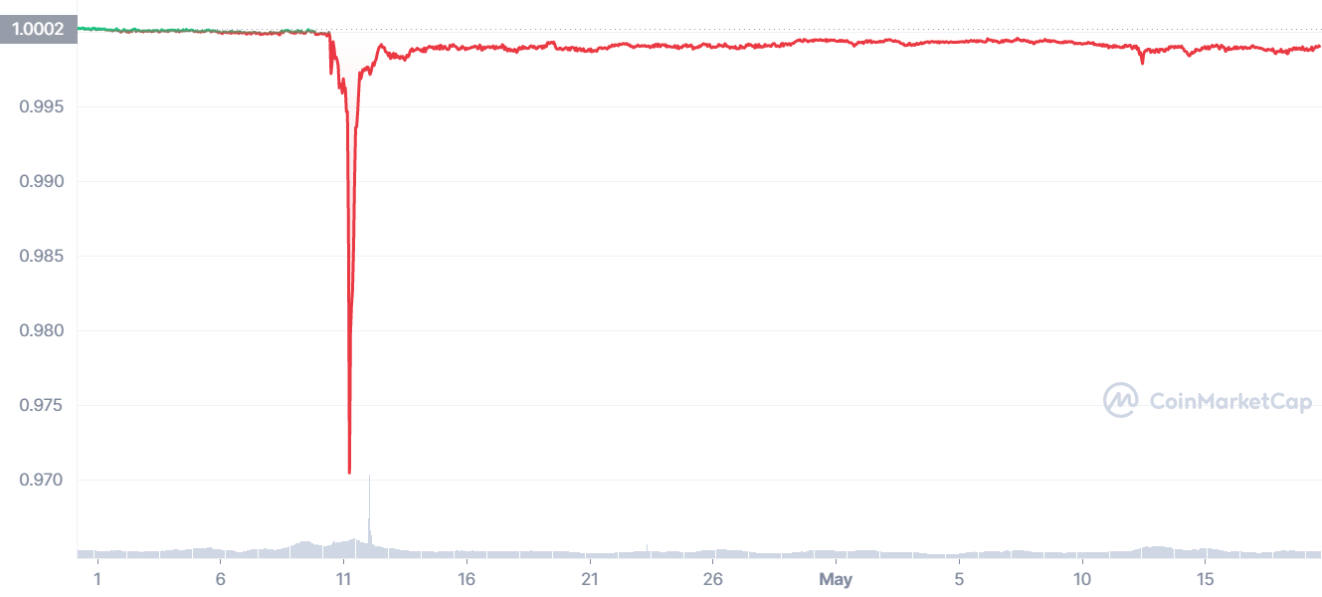
“Breaking the Buck?” Tether
Parallel with: Primary Reserve Fund MMF
Fed stepped in to insure MMF shares.
Also: low value of $0.97.
Also: market cap of $60 billion.
Notes:
Reserve Primary Fund broke the buck on 9/16/2008. Market cap $60 billion; lowest price 97 cents!

Slide 36
Mark Zuckerberg to the Rescue
Enter Facebook and Diem: Proposed blockchain enabled stablecoin, where all Facebook users would have diem wallets.
Regulators lodged lots of objections: Should a potentially ubiquitous private currency be run by one company?
What could go wrong?
Meta (Facebook) dropped out of the Diem project on 1/31/2022.
Notes:
WSJ, Headline, 8/11/2021, “Poly Network Hackers Steal More Than $600 Million in Cryptocurrency” Bloomberg 7/27/2021: “Tether and the Facebook Inc.-backed Diem token were a main focus of a recent meeting of U.S. regulators held on the financial risks posed by stablecoins.
Facebook NOVI wallets for holding Pax dollars ($1.1 billion in market cap)

Slide 37
Algorithmic Stablecoin
Create a regular cryptocurrency and call it say, luna.
If it has value, create a stablecoin and call it say, terra, that is tied to luna.
Smartcontract allows you to exchange terra into $1 worth or luna, or vice versa
Luna = $10, terra = $1, trade 1 luna for 10 terra
Luna = $1, terra =$1, trade 1 luna for 1 terra and vice versa
Terra price drops to $0.80, buy terra with luna
  Increased demand for terra increases its price.
Terra price rises to $1.20, buy luna with terra
  Reduced demand for terra lowers its price.
What could go wrong?
Notes:
Collapse of Terra/Luna erased $60billion

Slide 38
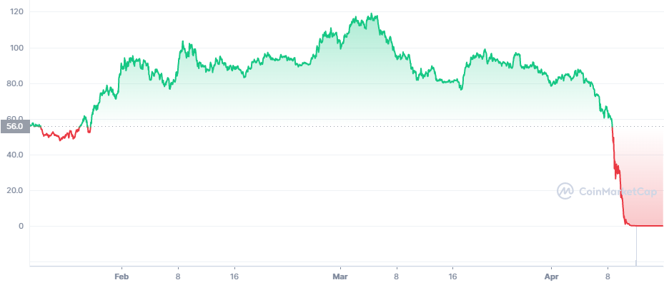
Luna’s Price This Year
https://coinmarketcap.com/
Notes:
Wiped out $60 billion in value

Slide 39
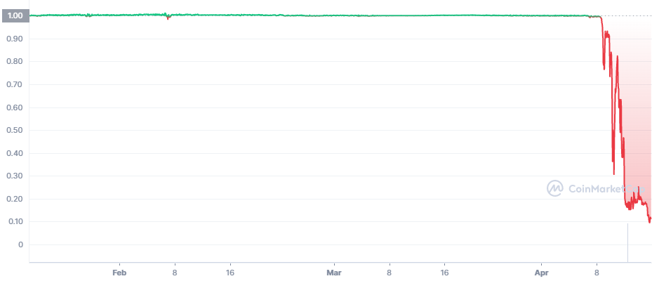
Terra’s Price
Death SpiRal!!!
Notes:
Collapse of Terra/Luna erased $60billion
If Luna has no value, terra doesn’t either.
The cryptocurrency has no clothes!

Slide 40
“Cryptocurrency is the Wild West of our
Financial System” Sen. E. Warren of Mass
Pick Your Own Adventure: (https://web3isgoinggreat.com/)

Slide 41
“Clean Up the Mess on Aisle 3”
Gary Gensler, Chair of the SEC quote from a WP interview.
Rostin Benham, Chair of the CFTC
Janet Yellen at Treasury.
They will act, but they would need Congressional legislation, too: Cash markets in cryptocurrencies are viewed as commodities and are unregulated
Notes:
Paper on CBDC

Slide 42
What is Good Regulation?
The Principles Are Easy;
  Eliminate fraud, abuse and manipulation.
  Do not let markets be dominated by a small number of powerful firms.
  Allow startups with new innovations to displace incumbent firms.
    - Regulations should not prevent this.
Legislation and Implementation: Not So Easy

Slide 43
1930s Regulation in the 21st Century
Bank: An institution that accepts deposits and makes loans for a profit.
  Stablecoins?
  Money Market Mutual Funds?
Investment Contract subject to security laws (Howey Test):
  Investment of Money
  Common Enterprise (pooling of funds)
  Expectation of profit from effort others.
  BlockFI and crypto Lending?
Notes:
BlockFi – deposit bitcoin and they pay interest and lend out your deposits
THAT’S a BANK

Slide 44
Feb, 14, 2022, NYTimes Headline
BlockFi, a crypto firm, reaches a $100 million settlement for failing to register loan products.
Cannot offer existing accounts to US residents.
BlockFi is working work with the SEC to develop an account that meets US security laws.

Slide 45
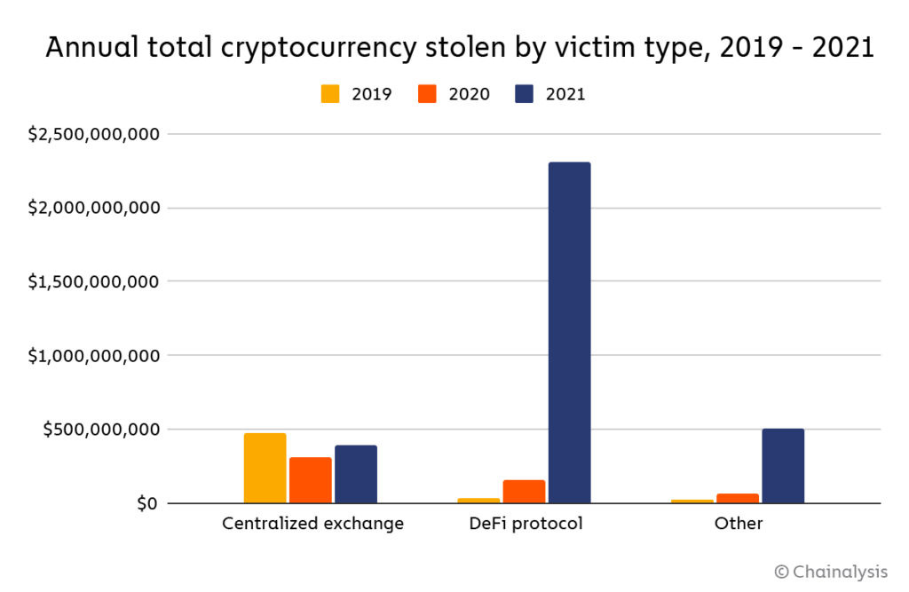
Clearly, Not Good News

Slide 46
Three Recent US Government Reports
Presidential Working Group on Financial Markets on Stable Coins and CBDC, 11/2021.
Federal Reserve Discussion Paper on CBDCs, 1/2022
Executive Order of the President, 3/09/2022
  (a) fraud; (b) stability; (c) illicit activity; (e) equitable access
  (d) “We must reinforce United States leadership in the global financial system and in technological and economic competitiveness.”
  (f) support responsible innovation;
  (g) explore Central Bank Digital Dollar
Notes:
Made crypto community happy

Slide 47
Do We Need More Than (Good) Regulation?
The Bank for International Settlement (BIS) and a number of central banks are exploring how the development of Central Bank Digital Currency (CBDC) can:
  “contribute to an open, safe and competitive monetary environment that supports innovation and serves the public interest.”
Source of quotes, BIS Annual Report 2021

Slide 48
CBDCs and Other Central Bank Liabilities
The Fed and most Central Banks presently already have digital money!
CBDCs would permit wider access to the Fed’s digital assets to other financial institutions and possibly to the public.
In addition, CBDCs could be designed for rapid settlement, finality, privacy and security (perhaps using blockchain technology).
Notes:
The Fed and most Central Banks presently have two financial liabilities:
Currency.
Bank Reserves.
Bank Reserves are Balances that Commercial Banks hold at the Fed and that are used in check clearing. They are already di

Slide 49
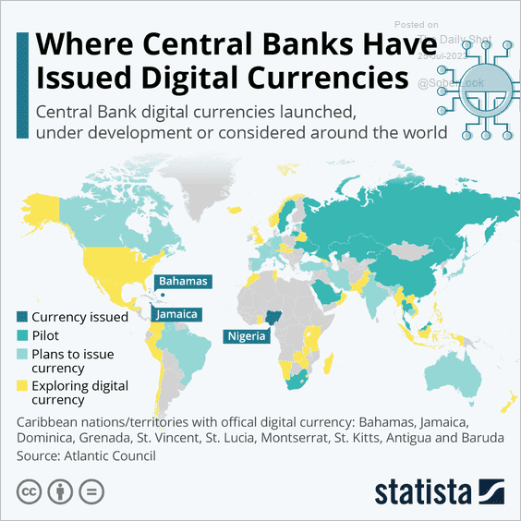
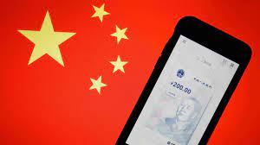
The Devil Is In the Details
Over 100 countries as diverse as Sweden, Ecuador and China have begun experiments with CBDCs.
Where’s the Fed?
Source: E. Prasad, The Future of Money
Notes:
MIT Boston Fed experiment. But pretty conservative vision. CBDC offered to consumers through insured institutions, i.e., banks. Electronic cash like checks.

Slide 50




Who should design our payment system?
Notes:
Vitalek Buterin, age 27 cofounder of Ethereum at age 20

Slide 51
Resources to Learn More
N. Mehta, et.al. Blockchain Bubble or Revolution
E Prasad, The Future of Money (https://youtu.be/o3NuHb7V1IA)
Presidential Working Group on Financial Markets, 11/1/21 (https://home.treasury.gov/system/files/136/StableCoinReport_Nov1_508.pdf)
Federal Reserve White paper
(https://www.federalreserve.gov/publications/files/money-and-payments-20220120.pdf)
Executive Order: https://www.whitehouse.gov/briefing-room/statements-releases/2022/03/09/fact-sheet-president-biden-to-sign-executive-order-on-ensuring-responsible-innovation-in-digital-assets/

Slide 52
Glossary
Traditional Money is currency plus bank checking accounts.
Currency is paper and coin issued by the government. Currency is legal tender and must be accepted for all debts. Transactions using currency are immediate and final (can’t be undone without the agreement of both parties.)
Digital Payments are used for purchases where no physical money is exchanged. Examples include many online banking payments, credit card payments, PayPal.
Digital Currency or Virtual currency is a form of money that exists solely in digital form, such as a digital token (i.e., as data on a computer). Examples: cryptocurrencies, central bank digital currencies and virtual currencies used in online gaming.
Cryptographic identity protection assigns people two account numbers, or keys, one public and one private. Public record keeping is done using the public key and transactions are authorized using the private key.
Cryptocurrency is a digital currency where the owner’s identity is protected using cryptographic encryption and where record keeping is done with a public blockchain, e.g., Bitcoin.
Stablecoin is a cryptocurrency with a stable value of $1, somewhat like a money market mutual fund.

Slide 53
Glossary (Cont.)
Distributed ledger is a database for recording transactions or other information, where the information or ledger is shared on a network of many computers simultaneously.
Blockchains are distributed ledgers where new transactions (new blocks) are added to the chain sequentially when a consensus of the network agrees that the transactions are valid.
Decentralized Finance (DeFi) is peer-to-peer financial activity conducted through public blockchains and smart contracts.
Smart Contracts are computer programs that execute automatically based on external conditions. Example, travel insurance that pays off automatically when a flight is cancelled.
Central Bank Digital Currency (CBDC) is a digital currency issued by a central bank. Different central banks are experimenting with various forms of CBDCs, including some using blockchain technology, electronic wallets and cryptography.

Slide 54
Thank you!
Any Questions?
www.NEEDelegation.org
Jon Haveman, Ph.D.
Jon@NEEDelegation.org
Contact NEED: info@needelegation.org
Submit a testimonial: www.NEEDelegation.org/testimonials.php
Become a Friend of NEED: www.NEEDelegation.org/friend.php

Slide 55
Consensus Mechanisms
Consensus mechanism requires:
  Many nodes competing to add a new block.
  Economic incentive to add valid new block.
  Mechanism to ensure validity of the new block.
Proof of Work (POW):
  Many miners with free entry competing to solve random number problem.
  If the new block is accepted (future blocks are added), miner gets a reward in bitcoin and transaction fees.
  Subsequent miners won’t add to the block if they don’t believe it is valid.

Slide 56
Proof of Stake (POS)
POS: A Better Way?
  Potential Block Creators place cryptocurrency in specialized wallets that are locked while they are acting as blockchain validators.
  Validators are selected randomly, where the odds of being selected are proportional to the value of the currency “staked” in the wallet.
  The rest of the process of validation is similar: transaction fees only paid if subsequent blocks are added, but!!
  If an invalid block is discovered the staked deposit is forfeited.
POW competition over computer power and energy usage.
POS competition over staked deposits (no computer power or energy usage involved).

Slide 57
History of POS
Invented in 2012 by Peercoin, a small crypto currency.
POS has been implemented by Cardano, Solana and Polkadot: numbers 8, 9 and 11 in terms of market cap.
Ethereum was supposed to implement POS in May of 2020, but has delayed. Recently announcing it would implement POS in September.

Slide 58
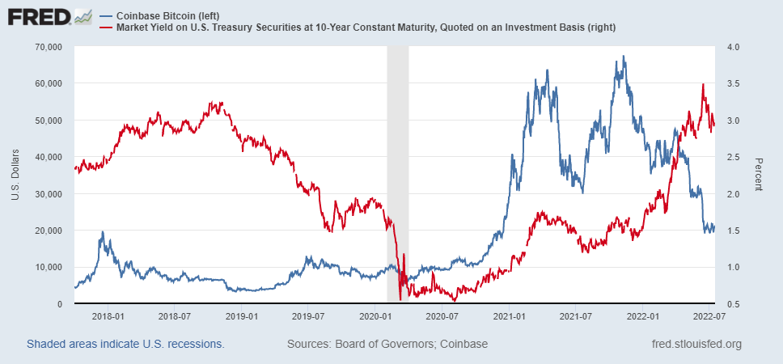
Coincidence?

Slide 59
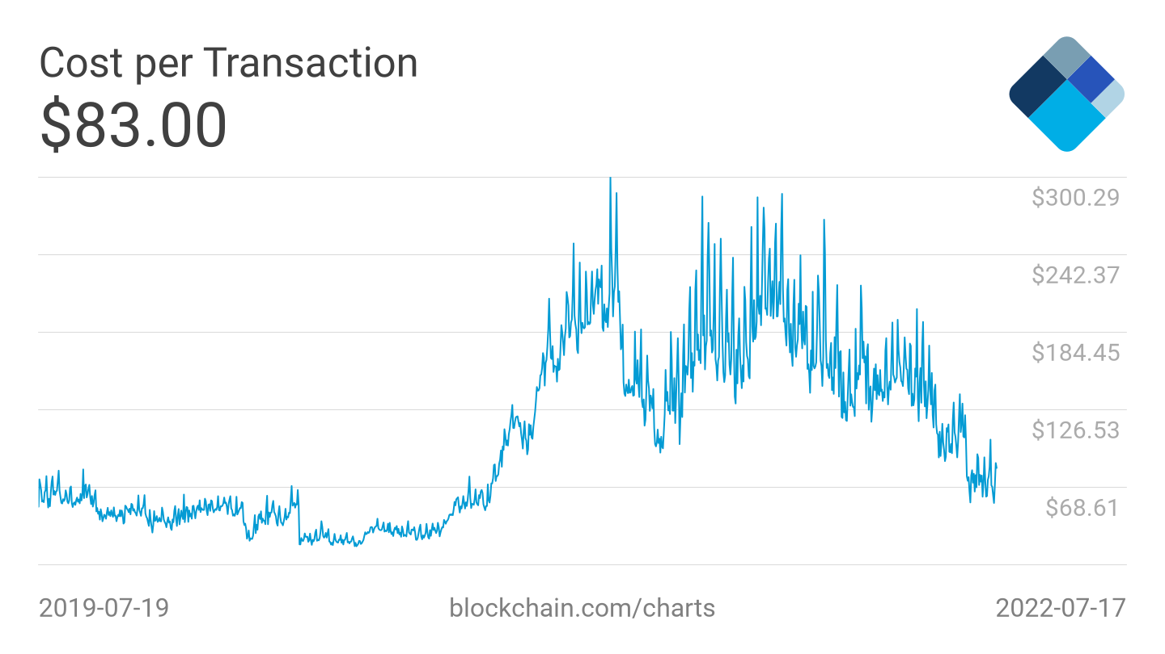

Slide 60
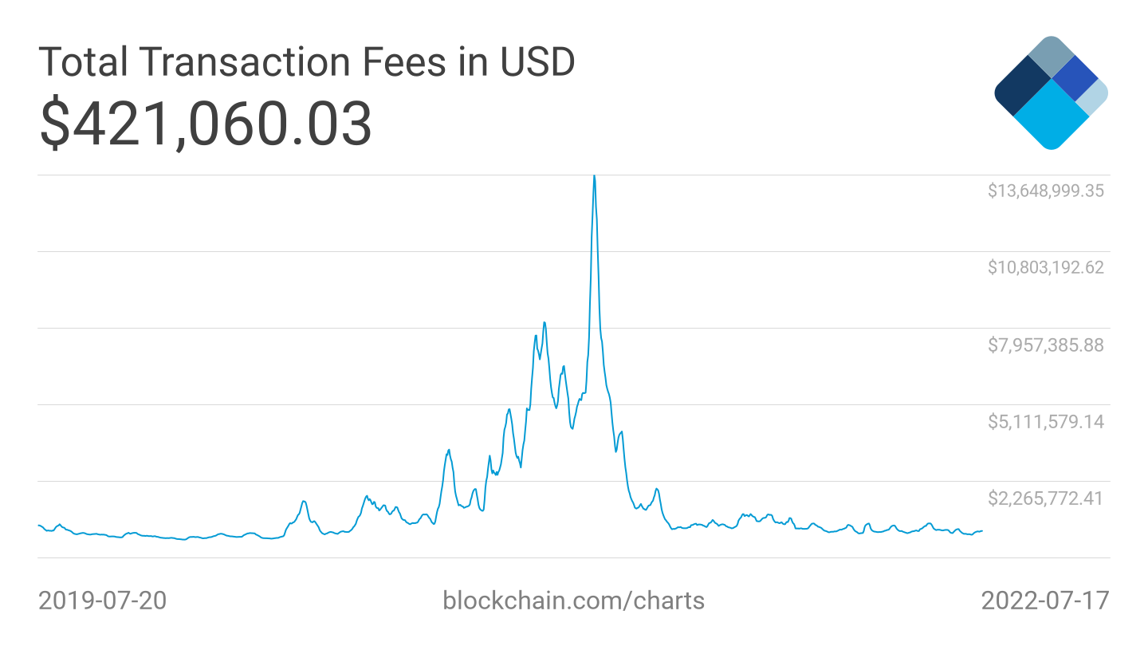

Slide 61
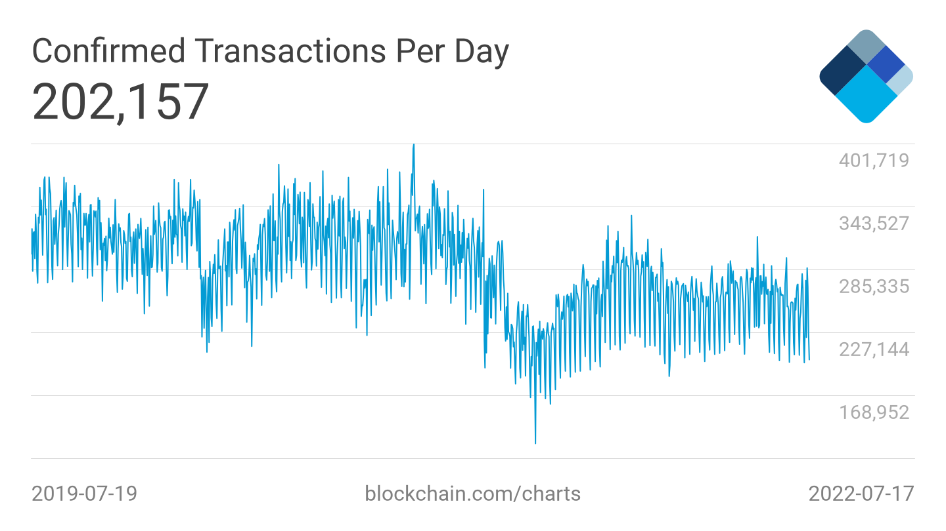

Slide 62
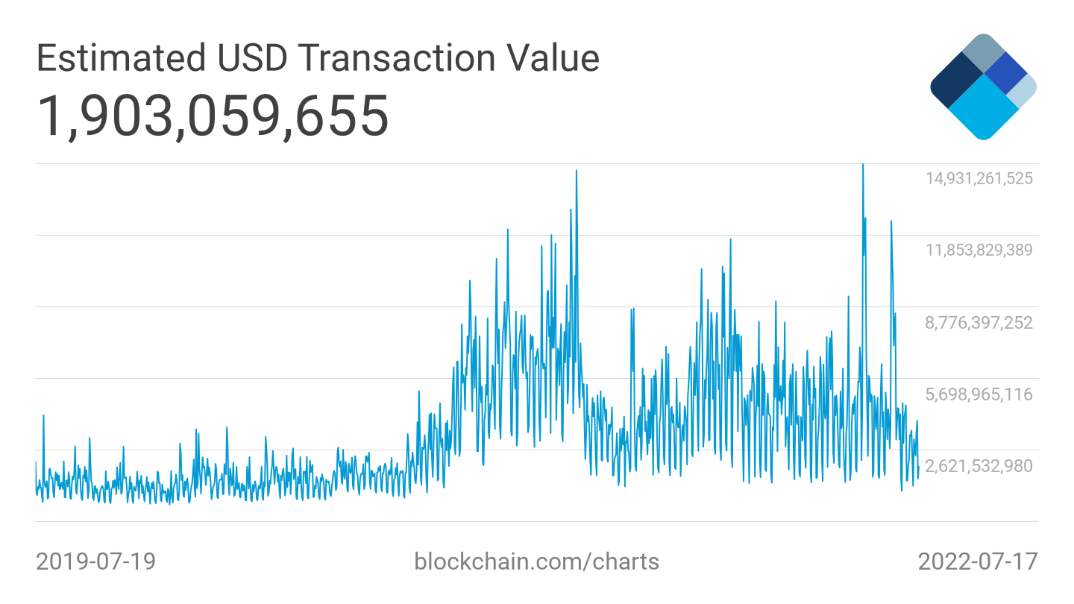
Notes:
With BTC at $20,000, implies 35 billion per day

Slide 63
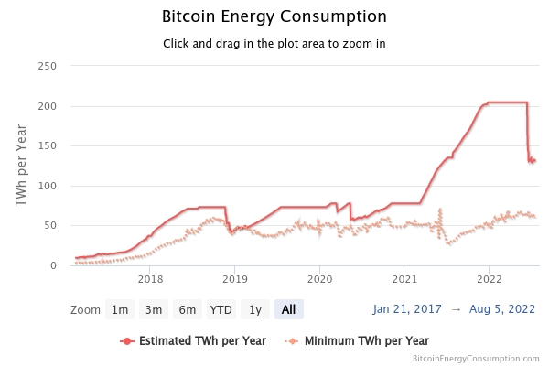
https://digiconomist.net/bitcoin-energy-consumption

