Slide 1

Cryptocurrencies & The Future of Money
Geoffrey Woglom,
Professor of Economics
Amherst College, emeritus
October 13, 2022

Slide 2
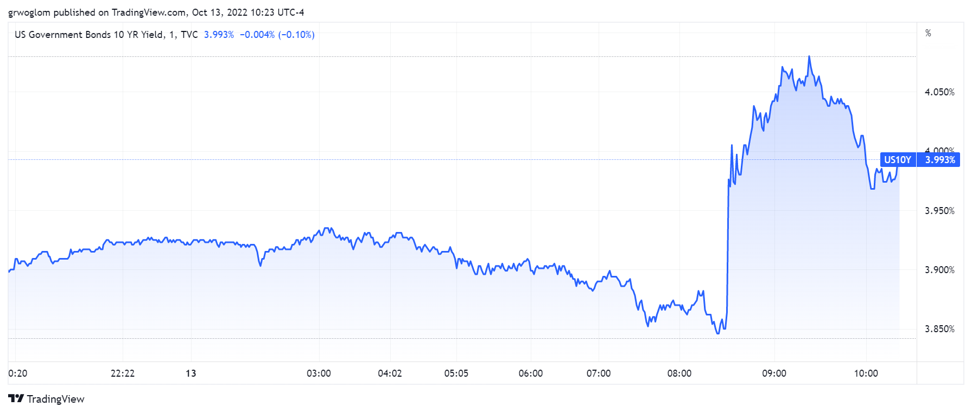
Where is 8:30 on the Chart & Why?

Slide 3
From Last Class: Judging Financial Innovations
Possible economic roles: improving the efficiency of
  Payments system.
  Saving and investment.
  Managing risk.
Regulation is needed to:
  Prevent fraud and other abuses.
  Maintain financial stability.

Slide 4
Outline of the Talk
Fun Facts about Bitcoin
A little bit on the underlying technology of bitcoin.
Economist evaluation of 2 Key Questions
  Is Bitcoin serving a legitimate economic role?
  Is there potential for beneficial, financial innovations using the underlying technology?
But, in order to tap that potential, we need:
  Legislation to provide “good” regulation of crypto markets.
  The Federal Reserve needs to follow other central banks in creating a safe and secure, digital means of payment: Central Bank Digital Currency (CBDC)

Slide 5
But First, What is Bitcoin?
Bitcoin is the first cryptocurrency and was invented in 2008.
Cryptocurrencies are a form of digital money (viz. data on a computer) where account ownership is confidential and where record keeping is decentralized over a multitude of computers
More importantly,…

Slide 6
Bitcoin Has Started a Revolution in Finance
The way we buy and sell things, our “payments system;” the way we save, borrow and invest; the role of banks and other financial firms are rapidly changing.
In my view, Bitcoin will NOT be an important player in these developments, but the technologies underlying Bitcoin may be.

Slide 7
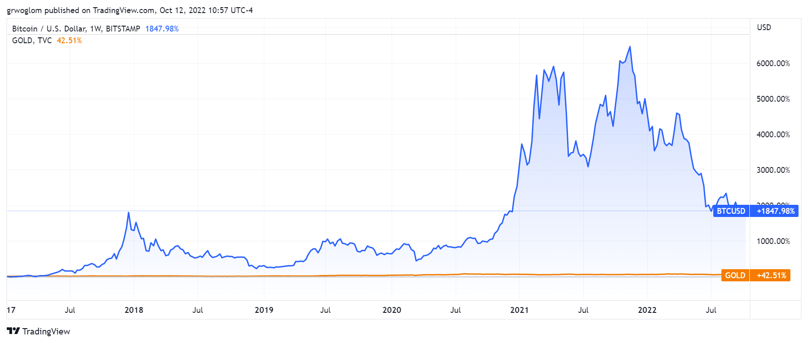
Bitcoins: What Is All the Excitement About?
Was
$18,400, 0n 10/13, 10:30 AM

Slide 8
One of the Over 50,000 Bitcoin ATMs
Notes:
660 Merrill Road

Slide 9
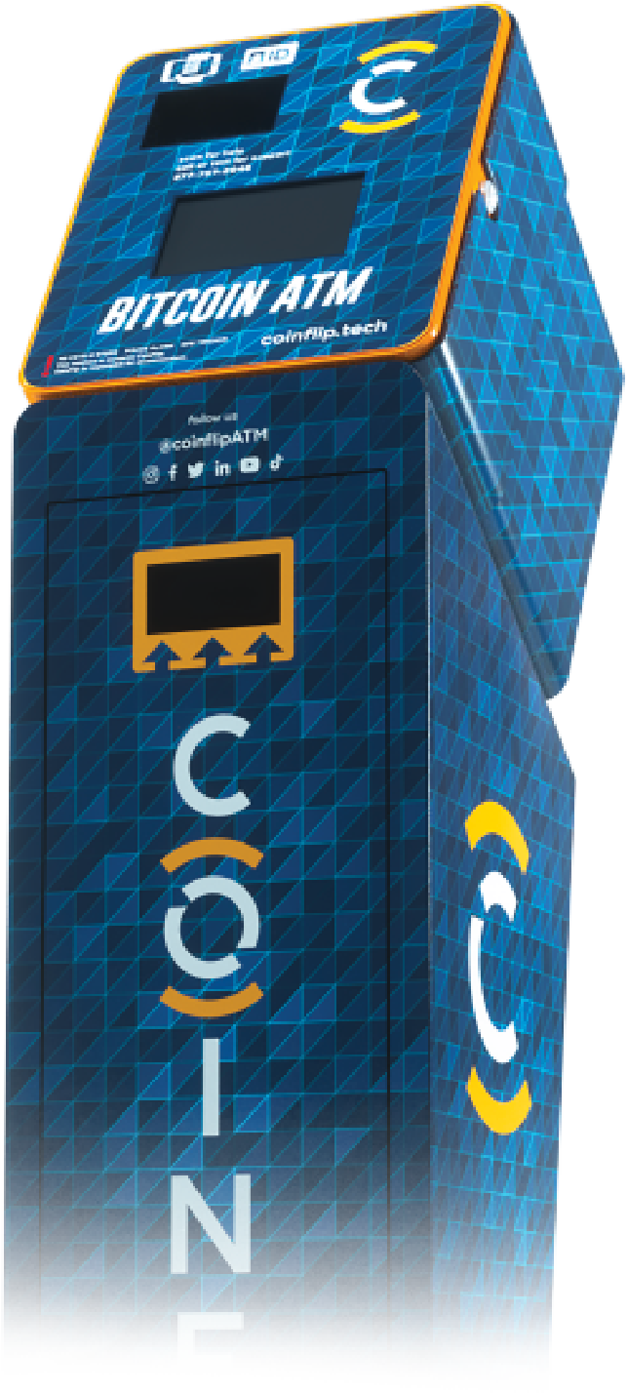
One of the Over 50,000 Bitcoin ATMs
Notes:
1074 Main Street

Slide 10
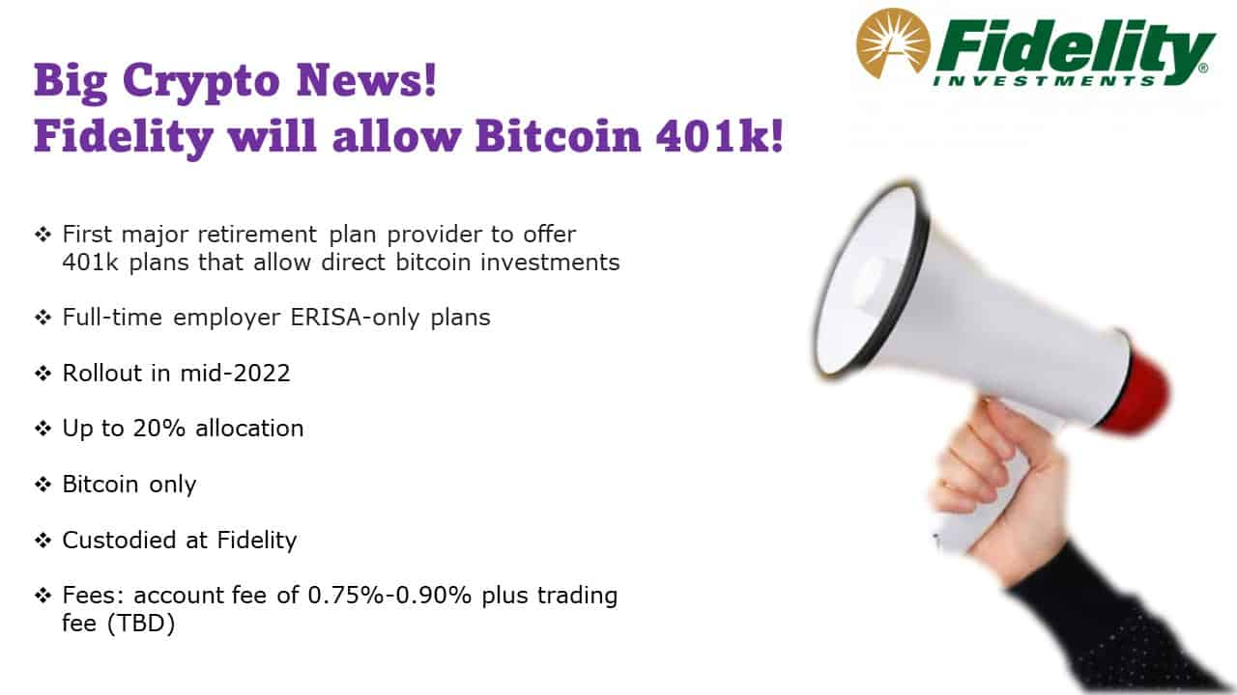
Give Me a Break?

Slide 11
An Origin Story Worthy of a Pulp Novel!
The Mysterious Satoshi Nakamoto:
  Lehman Brothers Bankruptcy, 9/2008
  Halloween 2008: a white paper is published on the Internet laying out the idea and design for Bitcoin. The author (or authors) used Satoshi Nakamoto as a pseudonym.
  January 2009: Satoshi releases the first version of the Bitcoin software.
  2009-2010: Satoshi releases new versions of the software and is actively involved in Internet Chatter about Bitcoin.
  April 2011: Satoshi ceases all known and/or verified communications.
To this date the identity or identities of Satoshi are unknown.
Notes:
Rick Santelli 2/19/2009 Teaparty Rant

Slide 12
The Possible Economic Role for Bitcoin
Satoshi’s Vision: “A purely peer-to-peer version of electronic cash [that] would allow online payments to be sent directly from one party to another without going through a financial institution.”
More, prosaically
Facilitate payments at lower costs with speed and security
  E.g., Credit Card Fees (3 percent).
  Merchant doesn’t get paid for at least 2 days.
  More importantly, cross-border transactions costs were $1.9 trillion in 2018.
  2019 Capital One hackers access personal information of 106 m users
Meet the needs of previously unbanked.
  Particularly a problem in the Developing World, but
  Fed estimates that 50 million US adults have little or no banking relationships.
Notes:
Satoshi, Bitcoin is “A purely peer-to-peer version of electronic cash [that] would allow online payments to be sent directly from one party to another without going through a financial institution.”
So, Natoshi’s goal was to improve money, in a way that did not depend banks or governments!

Slide 13
Facts about Cryptocurrencies (as of 10/13)
Bitcoin was the first and is the largest in terms of market cap (total value of all bitcoins) of about $353 billion.
Ethereum is in second place with a market cap of about $148 billion.
Presently, 11,500 different varieties with a total market cap of about $930 billion (https://www.coingecko.com/en)
Market cap of domestically listed US companies is about $40 trillion.

Slide 14
Underlying Technology of Bitcoin
Digital Token (exists only as data on a computer) whose ownership is cryptographically protected.
Distributed Ledger, Block Chain Technology.
Software protocol the provides a “consensus” mechanism on the validity of new transactions.
Payments based on trust, without a “trusted third party.” (i.e, a bank or the Fed).
Notes:
Define distributed Ledger

Slide 15
So, how does it work?
Jack, the owner of a bitcoin is given a public number or key and a private encrypted key.
Jack can trade his bitcoin with Jill by using Jill’s public key and verifying the transaction with his private key.
The new transaction is then posted on a a number of different computers and can be read by anyone.
The clearing of the transaction is done with public database or distributed ledger called a blockchain through a process know as bitcoin mining.
First, Bitcoin Miners gather about 3000 new transactions into a “block.”
The next step is to provide a decentralized mechanism to add the new block to the block chain and agree that the transactions are valid

Slide 16
Proof of Work: Bitcoin “Mining”
The miners’ competition involves generating long, random numbers (“hashing”) until one of the numbers fits a precise set of attributes.
Presently, miners produce on the order of 200 million trillion random numbers per second.
The winning miner then adds the new block to the previous block in the blockchain. The total process takes about 10 minutes
The incentive for miners is that the winner of the competition gets compensated with new bitcoins and transaction fees.
However, the miner will not get the reward unless other miners subsequently add new blocks to the first miner’s block.
In this way transactions are added to the chain via a “consensus” of miners.

Slide 17

Bitcoin Mine

Slide 18
Question #1: Is Bitcoin serving an economic role
Bitcoin is not and cannot be widely used to make transactions
Scalability?
Price Instability.
Transactions costs
And, the network is costly
  Resources used in mining
  Environmental Costs
BIS, Annual Report 2018, Chapter V
Notes:
Presently, Bitcoin mining requires 150-200 terawatt-hours per year, more than Thailand with a carbon footprinttof the Czech Republicenergy consumption (although less than is used in gold mining). (Note there are other consensus mechanisms that do not use as much energy.)
In addition, computer hardware quickly becomes obsolete and is dumped.

Slide 19
The Merge: Ethereum and Proof of Stake
Potential Block Creators place cryptocurrency in specialized wallets that are locked while they are acting as blockchain “validators” (as opposed to “miners”).
Validators are selected randomly, where the odds of being selected are proportional to the value of the currency “staked” in the wallet.
The rest of the process of validation is similar: transaction fees only paid if subsequent blocks are added, but!!
If an invalid block is discovered the staked deposit is forfeited.
Notes:
Merge occurred on September 15th

Slide 20
What Role Does Bitcoin (or Ether) Play?
For some it plays the same role as $100 bills: 32.8% of all bills in circulation (more than the number of $1 bills)
Illegal Activity
Notes:
Trading of banned goods; e.g, Silk Road
Ransomware Payments.
Money Laundering.
Tax Evasion

Slide 21

Illegal Activity and Bitcoinhe

Slide 22
But What about as an Financial Investment?
It is hard to argue with the fact that Bitcoin had provided outsized returns for many, albeit very volatile.
Financial Assets are Promises by the Issuer
The “fundamental value” of a financial assets is the value of those promises based on the time value of money and the risk that the promises will not be kept.
What does Bitcoin promise?
Notes:
Promised future payments such as dividends for stocks or coupon payments for bonds.
For currencies, promise of future use in exchange with stable values.
Bitcoin only promises the possibility of capital gains, but not based on future payments.

Slide 23
How Do Economist Think About Investments?
Good Starting Place
“In the short term the stock market behaves like a voting machine, but in the long term it acts like a weighing machine.”
What is being weighed is prospective payments from the security, or other intrinsic value, i.e. its fundamental value.
Bitcoin?
Notes:
Warren Buffet paraphrasing Benjamin Graham. Payments mean dividends or coupon payments. Even, gold has some intrinsic value as the ultimate insuarbne

Slide 24
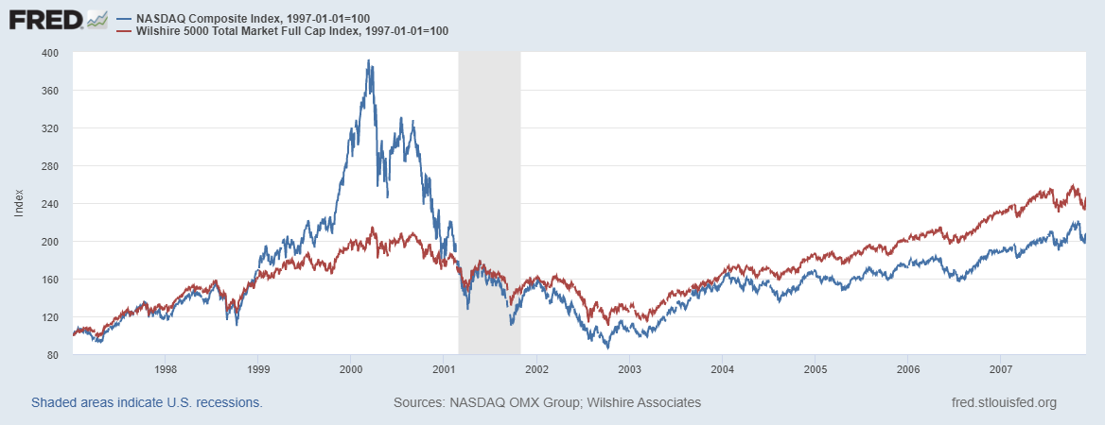

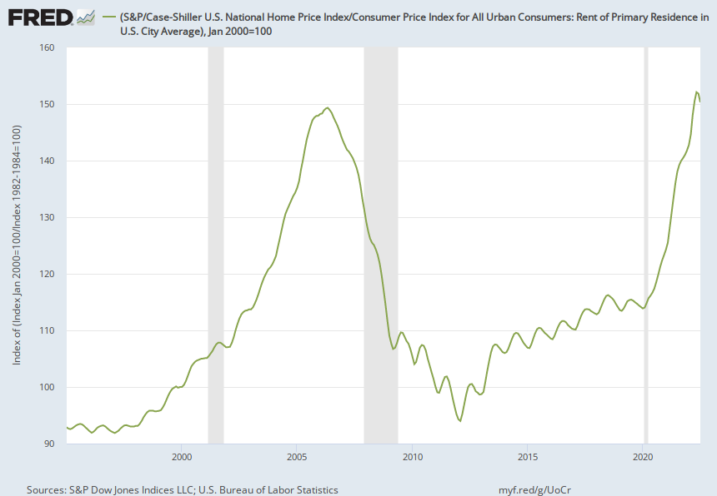
Does Voting Ever Get it “Wrong?”

Slide 25
Question #2: The Value of the New Technology?
Don’t Throw the baby out with the bathwater!
The value cryptographically protected digital-tokens is nuanced:
Blockchain technologies have significant promise some of which is already being realized.
  Private blockchains, Walmart and its produce suppliers
  Public Blockchains, Ethereum and smart contracts
See: Mehta N,. Agashe A., P. Detroja Blockchain Bubble or Revolution, 2021
Notes:
Cryptographic protection is a tougher call and depends on your views of privacy rights, as well as what information is being kept private (e.g., medical records versus financial transactions) Supply Chains (Walmart IBM)
Smart Contracts (Xbox royalties)

Slide 26
Smart Contracts on the Blockchain
A Smart Contract is a computer code that resides on the block chain and is executed based on incoming information.
Example, Parametric Hurricane Insurance via the Blockchain:
  Computer program on Ethereum continuously monitors Charleston Executive Airport wind speed for 1 year.
  If the windspeed is greater than 150 miles per hour, immediately transfers 100 bitcoin to the Seabrook Island Property Association.
  If the windspeed is less than 150 miles per hour, but more than 125 miles per hour, immediately transfers 75 bitcoin; etc.
Smart Contracts are Automatic, Immediate, Irreversible and Uncontestable.

Slide 27
DeFi and Smart Contracts
Broad Category of Decentralized Financial Services
  Crypto exchanges, online lending platforms, crypto derivatives, insurance, startup finance, etc.
  Explosion over time: $1b in 2019; $15b in 2020; $100b as of 12/2021 (DefiPulse.com). [Recently, it has fallen]
Smart Contracts are executed mostly on the Ethereum blockchain. No brokers, financial intermediaries, traders, and little regulation.
I personally have not seen the “killer application” of DEFI
Note in my insurance example, that bitcoin isn’t a great means of payment because of price volatility.
Notes:
Recently, these numbers have come down

Slide 28
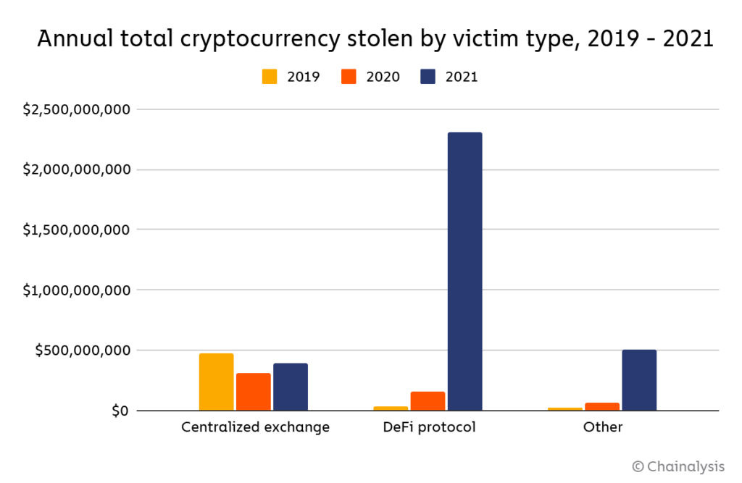
Clearly, Not Good News for Defi

Slide 29
Mark Zuckerberg & Stablecoins
Enter Facebook and Diem in 2019: Proposed blockchain enabled stablecoin, where all Facebook users would have diem wallets.
Regulators lodged lots of objections: Should a potentially ubiquitous private currency be run by one company?
What could go wrong?
Meta (Facebook) dropped out of the Diem project on 1/31/2022.
Notes:
WSJ, Headline, 8/11/2021, “Poly Network Hackers Steal More Than $600 Million in Cryptocurrency” Bloomberg 7/27/2021: “Tether and the Facebook Inc.-backed Diem token were a main focus of a recent meeting of U.S. regulators held on the financial risks posed by stablecoins.
Facebook NOVI wallets for holding Pax dollars ($1.1 billion in market cap)

Slide 30
Tether Stablecoin: Reserve Backed?
“The Coin That Could Wreck Crypto” (NYTIMES, 6/17): “In 2021, New York’s attorney general fined Tether $18.5 million and said the company had lied about its reserves, calling it ‘a stablecoin without stability.’”
Market cap of $68 billion; daily volume of $50 billion.
What could go wrong?
Notes:
WSJ, Headline, 8/11/2021, “Poly Network Hackers Steal More Than $600 Million in Cryptocurrency” Bloomberg 7/27/2021: “Tether and the Facebook Inc.-backed Diem token were a main focus of a recent meeting of U.S. regulators held on the financial risks posed by stablecoins.
Facebook NOVI wallets for holding Pax dollars ($1.1 billion in market cap)

Slide 31
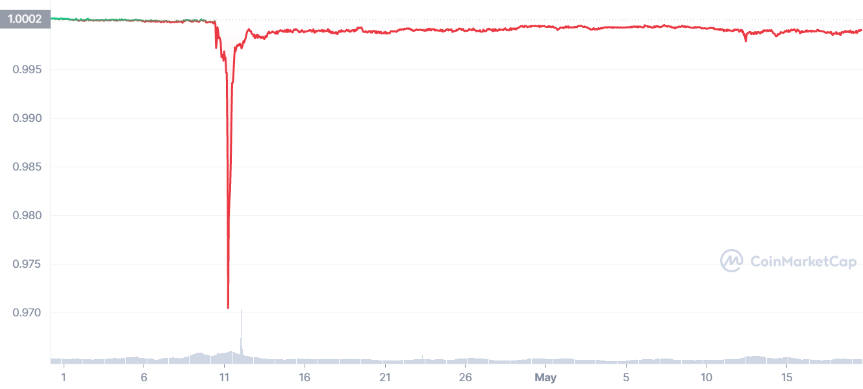
“Breaking the Buck?”
Notes:
Reserve Primary Fund broke the buck on 9/16/2008. Market cap $60 billion; lowest price 97 cents!

Slide 32
Algorithmic Stablecoin
Create a regular cryptocurrency and call it say, luna. If it has value:
Create a stablecoin and call it say, terra, that is tied to luna.
Smartcontract allows you to exchange terra into $1 worth or luna, or vice versa
Luna = $10, terra = $1, trade 1 luna for 10 terra
Luna = $1, terra =$1, trade 1 luna for 1 terra and vice versa
Terra price drops to $0.80, buy terra and get $1 of luna - Increased demand for terra increases its price.
Terra price rises to $1.20, sell terra and buy $1.20 of luna - Reduced demand for terra lowers its price.
What could go wrong?
Notes:
Collapse of Terra/Luna erased $60billion

Slide 33
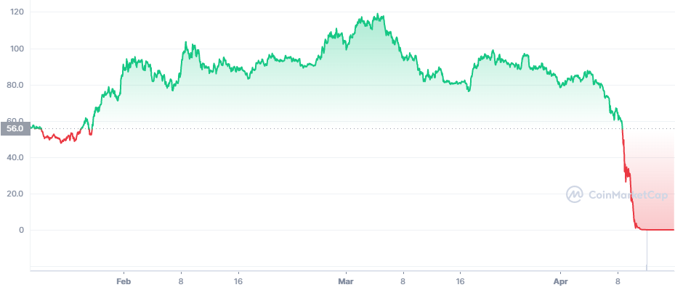
Luna’s Price This Year
https://coinmarketcap.com/
Notes:
Wiped out $60 billion in value

Slide 34
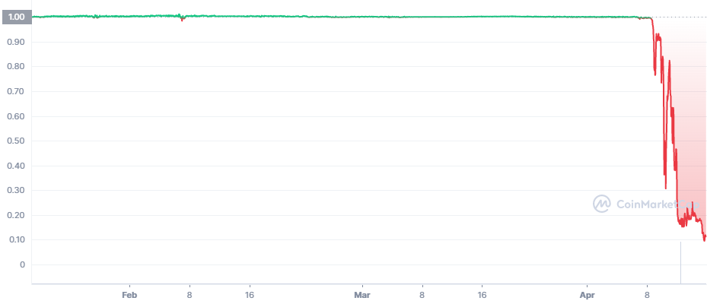
Terra’s Price
Death SpiRal!!!
Notes:
Collapse of Terra/Luna erased $60billion

Slide 35
It Is Still the Wild West!
Web3 is Going Great!

Slide 36
“Clean Up the Mess on Aisle 3”
Gary Gensler, Chair of the SEC quote from a WP interview.
Rostin Benham, Chair of the CFTC
Janet Yellen at Treasury.
They will act, but they would need Congressional legislation, too: Cash markets in cryptocurrencies are viewed as commodities and are unregulated
Notes:
Paper on CBDC

Slide 37
1930s Regulation in the 21st Century
Bank: An institution that accepts deposits and makes loans for a profit.
  Stablecoins?
Investment Contract subject to security laws (Howey Test):
  Investment of Money
  Common Enterprise (pooling of funds)
  Expectation of profit from effort others.
  BlockFI and crypto Lending

Slide 38
Feb, 14, 2022, NYTimes Headline
BlockFi, a crypto firm, reaches a $100 million settlement for failing to register loan products.
Cannot offer existing accounts to US residents.
BlockFi is working work with the SEC to develop an account that meets US security laws.

Slide 39
What is Good Regulation?
The Principles Are Easy;
  Eliminate fraud, abuse and manipulation.
  Do not let markets be dominated by a small number of powerful firms.
  Allow startups with new innovations to displace incumbent firms.
  Minimize risk of a financial crisis.
Legislation and Implementation: Not So Easy

Slide 40
Biden Framework for Regulating Crypto (9/16)
Protect Consumers, Investors, and Business.
Promote Access to Safe Financial Services.
Fostering Financial Stability.
Advancing Responsible Innovation.
Reinforcing our Global Financial Leadership.
Fighting Illicit Finance.
Exploring a U.S. Central Bank Digital Currency (CBDC)

Slide 41
Do We Need More Than (Good) Regulation?
The Bank for International Settlement (BIS) and a number of central banks are exploring how the development of Central Bank Digital Currency (CBDC) “contribute to an open, safe and competitive monetary environment that supports innovation and serves the public interest.”
Source of quotes, BIS Annual Report 2021

Slide 42
CBDCs and Other Central Bank Liabilities
The Fed and most Central Banks presently already have digital money!
CBDCs would permit wider access to the Fed’s digital assets to other financial institutions and possibly to the public
In addition, CBDCs could be designed for rapid settlement, finality, privacy and security (perhaps using blockchain technology)
Notes:
The Fed and most Central Banks presently have two financial liabilities:
Currency.
Bank Reserves.
Bank Reserves are Balances that Commercial Banks hold at the Fed and that are used in check clearing. They are already di

Slide 43
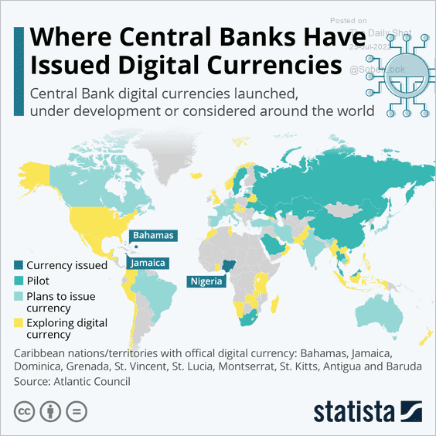
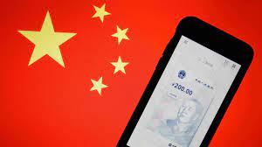
The Devil Is In the Details
Many countries as diverse as Sweden, Ecuador and China have begun experiments with CBDCs.
Where’s the Fed?
Source: E. Prasad, The Future of Money
Notes:
MIT Boston Fed experiment. But pretty conservative vision. CBDC offered to consumers through insured institutions, i.e., banks. Electronic cash like checks.

Slide 44




Who should design our payment system?
Notes:
Vitalek Buterin, age 27 cofounder of Ethereum at age 20

Slide 45
Your Turn!
www.NEEDelegation.org
Geoffrey Woglom
grwoglom@amherst.edu
Contact NEED: Info@NEEDelegation.org
Submit a testimonial: www.NEEDelegation.org/testimonials.php
Support NEED: www.NEEDelegation.org/donate.php

Slide 46
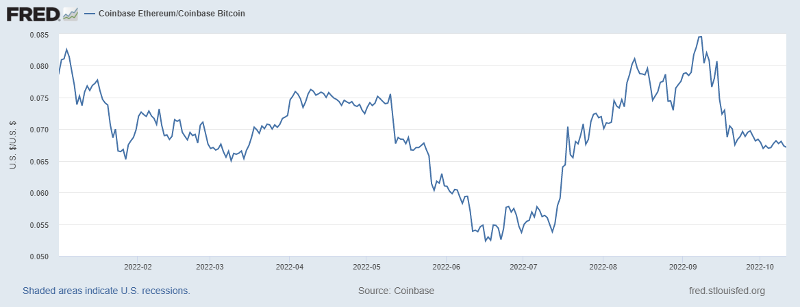
Ether to Bitcoin ratio

Slide 47
Resources to Learn More
N. Mehta, et.al. Blockchain Bubble or Revolution
E Prasad, The Future of Money (https://youtu.be/o3NuHb7V1IA)
Presidential Working Group on Financial Markets, 11/1/21 (https://home.treasury.gov/system/files/136/StableCoinReport_Nov1_508.pdf)
Federal Reserve White paper
(https://www.federalreserve.gov/publications/files/money-and-payments-20220120.pdf)
Executive Order: https://www.whitehouse.gov/briefing-room/statements-releases/2022/03/09/fact-sheet-president-biden-to-sign-executive-order-on-ensuring-responsible-innovation-in-digital-assets/

Slide 48
Glossary
Traditional Money is currency plus bank checking accounts.
Currency is paper and coin issued by the government. Currency is legal tender and must be accepted for all debts. Transactions using currency are immediate and final (can’t be undone without the agreement of both parties.)
Digital Payments are used for purchases where no physical money is exchanged. Examples include many online banking payments, credit card payments, PayPal.
Digital Currency or Virtual currency is a form of money that exists solely in digital form, such as a digital token (i.e., as data on a computer). Examples: cryptocurrencies, central bank digital currencies and virtual currencies used in online gaming.
Cryptographic identity protection assigns people two account numbers, or keys, one public and one private. Public record keeping is done using the public key and transactions are authorized using the private key.
Cryptocurrency is a digital currency where the owner’s identity is protected using cryptographic encryption and where record keeping is done with a public blockchain, e.g., Bitcoin.
Stablecoin is a cryptocurrency with a stable value of $1, somewhat like a money market mutual fund.

Slide 49
Glossary (Cont.)
Distributed ledger is a database for recording transactions or other information, where the information or ledger is shared on a network of many computers simultaneously.
Blockchains are distributed ledgers where new transactions (new blocks) are added to the chain sequentially when a consensus of the network agrees that the transactions are valid.
Decentralized Finance (DeFi) is peer-to-peer financial activity conducted through public blockchains and smart contracts.
Smart Contracts are computer programs that execute automatically based on external conditions. Example, travel insurance that pays off automatically when a flight is cancelled.
Central Bank Digital Currency (CBDC) is a digital currency issued by a central bank. Different central banks are experimenting with various forms of CBDCs, including some using blockchain technology, electronic wallets and cryptography.

Slide 50
Consensus Mechanisms
Consensus mechanism requires:
  Many nodes competing to add a new block.
  Economic incentive to add valid new block.
  Mechanism to ensure validity of the new block.
Proof of Work (POW):
  Many miners with free entry competing to solve random number problem.
  If the new block is accepted (future blocks are added), miner gets a reward in bitcoin and transaction fees.
  Subsequent miners won’t add to the block if they don’t believe it is valid.

Slide 51
Proof of Stake (POS)
POS: A Better Way?
  Potential Block Creators place cryptocurrency in specialized wallets that are locked while they are acting as blockchain validators.
  Validators are selected randomly, where the odds of being selected are proportional to the value of the currency “staked” in the wallet.
  The rest of the process of validation tis similar: transaction fees only paid if subsequent blocks are added, but!!
  If an invalid block is discovered the staked deposit is forfeited.
POW competition over computer power and energy usage
POS competition over staked deposits (no computer power or energy usage involved

Slide 52
History of POS
Invented in 2012 by Peercoin, a small crypto currency.
POS has been implemented by Cardano, Solana and Polkadot: numbers 8, 9 and 11 in terms of market cap.
Ethereum was supposed to implement POS in May of 2020, but has delayed. Recently announcing it would implement POS in September.

Slide 53
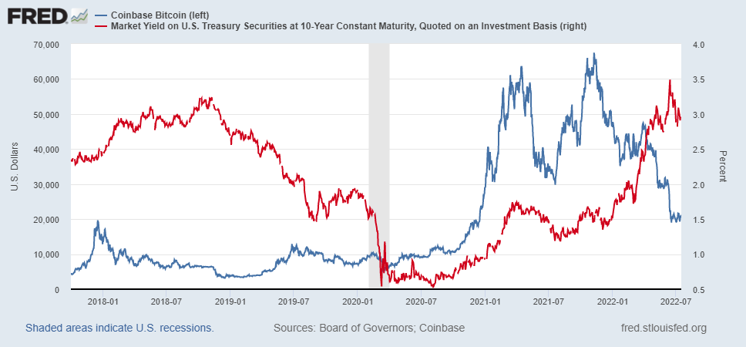
Coincidence?

Slide 54
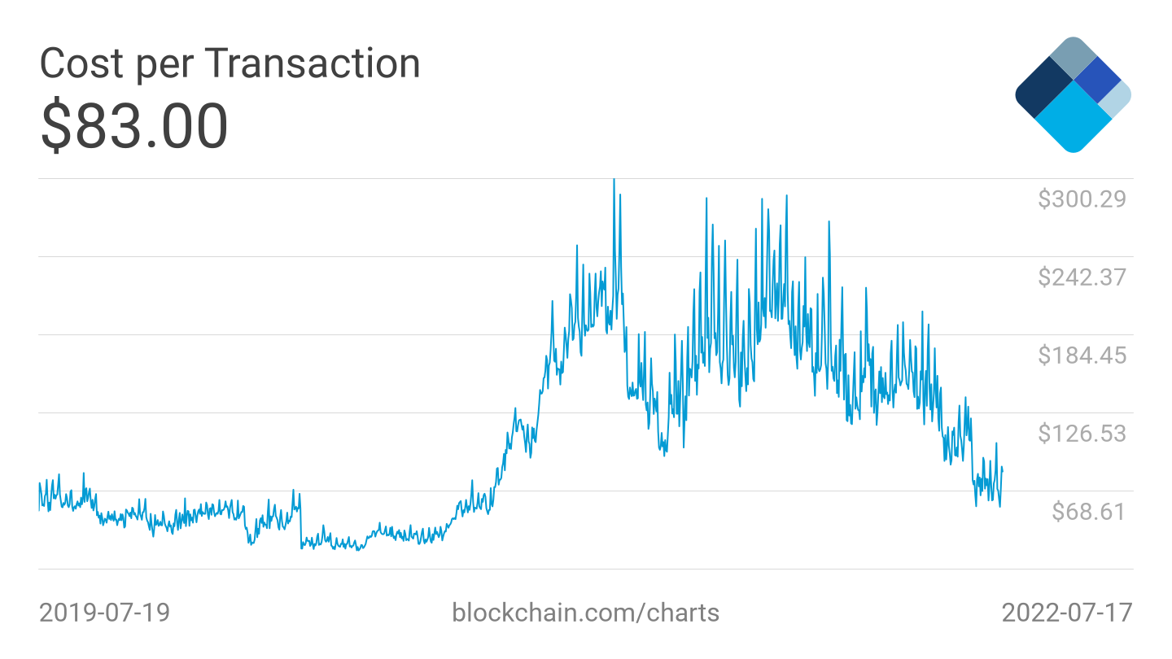

Slide 55
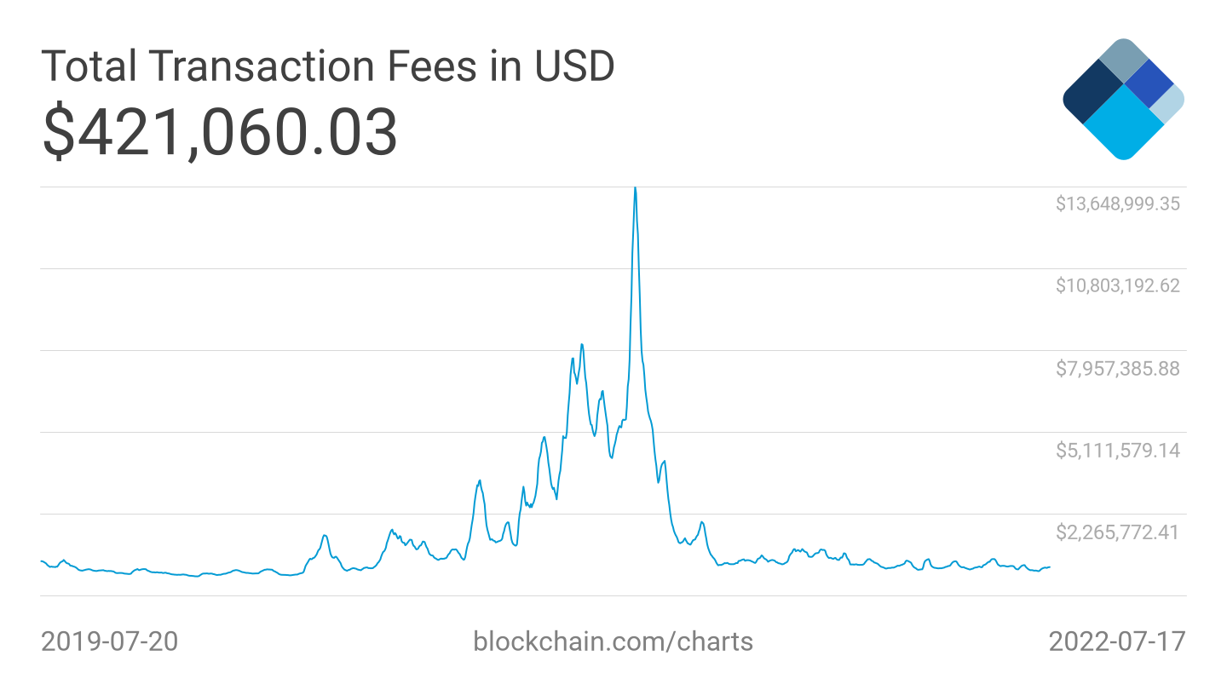

Slide 56
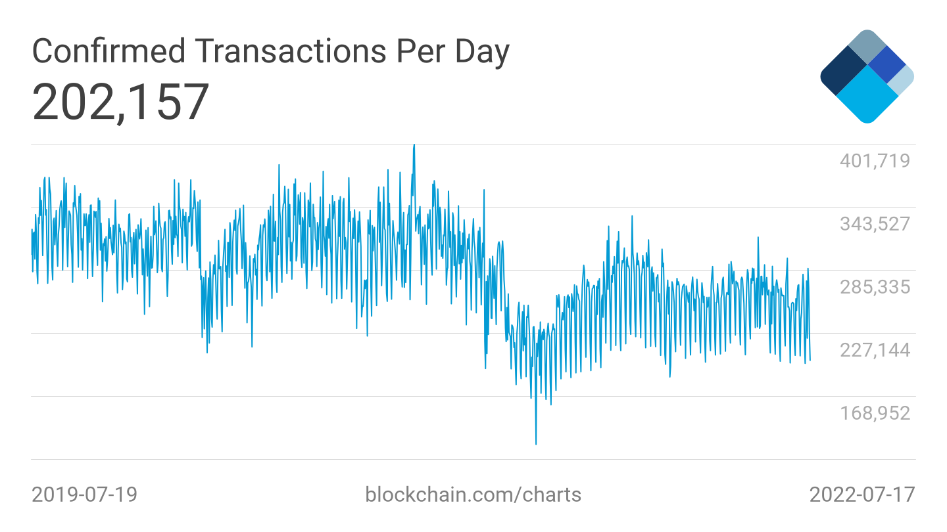

Slide 57
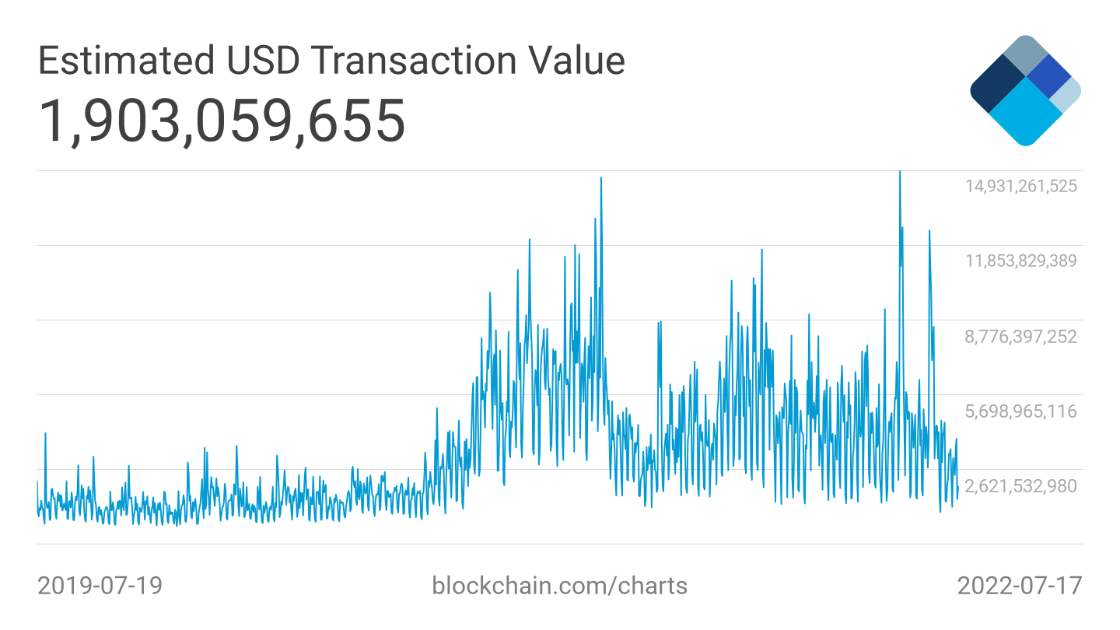
Notes:
With BTC at $20,000, implies 35 billion per day

Slide 58
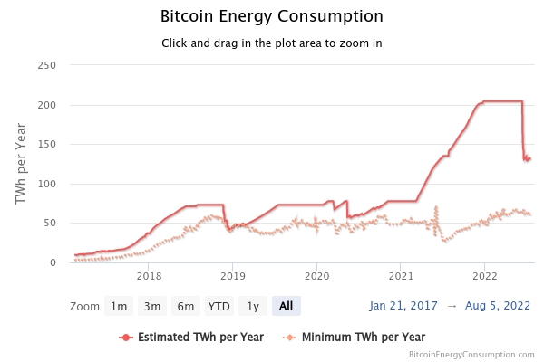
https://digiconomist.net/bitcoin-energy-consumption

Slide 59
