Slide 1
Osher Lifelong Learning Institute, Winter 2022
Contemporary Economic Policy
Clemson University
February-March, 2022
National Economic Education Delegation

Slide 2
Available NEED Topics Include:
Coronavirus Economics
US Economy
Climate Change
Economic Inequality
Economic Mobility
Trade and Globalization
Minimum Wages
Immigration Economics
Housing Policy
Federal Budgets
Federal Debt
Black-White Wealth Gap
Autonomous Vehicles
US Social Policy

Slide 3
Course Outline
Contemporary Economic Policy
  Week 1 (2/28): US Economy & Coronavirus Economics
  Week 2 (3/7): Economic Inequality (Brian Peterson, Central College)
  Week 3 (3/14): Cryptocurrencies (Geoffrey Woglom, Amherst College)
  Week 2 (3/21): Autonomous Vehicles (Jon Haveman, NEED)

Slide 4

Cryptocurrencies & The Future of Money
Clemson University
March 14, 2022
Geoffrey Woglom
Amherst College
Professor of Economics (emeritus)

Slide 5
Submitting Questions
Please submit questions of clarification in the chat.
  I will try to handle them as they come up
We will do a verbal Q&A once the material has been presented.
OLLI allowing, we can stay beyond the end of class to have further discussion.
Slides will be available on the NEED website tomorrow (www.NEEDelegation.org)

Slide 6
Outline of the Talk
Fun Facts about Bitcoin
A little bit on the underlying technology of bitcoin.
Economist evaluation of 2 Key Questions
  Is Bitcoin serving a legitimate economic role?
  Is their potential for valuable financial innovations with the underlying technology?
In order to tap that potential, we need:
  Legislation to provide “good” regulation of crypto markets.
  The Federal Reserve needs to follow other central banks in creating a safe and secure, digital means of payment: Central Bank Digital Currency (CBDC)

Slide 7
But First, What is Bitcoin?
Bitcoin is the first cryptocurrency and was invented in 2008.
Cryptocurrencies are a form of money that exists solely as a computer record.
More importantly,…

Slide 8
Bitcoin Has Started a Revolution in Finance
The way we buy and sell things, our “payments system;” the way we save, borrow and invest; the role of banks and other financial firms are rapidly changing.
In my view, Bitcoin will NOT be an important player in these developments, but the technologies underlying Bitcoin will.

Slide 9
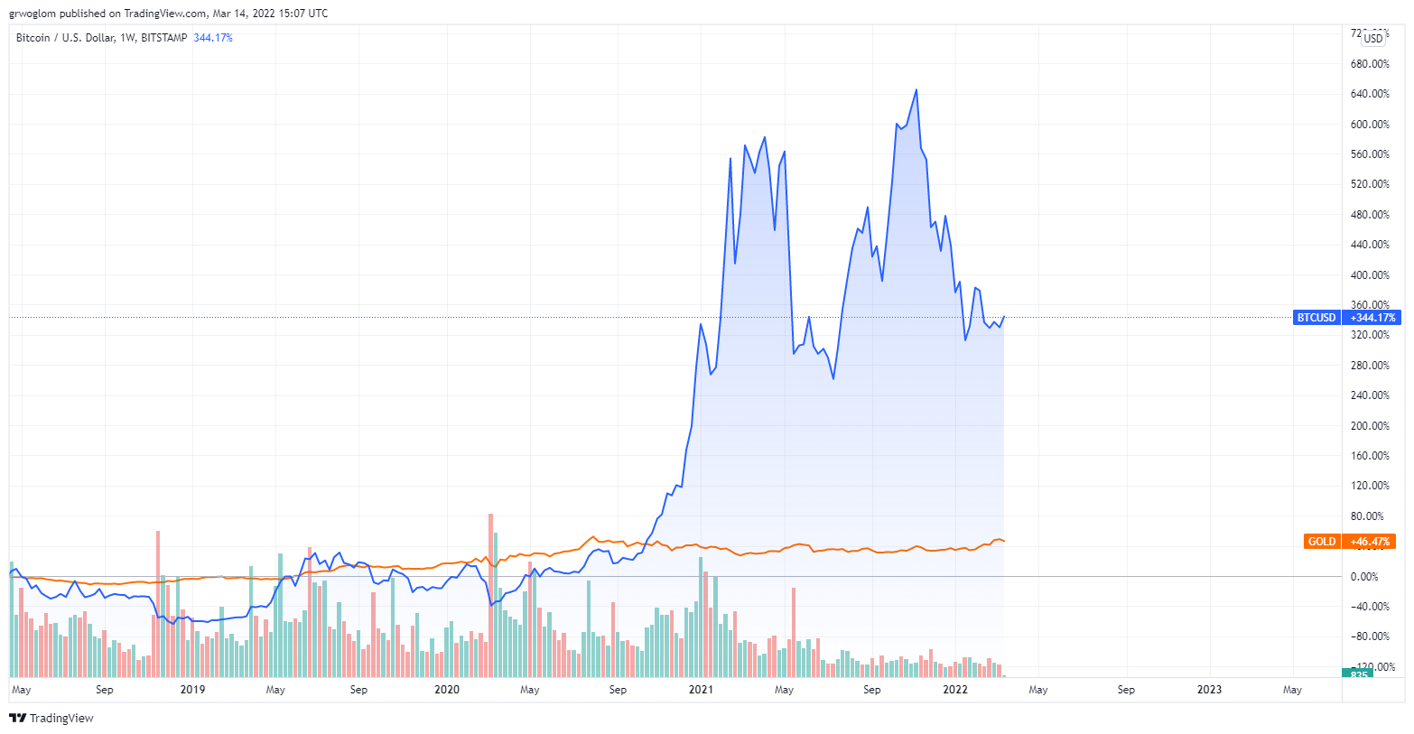
Bitcoins: What is the Excitement About?

Slide 10
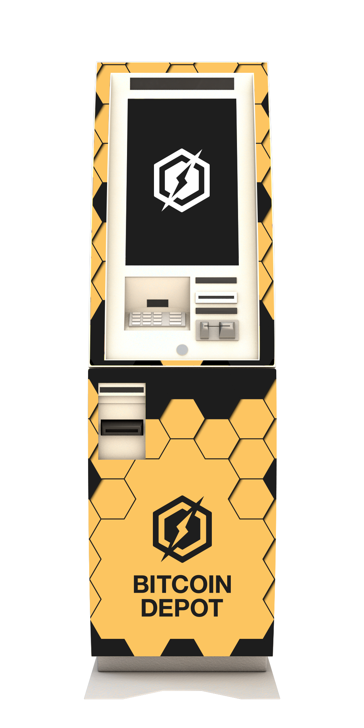
One of the Over 40,000 Bitcoin ATMs

Slide 11
An Origin Story Worthy of a Pulp Novel!
The Mysterious Satoshi Nakamoto:
  Lehman Brothers Bankruptcy, 9/2008
  Halloween 2008: a white paper is published on the Internet laying out the idea and design for Bitcoin. The author (or authors) used Satoshi Nakamoto as a pseudonym.
  January 2009: Satoshi releases the first version of the Bitcoin software.
  2009-2010: Satoshi releases new versions of the software and is actively involved in Internet Chatter about Bitcoin.
  April 2011: Satoshi ceases all known and/or verified communications.
To this date the identity or identities of Satoshi are unknown.

Slide 12
The Possible Economic Role for Bitcoin
Satoshi’s Vision: “A purely peer-to-peer version of electronic cash [that] would allow online payments to be sent directly from one party to another without going through a financial institution.”
More, prosaically
Facilitate payments at lower costs with speed and security.
  E.g., Credit Card Fees.
  Merchant doesn’t get paid for at least 2 days.
  2019 Capital One hackers access personal information of 106 m users
Meet the needs of previously unbanked.
  Particularly a problem in the Developing World, but
  Fed estimates that 50 million US adults have little or no banking relationships.
Notes:
Satoshi, Bitcoin is “A purely peer-to-peer version of electronic cash [that] would allow online payments to be sent directly from one party to another without going through a financial institution.”
So, Natoshi’s goal was to improve money, in a way that did not depend banks or governments!

Slide 13
Facts about Cryptocurrencies (as of 3/14)
Bitcoin was the first and is the largest in terms of market cap (total value of all bitcoins) of about $738 billion.
Ethereum is in second place with a market cap of about $309 billion.
Presently, 11,500 different varieties with a total market cap of about $1.8 trillion (https://www.coingecko.com/en)
NY stock exchange market cap is about $25 trillion

Slide 14
Underlying Technology of Bitcoin
Digital Token (exists only as data on a computer) whose ownership is cryptographically protected.
Distributed Ledger, Block Chain Technology.
Software protocol the provides a “consensus” mechanism on the validity of transactions without a “trusted third party.” (i.e, a bank or the Fed)
Notes:
Define distributed Ledger

Slide 15
So, how does it work?
Jack, the owner of a bitcoin is given a public number or key and a private encrypted key.
Jack can trade his bitcoin with Jill by using Jill’s public key and verifying the transaction with his private key.
The new transaction is then posted on a a number of different computers and can be read by anyone.
The clearing of the transaction is done with public database or distributed ledger called a blockchain through a process know as bitcoin mining.
Bitcoin “miners” have enormous computing power and they compete to add new transactions to the blockchain

Slide 16
Mining for Bitcoin
Bitcoin Miners gather about 3000 new transactions into a “block.”
The miners’ competition involves generating long, random numbers (“hashing”) until one of the numbers fits a precise set of attributes.
The winning miner then adds the new block to the previous block in the blockchain. The total process takes about 10 minutes
The incentive for miners is that the winner of the competition gets compensated with new bitcoins and transaction fees.
However, the miner will not get the reward unless other miners subsequently add new blocks to the first miner’s block.
In this way transactions are added to the chain via a “consensus” of miners.

Slide 17
Question #1: Is Bitcoin serving an economic role
Bitcoin is not and cannot be widely used to make transactions
Scalability?
Price Instability.
Transactions costs
Cash ATM vs. Bitcoin ATM
And, the network is costly
BIS, Annual Report 2018, Chapter V
Notes:
Presently, Bitcoin mining requires 80.7 terawatt-hours per year, a little less than Belgium’s energy consumption (although less than is used in gold mining). (Note there are other consensus mechanisms that do not use as much energy.)

Slide 18
What Role Does Bitcoin Play?
For some it plays the same role as $100 bills: 32.8% of all bills in circulation (more than the number of $1 bills) and 80.2% of the value of all bills.
Illegal Activity:
This claim is disputed: https://www.newsweek.com/illegal-use-bitcoin-dropped-50-2020-citibank-reports-1573263
Notes:
Trading of banned goods; e.g, Silk Road
Ransomware Payments.
Money Laundering.
Tax Evasion

Slide 19
But What about as an Investment?
It is hard to argue with the fact that Bitcoin has provided outsized returns for many, albeit very volatile.
But what is its the “fundamental value” ?
To me it is a purely speculative investment.
Notes:
Promised future payments such as dividends for stocks or coupon payments for bonds.
For currencies, promise of future use in exchange with stable values.
Bitcoin only promises the possibility of capital gains, but not based on future payments.

Slide 20
How Do Economist Think About Investments?
Good Starting Place
“In the short term the stock market behaves like a voting machine, but in the long term it acts like a weighing machine.”
What is being weighed is prospective payments from the security, or other intrinsic value, i.e. its fundamental value.
Bitcoin?
Notes:
Warren Buffet paraphrasing Benjamin Graham. Payments mean dividends or coupon payments. Even, gold has some intrinsic value as the ultimate insuarbne

Slide 21
So, What is the Harm?
“,…when [an American] purchases an investment, the American is attaching his hopes, not so much to its prospective yield, as to a favourable change in the [current price], i.e. that he is,…,a speculator. Speculators may do no harm as bubbles on a steady stream of enterprise. But the position is serious when enterprise becomes the bubble on a whirlpool of speculation. When the capital development of a country becomes a by-product of the activities of a casino, the job is likely to be ill-done.”
J.M. Keynes, General Theory, Ch 12
Notes:
John Maynard Keynes, The General Theory, Ch 12. Speculation on price changes due to information about future earnings

Slide 22
It’s Not Just Me
Question: Private, unbacked crypto assets serve no economic purpose.

Slide 23
Question #2: The Value of the New Technology?
Don’t Throw the baby out with the bathwater!
The value cryptographically protected digital-tokens is nuanced:
Blockchain technologies have significant promise some of which is already being realized.
  Private blockchains, Walmart and its produce suppliers
  Ethereum and smart contracts
See: Mehta N,. Agashe A., P. Detroja Blockchain Bubble or Revolution, 2021
Notes:
Cryptographic protection is a tougher call and depends on your views of privacy rights, as well as what information is being kept private (e.g., medical records versus financial transactions) Supply Chains (Walmart IBM)
Smart Contracts (Xbox royalties)

Slide 24
Smart Contracts on the Blockchain
A Smart Contract is a computer code that resides on the block chain and is executed based on incoming information.
Example, Parametric Hurricane Insurance via the Blockchain:
  Computer program on Ethereum continuously monitors Charleston Executive Airport wind speed for 1 year.
  If the windspeed is greater than 150 miles per hour, immediately transfers 100 bitcoin to the Seabrook Island Property Association.
  If the windspeed is less than 150 miles per hour, but more than 125 miles per hour, immediately transfers 75 bitcoin; etc.
Smart Contracts are Automatic, Immediate, Irreversible and Uncontestable.

Slide 25
DeFi and Smart Contracts
Broad Category of Decentralized Financial Services
  Crypto exchanges, online lending platforms, crypto derivatives, insurance, startup finance, etc.
  Explosion over time: $1b in 2019; $15b in 2020; $100b as of 12/2021 (DefiPulse.com).
Smart Contracts are executed mostly on the Ethereum blockchain. No brokers, financial intermediaries, traders, and little regulation.
Note in my insurance example, that bitcoin isn’t a great means of payment because of price volatility.
Notes:
Recently, these numbers have come down

Slide 26
But What about Digital Payments for Consumers?
Who pays for their lattes with cash? We already have digital payments, but what about the needs of the unbanked?
The US and the developed world are far behind Africa: Mobile, as in cellphone money, the M-Pesa.
Grameen Foundation:
Making Cash Digital is the Key to Possibility
When Poor Women Control their own money, it no longer controls them.
Notes:
Started in Kenya in 2007 and now available in 10 countries.
Buy M-Pesa credits from “agents” (local shop) which can be transferred to others with an M-Pesa account via cellphone.
96 percent of Kenyan households have a mobile account.
M-pesa is a digital currency, but not a crypto currency

Slide 27
Retail versus Wholesale Digital Payments
Retail: M-pesa
Wholesale: Cryptocurrency for DEFI transactions.
Bitcoin doesn’t work for either because of transactions costs and price volatility.
But, to tap into the potential benefits of DEFI we need:
  A safe and secure stablecoin to facilitate DEFI transactions, at least wholesale transactions.
  Regulation of crypto markets and DEFI

Slide 28
Stablecoins: Cryptocurrency with a stable value of $1 (we hope)
2014 “Tether”: a cryptocurrency supposed to be backed by dollars so its price would always have a value of $1.
All sorts of operational and legal problems.
Enter Facebook and Diem: Proposed blockchain enabled stablecoin.
Meta (Facebook) dropped out of the Diem project on 1/31/2022 due to regulatory pressure
Notes:
WSJ, Headline, 8/11/2021, “Poly Network Hackers Steal More Than $600 Million in Cryptocurrency” Bloomberg 7/27/2021: “Tether and the Facebook Inc.-backed Diem token were a main focus of a recent meeting of U.S. regulators held on the financial risks posed by stablecoins.
Facebook NOVI wallets for holding Pax dollars ($1.1 billion in market cap)

Slide 29
“Clean Up the Mess on Aisle 3”
Gary Gensler, Chair of the SEC quote from a WP interview.
Rostin Benham, Chair of the CFTC
Janet Yellen at Treasury.
Sarah Bloom Raskin, nominated to the Fed as Vice Chair for regulation.
They will act, but they would need Congressional legislation, too: Cash markets in cryptocurrencies are viewed as commodities and are unregulated
Notes:
Paper on CBDC

Slide 30
“Cryptocurrency is the Wild West of our
Financial System” Sen. E. Warren of Mass
Pick Your Own Adventure:
Mt. Gox, hacked in 2011 and $9 million in bitcoin stolen. Vows to do better, but suffers a $615 million hack in 2014.
“How the Feds Tracked Down $3.6 Billion in Stolen Bitcoin” WSJ, 2/9/2022.

Slide 31

Good News?

Slide 32
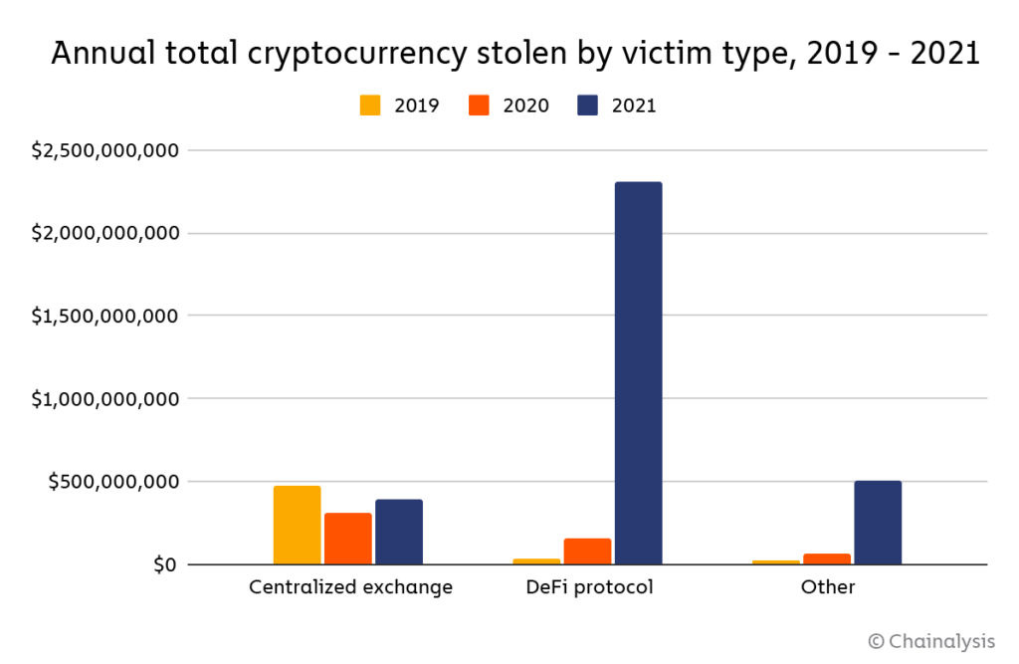
Clearly, Not Good News

Slide 33
What is Good Regulation?
The Principles Are Easy;
  Eliminate fraud, abuse and manipulation.
  Do not let markets be dominated by a small number of powerful firms.
  Allow startups with new innovations to displace incumbent firms.
Legislation and Implementation: Not So Easy

Slide 34
1930s Regulation in the 21st Century
Bank: An institution that accepts deposits and makes loans for a profit.
  Stablecoins?
  Money Market Mutual Funds?
Investment Contract subject to security laws (Howey Test):
  Investment of Money
  Common Enterprise (pooling of funds)
  Expectation of profit from effort others.
  BlockFI and crypto Lending

Slide 35
BlockFI
Crypto currency exchange founded in 2017 that offers a variety of consumer financial services
  Crypto wallets for storing crypto.
  Credit Cards with Bitcoin rewards.
  Crypto Loans: borrow 50% of your crypto account in $s
March 2019 BIA accounts
  Deposit Bitcoin and earn high interest rates.
  BlockFi lends out the bitcoin to other individuals and institutions.
How Does BIA fare on the Howey Test?

Slide 36
Feb, 14, 2022, NYTimes Headline
BlockFi, a crypto firm, reaches a $100 million settlement for failing to register loan products.
Cannot offer existing accounts to US residents.
The SEC will work with BlockFi to develop account that meets US security law

Slide 37
Do We Need More Than (Good) Regulation?
The Bank for International Settlement (BIS) and a number of central banks are exploring how the development of Central Bank Digital Currency (CBDC) “contribute to an open, safe and competitive monetary environment that supports innovation and serves the public interest.”
Source of quotes, BIS Annual Report 2021

Slide 38
Two Recent Government Report
Presidential Working Group on Financial Markets on Stable Coins and CBDC, 11/2021.
Federal Reserve Discussion Paper on CBDCs, 1/2022
  Congress needs to authorize action
  Digital Dollar should be offered by the Fed but managed by commercial banks and other regulated, insured firms.
Executive Order of the President, 3/09/2022

Slide 39
CBDCs and Other Central Bank Liabilities
The Fed and most Central Banks presently already have digital money!
CBDCs would permit wider access to the Fed’s digital assets to other financial institutions and possibly to the public
In addition, CBDCs could be designed for rapid settlement, finality, privacy and security (perhaps using blockchain technology)
Notes:
The Fed and most Central Banks presently have two financial liabilities:
Currency.
Bank Reserves.
Bank Reserves are Balances that Commercial Banks hold at the Fed and that are used in check clearing. They are already di

Slide 40
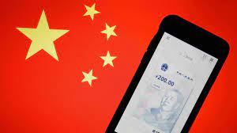
The Devil Is In the Details
Over 100 countries as diverse as Sweden, Ecuador and China have begun experiments with CBDCs.
Where’s the Fed?
Source: E. Prasad, The Future of Money

Slide 41




Who should design our payment system?
Notes:
Vitalek Buterin, age 27 cofounder of Ethereum at age 20

Slide 42
Resources to Learn More
N. Mehta, et.al. Blockchain Bubble or Revolution
E Prasad, The Future of Money (https://youtu.be/o3NuHb7V1IA)
Presidential Working Group on Financial Markets, 11/1/21 (https://home.treasury.gov/system/files/136/StableCoinReport_Nov1_508.pdf)
Federal Reserve White paper
(https://www.federalreserve.gov/publications/files/money-and-payments-20220120.pdf)
Executive Order: https://www.whitehouse.gov/briefing-room/statements-releases/2022/03/09/fact-sheet-president-biden-to-sign-executive-order-on-ensuring-responsible-innovation-in-digital-assets/

Slide 43
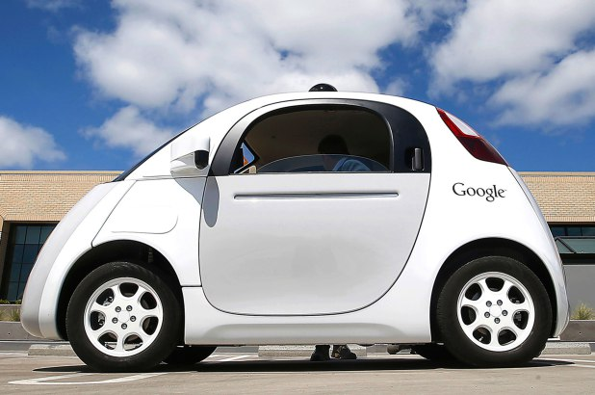
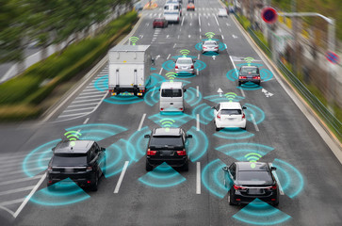


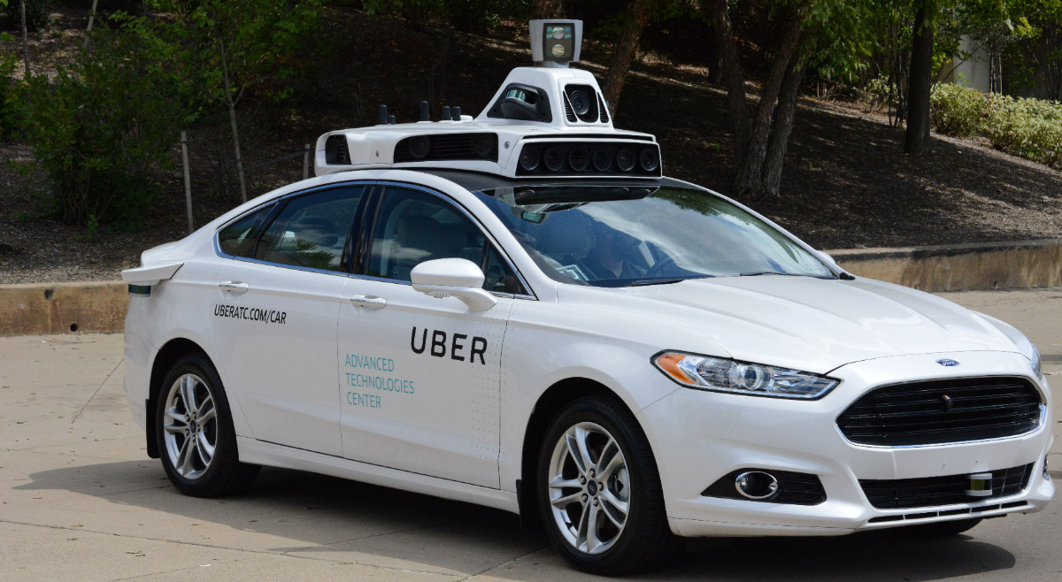
Autonomous Vehicles: Jon Haveman

Slide 44
Questions?
www.NEEDelegation.org
Geoffrey Woglom
grwoglom@amherst.edu
Contact NEED: Info@NEEDelegation.org
Submit a testimonial: www.NEEDelegation.org/testimonials.php
Support NEED: www.NEEDelegation.org/donate.php

Slide 45
Glossary
Traditional Money is currency plus bank checking accounts.
Currency is paper and coin issued by the government. Currency is legal tender and must be accepted for all debts. Transactions using currency are immediate and final (can’t be undone without the agreement of both parties.)
Digital Payments are used for purchases where no physical money is exchanged. Examples include many online banking payments, credit card payments, PayPal.
Digital Currency or Virtual currency is a form of money that exists solely in digital form, such as a digital token (i.e., as data on a computer). Examples: cryptocurrencies, central bank digital currencies and virtual currencies used in online gaming.
Cryptographic identity protection assigns people two account numbers, or keys, one public and one private. Public record keeping is done using the public key and transactions are authorized using the private key.
Cryptocurrency is a digital currency where the owner’s identity is protected using cryptographic encryption and where record keeping is done with a public blockchain, e.g., Bitcoin.
Stablecoin is a cryptocurrency with a stable value of $1, somewhat like a money market mutual fund.

Slide 46
Glossary (Cont.)
Distributed ledger is a database for recording transactions or other information, where the information or ledger is shared on a network of many computers simultaneously.
Blockchains are distributed ledgers where new transactions (new blocks) are added to the chain sequentially when a consensus of the network agrees that the transactions are valid.
Decentralized Finance (DeFi) is peer-to-peer financial activity conducted through public blockchains and smart contracts.
Smart Contracts are computer programs that execute automatically based on external conditions. Example, travel insurance that pays off automatically when a flight is cancelled.
Central Bank Digital Currency (CBDC) is a digital currency issued by a central bank. Different central banks are experimenting with various forms of CBDCs, including some using blockchain technology, electronic wallets and cryptography.

