Slide 1

Cryptocurrencies & The Future of Money
680 Exchange
August 17, 2022
Geoffrey Woglom
Amherst College (emeritus)

Slide 2
National Economic Education Delegation
Vision
  One day, the public discussion of policy issues will be grounded in an accurate perception of the underlying economic principles and data.
Mission
  NEED unites the skills and knowledge of a vast network of professional economists to promote understanding of the economics of policy issues in the United States.
NEED Presentations
  Are nonpartisan and intended to reflect the consensus of the economics profession.

Slide 3
Who Are We?
Honorary Board: 54 members
  2 Fed Chairs: Janet Yellen, Ben Bernanke
  6 Chairs Council of Economic Advisers
    Furman (D), Rosen (R), Bernanke (R), Yellen (D), Tyson (D), Goolsbee (D)
  3 Nobel Prize Winners
    Akerlof, Smith, Maskin
Delegates: 651+ members
  At all levels of academia and some in government service
  All have a Ph.D. in economics
  Crowdsource slide decks
  Give presentations
Global Partners: 49 Ph.D. Economists
  Aid in slide deck development

Slide 4


Where Are We?

Slide 5
Available NEED Topics Include:
Healthcare Economics
US Economy
Climate Change
Economic Inequality
Economic Mobility
Trade and Globalization
Minimum Wages
Immigration Economics
Housing Policy
Federal Budgets
Federal Debt
Black-White Wealth Gap
Autonomous Vehicles
US Social Policy

Slide 6
Outline of the Talk
Fun Facts about Bitcoin
A little bit on the underlying technology of bitcoin.
Economist evaluation of 2 Key Questions
  Is Bitcoin serving a legitimate economic role?
  Is there potential for beneficial, financial innovations using the underlying technology?
Prospects for regulation of the crypto space.

Slide 7
But First, What is Bitcoin?
Bitcoin is the first cryptocurrency and was invented in 2008.
Cryptocurrencies are a form of digital money (viz. data on a computer) where account ownership is confidential and where record keeping is decentralized over a multitude of computers
More importantly,…

Slide 8
Bitcoin Has Started a Revolution in Finance
The way we buy and sell things, our “payments system;” the way we save, borrow and invest; the role of banks and other financial firms are rapidly changing.
In my view, Bitcoin will NOT be an important player in these developments, but the technologies underlying Bitcoin may be.

Slide 9
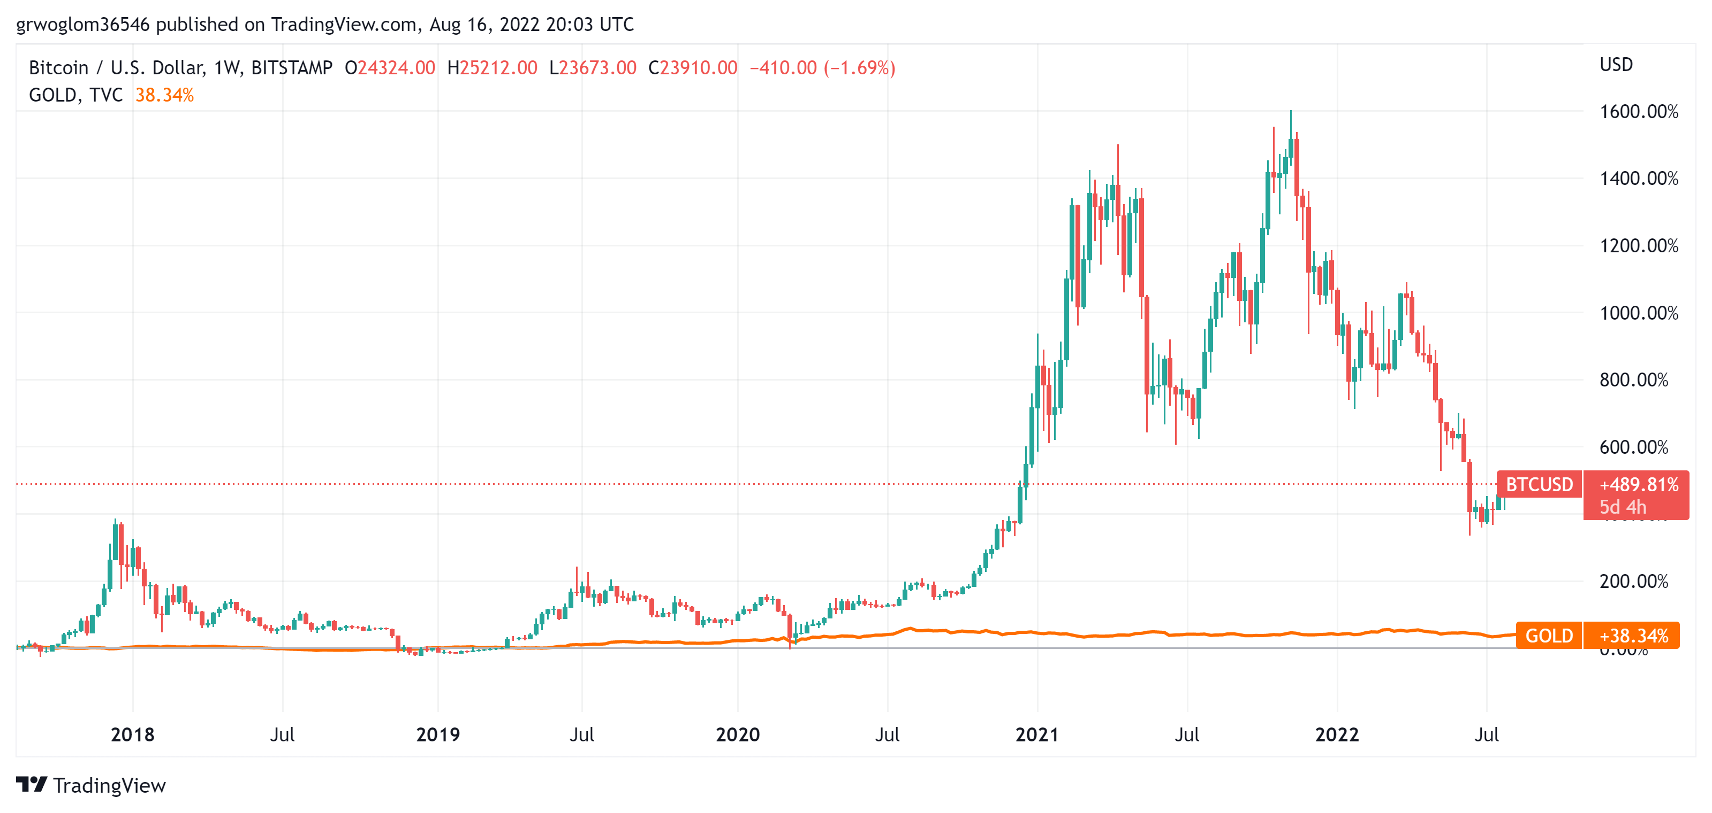
Bitcoins: What Is All the Excitement About?
Was
$23,400, 0n 8/17, 10:30 AM
Notes:
When I last spoke in March Bitcoin was $40k

Slide 10
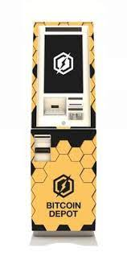
One of the Over 50,000 Bitcoin ATMs
Notes:
1387 S California Blvd, Walnut Creek, CA 94596

Slide 11
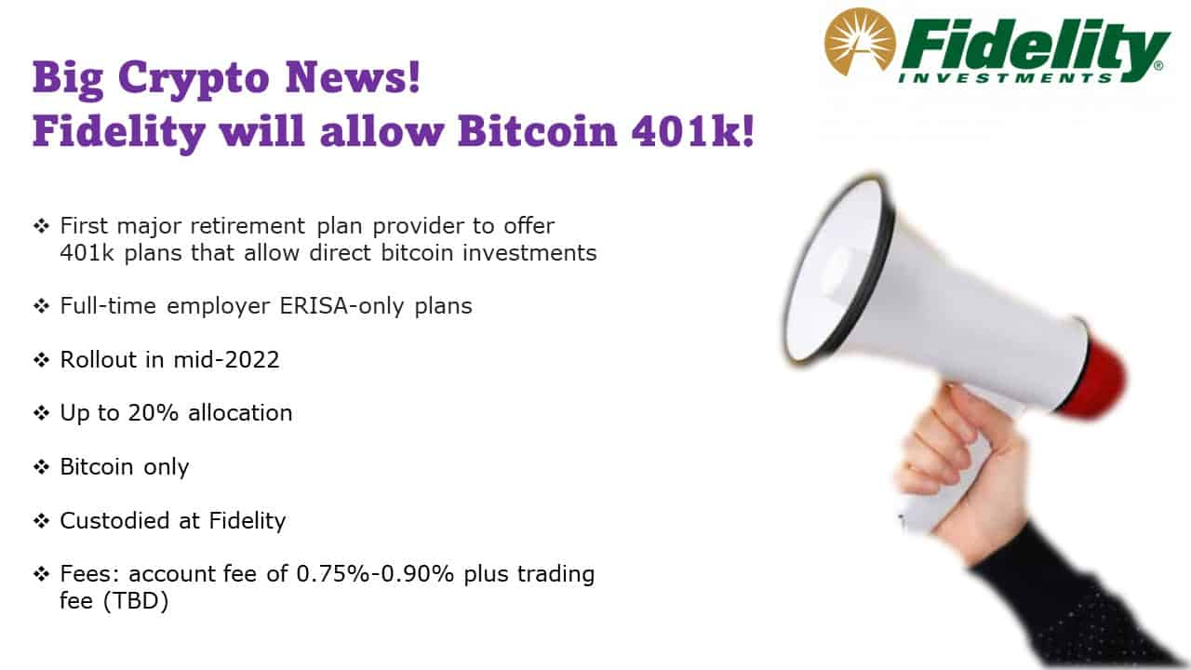
Give Me a Break?

Slide 12
Facts about Cryptocurrencies (as of 8/17)
Bitcoin was the first and is the largest in terms of market cap (total value of all bitcoins) of about $450 billion.
Ethereum is in second place with a market cap of about $220 billion.
Presently, 11,500 different varieties with a total market cap of about $1.2 trillion (https://www.coingecko.com/en)
Market cap of domestically listed US companies is about $40 trillion.

Slide 13
An Origin Story Worthy of a Pulp Novel!
The Mysterious Satoshi Nakamoto:
  Lehman Brothers Bankruptcy, 9/2008
  Halloween 2008: a white paper is published on the Internet laying out the idea and design for Bitcoin. The author (or authors) used Satoshi Nakamoto as a pseudonym.
  January 2009: Satoshi releases the first version of the Bitcoin software.
  2009-2010: Satoshi releases new versions of the software and is actively involved in Internet Chatter about Bitcoin.
  April 2011: Satoshi ceases all known and/or verified communications.
To this date the identity or identities of Satoshi are unknown.
Notes:
Rick Santelli 2/19/2009 Teaparty Rant

Slide 14
The Possible Economic Role for Bitcoin
Satoshi’s Vision: “A purely peer-to-peer version of electronic cash [that] would allow online payments to be sent directly from one party to another without going through a financial institution.”
More, prosaically
Facilitate payments at lower costs with speed and securit
  E.g., Credit Card Fees (3 percent).
  Merchant doesn’t get paid for at least 2 days.
  More importantly, cross-border transactions costs were $1.9 trillion in 2018.
  2019 Capital One hackers access personal information of 106 m users
Meet the needs of previously unbanked.
  Particularly a problem in the Developing World, but
  Fed estimates that 50 million US adults have little or no banking relationships.
Notes:
Satoshi, Bitcoin is “A purely peer-to-peer version of electronic cash [that] would allow online payments to be sent directly from one party to another without going through a financial institution.”
So, Natoshi’s goal was to improve money, in a way that did not depend banks or governments!

Slide 15
Underlying Technology of Bitcoin
Digital Token (exists only as data on a computer) whose ownership is cryptographically protected.
Distributed Ledger, Block Chain Technology.
Software protocol the provides a “consensus” mechanism on the validity of new transactions.
Payments based on trust, without a “trusted third party.” (i.e, a bank or the Fed).
Notes:
Define distributed Ledger

Slide 16
So, how does it work?
Jack, the owner of a bitcoin is given a public number or key and a private encrypted key.
Jack can trade his bitcoin with Jill by using Jill’s public key and verifying the transaction with his private key.
The new transaction is then posted on a a number of different computers and can be read by anyone.
The clearing of the transaction is done with public database or distributed ledger called a blockchain through a process know as bitcoin mining.
First, Bitcoin Miners gather about 3000 new transactions into a “block.”
Bitcoin “miners” then engage in an elaborate computational tournament to determine who adds the new transactions to the blockchain

Slide 17

Bitcoin Mine

Slide 18
Mining for Bitcoin
The miners’ competition involves generating long, random numbers (“hashing”) until one of the numbers fits a precise set of attributes.
Presently, miners produce on the order of 200 million trillion random numbers per second.
The winning miner then adds the new block to the previous block in the blockchain. The total process takes about 10 minutes
The incentive for miners is that the winner of the competition gets compensated with new bitcoins and transaction fees.
However, the miner will not get the reward unless other miners subsequently add new blocks to the first miner’s block.
In this way transactions are added to the chain via a “consensus” of miners.

Slide 19
Question #1: Is Bitcoin serving an economic role
Bitcoin is not and cannot be widely used to make transactions
Scalability?
Price Instability.
Transactions costs
And, the network is costly
  Resources used in mining
  Environmental Costs
BIS, Annual Report 2018, Chapter V
Notes:
Presently, Bitcoin mining requires 150-200 terawatt-hours per year, more than Thailand with a carbon footprinttof the Czech Republicenergy consumption (although less than is used in gold mining). (Note there are other consensus mechanisms that do not use as much energy.)
In addition, computer hardware quickly becomes obsolete and is dumped.

Slide 20
What Role Does Bitcoin Play?
For some it plays the same role as $100 bills: 32.8% of all bills in circulation (more than the number of $1 bills)
Illegal Activity
Notes:
Trading of banned goods; e.g, Silk Road
Ransomware Payments.
Money Laundering.
Tax Evasion

Slide 21

Illegal Activity and Bitcoinhe

Slide 22
But What about as an Financial Investment?
It is hard to argue with the fact that Bitcoin had provided outsized returns for many, albeit very volatile.
Financial Assets are Promises by the Issuer
  Bond – payment of coupons and repayment of principal in the future
  Stock – payment of dividends in the future; voting rights
  Options or Futures – payments of money conditional on future info.
  Currency – promise that it will be acceptable for payments in the future with stable value
The “fundamental value” of a financial assets is the value of those promises.
What does Bitcoin promise?
Notes:
Promised future payments such as dividends for stocks or coupon payments for bonds.
For currencies, promise of future use in exchange with stable values.
Bitcoin only promises the possibility of capital gains, but not based on future payments.

Slide 23
How Do Economist Think About Investments?
Good Starting Place
“In the short term the stock market behaves like a voting machine, but in the long term it acts like a weighing machine.”
What is being weighed is prospective payments from the security, or other intrinsic value, i.e. its fundamental value.
Bitcoin?
Notes:
Warren Buffet paraphrasing Benjamin Graham. Payments mean dividends or coupon payments. Even, gold has some intrinsic value as the ultimate insuarbne

Slide 24
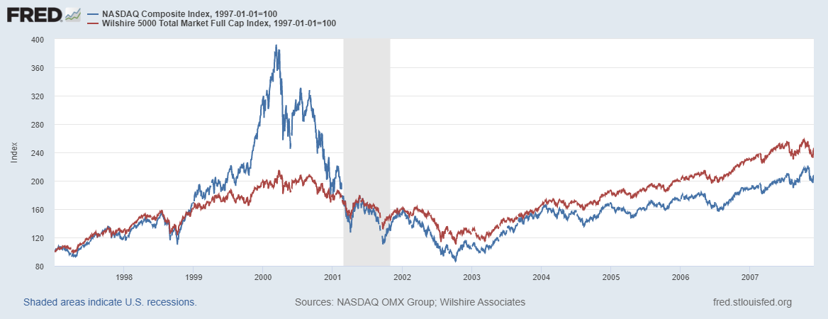
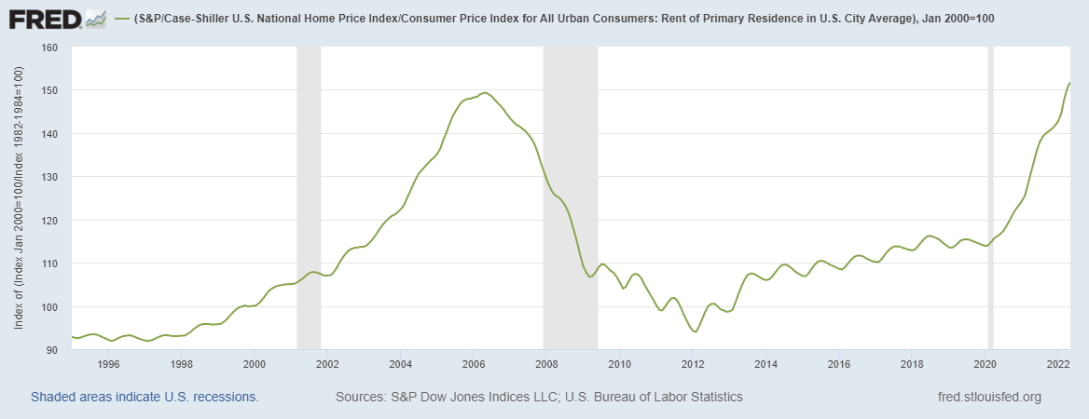

Does Voting Ever Get it “Wrong?”

Slide 25
Algorithmic Stablecoin
Create a regular cryptocurrency and call it say, luna.
If it has value, create a stablecoin and call it say, terra, that is tied to luna.
You can always exchange terra into $1 worth or luna, or vice versa
Luna = $10, terra = $1, trade 1 luna for 10 terra
Luna = $1, terra =$1, trade 1 luna for 1 terra and vice versa
Terra price drops to $0.80, buy luna with terra
Terra price rises to $1.20, buy terra with luna
What could go wrong?
Notes:
Collapse of Terra/Luna erased $60billion

Slide 26
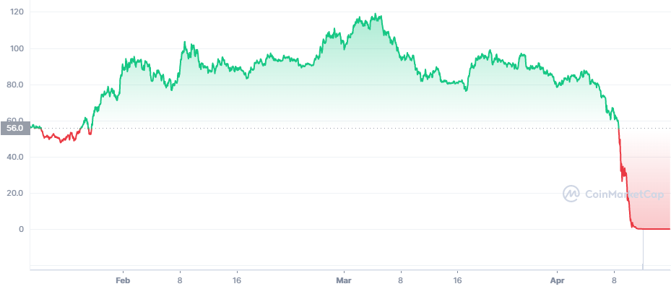
Luna’s Price This Year
https://coinmarketcap.com/
Notes:
Wiped out $60 billion in value

Slide 27
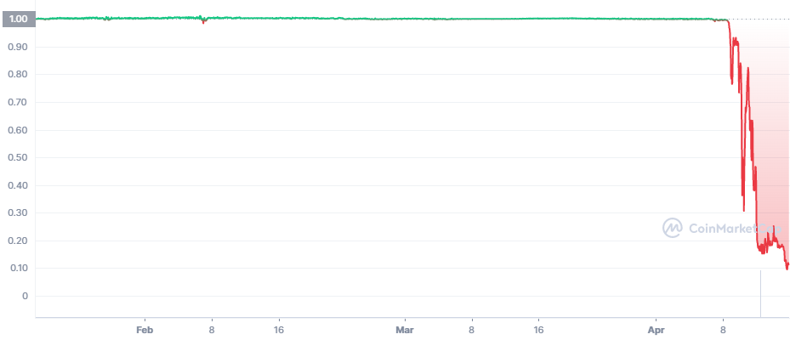
Terra’s Price
Death SpiRal!!!
Notes:
Collapse of Terra/Luna erased $60billion

Slide 28
Question #2: The Value of the New Technology?
Don’t Throw the baby out with the bathwater!
The value cryptographically protected digital-tokens is nuanced:
Blockchain technologies have significant promise some of which is already being realized.
  Private blockchains, Walmart and its produce suppliers
  Public Blockchains, Ethereum and smart contracts
See: Mehta N,. Agashe A., P. Detroja Blockchain Bubble or Revolution, 2021
Notes:
Cryptographic protection is a tougher call and depends on your views of privacy rights, as well as what information is being kept private (e.g., medical records versus financial transactions) Supply Chains (Walmart IBM)
Smart Contracts (Xbox royalties)

Slide 29
Smart Contracts on the Blockchain
A Smart Contract is a computer code that resides on the block chain and is executed based on incoming information.
Example, Parametric Hurricane Insurance via the Blockchain:
  Computer program on Ethereum continuously monitors Charleston Executive Airport wind speed for 1 year.
  If the windspeed is greater than 150 miles per hour, immediately transfers 100 bitcoin to the Seabrook Island Property Association.
  If the windspeed is less than 150 miles per hour, but more than 125 miles per hour, immediately transfers 75 bitcoin; etc.
Smart Contracts are Automatic, Immediate, Irreversible and Uncontestable.
DEFI, but note bitcoin is not good in my insurance example

Slide 30
Three Recent US Government Reports
Presidential Working Group on Financial Markets on Stable Coins and CBDC, 11/2021.
Federal Reserve Discussion Paper on CBDCs, 1/2022
Executive Order of the President, 3/09/2022
  (a): fraud; (b) stability; (c ) illicit activity; (e ) equitable access
  (d): “We must reinforce United States leadership in the global financial system and in technological and economic competitiveness.”
  (f) support responsible innovation;
  (g) explore Central Bank Digital Dollar (government issued: “Stablecoin”)

Slide 31
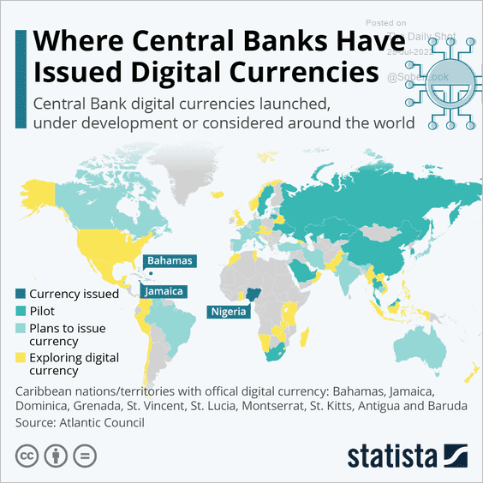
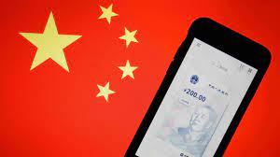
The Devil Is In the Details
Over 100 countries as diverse as Sweden, Ecuador and China have begun experiments with CBDCs.
Where’s the Fed?
Source: E. Prasad, The Future of Money
Notes:
MIT Boston Fed experiment. But pretty conservative vision. CBDC offered to consumers through insured institutions, i.e., banks. Electronic cash like checks.

Slide 32




Who should design our payment system?
Notes:
Vitalek Buterin, age 27 cofounder of Ethereum at age 20

Slide 33
Resources to Learn More
N. Mehta, et.al. Blockchain Bubble or Revolution
E Prasad, The Future of Money (https://youtu.be/o3NuHb7V1IA)
Presidential Working Group on Financial Markets, 11/1/21 (https://home.treasury.gov/system/files/136/StableCoinReport_Nov1_508.pdf)
Federal Reserve White paper
(https://www.federalreserve.gov/publications/files/money-and-payments-20220120.pdf)
Executive Order: https://www.whitehouse.gov/briefing-room/statements-releases/2022/03/09/fact-sheet-president-biden-to-sign-executive-order-on-ensuring-responsible-innovation-in-digital-assets/

Slide 34
Glossary
Traditional Money is currency plus bank checking accounts.
Currency is paper and coin issued by the government. Currency is legal tender and must be accepted for all debts. Transactions using currency are immediate and final (can’t be undone without the agreement of both parties.)
Digital Payments are used for purchases where no physical money is exchanged. Examples include many online banking payments, credit card payments, PayPal.
Digital Currency or Virtual currency is a form of money that exists solely in digital form, such as a digital token (i.e., as data on a computer). Examples: cryptocurrencies, central bank digital currencies and virtual currencies used in online gaming.
Cryptographic identity protection assigns people two account numbers, or keys, one public and one private. Public record keeping is done using the public key and transactions are authorized using the private key.
Cryptocurrency is a digital currency where the owner’s identity is protected using cryptographic encryption and where record keeping is done with a public blockchain, e.g., Bitcoin.
Stablecoin is a cryptocurrency with a stable value of $1, somewhat like a money market mutual fund.

Slide 35
Glossary (Cont.)
Distributed ledger is a database for recording transactions or other information, where the information or ledger is shared on a network of many computers simultaneously.
Blockchains are distributed ledgers where new transactions (new blocks) are added to the chain sequentially when a consensus of the network agrees that the transactions are valid.
Decentralized Finance (DeFi) is peer-to-peer financial activity conducted through public blockchains and smart contracts.
Smart Contracts are computer programs that execute automatically based on external conditions. Example, travel insurance that pays off automatically when a flight is cancelled.
Central Bank Digital Currency (CBDC) is a digital currency issued by a central bank. Different central banks are experimenting with various forms of CBDCs, including some using blockchain technology, electronic wallets and cryptography.

Slide 36
Questions?
www.NEEDelegation.org
Geoffrey Woglom
grwoglom@amherst.edu
Contact NEED: Info@NEEDelegation.org
Submit a testimonial: www.NEEDelegation.org/testimonials.php
Support NEED: www.NEEDelegation.org/donate.php

