Slide 1
Osher Lifelong Learning Institute
Aquinas College

Slide 2
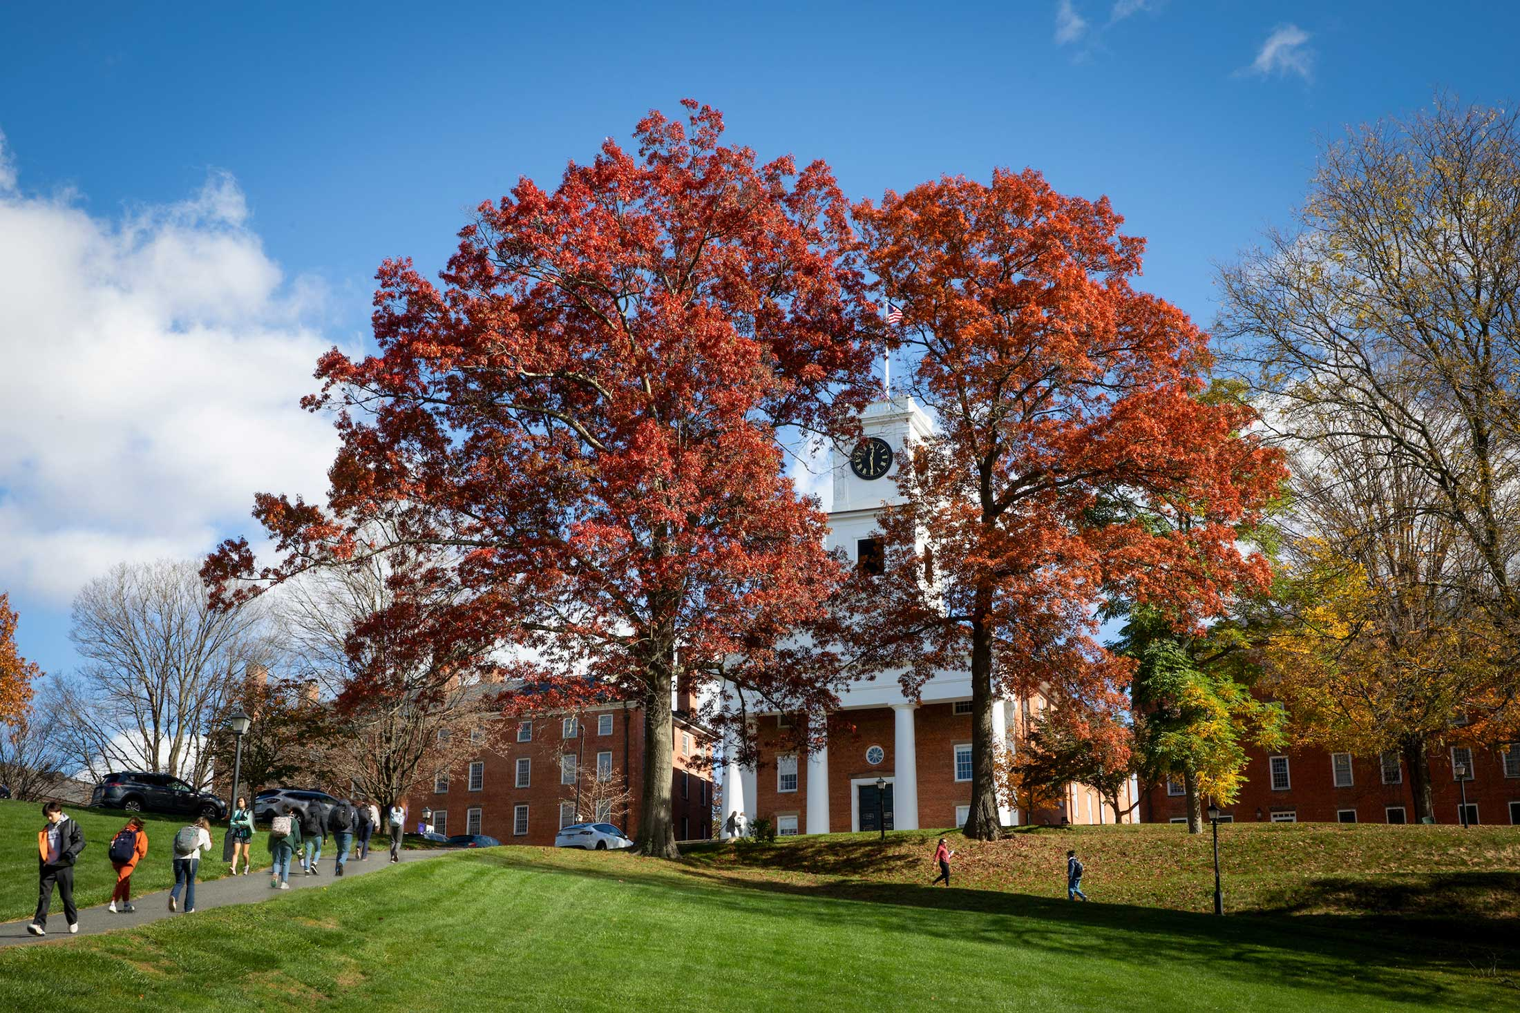
“Is College Worth It?”
Geoffrey Woglom, Amherst College, emeritus
May 8, 2024
“Is College Worth It?”
Geoffrey Woglom, Amherst College, emeritus
February, 13, 2024
Is I

Slide 3
Outline
Context for our discussion of the role of Higher Education
Public Attitudes towards Higher Education.
Economic Returns to a College Degree.
Non-Economic Returns.
The Future.

Slide 4
TwoMajor Shifts in Employment
https://www.visualcapitalist.com/visualizing-150-years-of-u-s-employment-history/

Slide 5
Out of Agriculture
D. Autor, C. Goldin, and L. Katz, Extending the Race between Education and Technology” AEA Papers and Proceedings 2020, 110: 347–351
Technology increase the demand for skilled workers tending into raise their wages.
Education increases the supply of skilled workers tending to lower their wages.
Example: Shift from agriculture to manufacturing in the late 19th and early 20th centuries: Increasing demand for high school graduates

Slide 6
Historical Returns to Education
High School Movement
Autor, Goldin and Katz

Slide 7
Early 20th Century Technology Adjustment
Four Keys to Success:
New technology created jobs in new sectors (e.g., Model T).
Wealthier nation could afford the new schooling and afford to buy the new goods.
Farm workers were geographically mobile to move to the new jobs.
Increase in educational attainment increased the supply of workers for new jobs.

Slide 8
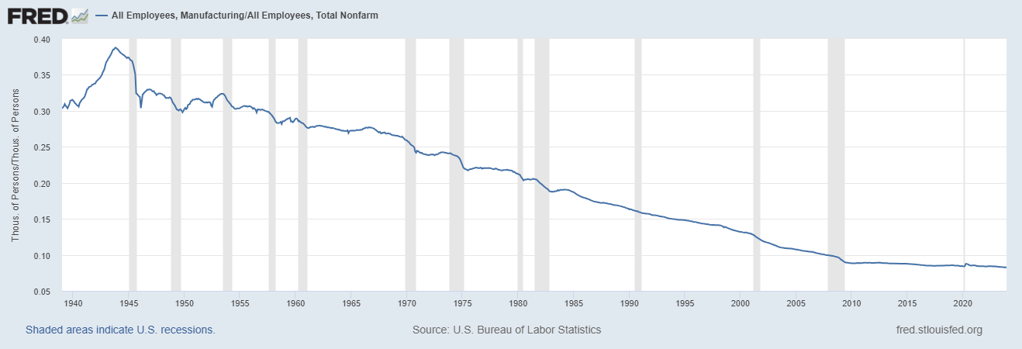
The Second Major Change Wasn’t Handled Well

Slide 9
What was Missing?
Mean Years of Schooling at Age 30 for the U.S. Born
1876 to 1987 Birth Cohorts
New Jobs ?
Wealth, check.
Education, No
Autor, Goldin and Katz

Slide 10
Geographic Mobility?
No
https://www.census.gov/data/tables/time-series/demo/geographic-mobility/historic.html

Slide 11
The Rust Belt and National Rank of Household Income (median)
Median State
Better
%s are fraction of total employment in manufacturing in 1959
Sources US Statistical Abstract, 1961 and Census Bureau

Slide 12
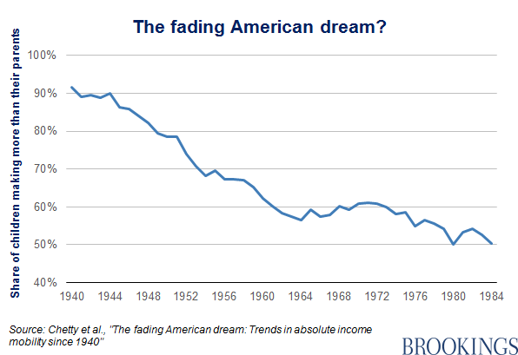
Consequence: Worsening Inequality?
Source: https://www.nytimes.com/interactive/2017/08/07/opinion/leonhardt-income-inequality.html

Slide 13
Consequences: Matters of Life or Death
Deaton Book: Economics in America
A. Case & A. Deaton “Accounting for the Widening Mortality Gap between American Adults with and without a BA,”BPEA Conference Draft, 9/28-29/23

Slide 14
The Coming Disruption?
Goldman Sachs, The Potentially Large Effects of AI on Economic Growth, Economic Research, March 2023

Slide 15
How Will We Adjust?
Can we copy the shift out of agriculture?
  Is the new technology creating new jobs in new sectors?
  Wealthier?
  Will workers move to new jobs?
  Will workers have the skills to do the new jobs?
I don’t know the answers to these questions, but the only answer I can imagine to 4. involves more education.
So, the answer to the question “Is College Worth It?” from a policy perspective is: It better be!

Slide 16
Perceived Problems with Higher Education
Ideological Bias: Story of the 3 College Presidents.
“Cost of College Has Gone Way Up.”
“Student Debt Has Become an Enormous Burden.”
“College is No Longer a Good Economic Investment.”
BA doesn’t guarantee literacy or numeracy.

Slide 17
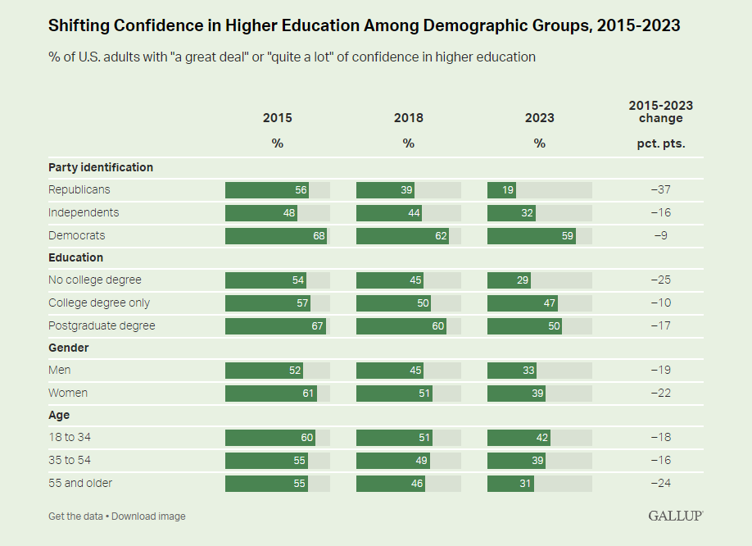
Confidence in Higher Education is Falling
https://news.gallup.com/poll/508352/americans-confidence-higher-education-down-sharply.aspx#

Slide 18
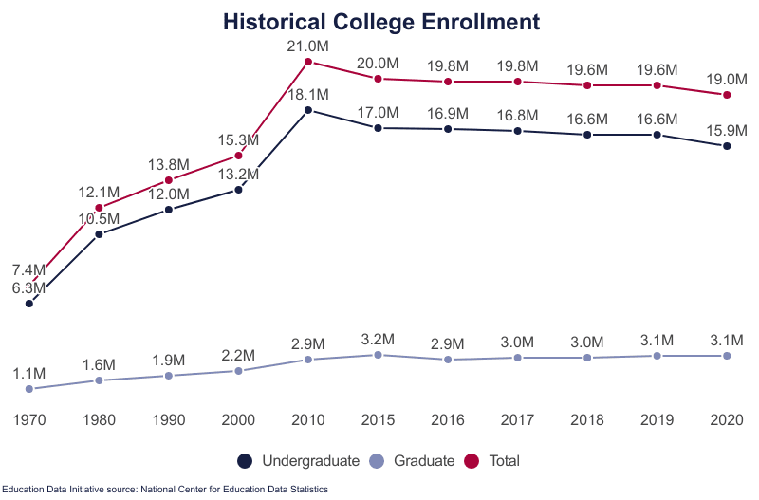
Tertiary Fall Enrollments
College Enrollments Falling

Slide 19
Many Students, However, Don’t Complete the BA

Slide 20
Trends in BA Degrees
https://www.pewresearch.org/short-reads/2022/04/12/10-facts-about-todays-college-graduates/

Slide 21
Major Reason for Not Getting a Degree

Slide 22
2. “Sticker” Price Had Been Rising

Slide 23


Closer to Home
Published Total Cost (in state): $33,556
Avg. Net Price : $19,318
Net price less than $30K: $5,713
Student Expenses per FTE: $70,387
Published Total Cost: $50,886
Avg. Net Price $18,605
Net price less than $30K: $12,825
Source: https://nces.ed.gov/ipeds/datacenter/institutionprofile.aspx?
Notes:
20/21 and 21/22 data; AC $83, net P $21, under 30, 7.9
Expense 100k

Slide 24
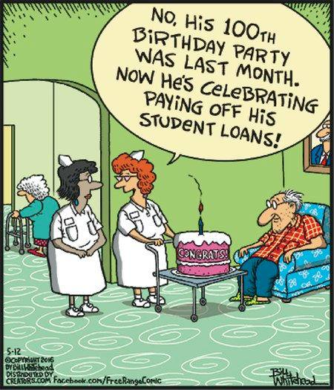
3. Student Debt

Slide 25
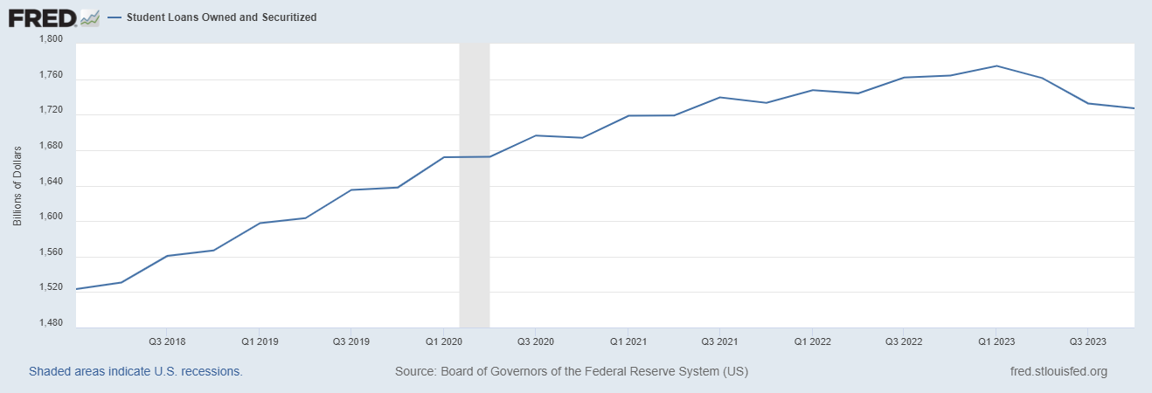
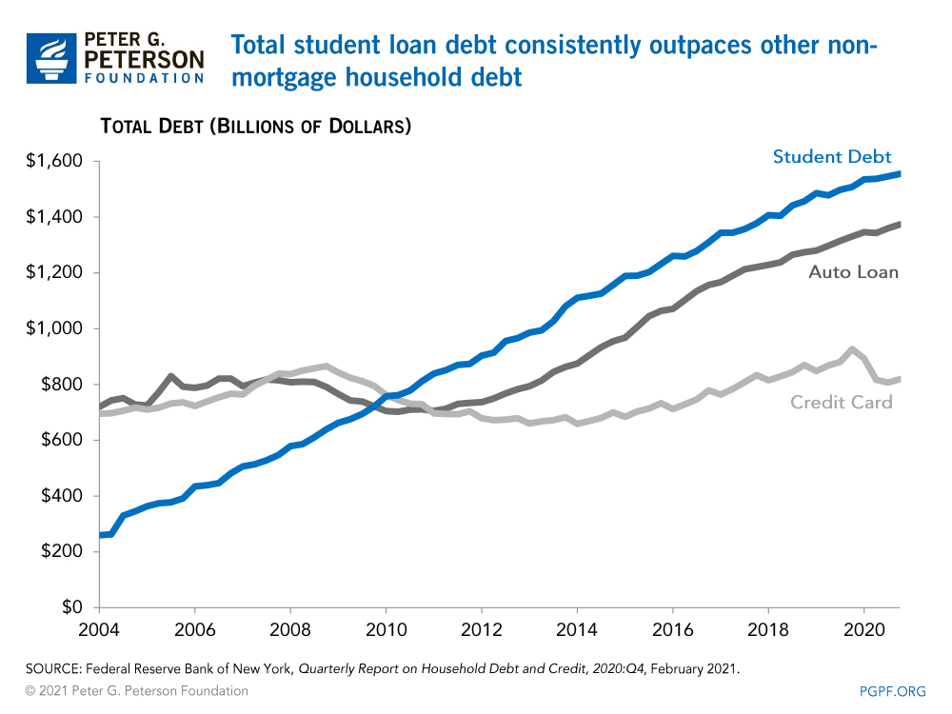
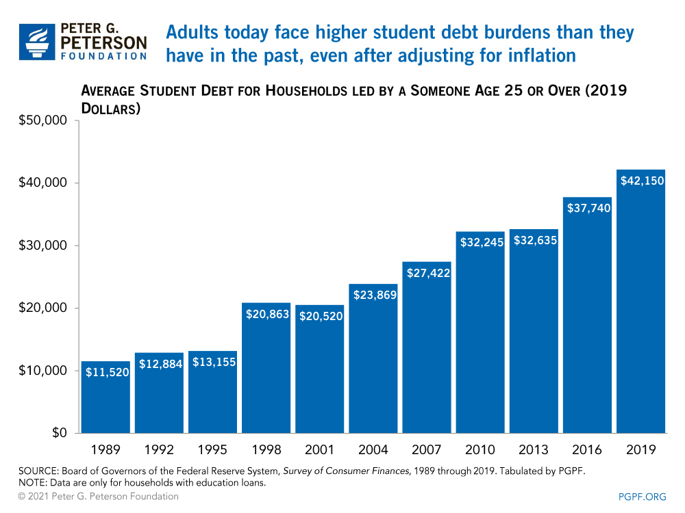
3. Student Debt Facts
But, it has started to fall

Slide 26
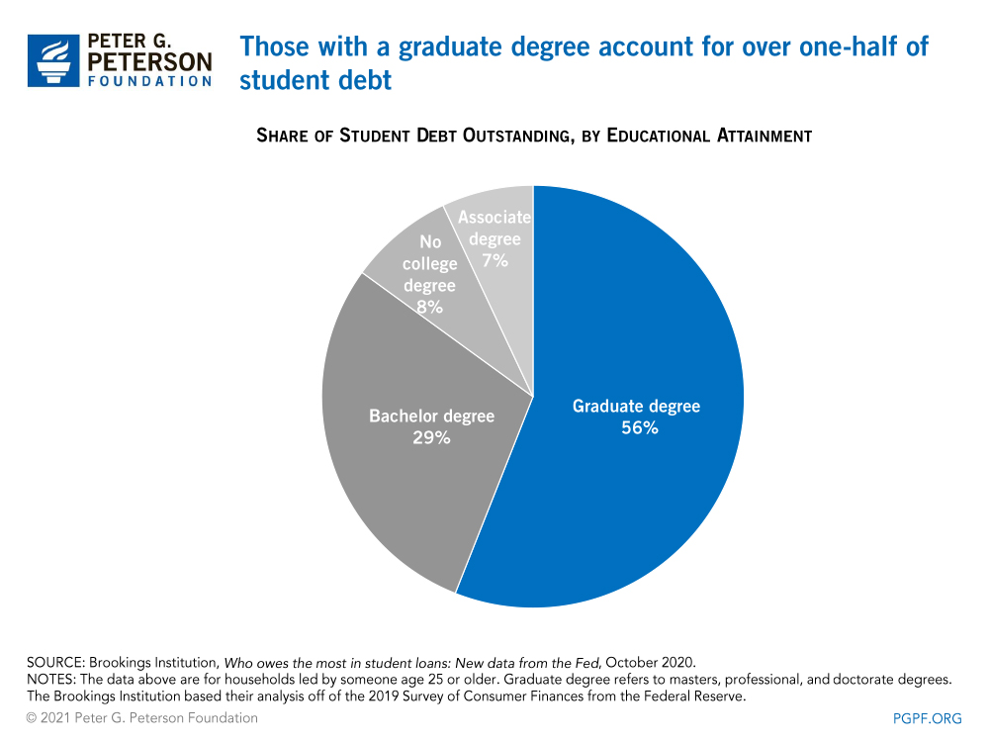
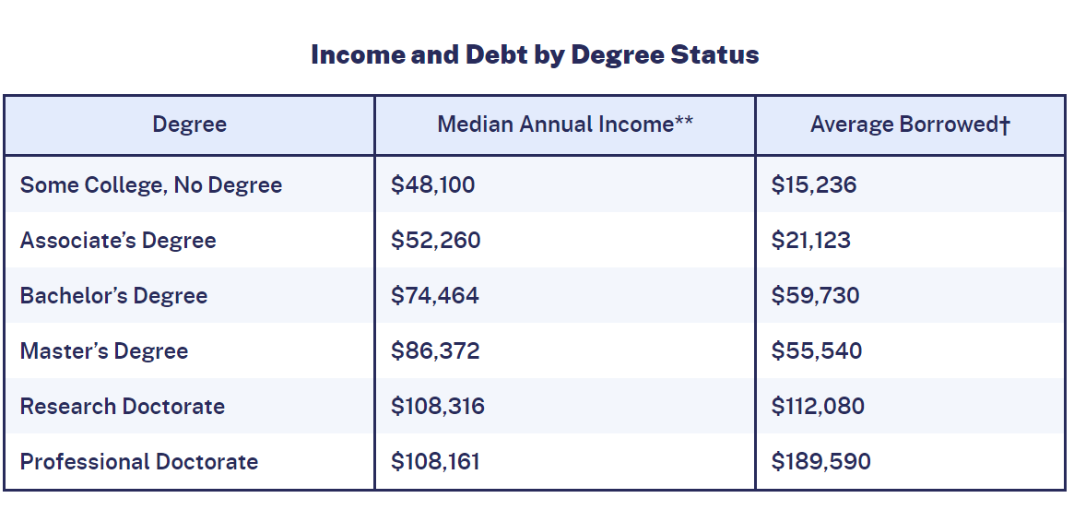
3. Student Debt Facts (Cont.)
https://educationdata.org/student-loan-debt-statistics

Slide 27
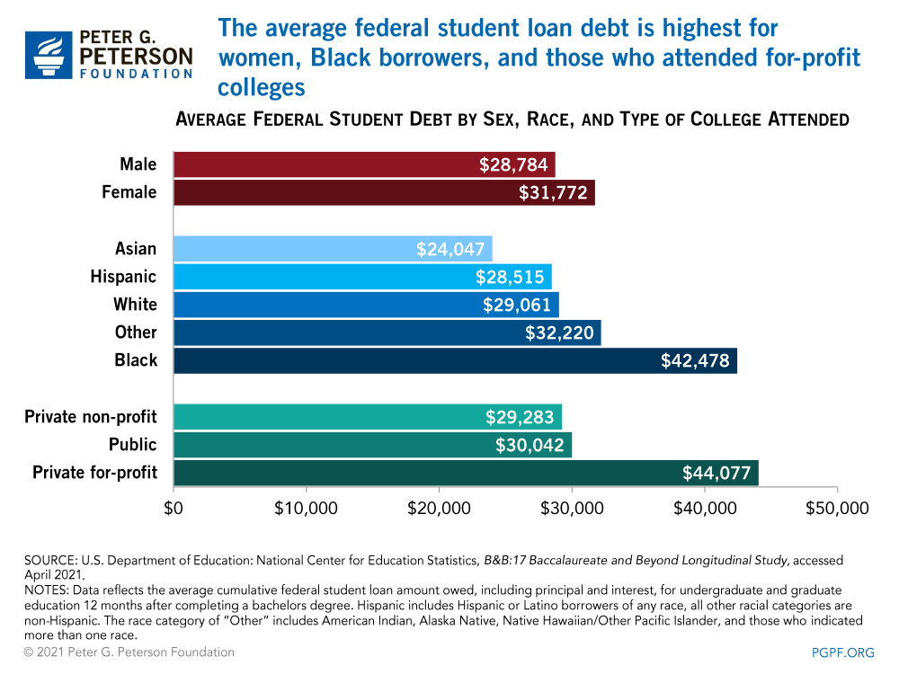
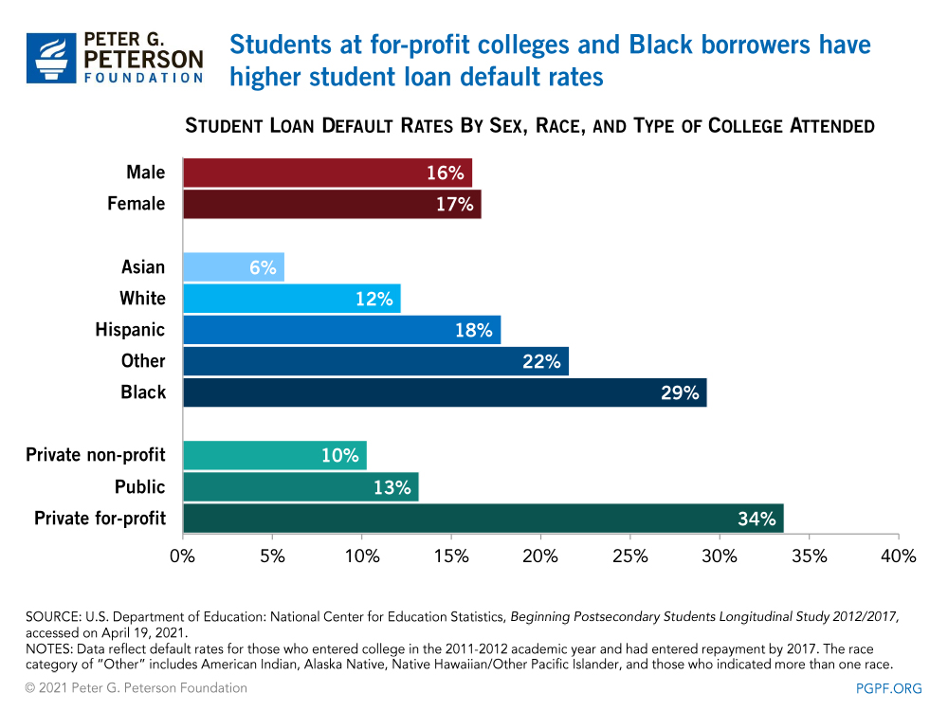
3.Break Down of Where There is a Debt Problem

Slide 28
3.What is the Student Debt “Problem?”
…
…
The government allowed-and often encouraged-people to make bad choices
Adam Looney, “A Better Way to Provide Relief to Student Loan Borrowers, “ 4/30/2019: https://www.brookings.edu/articles/a-better-way-to-provide-relief-to-student-loan-borrowers/

Slide 29
Solution (?): Income-Based Repayment
And, it exists!
  REPAYE (2015) that have morphed into SAVE Loans
  $600 billion of the $1.6 trillion
Terms
  Requires borrower to pay 10% of discretionary income.
  Payments end when the loan is repaid or after 20 or 25 years
  With better terms coming this year
Benefits
  Requires equal proportional sacrifice to pursue different careers
  Reduces the risk of pursuing a degree

Slide 30
4.More People Think BA is a Bad “Investment”

Slide 31
Calculating the Investment Value of a BA
Cost
  Net Tuition and Fees.
  Wages you could have earned
  Room and Board?
Benefit
  Difference in wage earned with BA and with only high school diploma after college.
Both Benefits and Costs must account for the Time value of Money: money in the future is worth less than money today.

Slide 32
Estimates of the Cost of a Degree at 4Yr Public
“Opportunity Cost” of lost wages while attending College = $135k
Sources: https://research.collegeboard.org/trends/college-pricing, and Census and BLS via https://www.newamerica.org/education-policy/edcentral/college-pays-off/

Slide 33
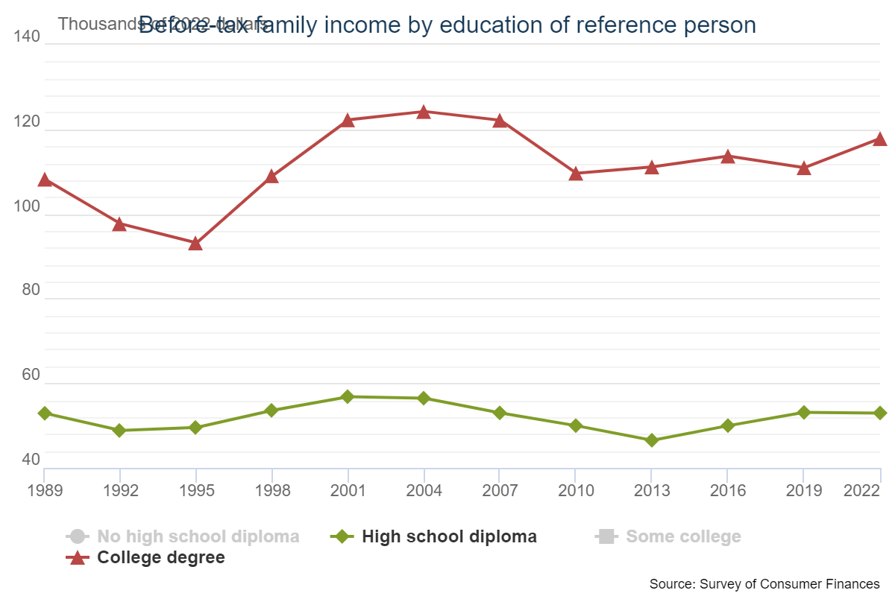
But, Aren’t Those Costs Trivial in Terms of
Future Income?
$118K
100X(118-53)/53= 122%
BA “Income Premium” = 122%
$53K

Slide 34
But, Averages Aren’t Really Relevant
For any individual the investment value of a college education must take into account the costs and benefits based on their individual characteristics.
A favorite example of mine: Serena Williams could not afford to go to college. Why?

Slide 35
Relevant Policy Question
Should we encourage more students to pursue BA degrees?
One partial answer is provided by looking at whether College is a good investment for a “typical” high school grad who does not go on.
But to look at this question, we have to take account of how the typical non-college high school grad differs for the typical college grad.
We need to “control” for other differences between high school and college graduates

Slide 36
One Example of the Effects of Controls
Note Wage Premium increase with age
David Deming, “Why Do Wages Grow Faster for Educated Workers,” NBER Working Paper 31373, 6/23

Slide 37
How about Controlling for Parent’s Income?
Career Earnings Ratios BA/NonBA
Bartik, Timothy J., and Brad Hershbein. 2016. “Degrees of Poverty: Family Income
Background and the College Earnings Premium.” Upjohn Institute mimeo.

Slide 38
Net Price by Family Income Public
https://research.collegeboard.org/trends

Slide 39
Most of the Literature: Its Worth It as a Financial Investment
What do Emmons, Kent and Ricketts Get Wrong?
There data stop in 2016, so their 1980
cohort is between 27 and 36 yrs old.
Young workers haven’t had time for
higher wages to offset costs of college.
Wealth is measured by Financial Net
Worth, What about future wages?

Slide 40
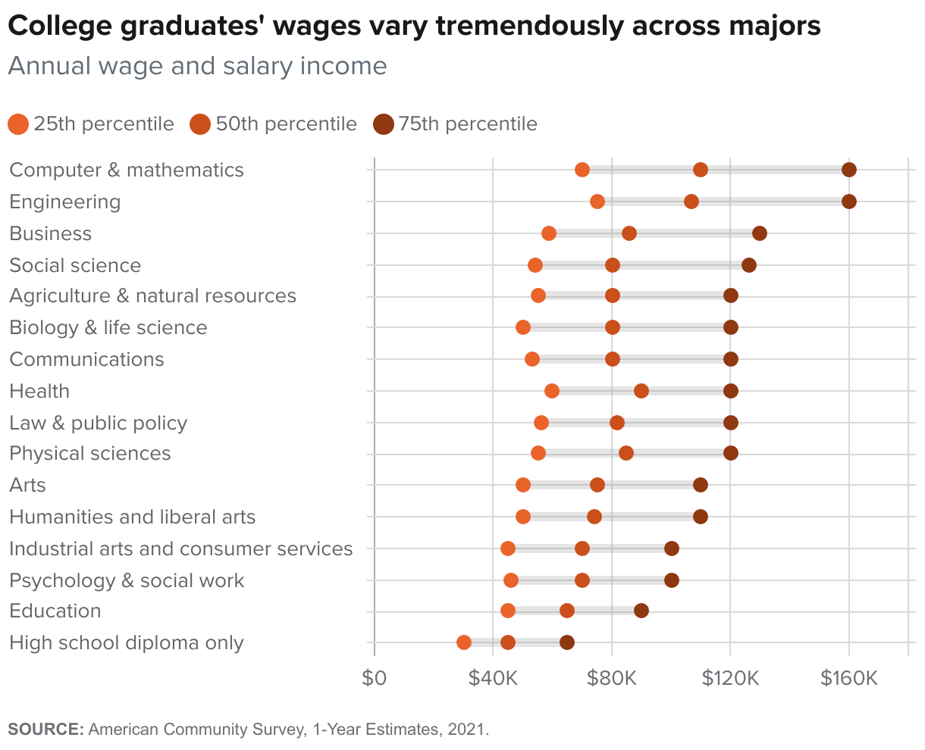
But, College is a Risky Investment
Risks:
Wrong Major.
Don’t Finish the Degree.
Come from a Poor Family.

Slide 41
Education Matters for Broader Measures of Inequality
Ratio of indicators of well being
OECD, “How’s Life in the United States?” https://www.oecd.org/wise/Better-Life-Initiative-country-note-United-States.pdf \

Slide 42
Are Colleges Increasing Economic Mobility?
Good News and Bad News: Amherst College, a case study:

Slide 43
Most Importantly
Stephen Carter, Professor Yale Law School, NYTimes, 1/24/2024
The difficulty stems,…, from the yielding to the “vocational ideal,”… that the purpose of education is to inculcate skills needed to excel in the labor market.
Teaching a subject is important; it is also in a sense incidental. The classroom is, first and foremost, a place to train young minds toward a yearning for knowledge – to be intellectually curious –even if what they wind up discovering challenges their most cherished convictions.

Slide 44
5. I Agree, but…
College has become more and more of a consumer culture
  Departmental budgets depend on enrollments.
  Student evaluations are important in promotion and tenure.
Are Course such as the following consistent with Carter’s View?
  True Crime: Unlearning Media.
  History of Race, Gender, and Comic Books.
Maybe! But..
  There are skills and information that educated young men and women need in addition to creative thinking and problem solving.

Slide 45
And, There Are No Guarantees That Education will Solve Our Adjustment Problems
Keynes (1930) Economic Possibilities for Our Grandchildren:
We are being afflicted with a new disease of which some readers may not yet have heard the name, but of which they will hear a great deal in the years to come--namely, technological unemployment. This means unemployment due to our discovery of means of economising the use of labour outrunning the pace at which we can find new uses for labour.
I draw the conclusion that, assuming no important wars and no important increase in population [climate change?], the economic problem may be solved [in 100 years].
Thus for the first time since his creation man will be faced with his real, his permanent problem-how to use his freedom from pressing economic cares, how to occupy the leisure, which science and compound interest will have won for him, to live wisely and agreeably and well.
But it will be those peoples, who can keep alive, and cultivate into a fuller perfection, the art of life itself and do not sell themselves for the means of life, who will be able to enjoy the abundance when it comes.
I believe that a major goal of a college education is to learn the “art of life”

Slide 46
Let’s Hear from You!
Geoffrey Woglom
grwoglom@amherst.edu
Contact NEED: Info@NEEDEcon.org
Submit a testimonial: www.NEEDEcon.org/testimonials.php
Support NEED: www.NEEDEcon.org/donate.php

