Slide 1




Climate Change Economics
Sarah Jacobson, Ph.D.
Williams College
York, Maine, Rotary Club
May 10, 2024

Slide 2
National Economic Education Delegation
Vision
  One day, the public discussion of policy issues will be grounded in an accurate perception of the underlying economic principles and data.
Mission
  NEED unites the skills and knowledge of a vast network of professional economists to promote understanding of the economics of policy issues in the United States.
NEED Presentations
  Are nonpartisan and intended to reflect the consensus of the economics profession.

Slide 3
Who Are We?
Honorary Board: 54 members
  2 Fed Chairs: Janet Yellen, Ben Bernanke
  6 Chairs Council of Economic Advisers
    Furman (D), Rosen (R), Bernanke (R), Yellen (D), Tyson (D), Goolsbee (D)
  3 Nobel Prize Winners
    Akerlof, Smith, Maskin
Delegates: 652+ members
  At all levels of academia and some in government service
  All have a Ph.D. in economics
  Crowdsource slide decks
  Give presentations
Global Partners: 48 Ph.D. Economists
  Aid in slide deck development

Slide 4
Credits and Disclaimer
This slide deck was authored by:
  Shana McDermott, Trinity University
  Sarah Jacobson, Williams College
  Sharon Shewmake, Western Washington University
This slide deck was reviewed by:
  Jason Shogren, University of Wyoming
  Walter Thurman, North Carolina State University
Disclaimer
  NEED presentations are designed to be nonpartisan.
  It is, however, inevitable that the presenter will be asked for and will provide their own views.
  Such views are those of the presenter and not necessarily those of the National Economic Education Delegation (NEED).

Slide 5
Outline
Economics of Climate Change
Reducing Emissions
Climate Change Policy
Policy in Action

Slide 6
Economics of Climate Change

Slide 7


Greenhouse Gas Emissions 1990-2019
Source: IPCC
Notes:
https://www.ipcc.ch/report/ar6/wg3/ Summary for Policymakers Figure SPM.1

Slide 8
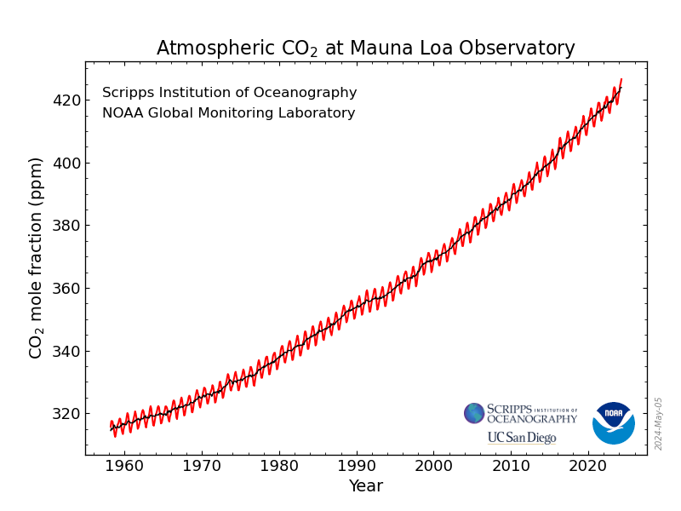
Atmospheric CO₂ Concentrations Up To Now
Source: NOAA
Notes:
https://gml.noaa.gov/ccgg/trends/

Slide 9
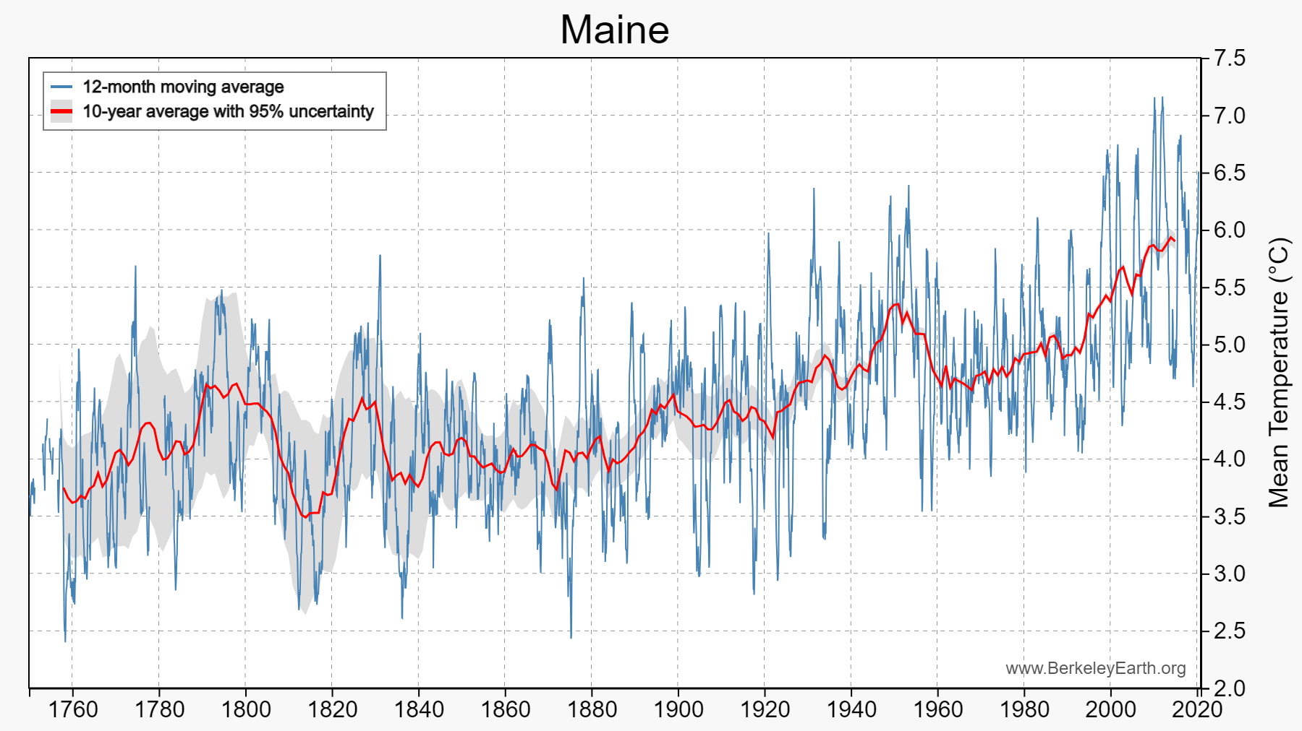
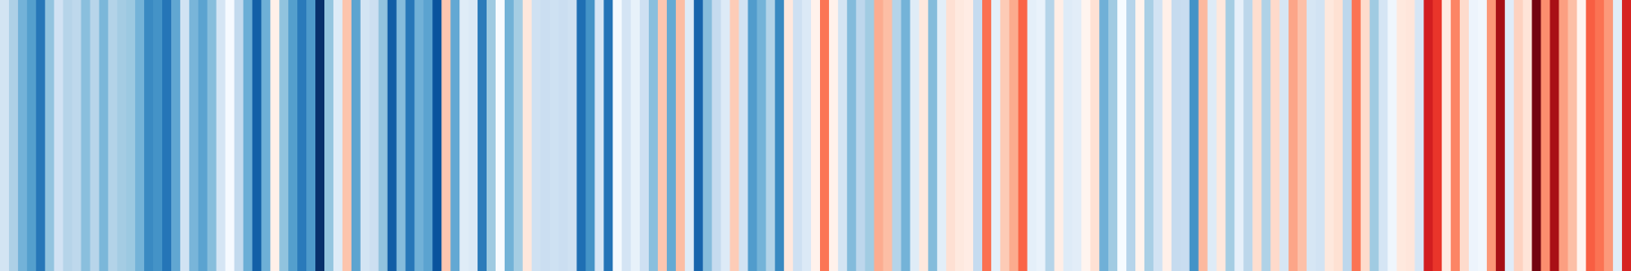
This Causes Warming & Other Consequences
Use https://berkeleyearth.org/temperature-city-list/ to see the temperature history of an area!
Here’s Maine!
Notes:
https://berkeleyearth.org/temperature-city-list/

Slide 10
How Climate Change Affects Humans
Agriculture
Fisheries
Coastal damages
Direct health effects, including sickness and death (temperature & drought; also pollution)
Indirect health effects (vector-borne disease)
Reduced fresh water availability
Wildfires
Shifting zones for important ecosystems, and desertification
Reduced worker productivity
Increased violence
Some of these may cause human migration and/or conflict

Slide 11
How Can Economists Help
Fight Climate Change? By…
Measuring climate change damages and estimating the costs of fighting climate change (abatement).
Identifying how, since climate change is an externality, without climate policy we will suffer inefficiently large costs.
Designing smart policies that minimize costs to society.
Assessing behavioral reactions to climate change.

Slide 12
How Economists Decide How Much to Fight
Climate Change: Cost Benefit Analysis
Abating greenhouse gas emissions is costly…
… but without action, climate change damages are even more costly.
Goal is not zero emissions, but efficient level that achieves a balance.
Expected costs of reducing emissions
Expected damages from allowing climate change

Slide 13

Social Cost of Carbon
The expected cost of damages from each unit of greenhouse gas emissions.
Current EPA estimate: ~$51 per metric ton of CO₂
New estimate is $190!
Social cost of carbon will increase over time.
Notes:
18.07 lbs/mile
2204.62 lbs/metric ton
1.8 cents/mile

Slide 14
Adaptation Reduces Damages
Adaptation: costly action that reduce damages from climate change.
The net damage cost to society is the cost of adaptation plus the cost of remaining damages.
People and firms will take some actions on their own, up to the point where they find it worthwhile.
Some adaptation requires government involvement.

Slide 15
Reducing Emissions

Slide 16
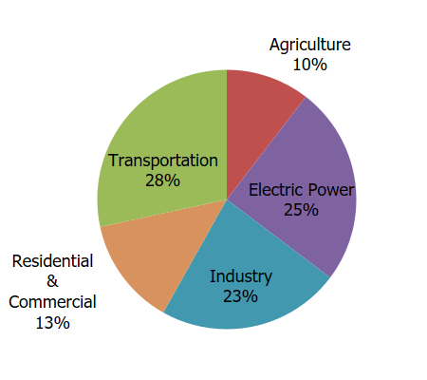
Total US Greenhouse Gas Emissions by Economic Sector in 2022
Notes:
https://www.epa.gov/ghgemissions/sources-greenhouse-gas-emissions

Slide 17


New Estimated Abatement Cost Curve
Notes:
IPCC AR6 Working Group 3 Summary for Policymakers
Figure SPM.7: Overview of mitigation options and their estimated ranges of costs and potentials in 2030.

Slide 18

New Estimated Abatement Cost Curve
Notes:
IPCC AR6 Working Group 3 Summary for Policymakers
Figure SPM.7: Overview of mitigation options and their estimated ranges of costs and potentials in 2030.

Slide 19
Climate Change Policy

Slide 20
Policies That Reduce Emissions Directly
Command and control regulation
  Emissions standards or limits (e.g., Clean Water Act discharge limits)
  Tech standards (e.g., require scrubbers on power plants)
Incentive-based policies
  Putting a price on emissions – leveling the playing field!
    Tax or cap & trade
    Subsidizing green energy (e.g., feed-in tariffs)

Slide 21
Command and Control vs. Incentive-Based Regulation
Efficiency
  Both can achieve the same amount of emissions reduction.
  Incentive-based policies can achieve emissions reduction at much lower cost.
Equity
  Both have may regressive impacts (low-income families bear costs that are a larger percent of their incomes vs hi-income families)
    However, new evidence increasingly questions this.
  Cap and trade and carbon tax can generate revenues that can be used to offset the regressivity.
    E.g.: “carbon dividend”
  Command and control regulations do not.

Slide 22
How Does a Carbon Tax Work?
Choose activities to be covered (e.g., electricity sector, all emitters, etc.).
Set tax level.
  Optimally, it represents the social cost of polluting.
Polluters must pay a tax for every unit emitted.
  Polluters with low abatement costs will abate to avoid the tax
  Polluters with high abatement costs will pollute and pay the tax

Slide 23
How Does Cap and Trade Work?
Choose activities to be covered (e.g., electricity sector, all emitters, etc.).
Set maximum emissions level (“cap”).
That many pollution permits are issued.
  Can be auctioned off or given to polluters
Every polluter in a covered sector must have a permit for every unit of pollution.
Polluters buy and sell (“trade”) permits on a market as they wish.
  Polluters with low abatement costs will make / save money by abating and selling / not buying permits
  Polluters with high abatement costs will buy permits and pollute

Slide 24
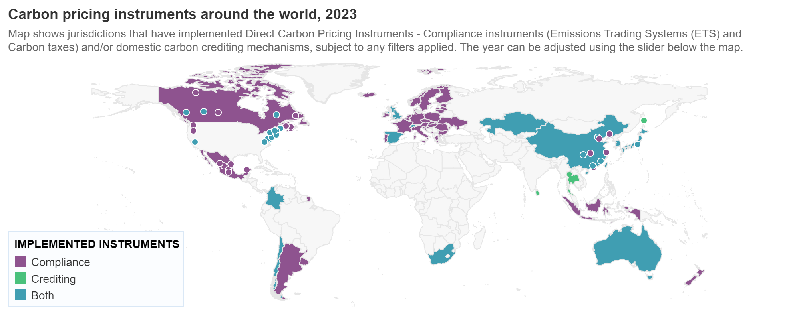
Incentive-Based Climate Policies Right Now
Source: World Bank Carbon - Pricing Dashboard
Notes:
https://carbonpricingdashboard.worldbank.org/

Slide 25
Examples of Other Policies that Reduce Emissions
Research and development subsidies
Renewable energy mandates (e.g., renewable portfolio standards)
Energy efficiency mandates and subsidies (e.g. CAFE fuel economy standards)
Grid / infrastructure improvements
Public transportation
Land use / zoning policies

Slide 26
Climate Change Policy in Action

Slide 27

California’s Cap and Trade System Since 2013
0.7%
of global greenhouse gas emissions

Slide 28
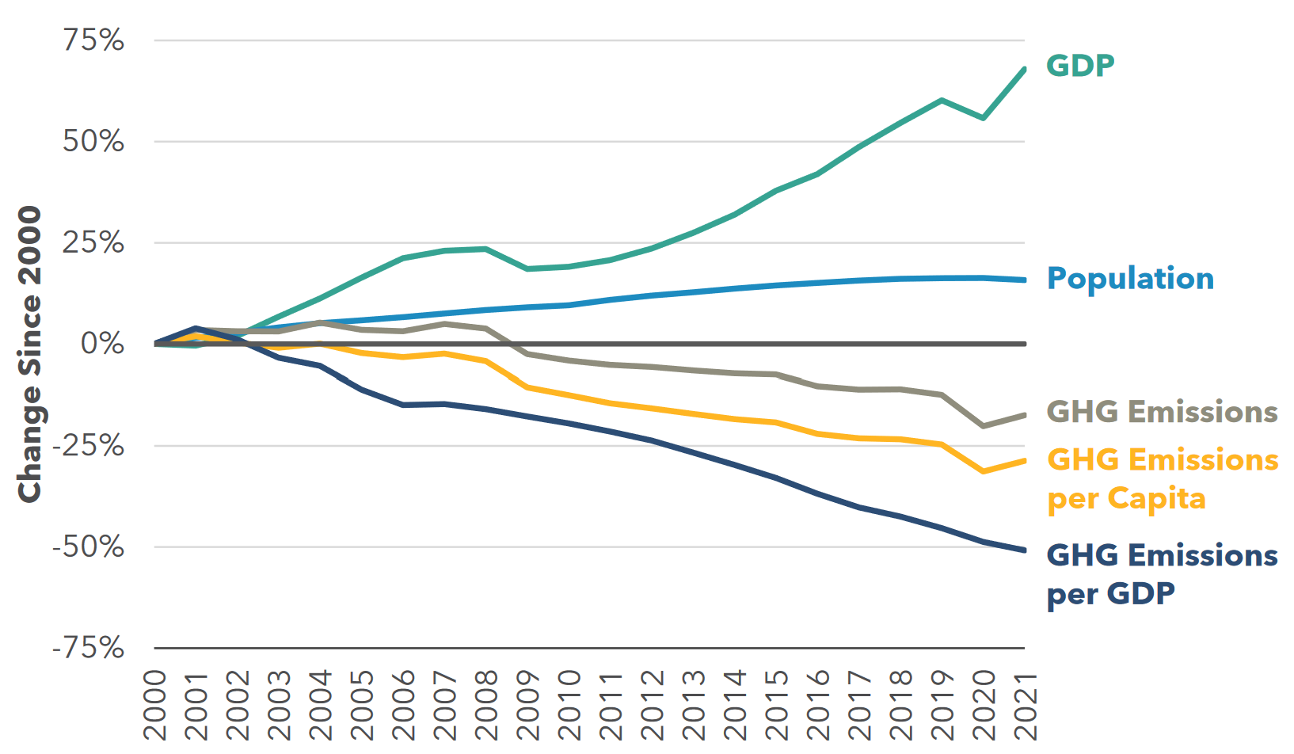
Changes in California GDP, Population, and
GHG Emissions since 2000
Cap & Trade ->
Notes:
Source: https://ww2.arb.ca.gov/ghg-inventory-data

Slide 29

Projected trends in California’s emissions
Notes:
https://www.c2es.org/content/california-cap-and-trade/

Slide 30
Summary
Climate change is real, is caused by human actions, and has impacts we’re already feeling.
This problem won’t solve itself; we need policy intervention, and fast.
Smart policy can reduce greenhouse gas emissions by the right amount and at the lowest possible cost.
  For example, cap and trade and emissions taxes!
We also need policies to help with adaptation and support those bearing the greatest damages.

Slide 31
Thank you!
Any Questions?
www.NEEDEcon.org
Sarah Jacobson, Ph.D.
saj2@williams.edu
Contact NEED: info@NEEDEcon.org
Submit a testimonial: www.NEEDEcon.org/testimonials.php
Become a Friend of NEED: www.NEEDEcon.org/friend.php

