Slide 1




Climate Change Economics
Jon Haveman, Ph.D.
NEED
Tiger 21, Vancouver BC
September 15, 2022

Slide 2
Credits and Disclaimer
This slide deck was authored by:
  Shana McDermott, Trinity University
  Sarah Jacobson, Williams College
  Sharon Shewmake, Western Washington University
This slide deck was reviewed by:
  Jason Shogren, University of Wyoming
  Walter Thurman, North Carolina State University
Disclaimer
  NEED presentations are designed to be nonpartisan.
  It is, however, inevitable that the presenter will be asked for and will provide their own views.
  Such views are those of the presenter and not necessarily those of the National Economic Education Delegation (NEED).

Slide 3
Outline
Economic Building Blocks
Climate Change
Impacts of Climate Change
Reducing Emissions
Climate Change Policy
Policy in Action

Slide 4
Economic Building Blocks

Slide 5
How Can Economists Help
Fight Climate Change?
By measuring climate change damages and estimating the costs of fighting climate change.
By designing smart policies that minimize costs to society.

Slide 6
Econ 101: When Everything Is Simple,
No Regulation Is Needed for Efficiency
Simple transactions: buyer and seller feel all costs and benefits of sales
They choose based on the costs & benefits they feel
→ Efficient number of transactions! (Maximizes social benefits)

Slide 7
When Our Decisions Affect Others,
We Need Regulation
Pollution causes an EXTERNALITY: a side effect (here, a cost) that affects someone else
  Polluting things have an “unfair cost advantage” because part of cost is offloaded on others
  → Too much pollution is generated.
The “efficient” amount of pollution balances costs & benefits of pollution

Slide 8
How Economists Decide How Much to Fight
Climate Change: Cost Benefit Analysis
Abating greenhouse gas emissions is costly…
… but without action, climate change damages are even more costly.
Goal is not zero emissions, but efficient level that achieves a balance.
Expected costs of reducing emissions
Expected damages from allowing climate change

Slide 9
Cost-Benefit Analysis of
Fighting Climate Change
Most economic models suggest the costs of keeping warming below 2°C are relatively small, amounting to 1-4% of GDP by 2030.
Costs of acting to keep warming below 2°C are almost certainly less than future economic damages they would avoid.
  Damages estimated to be between: 7-20% of worldwide GDP.

Slide 10
Climate Change

Slide 11
The Atmospheric Greenhouse Effect
Sun
Atmosphere
Energy reflected back
onto earth
Energy reflected back
into space

Slide 12

Atmospheric CO₂ Concentrations Up To Now
Source: NOAA
Notes:
https://gml.noaa.gov/ccgg/trends/

Slide 13
What Do Greenhouse Gas Emissions
Do to the Planet?
Increased temperatures
  Sea level rise
  Storm surges
Altered precipitation patterns
More variable weather
More / more powerful storms
Carbon dissolves in ocean

Slide 14
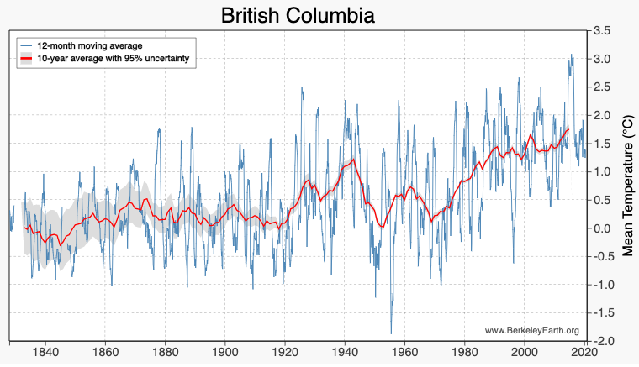
These Changes Are Already Underway
Use http://berkeleyearth.lbl.gov/city-list/ to see the temperature history of an area!
Here’s British Columbia.
Notes:
http://berkeleyearth.lbl.gov/city-list/

Slide 15
Impacts of Climate Change

Slide 16
How Climate Change Affects Humans
Agriculture
Fisheries
Coastal damages
Direct health effects, including sickness and death (temperature & drought; also pollution)
Indirect health effects (vector-borne disease)
Reduced fresh water availability
Wildfires
Shifting zones for important ecosystems, and desertification
Reduced worker productivity
Increased violence
Some of these may cause human migration and/or conflict

Slide 17

Social Cost of Carbon
The expected cost of damages from each unit of greenhouse gas emissions.
Current EPA estimate: ~$51 per metric ton of CO₂ (but estimates vary a lot!)
  About $230/car per year.
  $42 Billion for all vehicles in the US.
Social cost of carbon will increase over time.
Notes:
18.07 lbs/mile
2204.62 lbs/metric ton
1.8 cents/mile

Slide 18
Reducing Emissions

Slide 19
Global Net Emissions
Are What We Care About
For climate impacts, we don’t care where they are emitted, only how much
  There may be other local impacts
Gross emissions (greenhouse gas sources): how much greenhouse gases (including CO2) we put out.
Greenhouse gas sinks: ways to pull CO2 out of the air
  Existing: oceans, forests
  Increase sinkage by planting trees, or other measures

Slide 20

Sources of the Global Flow of Emissions
Notes:
https://www.nytimes.com/interactive/2021/11/12/climate/cop26-emissions-compensation.html

Slide 21

Sources of the Global Stock of Emissions
Notes:
https://www.nytimes.com/interactive/2021/11/12/climate/cop26-emissions-compensation.html

Slide 22

Sources of the Global Stock of Emissions
Notes:
https://www.nytimes.com/interactive/2021/11/12/climate/cop26-emissions-compensation.html

Slide 23


How Does This Look Per Capita (Per Person)?
Notes:
https://www.ipcc.ch/report/ar6/wg3/ Summary for Policymakers Figure SPM.2

Slide 24

Total US Greenhouse Gas Emissions by Economic Sector in 2020
Notes:
https://www.epa.gov/ghgemissions/sources-greenhouse-gas-emissions

Slide 25
Which Emissions Should We Cut?
List all possible ways to reduce emissions
Figure out how much each can reduce in total
Figure out how much each costs per unit of emissions reduced
Line them up in order: cheapest to costliest (“marginal abatement cost curve”)
  → Tackle first the cheapest ones!

Slide 26

Example Abatement Cost Curve
(Don’t trust these numbers, this is just to show the idea)
Notes:
McKinsey report: https://www.mckinsey.com/business-functions/sustainability/our-insights/impact-of-the-financial-crisis-on-carbon-economics-version-21

Slide 27
Climate Change Policy

Slide 28
Policies That Reduce Emissions Directly
Command and control regulation
  Emissions standards or limits (e.g., Clean Water Act discharge limits)
  Tech standards (e.g., require scrubbers on power plants)
Incentive-based policies
  Putting a price on emissions – leveling the playing field!
    Tax or cap & trade
    Subsidizing green energy (e.g., feed-in tariffs)

Slide 29
Command and Control vs. Incentive-Based Regulation
Efficiency
  Both can achieve the same amount of emissions reduction.
  Incentive-based policies can achieve emissions reduction at much lower cost.
Equity
  Both have may regressive impacts (low-income families bear costs that are a larger percent of their incomes vs hi-income families)
    However, new evidence increasingly questions this.
  Cap and trade and carbon tax can generate revenues that can be used to offset the regressivity.
    E.g.: “carbon dividend”
  Command and control regulations do not.

Slide 30
How Does a Carbon Tax Work?
Choose activities to be covered (e.g., electricity sector, all emitters, etc.).
Set tax level.
  Optimally, it represents the social cost of polluting.
Polluters must pay a tax for every unit emitted.
  Polluters with low abatement costs will abate to avoid the tax
  Polluters with high abatement costs will pollute and pay the tax

Slide 31
How Does Cap and Trade Work?
Choose activities to be covered (e.g., electricity sector, all emitters, etc.).
Set maximum emissions level (“cap”).
That many pollution permits are issued.
  Can be auctioned off or given to polluters
Every polluter in a covered sector must have a permit for every unit of pollution.
Polluters buy and sell (“trade”) permits on a market as they wish.
  Polluters with low abatement costs will make / save money by abating and selling / not buying permits
  Polluters with high abatement costs will buy permits and pollute

Slide 32
One Thing: Cap and Trade vs. Carbon Tax
Emissions regulations and Cap and Trade can work at cross purposes.
  Regulations that lower emissions from big polluters…
    Lower the demand for permits
    Lowers the price of permits
    Reduces incentives for other industries to cut emissions
Regulations can undermine the effectiveness of Cap and Trade.
The same is not true of a carbon tax.
  Though regulations might cut tax revenue, revenue is not the goal of the carbon tax.

Slide 33
Efficiency: CAFÉ vs Carbon Tax
CAFÉ = Corporate Average Fuel Efficiency
  A fuel economy standard mandating that an auto‐maker’s vehicle fleet must meet minimum fuel economy standards.
Horse Race
  Tax on fuel applies to ALL vehicles, not just new.
  Rebound Effect:
    Driving a more efficient vehicle lowers the cost per mile driven
      leading to more miles driven.
  Slower turnover of inefficient vehicles: higher cost of new.
Summary
  A given level of emission reductions costs 3-14 times more with CAFÉ standards than under a comparable carbon tax.

Slide 34
Examples of Other Policies that Reduce Emissions
Research and development subsidies
Renewable energy mandates (e.g., renewable portfolio standards)
Energy efficiency mandates and subsidies (e.g. CAFE fuel economy standards)
Grid / infrastructure improvements
Public transportation
Land use / zoning policies

Slide 35
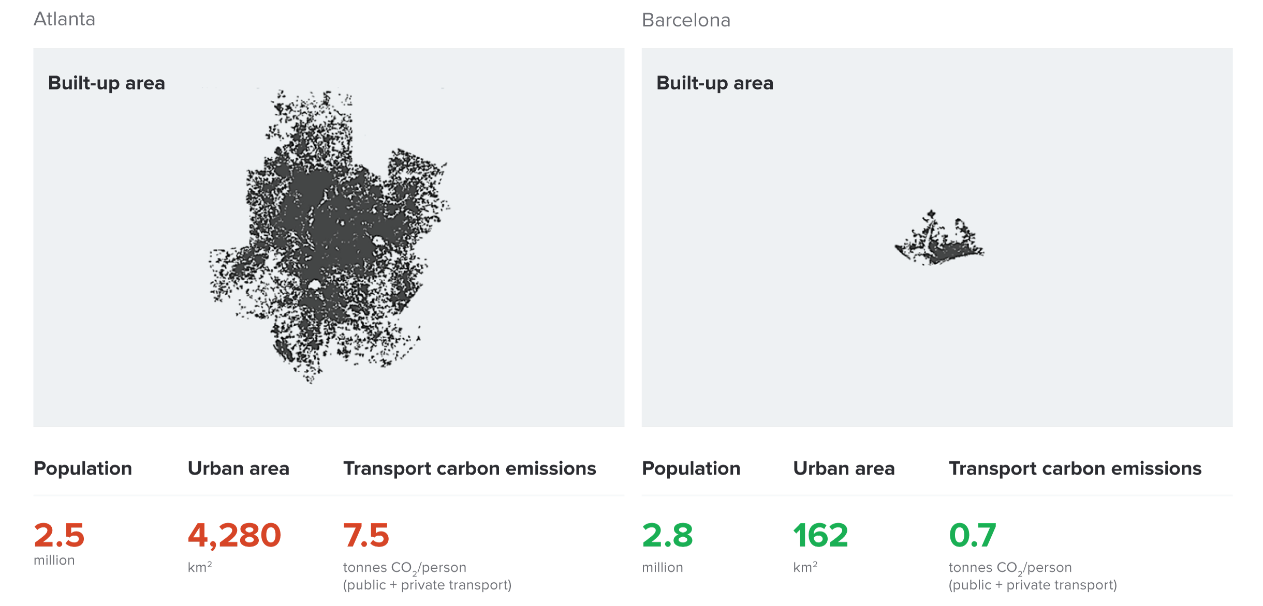
Atlanta and Barcelona Have Similar Populations but Very Different Carbon Productivity
Atlanta
Barcelona
Source: New Climate Economy Report, 2014
Notes:
Source: New Climate Economy Report

Slide 36
Climate Change Policy in Action

Slide 37

Incentive-Based Climate Policies Right Now
Source: World Bank Carbon - Pricing Dashboard
Notes:
https://carbonpricingdashboard.worldbank.org/

Slide 38

British Columbia’s Carbon Tax Policy
0.1%
of global greenhouse gas emissions

Slide 39

“
Tax the pollution we do not want, and return the money for what we do want — money in people’s pockets, jobs and investment.
- B.C. Government - Carbon Tax Brochure
“

Slide 40
British Columbia's Tax on Carbon
Covers 70% of the province’s GHG emissions.
Notes:
Source for slide: https://www2.gov.bc.ca/gov/content/environment/climate-change/planning-and-action/carbon-tax

Slide 41
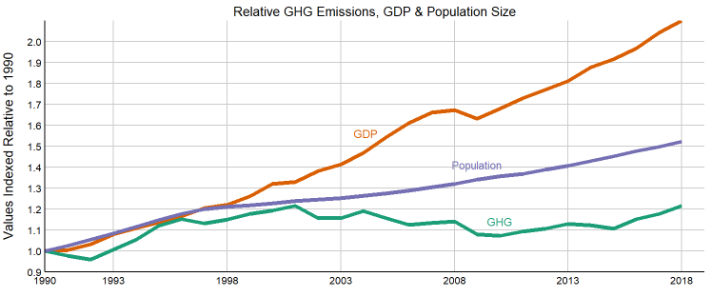
Relative Greenhouse Gas Emissions, GDP & Population Size: British Columbia
Carbon Tax ->
http://www.env.gov.bc.ca/soe/indicators/sustainability/ghg-emissions.html
Notes:
http://www.env.gov.bc.ca/soe/indicators/sustainability/ghg-emissions.html

Slide 42
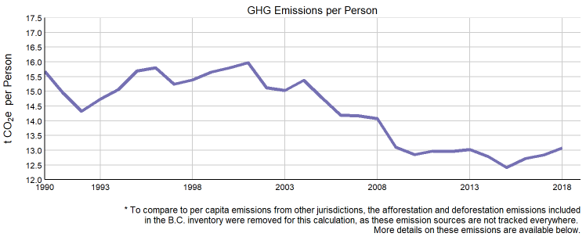
Was it the Carbon Tax? Maybe!
Carbon Tax ->

Slide 43
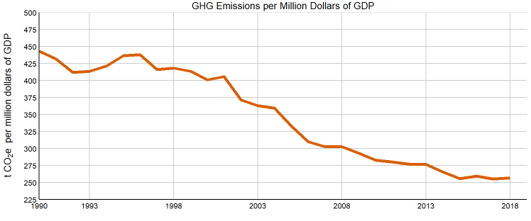
Was it the Carbon Tax? Maybe Not…
Carbon Tax ->

Slide 44
Summary
Climate change is real, is caused by human actions, and has impacts we’re already feeling.
This problem won’t solve itself; we need policy intervention, and fast.
Smart policy can reduce greenhouse gas emissions by the right amount and at the lowest possible cost.
  For example, cap and trade and emissions taxes!
We also need policies to help with adaptation and support those bearing the greatest damages.

Slide 45
Thank you!
Any Questions?
www.NEEDelegation.org
Jon Haveman, Ph.D.
Jon@NEEDelegation.org
Contact NEED: info@NEEDelegation.org
Submit a testimonial: www.NEEDelegation.org/testimonials.php
Become a Friend of NEED: www.NEEDelegation.org/friend.php

Slide 46


Greenhouse Gas Emissions 1990-2019
Source: IPCC
Notes:
https://www.ipcc.ch/report/ar6/wg3/ Summary for Policymakers Figure SPM.1

Slide 47

How Damages Will Vary Globally:
Mortality as an Example
Notes:
Carleton et al. 2021: https://papers.ssrn.com/sol3/papers.cfm?abstract_id=3674927

