Slide 1




Climate Change Economics
Jon Haveman, Ph.D.
Executive Director, NEED
Science and Society
March 25, 2021

Slide 2
National Economic Education Delegation
Vision
  One day, the public discussion of policy issues will be grounded in an accurate perception of the underlying economic principles and data.
Mission
  NEED unites the skills and knowledge of a vast network of professional economists to promote understanding of the economics of policy issues in the United States.
NEED Presentations
  Are nonpartisan and intended to reflect the consensus of the economics profession.

Slide 3
Who Are We?
Honorary Board: 53 members
  2 Fed Chairs: Janet Yellen, Ben Bernanke
  6 Chairs Council of Economic Advisers
    Furman (D), Rosen (R), Bernanke (R), Yellen (D), Tyson (D), Goolsbee (D)
  3 Nobel Prize Winners
    Akerlof, Smith, Maskin
Delegates: 585+ members
  At all levels of academia and some in government service
  All have a Ph.D. in economics
  Crowdsource slide decks
  Give presentations
Global Partners: 45 Ph.D. Economists
  Aid in slide deck development

Slide 4
Available NEED Topics Include:
US Economy
Economic Inequality
Climate Change
US Social Policy
Trade and Globalization
Economic Mobility
Trade Wars
Housing Policy
Federal Budgets
Federal Debt
Black-White Wealth Gap
Autonomous Vehicles

Slide 5
Credits and Disclaimer
This slide deck was authored by:
  Sarah Jacobson, Williams College
  Shana McDermott, Trinity University
  Sharon Shewmake, Western Washington University
This slide deck was reviewed by:
  Jason Shogren, University of Wyoming
  Walter Thurman, North Carolina State University
Disclaimer
  NEED presentations are designed to be nonpartisan.
  It is, however, inevitable that the presenter will be asked for and will provide their own views.
  Such views are those of the presenter and not necessarily those of the National Economic Education Delegation (NEED).

Slide 6
Outline
Economics of climate change
Reducing emissions
Climate change policy
Policy in action

Slide 7
How Can Economists Contribute to
Thinking about Climate Change?
By assessing behavioral reactions to climate change.
By measuring the damage and estimating the economic costs of fighting climate change.
By designing smart policies that minimize costs.
  Balance economic growth with GHG emission mitigation.

Slide 8
Economics of Climate Change

Slide 9
When Everything Is Simple,
No Regulation Is Needed
Simple transactions: buyer and seller feel all costs and benefits of sales
→ Efficient number of transactions!

Slide 10
When Our Decisions Affect Others,
We Need Regulation
Pollution causes an EXTERNALITY: a side effect (cost or benefit) that affects someone else
  Polluting things have an “unfair cost advantage” because part of the cost is offloaded on others.
  → Too much pollution is generated.
  Regulation limiting pollution has net benefits.
The “efficient” level of pollution balances the costs & benefits of pollution.

Slide 11
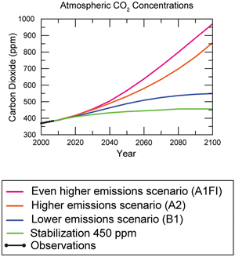
Atmospheric CO₂ Concentrations
Projections →
Source: IPCC data distribution center and climate.gov

Slide 12
What Does That Do?
Increased temperatures
Altered precipitation patterns
More variable weather
More / more powerful storms
Carbon dissolves in ocean

Slide 13
What Does That Do?
Increased temperatures
Altered precipitation patterns
More variable weather
More / more powerful storms
Carbon dissolves in ocean

Slide 14
Global Warming Indicators

Slide 15
How These Impacts Affect Humans
Agriculture
Fisheries
Coastal damages
Direct health effects, including sickness and death (temperature & drought; also pollution)
Indirect health effects (vector-borne disease)
Reduced fresh water availability
Wildfires
Shifting zones for important ecosystems, and desertification
Reduced worker productivity
Increased violence
Some of these may cause human migration and/or conflict
Notes:
This could be a series of slides with pictures for each one

Slide 16
A Climate Change Ladder
Emissions
Mitigation (a.k.a. Abatement)
Adaptation
Damages

Slide 17
How Economists Decide How Much to Fight
Climate Change: Cost Benefit Analysis
Abating greenhouse gas emissions is costly…
… but without action, climate change damages are even more costly.
Goal is not zero emissions, but efficient level that achieves a balance.
Expected costs of reducing emissions
Expected damages from allowing climate change

Slide 18
Cost-Benefit Analysis of Fighting Climate
Change
Most economic models suggest the costs of keeping warming below 2°C are relatively small.
  Costs amount to 1-4% of GDP by 2030.
Costs of acting to keep warming below 2°C are almost certainly less than future economic damages they would avoid.
  Damages estimated to be between: 7 - 20% of worldwide GDP.
Caveats:
  Putting a monetary value on priceless things
  Inequality
  Uncertainty and risk

Slide 19
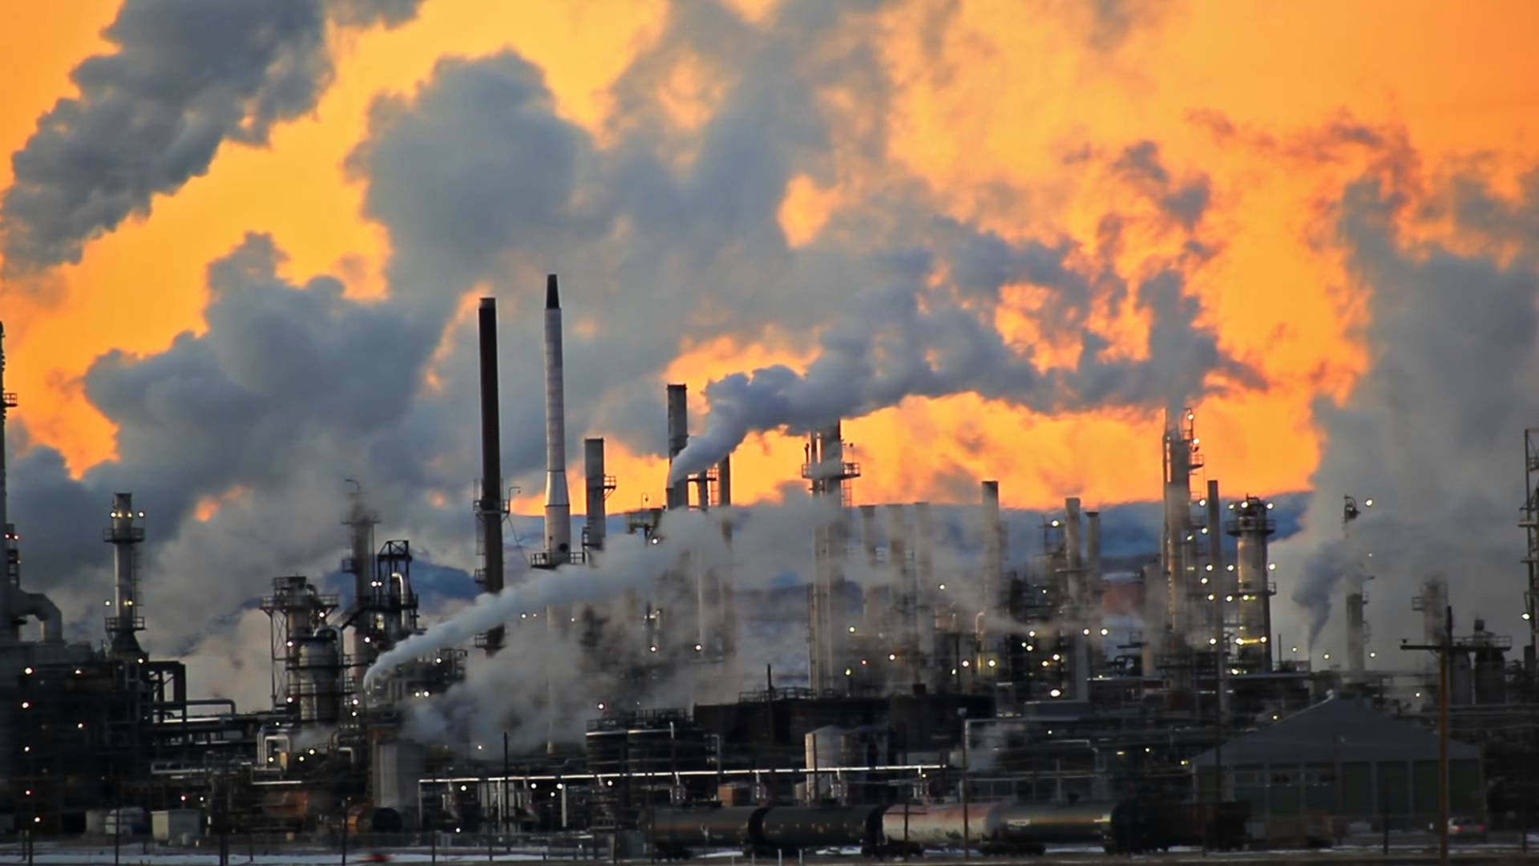
Present Value of a Future $100 Cost or Benefit
“
It is better to be roughly right
than precisely wrong.
- John Maynard Keynes
“

Slide 20
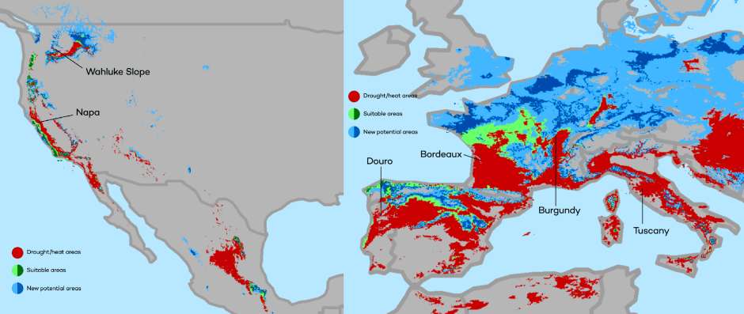
This is What Precisely Wrong Looks Like
The changing map of the world’s wine-growing regions.

Slide 21
Reducing Emissions

Slide 22
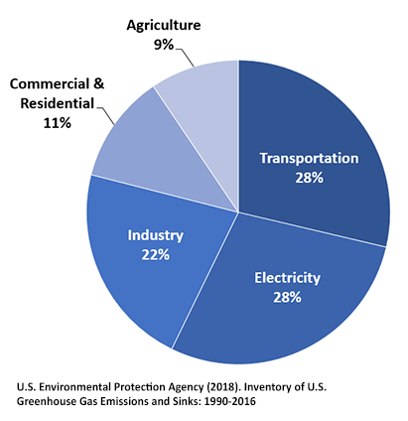
Total U.S. Greenhouse Gas Emissions by
Economic Sector in 2016
Notes:
https://www.epa.gov/ghgemissions/sources-greenhouse-gas-emissions

Slide 23
Global Net Emissions Are What We Care About
For climate impacts, we don’t care where they are emitted, only how much.
  There may be other local impacts.
Gross emissions (greenhouse gas sources): how much greenhouse gases (incl. CO2) we put out.
Greenhouse gas sinks: ways to pull CO2 out of the air
  Existing: oceans, forests.
  Increase sinkage by planting trees, or other measures.

Slide 24
Example Global Abatement Cost Curve
Notes:
McKinsey report

Slide 25
Climate Change Policy

Slide 26
Policies That Reduce Emissions Directly
Command and control regulation
  Emissions standards or limits (e.g., Clean Water Act discharge limits)
  Tech standards (e.g., require scrubbers on power plants)
Incentive-based policies
  Putting a price on emissions – leveling the playing field!
    Tax or cap & trade
    Subsidizing green energy (e.g., feed-in tariffs)
  Can achieve the same emissions goals at a lower cost!

Slide 27
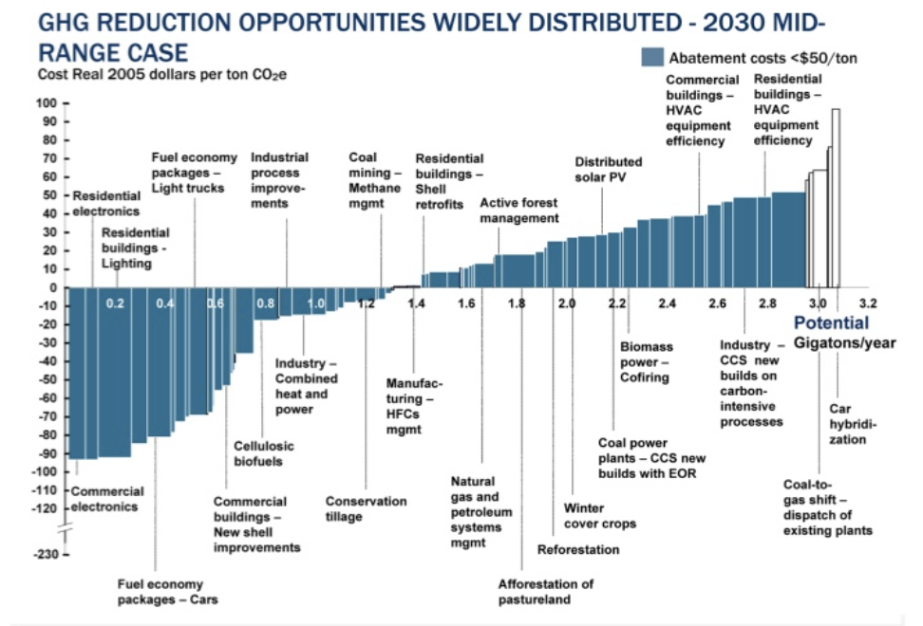
Putting a Price on Carbon
Suppose a Social Cost
Of Carbon of $50
Notes:
Shana: perhaps another infographic is beneficial here. Reintroduce the original cost graph. Fade out the costs and leave the MAC. Then introduce a price. If it’s cheaper to abate, then firms will do that, otherwise they will buy a permit or pay the tax. I know this is super simplified. I introduce specifics at the start of the emissions trading section and the tax section below.

Slide 28
How Does a Carbon Tax Work?
Choose activities to be covered (e.g., electricity sector, all emitters, etc.).
Set tax level.
  Optimally, it represents the social cost of polluting.
Polluters must pay a tax for every unit emitted.
  Polluters with low abatement costs will abate to avoid the tax.
  Polluters with high abatement costs will pollute and pay the tax.
Q: What to do with the tax revenue?

Slide 29
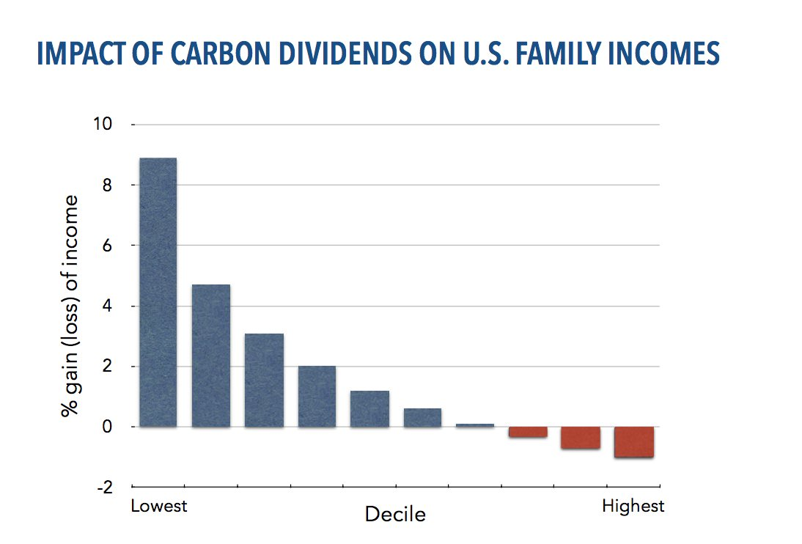
Revenue Dividend Eliminates Regressivity
Source: U.S. Treasury, 2017

Slide 30
How Does Cap and Trade Work?
Choose activities to be covered (e.g., electricity sector, all emitters, etc.).
Set maximum emissions level (“cap”).
That many pollution permits are issued.
  Can be auctioned off or given to polluters.
Every polluter in a covered sector must have a permit for every unit of pollution.
Polluters buy and sell (“trade”) permits on a market as they wish.
  Polluters with low abatement costs will make / save money by abating and selling / not buying permits.
  Polluters with high abatement costs will buy permits and pollute.

Slide 31
Carbon Tax and Cap & Trade: the Differences
 | Carbon Tax | Cap & Trade
Carbon Price | Certain | Uncertain
Emissions | Uncertain | Certain
Ease of Implementation | May be easier to implement
Additional concerns | Always generates revenue May require legislation to change | May be more susceptible to lobbying Only generates revenue if government sells permits Cap can be changed by regulator

Slide 32
Carbon Tax and Cap & Trade: the Differences
 | Carbon Tax | Cap & Trade
Carbon Price | Certain | Uncertain
Emissions | Uncertain | Certain
Ease of Implementation | May be easier to implement
Additional concerns | 1) Always generates revenue 2) May require legislation to change 3) Predictability | 1) Susceptible to lobbying. 2) Only generates revenue if government sells permits. 3) Cap can be changed by regulator. 4) Less certainty over future. 5) Regulations reduce efficacy of Cap & Trade

Slide 33
That Last Thing: Cap and Trade vs. Carbon Tax
Emissions regulations and Cap and Trade can work at cross purposes.
  Regulations that lower emissions from big polluters…
    Lowers the demand for permits.
    Lowers the price of permits.
    Reduces incentives for other industries to cut emissions.
Regulations can undermine the effectiveness of Cap and Trade.
The same is not true of a carbon tax.
  Though regulations might cut tax revenue, revenue is not the goal of the carbon tax.

Slide 34
Thoughts on Regulation vs Market-Oriented
Equity.
  Both types of policies are regressive.
    Cap and Trade and a Carbon Tax can offset the regressivity.
    Regulations do not.
Efficiency.
  Market-oriented policies tend to achieve emissions reduction at much lower cost.
    Example: CAFÉ Standards vs Carbon Tax
      Tax is significantly more efficient.
      Why?

Slide 35
Efficiency: CAFÉ vs Carbon Tax
CAFÉ = Corporate Average Fuel Efficiency
  A fuel economy standard mandating that an auto‐maker’s vehicle fleet must meet minimum fuel economy standards.
Horse Race
  Tax on fuel applies to ALL vehicles, not just new.
  Rebound Effect:
    Driving a more efficient vehicle lowers the cost per mile driven
      leading to more miles driven.
  Slower turnover of inefficient vehicles: higher cost of new.
Summary
  A given level of emission reductions costs 3-14 times more with CAFÉ standards than under a comparable carbon tax.

Slide 36
Examples of Other Policies that Reduce Emissions
R&D subsidies
Renewable energy mandates (e.g., renewable portfolio standards)
Energy efficiency mandates and subsidies (e.g. CAFE fuel economy standards)
Grid / infrastructure improvements
Public transportation
Land use / zoning policies

Slide 37
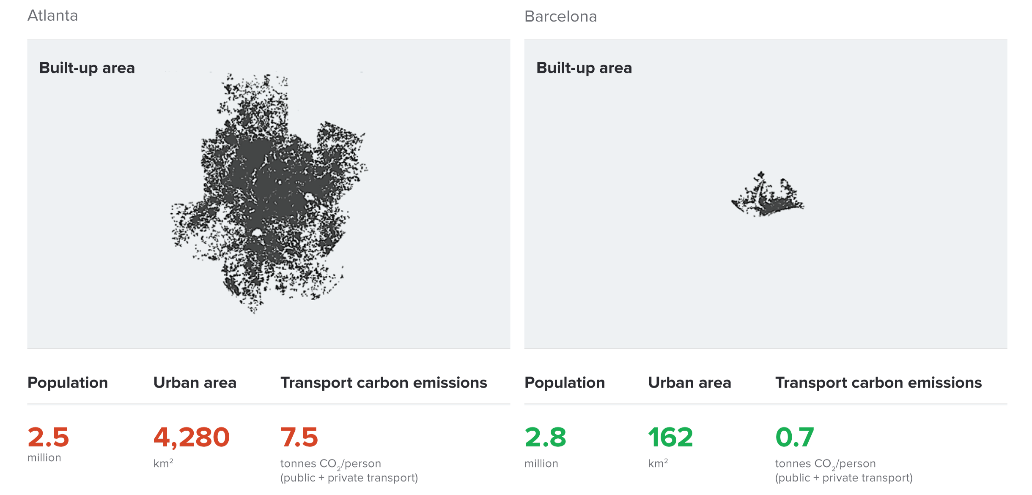
Atlanta and Barcelona Have Similar Populations but Very Different Carbon Productivity
Atlanta
Barcelona
Source: New Climate Economy Report, 2014
Notes:
Source: New Climate Economy Report

Slide 38
Climate Change Policy in Action

Slide 39
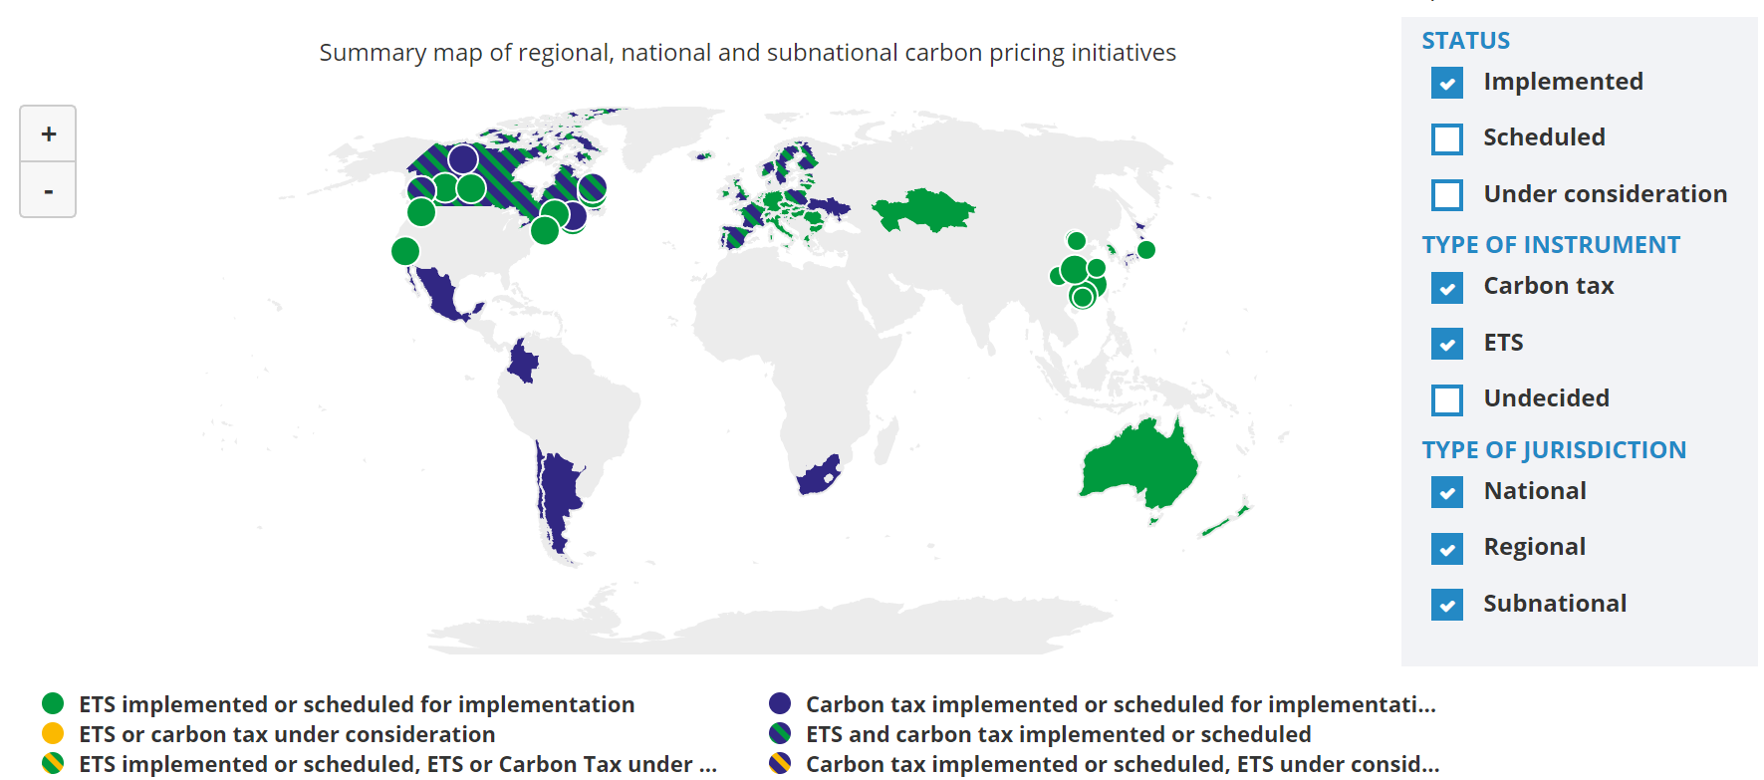
Climate Policies Across the World
Source: World Bank Carbon - Pricing Dashboard

Slide 40

California’s Cap and Trade System: 2012+
0.7%
of global greenhouse gas emissions

Slide 41
California’s AB32: Global Warming Solutions
California’s goals:
  Reduce emissions to 1990 levels by 2020
  An 80% reduction in emissions from 1990 levels by 2030
California’s Tools:
  Cap and Trade
  Renewable Portfolio Standard
  Clean Cars Program
  Low Carbon Fuel Standard

Slide 42
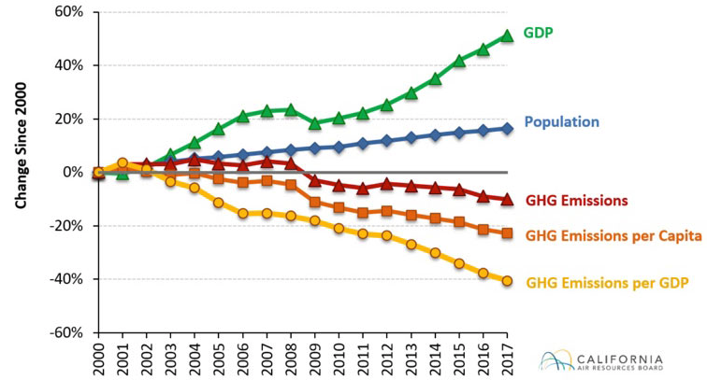
Change in California GDP, Population, and
GHG Emissions since 2000
Cap & Trade ->
Notes:
Source: https://www.arb.ca.gov/newsrel/newsrelease.php?id=933

Slide 43
Summary
Climate change is real, is caused by human actions, and has impacts we’re already feeling.
This problem won’t solve itself; we need policy intervention, and fast.
Smart policy can reduce greenhouse gas emissions by the right amount and at the lowest possible cost.
  For example, cap and trade and emissions taxes!
We also need policies to help with adaptation and support those bearing the greatest damages.

Slide 44
Thank you!
Any Questions?
www.NEEDelegation.org
Jon Haveman
Jon@NEEDelegation.prg
Contact NEED: Info@NEEDelegation.org
Submit a testimonial: www.NEEDelegation.org/testimonials.php

