Slide 1
Osher Lifelong Learning Institute, Winter 2022
Contemporary Economic Policy
Oklahoma State University
February-March, 2022
Jon Haveman, Ph.D.
National Economic Education Delegation

Slide 2
Available NEED Topics Include:
Coronavirus Economics
US Economy
Climate Change
Economic Inequality
Economic Mobility
Trade and Globalization
Minimum Wages
Immigration Economics
Housing Policy
Federal Budgets
Federal Debt
Black-White Wealth Gap
Autonomous Vehicles
US Social Policy

Slide 3
Course Outline
Contemporary Economic Policy
Week 2 (2/15): US Economy & Coronavirus Economics
Week 3 (2/22): Climate Change Economics (Simone Wegge, CUNY)
Week 4 (3/1): Immigration Economics (Roger White, Whittier College)
Week 5 (3/8): Infrastructure Economics (Mallika Pung, Univ. of New Mexico)
Week 5 (3/15): Trade and Globalization (Alan Deardorff, Univ. of Michigan)
Week 6 (3/22): The Black-White Wealth Gap (Me)

Slide 4
Submitting Questions
Please submit questions in the chat.
I will try to handle them as they come up, but may take them in a bunch as time permits.
We will do a verbal Q&A once the material has been presented.
And the questions in the chat have been addressed.
OLLI allowing, we can stay beyond the end of class to have further discussion.

Slide 5
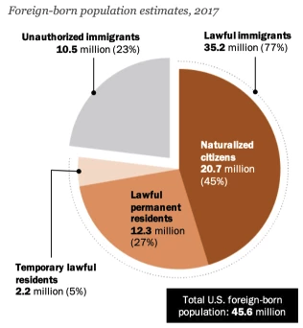
Immigration - w/ Roger White
Categories of the total number
of immigrants in the United States.
https://www.pewresearch.org/fact-tank/2019/07/12/how-pew-research-center-counts-unauthorized-immigrants-in-us/

Slide 6
Thank you!
Any Questions?
www.NEEDelegation.org
Simone Wegge, Ph.D.
Simone.Wegge@csi.cuny.edu
Contact NEED: info@NEEDelegation.org
Submit a testimonial: www.NEEDelegation.org/testimonials.php
Become a Friend of NEED: www.NEEDelegation.org/friend.php

