Slide 1
Osher Lifelong Learning Institute, Spring 2025
Contemporary Economic Policy
University of Hawaii, Manoa
Host: Geoffrey Woglom
Director, National Economic Education Delegation

Slide 2
Available NEED Topics Include:
US Economy
Healthcare Economics
Climate Change
Economic Inequality
Economic Mobility
Trade and Globalization
Minimum Wages
Immigration Economics
Housing Policy
Federal Budgets
Federal Debt
Black-White Wealth Gap
Autonomous Vehicles
US Social Policy

Slide 3
Course Outline
Contemporary Economic Policy
  Week 1 (6/2): Economic Update (Geoffrey Woglom, Amherst College)
  Week 2 (6/9): Climate Change Economics (Sarah Jacobson, Williams College)
  Week 3 (6/16): Economic Mobility (Jon Haveman, Exec Director, NEED)
  Week 4 (6/23): Health Economics (Robert Rebelein, Vassar College)
  Week 5 (6/30): Cryptocurrencies (Joan Nix Queens College (CUNY)

Slide 4
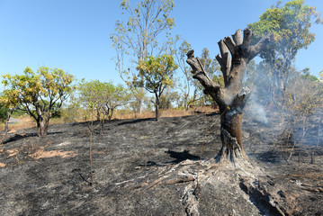



Climate Change Economics
Sarah Jacobson, Ph.D.
Williams College
University of Hawaii
June 9, 2025

Slide 5
Credits and Disclaimer
This slide deck was authored by:
  Shana McDermott, Trinity University
  Sarah Jacobson, Williams College
  Sharon Shewmake, Western Washington University
This slide deck was reviewed by:
  Jason Shogren, University of Wyoming
  Walter Thurman, North Carolina State University
Disclaimer
  NEED presentations are designed to be nonpartisan.
  It is, however, inevitable that the presenter will be asked for and will provide their own views.
  Such views are those of the presenter and not necessarily those of the National Economic Education Delegation (NEED).

Slide 6
Submitting Questions
Please submit questions of clarification in the chat or raise your hand.
  I will try to handle them as they come up.
We can have a verbal Q&A at the end of the presentation.
Slides will be available from the NEED website soon (https://needelegation.org/delivered_presentations.php)

Slide 7
Outline
Economic Building Blocks
Climate Change
Impacts of Climate Change
Reducing Emissions
Climate Change Policy
Policy in Action

Slide 8
Economic Building Blocks

Slide 9
How Can Economists Help
Fight Climate Change?
By assessing behavioral reactions to climate change.
By measuring climate change damages and estimating the costs of fighting climate change.
By designing smart policies that minimize costs to society.

Slide 10
Econ 101: When Everything Is Simple,
No Regulation Is Needed for Efficiency
Simple transactions: buyer and seller feel all costs and benefits of sales
They choose based on the costs & benefits they feel
→ Efficient number of transactions! (Maximizes social benefits)

Slide 11
When Our Decisions Affect Others,
We Need Regulation
Pollution causes an EXTERNALITY: a side effect (here, a cost) that affects someone else
  Polluting things have an “unfair cost advantage” because part of cost is offloaded on others
  → Too much pollution is generated
  Regulation limiting pollution has net benefits
The “efficient” amount of pollution balances costs & benefits of pollution

Slide 12
How Economists Decide How Much to Fight
Climate Change: Cost Benefit Analysis
Abating greenhouse gas emissions is costly…
… but without action, climate change damages are even more costly.
Goal is not zero emissions, but efficient level that achieves a balance.
Expected costs of reducing emissions
Expected damages from allowing climate change

Slide 13
Cost-Benefit Analysis of
Fighting Climate Change
Most economic models suggest the costs of keeping warming below 2°C are relatively small, amounting to 1-4% of GDP by 2030.
Costs of acting to keep warming below 2°C are almost certainly less than future economic damages they would avoid.
  Damages estimated to be between: 7-20% of worldwide GDP.

Slide 14
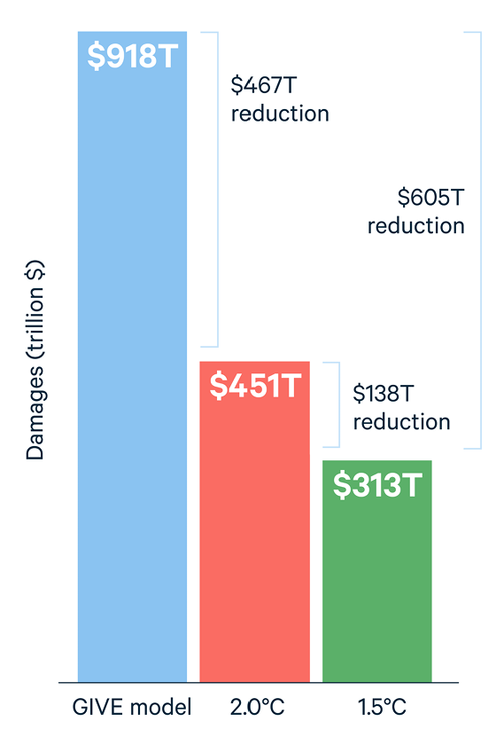
Newer Estimates of Benefits of
Fighting Climate Change
Policies already declared should limit warming to 2.5°C
Keeping warming even lower would yield additional global benefits of:
  2° → $5.2T annually ($467T total)
  1.5° → $6.8 trillion annually (605T total)
Notes:
https://www.rff.org/publications/issue-briefs/the-economic-benefits-of-achieving-the-paris-agreement-goals/
2023 estimates. Global GDP was $106.17 trillion in 2023 so these are big

Slide 15
Climate Change

Slide 16
A Climate Change Ladder
Emissions
Mitigation (a.k.a. Abatement)
Adaptation
Damages

Slide 17
The Atmospheric Greenhouse Effect
Sun
Atmosphere
Energy reflected back
onto earth
Energy reflected back
into space

Slide 18
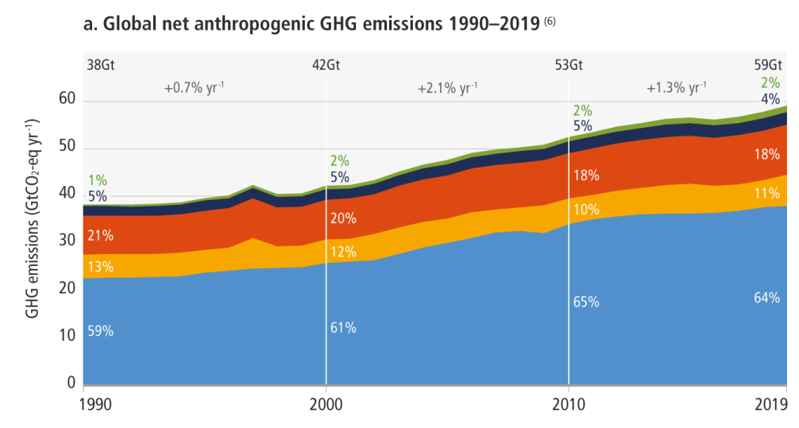
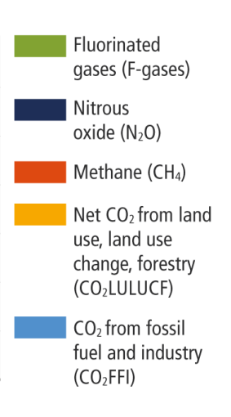
Greenhouse Gas Emissions 1990-2019
Source: IPCC
Notes:
https://www.ipcc.ch/report/ar6/wg3/ Summary for Policymakers Figure SPM.1

Slide 19
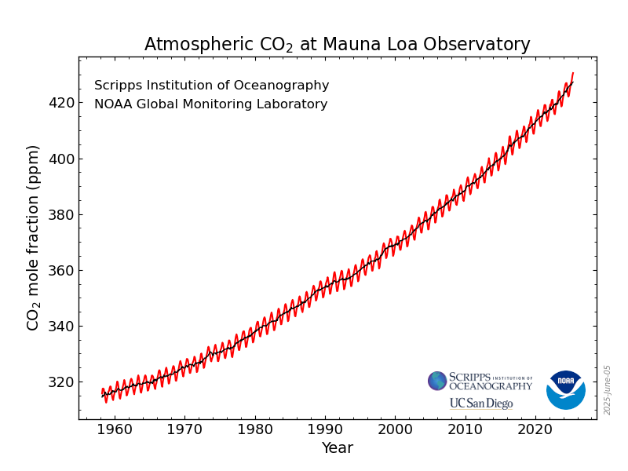
Atmospheric CO₂ Concentrations Up To Now
Source: NOAA
Notes:
https://gml.noaa.gov/ccgg/trends/

Slide 20
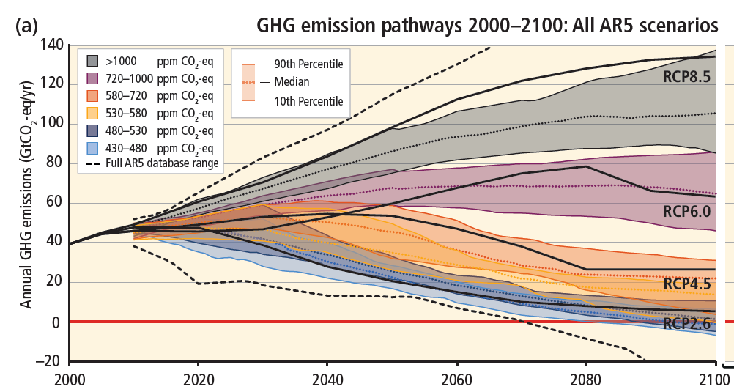
Emissions Trajectories into the Future
Source: IPCC Assessment Report 5
Notes:
Figure SPM.11 from the Summary for Policymakers of AR5

Slide 21
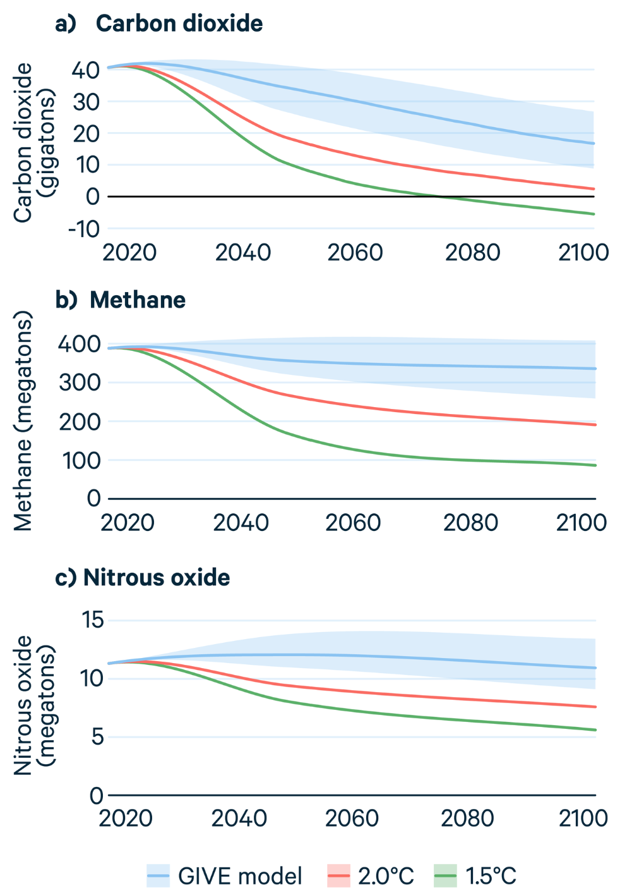
Newer Estimates
Pathways of greenhouse gas emissions to keep warming below 2° or 1.5°C
Notes:
https://www.rff.org/publications/issue-briefs/the-economic-benefits-of-achieving-the-paris-agreement-goals/

Slide 22
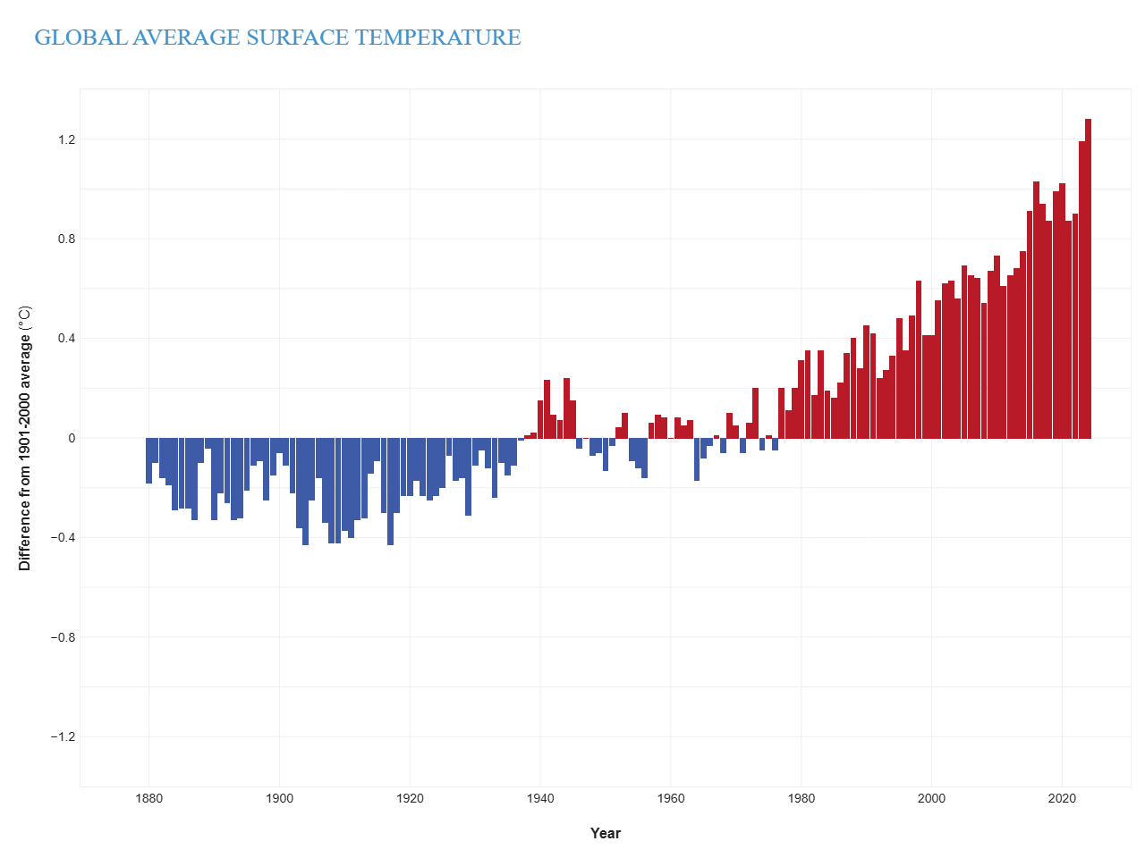
Global Temperatures are Already Changing
Surface temperatures have increased 1.29°C already as of 2024
Notes:
https://www.climate.gov/news-features/understanding-climate/climate-change-global-temperature

Slide 23
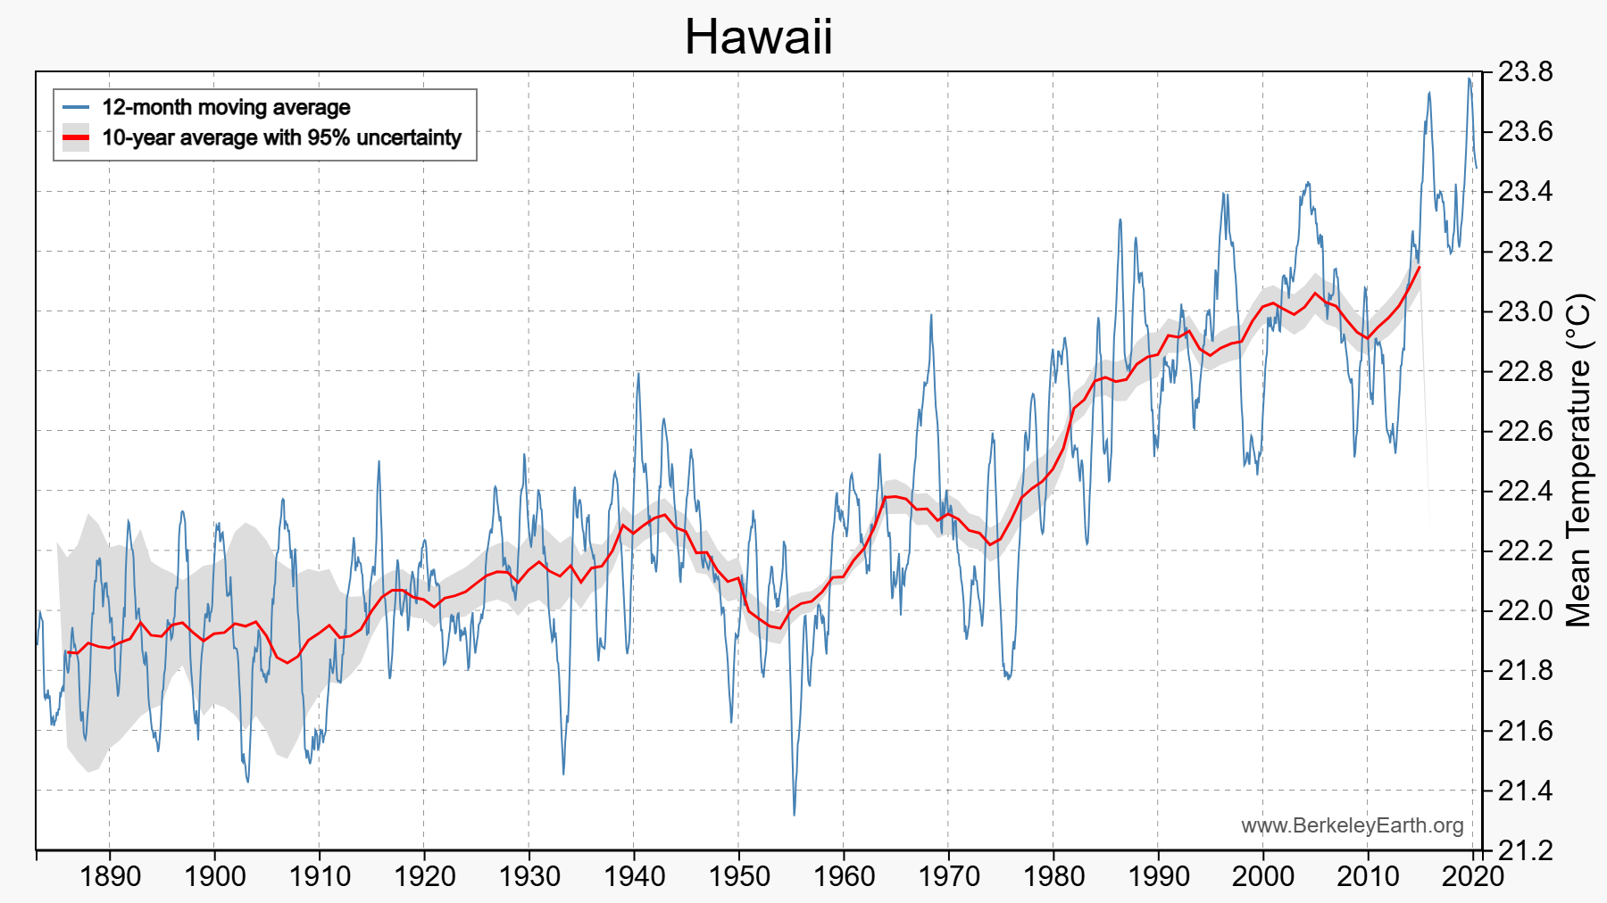
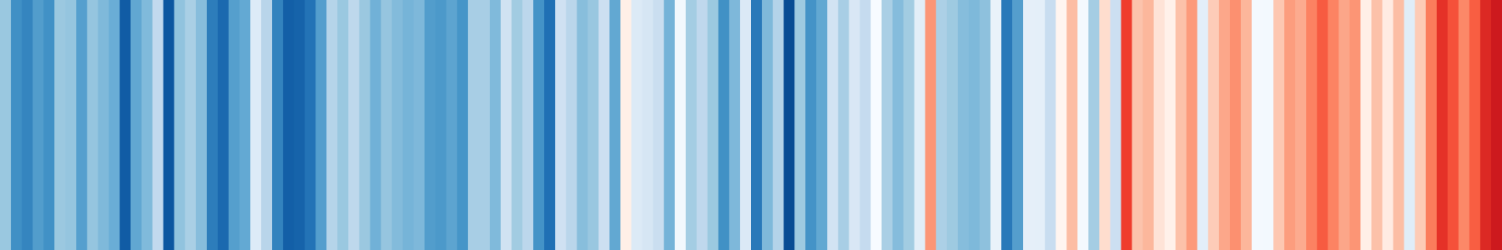
And So Are Local Temperatures
Use https://berkeleyearth.org/temperature-city-list/ to see the temperature history of an area!
Here’s Hawaii!
Notes:
https://berkeleyearth.org/temperature-city-list/

Slide 24
Impacts of Climate Change

Slide 25
What Do Greenhouse Gas Emissions
Do to the Planet?
Increased temperatures
  Sea level rise
  Storm surges
Altered precipitation patterns
More variable weather
More / more powerful storms
Carbon dissolves in ocean

Slide 26
How Climate Change Affects Humans
Agriculture
Fisheries
Coastal damages
Direct health effects, including sickness and death (temperature & drought; also pollution)
Indirect health effects (vector-borne disease)
Reduced fresh water availability
Wildfires
Shifting zones for important ecosystems, and desertification
Reduced worker productivity
Increased violence
Some of these may cause human migration and/or conflict

Slide 27
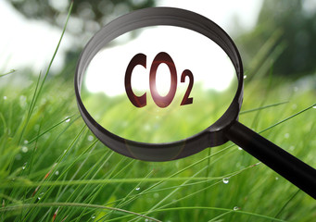
Social Cost of Carbon (SCC)
The expected cost of damages from each unit of greenhouse gas emissions
Should increase over time
EPA used ~$51 per metric ton of CO₂ until 2024
  About $157/car per year.
  $32 billion for all vehicles in the US.
In 2024, adopted new estimate: $190
2025: EPA proposes elimination of SCC
Notes:
18.07 lbs/mile
2204.62 lbs/metric ton
1.8 cents/mile

Slide 28
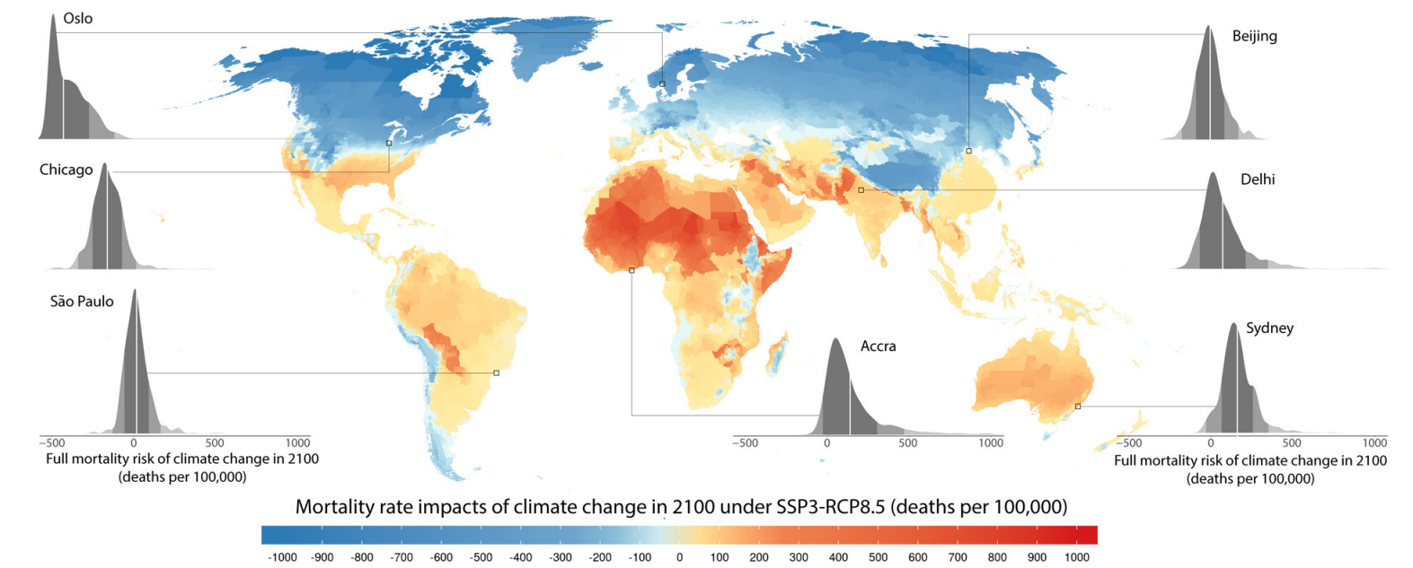
How Damages Will Vary Globally:
Mortality as an Example
Notes:
Carleton et al. 2021: https://papers.ssrn.com/sol3/papers.cfm?abstract_id=3674927

Slide 29
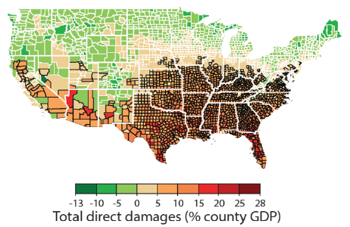
How Damages Will Vary in the US
Notes:
Hsiang, S., Kopp, R., Jina, A., Rising, J., Delgado, M., Mohan, S., Rasmussen, D.J., Muir-Wood, R., Wilson, P., Oppenheimer, M., Larsen, K., Houser, T., 2017. Estimating economic damage from climate change in the United States. Science 356, 1362-1369.
“County-level median values for average 2080 to 2099 RCP8.5 impacts. Impacts are changes relative to counterfactual “no additional climate change” trajectories.”

Slide 30
Adaptation Reduces Damages
Adaptation: costly action that reduce damages from climate change.
The net damage cost to society is the cost of adaptation plus the cost of remaining damages.
People and firms will take some actions on their own, up to the point where they find it worthwhile.
Some adaptation requires government involvement.

Slide 31

Individual-Level Adaptation
Perhaps you…
  Stay inside more.
  Turn on the air conditioning.
Farmers may:
  Plant at different times.
  Plant new crops.
Businesses may:
  Give outdoor workers water / shade breaks.
Everyone might:
  Think about moving to a safer place.

Slide 32
Public Adaptation
Governments can help:
  When collective action is less costly than everyone acting alone.
  When individual action is not possible or likely.
  When some people can’t protect themselves.
Sea walls
Ecosystems that provide protection
Policies that protect workers or low-income and vulnerable populations
Planned retreat (moving a community)

Slide 33
Reducing Emissions

Slide 34
Global Net Emissions
Are What We Care About
For climate impacts, we don’t care where they are emitted, only how much
  There may be other local impacts
Gross emissions (greenhouse gas sources): how much greenhouse gases (including CO2) we put out
Greenhouse gas sinks: ways to pull CO2 out of the air
  Existing: oceans, forests
  Increase sinkage by planting trees, or other measures

Slide 35
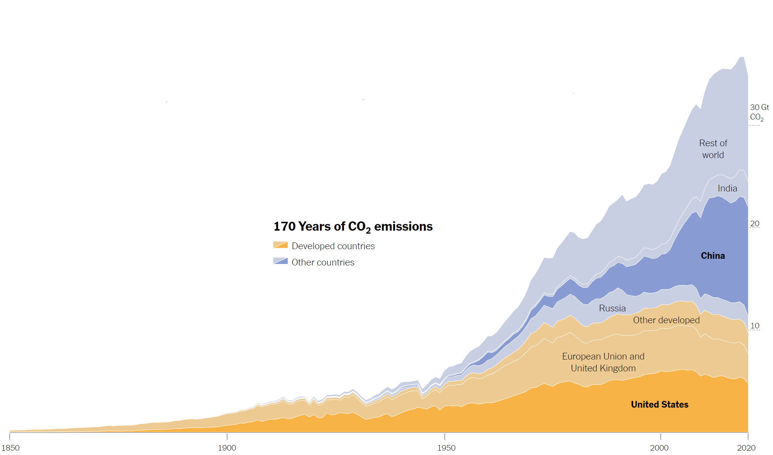
Sources of the Global Flow of Emissions
Notes:
https://www.nytimes.com/interactive/2021/11/12/climate/cop26-emissions-compensation.html

Slide 36
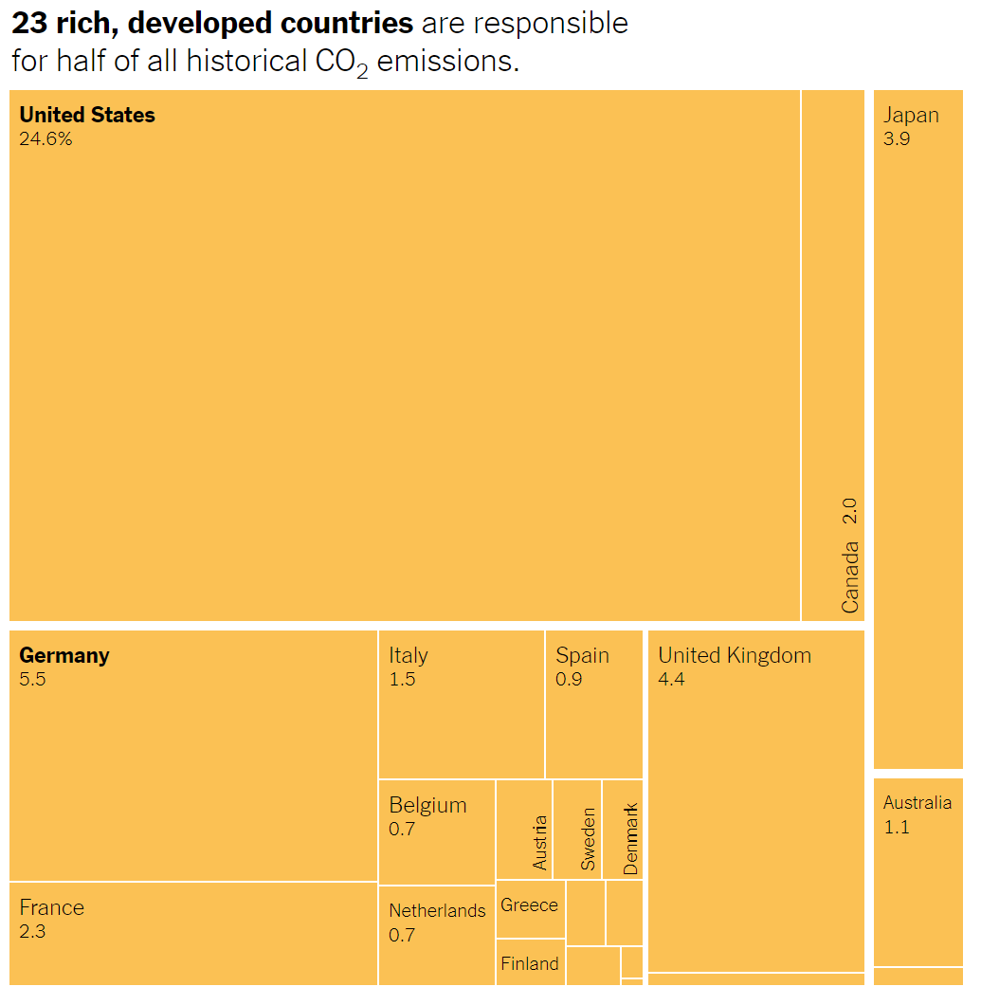
Sources of the Global Stock of Emissions
Notes:
https://www.nytimes.com/interactive/2021/11/12/climate/cop26-emissions-compensation.html

Slide 37
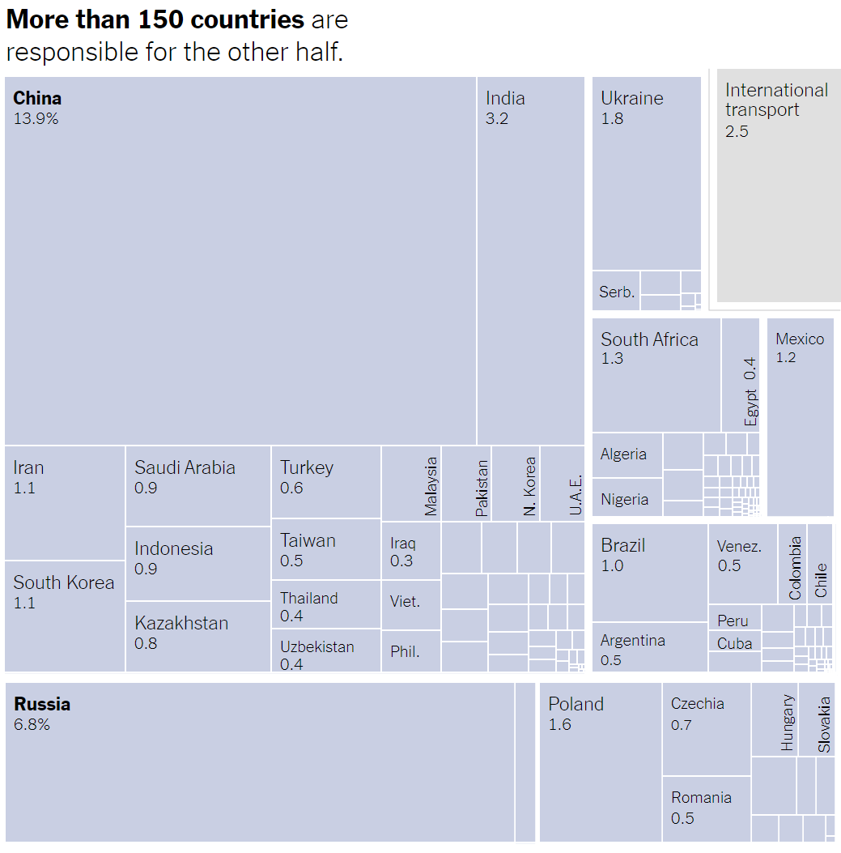
Sources of the Global Stock of Emissions
Notes:
https://www.nytimes.com/interactive/2021/11/12/climate/cop26-emissions-compensation.html

Slide 38
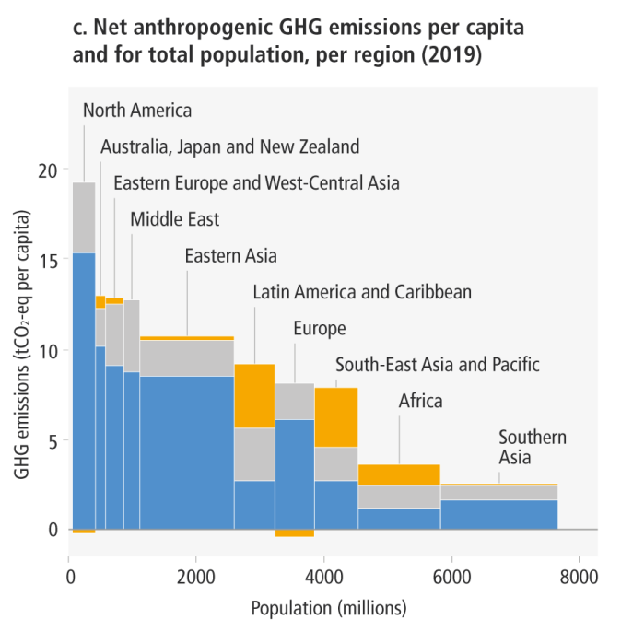
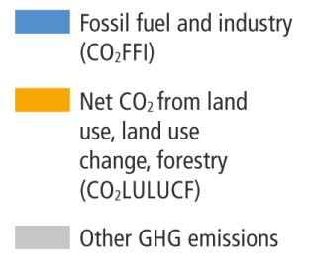
How Does This Look Per Capita (Per Person)?
Notes:
https://www.ipcc.ch/report/ar6/wg3/ Summary for Policymakers Figure SPM.2

Slide 39
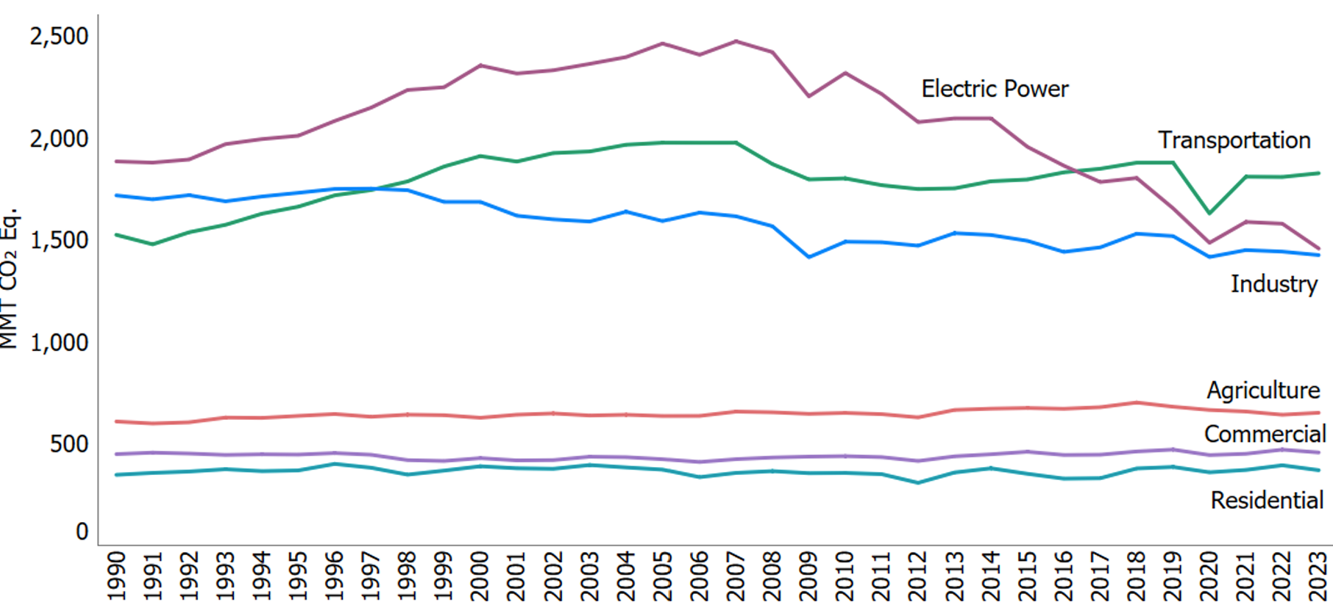
Total US Greenhouse Gas Emissions by Economic Sector through 2023
Notes:
https://www.edf.org/freedom-information-act-documents-epas-greenhouse-gas-inventory?tab=executive_summary
formerly:
https://www.epa.gov/ghgemissions/sources-greenhouse-gas-emissions

Slide 40
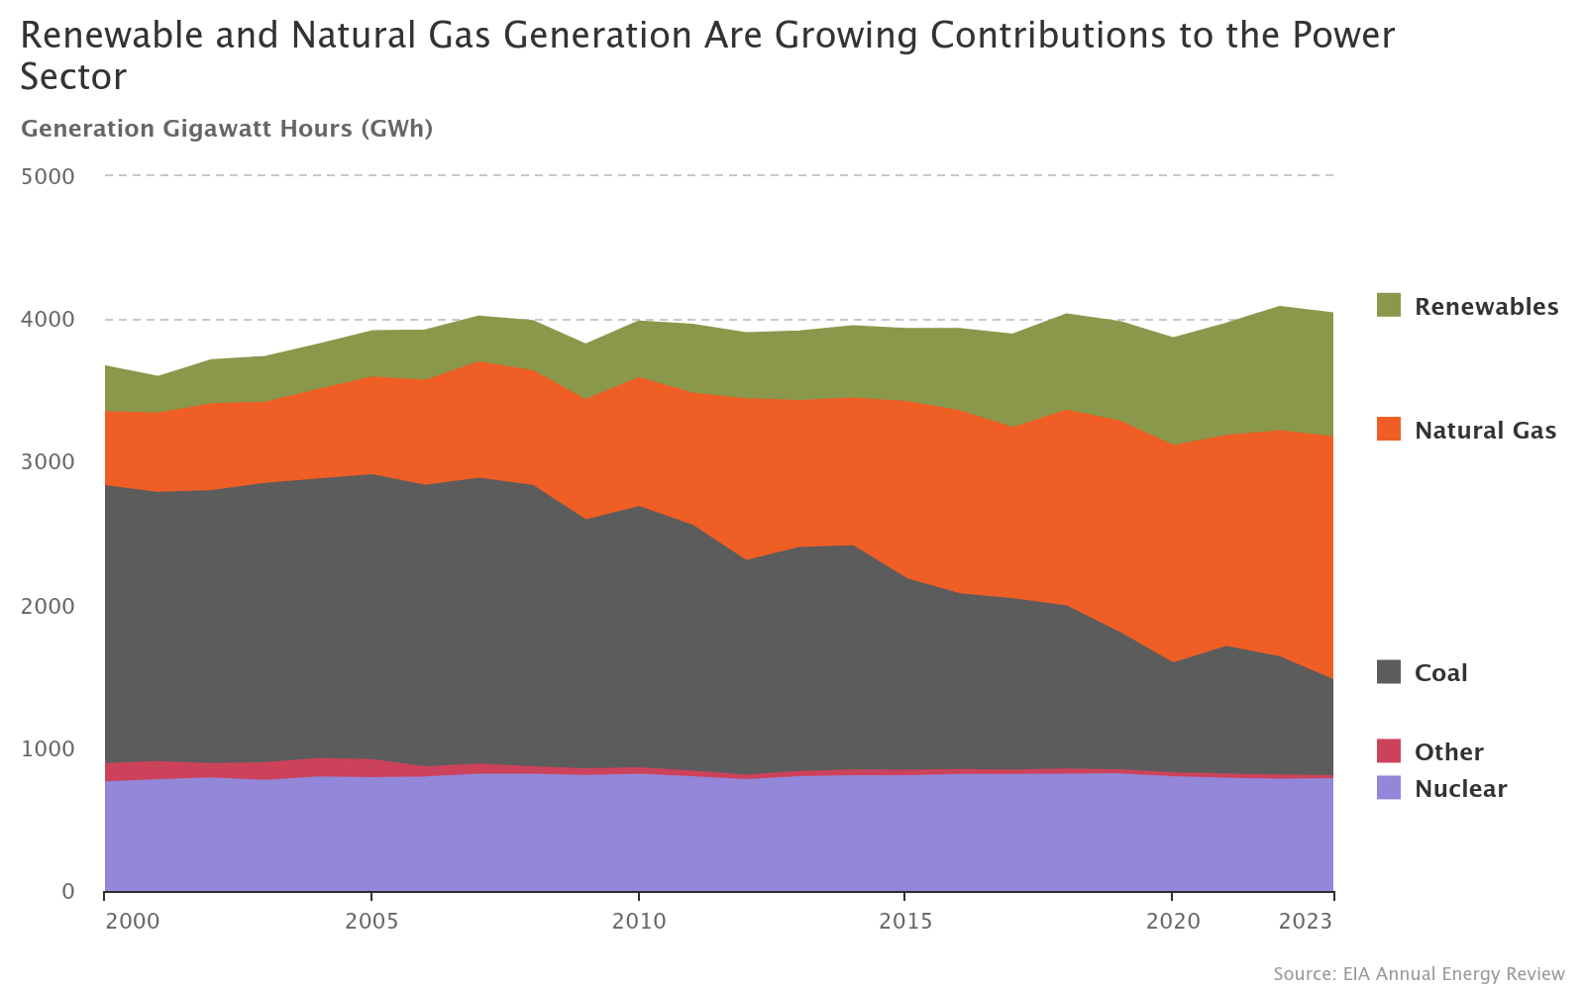
US Electricity Sources for Last 25 Years
Notes:
Source: https://www.epa.gov/power-sector/power-sector-evolution

Slide 41
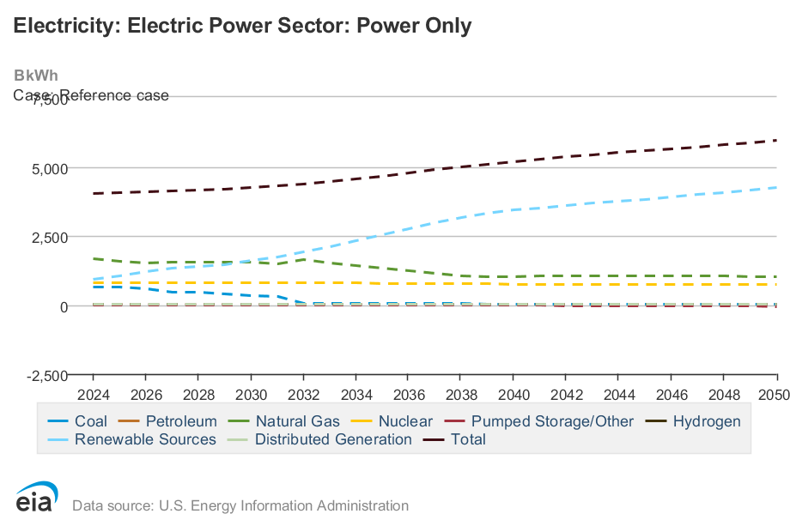
US Electricity Sources Future Projections
Notes:
Source: https://www.eia.gov/outlooks/aeo/data/browser/#/?id=8-AEO2025&region=0-0&cases=ref2025&start=2023&end=2050&f=A&linechart=ref2025-d032025a.6-8-AEO2025~ref2025-d032025a.7-8-AEO2025~ref2025-d032025a.8-8-AEO2025~ref2025-d032025a.9-8-AEO2025~ref2025-d032025a.10-8-AEO2025~ref2025-d032025a.11-8-AEO2025~ref2025-d032025a.12-8-AEO2025~ref2025-d032025a.13-8-AEO2025~ref2025-d032025a.14-8-AEO2025&sourcekey=0

Slide 42
Which Emissions Should We Cut?
List all possible ways to reduce emissions
Figure out how much each can reduce in total
Figure out how much each costs per unit of emissions reduced
Line them up in order: cheapest to costliest (“marginal abatement cost curve”)
  → Tackle first the cheapest ones!

Slide 43
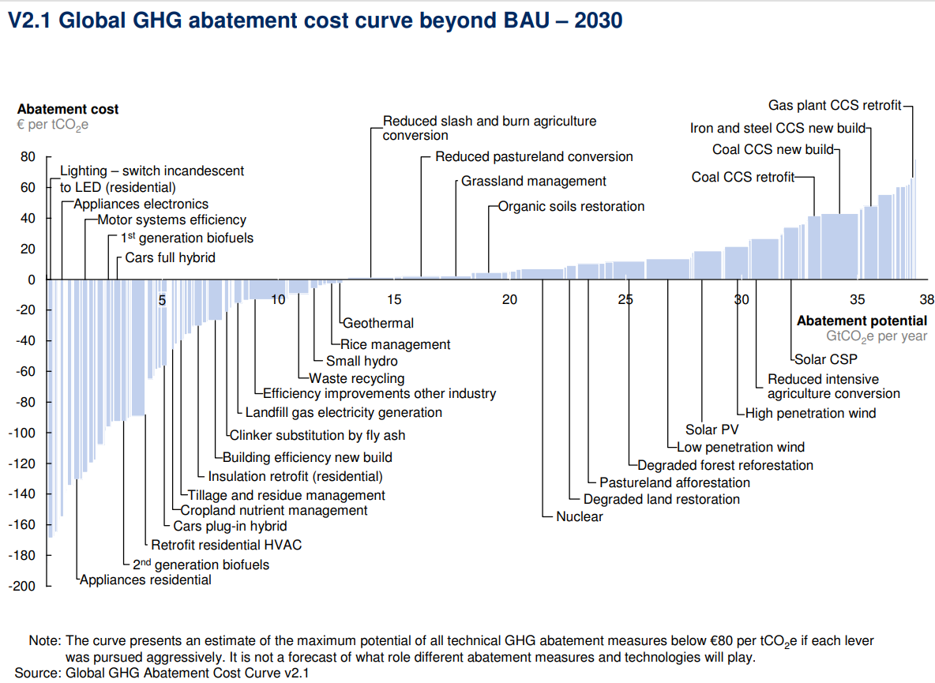
Example Abatement Cost Curve
(Don’t trust these numbers, this is just to show the idea)
Notes:
McKinsey report: https://www.mckinsey.com/business-functions/sustainability/our-insights/impact-of-the-financial-crisis-on-carbon-economics-version-21

Slide 44
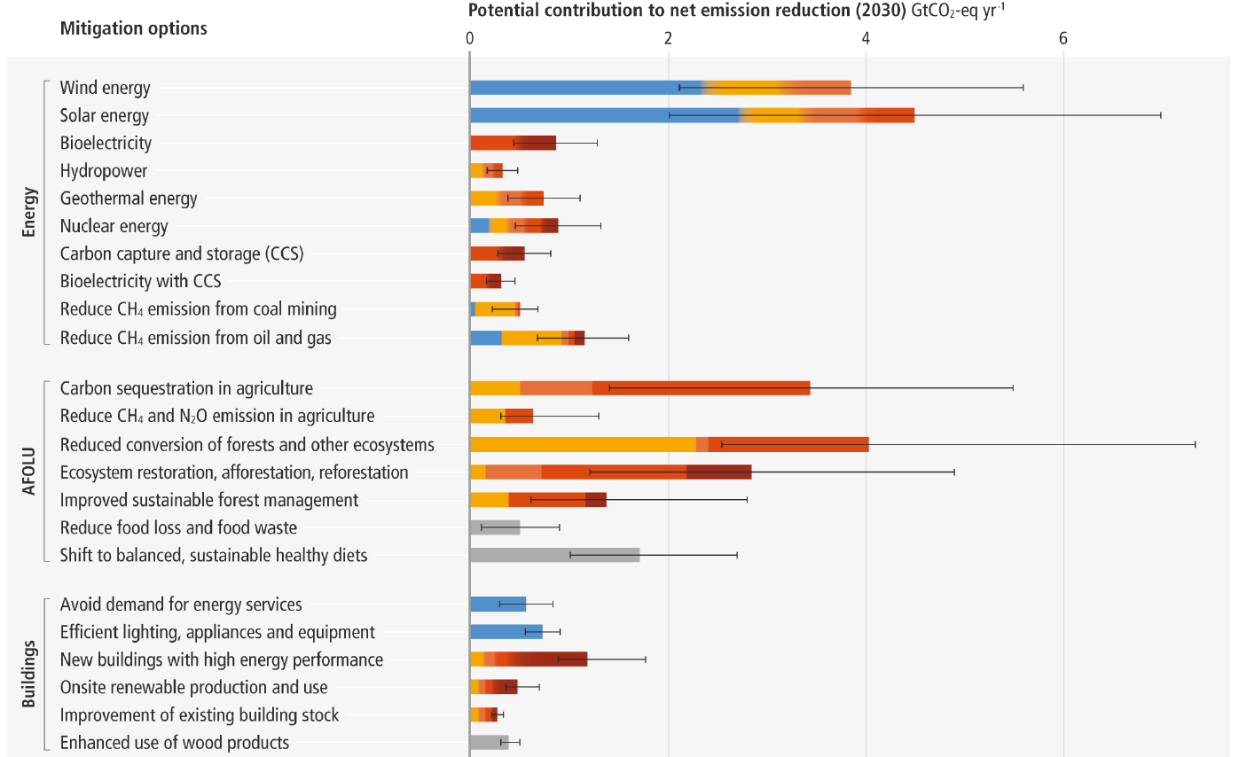
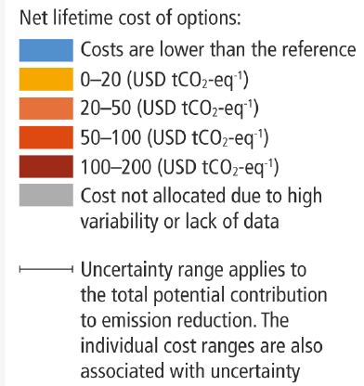
Newer Estimated Abatement Cost Curve
Notes:
IPCC AR6 Working Group 3 Summary for Policymakers
Figure SPM.7: Overview of mitigation options and their estimated ranges of costs and potentials in 2030.

Slide 45
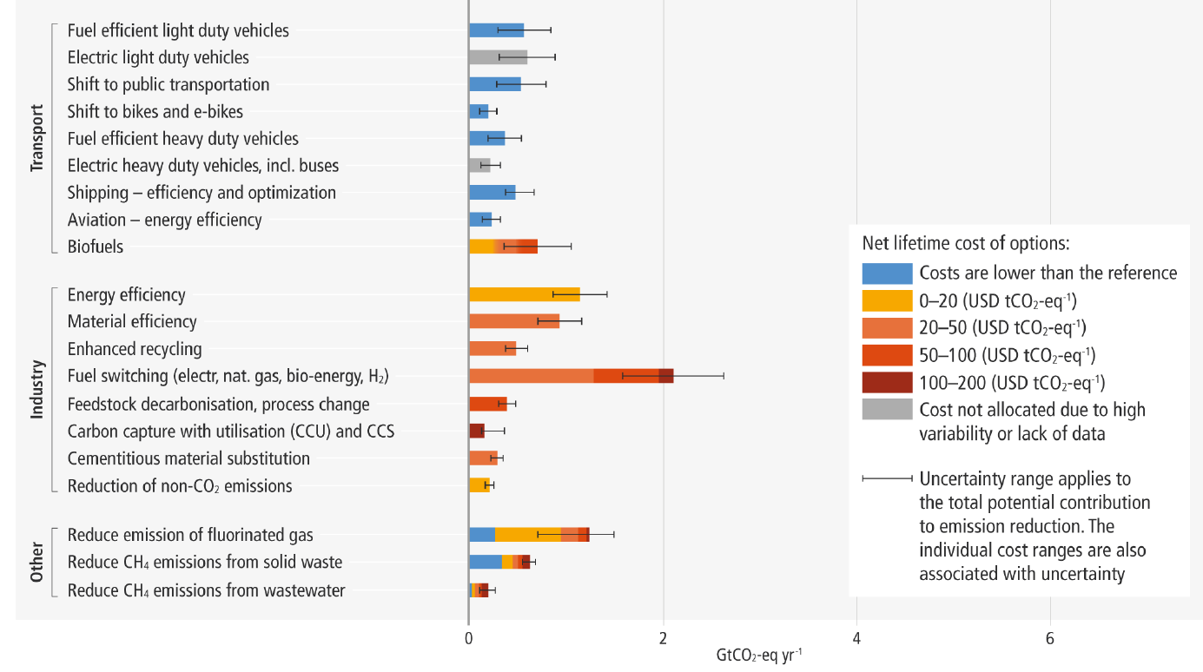
Newer Estimated Abatement Cost Curve
Notes:
IPCC AR6 Working Group 3 Summary for Policymakers
Figure SPM.7: Overview of mitigation options and their estimated ranges of costs and potentials in 2030.

Slide 46
Costs and Barriers Can Be Difficult to Assess
Difficult to project future costs for new technology
  Costs of renewables have been dropping fast
Investments in research and development and infrastructure (e.g., EV charging) can lower future costs
Barrier to expanding renewable energy: intermittency
  Battery technology under development

Slide 47
Geoengineering and Carbon Capture
Technical pathways to reduce climate change without reducing emissions
Carbon capture: captures CO2 emissions and stores them or “utilizes” them (for energy, pressure, etc.)
  Not yet proven at scale
Solar geoengineering: make the atmosphere reflect more light to regain earlier thermal balance
  Totally theoretical
  Potentially risky

Slide 48
Climate Change Policy

Slide 49
Policies That Reduce Emissions Directly
Command and control regulation
  Emissions standards or limits (e.g., Clean Water Act discharge limits)
  Tech standards (e.g., require scrubbers on power plants)
Incentive-based policies
  Putting a price on emissions – leveling the playing field!
    Tax or cap & trade
    Subsidizing green energy (e.g., feed-in tariffs)

Slide 50
Command and Control vs. Incentive-Based Regulation
Efficiency
  Both can achieve the same amount of emissions reduction.
  Incentive-based policies can achieve emissions reduction at much lower cost.
Equity
  Both have may regressive impacts (low-income families bear costs that are a larger percent of their incomes vs hi-income families)
    However, new evidence increasingly questions this.
  Cap and trade and carbon tax can generate revenues that can be used to offset the regressivity.
    E.g.: “carbon dividend”
  Command and control regulations do not.

Slide 51
How Does a Carbon Tax Work?
Choose activities to be covered (e.g., electricity sector, all emitters, etc.).
Set tax level.
  Optimally, it represents the social cost of polluting.
Polluters must pay a tax for every unit emitted.
  Polluters with low abatement costs will abate to avoid the tax
  Polluters with high abatement costs will pollute and pay the tax

Slide 52
How Does Cap and Trade Work?
Choose activities to be covered (e.g., electricity sector, all emitters, etc.).
Set maximum emissions level (“cap”).
That many pollution permits are issued.
  Can be auctioned off or given to polluters
Every polluter in a covered sector must have a permit for every unit of pollution.
Polluters buy and sell (“trade”) permits on a market as they wish.
  Polluters with low abatement costs will make / save money by abating and selling / not buying permits
  Polluters with high abatement costs will buy permits and pollute

Slide 53
Examples of Other Policies that Reduce Emissions
Research and development subsidies
Renewable energy mandates (e.g., renewable portfolio standards)
Energy efficiency mandates and subsidies (e.g. CAFE fuel economy standards)
Grid / infrastructure improvements
Public transportation
Land use / zoning policies

Slide 54
Climate Change Policy in Action

Slide 55
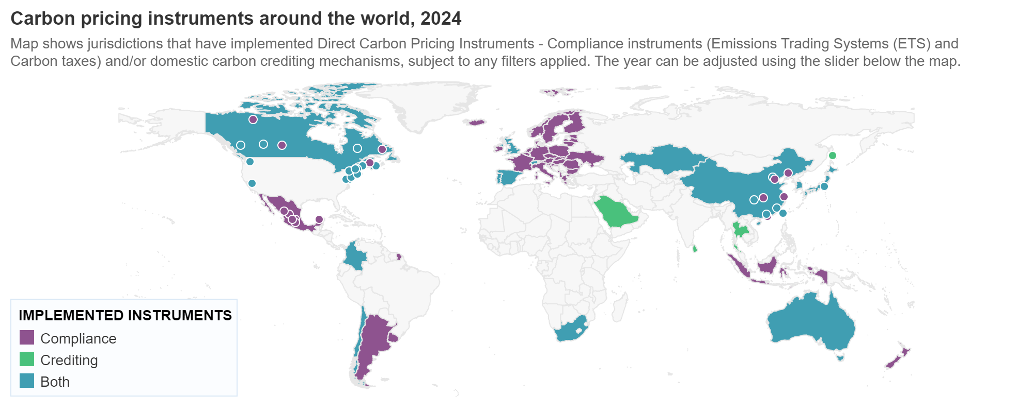
Incentive-Based Climate Policies Right Now
Source: World Bank Carbon - Pricing Dashboard
Notes:
https://carbonpricingdashboard.worldbank.org/

Slide 56

California’s Cap and Trade System Since 2013
0.7%
of global greenhouse gas emissions

Slide 57
California’s AB32: Global Warming Solutions
Passed in 2006
California’s goals:
  Reduce emissions to 1990 levels by 2020
  An 80% reduction in emissions from 1990 levels by 2030
California’s Tools:
  Cap and Trade
  Renewable Portfolio Standard
  Clean Cars Program
  Low Carbon Fuel Standard

Slide 58
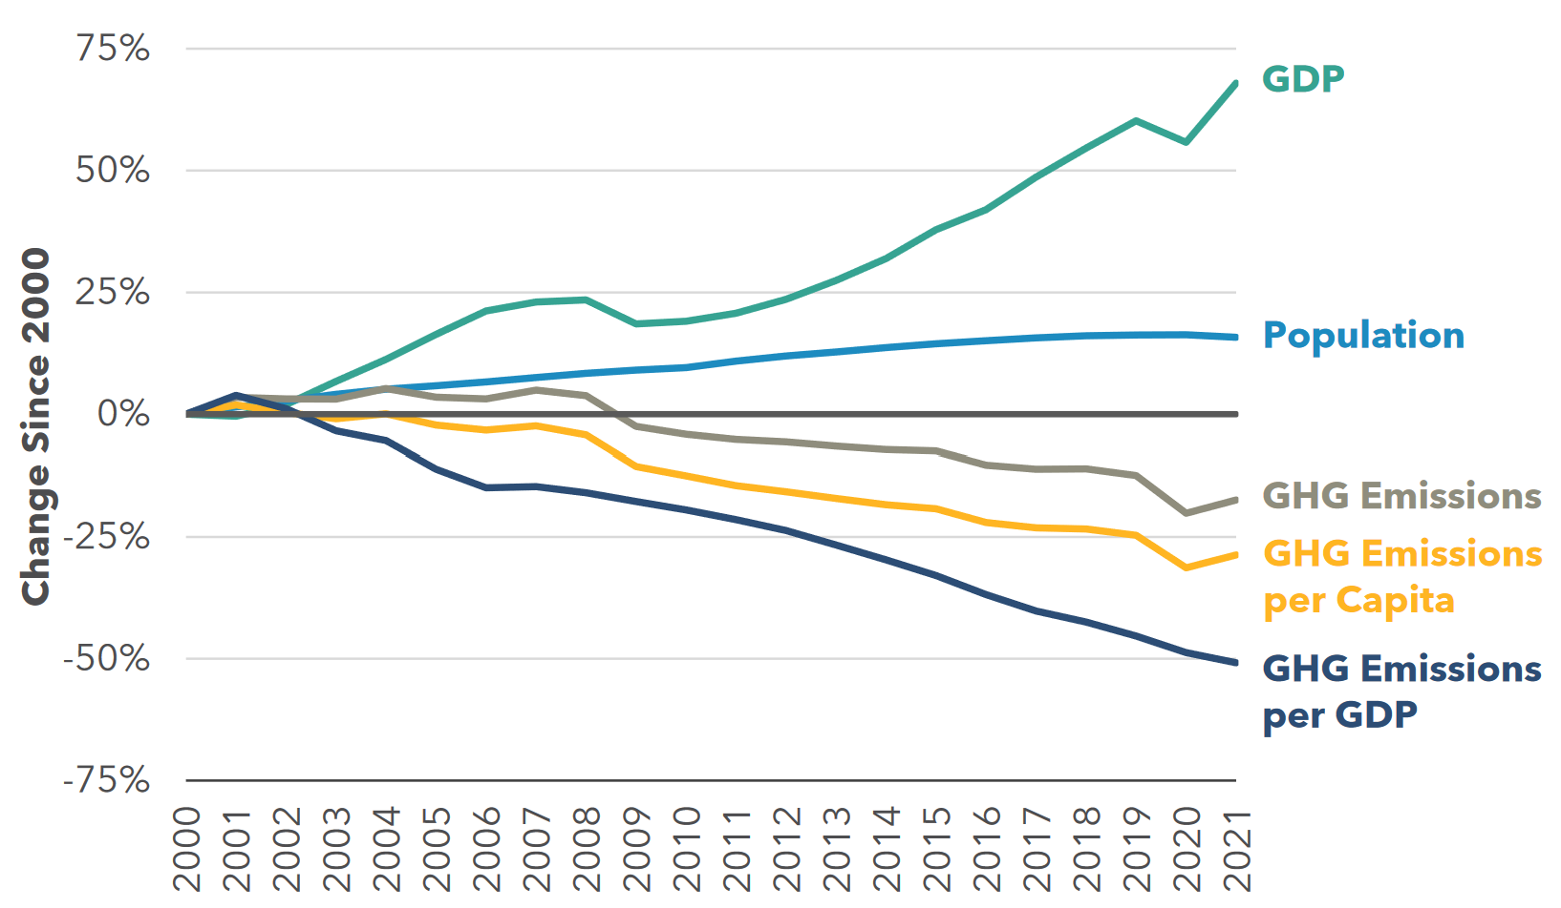
Changes in California GDP, Population, and
GHG Emissions since 2000
Cap & Trade ->
Notes:
Source: https://ww2.arb.ca.gov/ghg-inventory-data

Slide 59
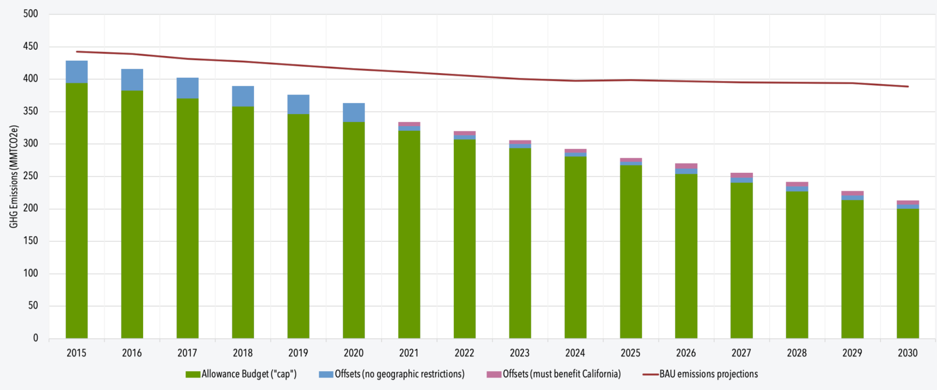
Projected trends in California’s emissions
Notes:
https://www.c2es.org/content/california-cap-and-trade/

Slide 60
Summary
Climate change is real, is caused by human actions, and has impacts we’re already feeling.
This problem won’t solve itself; we need policy intervention, and fast.
Smart policy can reduce greenhouse gas emissions by the right amount and at the lowest possible cost.
  For example, cap and trade and emissions taxes!
We also need policies to help with adaptation and support those bearing the greatest damages.

Slide 61
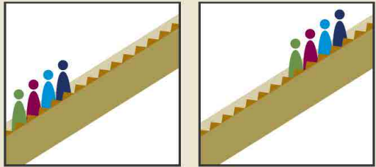
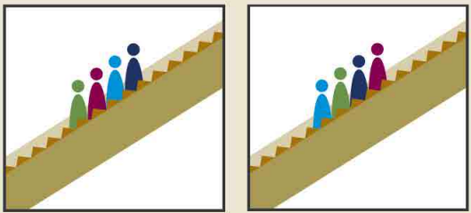
Next Week: Absolute vs Relative Mobility
Can there be absolute mobility with NO relative mobility?
  Yes: if everybody experiences the same increase in income, there will be no relative mobility.
Can there be relative mobility with NO absolute mobility?
  Yes: There can be a dramatic reshuffling of the distribution even if there is no increase in average income.
Parents Kids
Parents Kids
+2
-1
+1
-2

Slide 62
Thank you!
Any Questions?
www.NEEDEcon.org
Sarah Jacobson, Ph.D.
saj2@williams.edu
Contact NEED: info@NEEDEcon.org
Submit a testimonial: www.NEEDEcon.org/testimonials.php
Become a Friend of NEED: www.NEEDEcon.org/friend.php

