Slide 1
Osher Lifelong Learning Institute, June 2026
The Economics of Public Policy Issues
University Of Minnesota
Host: Geoffrey Woglom, Director
National Economic Education Delegation

Slide 2
Available NEED Topics Include:
US Economy
Healthcare Economics
Climate Change
Economic Inequality
Economic Mobility
Trade and Globalization
Minimum Wages
Immigration Economics
Housing Policy
Federal Budgets
Federal Debt
Black-White Wealth Gap
Autonomous Vehicles
US Social Policy

Slide 3
Course Schedule
Contemporary Economic Policy
  Week 1 (10/8): Economic Update & Changes at the Fed, Geoffrey Woglom, Amherst College
  Week 2 (10/15): Climate Change Economics, Galina Hale, UC Santa Cruz
  Week 3 (10/22): The Future of Money, Geoffrey Woglom, Amherst College
  Week 4 (10/29): The Economics of Tariffs, Tibor Besedes, Georgia Institute of Technology
  Week 5 (11/5): Economics of Immigration, Roger White, Whittier College
  Week 6 (11/12): Gender Pay Gap, Tibor Besedes, Georgia Institute of Technology

Slide 4
Submitting Questions
I encourage questions. Please put questions in the chat and I will answer them periodically during the talk,
We will do a verbal Q&A once the material has been presented.
Slides are available from the NEED website https://needecon.org/delivered_presentations.php.

Slide 5
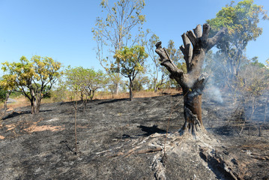



Climate Change Economics
Galina Hale, Ph.D.
UC Santa Cruz
Osher Lifelong Learning Institute
Fall 2026

Slide 6
Credits and Disclaimer
This slide deck was authored by:
  Shana McDermott, Trinity University
  Sarah Jacobson, Williams College
  Sharon Shewmake, Western Washington University
  Galina Hale, UC Santa Cruz
This slide deck was reviewed by:
  Jason Shogren, University of Wyoming
  Walter Thurman, North Carolina State University
Disclaimer
  NEED presentations are designed to be nonpartisan.
  It is, however, inevitable that the presenter will be asked for and will provide their own views.
  Such views are those of the presenter and not necessarily those of the National Economic Education Delegation (NEED).

Slide 7
Outline
Economic Building Blocks
Climate Change
Impacts of Climate Change
Reducing Emissions
Climate and the Food System
Climate Change Policy
Climate and Finance

Slide 8
Economic Building Blocks

Slide 9
How Can Economists Help
Fight Climate Change?
By measuring climate change damages and estimating the costs of fighting climate change.
By assessing behavioral reactions to climate change.
By designing smart policies that minimize costs to society.

Slide 10
When Everything Is Simple,
No Regulation Is Needed for Efficiency
Simple transactions: buyer and seller feel all costs and benefits of sales
They make decisions based on the costs & benefits they feel
→ Efficient allocation and production of everything!
(Maximizes social benefits)
Simple economic assumptions that proved wrong
  Abundant resources are cheap or free (air, water)
  “Free disposal” (therefore “more is always better”):
  waste is not free for the planet

Slide 11
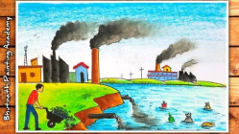


Market failure
A situation in which free markets produce prices of goods or services and allocation of such goods or services that is not socially optimal.
It can arise due to
Externalities (when actions of one agent affect others)
Public goods
Goods that are non-excludable
(I can’t stop you from using it) and
non-rival (me using it does not
diminish your benefit from using it)

Slide 12
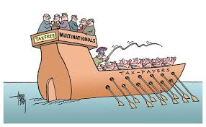
Market failure
A situation in which free markets produce prices of goods or services and allocation of such goods or services that is not socially optimal.
It can arise due to
Externalities
Public goods
Free rider problem
People can enjoy benefits of others’ actions without
paying for them (or paying for them insufficiently)

Slide 13
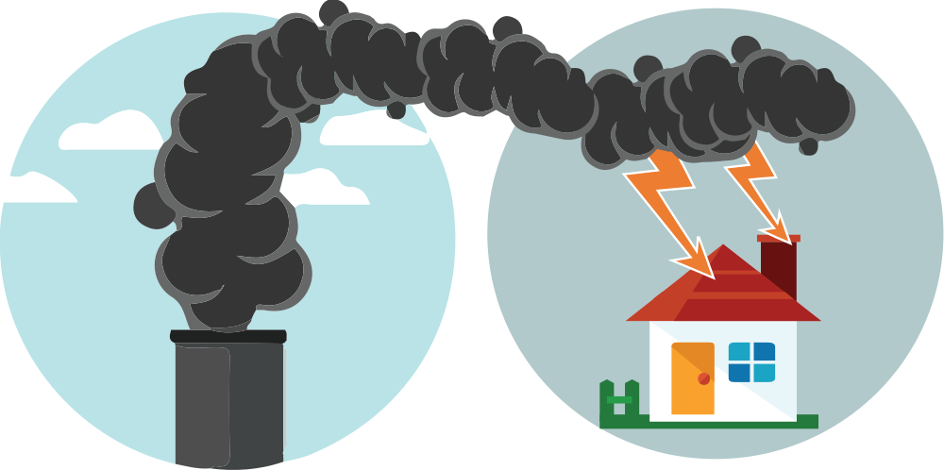
When Our Decisions Affect Others,
We Need Regulation
Emissions produce an EXTERNALITY:
a cost on all others: Polluting things have an “unfair cost advantage” because part of cost is offloaded on others
  => Too much pollution is generated
  Regulation of pollution has net benefits
The “efficient” amount of pollution balances all costs & benefits of pollution

Slide 14

How Economists Decide How Much to Fight
Climate Change: Cost Benefit Analysis
Abating greenhouse gas emissions is costly…
… but without action, climate change damages are even more costly.
Goal is not zero emissions, but efficient level that achieves a balance.
Expected costs of reducing emissions
Expected damages from allowing climate change

Slide 15
Cost-Benefit Analysis of
Fighting Climate Change
Most economic models suggest the costs of keeping warming below 2°C are relatively small, amounting to 1-4% of GDP by 2030.
Costs of acting to keep warming below 2°C are almost certainly less than future economic damages they would avoid.
  Damages estimated to be between: 7-20% of worldwide GDP.

Slide 16
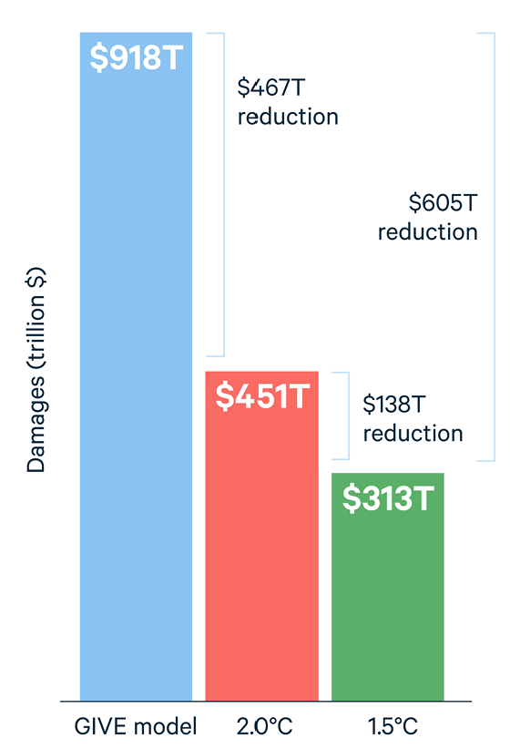
Newer Estimates of Benefits of
Fighting Climate Change
Policies already declared should limit warming to 2.5°C
Keeping warming even lower would yield additional global benefits of:
  2° → $5.2T annually ($467T total)
  1.5° → $6.8 trillion annually (605T total)
Notes:
https://www.rff.org/publications/issue-briefs/the-economic-benefits-of-achieving-the-paris-agreement-goals/
2023 estimates. Global GDP was $106.17 trillion in 2023 so these are big

Slide 17
Climate Change

Slide 18
A Climate Change Ladder
Emissions
Mitigation (a.k.a. Abatement)
Adaptation
Damages

Slide 19

The Atmospheric Greenhouse Effect
Sun
Atmosphere
Energy reflected back
onto earth
Energy reflected back
into space

Slide 20
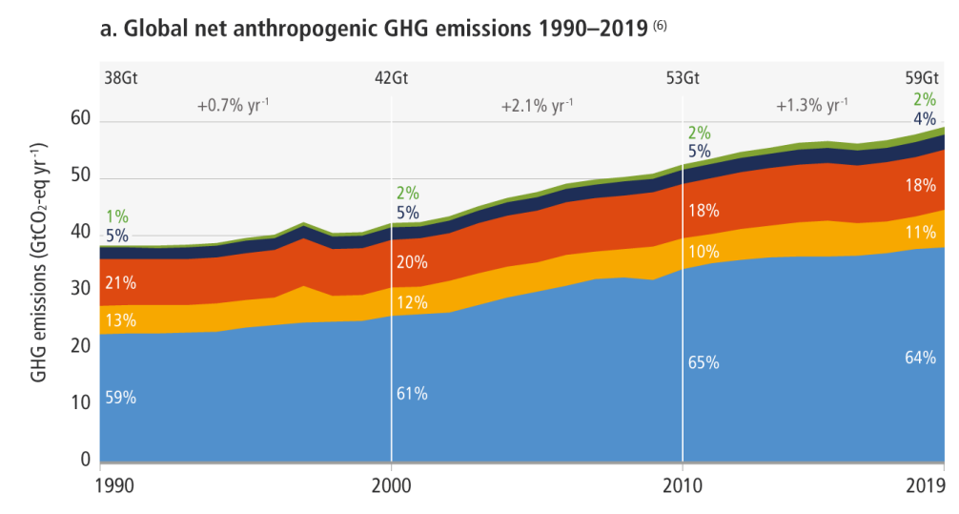
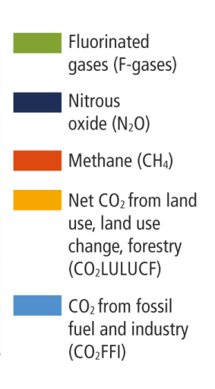
Greenhouse Gas Emissions 1990-2019
Source: IPCC
Notes:
https://www.ipcc.ch/report/ar6/wg3/ Summary for Policymakers Figure SPM.1

Slide 21
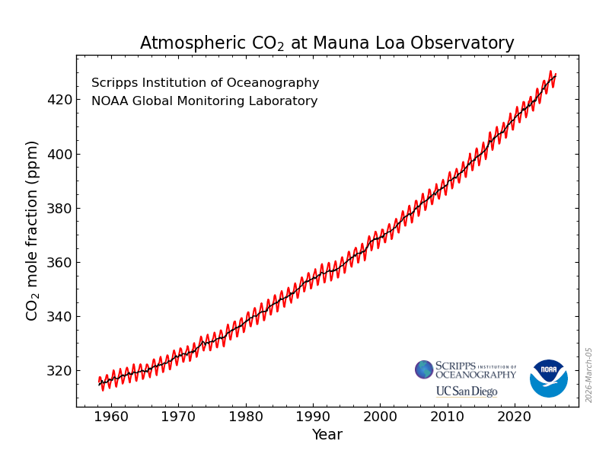
Atmospheric CO₂ Concentrations Up To Now
Source: NOAA
Notes:
https://gml.noaa.gov/ccgg/trends/

Slide 22
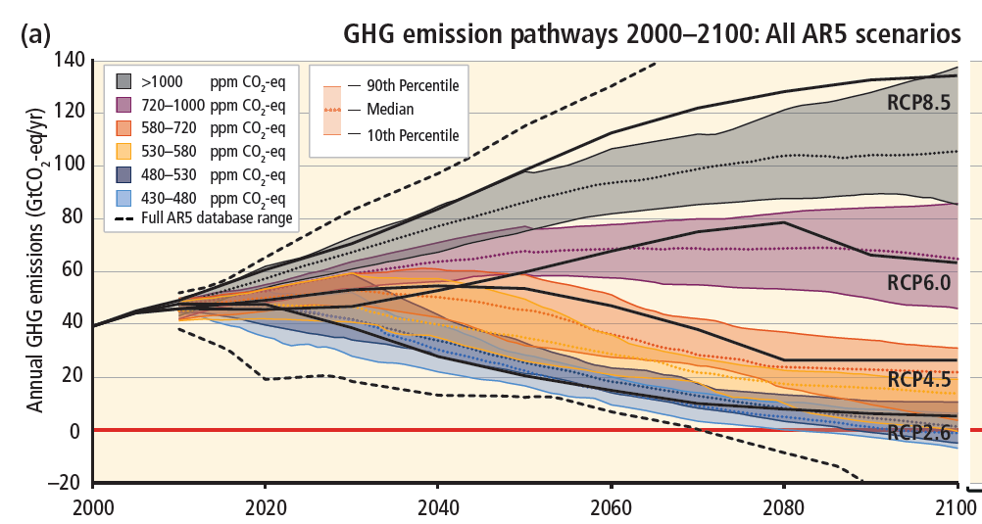
Emissions Trajectories into the Future
Source: IPCC Assessment Report 5
Notes:
Figure SPM.11 from the Summary for Policymakers of AR5

Slide 23
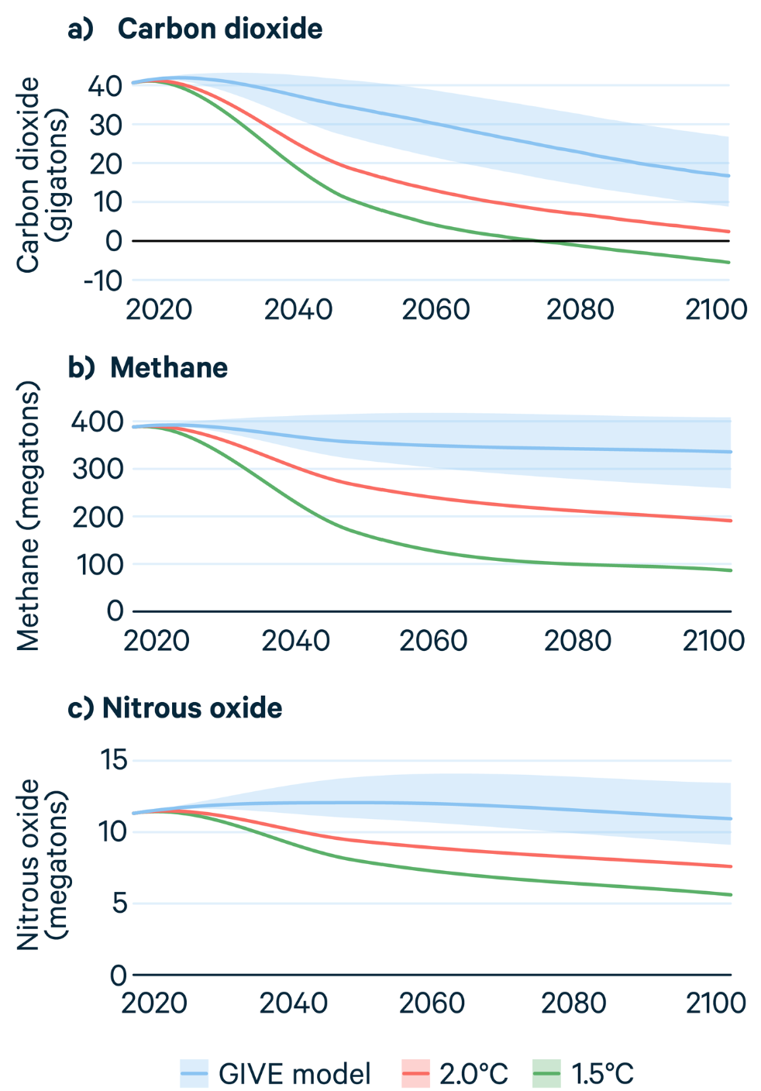
Newer Estimates
Pathways of greenhouse gas emissions to keep warming below 2° or 1.5°C
Notes:
https://www.rff.org/publications/issue-briefs/the-economic-benefits-of-achieving-the-paris-agreement-goals/

Slide 24
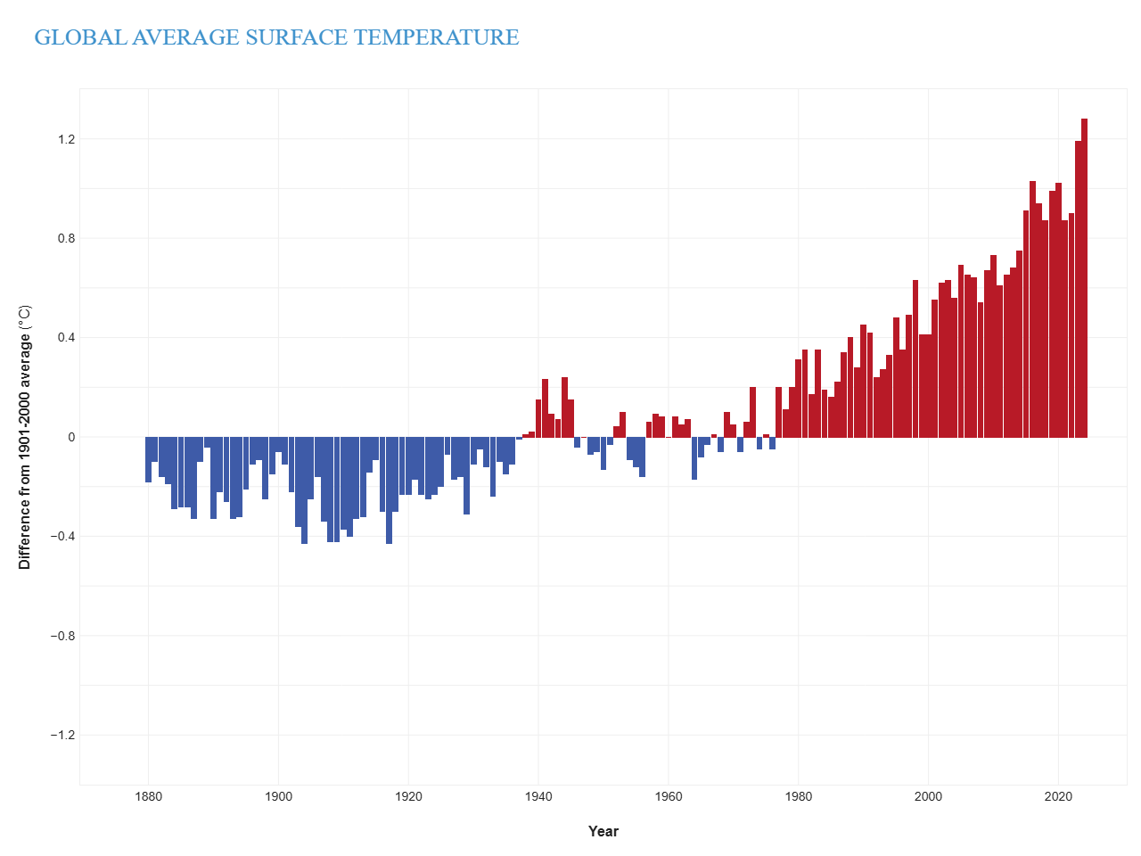
Global Temperatures are Already Changing
Earth is now about 1.3°C warmer than pre-industrial times. 2023, 2024 and 2025 were the three warmest years on record.
Notes:
https://www.climate.gov/news-features/understanding-climate/climate-change-global-temperature

Slide 25
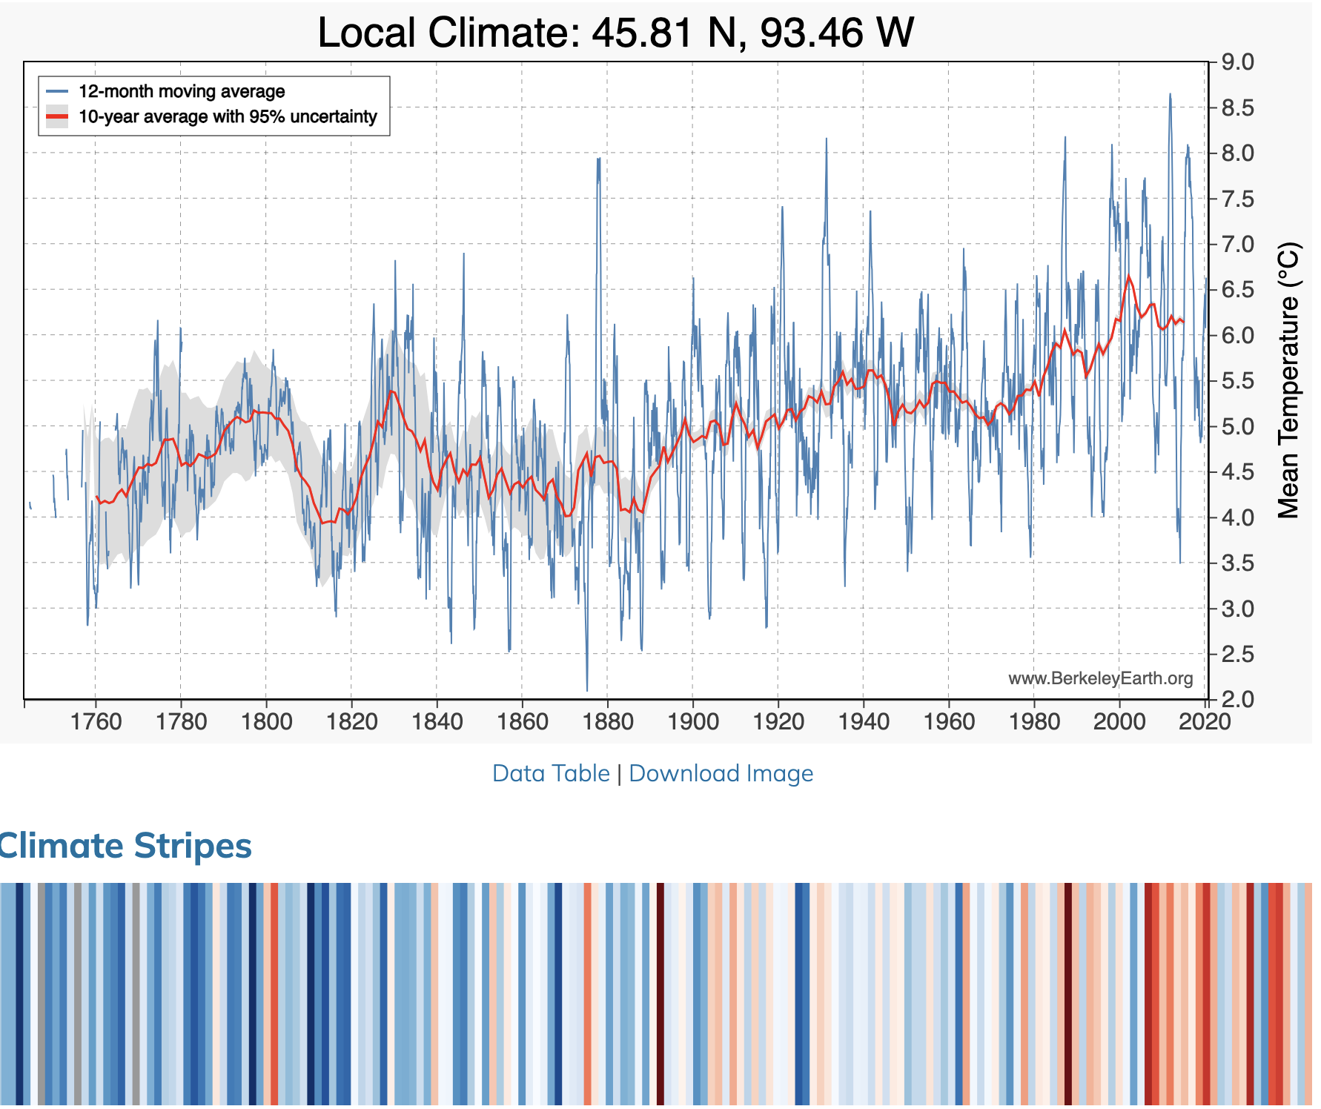
And So Are Local Temperatures
Use https://berkeleyearth.org/temperature-city-list/ to see the temperature history of an area!
Here’s Minneapolis!
Notes:
https://berkeleyearth.org/temperature-city-list/

Slide 26
Impacts of Climate Change

Slide 27
What Do Greenhouse Gas Emissions
Do to the Planet?
Increased temperatures
  Sea level rise (warmer water => volume increase + ice melts)
  Storm surges, increased wave energy
  Larger number of hotter-than-safe days in many areas
Altered precipitation patterns => floods, wildfires, crop yield decline
More variable weather
Carbon dissolves in ocean
Increased loss of biodiversity (change too fast to adapt)

Slide 28
How Climate Change Affects Humans
“Chronic effects”
Agriculture and Fisheries
Coastal damages
Direct health effects, including sickness and death
Indirect health effects (vector-borne disease)
Reduced fresh water availability
Reduced worker productivity
“Acute effects”
Wildfires
Coastal/riverine damages from floods
Resulting social consequences
Increased violence
Migration and/or conflict

Slide 29
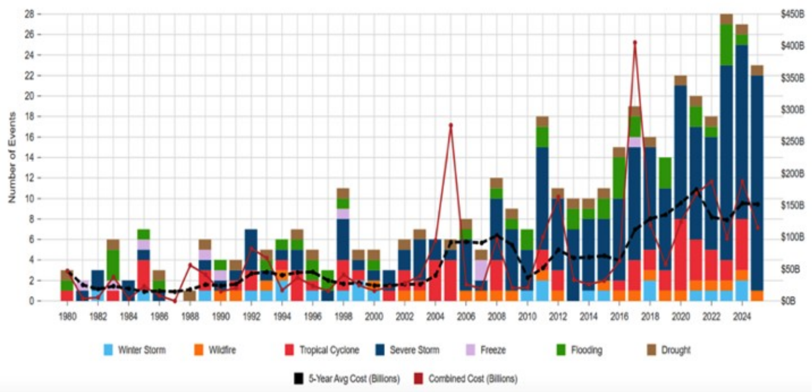
Billion-Dollar Disasters Are
Becoming More Common
23
billion-dollar weather disasters in the U.S. in 2025
≈ $115 billion
in total damages
Bars: number of U.S. events by type (left axis). Lines: total cost, $ billions (right axis).
Source: Climate Central, U.S. Billion-Dollar Weather and Climate Disasters (2025 data; inflation-adjusted). Chart through 2025.
Notes:
NEW (Hale). Source: Climate Central, U.S. Billion-Dollar Weather and Climate Disasters 2025, https://www.climatecentral.org/report/us-billion-dollar-weather-and-climate-disasters-2025
NOAA retired its billion-dollar disaster database in 2025; Climate Central (with the database's original lead author) now maintains it.
2025: 23 events, ~$115B — third-highest count since 1980 after 2023 (28) and 2024 (27). Bridge to finance section: these losses land on households, insurers, banks and governments.

Slide 30
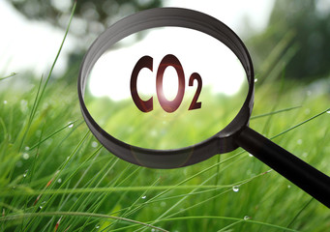
Social Cost of Carbon (SCC)
The expected cost of damages from each unit of greenhouse gas emissions
Should increase over time
EPA used ~$51 per metric ton of CO₂ until 2024
  About $157/car per year.
  $32 billion for all vehicles in the US.
2024: EPA adopted a new estimate: $190
2025: Federal SCC estimates withdrawn
Notes:
18.07 lbs/mile
2204.62 lbs/metric ton
1.8 cents/mile

Slide 31
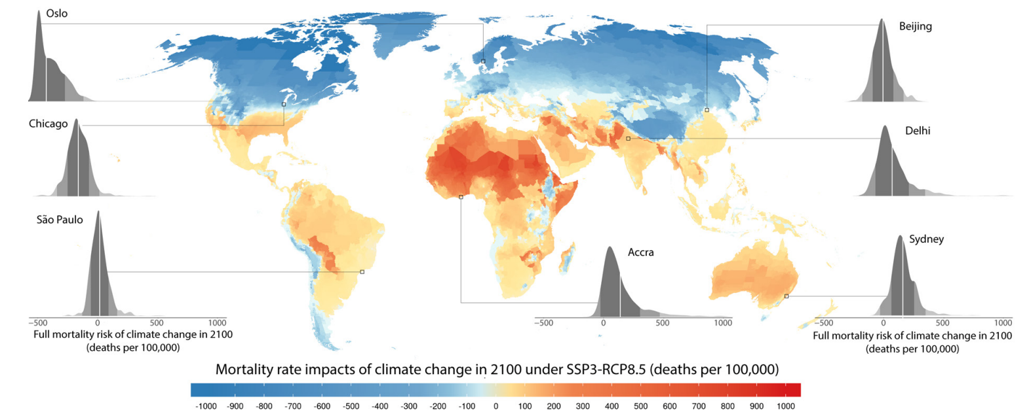
How Damages Will Vary Globally:
Mortality as an Example
Notes:
Carleton et al. 2021: https://papers.ssrn.com/sol3/papers.cfm?abstract_id=3674927

Slide 32
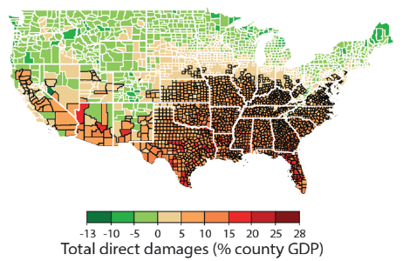
How Damages Will Vary in the US
Notes:
Hsiang, S., Kopp, R., Jina, A., Rising, J., Delgado, M., Mohan, S., Rasmussen, D.J., Muir-Wood, R., Wilson, P., Oppenheimer, M., Larsen, K., Houser, T., 2017. Estimating economic damage from climate change in the United States. Science 356, 1362-1369.
“County-level median values for average 2080 to 2099 RCP8.5 impacts. Impacts are changes relative to counterfactual “no additional climate change” trajectories.”

Slide 33
Adaptation Reduces Damages
Adaptation: costly action that reduce damages from climate change
The net damage cost to society is the cost of adaptation plus the cost of remaining damages
People and firms will take some actions on their own, up to the point where they find it worthwhile
Most adaptation requires government involvement due to its local public good nature (privately insufficient investment)

Slide 34

Individual-Level Adaptation
Perhaps you…
  Stay inside more.
  Turn on the air conditioning.
Farmers may:
  Plant at different times.
  Plant new crops.
Businesses may:
  Give outdoor workers water / shade breaks.
Everyone might:
  Think about moving to a safer place.

Slide 35
Public Adaptation
Governments can help:
  When collective action is less costly than everyone acting alone
  When individual action is not possible or likely
  When some people can’t protect themselves
Sea walls
Ecosystems that provide protection
Policies that protect workers or low-income and vulnerable populations
Planned retreat (moving a community)

Slide 36
Reducing Emissions

Slide 37
Global Net Emissions
Are What We Care About
For climate impacts, we don’t care where they are emitted, only how much
  There may be other local impacts
Gross emissions (greenhouse gas sources): how much greenhouse gases (including CO2) we put out
Greenhouse gas sinks: ways to pull CO2 out of the air
  Existing: oceans, forests (1/3 of land-based sink is Amazon)
  Increase sequestration by planting trees, or other measures

Slide 38
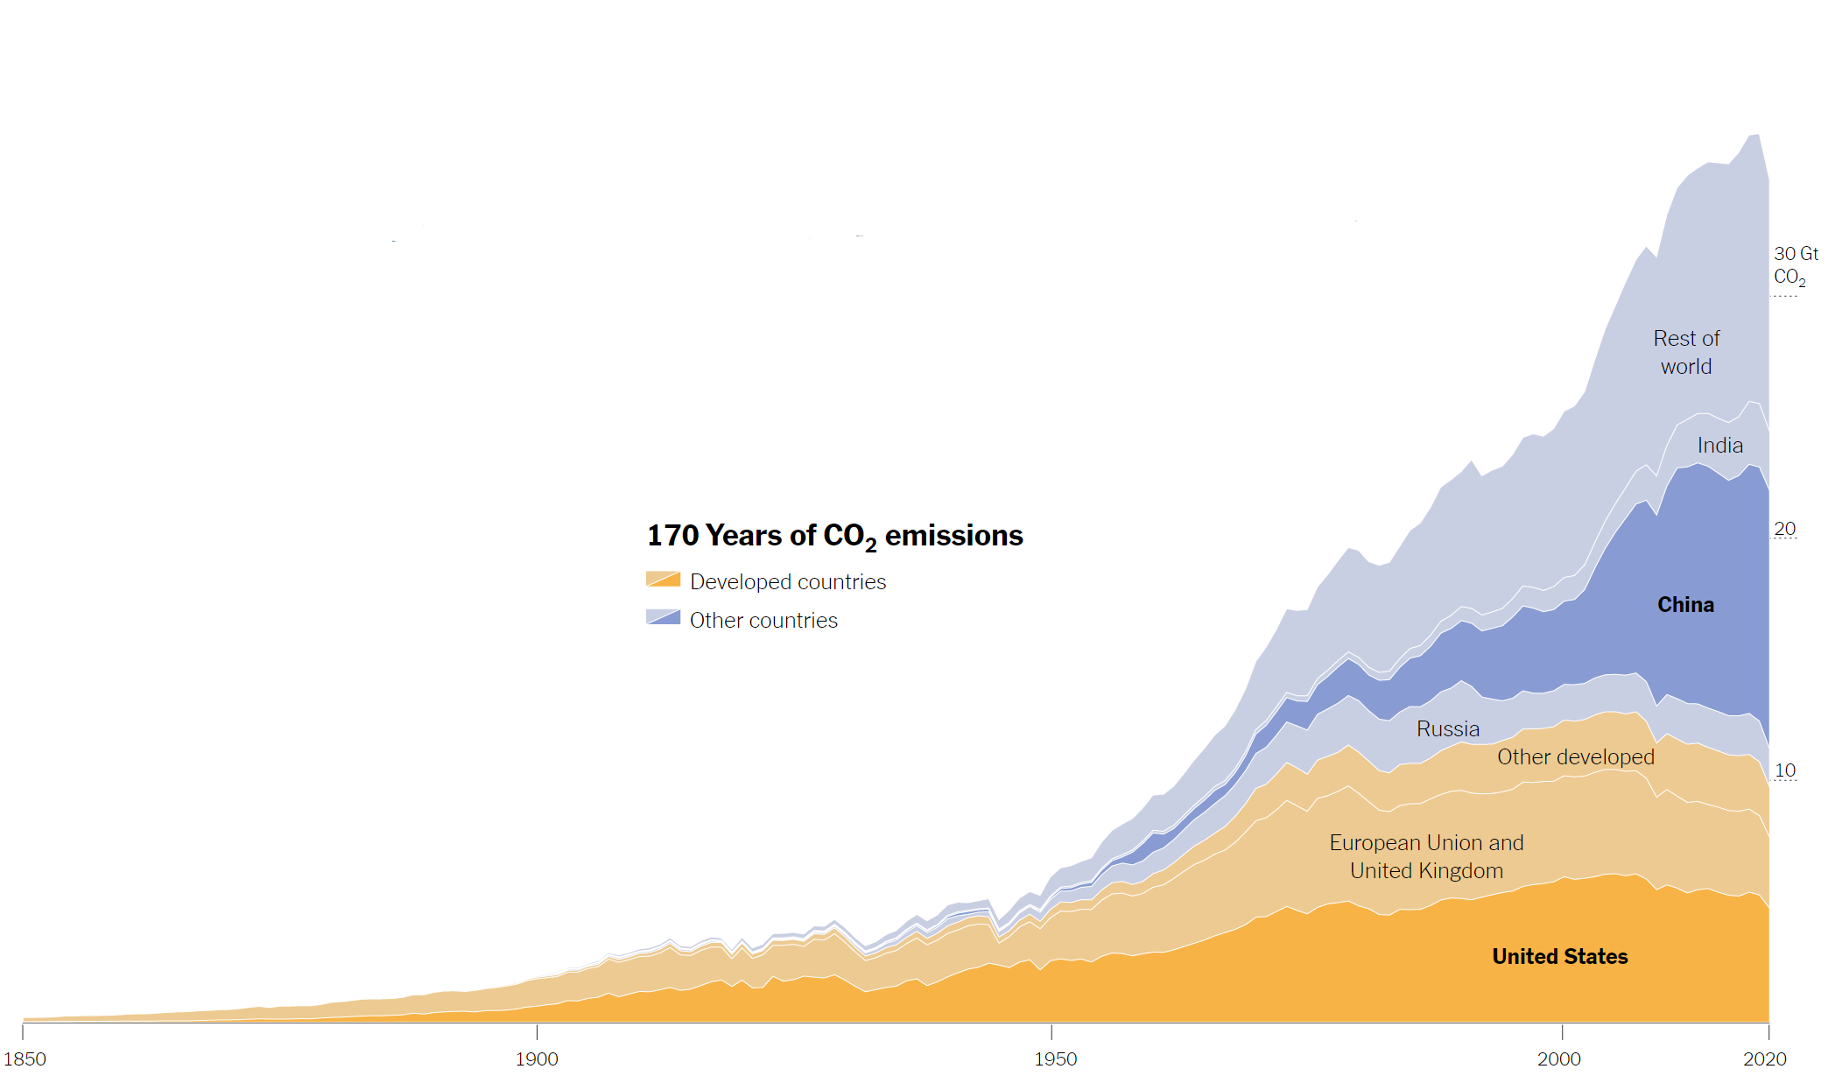
Sources of the Global Flow of Emissions
Notes:
https://www.nytimes.com/interactive/2021/11/12/climate/cop26-emissions-compensation.html

Slide 39
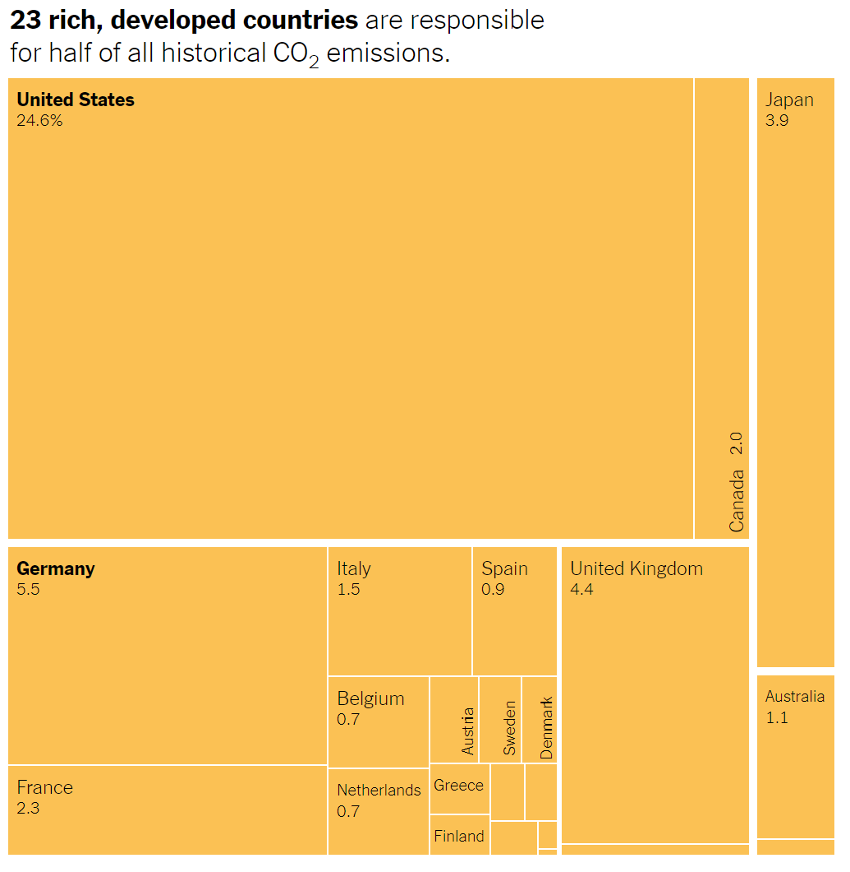
Sources of the Global Stock of Emissions
Notes:
https://www.nytimes.com/interactive/2021/11/12/climate/cop26-emissions-compensation.html

Slide 40
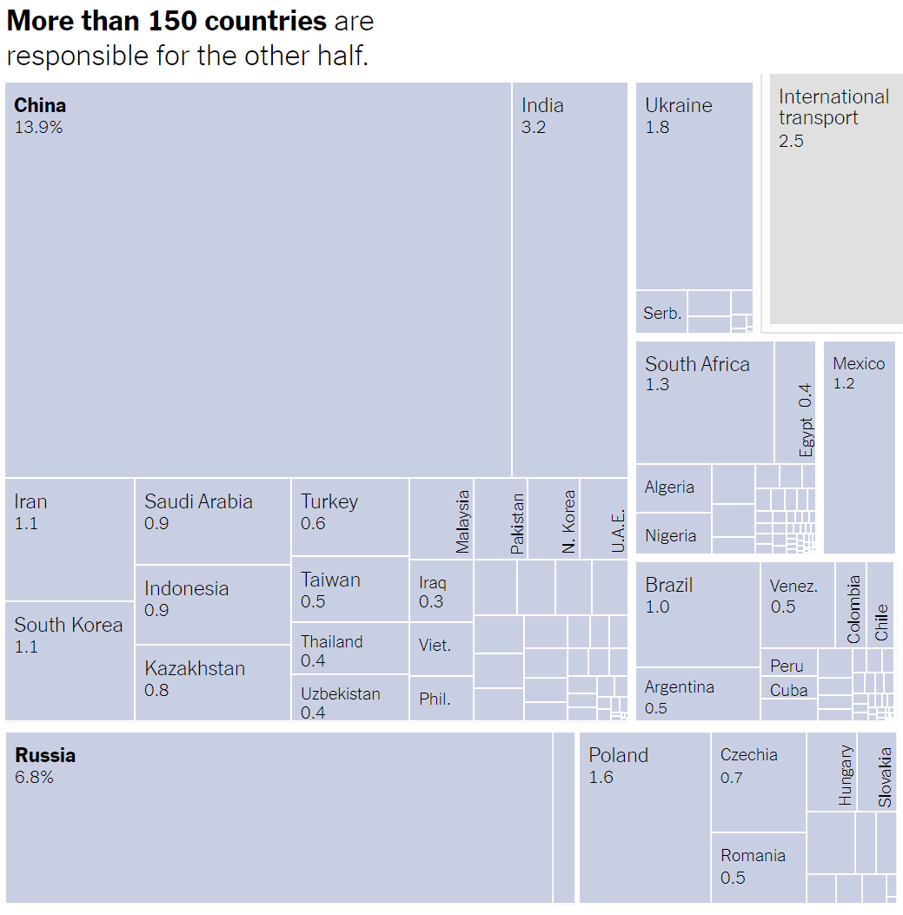
Sources of the Global Stock of Emissions
Notes:
https://www.nytimes.com/interactive/2021/11/12/climate/cop26-emissions-compensation.html

Slide 41
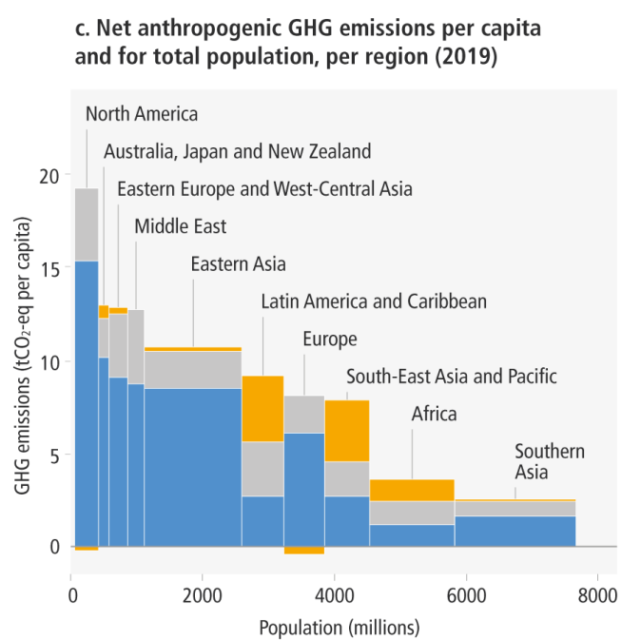
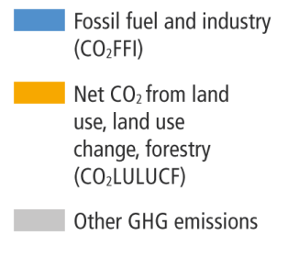
How Does This Look Per Capita (Per Person)?
Notes:
https://www.ipcc.ch/report/ar6/wg3/ Summary for Policymakers Figure SPM.2

Slide 42
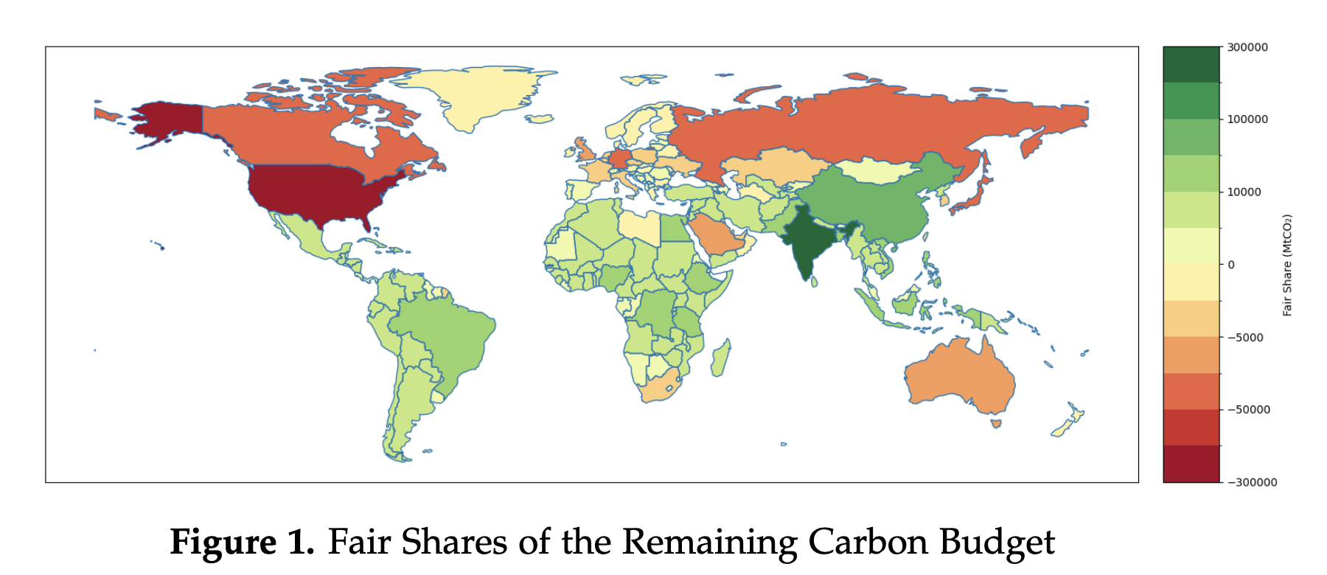
What does it mean for future emissions?

Slide 43
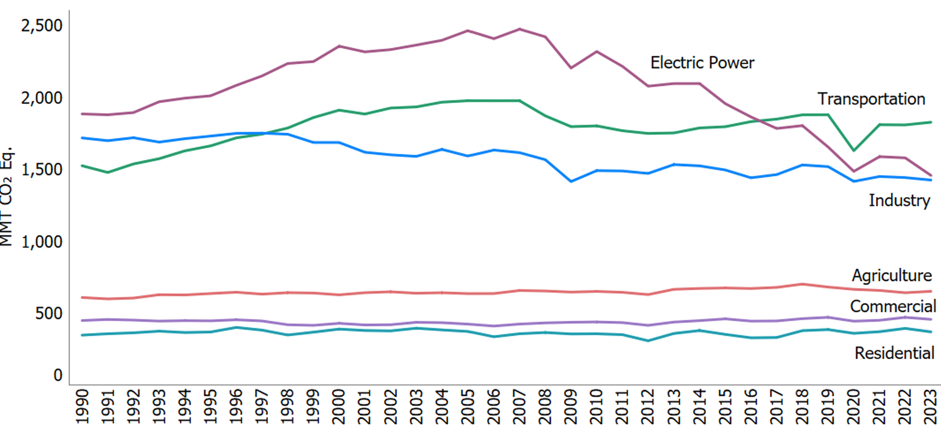
Total US Greenhouse Gas Emissions by Economic Sector through 2023
Notes:
https://www.edf.org/freedom-information-act-documents-epas-greenhouse-gas-inventory?tab=executive_summary
formerly:
https://www.epa.gov/ghgemissions/sources-greenhouse-gas-emissions

Slide 44
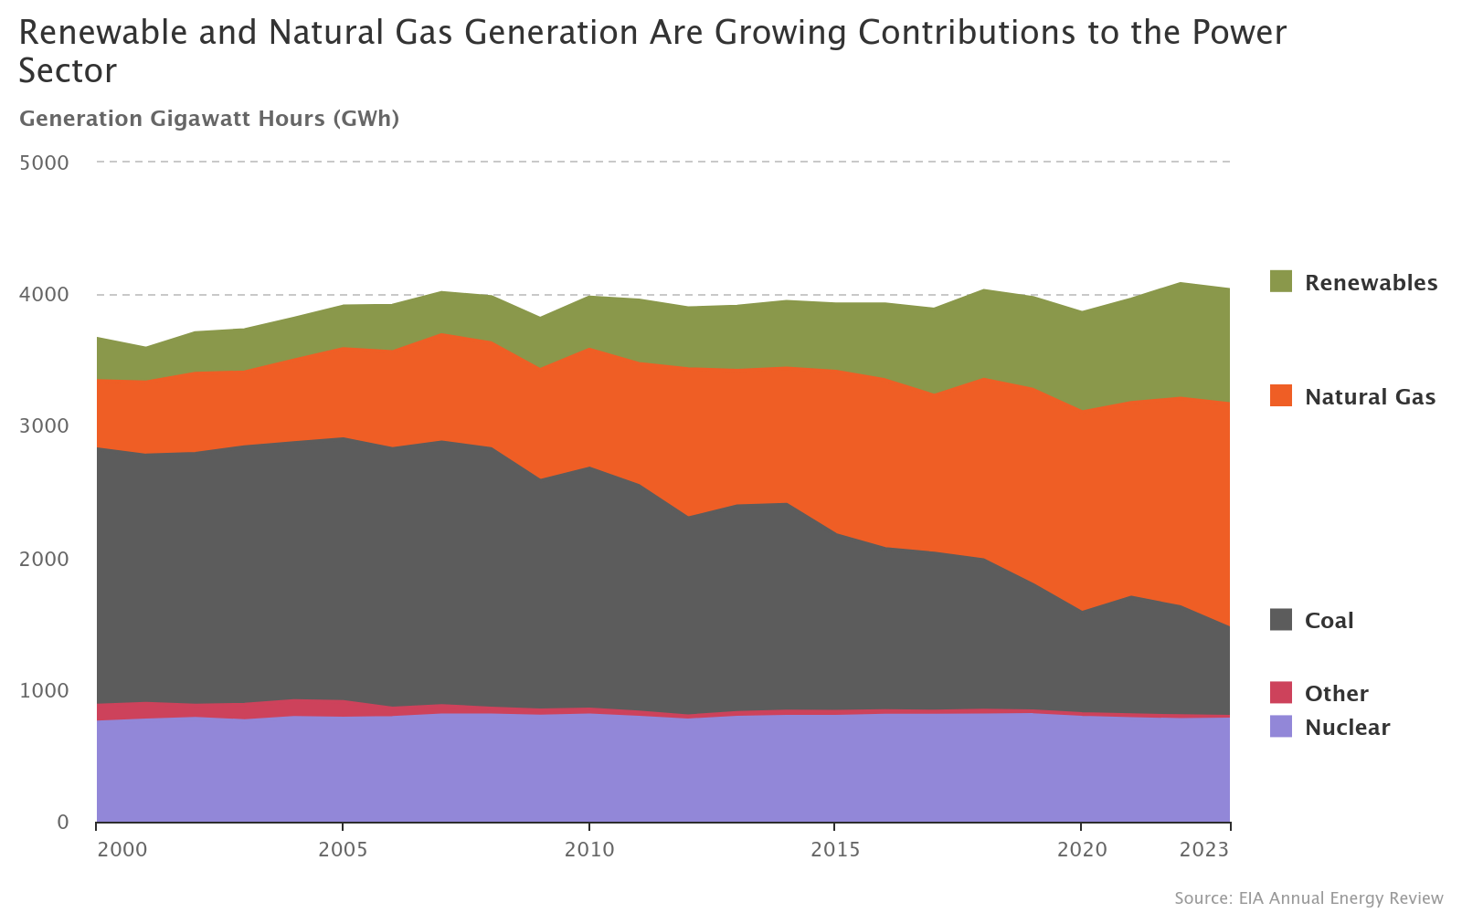
US Electricity Sources for the Last 25 Years
Notes:
Source: https://www.epa.gov/power-sector/power-sector-evolution

Slide 45
Which Emissions Should We Cut?
List all possible ways to reduce emissions
Figure out how much each can reduce in total
Figure out how much each costs per unit of emissions reduced
Line them up in order: cheapest to costliest (“marginal abatement cost curve”)
  → Tackle first the cheapest per unit of emissions!

Slide 46
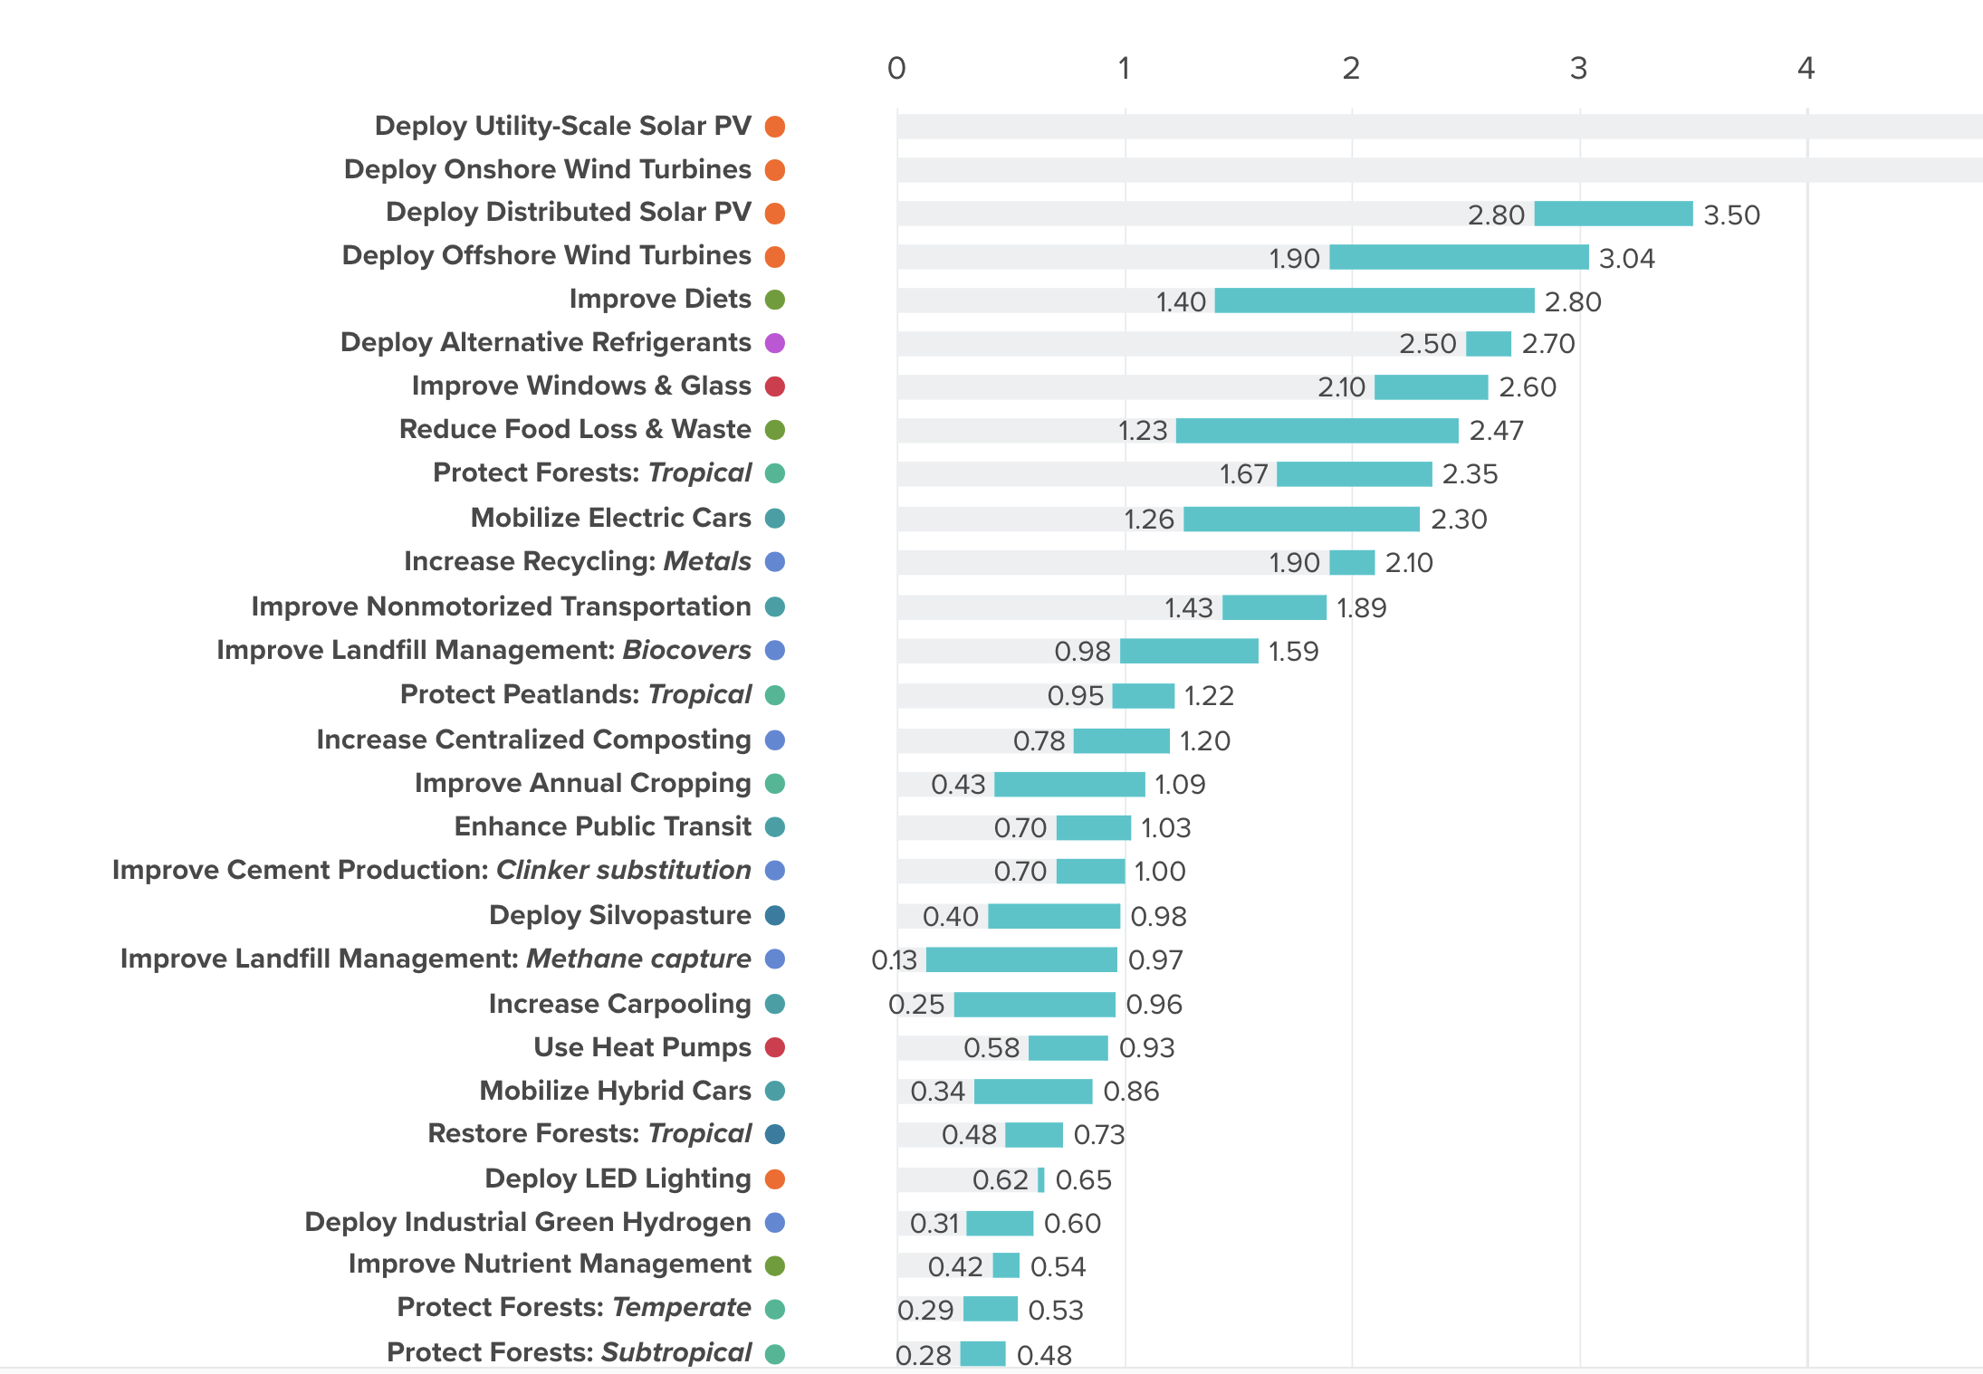
Ranking solutions more generally
Project Drawdown compares more than 100 climate solutions
Solar and wind are 4 top solutions
Improving diets is the biggest food solution: 1.4–2.8 billion tonnes CO₂-eq a year
Reducing food loss and waste is close behind, and it saves money
Both rank alongside clean electricity and electric cars
Source: Project Drawdown, Drawdown Explorer (drawdown.org/explorer)
Emissions avoided, billion tonnes CO₂-eq per year (low–high estimate). Top two bars run off the scale.
Notes:
NEW (Hale). Screenshot: Project Drawdown, Drawdown Explorer, https://drawdown.org/explorer — solutions ranked by estimated emissions reductions (Gt CO2-eq per year, low–high range).
Improve Diets (1.40–2.80) is the largest food solution; Reduce Food Loss & Waste (1.23–2.47) is also 'Highly Recommended' and comes with cost savings. Utility-scale solar and onshore wind run off the chart's scale.

Slide 47
Costs and Barriers Can Be Difficult to Assess
Difficult to project future costs for new technology
  Costs of renewables have been dropping fast
Investments in research and development and infrastructure (e.g., EV charging) can lower future costs
Barrier to expanding renewable energy: intermittency
  Battery technology under development

Slide 48
Geoengineering and Carbon Capture
Technical pathways to reduce climate change without reducing emissions
Carbon capture: captures CO2 emissions and stores them or “utilizes” them (for energy, pressure, etc.)
  Still very expensive
Solar geoengineering: make the atmosphere reflect more light to regain earlier thermal balance
  Totally theoretical
  Potentially risky

Slide 49
Climate and the Food System

Slide 50
Food Is Both a Cause and a Victim
~1/3
of global greenhouse gas emissions come from the food system: farming, land clearing, processing, transport and waste
~32%
of human-caused methane comes from livestock (digestion and manure)
21%
lower global farm productivity since 1961 because of climate change
Cause: what we eat changes the climate. Victim: climate change makes food harder to grow.
Sources: Crippa et al. (2021), Nature Food; UNEP & CCAC, Global Methane Assessment (2021); Ortiz-Bobea et al. (2021), Nature Climate Change.
Notes:
NEW (Hale). Estimates of the food system's share range from about 26% (Poore & Nemecek 2018) to 34% (Crippa et al. 2021); the difference is mostly how much deforestation is attributed to agriculture. See https://ourworldindata.org/greenhouse-gas-emissions-food
Livestock ~32% of human-caused methane: UNEP, https://www.unep.org/news-and-stories/story/methane-emissions-are-driving-climate-change-heres-how-reduce-them
21%: Ortiz-Bobea et al. (2021), 'Anthropogenic climate change has slowed global agricultural productivity growth,' Nature Climate Change 11, 306–312.

Slide 51
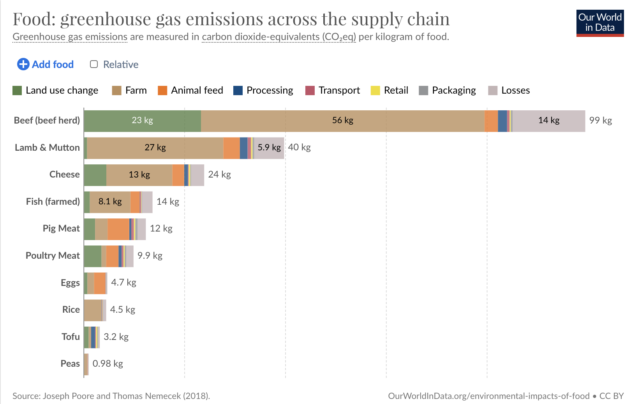
Sources of Food Emissions
Beef emits about 100 times more per kilogram than peas
Most emissions happen on the farm and from clearing land, not from transport
Methane is ~80× as potent as CO₂ over 20 years but fades in about a decade, so cutting it slows warming fast
Notes:
NEW (Hale). Chart: Our World in Data, based on Poore & Nemecek (2018), Science. https://ourworldindata.org/environmental-impacts-of-food
Methane: ~80x the warming power of CO2 over 20 years, but breaks down in about a decade, so cutting it slows warming quickly (UNEP).

Slide 52
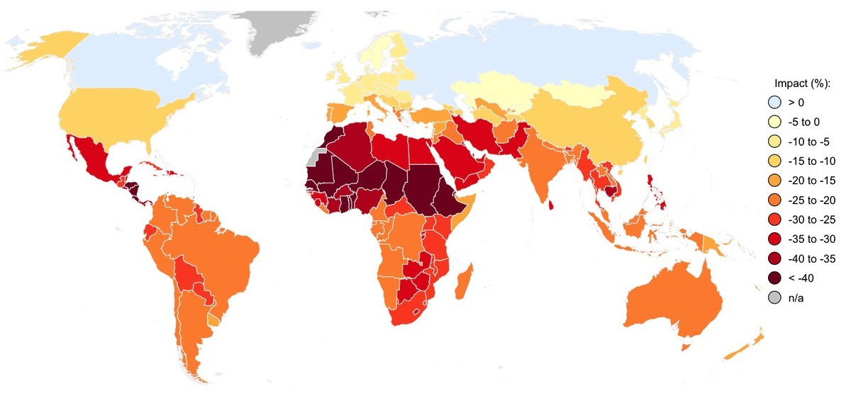
Climate Change Hurts Farms,
Especially in Poorer Places
Hotter, drier places, often lower-income countries, lose the most farm productivity
Higher food prices and lower farm incomes hit those who can least afford it
Farmers adapt (new seeds, irrigation, planting dates), but adaptation costs money
Estimated effect of climate change on agricultural productivity (total factor productivity), %
Notes:
NEW (Hale). Map from G. Hale, 'Climate Change and the Global Food System' (Earth Day 2024). Related evidence: Ortiz-Bobea et al. (2021), Nature Climate Change — climate change has reduced global agricultural productivity growth by about 21% since 1961, with larger losses in warmer regions such as Africa, Latin America and the Caribbean.
Speaker point: this is a climate-justice issue — the countries that emitted least are losing the most food-producing capacity.

Slide 53
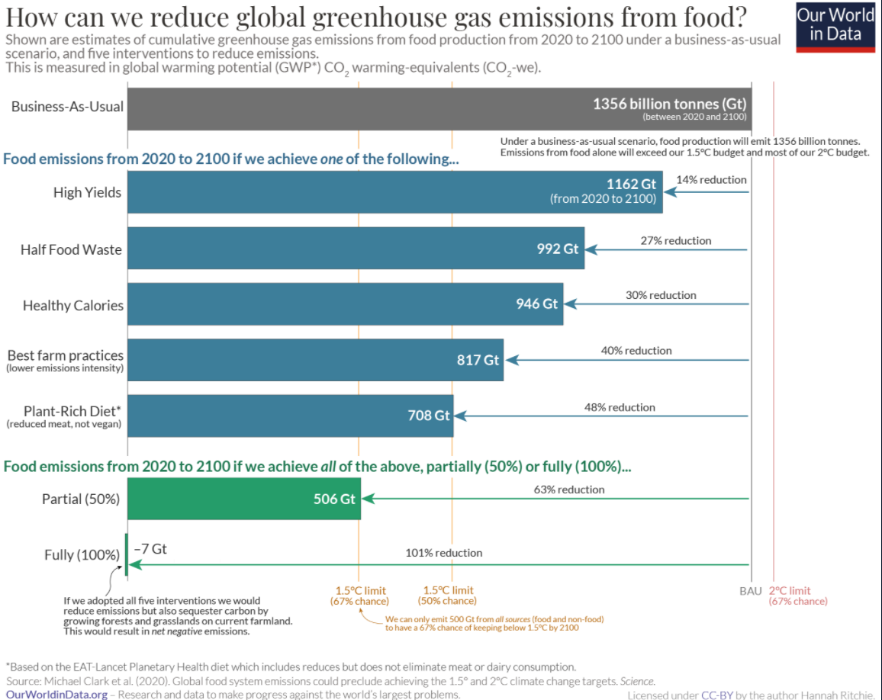
Cutting Food Emissions
Waste less: about 1/5 of food available to consumers is wasted; food loss and waste cause up to 10% of global emissions
Shift diets toward plants: cuts food emissions by about half (not vegan, just less meat)
Better farm practices and new alternative proteins
Economist’s toolkit:
put a price on methane
redirect farm subsidies toward low-emission foods
fund research and development
Notes:
NEW (Hale). Chart: Our World in Data (H. Ritchie), based on Clark et al. (2020), Science, 'Global food system emissions could preclude achieving the 1.5° and 2°C climate change targets.'
Food waste: UNEP Food Waste Index Report 2024 — 1.05 billion tonnes wasted in 2022 (19% of food available to consumers), plus ~13% lost in the supply chain (FAO); food loss and waste generate up to 10% of global GHG emissions. https://news.un.org/en/story/2024/03/1147036

Slide 54
Climate Change Policy

Slide 55
Policies That Reduce Emissions Directly
Command and control regulation
  Emissions standards or limits (e.g., Clean Water Act discharge limits)
  Tech standards (e.g., require scrubbers on power plants)
  Bans (e.g. no gas appliances in new residential developments)
Incentive-based policies
  Putting a price on emissions – leveling the playing field!
    Tax or cap & trade
    Subsidizing green energy (e.g., feed-in tariffs)

Slide 56
Command and Control vs. Incentive-Based Regulation
Efficiency
  Both can achieve the same amount of emissions reduction.
  Incentive-based policies can achieve emissions reduction at much lower cost.
Equity
  Both have may regressive impacts (low-income families bear costs that are a larger percent of their incomes vs hi-income families)
    However, new evidence increasingly questions this.
    Cost of inaction is also regressive
  Cap and trade and carbon tax can generate revenues, Command and control regulations do not.

Slide 57
How Does a Carbon Tax Work?
Choose activities to be covered (e.g., electricity sector, all emitters, etc.).
Set tax level.
  Optimally, it represents the social cost of polluting.
Polluters must pay a tax for every unit emitted.
  Polluters with low abatement costs will abate to avoid the tax
  Polluters with high abatement costs will pollute and pay the tax

Slide 58
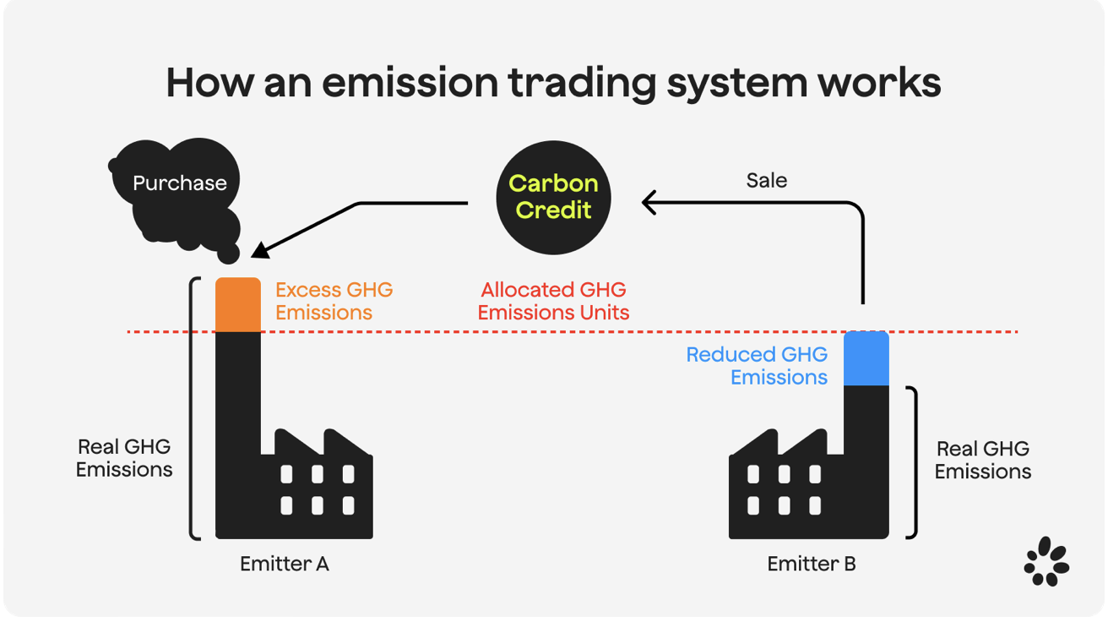
How Does Cap and Trade Work?
Choose activities to be covered
Set maximum emissions level (“cap”) to determine # of permits issued
  Can be auctioned off or given to polluters
Every polluter in a covered sector must have a permit for every unit of pollution
Polluters buy and sell (“trade”) permits on a market as they wish.

Slide 59
Examples of Other Policies that Reduce Emissions
Research and development subsidies
Renewable energy mandates (e.g., renewable portfolio standards)
Energy efficiency mandates and
Grid / infrastructure improvements
Public transportation
Land use / zoning policies

Slide 60
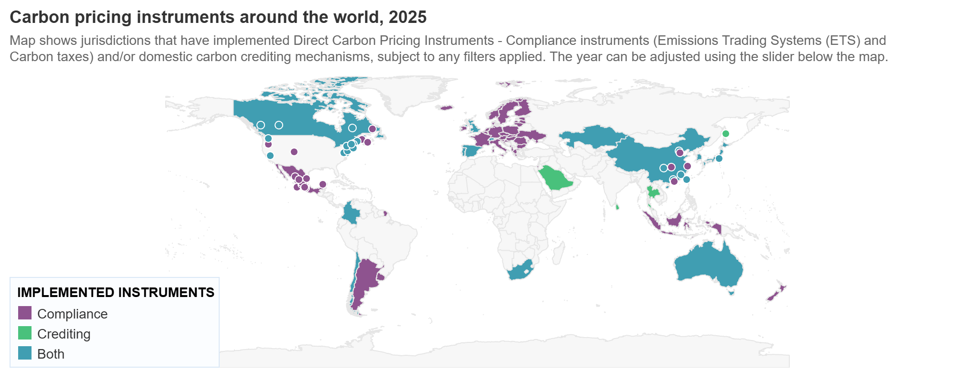
Incentive-Based Climate Policies Right Now
Source: World Bank Carbon - Pricing Dashboard
Notes:
https://carbonpricingdashboard.worldbank.org/

Slide 61

California’s Cap and Trade System Since 2013
0.7%
of global greenhouse gas emissions

Slide 62
California’s AB32: Global Warming Solutions
Passed in 2006
California’s goals:
  Back to 1990 levels by 2020 (met in 2016)
  40% below 1990 levels by 2030 (SB 32)
  Net-zero emissions by 2045 (AB 1279)
California’s Tools:
  Cap-and-Trade, renamed “Cap-and-Invest” and extended to 2045 (2025)
  Renewable Portfolio Standard
  Clean Cars Program
  Low Carbon Fuel Standard

Slide 63
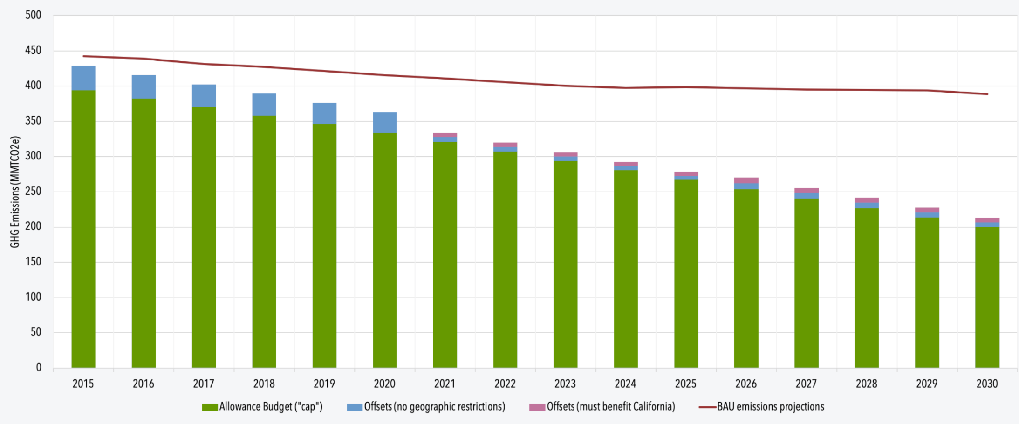
Emissions Cap Designed to Tighten over Time
Notes:
https://www.c2es.org/content/california-cap-and-trade/

Slide 64
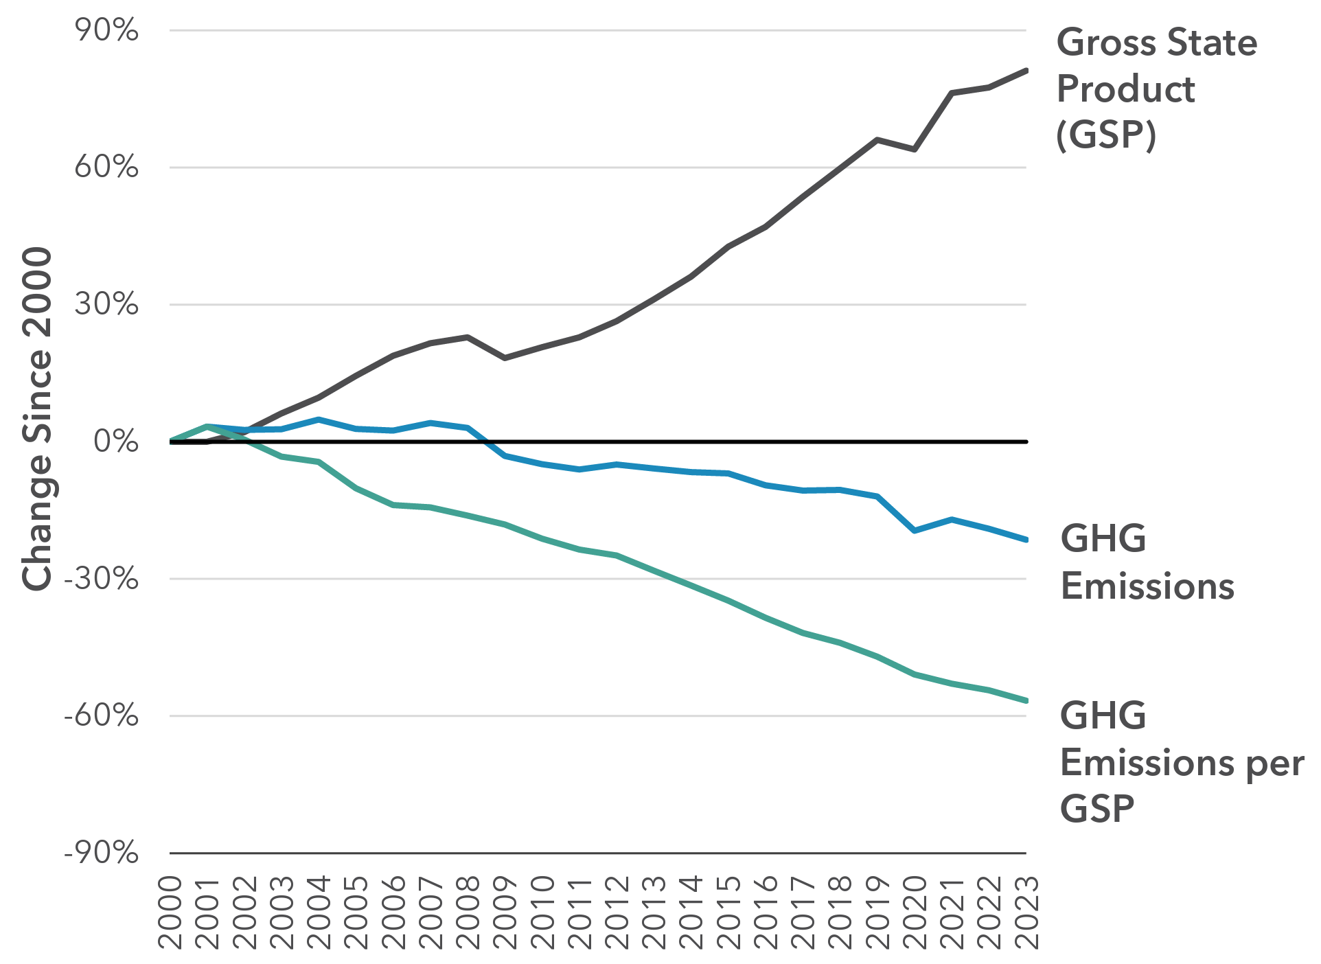
Changes in California Gross State Product and
GHG Emissions since 2000
Cap & Trade ->
Notes:
Source: https://ww2.arb.ca.gov/ghg-inventory-data

Slide 65
Climate and Finance

Slide 66
Climate Risk Is Financial Risk
Physical risk
Floods, fires, storms and heat damage homes, farms and businesses → losses for households, insurers, banks and investors
Transition risk
New policies, technologies and tastes can make polluting assets lose value (“stranded assets,” e.g., coal plants) → losses for their owners and lenders
Delay doesn’t avoid transition risk, it raises it:
the longer we wait, the faster and costlier the shift has to be.
Notes:
NEW (Hale). Adapted from G. Hale, Econ 241 (UCSC), lecture on ESG and climate risk.
Physical risk = losses directly from climate change (sea level rise, heat, extreme weather). Transition risk = losses from the shift to a low-carbon economy (repricing, stranded assets, obsolete technology).

Slide 67
Insurance Is on the Front Line
Insurers are raising premiums or leaving high-risk areas (California, Florida, Louisiana)
State “insurer of last resort” plans are growing → risk shifts to other policyholders and taxpayers
Premiums that reflect risk send a useful price signal, but raise affordability concerns and can lower home values
Mortgages need insurance → climate risk spreads to banks and the wider financial system
~$40B
estimated insured losses, Jan. 2025 Los Angeles fires
+43%
growth in California’s FAIR Plan, Sept. 2024 – Dec. 2025
Notes:
NEW (Hale). LA fires (~$40B insured losses, ~12,000 homes destroyed) and FAIR Plan growth (+43% Sept 2024–Dec 2025): Insurance Business, March 15, 2026, https://www.insurancebusinessmag.com/us/news/catastrophe/californias-fair-plan-carries-growing-load-as-insurers-retreat-beyond-wildfire-zones-568596.aspx
Insurer retreat in CA, FL, LA: Environmental Law Institute (2024), coastal property insurance briefing (also used in G. Yohe's NEED deck).

Slide 68
Interest Rates and the Green Transition
Solar and wind cost a lot to build but little to run, so the cost of borrowing matters a lot
As interest rates rose after 2022, solar power got more expensive than gas power did
Tax credits softened the blow (+12% instead of +18%)
Central-bank decisions and lending costs shape how fast the transition happens
Increase in U.S. electricity cost from higher interest rates
Solar
+18%
Solar, with tax credits
+12%
Gas power plant
+9%
Source: Wilson, Shrimali & Caldecott (2025), “Financing costs and the competitiveness of renewable power,” iScience. Real interest rate rising from −0.5% to 2.5%.
Notes:
NEW (Hale). Wilson, Shrimali & Caldecott (2025), iScience 28(12): 113777. Modeling a U.S. real-rate rise from -0.5% to 2.5%: solar PV levelized cost +18% without tax credits (+12% with), combined-cycle gas +9%. U.S. cost of debt for solar/wind project finance rose from under 2% (2021) to 6.5% (2024).

Slide 69
Following the Climate Money
$1.9T
global climate finance in 2023, a record
$6T+
per year needed to meet climate goals
$4T+
in green bonds issued to date
$107B
raised by carbon prices worldwide in 2025
Rich countries pledged $300B a year for developing countries by 2035 (COP29) and to triple adaptation finance (COP30)
Private money now provides over half of climate finance, but voluntary bank pledges have faded (the Net-Zero Banking Alliance shut down in 2025)
Sources: Climate Policy Initiative (2025); Climate Bonds Initiative (2026); World Bank, State and Trends of Carbon Pricing (2026); UNFCCC.
Notes:
NEW (Hale). $1.9T in 2023, private finance >$1T, ~$6T/yr needs (most conservative estimate): Climate Policy Initiative, Global Landscape of Climate Finance 2025.
Green bonds: >$4T cumulative; aligned green/social/sustainability debt $6.8T by end-2025; 2025 green bond issuance $653.5B — Climate Bonds Initiative press release, March 17, 2026.
Carbon pricing: 87 instruments covering ~29% of global emissions; >$107B revenue in 2025; average price ~$21/tCO2e — World Bank, May 19, 2026.
COP29 (Baku, 2024): New Collective Quantified Goal of $300B/yr by 2035. COP30 (Belém, 2025): call to triple adaptation finance by 2035.
Net-Zero Banking Alliance ceased operations Oct 3, 2025, after major U.S., Canadian and European banks left.

Slide 70
Summary
Climate change is real, is caused by human actions, and has impacts we’re already feeling.
This problem won’t solve itself; we need policy intervention, and fast.
Smart policy can reduce greenhouse gas emissions by the right amount and at the lowest possible cost.
We also need policies to help with adaptation and support those bearing the greatest damages.
The food system is a big, often overlooked source of emissions, and it is highly exposed to climate damages.
Finance prices climate risk and pays for the transition: insurance and interest rates matter.

Slide 71


The Future of Money
Geof Woglom
Associate Director, NEED

Slide 72
Let’s Hear from You!
Questions?
Galina Hale
gbhale@ucsc.edu
Contact NEED: Info@NEEDEcon.org
Support NEED: www.NEEDEcon.org/donate.php

