Slide 1
Osher Lifelong Learning Institute, Fall 2023
Contemporary Economic Policy
Dominican University
Fall, 2023
Jon Haveman, Ph.D.
National Economic Education Delegation

Slide 2
Available NEED Topics Include:
US Economy
Healthcare Economics
Climate Change
Economic Inequality
Economic Mobility
Trade and Globalization
Minimum Wages
Immigration Economics
Housing Policy
Federal Budgets
Federal Debt
Black-White Wealth Gap
Autonomous Vehicles
US Social Policy

Slide 3
Course Outline
Contemporary Economic Policy
  Week 1 (11/1): Economic Update (Geoffrey Woglom Amherst College)
  Week 2 (11/8): Healthcare Economics (Jon Haveman, NEED)
  Week 3 (11/15): Climate Change Economics (Jon Haveman)
  Week 4 (11/22): Autonomous Vehicles (Jon Haveman)

Slide 4




Climate Change Economics
OLLI – Dominican University
November 15, 2023

Slide 5
Credits and Disclaimer
This slide deck was authored by:
  Shana McDermott, Trinity University
  Sarah Jacobson, Williams College
  Sharon Shewmake, Western Washington University
This slide deck was reviewed by:
  Jason Shogren, University of Wyoming
  Walter Thurman, North Carolina State University
Disclaimer
  NEED presentations are designed to be nonpartisan.
  It is, however, inevitable that the presenter will be asked for and will provide their own views.
  Such views are those of the presenter and not necessarily those of the National Economic Education Delegation (NEED).

Slide 6
Outline
Economic Building Blocks
Climate Change
Impacts of Climate Change
Reducing Emissions
Climate Change Policy
Policy in Action

Slide 7
Economic Building Blocks

Slide 8
How Can Economists Help
Fight Climate Change?
By measuring climate change damages and estimating the costs of fighting climate change.
By assessing behavioral reactions to climate change.
By designing smart policies that minimize costs to society.

Slide 9
Econ 101: When Everything Is Simple,
No Regulation Is Needed for Efficiency
Simple transactions: buyer and seller feel all costs and benefits of sales
They choose based on the costs & benefits they feel
→ Efficient number of transactions! (Maximizes social benefits)

Slide 10
When Our Decisions Affect Others,
We Need Regulation
Pollution causes an EXTERNALITY: a side effect (here, a cost) that affects someone else
  Polluting things have an “unfair cost advantage” because part of cost is offloaded on others
  → Too much pollution is generated
  Regulation limiting pollution has net benefits
The “efficient” amount of pollution balances costs & benefits of pollution

Slide 11
How Economists Decide How Much to Fight
Climate Change: Cost Benefit Analysis
Abating greenhouse gas emissions is costly…
… but without action, climate change damages are even more costly.
Goal is not zero emissions, but efficient level that achieves a balance.
Expected costs of reducing emissions
Expected damages from allowing climate change

Slide 12
Cost-Benefit Analysis of
Fighting Climate Change
Most economic models suggest the costs of keeping warming below 2°C are relatively small, amounting to 1-4% of GDP by 2030.
Costs of acting to keep warming below 2°C are almost certainly less than future economic damages they would avoid.
  Damages estimated to be between: 7-20% of worldwide GDP.

Slide 13
Climate Change

Slide 14
A Climate Change Ladder
Emissions
Mitigation (a.k.a. Abatement)
Adaptation
Damages

Slide 15
The Atmospheric Greenhouse Effect
Sun
Atmosphere
Energy reflected back
onto earth
Energy reflected back
into space

Slide 16


Greenhouse Gas Emissions 1990-2019
Source: IPCC
Notes:
https://www.ipcc.ch/report/ar6/wg3/ Summary for Policymakers Figure SPM.1

Slide 17
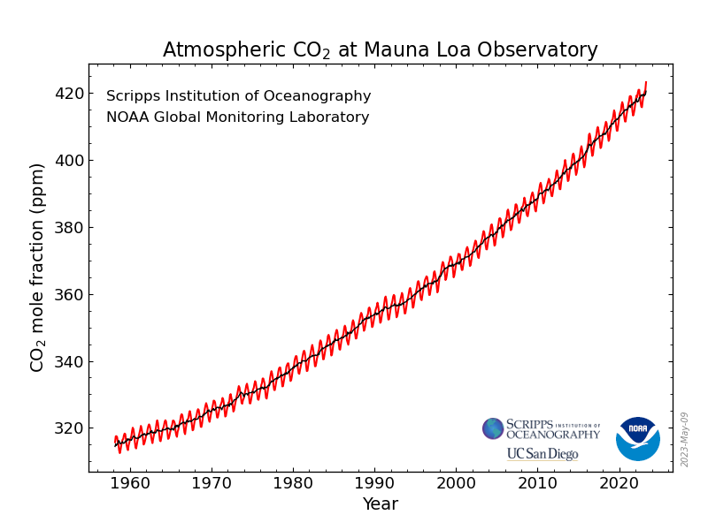
Atmospheric CO₂ Concentrations Up To Now
Source: NOAA
Notes:
https://gml.noaa.gov/ccgg/trends/

Slide 18
What Do Greenhouse Gas Emissions
Do to the Planet?
Increased temperatures
  Sea level rise
  Storm surges
Altered precipitation patterns
More variable weather
More / more powerful storms
Carbon dissolves in ocean

Slide 19
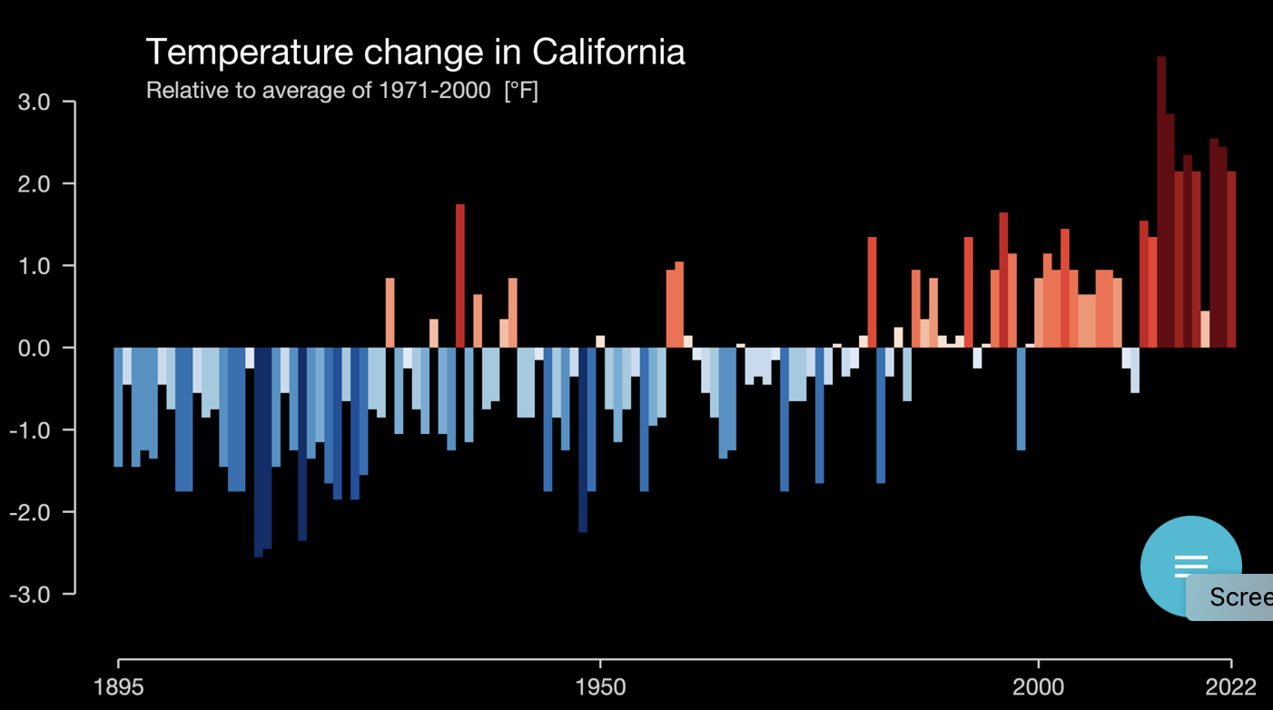
These Changes Are Already Underway
Use https://showyourstripes.info/ to see the temperature history of an area!
Here’s WA!
Notes:
New: https://showyourstripes.info/
Old: http://berkeleyearth.lbl.gov/city-list/

Slide 20
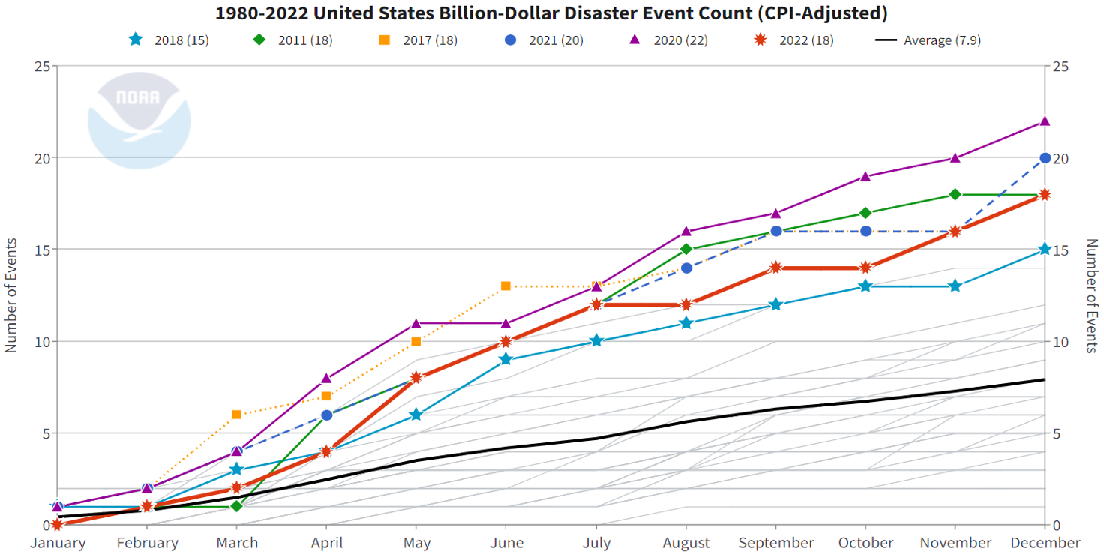
# of Billion $ Storms
2022

Slide 21
Impacts of Climate Change

Slide 22
How These Impacts Affect Humans
Agriculture
Fisheries
Coastal damages
Direct health effects, including sickness and death (temperature & drought; also pollution)
Indirect health effects (vector-borne disease)
Reduced fresh water availability
Wildfires
Shifting zones for important ecosystems, and desertification
Reduced worker productivity
Increased violence
Some of these may cause human migration and/or conflict
Notes:
This could be a series of slides with pictures for each one

Slide 23

Social Cost of Carbon
The expected cost of damages from each unit of greenhouse gas emissions.
Current EPA estimate: ~$51 per metric ton of CO₂
  About $157/car per year for an avg driver.
But in 2022 they put forward a proposal to raise it to $190!
Cost will increase over time.
Notes:
18.07 lbs/mile
2204.62 lbs/metric ton
1.8 cents/mile

Slide 24

How Damages Will Vary Globally:
Mortality as an Example
Notes:
Carleton et al. 2021: https://papers.ssrn.com/sol3/papers.cfm?abstract_id=3674927

Slide 25

How Damages Will Vary in the US
Notes:
Hsiang, S., Kopp, R., Jina, A., Rising, J., Delgado, M., Mohan, S., Rasmussen, D.J., Muir-Wood, R., Wilson, P., Oppenheimer, M., Larsen, K., Houser, T., 2017. Estimating economic damage from climate change in the United States. Science 356, 1362-1369.
“County-level median values for average 2080 to 2099 RCP8.5 impacts. Impacts are changes relative to counterfactual “no additional climate change” trajectories.”

Slide 26
Adaptation Reduces Damages
Adaptation: costly action that reduce damages from climate change.
The net damage cost to society is the cost of adaptation plus the cost of remaining damages.
People and firms will take some actions on their own, up to the point where they find it worthwhile.
Some adaptation requires government involvement.

Slide 27

Individual-Level Adaptation
Perhaps you…
  Stay inside more.
  Turn on the air conditioning.
Farmers may:
  Plant at different times.
  Plant new crops.
Businesses may:
  Give outdoor workers water / shade breaks.
Everyone might:
  Think about moving to a safer place.
Notes:
Could be one or several slides with images to represent

Slide 28
Public Adaptation
Governments can help:
  When collective action is less costly than everyone acting alone.
  When individual action is not possible or likely.
  When some people can’t protect themselves.
Sea walls
Ecosystems that provide protection
Policies that protect workers or low-income and vulnerable populations
Planned retreat (moving a community)
Notes:
Could be one or several slides with images to represent

Slide 29
Reducing Emissions

Slide 30
Global Net Emissions
Are What We Care About
For climate impacts, we don’t care where they are emitted, only how much
  There may be other local impacts
Gross emissions (greenhouse gas sources): how much greenhouse gases (including CO2) we put out
Greenhouse gas sinks: ways to pull CO2 out of the air
  Existing: oceans, forests
  Increase sinkage by planting trees, or other measures

Slide 31

Sources of the Global Flow of Emissions
Notes:
https://www.nytimes.com/interactive/2021/11/12/climate/cop26-emissions-compensation.html

Slide 32

Sources of the Global Stock of Emissions
Notes:
https://www.nytimes.com/interactive/2021/11/12/climate/cop26-emissions-compensation.html

Slide 33

Sources of the Global Stock of Emissions
Notes:
https://www.nytimes.com/interactive/2021/11/12/climate/cop26-emissions-compensation.html

Slide 34


How Does This Look Per Capita (Per Person)?
Notes:
https://www.ipcc.ch/report/ar6/wg3/ Summary for Policymakers Figure SPM.2

Slide 35
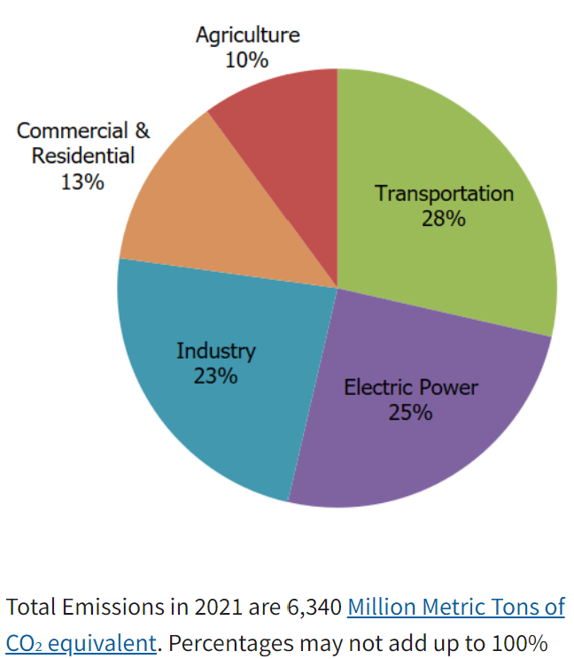
Total US Greenhouse Gas Emissions by Economic Sector in 2021
Notes:
https://www.epa.gov/ghgemissions/sources-greenhouse-gas-emissions

Slide 36

US Electricity Sources

Slide 37
Which Emissions Should We Cut?
List all possible ways to reduce emissions
Figure out how much each can reduce in total
Figure out how much each costs per unit of emissions reduced
Line them up in order: cheapest to costliest (“marginal abatement cost curve”)
  → Tackle first the cheapest ones!

Slide 38

Example Abatement Cost Curve
(Don’t trust these numbers, this is just to show the idea)
Notes:
McKinsey report: https://www.mckinsey.com/business-functions/sustainability/our-insights/impact-of-the-financial-crisis-on-carbon-economics-version-21

Slide 39
Costs and Barriers Can Be Difficult to Assess
Difficult to project future costs for new technology
  Costs of renewables have been dropping fast
Investments in research and development and infrastructure (e.g., EV charging) can lower future costs
Barrier to expanding renewable energy: intermittency
  Battery technology under development

Slide 40
Geoengineering and Carbon Capture
Technical pathways to reduce climate change without reducing emissions
Carbon capture: captures CO2 emissions and stores them or “utilizes” them (for energy, pressure, etc.)
  Not yet proven at scale, but getting there.
Solar geoengineering: make the atmosphere reflect more light to regain earlier thermal balance
  Totally theoretical
  Potentially risky

Slide 41
Climate Change Policy

Slide 42
Policies That Reduce Emissions Directly
Command and control regulation
  Emissions standards or limits (e.g., Clean Water Act discharge limits)
  Tech standards (e.g., require scrubbers on power plants)
Incentive-based policies
  Putting a price on emissions – leveling the playing field!
    Tax or cap & trade
    Subsidizing green energy (e.g., feed-in tariffs)

Slide 43
How Does a Carbon Tax Work?
Choose activities to be covered (e.g., electricity sector, all emitters, etc.).
Set tax level.
  Optimally, it represents the social cost of polluting.
Polluters must pay a tax for every unit emitted.
  Polluters with low abatement costs will abate to avoid the tax
  Polluters with high abatement costs will pollute and pay the tax

Slide 44
How Does Cap and Trade Work?
Choose activities to be covered (e.g., electricity sector, all emitters, etc.).
Set maximum emissions level (“cap”).
That many pollution permits are issued.
  Can be auctioned off or given to polluters
Every polluter in a covered sector must have a permit for every unit of pollution.
Polluters buy and sell (“trade”) permits on a market as they wish.
  Polluters with low abatement costs will make / save money by abating and selling / not buying permits
  Polluters with high abatement costs will buy permits and pollute

Slide 45
One Thing: Cap and Trade vs. Carbon Tax
Emissions regulations and Cap and Trade can work at cross purposes.
  Regulations that lower emissions from big polluters…
    Lower the demand for permits
    Lowers the price of permits
    Reduces incentives for other industries to cut emissions
Regulations can undermine the effectiveness of Cap and Trade.
The same is not true of a carbon tax.
  Though regulations might cut tax revenue, revenue is not the goal of the carbon tax.

Slide 46
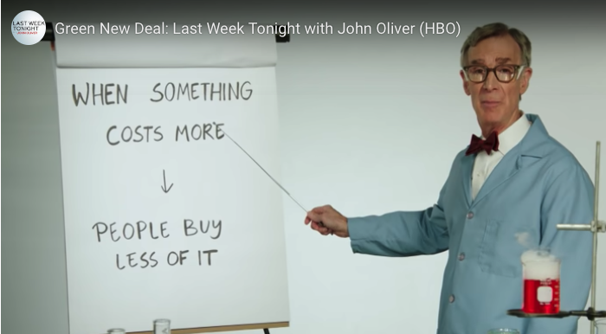
Both Policies are Work Through Prices
Full video: https://www.youtube.com/watch?v=XHK1OBSBpwc

Slide 47
Thoughts on Regulation vs Market-Oriented
Equity.
  Both types of policies might be regressive.
    Cap and Trade and a Carbon Tax can offset the regressivity.
    Regulations do not.
Efficiency.
  Market-oriented policies tend to achieve emissions reduction at much lower cost.
    Example: CAFÉ Standards vs Carbon Tax
      Tax is significantly more efficient.
      Why?

Slide 48
Efficiency: CAFÉ vs Carbon Tax
CAFÉ = Corporate Average Fuel Efficiency
  A fuel economy standard mandating that an auto‐maker’s vehicle fleet must meet minimum fuel economy standards.
Horse Race
  Tax on fuel applies to ALL vehicles, not just new.
  Rebound Effect:
    Driving a more efficient vehicle lowers the cost per mile driven
      leading to more miles driven.
  Slower turnover of inefficient vehicles: higher cost of new.
Summary
  A given level of emission reductions costs 3-14 times more with CAFÉ standards than under a comparable carbon tax.

Slide 49

Carbon Prices: the Good and Bad
Good:
  Provide price signal to lower emissions.
  They yield low-cost reductions in emissions.
  They spur innovation in clean technologies.
Bad:
  Firms might leave to flee regulation.
  It is necessary to monitor emissions.
  Potentially regressive
    Costs may weigh more heavily on low-income households.

Slide 50
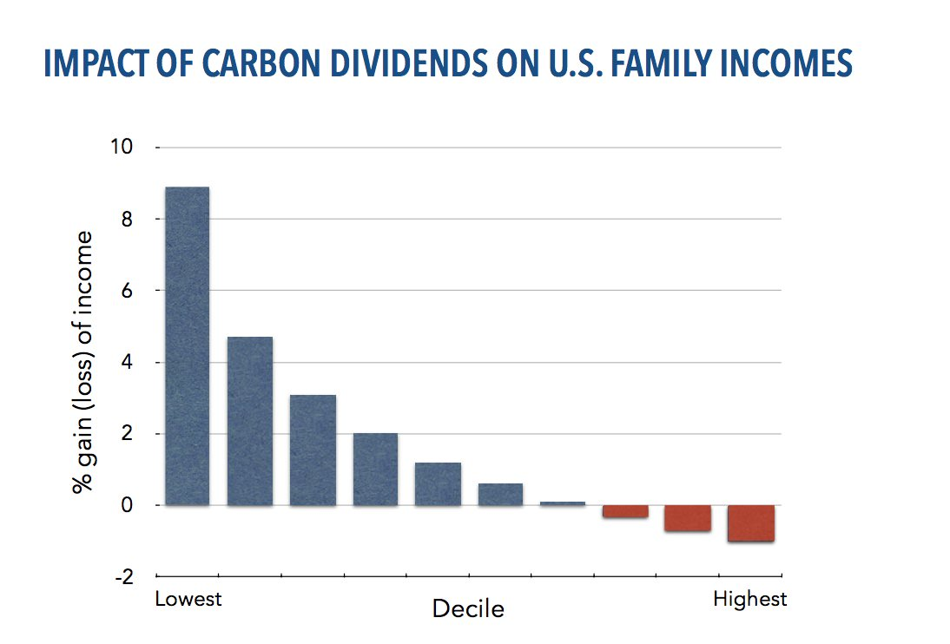
Revenue Dividend Eliminates Regressivity
Source: U.S. Treasury, 2017

Slide 51
Examples of Other Policies that Reduce Emissions
Research and development subsidies
Renewable energy mandates (e.g., renewable portfolio standards)
Energy efficiency mandates and subsidies (e.g. CAFE fuel economy standards)
Grid / infrastructure improvements
Public transportation
Land use / zoning policies

Slide 52
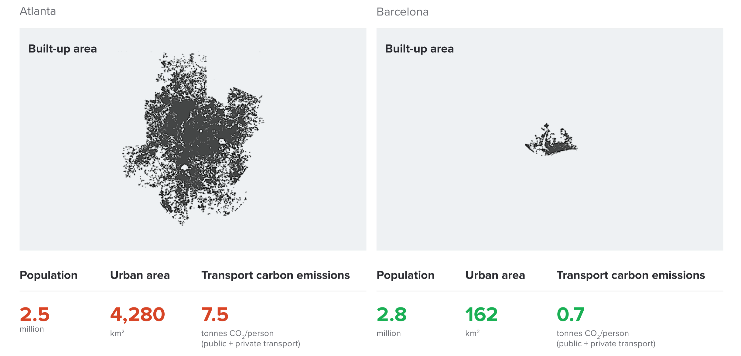
Atlanta and Barcelona Have Similar Populations but Very Different Carbon Productivity
Atlanta
Barcelona
Source: New Climate Economy Report, 2014
Notes:
Source: New Climate Economy Report

Slide 53
Climate Change Policy in Action

Slide 54
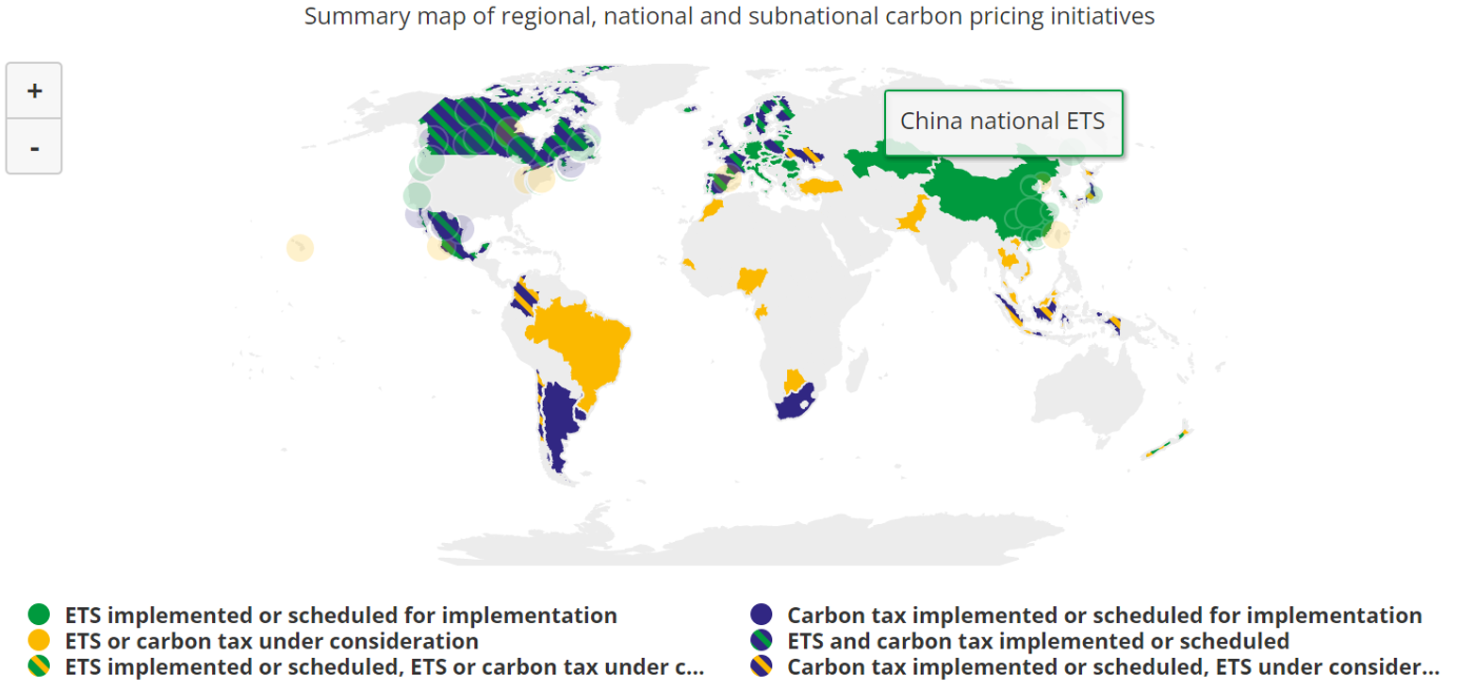
Incentive-Based Climate Policies Right Now
Source: World Bank Carbon - Pricing Dashboard
Notes:
https://carbonpricingdashboard.worldbank.org/

Slide 55

California’s Cap and Trade System Since 2012
0.7%
of global greenhouse gas emissions

Slide 56
California’s AB32: Global Warming Solutions
California’s goals:
  Reduce emissions to 1990 levels by 2020
    Was 14% under in 2020. Success!
  A 48% reduction in emissions from 1990 levels by 2030
California’s Tools:
  Cap and Trade
  Renewable Portfolio Standard
  Clean Cars Program
  Low Carbon Fuel Standard

Slide 57
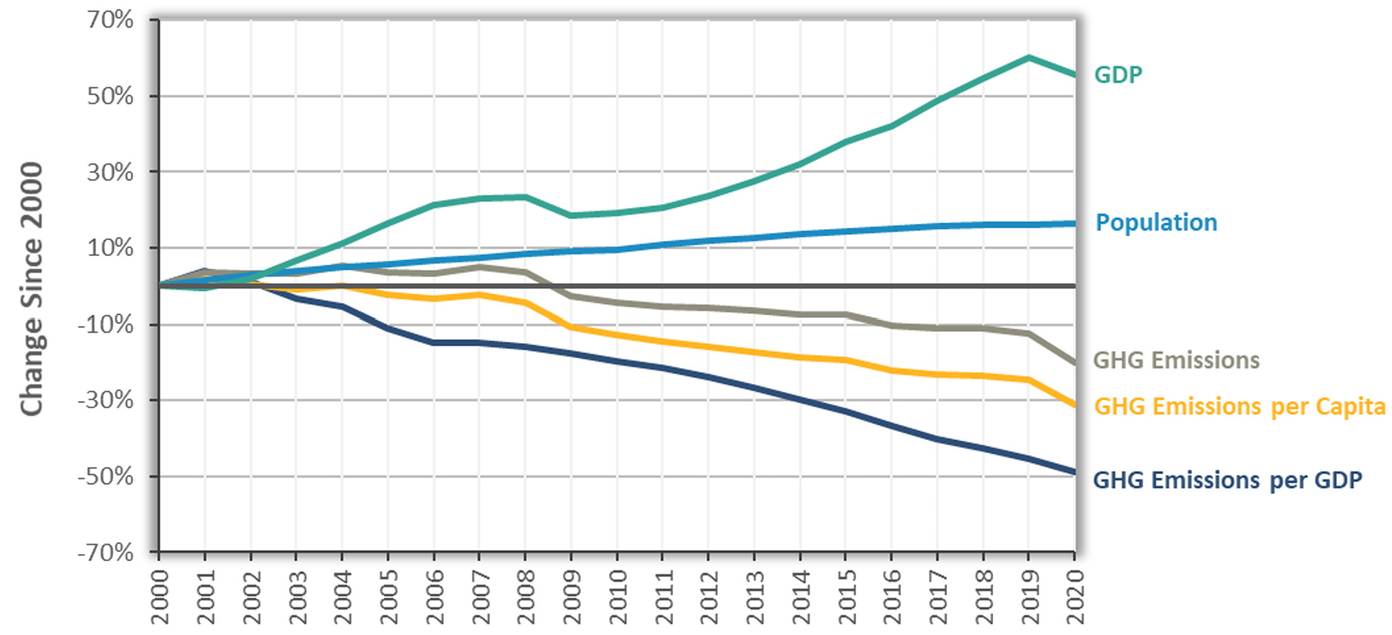
Change in California GDP, Population, and
GHG Emissions since 2000
Cap & Trade ->
Notes:
https://ww2.arb.ca.gov/ghg-inventory-data “California Greenhouse Gas Emissions for 2000 to 2020, Trends of Emissions and Other Indicators”

Slide 58
Concern: So much uncertainty…

Slide 59
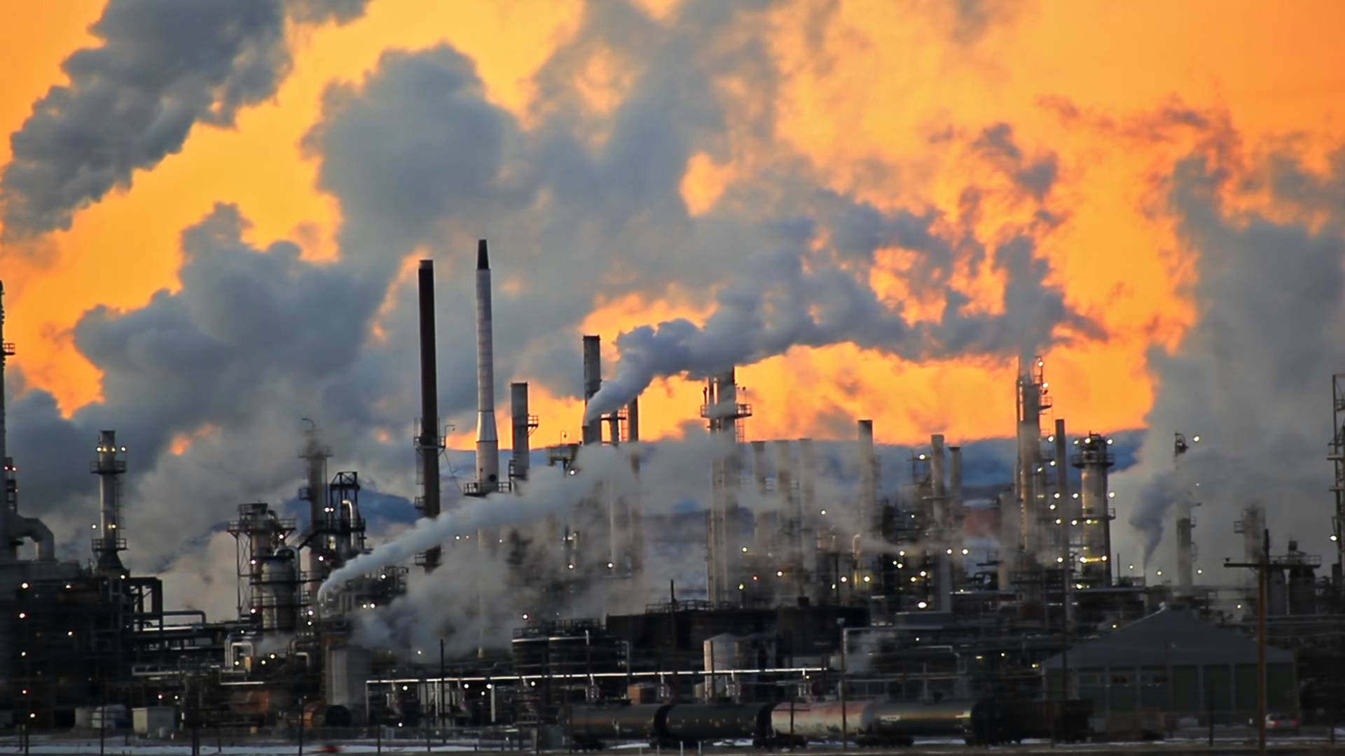
Present Value of a Future $100 Cost or Benefit
“
It is better to be roughly right
than precisely wrong.
- John Maynard Keynes
“

Slide 60
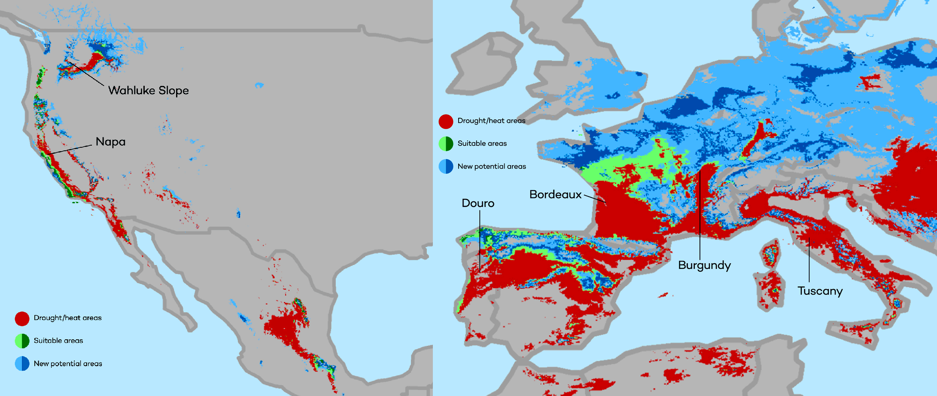
This is What Precisely Wrong Looks Like
The changing map of the world’s wine-growing regions.

Slide 61
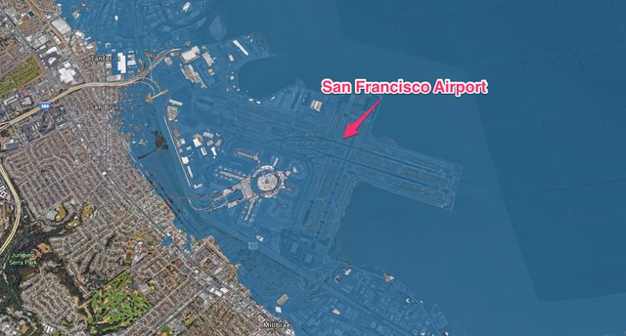
This is What Precisely Wrong Looks Like

Slide 62
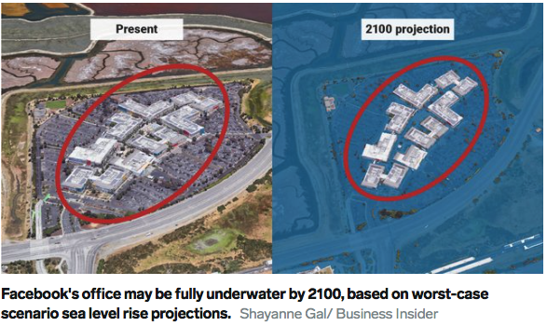
This is What Precisely Wrong Looks Like

Slide 63
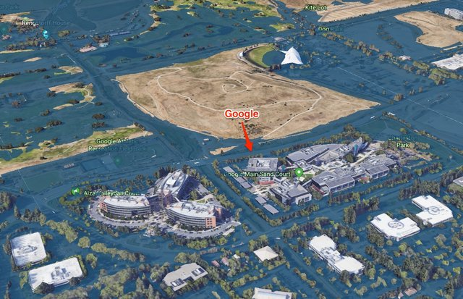
This is What Precisely Wrong Looks Like

Slide 64
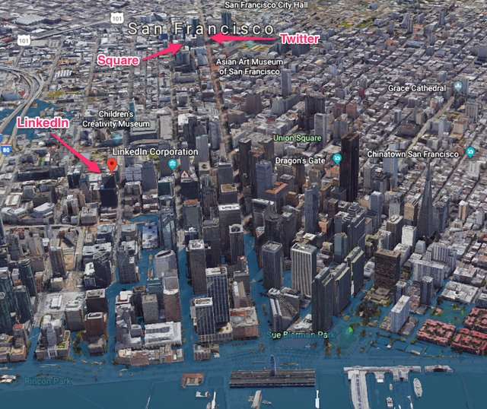
This is What Precisely Wrong Looks Like

Slide 65
Summary
Climate change is real, is caused by human actions, and has impacts we’re already feeling.
This problem won’t solve itself; we need policy intervention, and fast.
  Fortunately, a lot of action is happening – we need to double down!
Smart policy can reduce greenhouse gas emissions by the right amount and at the lowest possible cost.
  For example, cap and trade and emissions taxes!
We also need policies to help with adaptation and support those bearing the greatest damages.

Slide 66
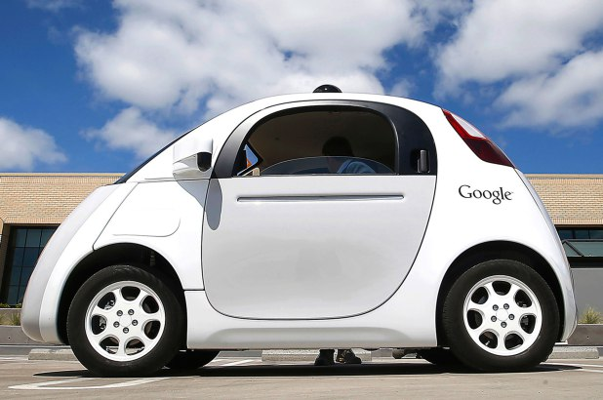
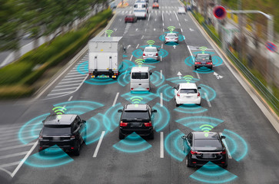
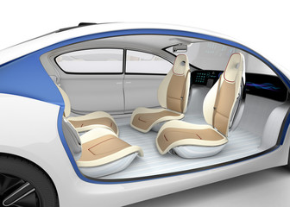

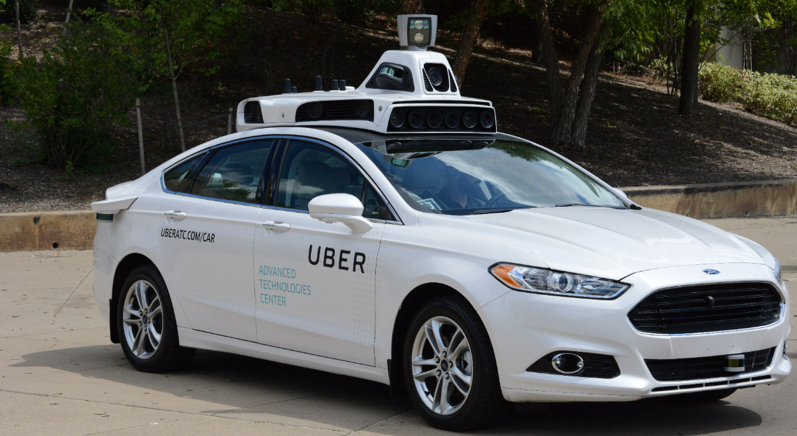
Autonomous Vehicles

Slide 67
Thank you!
Any Questions?
www.NEEDEcon.org
Jon Haveman, Ph.D.
Jon@NEEDEcon.org
Contact NEED: info@NEEDEcon.org
Submit a testimonial: www.NEEDEcon.org/testimonials.php
Become a Friend of NEED: www.NEEDEcon.org/friend.php

