Slide 1




Climate Change Economics
Dr. Shana McDermott
Department of Economics
Trinity University
Madison, WI Kiwanis Feb 2021/April 2021

Slide 2
And How Does Economics Contribute to
Thinking about Climate Change? A Preview.
Account for behavioral reactions to climate change
Estimate / measure costs of climate change damages and costs of fighting climate change
Design smart policy to minimize costs of fighting climate change

Slide 3
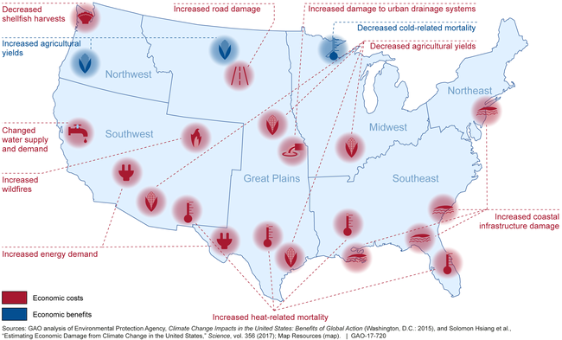
Projected Damages Vary Across the US
Estimated at 1.2% of GDP per 1C Increase

Slide 4
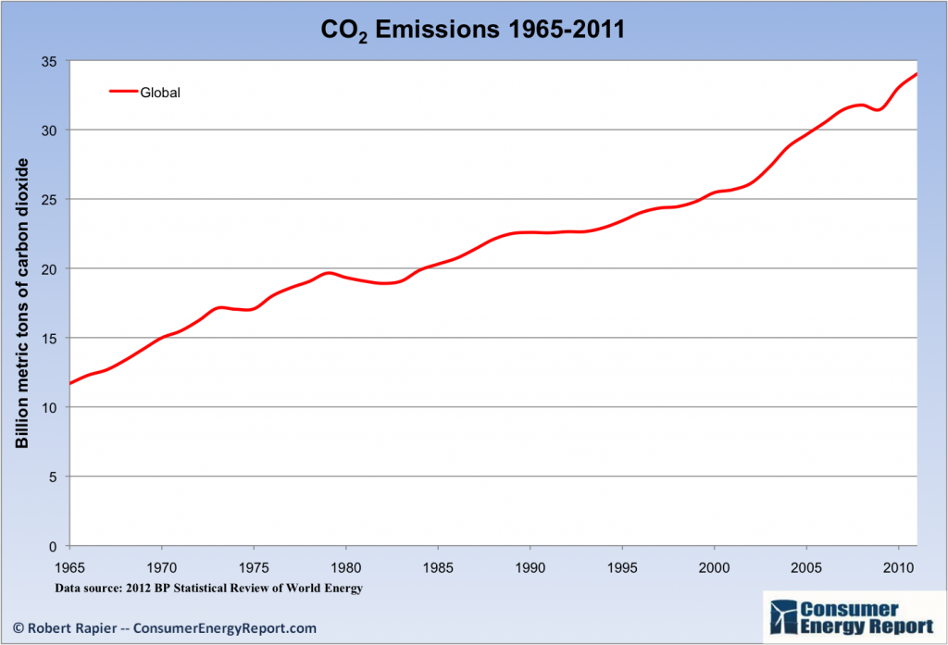
Recent Progress on Climate Goals
IPCC’s Fifth Assessment Report (2014)
  Goals from previous report (2007) were met!
  … but mainly because of the Great Recession…
  … which was not a good thing.
Notes:
Could use this graph of emissions over time or energy use over time, as it clearly shows a dip where the recession is; from the US Energy Information Administration International Energy Outlook

Slide 5
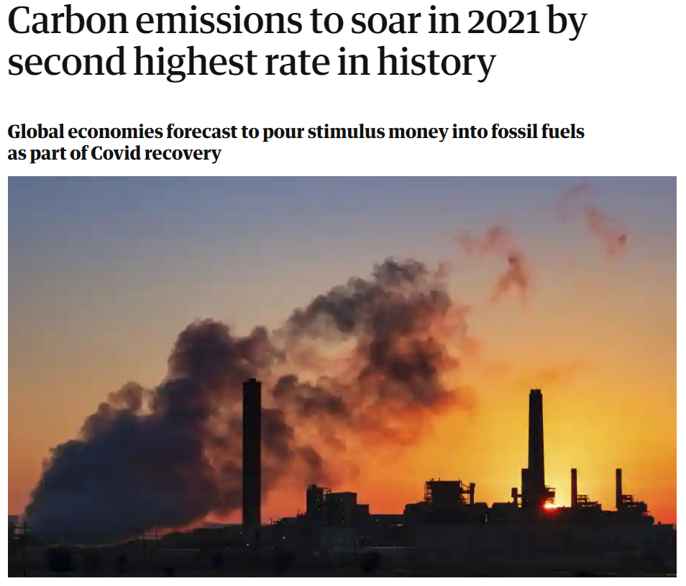
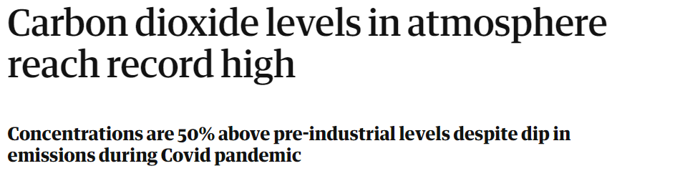
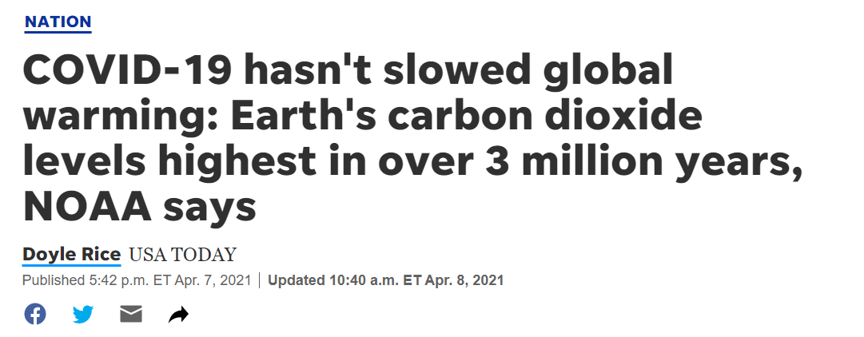

Slide 6
Climate Change Policy

Slide 7
Policies to Fight Climate Change that Are Relatively Indirect
Subsidizing R&D
Grid / infrastructure
Land use policies
Energy efficiency mandates and subsidies
Mandating renewable energy (e.g. renewable portfolio standards)

Slide 8
Policies to Fight Climate Change that Directly
Reduce Emissions
Emissions standards or limits
Putting a price on emissions
  Tax or cap & trade!

Slide 9

Social Cost of Carbon
The expected cost of damages from each unit of greenhouse gas emissions
Current EPA estimate: ~$53 per metric ton CO₂
Social cost of carbon will increase over time into the future

Slide 10
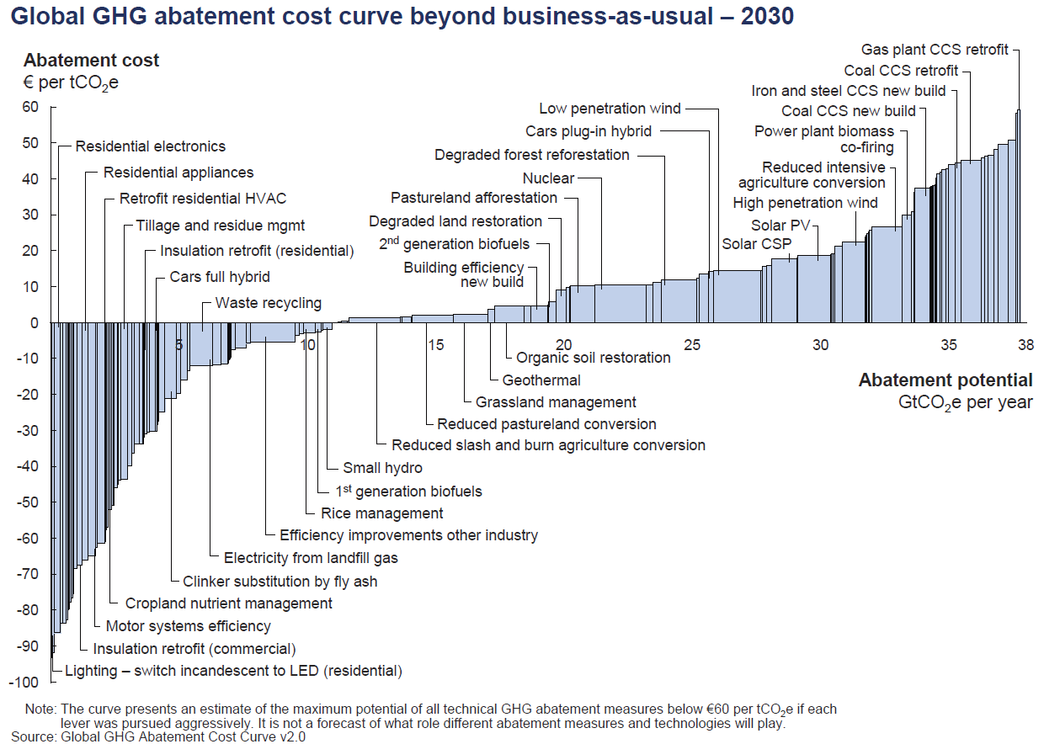
Global GHG Abatement Cost Curve Beyond
Business-as-usual - 2030
Notes:
McKinsey report

Slide 11
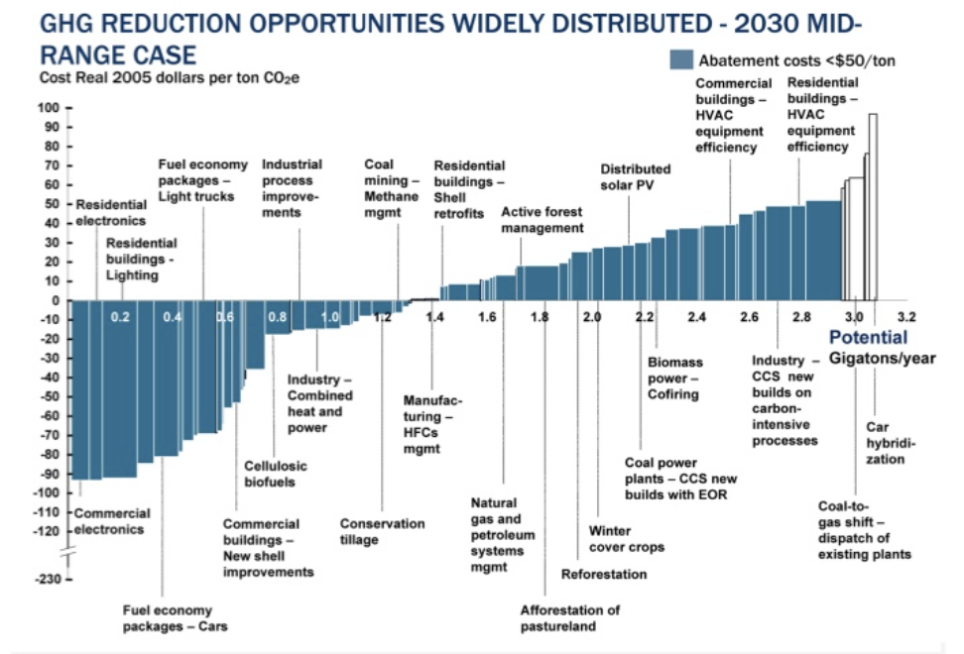
Putting a Price on Carbon
TAX = Carbon Price
MAC
Abate
Buy permit
or pay tax
Notes:
Shana: perhaps another infographic is beneficial here. Reintroduce the original cost graph. Fade out the costs and leave the MAC. Then introduce a price. If it’s cheaper to abate, then firms will do that, otherwise they will buy a permit or pay the tax. I know this is super simplified. I introduce specifics at the start of the emissions trading section and the tax section below.

Slide 12
Climate Change Policy in Action

Slide 13
Carbon Tax
Notes:
Does NEED want transition (section-starter) slides to maybe ALL look like this? If not, maybe these slides should be plain text like the rest of them?

Slide 14
26
Carbon Tax Programs
24
National Jurisdictions Covered
5.3%
of global greenhouse gas emissions

Slide 15

British Columbia’s Carbon Tax Policy
0.1%
of global greenhouse gas emissions

Slide 16

“
Tax the pollution we do not want, and return the money for what we do want — money in people’s pockets, jobs and investment.
- B.C. Government - Carbon Tax Brochure
“

Slide 17
British Columbia's Tax on Carbon
Notes:
Source for slide: https://www2.gov.bc.ca/gov/content/environment/climate-change/planning-and-action/carbon-tax

Slide 18
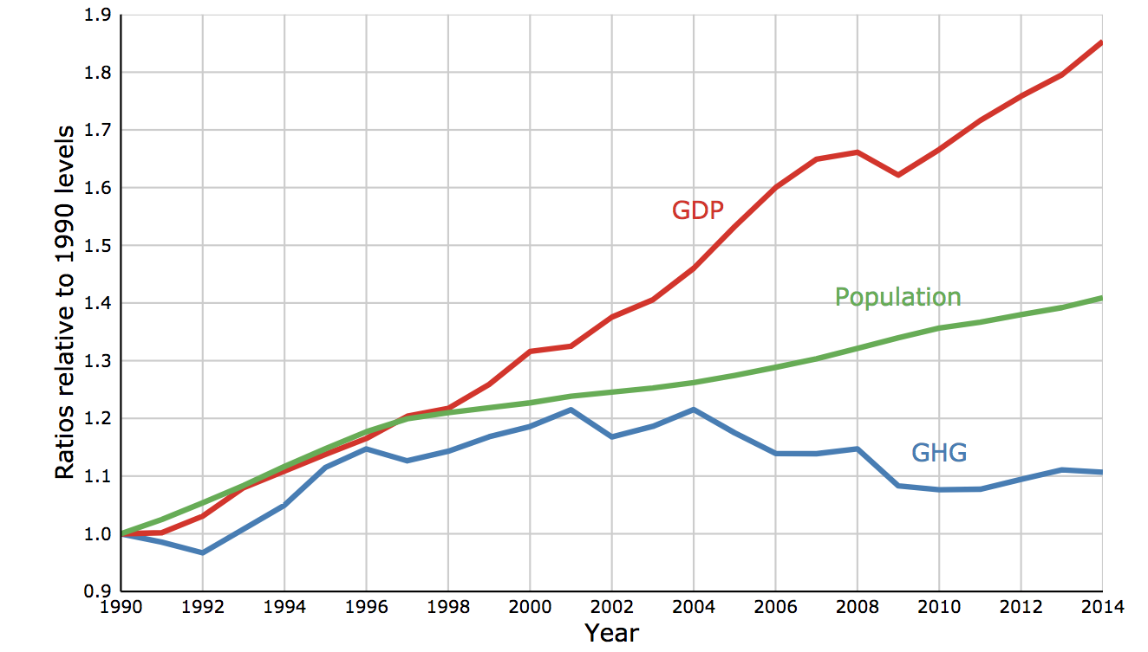
Relative Greenhouse Gas Emissions, Gross
Domestic Product & Population Size
Notes:
http://www.env.gov.bc.ca/soe/indicators/sustainability/ghg-emissions.html

Slide 19

Oldest Carbon Tax

Slide 20
Sweden’s Carbon Tax Policy
Started in 1991
Currently at $140/ton

Slide 21
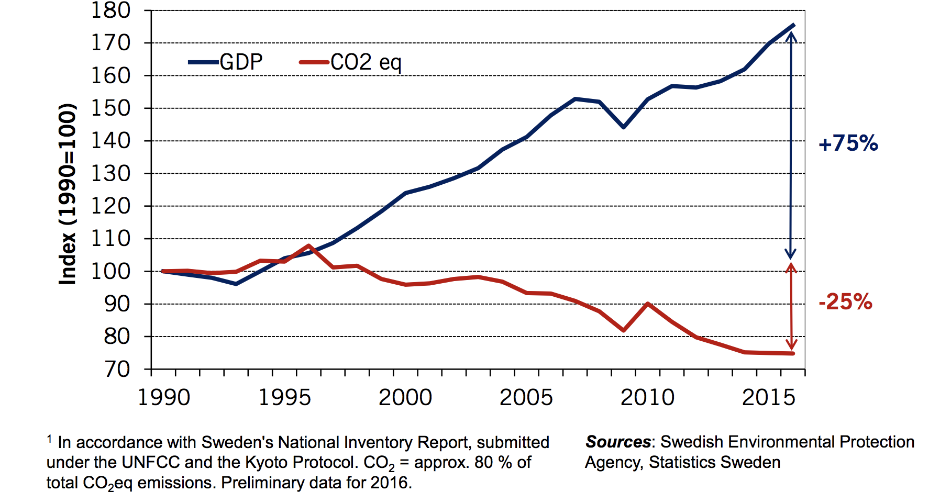
Real GDP and Domestic Co₂eq Emissions¹
In Sweden, 1990-2016
Notes:
Source: http://www.government.se/492fd9/contentassets/18ed243e60ca4b7fa05b36804ec64beb/170925-aakerfeldt-panel-debate-tuscon-gcet.pdf

Slide 22

U.S. Carbon Tax Plans
Climate Leadership Council
Citizens Climate Lobby
States and municipalities: Washington state, Oregon,
Washington DC
CO₂

Slide 23
Summary
Climate change is real, is caused by human actions, and has impacts we’re already feeling
Scientists and the IPCC recommend that we work to keep warming below 2 degrees C
There are many ways to reduce emissions
Economics-inspired policies can help us do this at the lowest cost
Taxes and cap-and-trade are proven effective tools to fight climate change!

Slide 24

“
Economic policies will be central to accomplishing
the goals we choose
~ Harris and Roach (2007)
“

Slide 25
How These Impacts Affect Humans
Agriculture
Fisheries
Coastal damages
Direct health effects, including sickness and death (temperature & drought; also pollution)
Indirect health effects (vector-borne disease)
Reduced fresh water availability
Wildfires
Shifting zones for important ecosystems, and desertification
Reduced worker productivity
Increased violence
Some of these may cause human migration and/or conflict
Notes:
This could be a series of slides with pictures for each one

Slide 26
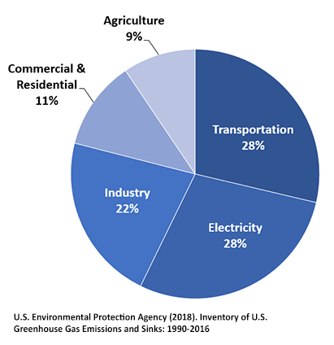
Total U.S. Greenhouse Gas Emissions by
Economic Sector in 2016
Notes:
https://www.epa.gov/ghgemissions/sources-greenhouse-gas-emissions

