Slide 1




Climate Change Economics
Jon Haveman, Ph.D.
NEED
ExtraFood
November 30, 2023

Slide 2
Credits and Disclaimer
This slide deck was authored by:
  Shana McDermott, Trinity University
  Sarah Jacobson, Williams College
  Sharon Shewmake, Western Washington University
This slide deck was reviewed by:
  Jason Shogren, University of Wyoming
  Walter Thurman, North Carolina State University
Disclaimer
  NEED presentations are designed to be nonpartisan.
  It is, however, inevitable that the presenter will be asked for and will provide their own views.
  Such views are those of the presenter and not necessarily those of the National Economic Education Delegation (NEED).

Slide 3
Economic Building Blocks

Slide 4
When Our Decisions Affect Others,
We Need Regulation
Pollution causes an EXTERNALITY: a side effect (here, a cost) that affects someone else
  Polluting things have an “unfair cost advantage” because part of cost is offloaded on others
  → Too much pollution is generated
  Regulation limiting pollution has net benefits
The “efficient” amount of pollution balances costs & benefits of pollution

Slide 5
How Economists Decide How Much to Fight
Climate Change: Cost Benefit Analysis
Abating greenhouse gas emissions is costly…
… but without action, climate change damages are even more costly.
Goal is not zero emissions, but efficient level that achieves a balance.
Expected costs of reducing emissions
Expected damages from allowing climate change

Slide 6
Cost-Benefit Analysis of
Fighting Climate Change
Most economic models suggest the costs of keeping warming below 2°C are relatively small, amounting to 1-4% of GDP by 2030.
Costs of acting to keep warming below 2°C are almost certainly less than future economic damages they would avoid.
  Damages estimated to be between: 7-20% of worldwide GDP.

Slide 7
A Climate Change Ladder
Emissions
Mitigation (a.k.a. Abatement)
Adaptation
Damages

Slide 8


Greenhouse Gas Emissions 1990-2019
Source: IPCC
Notes:
https://www.ipcc.ch/report/ar6/wg3/ Summary for Policymakers Figure SPM.1

Slide 9

Sources of the Global Flow of Emissions
Notes:
https://www.nytimes.com/interactive/2021/11/12/climate/cop26-emissions-compensation.html

Slide 10
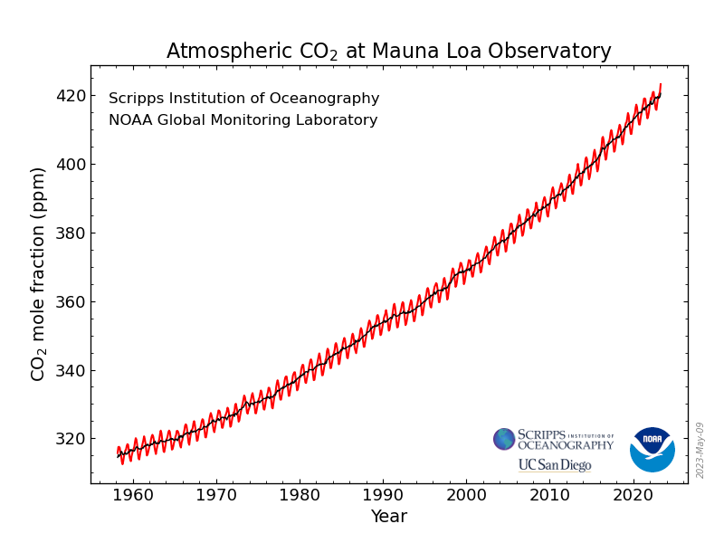
Atmospheric CO₂ Concentrations Up To Now
Source: NOAA
Notes:
https://gml.noaa.gov/ccgg/trends/

Slide 11
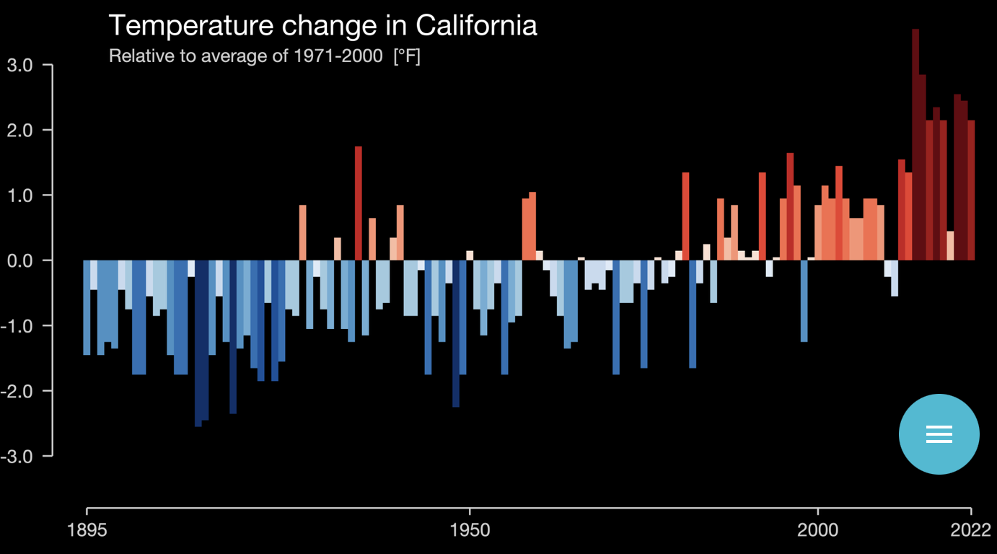
These Changes Are Already Underway
Use https://showyourstripes.info/ to see the temperature history of an area!
Here’s WA!
Notes:
New: https://showyourstripes.info/
Old: http://berkeleyearth.lbl.gov/city-list/

Slide 12
Impacts of Climate Change

Slide 13
How Climate Change Affects Humans
Agriculture
Fisheries
Coastal damages
Direct health effects, including sickness and death (temperature & drought; also pollution)
Indirect health effects (vector-borne disease)
Reduced fresh water availability
Wildfires
Shifting zones for important ecosystems, and desertification
Reduced worker productivity
Increased violence
Some of these may cause human migration and/or conflict

Slide 14

How Damages Will Vary Globally:
Mortality as an Example
Notes:
Carleton et al. 2021: https://papers.ssrn.com/sol3/papers.cfm?abstract_id=3674927

Slide 15
Adaptation Reduces Damages
Adaptation: costly action that reduce damages from climate change.
The net damage cost to society is the cost of adaptation plus the cost of remaining damages.
People and firms will take some actions on their own, up to the point where they find it worthwhile.
Some adaptation requires government involvement.

Slide 16

Individual-Level Adaptation
Perhaps you…
  Stay inside more.
  Turn on the air conditioning.
Farmers may:
  Plant at different times.
  Plant new crops.
Businesses may:
  Give outdoor workers water / shade breaks.
Everyone might:
  Think about moving to a safer place.
Notes:
Could be one or several slides with images to represent

Slide 17
Public Adaptation
Governments can help:
  When collective action is less costly than everyone acting alone.
  When individual action is not possible or likely.
  When some people can’t protect themselves.
Sea walls
Ecosystems that provide protection
Policies that protect workers or low-income and vulnerable populations
Planned retreat (moving a community)
Notes:
Could be one or several slides with images to represent

Slide 18
Reducing Emissions

Slide 19
Sources of the Global Flow of Emissions
Notes:
https://www.nytimes.com/interactive/2021/11/12/climate/cop26-emissions-compensation.html

Slide 20

Sources of the Global Stock of Emissions
Notes:
https://www.nytimes.com/interactive/2021/11/12/climate/cop26-emissions-compensation.html

Slide 21

Sources of the Global Stock of Emissions
Notes:
https://www.nytimes.com/interactive/2021/11/12/climate/cop26-emissions-compensation.html

Slide 22


How Does This Look Per Capita (Per Person)?
Notes:
https://www.ipcc.ch/report/ar6/wg3/ Summary for Policymakers Figure SPM.2

Slide 23
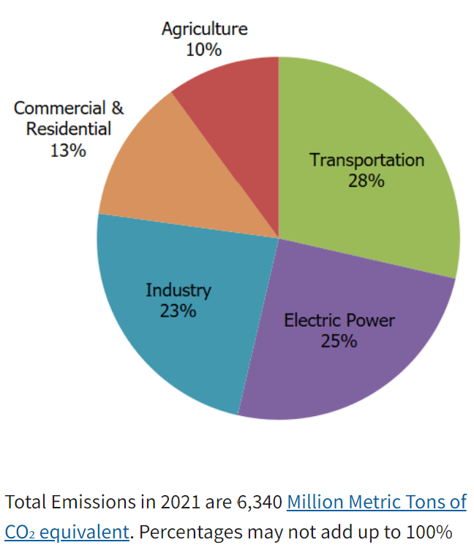
Total US Greenhouse Gas Emissions by Economic Sector in 2021
Notes:
https://www.epa.gov/ghgemissions/sources-greenhouse-gas-emissions

Slide 24
Which Emissions Should We Cut?
List all possible ways to reduce emissions
Figure out how much each can reduce in total
Figure out how much each costs per unit of emissions reduced
Line them up in order: cheapest to costliest (“marginal abatement cost curve”)
  → Tackle first the cheapest ones!

Slide 25

Example Abatement Cost Curve
(Don’t trust these numbers, this is just to show the idea)
Notes:
McKinsey report: https://www.mckinsey.com/business-functions/sustainability/our-insights/impact-of-the-financial-crisis-on-carbon-economics-version-21

Slide 26
Climate Change Policy

Slide 27
Policies That Reduce Emissions Directly
Command and control regulation
  Emissions standards or limits (e.g., Clean Water Act discharge limits)
  Tech standards (e.g., require scrubbers on power plants)
Incentive-based policies
  Putting a price on emissions – leveling the playing field!
    Tax or cap & trade
    Subsidizing green energy (e.g., feed-in tariffs)

Slide 28
Command and Control vs. Incentive-Based Regulation
Efficiency
  Both can achieve the same amount of emissions reduction.
  Incentive-based policies can achieve emissions reduction at much lower cost.
Equity
  Both have may regressive impacts (low-income families bear costs that are a larger percent of their incomes vs hi-income families)
    However, new evidence increasingly questions this.
  Cap and trade and carbon tax can generate revenues that can be used to offset the regressivity.
    E.g.: “carbon dividend”
  Command and control regulations do not.

Slide 29
Examples of Other Policies that Reduce Emissions
Research and development subsidies
Renewable energy mandates (e.g., renewable portfolio standards)
Energy efficiency mandates and subsidies (e.g. CAFE fuel economy standards)
Grid / infrastructure improvements
Public transportation
Land use / zoning policies

Slide 30
Climate Change Policy in Action

Slide 31

California’s AB32: Global Warming Solutions
California’s goals:
  Reduce emissions to 1990 levels by 2020
  An 80% reduction in emissions from 1990 levels by 2030
California’s Tools:
  Cap and Trade
  Renewable Portfolio Standard
  Clean Cars Program
  Low Carbon Fuel Standard

Slide 32
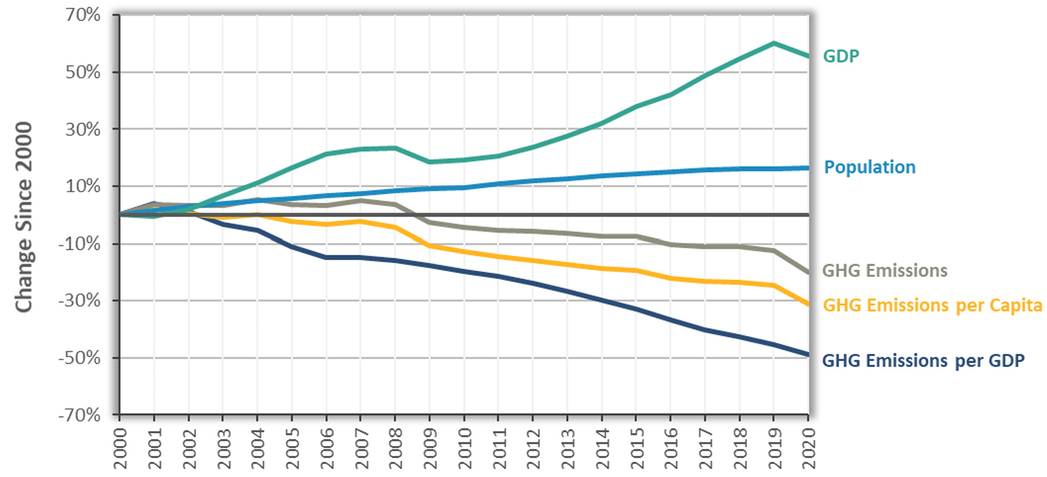
Change in California GDP, Population, and
GHG Emissions since 2000
Cap & Trade ->
Notes:
https://ww2.arb.ca.gov/ghg-inventory-data “California Greenhouse Gas Emissions for 2000 to 2020, Trends of Emissions and Other Indicators”

Slide 33
Summary
Climate change is real, is caused by human actions, and has impacts we’re already feeling.
This problem won’t solve itself; we need policy intervention, and fast.
  Fortunately, a lot of action is happening – we need to double down!
Smart policy can reduce greenhouse gas emissions by the right amount and at the lowest possible cost.
  For example, cap and trade and emissions taxes!
We also need policies to help with adaptation and support those bearing the greatest damages.

Slide 34
Thank you!
Any Questions?
www.NEEDEcon.org
Jon Haveman, Ph.D.
Contact NEED: Jon@NEEDEcon.org
Submit a testimonial: www.NEEDEcon.org/testimonials.php
Support NEED: www.NEEDEcon.org/donate.php

