Slide 1




Climate Change Economics
Sarah Jacobson, Ph.D.
Associate Professor of Economics at Williams College
Kiwanis Club of San Jose
March 29, 2021

Slide 2
National Economic Education Delegation
Vision
  One day, the public discussion of policy issues will be grounded in an accurate perception of the underlying economic principles and data.
Mission
  NEED unites the skills and knowledge of a vast network of professional economists to promote understanding of the economics of policy issues in the United States.
NEED Presentations
  Are nonpartisan and intended to reflect the consensus of the economics profession.

Slide 3
Who Are We?
Honorary Board: 48 members
  2 Fed Chairs: Janet Yellen, Ben Bernanke
  6 Chairs Council of Economic Advisers
    Furman (D), Rosen (R), Bernanke (R), Yellen (D), Tyson (D), Goolsbee (D)
  3 Nobel Prize Winners
    Akerlof, Smith, Maskin
Delegates: 500+ members
  At all levels of academia and some in government service
  All have a Ph.D. in economics
  Crowdsource slide decks
  Give presentations
Global Partners: 45 Ph.D. Economists
  Aid in slide deck development

Slide 4
Available NEED Topics Include:
US Economy
Economic Inequality
Climate Change
US Social Safety Net
Trade and Globalization
Economic Mobility
Immigration
COVID-19
Housing Policy
Federal Budgets
Federal Debt
2017 Tax Law
Autonomous Vehicles
Black-White Wealth Gap

Slide 5
Credits and Disclaimer
This slide deck was authored by:
  Sarah Jacobson, Williams College
  Shana McDermott, Trinity University
  Sharon Shewmake, Western Washington University
This slide deck was reviewed by:
  Jason Shogren, University of Wyoming
  Walter Thurman, North Carolina State University
Disclaimer
  NEED presentations are designed to be nonpartisan.
  It is, however, inevitable that the presenter will be asked for and will provide their own views.
  Such views are those of the presenter and not necessarily those of the National Economic Education Delegation (NEED).

Slide 6
Outline
Economics of climate change
Reducing emissions
Climate change policy
Policy in action

Slide 7
Economics of Climate Change

Slide 8
When Everything Is Simple,
No Regulation Is Needed
Simple transactions: buyer and seller feel all costs and benefits of sales
→ Efficient number of transactions!

Slide 9
When Our Decisions Affect Others,
We Need Regulation
Pollution causes an EXTERNALITY: a side effect (cost or benefit) that affects someone else
  Polluting things have an “unfair cost advantage” because part of cost is offloaded on others
  → Too much pollution is generated
  Regulation limiting pollution has net benefits
The “efficient” level of pollution balances the costs & benefits of pollution

Slide 10
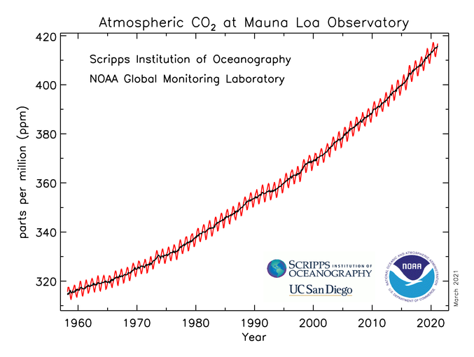
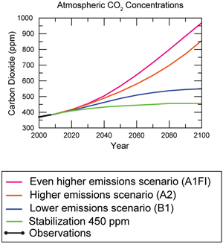
Atmospheric CO₂ Concentrations
Projections →
Source: IPCC data distribution center and climate.gov

Slide 11
W hat Does That Do?
Increased temperatures
  Sea level rise
  Storm surges
Altered precipitation patterns
More variable weather
More / more powerful storms
Carbon dissolves in ocean

Slide 12
How These Impacts Affect Humans
Agriculture
Fisheries
Coastal damages
Direct health effects, including sickness and death (temperature & drought; also pollution)
Indirect health effects (vector-borne disease)
Reduced fresh water availability
Wildfires
Shifting zones for important ecosystems, and desertification
Reduced worker productivity
Increased violence
Some of these may cause human migration and/or conflict

Slide 13
Adaptation Reduces Damages
Adaptations: costly actions that reduce damages from climate change.
  Examples: staying indoors, changing agricultural practices, building seawalls, migration
The net cost to society is the cost of adaptation plus the cost of remaining damages.
People will take some actions on their own, up to the point where they find it worthwhile.
Some responses require government involvement: large-scale actions or actions with shared benefits.

Slide 14
A Climate Change Ladder
Emissions
Mitigation (a.k.a. Abatement)
Adaptation
Damages

Slide 15
Reducing Emissions

Slide 16
How Economists Decide How Much to Fight
Climate Change: Cost Benefit Analysis
Abating greenhouse gas emissions is costly…
… but without action, climate change damages are even more costly.
Goal is not zero emissions, but efficient level that achieves a balance.
Expected costs of reducing emissions
Expected damages from allowing climate change

Slide 17
Cost-Benefit Analysis of
Fighting Climate Change
Most economic models suggest the costs of keeping warming below 2°C are relatively small, amounting to 1-4% of GDP by 2030.
Costs of acting to keep warming below 2°C are almost certainly less than future economic damages they would avoid.
  Damages estimated to be between: 7 - 20% of worldwide GDP.

Slide 18
Global Net Emissions
Are What We Care About
For climate impacts, we don’t care where they are emitted, only how much
  There may be other local impacts
Gross emissions (greenhouse gas sources): how much greenhouse gases (incl. CO2) we put out
Greenhouse gas sinks: ways to pull CO2 out of the air
  Existing: oceans, forests
  Increase sinkage by planting trees, or other measures

Slide 19
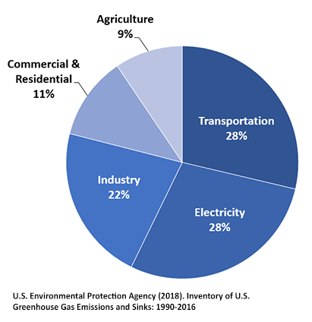
Total U.S. Greenhouse Gas Emissions by Economic Sector in 2016
Notes:
https://www.epa.gov/ghgemissions/sources-greenhouse-gas-emissions

Slide 20

Example Global Abatement Cost Curve
Notes:
McKinsey report: https://www.mckinsey.com/business-functions/sustainability/our-insights/impact-of-the-financial-crisis-on-carbon-economics-version-21

Slide 21
Climate Change Policy

Slide 22
Policies That Reduce Emissions Directly
Command and control regulation
  Emissions standards or limits (e.g., Clean Water Act discharge limits)
  Tech standards (e.g., require scrubbers on power plants)
Incentive-based policies
  Putting a price on emissions – leveling the playing field!
    Tax or cap & trade
    Subsidizing green energy (e.g., feed-in tariffs)

Slide 23
Command and Control vs. Incentive-Based Regulation
Efficiency
  Both can achieve the same amount of emissions reduction.
  Incentive-based policies can achieve emissions reduction at much lower cost.
Equity
  Both have regressive impacts (low-income families bear costs that are a larger percent of their incomes).
  Cap and trade and carbon tax can generate revenues that can be used to offset the regressivity.
  Command and control regulations do not.

Slide 24
How Does a Carbon Tax Work?
Choose activities to be covered (e.g., electricity sector, all emitters, etc.).
Set tax level.
  Optimally, it represents the social cost of polluting.
Polluters must pay a tax for every unit emitted.
  Polluters with low abatement costs will abate to avoid the tax
  Polluters with high abatement costs will pollute and pay the tax

Slide 25
How Does Cap and Trade Work?
Choose activities to be covered (e.g., electricity sector, all emitters, etc.).
Set maximum emissions level (“cap”).
That many pollution permits are issued.
  Can be auctioned off or given to polluters
Every polluter in a covered sector must have a permit for every unit of pollution.
Polluters buy and sell (“trade”) permits on a market as they wish.
  Polluters with low abatement costs will make / save money by abating and selling / not buying permits
  Polluters with high abatement costs will buy permits and pollute

Slide 26
Examples of Other Policies that Reduce Emissions
R&D subsidies
Renewable energy mandates (e.g., renewable portfolio standards)
Energy efficiency mandates and subsidies (e.g. CAFE fuel economy standards)
Grid / infrastructure improvements
Public transportation
Land use / zoning policies

Slide 27
Climate Change Policy in Action

Slide 28
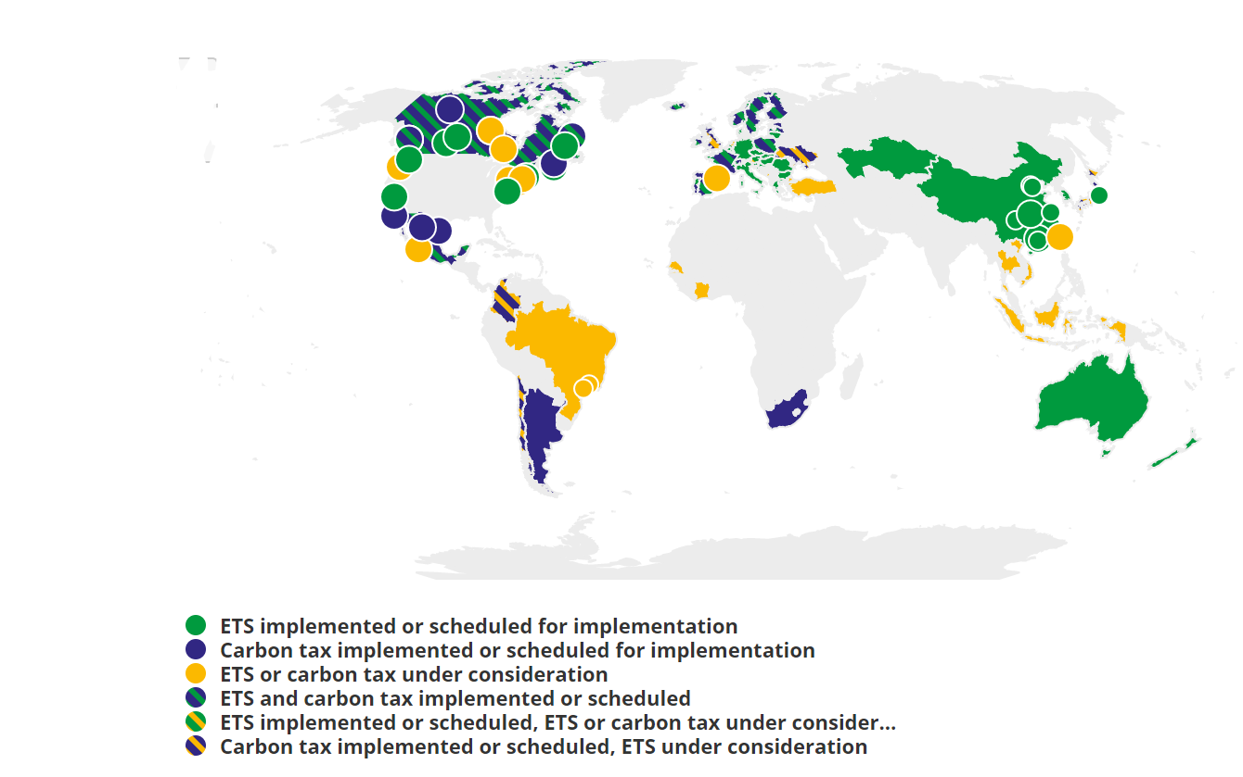
Incentive-Based Climate Policies Right Now
Source: World Bank Carbon - Pricing Dashboard

Slide 29

California’s Cap and Trade System: 2012+
0.7%
of global greenhouse gas emissions

Slide 30
California’s AB32: Global Warming Solutions
California’s goals:
  Reduce emissions to 1990 levels by 2020
  An 80% reduction in emissions from 1990 levels by 2030
California’s Tools:
  Cap and Trade
  Renewable Portfolio Standard
  Clean Cars Program
  Low Carbon Fuel Standard

Slide 31
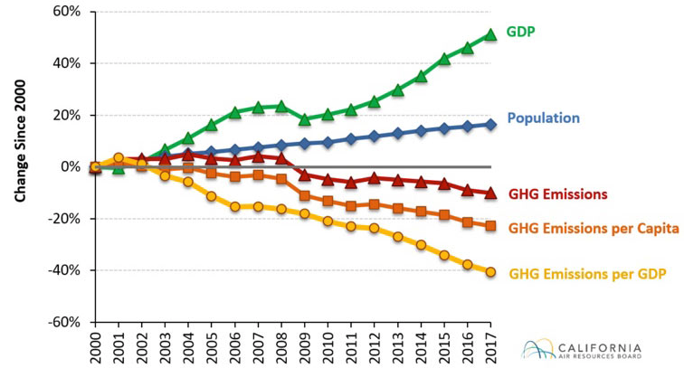
Change in California GDP, Population, and
GHG Emissions since 2000
Cap & Trade ->
Notes:
Source: https://www.arb.ca.gov/newsrel/newsrelease.php?id=933

Slide 32

Projected trends in California’s emissions
Notes:
https://www.c2es.org/content/california-cap-and-trade/

Slide 33
Summary
Climate change is real, is caused by human actions, and has impacts we’re already feeling.
This problem won’t solve itself; we need policy intervention, and fast.
Smart policy can reduce greenhouse gas emissions by the right amount and at the lowest possible cost.
  For example, cap and trade and emissions taxes!
We also need policies to help with adaptation and support those bearing the greatest damages.

Slide 34
Thank you!
Questions?
www.NEEDelegation.org
Sarah Jacobson
saj2@williams.edu
Contact NEED: Info@NEEDelegation.org
Submit a testimonial: www.NEEDelegation.org/testimonials.php

