Slide 1




Climate Change Economics
Jon Haveman, Ph.D.
NEED
Kiwanis Club of San Diego
August 16, 2022

Slide 2
National Economic Education Delegation
Vision
  One day, the public discussion of policy issues will be grounded in an accurate perception of the underlying economic principles and data.
Mission
  NEED unites the skills and knowledge of a vast network of professional economists to promote understanding of the economics of policy issues in the United States.
NEED Presentations
  Are nonpartisan and are intended to reflect the consensus of the economics profession.

Slide 3
Who Are We?
Honorary Board: 54 members
  2 Fed Chairs: Janet Yellen, Ben Bernanke
  6 Chairs Council of Economic Advisers
    Furman (D), Rosen (R), Bernanke (R), Yellen (D), Tyson (D), Goolsbee (D)
  3 Nobel Prize Winners
    Akerlof, Smith, Maskin
Delegates: 651+ members
  At all levels of academia and some in government service
  All have a Ph.D. in economics
  Crowdsource slide decks
  Give presentations
Global Partners: 49 Ph.D. Economists
  Aid in slide deck development

Slide 4
Available NEED Topics Include:
Healthcare Economics
US Economy
Climate Change
Economic Inequality
Economic Mobility
Trade and Globalization
Minimum Wages
Immigration Economics
Housing Policy
Federal Budgets
Federal Debt
Black-White Wealth Gap
Autonomous Vehicles
US Social Policy

Slide 5
Credits and Disclaimer
This slide deck was authored by:
  Shana McDermott, Trinity University
  Sarah Jacobson, Williams College
  Sharon Shewmake, Western Washington University
This slide deck was reviewed by:
  Jason Shogren, University of Wyoming
  Walter Thurman, North Carolina State University
Disclaimer
  NEED presentations are designed to be nonpartisan.
  It is, however, inevitable that the presenter will be asked for and will provide their own views.
  Such views are those of the presenter and not necessarily those of the National Economic Education Delegation (NEED).

Slide 6
Outline
Impacts of Climate Change
Reducing Emissions
Climate Change Policy

Slide 7
How Can Economists Help
Fight Climate Change?
By assessing behavioral reactions to climate change.
By measuring climate change damages and estimating the costs of fighting climate change.
By designing smart policies that minimize costs to society.

Slide 8
Econ 101: When Everything Is Simple,
No Regulation Is Needed for Efficiency
Simple transactions: buyer and seller feel all costs and benefits of sales
They choose based on the costs & benefits they feel
→ Efficient number of transactions! (Maximizes social benefits)

Slide 9
When Our Decisions Affect Others,
We Need Regulation
Pollution causes an EXTERNALITY: a side effect (here, a cost) that affects someone else
  Polluting things have an “unfair cost advantage” because part of cost is offloaded on others
  → Too much pollution is generated
  Regulation limiting pollution has net benefits
The “efficient” amount of pollution balances costs & benefits of pollution

Slide 10
How Economists Decide How Much to Fight
Climate Change: Cost Benefit Analysis
Abating greenhouse gas emissions is costly…
… but without action, climate change damages are even more costly.
Goal is not zero emissions, but efficient level that achieves a balance.
Expected costs of reducing emissions
Expected damages from allowing climate change

Slide 11
Cost-Benefit Analysis of
Fighting Climate Change
Most economic models suggest the costs of keeping warming below 2°C are relatively small, amounting to 1-4% of GDP by 2030.
Costs of acting to keep warming below 2°C are almost certainly less than future economic damages they would avoid.
  Damages estimated to be between: 7-20% of worldwide GDP.

Slide 12
Climate Change

Slide 13
The Atmospheric Greenhouse Effect
Sun
Atmosphere
Energy reflected back
onto earth
Energy reflected back
into space

Slide 14

Atmospheric CO₂ Concentrations Up To Now
Source: NOAA
Notes:
https://gml.noaa.gov/ccgg/trends/

Slide 15
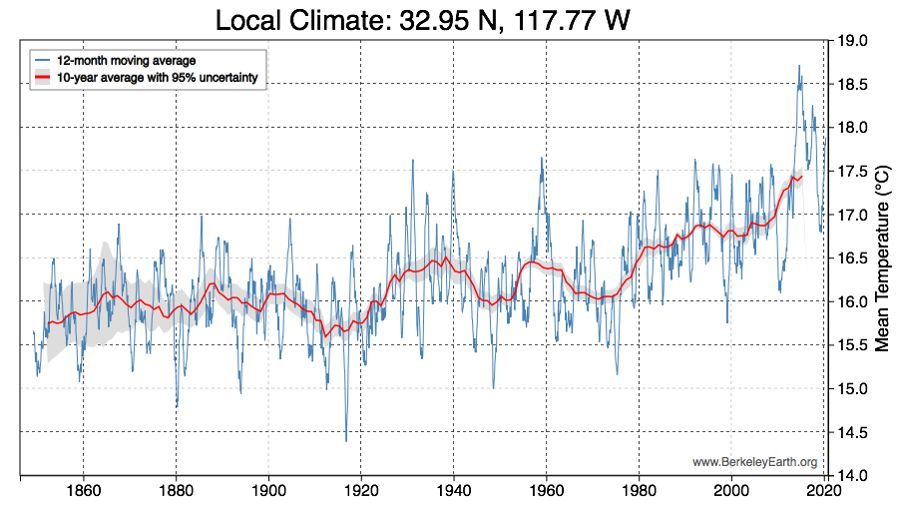
These Changes Are Already Underway
Use http://berkeleyearth.lbl.gov/city-list/ to see the temperature history of a city!
Here’s San Diego.
Last 40 yeears
Notes:
http://berkeleyearth.lbl.gov/city-list/

Slide 16
How Climate Change Affects Humans
Agriculture
Fisheries
Coastal damages
Direct health effects, including sickness and death (temperature & drought; also pollution)
Indirect health effects (vector-borne disease)
Reduced fresh water availability
Wildfires
Shifting zones for important ecosystems, and desertification
Reduced worker productivity
Increased violence
Some of these may cause human migration and/or conflict

Slide 17

Social Cost of Carbon
The expected cost of damages from each unit of greenhouse gas emissions.
Current EPA estimate: ~$51 per metric ton of CO₂ (but estimates vary a lot!)
  About $157/car per year.
  $32 Billion for all vehicles in the US.
Social cost of carbon will increase over time.
Notes:
18.07 lbs/mile
2204.62 lbs/metric ton
1.8 cents/mile

Slide 18

How Damages Will Vary in the US
Notes:
Hsiang, S., Kopp, R., Jina, A., Rising, J., Delgado, M., Mohan, S., Rasmussen, D.J., Muir-Wood, R., Wilson, P., Oppenheimer, M., Larsen, K., Houser, T., 2017. Estimating economic damage from climate change in the United States. Science 356, 1362-1369.
“County-level median values for average 2080 to 2099 RCP8.5 impacts. Impacts are changes relative to counterfactual “no additional climate change” trajectories.”

Slide 19
Global Net Emissions
Are What We Care About
For climate impacts, we don’t care where they are emitted, only how much
  There may be other local impacts
Gross emissions (greenhouse gas sources): how much greenhouse gases (including CO2) we put out
Greenhouse gas sinks: ways to pull CO2 out of the air
  Existing: oceans, forests
  Increase sinkage by planting trees, or other measures

Slide 20

Sources of the Global Flow of Emissions
Notes:
https://www.nytimes.com/interactive/2021/11/12/climate/cop26-emissions-compensation.html

Slide 21


How Does This Look Per Capita (Per Person)?
Notes:
https://www.ipcc.ch/report/ar6/wg3/ Summary for Policymakers Figure SPM.2

Slide 22

Total US Greenhouse Gas Emissions by Economic Sector in 2020
Notes:
https://www.epa.gov/ghgemissions/sources-greenhouse-gas-emissions

Slide 23
Which Emissions Should We Cut?
List all possible ways to reduce emissions
Figure out how much each costs per unit of emissions reduced
Figure out how much each can reduce in total
Line them up in order: cheapest to costliest
  → Tackle first the cheapest ones!

Slide 24

Example Abatement Cost Curve
(Don’t trust these numbers, this is just to show the idea)
Notes:
McKinsey report: https://www.mckinsey.com/business-functions/sustainability/our-insights/impact-of-the-financial-crisis-on-carbon-economics-version-21

Slide 25
Policies That Reduce Emissions Directly
Command and control regulation
  Emissions standards or limits (e.g., Clean Water Act discharge limits)
  Tech standards (e.g., require scrubbers on power plants)
Incentive-based policies
  Putting a price on emissions – leveling the playing field!
    Tax or cap & trade
    Subsidizing green energy (e.g., feed-in tariffs)

Slide 26
Command and Control vs. Incentive-Based Regulation
Efficiency
  Both can achieve the same amount of emissions reduction.
  Incentive-based policies can achieve emissions reduction at much lower cost.
Equity
  Both have may regressive impacts (low-income families bear costs that are a larger percent of their incomes vs hi-income families)
    However, new evidence increasingly questions this.
  Cap and trade and carbon tax can generate revenues that can be used to offset the regressivity.
    E.g.: “carbon dividend”
  Command and control regulations do not.

Slide 27
How Does a Carbon Tax Work?
Choose activities to be covered (e.g., electricity sector, all emitters, etc.).
Set tax level.
  Optimally, it represents the social cost of polluting.
Polluters must pay a tax for every unit emitted.
  Polluters with low abatement costs will abate to avoid the tax
  Polluters with high abatement costs will pollute and pay the tax

Slide 28
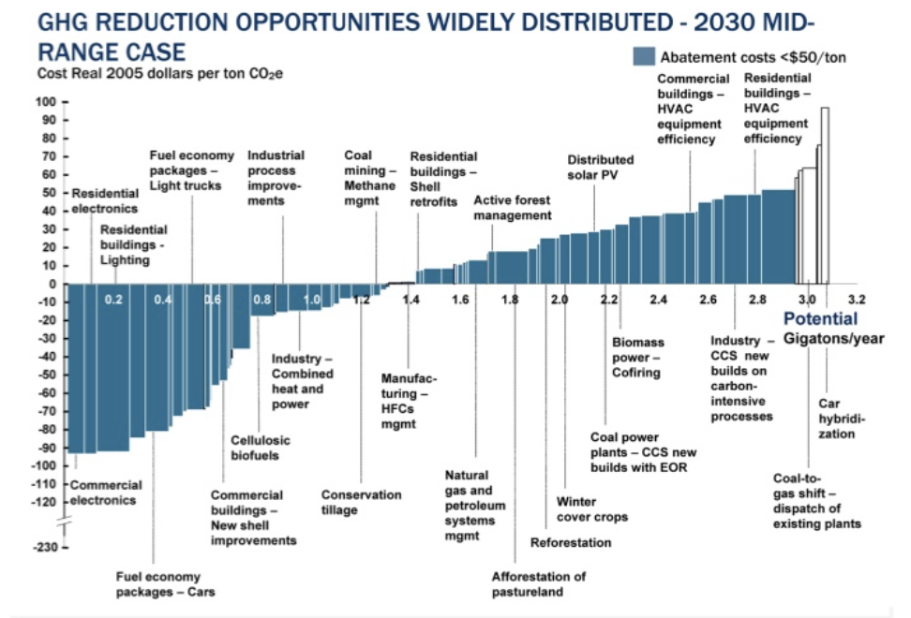
Putting a Price on Carbon
Suppose a Social Cost
Of Carbon of $50
Notes:
Shana: perhaps another infographic is beneficial here. Reintroduce the original cost graph. Fade out the costs and leave the MAC. Then introduce a price. If it’s cheaper to abate, then firms will do that, otherwise they will buy a permit or pay the tax. I know this is super simplified. I introduce specifics at the start of the emissions trading section and the tax section below.

Slide 29
Efficiency: CAFÉ vs Carbon Tax
CAFÉ = Corporate Average Fuel Efficiency
  A fuel economy standard mandating that an auto‐maker’s vehicle fleet must meet minimum fuel economy standards.
Horse Race
  Tax on fuel applies to ALL vehicles, not just new.
  Rebound Effect:
    Driving a more efficient vehicle lowers the cost per mile driven,
      leading to more miles driven.
  Slower turnover of inefficient vehicles: higher cost of new.
Summary
  A given level of emission reductions costs 3-14 times more with CAFÉ standards than under a comparable carbon tax.

Slide 30
Examples of Other Policies that Reduce Emissions
Research and development subsidies
Renewable energy mandates (e.g., renewable portfolio standards)
Energy efficiency mandates and subsidies (e.g. CAFE fuel economy standards)
Grid / infrastructure improvements
Public transportation
Land use / zoning policies

Slide 31
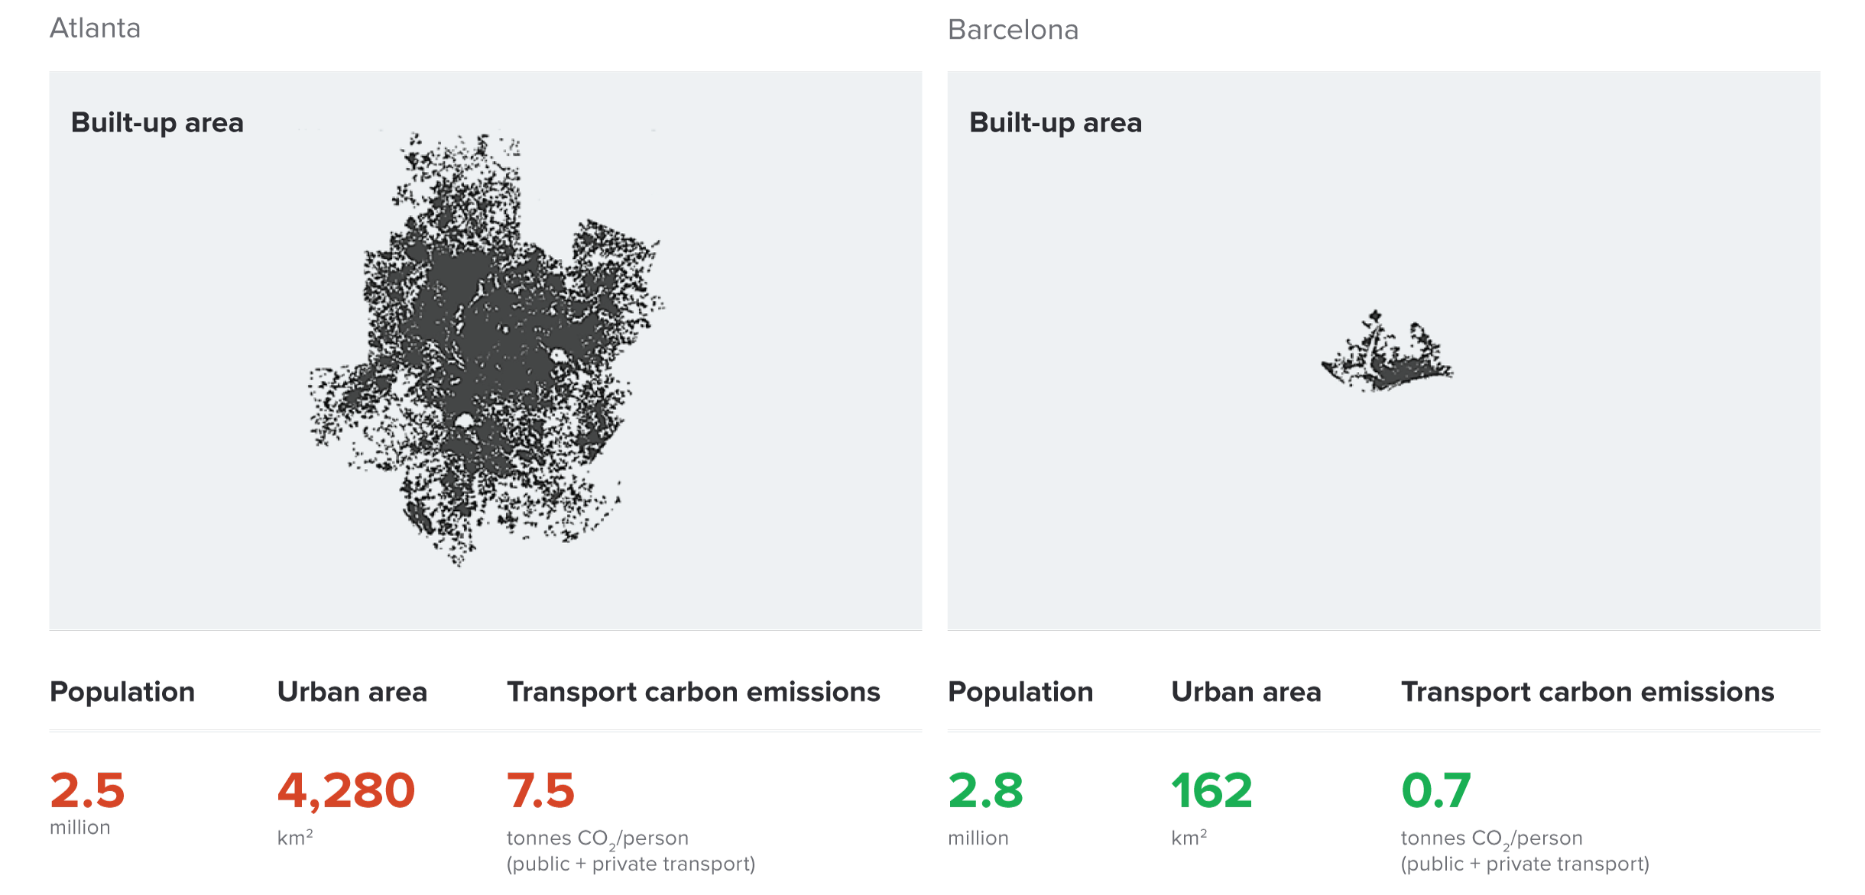
Atlanta and Barcelona Have Similar Populations but Very Different Carbon Productivity
Atlanta
Barcelona
Source: New Climate Economy Report, 2014
Notes:
Source: New Climate Economy Report

Slide 32
Inflation Reduction Act of 2022
Pssssst…. It’s not about reducing inflation, but that’s ok.
Major provisions include:
  Clean Electricity Tax Credits
  Funding Programs to Support Local Clean Investment
  Clean Vehicles Incentives
  Agriculture and Conservation
  Funding, Investments, and Incentives for Heavy Industry and Manufacturing
Result: Emissions reductions of 40% or more by 2030.
Source: https://www.nrdc.org/experts/amanda-levin/top-climate-elements-senate-budget-reconciliation

Slide 33
Summary
Climate change is real, is caused by human actions, and has impacts we’re already feeling.
This problem won’t solve itself; we need policy intervention, and fast.
Smart policy can reduce greenhouse gas emissions by the right amount and at the lowest possible cost.
  For example, cap and trade and emissions taxes!
We also need policies to help with adaptation and support those bearing the greatest damages.

Slide 34
Thank you!
Any Questions?
www.NEEDelegation.org
Jon D. Haveman
Jon@NEEDelegation.org
Contact NEED: info@NEEDelegation.org
Submit a testimonial: www.NEEDelegation.org/testimonials.php
Become a Friend of NEED: www.NEEDelegation.org/friend.php

Slide 35

Sources of the Global Stock of Emissions
Notes:
https://www.nytimes.com/interactive/2021/11/12/climate/cop26-emissions-compensation.html

Slide 36

Sources of the Global Stock of Emissions
Notes:
https://www.nytimes.com/interactive/2021/11/12/climate/cop26-emissions-compensation.html

