Slide 1
Osher Lifelong Learning Institute, Winter 2022
Contemporary Economic Policy
Santa Clara University
January 5, 2022
Jon Haveman, Ph.D.
National Economic Education Delegation

Slide 2
Course Outline
Contemporary Economic Policy
Week 1 (1/5): US Economy & Coronavirus Economics
Week 2 (1/12): Climate Change Economics (Bevin Ashenmiller, Occidental College)
Week 3 (1/19): Health Economics (Me)
Week 4 (1/26): Economics of Immigration (Jennifer Alix-Garcia, Oregon St.)
Week 5 (2/2): Infrastructure Economics (Mallika Pung, Univ. of New Mexico)
Week 6 (2/9): The U.S. Safety Net (Marianne Bitler, UC Davis)

Slide 3
About Bevin Ashenmiller

Slide 4
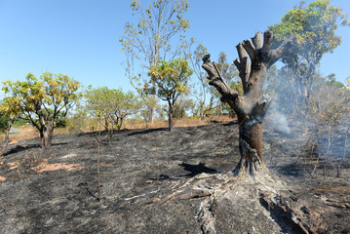
Climate Change Economics
Bevin Ashenmiller, Ph.D.
Occidental College
January 12, 2022

Slide 5
Credits and Disclaimer
This slide deck was authored by:
Shana Mcdermott, Trinity University
Sarah Jacobson, Williams College
Sharon Shewmake, Western Washington University
This slide deck was reviewed by:
Jason Shogren, University of Wyoming
Walter Thurman, North Carolina State University
Disclaimer
NEED presentations are designed to be nonpartisan.
It is, however, inevitable that the presenter will be asked for and will provide their own views.
Such views are those of the presenter and not necessarily those of the National Economic Education Delegation (NEED).

Slide 6
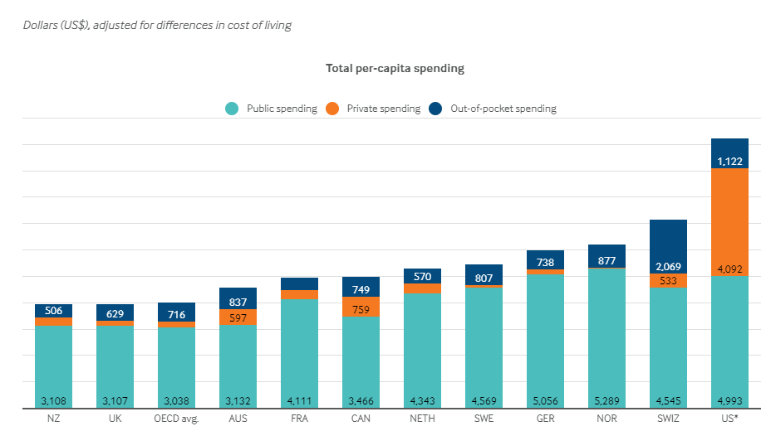
International Comparison: Health Spending
With
Jon Haveman, NEED
Notes:
Some good resources:
https://www.commonwealthfund.org/publications/issue-briefs/2020/jan/us-health-care-global-perspective-2019
A bit older report: https://www.commonwealthfund.org/publications/issue-briefs/2015/oct/us-health-care-global-perspective
https://www.healthsystemtracker.org/chart-collection/quality-u-s-healthcare-system-compare-countries/#item-overall-age-specific-potential-years-of-life-lost-per-100000-population-1990-2017
https://axenehp.com/international-healthcare-systems-us-versus-world/

Slide 7
Thank you!
Any Questions?
www.NEEDelegation.org
Jon D. Haveman
Jon@NEEDelegation.org
Contact NEED: info@NEEDelegation.org
Submit a testimonial: www.NEEDelegation.org/testimonials.php
Become a Friend of NEED: www.NEEDelegation.org/friend.php

Slide 8
www.NEEDelegation.org/LocalGraphs
For every state and county in the United States.
Detailed graphs on employment, housing, moves, and other statistics.

