Slide 1
Osher Lifelong Learning Institute, Spring 2022
Climate Change Economics
California State University – East Bay
March 30 and April 6, 2022
Jon Haveman, Ph.D.
National Economic Education Delegation

Slide 2
National Economic Education Delegation
Vision
  One day, the public discussion of policy issues will be grounded in an accurate perception of the underlying economic principles and data.
Mission
  NEED unites the skills and knowledge of a vast network of professional economists to promote understanding of the economics of policy issues in the United States.
NEED Presentations
  Are nonpartisan and intended to reflect the consensus of the economics profession.

Slide 3
Who Are We?
Honorary Board: 54 members
  2 Fed Chairs: Janet Yellen, Ben Bernanke
  6 Chairs Council of Economic Advisers
    Furman (D), Rosen (R), Bernanke (R), Yellen (D), Tyson (D), Goolsbee (D)
  3 Nobel Prize Winners
    Akerlof, Smith, Maskin
Delegates: 651+ members
  At all levels of academia and some in government service
  All have a Ph.D. in economics
  Crowdsource slide decks
  Give presentations
Global Partners: 49 Ph.D. Economists
  Aid in slide deck development

Slide 4


Where Are We?

Slide 5
Available NEED Topics Include:
Coronavirus Economics
US Economy
Climate Change
Economic Inequality
Economic Mobility
Trade and Globalization
Minimum Wages
Immigration Economics
Housing Policy
Federal Budgets
Federal Debt
Black-White Wealth Gap
Autonomous Vehicles
US Social Policy

Slide 6
Credits and Disclaimer
This slide deck was authored by:
  Shana Mcdermott, Trinity University
  Sarah Jacobson, Williams College
  Sharon Shewmake, Western Washington University
This slide deck was reviewed by:
  Jason Shogren, University of Wyoming
  Walter Thurman, North Carolina State University
Disclaimer
  NEED presentations are designed to be nonpartisan.
  It is, however, inevitable that the presenter will be asked for and will provide their own views.
  Such views are those of the presenter and not necessarily those of the National Economic Education Delegation (NEED).

Slide 7
Outline
Climate change science
Impacts of climate change
Economics of responding to climate change
Addressing the sources of our emissions
Climate change policy
Policy in action

Slide 8
Economics Informs Almost Everything
Prices
Incentives
Externalities
Cost-Benefit Analysis
Growth
Inflation
Interest Rates
Climate Change
International Trade
Immigration
Housing
Education
Health Care
Gun Control

Slide 9
How Can Economists Contribute to
Thinking about Climate Change?
By assessing behavioral reactions to climate change.
By measuring the damage and estimating the economic costs of fighting climate change.
By designing smart policies that minimize costs.
  Balance economic growth with GHG emission mitigation.

Slide 10
Climate Change:
A Little Science

Slide 11
The Atmospheric Greenhouse Effect
Sun
Atmosphere
Light reflected back
onto earth
Light reflected back
into space

Slide 12




Uncertainty
?
?
?

Slide 13
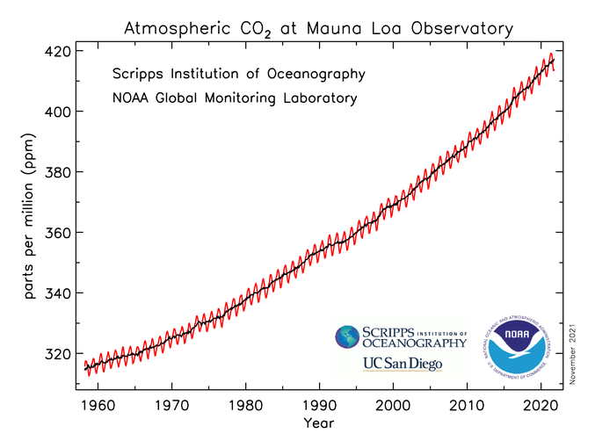
Atmospheric CO₂ Concentrations Up To Now
Source: NOAA
Notes:
https://gml.noaa.gov/ccgg/trends/

Slide 14

Emissions Trajectories into the Future
Source: IPCC Assessment Report 5
Notes:
Figure SPM.11 from the Summary for Policymakers of AR5

Slide 15
What Do Greenhouse Gas Emissions
Do to the Planet?
Increased temperatures
  Sea level rise
  Storm surges
Altered precipitation patterns
More variable weather
More / more powerful storms
Carbon dissolves in ocean

Slide 16
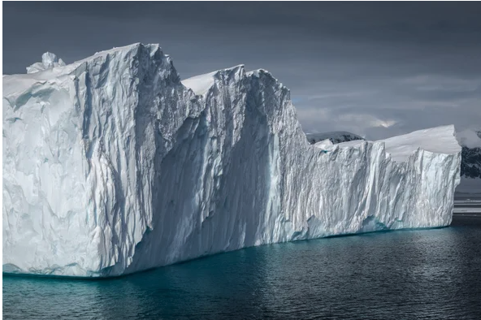
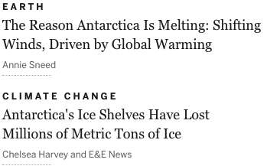
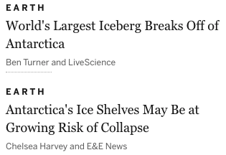
Icebergs Are Significant Contributors
https://www.scientificamerican.com/article/what-to-know-about-antarcticas-conger-ice-shelf-collapse/

Slide 17
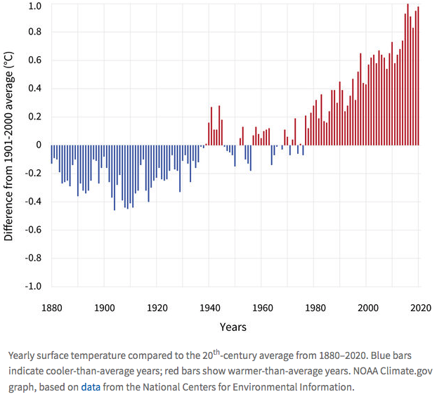
The Earth is Clearly Warming
Global Average
Surface Temperature
Notes:
https://www.climate.gov/news-features/understanding-climate/climate-change-global-temperature

Slide 18
Impacts of Climate Change

Slide 19
Global Warming Indicators

Slide 20
How These Impacts Affect Humans
Agriculture
Fisheries
Coastal damages
Direct health effects, including sickness and death (temperature & drought; also pollution)
Indirect health effects (vector-borne disease)
Reduced fresh water availability
Wildfires
Shifting zones for important ecosystems, and desertification
Reduced worker productivity
Increased violence
Some of these may cause human migration and/or conflict
Notes:
This could be a series of slides with pictures for each one

Slide 21

How Damages Will Vary Globally:
Mortality as an Example
Notes:
Carleton et al. 2021: https://papers.ssrn.com/sol3/papers.cfm?abstract_id=3674927

Slide 22

How Damages Will Vary in the US
Notes:
Hsiang, S., Kopp, R., Jina, A., Rising, J., Delgado, M., Mohan, S., Rasmussen, D.J., Muir-Wood, R., Wilson, P., Oppenheimer, M., Larsen, K., Houser, T., 2017. Estimating economic damage from climate change in the United States. Science 356, 1362-1369.
“County-level median values for average 2080 to 2099 RCP8.5 impacts. Impacts are changes relative to counterfactual “no additional climate change” trajectories.”

Slide 23
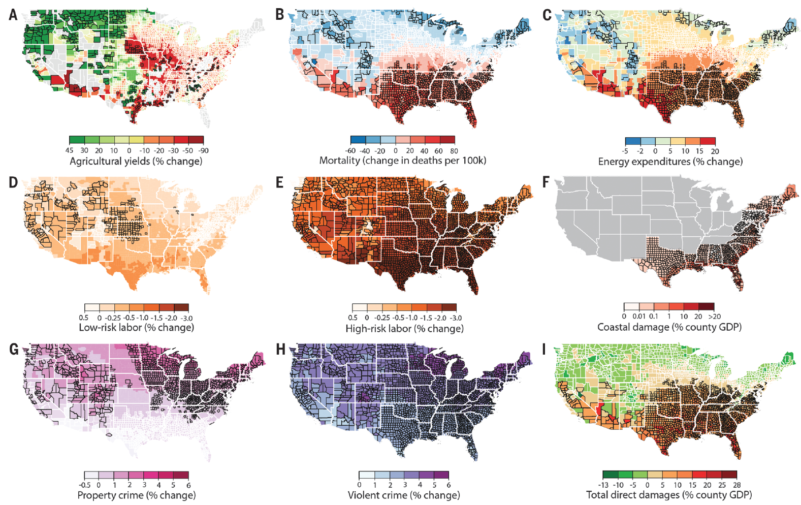
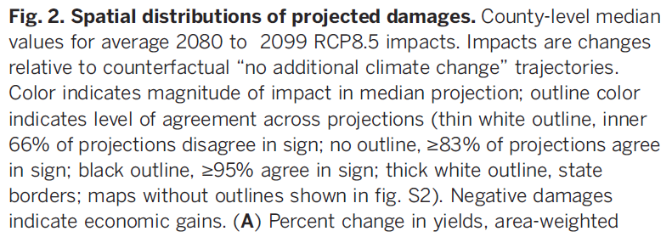
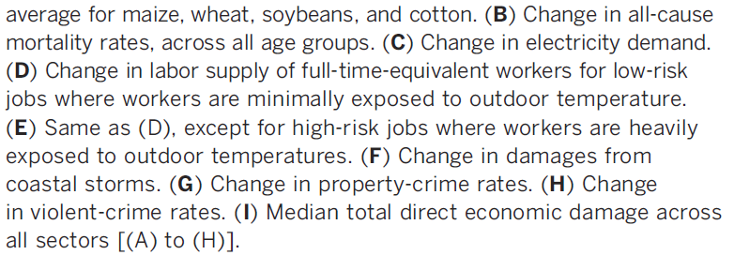
Projected Effects Vary Across the U.S. but Are Estimated at 1.2% of GDP per 1C Increase

Slide 24
How Damages Will Vary in the US
Notes:
Hsiang, S., Kopp, R., Jina, A., Rising, J., Delgado, M., Mohan, S., Rasmussen, D.J., Muir-Wood, R., Wilson, P., Oppenheimer, M., Larsen, K., Houser, T., 2017. Estimating economic damage from climate change in the United States. Science 356, 1362-1369.
“County-level median values for average 2080 to 2099 RCP8.5 impacts. Impacts are changes relative to counterfactual “no additional climate change” trajectories.”

Slide 25

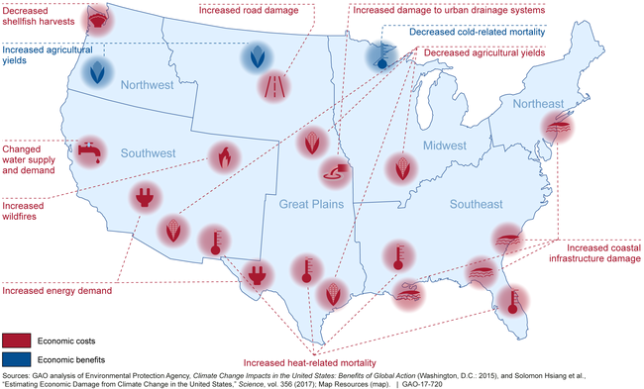
Most Vulnerable People and Places
Tropical areas
Low-lying coastal areas
Low-income people
Notes:
Add pictures or replace words with pictures

Slide 26
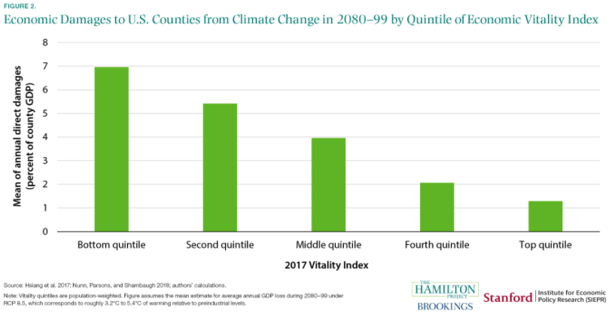
https://www.brookings.edu/research/ten-facts-about-the-economics-of-climate-change-and-climate-policy/

Slide 27
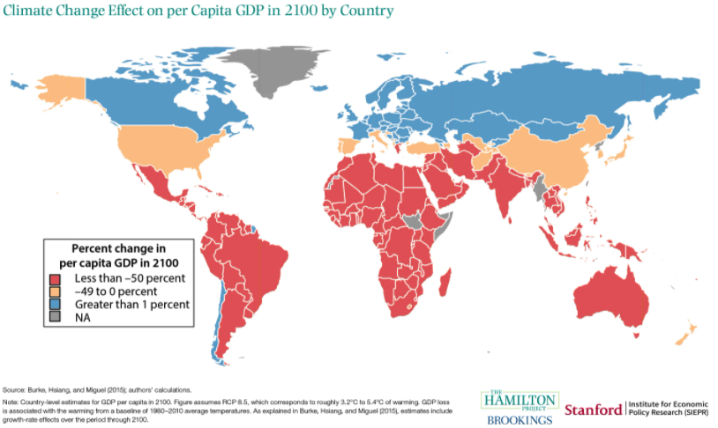

Slide 28
Economics & Climate Change

Slide 29
A Climate Change Ladder
Emissions
Mitigation (a.k.a. Abatement)
Adaptation
Damages

Slide 30
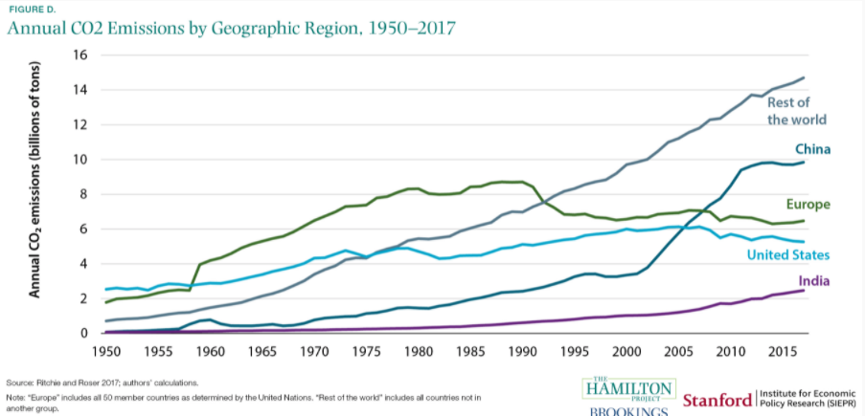
Sources of the Global Flow of Emissions
Notes:
https://www.nytimes.com/interactive/2021/11/12/climate/cop26-emissions-compensation.html

Slide 31

Sources of the Global Stock of Emissions
Notes:
https://www.nytimes.com/interactive/2021/11/12/climate/cop26-emissions-compensation.html

Slide 32

Sources of the Global Stock of Emissions
Notes:
https://www.nytimes.com/interactive/2021/11/12/climate/cop26-emissions-compensation.html

Slide 33
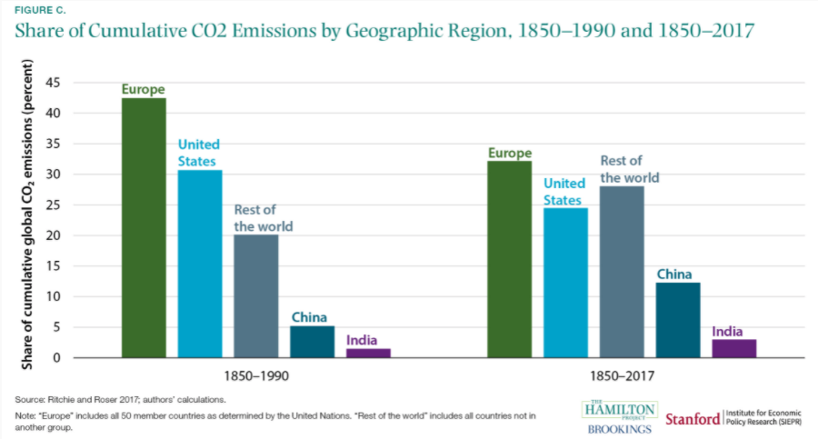

Slide 34

Total U.S. Greenhouse Gas Emissions by Economic Sector in 2020
Notes:
https://www.epa.gov/ghgemissions/sources-greenhouse-gas-emissions

Slide 35
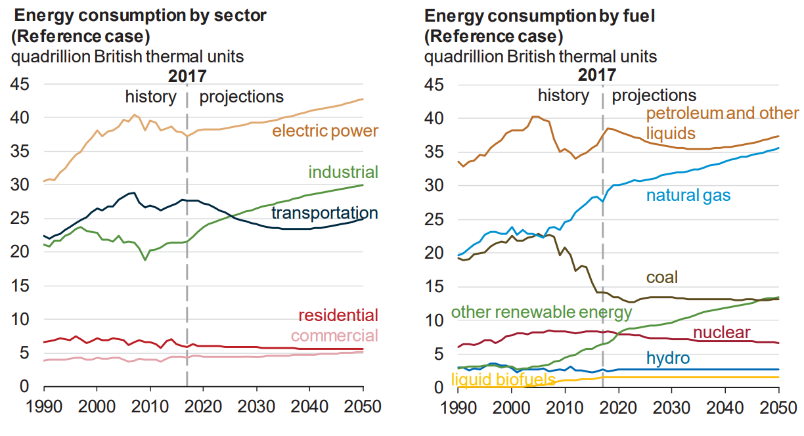
Fossil Fuels Dominate U.S. Energy Production
Notes:
US Energy Information Agency Annual Energy Outlook 2018

Slide 36

US Electricity Sources
Notes:
Source: U.S. Energy Information Administration, Annual Energy Outlook 2020 (AEO2020) Reference case

Slide 37
A Climate Change Ladder
Emissions
Mitigation (a.k.a. Abatement)
Adaptation
Damages

Slide 38
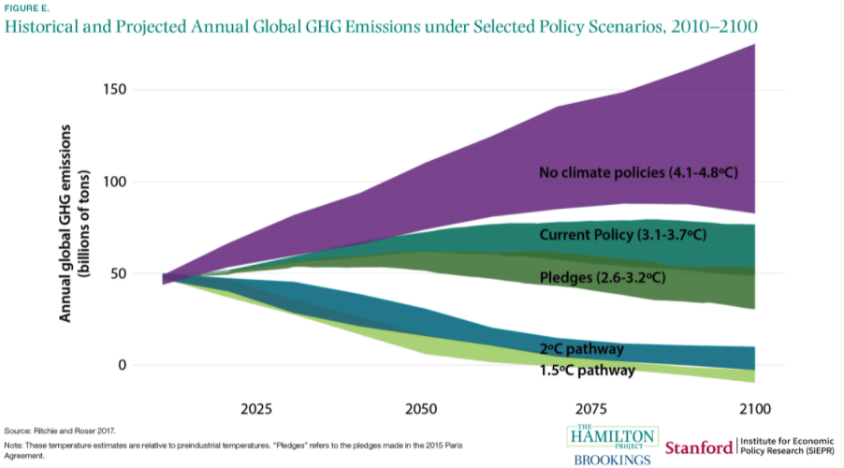
Mitigation is Crucial

Slide 39
Econ 101: When Everything Is Simple,
No Regulation Is Needed for Efficiency
Simple transactions: buyer and seller feel all costs and benefits of sales
They choose based on the costs & benefits they feel
→ Efficient number of transactions! (Maximizes social benefits)

Slide 40
How Much Pollution Does Society Want?
Analogy: How Many Oranges Does Society Want?
People grow and sell oranges for a price that at least covers costs (supply).
People will not pay more for them than what they consider to be their value (demand).
Prices let supply and demand balance out. The price settles where:
This is the “right” number of oranges for society.
Prices reflect scarcity and the social value of the resource.
# of oranges people want to sell = # of oranges people want to buy
Notes:
Simple Supply and demand game.
Ask who likes oranges and then ask how much a few students would pay for an orange right now.
If I supply them for some price in the middle – who gets them?
Not everybody who wants an orange.
- This also illustrates how value gets created with trade

Slide 41
The First Theorem of Welfare Economics
…is that private markets are perfectly efficient on their own, with no interference from government, provided certain conditions are met.
Economic Efficiency: When the sum of the profits of buyers and the profits of sellers is maximized.
*You can’t make anyone better off without making someone worse off.

Slide 42
What are “certain conditions”?
No public goods No information problems
No externalities No transaction costs
No taxes No common property
No monopoly buyers or sellers No increasing returns to scale
No other ‘distortions’ between the costs paid by buyers and the benefits received by sellers.
Notes:
So I am not going to go through all of these – but suffice it to say that there are a lot of conditions under which markets fail. And in the field of environmental economics it is a rare thing to find a market that doesn’t have at least one of these problems.

Slide 43
Characteristics of Goods
Excludable: Goods that you can exclude people from using.
Rival: One person’s use of the good diminishes other’s ability to use the good.
Public Goods (Not Rival or Excludable): Benefits additional users at no cost to society.
Common Resources (Rival, but not Excludable): Common property, or open access resources, where anyone can extract or harvest the resource freely and no one recognizes the full cost of using the resource.
Notes:
PG: We share the level of the public good and additional consumers do not use up the good. But you can not prevent someone from using it. Lighthouse.
Externalities: Pollution
CR: Fisheries

Slide 44
Characteristics of Goods & Environmental Economics
Externalities: some costs or benefits of producing, consuming, or disposing of a good or service are external to the market.
Missing Markets Problem: some goods (or inputs) into production are not sold on a market. Firms and individuals then sometimes value the good at what they pay for it, $0, instead of what it is worth.

Slide 45
Examples of Externalities
Negative Externalities:
  Heating your house
  Smoking
  Getting a dog
  Pig farming
Positive Externalities
  Education
  Growing apples
  Getting a vaccination
  Basic scientific research

Slide 46
Pigouvian Taxes
Internalize negative externalities.
  Make the buyers of the good that produces an externality pay for the externality.
    Creates a market of sorts for the externality.
      Government is the caretaker of clean air, for example.
      Cigarette’s pollute the air, so smokers pay the government for the right to pollute the air.
It does this by equalizing “marginal social cost (MSC)” with “marginal social benefit (MSB)”.
  With no externality: MSB = MSC
  With a negative externality: MSB < MSC
    My actions cost society more than I am paying to undertake them.

Slide 47
Marginal Social Cost and Social Benefit?
Marginal: refers to the costs and benefits of the last unit sold.
Marginal Cost (MC): refers to the cost of making the last unit sold.
Marginal Benefit (MB): refers to the value the consumer puts on buying the last unit.
Social cost: the impact, in dollar terms, of consuming the last unit sold.
With a negative externality:
    MSB = MB
    MSC = MC + Social cost

Slide 48
How Does A Pigouvian Tax Work?
A market with no externalities.
Price
Oranges
Supply
=MC
=MSC
MSC = MC
MSB = MB
Market Price = P
Economically Efficient
Equilibrium
MSB = MSC
Demand
=MB
=MSB
No Pigouvian tax is necessary.
Number Sold
Quantity

Slide 49
How Does A Pigouvian Tax Work?
Supply
=MSC = MC + x
A market with a negative externality.
Price
Cigarettes
x
Supply
=MC
X = social cost
MSC = MC+x
New P+x
MSB = MB
x
Economically Efficient
Equilibrium
Pigouvian Tax = x
P
MSB < MSC
New P
A Pigouvian tax is necessary to set MSB = MSC.
Demand
=MB
=MSB
Number Sold
Quantity

Slide 50
How Does A Pigouvian Tax Work?
1) A Pigouvian tax raises the cost of buying the item.
2) The higher cost results in less of the item being purchased.
3) With lower consumption, comes less of the externality.
Key: Consumer is now paying for all of the costs associated with the good.
Note: the tax REDUCES the amount of the externality. It does not eliminate it.
How much of a cost should we bear to get rid of a $5 externality?
Answer: $5

Slide 51
Electricity Is Different From Oranges
Many sources of electricity generate pollution.
Pollution is an EXTERNALITY:
  a side effect (cost or benefit) that affects someone
  else when something is bought or sold.
  This is a market failure.
The price of electricity does not reflect all of the costs.
  Electricity is too cheap.
  There is too much pollution.

Slide 52
Addressing a Negative Externality
Set thermostat to:
68 degrees
$.14/Kwh
Social cost = $.02/Kwh
$.16/Kwh
Set thermostat to:
65 degrees
The social cost of $.02/Kwh has been INTERNALIZED.

Slide 53

Social Cost of Carbon
The expected cost of damages from each unit of greenhouse gas emissions.
Current EPA estimate: ~$51 per metric ton of CO₂ (but estimates vary a lot!)
  About $157/car per year.
  $32 Billion for all vehicles in the US.
Reduce emissions until the cost of reducing emissions is greater than $51 per metric ton.
Price of emissions rises with level of emissions in the atmosphere.
Notes:
18.07 lbs/mile
2204.62 lbs/metric ton
1.8 cents/mile

Slide 54
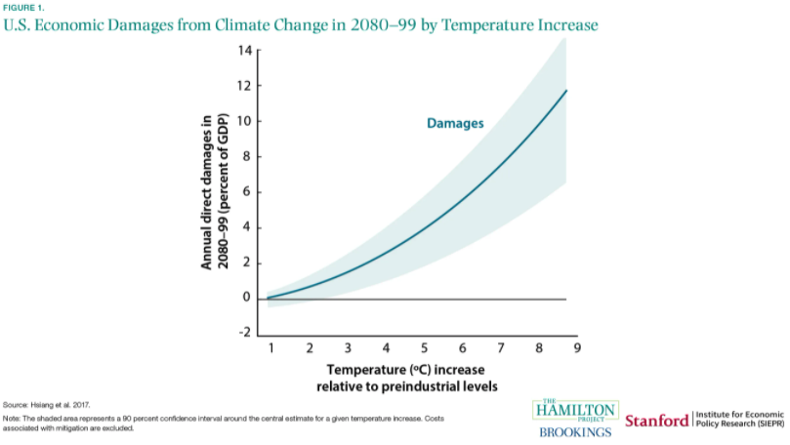

Slide 55
Pros and Cons of A Pigouvian Tax
Pros:
  Fosters market efficiency:
    Pigouvian taxes promote market efficiency by incorporating the additional costs imposed by negative externalities.
  Discourages harmful activities:
    In certain cases, Pigouvian taxes may effectively discourage the activities that lead to negative externalities. For example, the introduction of a carbon tax may place a significant burden on a company that produces substantial emission gases. Therefore, a company may decide to transfer to operations that produce fewer emission gases.
  Generates additional government revenue:
    Pigouvian taxes generate additional revenues for the government. The additional funds may be used to subsidize initiatives and programs that will further challenge negative externalities.

Slide 56
Pros and Cons of A Pigouvian Tax
Cons:
  Hard to measure:
    In theory, Pigouvian taxes must be equal to the costs generated by the negative externality. However, in the real world, the precise measurement of such costs is not always possible. Thus, in practice, the taxes are less effective than in theory.
  Political issues:
    The imposition of Pigouvian taxes is frequently associated with political problems. Government attempts to introduce such taxes generally face resistance from lobbyists who support parties that can be affected by the taxes (e.g., tobacco producers). Therefore, such taxes are not always an optimal solution from a political perspective.

Slide 57
Osher Lifelong Learning Institute, Spring 2022
Climate Change Economics
California State University – East Bay
March 30 and April 6, 2022
Jon Haveman, Ph.D.
National Economic Education Delegation

Slide 58
Available NEED Topics Include:
Coronavirus Economics
US Economy
Climate Change
Economic Inequality
Economic Mobility
Trade and Globalization
Minimum Wages
Immigration Economics
Housing Policy
Federal Budgets
Federal Debt
Black-White Wealth Gap
Autonomous Vehicles
US Social Policy

Slide 59
Outline
Climate change science
Impacts of climate change
Economics of responding to climate change
Addressing the sources of our emissions
Climate change policy
Policy in action

Slide 60
Climate Change:
Week 2

Slide 61
A Climate Change Ladder
Emissions
Mitigation (a.k.a. Abatement)
Adaptation
Damages

Slide 62
Adaptation Reduces Damages
Human adaptations are costly actions that can reduce damages from climate change.
The net cost to society is the cost of adaptation plus the cost of the remaining damages.
People will take some actions on their own, up to the point where they find it worthwhile.
Some responses require government involvement: large-scale actions or actions with shared benefits.
Adaptation is already underway.

Slide 63

Individual-Level Adaptation
Perhaps you…
  Stay inside more.
  Turn on the air conditioning.
Farmers may:
  Plant at different times.
  Plant new crops.
Businesses may:
  Give outdoor workers water / shade breaks.
Everyone might:
  Think about moving to a safer place.
Notes:
Could be one or several slides with images to represent

Slide 64
Public Adaptation
Governments can help:
  When collective action is less costly than everyone acting alone.
  When individual action is not possible or likely.
  When some people can’t protect themselves.
Sea walls
Ecosystems that provide protection
Supporting low-income and vulnerable populations
Moving residents of a town
Notes:
Could be one or several slides with images to represent

Slide 65
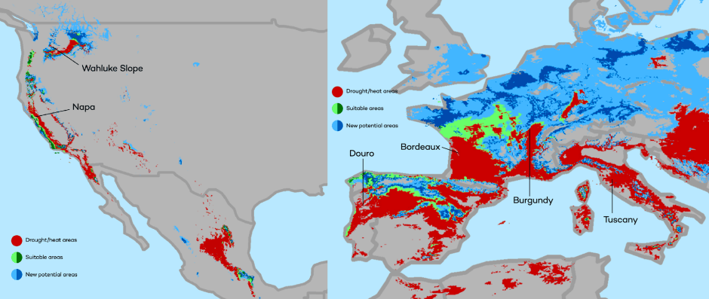
Market Based Adaptation
Prices and costs influence behavior.
  Where to live.
  Where/when/what to plant.
Avoid barriers to market adjustment.
  Trade barriers, immigration restrictions, federal flood insurance, agricultural subsidies, and zoning regulations.
The changing map of the world’s wine-growing regions.

Slide 66
A Climate Change Ladder
Emissions
Mitigation (a.k.a. Abatement)
Adaptation
Damages

Slide 67
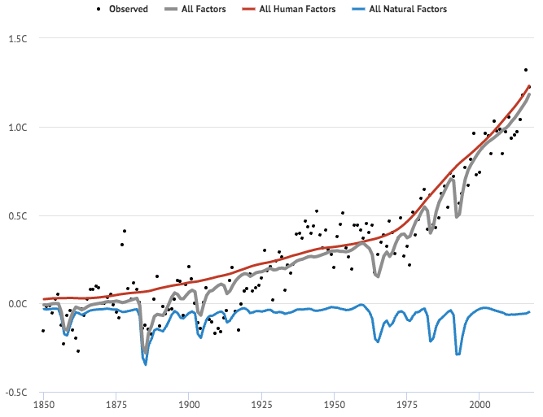
Global Temps: Human and Other Sources
Source: https://www.carbonbrief.org/analysis-why-scientists-think-100-of-global-warming-is-due-to-humans

Slide 68
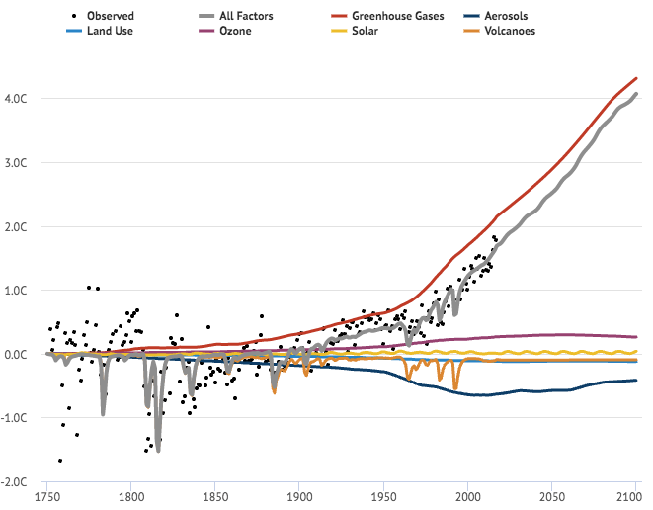
Global Temps: Forecast
Source: https://www.carbonbrief.org/analysis-why-scientists-think-100-of-global-warming-is-due-to-humans

Slide 69
International Climate Policy Goals
Intergovernmental Panel on Climate Change (IPCC)
  Global effort to fight climate change
  Reports on consensus of climate science, including economics
IPCC report in 2007:
  Recommended goal: < 2 degrees C (3.6 degrees F)
  Industrialized countries should reduce GHG emissions between 25% and 40% below 1990 levels by 2020.
2016 Paris Agreement:
  Basic goal of 2 degrees C: requires 40-70% GHG reduction 2010 → 2050
  Reach goal of 1.5 degrees C: requires 70-95% GHG reduction 2010 → 2050
IPCC report in 2018:
  Temperature has already increased by 1.0 degrees C - Recommended: < 1.5 C

Slide 70
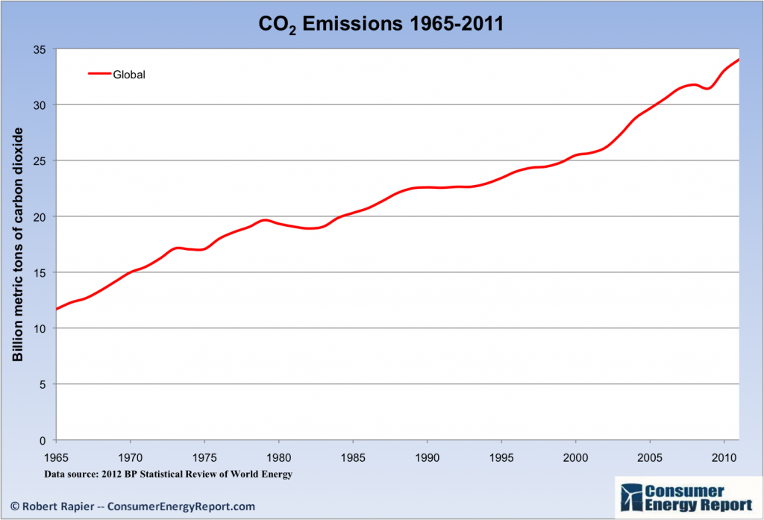
Recent Progress on Climate Goals
IPCC’s Fifth Assessment Report (2014)
  Goals from previous report (2007) were met!
  … but mainly because of the Great Recession…
  … which is not the preferred method of reducing emissions.
Notes:
Could use this graph of emissions over time or energy use over time, as it clearly shows a dip where the recession is; from the US Energy Information Administration International Energy Outlook

Slide 71
Electricity Is Different From Oranges
Many sources of electricity generate pollution.
Pollution is an EXTERNALITY:
  a side effect (cost or benefit) that affects someone
  else when something is bought or sold.
  This is a market failure.
The price of electricity does not reflect all of the costs.
  Electricity is too cheap.
  There is too much pollution.

Slide 72
How Economists Decide How Much to Fight
Climate Change
Cost Benefit Analysis
Expected costs of reducing emissions
Weigh:
Expected damages from allowing climate change

Slide 73
Cost-Benefit Analysis of Fighting Climate
Change
Most economic models suggest the costs of keeping warming below 2°C are relatively small.
  Costs amount to 1 - 4% of global GDP by 2030.
Costs of acting to keep warming below 2°C are almost certainly less than future economic damages they would avoid.
  Damages estimated to be between: 7 - 20% of worldwide GDP.
Caveats:
  Putting a monetary value on priceless things
  Inequality
  Uncertainty and risk

Slide 74
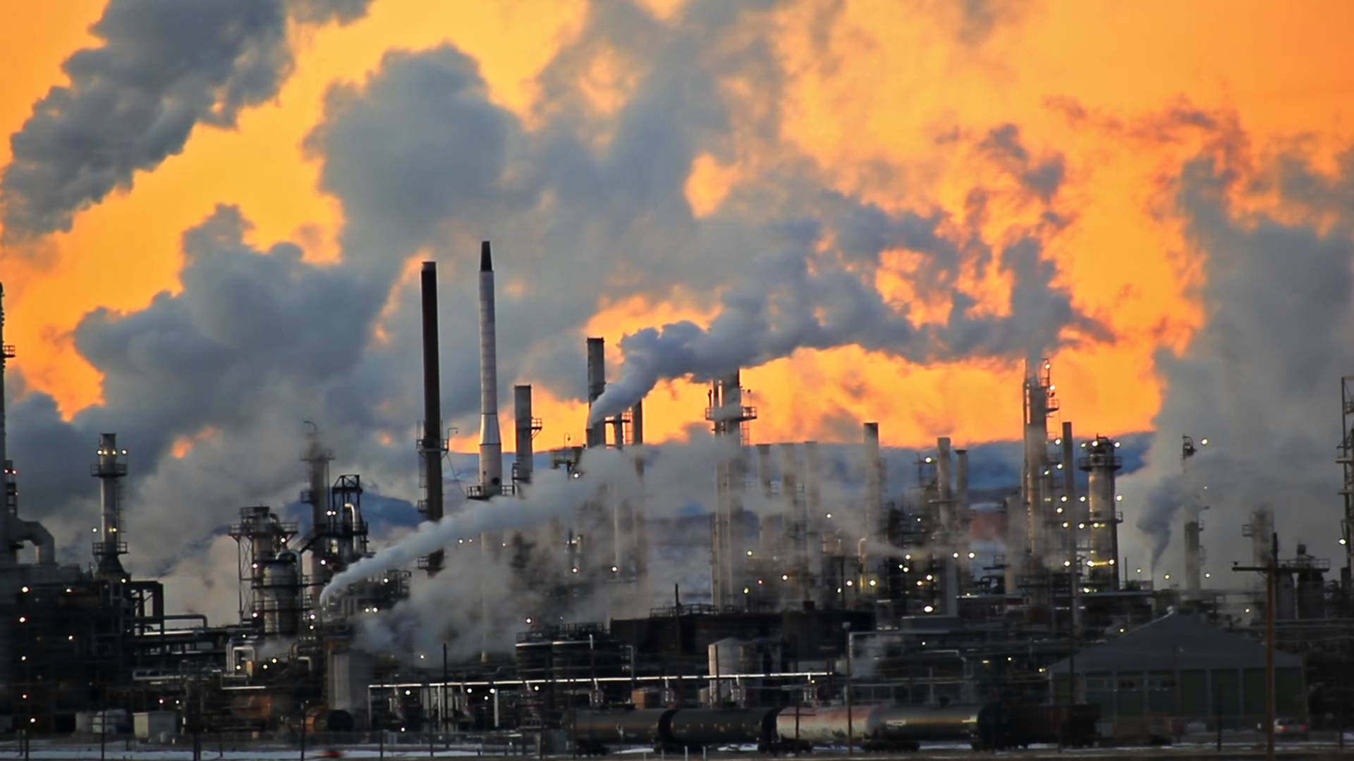
Present Value of a Future $100 Cost or Benefit
“
It is better to be roughly right
than precisely wrong.
- John Maynard Keynes
“

Slide 75
This is What Precisely Wrong Looks Like
The changing map of the world’s wine-growing regions.

Slide 76
Air Travel
Warmer weather makes air travel more difficult and more costly.
  Warmer weather means that:
    Planes need to be lighter.
    Runways need to be longer.
    Schedules may need to be adjusted to earlier and later in the day.
  Specific events:
    June 2021 – Heat Dome – Seattle/Portland
      Flights cancelled and delayed, ramp employees can’t work.
    2018 – London – many flights cancelled.
    2017 – Phoenix – many flights cancelled.
  It’s not just the Middle East anymore.
  Spillover effects onto the rest of the economy.
    Business travel as well as shipping of goods.

Slide 77
Extreme Heat Events
1960s | 2010s
Average 2/year | Averaged 6/year
 | - On average one day longer than in the 1960s.
 | - Season for heat waves more than 47 days longer.
And more intense heat waves are on the way.

Slide 78
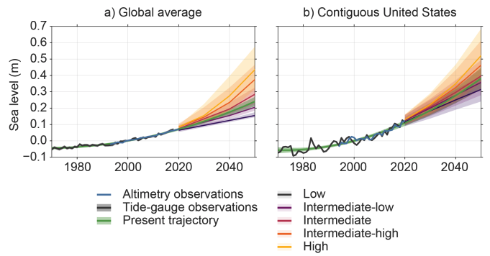
Sea Level Rise – to 2050
1.9 Feet
2.2 Feet
Source: https://aambpublicoceanservice.blob.core.windows.net/oceanserviceprod/hazards/sealevelrise/2.0-Future-Mean-Sea-Level.pdf
Notes:
https://aambpublicoceanservice.blob.core.windows.net/oceanserviceprod/hazards/sealevelrise/2.0-Future-Mean-Sea-Level.pdf

Slide 79
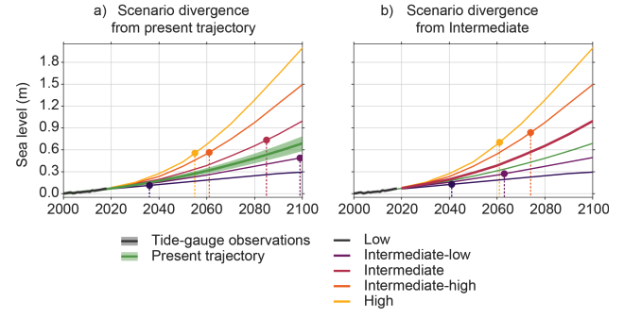
Sea Level Rise – to 2100
6.5 Feet
Source: https://aambpublicoceanservice.blob.core.windows.net/oceanserviceprod/hazards/sealevelrise/2.0-Future-Mean-Sea-Level.pdf
Notes:
https://aambpublicoceanservice.blob.core.windows.net/oceanserviceprod/hazards/sealevelrise/2.0-Future-Mean-Sea-Level.pdf

Slide 80
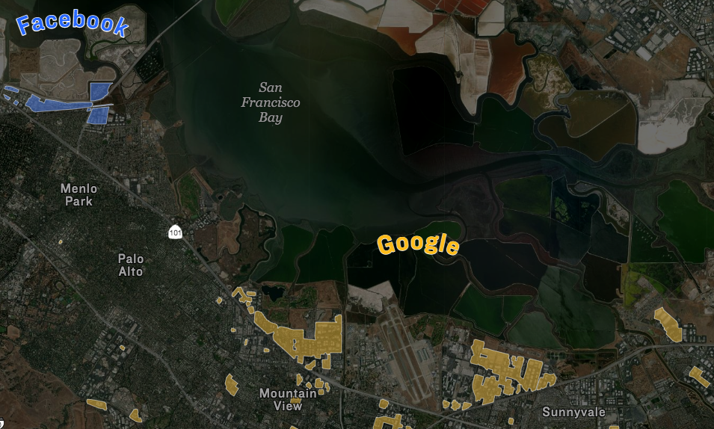
Silicon Valley is Vulnerable

Slide 81
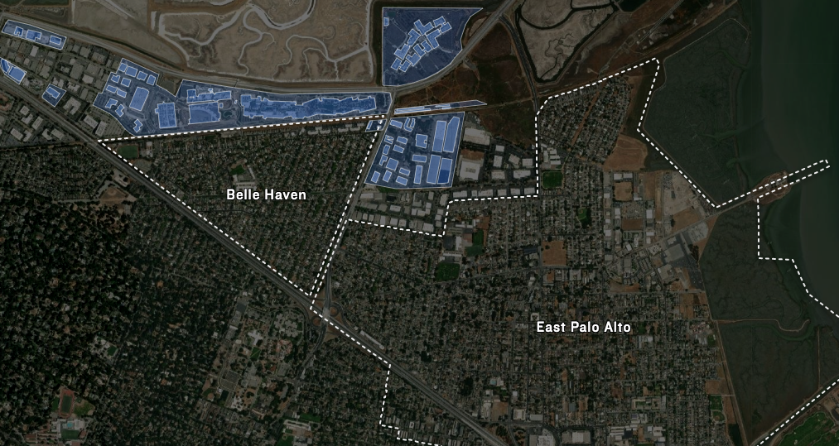
Silicon Valley: Facebook’s Vulnerability
Facebook
Notes:
https://apps.npr.org/sea-level-rise-silicon-valley/

Slide 82
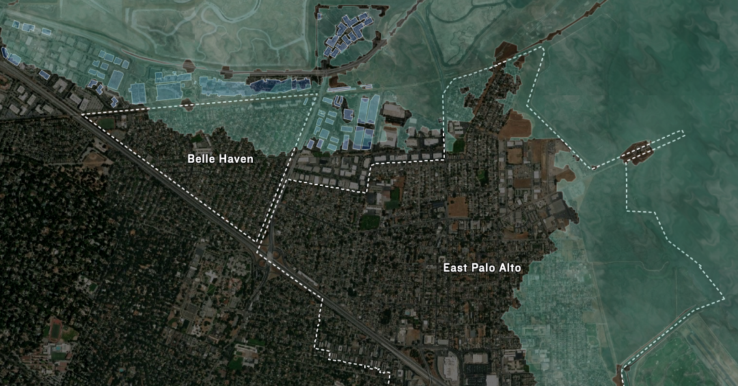
Silicon Valley: In Just A Couple of Decades
Facebook

Slide 83
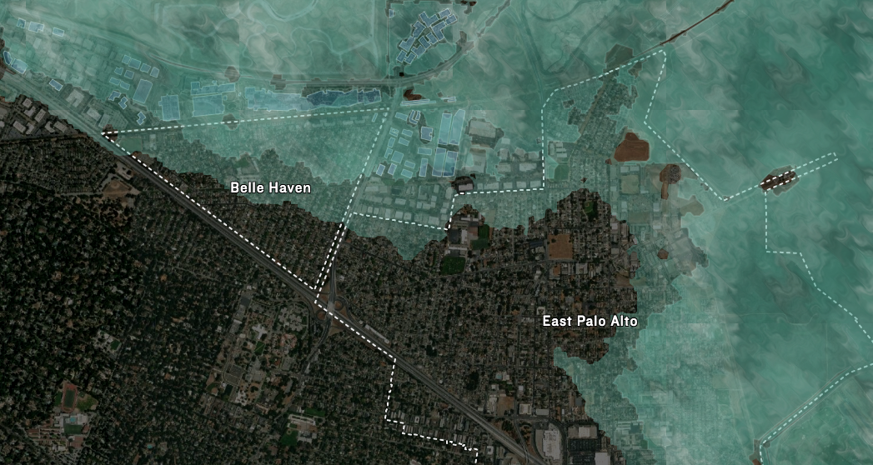
Silicon Valley: End of the Century
Facebook

Slide 84
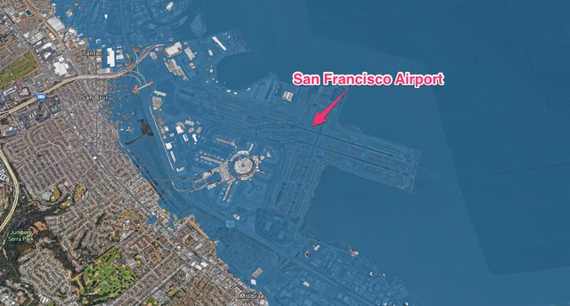
Lots of Infrastructure is Vulnerable

Slide 85
Downhill Skiing: Sierra Nevadas
By the end of the century:
  Temperatures will likely rise 6-9 degrees F.
  Rain-to-snow transition will rise by 1,500 to 3,000 feet.
    No snowpack below 6,000 feet.
  60% reduction of the snowpack.
Implications not only for the ski industry, but for water in the Bay Area.
  The Sierras are (as of now) a massive water reservoir.
Notes:
https://www.climate.gov/news-features/climate-and/climate-skiing

Slide 86
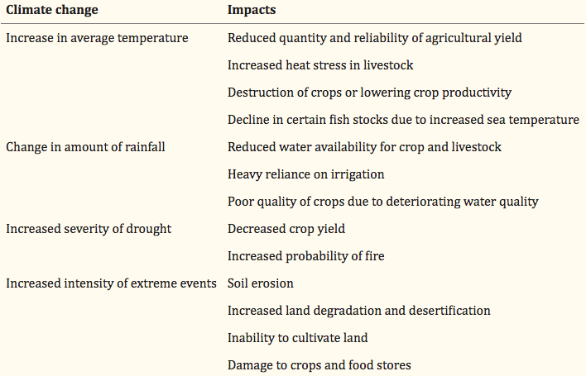
Food Insecurity
Source: National Institute for Health
Notes:
https://www.ncbi.nlm.nih.gov/pmc/articles/PMC6014268/

Slide 87
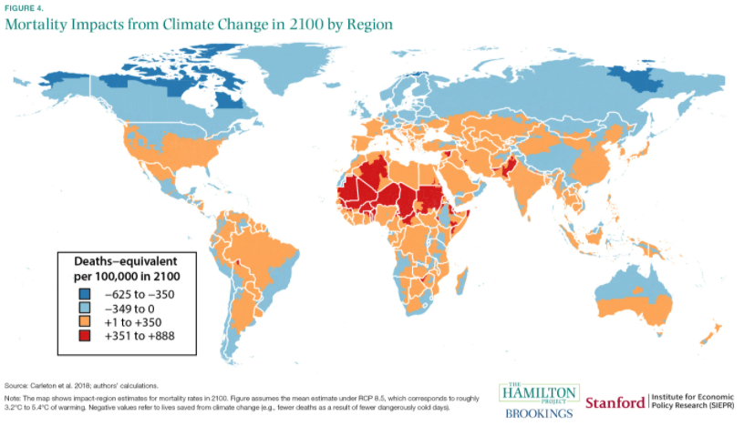
https://www.brookings.edu/research/ten-facts-about-the-economics-of-climate-change-and-climate-policy/
Notes:
https://www.brookings.edu/research/ten-facts-about-the-economics-of-climate-change-and-climate-policy/

Slide 88
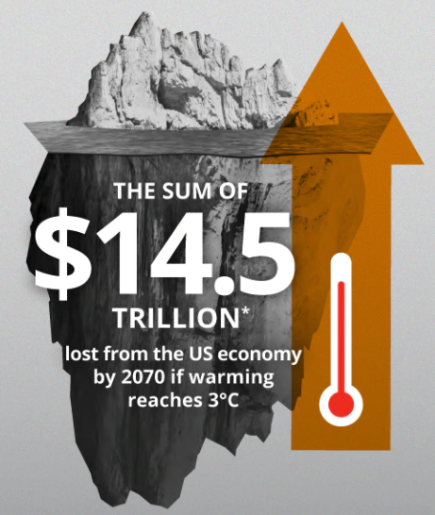
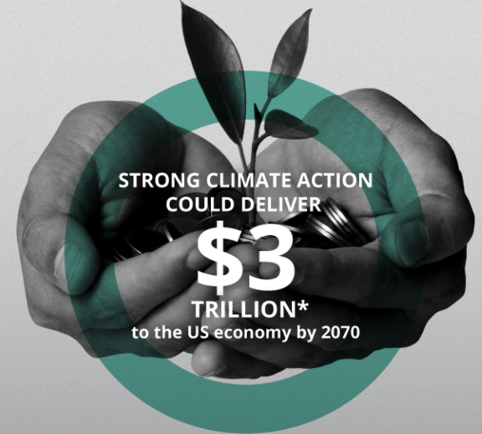

One Estimate of Costs and Benefits

Slide 89
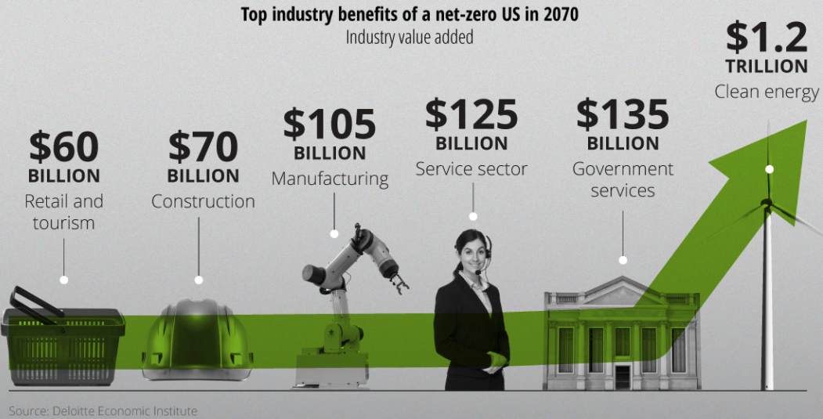
Where do the Benefits Accrue?

Slide 90
Economic Growth and Climate Change Action
Are Compatible
Abating greenhouse gas emissions is costly…
… but climate change damages are even more costly.
Economic growth comes with consequences that we have to deal with, including climate consequences.
Economies with environmental regulations can still be dynamic.
Goal: design policies that reach climate goals at the least possible cost.

Slide 91
Reducing Emissions:
Policy Focused on Mitigation

Slide 92
Global Net Emissions
Are What We Care About
For climate impacts, we don’t care where they are emitted, only how much
  There may be other local impacts
Gross emissions (greenhouse gas sources): how much greenhouse gases (including CO2) we put out
Greenhouse gas sinks: ways to pull CO2 out of the air
  Existing: oceans, forests
  Increase sinkage by planting trees, or other measures

Slide 93
Electricity Is Different From Oranges
Many sources of electricity generate pollution.
Pollution is an EXTERNALITY:
  a side effect (cost or benefit) that affects someone
  else when something is bought or sold.
  This is a market failure.
The price of electricity does not reflect all of the costs.
  Electricity is too cheap.
  There is too much pollution.

Slide 94
Total U.S. Greenhouse Gas Emissions by Economic Sector in 2020
Notes:
https://www.epa.gov/ghgemissions/sources-greenhouse-gas-emissions

Slide 95
Which Emissions Should We Cut?
List all possible ways to reduce emissions
Figure out how much each can reduce in total
Figure out how much each costs per unit of emissions reduced
Line them up in order: cheapest to costliest (“marginal abatement cost curve”)
  → Tackle first the cheapest ones!

Slide 96
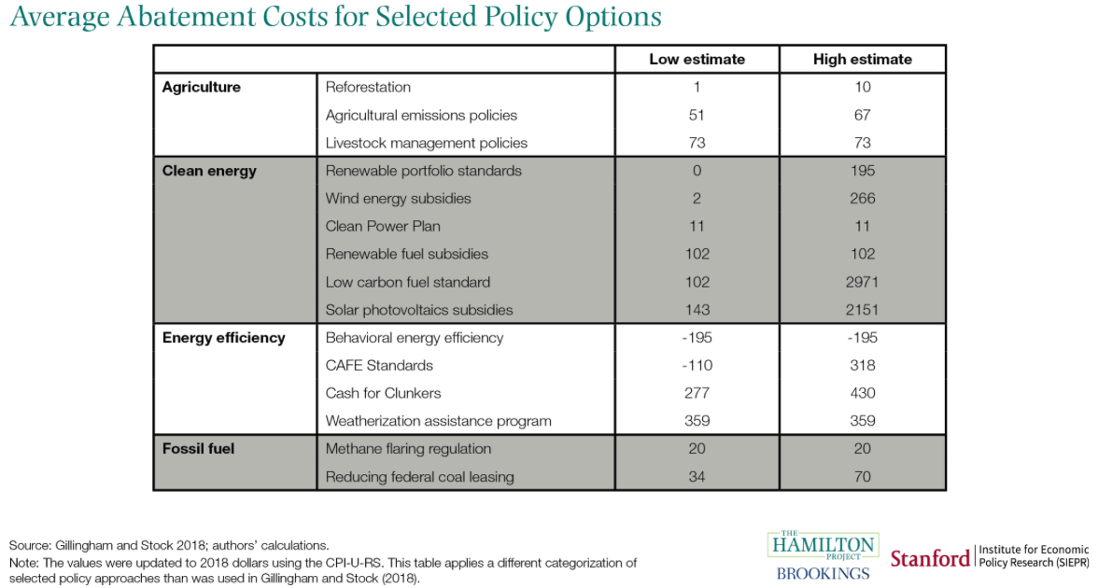
$/Ton of
Emissions
Reduction
https://www.brookings.edu/research/ten-facts-about-the-economics-of-climate-change-and-climate-policy/
Notes:
https://www.brookings.edu/research/ten-facts-about-the-economics-of-climate-change-and-climate-policy/

Slide 97
Global GHG Abatement Cost Curve
Lighting
Appliances
Hybrid cars
Notes:
McKinsey report

Slide 98
But Are Costs So Easy to Assess?
Difficult to project future costs for new technology
  Costs of renewables have been dropping fast
Investments in research and development and infrastructure (e.g., EV charging) can lower future costs

Slide 99
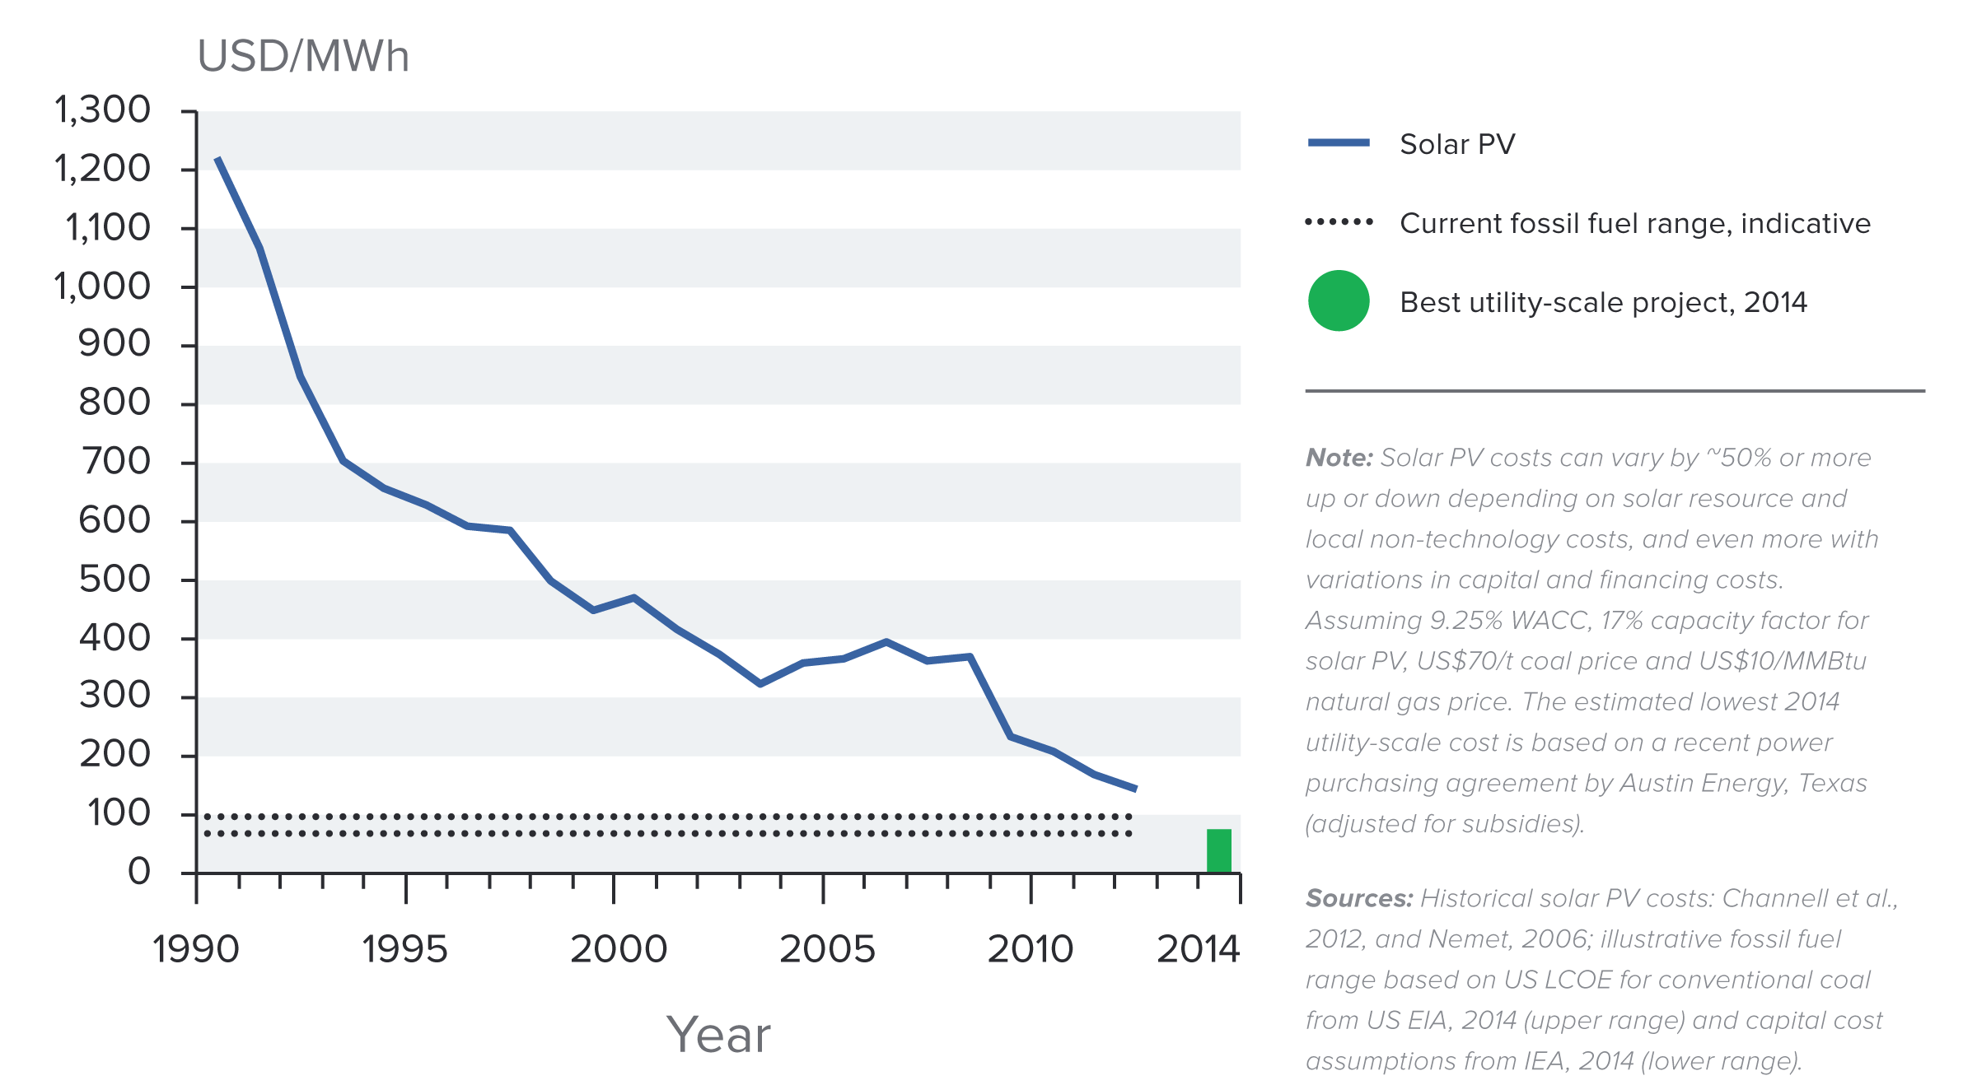
Indicative Solar Costs Over Time
Notes:
Source: New Climate Economy Report

Slide 100
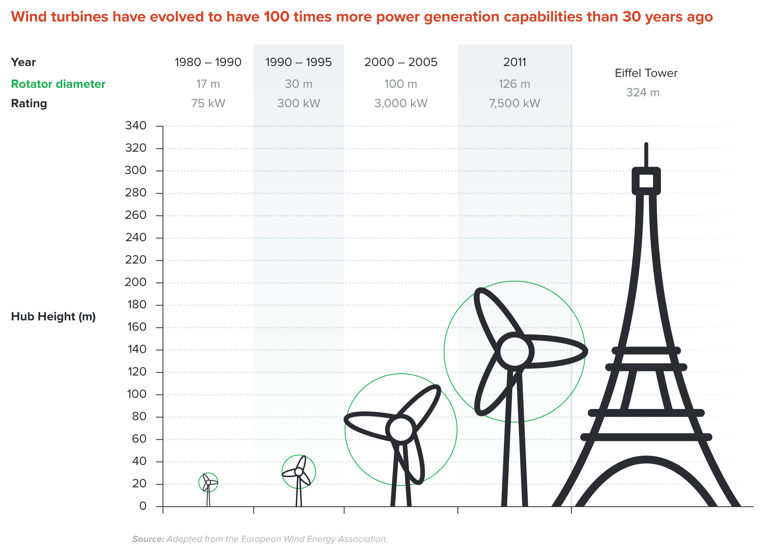
Wind Turbines Have 100 Times More Power
Generation Capabilities Than 30 Years Ago
Notes:
Source: New Climate Economy Report

Slide 101
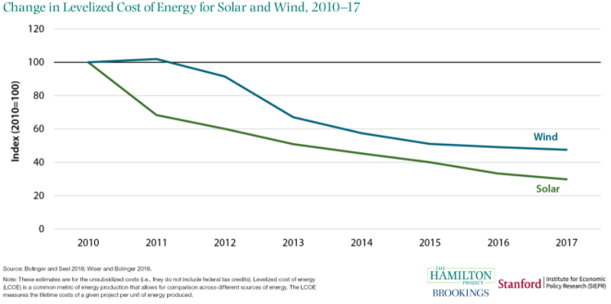
https://www.brookings.edu/research/ten-facts-about-the-economics-of-climate-change-and-climate-policy/

Slide 102


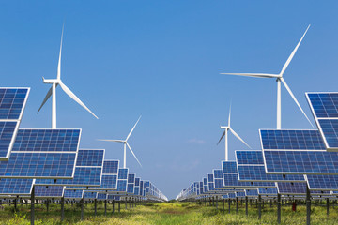
Challenges with Renewable Energy
It’s intermittent - only produced if there is sun or wind.
Energy is needed all day and night, with peak times.
Limited w/o storage.
  Creative storage options are under development.

Slide 103
Climate Change Policy

Slide 104
Policies That Reduce Emissions: Directly
Regulation
  Emissions standards or limits
    E.g., CAFE standards
Market-oriented policies
  Putting a price on emissions
    Subsidizing green energy (e.g., feed-in tariffs)
    Tax or cap & trade
Notes:
These are the favored policies. Address a problem head on and let the market deal with it.

Slide 105
How Does a Carbon Tax Work?
Activities to be covered are determined.
The price of emissions is determined.
  Presumably some relation to the social cost of polluting.
Emissions are measured.
Taxes are determined.
Q: What to do with the tax revenue?

Slide 106
How Does Cap and Trade Work?
Activities to be covered are determined.
Acceptable emissions levels are indicated.
“Permits” that allow acceptable emissions levels are issued.
  How?
    According to historical emissions?
    Evenly across emitters?
    Sold at some price?
A “market” is developed.
Those desiring to emit will have to buy sufficient permits to accommodate their emissions.
Those wishing to abate will offer their permits on the “market”.
  The price of a permit indicates:
    The benefit of eliminating further emissions.
    The cost of emitting.
Gov’t agency determines equality of permits in possession and emissions.

Slide 107
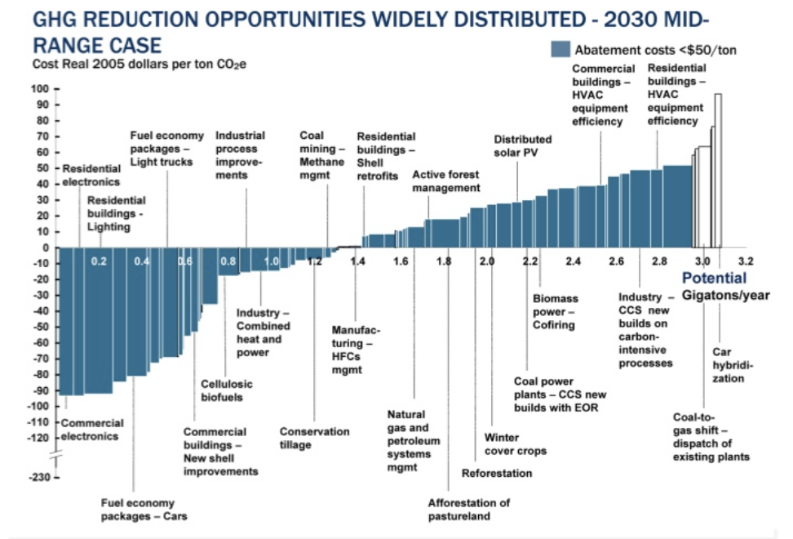
Putting a Price on Carbon
Suppose a Social Cost
Of Carbon of $50
Notes:
Shana: perhaps another infographic is beneficial here. Reintroduce the original cost graph. Fade out the costs and leave the MAC. Then introduce a price. If it’s cheaper to abate, then firms will do that, otherwise they will buy a permit or pay the tax. I know this is super simplified. I introduce specifics at the start of the emissions trading section and the tax section below.

Slide 108

Carbon Prices: the Good and Bad
Good:
  Provide price signal to lower emissions.
  They yield low-cost reductions in emissions.
  They spur innovation in clean technologies.
Bad:
  Firms might leave to flee regulation.
  It is necessary to monitor emissions.
  Potentially regressive
    Costs may weigh more heavily on low-income households.

Slide 109
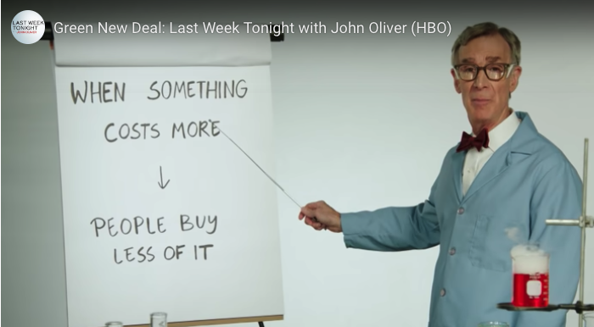
Both Policies Work Through Prices
Full video: https://www.youtube.com/watch?v=XHK1OBSBpwc

Slide 110
Carbon Tax and Cap & Trade: the Differences
 | Carbon Tax | Cap & Trade
Carbon Price | Certain | Uncertain
Emissions | Uncertain | Certain
Ease of Implementation | May be easier to implement
Additional concerns | Always generates revenue May require legislation to change | May be more susceptible to lobbying Only generates revenue if government sells permits Cap can be changed by regulator

Slide 111
Carbon Tax and Cap & Trade: the Differences
 | Carbon Tax | Cap & Trade
Carbon Price | Certain | Uncertain
Emissions | Uncertain | Certain
Ease of Implementation | May be easier to implement
Additional concerns | 1) Always generates revenue 2) May require legislation to change 3) Predictability | 1) Susceptible to lobbying. 2) Only generates revenue if government sells permits. 3) Cap can be changed by regulator. 4) Less certainty over future. 5) Regulations reduce efficacy of Cap & Trade

Slide 112
One Other Thing: Cap and Trade vs. Carbon Tax
Emissions regulations and Cap and Trade can work at cross purposes.
  Regulations that lower emissions from big polluters…
    Lower the demand for permits
    Lowers the price of permits
    Reduces incentives for other industries to cut emissions
Regulations can undermine the effectiveness of Cap and Trade.
The same is not true of a carbon tax.
  Though regulations might cut tax revenue, revenue is not the goal of the carbon tax.

Slide 113
Command and Control vs. Incentive-Based Regulation
Equity
Efficiency

Slide 114
Command and Control vs. Incentive-Based Regulation
Equity
  Both may have regressive impacts (low-income families bear costs that are a larger percent of their incomes vs hi-income families)
    Cap and trade and carbon tax can generate revenues that can be used to offset the regressivity.
      E.g.: “carbon dividend”
    Command and control regulations do not.

Slide 115
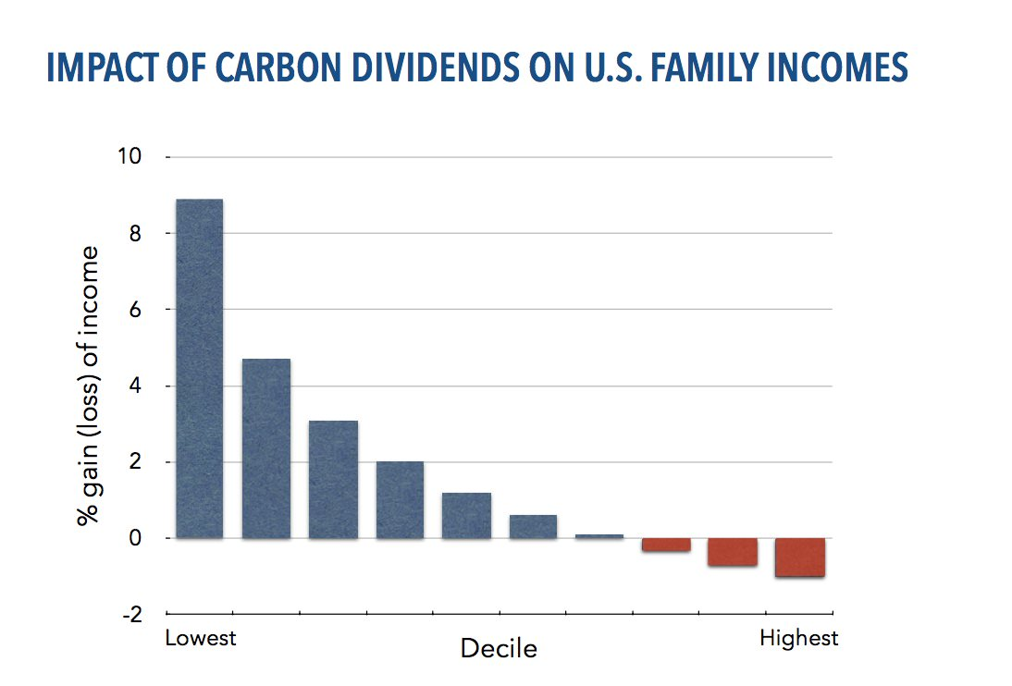
Revenue Dividend Eliminates Regressivity
Source: U.S. Treasury, 2017

Slide 116
Command and Control vs. Incentive-Based Regulation
Efficiency.
  Both can achieve the same amount of emissions reduction.
  Incentive-based policies can achieve emissions reduction at much lower cost.
    Example: CAFÉ Standards vs Carbon Tax
      Tax is significantly more efficient.
      Why?

Slide 117
Efficiency: CAFÉ vs Carbon Tax
CAFÉ = Corporate Average Fuel Efficiency
  A fuel economy standard mandating that an auto‐maker’s vehicle fleet must meet minimum fuel economy standards.
Horse Race
  Tax on fuel applies to ALL vehicles, not just new.
  Rebound Effect:
    Driving a more efficient vehicle lowers the cost per mile driven
      leading to more miles driven.
  Slower turnover of inefficient vehicles: higher cost of new.
Summary
  A given level of emission reductions costs 3-14 times more with CAFÉ standards than under a comparable carbon tax.

Slide 118
Policies That Reduce Emissions: INDirectly
Subsidizing R&D
Grid / infrastructure
Energy efficiency mandates and subsidies
Mandating renewable energy (e.g., renewable portfolio standards)
Land use policies

Slide 119
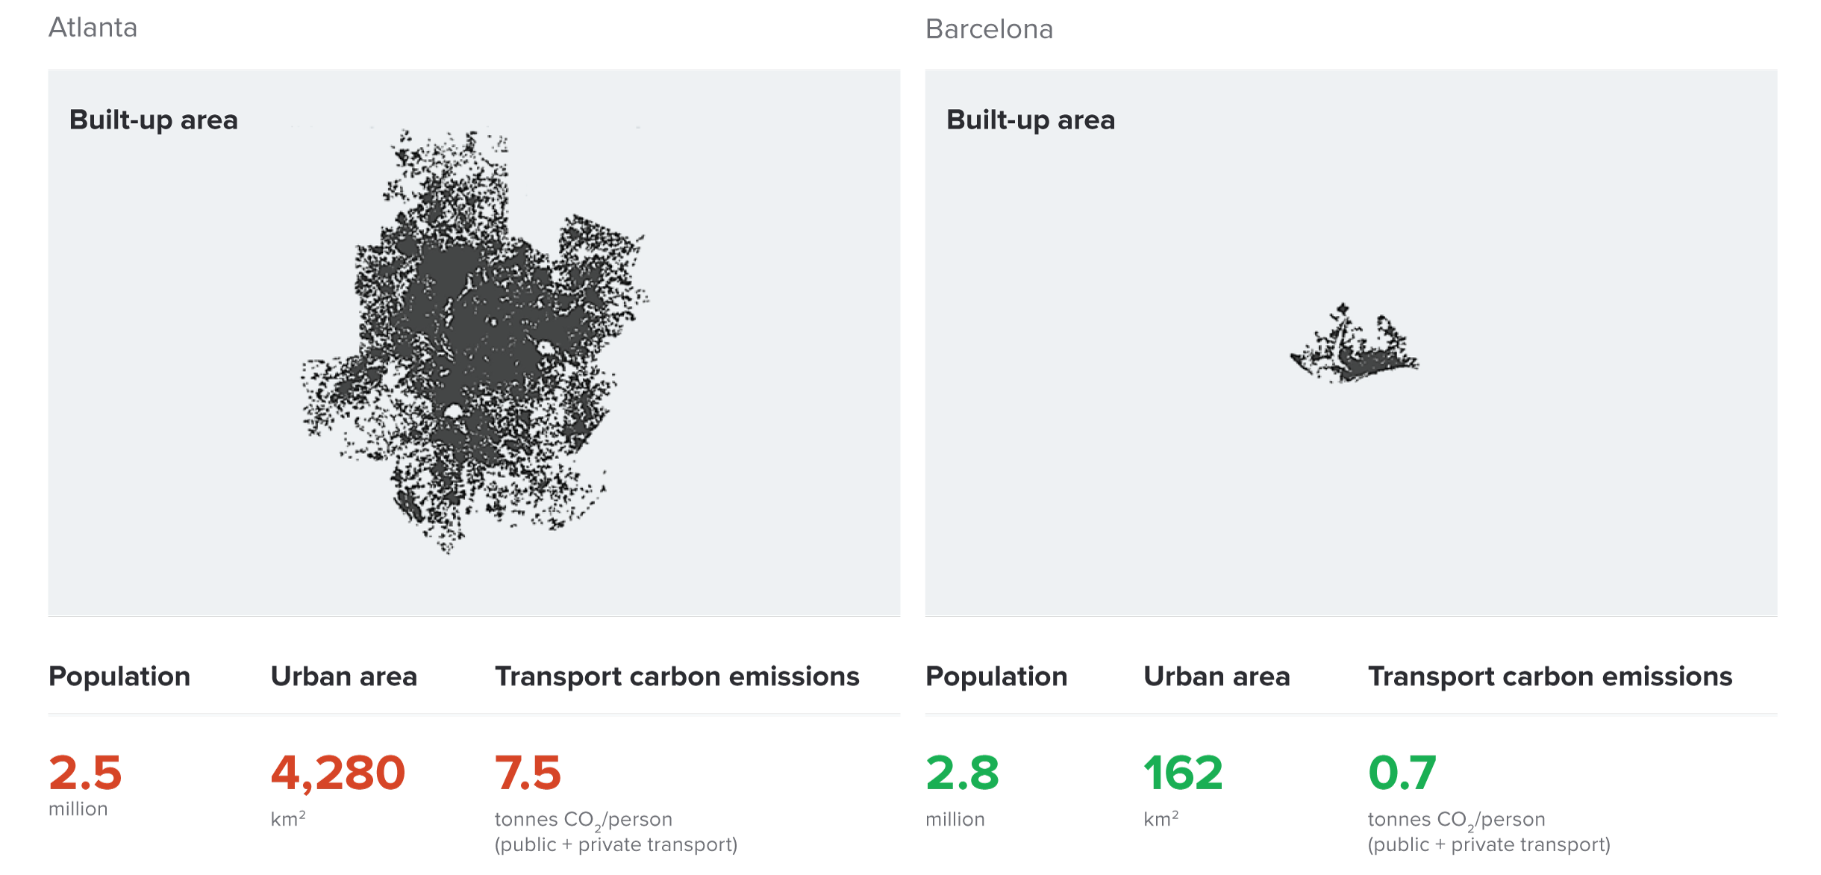
Atlanta and Barcelona Have Similar Populations but Very Different Carbon Productivity
Atlanta
Barcelona
Source: New Climate Economy Report, 2014
Notes:
Source: New Climate Economy Report

Slide 120
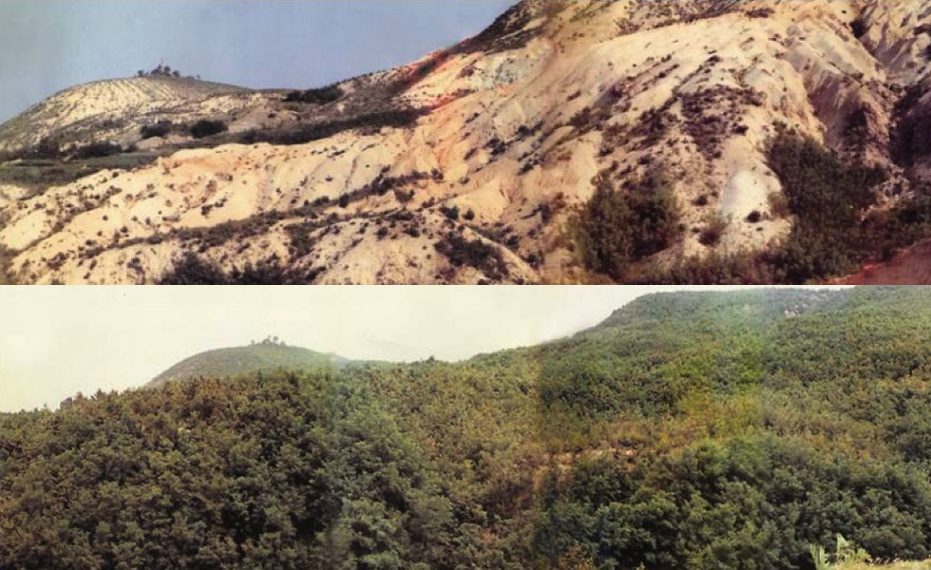
Land Use: Restoration Is Possible
1953
2000
South Korea restored its forest cover from 35% to 64% of the country’s total area
Notes:
Source: New Climate Economy Report

Slide 121
Climate Change Policy in Action

Slide 122

Incentive-Based Climate Policies Right Now
Source: World Bank Carbon - Pricing Dashboard
Notes:
https://carbonpricingdashboard.worldbank.org/

Slide 123
Cap and Trade
Notes:
Does NEED want transition (section-starter) slides to maybe ALL look like this? If not, maybe these slides should be plain text like the rest of them?

Slide 124
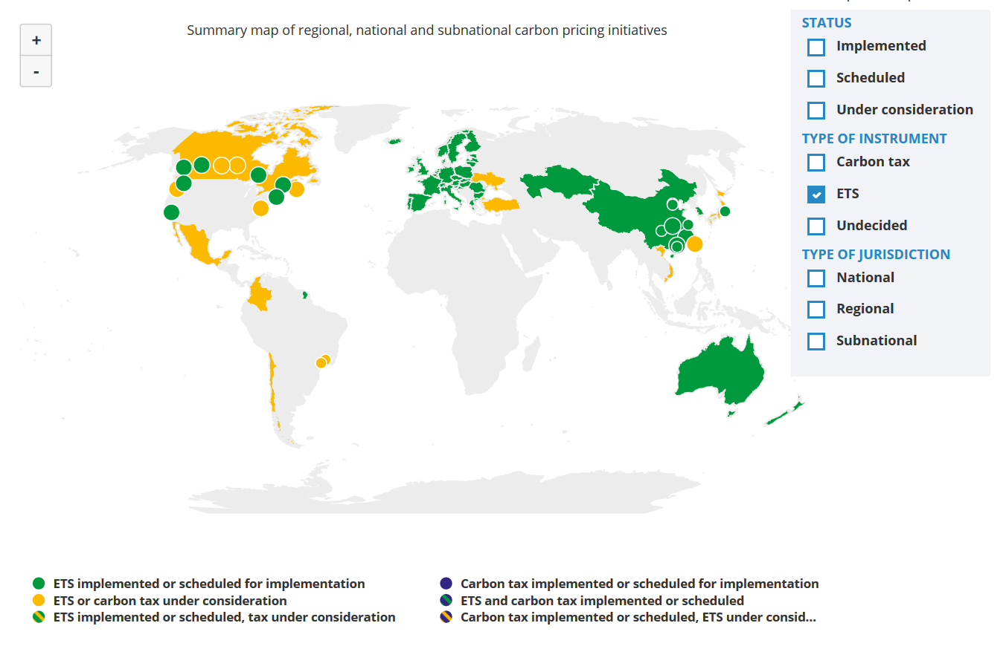
Cap and Trade Policies Around the World
ETS = Emissions Trading System = Cap and Trade
Source: World Bank - Carbon Pricing Dashboard

Slide 125

European Union’s Emissions Trading Scheme
4%
of global greenhouse gas emissions
Circa 2005

Slide 126
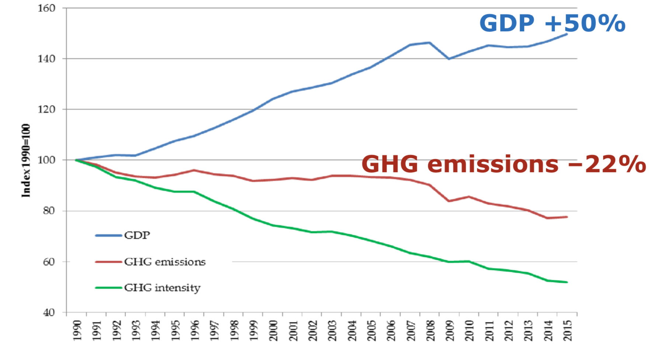
EU Has Decoupled Economic Growth from Greenhouse Gas Emissions
European Commission
Cap & Trade ->
Climate Action
Notes:
Source: “REPORT FROM THE COMMISSION TO THE EUROPEAN PARLIAMENT AND THE COUNCIL Implementing the Paris Agreement - Progress of the EU towards the at least -40% target” https://eur-lex.europa.eu/legal-content/EN/TXT/?uri=COM%3A2016%3A707%3AFIN

Slide 127

California’s Cap and Trade System: 2012+
0.7%
of global greenhouse gas emissions

Slide 128
California’s System Is Flexible
California’s goals:
  Reduce emissions to 1990 levels by 2020 (2016)
  An 80% reduction in emissions from 1990 levels by 2030
California’s Tools:
  Cap and Trade
  Renewable Portfolio Standard
  Clean Cars Program
  Low Carbon Fuel Standard

Slide 129

Change in California GDP, Population, and
GHG Emissions since 2000
Cap & Trade ->
Notes:
Source: https://ww3.arb.ca.gov/cc/inventory/pubs/reports/2000_2019/ghg_inventory_trends_00-19.pdf

Slide 130

Projected Trends in California’s Emissions
Notes:
https://www.c2es.org/content/california-cap-and-trade/

Slide 131
RGGI: the Regional Greenhouse Gas Initiative
Participants: Connecticut, Delaware, Maine, Maryland, Massachusetts, New Hampshire, New York, Rhode Island, and Vermont
  7% of US emissions
Covers power plants
First implemented in 2009
Caused emissions reduction of 24% below what they would have been

Slide 132
Carbon Tax
Notes:
Does NEED want transition (section-starter) slides to maybe ALL look like this? If not, maybe these slides should be plain text like the rest of them?

Slide 133
Worldwide Carbon Taxes
28
carbon tax programs
25
national jurisdictions
covered
5.5%
of global greenhouse gas emissions

Slide 134

British Columbia’s Carbon Tax Policy
0.1%
of global greenhouse gas emissions

Slide 135

“
Tax the pollution we do not want, and return the money for what we do want — money in people’s pockets, jobs and investment.
- B.C. Government - Carbon Tax Brochure
“

Slide 136
British Columbia's Tax on Carbon
Notes:
Source for slide: https://www2.gov.bc.ca/gov/content/environment/climate-change/planning-and-action/carbon-tax

Slide 137
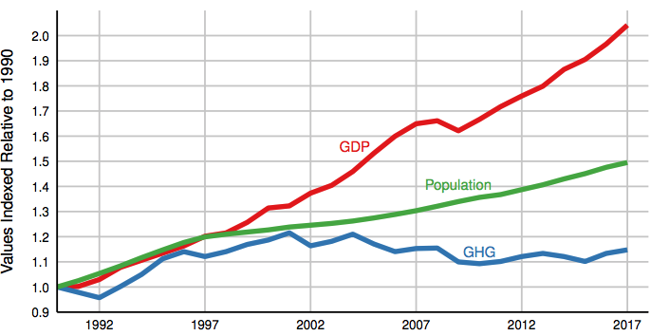
Relative Greenhouse Gas Emissions, GDP & Population Size: British Columbia
Carbon Tax ->
Notes:
http://www.env.gov.bc.ca/soe/indicators/sustainability/ghg-emissions.html

Slide 138

Sweden’s Carbon Tax Policy
Oldest Carbon Tax

Slide 139
Sweden’s Carbon Tax Policy
Started in 1991
Currently at $140/ton

Slide 140
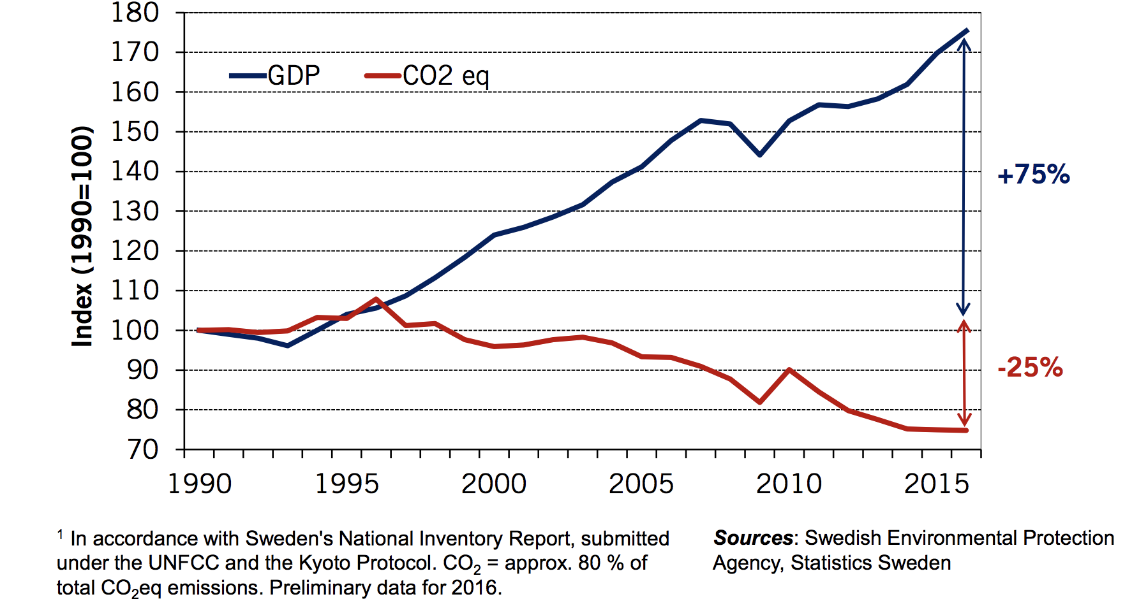
Real GDP and Domestic CO₂eq Emissions¹
In Sweden, 1990-2016
Notes:
Source: http://www.government.se/492fd9/contentassets/18ed243e60ca4b7fa05b36804ec64beb/170925-aakerfeldt-panel-debate-tuscon-gcet.pdf

Slide 141

U.S. Carbon Tax Plans
Climate Leadership Council
Citizens Climate Lobby
States and municipalities: Washington state, Oregon,
Washington, DC
CO₂

Slide 142

“
Economic policies will be central to accomplishing
the goals we choose.
- Harris and Roach (2007)
“

Slide 143
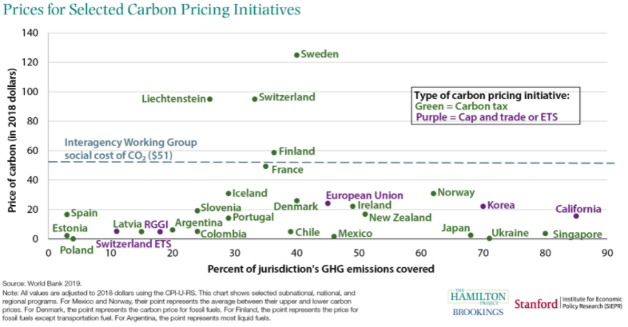

Slide 144
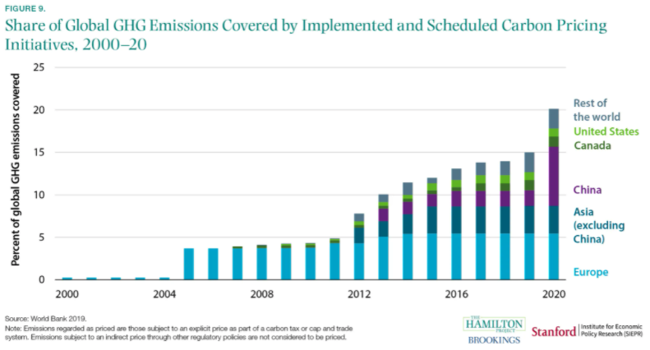
https://www.brookings.edu/research/ten-facts-about-the-economics-of-climate-change-and-climate-policy/

Slide 145
Summary
Climate change is real, is caused by human actions, and has impacts we’re already feeling.
We need to reduce emissions to balance the costs of action against the costs of inaction.
Scientists and the IPCC recommend that we work to keep warming below 1.5 degrees celcius.
  Economists believe that this goal is well worth the costs!

Slide 146
Summary – continued
There are many ways to reduce emissions.
Economics-inspired policies can help us do this at the lowest cost.
Taxes and cap and trade are proven effective tools to fight climate change!
Other tools may also be necessary.

Slide 147
Thank you!
Any Questions?
www.NEEDelegation.org
Jon D. Haveman
Jon@NEEDelegation.org
Contact NEED: info@NEEDelegation.org
Submit a testimonial: www.NEEDelegation.org/testimonials.php
Become a Friend of NEED: www.NEEDelegation.org/friend.php

