Slide 1




Climate Change Economics
Simone A. Wegge, Ph.D.
City University of New York
Kiwanis Club Of Columbus, OH
January 10, 2022

Slide 2
National Economic Education Delegation
Vision
  One day, the public discussion of policy issues will be grounded in an accurate perception of the underlying economic principles and data.
Mission
  NEED unites the skills and knowledge of a vast network of professional economists to promote understanding of the economics of policy issues in the United States.
NEED Presentations
  Are nonpartisan and intended to reflect the consensus of the economics profession.

Slide 3
Who Are We?
Honorary Board: 53 members
  2 Fed Chairs: Janet Yellen, Ben Bernanke
  6 Chairs Council of Economic Advisers
    Furman (D), Rosen (R), Bernanke (R), Yellen (D), Tyson (D), Goolsbee (D)
  3 Nobel Prize Winners
    Akerlof, Smith, Maskin
Delegates: 585+ members
  At all levels of academia and some in government service
  All have a Ph.D. in economics
  Crowdsource slide decks
  Give presentations
Global Partners: 45 Ph.D. Economists
  Aid in slide deck development

Slide 4
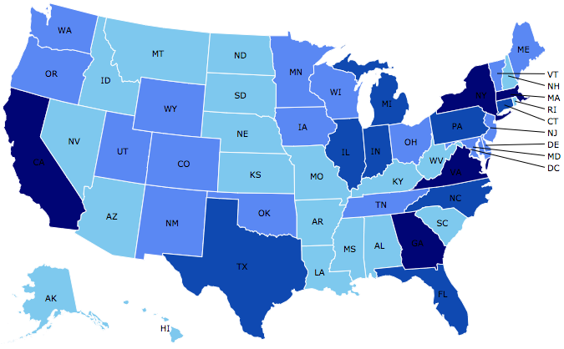
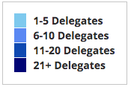
Where Are We?

Slide 5
Credits and Disclaimer
This slide deck was authored by:
  Shana Mcdermott, Trinity University
  Sarah Jacobson, Williams College
  Sharon Shewmake, Western Washington University
This slide deck was reviewed by:
  Jason Shogren, University of Wyoming
  Walter Thurman, North Carolina State University
Disclaimer
  NEED presentations are designed to be nonpartisan.
  It is, however, inevitable that the presenter will be asked for and will provide their own views.
  Such views are those of the presenter and not necessarily those of the National Economic Education Delegation (NEED).

Slide 6
Outline
Climate change science
Impacts of climate change
Economics of responding to climate change
Addressing the sources of our emissions
Climate change policy
Policy in action

Slide 7
How Can Economists Contribute to
Thinking about Climate Change?
By assessing behavioral reactions to climate change.
By measuring the damage and estimating the economic costs of fighting climate change.
By designing smart policies that minimize costs.
  Balance economic growth with GHG emission mitigation.

Slide 8
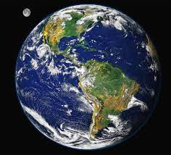
Climate Change Science

Slide 9
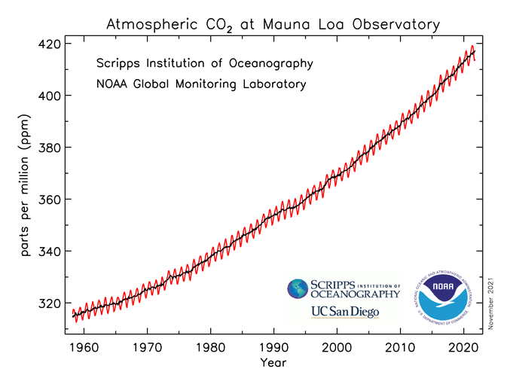
Atmospheric CO₂ Concentrations
Source: NOAA
Notes:
https://gml.noaa.gov/ccgg/trends/

Slide 10
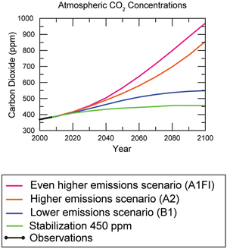
Atmospheric CO₂ Concentrations
Projections →
Source: IPCC data distribution center and climate.gov
Notes:
https://gml.noaa.gov/ccgg/trends/

Slide 11
The Atmospheric Greenhouse Effect
Sun
Atmosphere
Light reflected back
onto earth
Light reflected back
into space

Slide 12




Uncertainty
?
?
?

Slide 13
How Much Pollution Does Society Want?
Analogy: How Many Oranges Does Society Want?
People grow and sell oranges for a price that at least covers costs (supply).
People will not pay more for them than what they consider to be their value (demand).
Prices let supply and demand balance out. The price settles where:
This is the “right” number of oranges for society.
Prices reflect scarcity and the social value of the resource.
# of oranges people want to sell = # of oranges people want to buy

Slide 14
Electricity Is Different From Oranges
Many sources of electricity generate pollution.
Pollution is an EXTERNALITY:
  a side effect (cost or benefit) that affects someone
  else when something is bought or sold.
  This is a market failure.
The price of electricity does not reflect all of the costs.
  Electricity is too cheap.
  There is too much pollution.

Slide 15
Impacts of Climate Change

Slide 16
Global Warming Indicators

Slide 17
How These Impacts Affect Humans
Agriculture
Fisheries
Coastal damages
Direct health effects, including sickness and death (temperature & drought; also pollution)
Indirect health effects (vector-borne disease)
Reduced fresh water availability
Wildfires
Shifting zones for important ecosystems, and desertification
Reduced worker productivity
Increased violence
Some of these may cause human migration and/or conflict
Notes:
This could be a series of slides with pictures for each one

Slide 18
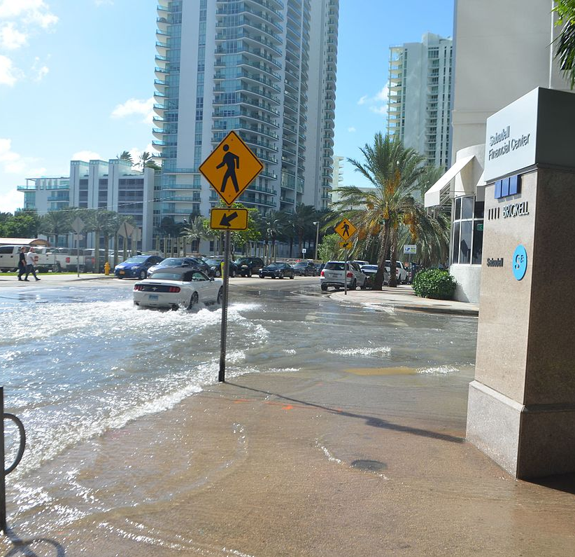
Real Estate Markets
Sea level rise
Wildfire risk
Extreme weather events
  Hurricanes
  Extreme rainfall
  Drought
Water supplies, electricity reliability
Residential markets affected
Turnover leading indicator
This Photo by Unknown Author is licensed under CC BY-SA
Notes:
Add pictures or replace words with pictures

Slide 19
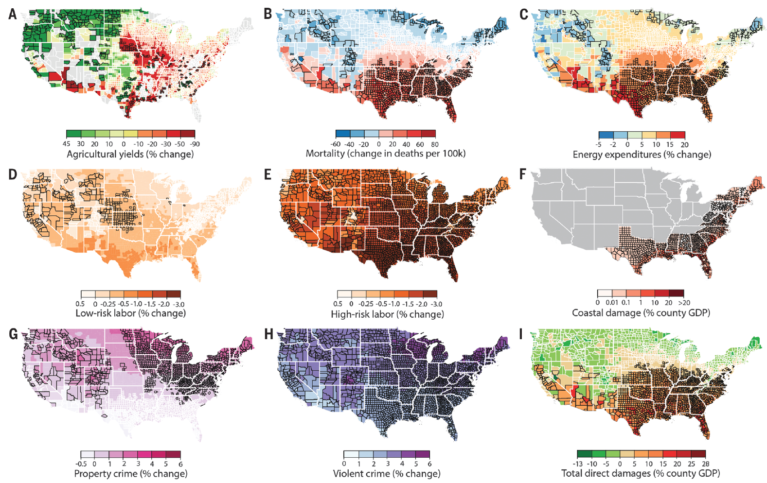
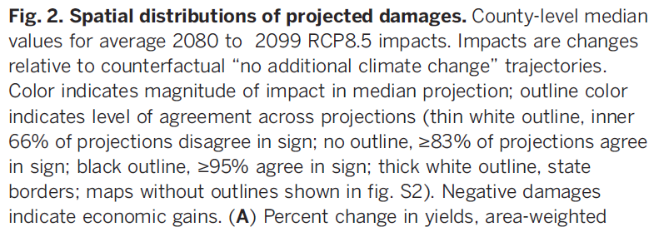
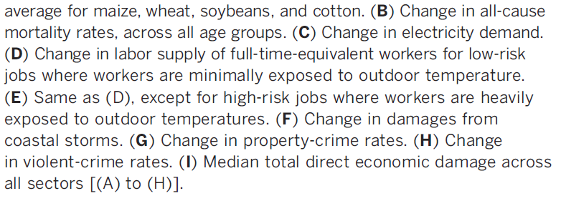
Projected Effects Vary Across the U.S. but Are Estimated at 1.2% of GDP per 1C Increase
Notes:
From, Hsiang et al. “Estimating economic damage from climate change in the United States.” Science 356, Issue 6345 (June 30 2017), pp. 1362-69.

Slide 20
Adaptation Reduces Damages
Human adaptations are costly actions that can reduce damages from climate change.
The net cost to society is the cost of adaptation plus the cost of the remaining damages.
People will take some actions on their own, up to the point where they find it worthwhile.
Some responses require government involvement: large-scale actions or actions with shared benefits.
Adaptation is already underway.

Slide 21
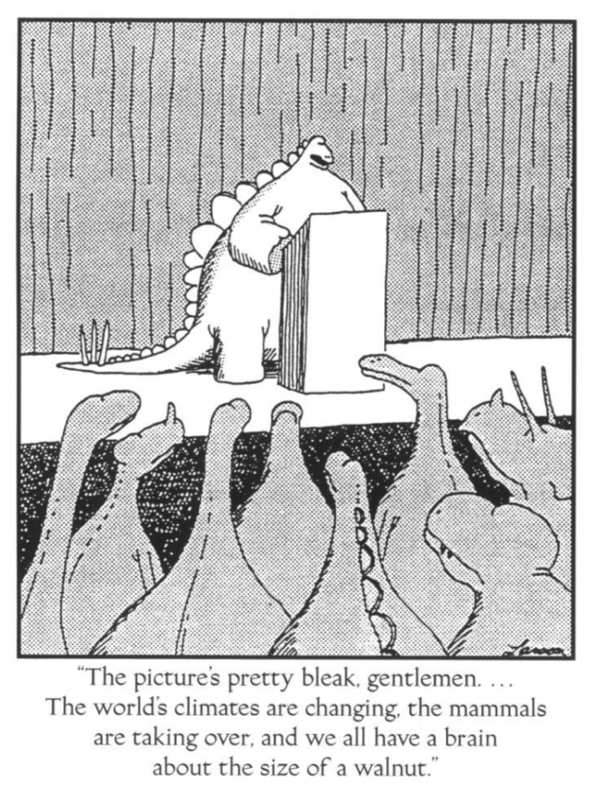

Slide 22
Economics of Responding to Climate Change

Slide 23
International Climate Policy Goals
Intergovernmental Panel on Climate Change (IPCC)
  Global effort to fight climate change
  Reports on consensus of climate science, including economics
IPCC report in 2007, 4th report:
  Recommended goal: < 2 degrees C (3.6 degrees F)
  Industrialized countries should reduce GHG emissions between 25% and 40% below 1990 levels by 2020.
2016 Paris Agreement:
  Basic goal of 2 degrees C: requires 40-70% GHG reduction 2010 → 2050
  Reach goal of 1.5 degrees C: requires 70-95% GHG reduction 2010 → 2050
IPCC report in 2021, Part 1 of 6th Report:
  “Unless there are immediate, rapid, and large-scale reductions in greenhouse gas emissions, limiting warming to 1.5°C will be beyond reach.” Ko Barrett, NOAA & IPCC Vice-Chair
Notes:
Website of the IPCC: https://www.ipcc.ch/
The sea level has already risen by about seven inches in the last century, according to one group of scientist using tide gauges (see NOAA). Source: https://sealevel.nasa.gov/understanding-sea-level/by-the-numbers

Slide 24
How Economists Decide How Much to Fight
Climate Change
Cost Benefit Analysis
Expected costs of reducing emissions
Weigh:
Expected damages from allowing climate change

Slide 25
Economic Growth and Climate Change Action
Are Compatible
Abating greenhouse gas emissions is costly…
… but climate change damages are even more costly.
Economic growth comes with consequences that we have to deal with, including climate consequences.
Economies with environmental regulations can still be dynamic.
Goal: design policies that reach climate goals at the least possible cost.

Slide 26
Addressing the Sources of Our Emissions

Slide 27
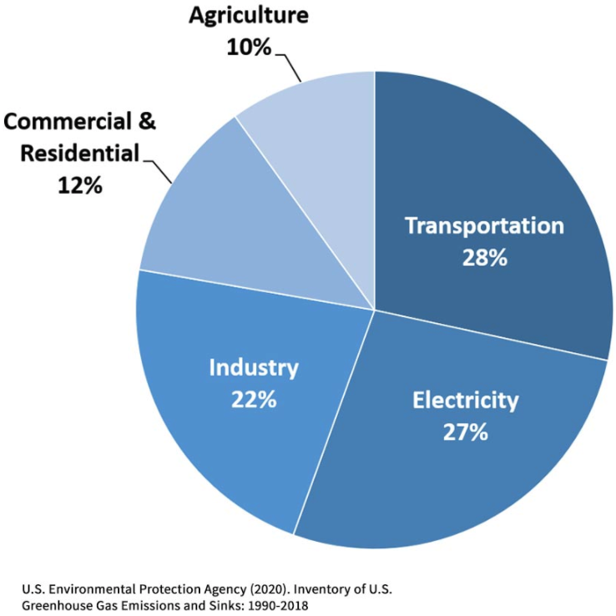
Total U.S. Greenhouse Gas Emissions by
Economic Sector in 2018
Notes:
https://www.epa.gov/ghgemissions/sources-greenhouse-gas-emissions

Slide 28
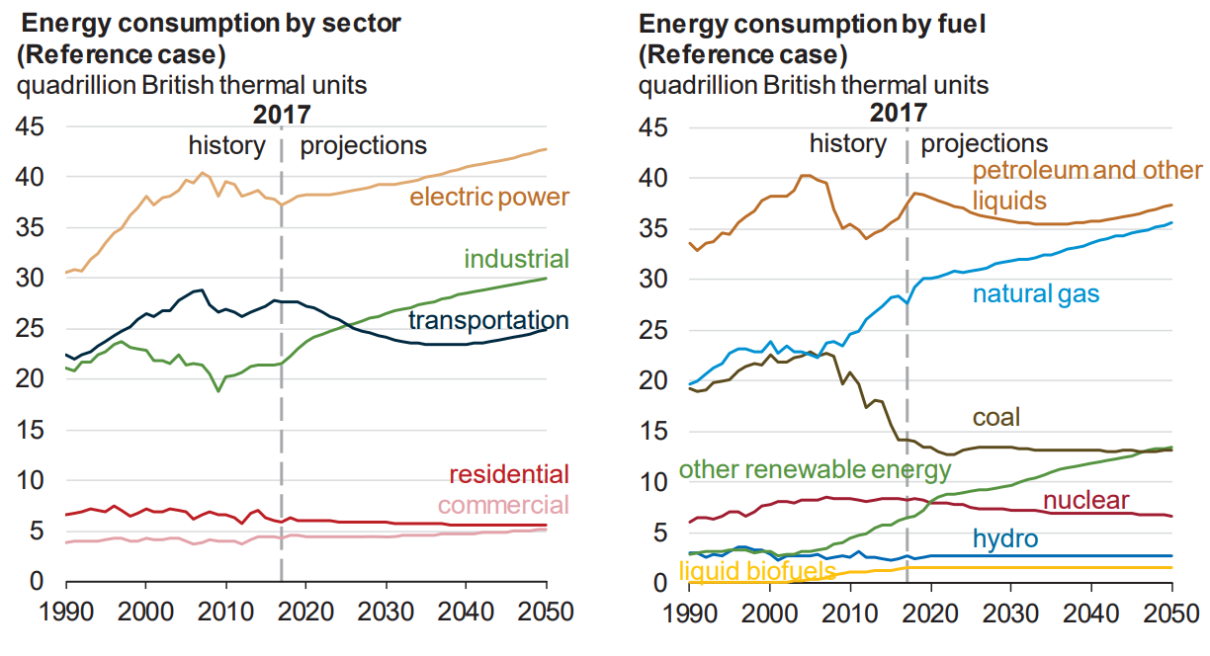
Fossil Fuels Dominate U.S. Energy Production
Notes:
US Energy Information Agency Annual Energy Outlook 2018

Slide 29
Global GHG Abatement Cost Curve
Lighting
Appliances
Hybrid cars
Solar?
Wind?

Slide 30
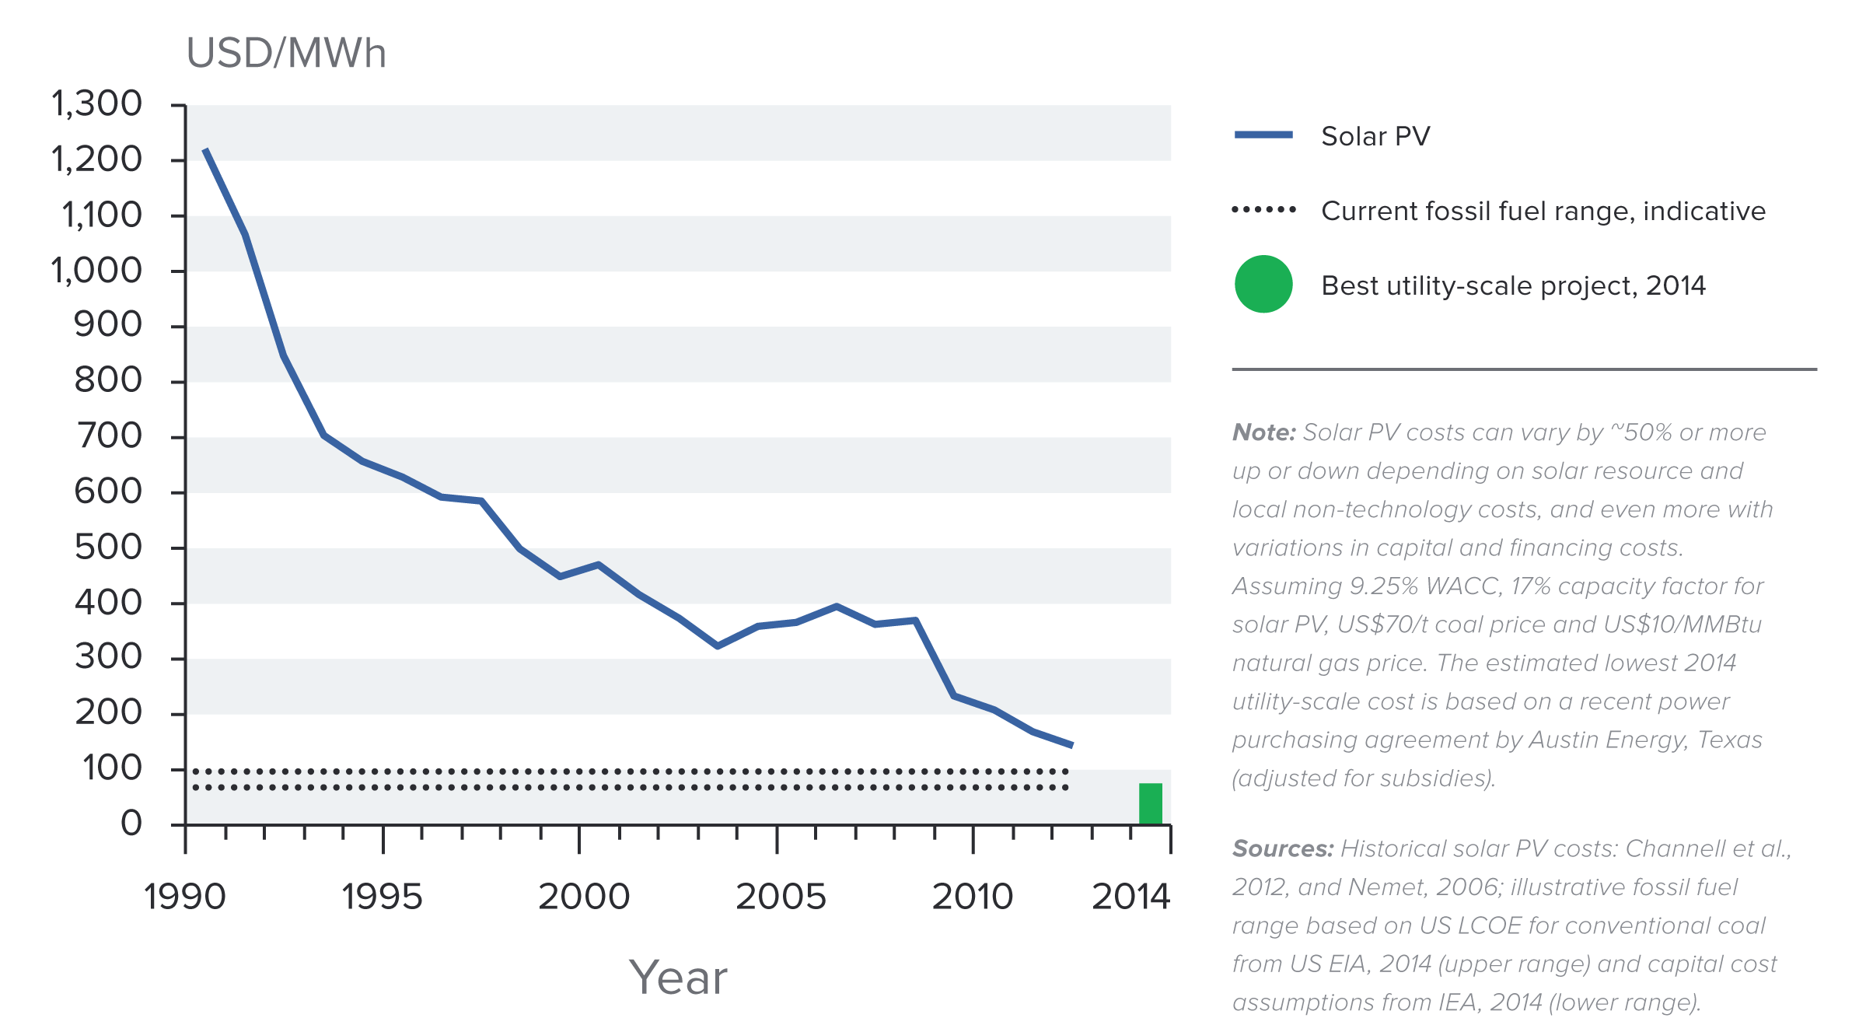
Indicative Solar Costs Over Time
Notes:
Source: New Climate Economy Report

Slide 31
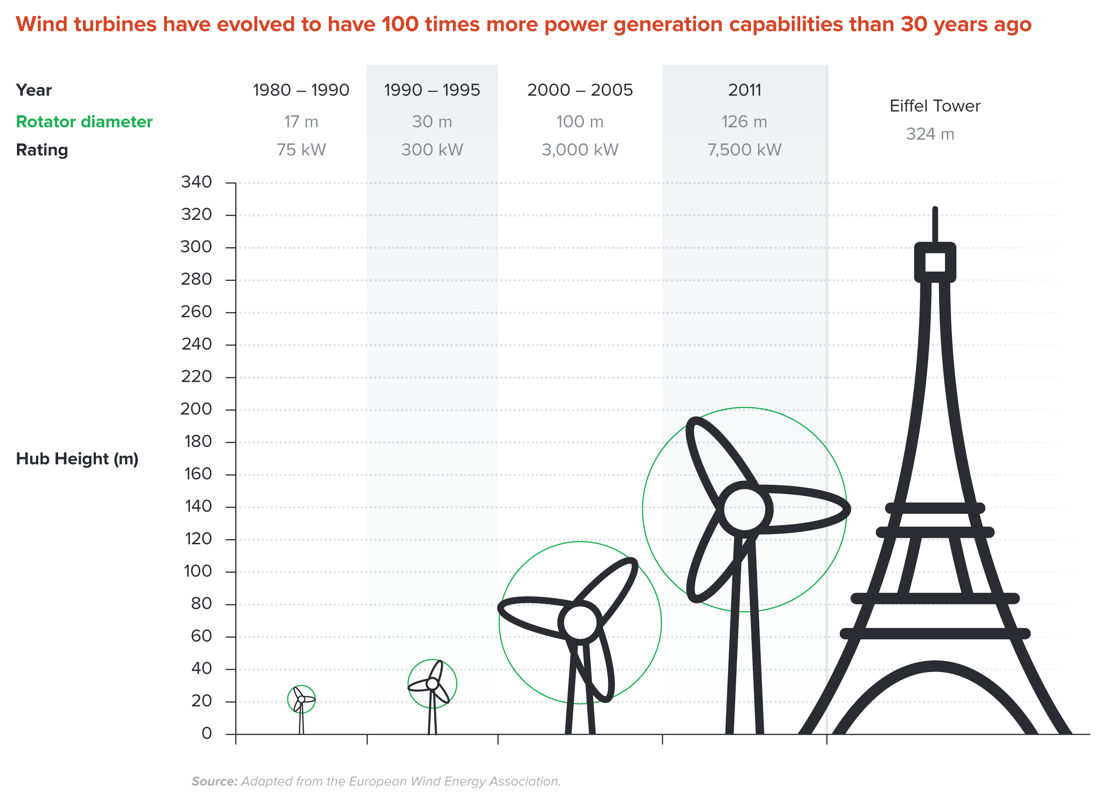
Wind Turbines Have 100 Times More Power
Generation Capabilities Than 30 Years Ago
Notes:
Source: New Climate Economy Report

Slide 32


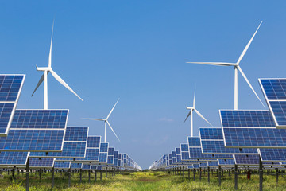
Challenges with Renewable Energy
It’s intermittent - only produced if there is sun or wind.
Energy is needed all day and night, with peak times.
Limited w/o storage.
  Creative storage options are under development.

Slide 33
Climate Change Policy

Slide 34
Policies That Reduce Emissions: Directly
Regulation
  Emissions standards or limits
    E.g., CAFE standards (CAFE: Corporate Average Fuel Economy)
Market-oriented policies
  Putting a price on emissions
    Subsidizing green energy (e.g., feed-in tariffs)
    Tax or cap & trade

Slide 35
Thoughts on Regulation vs Market-Oriented
Equity.
  Both types of policies are regressive.
    Cap and Trade and a Carbon Tax can offset the regressivity.
    Regulations do not.
Efficiency.
  Market-oriented policies tend to achieve emissions reduction at much lower cost.
    Example: CAFÉ Standards vs Carbon Tax
      Tax is significantly more efficient.
      Why?

Slide 36
Climate Change Policy in Action

Slide 37

California’s Cap and Trade System: 2012+
0.7%
of global greenhouse gas emissions

Slide 38
California’s System Is Flexible
California’s goals:
  Reduce emissions to 1990 levels by 2020
  An 80% reduction in emissions from 1990 levels by 2030
California’s Tools:
  Cap and Trade
  Renewable Portfolio Standard
  Clean Cars Program
  Low Carbon Fuel Standard

Slide 39
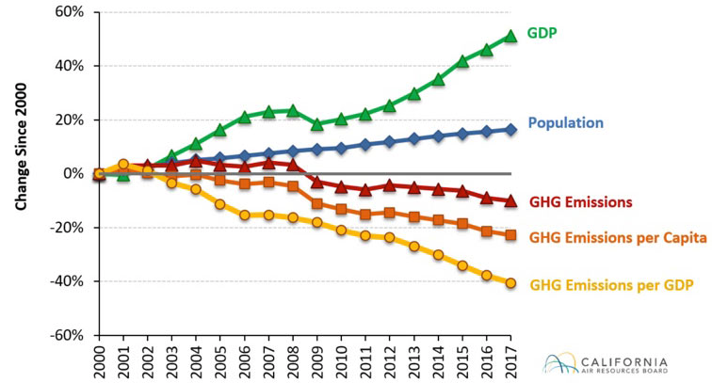
Change in California GDP, Population, and
GHG Emissions since 2000
Cap & Trade ->
Notes:
This would be nice animated.
Source: https://www.arb.ca.gov/newsrel/newsrelease.php?id=933
The Summary of Emissions by Gas Type from the California Air Resources Board shows that biogenic increased. Can we thus assume that the CO2 from more fires is being included? Here is the table:
https://ww3.arb.ca.gov/cc/inventory/data/tables/ghg_inventory_bygas.pdf

Slide 40
Summary
Climate change is real, is caused by human actions, and has impacts we’re already feeling.
We need to reduce emissions to balance the costs of action against the costs of inaction.
Scientists and the IPCC recommend that we work to keep warming below 1.5 degrees celsius.
  Economists believe that this goal is well worth the costs!

Slide 41
Summary – continued
There are many ways to reduce emissions.
Economics-inspired policies can help us do this at the lowest cost.
Taxes and cap and trade are proven effective tools to fight climate change!
Other tools may also be necessary.

Slide 42
Thank you!
Any Questions?
www.NEEDelegation.org
Sarah E. West
wests@macalester.edu
Contact NEED: Info@NEEDelegation.org
Submit a testimonial: www.NEEDelegation.org/testimonials.php

