Slide 1
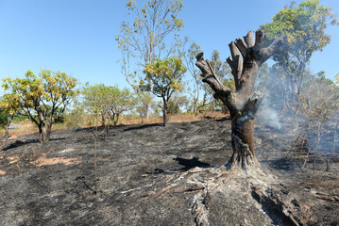
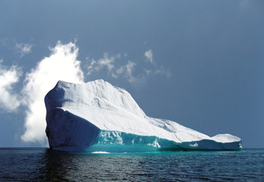
Climate Change Economics Mina Kim, Ph.D.
Kiwanis Club of Bozeman
July 19, 2021

Slide 2
National Economic Education Delegation
Vision
One day, the public discussion of policy issues will be grounded in an accurate perception of the underlying economic principles and data.
Mission
NEED unites the skills and knowledge of a vast network of professional economists to promote understanding of the economics of policy issues in the United States.
NEED Presentations
Are nonpartisan and intended to reflect the consensus of the economics profession.

Slide 3
Who Are We?
Honorary Board: 47 members
2 Fed Chairs: Janet Yellen, Ben Bernanke
6 Chairs Council of Economic Advisers
Furman (D), Rosen (R), Bernanke (R), Yellen (D), Tyson (D), Goolsbee (D)
3 Nobel Prize Winners
Akerlof, Smith, Maskin
Delegates: 500+ members
At all levels of academia and some in government service
All have a Ph.D. in economics
Crowdsource slide decks
Give presentations
Global Partners: 45 Ph.D. Economists
Aid in slide deck development

Slide 4
Credits and Disclaimer
This slide deck was authored by:
Shana Mcdermott, Trinity University
Sarah Jacobson, Williams College
Sharon Shewmake, Western Washington University
This slide deck was reviewed by:
Jason Shogren, University of Wyoming
Walter Thurman, North Carolina State University
Disclaimer
NEED presentations are designed to be nonpartisan.
It is, however, inevitable that the presenter will be asked for and will provide their own views.
Such views are those of the presenter and not necessarily those of the National Economic Education Delegation (NEED).

Slide 5
How Can Economists Contribute to Thinking about Climate Change?
By assessing behavioral reactions to climate change.
By measuring the damage and estimating the economic costs of fighting climate change.
By designing smart policies that minimize costs.
Balance economic growth with GHG emission mitigation.

Slide 6
Pollution is an externality
Human activity creates pollution.
The goal is not zero pollution but society’s best balance between pollution and human benefits.
Pollution is an EXTERNALITY: a side effect (cost or benefit) that affects someone else when something is bought or sold
The power company sells you electricity for your house, but the pollution from the power plant affects everyone, not just you.
This is a market failure.
All of the effects are not always felt by the buyers and sellers.
The price of electricity does not reflect all of the costs, leading to too much pollution
Electricity is too cheap. The balance is wrong.

Slide 7
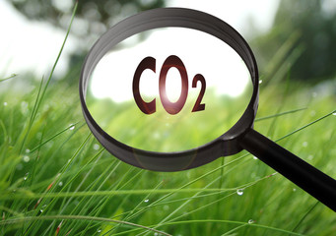
Social Cost of Carbon
Cost above price paid.
The expected cost of damages from each unit of greenhouse gas emissions.
Current EPA estimate: ~$40 per metric ton of CO₂.
About $123/car per year.
$26 Billion for all vehicles in the US.
Social cost of carbon will increase over time.
Notes:
18.07 lbs/mile
2204.62 lbs/metric ton
1.8 cents/mile

Slide 8
Economics of Responding to Climate Change

Slide 9
Cost-Benefit Analysis of Fighting Climate Change
Most economic models suggest the costs of keeping warming below 2°C are relatively small.
Costs amount to 1-4% of GDP by 2030.
Costs of acting to keep warming below 2°C are almost certainly less than future economic damages they would avoid.
Damages estimated to be between: 7 - 20% of worldwide GDP.
Caveats:
Putting a monetary value on priceless things
Inequality
Uncertainty and risk

Slide 10
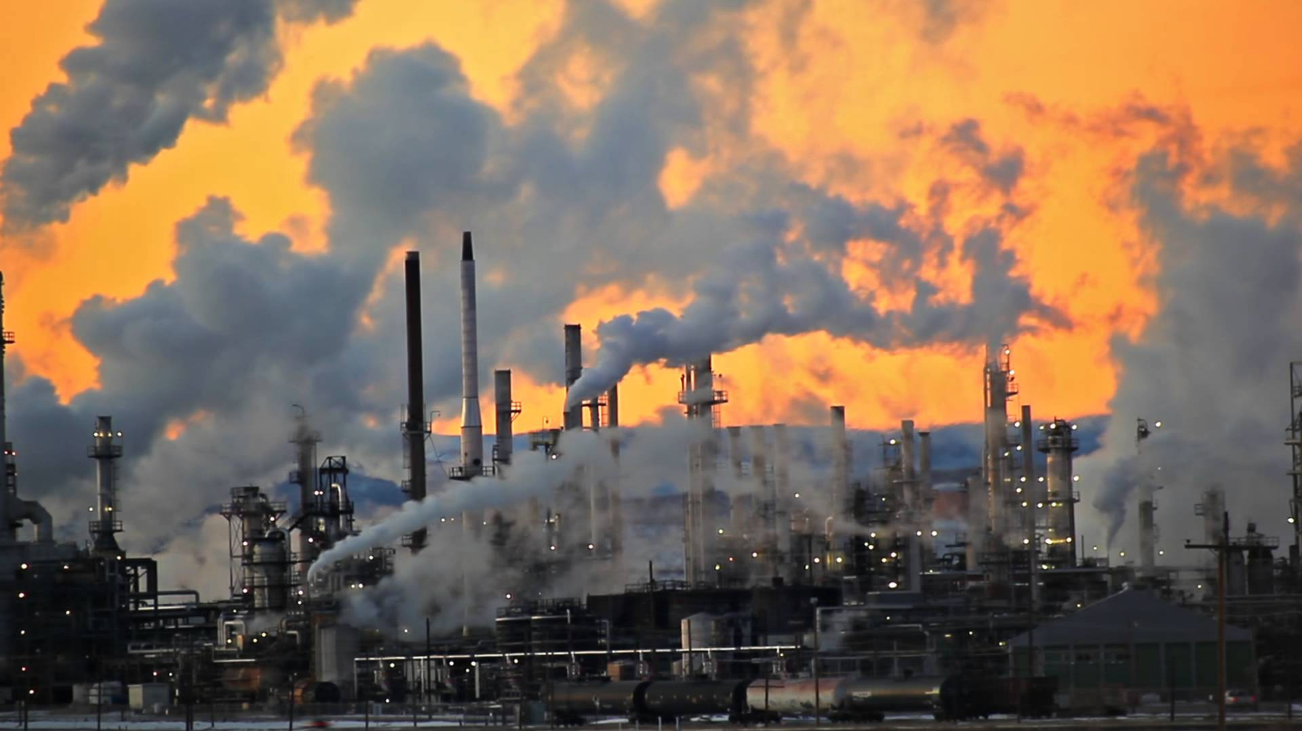
Present Value of a Future $100 Cost or Benefit
“
It is better to be roughly right
than precisely wrong.
- John Maynard Keynes
“

Slide 11
Economic Growth and Climate Change Action Are Compatible
Abating greenhouse gas emissions is costly…
… but climate change damages are even more costly.
Economic growth comes with consequences that we have to deal with, including climate consequences.
Economies with environmental regulations can still be dynamic.
Goal: design policies that reach climate goals at the least possible cost.

Slide 12
Climate Change Policy

Slide 13
Policies That Reduce Emissions: Directly
Regulation
Emissions standards or limits
E.g., CAFE standards
Market-oriented policies
Putting a price on emissions
Subsidizing green energy (e.g., feed-in tariffs)
Tax or cap & trade
Notes:
These are the favored policies. Address a problem head on and let the market deal with it.

Slide 14
How Does Cap and Trade Work?
Activities to be covered are determined.
Acceptable emissions levels are indicated.
“Permits” that allow acceptable emissions levels are issued.
How?
According to historical emissions?
Evenly across emitters?
Sold at some price?
A “market” is developed.
Those desiring to emit will have to buy sufficient permits to accommodate their emissions.
Those wishing to abate will offer their permits on the “market”.
The price of a permit indicates:
The benefit of eliminating further emissions.
The cost of emitting.
Gov’t agency determines equality of permits in possession and emissions.

Slide 15
How Does a Carbon Tax Work?
Activities to be covered are determined.
The price of emissions is determined.
Presumably some relation to the social cost of polluting.
Emissions are measured.
Taxes are determined.
Q: What to do with the tax revenue?

Slide 16
Carbon Prices: the Good and Bad
Good:
Provide price signal to lower emissions.
They yield low-cost reductions in emissions.
They spur innovation in clean technologies.
Bad:
Firms might leave to flee regulation.
It is necessary to monitor emissions.
Potentially regressive
Costs may weigh more heavily on low-income households.

Slide 17
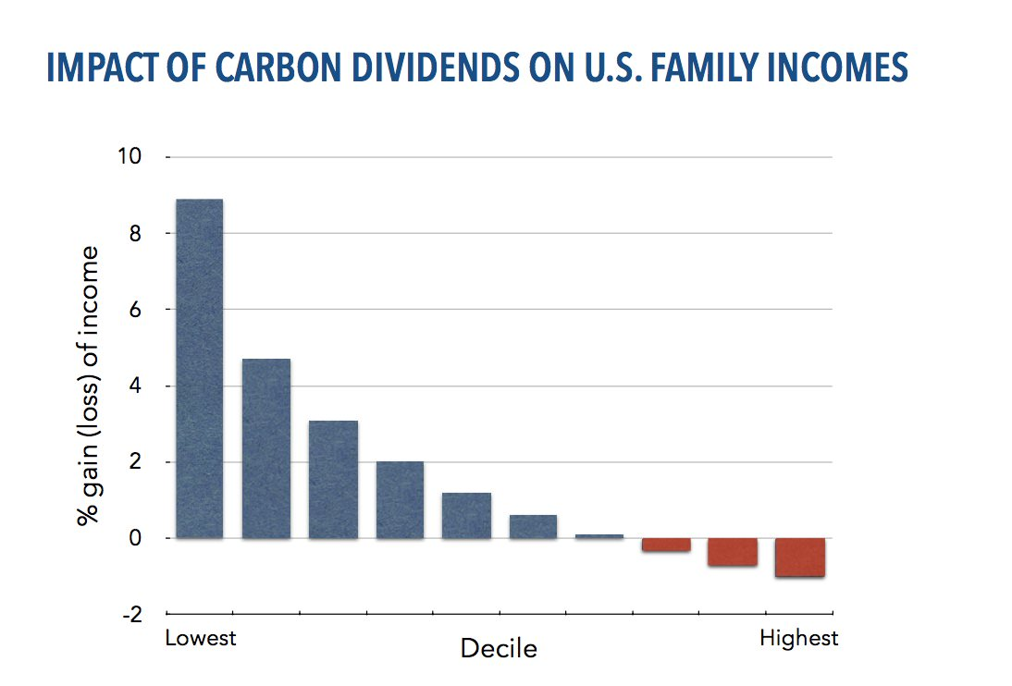
Revenue Dividend Eliminates Regressivity
Source: U.S. Treasury, 2017

Slide 18
Carbon Tax and Cap & Trade: the Differences
 | Carbon Tax | Cap & Trade
Carbon Price | Certain | Uncertain
Emissions | Uncertain | Certain
Ease of Implementation | May be easier to implement
Additional concerns | Always generates revenue May require legislation to change | May be more susceptible to lobbying Only generates revenue if government sells permits Cap can be changed by regulator

Slide 19
Carbon Tax and Cap & Trade: the Differences
 | Carbon Tax | Cap & Trade
Carbon Price | Certain | Uncertain
Emissions | Uncertain | Certain
Ease of Implementation | May be easier to implement
Additional concerns | 1) Always generates revenue 2) May require legislation to change 3) Predictability | 1) Susceptible to lobbying. 2) Only generates revenue if government sells permits. 3) Cap can be changed by regulator. 4) Less certainty over future. 5) Regulations reduce efficacy of Cap & Trade

Slide 20
One Other Thing: Cap and Trade vs. Carbon Tax
Emissions regulations and Cap and Trade can work at cross purposes.
Regulations that lower emissions from big polluters…
Lower the demand for permits
Lowers the price of permits
Reduces incentives for other industries to cut emissions
Regulations can undermine the effectiveness of Cap and Trade.
The same is not true of a carbon tax.
Though regulations might cut tax revenue, revenue is not the goal of the carbon tax.

Slide 21
Thoughts on Regulation vs Market-Oriented
Equity.
Both types of policies are regressive.
Cap and Trade and a Carbon Tax can offset the regressivity.
Regulations do not.
Efficiency.
Market-oriented policies tend to achieve emissions reduction at much lower cost.
Example: CAFÉ Standards vs Carbon Tax
Tax is significantly more efficient.
Why?

Slide 22
Efficiency: CAFÉ vs Carbon Tax
CAFÉ = Corporate Average Fuel Efficiency
A fuel economy standard mandating that an auto‐maker’s vehicle fleet must meet minimum fuel economy standards.
Horse Race
Tax on fuel applies to ALL vehicles, not just new.
Rebound Effect:
Driving a more efficient vehicle lowers the cost per mile driven
leading to more miles driven.
Slower turnover of inefficient vehicles: higher cost of new.
Summary
A given level of emission reductions costs 3-14 times more with CAFÉ standards than under a comparable carbon tax.

Slide 23
Policies That Reduce Emissions: INDirectly
Subsidizing R&D
Grid / infrastructure
Energy efficiency mandates and subsidies
Mandating renewable energy (e.g., renewable portfolio standards)
Land use policies

Slide 24
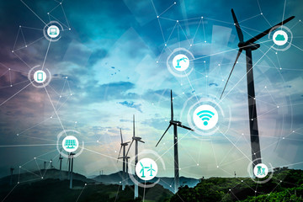
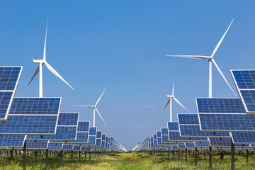
Challenges with Renewable Energy
It’s intermittent - only produced if there is sun or wind.
Energy is needed all day and night, with peak times.
Limited w/o storage.
Creative storage options are under development.

Slide 25
Infrastructure and Climate Change
$90 trillion in investment will be needed for U.S. infrastructure, 2015-2030.
Add $4 trillion (< 5%) to make it low-carbon infrastructure.
This would also reduce climate damage to infrastructure.
Railway, urban transport, renewables.
The electrical grid is particularly troublesome.
It is outdated and not suited for renewable energy storage.
Those with solar panels use the grid but contribute little to its upkeep.
Notes:
Sources for these
Some examples of low-carbon infrastructure are:
Railway infrastructure, which can reduce the number of carbon-emitting trucks
Urban transport projects, such as Metros and Light Rail projects which reduce car usage- one of the more notable sources of carbon emissions
Renewable energy projects (solar, wind, and hydropower), which have much lower carbon emissions compared to fossil fuels

Slide 26
Biden’s Climate Plan
Regulation and infrastructure investment aimed at meeting specific climate targets and creating jobs
“He also pressed the need to link environmental advocacy to racial justice, describing pollution and other toxic harms that disproportionately affect communities of color. His plan calls for establishing an office of environmental and climate justice at the Justice Department and developing a broad set of tools to address how “environmental policy decisions of the past have failed communities of color.” “
“Mr. Biden set a goal for disadvantaged communities to receive 40 percent of all clean energy and infrastructure benefits he was proposing. He also made explicit references to tribal communities and called for expanding broadband access to tribal lands.”
Plan will be paid for using corporate income taxes.

Slide 27
“
Economic policies will be central to accomplishing the goals we choose.
- Harris and Roach (2007)
“

Slide 28
Summary
Climate change is real, is caused by human actions, and has impacts we’re already feeling.
We need to reduce emissions to balance the costs of action against the costs of inaction.
Scientists and the IPCC recommend that we work to keep warming below 1.5 degrees celcius.
Economists believe that this goal is well worth the costs!

Slide 29
Summary – continued
There are many ways to reduce emissions.
Economics-inspired policies can help us do this at the lowest cost.
Taxes and cap and trade are proven effective tools to fight climate change!
Other tools may also be necessary.

Slide 30
Thank you!
Any Questions?
www.NEEDelegation.org
Mina Kim
minakim@mkecon.com
Contact NEED: Info@NEEDelegation.org
Submit a testimonial: www.NEEDelegation.org/testimonials.php

