Slide 1




Climate Change Economics
Jennifer Alix-Garcia, Ph.D.
Osher Lifelong Learning Institute
June, 2021
Notes:
It is a pleasure to be here with you all today. I’m Jennifer Alix-Garcia and I work at Oregon State University. I’m here to talk with you about the economics of climate change.
Climate change will produce complex effects—with warming in most areas, changes in rain and snow levels, and generally increased variability in weather patterns. There are some uncertainties about how climate change will progress. What we know, however, is that it will hurt people and damage livelihoods all over the world. We’re already feeling its effects.

Slide 2
National Economic Education Delegation
Vision
  One day, the public discussion of policy issues will be grounded in an accurate perception of the underlying economic principles and data.
Mission
  NEED unites the skills and knowledge of a vast network of professional economists to promote understanding of the economics of policy issues in the United States.
NEED Presentations
  Are nonpartisan and intended to reflect the consensus of the economics profession.
Notes:
NEED a non profit organization that intends to close the gap between what professional economists generally think and the economic arguments that are made in policy debates.

Slide 3
Who Are We?
Honorary Board: 54 members
  2 Fed Chairs: Janet Yellen, Ben Bernanke
  6 Chairs Council of Economic Advisers
    Furman (D), Rosen (R), Bernanke (R), Yellen (D), Tyson (D), Goolsbee (D)
  3 Nobel Prize Winners
    Akerlof, Smith, Maskin
Delegates: 590+ members
  At all levels of academia and some in government service
  All have a Ph.D. in economics
  Crowdsource slide decks
  Give presentations
Global Partners: 45 Ph.D. Economists
  Aid in slide deck development
Notes:
NEED has a board of over 48 members, including two former fed chairs, 3 Nobel Prize winners and 6 former chairs of the Council of Economic advisors. It is comprised of PhD economists working in different sectors all over the country. We donate our time to give these kind of talks and hopefully elevate the conversation. The slide decks that we use are made collaboratively and then reviewed by experts in the field.

Slide 4
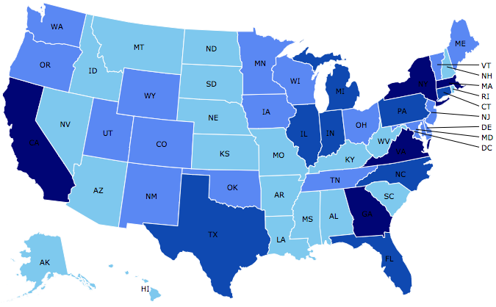
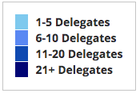
Where Are We?
Notes:
Our delegates are spread all over the country.

Slide 5
Credits and Disclaimer
This slide deck was authored by:
  Shana Mcdermott, Trinity University
  Sarah Jacobson, Williams College
  Sharon Shewmake, Western Washington University
This slide deck was reviewed by:
  Jason Shogren, University of Wyoming
  Walter Thurman, North Carolina State University
Disclaimer
  NEED presentations are designed to be nonpartisan.
  It is, however, inevitable that the presenter will be asked for and will provide their own views.
  Such views are those of the presenter and not necessarily those of the National Economic Education Delegation (NEED).

Slide 6
Outline
Climate change science
Impacts of climate change
Economics of responding to climate change
Addressing the sources of our emissions
Climate change policy
Policy in action

Slide 7
How Can Economists Contribute to
Thinking about Climate Change?
By assessing behavioral reactions to climate change.
By measuring the damage and estimating the economic costs of fighting climate change.
By designing smart policies that minimize costs.
  Balance economic growth with GHG emission mitigation.
Notes:
You might think that climate change has nothing to do with economics, but you’ll see that economics offers very useful tools for thinking about why climate change is happening and how we can design policies to address it. Also, and maybe most important, economists design policies that achieve goals at the lowest possible costs. In the context of climate change, that means that we reach our climate goals while having to give up the least amount of economic growth possible. This makes climate policies more politically viable.

Slide 8
Climate Change Science
Notes:
Let’s talk about the science of climate change first.

Slide 9
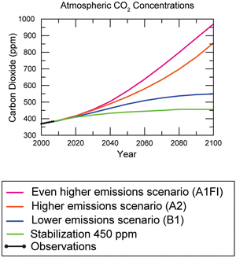
Atmospheric CO₂ Concentrations
Projections →
Source: IPCC data distribution center and climate.gov
Notes:
You’ve probably heard a lot about carbon dioxide emissions and how they’re causing climate change. We’re going to get into this in more detail in a minute, but let’s start by looking at what’s happened with these gases in the atmosphere in recent years and what’s predicted to happen. In this graph, the horizontal axis is the year, and the vertical axis is the concentration of carbon dioxide in the atmosphere in that year. You can see that human activity has, even since the year 1975, when this graph starts, increased the concentration of greenhouse gases in the atmosphere. Having increased from around 330 to 400, the abundance of carbon dioxide in the atmosphere increased by 20% over just these 43 years.
“Greenhouse gases,” abbreviated GHGs, include the most famous and in some ways most important gas, carbon dioxide, or CO2. But there are other gases that also act as greenhouse gases when they enter the atmosphere, including methane and nitrous oxides. You’ll often hear people refer to GHGs as carbon or CO2 as shorthand, but all greenhouse gases are important, and policy should address all of them. We measure them in a standardized unit called a “carbon dioxide equivalent.”
[CLICK]
Scientists have different predictions for possible future increases, and the different colored lines on the graph show some of the predictions. Note that only the early years, black lines, represent observed emissions, the remainder of each line comes from a forecast.
Which path we take depends on what actions we implement to reduce emissions. Even conservative estimates have concentration exceeding 550 by 2100.
But let’s see where these emissions come from and why they matter.

Slide 10
The Atmospheric Greenhouse Effect
Sun
Atmosphere
Light reflected back
onto earth
Light reflected back
into space
Notes:
When sunlight passes through the earth’s atmosphere and warms the surface of the earth, some light is reflected back into space and some is reflected back onto earth due to greenhouse gases, which act like a blanket.
Some of these gases exist naturally in the atmosphere, as there are natural sources of emission (such as animals and fires) and some natural “sinks” that soak them up (like forests). Without human interference there’s a natural balance of gases going into and out of the atmosphere, leading to a stable climate. But we are adding to the gases. Many human activities either put more greenhouse gases into the atmosphere (for example, the burning of fuels or the release of methane from ranching and farming) or reduce the natural “sinks” that pull greenhouse gases from the atmosphere (like deforestation). This causes the atmospheric “blanket” to become thicker, warming the planet.
Greenhouse gas emissions thicken the atmospheric blanket, increasing the average temperature on earth. Carbon dioxide also goes into the ocean, causing it to become more acidic. And, of course, the heat and CO2 stored in the oceans influences land and air temperatures and vice versa, until we reach a global equilibrium of gases and temperatures.
If we don’t address climate change, temperatures are expected to rise by 3.7 to 4.8 degrees Celsius (6.7 to 8.6 degrees F) by 2100 on average across the globe, and to continue rising after that time. As we’ll discuss later, this is significantly higher than the commonly discussed goal of 2 degrees Celsius.
Another thing that’s complicated about all of this is that greenhouse gases stay in the atmosphere for a long time, and carbon dioxide and heat stored in the ocean take time to dissipate, so even if we stop all of our emissions right now, we’ll still feel the effects of climate change for some time.
Each of these direct effects then leads to more indirect effects. For example, the increase in temperatures causes changes in precipitation patterns, an increase in extreme weather events (e.g., droughts and floods), sea level rise and storm surges, and melted permafrost.
It’s worth noting that the temperature and precipitation changes that will happen will vary significantly from place to place. Some places will get much warmer and some only a little warmer; some will get wetter while others will get drier. We can generally predict that precipitation will come in increasingly concentrated bursts, so that there will be more of both droughts and floods.
These changes in the earth systems will change the patterns of storms we experience. However, some of the science of exactly what will happen to hurricanes is still unsettled.
The changes in temperature, precipitation, and storms will cause sea levels to rise and contribute to storm surges. (The “surge” of the ocean onto land when there’s a storm can be much more destructive and far-reaching than the sea level rise itself.)
The way we’ve described it so far makes it sound like a linear, predictable set of effects. But a lot of people who study climate change are worried about “tipping points”—important thresholds in ecological or geophysical systems that, once we pass them, are irreversible and potentially quite damaging. Usually, we don’t know exactly when those tipping points will be crossed. Examples of irreversible events include:
Extinctions of important species
Collapse of the Greenland ice sheet
Losses of entire ecosystems
Dramatic changes in the existing flow of ocean currents (the “conveyer belt”)

Slide 11
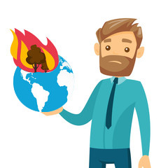



Uncertainty
?
?
?
Notes:
You may have noticed that I said we don’t know for certain how climate change will affect hurricanes, or when these tipping points will be triggered. I know that makes it sound as if the science of climate change is uncertain. That’s a little true and a little not true.
When we think about climate change, there’s a lot going on. People are taking actions that increase greenhouse gases in the atmosphere. Those greenhouse gases are having effects on the physical world that we live in and rely on. This translates into impacts on people, which we call “damages,” and we’ll discuss those more in a moment.
Is there uncertainty that this is happening? No. Scientists are still researching and learning about specific details about exactly how each of these steps progresses: How does water vapor interact with other greenhouse gases? Will hurricanes become more likely? How much will permafrost melt accelerate climate change? What species will dominate the new ecosystems that are created as climate change progresses? Is violence by humans really increased by high temperatures? How well will people adapt their lifestyles, their agricultural practices, and their infrastructure to withstand climate change? These are uncertainties, but mostly about how much and how, not whether.
There are also other kinds of uncertainty that are harder to get a handle on. We mentioned tipping points in the last slide, and some of those can be quite catastrophic, but we don’t know exactly what will trigger those tipping points. And there are things that we just don’t know enough to be worried about—the unknown unknowns.
This is why scientists and social scientists need to keep studying climate change.

Slide 12
How Much Pollution Does Society Want?
Analogy: How Many Oranges Does Society Want?
People grow and sell oranges for a price that at least covers costs (supply).
People will not pay more for them than what they consider to be their value (demand).
Prices let supply and demand balance out. The price settles where:
This is the “right” number of oranges for society.
Prices reflect scarcity and the social value of the resource.
# of oranges people want to sell = # of oranges people want to buy
Notes:
What I’ve talked to you about so far has mostly been about atmospheric science. Where does economics come in? In the context of climate change, economics suggests that without policy changes, people will continue to put out more greenhouse gases and deforest more land, accelerating climate change and thus hurting people. Let me explain why, starting with an example.
In an ideal world with a well-functioning market, like the market for oranges, prices reflect the true scarcity of a resource or the true social value of a resource, because prices are driven by the amount of money sellers are willing to accept and how much buyers are willing to pay. The way this works is that people who want to sell oranges will only sell them for a price that at least covers their costs, and people who want to buy oranges will only pay a price up to their personal value for oranges. Since all of the costs and benefits associated with oranges accrue to the buyer and the seller, supply and demand will automatically push the market to an equilibrium price where the costs and benefits of oranges are in balance: at this price, sellers want to sell the exact same number of oranges that buyers want to buy. This is the right number of oranges for society because society is getting as much value as it can from people buying and selling oranges.

Slide 13
Electricity Is Different From Oranges
Many sources of electricity generate pollution.
Pollution is an EXTERNALITY:
  a side effect (cost or benefit) that affects someone
  else when something is bought or sold.
  This is a market failure.
The price of electricity does not reflect all of the costs.
  Electricity is too cheap.
  There is too much pollution.
Notes:
However, pollution (including the pollution that causes climate change) is different from oranges. When you turn on your light switch, that draw of electricity causes the power plant to burn more coal or natural gas; you are buying electricity from the power company. But another thing happens: pollution is generated, and that pollution contributes to climate change. Human activity in general causes some amount of pollution. The way economists think about it is not to try to get to zero pollution necessarily, but to find the right balance between the benefits from things like electricity and the harm that pollution causes to humans.
The fact that pollution affects everyone, not just the buyers and sellers of electricity, makes it an externality—a side effect, or an example of a market failure. A market failure occurs when people make decisions based on their own values don’t end up getting to the right balance of costs and benefits for society. With electricity, the externality of pollution is that some costs are borne by people other than the buyers and sellers: 90% of the people living in Malawi do not have electricity. However, all these people are affected by the pollution from this electricity market they’re not part of.
The reason this is called a market failure is that a free market (people making decisions on their own) will in this case end up failing to reach the right balance of the costs and benefits of electricity: because there are some costs that the buyer and seller don’t bear, the price they negotiate is “wrong” in the sense that it doesn’t reflect all the costs. As a result, the price of electricity is too low and society consumes too much electricity relative to what would be the best balance. In this example, unlike our example of the orange market, society is not getting the maximum value it could get from buying and selling electricity because the costs are too great.
You can also think of the climate as a common pool resource: something we all benefit from but no one has an incentive to maintain and take care of. As a result, we all keep damaging the climate by pouring greenhouse gases into the atmosphere.
Sometimes people are surprised at economists’ approach to pollution. If we think about pollution as an externality from a transaction (e.g., the purchase of electricity), then we consider pollution an additional cost that needs to be taken into account. Thus, for economists, climate change per se isn’t a problem, but rather the lack of balance in the market; thus, the goal is to reduce pollution, not to eliminate it. If we don’t regulate greenhouse gas emissions, then the damages caused by climate change will be larger than what is efficient. Remember, those transactions are things that buyers and sellers get a lot of value from, so we want some of them to continue. The goal is to “fix” these externalities and do a kind of balancing act between the costs climate change will impose and the costs of fighting climate change. We’ll talk a lot about this in the rest of the presentation.
Economic analyses can help us quantify how much we’ll be affected by climate change, and they can help us find efficient ways to respond.

Slide 14
Reflection:
Take a moment to write into the chat box a situation in which some market activity creates either benefits or costs to someone outside of the market
    Example 1: in the market for electricity, the cost of carbon emissions is borne by everyone, even people who do not use electricity
    Example 2: in the market for beautiful front yard gardens, the joy of beautiful flowers is enjoyed by everyone who walks by, not just the owner of the garden

Slide 15
Impacts of Climate Change
Notes:
Next we’ll talk about the impacts of climate change. I’m going to try to convince you that even though we frame these impacts as environmental, they actually have important economic implications.

Slide 16
Global Warming Indicators
Notes:
This figure shows some of the dynamics that are occurring as a result of climate change. Increasing air temperature leads to increase transpiration from plants and increased evaporation from water. These higher temperatures mean faster glacial and ice sheet melt, and so rising sea level. The temperature changes also mean that the usual cycles of climate and circulation of water within the ocean also changes.

Slide 17
How These Impacts Affect Humans
Agriculture
Fisheries
Coastal damages
Direct health effects, including sickness and death (temperature & drought; also pollution)
Indirect health effects (vector-borne disease)
Reduced fresh water availability
Wildfires
Shifting zones for important ecosystems, and desertification
Reduced worker productivity
Increased violence
Some of these may cause human migration and/or conflict
Notes:
This all sounds dramatic, but the reason that economists say that people should be worried about climate change is not because of the significant changes to the planet, but rather for how these changes will affect people—we call this the “damages” caused by climate change.
There may be ethical reasons to care about the damage to the environment or other species beyond the outcome for humans, but economists focus on the damages that affect people.
Climate change has a physical impact on human life. For some people, the effects are positive, but the negative consequences are much larger and widespread. I’m going to talk about these effects in the future tense on this slide because the biggest repercussions are in the future, but many of these events are already happening. I’m just going to highlight a few of the dynamics listed on this slide.
Changes in temperature and precipitation will hurt agriculture because of the increase in heat, droughts, flooding, erosion, and water availability, as well as the potential for increased threats from pests. Places farther north will see improvements in agriculture (in the medium-term—eventually they will likely also suffer) because the warmer temperatures will lead to longer growing seasons, but most estimates for the world predict overall decreases in agricultural productivity.
Fisheries will be affected as oceans get warmer and become very slightly more acidic. Some species will move and some will become less able to survive, while others will do better. For example, there is evidence that the cod fishery on the east coast of the United States has started to migrate northward.
Fully 40% of the global human population lives within 100 km of the coast (UN, 2007). Sea level rise and storm surge, along with erosion, will lead to loss of coastal land and damage to coastal properties. Many populous urban areas across the world are vulnerable to flooding as a result of storms, and these floods will become more frequent and more intense over time.
Wildfires are expected to become more common because of droughts; in addition, the lack of a hard freeze in winter allows pests that weaken forests to flourish.
In addition, as resources become scarce or move around, or as people’s homes become unlivable because of flooding or other climate-related damages, people will themselves migrate in response to the climate threats they face. When this happens on a large scale, we call these migrants “climate refugees.” Conflict between groups can result from this kind of migration, or as groups fight over scarce and shifting resources.

Slide 18
Adaptation Reduces Damages
Human adaptations are costly actions that can reduce damages from climate change.
The net cost to society is the cost of adaptation plus the cost of the remaining damages.
People will take some actions on their own, up to the point where they find it worthwhile.
Some responses require government involvement: large-scale actions or actions with shared benefits.
Adaptation is already underway.
Notes:
One reason it’s useful to think about climate change as an economist is because economists think about how humans respond to changes in the world. So, when we think about the human impacts of these changes in our natural world, we have to account for the fact that people change their behavior in ways that lessen those damages. Adaptation is the word used in climate policy to refer to these changes.
People can find ways to avoid or minimize a harm, like flooding, or they can take advantage of a new opportunity, like a longer growing season. When we think about the net costs that climate change imposes on us, those costs include the costs of adaptation and any damages that remain after the adaptation.
We know that people will take many of these actions on their own, and some of them will not be very costly. But many actions are too costly for individuals, and in some cases adaptation is more efficient if it happens on a community scale. In some of these cases, governments should be involved to coordinate and help pay for these measures.

Slide 19

Individual-Level Adaptation Examples
Do you behave differently on a hot day?
  Write what you do differently in the chat
  Staying inside more.
  Turn on the air conditioning.
  Plant at different times.
  Plant new crops.
  Think about moving.
Notes:
It’s easy to envision adaptation at the individual level if you think about what you do on a hot day versus a cool day.
WHAT DO YOU DO?
On a hot day you may stay in the shade or indoors, while on a cool day you might behave very differently. That’s a form of adaptation. It’s costly because you’re giving up something that you would otherwise have done if it wasn’t so hot.
But some actions will take more investment from you. You may need to buy an air conditioner, or you may need to use the air conditioner that you own more often. Farmers and business owners may change their practices: if the growing season has changed, farmers may plant earlier or later; they might discover that different crops do better. These are decisions they make on their own.
Another element of adaptation is migration. It might be the case that if your house floods or burns down too many times, or if it’s just too hot, you might choose to move somewhere else.

Slide 20
Public Adaptation
Governments can help:
  When collective action is less costly than everyone acting alone.
  When individual action is not possible or likely.
  When some people can’t protect themselves.
Sea walls
Ecosystems that provide protection
Supporting low-income and vulnerable populations
Moving residents of a town
Notes:
You can see that some of these individual actions can get expensive. In some cases, it might be better for governments to take responsibility for adaptation. First, some adaptation investments are more cost-effective when they are undertaken as a group. Sea walls or other large-scale anti-flooding measures require city or regional planning.
Many people benefit when ecosystems are developed to provide protection—wetlands can buffer communities against floods, and forests can reduce erosion and filter water supplies. These are investments that individuals would almost certainly not make on their own because everyone benefits; any person who provided a wetland would just get a tiny portion of the benefit the wetland provided.
Second, because adaptation can be very costly, low-income and vulnerable populations may not be able to afford measures that higher-income people can afford, like buying a new air conditioner. Society as a whole may decide to help people access these things if they become necessary for a reasonable standard of living.
Some people might move on their own accord as risks and damages mount, but the government might take an active part in helping people relocate. The U.S. Department of Housing and Urban Development has already funded a grant that aims to resettle a small number of climate refugees from Ile de Jean Charles, Louisiana, because of rising waters around this indigenous community.

Slide 21
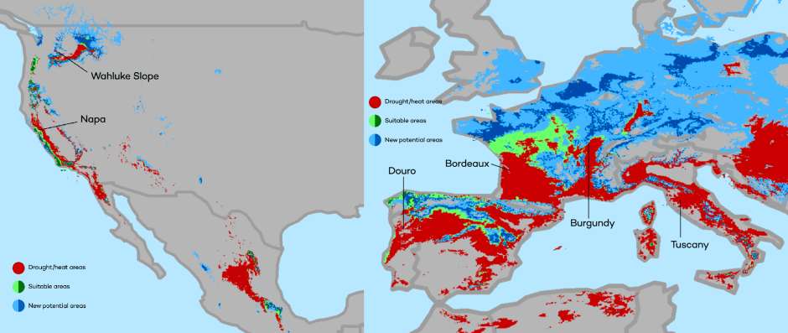
Market Based Adaptation
Prices and costs influence behavior.
  Where to live.
  Where/when/what to plant.
Avoid barriers to market adjustment.
  Trade barriers, immigration restrictions, federal flood insurance, agricultural subsidies, and zoning regulations.
The changing map of the world’s wine-growing regions.
Notes:
Another way in which the effects of climate change will be ameliorated is through price signals. Activities that today are cheap will become more expensive tomorrow. Living in warm climates will become more expensive as air conditioning has to run more often. Planting wine in certain regions will get harder and harder as the climate changes. Making it more expensive to grow wine where it has traditionally been found. Instead, the climate will become more favorable in other parts of the world – generally in areas to the north of existing wine growing regions.
There is a case to be made that these adjustments are not unlike other adjustments to changing circumstance. One important aspect is the sheer magnitude of the population and markets that will be affected.
Two other important aspect of these market adjustments are that:
There are a host of policies and programs that serve to mask their need. For instance, as more and more areas become flood prone, flood insurance will reduce the costs of continuing to build in these areas.
The image reflects changes in the location of optimal climate conditions for wine growing. Napa valley will likely diminish as an attractive place to grow wine, while Oregon and Washington will become more attractive. Additionally, southern Europe (Spain, France, and Italy) will be less conducive to wine growing while northern parts of Europe will become more viable.
This is just one example of significant changes in the geography of agricultural production that will likely result from climate change.
Markets may not be our friend to the extent that there is no market in CO₂ and market prices encourage CO₂ production. But markets are our friend when it comes to adaptation. For example, in agriculture, in the face of a warmer climate and changes in the distributions of weather variables, market signals do and will encourage the planting of higher-yielding crops in newly appropriate locations.
A very real public policy issue is that federally subsidized flood insurance inhibits that response. (See, among others’, Kerry Smith’s recent work on this issue, which highlights the distributional consequences of insurance subsidy). Another is the debate over whether it is better to build sea walls and fortify in response to sea- level rise or better to encourage to relocation away from flood risk.

Slide 22

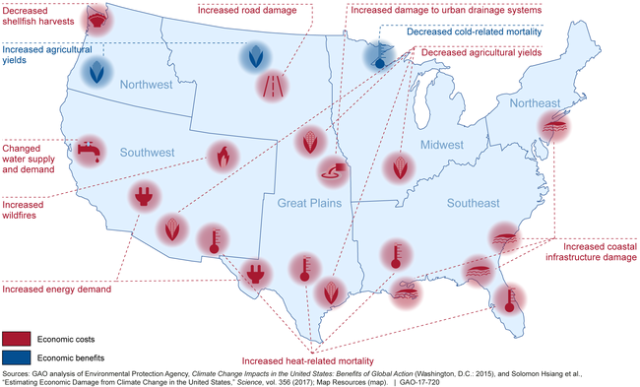
Most Vulnerable People and Places
Tropical areas
Low-lying coastal areas
Low-income people
Notes:
The burdens of climate change are distributed unequally across the planet, mostly because of the geographic distribution of the physical impacts. Tropical areas are expected to see the greatest physical impacts in terms of temperature, precipitation, sea level rise, and storms. People who live in low-lying coastal areas are most exposed to sea level rise and storm surges. All over the world, low-income residents will have less capacity to adapt than those with higher incomes, since adaptation often requires investments or up-front costs.
(Barbier and Hochard 2018, and IPCC)
I mentioned that impacts will vary across the globe. The United States will not escape the effects of climate change. In fact, the U.S. Department of Defense considers climate change to be a serious threat, and it acknowledges that the U.S. is currently feeling the effects of climate change.
This map shows how impacts will vary across the United States. The things that are blue are positive impacts—the benefits from climate change, such as improved agriculture in some northern regions and decreased cold-related deaths. But you see a lot of red spots on the map that show significant damages we expect from climate change. As you’d expect, the east coast will see a lot of coastal infrastructure damage. The south will experience an increase in heat-related deaths. Much of the country will see reduced agricultural yields.
You can also see that some of these effects represent adaptation. For example, the increased energy demand in the southwest is from increased use of air conditioners.

Slide 23
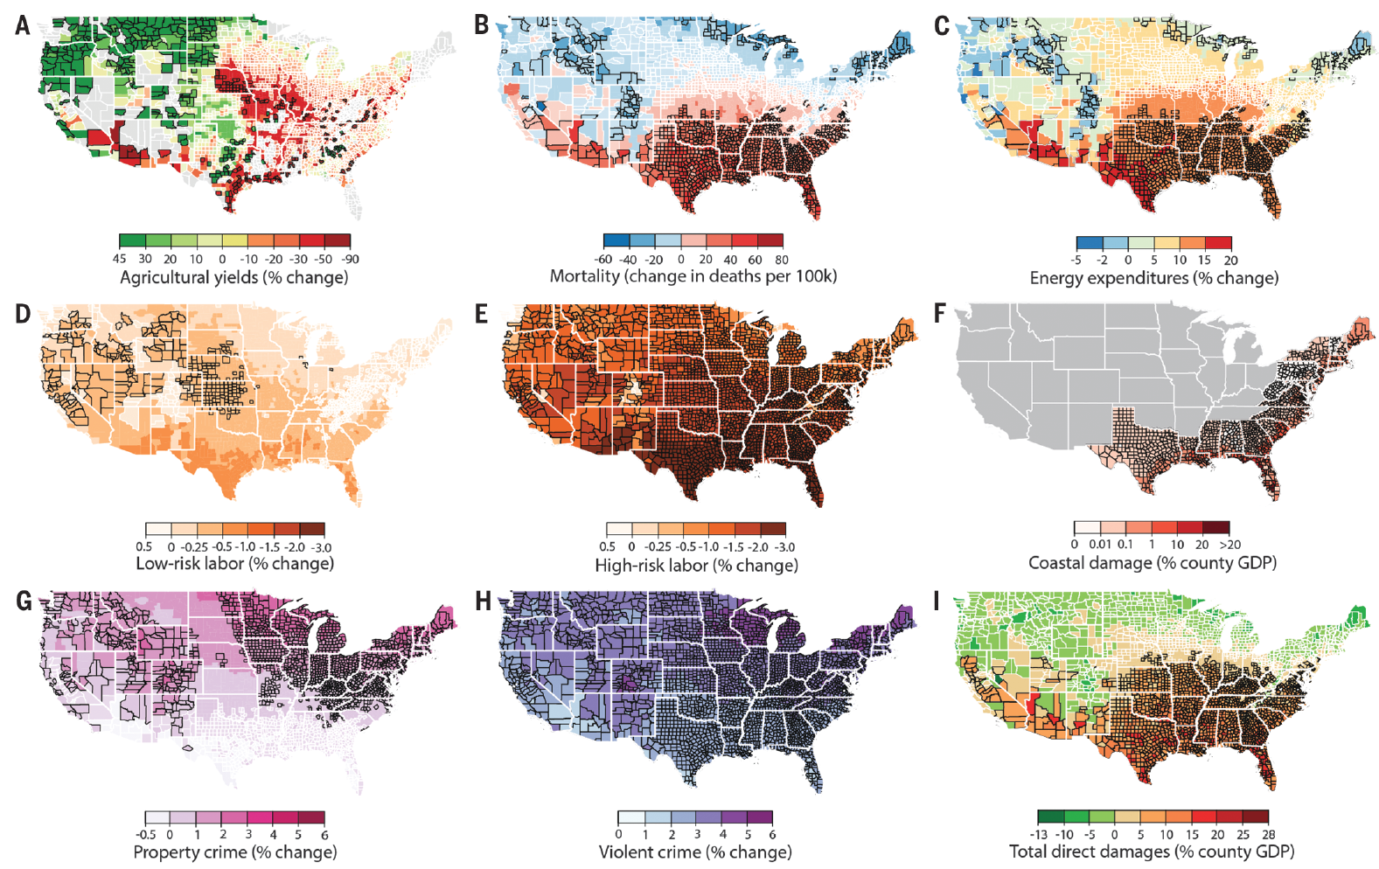
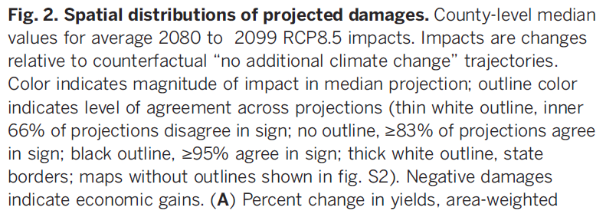
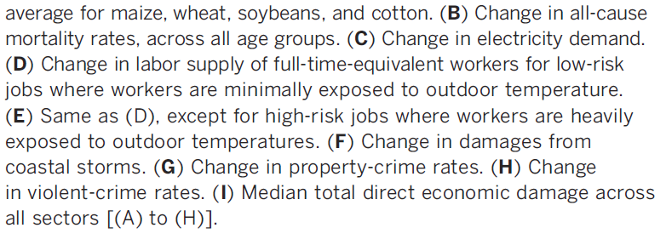
Projected Effects Vary Across the U.S. but Are Estimated at 1.2% of GDP per 1C Increase
Notes:
These maps show in much finer detail how impacts will vary across the United States. This study compiled the expected effects from a 1 degree Celsius (1.8 degree F) temperature rise from many other studies. The net effect for the nation was predicted to be 1.2% of GDP per 1 degree Celsius of warming. Remember that we said that current estimates, if we don’t act on climate change, indicate an increase of 3.7 to 4.8 degrees Celsius by 2100. To put 1.2% of GDP in context, the U.S. GDP is $18.6 trillion, and we think of good growth for the U.S. GDP as being 3% per year, so a 1.2% reduction is the difference between a robustly growing economy and a relatively stagnant economy.
States in the far north may see net benefits, mostly because of agricultural gains, but the south, the southeast, and the mid-Atlantic region are expected to be hit hard because of agriculture, mortality (death), energy costs, coastal damages, and crime (Hsiang et al., 2017).

Slide 24

Social Cost of Carbon
Cost above price paid.
The expected cost of damages from each unit of greenhouse gas emissions.
Current EPA estimate: ~$51 per metric ton of CO₂.
  About $32 Billion for all vehicles in the US.
Social cost of carbon will increase over time.
Notes:
18.07 lbs/mile
2204.62 lbs/metric ton
1.8 cents/mile
When we think about all of these damages, we try to evaluate how much they cost in terms of the losses and suffering caused to human beings. We use these estimates to come up with something we call the social cost of carbon. This is the amount of damages to humans caused by each unit of greenhouse gas emissions. This is an important quantity; we’ll come back to it in a little bit.
Right now, the U.S. Environmental Protection Agency uses an estimate of around $51 per metric ton of CO2. But different models can estimate values less than $10 or above $100. More importantly, most models estimate that the social cost of carbon will increase as we move farther into the future, even if we take immediate action to fight climate change.
As discussed in the 2010 SC-CO₂ TSD, estimates of the social cost of these greenhouse gases increase over time because future emissions are expected to produce larger incremental damages as physical and economic systems become more stressed in response to greater climatic change, and because GDP is growing over time and many damage categories are modeled as proportional to gross GDP.

Slide 25
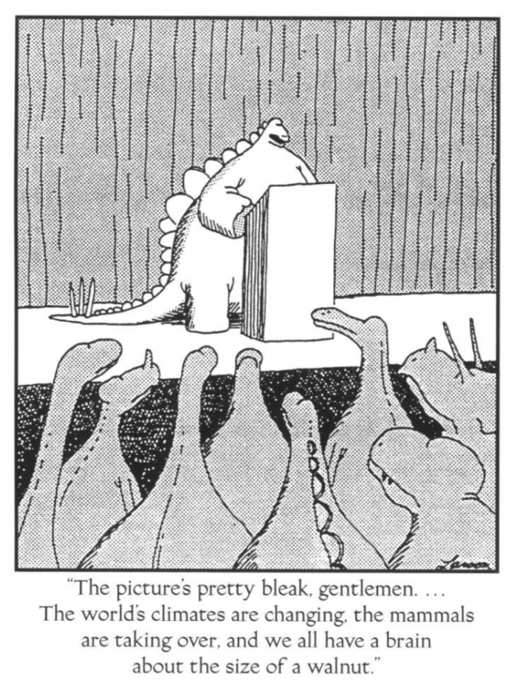
Notes:
So, this has all been pretty depressing! But let’s not forget: we have big brains and economic tools. We can use both to devise a pragmatic solution to climate change.

Slide 26
Economics of Responding to Climate Change
Notes:
Now that we know how economic activity affects greenhouse gas emissions, we can start to understand possible steps to mitigate climate change.

Slide 27
International Climate Policy Goals
Intergovernmental Panel on Climate Change (IPCC)
  Global effort to fight climate change
  Reports on consensus of climate science, including economics
IPCC report in 2007:
  Recommended goal: < 2 degrees C (3.6 degrees F)
  Industrialized countries should reduce GHG emissions between 25% and 40% below 1990 levels by 2020.
2016 Paris Agreement:
  Basic goal of 2 degrees C: requires 40-70% GHG reduction 2010 → 2050
  Reach goal of 1.5 degrees C: requires 70-95% GHG reduction 2010 → 2050
IPCC report in 2018:
  Temperature has already increased by 1.0 degrees C - Recommended: < 1.5 C
Notes:
The international community has been concerned about climate change for decades, and has convened experts and policymakers through the Intergovernmental Panel on Climate Change (IPCC). This group produces reports on the consensus view of scientists about how climate change is progressing and what will continue to happen. Economists contribute to this work, particularly in thinking about the value of damages, the cost of fighting climate change, how adaptation will happen, and what policies are recommended.
Remember that we said that economists recommend balancing the costs and benefits of pollution rather than setting a goal of zero pollution? The IPCC’s Fourth Assessment Report (2007) recommended a goal not of zero temperature increase (which would be impossible at this point), but rather 2 degrees Celsius (3.6 degrees F). They calculated at that time that to reach this goal, industrialized countries would need to reduce emissions between 25% and 40% below 1990 levels by 2020.
In their Fifth Assessment Report (2014), the IPCC reported that temperatures had already increased by 0.85 degrees Celsius. The sea level has already risen by about seven inches in the last century.
In 2016, countries convened through the United Nations Framework Convention on Climate Change (UNFCCC) to form the Paris Agreement. In this agreement, countries agreed to the goal of limiting temperature increases to 2 degrees Celsius and to try to reach an even more difficult goal of a 1.5 degree increase. Given our current understanding and the technology we have and expect to become available, either goal will require dramatic reductions in emissions. It is not clear that the goal of a 1.5 degree Celsius increase is achievable with current technology, but this goal was chosen because, now that we have learned more about the science of climate change, we now understand that humanity will bear a lot of damages if we let warming get to 2 degrees.
DOES ANYONE KNOW WHICH COUNTRIES HAVE NOT SIGNED THE PARIS AGREEMENT? WRITE IN THE CHAT YOUR GUESSES.
The only countries who are not signatories to the Paris Agreement are Iran, Iraq, Yemen, Libya, and Eritrea.

Slide 28
How Economists Decide How Much to Fight
Climate Change
Cost Benefit Analysis
Expected costs of reducing emissions
Weigh:
Expected damages from allowing climate change
Notes:
To determine whether and how much we should act, economists place the analysis of global climate change in the context of a cost-benefit analysis (CBA). A cost-benefit analysis weighs the expected consequences of the projected increase in carbon emissions versus the expected costs of policy actions to reduce emissions.

Slide 29
Cost-Benefit Analysis of Fighting Climate
Change
Most economic models suggest the costs of keeping warming below 2°C are relatively small.
  Costs amount to 1-4% of GDP by 2030.
Costs of acting to keep warming below 2°C are almost certainly less than future economic damages they would avoid.
  Damages estimated to be between: 7 - 20% of worldwide GDP.
Caveats:
  Putting a monetary value on priceless things
  Inequality
  Uncertainty and risk
Notes:
Most of the economic models that have attempted to estimate the net costs of achieving a likely pathway toward a reduction of 2 degrees Celsius suggest that the costs are relatively small, amounting from 1% to 4% of GDP by 2030 (Rosen and Guenther, 2015).
Studies show that these costs are almost certainly outweighed by the future economic damages associated with warming of more than 2 degrees Celsius that they would avoid. For example, the Stern Review calculates that the possible damage of climate inaction (or business-as-usual) could be as high at 20% of worldwide GDP (Stern, 2006). Since the expected costs of acting are less than what we expect the benefits of acting to be, the cost-benefit analysis for climate policy passes!
However, there are some caveats to CBA that we need to consider.
To do a CBA, we have to put a monetary value on all the costs of climate change. Critics say that the social, political, and ecological implications of climate change can’t be captured in a dollar value. For example, climate change can increase mortality, and those deaths have to be valued in a CBA. At the same time, if money spent to fight climate change comes from other human development uses (some of which are literally life-saving), the opportunity costs (i.e., what we have to give up) of fighting climate change could be very large. And indeed, some of the values that we want to incorporate are extremely hard to put dollar values on; economists have a lot of techniques to get at these numbers under the philosophy that some number is better than no number, but they are not uncontroversial.
The costs and benefits of fighting climate change are also uncertain, which makes the CBA harder. This uncertainty comes from a few things. First, as we have already discussed, the impacts of climate change can’t be precisely estimated yet. Second, unknown ecological tipping points might amplify the risks of not acting against climate change (Lenton et al., 2008). Third, technological change will reduce costs of fighting climate change in the future, but we don’t know how much because we don’t know what innovations will happen in the future. Fourth, we don’t know how human society will develop over the coming years: how rich people will be and where they will live. Again, these factors make it so we don’t have precise estimates of costs of fighting climate change or costs of climate change damages, but what we do know allows us to come up with expected ranges and average expected values of each.
For these reasons, we might think of CBA as a rough, back-of-the-envelope way to get general impressions; it can tell us whether action is a no-brainer one way or the other, but it would be hard to pretend we can be precise about the exact efficient degree to which we should fight climate change.
CBA has also been criticized because it does not inherently address inequality; a global CBA just tells us the comparison of the sum of total global costs to the sum of total global benefits, so is really a global average. Effects will vary from one place to another, as we discussed, and will fall most heavily upon the poor of the world. Regions such as Africa could face severely compromised food production and water shortages, while coastal areas in South, East, and Southeast Asia will be at great risk of flooding. Tropical Latin America will see damage to forests and agricultural areas due to drier climate, while in South America changes in precipitation patterns and the disappearance of glaciers will significantly affect water availability. While the richer countries may have the economic resources to adapt to many of the effects of climate change, poorer countries will be unable to implement preventative measures, especially those that rely on the newest technologies, and without financial help they will be unable to adapt and will thus face heftier damages.
The way in which economists incorporate inequality into their analyses can have a significant impact on their policy recommendations. If we think about costs in absolute amounts, then a cost of (say) $500 million is much more damaging to a country like the Maldives, which has a GDP of $3.6 billion, than to the United States, which has a GDP of $18.6 trillion. The Stern Review (the predecessor to the New Climate Economy Report) asserts that if we properly considered the disproportionate effects of climate change on the world’s poorest people, it would increase the estimated costs of climate change. Stern estimates that, without the effects of inequity, the costs of a business-as-usual (no climate policy) scenario will be 11% to 14% of global GDP annually.

Slide 30
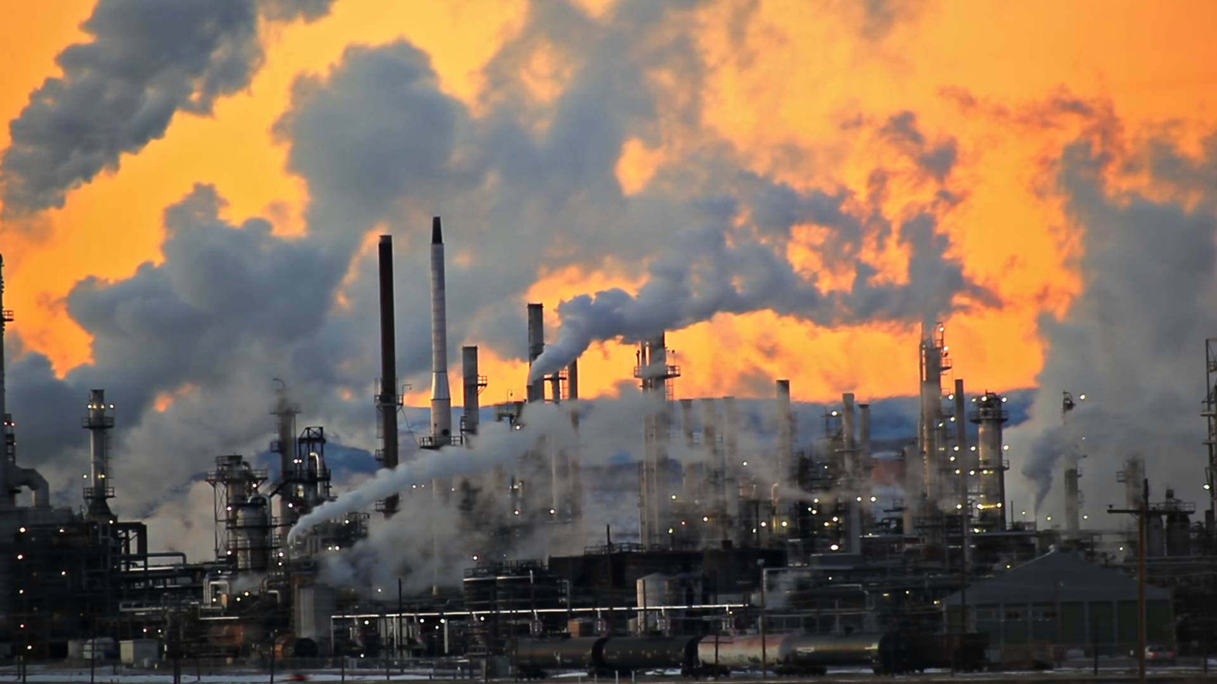
Present Value of a Future $100 Cost or Benefit
“
It is better to be roughly right
than precisely wrong.
- John Maynard Keynes
“
Notes:
Economic models can generate precise numbers—–for GDP growth, jobs, or emissions—but they can only ever offer approximations of the future. Too much is unknown about the course of technological and structural change, with the key processes difficult to capture formally. Too much that is of value—such as people’s health, the reduction of risk, the sustainability of the natural environment—is hard to quantify. But as John Maynard Keynes once said, “It is better to be roughly right than precisely wrong.”
Many climate experts, including those who contribute to the New Climate Economy report, recognize this point and warn against the search for false precision. We gather whatever evidence we can and make the best decision we can about what climate targets to set, informed by a range of perspectives and evidence; but since our knowledge is imperfect, we continue the scientific research that will help us refine our goals as we go forward.
In other words, while we may not know exactly what temperature rise or level of emissions reduction is precisely optimal, we know in general that we need to reduce emissions a lot, and soon.

Slide 31
Economic Growth and Climate Change Action
Are Compatible
Abating greenhouse gas emissions is costly…
… but climate change damages are even more costly.
Economic growth comes with consequences that we have to deal with, including climate consequences.
Economies with environmental regulations can still be dynamic.
Goal: design policies that reach climate goals at the least possible cost.
Notes:
What is the relationship between fighting climate change and economic growth? It’s complicated!
Economists like to say that there is no such thing as a free lunch. Reducing our greenhouse gas emissions (abatement) will have some real economic costs; we shouldn’t pretend that it won’t. But it’s worth doing because the costs of NOT fighting climate change are even worse.
The way we like to think about it is to acknowledge that economic growth has consequences, including climate change, and we have to be sophisticated and deal with those consequences. Economic growth will still continue with environmental regulations in place; as I said before, we don’t want or need to create a recession to address climate change. With smart regulations, we can have robust growth and an environment that’s healthy and promotes the human activities that depend on natural resources. It’s about balancing the different things we value.
Remember, one of economists’ special contributions to climate policy is that we create policies that achieve goals at the lowest possible cost. In the context of climate change, that means that we reach our climate goals with the lowest direct cost in terms of economic growth. This also makes policies more politically viable.

Slide 32
Addressing the Sources of Our Emissions
Notes:
NEED TO GET HERE BEFORE THE BREAK.
So, we know we need to reduce emissions; what are the best ways to do that? Let’s see where our emissions come from.

Slide 33
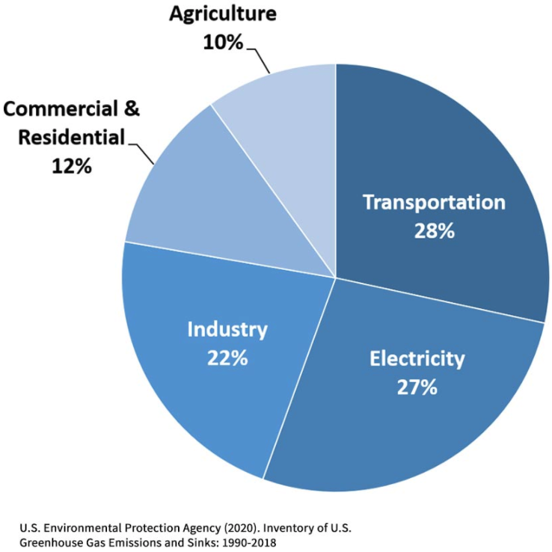
Total U.S. Greenhouse Gas Emissions by
Economic Sector in 2018
Notes:
https://www.epa.gov/ghgemissions/sources-greenhouse-gas-emissions
In the U.S., as in most of the world, most of our greenhouse gas emissions come from electricity, transportation, or industry. Some come from agriculture and commercial properties (like stores) and residential properties (homes).
The mix of activities that produce emissions that we’ve shown you so far are all for the United States; worldwide, land use may also play a big role. Deforestation releases carbon into the atmosphere, and agriculture releases methane (and often also carbon, though it need not always). Remember that these are sources of greenhouse gas emissions, but deforestation also reduces the forest “sink” for greenhouse gases, and so deforestation is both a source of GHGs and a reduction in a sink. Agriculture, forestry, and other land use (AFOLU) are responsible for a quarter of global GHG emissions due to deforestation and forest degradation, as well as emissions from methane (livestock), nitrous oxide (e.g., fertilizer), and carbon dioxide (e.g., tractors and fertilizer production).
WHICH SECTOR DO YOU THINK WILL GIVE US THE BIGGEST BANG FOR OUR BUCK IN ORDER TO ADDRESS GHG? [TRICK QUESTION: IF WE FIX ELECTRICITY, THIS ALSO HELPS US FIX INDUSTRY AND TRANSPORT]

Slide 34
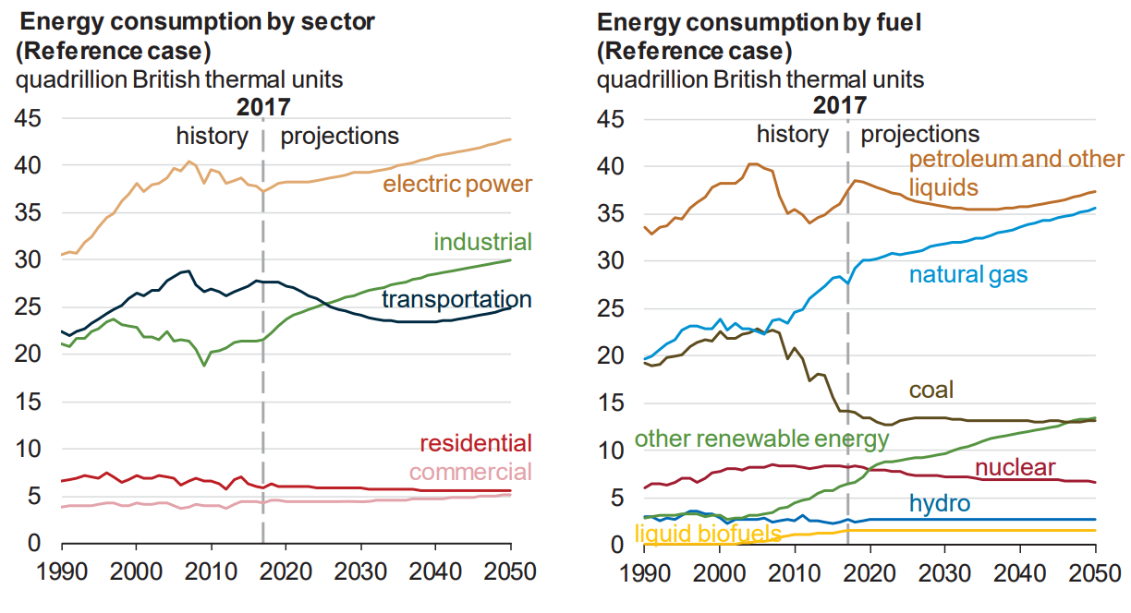
Fossil Fuels Dominate U.S. Energy Production
Notes:
US Energy Information Agency Annual Energy Outlook 2018
The burning of fossil fuels creates the great majority of our emissions. It is also the main way we get our energy in the modern world.
The chart on the right shows our energy sources, and you can see that the biggest sources of our energy by far are all fossil fuels: petroleum, natural gas, and coal.
The chart on the left shows the uses of energy today in the nation; since most of our emissions come from energy use, the mix is similar to what we showed on the last slide for emissions. Electricity (think: coal-fired power plants and natural gas-fired power plants) makes up the biggest portion of our energy use, followed by transportation (think: gasoline and diesel fuel in cars and trucks) and industrial or other uses. It is for this reason that people talk about how we need to reduce our use of fossil fuels to produce energy.
You may have heard that renewables (which are low- or no-carbon) are growing in huge percentage terms, and that’s true; you can see that the green line on the right slopes sharply upward. However, they’re still a very small part of the overall energy mix worldwide, just about 8%. Still, they’re expected to keep growing, and quite regularly they have outstripped predictions by leaps and bounds. Investment in renewables reflects this promise: global investment in renewable power and fuels in 2015 was $270 billion, a 17% increase from 2014.
Fossil fuels provide the bulk of our energy because they’re cheap. We’ve already told you that they are artificially cheap because the environmental costs are not being counted. You may not know that their prices are further lowered because governments all over the world subsidize fossil fuels in one way or another, whether it be in subsidies for fuel for citizens or in steeply discounted contracts that let fossil fuel companies extract fuels on government lands.

Slide 35
Global GHG Abatement Cost Curve
Lighting
Appliances
Hybrid cars
Solar?
Wind?
Notes:
McKinsey report
Knowing where our emissions come from, we can start to think about how to reduce them. Remember, economists are concerned with the idea of doing this at the lowest cost. So, let’s think about the cost of each possible way to reduce emissions. We call reductions “abatement,” and we rank these abatement opportunities by their cost to create what we call a “marginal abatement cost curve.”
That’s what this graph is. It was made by McKinsey in 2009, itemizing GHG reduction opportunities and their associated costs. The width of each bar shows how much emissions could be reduced by it. We want to do things from the left to the right: from lowest cost to highest cost. Notice that some of the “costs” are negative—that means we can save money by doing them! This may only be true in theory; remember that these are all approximations.
Since this is several years old, the costs have changed some, and some things are not on here. One really important thing to remember, too, is that these costs can change as we take actions. Technological advancements can bring down the costs of some of these abatement methods; we don’t yet know which ones! For this reason, governments invest in research and development to help spur these advancements. Private companies will do this, too, and will have more incentive to do so if we can fix the prices so that polluting is costly. But since society has a special interest in reducing emissions, governments can provide subsidies and grants for research into low-abatement, cost-saving technologies.
(If there’s time, spend more time talking about specific items in the graph here, pointing out low-cost and high-cost items.)

Slide 36
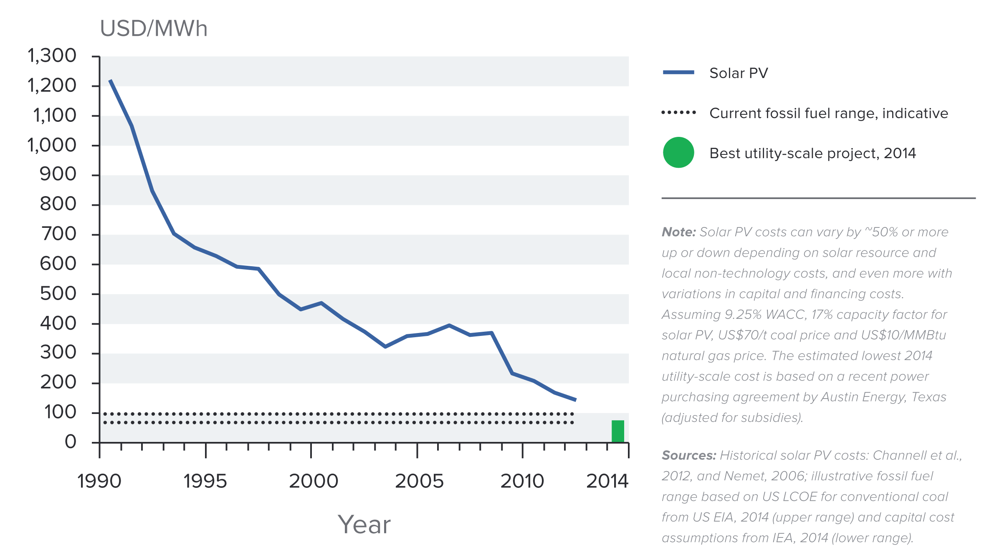
Indicative Solar Costs Over Time
Notes:
Source: New Climate Economy Report
Remember that we talked about how fossil fuel energy is “unfairly” cheap because of externality costs that aren’t reflected in the prices, and that fossil fuels dominate our energy because they are so cheap. However, costs of renewables have been falling for years, especially solar, and that’s promising—when they’re cheap enough, people will naturally switch over to them. The price of solar panels has fallen so dramatically that in some places they are cost competitive with fossil-fuel-based electricity from the grid.

Slide 37
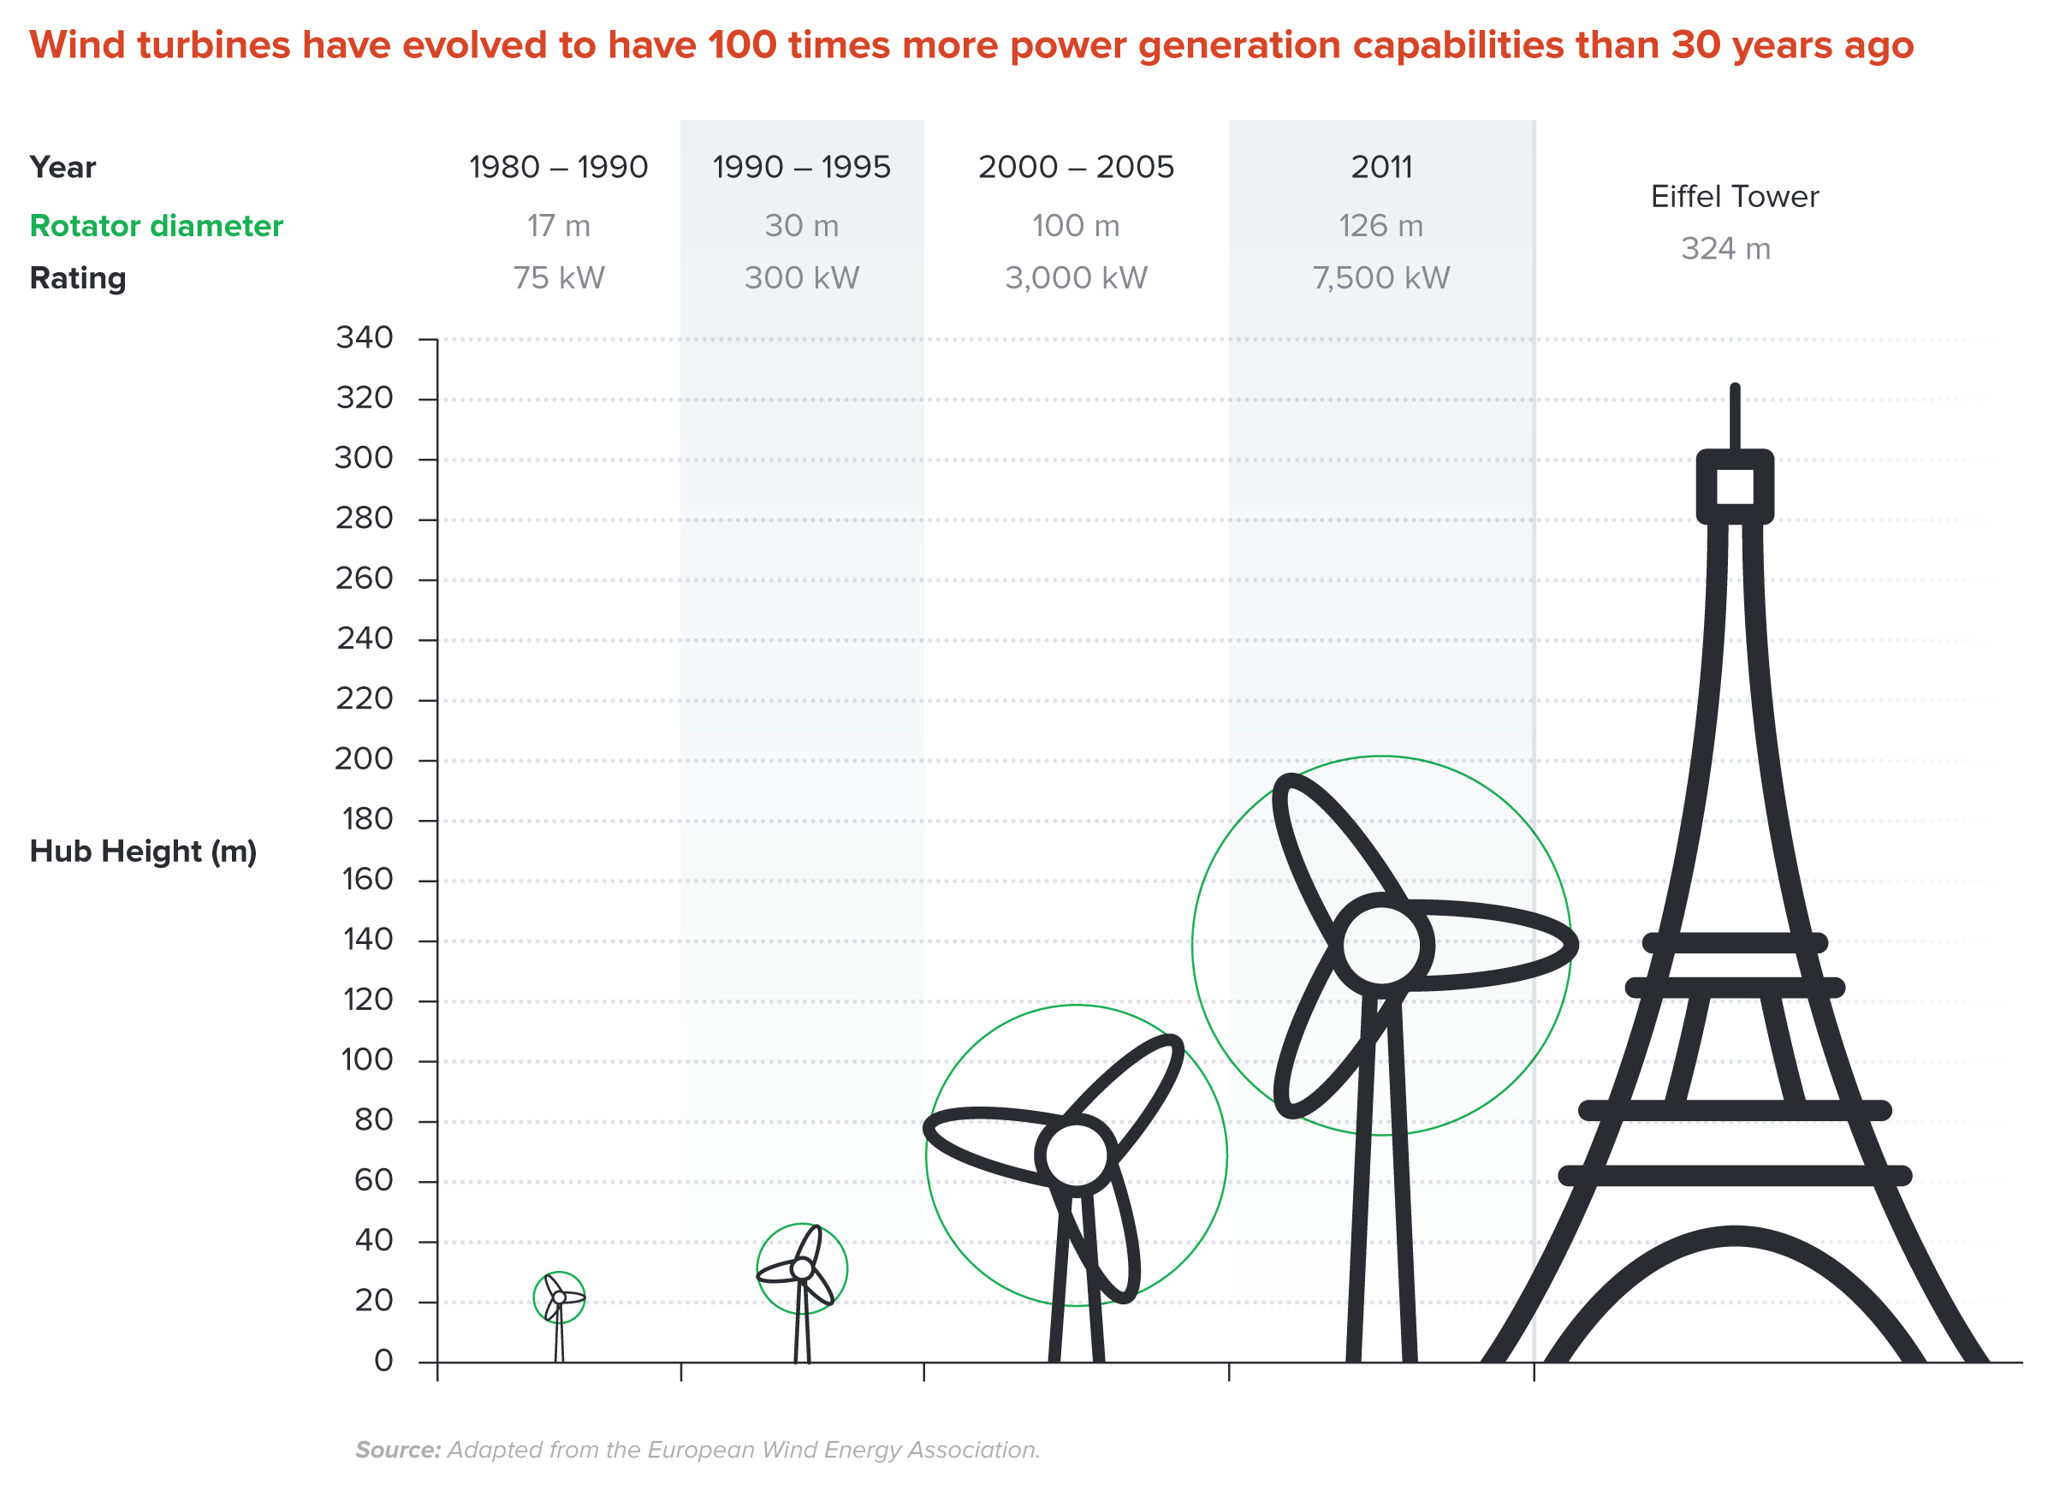
Wind Turbines Have 100 Times More Power
Generation Capabilities Than 30 Years Ago
Notes:
Source: New Climate Economy Report
Wind energy is also becoming more advanced as the years go by, which reduces the cost per unit of wind energy.

Slide 38
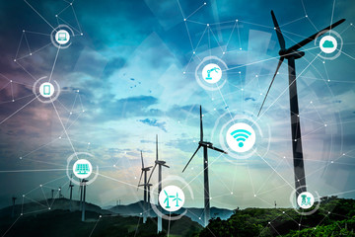
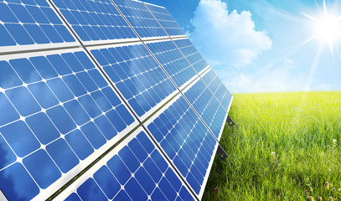
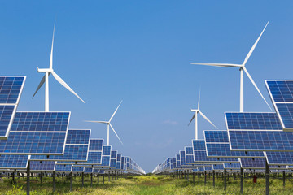
Challenges with Renewable Energy
It’s intermittent - only produced if there is sun or wind.
Energy is needed all day and night, with peak times.
Limited w/o storage.
  Creative storage options are under development.
Notes:
It’s easy to get excited about advances in renewable energy technology. However, we have to be realistic and remember that solar and wind power in particular have an important limitation. They are what we call intermittent sources: solar panels only work when the sun is shining, and wind power only works when the wind is blowing. Energy demand is strong all day and night, and there are peak surges at particular times of day, with bigger peaks on some days (e.g., hot days in summer) than others. Hence there’s a mismatch between the pattern of energy provided across the day by renewable sources, and the pattern of energy needed across the day. Energy needs to be supplied in the exact amount it is demanded at any minute.
As a result, it’s vital that we develop better energy storage technology that is low-cost and that loses as little energy as possible. No matter how good solar and wind power become, they will always be limited if we cannot store the energy. More research is underway in this area, which is very important.
The image is of a proposed storage facility. As energy is collected, a tower is created. This translates the energy that is generated into potential or gravitational energy in the blocks. During the day, the blocks are lifted and the tower is built. At night, the blocks are lowered back to the ground, generating energy that can be put out onto the grid.

Slide 39
Infrastructure and Climate Change
$90 trillion in investment will be needed for U.S. infrastructure, 2015-2030.
Add $4 trillion (< 5%) to make it low-carbon infrastructure.
  This would also reduce climate damage to infrastructure.
  Railway, urban transport, renewables.
The electrical grid is particularly troublesome.
  It is outdated and not suited for renewable energy storage.
  Those with solar panels use the grid but contribute little to its upkeep.
Notes:
Sources for these
Some examples of low-carbon infrastructure are:
Railway infrastructure, which can reduce the number of carbon-emitting trucks
Urban transport projects, such as Metros and Light Rail projects which reduce car usage- one of the more notable sources of carbon emissions
Renewable energy projects (solar, wind, and hydropower), which have much lower carbon emissions compared to fossil fuels
In the U.S., $90 trillion will be invested in infrastructure (such as power grids, water and sewer systems, transportation systems, and communications networks) between 2015 and 2030. A shift to low-carbon investments would add about $4 trillion (a less than 5% increase over that $90 trillion) (New Climate Economy Report, 2014). Remember that climate change will also damage infrastructure, so if these low-carbon infrastructure investments reduce climate change, these damages will be reduced.
Energy infrastructure is particularly an issue. The electrical grid in the United States is outdated. It’s also not ready to receive large amounts of renewable energy, because of the problem we just discussed about the intermittent nature of solar and wind energy and the need for better energy storage. We need a modernized grid.
The grid also needs to be paid for. Right now, we pay for it as part of our electric bills. When people put solar panels on their homes, they usually still use the grid, but pay less for its upkeep. As a result, those grid upkeep costs are shifted onto people who don’t have solar panels, who might be lower income. This is the debate about “net metering,” and it’s a fairness issue because higher-income people tend to have the solar panels while lower-income people are paying regular electric bills that support the grid’s maintenance and operation. Electricity suppliers will need to work out pricing schemes that accommodate and encourage renewable energy without unfairly burdening anyone.
$65 subsidy paid to those w/rooftop solar in CA: https://energyathaas.wordpress.com/2018/03/26/why-am-i-paying-65-year-for-your-solar-panels/

Slide 40
Climate Change Policy
Notes:
So, we’ve seen the sources of emissions, including energy, cities, and land use (agriculture and deforestation). Now let’s talk about how we can reduce those emissions through policies—through the actions governments take.

Slide 41
Policies That Reduce Emissions: Directly
Regulation
  Emissions standards or limits
    E.g., CAFE standards
Market-oriented policies
  Putting a price on emissions
    Subsidizing green energy (e.g., feed-in tariffs)
    Tax or cap & trade
Notes:
Climate policies all try to find ways to reduce net greenhouse gas emissions. Remember that the basic problem is that all activities that produce greenhouse gas emissions, including burning fossil fuels, are “too cheap.” So, policies that push toward reductions in energy use overall, improvements in renewable energy technology, and greener use of land can fight climate change.
The way most pollution is regulated is that you see where the pollution is emitted and you try to get there to be less pollution coming out. The old-fashioned simple way of doing this for normal pollutants is that you go to the places where the emissions are coming out, like power plants, and you give them an emissions standard or limit that says they’re only allowed to put out so much pollution. But these policies are usually very inflexible in the sense that they may treat a pollution source that finds it really expensive to reduce emissions the same as one that finds it really cheap to reduce emissions.
Instead, to help increase reductions, economists put a price on emissions. The basic idea is that the root of the problem is the artificially low price of fossil fuels, which happens because the pollution creates a cost that’s external to the buyer and seller. This problem can be fixed by using policy tools to make the prices reflect the true costs to society. Increasing the relative prices of fossil fuels would essentially level the playing field.
One way to do this is to provide subsidies for green activities. We wouldn’t want to “pick a winner,” but instead subsidize any technology that seems to legitimately reduce emissions. One current method of subsidization for renewable electricity is called “feed-in tariffs.” A feed-in tariff is, essentially, a per megawatt-hour subsidy that is added on to green energy to let it compete with traditional energy sources on the grid.
Economists recommend instituting taxes as an even more powerful solution than green subsidies. These taxes are often called “carbon taxes,” or “cap and trade” programs (also known as pollution permits). The reason is that either of these methods help ensure that emissions reductions are accomplished with the lowest possible costs. This is good in its own right, because it means that meeting our environmental goals requires less sacrifice; but it’s also good because it makes implementing a policy more feasible (people object more strongly to a policy that involves more costs). We’ll explain this further in a moment.

Slide 42
How Does Cap and Trade Work?
Activities to be covered are determined.
Acceptable emissions levels are indicated.
“Permits” that allow acceptable emissions levels are issued.
  How?
    According to historical emissions?
    Evenly across emitters?
    Sold at some price?
A “market” is developed.
Those desiring to emit will have to buy sufficient permits to accommodate their emissions.
Those wishing to abate will offer their permits on the “market”.
  The price of a permit indicates:
    The benefit of eliminating further emissions.
    The cost of emitting.
Gov’t agency determines equality of permits in possession and emissions.

Slide 43
How Does a Carbon Tax Work?
Activities to be covered are determined.
The price of emissions is determined.
  Presumably some relation to the social cost of polluting.
Emissions are measured.
Taxes are determined.
Q: What to do with the tax revenue?

Slide 44
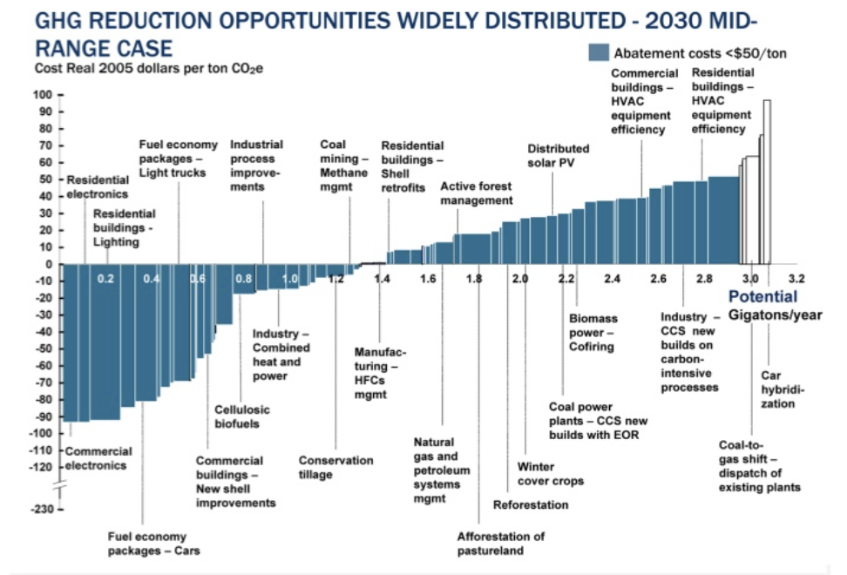
Putting a Price on Carbon
Suppose a Social Cost
Of Carbon of $50
Notes:
Let’s demonstrate how carbon prices work. On the horizontal axis of this graph, we have amounts of emissions. On the vertical axis, we have costs of reducing emissions. The blue line is like an abstract version of that McKinsey curve we showed you before—these are all the ways to reduce emissions, some more costly, and some less so.
If everyone who emitted a unit of greenhouse gases had to pay some carbon price, they’d have to ask themselves for each unit: do I want to emit and pay that carbon price, or do I want to not emit (abate) and pay the abatement cost? In this way, all of the low-cost reduction opportunities will happen because it’s cheaper for the person to abate than to pay the carbon price.
Let’s suppose the we set the cost of emitting carbon at $50/ton. The all of the activities in blue, those where the bar is entirely below $50/ton would abate instead of paying the fee.

Slide 45

Carbon Prices: the Good and Bad
Good:
  Provide price signal to lower emissions.
  They yield low-cost reductions in emissions.
  They spur innovation in clean technologies.
Bad:
  Firms might leave to flee regulation.
  It is necessary to monitor emissions.
  Potentially regressive
    Costs may weigh more heavily on low-income households.
Notes:
To economists, carbon taxes and cap and trade systems are likely to perform in ways that are mostly similar, by “fixing” the price problem and getting low-cost emissions reductions.
There are some potential concerns with pricing carbon, either through a tax, or through cap and trade.
It turns out that lower-income people spend a larger portion of their income on consumption items, including electricity, transportation, and goods produced using energy; as a result, any form of a price on carbon (either a tax or cap and trade) has a “regressive” impact, which means that low-income people pay a higher percentage of their income than do high-income people. This is easiest to see with a tax, but is also true of cap and trade, since greenhouse-gas intensive things will have higher prices to reflect pollution permit prices. Most countries, including the United States, prefer policies that are “progressive” in terms of their impact on income distribution, so that the proportion of income paid goes up with income. One way to fight this is to use any revenue the system generates to give families money back, and more money can be given back to lower-income families. (Taxes obviously generate revenue directly; cap and trade can be used to generate revenues if the permits are sold or auctioned to firms rather than given away.)
The subsequent revenue could be spent on public works, including environmental projects, but these tend to be less progressive or even regressive (benefiting high-income people more than low-income people). This is why current proposals (some of which we will discuss in a moment) call for returning the tax revenue generated from the carbon tax back to households. A system that returns carbon tax revenue to people is known as a carbon fee and dividend.
Additionally, if one area implements a carbon price and there are other areas that do not, some people fear that firms might flee for those less-regulated areas, thus taking away jobs. It has been argued, however, that carbon taxes are more efficient than direct regulation and may even lead to higher employment (Newell and Pizer, 2003). Recent careful estimates show that employment effects of greenhouse gas regulation are likely very small (Hafstead and Williams, 2018).
Both policies require close monitoring of greenhouse gas emissions, which might be costly and difficult in some situations.

Slide 46
Carbon Tax and Cap & Trade: the Differences
 | Carbon Tax | Cap & Trade
Carbon Price | Certain | Uncertain
Emissions | Uncertain | Certain
Ease of Implementation | May be easier to implement
Additional concerns | Always generates revenue May require legislation to change | May be more susceptible to lobbying Only generates revenue if government sells permits Cap can be changed by regulator

Slide 47
Carbon Tax and Cap & Trade: the Differences
 | Carbon Tax | Cap & Trade
Carbon Price | Certain | Uncertain
Emissions | Uncertain | Certain
Ease of Implementation | May be easier to implement
Additional concerns | 1) Always generates revenue 2) May require legislation to change 3) Predictability | 1) Susceptible to lobbying. 2) Only generates revenue if government sells permits. 3) Cap can be changed by regulator. 4) Less certainty over future. 5) Regulations reduce efficacy of Cap & Trade
Notes:
There are some practical differences between taxes and cap and trade
Price and emissions: A carbon tax provides more certainty about the price firms face, but little certainty about the amount of emissions reduced. If the tax is set too low or too high, emissions will be too high or too low relative to the target. On the other hand, cap and trade provides more certainty about the amount of emissions reductions that will be achieved, and this might be important if we think that there’s an ecological threshold that we’re afraid of crossing if emissions turn out to be higher than expected. However, cap and trade has little certainty about the price of emissions, which is set by the emissions trading market (the number of permits on the market). Fluctuations in markets (e.g., a really hot day in summer causing a spike in demand for electricity) can cause permit prices to spike; this could cause blackouts and brownouts and high costs for firms and households to bear.
Ease of implementation: It may be easier and quicker for governments to implement a carbon tax. Governments already have systems set up to tax things, and often already have taxes on fuels that they can just add to. Therefore, a carbon tax may be able to be implemented in just a few months (voting aside). In theory, the same applies to cap and trade systems, but in practice they tend to be slightly more complex, requiring more time to develop the necessary regulations, since a cap and trade system is an entirely new institution and can’t piggyback on existing regulations in the way that new taxes can be piggybacked on and implemented by existing tax authorities.
Additional concerns: Because they require more new development, cap and trade systems may be susceptible to lobbying and loopholes. Also, tax systems always generate revenue that the government can use to reduce other taxes or redistribute back to people; cap and trade systems can generate revenue, but only if the permits are distributed by selling them to the firms initially, and the government may be tempted to give them away. Finally, cap and trade may be more flexible in the long run, though this depends on how the country’s regulations work. In the United States, a tax would probably require legislative approval to change the tax level, while a change in a cap and trade system could probably be adjusted by a regulatory agency like the EPA.

Slide 48
Thoughts on Regulation vs Market-Oriented
Equity.
  Both types of policies are regressive.
    Cap and Trade and a Carbon Tax can offset the regressivity.
    Regulations do not.
Efficiency.
  Market-oriented policies tend to achieve emissions reduction at much lower cost.
    Example: CAFÉ Standards vs Carbon Tax
      Tax is significantly more efficient.
      Why?
Notes:
We have discussed several ways in which emissions reductions can be achieved. These include regulations, market-oriented policies, and indirect mechanisms. Although all three are pursued in the name of emissions reductions, they may well be appropriate in different circumstances.
In particular, indirect policies are useful for accelerating the effects of market-oriented policies. They are also useful in cases where the market-oriented policies might have less of an effect than might be desired; in particular, land use policies or massive infrastructure updates.
Regulation and market-oriented policies, however, very often address the same types of issues and both can remove the same set of emissions.
Accordingly, it is worth going back to fundamental issues when comparing policy instruments: equity and efficiency.
From an equity perspective, there is no absolute answer. Both policies tend to be regressive in that they impose a greater cost, as a percent of income, on low income households than high income households.
The difference is that some market-oriented policies – cap and trade and a carbon tax – have the potential to generate revenue. This revenue CAN be used to eliminate the regressive nature of the emissions reductions.
With a regulation, this revenue stream is not available and the policy will likely be regressive.
Equity issues exist with both sets of policies, but market based policies have the potential to reverse this effect.
From an EFFICIENCY perspective, most research indicates that market-oriented policies tend to achieve a given reduction in emissions at lower cost.

Slide 49
Policies That Reduce Emissions: INDirectly
Subsidizing R&D
Grid / infrastructure
Energy efficiency mandates and subsidies
Mandating renewable energy (e.g., renewable portfolio standards)
Land use policies
Notes:
First, though, you may be thinking about other policies to fight climate change. Here are some of the policies that people tend to talk about. They can often help achieve climate goals and may have other benefits, even though, on their own, they generally will not solve climate change. This is because none of them fully solve the problem of the “unfair advantage” that fossil fuels have.
Subsidizing R&D
Promoting low-carbon or no-carbon technologies is a good idea. Research and development might be particularly in need of subsidies. The payoff for research is always uncertain and happens long in the future, so firms may be too cautious to invest heavily for unknown results.
Grid/infrastructure
As I’ve mentioned, infrastructure in general and the electrical grid in particular need investments, and low-carbon investments are a smart choice right now and heading into the future.
Energy Efficiency Mandates & Subsidies
A lot of attention is paid to energy efficiency, which governments can influence through mandates (e.g., California building codes) or subsidies for purchase of energy efficient alternatives (e.g., hybrid car subsidies). Energy efficiency is good because it lets people get more benefits from less energy. But most claims of energy reductions from energy efficiency investments have not proven to be very effective, either because efficiency improvements are less effective than expected or because people adjust their behavior to use efficient goods more often (e.g., you drive a hybrid more than you would drive a Hummer). Although society might want to encourage energy efficiency, economists don’t expect that these policies alone will solve climate change.
Mandating Renewable Energy
Many states in the U.S. have policies (“renewable portfolio standards”) that mandate that at least a certain percentage of the state’s electricity be from renewable energy sources, with the percentage growing larger over time. These standards have the potential to reduce emissions, but they do not guarantee low costs for doing so.
Land use policies
Land-use policies like smart city planning and policies for reducing deforestation and making agriculture less emissions-intensive could be low-cost ways of reducing emissions if pursued carefully. Some of these methods can fit into emissions pricing schemes, which we’ll talk about in a minute.

Slide 50
Climate Change Policy in Action
Notes:
I know I’ve introduced a lot of theory, but understanding the theory of carbon pricing is vital for appreciating and evaluating how we can apply it.

Slide 51
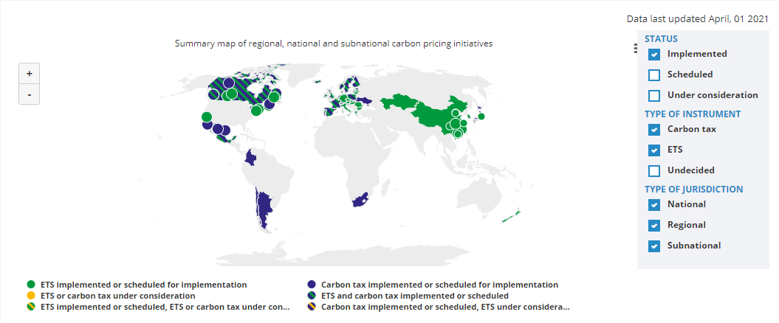
Carbon Policies Across the World
ETS = Emissions Trading System = Cap and Trade
Source: World Bank Carbon - Pricing Dashboard
Notes:
In fact, the application of pricing carbon is gaining traction throughout the world. As of April 2021, there were 64 carbon pricing initiatives across 45 countries (or about 26% of all countries). These initiatives account for 21% of global GHG emissions, and the implemented initiatives are valued at US$ 81.68 billion (or roughly 4% of annual U.S. GDP or 30% of the cash Apple has on hand). And while many large users of carbon resources in electricity generation, such as the United States, Russia, and China, have been slow to implement carbon prices, we are starting to see a break in this trend.
For example, nine states in the northeast U.S. participate in the Regional Greenhouse Gas Initiative (RGGI), which is the first mandatory market-based carbon pricing program in the United States. Federally, there is a bipartisan caucus (the Climate Solutions Caucus) in Congress that is currently evaluating possible federal carbon pricing models. One such example is the bipartisan carbon pricing system that was introduced as the Baker-Shultz Carbon Dividends Plan. Internationally, China, in December 2017, formally launched a national carbon market.
As you can see, carbon pricing is becoming more common and most likely will spread even further in the future. Let’s dive into more detail on current applications of carbon pricing, either through a tax or cap and trade.
Sources: https://carbonpricingdashboard.worldbank.org/map_data
(ETS stands for emissions trading system, which is cap and trade)

Slide 52
Cap and Trade
Notes:
Let’s begin with cap and trade programs, which you’ll remember means that a governing entity sets a limit on the amount of CO2 or CO2 equivalent emissions. I begin with the cap and trade programs because they currently make up the largest carbon pricing policy. As of April 2018, there are emissions trading systems at most levels of government: regional, national, and subnational (e.g., state or province).

Slide 53
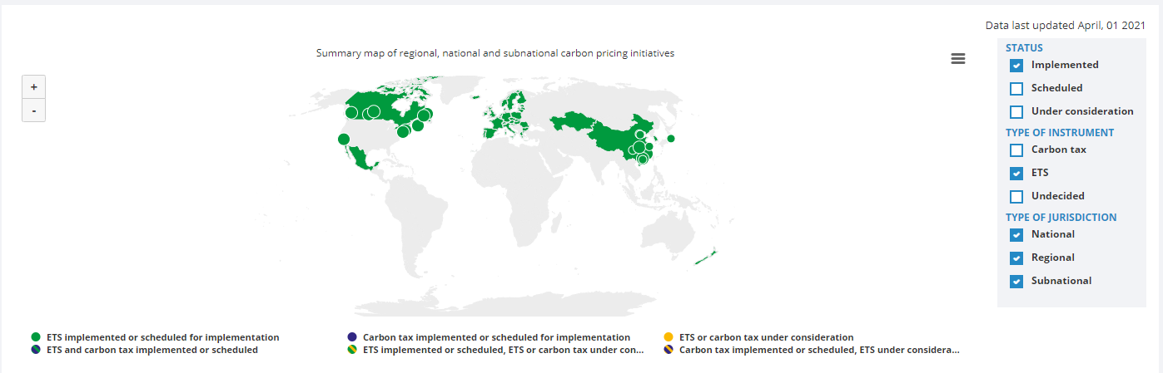
Cap and Trade Policies Around the World
ETS = Emissions Trading System = Cap and Trade
Source: World Bank - Carbon Pricing Dashboard
Notes:
As this map shows, there are 29 emissions trading schemes implemented or scheduled, covering over 38 national jurisdictions and 16.1% of global greenhouse gas emissions.

Slide 54

California’s Cap and Trade System: 2012+
0.7%
of global greenhouse gas emissions
Notes:
California’s cap and trade program, which launched in 2013, is one of the largest programs in the United States. Over 450 companies, together responsible for 85% of California’s total GHG emissions, are regulated in this system. Because California is so big, that makes up 0.7% of global GHG emissions.

Slide 55
California’s System Is Flexible
California’s goals:
  Reduce emissions to 1990 levels by 2020
  An 80% reduction in emissions from 1990 levels by 2030
California’s Tools:
  Cap and Trade
  Renewable Portfolio Standard
  Clean Cars Program
  Low Carbon Fuel Standard
Notes:
California’s climate goal is to reduce regulated businesses’ GHG emissions to 1990 levels by 2020 and to 80% below 1990 levels by 2030. California’s program is a great example of the flexibility that cap and trade programs provide. For example, California’s program works in tandem with the Canadian provinces of Ontario and Quebec, which means that businesses can trade emission allowances across jurisdictions, leading to additional economic efficiencies. Their cap and trade program also works alongside other state climate policies, such as the Renewable Portfolio Standard, which requires all utilities in the state to source half of their electricity sales from renewable sources such as wind, solar, geothermal, and biopower by 2030. Clean Cars Program, which requires automakers to show a 30% overall reduction in GHG emissions on vehicles by 2016. Low Carbon Fuel Standard, which requires that all fuels sold in California by 2020 be 10% less carbon intensive than they were when the regulation was implemented in 2007.

Slide 56
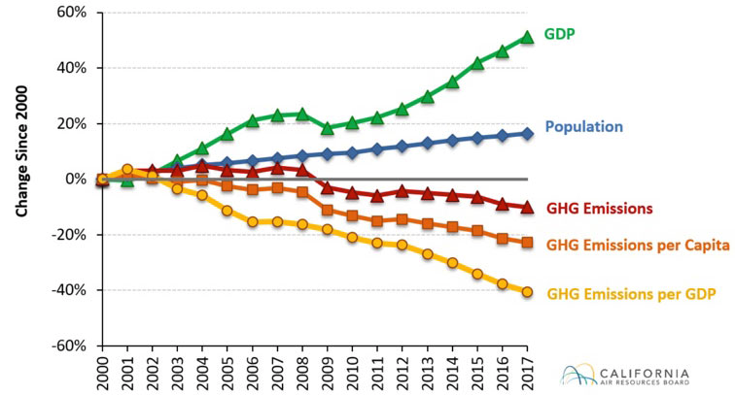
Change in California GDP, Population, and
GHG Emissions since 2000
Cap & Trade ->
Notes:
As you can see, California has implemented several policies that have decreased GHG emissions, as shown by the red, yellow, and orange lines on the graph. California has also shown that it can reduce emissions as the population grows. The blue line in the graph shows population growth, and the green line marks economic growth.

Slide 57
Carbon Tax
Notes:
Now let’s talk about carbon taxes.

Slide 58
Worldwide Carbon Taxes
35
carbon tax programs
27
national jurisdictions
covered
5.5%
of global greenhouse gas emissions
Notes:
There are currently 35 carbon taxes across 27 nations regulating 5.5% of global GHG emissions. Even though carbon taxes are not quite as popular as emissions trading schemes, they have been used in many places and are gaining traction at the federal level. A carbon tax is generally priced per ton of C02 or C02 equivalent. As we said before, this should match, or ramp up to match, the social cost of carbon—the total cost of damages each unit of greenhouse gases causes to humans.

Slide 59

Sweden’s Carbon Tax Policy
Oldest Carbon Tax
Notes:
Finally, let’s introduce the world’s oldest carbon tax, which is in Sweden. The tax was put alongside other fuel taxes. It was introduced primarily as a way to raise revenue, but it has become a cornerstone of Swedish climate policy.

Slide 60
Sweden’s Carbon Tax Policy
Started in 1991
Currently at $140/ton
Notes:
Sweden’s carbon tax began around $30/ton and was gradually increased to give businesses and households time to adapt. The tax currently sits around $140/ton. Sweden’s goal is to reach a point of no net emissions of greenhouse gasses by 2045.

Slide 61
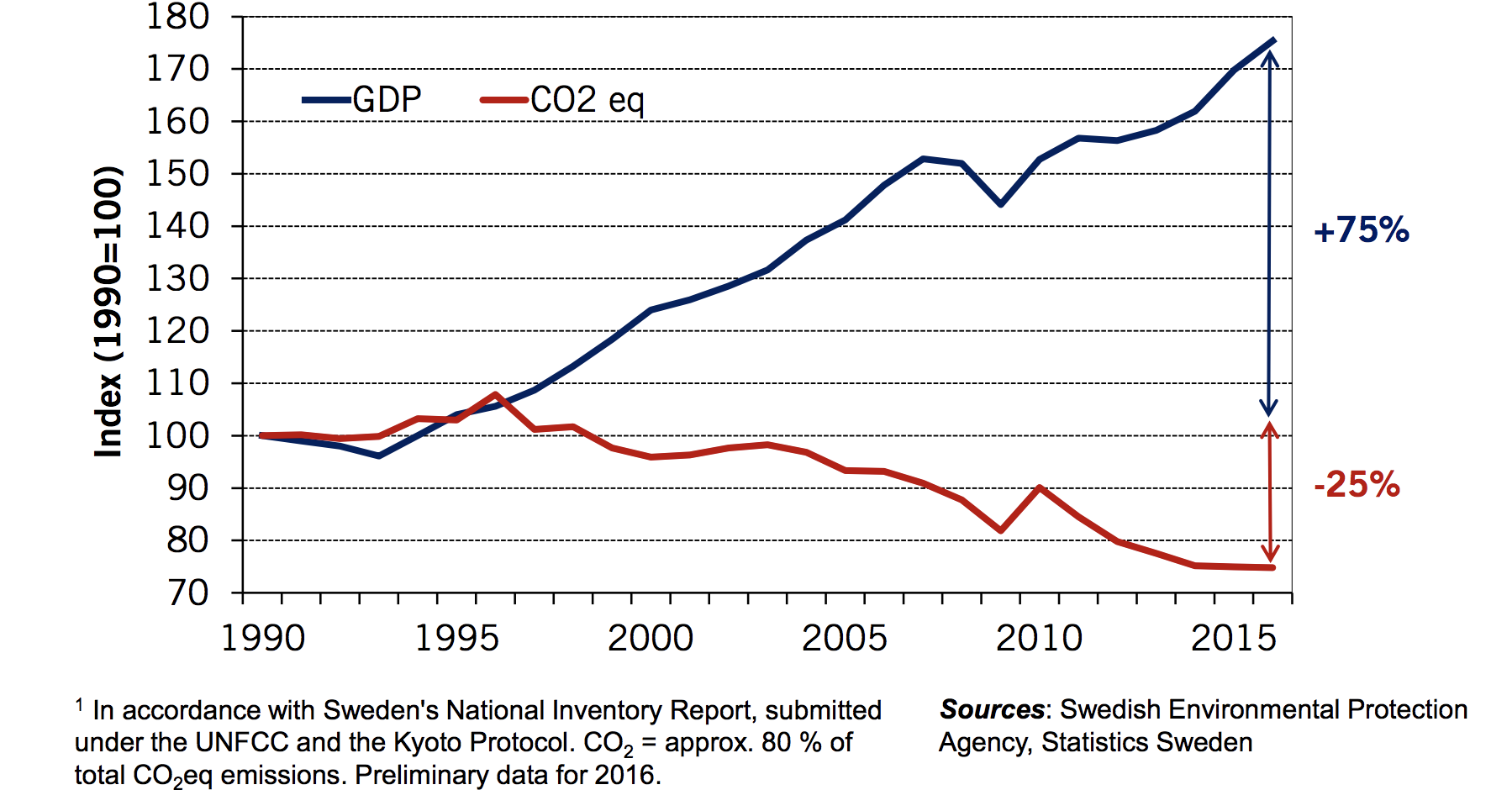
Real GDP and Domestic CO₂eq Emissions¹
In Sweden, 1990-2016
Notes:
Sweden, too, has been able to decrease their emissions (solid red line in the figure) while growing their economy (solid blue line in the figure).

Slide 62
Summary
Climate change is real, is caused by human actions, and has impacts we’re already feeling.
We need to reduce emissions to balance the costs of action against the costs of inaction.
Scientists and the IPCC recommend that we work to keep warming below 1.5 degrees celcius.
  Economists believe that this goal is well worth the costs!
Notes:
Climate change is real, is caused by human actions, and has impacts we’re already feeling. We need to reduce emissions to balance the costs of action against the costs of inaction. Scientists and the IPCC recommend that we work to keep warming below 2 degrees Celsius.

Slide 63
Summary – continued
There are many ways to reduce emissions.
Economics-inspired policies can help us do this at the lowest cost.
Taxes and cap and trade are proven effective tools to fight climate change!
Other tools may also be necessary.
Notes:
Thankfully, there are many ways to reduce emissions and economics-inspired policies can help us do this at the lowest cost. Taxes and cap and trade programs are proven, effective tools that we can use to fight climate change!

Slide 64
Thank you!
Any Questions?
www.NEEDelegation.org
Jennifer Alix-Garcia
jennifer.alix-garcia@oregonstate.edu
Contact NEED: Info@NEEDelegation.org
Submit a testimonial: www.NEEDelegation.org/testimonials.php

Slide 65
Available NEED Topics Include:
Coronavirus Economics
US Economy
Climate Change
Economic Inequality
Economic Mobility
Trade and Globalization
Minimum Wages
Immigration Economics
Housing Policy
Federal Budgets
Federal Debt
Black-White Wealth Gap
Autonomous Vehicles
US Social Policy

